Slide 1
sPhenix Cryogenic Review
9/14/2016

Slide 2
sPhenix Cryogenics Requirements
Control temperature gradient to no more than 40K during cooldown/warmup
7.5 g/s of liquid helium supply flow to do forced feed to solenoid circuit.
Shield flow 4.5K vapor: 0.3 - 0.6 g/s.
Current lead cooling: 0.1 - 0.6 g/s. Ramp with current
Cooldown/warmup rate 300K to 4K in 7 days [3 weeks of 45K supply during RHIC 45K wave cooldown]
Ability to disconnect cryogenic lines to move the detector into assembly hall
500L phase separator/ reservoir
  to ramp down magnet when cryogenic supply is lost
  to remove heat leak from the long 4.5K supply transfer line
Hold at <100K during summer shutdown to limit thermal cycling on solenoid
Precool to 100K before RHIC run startup
Testing with 500L dewars:
  Summer Shutdown Testing 4.5K in IP location
  Summer Shutdown Testing 4.5K in assembly hall location
  Summer Shutdown Testing 4.5K, short duration and low current test e.g. 4 hours, 1000A
  Summer Shutdown Testing 4.5K, full current test 4650A

Slide 3
Control temperature gradient to no more than 40K during cooldown/warmup
COLD SUPPLY AND CAPACITY
  RHIC: Cold helium: S header during RHIC 45K wave, during 4.5K wave
  500L dewars during shutdown
  LN2 supply during shutdown
WARMUP SOURCE AND CAPACITY
  Gas heating capacity
    Electric Heater
    Ambient vaporizer
  Source of gas flow
    RHIC cold / with Heat exchanger
    Local 1008B circulation compressor. Requires water at 20 GPM
HEAT EXCHANGER
  To use RHIC cold supply during cooldown/warmup

Slide 4
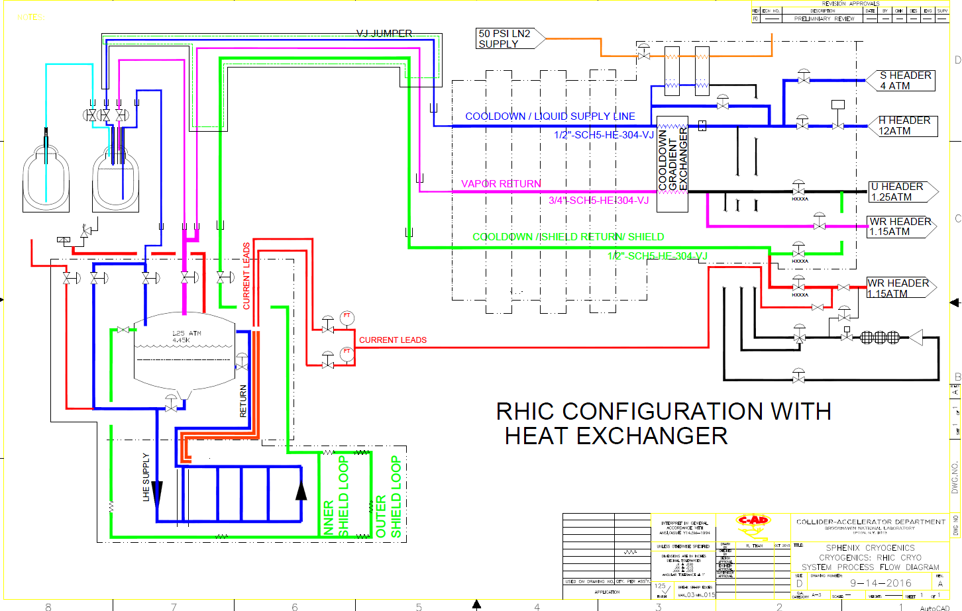

Slide 5
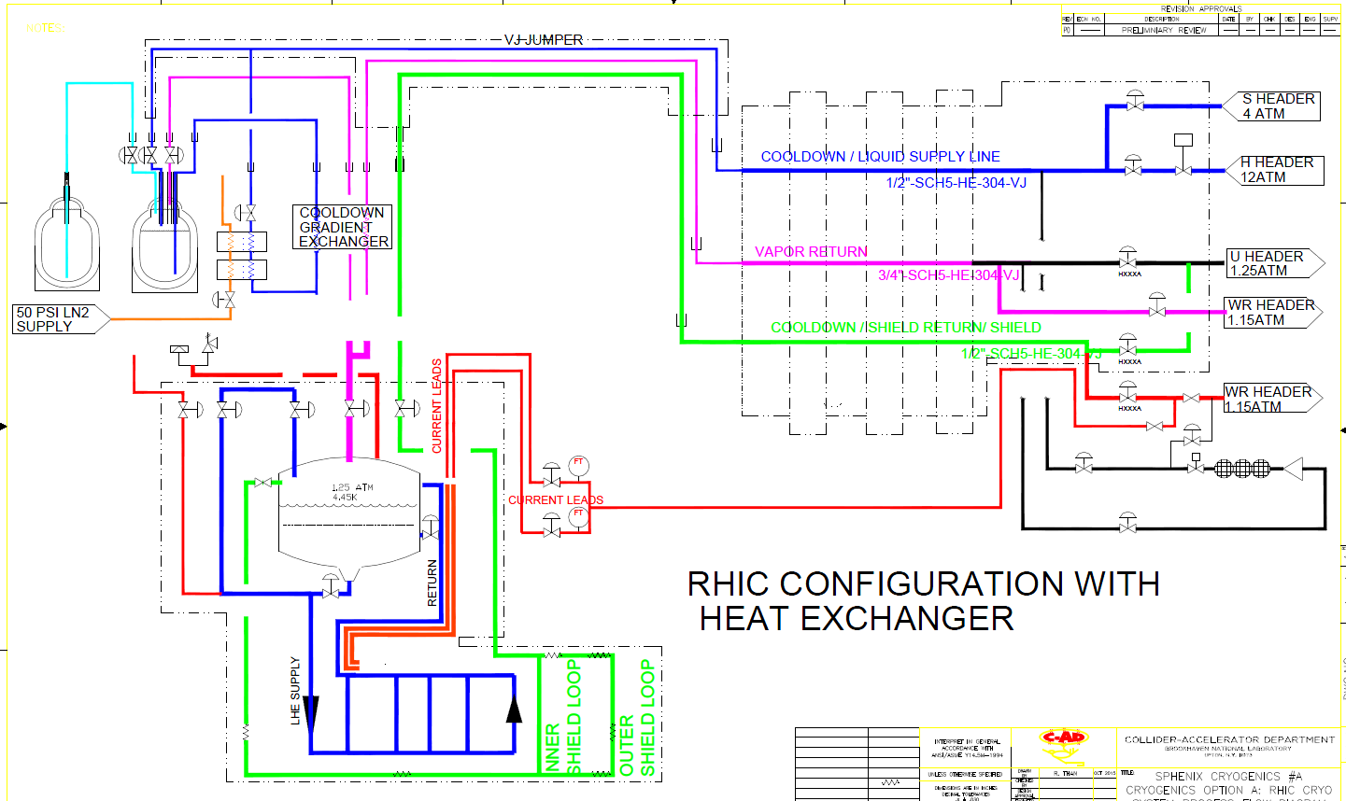

Slide 6
Cooldown Requirements without RHIC plant
LN2: ~4000 Gallons
LHe: ~ 5000 Liters
Small helium Compressor during summer
  IP4 56MHz compressor in 1004E
  e lens compressor in 1010 mezzanie
  ERL 912/NSLS-1 install 1008B if room available
Return Heater
  Allows summer testing with Dewars
  Summer keep cold

Slide 7
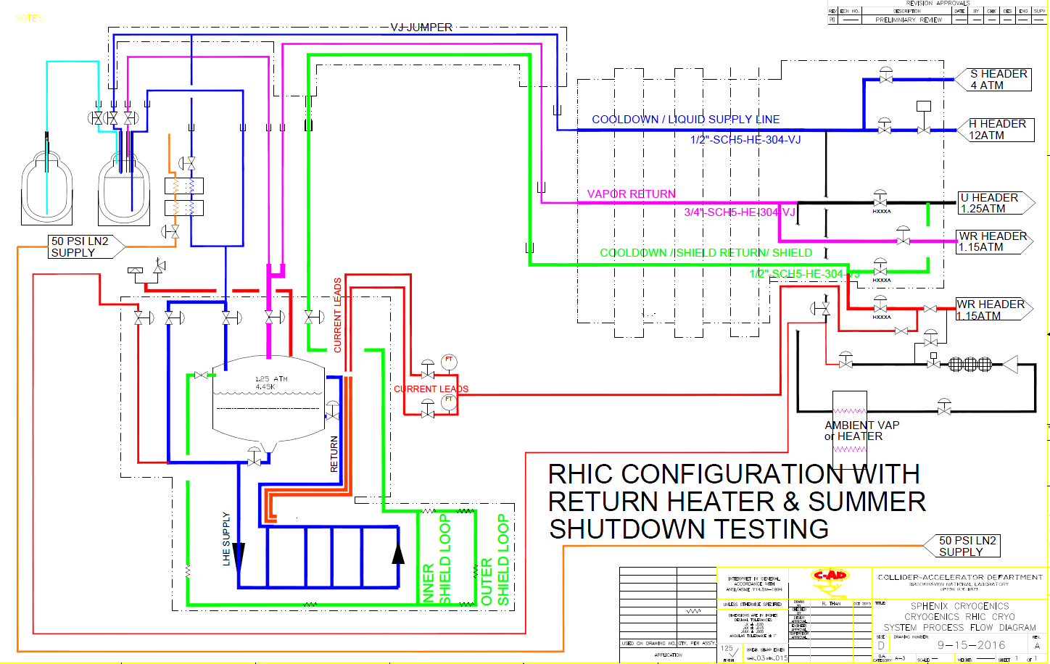
CONFIG with RETURN HTR

Slide 8
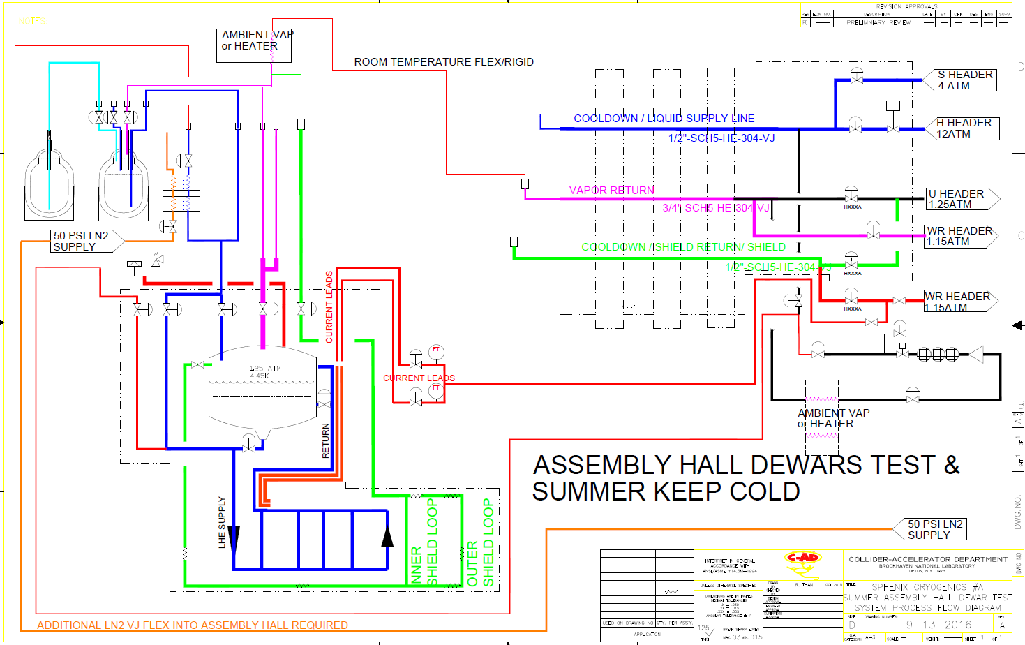
CONFIG with RETURN HTR, Assembly hall test

Slide 9
Keep cold during summer shutdown
Helium circulation loop with LN2 feed ia transfer line and exchanger
PROs
  300K – 100K cooldown and warmup independent from RHIC
CONS
  Higher cost
LN2 FLOODED MODE Using cryocooler with condenser surface
CONS
  No 300K – 100K cooldown/warmup with cryocooler
  Pump and purge
PROs
  All equipment will reside on platform. Air cooled compressor
  More economical

Slide 10
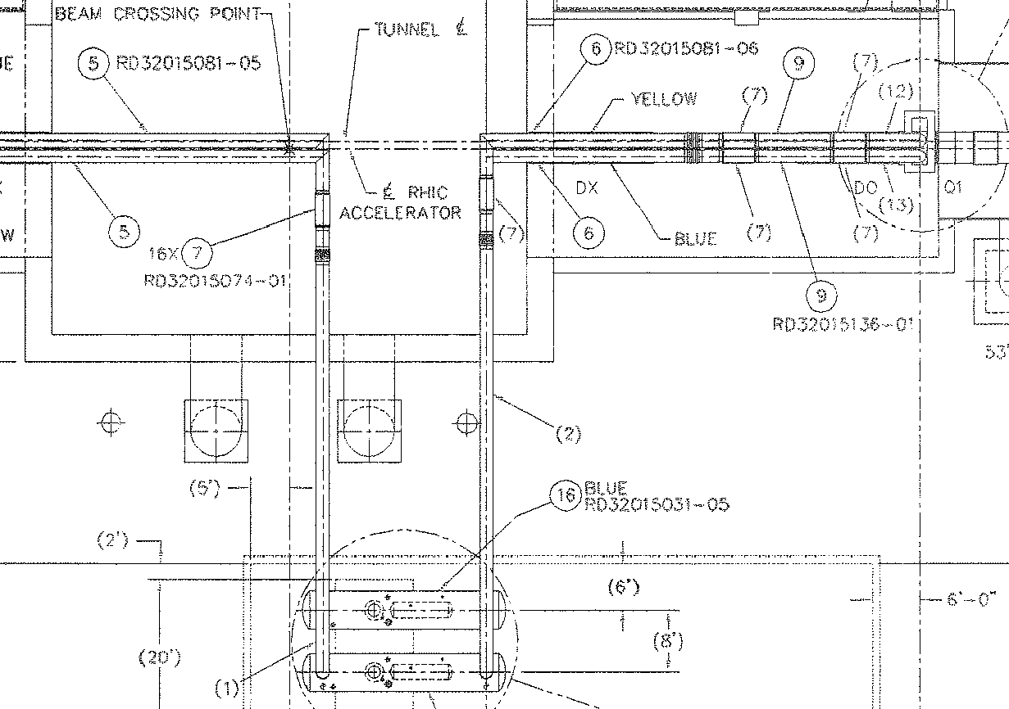
SPHENIX: MAGNET: Cryogenics
System diagram: RHIC Interface Option

