Slide 1

News from the ePIC Collaboration
J. Lajoie, S. Dalla Torre
August 14, 2024

Slide 2
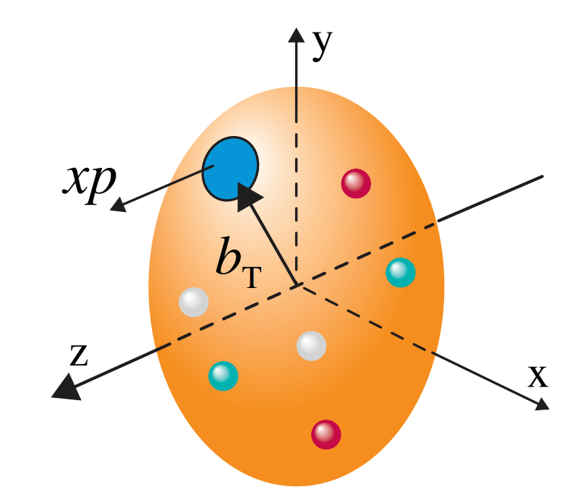
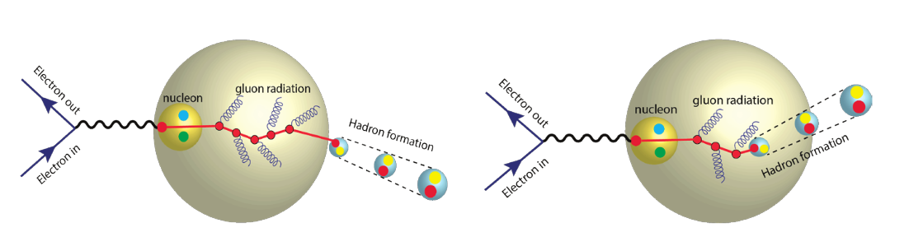
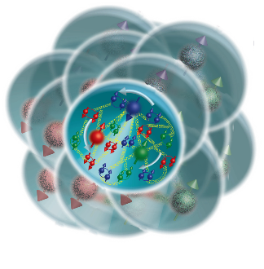
The Collaboration Pursues the Science
How do the nucleon properties like mass and spin emerge from quarks and their interactions?
How are the sea quarks and gluons distributed in space and momentum inside the nucleon? How is spin dynamically generated?
What is the mechanism through which quark-gluon interactions give rise to nuclear binding?
Is there a saturation point for the density of gluons in nuclei at high energies, and does this lead to the formation of gluonic matter with universal properties across all nuclei, including the proton?
In what manner do color-charged quarks and gluons, along with colorless jets, interact with the nuclear medium? And how do the confined hadronic states emerge from these quarks and gluons?
What impact does a high-density nuclear environment have on the interactions, correlations, and behaviors of quarks and gluons?
2

Slide 3

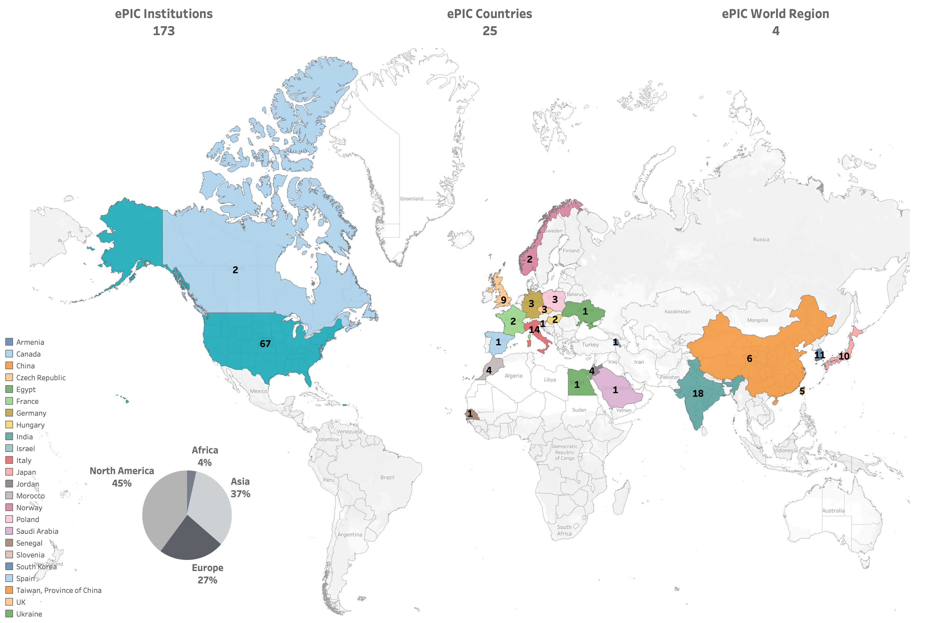
By the numbers…
ePIC Initiated in
July 2022
Currently:
>850 collaborators (from 2024 Institutional Survey)
>650 members
active in ePIC activities

Slide 4
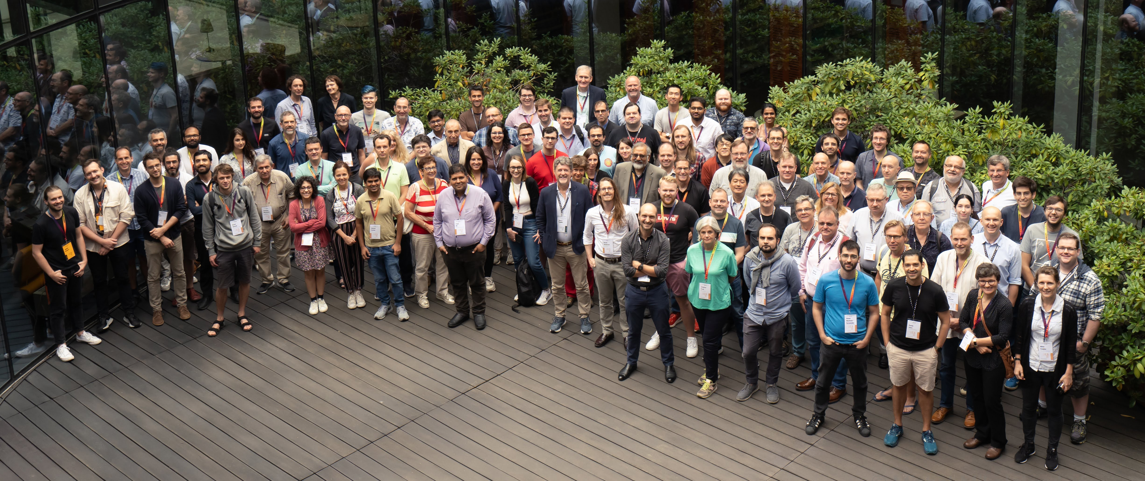
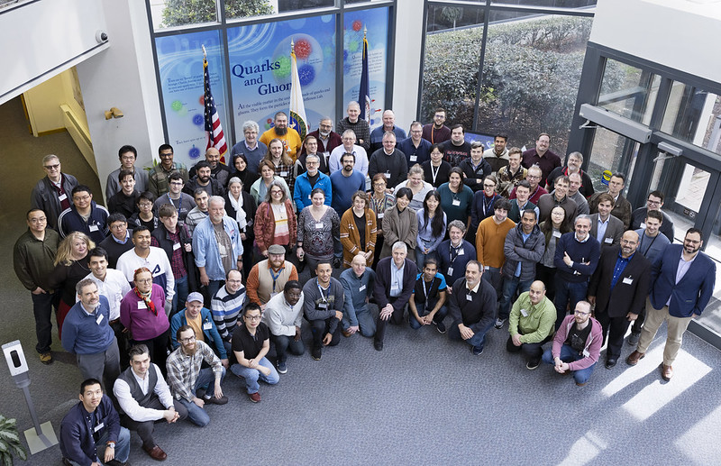
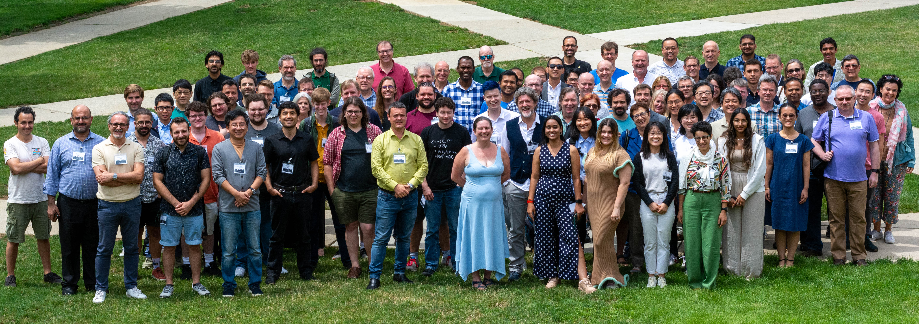
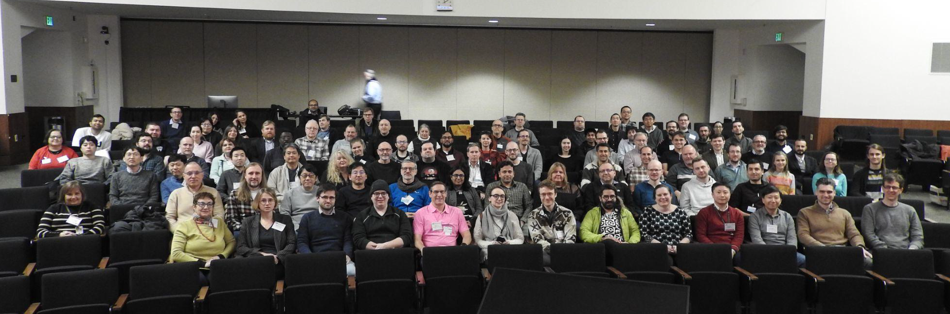
The Collaboration
Warsaw, July 2023
JLab, Jan. 2023
ANL,
Jan. 2024
ePIC is a community of scientists dedicated to realizing the EIC science mission.
The ePIC Collaboration is as unique as the ePIC detector.
EICUG/ePIC Meeting – Lehigh, July 2024

Slide 5
From there to here 2024…
10 General Meetings
22 TIC Meetings
100’s of DSC and WG Mtgs
Test beams, etc.
3rd EIC-Asia Workshop
Jan 29-31st
4th EIC-Asia Workshop
July 1-5th
Argonne Collab. Mtg. Jan 2024
BIC Workshop
May 14-17th
Lehigh Collab. Mtg. July 2024
hpDIRC Annual Meeting
May 16-22nd
ePIC Software and Computing Meeting
@ CERN– Apr 22-26th
INFN ePIC Meeting
June 27-28th
2024
2025
ePIC/EIC Det. R&D Day
March 25th
PDR: Integration, Installation
and Infrastructure
July 15th
PDR2: IR Integration and Auxiliary Detectors – Feb 12th
PDR2: Electronics & DAQ
FDR for VTRx+/lpGBT
(poss. CD-3B scope)
June 10-11th
PDR1: Tracking Detectors
March 20-21st
FDR: Magnet Power Supply
(poss. CD-3B scope)
May 28th
8th Detector Advisory Committee
June 21st

Slide 6
From there to here 2024…to 2025
10 General Meetings
22 TIC Meetings
100’s of DSC and WG Mtgs
Test beams, etc.
EIC Strategy Mtg
August 21st
ePIC Early Physics Workshop
Sept. 13, 2024
3rd EIC-Asia Workshop
Jan 29-31st
ePIC draft pre-TDR sections complete
December 2024
4th EIC-Asia Workshop
July 1-5th
Argonne Collab. Mtg. Jan 2024
BIC Workshop
May 14-17th
Lehigh Collab. Mtg. July 2024
Frascati Collab. Mtg. Jan 2025
hpDIRC Annual Meeting
May 16-22nd
PDR2: PID Detectors
Summer/Fall 2024
ePIC Software and
Computing Review
Sept. 26-27th
ePIC Software and Computing Meeting
@ CERN– Apr 22-26th
INFN ePIC Meeting
June 27-28th
2024
2025
ePIC/EIC Det. R&D Day
March 25th
PDR: Integration, Installation
and Infrastructure
July 15th
FDR: Magnet Flux Return Steel
(poss. CD-3B scope)
Sept. 2024
PDR2: IR Integration and Auxiliary Detectors – Feb 12th
PDR2: Electronics & DAQ
FDR for VTRx+/lpGBT
(poss. CD-3B scope)
June 10-11th
PDR1: Tracking Detectors
March 20-21st
9th Detector Advisory
Committee
Sept. (TBD)
FDR: Magnet Power Supply
(poss. CD-3B scope)
May 28th
Backward & Forward EM Calorimetry, Barrel & Forward HCAL, Fall 2024
Barrel EMCal, Fall 2024
EIC Project CD-3B Review
January 7-9th, 2025
8th Detector Advisory Committee
June 21st

Slide 7

The Three Pillars of ePIC
Technical Coordination
  Develop technical design of ePIC
  Support the ePIC TDR contributions
  Facilitate technical communication with the EIC project
Software & Computing Coordination
  Software and simulation productions for TDR and beyond.
  Onboarding via landing page and targeted tutorials.
  Development of ePIC Streaming Computing Model.
Analysis Coordination
  Organizing physics “benchmark” plots for the TDR
  Sets priorities for reconstruction development in
  conjunction with Software and Computing
Silvia Dalla Torre
Prakhar Garg
Oskar Hartbrich
Matt Posik
Markus Diefenthaler
Wouter Deconinck
Dmitry Kalinkin
Torre Wenaus
Rosi Reed
Salvatore Fazio

Slide 8


TDR/Publication Timeline
Executing the plan from the Jan. 2024 Collaboration Meeting:
process design phase
structuring the
effort
draft ePIC pre-TDR
ePIC pre-TDR (CD-2)
writing
(TDR/notes)
Preparing papers for
publication
Mid Jan.24
Mid Mar.24
End Oct. 24
Late 2024
Early 2025
Putting the tools in place:
Overleaf/Github for TDR
Zenodo.org selected as document database solution

Slide 9
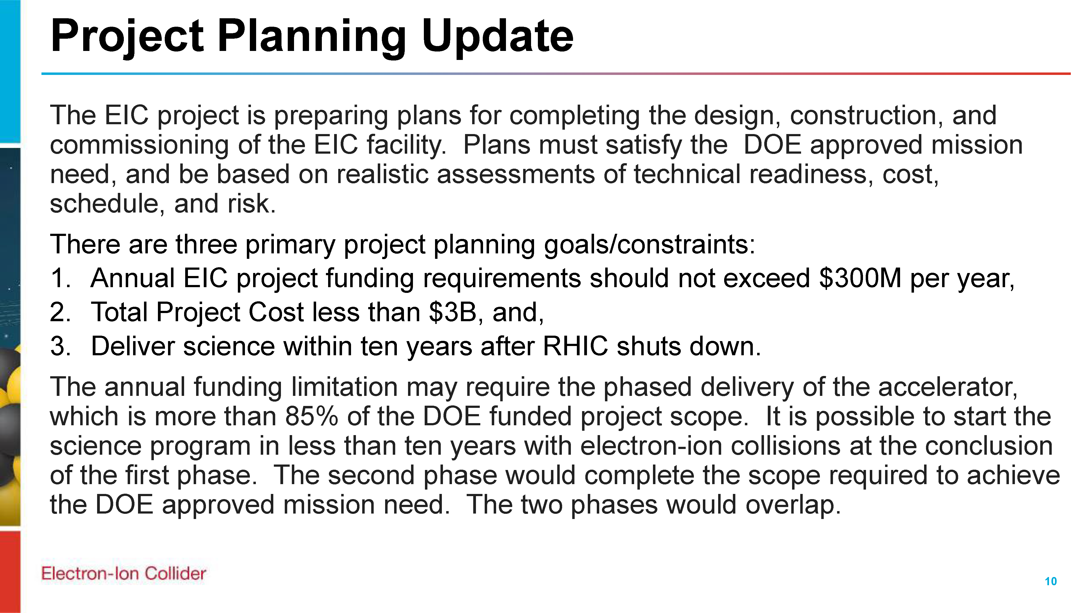
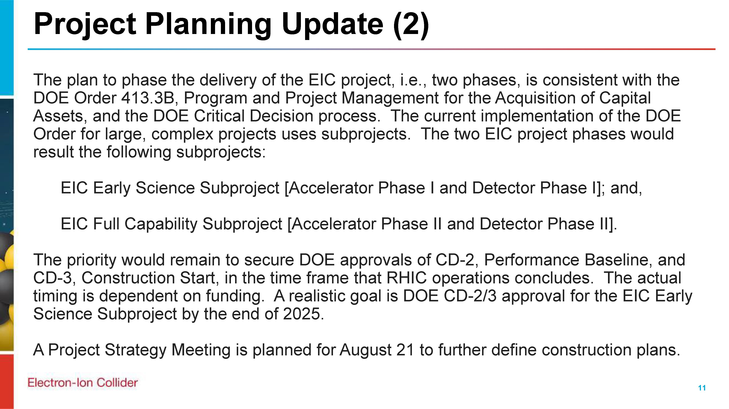
EIC Project Strategy Workshop
From Jim Yeck’s recent EICUG report
The purpose of the Workshop is to engage stakeholders in the development of plans for delivering the EIC project scope and performance and to consider lessons from other large projects.
There will be a Director’s Review of the EIC Project on October 22-24, 2024, and a DOE Independent Project Review on January 7-9, 2025. The August Workshop will help us prepare for these important reviews.
Sylvia and I will present on
“ePIC Collaboration Plans in Support of Early Science”

Slide 10
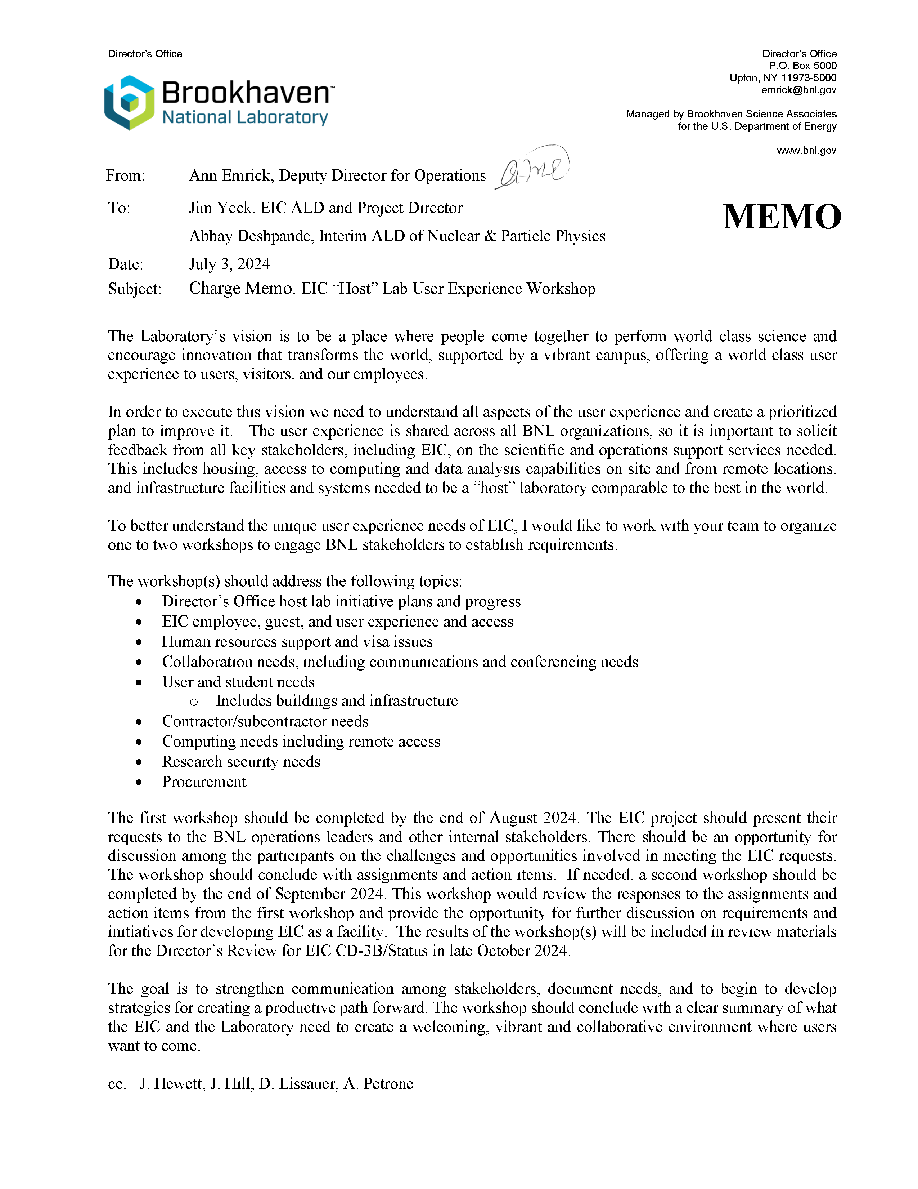
EIC “Host” Lab
User Experience
Workshop
Workshop August 26th
We will present “ePIC Collaboration Needs Overview” – will coordinate with EICUG and RHIC/AGS Users Group

Slide 11
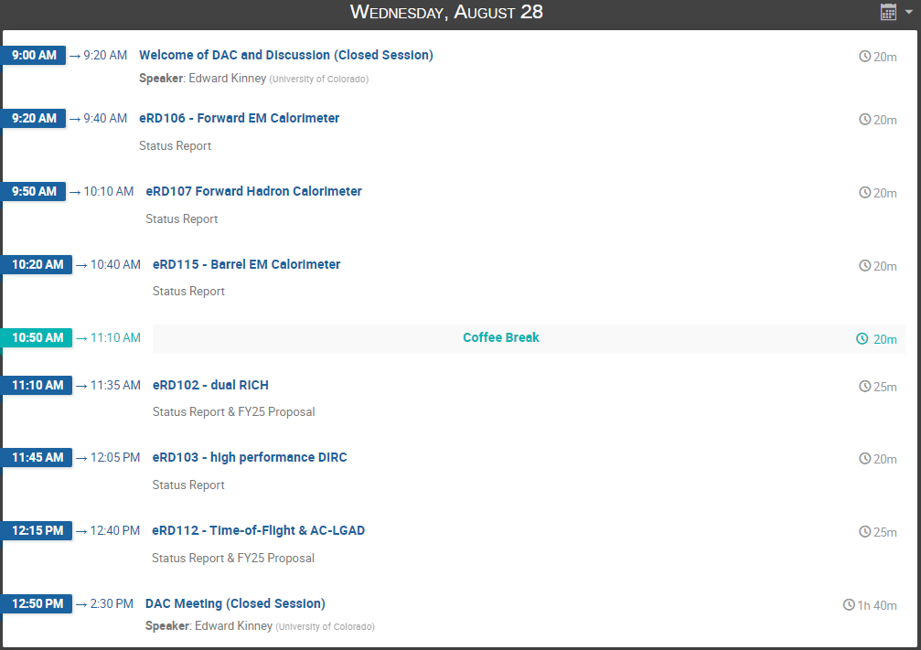
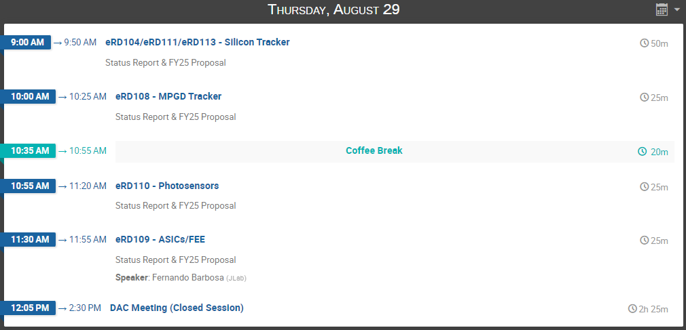
DAC R&D Meeting:
August 28-29th
https://indico.bnl.gov/event/24086/
FY’24 Progress Reports and FY’25 Proposals:
https://wiki.bnl.gov/conferences/index.php/ProjectRandDFY25

Slide 12
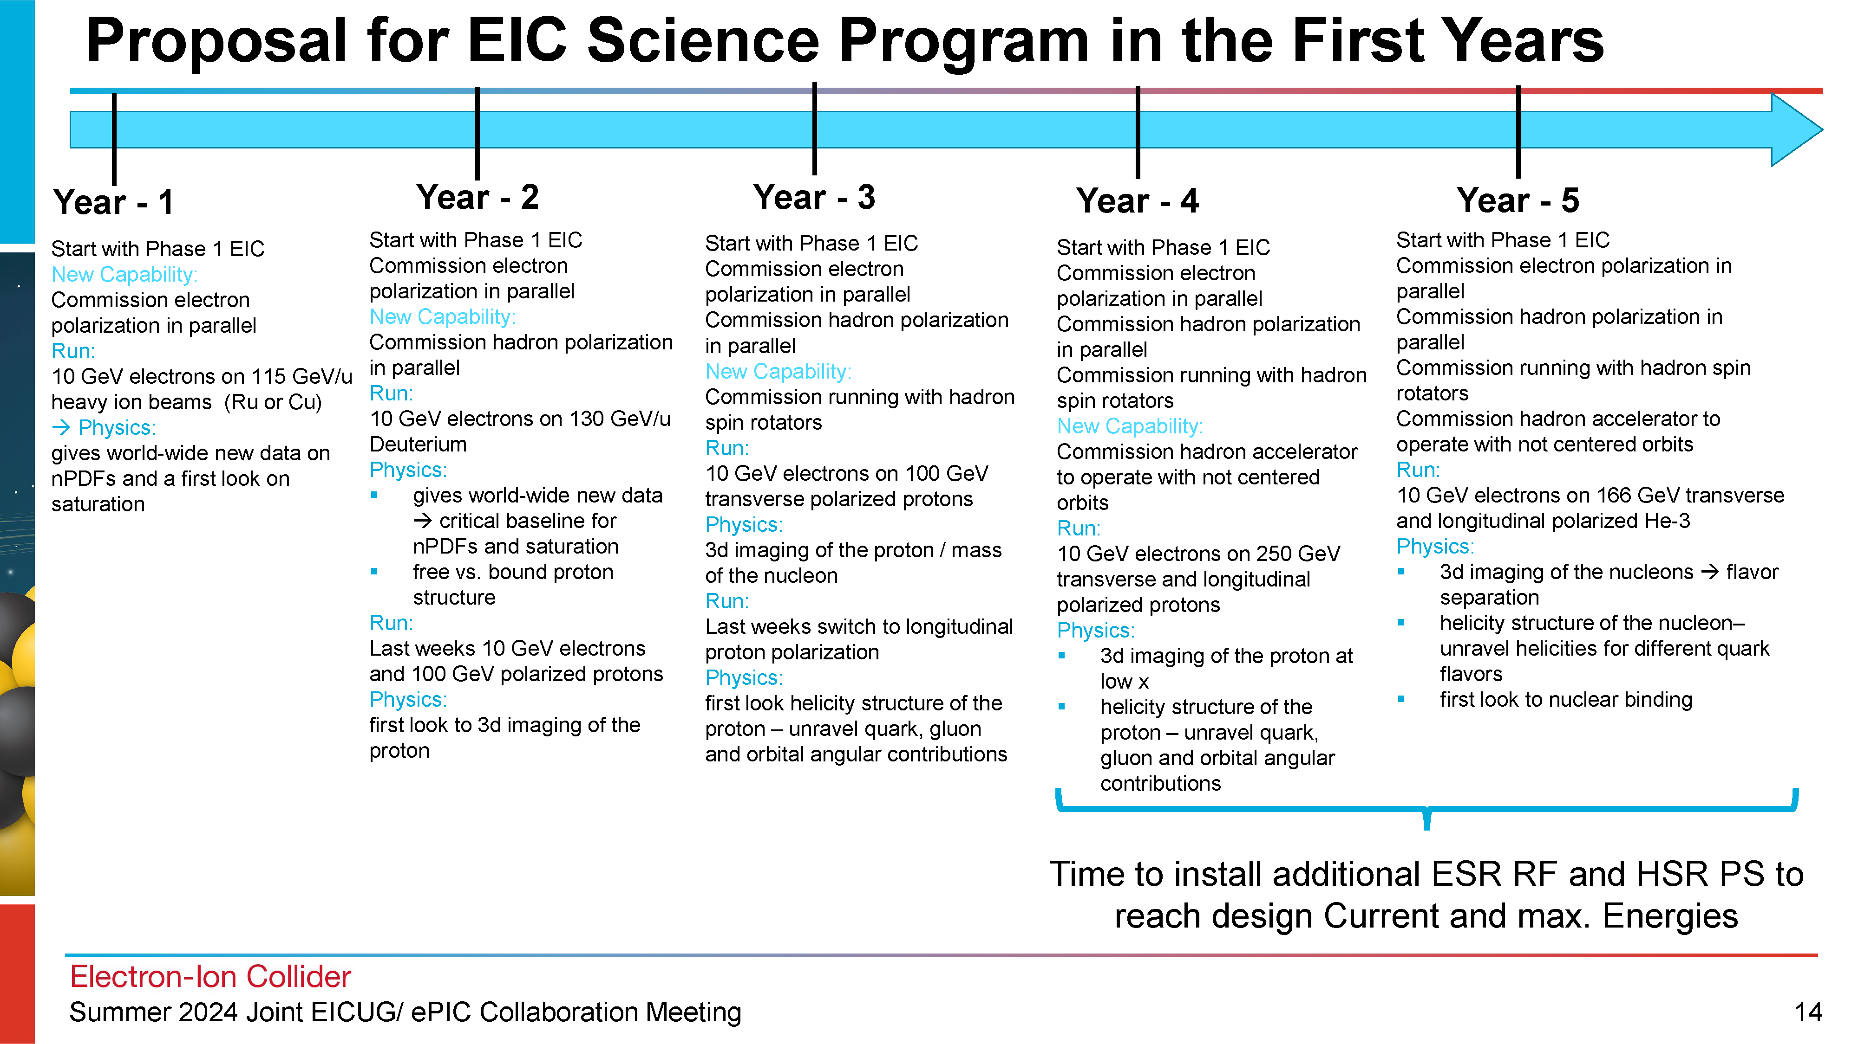
Early Physics with ePIC
From Elke’s recent EICUG talk
At the recent EICUG/ePIC meeting, Elke started the discussion of what the staging the EIC might mean to an early science program, and what that program might look like.
This is a starting point for discussion, and was presented as such.
Lots of hallway discussions, lots of ideas…

Slide 13
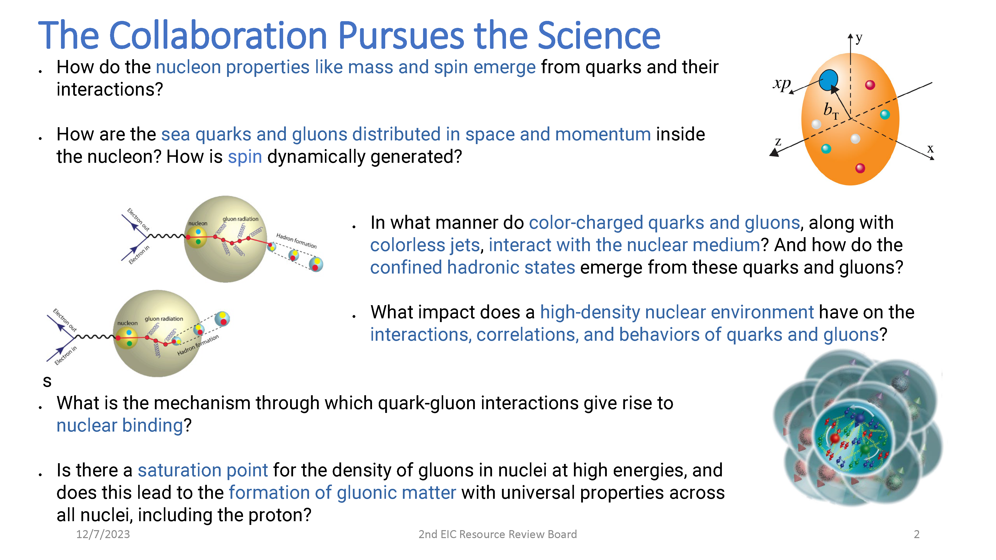
ePIC Early Physics Workshop and Discussion
First ePIC Early Physics Workshop:
Sept. 13th, 2024, 10:30AM ET
Between GM’s but we are using the GM time slot. Format and agenda TBD.
An opportunity for the collaboration to consider the EIC early science program, taking into account both the evolution of the EIC and the need to do impactful science.
Should result in tangible actions items.
This will be the first in what will likely be a series of workshops.

Slide 14
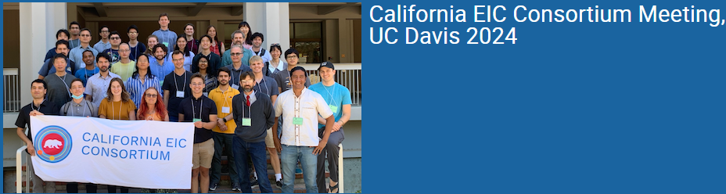
Important Meetings w/in ePIC
CA Consortium Meeting
  August 14-15th, 2024
The California EIC Consortium is a UC-wide Multicampus Research Programs and Initiatives (MRPI) center focused on the physics of Electron Ion Collider (EIC). We are funded by UC Office of the President. Our consortium consists of four UC campuses (Berkeley, Davis, Los Angeles and Riverside), Cal Poly SLO and three national laboratories (LANL, LBNL and LLNL).

Slide 15
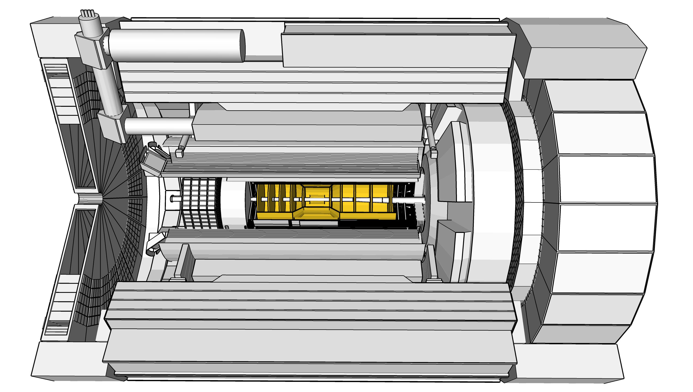

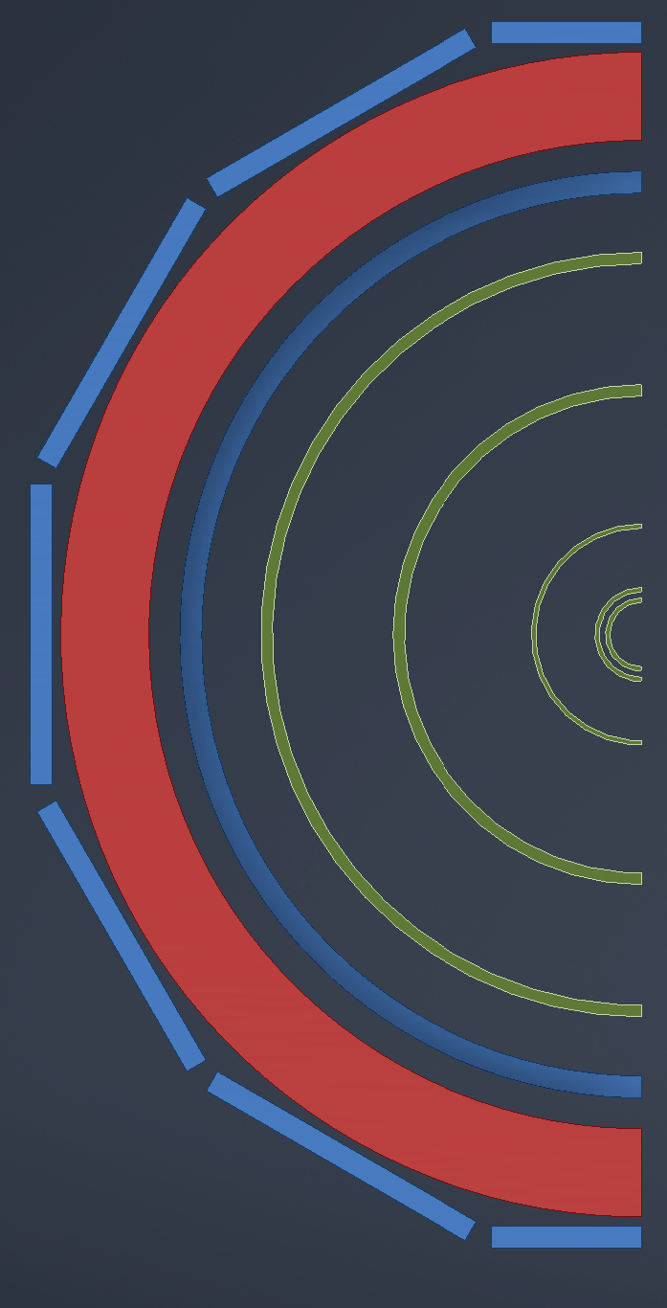

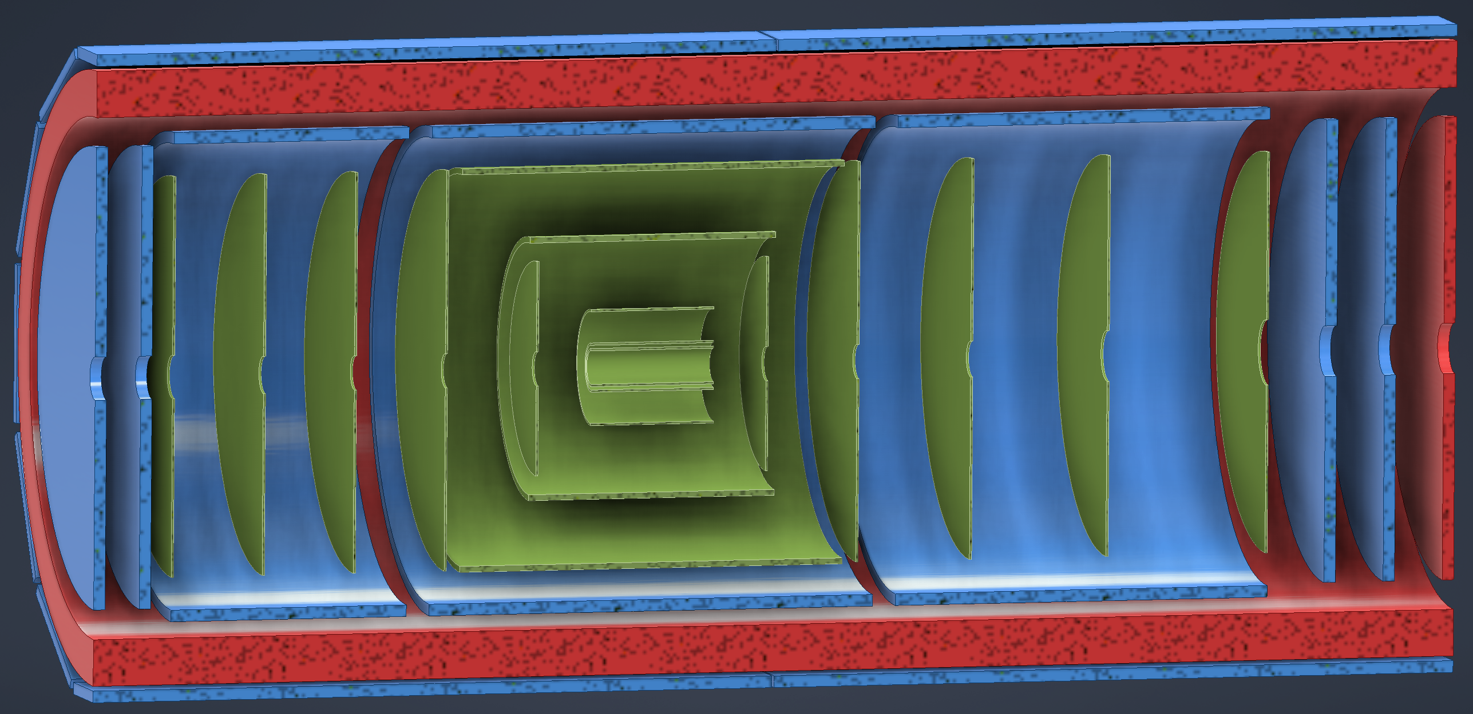
ePIC Tracking Detectors
MAPS Tracker:
  Small pixels (20 μm), low power consumption (<20 mW/cm²) and material budget (0.05% to 0.55% X/X₀) per layer
  Based on ALICE ITS3 development
  Vertex layers optimized for beam pipe bakeout and ITS-3 sensor size
  Barrel layers based on EIC LAS development
  Forward and backwards disks
MPGD Layers:
  Provide timing and pattern recognition redundancy
  Cylindrical μMEGAs
  Planar μRWell’s before hpDIRC
    Impact point and direction for ring seeding
AC-LGAD TOF and AstroPix (BECAL)
  Additional space point for pattern recognition / redundancy
Status of the ePIC Tracker – Shujie Li
Tracking Performance of the ePIC Detector – Minjung Kim
Progress on Noise Effects in ePIC Tracking – Mito Funatsu
Sensor Development for the ePIC SVT – Zhenyu Ye et al.
Corrugated Carbon Composite Disc R&D – Syke Heiles
world’s first
at
world’s first
at
MAPS Barrel + Disks
MPGD Barrels + Disks
AC-LGAD based ToF

Slide 16
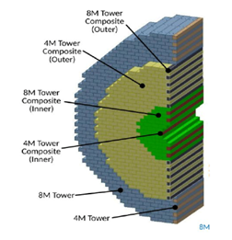
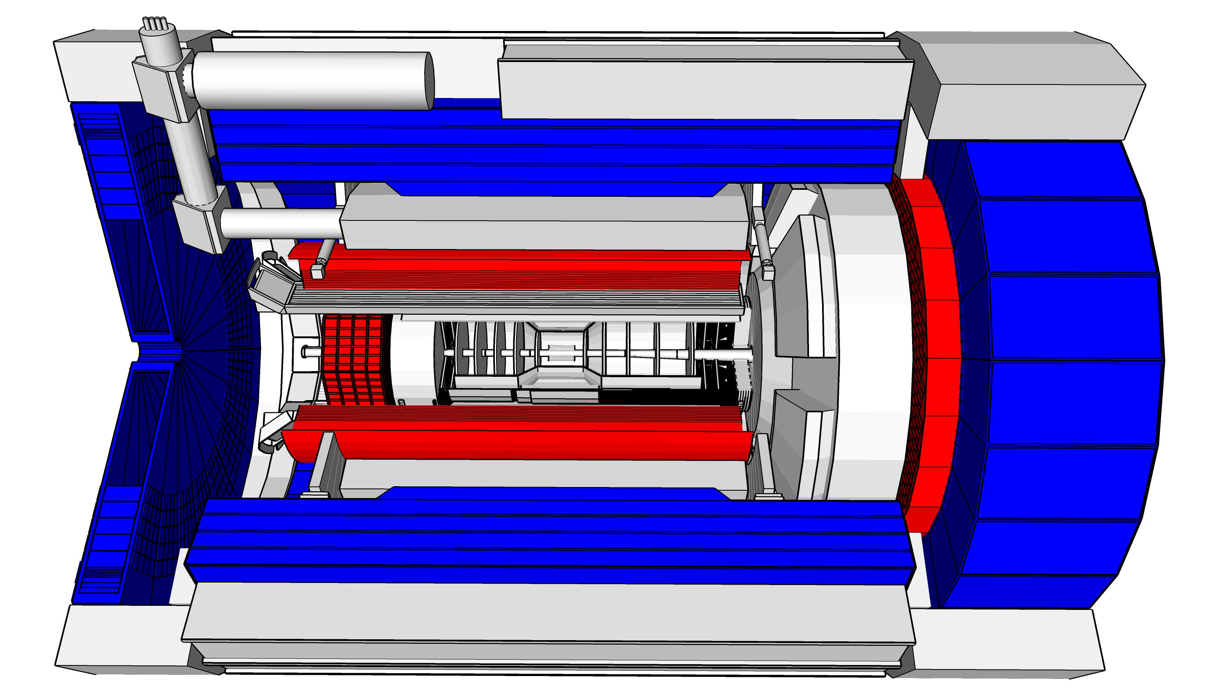
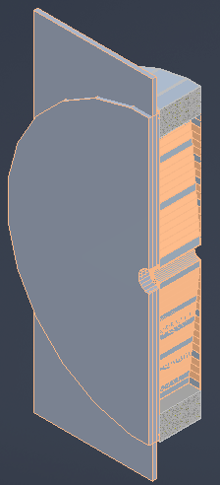
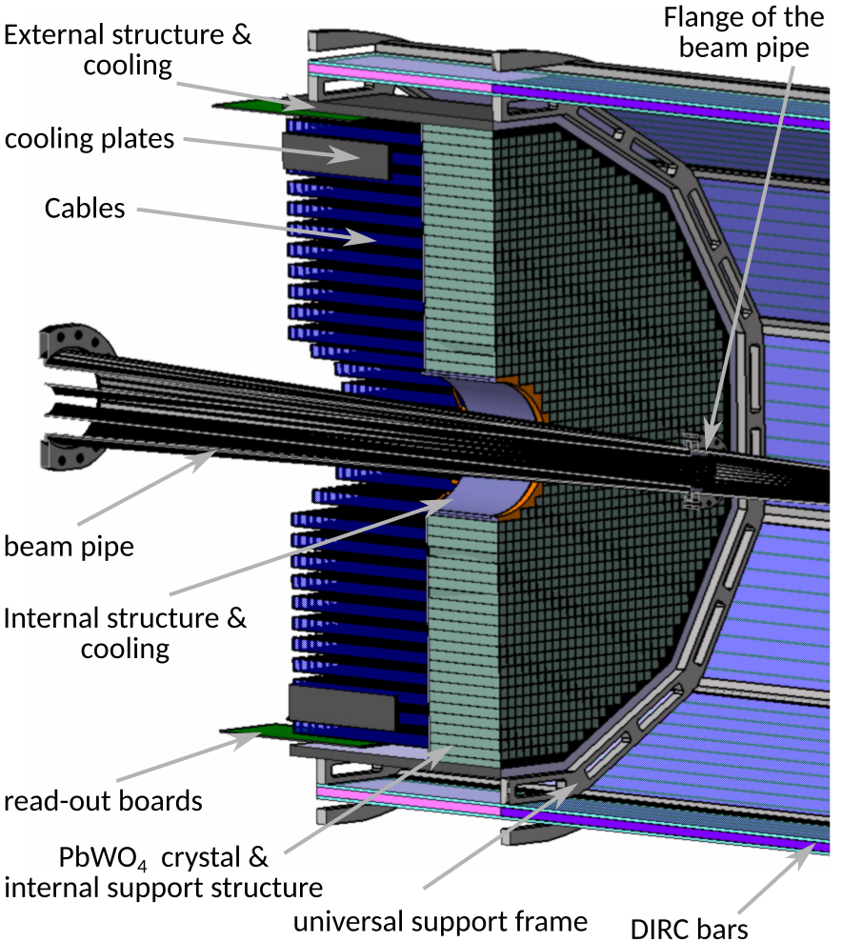
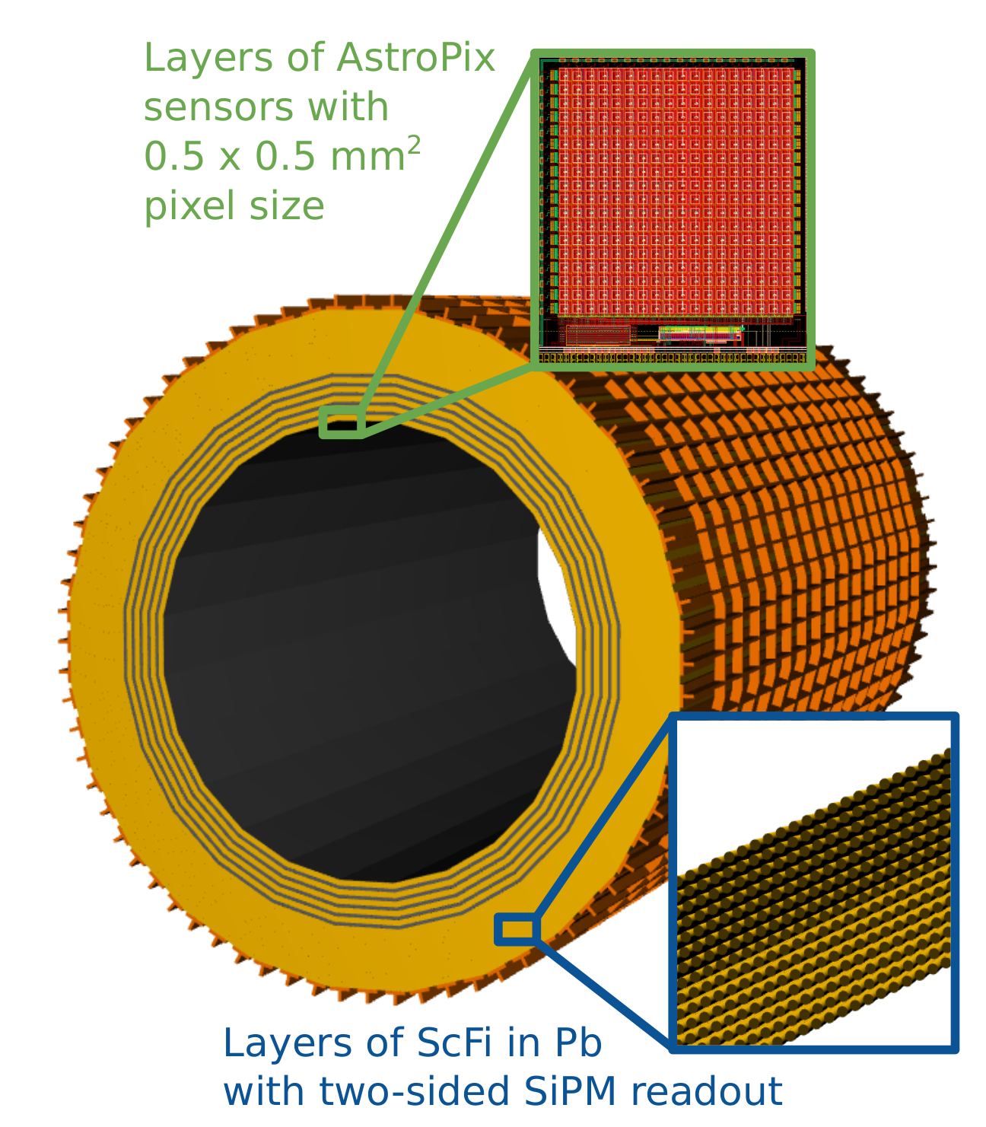
Calorimetry
hadrons
electrons
Backwards HCal
Steel/Sc Sandwich
tail catcher
world’s first
at
High granularity
W/SciFi EMCal
Longitudinally separated HCAL with high-η insert
world’s first
at
Backwards EMCal
PbW04 crystals, SiPM photosensor
Barrel HCAL
(sPHENIX re-use)
world’s first
at

Slide 17
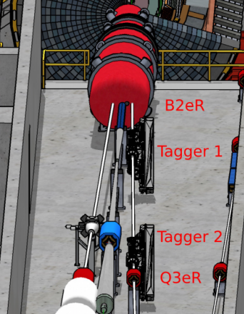
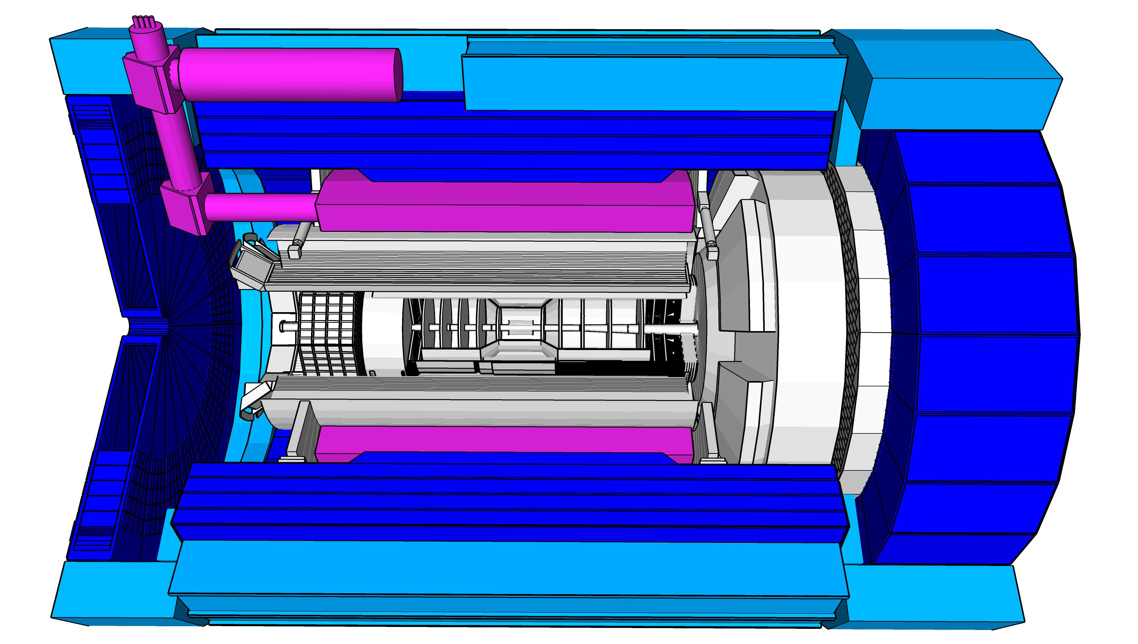
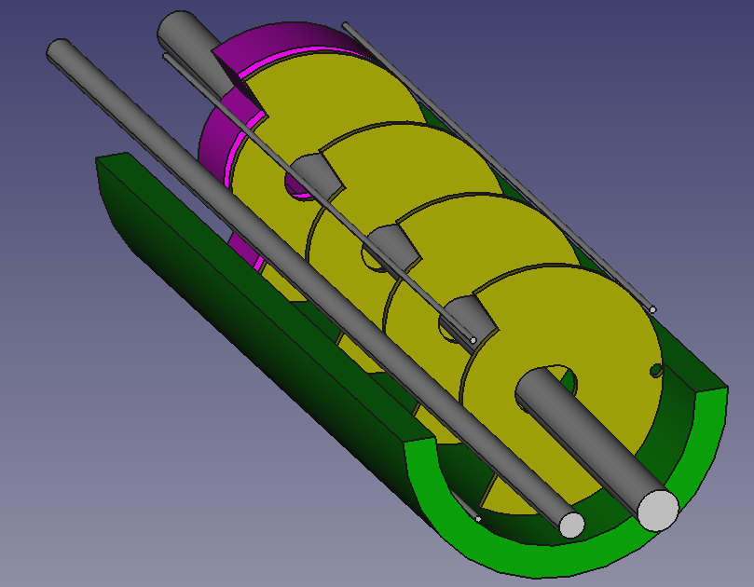
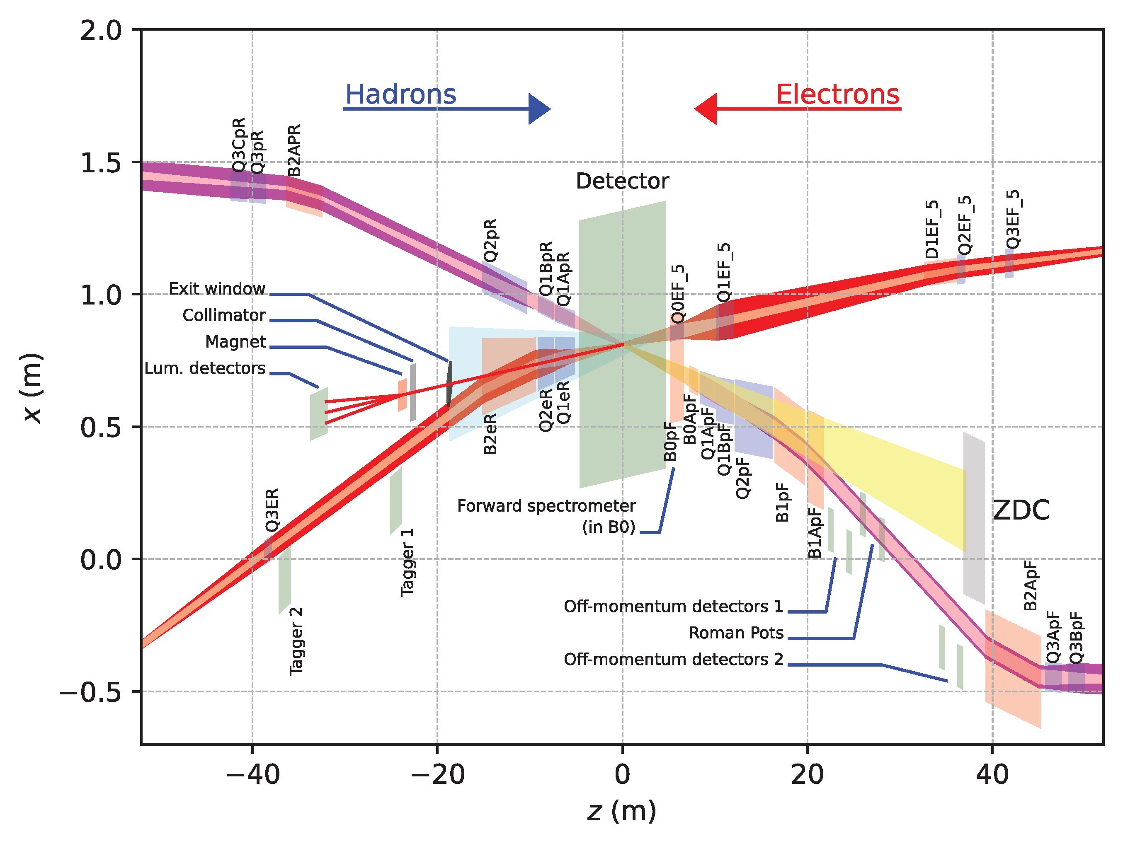
Far-Forward and Far-Backward Detectors
8.5m
Status and Progress for CALI/ZDC
test at RHIC – Weibin Zhang et al.
Simulations for ZDC prototype beamtest – Mia Macias
ML studies on lambda decay for ZDC – Ryan Milton
Davis Cyclotron Irradiated SiPM Test and Annealing Studies – Chase Owen
PbW04 EMCAL
Si Tracking
Far-Backward Detectors
Luminosity monitor
Low-Q² Tagging Detectors
Far-Forward Detectors
B0 Tracking and Photon Detection
Roman Pots and Off-Momentum Detectors
Zero-Degree Calorimeter

Slide 18
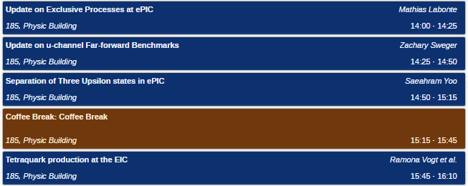
Physics with
Presentations on ePIC Physics:

Slide 19
Lots of other activity as well…
Progress on collab tools, website
  Collaboration database requirements document provided to SDCC
    https://zenodo.org/records/13273309
Simulation plot browser is gaining material and functionality
  https://eic.jlab.org/epic/image_browser.html#

Slide 20
Software Tutorial Series
Next Tutorial: Working with Simulation Output
Presenter: Stephen Kay (University of York)
Date: Thursday, September 12
Time:
10:00 a.m. (BST) for Africa, Asia, Australia, and Europe.
4:00 p.m. (BST) for Africa, Europe, North America, and South America.
Upcoming Tutorials:
Reconstruction Algorithms
Validation
“Working with Simulation Output” on a monthly basis,
  With a focus on the changes to the software and simulation campaigns.
  “Full chain” analysis example
We welcome suggestions for future tutorials, including shorter tutorials on specialized topics, such as calorimeter reconstruction as suggested during the collaboration meeting.

Slide 21
Challenges
The ePIC Collaboration needs to continue to engage more of its membership in ePIC activities.
The ePIC Collaboration needs to engage more of the NP community both in the US and internationally.
The availability of EIC research support for university and lab groups is a major concern
  Will continue to work with the EICUG to communicate this to funding agencies

Slide 22

Summary
The ePIC Collaboration is strong and growing!
  Mechanisms of collaboration are in place and being exercised
  Establishing policies and procedures
  Building the tools to support the collaboration
  Working with the EIC Project to realize ePIC
ePIC is up to the challenges ahead:
  Completing the technical design and TDR
  Publishing first papers:
    ePIC Design
    Physics Performance
    Software and Computing Model

Slide 23


Slide 24
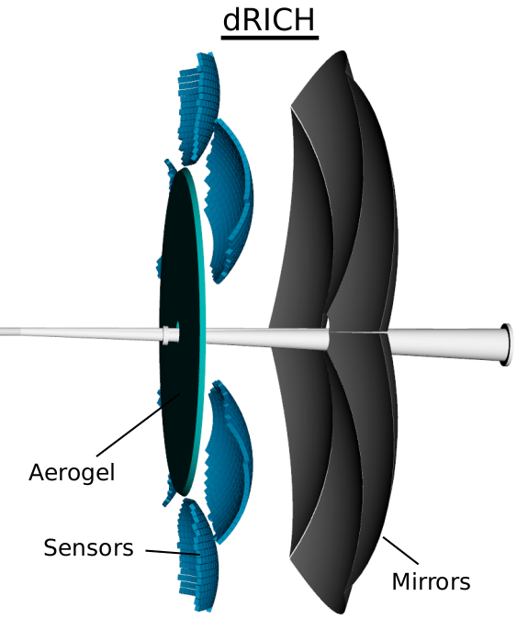
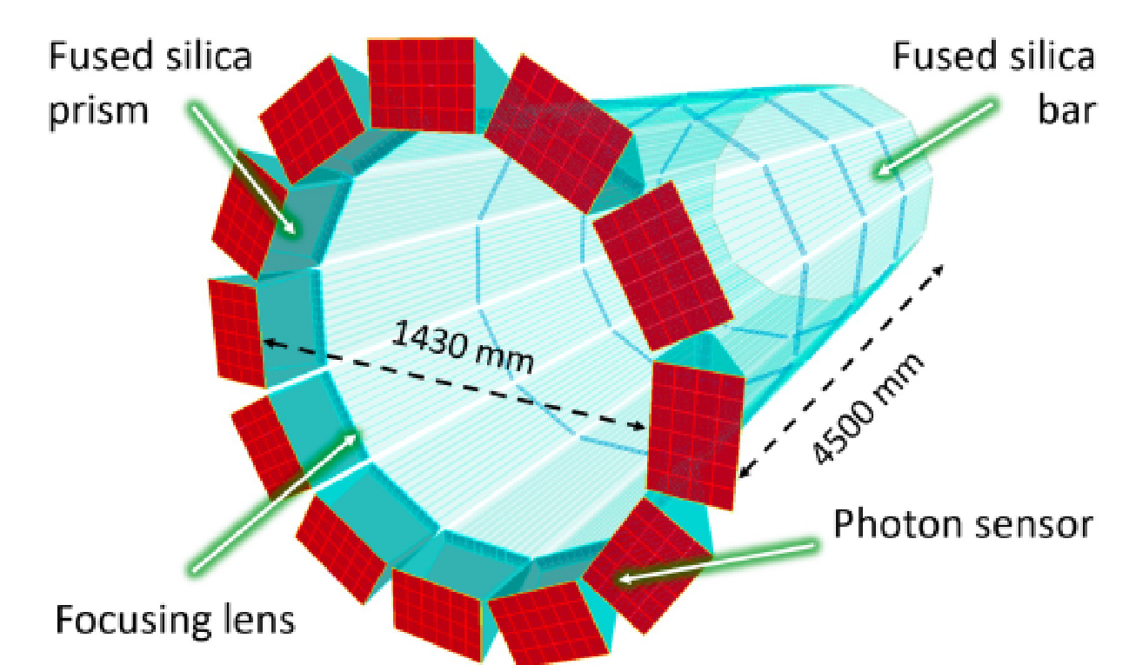
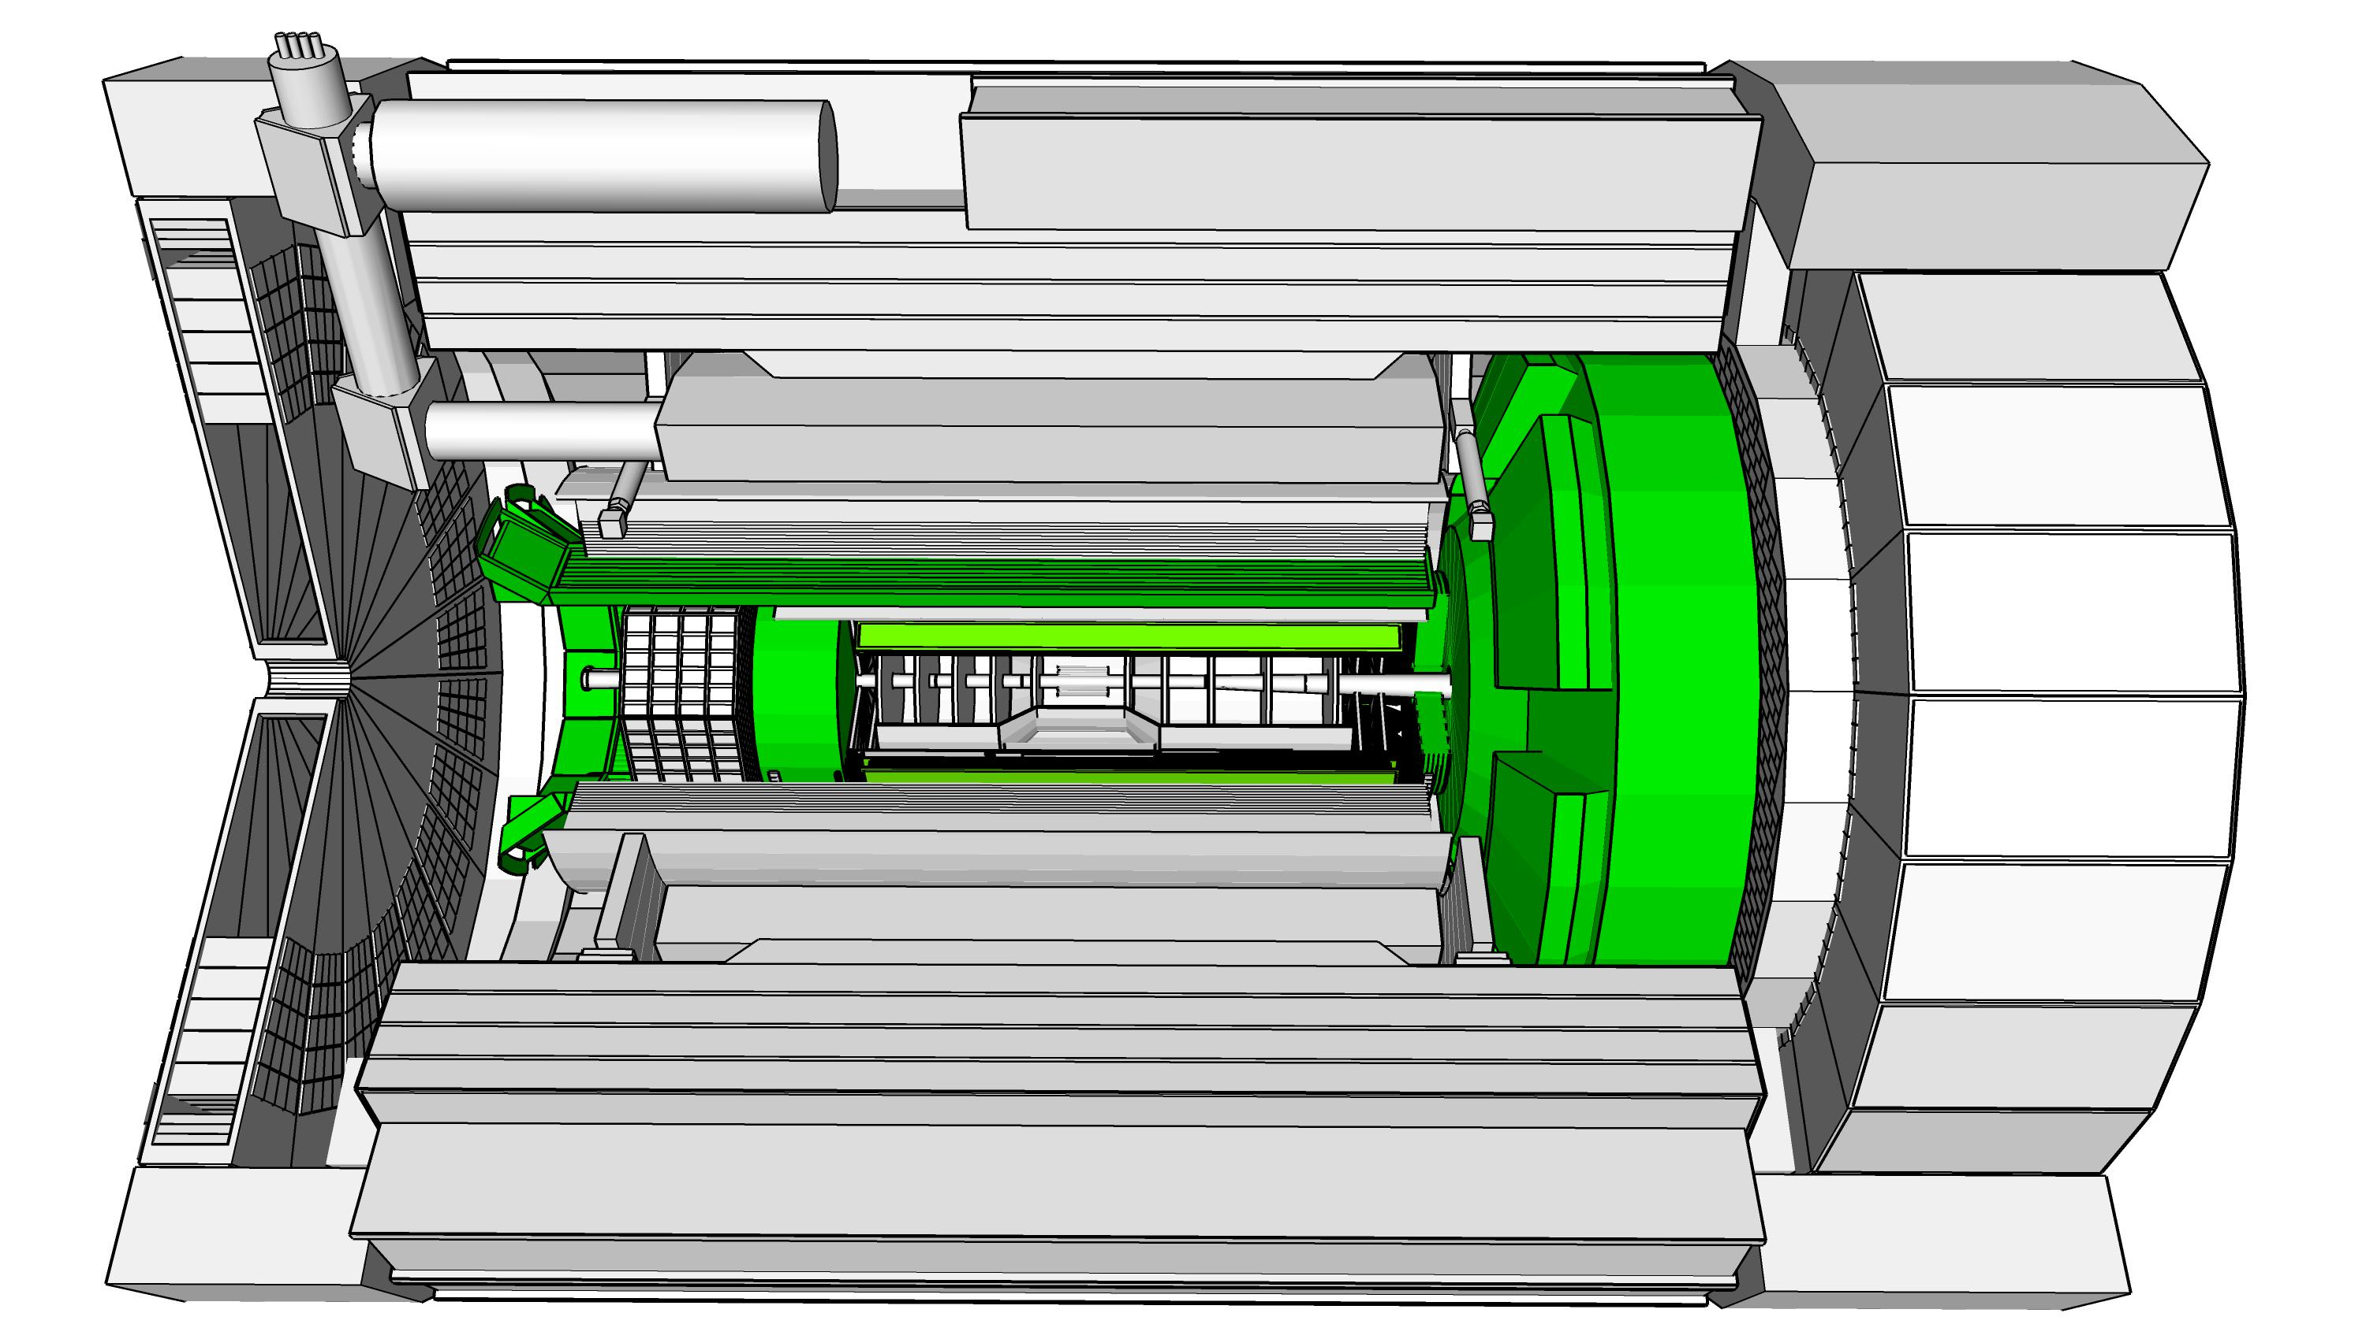
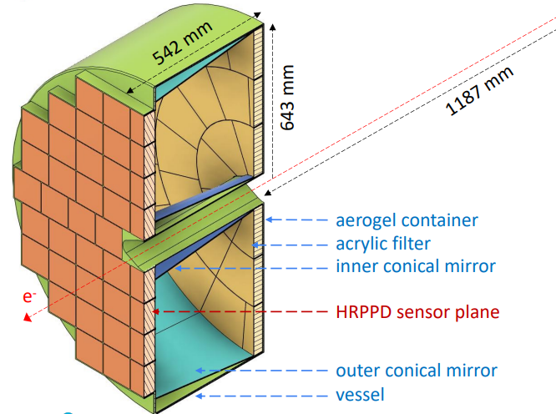
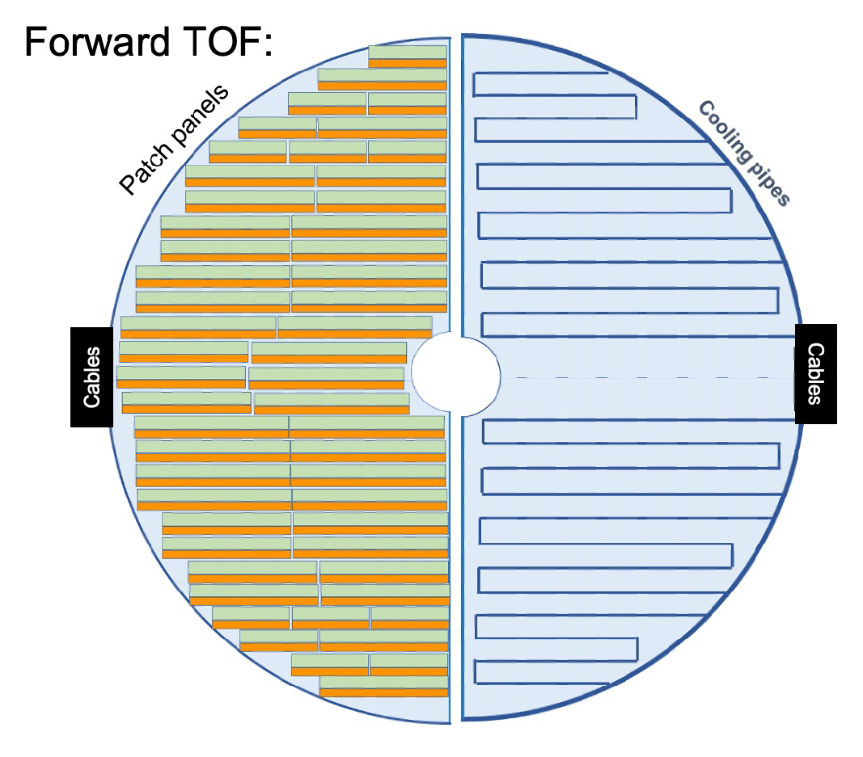
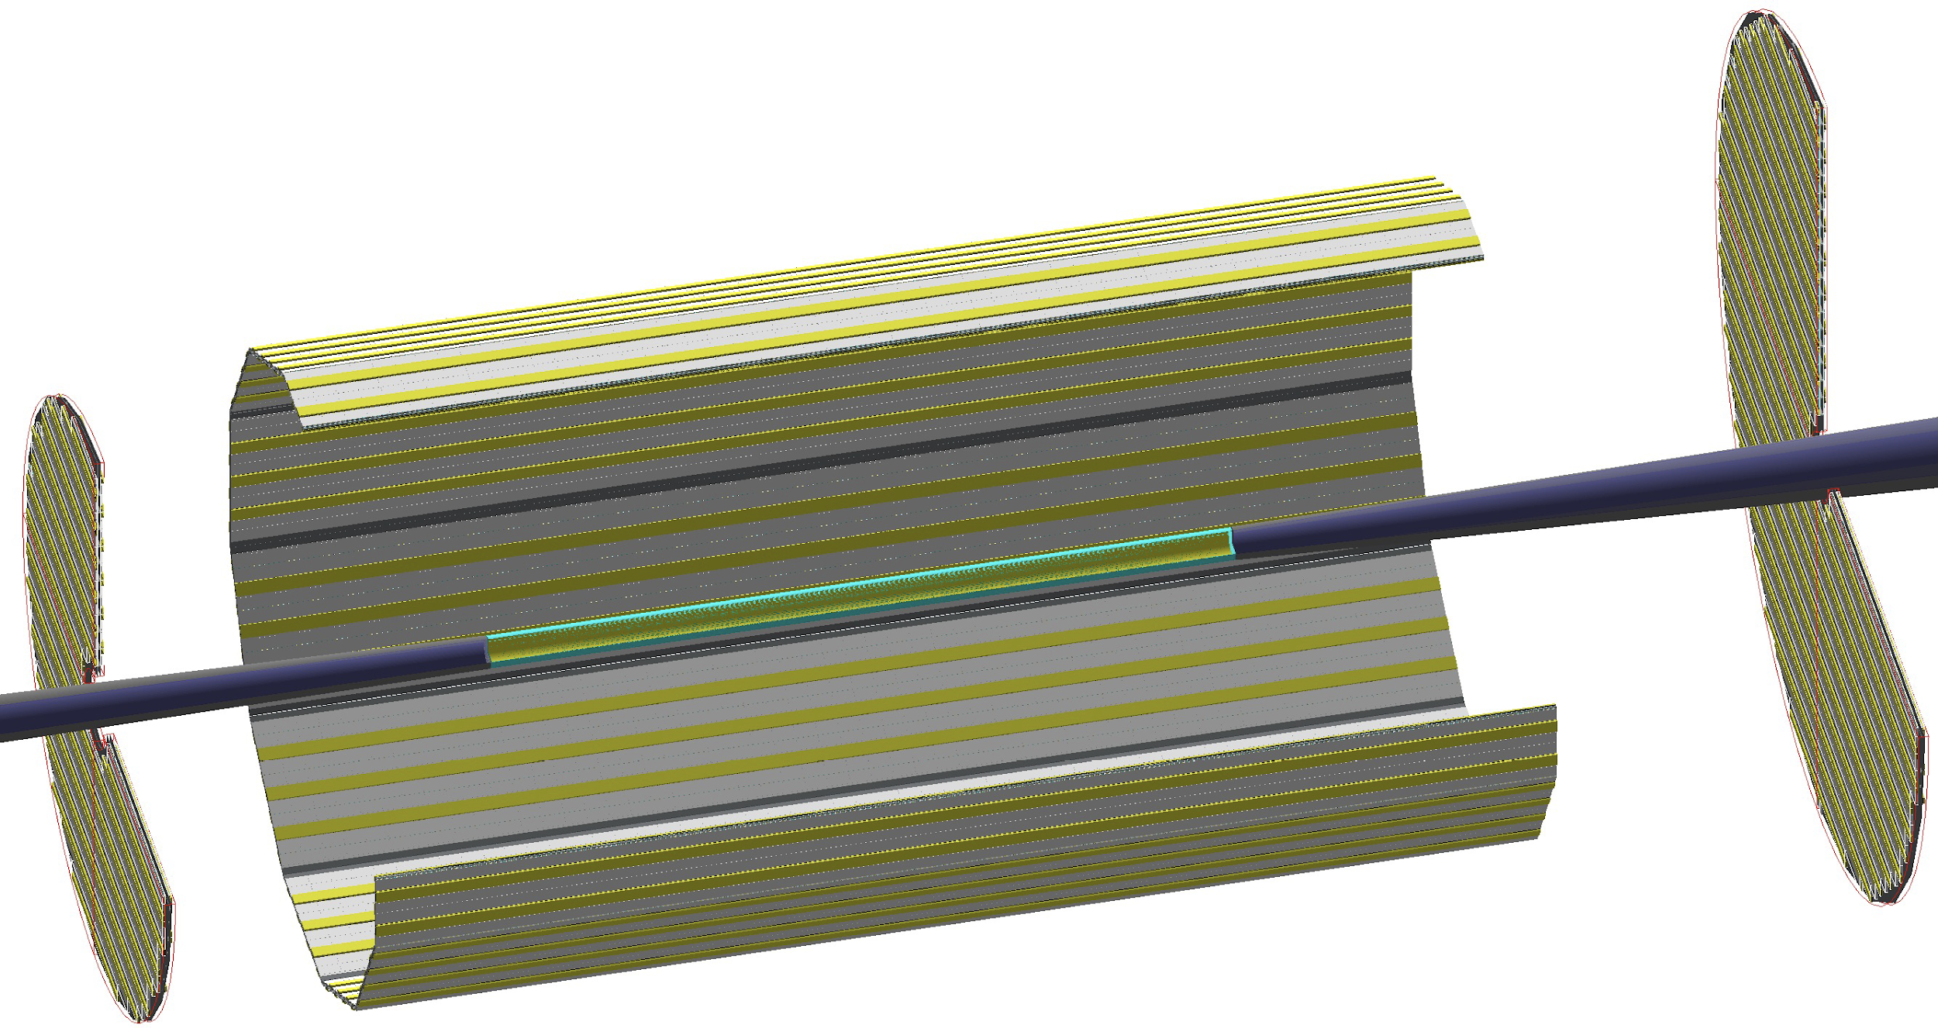
Particle ID
Dual-Radiator RICH(dRICH)
High-Performance DIRC
Quartz bar radiator (BaBAR bars)
light detection with MCP-PMTs
Fully focused
π/K 3σ separation at 6 GeV/c
Proximity Focused (pfRICH)
Long proximity gap (~40 cm)
Sensor: HRPPDs
up to 9 GeV/c 3σ π/K sep.
world’s first
at
C₂F₆ Gas Volume and Aerogel
Sensors tiled on spheres (SiPMs)
π/K 3σ sep. at 50 GeV/c
AC-LGAD
TOF (~30ps)
world’s first
at
world’s first
at
hadrons
electrons
Accurate space point for tracking
forward disk and central barrel

Slide 25
ePIC Resources
Public Website - https://www.bnl.gov/eic/epic.php
Mailing Lists – https://lists.bnl.gov/mailman/listinfo
Indico Agenda - https://indico.bnl.gov/category/402/
  ePIC Software and Computing: https://indico.bnl.gov/category/435/
Wiki - https://wiki.bnl.gov/EPIC
ePIC Software Training:
  Landing Page: https://eic.github.io/documentation/landingpage.html
  Tutorials: https://eic.github.io/documentation/tutorials.html
Mattermost: https://chat.epic-eic.org
ePIC Zenodo Community: https://zenodo.org/communities/epic

Slide 26
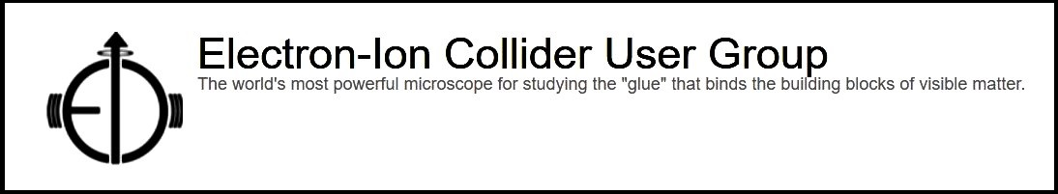

EICUG Membership
The EICUG is a vital organization to promote the interests of the EIC community!
  Without the EICUG we would never have gotten far enough to form ePIC!
Please register your institution!
Check with your EICUG IB representative to get registered as a member
https://www.eicug.org/content/join.html

Slide 27
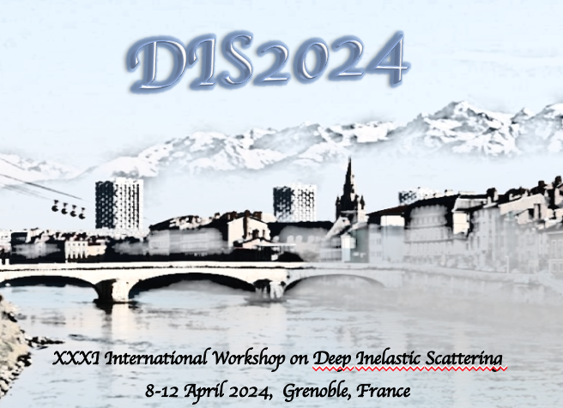

Upcoming Notable Events…
DIS 2024 in Grenoble, France April 8-12th , 2024
  https://lpsc-indico.in2p3.fr/event/3268/
ePIC Software and Computing meeting
@ CERN April 22nd-26th
  https://indico.cern.ch/event/1343984/
EIC RRB Meeting – May 6-7th in Italy
MC4EIC @ Durham University June 5-7th
  https://conference.ippp.dur.ac.uk/event/1292/
JLab Users Meeting, June 8-12th
  https://www.jlab.org/conference/2024-jluo
4th EIC-Asia Workshop in Shanghai July 1-5, 2024
  https://indico.cern.ch/event/1361239/
Joint EICUG/ePIC Collaboration Meeting
@ Lehigh University July 22nd-28th
  https://indico.bnl.gov/event/20727/

Slide 28



Collaborative Tools Development
Ad-Hoc Committee working to put together the tools we will need to support the collaboration:
  Mattermost and GitHub already in use
  Overleaf available for TDR effort
  Zenodo.org selected as document database solution
  Website under development
    ePIC has a page under the EIC Project BNL site
    Push to develop both public and collaboration sections
  Working on collaboration database solution
    Based on BNL developed “phone book” for EICUG/sPHENIX
Federated Login
Identity
User Request
Login
ePIC Collaboration Database
Authorization

Slide 29
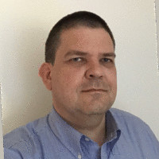
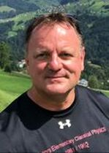
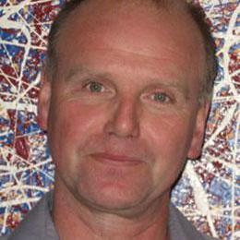
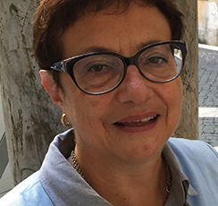
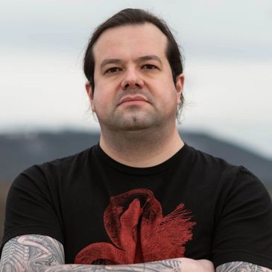
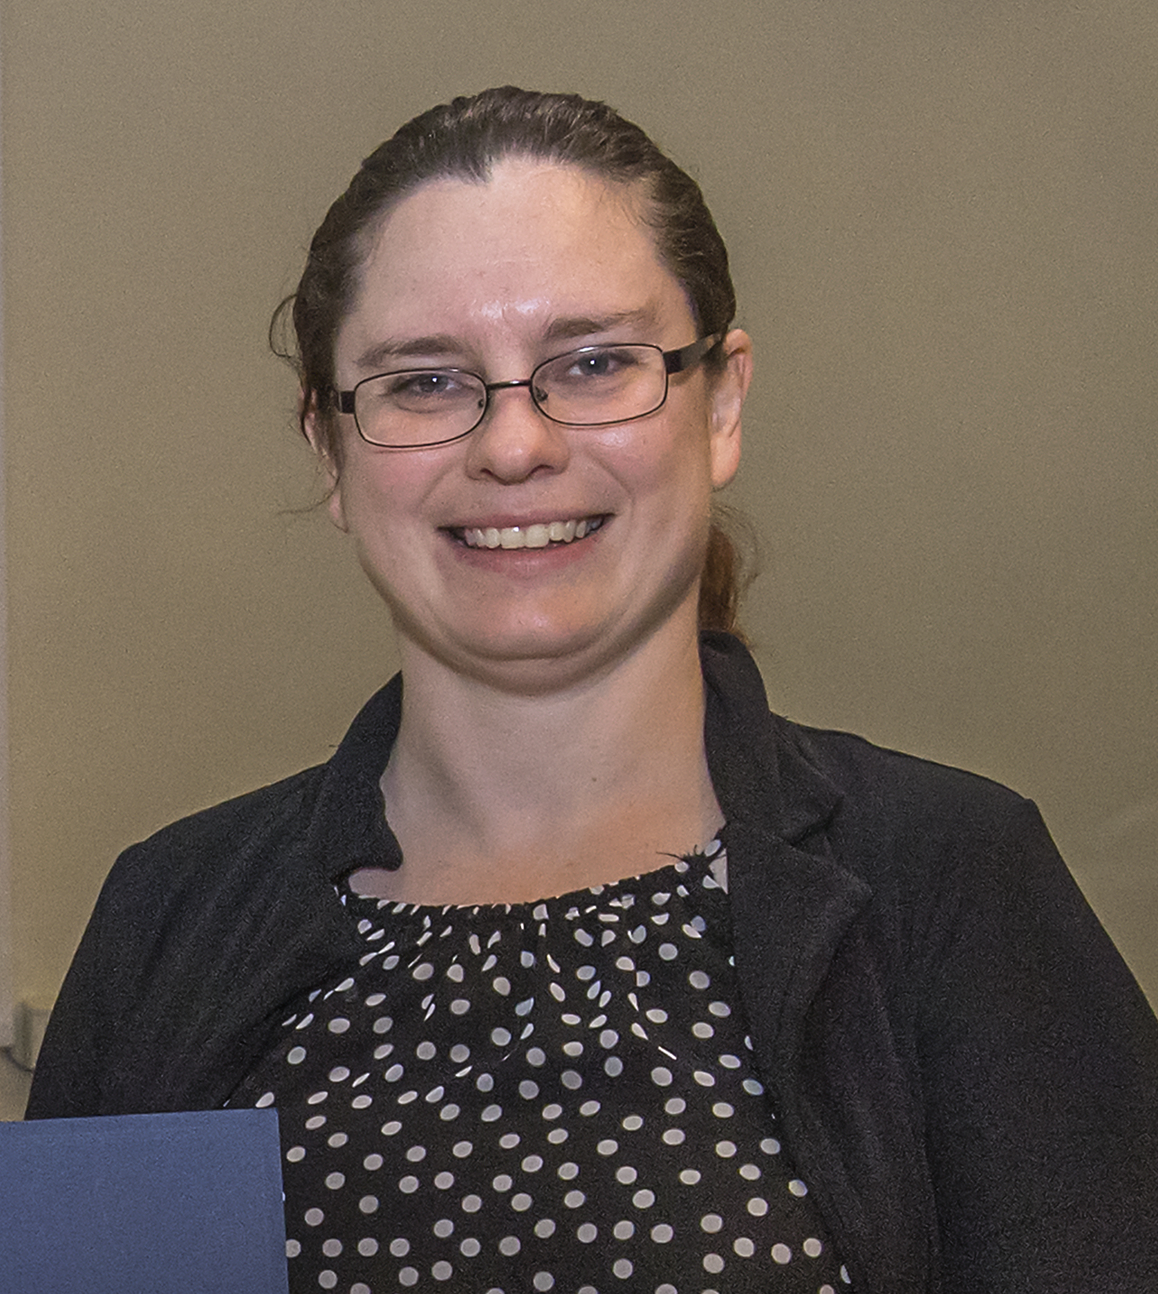
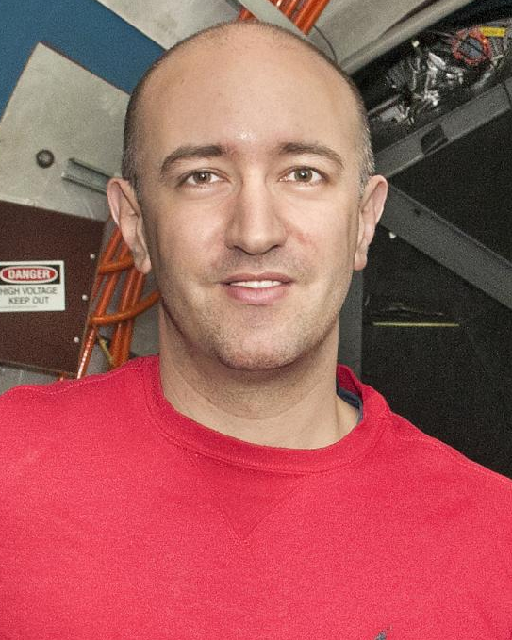
ePIC Collaboration Structure
Collaboration Council
Institutional Representatives
Spokesperson’s Office
Spokesperson (SP)
Deputies
EIC Project
Executive Board
Ernst Sichtermann: Past Chair
Bernd Surrow: Chair
Thomas Ullrich: Vice-Chair
Standing Committees
DE&I
Conferences and Talks
Membership
Elections
Publications
Ad-Hoc Committees
Technical Coordinator (TC)
Software and Computing Coordinator (SCC)
Analysis Coordinator
(AC)
Technical Coordinator (Acting)
• Silvia Dalla Torre (INFN)
Deputy TC’s:
Prakhar Garg (Yale)
Oskar Hartbrich (ORNL)
Matt Posik (Temple)
SCC Coordinator
• Markus Diefenthaler (JLab)
Dmitry Kalinkin
(Kentucky, Deputy SCC for Development)
Torre Wenaus
(BNL, Deputy SCC for Infrastructure)
Wouter Deconinck
(U. Manitoba, Deputy SCC for Operations)
Analysis Co-Coordinators
• Rosi Reed (Lehigh Univ.)
• Salvatore Fazio (Univ. Calabria)
Blue: New since last year

Slide 30
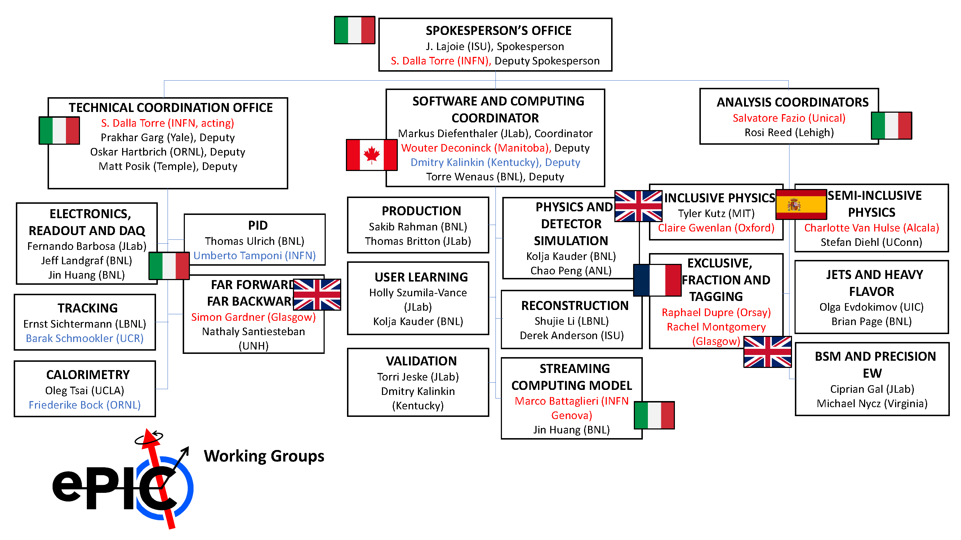
ePIC Working Group Structure
Red: International
Blue: New since last year
New PWG and SCC Conveners will be recommended to the CC in Thursday’s meeting.

Slide 31
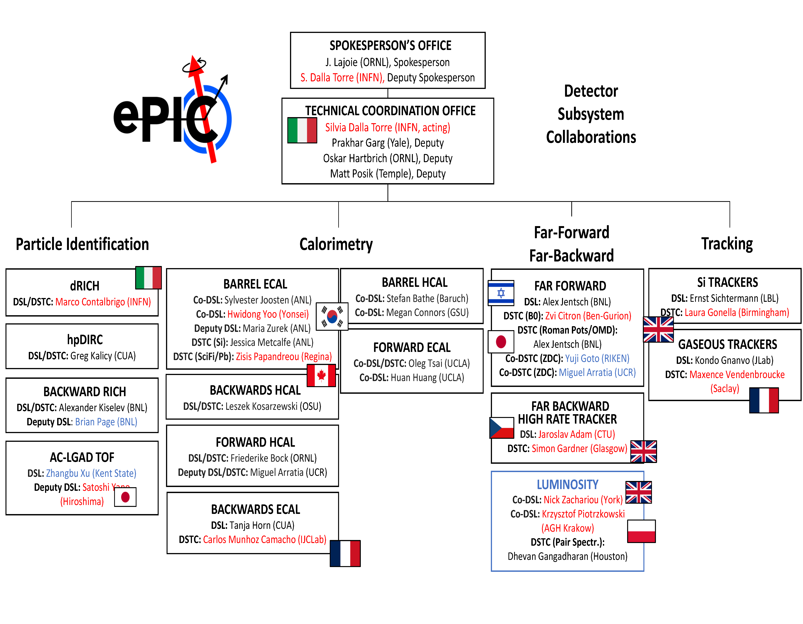
ePIC DSC Structure
Red: International
Blue: New since last year

Slide 32
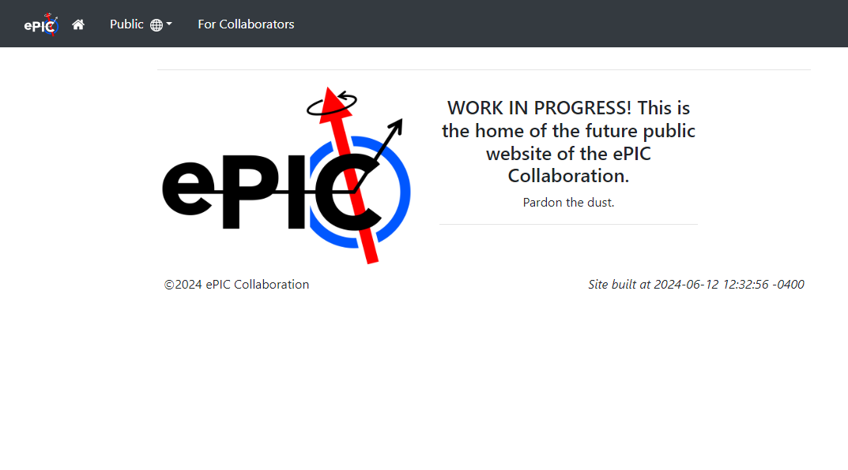
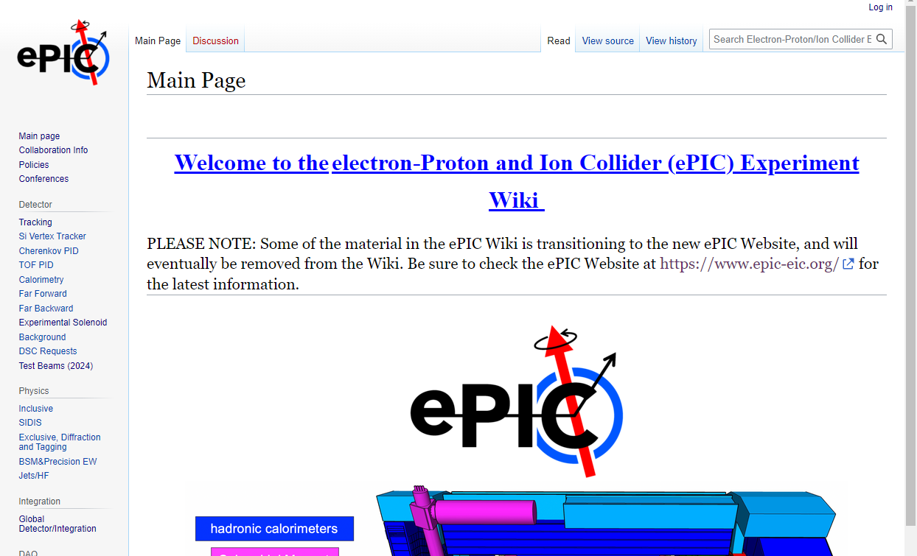
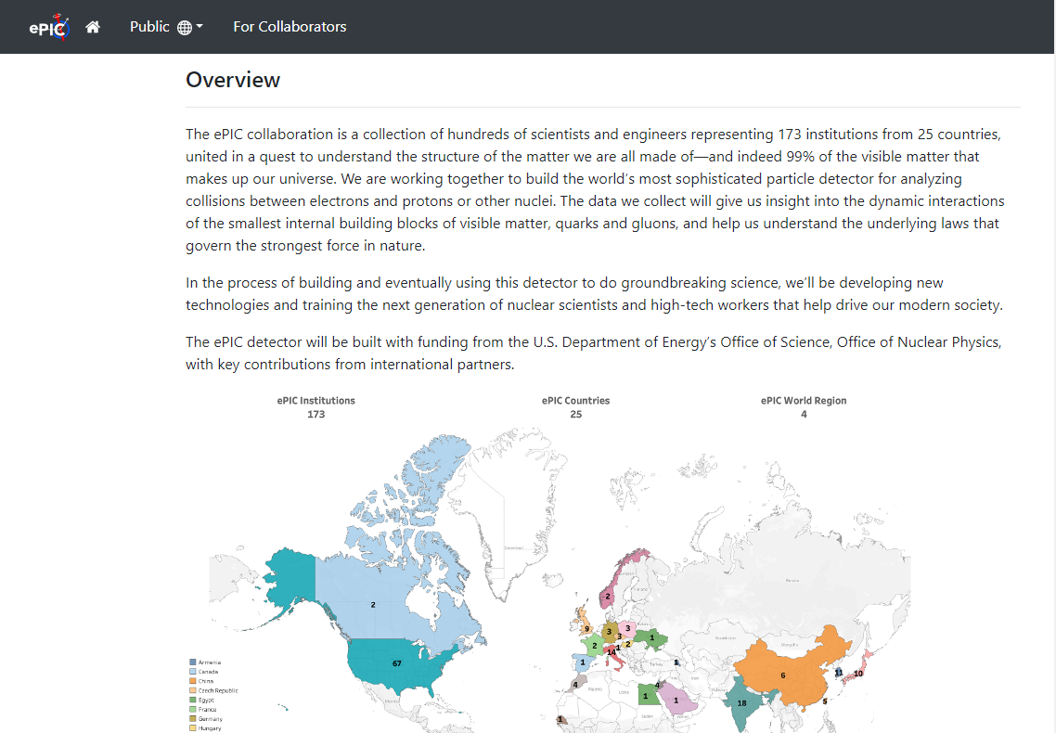
ePIC Website Progress
https://www.epic-eic.org/

Slide 33






ePIC Committees
DE&I Committee:
Chair: Megan Connors (GSU)
Vice-Chair: Christine Nattrass (UTK)
Francesco Bossù (CEA-Saclay), Wouter Deconinck (University of Manitoba), Narbe Kalantarians (Virginia Union University) , Iris Ponce Pinto (Yale University) , Maya Shimomura (Nara Women’s University) , Allison Zec (University of New Hampshire)
Collaboration Council
Institutional Representatives
Conferences and Talks:
Chair: Maria Zurek (ANL)
Vice-Chair: Brian Page (BNL)
Barbara Jacak (Berkeley), Daniel Brandenburg (OSU), Dmitry Kalinkin (Kentucky), Nick Zachariou (York), Xuan Li (LANL), Nicola Rubini (Bologna), Wouter Deconinck (Manitoba)
Standing Committees
DE&I
Conferences and Talks
Membership
Elections
Publications
Ad-Hoc Committees
Membership Committee:
Chair: Peter Steinberg (BNL)
Vice-Chair: Pietro Anontioli (INFN-Bologna)
Friederike Bock (ORNL), Helen Caines (Yale), Doug Higinbotham (JLab), Bedhangas Moharty (NISER), Silvia Niccolai (IJCLAB), Marzia Rosati (ISU)
Elections Committee:
Chair: Helen Caines (Yale)
Vice-Chair: Ken Barish (UCR)
Past-Chair: John Arrington (LBNL)
Maria Stefaniak (OSU), Domenico Elia (INFN)
All ePIC Standing Committees now formed and at work.
Voting underway to ratify ePIC Membership policy.
Drafting of Conf. and Talks, Code of Conduct, and Publication Policy underway.
Publications Committee:
Chair: Rene Bellwied (U. Houston)
Vice –Chair: Annalisa Mastroserio (INFN Bari)
Lokesh Kumar (Panjab U.), Michela Chiosso (Torino), Prithwish Tribedy (BNL), Markus Diefenthaler (JLab), Sevil Salur (Rutgers),
ex-officio w. Conferences and Talks Committee:
Daniel Brandenburg (OSU)

Slide 34
ePIC Detector Design
4.5m
η=0
5.0m
“Backward”
“Forward”
Tracking:
  New 1.7T (2.0T) solenoid
  Si MAPS Tracker
  MPGDs (μRWELL/μMegas)
PID:
  high-performance DIRC
  proximity-focused RICH
  dual-radiator RICH
  AC-LGAD (~30ps TOF)
Calorimetry:
  Imaging Barrel EMCal
  PbWO4 EMCal (backwards)
  Finely segmented EMCal +HCal
  in forward direction
  Outer HCal (sPHENIX re-use)
  Backwards HCal (tail-catcher)
6.52m
hadrons
electrons

