Slide 1
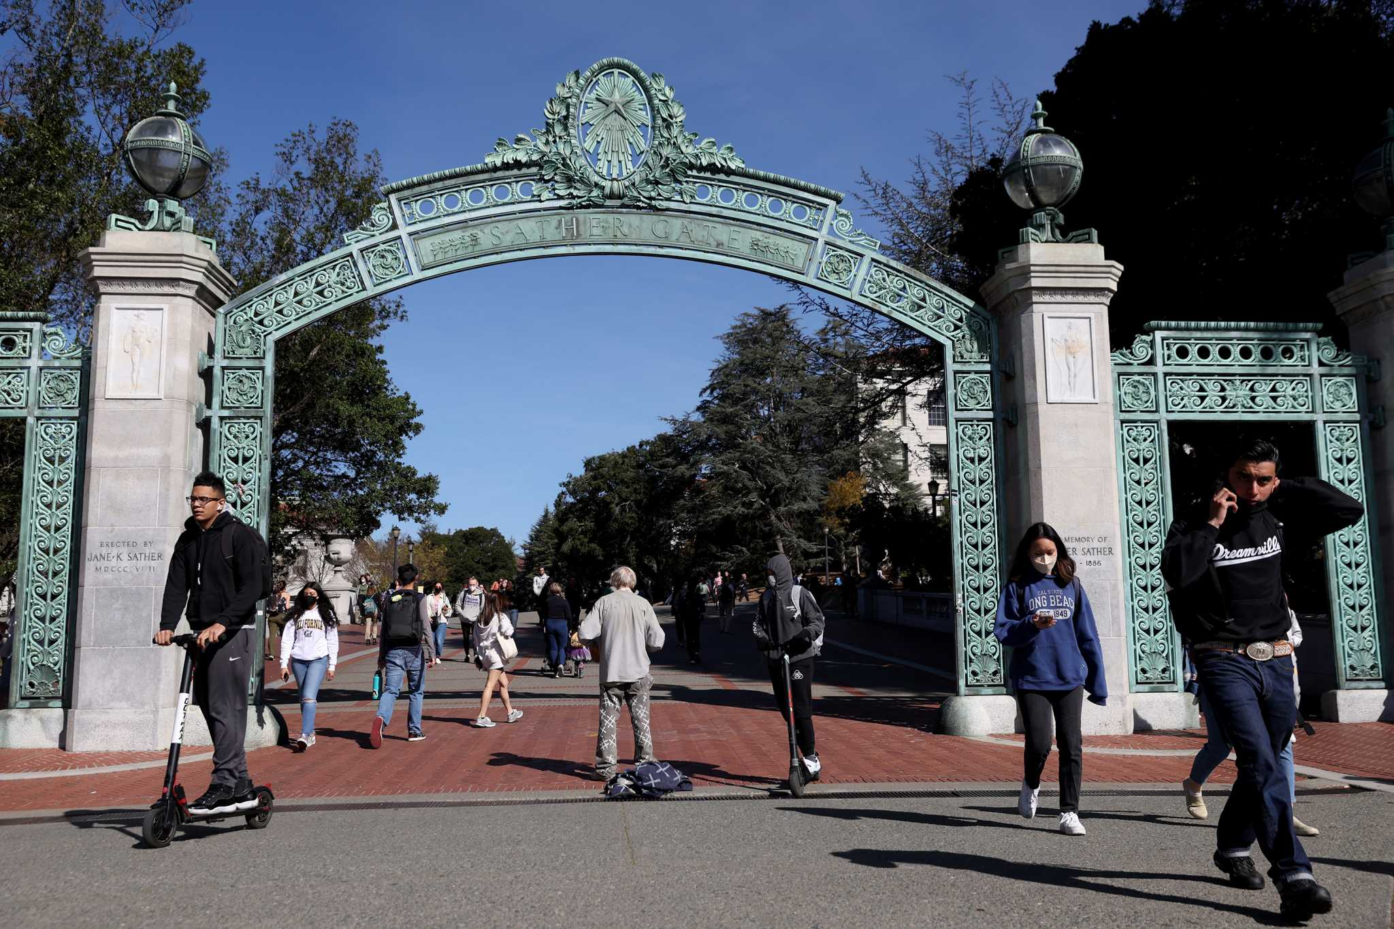
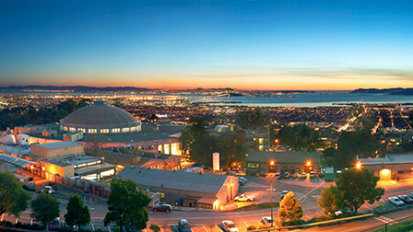

Berkeley Status & Plans
Barbara Jacak
August 13, 2024

Slide 2
UC Berkeley & LBNL Groups today
UCB PD: Preeti Dhankher, Minjung Kim
LBNL PD: Rita Sadek (new), Yu Hu
UCB Grad students: Beatrice Liang Gilman, Tucker Hwang, Anjali Nambrath, Kirill Naumov, Emma Yeats, Katie Gray(new)
UCB Undergrad students: Mito Funatsu, Skye Heiles, Joe Xu
LBNL staff: Ernst Sichtermann, Zhenyu Ye, Spencer Klein, John Arrington, Nikki Apadula, Shujie Li, Xin Dong, Barbara Jacak
Wenqing moves to Univ. of Houston, Kyle to MIT, Ben to Johns Hopkins, Tyler to JLab

Slide 3
Key roles
Ernst is SVT subsystem leader
Shujie is Reconstruction working group co-convener
Ernst is Tracking working group co-convener
Nikki and Zhenyu are SVT work package leads

Slide 4
Berkeley Group Works on
EIC, ALICE, STAR, sPHENIX, JLab experiments
HI Physics goals
Transport properties of dense QCD matter (hot and cold)
Jet evolution and modification in dense matter
Hadronization process
Hadron Physics Goals
Where is the proton’s spin & what is the structure of the pion?
Short range correlations in nuclei & quark-level understanding
Source of EMC effect & parity violating probes of it
Our approach is to study with available machines now and design, build, and analyze EIC experiment to study with e+p, A

Slide 5
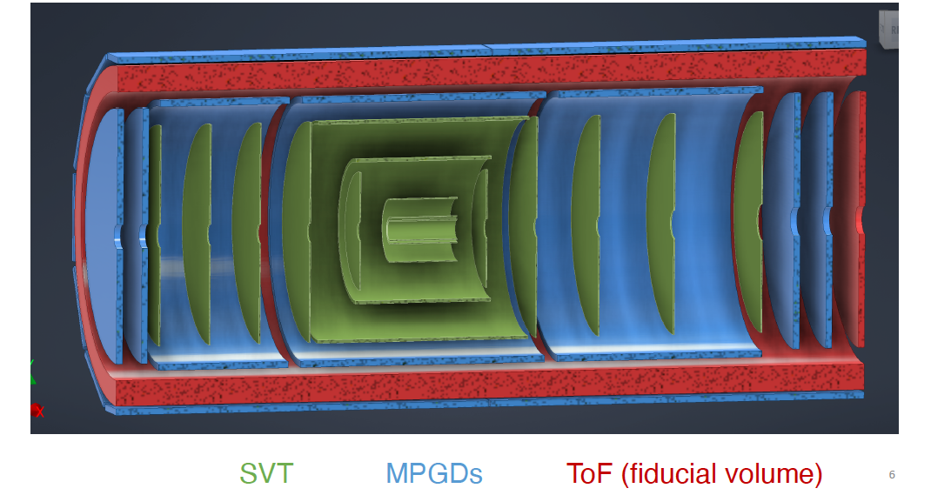
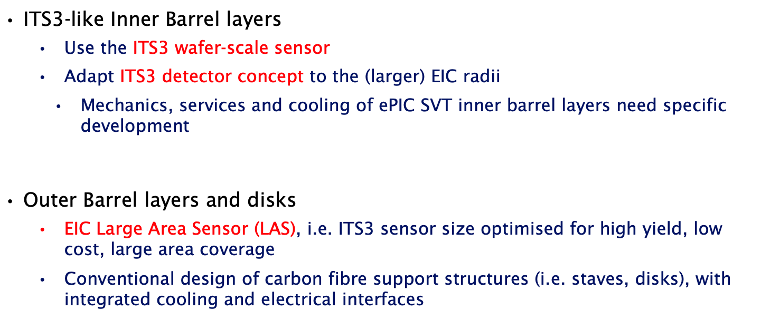
EIC silicon tracker
We are part of ITS3 in ALICE; you will hear from Zhenyu
You will hear from Skye

Slide 6
Key Berkeley accomplishments
Silicon vertex detector design
Progress on sensor tiling
Silicon vertex detector R&D
Mechanics/cooling studies & prototyping of carbon fiber
Contributions to ITS3 sensor & ASIC design (Engineering)
babyMOSS beam tests
Track reconstruction
SVT geometry definition and impact studies
Simulation and reconstruction software development
Pattern recognition (track hit association, duplicate rejection)
Efficiency, purity, resolution & background, noise effects
Vertexing
You will hear from Zhenyu
You will hear several talks about track reconstruction

Slide 7
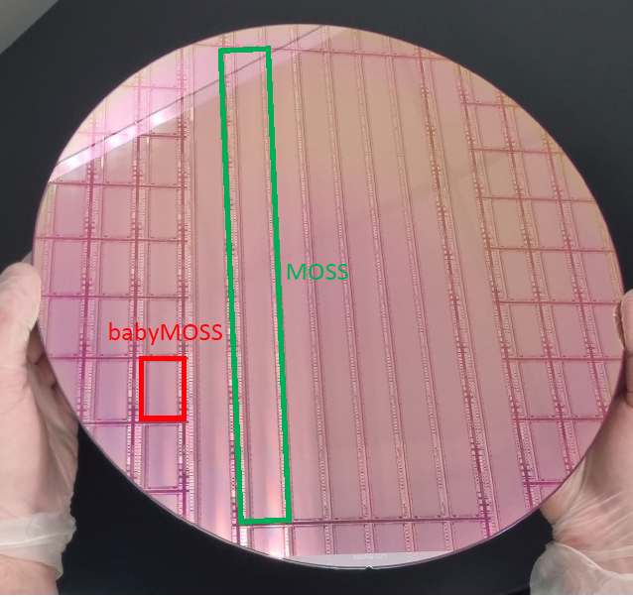
baby MOSS *
* Engineering run pixels structure for testing

Slide 8
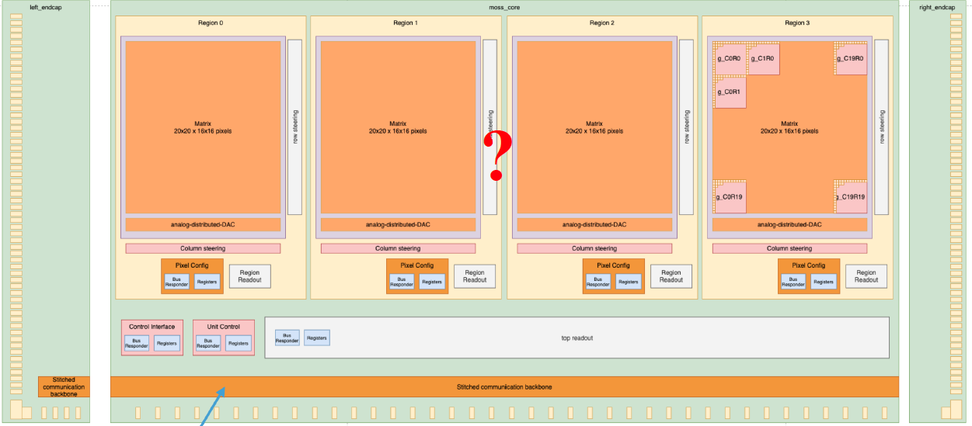
What’s inside

Slide 9
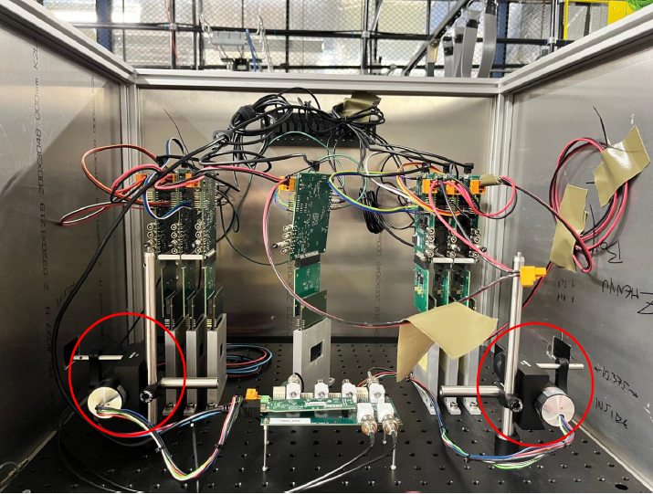
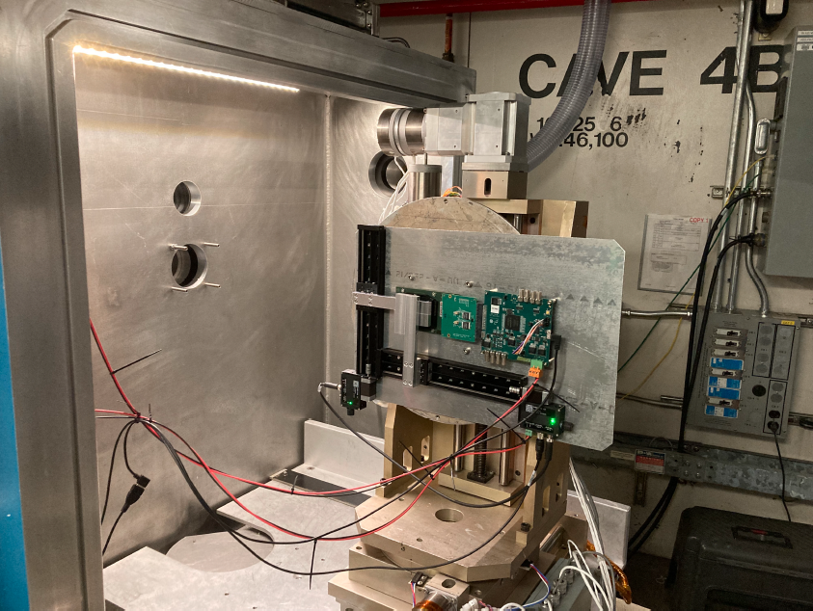
Test beam set ups
120 GeV protons at FNAL
Study different angles of incidence
Reconstruct tracks in telescope
10 MeV/A heavy ion cocktail at the LBNL 88” cyclotron
Look at single event upsets & latchups

Slide 10
Silicon Hardware Plans for 2024
Sensor development
Develop large area sensor for EIC, for review in 2024
babyMOSS bench and beam test & feedback to designers ☑️
Test set-up development for ER-1
Ancillary chip development for power, bias, slow controls underway
Finalize layout
Optimize resolution & efficiency, including backgrounds underway
Mechanical design & simulation of mechanics
Overall support & cooling design underway
Selection of materials
Develop aluminum conductor flex cables
Prepare for EIC CD-2 in 2025 underway

Slide 11
Silicon Software plans
Better quantify performance ☑️ *
Complete hit selection & track quality studies ☑️
Complete studies of background, noise, dead area effects
Implement hit clustering in MC and reconstruction getting started
Improve geometry description underway **
Tracking beam test to inform clustering, etc. underway
Prepare for EIC CD-2 in 2025 underway
*with lots of help from Barak
** Shujie is the master of this work
*

Slide 12
Backup

Slide 13
Leadership roles in ePIC/EIC
Arrington – Nominating Committee past chair
Jacak – EIC Project Advisory Committee member, ePIC EB & conference commitee
Sichtermann – Silicon Vertex Tracker Subsystem Leader & Tracking WG co-convener
Apadula & Ye – Silicon R&D work package leads
Li – Reconstruction WG co-convener
Dong – Vertexing leader

