Slide 1
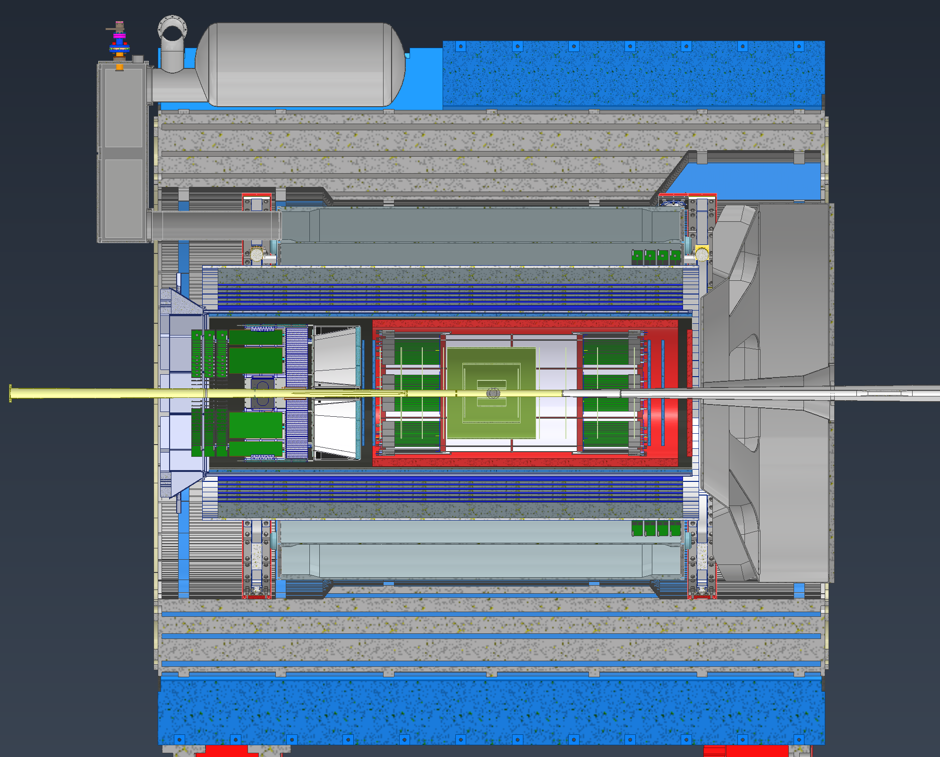

Slide 2
Option 1-
RDOs are placed on the outside of the barrel for both the lepton and hadron sides.
Hadron would be 6.5m +10% for contingency, so ~7.2m
Lepton would be 6.8m +10% for contingency, so ~7.5m
For all the numbers I list the distances are from the Inner MPGDs since I believe they are the worst case. If we need RDOs for the inner Silicon we must add to 0.5m the numbers.
RDOs
RDOs
~7.5m Silicon ~7m MPGD
~7m Silicon ~6.5m MPGD

Slide 3
Option 2-
RDOs are placed on the outside of the barrel EMCAL for both the lepton and hadron sides. This option potentially creates issues for the Hadron side as getting access to the RDOs may be difficult. Also routing of the cables in this area will be a nightmare. On the Lepton side we have much more space since we are not limited by the dRICH.
Hadron would be 2.4m +10% for contingency, so ~2.7m
Lepton would be 4.2m +10% for contingency, so ~4.6m
RDOs
RDOs

Slide 4
Option 3-
RDOs are placed on the outside of the barrel EMCAL for hadron side and inside the DIRC on the Lepton side. This option has the shortest distances, but I don’t think its possible. It has the same issues on the Hadron side but also additional issues on the lepton side. The EEEMCAL and pfRICH will be slid into and out of the detector here, so anytime we need to service them or another detector inside of them we’ll have to disconnect every RDO in this area and remove them. The cabling in this area would also be extremely messy.
Hadron would be 2.4m +10% for contingency, so ~2.7m
Lepton would be 2.5m +10% for contingency, so ~2.8m
RDOs
RDOs

