Slide 1
STAR
Time projection Chamber and
Heavy Flavor Tracker (HFT)
Flemming Videbæk
Brookhaven National Lab
Notes:
Some of the key detectors in STAR TPC since 200 HFT 2014-2016; intro

Slide 2
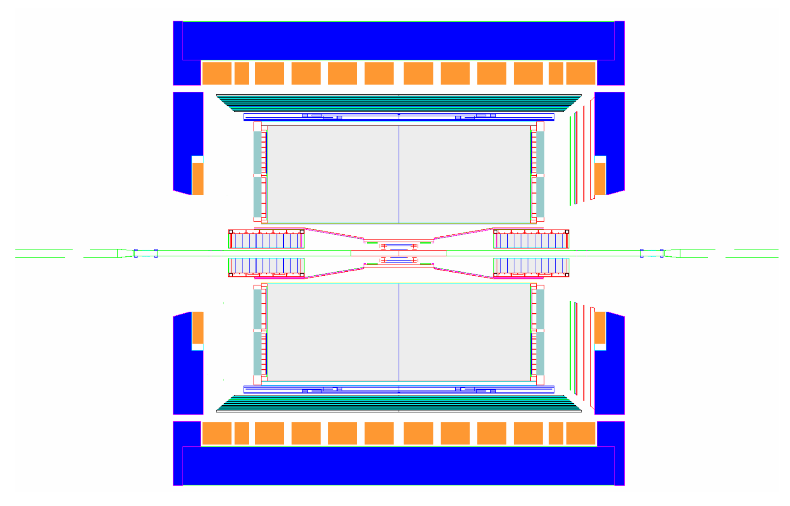
The STAR Detector at RHIC
Magnet
Time Projection Chamber
Coils
Silicon Trackers
SVT & SSD
TPC Endcap & MWPC
FTPCs
Beam Beam Counters
Endcap Calorimeter
Central Trigger Barrel & TOF
Barrel EM Calorimeter
The central STAR detector with the TPC is the key element of STAR

Slide 3
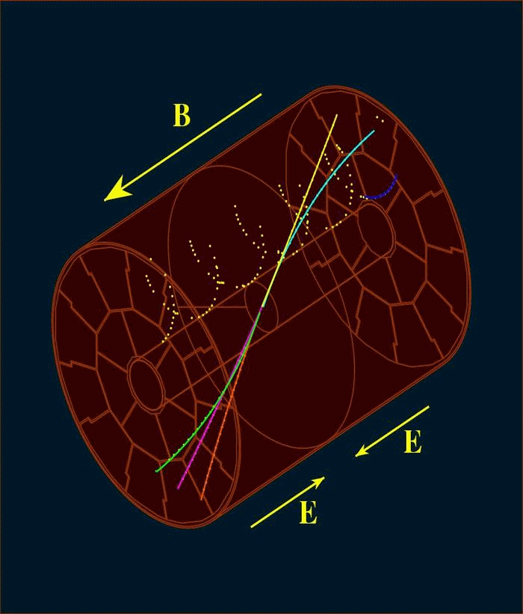
Principles of TPC Operation

Slide 4
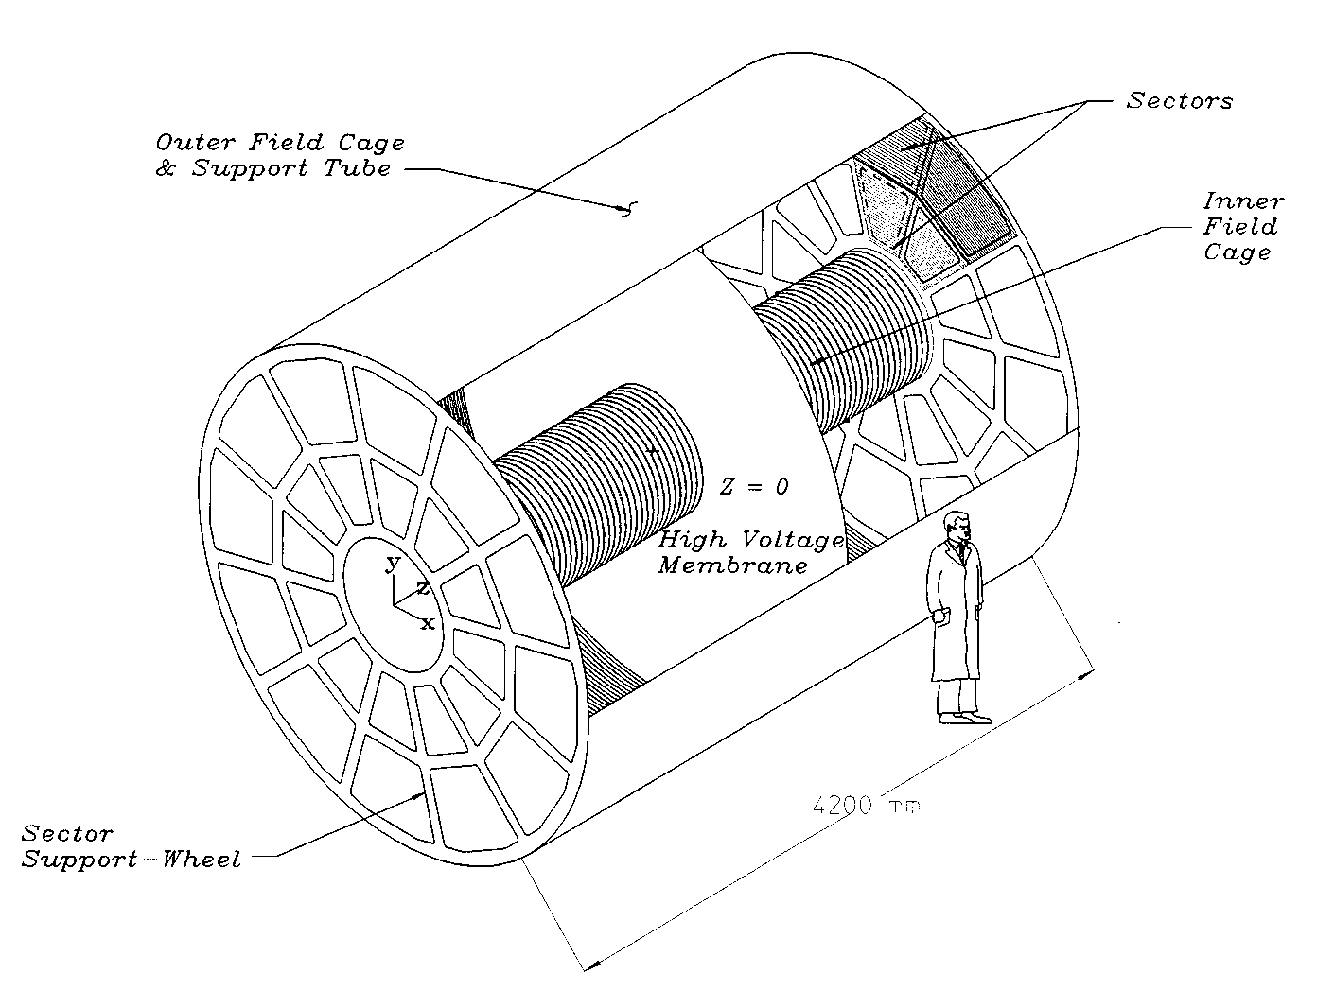
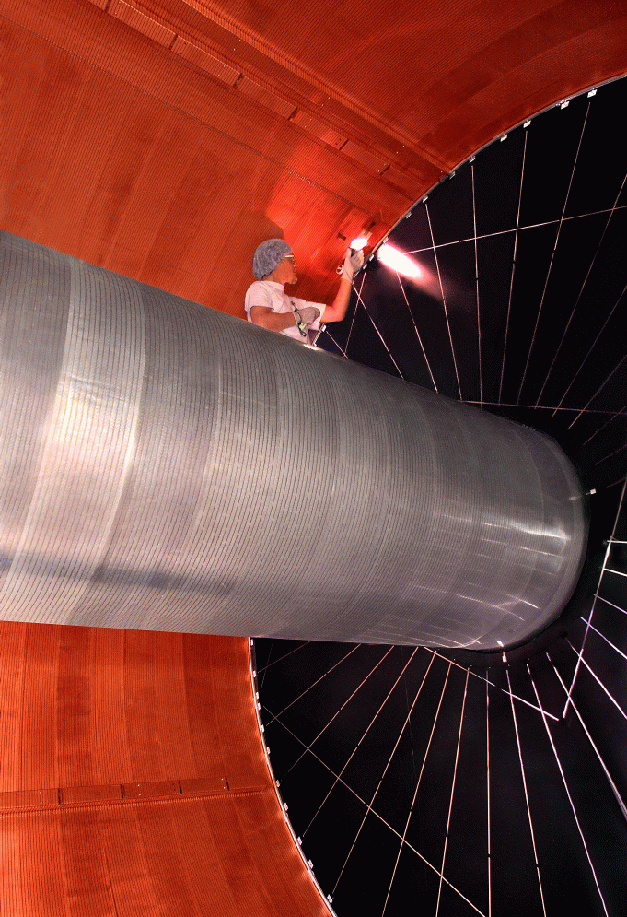
TPC: Principles of Operation
420 CM
Voltage : - 28 kV at the central membrane 135 V/cm over 210 cm drift path
Secondary electrons, resulting from a primary track, drift in parallel and uniform electric and magnetic fields inside the TPC. These electrons are ‘captured’ as a function of time by a 2D readout system on the endcaps to form a 3D image.

Slide 5
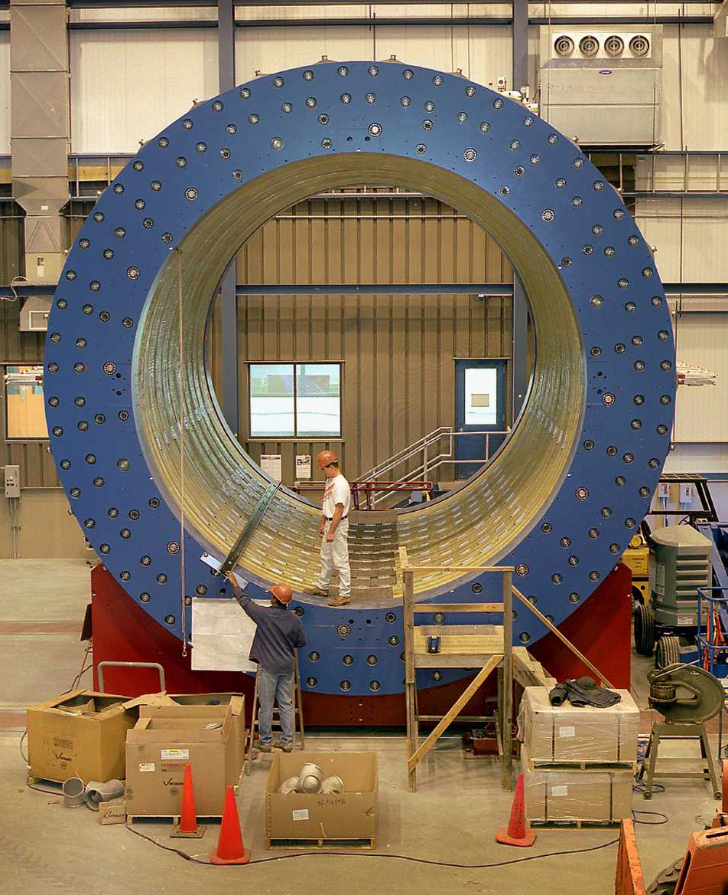
The STAR Magnet (room temp Aluminum coils)
A charged particle in a uniform field follows a (perfect) circular path

Slide 6
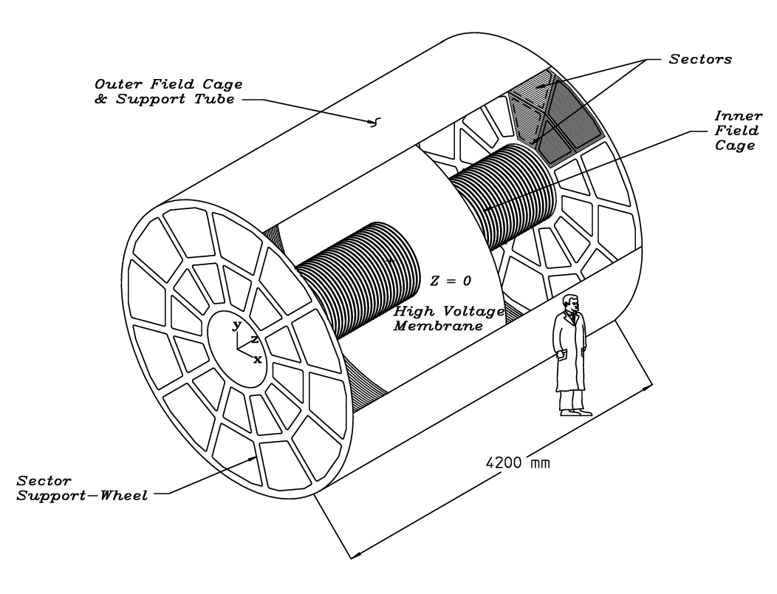
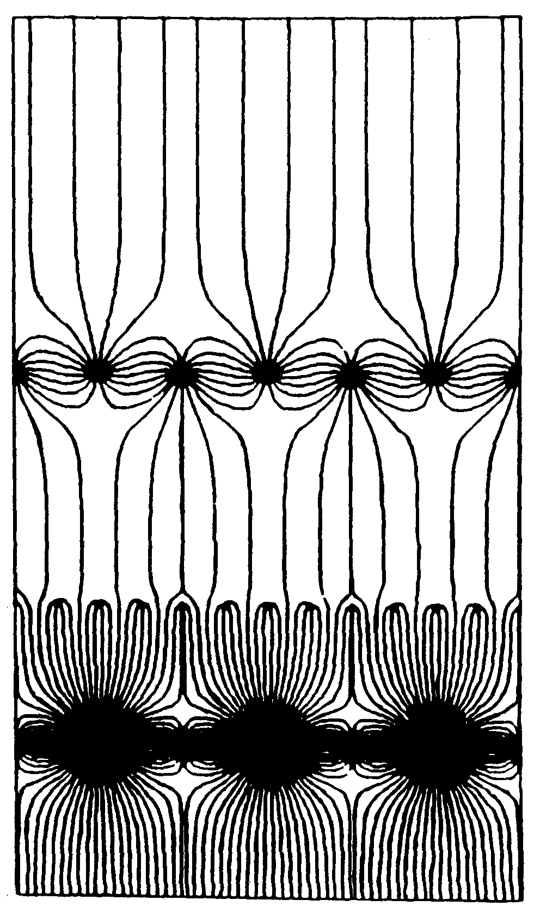
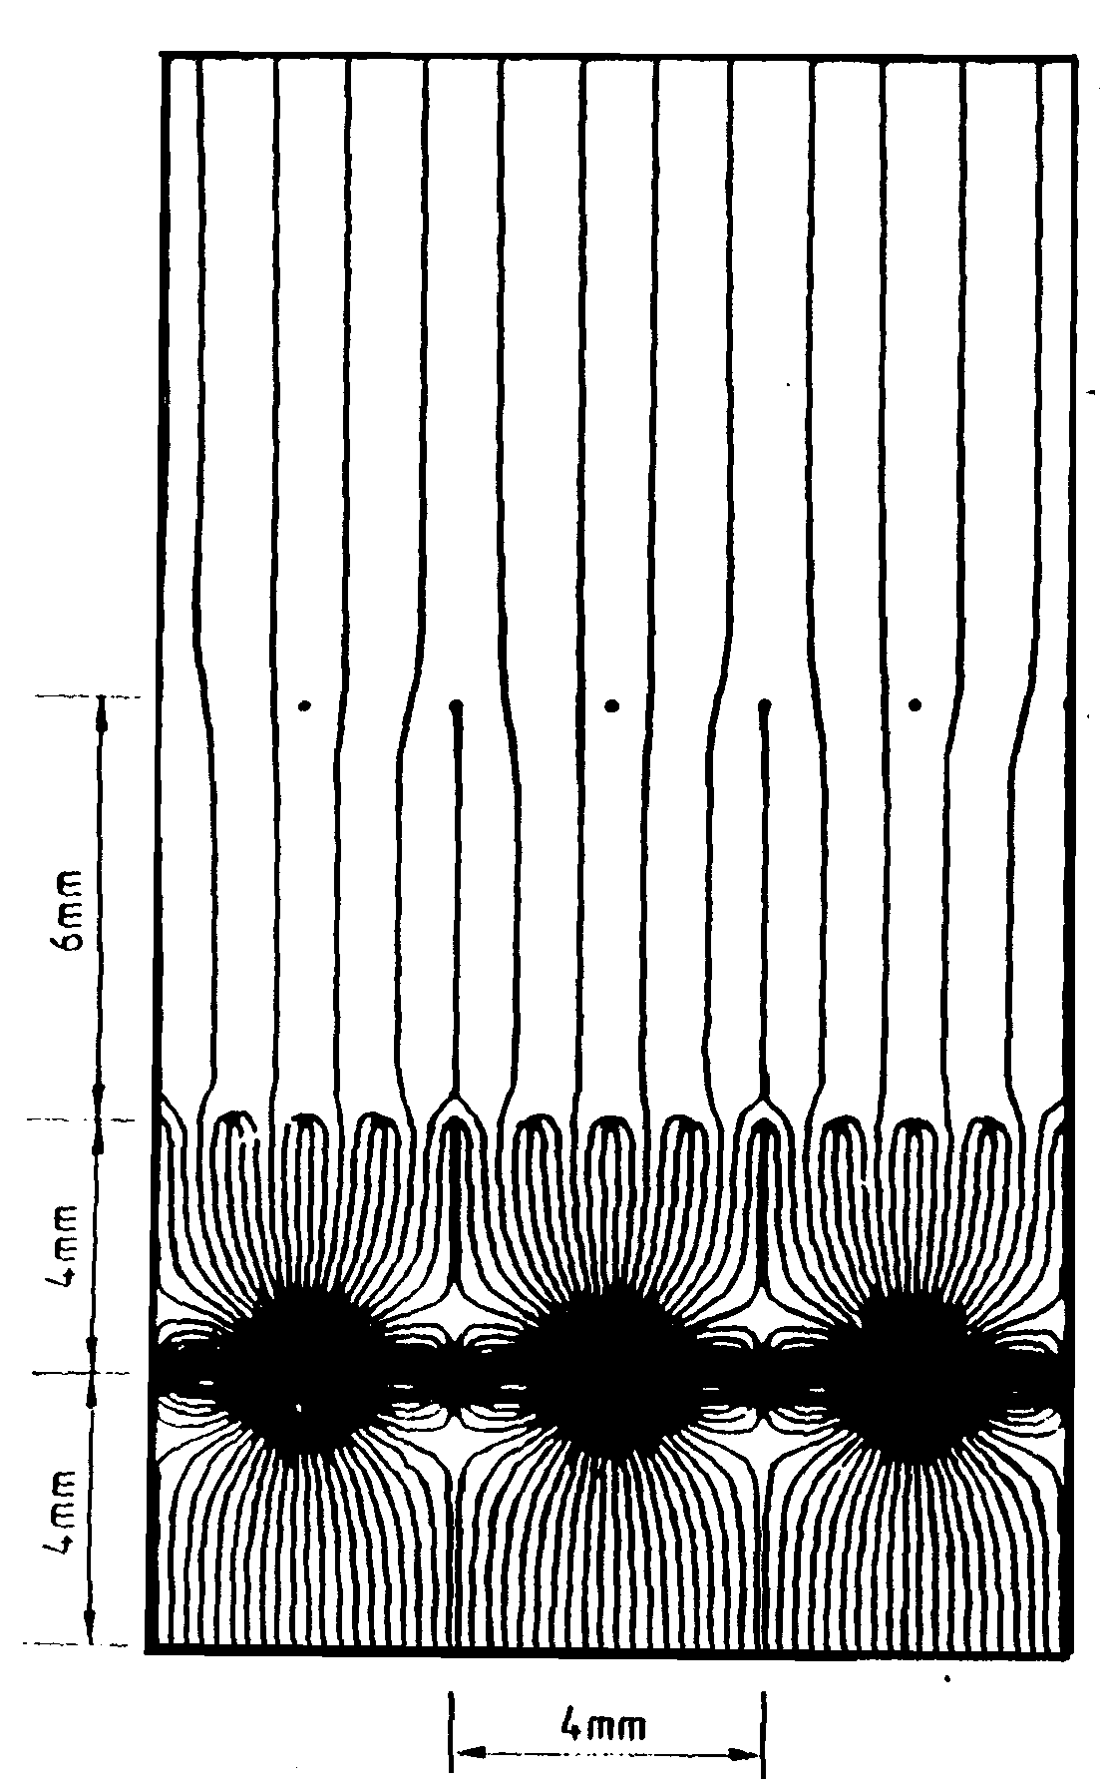
3D: The Time Projection Chamber
Time Projection Chamber → full 3-D track reconstruction
x-y from wires and segmented cathode of MWPC
z from drift time
in addition dE/dx information (charge of ionization)
STAR TPC
Diffusion significantly reduced by B-field.
Requires precise knowledge of v_{D} → LASER calibration + p,T corrections
Drift over long distances → very good gas
quality required
Space charge problem from positive ions, drifting back to central membrane → use a gated grid
Gate open
Gate closed

Slide 7
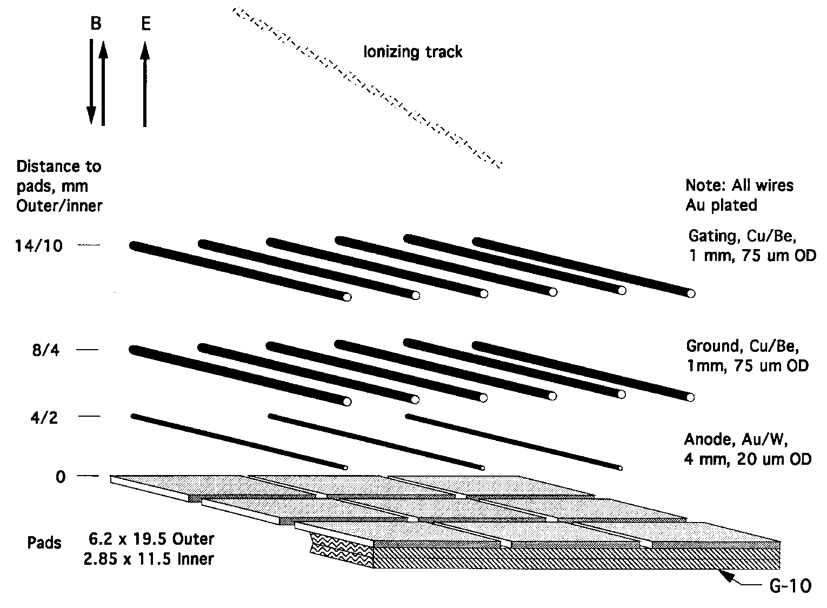
Sector Wire Geometry
Blown up picture of sensitive area on readout chambers

Slide 8
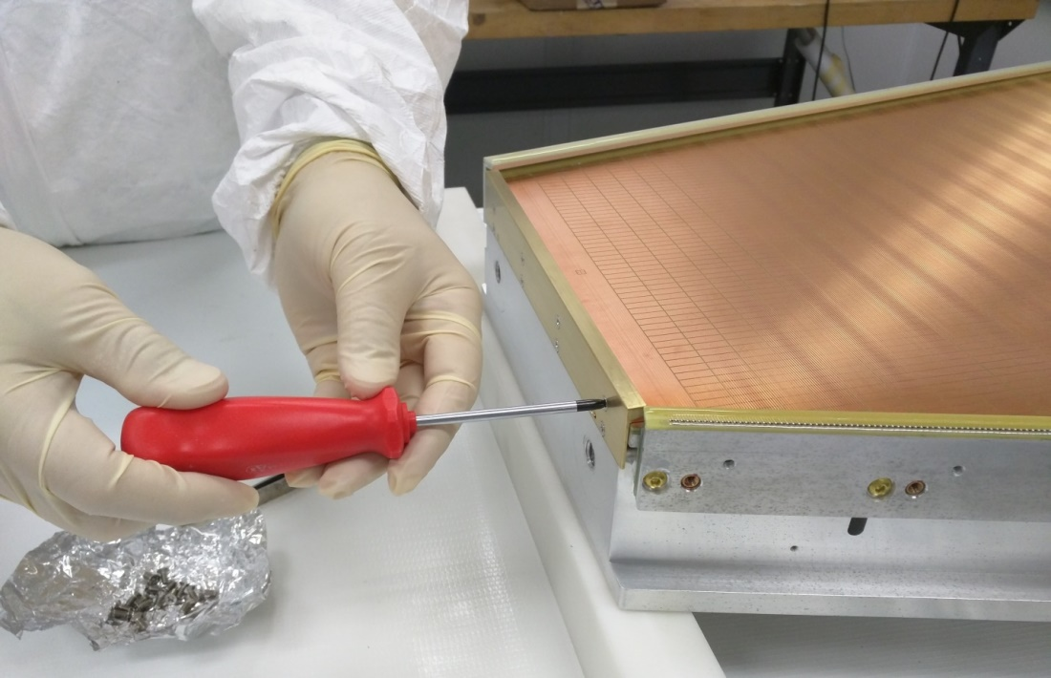
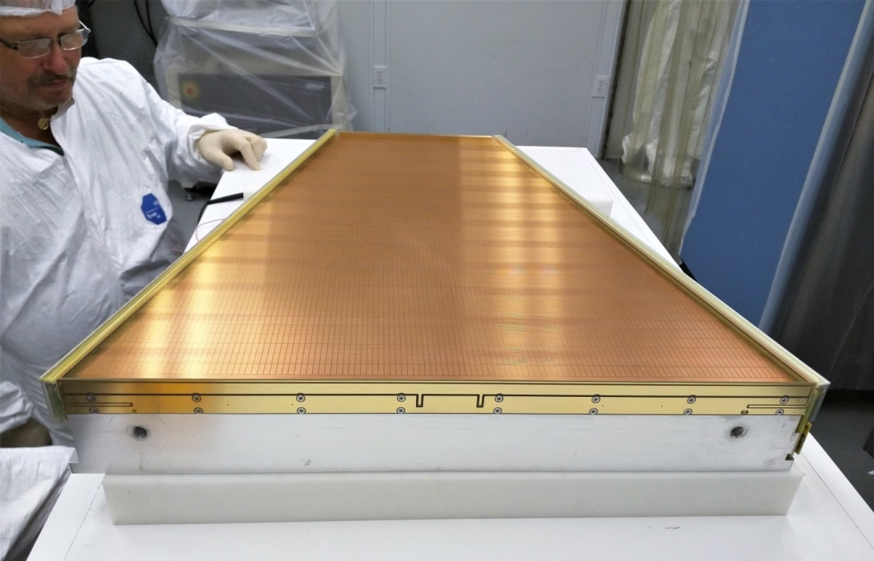
Picture of Chambers and pad plane
(iTPC)
The STAR TPC was upgraded in 2019 with improved chambers that increased acceptance and accuracy (Beam Energy Scan)
Here pad plane and wire planes during final assembly

Slide 9
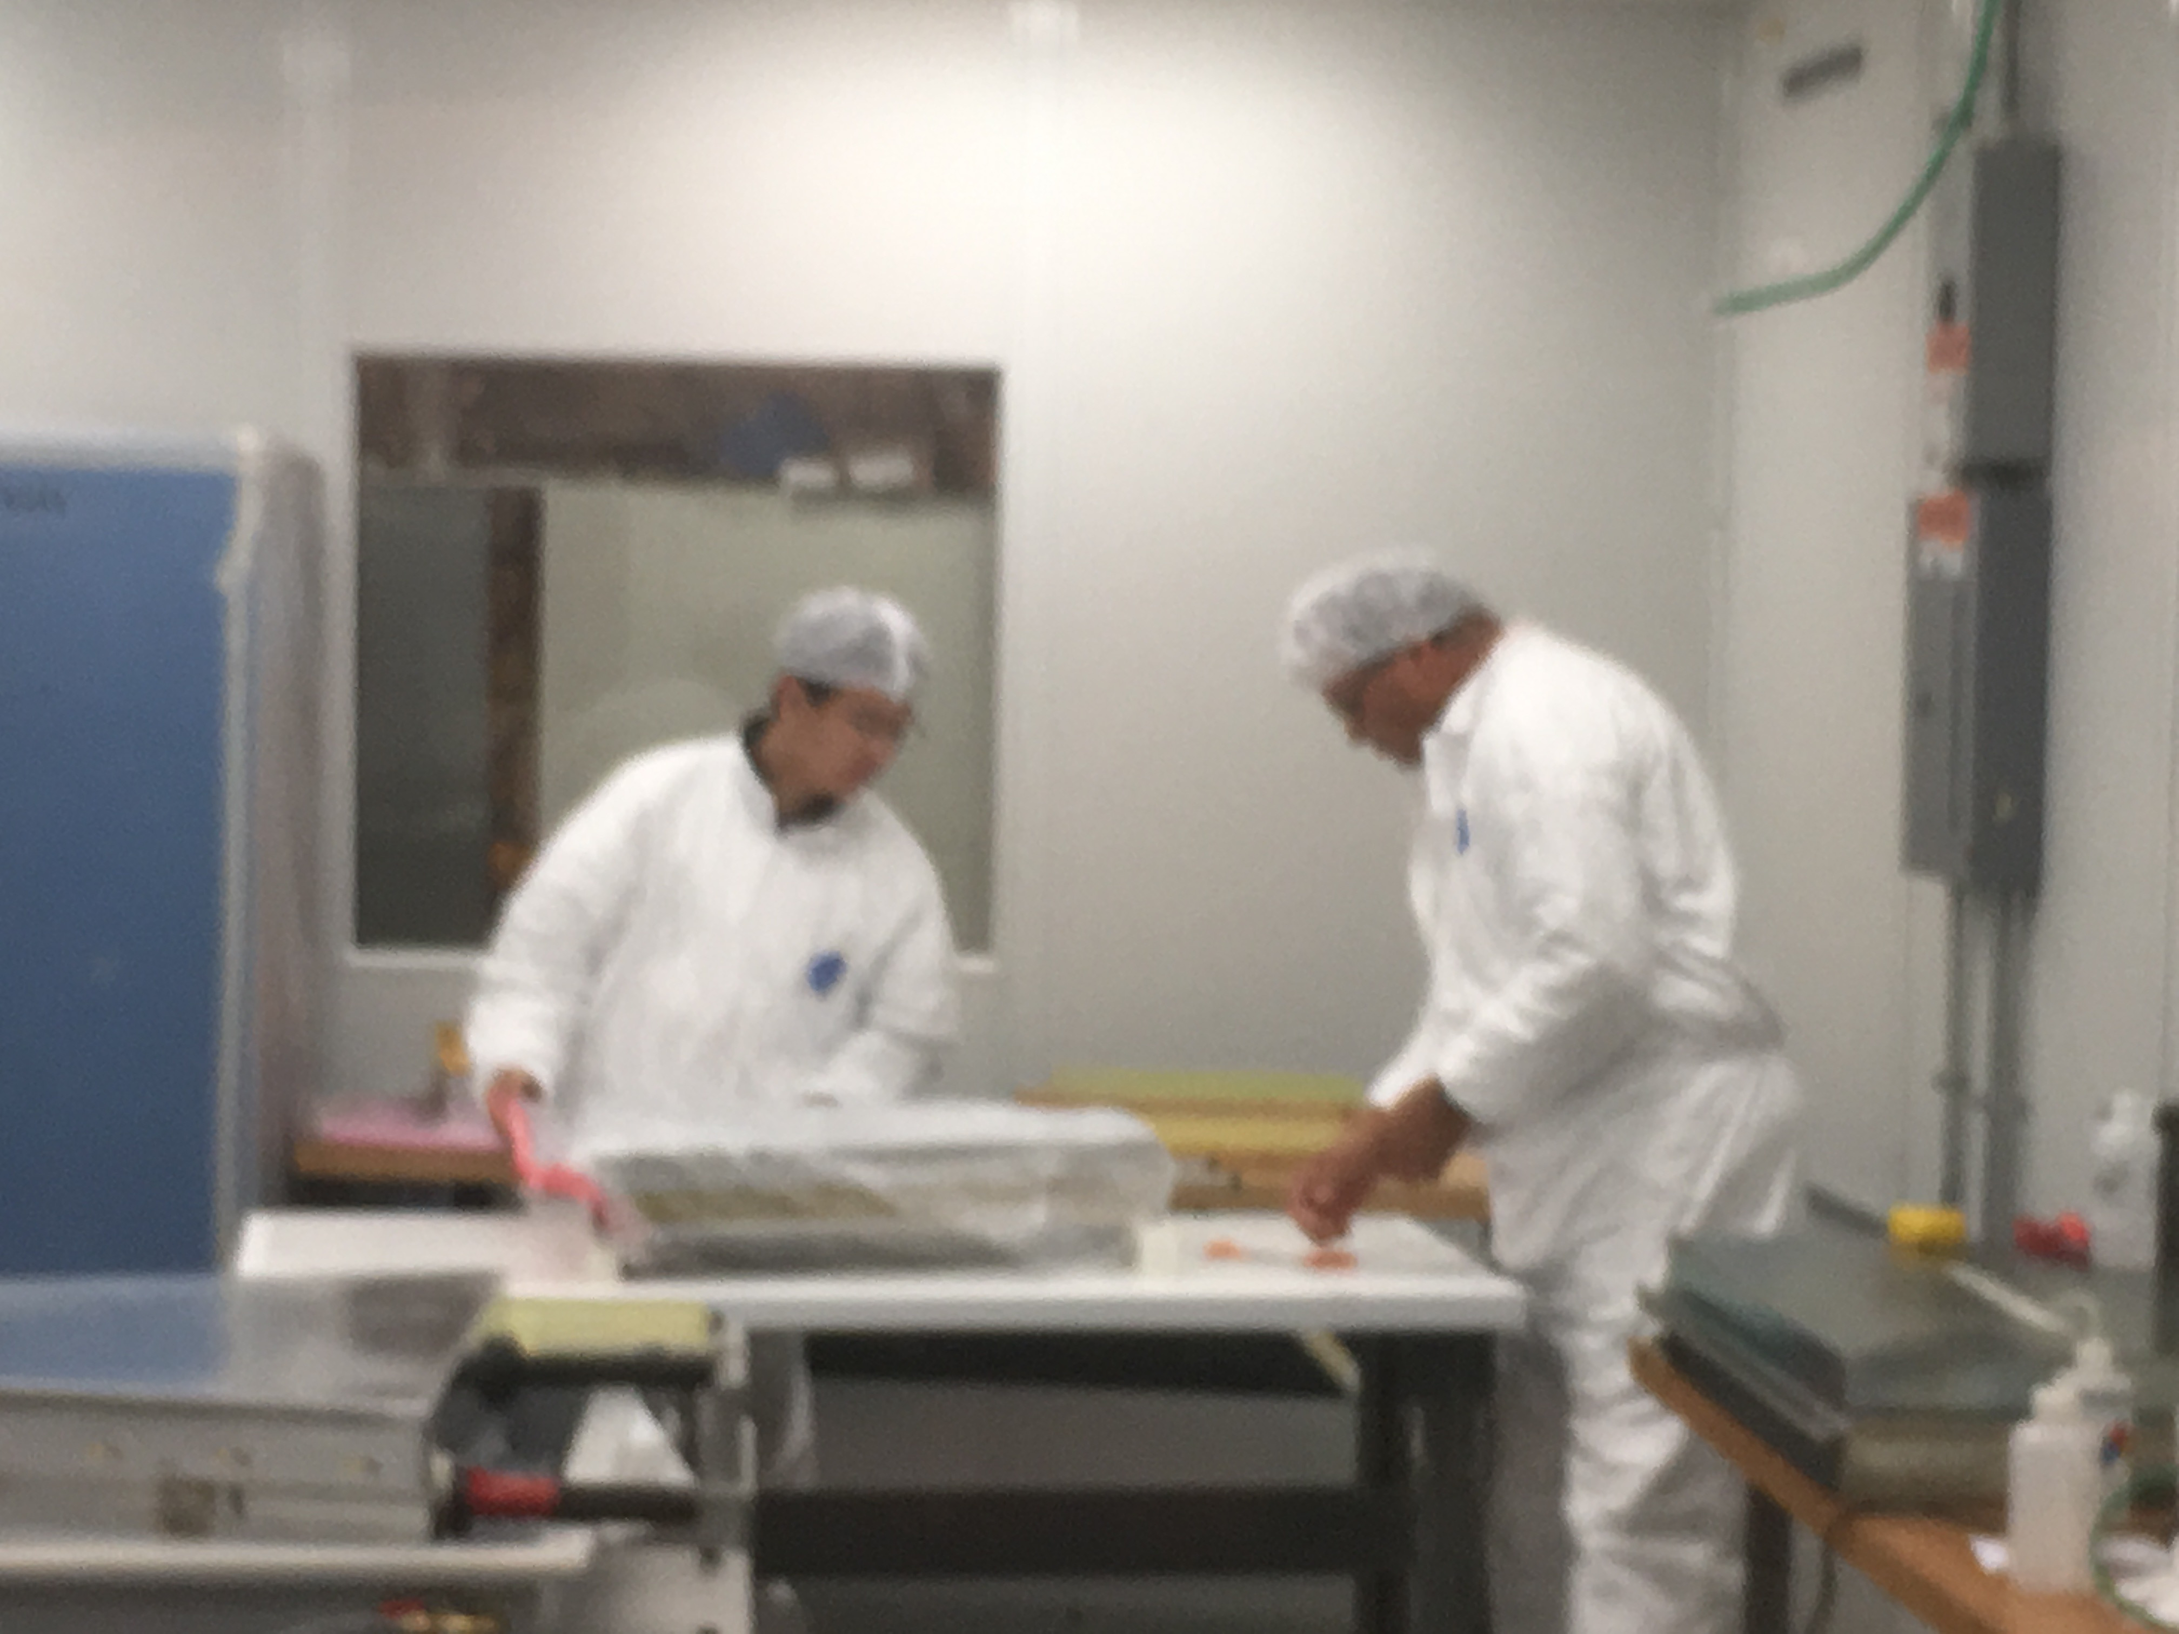
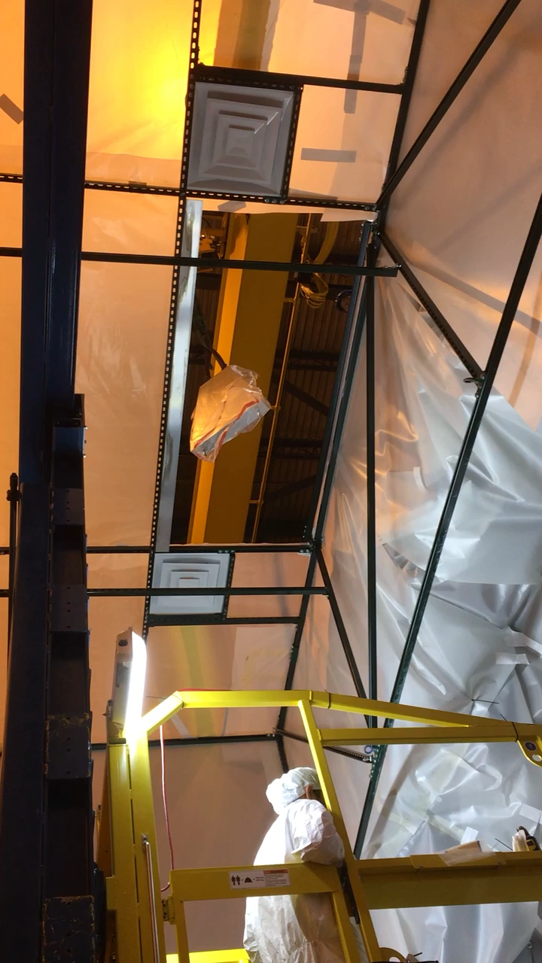
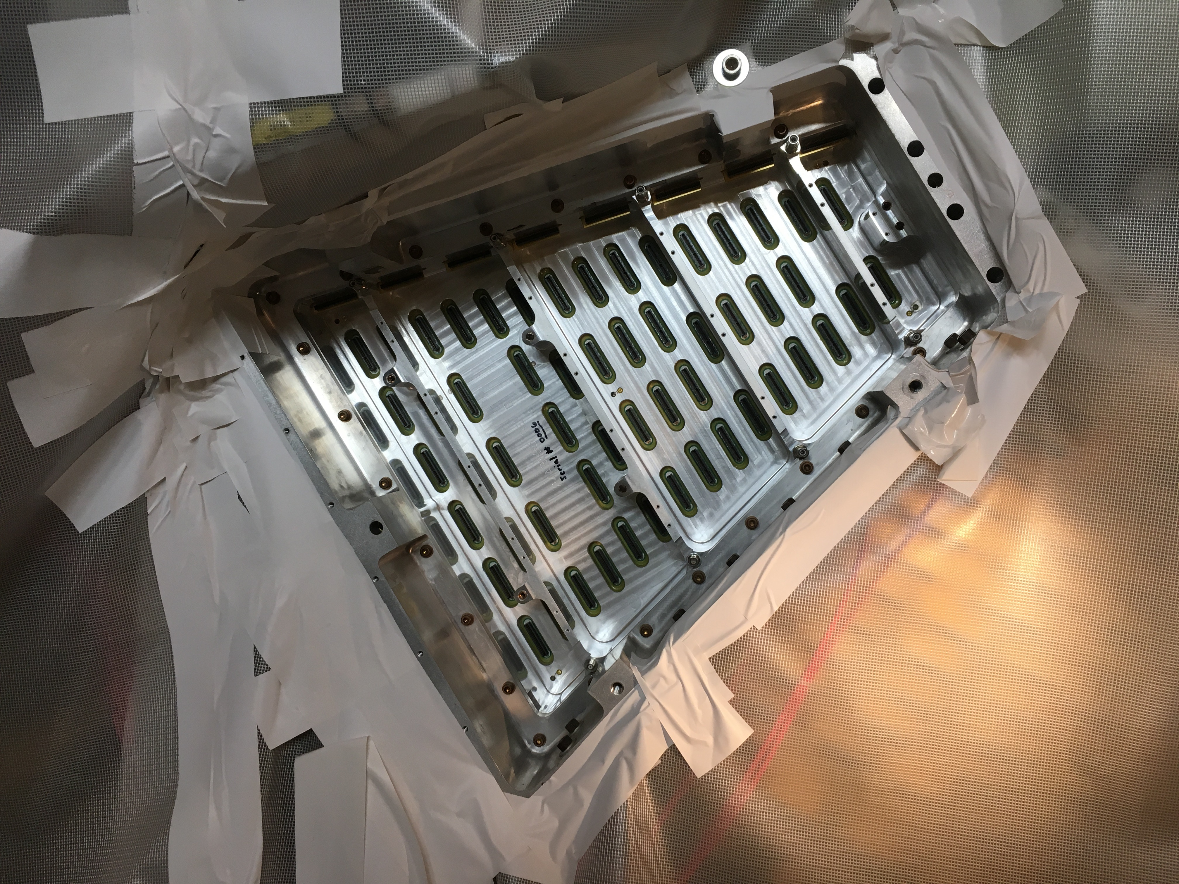
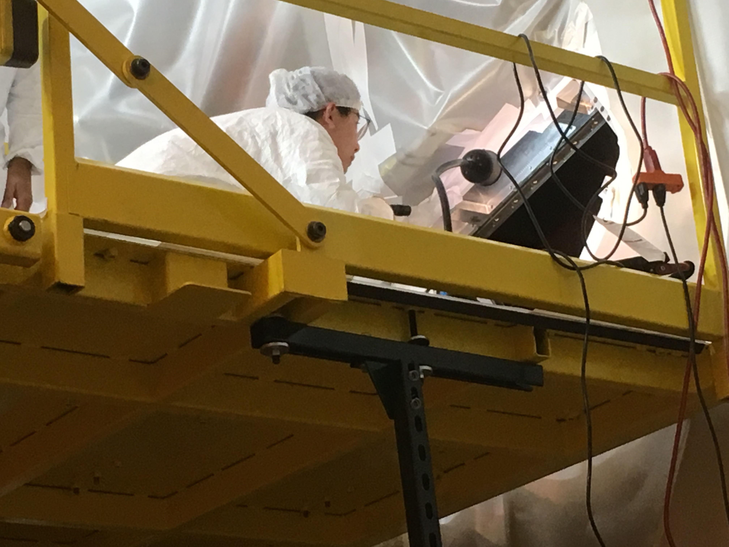
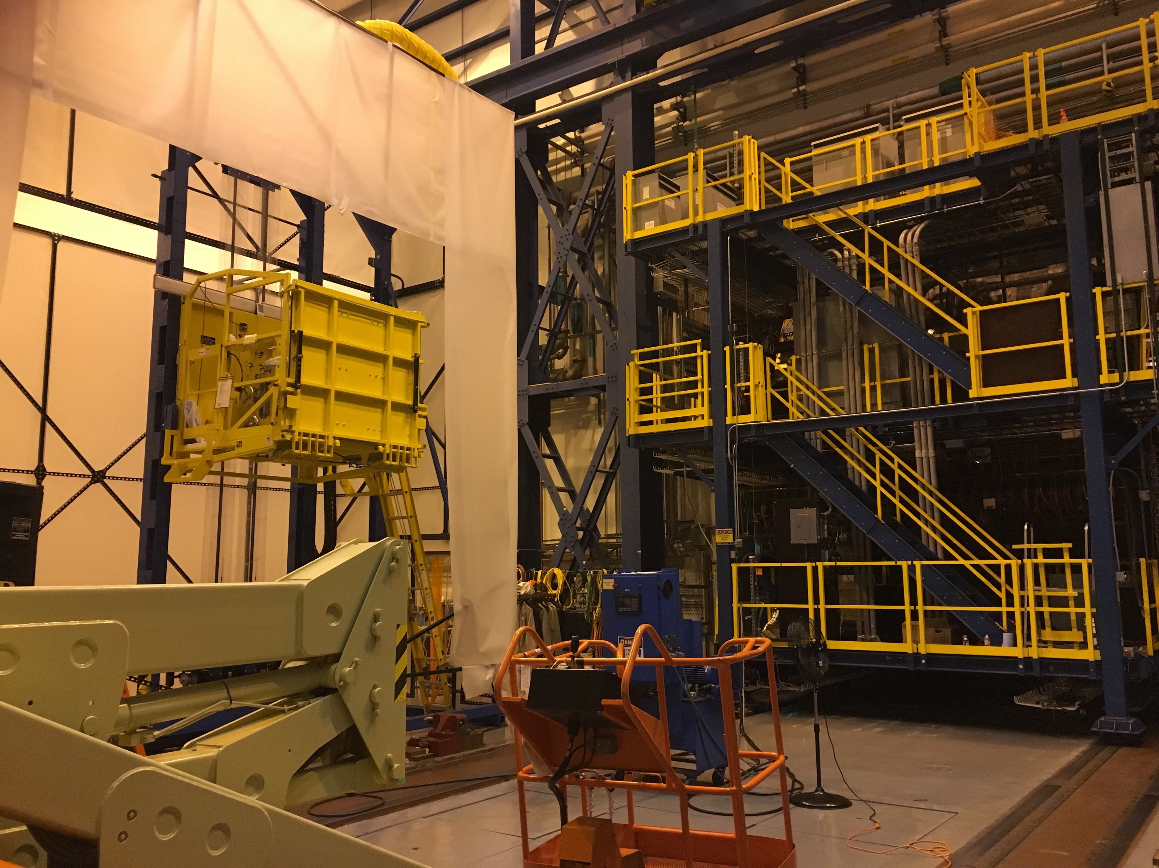
Actual installation
Unpacking and cover

Slide 10
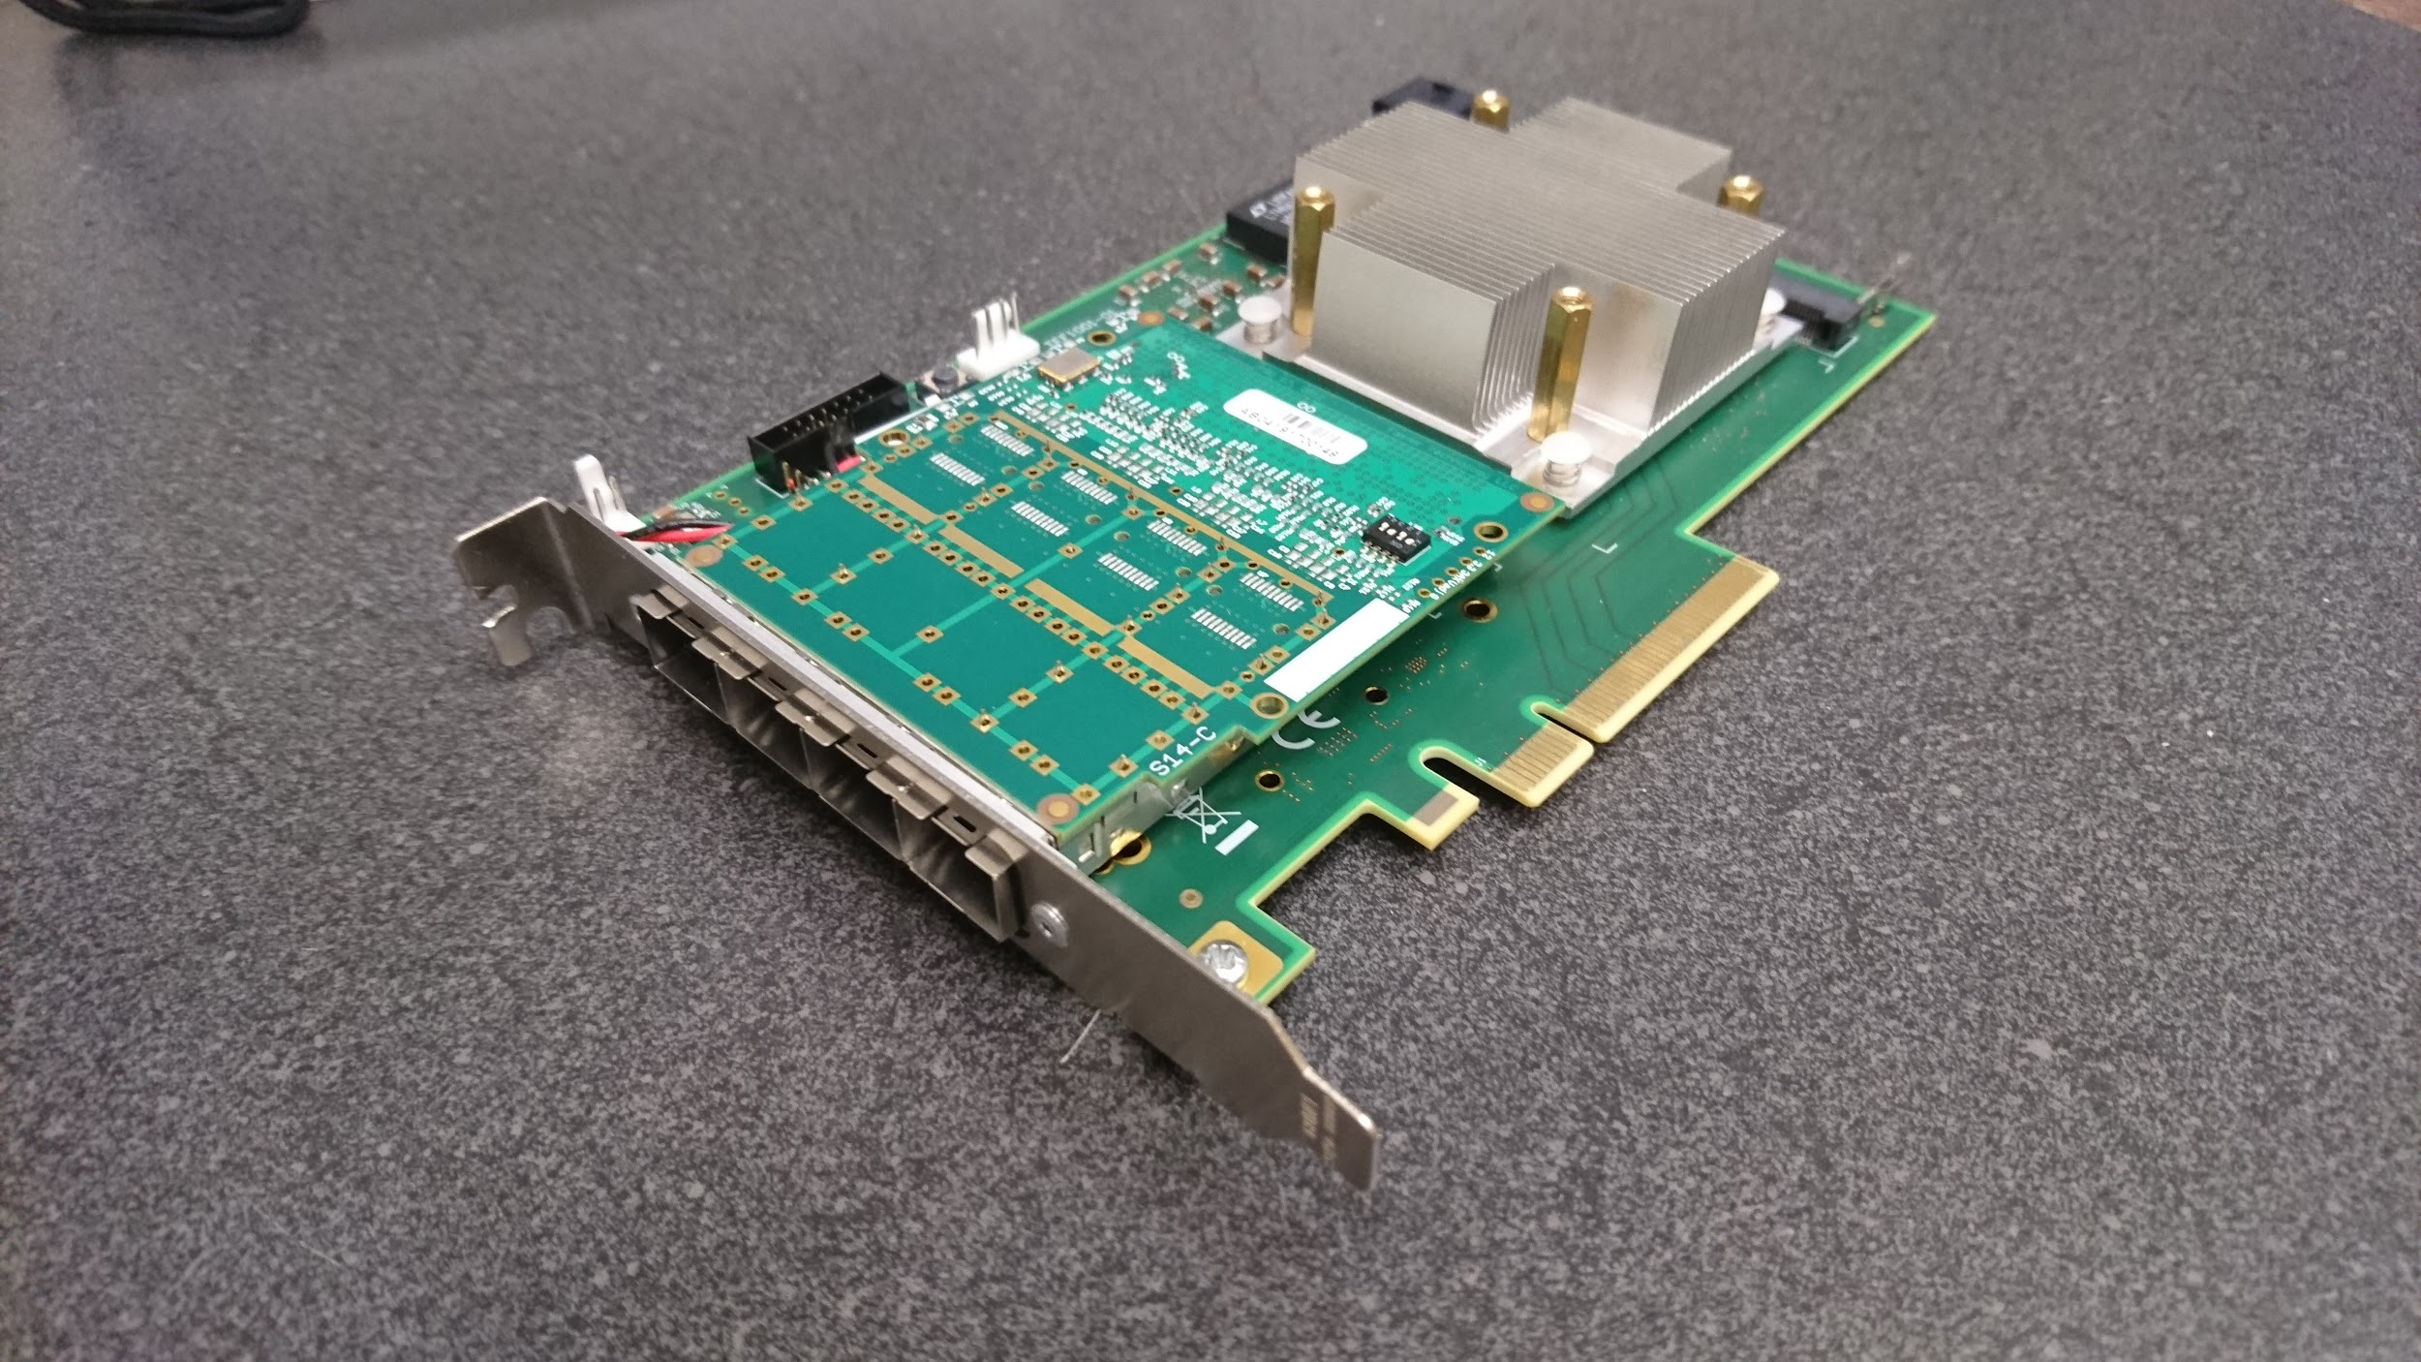
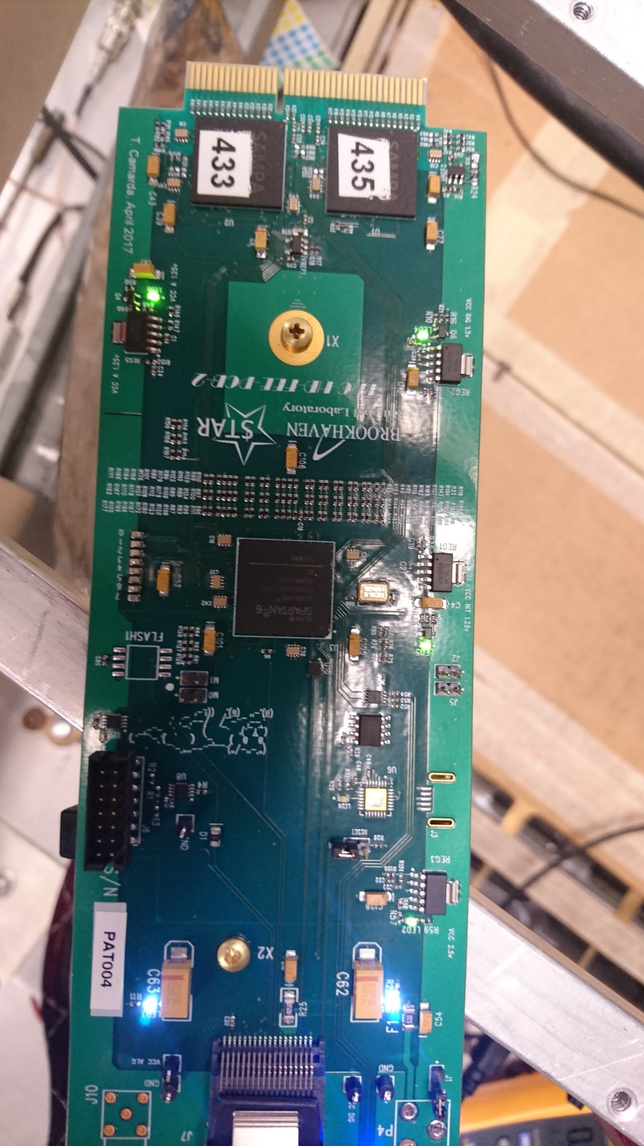
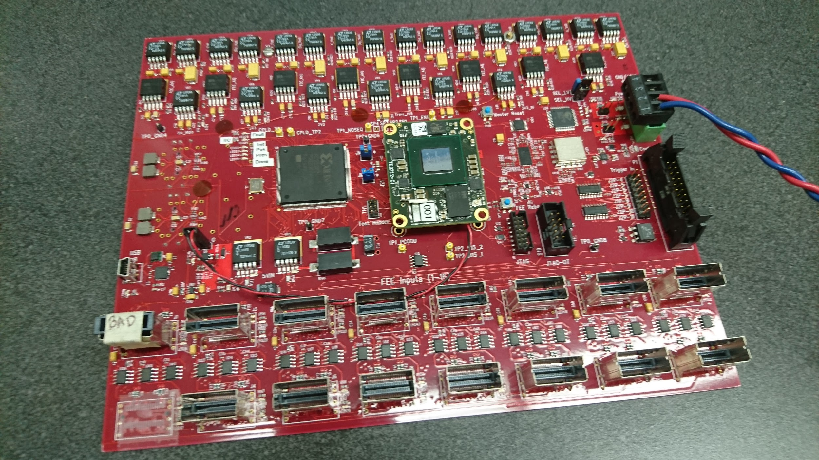
Electronics
Doubling #channels per FEE card. 2 SAMPA per FEE
55 FEEs per inner sector
16 FEEs per RD0
4 RDOs per inner sector
iFFE
Pre-production RDO-- installed
Readout Board

Slide 11
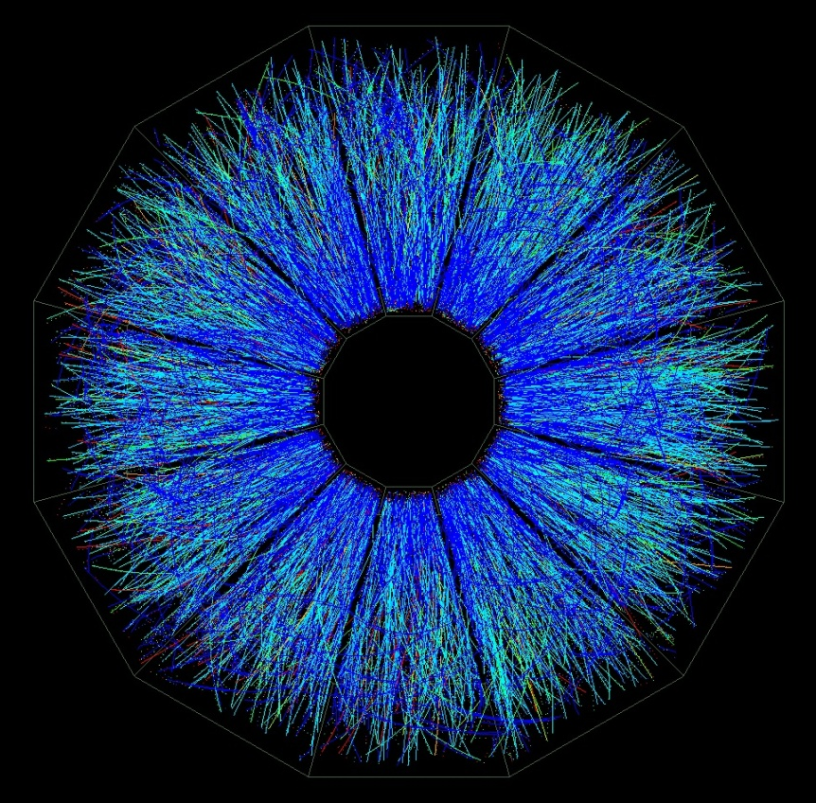
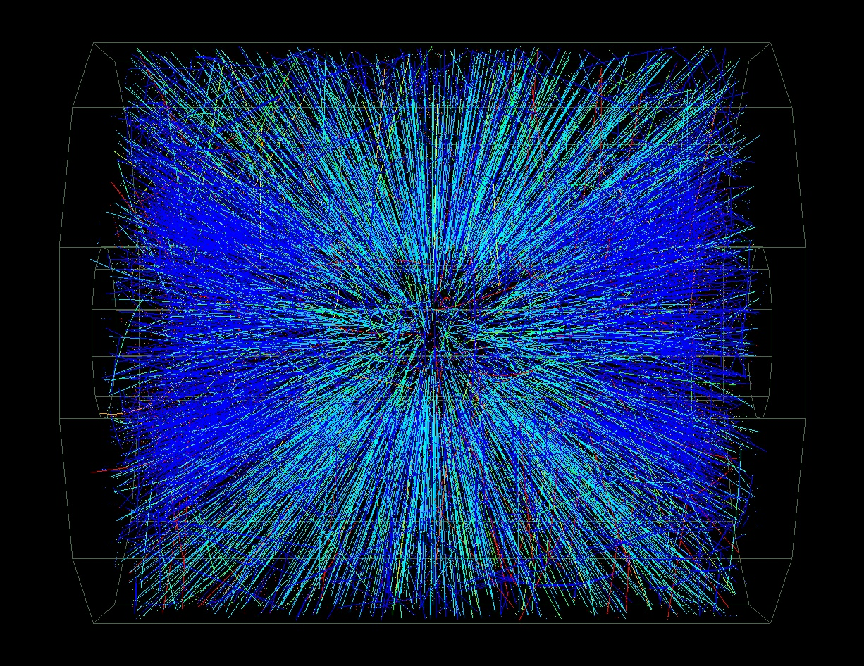
Au on Au Event at CM Energy ~ 130 GeV*A
Data Taken June 25, 2000.

Slide 12
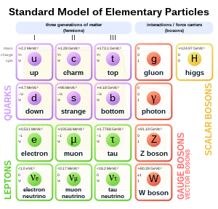
Physics Goal
Heavy Flavor
Heavy quarks at RHIC
Charm M~1280 MeV
Bottom/beauty M~ 4180MeV
Heavy quarks usually created in pairs c,c-bar b,b-bar
Forms mesons, baryons that decays rather quickly with few mm.

Slide 13
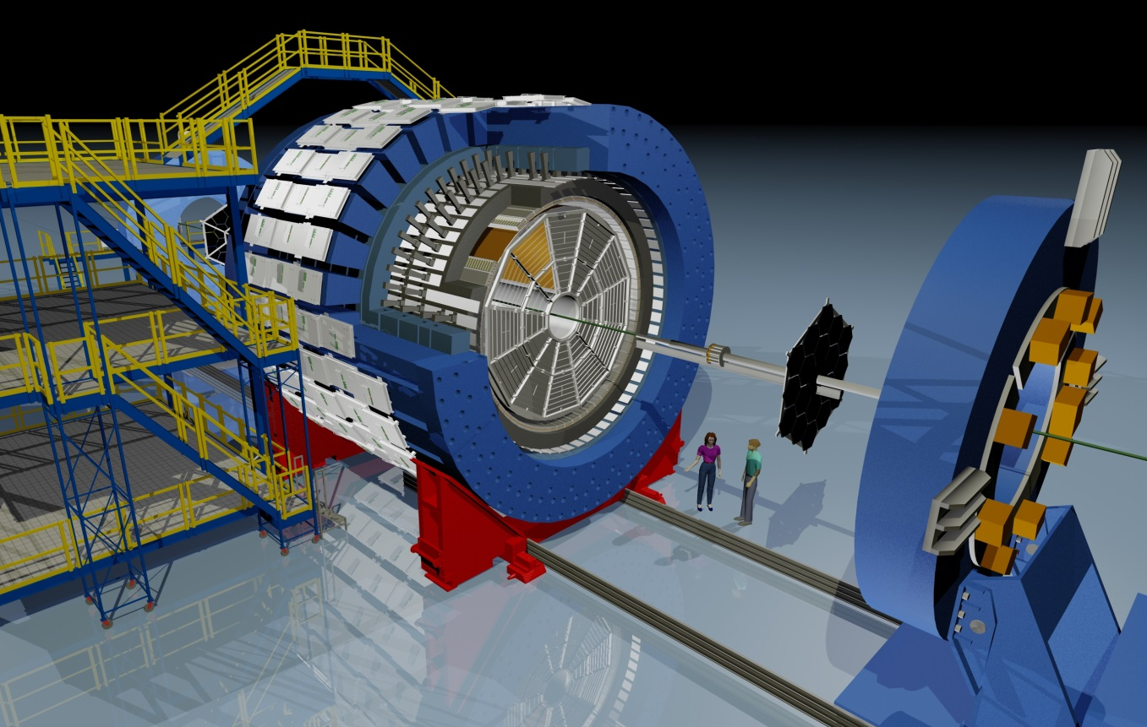
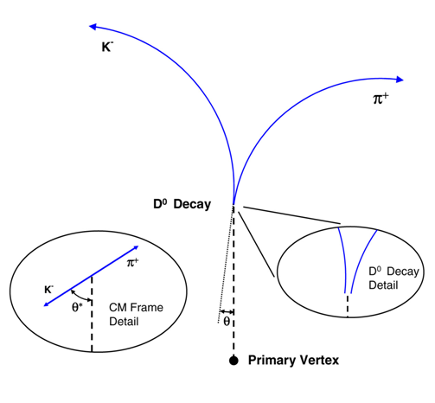

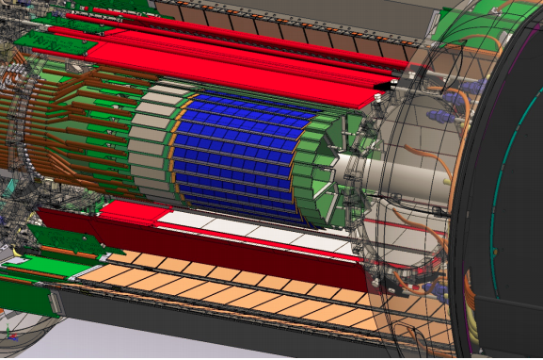
STAR HFT Physics Motivation
Extend the measurement capabilities in the heavy flavor domain, good probe to QGP:
Direct topological reconstruction of charm hadrons (small cτ decays, e.g. D⁰ → K π)
The STAR detector
@ RHIC
Method: Resolve displaced vertices (~120 μm)
200 GeV Au+Au collisions @ RHIC
dN_{ch}/dη ~ 700 in central events
HFT
Notes:
SV
Highlight detecting short lived particles –
you have heard about the physics in previous talks

Slide 14
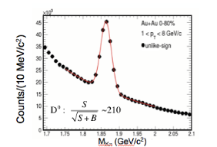
How are measurements done?
Measure points on the tracks
Determine momentum by fitting to a circle (helix)
Project to primary vertex,
Determine decay point and angles.
From the momenta and masses of decay products calculate mass of decaying meson
Notes:
Note to scale -

Slide 15
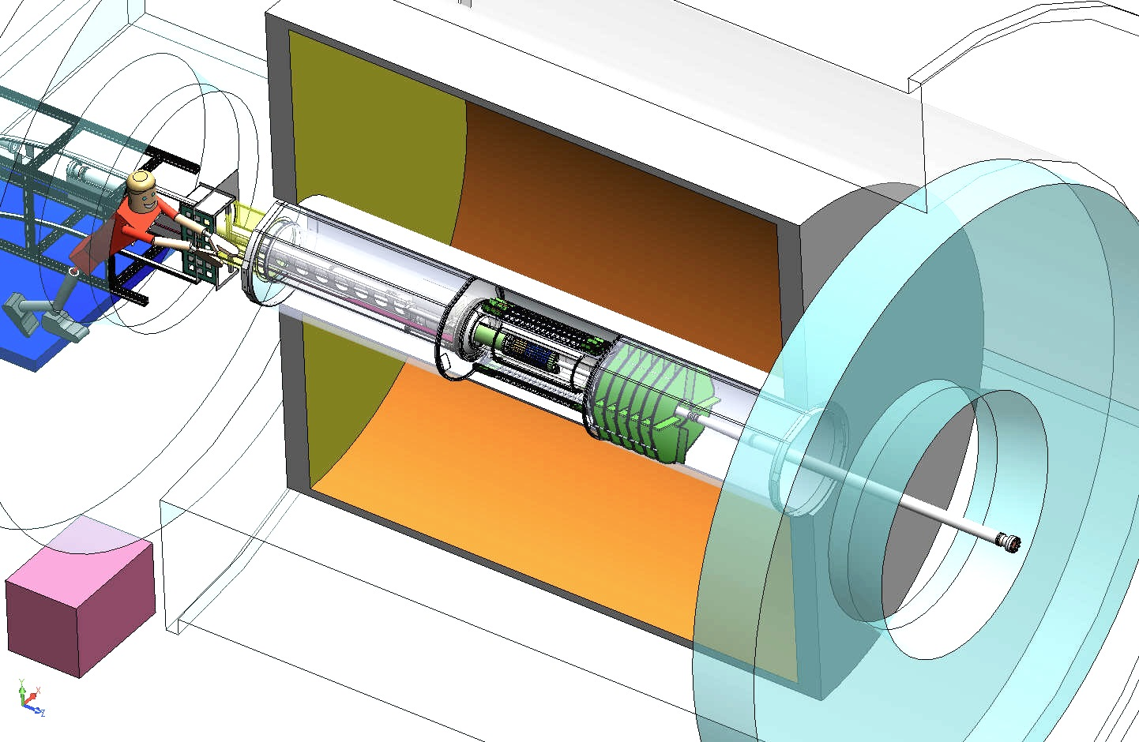
Heavy Flavor Tracker (HFT)
Inner Field Cage
Magnet
Return Iron
Outer Field Cage
FGT
TPC Volume
Solenoid
EAST
WEST

Slide 16
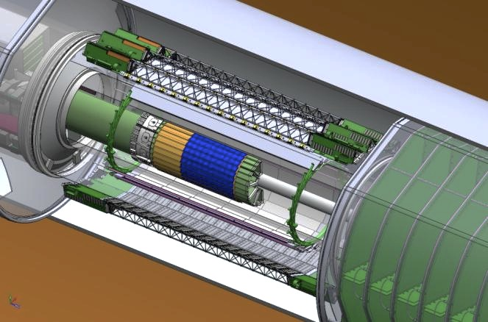
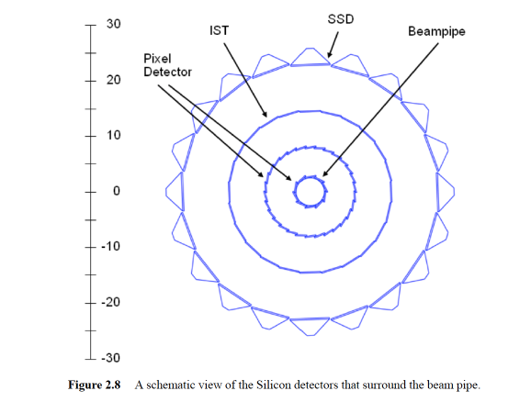
HFT was installed into STAR
HFT
SSD
IST
PXL

Slide 17
Heavy Flavor Tracker (HFT)
HFT
Detector | Radius (cm) | Hit Resolution R/ϕ - Z (μm - μm) | Radiation length
SSD | 22 | 20 / 740 | 1% X₀
IST | 14 | 170 / 1800 | <1.5 %X₀
PIXEL | 8 | 12/ 12 | ~0.4 %X₀
 | 2.5 | 12 / 12 | ~0.4% X₀
SSD
IST
PXL
PIXEL
two layers
18.4x18.4 μm pixel pitch
10 sectors, delivering ultimate Pointing resolution that allows for direct topological identification of charm.
Monolithic active pixel sensors (MAPS) technology
SSD
Existing single layer detector, double side strips (electronic upgrade)
IST One layer of silicon strips along the beam direction (r-φ) , guiding tracks from the SSD to PIXEL detector.

Slide 18
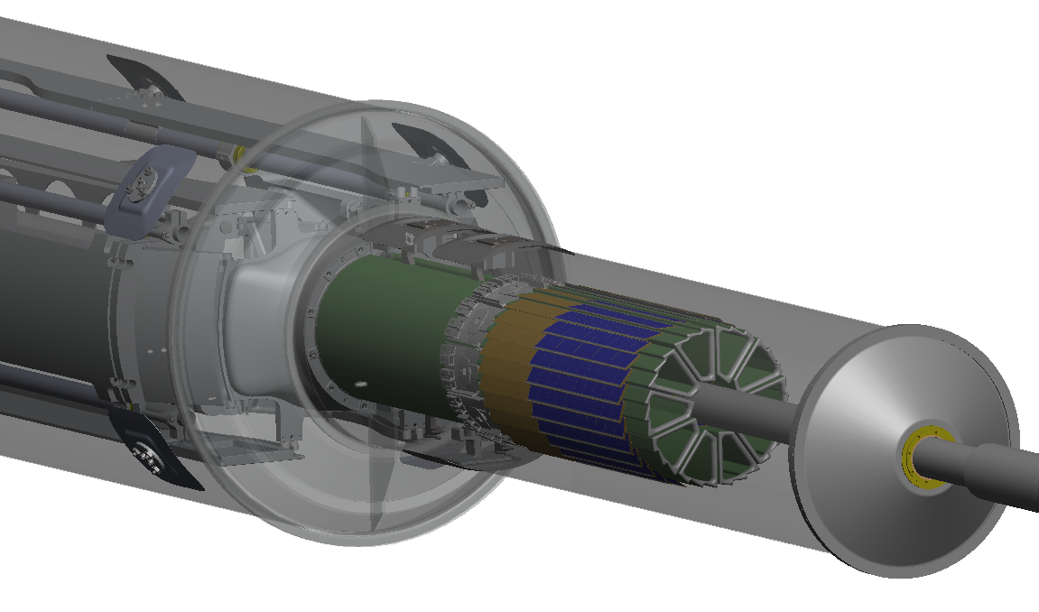
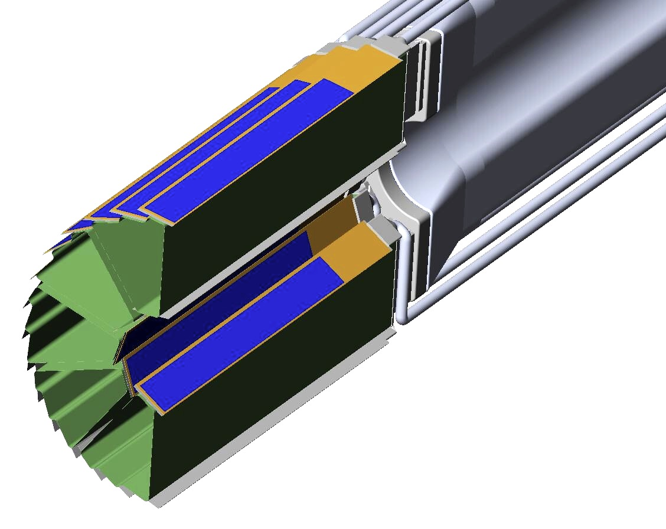
PXL Detector Mechanical Design
Mechanical support with kinematic mounts (insertion side)
carbon fibre sector tubes (~ 200µm thick)
Insertion from one side
2 layers
5 sectors / half (10 sectors total)
4 ladders / sector
Ladder with 10 MAPS sensors (~ 2×2 cm each)
Aluminum conductor Ladder Flex Cable
20 cm

Slide 19
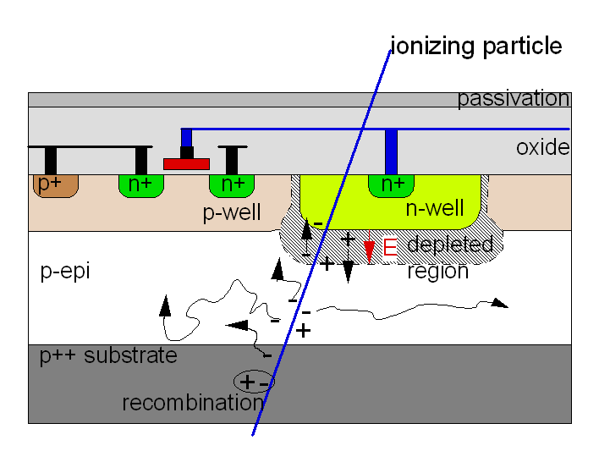
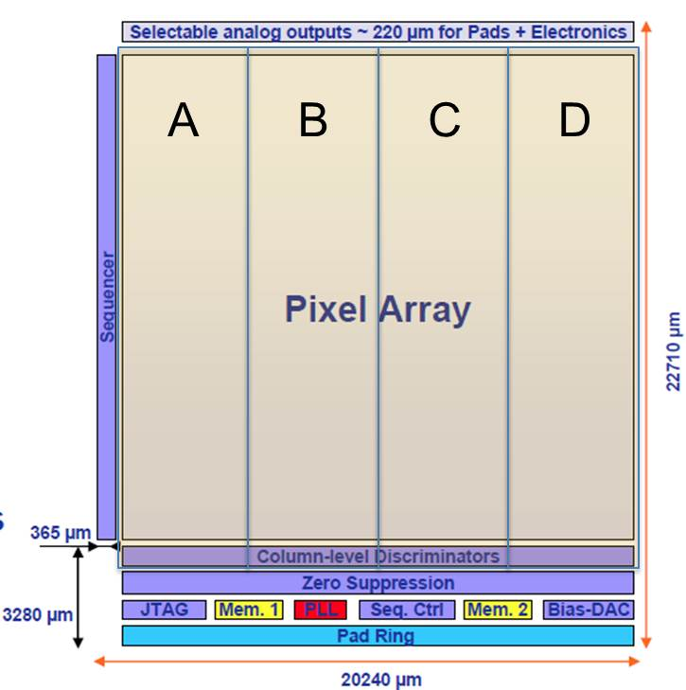
PXL Sensor
Monolithic Active Pixel Sensor technology
Ultimate-2: third generation sensor developed for the PXL detector by the PICSEL group of IPHC, Strasbourg
High resistivity p-epi layer
  Reduced charge collection time
  Improved radiation hardness
    20 to 90 kRad / year - 2*10¹¹ to 10¹² 1MeV n eq/cm²
S/N ~ 30
MIP Signal ~ 1000 e⁻
928 rows * 960 columns = ~1M pixel
Rolling-shutter readout
  connects row by row to end-of-column discriminators
  185.6 μs integration time
  ~170 mW/cm² power dissipation
  Configurable via JTAG
  2 LVDS data outputs @ 160 MHz

Slide 20
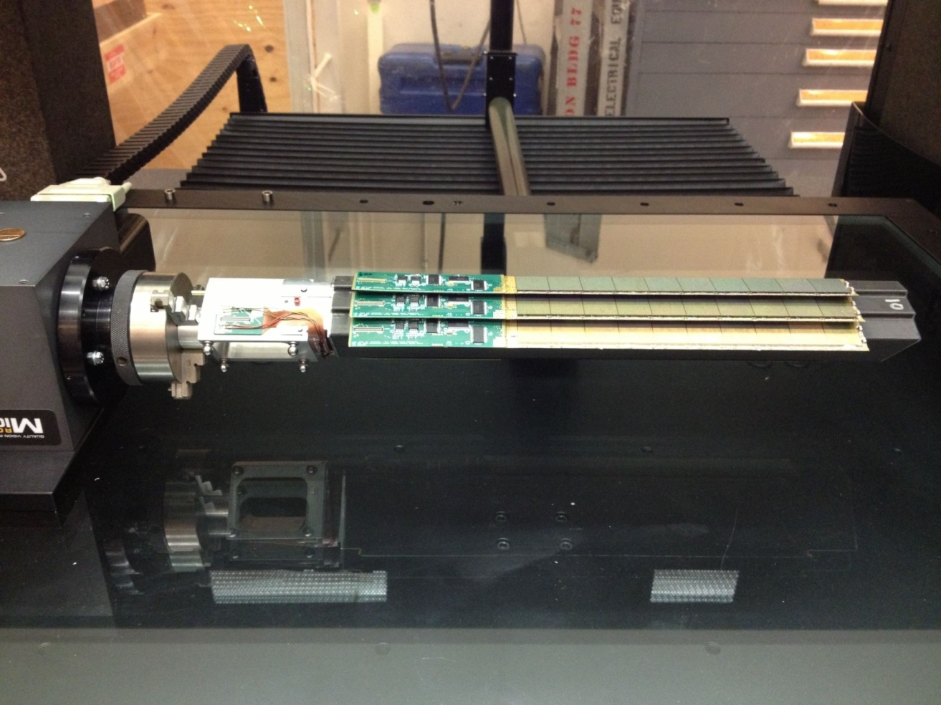
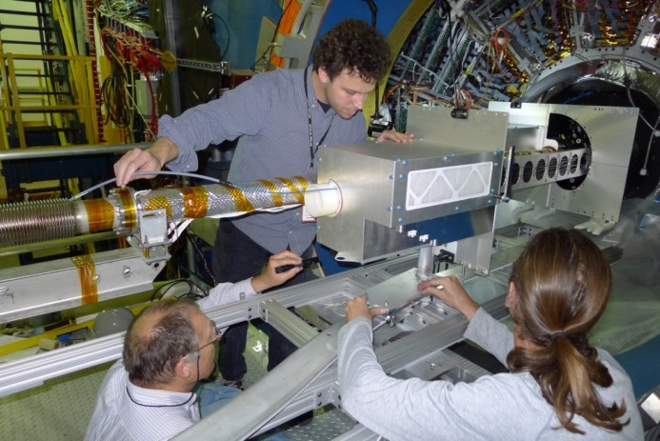
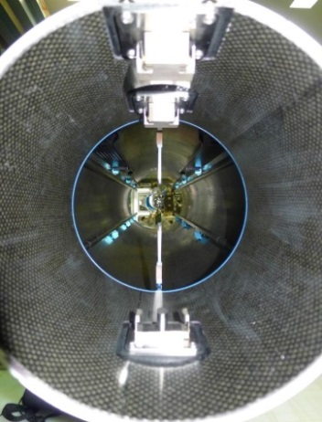
PXL Hit Position Resolution
Ultimate-2 sensor geometry
  pixel size: 20.7 μm X 20.7 μm ~6 μm geometrical resolution
  3-pixel av. cluster size ~3.7 μm resolution on center-of-mass
Position stability
  Vibration at air cooling full flow: ~5 μm RMS
  Stable displacement at full air flow: ~30 μm
  Stable displacement at power on: ~5 μm
Global hit resolution: Δx ~ 6.2 μm
Δx ~ 6.2 μm
r₁ = 2.8 cm
r₂ = 8 cm
HFT DCA pointing resolution:
( 10 ⊕ 24/p) μm
Sector in the metrology setup
Metrology survey
  3D pixel positions fully mapped and related to kinematic mounts
Novel insertion approach
  Inserted along rails and locked into a kinematic mount inside the support structure
  Capability to fully replace PXL within 12 hour
PXL insertion
Kinematic mounts

Slide 21
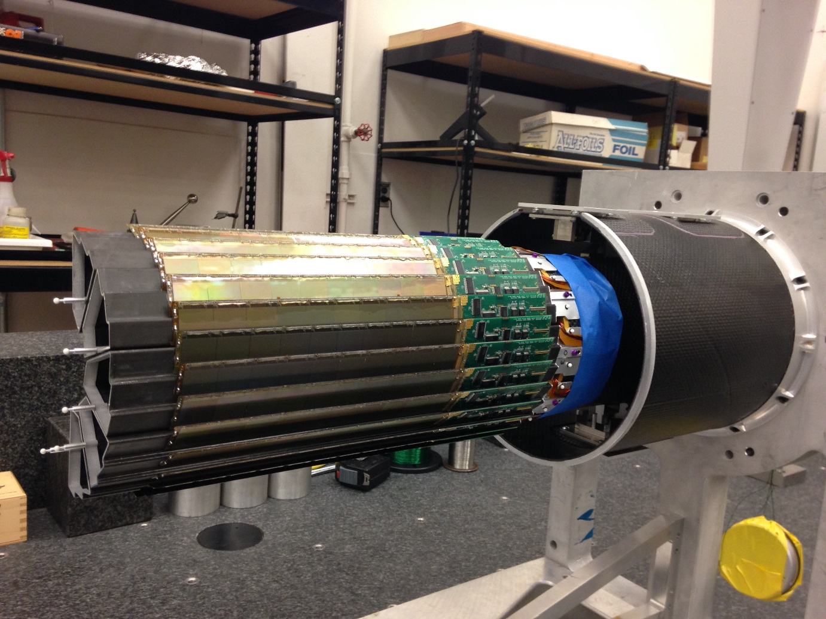
After assembling sectors in a half shell sector tooling balls measured with touch probe relative to kinematic mount coordinate frame
Since the shells are supported the same way in the CMM and in the STAR installation the relative pixel position mapping is not disturbed
duplicate, truncated PXL support tube with kinematic mounts

Slide 22
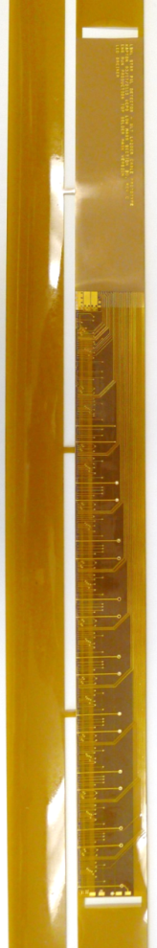
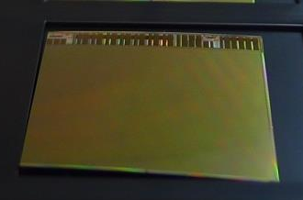
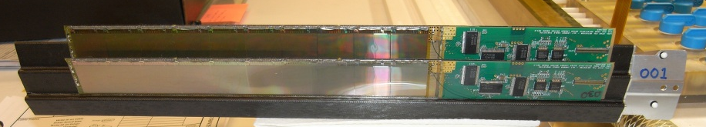
PXL Material Budget
Curved sensor
40-60% yield after thinning, dicing and probe testing
Thinned Sensor
  50 μm
  0.068% X₀
Flex Cable
  Aluminum-Kapton
  two 32 μm-thick Al layers
  0.128% X₀
    Copper version → 0.232% X₀
Carbon fiber supports
  125 μm stiffener
  250 μm sector tube
  0.193% X₀
Cooling
  Air cooling: negligible contribution
Total material budget on inner layer: 0.388% X₀
  (0.492% X₀ for the Cu conductor version)
HFT DCA pointing resolution:
( 10 ⊕ 24/p) μm

Slide 23
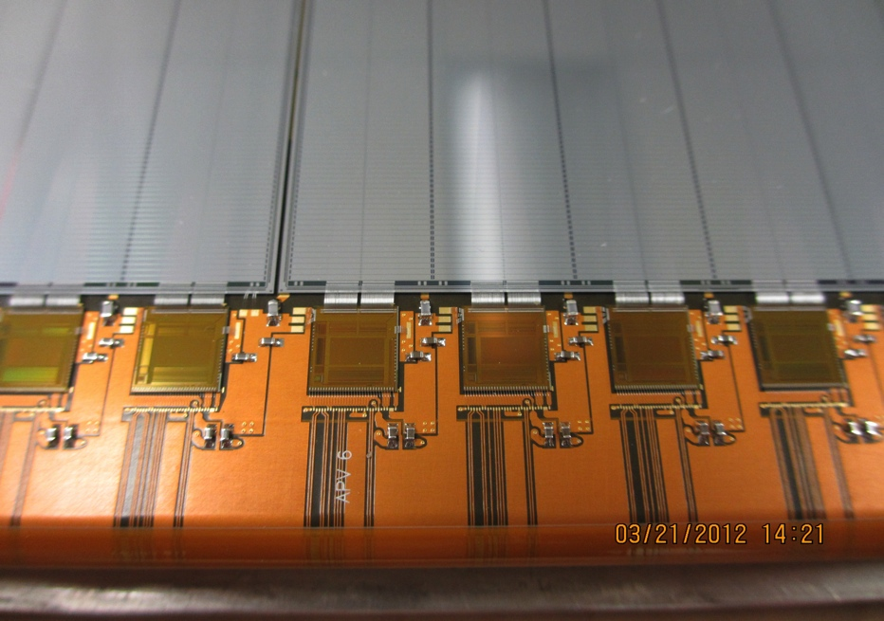
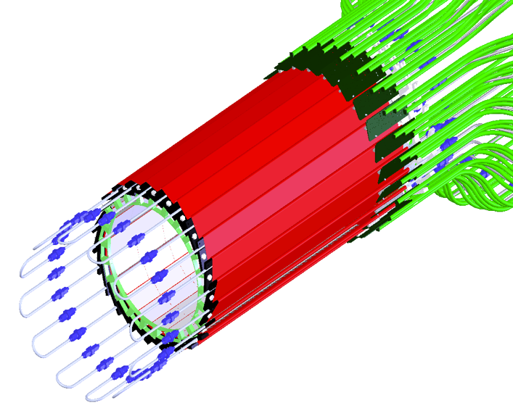
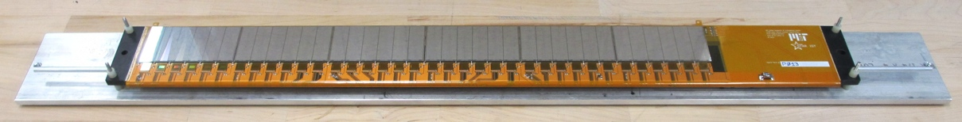
Intermediate Si Tracker
24 ladders, liquid cooling
Details of wire bonding
Prototype Ladder
S:N > 20:1
>99.9% live and functioning channels

Slide 24
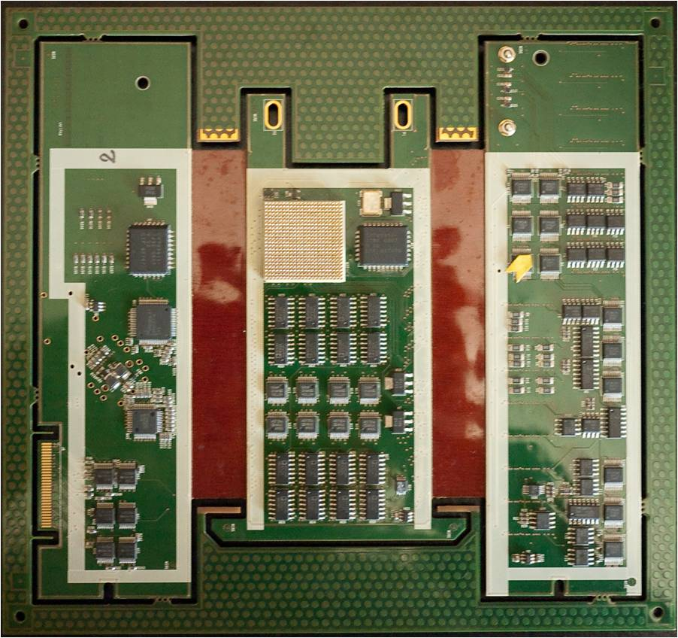
Silicon Strip Detector (SSD)
20 Ladders
Ladder Cards
Add pictures
The ladders and Si-sensors was from existing detector
Upgrade readout system with new ladder cards on detector, RDO cards, and cooling system

Slide 25
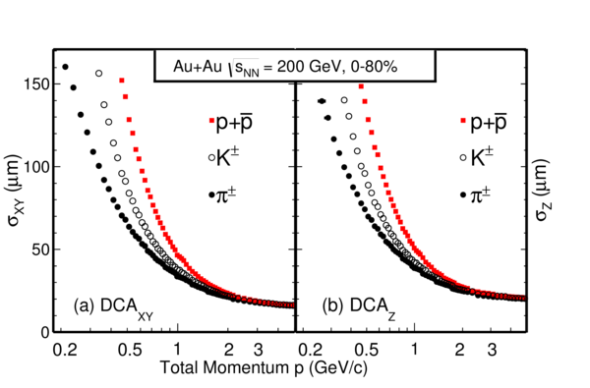
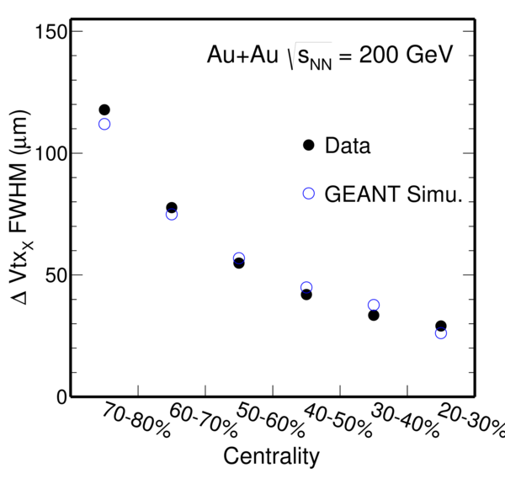
HFT performance
Pointing resolution was determined in Au+Au collisions at 200 GeV in transverse plane and longitudinal. Measurements are in agreement with expectations.
Important also to take into account the vertex resolution vs. centrality, particular for the most peripheral collisions

Slide 26
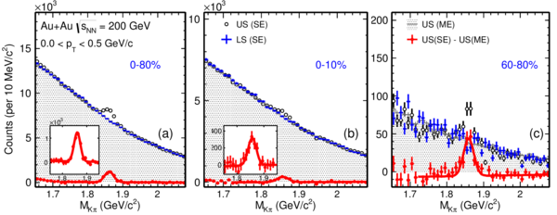
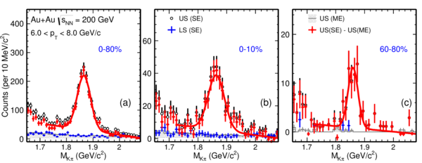
D⁰ spectra
We have achieved very good significance for D⁰
Low p_{T} is difficult due to the pileup and miss matched hit points
Notes:
Of course bot d0 and d0-bar

Slide 27
Physics of the Heavy Flavor Tracker at STAR
Direct HF hadron measurements (p+p and Au+Au)
  (1) Heavy-quark cross sections: D^{0±}*, D_{S}, Λ_{C} , B, …
  (2) Both spectra (R_{AA}, R_{CP}) and v₂ in a wide p_{T} region: 0.5 - 10 GeV/c
  (3) Charm hadron correlation functions, heavy flavor jets
  (4) Full spectrum of the heavy quark hadron decay electrons
Physics
  (1) Measure heavy-quark hadron v₂, heavy-quark collectivity, to study the medium properties e.g. light-quark thermalization
  (2) Measure heavy-quark energy loss to study pQCD in hot/dense medium e.g. energy loss mechanism
  (3) Analyze hadro-chemistry including heavy flavors
Notes:
Need to go through formatting

Slide 28
Timeline
R&D 2003- LBL with IHPC, Strasbourg for MAPS sensors
2008 Project start ; 2010-2014 construction
2013 Commissioning run
2014-16 Physics
  14: AuAu
  15: pp
  16: AuAu dAu
2017 Removed from STAR and in storage

Slide 29
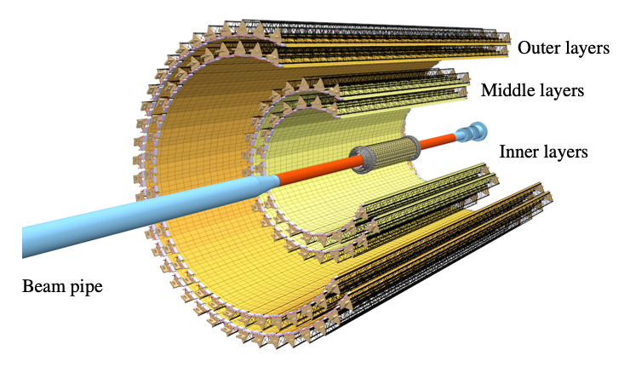
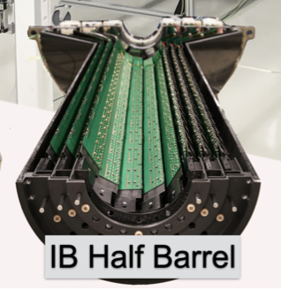
Next Generation MAPS
For the upgrade of the ALICE detector in the current RUN-3 at LHC, the collaboration developed a next generation MAPS sensors
  Faster readout time (~5 micro sec)
  Better radiation hardness
  Pixels size 30*30 micron
See e.g. https://arxiv.org/pdf/2111.08301.pdf

Slide 30



MVTX - sPHENIX Inner Most Detector for HF physics
Carb. Fib. Comp./CFC = EW, CYSS, SB
Total Weight: ~24 kg
(sensor part: ~3 kg)
Cylindrical Shell
Structure (CYSS)
North
North
🡪
End-Wheels (EW);
- 3 layers
Service Barrel (SB)
MVTX parameters: L = 271 mm
3-layer sensor barrel
- 48 staves, 432 chips
R (mm) | min | mid | max
Layer 0 | 24.61 | 25.23 | 27.93
Layer 1 | 31.98 | 33.35 | 36.25
Layer 2 | 39.93 | 41.48 | 44.26
New BP
Notes:
A quick reminder of the MVTX overall design -

Slide 31


sPHENIX MVTX Photos
Viewed from South right before the installation: One can clearly see the service lines inside the Service Barrel (SB):
Blue: data cable, Green: Cooling air, Red/Black/White: LV power
Viewed from North after installation
MVTX North EndWheel

Slide 32


Pixel size: 28 um x 27um
512 rows
(~1.5cm)
1024 columns (~3cm)

Slide 33




First outer layer assembled
North-end view of MVTX
half-detector @BNL 2-88

Slide 34
MAPS detector has matured a lot, and next generations with be used at eRHIC in EPIC detector and at another upgrade to ALICE
TPC are used at collider experiments and also in neutrino physics experiments
More questions?

Slide 35
ideas to explore
What are the applications for MAPS in current and planned experiments?
Radiation damage is important to understand at RHIC, LHC, and space. How are this being investigated?
Where does radiation have a positive impact?
Where has Nuclear Physics impacted society with inventions and applications?

Slide 36
Info on PXL detector mechanics and construction
NIM Article
  arXiv 1710.02176
  NIM A97(2018) 60
Howard Wieman
  HFT PXL mechanics
  Forum on Tracking Detector Mechanics
  30 June-2 July 2014 at DESY, Hamburg
  https://indico.cern.ch/event/287285/contributions/1640694/attachments/534386/736809/PXL_mechanics.pdf

Slide 37


Spatial mapping of the pixels
Pixel locations determined with CMM equipment to within 10 μm prior to installation in STAR
Programmed CMM Measurement method#:
All pixels located on a sector with respect to 3 sector tooling balls
  2 Lithography points on the chips measured with optical head
  Chip surface profile measured with 11 x 11 point pattern using a Feather Probe∗. Using a touch probe permits picking up over hung surfaces
PXL sensor surface profile from survey: ± 30 μm > PXL hit error,
and the chip to chip surface deviation along the ladder surface is still larger, but all of this is then corrected with the spatial map
Parametriuzed by 5*5 spline fct
Full sector measurement takes ~ 8 hours

Slide 38

Final operating pointing performance in STAR
Cosmic ray result
Excellent half to half pointing, sub 30 μm
But after half to half alignment which was required to correct poor reproducibility of kinematic mount seating
Check alignment with very low luminosity AuAu also
X
X
X
X
X
X

Slide 39



D⁰ reconstruction
Use topological variables
Use particle ID

Slide 40
Grid Leak Walls checked
The narrow end uses a simple brass wall to terminate the array of wires
  Ground Potential
  No bias required
  Anode wires > 10 mm away
The wide end uses a G10 PCB board to terminate the array
  Inside wall is grounded to the strongback.
    Anode wires > 10 mm away
  Outside wall is used to suck ions off the Anode wires of the outer sector
    No shield wall on outer
    So requires ~750 volts (DC) to suck ions across the gap
    Outer Sector Anode wires > 2 cm away
    3 Pads & 3 voltages (-115 V, ~750 V & ground)
Courtesy Jim Thomas

Slide 41


Some words on efficiency
We have applied two methods to evaluate efficiencies
Fast simulation data driven to replicate multi dimensional basic observables
Geant embedding with displaced geometries
Methods agrees well

Slide 42

Inner Detector Support (IDS)
IDS
East Support Cylinder
Outer Support Cylinder
West Support Cylinder
PIT
Middle Support Cylinder
PST
MSC
Pixel Insertion Tube
Pixel Support Tube
ESC
Shrouds
Installed for Run-12
MSC installed for Run-13 for PXL
OSC
Carbon Fiber Structures provide support for 3 inner detector systems and FGT.
All systems are highly integrated into IDS.
Inner Detector Support
WSC

Slide 43


D⁰ spectra
Precise measurements extends to low p_{T} and non-central collisions. Data from 2014
Results consistent with 2010/11 TPC only analysis
Data from submitted paper: arXiv 1812.10224

Slide 44


D⁰ R_{AA}
R_{AA} < 1 for 0-10% for all p_{T}
Suppression at high p_{T} increases for more central collisions
Same trends as at LHC and for light mesons
Notes:
Add references

Slide 45


D⁰ R_{CP}
Significant suppression at high p_{T}
Matches theoretical calculations
D⁰-bar/D⁰ slightly greater than one
  Possible due to slight baryon asymmetry at RHIC

Slide 46

D⁰ cross section
Total D⁰ cross section is nearly independent of centrality, and smaller than in p+p. For p_{T} > 4 GeV/c it decreases with centrality

Slide 47


Λ_{c} reconstruction
More than 50% improvement in signal significance with TMVA methods
Includes 2016 dataset

Slide 48

Λ_{c}/D⁰ centrality dependence
Λ_{c} enhancement increases towards more central Au+Au collisions
Large contribution to total charm cross sections in HI

Slide 49

Λ_{c}/D⁰ p_{T} dependence
Significant enhancement of Λ_{c}/D⁰ compared to p+p.
Comparable with light flavor B-to-M ratios
Consistent with charm quark hadronization via coalescence
Notes:
Ko PRC79(2009) 044905.
Greco Eur.Phys.JC(2018) 78:348
SHM PRC79(2009( 044905

Slide 50

Strange Charmed quarks

Slide 51

Total charm cross section
D⁰ yields measured down to p_{T}=0 GeV/c
For D⁺⁻, D_{s} Levy fits to measured spectra for extrapolation
For Λ_{c} three model fits to data are used and included in systematics
Total charm cross section is consistent with p+p values
Redistributed on meson and baryons

Slide 52


D_{s}, D⁰ enhancement
Strong enhancement of D_{s}/D⁰ observed in central A+A w.r.t fragmentation baseline
->Strangeness enhancement and coalescence
Enhancement larger than model, particular at high p_{T}

Slide 53


Non prompt D⁰, B-decay
Strong interaction of charm with the medium.
What about bottom?
R_{AA} of non-prompt D⁰ extracted.
Improved signal significance using BDT
Will get results form combined data set

Slide 54


B study from different channels

Slide 55


D⁰ Elliptic Flow
Published D⁰ v₂ from 2014 dataset
Clear mass ordering for p_{T} < 2 GeV/c
Follows NCQ scaling in mid-central (10-40%) collisions
Phys.Rev.Lett 118, 212301 (2017)

Slide 56

D⁰ Elliptic Flow
D⁰ v₂ measurements extended to 0-10% centrality with combined 2014 and 2016 data set
Significant flow observed

Slide 57



Slide 58


Slide 59

D⁰ directed flow (v₁)
First evidence for non-zero v1 for D’s
Much larger than K+-K-
May imply effect of strong EM fields in collision system

Slide 60



Slide 61



Slide 62
Summary
The HFT upgrade was overall successfully and has hopefully lead the way for future high resolution vertex detectors (ALICE ITS, sPHENIX, EIC)
Strong Modification of charm hadron spectra and hadro chemistry in AA collisions as witnessed by the different observations
  Total charm cross section is conserved.
  Substantial energy loss , coalescence
  Gain significant flow & may have achieved thermal equilibrium in medium (v₂)
  Observed non-zero directed flow
Indication for suppression at high p_{T} for B->D⁰ ,… measurements
Thanks to the many STAR collaborators that has worked on HFT construction and analysis over the years

Slide 63


The STAR Upgrades and BES Phase II
i
TPC
Major improvements for BES-II
Endcap TOF
E
EPD Upgrade:
Allows a better and independent reaction plane measurement critical to BES physics
Improves trigger
iTPC Upgrade:
Rebuilds the inner sectors of the TPC
Continuous Spatial Coverage
Improves dE/dx
Extends η coverage from 1.0 to 1.5
Lowers p_{T} cut-in from 125 MeV/c to 60 MeV/c
EndCap TOF Upgrade:
PID at η = 1.1 to 1.5
Provided by CBM-FAIR Phase-0

Slide 64


All detectors now in place for BES II

