Slide 1
SBND News
Hanyu Wei
Jun 13, 2024

Slide 2
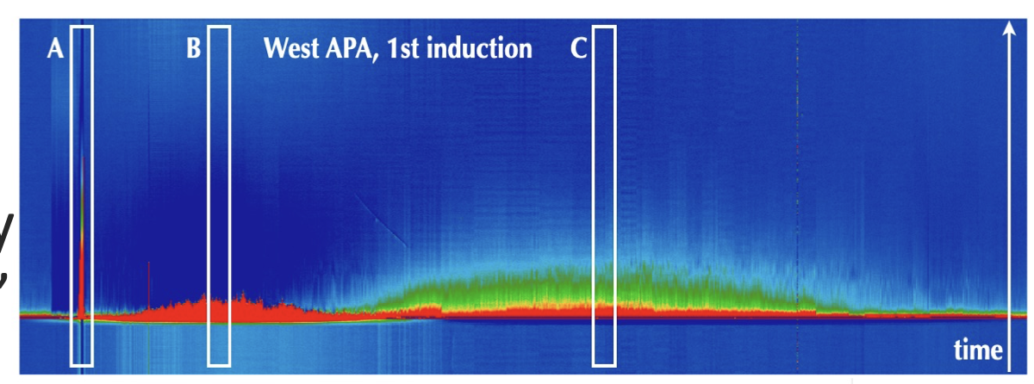
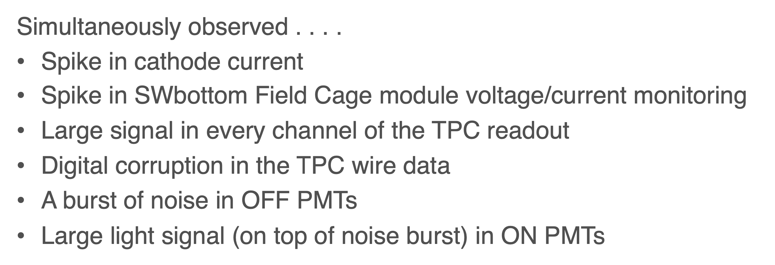
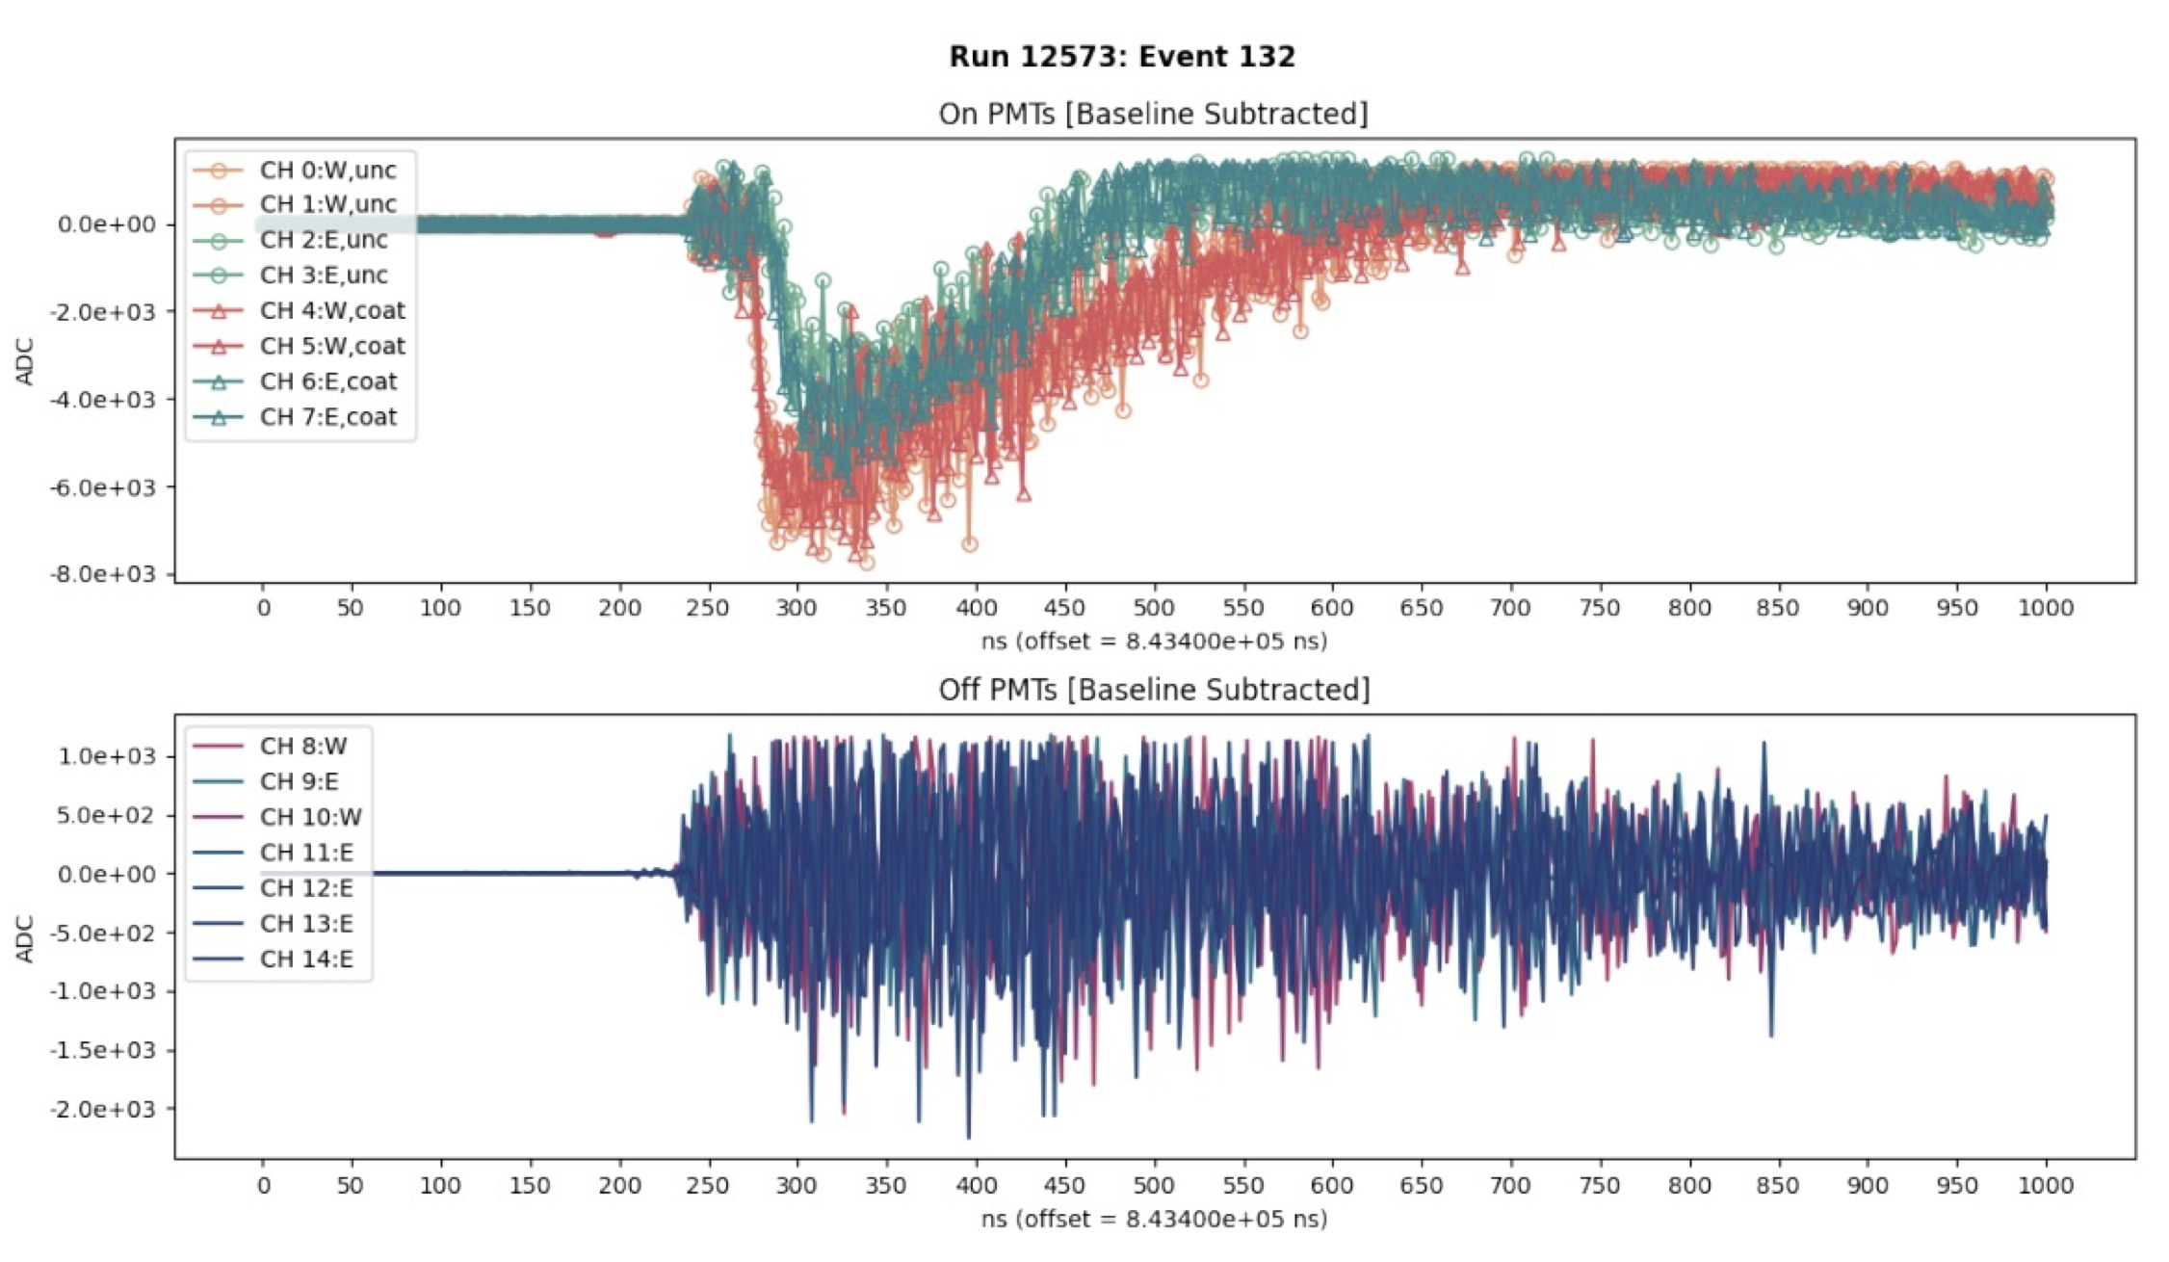
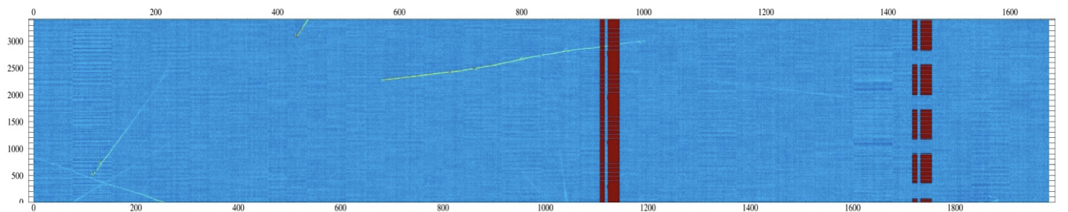
For internal discussion
SBND
Sunset noise: 1-2% event lost
Lynn T.
Digital corruption (when transferring data from FEMB to warm WIB):
triggered by sunset noise
~2% of the channels moving around at any moment likely during the entire run until reset /resynch
PMT signals (during sunset):
West APA side always saturated when HV ON
Catastrophic noise when HV OFF

Slide 3
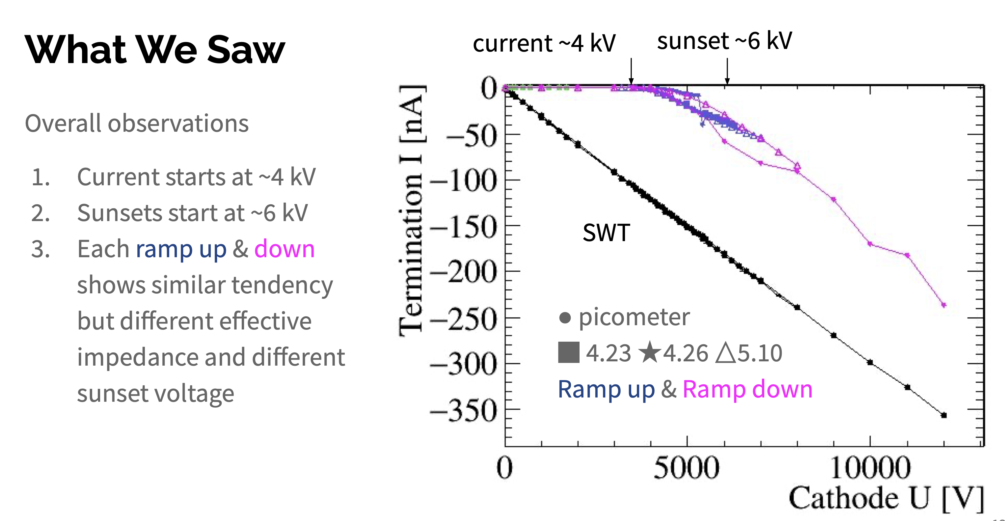
Field cage current vs cathode HV
“breakdown gap”
SWB

Slide 4
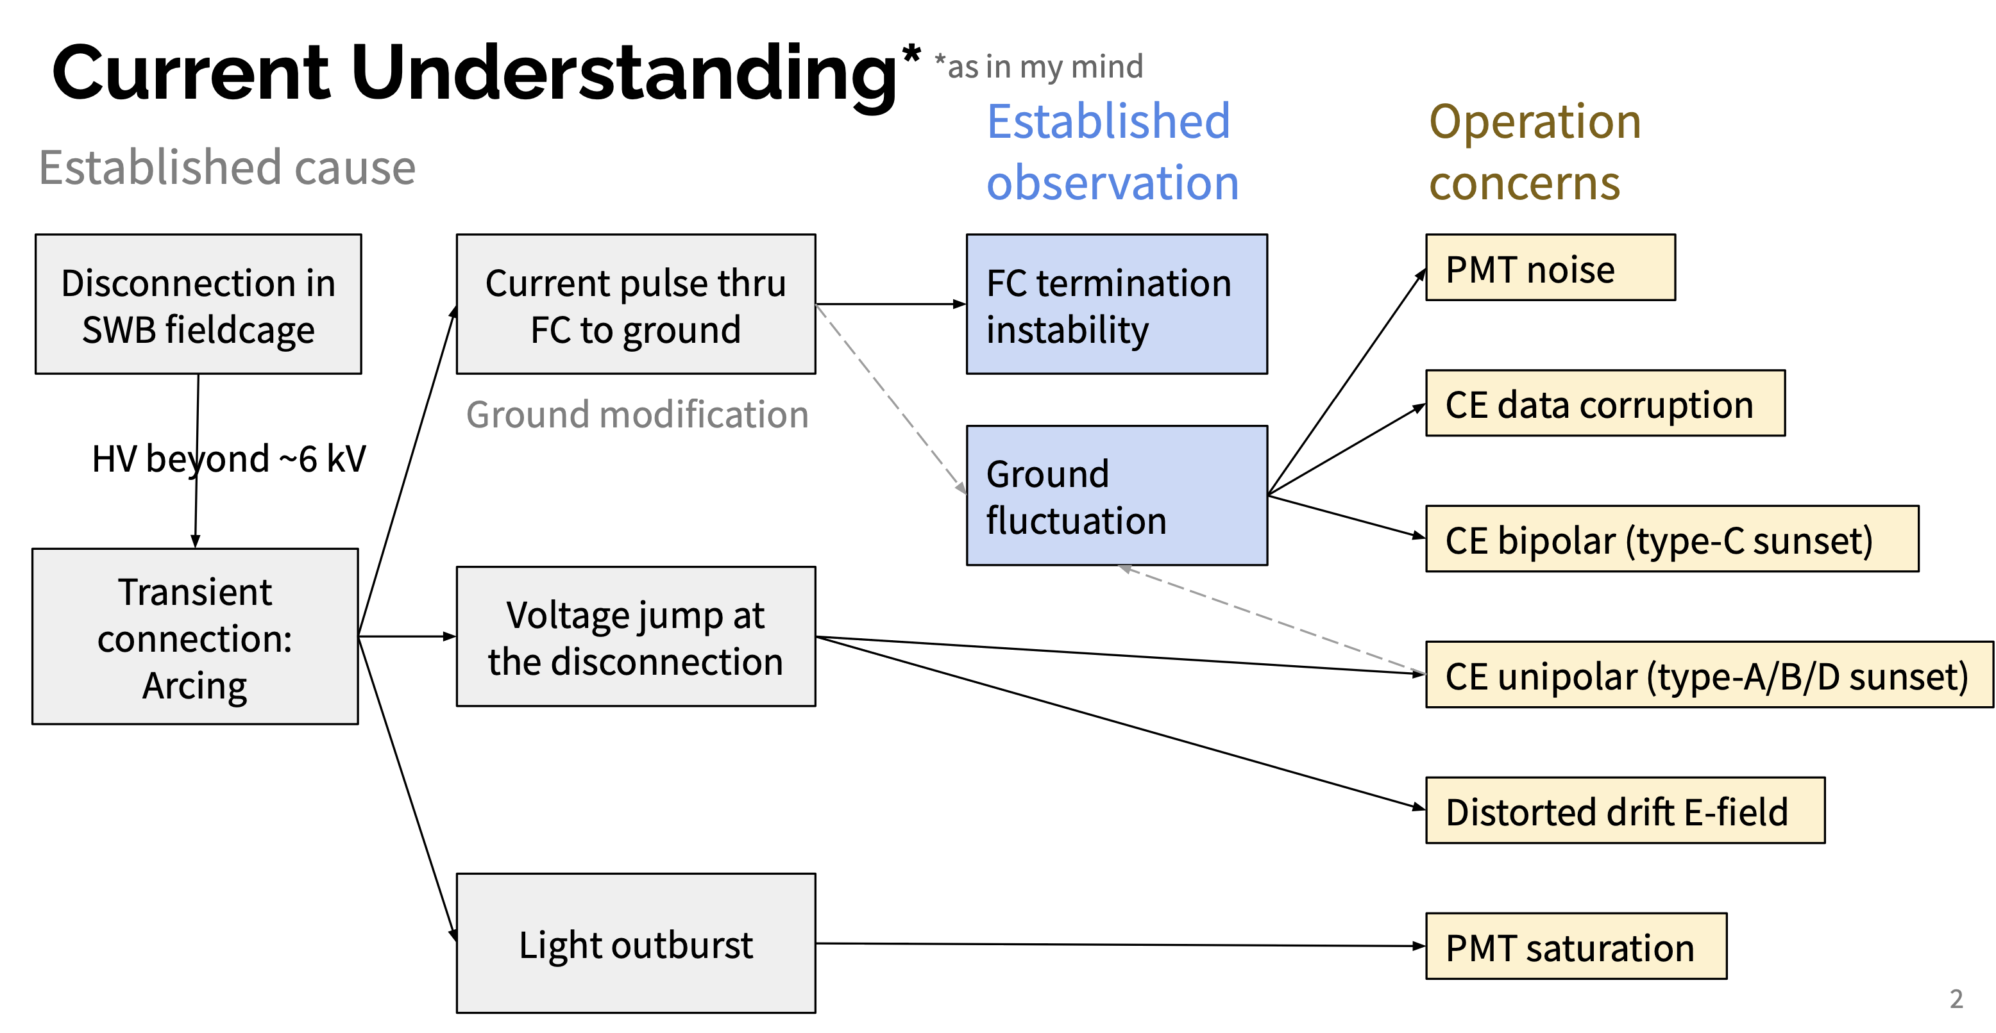
From Linyan Wan (Fermilab)
For internal discussion!
Working on a fix to this

Slide 5
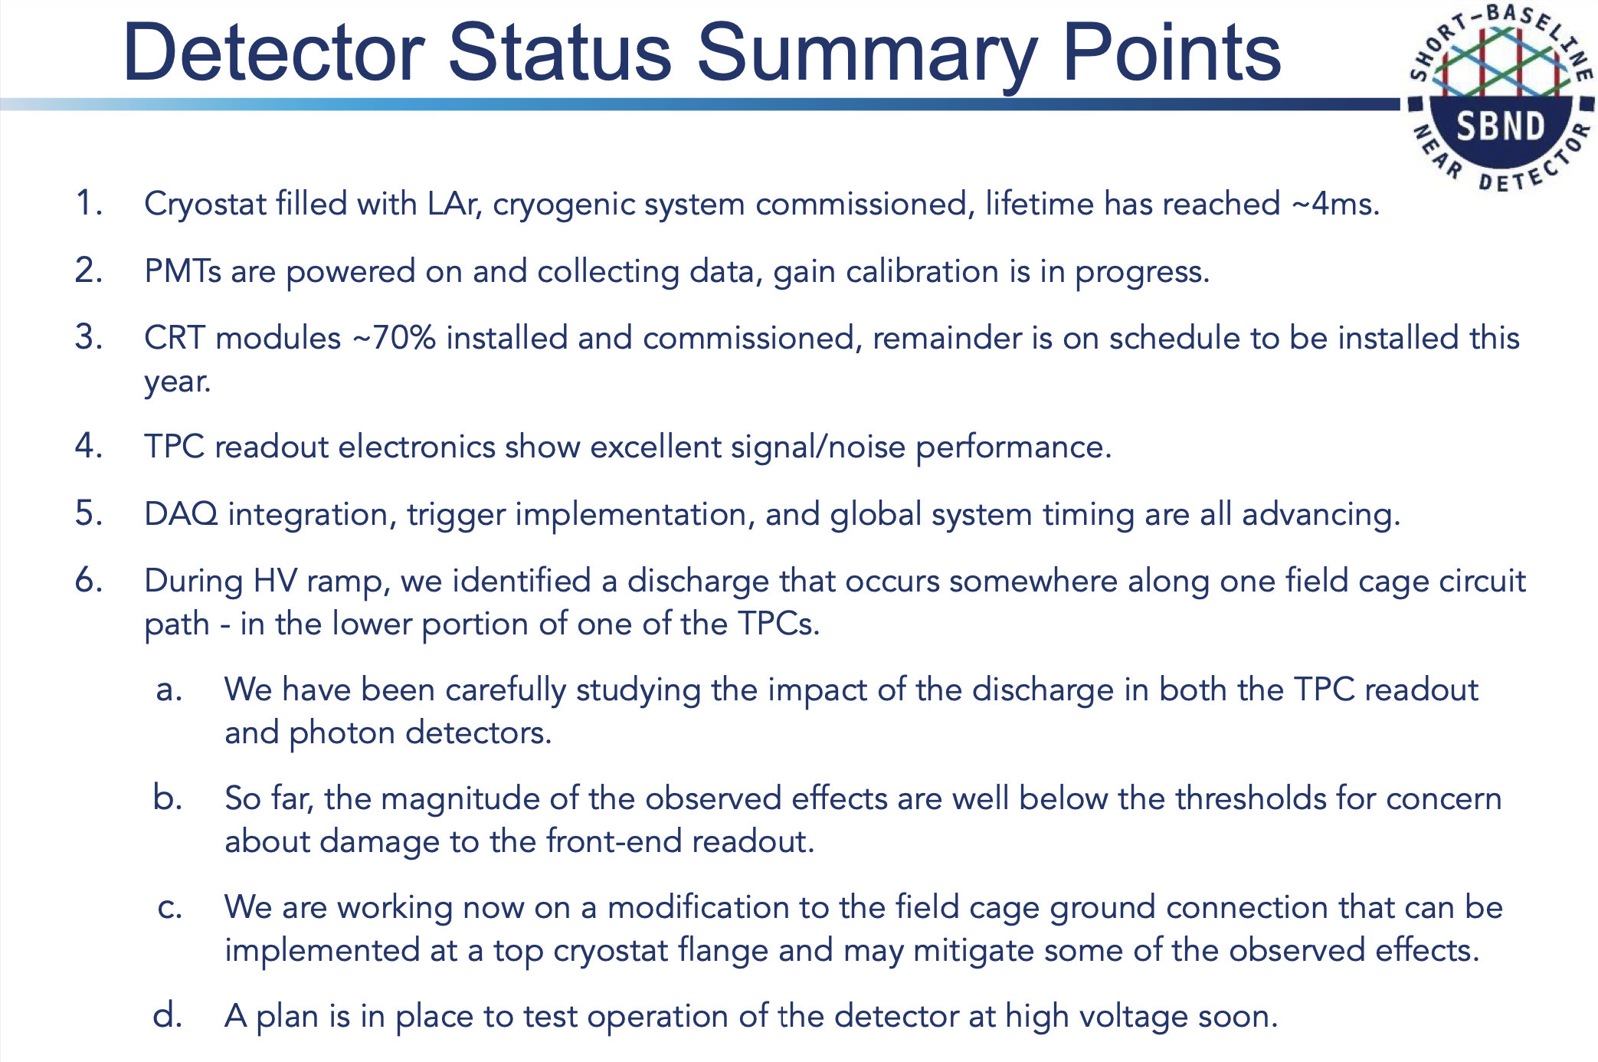
From spokespersons
To public & media
My comments (internal):
the modification may not fix the observed issues, at least cannot fix all observed issues (see previous slide)
after mitigation in item c.
Likely take some data to gain more understanding for next steps

Slide 6
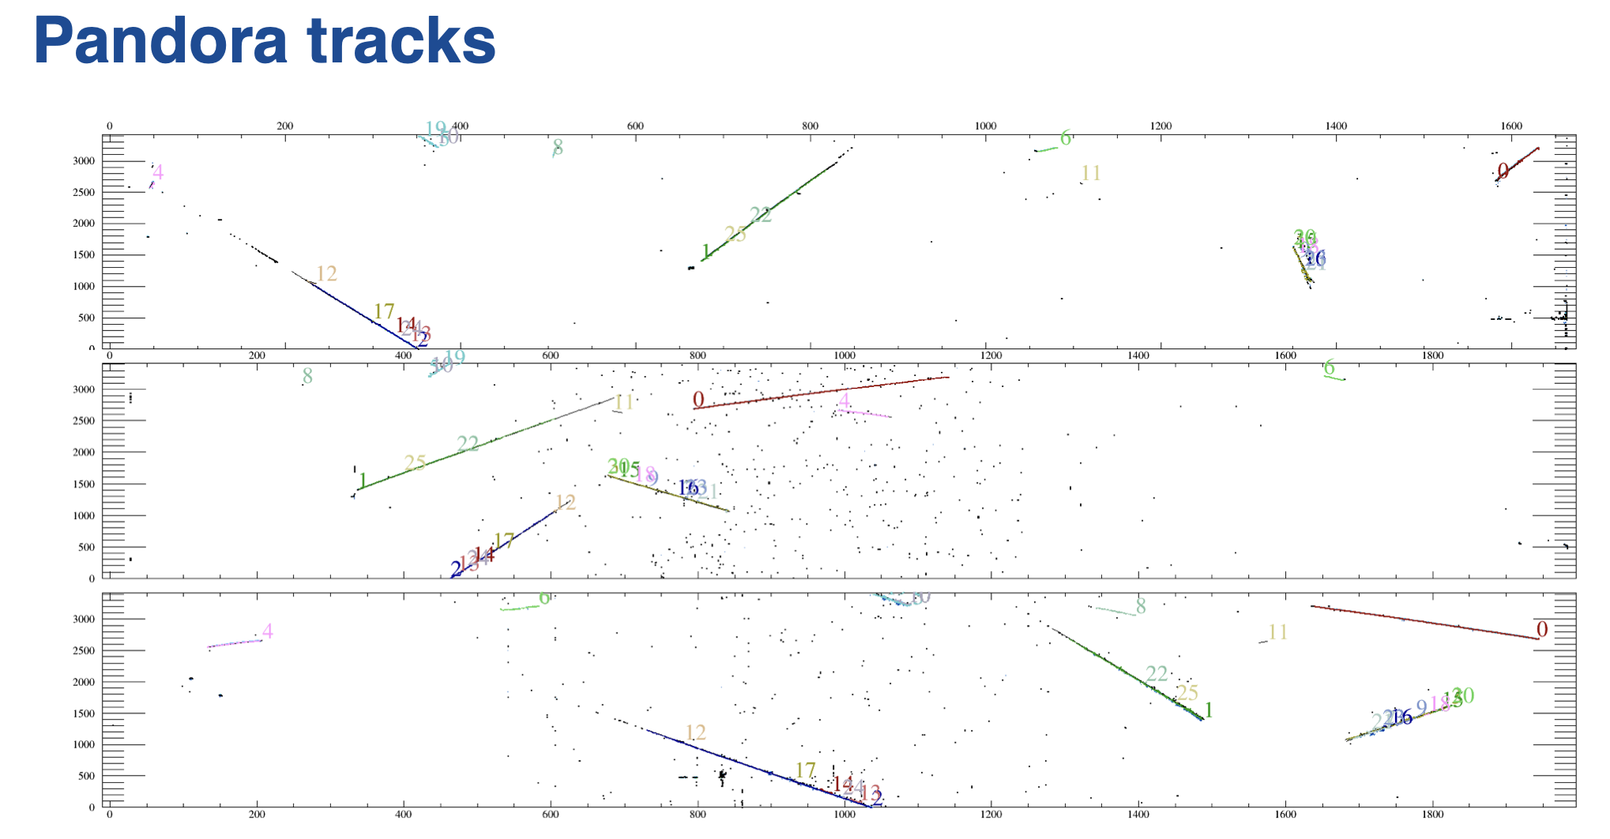
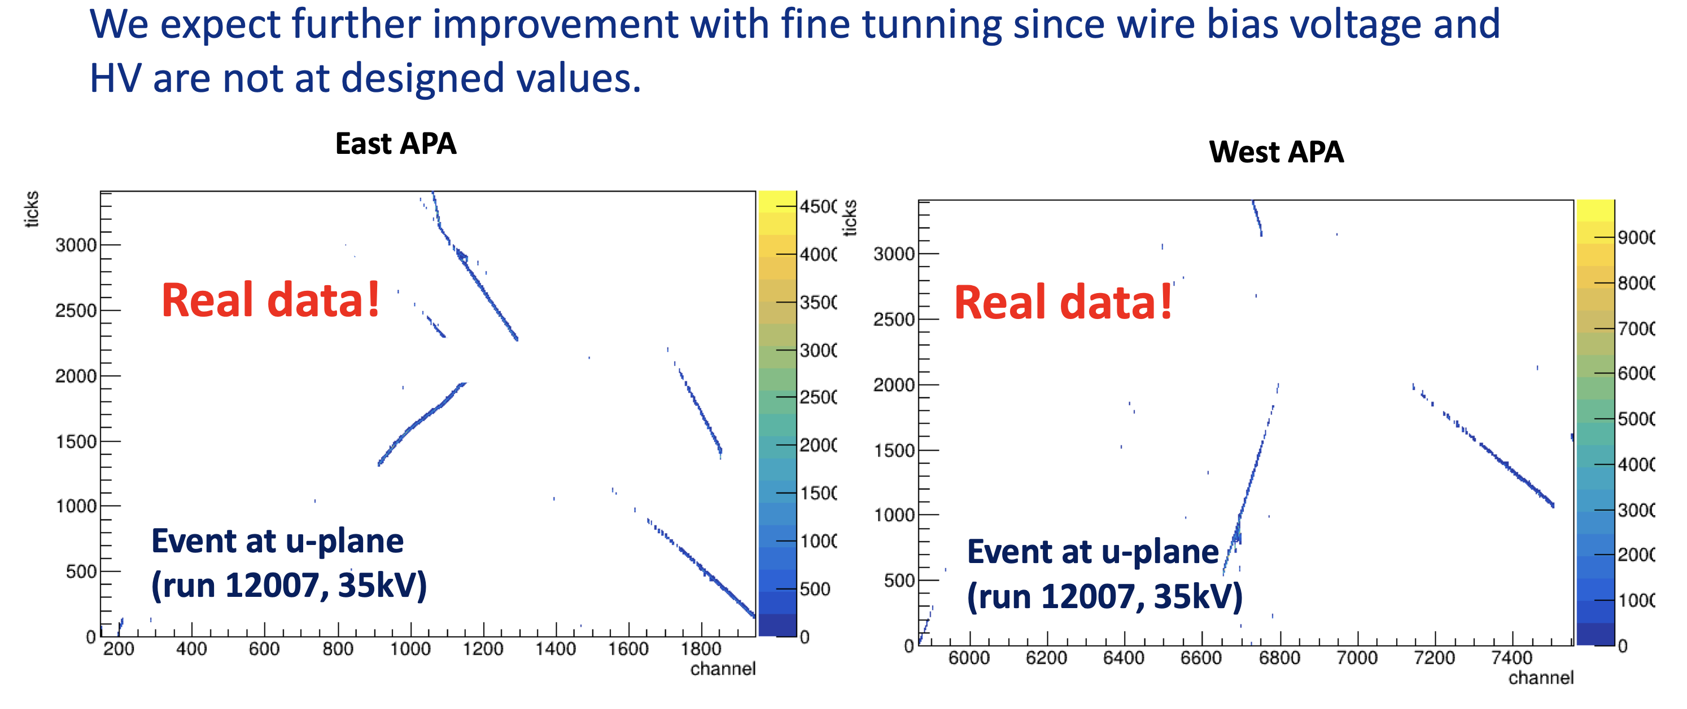
“Good run” data at 35 kV (35% of design value)
From Tingjun (no wirecell processing)
From Ewerton (wirecell processing)

Slide 7
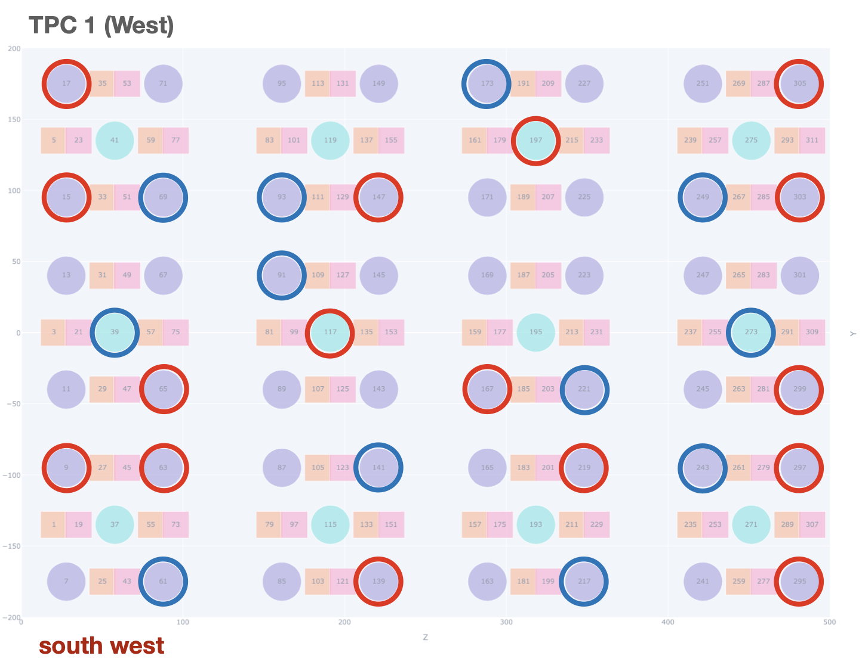
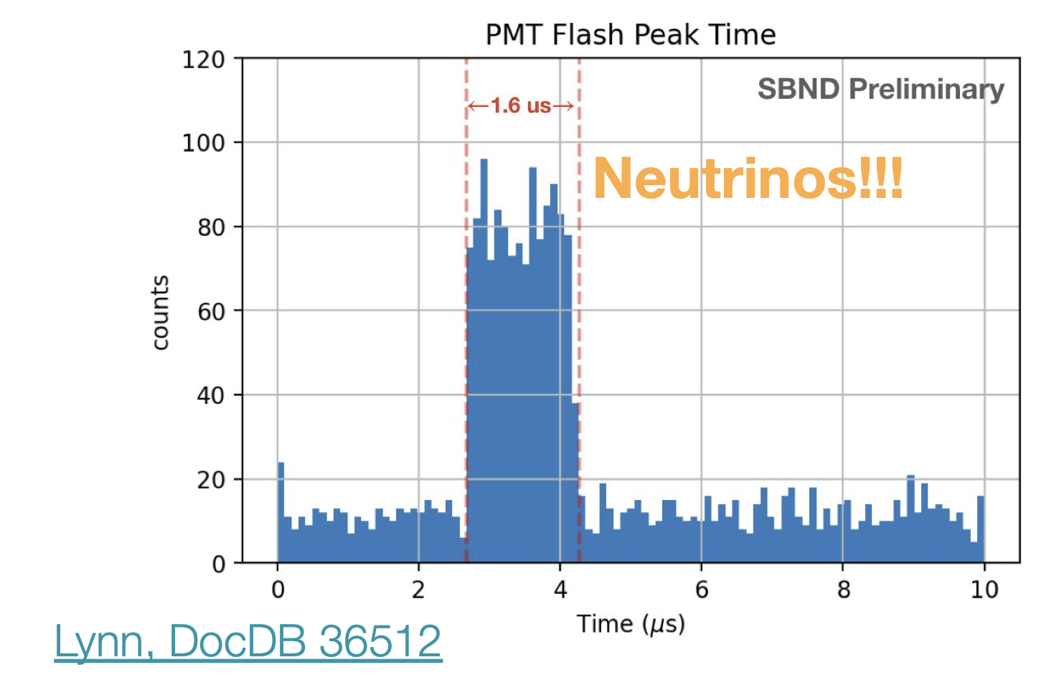
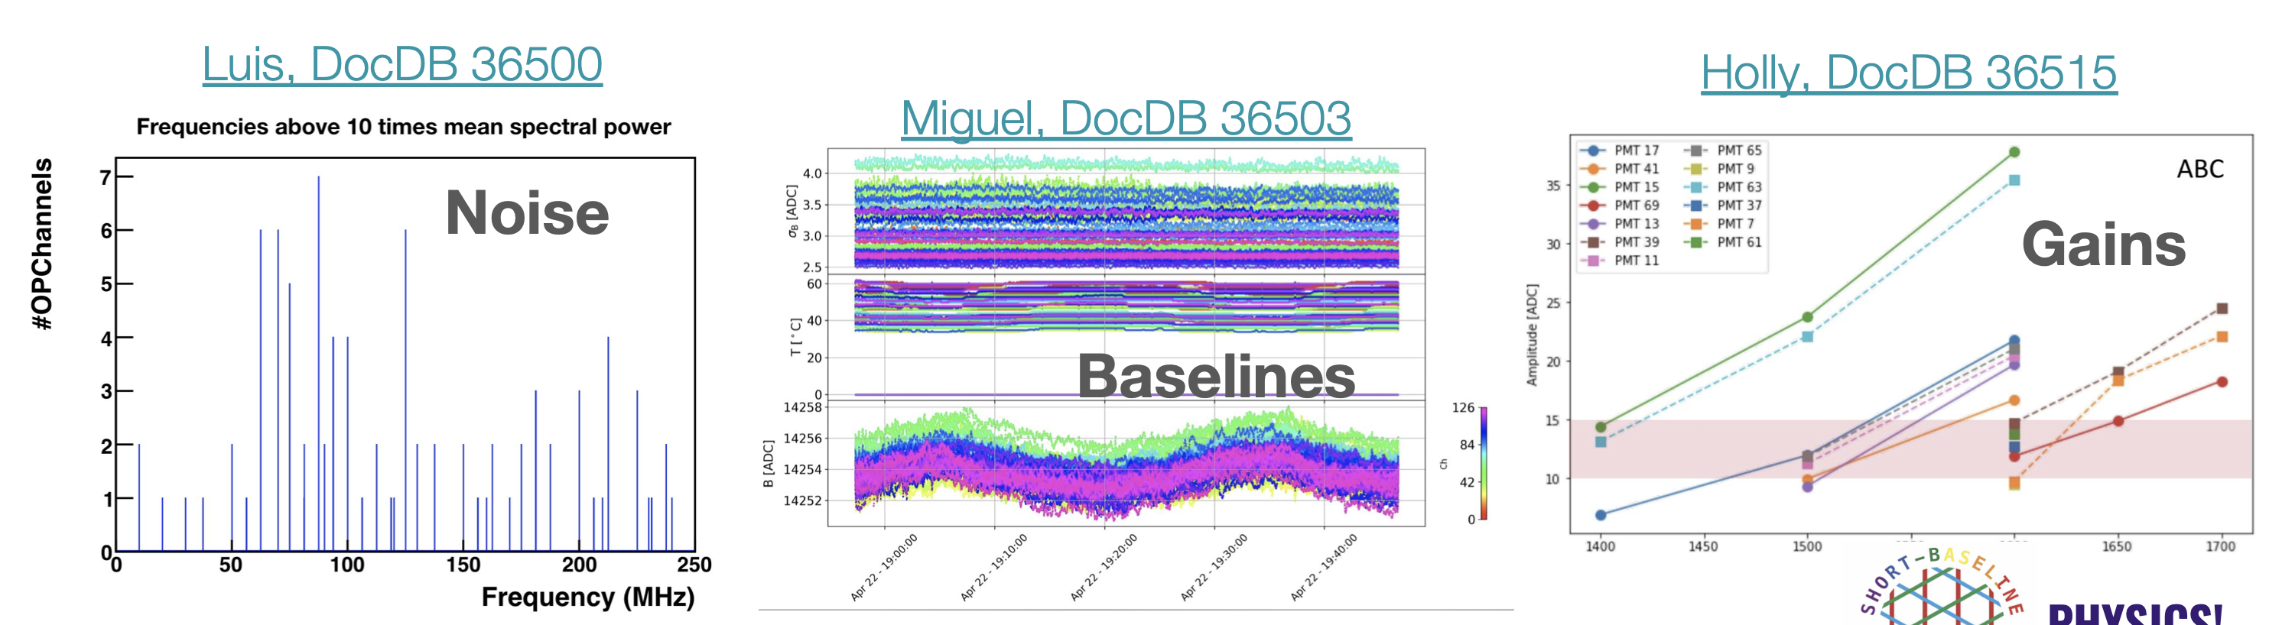
PMT system
Commissioning and data taking is well progressing
Readout of the full X-ARAPUCA system will be added in the coming months

Slide 8
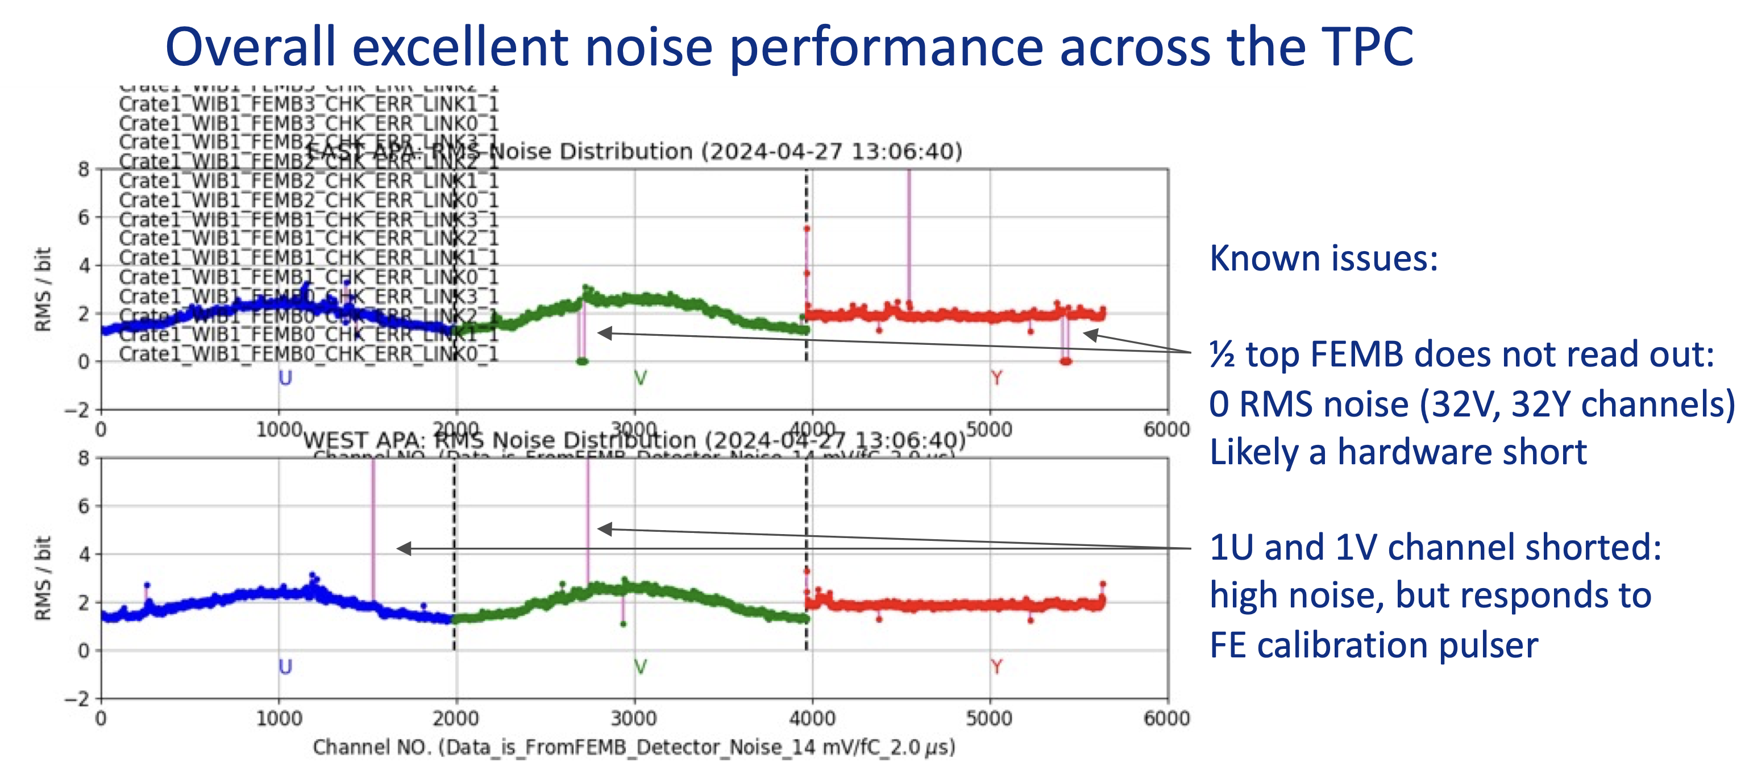
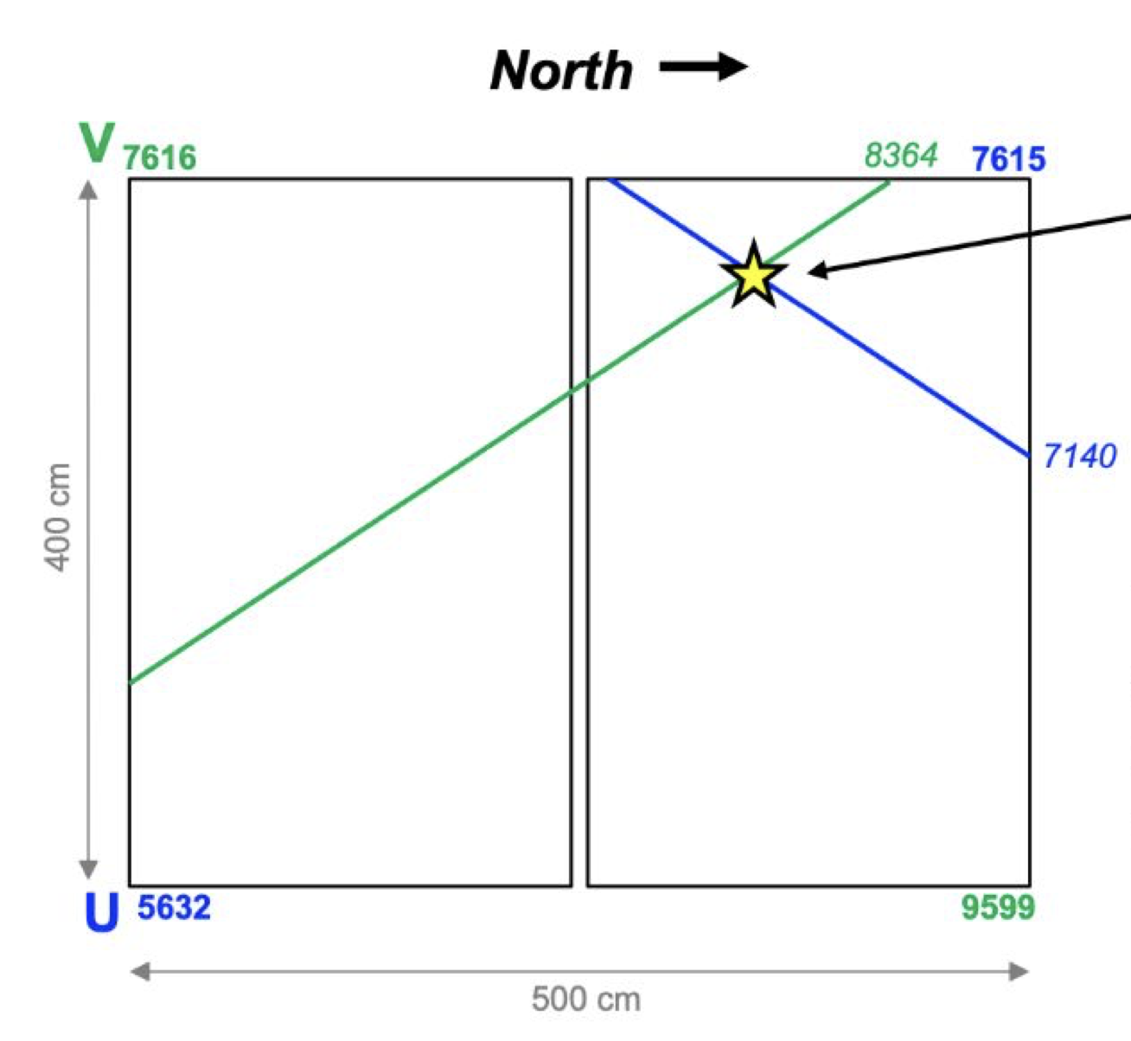
TPC cold electronics

Slide 9
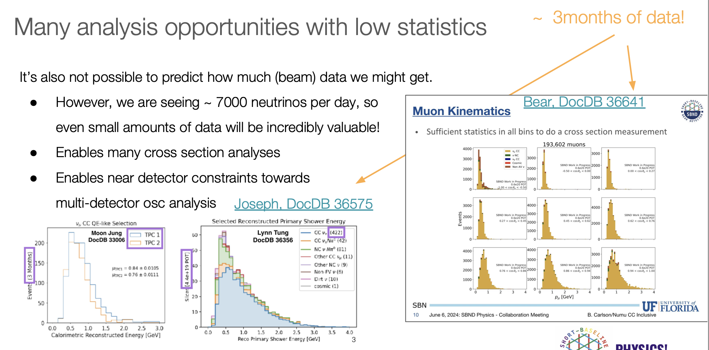

Slide 10
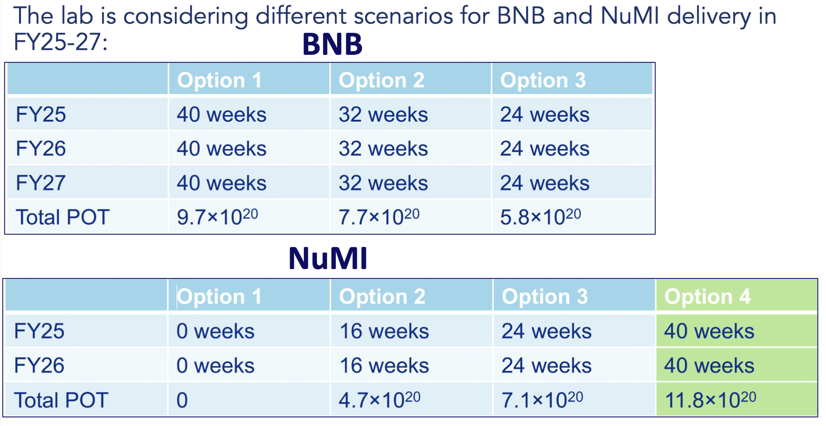
Beam
FY24 shutdown by mid July
  FY25 begins in Oct 2024
FY25-27 scenarios (TBD)

Slide 11
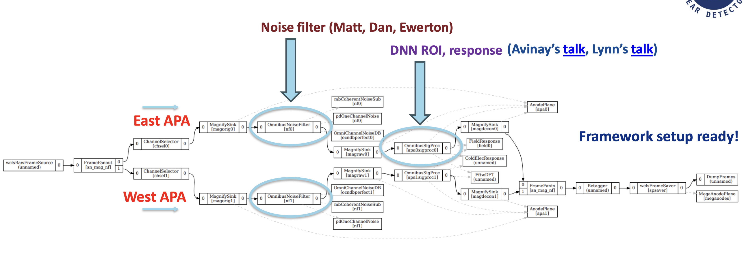
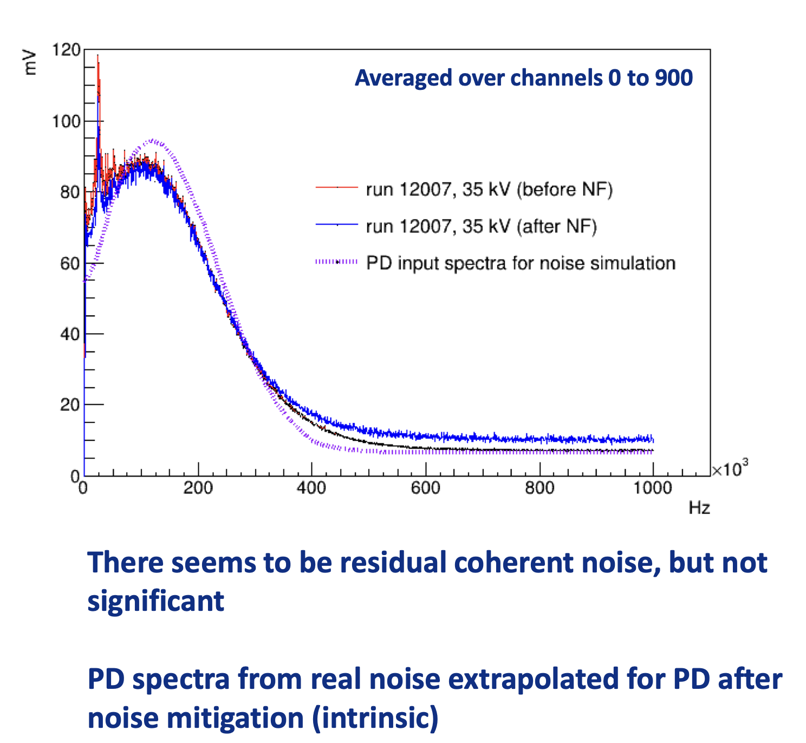
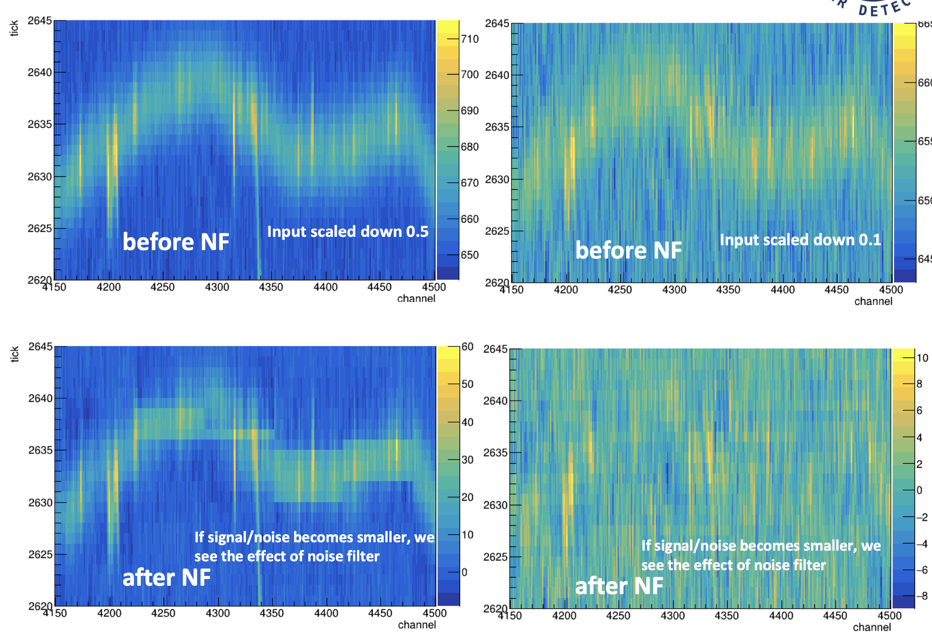
wirecell noise filtering
From Ewerton
Real data
Signal protection (simulation)

Slide 12
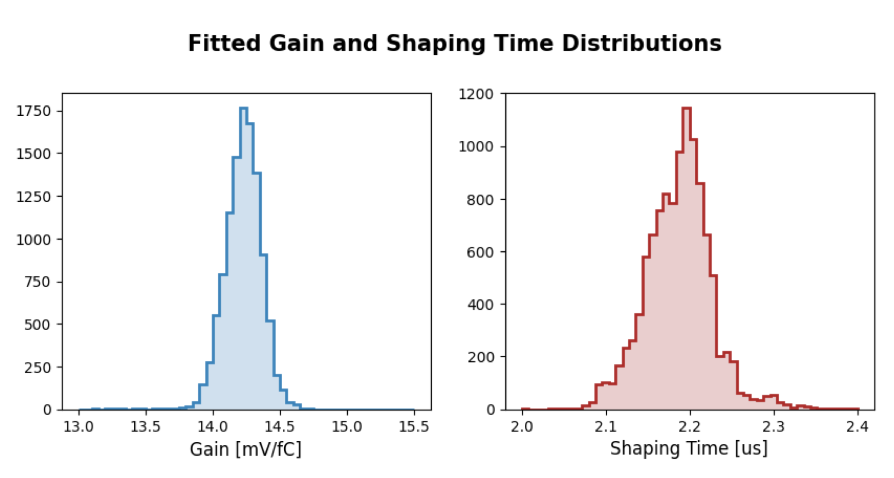
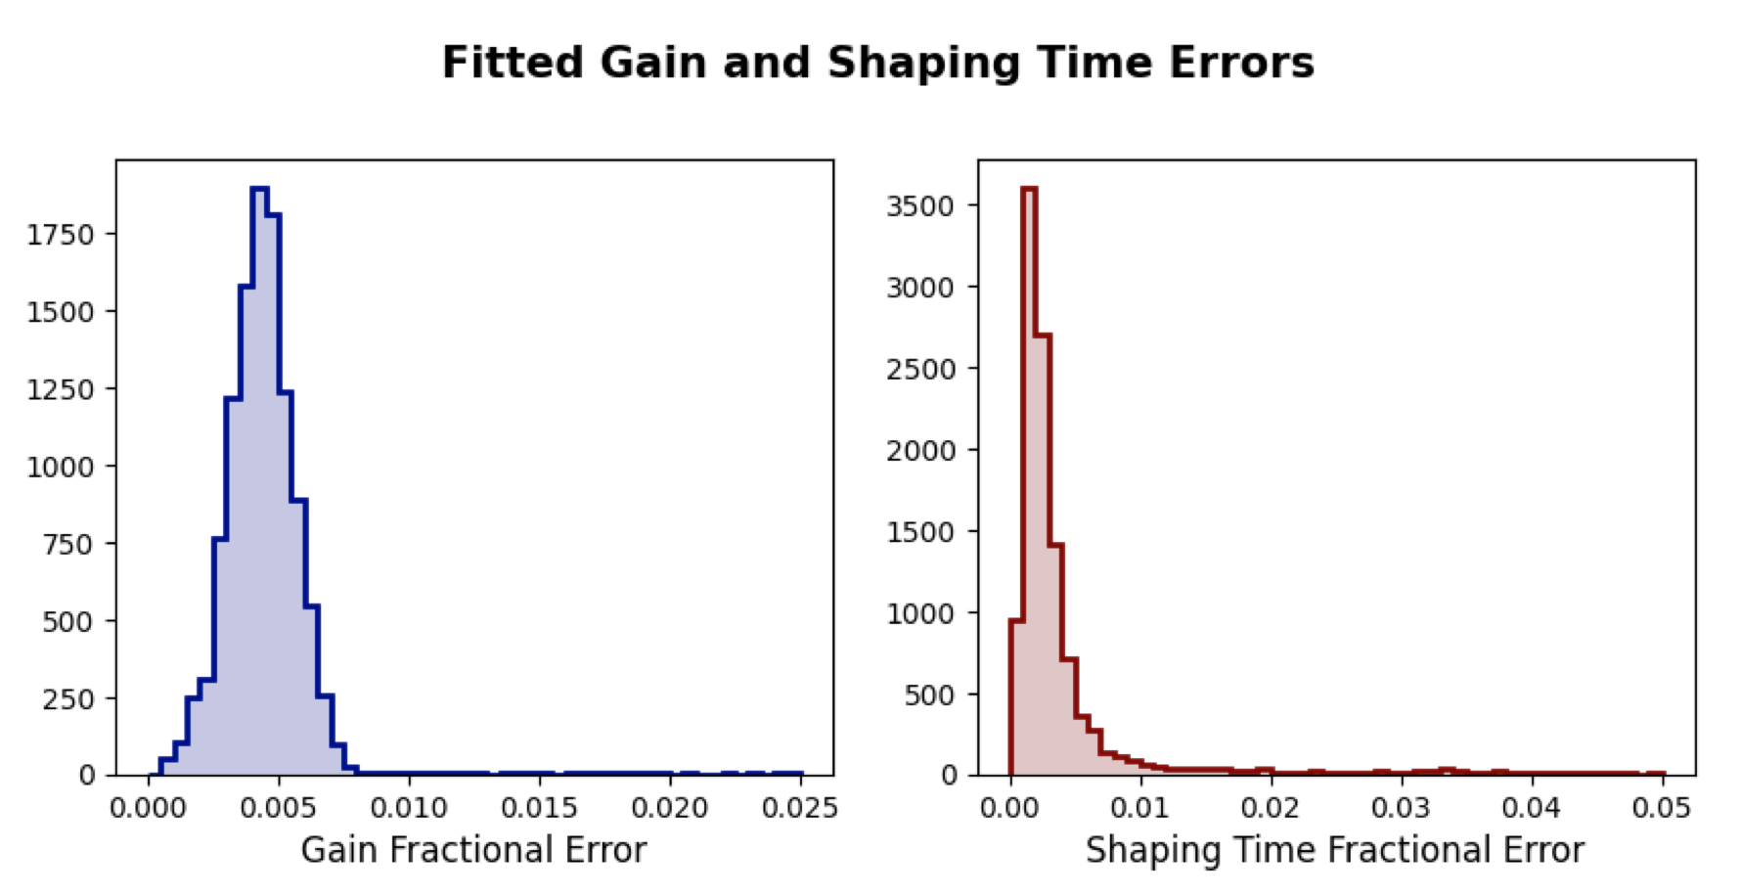
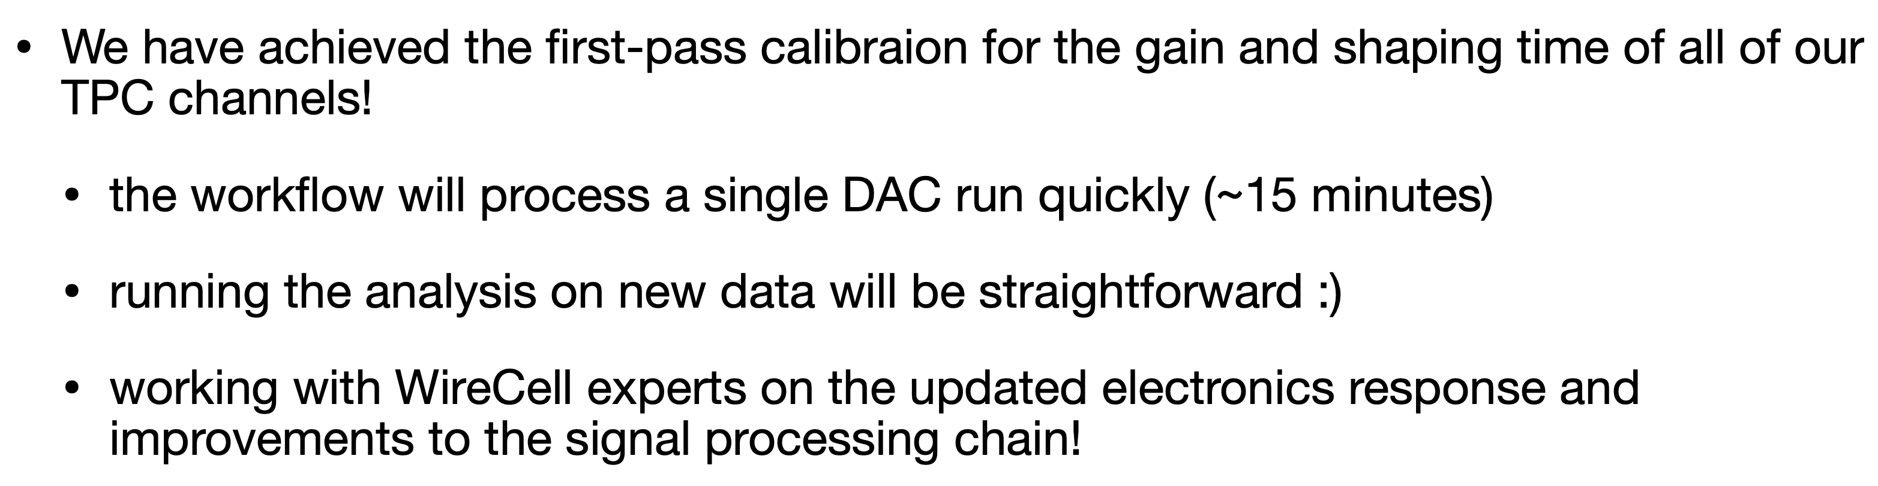
TPC electronics calibration
From Lynn

Slide 13
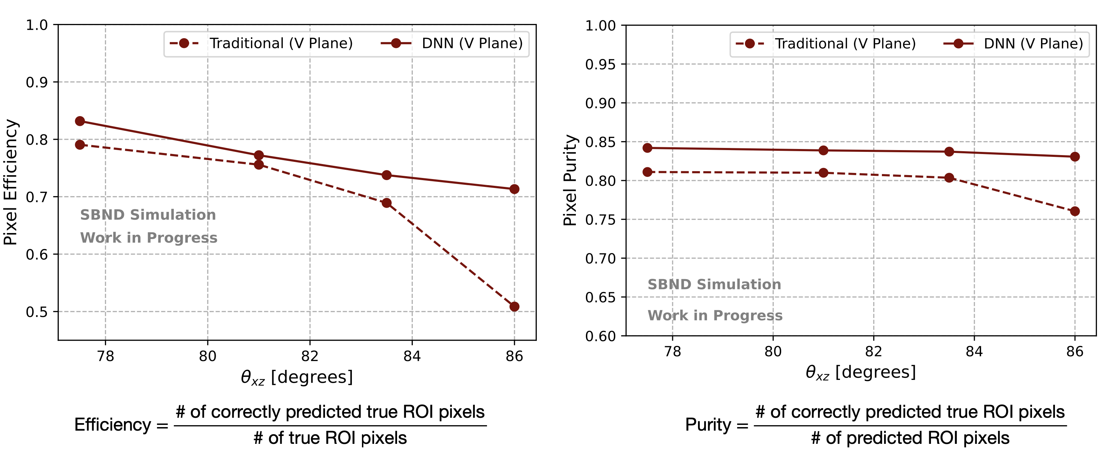
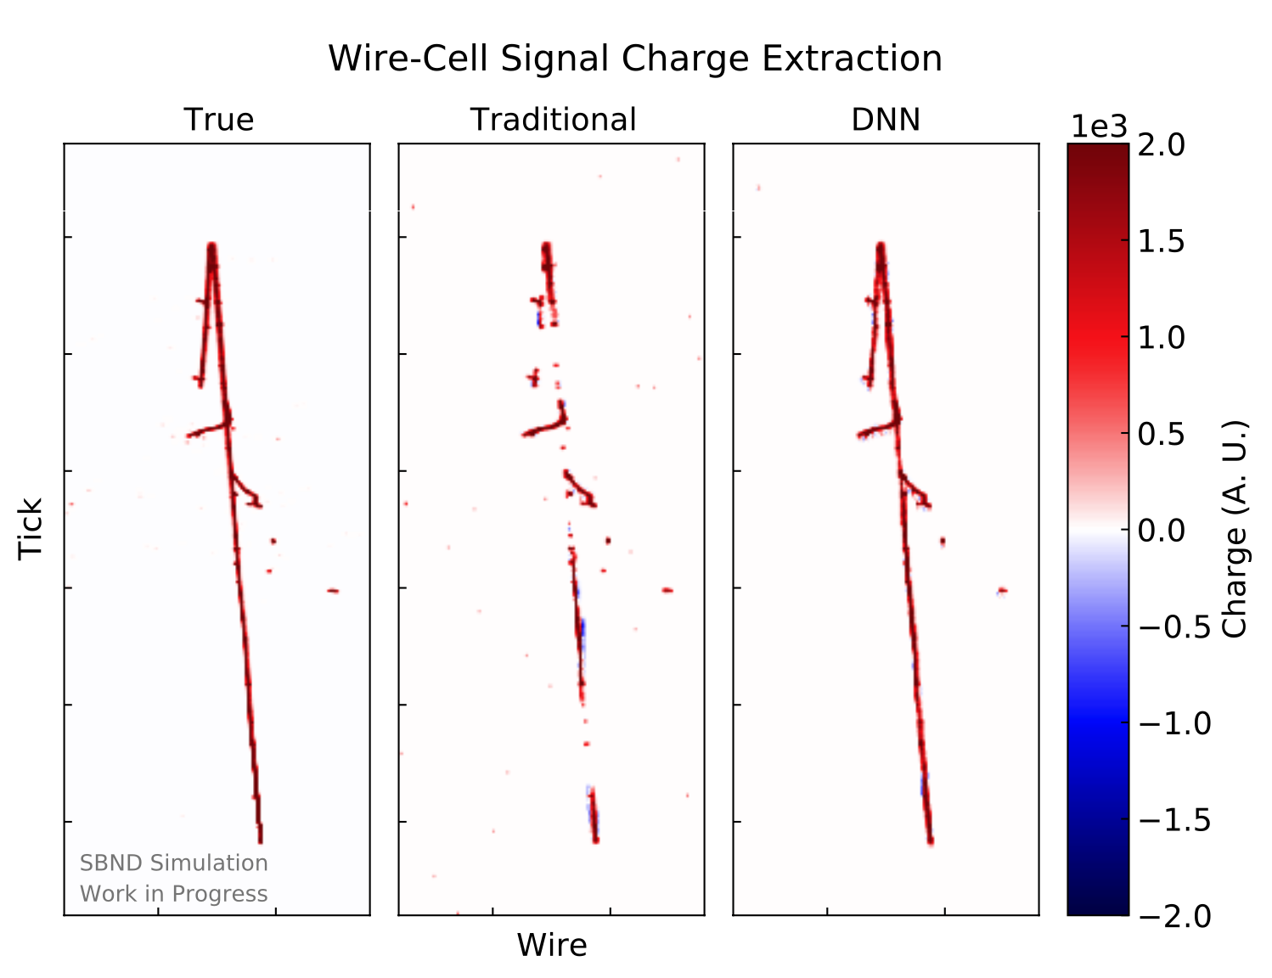
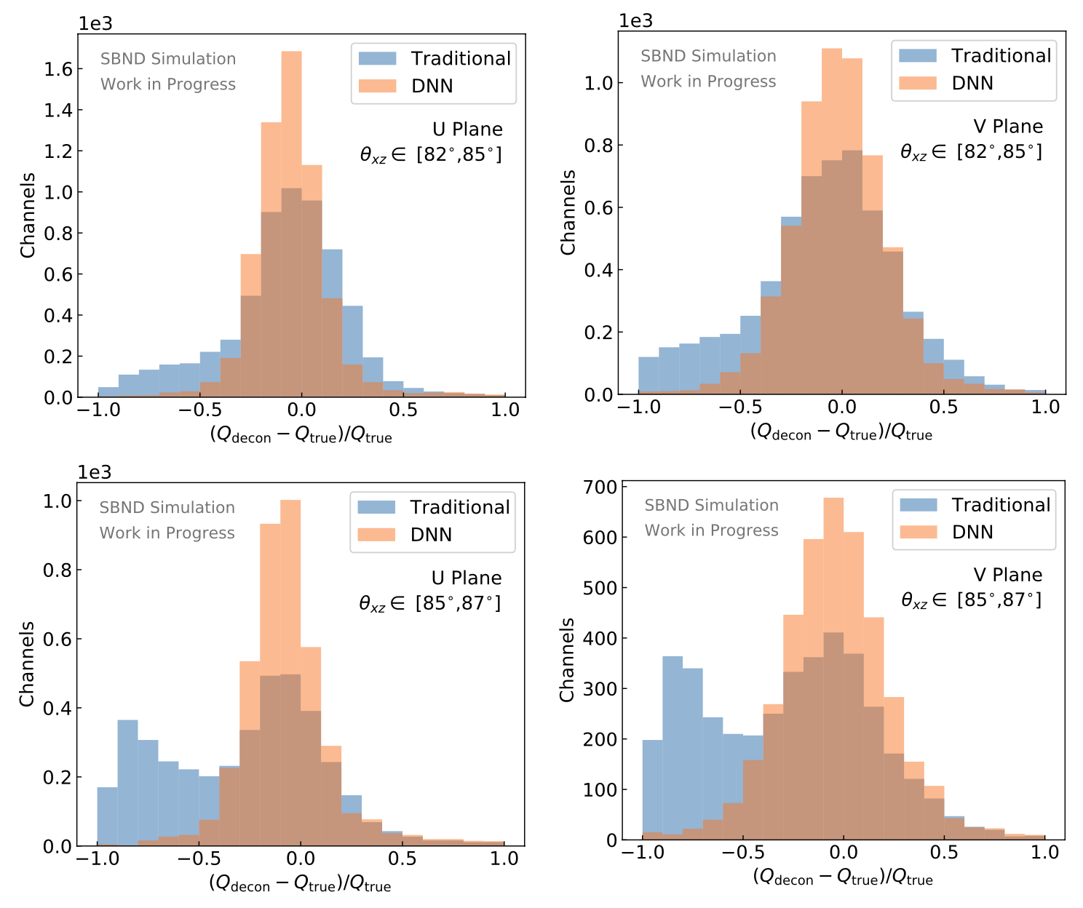
DNN ROI
From Moon and Avinay
Apply DNN ROI to decon charge waveforms
Good charge extraction!

Slide 14
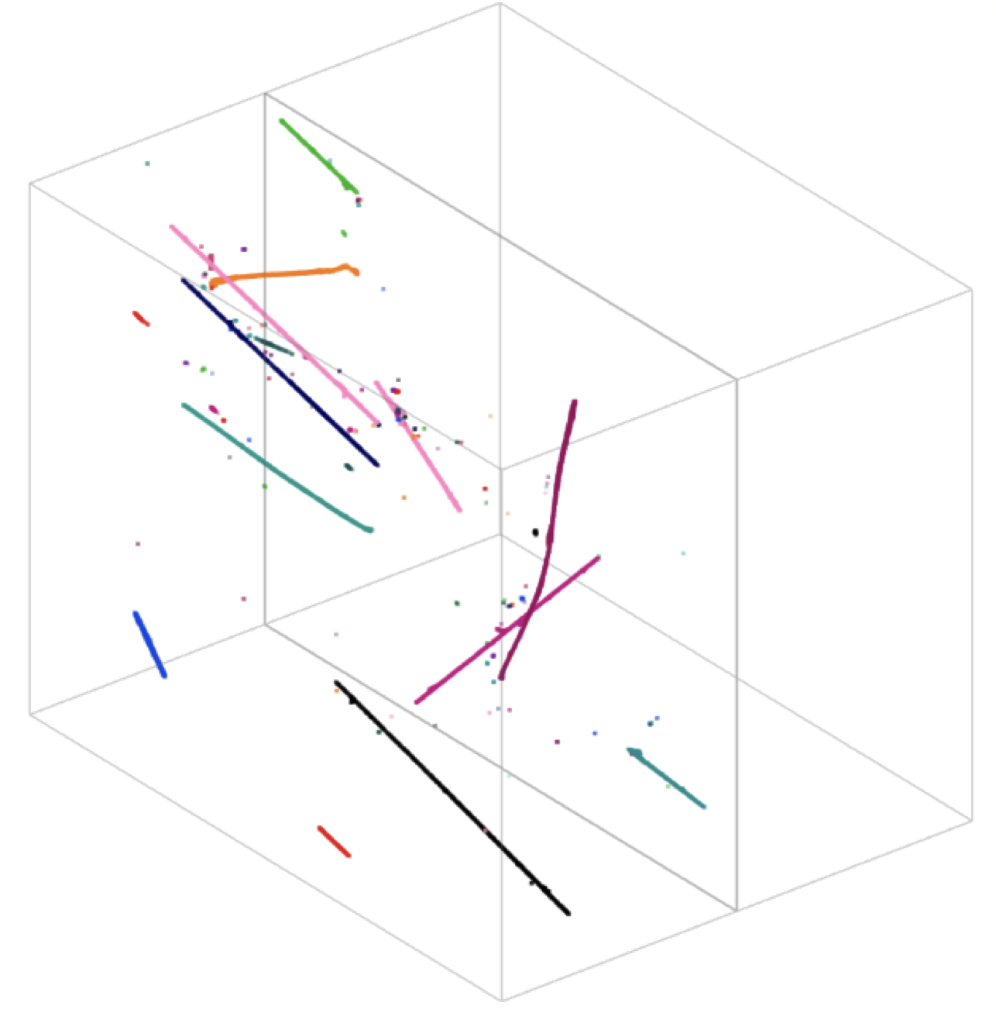
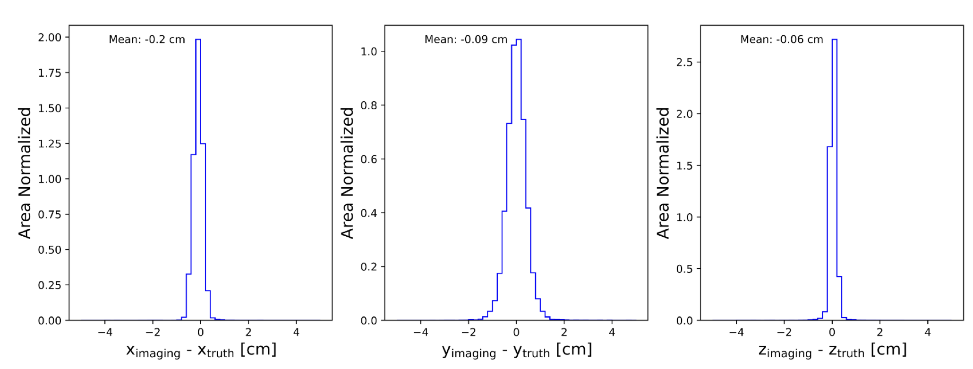
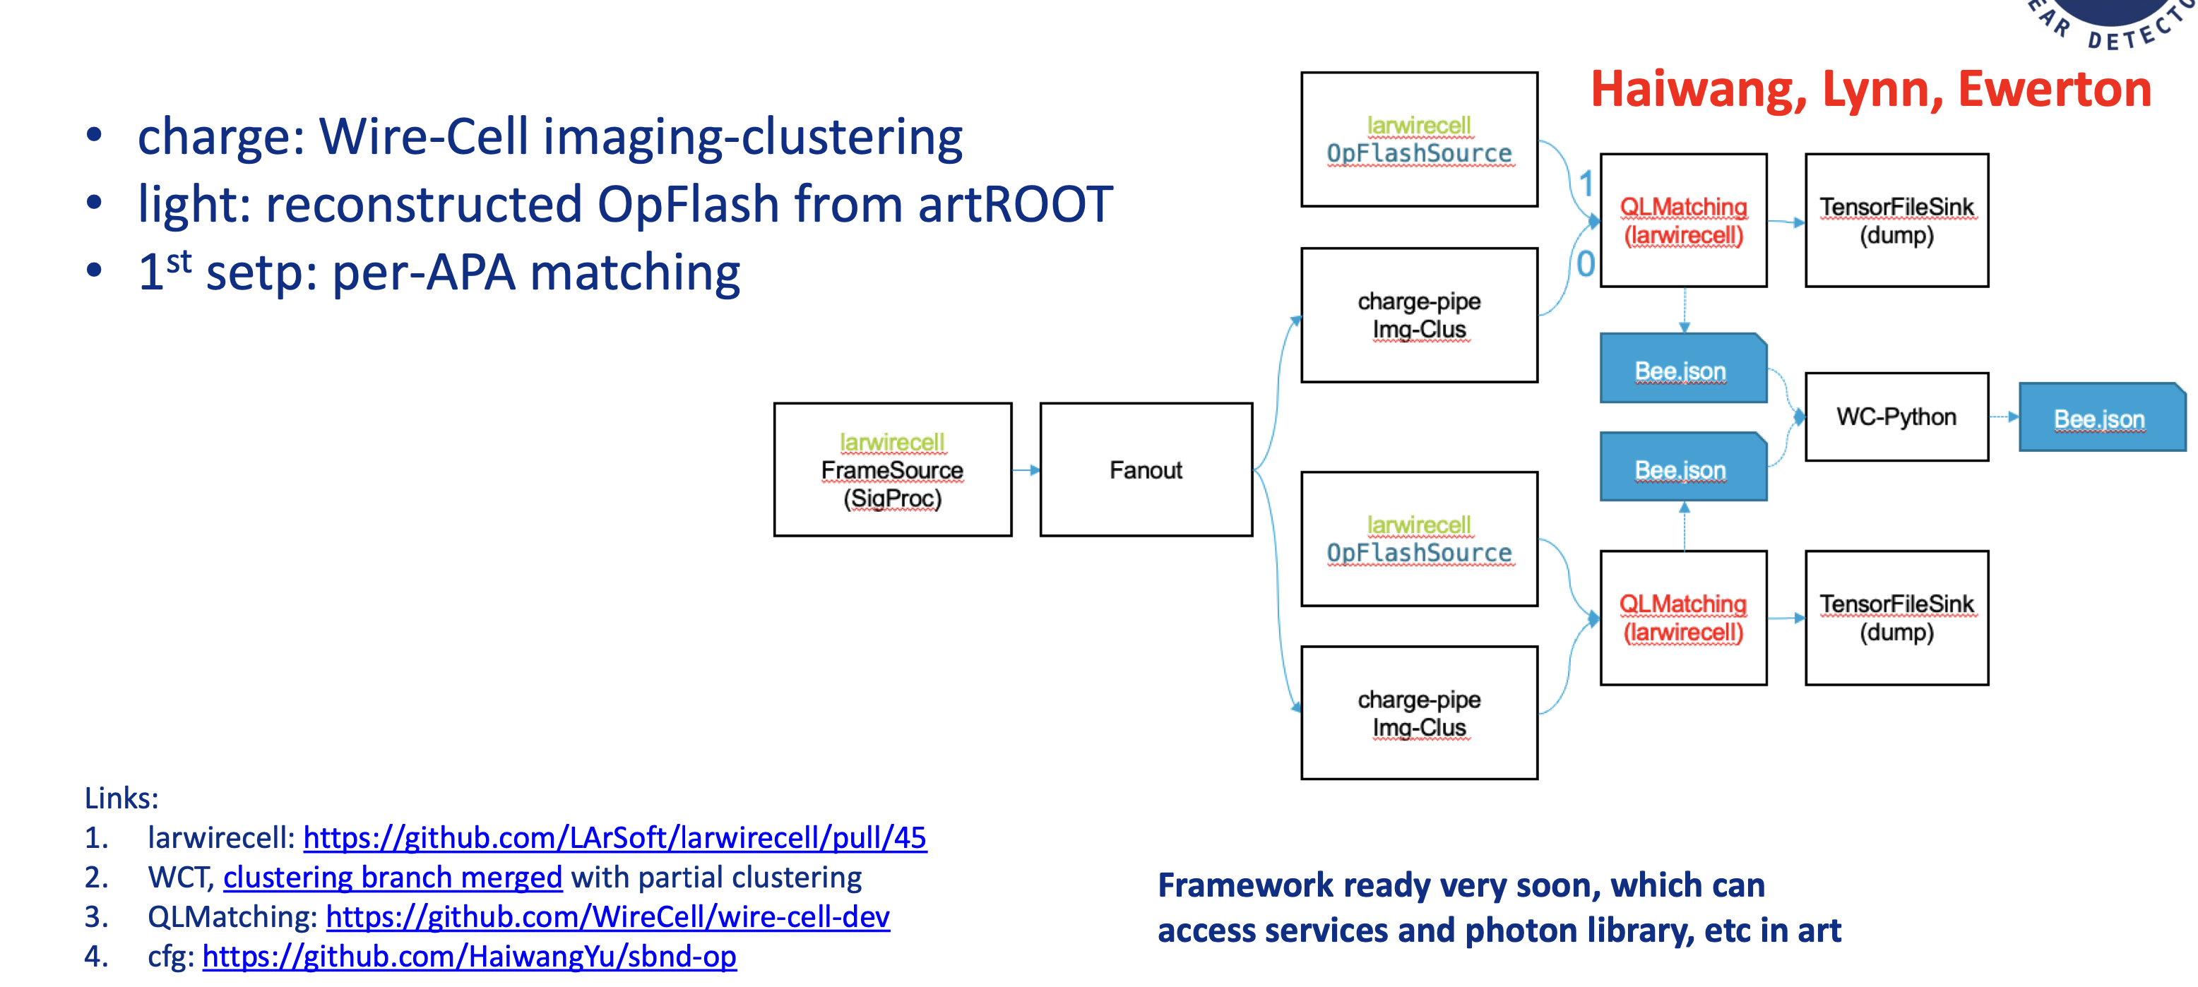
WireCell imaging, clustering, Q-L matching
Preliminary clustering
(porting not completed)
Good imaging performance (simulation)
Framework (partial WCT) for img + clustering + QL matching almost ready
Q-L codes to be filled

Slide 15
SBND WireCell group next steps
Practice current processing chain up to clustering for the most recent data (no sunset, no digital corruption, 35% HV)
Coherent noise further investigation
RC response in data and deconvolution in noise filtering module
Practice electronics channel-by-channel correction (new parameterization model) in wirecell SP
DNN ROI readiness in production
  time and memory issues in CPU mode?
  low angle track, shower, blips performance
QL matching codes filling in and bee display

