Slide 1
ePIC FPC cables
Latest Eye’s from R. Halsall

Slide 2
Best eye we get now
KCU105 at RAL
conditions
Differential signal into a balun
Running at 10 Gbps

Slide 3
The land of many eyes
Virex7 board and No Balun
Virex7 board and using a balun

Slide 4
What is a “balun”?
Makes a single ended output from Diff. input
Here is a picture of it.
I’ll find out on the internet.

Slide 5
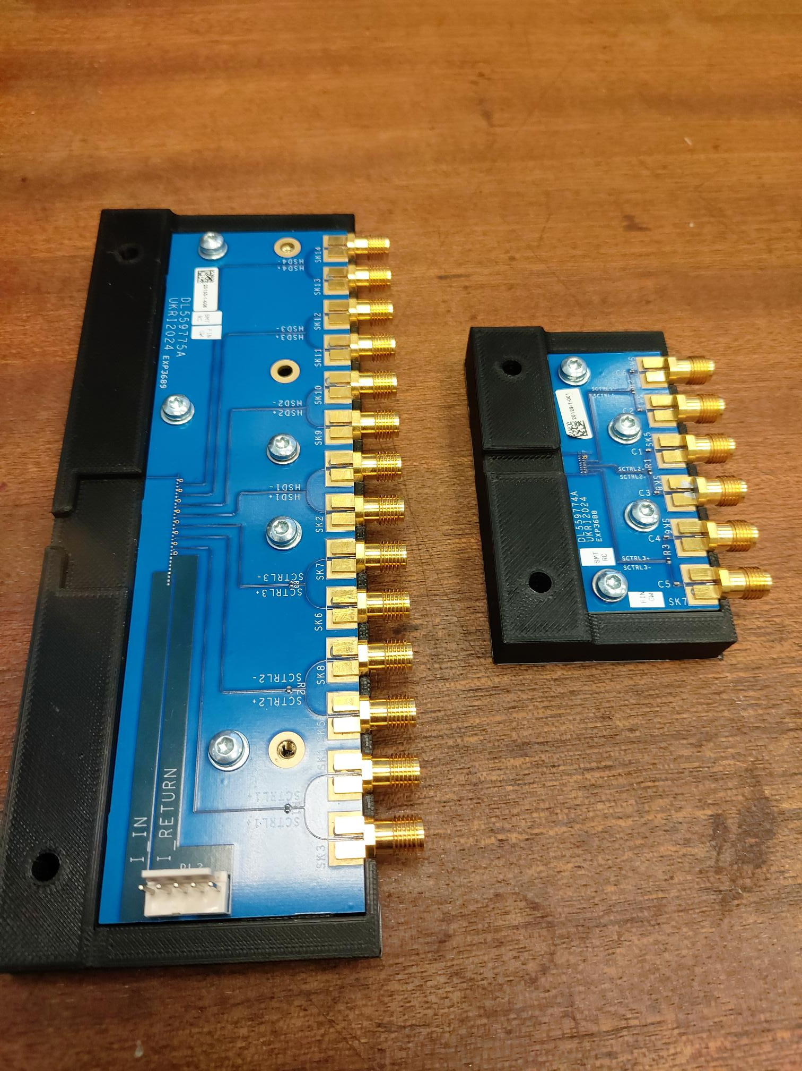
FPC + interface board carrier
Terminations need to be removed. Blocking capacitors replaced with shorts Then - Take to RAL and have TDR look at these boards.
Status of the test FPC – Marcello

Slide 6
Backups

Slide 7
Always use the expensive cables.
Differential Electrical – straight from test board → compare to slide 2
Thin black coax carries signal that makes lower set of traces

