Slide 1
End Ring Way Ahead
Alex Eslinger (JLab)
6-20-2024

Slide 2
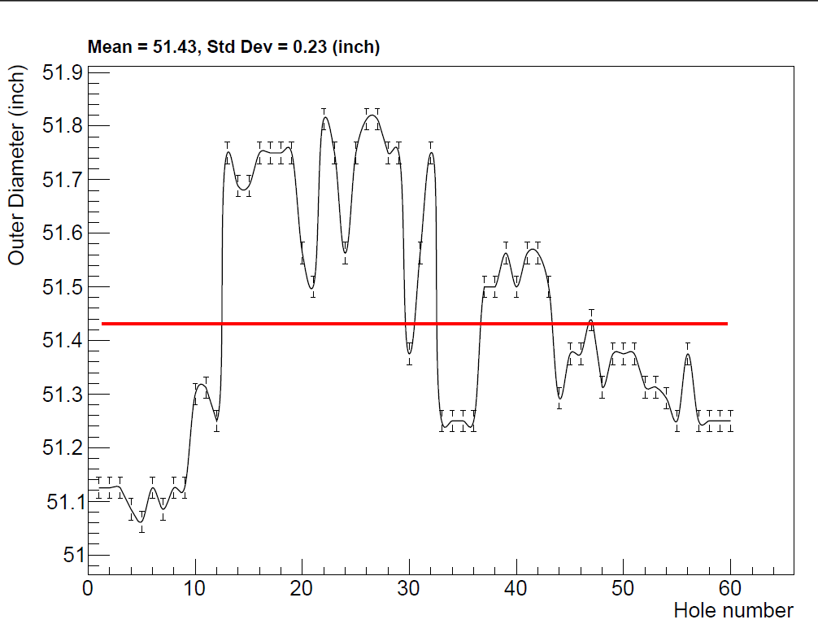
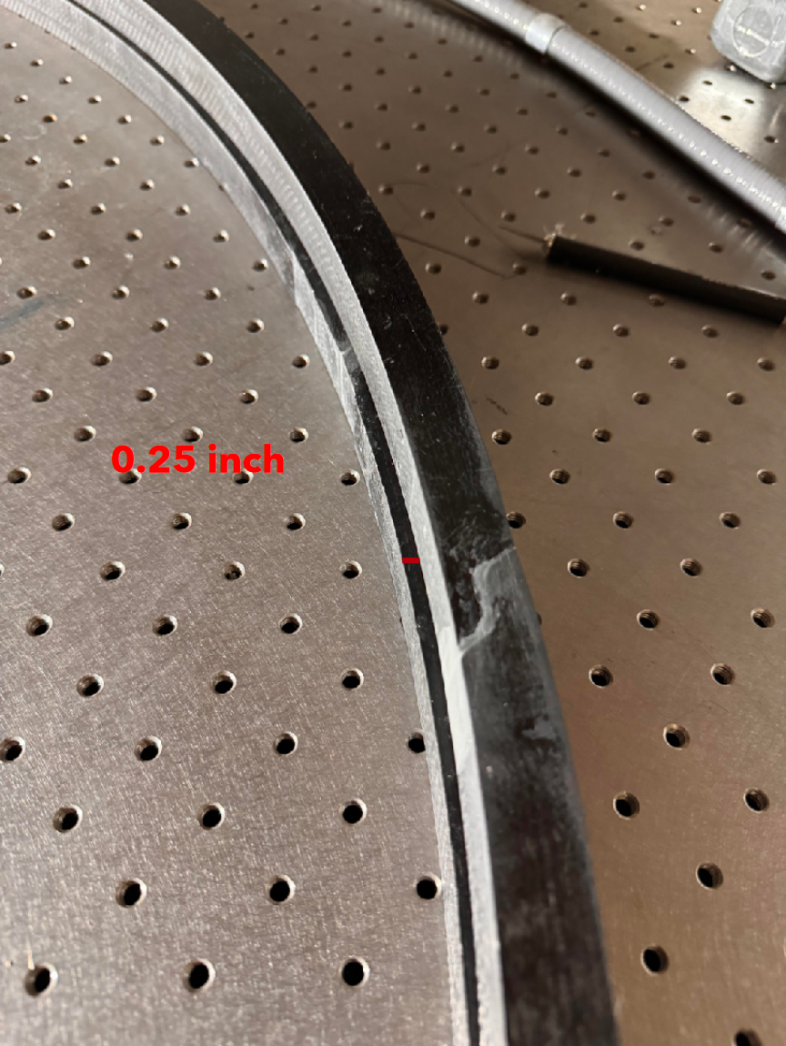
Problem Summary
End rings were received by SBU and inspected visually and with some rough measurements
The end rings seem to be roughly ¼” different in size from each other
The bolt holes do not appear to be uniform throughout the circumference
The flatness appeared to be a problem, as well.

Slide 3
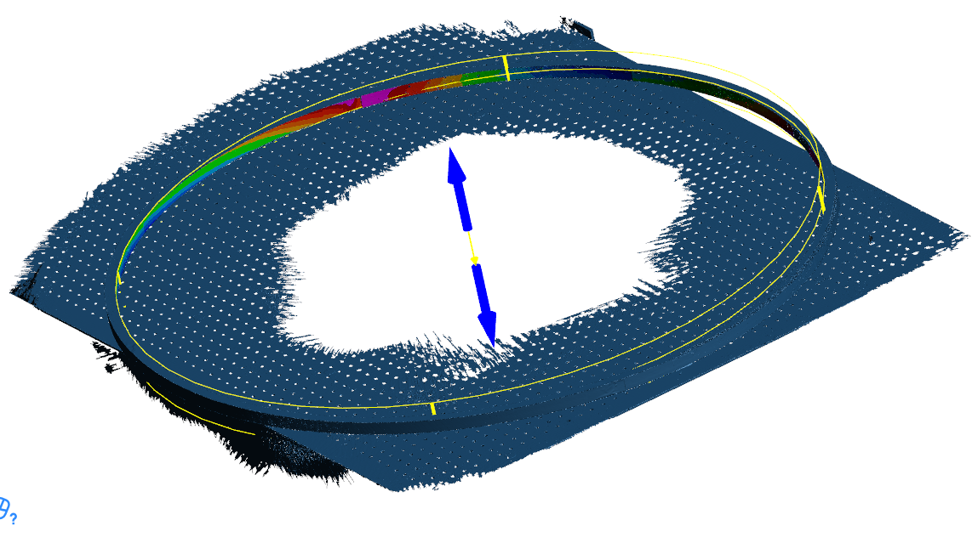
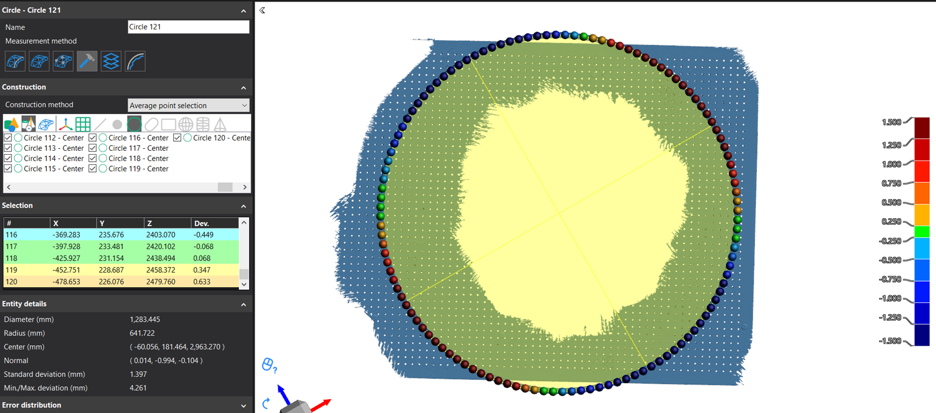
New Information from Meeting
Sushrut presented and discussed a detailed metrology report with discussions on what were considered the critical dimensions
The flatness of SBU’s optical table is in question
The rough measurements that SBU took roughly match the metrology report

Slide 4
Options
We can test fit the current end rings to the foam if we only mill ~2” (in z-) from the foam to the nominal dimension.
We also discussed remanufacturing the rings by only having one machining step at the end.

Slide 5
Test Fitting Existing End Rings
By milling one end of the foam to the nominal dimension, we can test fit the existing ring to get an idea of the severity of the problem.
There is enough foam left to pursue this option without needing to remake the mandrel
Foam
2”
Z-axis
End Ring
Mill to nominal size last 2”

Slide 6
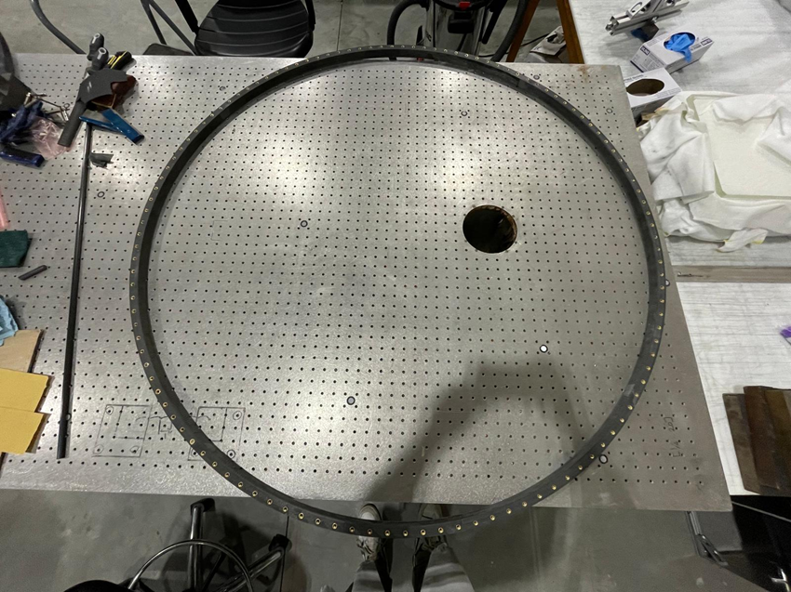
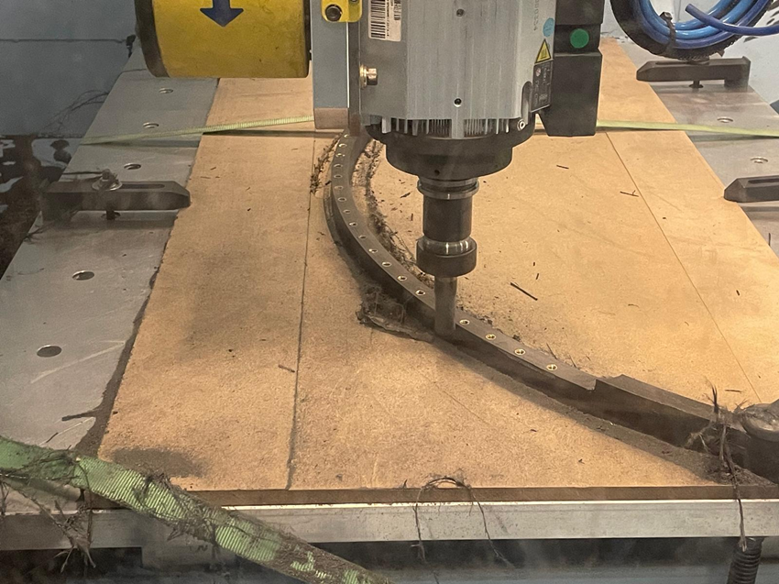
Remanufacturing End Rings
Remanufacturing the end rings would involve reusing the existing molds, manufacturing 8 more quarter sections, gluing them together and machining them as a last and final step
Ideally this means that the end rings final dimensions will be accurate to the level of the CNC machine that is doing the final milling.

Slide 7
Schedule
Charles (SBU) had mentioned that they can start milling the foam to shape but only cutting to 80-90% final size to mitigate some schedule delays. Thereby reducing the milling time if we have to produce new end rings
Sushrut has machining time on the large CNC router for the sensor plates in mid to late July already. This was the biggest delay overall

Slide 8
Conclusion
The outcome of the meeting was that we would pursue both options.
First, we can test fit the rings that we already have to see if there's any way to make them work by milling some extra area of the foam.
Second, Sushrut will put together estimates on whether we can remanufacture the rings.

Slide 9
Questions?

