Slide 1
Electronics and DAQ WG – 8/20/24
Announcements:
DAC meeting 6/21/24 (Dave Abbott to present for Fernando as Chief Electronics Engineer)
Zenodo document database announced last Friday in General Meeting:
Link with ORCID iD & Email eic-software-l-owner@lists.bnl.gov
Will need keyword discipline.
“epic-eic”
“epic-electronics-daq”
As I get time, will migrate the sharepoint docs to the Zenodo…
EICUG / ePIC collaboration meeting July 22-28
Thursday July 25th: all day joint SRO+DAQ workfest
Topics “supporting detector development” and “integrating SRO to simulations”
Parallel to: MPGD / SVT / Path towards holistic reconstruction / PID / Integration
Friday afternoon will split our group
Parallel: MPGD / TOF / Vertex Finding / HCROC / Interaction Tagger sessions
Saturday summary of parallel sessions…
WG Meetings.
6/27, 7/4, 7/11, 7/18 , 7/25 (Possibly augmented by Tuesday SRO meetings)

Slide 2
Electronics and DAQ WG – 8/20/24
Announcements:
Discussion of proposed protocol document
See todays indico
See ePIC DAQ WIKI -> Talks and Slide Library -> DAQ Directory Link -> proposed_DAQ_PROTOCOL_v0.1.pdf
Starting point for detailed discussion, not a finished concept!
Overleaf, currently shared with Fernando, Myself, Jin & Dave. I can add anyone interested…

Slide 3
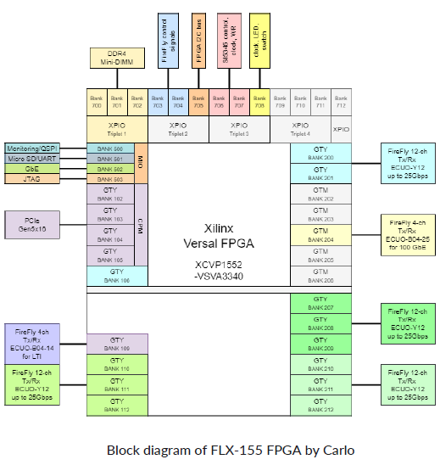
Fiber Links between GTU/RDO/DAM/FBDC
RDO – 48 GTYP transceivers (up to 32.65gbps)
expect 14gbps firefly (25 is possible)
8gbps 8b10b -> 64bits synced to BCO
FBDC – PCIe Gen5 (16 GTYP transceivers)
WORLD – 100GbE (GTM transceivers)
GTU – 4 GTYP transceivers (up to 32.65gbps)
expect 14gbps firefly (25 is possible)
encoding? Synced to BCO but not 8b/10b?
- up to 80 bits x 3 links?
- fourth link used for dedicated timing

Slide 4
GTU Fanout Scheme:
Distribute copies of GTU signals to O(140) DAM boards to be forwarded to RDO. These signals should reach RDO boards with fixed latency (Assume 64 bits / BX)
Distribute copies of a dedicated clock to O(140) DAM boards
Independently address (some) commands to up to 32 detectors/groups of detectors
Receive in the GTU at least N bits of Flow Control / Time Frame Status information from O(140) DAM boards. (N = up to 64)
Receive in the GTU at least N bits of information constructed for triggering from a specific selection of DAM boards TBD (N = up to 160)
GTU is going to be complex:
Define a group to discuss the hardware details & options
Project does have PED engineering defined for this, but we should consider options? Tree of FELIX boards?

Slide 5
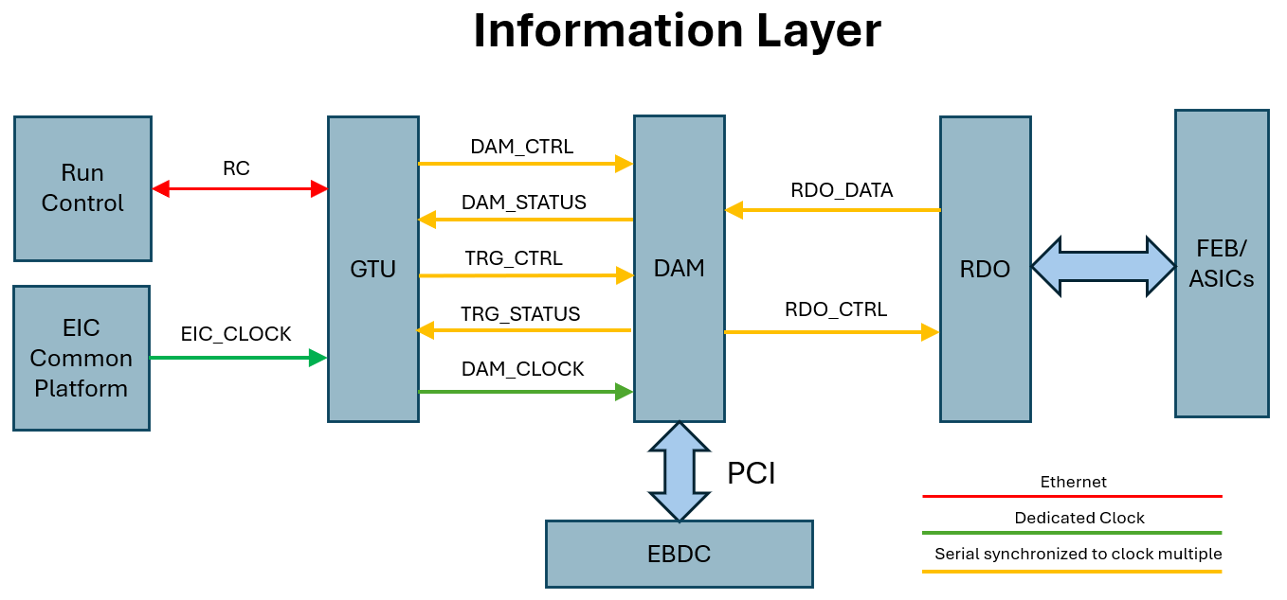
DAM_CTRL = 64 bits. Same information copied to all DAM. Forwarded to RDO_CTRL
DAM_STATUS = 20(64) bits DAM information copied back to GTU.
Timeframe handling, Error conditions, Dam responses (e.g. returning control after config)
TRG_CTRL = 20(160) bits Send trigger commands (to selected DAM boards)
TRG_STATUS = 160 bits Return summary information (from selected DAM boards)
RDO_CTRL = 64 bits Clock + RDO commands
RDO_DATA = 64 bits ASIC DATA + SC data + headers

Slide 6
Feature Implementation
Bunch definition
BCO itself:
64 bit BCO
Time frames maximum 16 bits
BCO verification (require verification at least every timeframe)
Periodic full specification
Checksum-like verification of bits over many bunchcrossings (7 bit scheme?)
Beam Info (REV_TIC x 2, BUNCH_FILLED x2)
Resync (issued by RDO or by GTU)
Time Frame Handling
Start/Stop frames (Start is enough!?), or automatic handling by fixed duration?
Time frame identification
High order bits of BCO?
Re-usable identifier (token)

Slide 7
Feature Implementation
RDO and DAM Data Processing Flags.
Identify periods when unprocessed data should be kept
Firmware, Run Control Configuration & Resets
Likely these involve giving control to the DAM boards and selecting appropriate data to be loaded via run control or slow controls. But need command to indicate to DAM board to take over, and for the DAM boards to relinquish control when they are finished.
Fast configuration
We have had discussions of potential configuration during a run
Could involve calibration control, error mitigation and recovery. Possibly to be handled by standard configuration scheme, but if so need to indicate when certain components are disabled for timeframe building and coherency
Triggering
Firing hardware actions / activities (e.g. laser or pulser system, requests to read slow controls information, or to write out unzero-suppressed for a short time to calculate pedestals)
Firmware trigger as needed by dRICH / low Q2 taggers

Slide 8
Feature Implementation
Flow control
Sense ASIC overflow/truncation
RDO overflow/truncation
DAM overflow/truncation
Prevention strategy
Sense truncation and apply deadtimes?
Force deadtime before truncation occurs?
We don’t need perfection, but we must clearly sense, mark, and minimize overflow situations!
Data link
Will consist of multiplexed headers, ASIC data, & SC data.
Define headers
Provide link between BCO and ASIC clock based time measurements

Slide 9
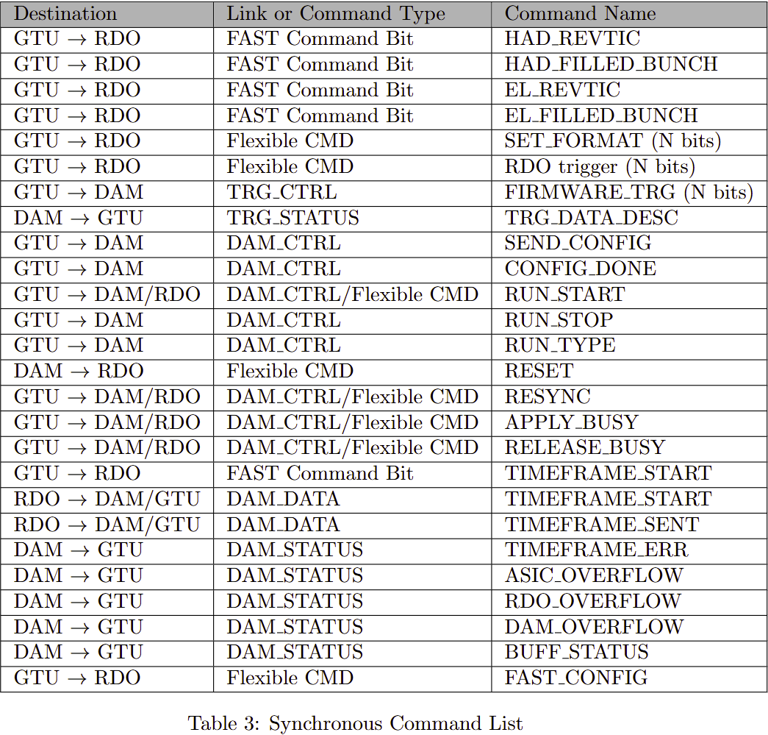
Started to think about the kinds of define commands to implement these features.
5/29/24 command structure
Proposed command structure

Slide 10
Way forward:
Discussions of details
How to handle other proposed schemes?
Email list?
Mattermost?
Subgroup(s) particularly for GTU specification

