Slide 1
Virtual Human Global Summit: Overview and Updates
Eric Stahlberg, PhD
New York Scientific Data Summit
September 16, 2024
SUNY Global Center, New York
Contact: Eric.Stahlberg@nih.gov

Slide 2
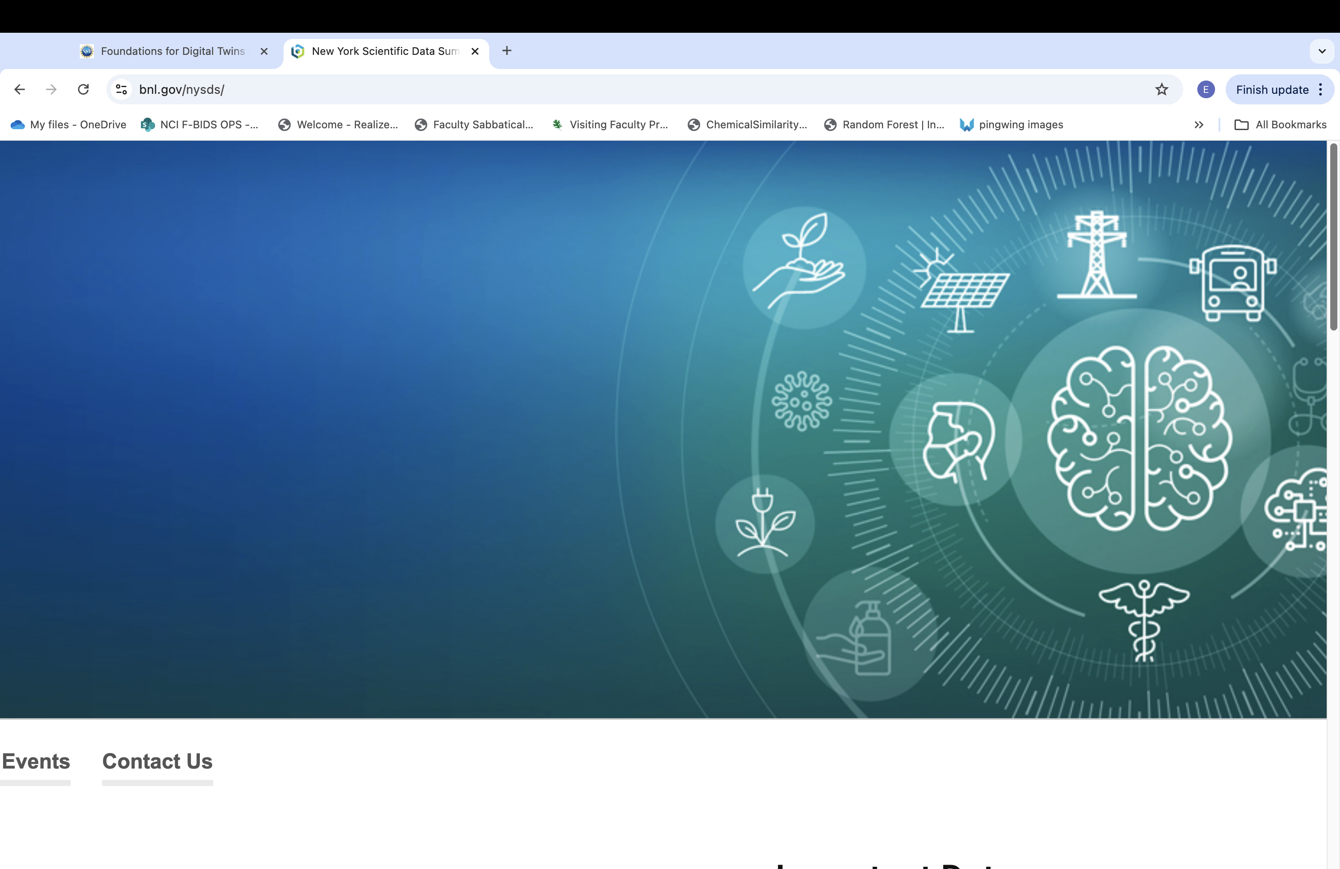
Welcome
Context and Perspectives
First Virtual Human Global Summit – 2023
Who was there?
What was it about?
What was learned?
Updates
Summary
New York Scientific Data Summit 2024

Slide 3
Frederick National Laboratory for Cancer Research
FNL’s mission: To provide a unique national resource for the rapid development of new technologies to address some of the most urgent and demanding problems in the biomedical sciences, including cancer, ongoing unmet challenges in HIV/AIDS, and threats of emerging infectious diseases.
FNLCR is the only Federally-Funded Research and Development Center (FFRDC) dedicated exclusively to biomedical research
Operated in the public interest by Leidos Biomedical Research, Inc. on behalf of the National Cancer Institute
Two major campuses in Frederick, MD-- located at Fort Detrick and the ATRF
Frederick National Laboratory employees co-located with NCI researchers and other contractors
Additional Frederick National Laboratory scientists at Bethesda and Rockville sites
3

Slide 4
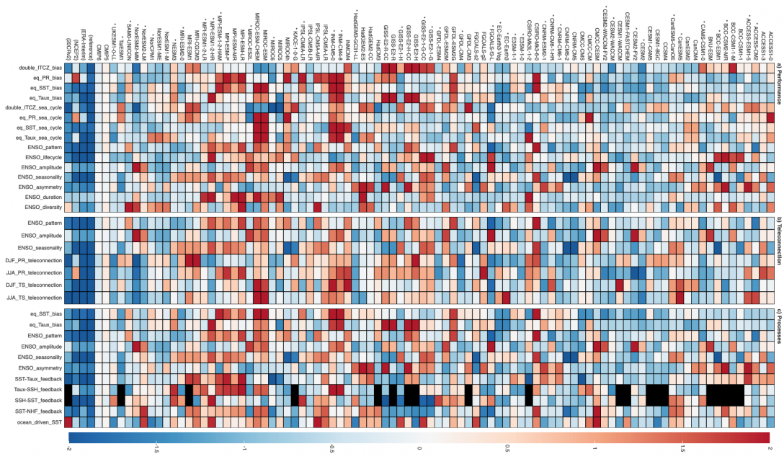
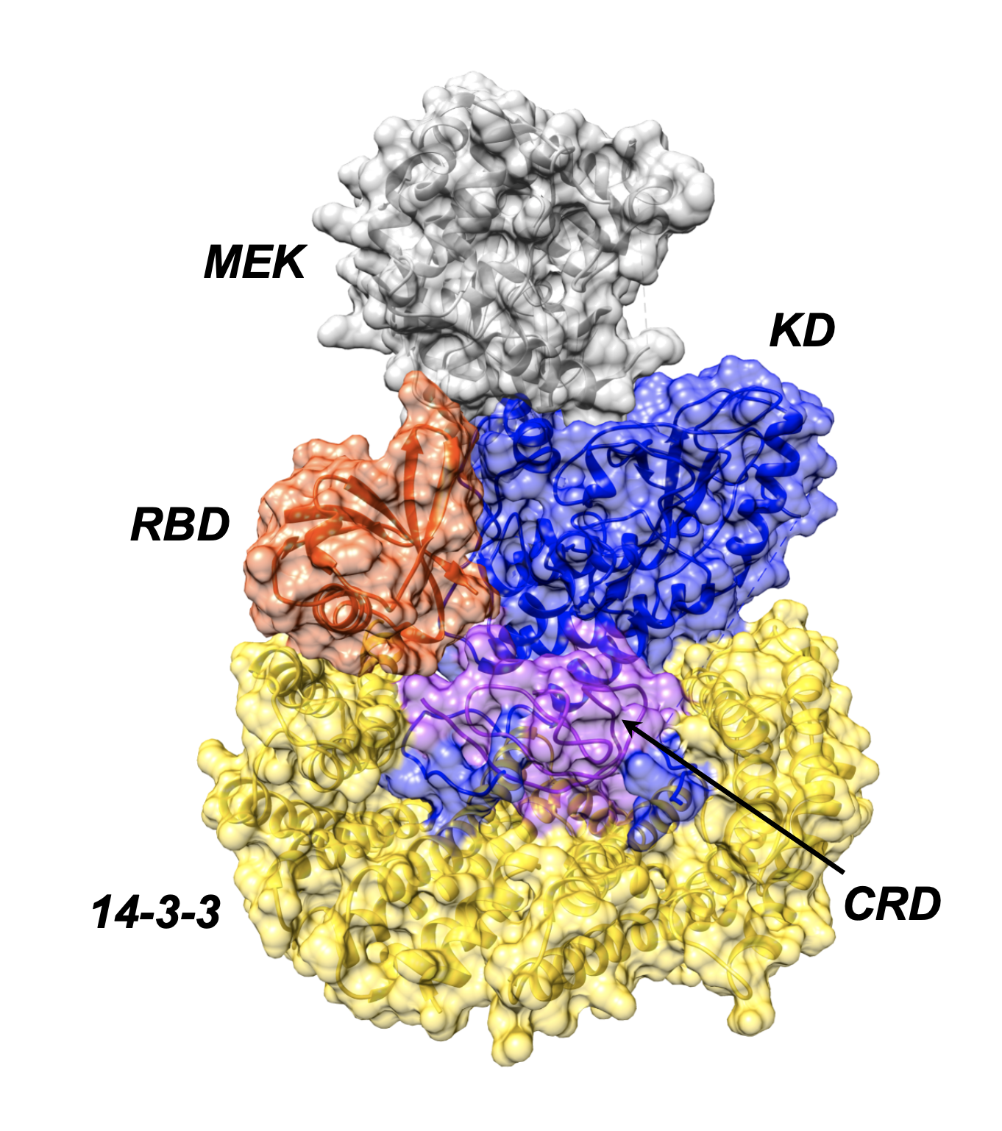
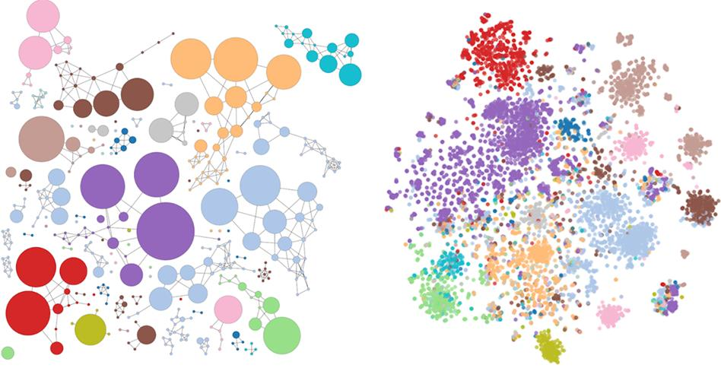
NCI-DOE Collaborations Advance Cancer Research Using Computing A collaboration between the Department of Energy and the National Cancer Institute
IMPROVE
Innovative Methodologies and New Data for Predictive Model Evaluation
Rick Stevens (ANL)
Jeff Hildesheim (NCI)
Ryan Weil (FNLCR)
ADMIRRAL
AI-Driven Multiscale Investigation of RAS-RAF Activation Lifecycle
Dwight Nissley (FNLCR)
Fred Streitz (LLNL)
MOSSAIC Modeling Outcomes using Surveillance data and Scalable AI for Cancer
Betsy Hsu (NCI)
Heidi Hanson (ORNL)
NCI
National Cancer Institute
Computing driving cancer advances
DOE
Department
of Energy
Cancer driving computing advances
Notes:
Pilot 1: Predictive model of drug response; UQ and improved experiment; develop hybrid (mechanistic/ML) models
Patient derived xenographs or cell lines
Pilot 3: Information capture; Information integration; Population-level modeling

Slide 5
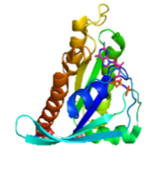
Cancer Patient Digital Twin: New insights and approaches from molecular to patient scale
Multiple perspectives
Integrated objectives
MOSSAIC
Patient Level Surveillance
New observables
New data
New approaches
Prescriptive cancer models
Patient specific disease ensembles
IMPROVE
Cellular Scale AI Predictions
Multiple distinct cancer models
Reaching the Patient for Impact
Single cancer
ensemble
Multi-scale
Multi-cell models
ADMIRRAL
Molecular Scale Predictions
Multi-mechanism
Multi-ensemble
Multi-scale
Single cell models
ATOM
Molecular AI Predictions
Multiple starting points team collaborations
Single mechanism
Single ensemble
Multi-mechanism
Single ensemble
Single mechanism
Single trial
Notes:
Human body has approximately 10^27 ATOMS

Slide 6
Challenges in Medicine Today
Clinicians are overloaded
Too many patients, too much information, not enough insight
Patients are disconnected
Access to care challenges, information fragmentation
Increasing diagnostic and treatment options
Innovation, AI and technology advances
Treatments are increasingly expensive
Balancing broad use and precision medicine
Outside patient factors
Behavior, nutrition, compliance, overall wellness
Exposure factors
Social Determinants of Health
Education
Keeping up with it all
How do we improve the health of everyone, including the medical system?
Notes:
Clinicians are overloaded
Too many patients
Too much extra work
Too much extra information
Too little quality information
Too much uncertainty
Too many choices and too few
Rapidly advancing capabilities
Limited computational literacy
Limited patient understanding
Limits precision medicine
Needing new approaches
Patients are disconnected
Too many doctors for some
Too few doctors for others
Too much extra information
Too little useful information
Lack of awareness
Too many choices and too few
Limited medical and computational literacy
Seeking new greater personalization
Wanting new approaches
Treatment development is expensive

Slide 7
“The Digital Twin Approach”
Digital twin brings predictive analytics to the forefront
Explore possible treatments
Pursue and refine hypotheses
Explore conditions and scenarios
Progressively iterate and integrate understanding and insights
Personalized scenarios
(identical population with directed variability)
Goal: Provide critical insights for the individual patient

Slide 8
First Virtual Human Global Summit – October 3-4, 2023
Bringing global digital twin communities together from research to patient
Over 80 attendees from multiple countries, domains, disciplines, and perspectives
Website: https://www.bnl.gov/virtual-human-global-summit/

Slide 9
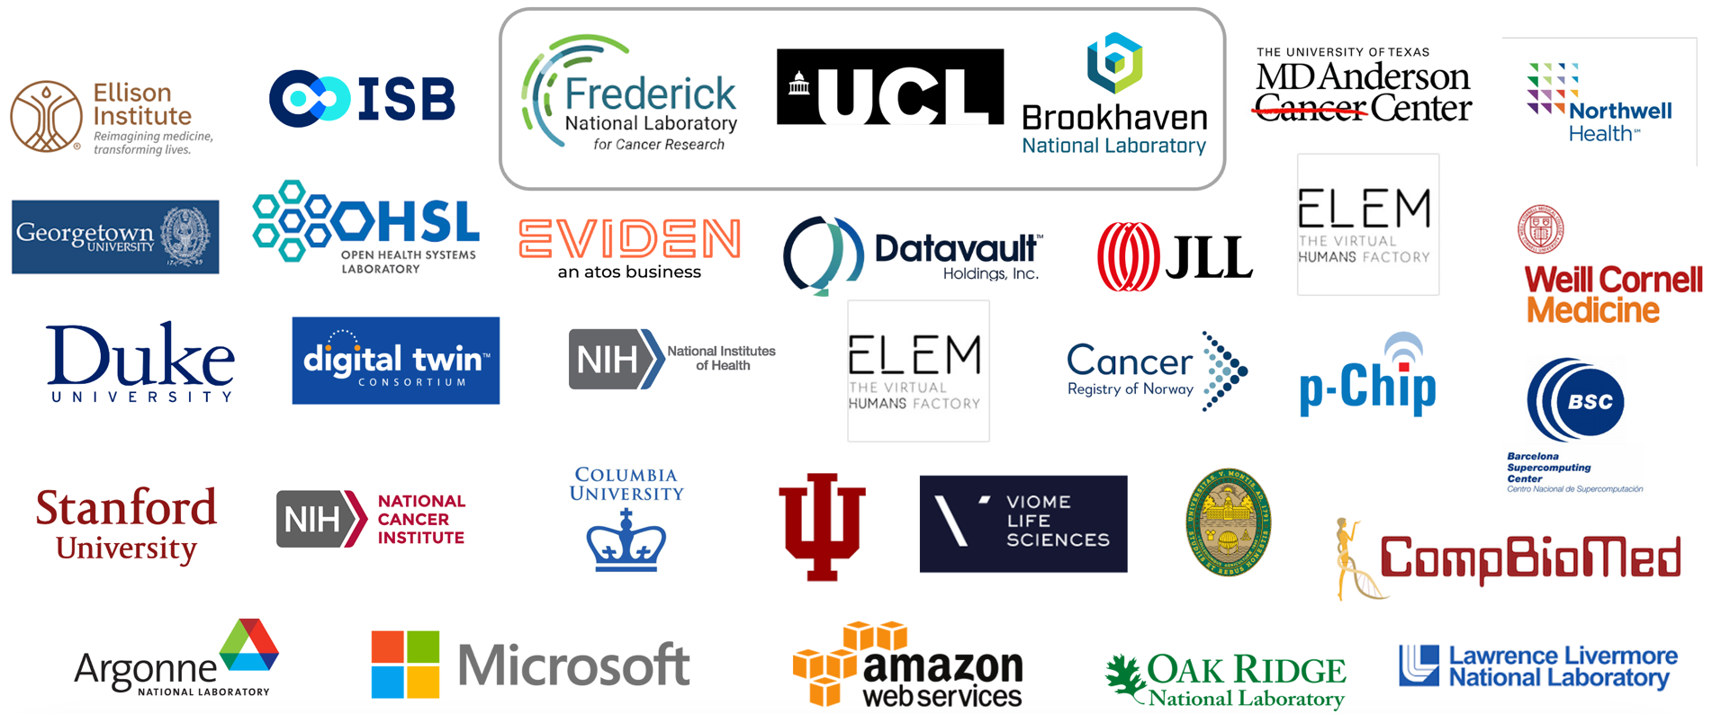
First Virtual Human Global Summit – October 3-4, 2023

Slide 10
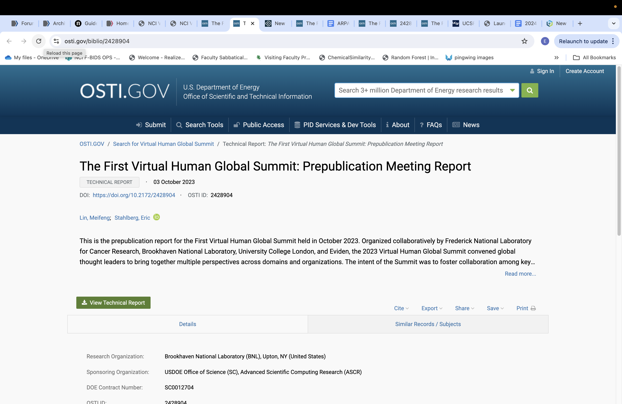
First Virtual Human Global Summit – October 3-4, 2023
Bringing global digital twin communities together from research to patient
Over 80 attendees from multiple countries, domains, disciplines, and perspectives
Website: https://www.bnl.gov/virtual-human-global-summit/
Report available: https://www.osti.gov/biblio/2428904

Slide 11
VHGS Participation Statistics
Cross-disciplinary
Industry aggregate market cap over $5 trillion
Start-up to large multi-national corporations
Over $13 billion annual academic research investment
Based on the NSF Higher Education Research and Development Fiscal Year 2022 report
Health system representation
Northwell - largest community health system in New York state
Over ten academic medical research organizations and clinical hospitals
Government organizations and agencies
DOE, NIH, NCI, Cancer Registry Norway
Multinational representation
US, UK, Canada, Norway, Spain, India, Catawba Native American tribe, and Mohawk Native American tribe

Slide 12
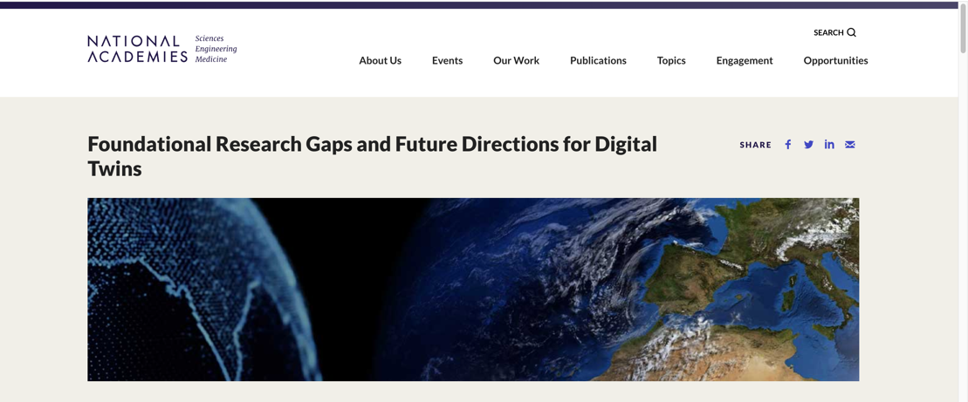
National Academies of Science, Engineering and Medicine: 2023 Report on Digital Twins
US National Academies of Science, Engineering and Medicine Report released December 2023
Emphasized Research Gaps and Future Directions
Download:
https://www.nationalacademies.org/our-work/foundational-research-gaps-and-future-directions-for-digital-twins
“A digital twin is a set of virtual information constructs that mimics the structure, context, and behavior of a natural, engineered, or social system (or system-of-systems), is dynamically updated with data from its physical twin, has a predictive capability, and informs decisions that realize value. The bidirectional interaction between the virtual and the physical is central to the digital twin.”

Slide 13
Digital Twins for Cancer
Improve awareness
Brings predictive analytics forward
Explore options and choices
Pursue and refine hypotheses
Intersection of Insight and Innovation
Image source: National Academies Sciences, Engineering, Medicine
Foundational Research Gaps and Future Directions for Digital Twins (2023)

Slide 14
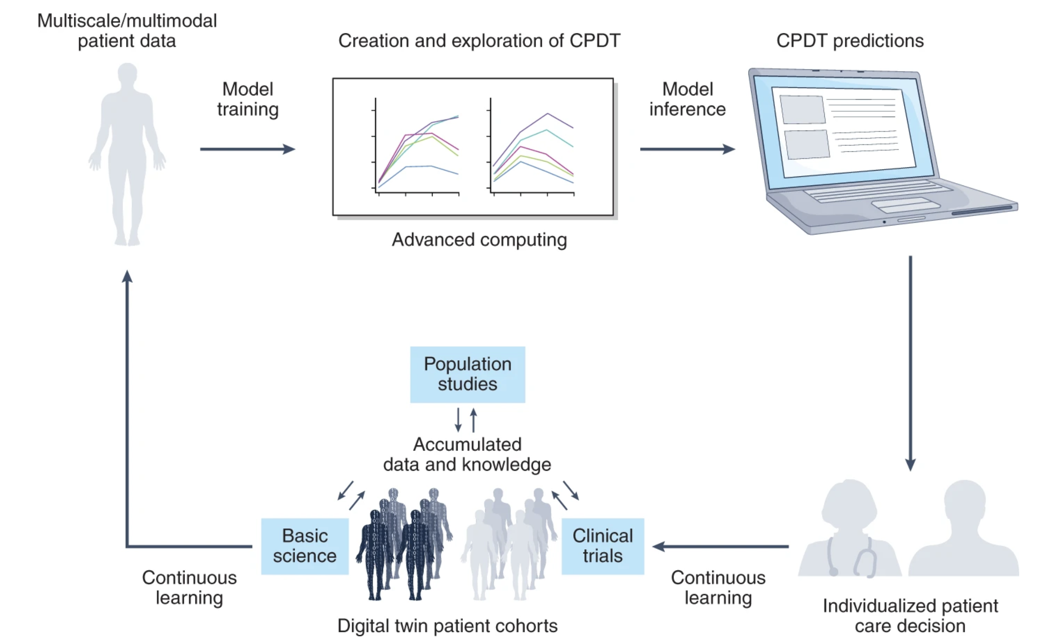
Digital Twin Paradigm for Cancer Patients
Digital twins for cancer patients based care bring together data, models, computing, and technology together with researchers, patients and physicians to improve the care options for each individual.
Image from Hernandez-Boussard, T., Macklin, P., Greenspan, E.J. et al. Digital twins for predictive oncology will be a paradigm shift for precision cancer care. Nat Med 27, 2065–2066 (2021). https://doi.org/10.1038/s41591-021-01558-5

Slide 15
The Challenge: Digital Twin Learning System
Patient-tailored models incorporating multi-omic, clinical, environmental and social data that can evaluate and predict the most effective prevention and therapeutic plans
Spatial Scale
Time Scale
Patient Care Decision
PREDICTIONS
Notes:
Creating cancer patient digital twin technology stands as a grand challenge for the convergence of advanced computing technologies and oncology.
An individual’s phenotype (including personal/family history, genome, proteome, immunology, clinical characteristics) among many other factors is used to determine cancer treatment options
It involves bridging spatiotemporal scales as never before -- from the molecular, cellular, and tissue levels to the individual, population, and environmental levels., from processes that occur within nanoseconds to others that take years or decades
At each scale, agents interact with each other, and it will be necessary to identify the multitude of variables -- many not currently captured systematically -- that allow scales to be bridged and connected.
By using a digital twin to make predictions, one can begin to determine multiple personalized care trajectories that can inform shared decision making between the patient and doctors
Data from these decisions can be fed back into the system to iteratively improve the digital twin and accuracy of predictions in an active learning loop
Advancing digital twin technology will benefit from dynamic, large-scale, multidisciplinary collaboration and is a major opportunity for co-design efforts integrating cancer research with artificial intelligence and advanced computing technologies.

Slide 16
Medical Digital Twins: Drivers and Interest
Motivations for Medical Digital Twins
Improve health, wellness, and care for each person
Represent the next frontier for precision medicine
A means to learn from every patient to help all patients
Focuses future research on key gaps in translational
Path for translation of research to clinical application
Improve collaborative patient involvement
An avenue to address medical disparities
The low current technical barrier to entry
Ethics
Uncertainty
Cost
Culture
Payment
Fairness
Privacy
Data
Liability
Bias
Quality
Complexity
Reliability
Controversy
Self interest
Unknowns
Mistrust
Skepticism

Slide 17
Challenges Facing Medical Digital Twins
“Trustworthiness, we agreed, is probably the most pressing near-term concern. Addressing the provenance of information and its traceability is key.”
IEEE Spectrum 2023 Editor’s Note, AI Everywhere, All at Once
Social and Societal Challenges
Achieving cross-stakeholder buy-in
Cultural and social changes needed
Setting accurate expectations of use of MDT
Technical Challenges
Establishing baseline healthy state for each individual
Quality data
Affordable and accessible computational implementations
Methodologies for trust
Financial Challenges
Cost of first implementations
Reimbursement pathways
Regulatory, privacy, and liability concerns
Photo by Joshua Hibbert on Unsplash

Slide 18
Feasibility of Medical Digital Twins
Medical digital twins exist today in limited applications, including:
Cardiovascular
Respiratory
Diabetes
Sepsis
Cancer
Medical digital twin solutions will problem driven
Technical infrastructure exists in several instances
The repertoire of predictive human models is growing
Availability medically relevant data is also growing

Slide 19
Medical Digital Twins: Things to Address Now
Focus on personal health and wellness, not just treatment
Organize the global community
Engagement and communication
Communicate across stakeholders
Engage patients and advocacy groups
Build awareness of benefits
Identify specific problems
Develop training
Build trust
Technical foundations
Develop individual patient health baselines
Sustainable and equitable access to data
Enable models and data to move ahead together
Notes:
Focus on personal health and wellness, not just treatment
Organize the global community
Engagement and communication
Communicate across stakeholders
Engage with patients and patient advocacy groups
Build awareness of benefits
Identify problems to be addressed
Develop training opportunities
Build trust in technologies
Technical foundations
Develop individual patient health baselines
Enable models and data to move ahead together
Approaches for sustainable and equitable access to data

Slide 20
Updates on Medical Digital Twins
Standing NSF-NIH-FDA call for “Catalysts for Biomedical Digital Twins”
Next responses due May 2025
https://new.nsf.gov/funding/opportunities/fdt-biotech-foundations-digital-twins-catalyzers-biomedical
Upcoming Digital Twin Workshop by NIH Interagency Modeling Group
URL: https://www.imagwiki.nibib.nih.gov/news-events/imag-hosted-events
September 30 – October 2, 2024
Open to all
Public Portal for Computational Cancer Resources
Primary URL: https://computational.cancer.gov
Model and Data Clearinghouse: https://modac.cancer.gov
Stepping off point for cancer digital twins
User group to build the community
First Virtual Human Global Summit Report Released
Prepublication meeting report from October 2023
Medical Digital Twins – Research to Operation
Available at: https://www.osti.gov/biblio/2428904
Growing broader interest observed at the latest Digital Twin Consortium Member meeting

Slide 21
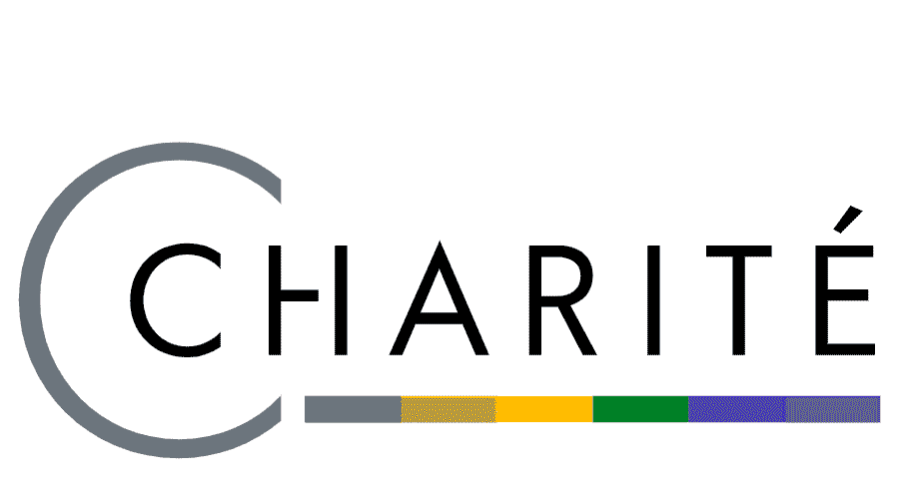
ATOM: Portable Predictive Models in Health
Increase Access
Current AMPL Availability
FNLCR FRCE computing environment
NIH Biowulf
DOE ORNL Frontier system
DOE LLNL system
NSF Darwin (University of Delaware)
NCI supported Cancer Genomics Cloud
Zuse Institute Berlin (supporting Charite’ collaboration)
Multiple sites in India
Availability in Process
FDA – Precision FDA Environment (working through subcontractor)
Cloud computing – Microsoft Azure, AWS, Google Cloud
Collaborative Drug Discovery (CDD) utilization
Digital Twin Consortium
Future support in computational.cancer.gov portal

Slide 22
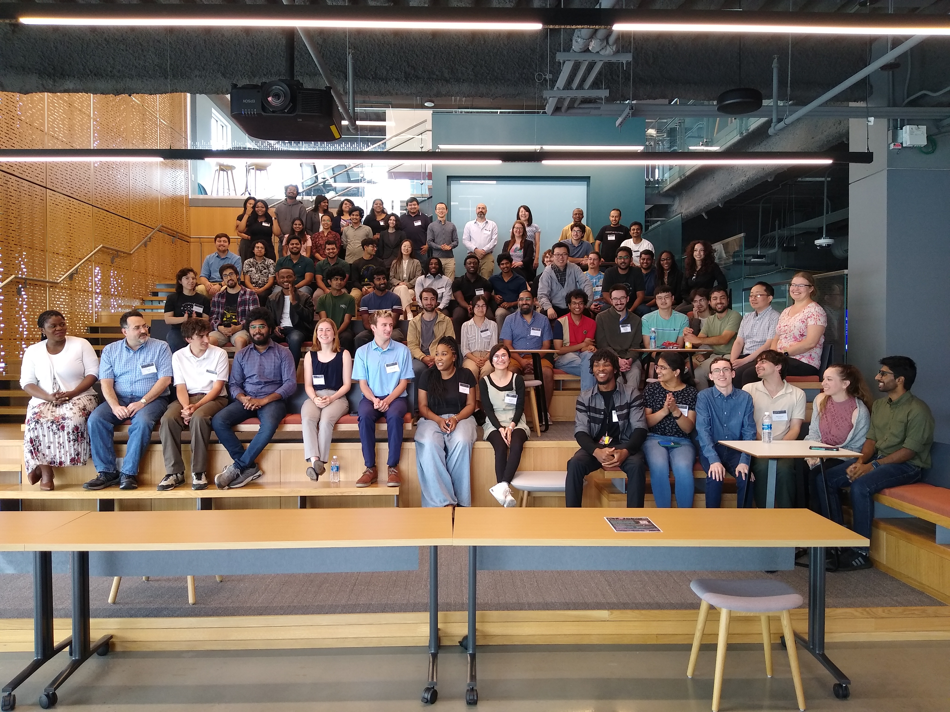
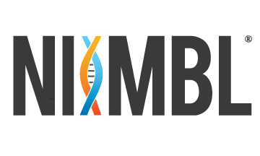
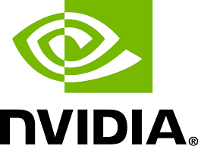
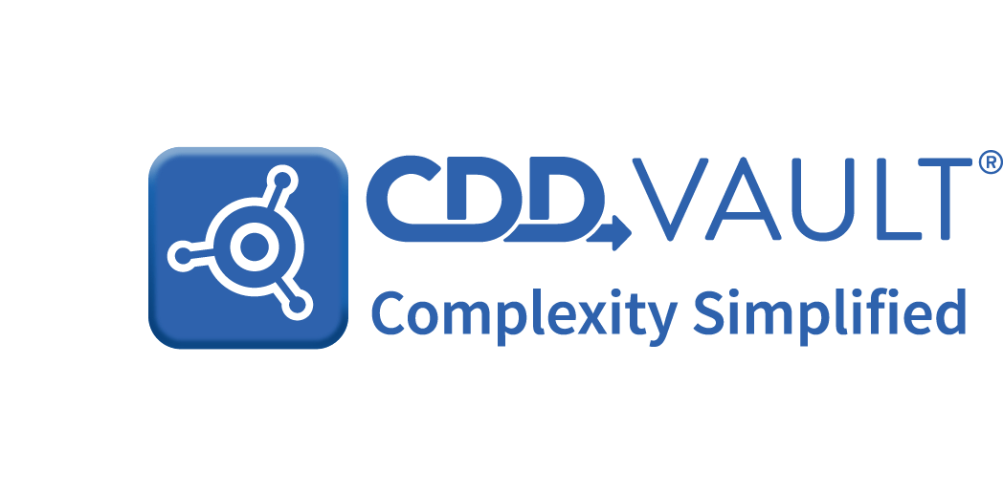
University of Delaware – ATOM Hackathon
July 18-20 at University of Delaware
Over 70 participants from government, industry and academia
Multiple universities
University of Delaware
Delaware State (HBCU)
Bowie State University (HBCU)
UC Berkeley
Northeastern University
Penn State University
UC San Francisco
University of Southern California
Multiple sponsors
Multiple projects
Model development
Software improvement
Drug discovery

Slide 23
Takeaway Points
The Summit….
It’s a special two days – connect and make the most of it
Virtual Human Global Summit
Medical digital twins have great interest
Feasibility is envisioned, challenges remain, next steps are there
Insights from efforts to create medical digital twins can inform analogous issues across verticals
Medical digital twins are moving ahead
Technical overlaps
Government support
Community interest
More work is to be done
Medical digital twins can be aided by insights from other domains

