Slide 1

Curating Carbon Storage Data for Reuse: Enabling Research and Modeling from Earth’s Surface to Subsurface
Paige Morkner
Geologist + Geo-Data Scientist
New York Scientific Data Summit
September, 2024

Slide 2
Authors and Contact Information
Paige Morkner^{1,2}; Abigail Choisser^{1,2}; Michael Sabbatino^{1,2}; Stephen Leveckis^{1,2}; Kelly Rose¹; Jennifer Bauer¹
¹ National Energy Technology Laboratory, 1450 Queen Avenue SW, Albany, OR 97321, USA
² NETL Support Contractor, 1450 Queen Avenue SW, Albany, OR 97321, USA

Slide 3
Disclaimer and Acknowledgement
This project was funded by the United States Department of Energy, National Energy Technology Laboratory. Neither the United States Government nor any agency thereof, nor any of their employees, nor the support contractor, nor any of their employees, makes any warranty, express or implied, or assumes any legal liability or responsibility for the accuracy, completeness, or usefulness of any information, apparatus, product, or process disclosed, or represents that its use would not infringe privately owned rights. Reference herein to any specific commercial product, process, or service by trade name, trademark, manufacturer, or otherwise does not necessarily constitute or imply its endorsement, recommendation, or favoring by the United States Government or any agency thereof. The views and opinions of authors expressed herein do not necessarily state or reflect those of the United States Government or any agency thereof.
This work was performed in support of the U.S. Department of Energy’s Fossil Energy and Carbon Management’s Advanced Storage R&D Carbon Transport and Storage Multiyear Research Plan and executed through the National Energy Technology Laboratory (NETL) Research & Innovation Center’s FWP1025032.

Slide 4
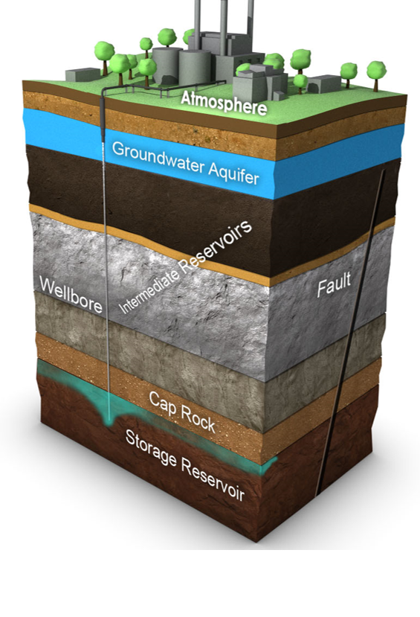
Geologic Carbon Storage
Geologic carbon storage is the engineered process of injecting captured CO₂ into the deep subsurface for permanent storage
To safely and confidently store CO₂, extensive subsurface and surface data is necessary quantify
  Feasibility
  Storage capacity
  Risk quantification
  Cost analysis
  Impact to communities/environmental justice/social justice

Slide 5







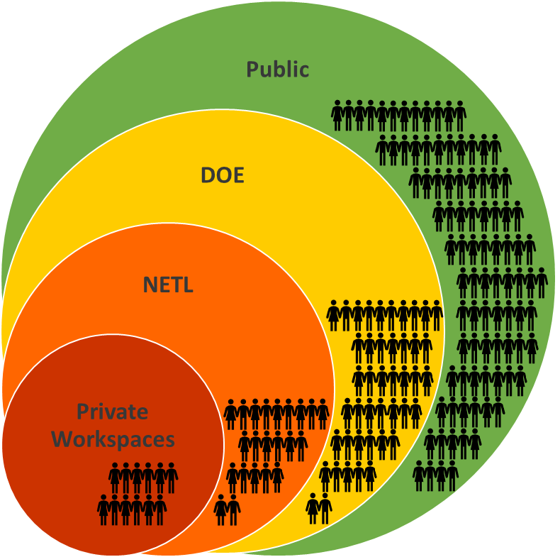







What is the Energy Data Exchange (EDX)?
An online virtual library and laboratory
A comprehensive data clearinghouse and system that enables access to data, tools, presentations, publications, and promotes reuse
Supports the entire life-cycle of data curation through private collaboration and public dissemination
Uses a tiered access approach and roll-based security
Provides tools to enable data visualization and query
6
1
Acquire
Preserve
Collect data from sensors, experiments, simulations, geospatial assets
6
Index, curate, age, track, provenance
1
5
2
Transfer
Publish
5
Upload to EDX
4
2
Disseminate, aggregate, promote
3
Use/reuse
4
3
clean
Anaylyze, mine, model, learn, infer, derive, predict
Organize, annotate, package, filter
Other systems & resources
Off-Prem
Cloud Compute
https://edx.netl.doe.gov/
On-Prem Compute
Tiered, roll-based security for access to data resources

Slide 6


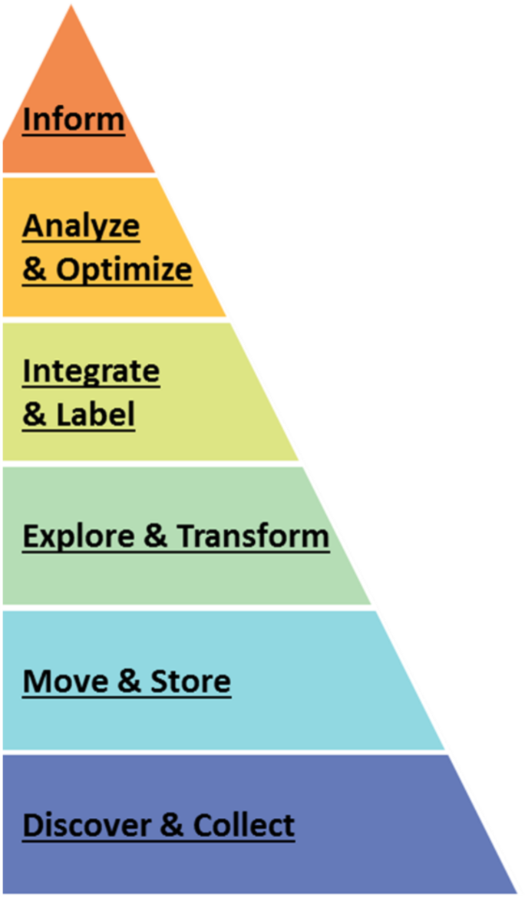












Leveraging EDX for Carbon Storage Data
There is a need to preserve and efficiently access resources to drive the next generation of R&D while ensuring compliance with DOE regulations
Focus shifted in 2015 to preserve and curate carbon storage data products, both public and private through the EDX
Since then, millions of dollars in R&D products have been preserved and made publicly available from carbon storage research and projects
PUBLIC PRODUCTS*
Big Data
PUBS | SPATIAL LAYERS
DATA & WEB TOOLS
PRODUCTS | GROUPS
1000+ | 700+
80+
>3500k | >20

Slide 7
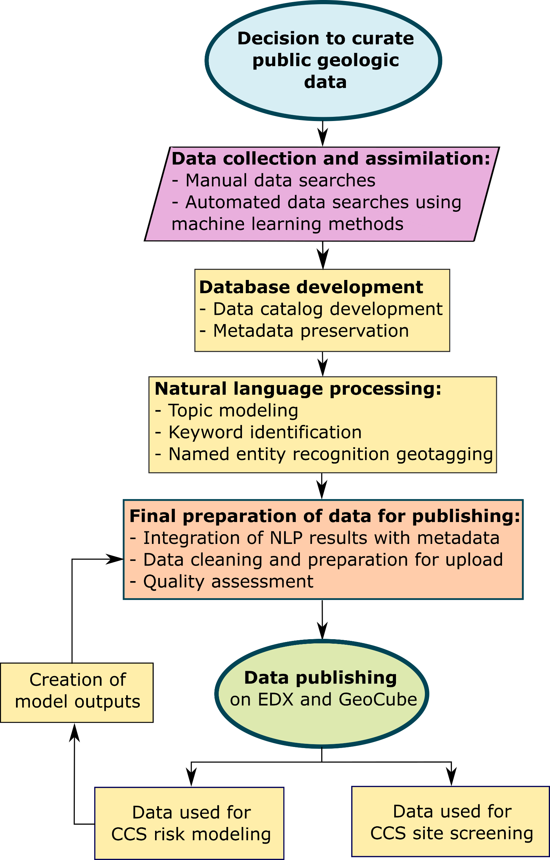
Addressing and Optimizing the Carbon Storage Data Lifecycle
Challenge: Finding open-source data to drive spatial and model-based derivative analysis is not easy nor intuitive
Solution: We have a standardized workflow for collecting, aggregating, curating, and producing data products from open-data resources
Why: At the intersection of geology and data science is the ability to help our end users and ourselves with data visualization, tool development, and derivative data analysis and modeling
How: Through deploying a data lifecycle workflow that integrates artificial intelligence (AI), machine learning (ML), and Natural Language Processing (NLP), and producing tools that enable data discovery and interaction
in Tools
derivative analysis

Slide 8

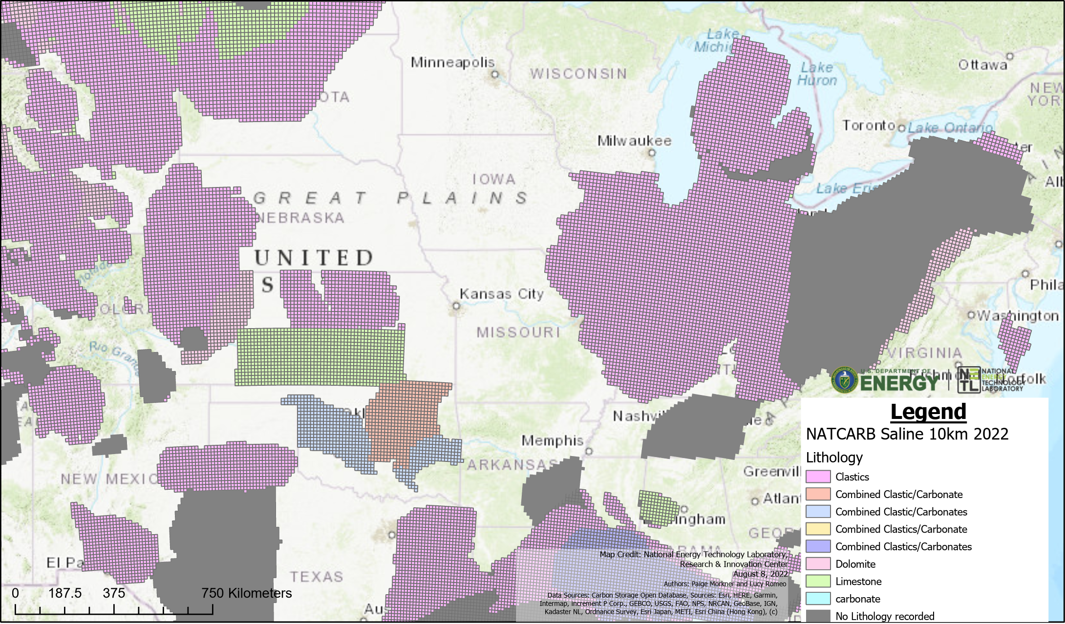
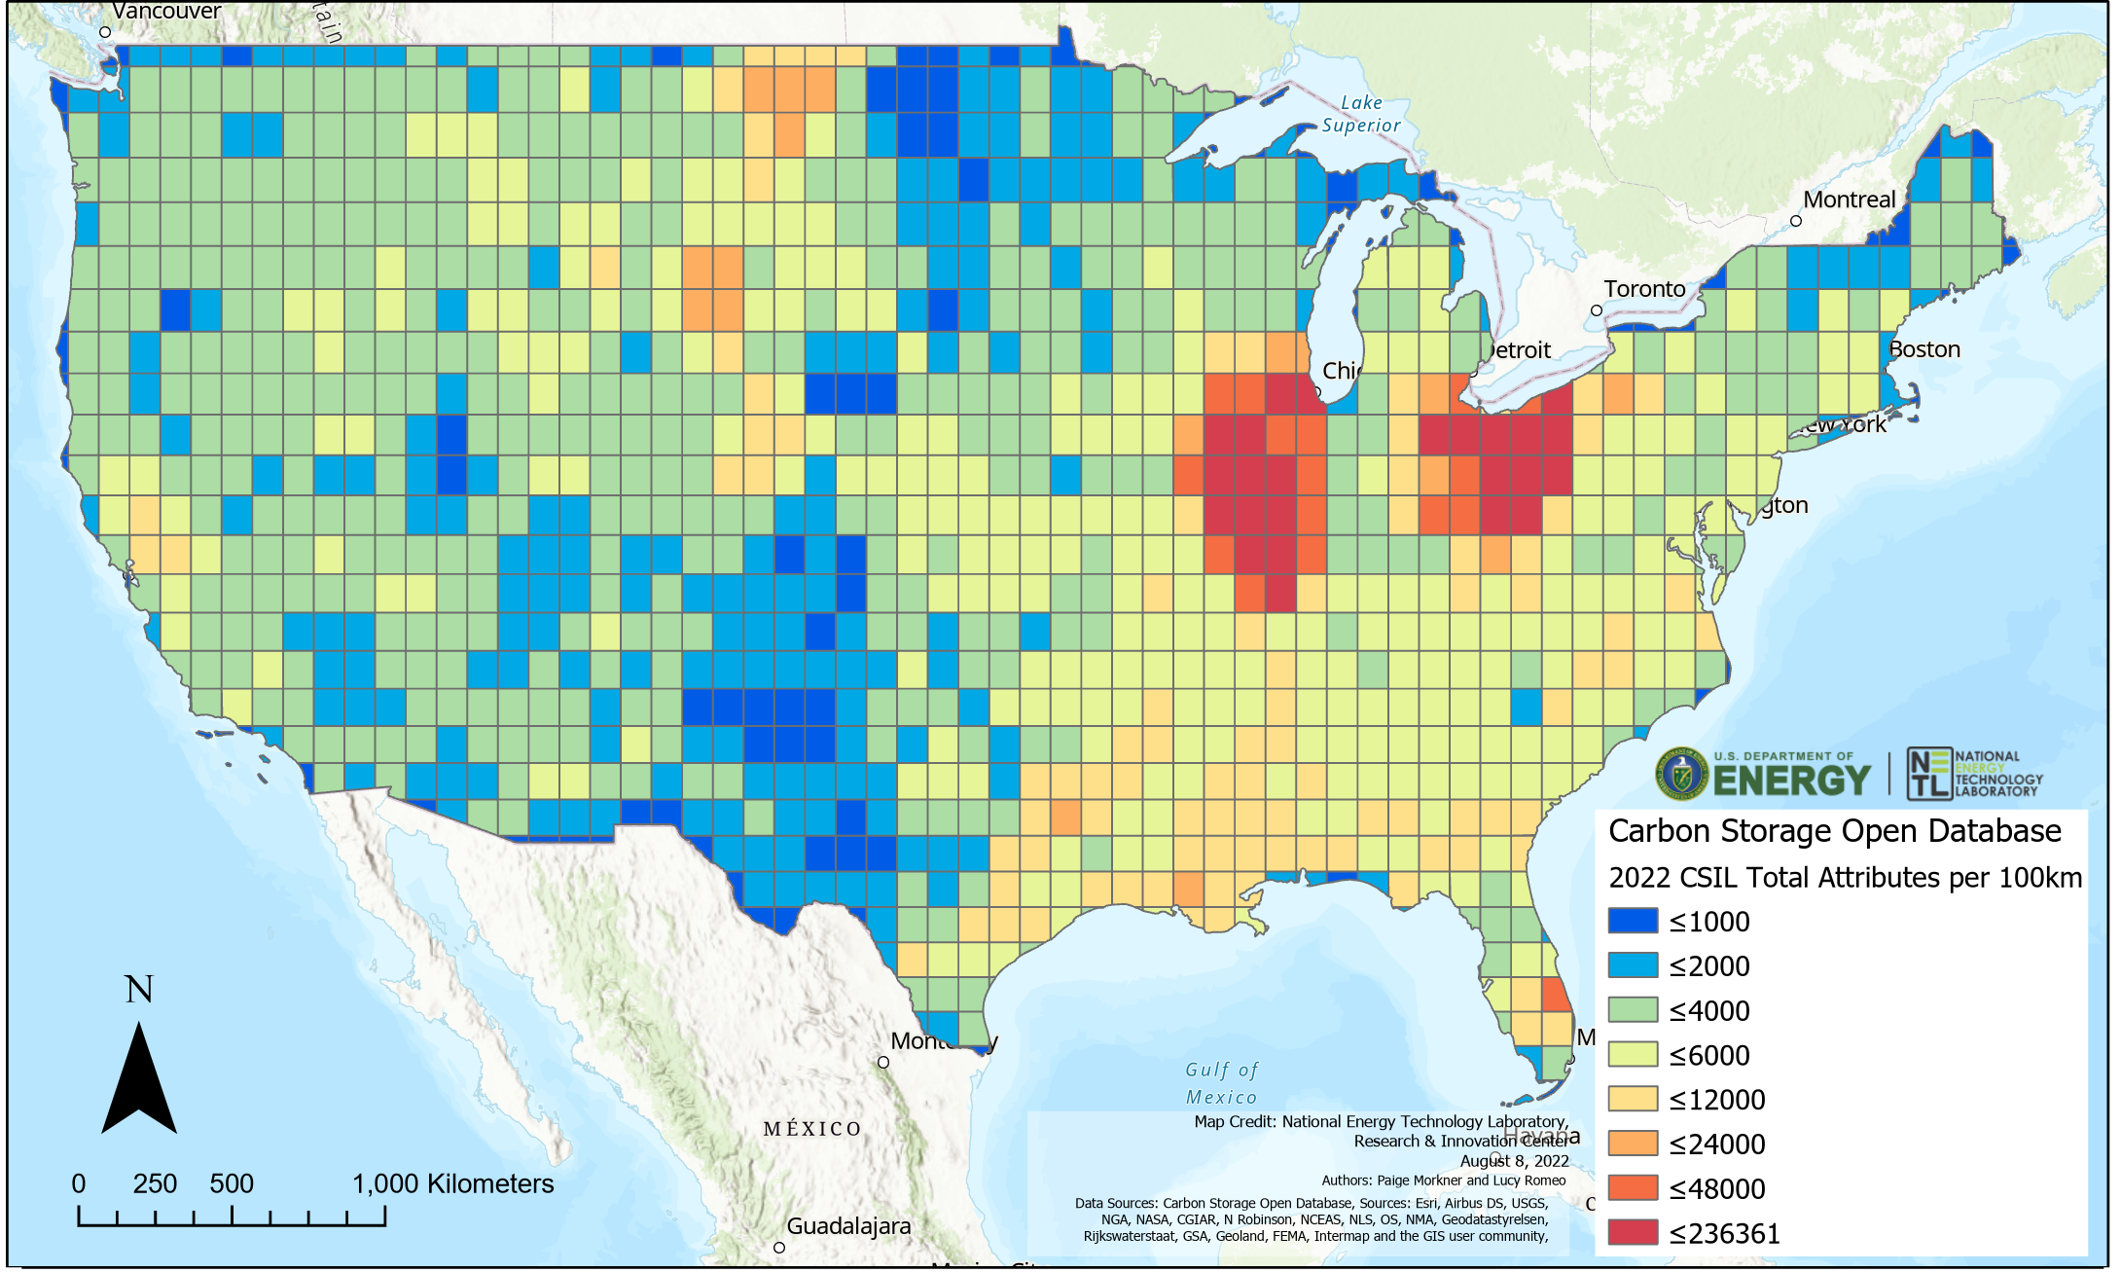

Carbon Storage Data Collections
Data on EDX
3185+ public data resources on EDX related to carbon storage
100+ TB of seismic data on private servers (going cloud)
8+ field projects represented, with two benchmark datasets:
  Illinois Basin Decatur Project
  FutureGen 2.0 Dataset
The National Carbon Sequestration Database (NATCARB)
Reservoir data for deep saline, unminable coal, and depleted oil and gas reservoirs
10km grid layer containing properties for each formation
Key reservoir property data at different spatial scales
Carbon Storage Open Database:
800+ Shapefiles (Lines, Polygons, Points) and Rasters available on EDX’s GeoCube
1846 text-based documents on EDX
1000s of additional resources published to
Example of lithologies identified for NATCARB Saline 10 km reservoir units
Spatial Data Availability Heat Map
Carbon Storage Open Database

Slide 9


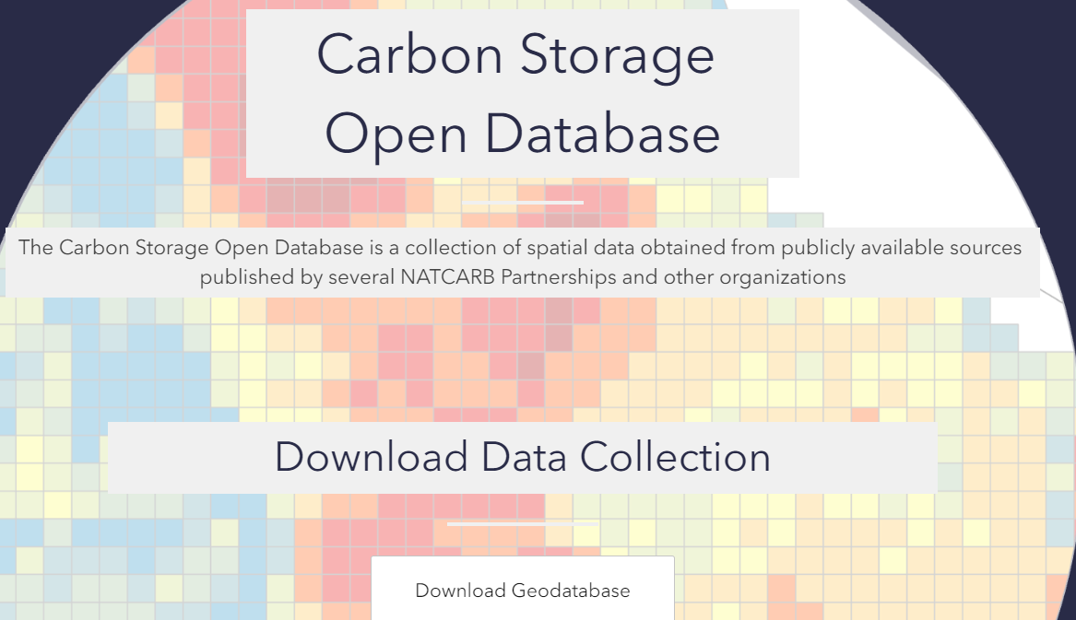

The Carbon Storage Open Database
How do we leverage and curate all the different types of data into a single resource?
ML and NLP can be used to improve collection, movement, storing, exploring, transforming, aggregating, and labeling of data
Public data collection from
expert-driven research and leveraging “smarter” ML/NLP search tools
Text-based data
Text sources parsed with natural language processing for keywords, topic modeling
Information and data is extracted for further use in analytical tools and platforms
Spatial data
ML/NLP tools to increase data discovery

Slide 10
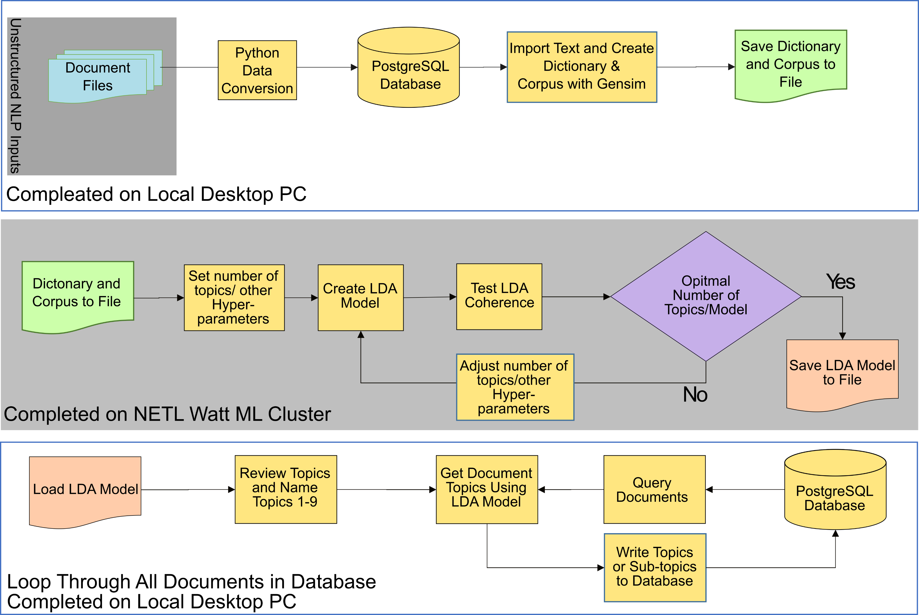

NLP Unsupervised ML for Document Classification
  Problem: 1800+ documents were collected from public resources but needed to be organized prior to publishing on EDX
  Solution: NLP topic modeling
  Latent Dirichlet allocation (LDA) model based on corpus of 2071 text-based documents
  Topic names assigned by subject-matter experts
  Each document is classified by % of each topic it’s associated with
  Each document has 50+ keywords identified and can be associated with metadata on EDX
  Parse geographic location to associate with each document – when possible
Morkner et al. 2022. Distilling data to drive carbon storage insights. Computers & Geosciences, https://doi.org/10.1016/j.cageo.2021.104945

Slide 11
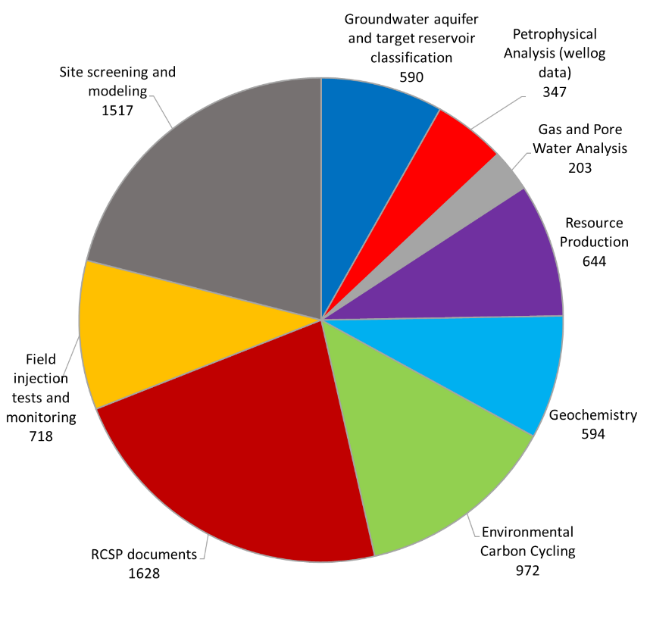

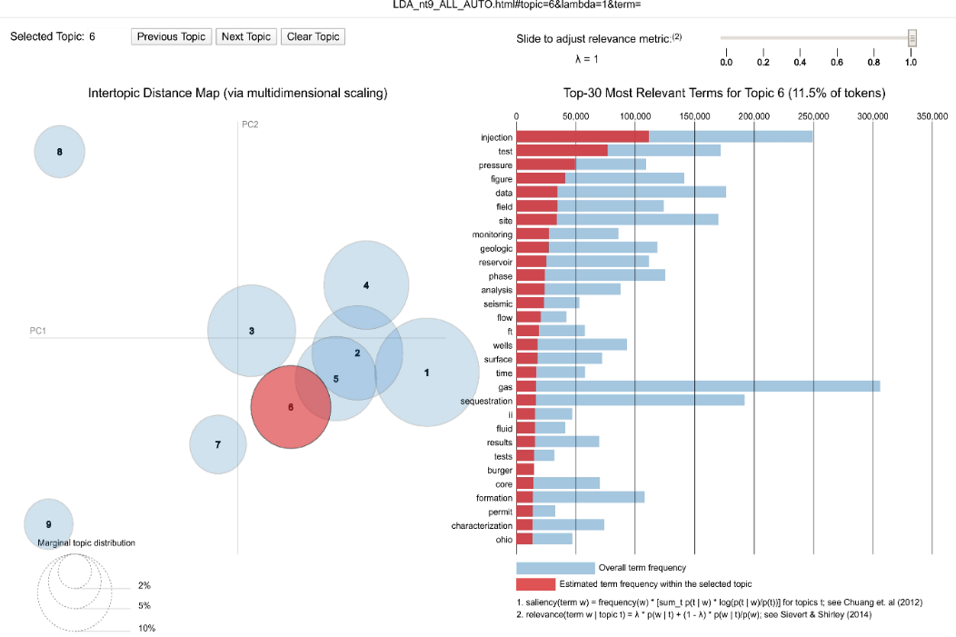

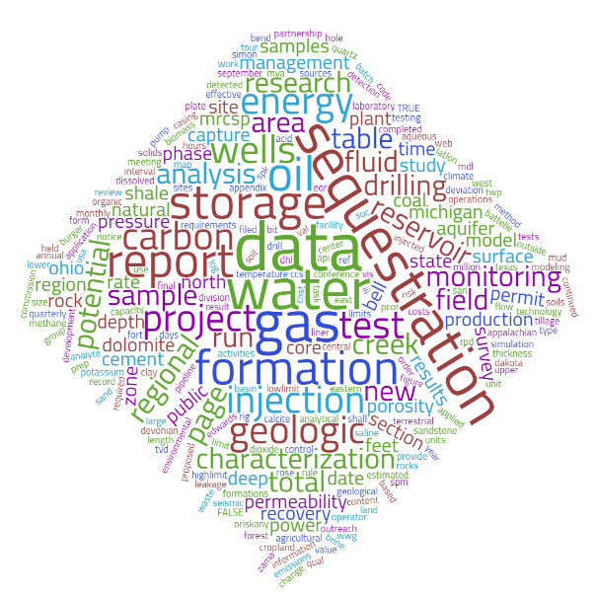
Results: NLP
Produced a nine topic LDA model – grouping similar papers
Produced keywords associated with resources
Geographic location recognition
Papers published in groupings to EDX
Number of documents with at least 1% topic assignment
Field Injection
tests and
monitoring
Morkner et al. 2022. Distilling data to drive carbon storage insights. Computers & Geosciences, https://doi.org/10.1016/j.cageo.2021.104945

Slide 12
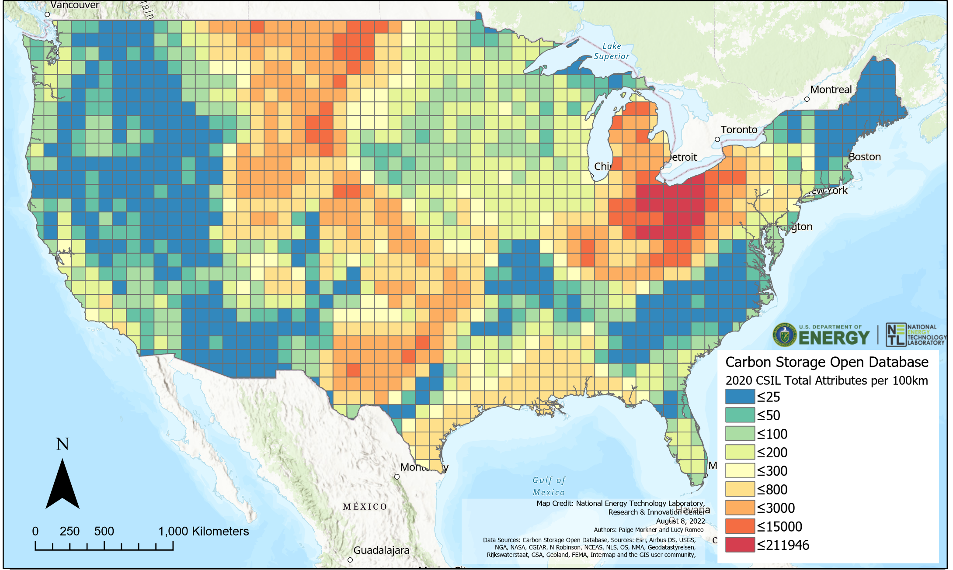
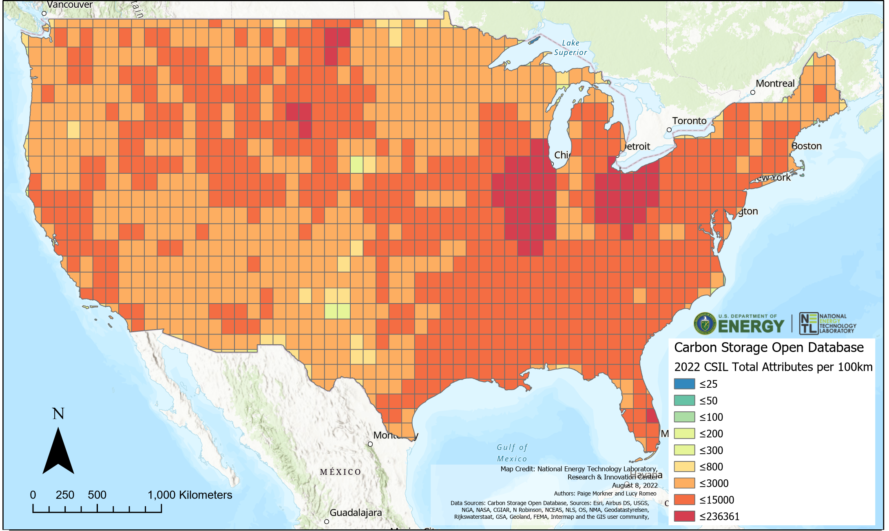
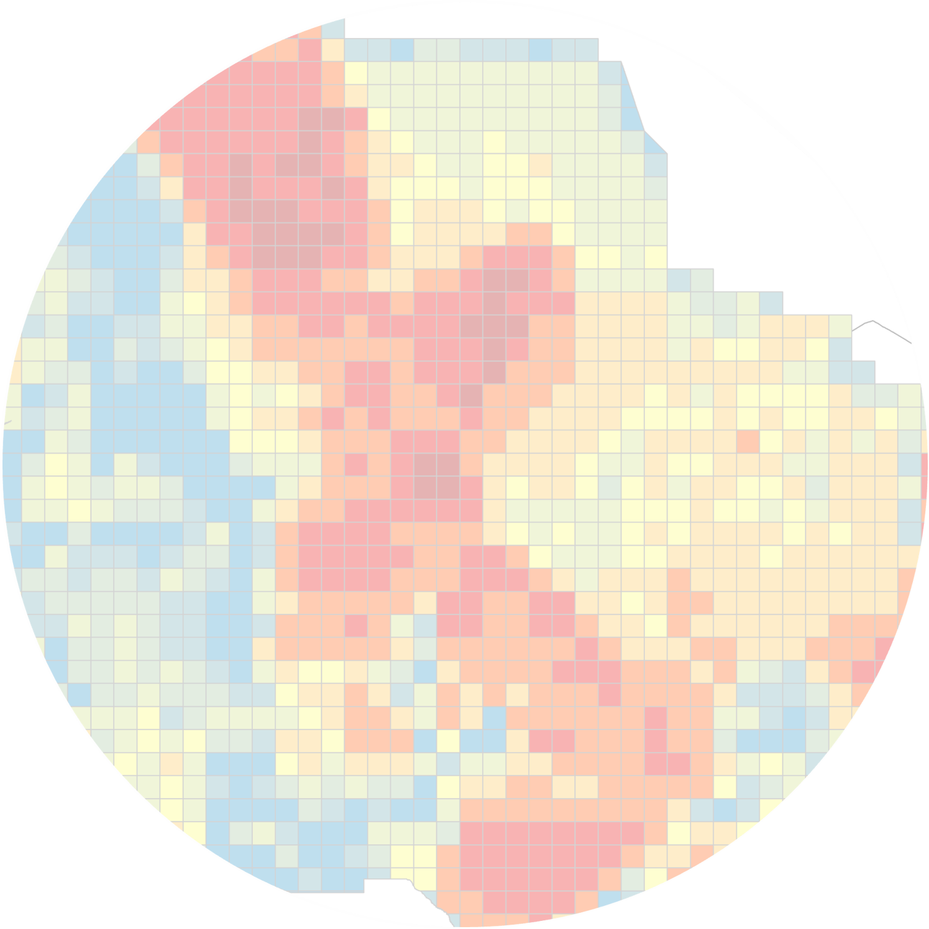
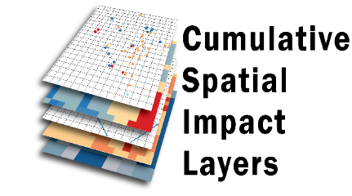
Updating public data collections in
2019 Carbon Storage Open Database
2022 Carbon Storage Open Database
with 580 additional shapefiles and rasters
Carbon Storage
Open
Database
https://edx.netl.doe.gov/dataset/carbon-storage-open-database
https://edx.netl.doe.gov/dataset/geocube

Slide 13

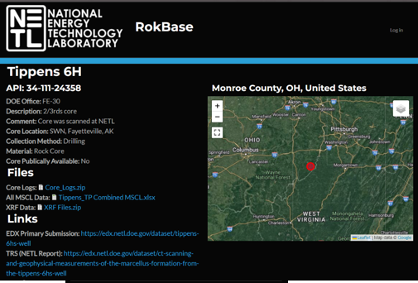
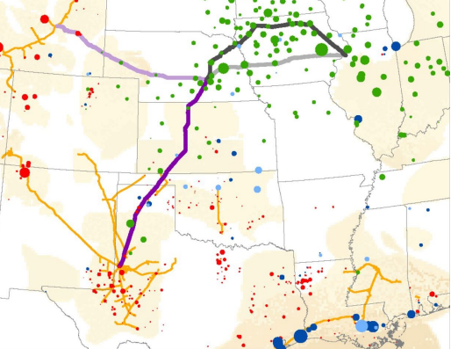
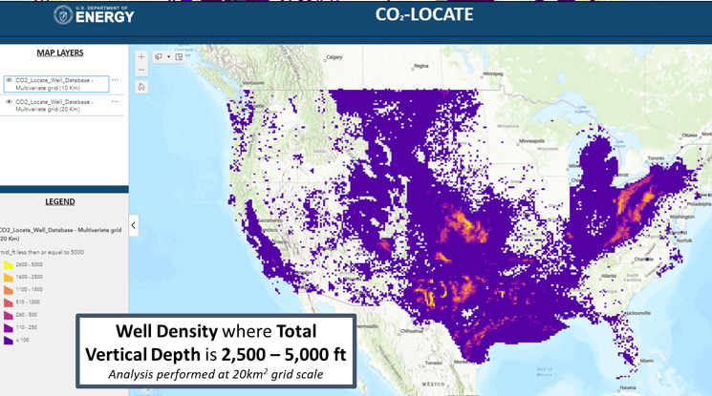
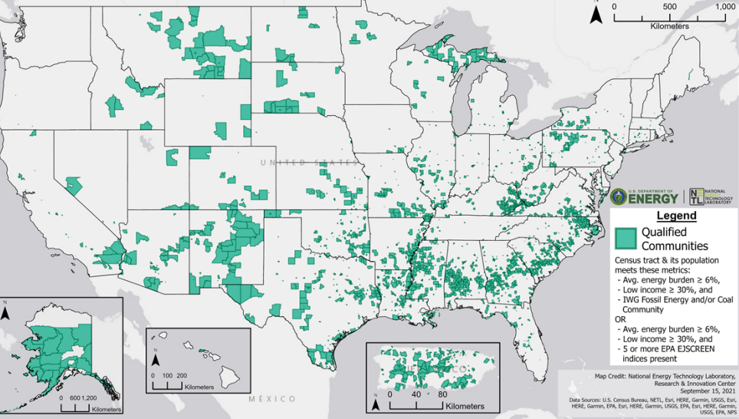
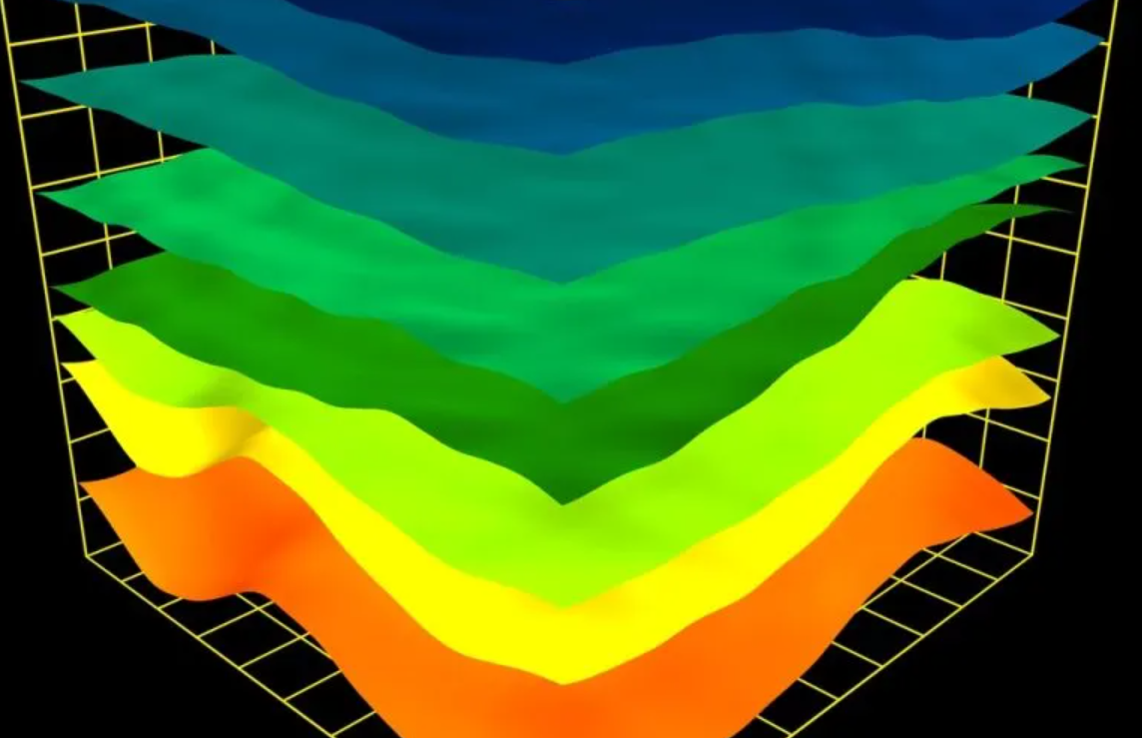
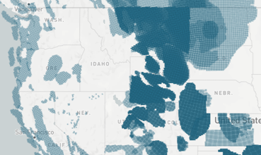


Workflows such as this have enabled action-orientated science under BIL work
RokBase
CCS Pipeline Route Planning Database
Virtual portal and tool for users to access, explore and query available core and rock property data collected from carbon storage spots across the U.S.
Containing >90 gigabytes of data representing critical considerations for the spatial routing of pipelines and transport of CO2
CO₂-Locate Database
CCS EJ-SJ Database
National Well Database & Class II Well Reuse and Regional Evaluation Tool built to support site selection, risk analysis and other stakeholder needs
Social and environmental justice database aligned to carbon storage systems to aid in decision making around key future infrastructure placement & more
Class VI Data Support Tool
CS Technical Viability Database V0.1
Geodatabase of geologic, geophysical, structural, hydrologic, energy extraction, transportation infrastructure, local political boundaries, community and environmental data
Geodatabase of spatial data layers to support the initial development of EPA Underground Injection Control (UIC) Class VI permits

Slide 14





NETL
Resources
VISIT US AT: www.NETL.DOE.gov
@NETL_DOE
@NETL_DOE
@NationalEnergyTechnologyLaboratory
Notes:
Photo: 3-D printing of NETL logo in the Multiphase Flow Analysis Laboratory at NETL Morgantown

