Slide 1
Digital Twins in Industry: Lessons from Aerospace and Healthcare
Nabeel Qureshi
NYSDS, 09/17/2024

Slide 2
Bio
CEO of new company (stealth), working on privacy-preserving healthcare data infrastructure
8 years at Palantir Technologies:
NIH lead, led implementation for N3C enclave, one of largest patient-level datasets for research worldwide
Built digital twins in aerospace at Airbus, Toulouse
Visiting Scholar with the Program on Artificial Intelligence and Progress at Mercatus Center (GMU)
Recent Special Study: "Compounding Intelligence: Adapting to the AI Revolution" (2024)
https://www.mercatus.org/research/research-papers/compounding-intelligence-adapting-ai-revolution

Slide 3
The AI diffusion gap
Real-world complexities (e.g., "last mile" problem in self-driving cars)
Regulatory hurdles and high deployment standards (e.g., medicine)
Data integration issues:
Siloed data in different databases
Need for a single source of truth
Requirement for common vocabulary (ontology)

Slide 4
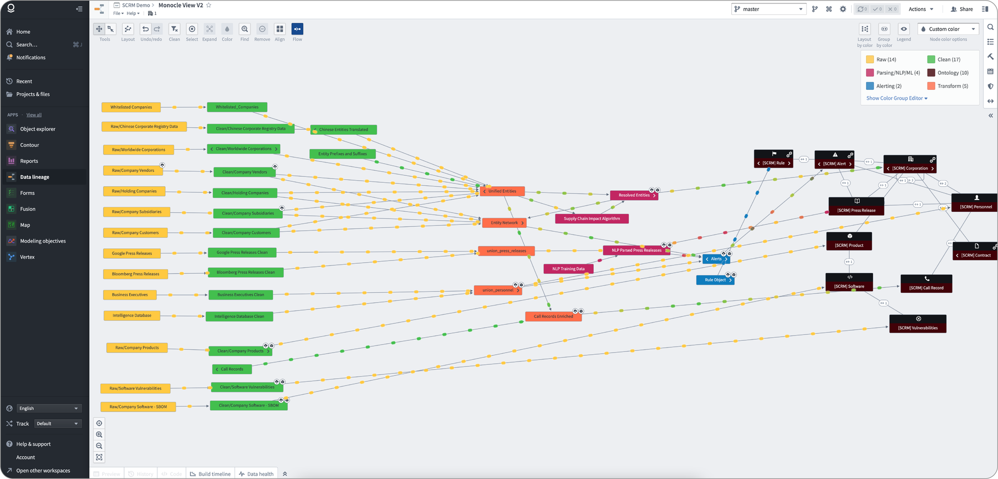
Digitizing business
Creating a unified data foundation
Mapping to common ontologies
Enabling AI operations at an organizational level

Slide 5
Case Study: Airbus A350 Production
Goal: Quadruple A350 production without compromising safety or quality
Challenges:
5 million parts
Production across 4 countries (England, Spain, France, Germany)
Assembly in Toulouse

Slide 6
Airbus: Data Integration
Integrated information into Palantir Foundry:
Schedules
Crew shifts
Parts inventory
Deliveries
Defects ("non-conformities")
Full data provenance to original sources
Semantic search for troubleshooting past issues

Slide 7
Airbus: Results
User interface for planning and troubleshooting
33% acceleration in A350 delivery
Expanded to entire business digitization:
Petabyte-scale live streaming from thousands of sensor systems
Connected entire Airbus fleet for predictive maintenance
Digital twin of Airbus's business:
18,000+ users
100+ airlines onboarded

Slide 8
Healthcare Case Study: N3C
Challenge: No unified way to query U.S. medical system at patient level
Use cases:
Pandemic response
Observational studies
Post-market surveillance
CDC monitoring
Cancer reporting
N3C National COVID Cohort Collaborative (led by NCATS & NIH)
Haendel MA, Chute CG, Bennett TD, et al. The National COVID Cohort Collaborative (N3C): Rationale, design, infrastructure, and deployment. J Am Med Inform Assoc. 2021
Bennett TD, Moffitt RA, Hajagos JG, et al. Clinical Characterization and Prediction of Clinical Severity of SARS-CoV-2 Infection Among US Adults Using Data From the US National COVID Cohort Collaborative. JAMA Netw Open. 2021

Slide 9
N3C Overview
Centralized database of COVID-19 patients
Largest, most representative U.S. cohort of COVID-19 cases and controls
Over 13 million patient records
Data from 75+ healthcare organizations
6.5+ million COVID-19 positive cases
2.1+ billion rows of data
500+ research projects supported

Slide 10
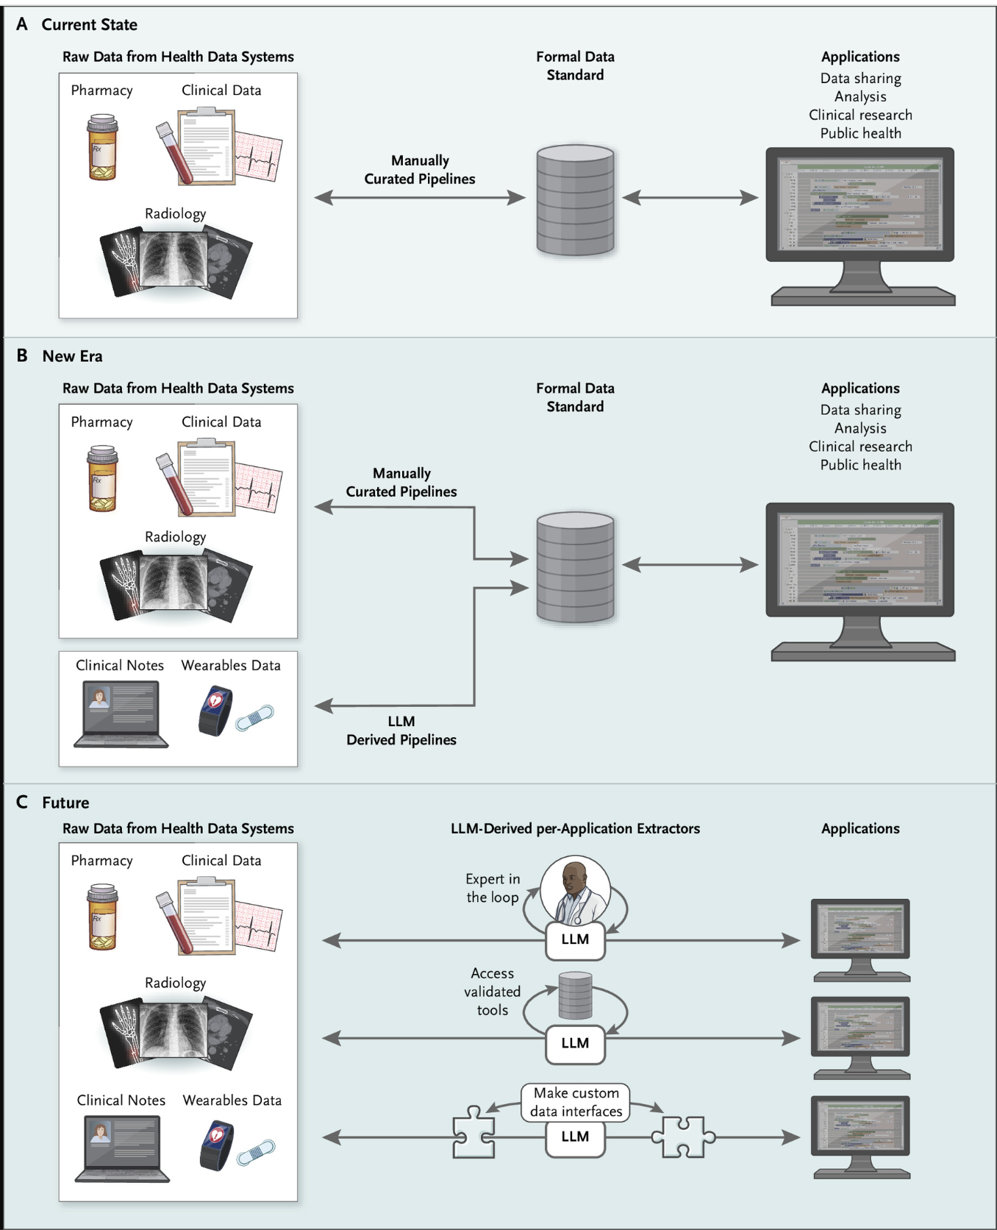
Challenges and Future Directions
Extracting data vs. querying
Data privacy tradeoffs
Research environment – open source tooling
Seamless collection from clinical environments
LLMs for clinical abstraction
LLMs for clinical trial matching
Data mutation
Do We Need Data Standards in the Era of Large Language Models? (Mandel et al., 2023)
Diagram is from: Brat GA, Mandel JC, McDermott MBA. Do We Need Data Standards in the Era of Large Language Models? NEJM AI. 2024;1(8). doi:10.1056/AIe2400548

