Slide 1
AuroraGPT: Rationale, Data Challenges and Development of an AI Research Assistant
Franck Cappello
Lead of AuroraGPT Evaluation
Argonne National Laboratory

Slide 2
AI as Research/Scientific Assistant
AI models are producing fundamental changes in the way we search, access, transform information/data, control, operate, steer robots machines, vehicles, experimental facilities, simulate phenomena, and solve optimization problems.
AI will inevitably profoundly change the research practice, perhaps much more than what the Internet did.
As a research institution, Argonne is interested in developing AI foundation models specifically and optimized for Science.
AI will inevitably

Slide 3
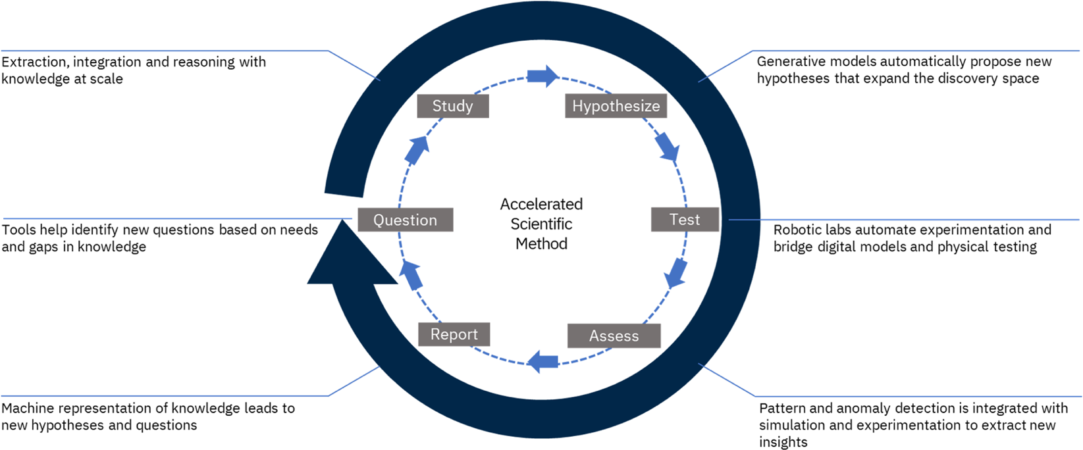
Accelerating Discovery: Accelerating All Steps of Research
Study
Hypothesis
Accelerated Scientific Method
Start here
Question
Test
Report
Assess
Ideally AI will help in all these steps
https://doi.org/10.1038/s41524-022-00765-z

Slide 4
Accelerating Discovery: Digital Twin Example
Data Collection and Integration
Develop a mathematical, simulation-based or AI based model
Study
Hypothesis
Define the Objectives and Scope
Accelerated Scientific Method
Simulate the behavior of the system under different conditions, leveraging physics-based models and incorporating real-world constraints
Start here
Question
Test
Report
Assess
Publish paper(s)
And software
Compare the outputs of the digital twin against real-world observations
Ideally AI will help in all these steps
https://doi.org/10.1038/s41524-022-00765-z
Notes:
Develop a mathematical or simulation-based model:
Finite Element Analysis (FEA) for mechanical systems.
Computational Fluid Dynamics (CFD) for fluid systems.
Agent-based modeling for biological systems.
Integrate data-driven models using AI and machine learning algorithms to predict outcomes or behaviors that evolve from the physical system

Slide 5
What do we mean by: “AI scientific assistant”?
An AI-based system with:
Scientific skills
Reasoning, math, literature understanding, integrity, safety
Effective assistance (no hallucination!)
Trustworthy in the different tasks related to scientific activities
Relevant human and environment interaction modalities (communication skills)
Understanding command (semantic of it), interface with tools and devices
Degree of autonomy
From repeating learned workflows to developing the workflow.
Capable of hypothesis generation

Slide 6
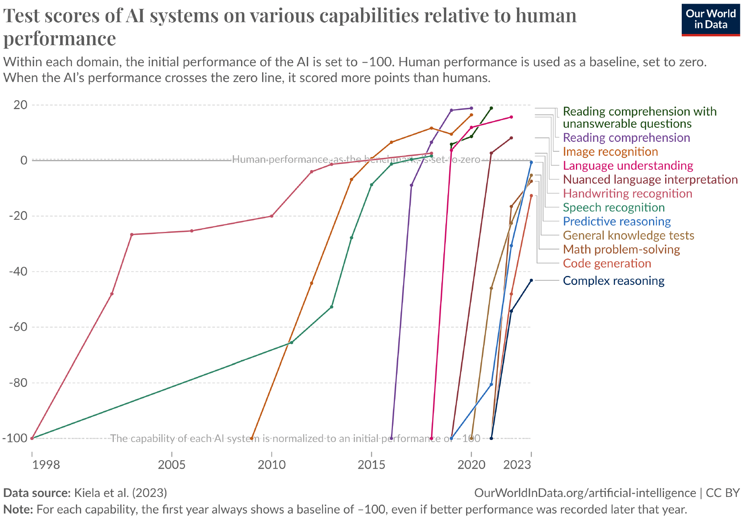
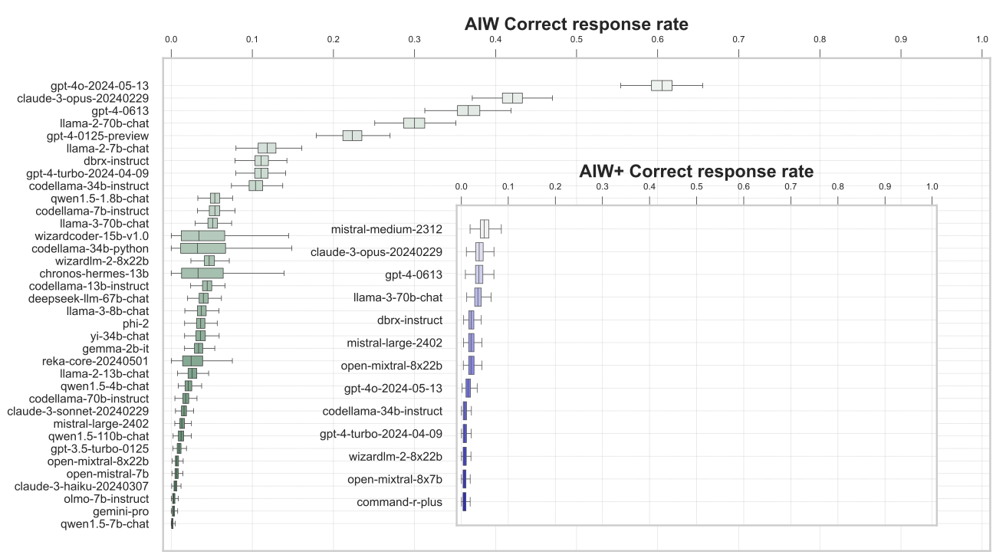
Gap Analysis in the Literature: 2 recent examples
What’s the current skill levels of the best models
→ Two visions of the word: is this due to contamination???
Smart High-Schooler?
Reasoning → Primary Schooler?
What about OpenAI O1?
How it will perform on Alice in Wonderland?
Marianna Nezhurina, L. Cipolina-Kun, M. Cherti, Jenia Jitsev, Alice in Wonderland: Simple Tasks Showing Complete Reasoning Breakdown in State-Of-the-Art Large Language Models, 5 Jun 2024, arXiv:2406.02061v2
Situational Awareness, leopold@situational-awareness.ai, San Francisco, California, Updated June 6 2024

Slide 7
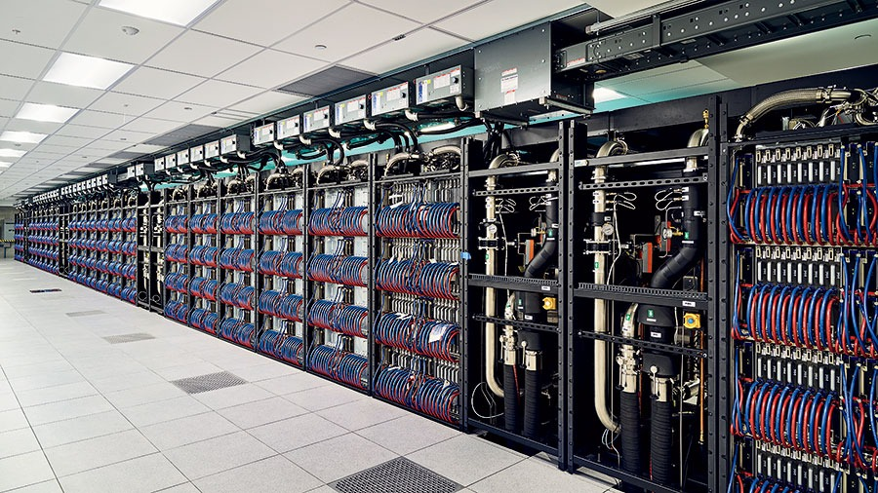
AuroraGPT*:
Aurora is:
166 Racks
10,624 Nodes
21,248 CPUs
63,744 GPUs
84,992 NICs
8 PB HBM
10 PB DDR5c
Goals?
General purpose scientific LLM – broadly trained – general corpora plus scientific papers and texts and structure science data
SAFE: Trustworthiness, Safety, Security, Robustness, Privacy, Machine Ethics
Explore pathways towards a “Scientific Assistant” model
Build with international partners (RIKEN, BSC, others)
Multilingual – English, 日本語, Français, Deutsche, Español, Italiana
Multimodal – images, tables, equations, proofs, time-series, graphs, fields, sequences, etc.
*named after the Leadership Class Supercomputer at Argonne that will be used for much of the training

Slide 8
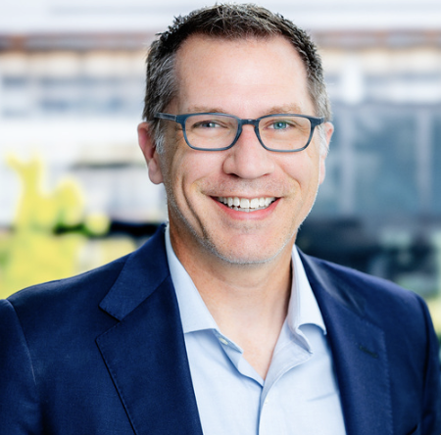
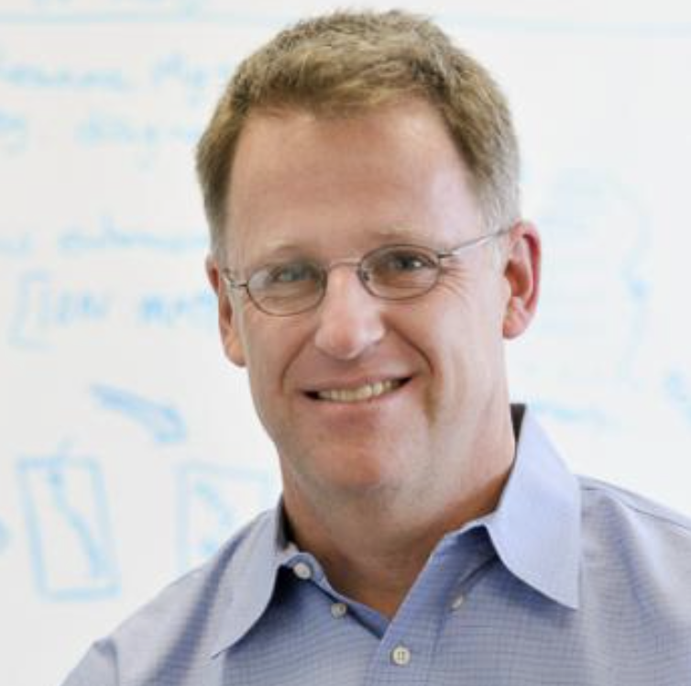
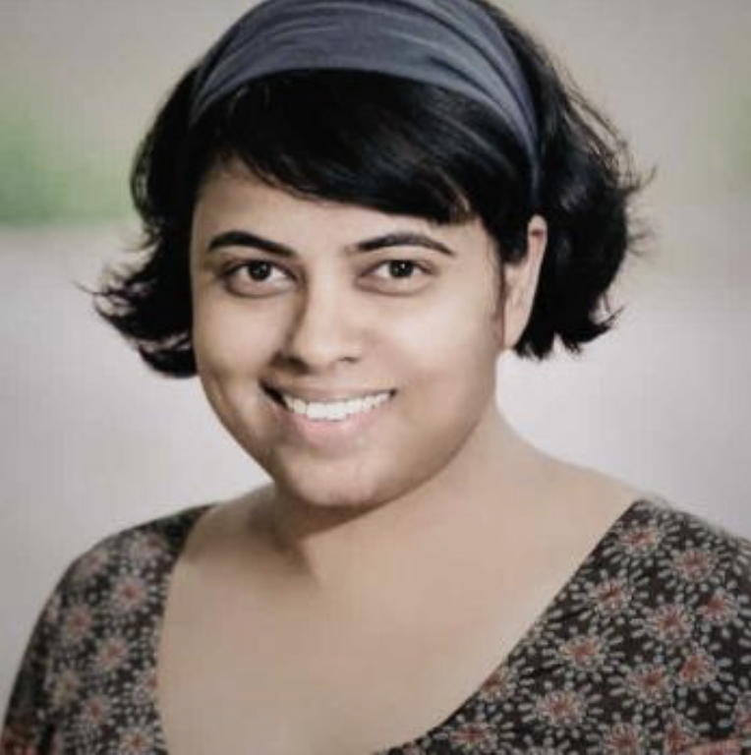
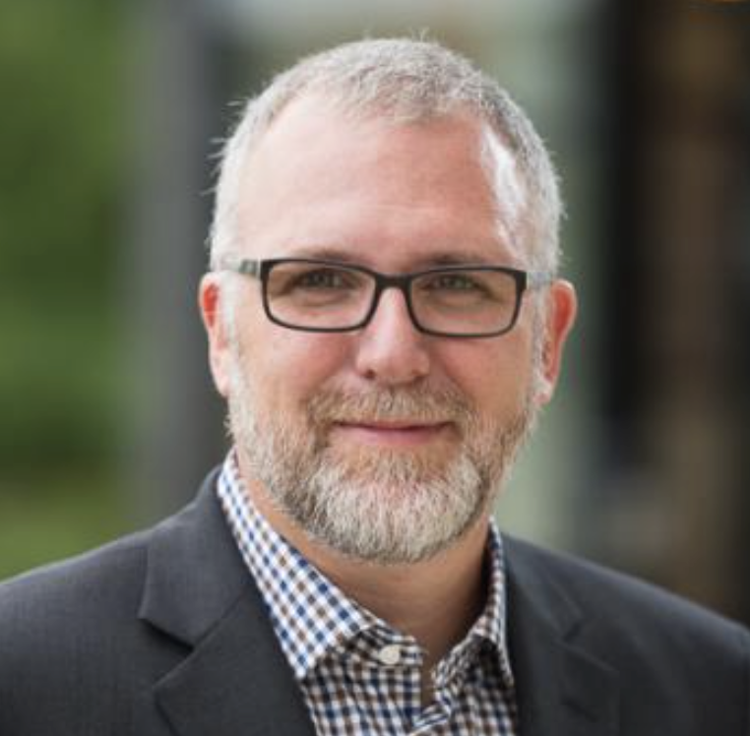
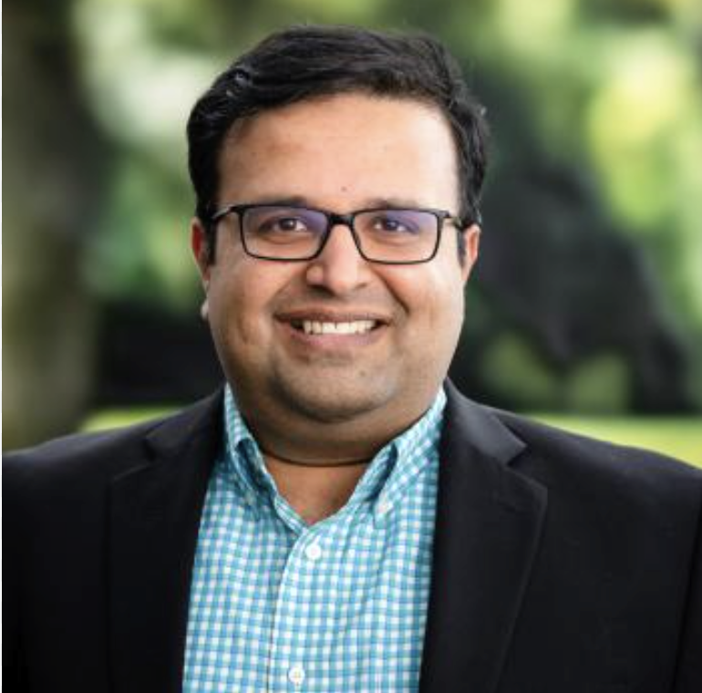
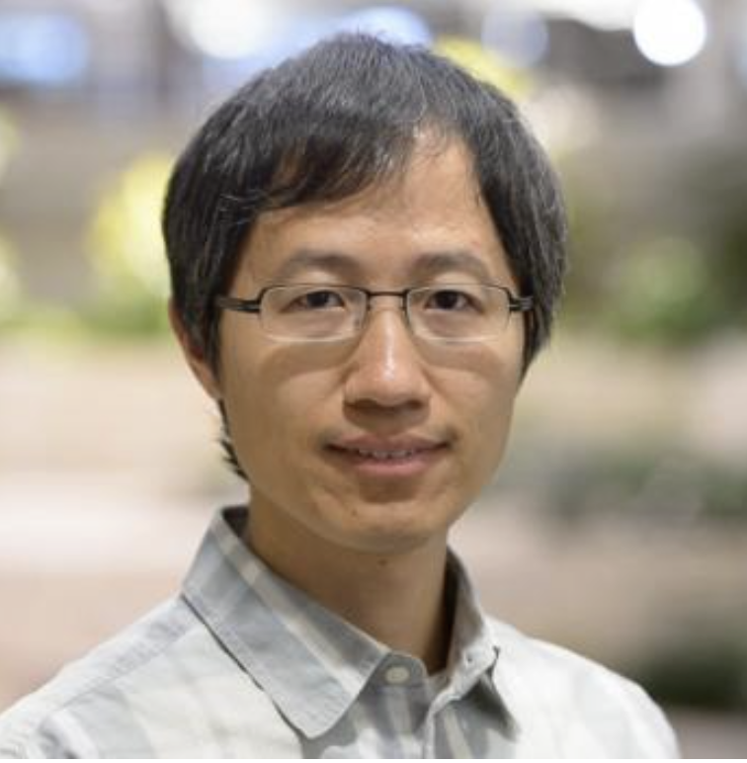
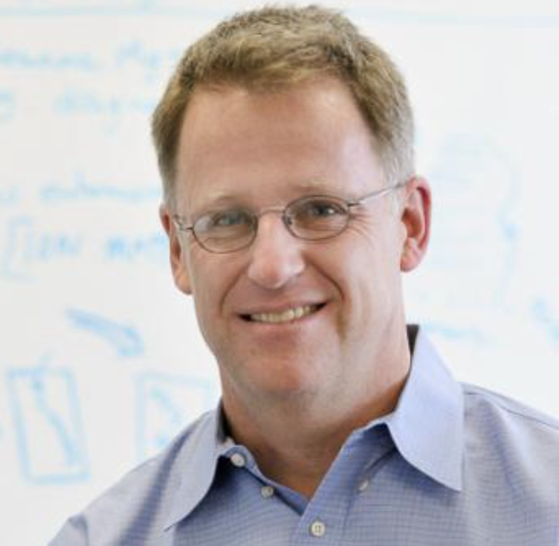
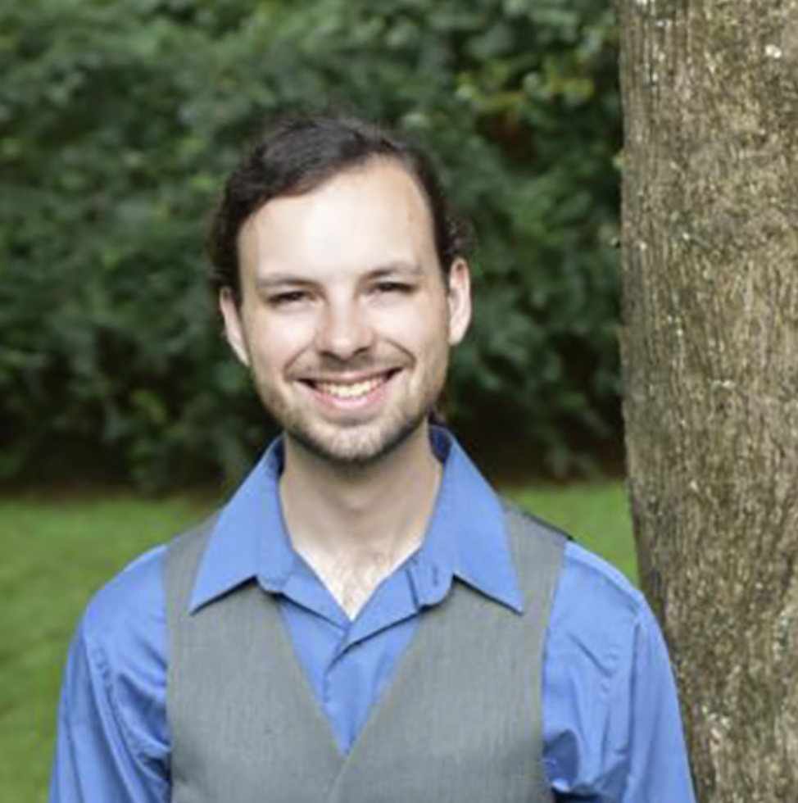
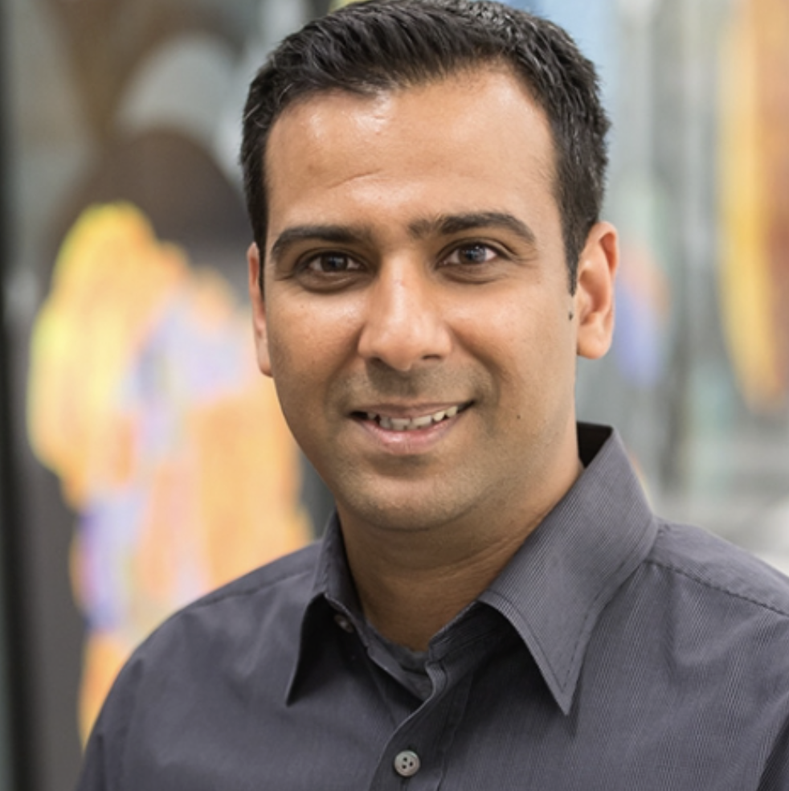
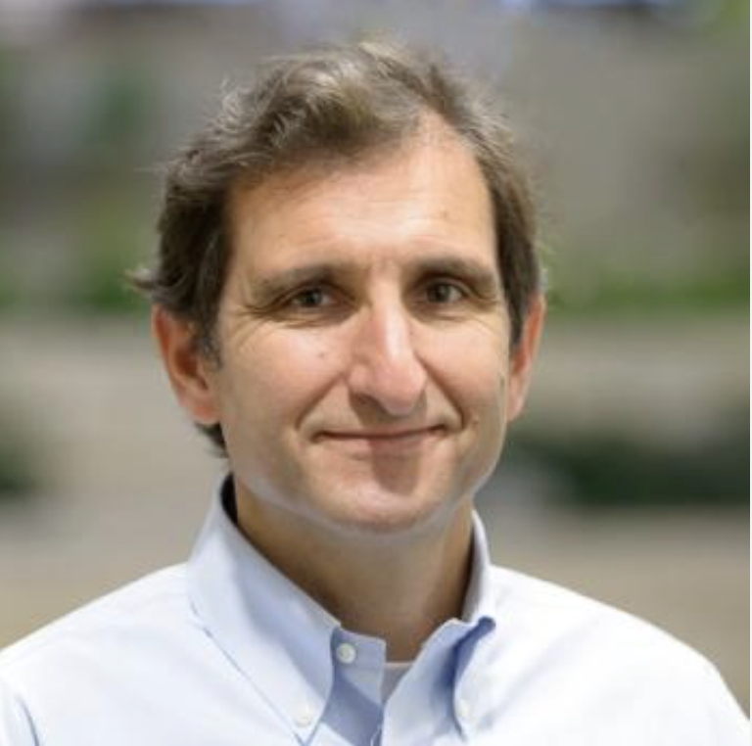
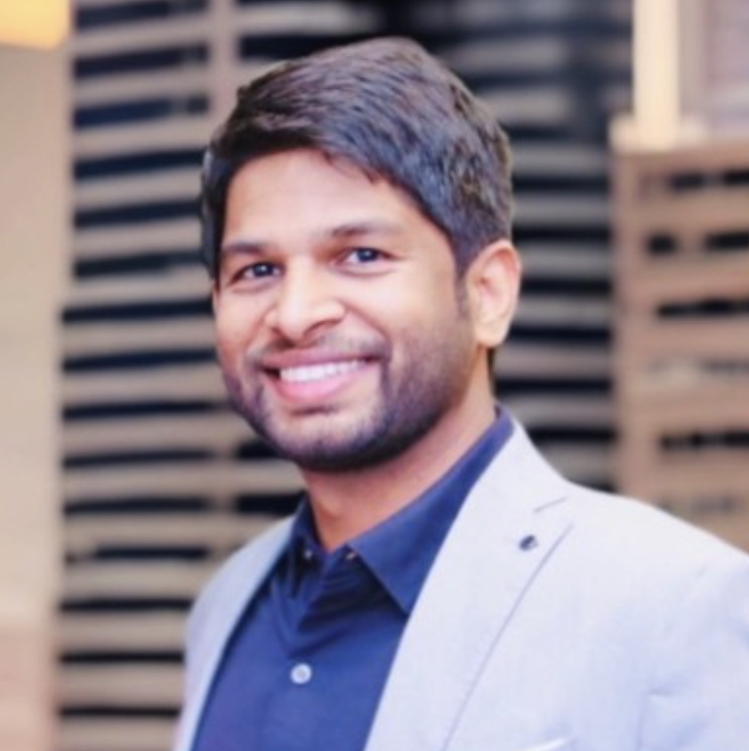
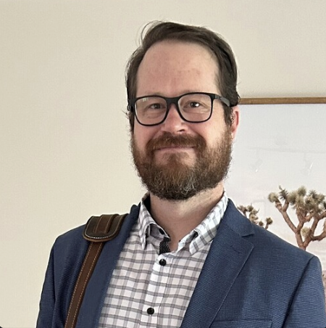
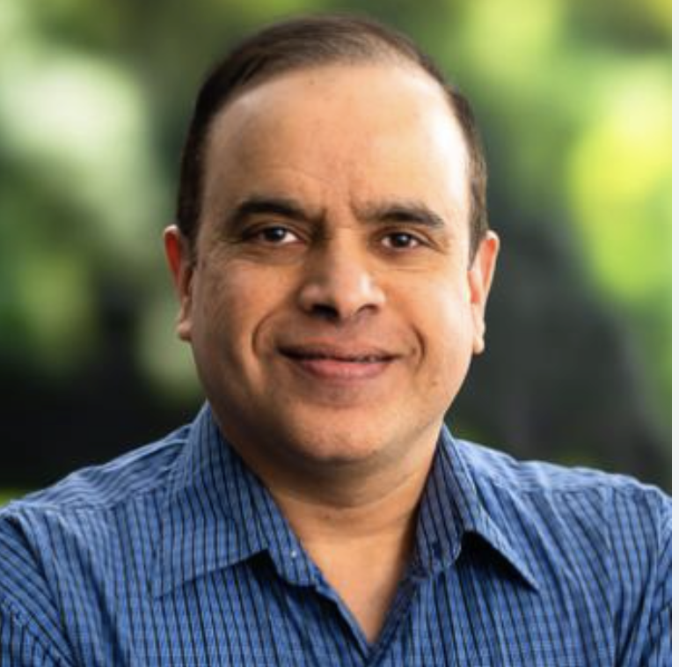
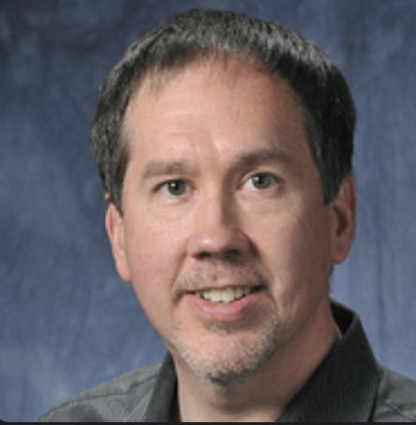
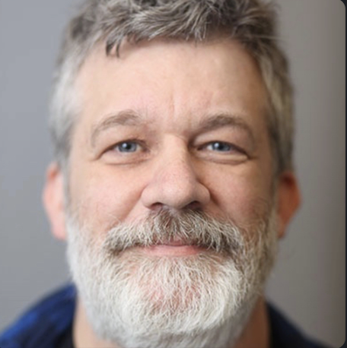
Who (leaders)?
DISTRIBUTION
PLANNING
BRAD ULLRICH
RICK STEVENS (LEAD)
IAN FOSTER
RINKU GUPTA (PM)
MIKE PAPKA
ARVIND RAMANATHAN
FANGFANG XIA
MODELS
DATA
IAN FOSTER
ROBERT UNDERWOOD
VENKAT VISHWANATH
SAM FOREMAN
EVALUATION AND SAFETY
POST-PRE TRAINING
FRANCK
CAPPELLO
SANDEEP MADIREDDY
BO LI
ELIU HUERTA
AZTON WELLS
INFERENCE
COMMUNICATIONS
RAJEEV THAKUR
DAVID MARTIN
CHARLIE CATLETT

Slide 9
For what outcomes?
Datasets and data pipelines for preparing Science training data
Software Infrastructure and workflows to train, evaluate, and deploy LLMs at scale for scientific research purposes
Evaluation of state-of-the-art LLM models to determine where they fall short in deep scientific tasks and where deep data may have an impact
Assessment of the approach of augmenting web training data with two forms of data specific to science
Full-text scientific papers
Structured scientific datasets (suitably mapped to narrative form)
Research grade artifacts (models) for scientific community and adaptation for downstream uses
Promotion of responsible AI best practices where we can figure them out
International collaborations around the long-term goal of AGI for science

Slide 10
How?
AuroraGPT Project (large LDRD).
AuroraGPT working groups:
01 Planning
02 Data
03 Model training (pre-training)
04 Evaluation (skills, trustworthiness, safety)
05 Post-training (fine tuning, alignment)
06 Inference (on Aurora)
07 Distribution
08 Communication

Slide 11
02 Data: Leads: I. Foster, R. Underwood
Slide: Robert Underwood (ANL)
Slide Credit: Ian Foster

Slide 12
02 Data. Goals and Activities
Typical size & quality
20+T tokens of high-quality scientific text (x100M) and structured data (xPetabytes)
Collect data from sources of multi-modal training data
General Text and Code (Dolma, RP2)
Scientific Publications (ACM, PMC, ArXiv, etc., etc.)
Scientific data from simulation, experiments, observation
Domains: Material, Physics, Biology, Computer Science, Climate
Preparation operations before training
Deduplication
Contamination analysis (Evaluation)
Workflows for data preparation
PDF, Latex, XML to text
PDF to multimodal objects (figures, tables, equations)
Data modalities (sequence-time series, tables, images, particles positions, etc.)
Datasets for Evaluation
Provide data “in sample” and “out of sample” for evaluation teams to use for tests
Slide Credit: Ian Foster
Slide source: Robert Underwood (ANL)

Slide 13
02 Data: Collection (partial)
Scientific Papers
Dataset | Format | Size
RP1 | JSONL (general web text) | ~3TB
RP2 | JSONL (general web text) | ~5TB
DOECode | Code (DOE only) | 9GB
PILE | JSONL (2/3 general) | 825GB
StackCode | parquet(code) | 783GB
Dolma | JSONL | 5TB
Dataset | Format | Size
CORE | Full text collection of scientific papers | >2TB
peS2o | Jsonl (40M open access academic papers) | 259GB
PMC-OA | markdown+pdf | 202GB
Arxiv | pdf+figures | 2.2TB
Biorxiv | xml+pdf+figures | 9.7TB
Medrxiv | xml+pdf+figures | 542GB
chemrxiv | pdf
ACM | XML | 16GB
NIH_LITARCH | xml+pdf+figures | 153GB
Dataset | Format | Size
PubChem Compound | json
PubChem Compound (no description) | json
PubChem Gene | json
PubChem Pathway | json
UniProt TrEMBL | json
UniProt uniref100 | json
Significant overlap → De-duplication is important
Credit: Data team.

Slide 14
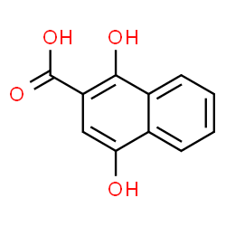
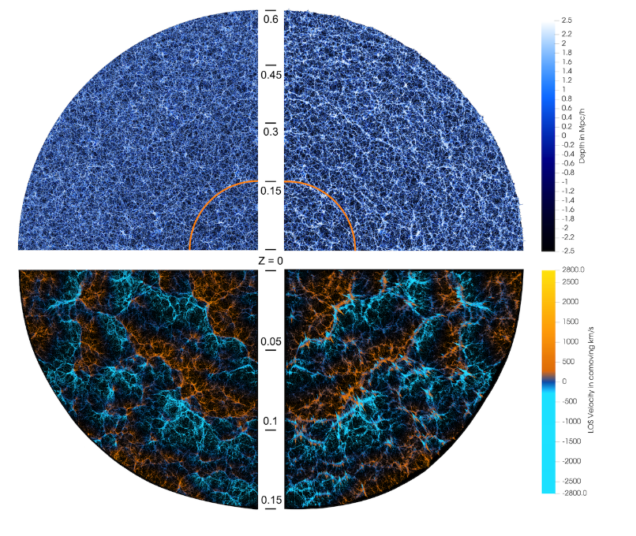
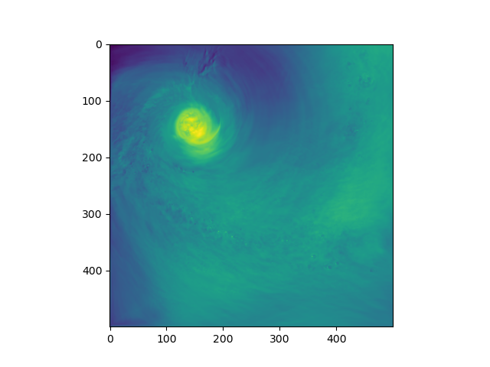
02 Data: Preparation Challenges
Short Identifiers
In chemistry and materials science (other fields too), there are many identifiers.
2-Naphthalenecarboxylic acid; 1,4-Dihydroxy-2-naphthoic acid
651
We’ve found that longer identifiers tend to produce better results
Extreme data size
In cosmology, a HACC simulation used 1.8 trillion particles producing petabytes of data (65TB/snapshot)
Even if training a foundation model with 65TB was feasible technically, do we really need all that data?
What about the real information that we want the model to learn?
What data to keep/filter?
Different domains of expertise interpret the same data differently
Tropical Meteorologist
Fire Ecologist
We think this means that science data needs multiple encodings
Visualization of Light Cone for HACC Farpoint Simulation
Wind over the US Gulf Coast
Slide Credit: Ian Foster
Slide source: Robert Underwood (ANL)

Slide 15
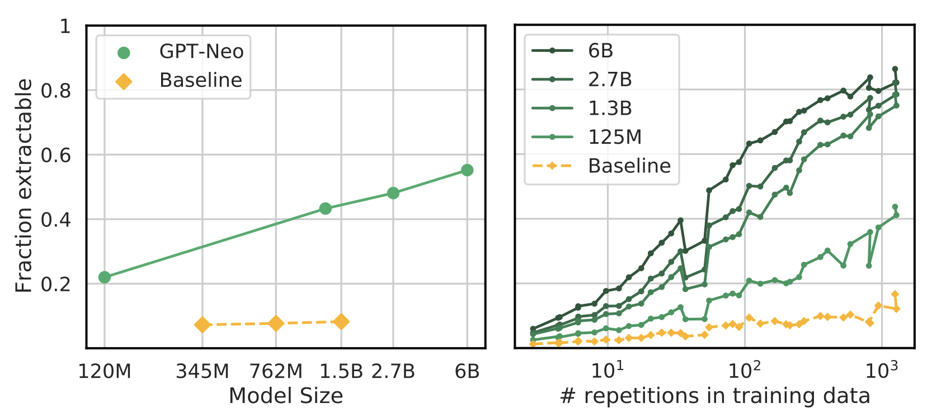
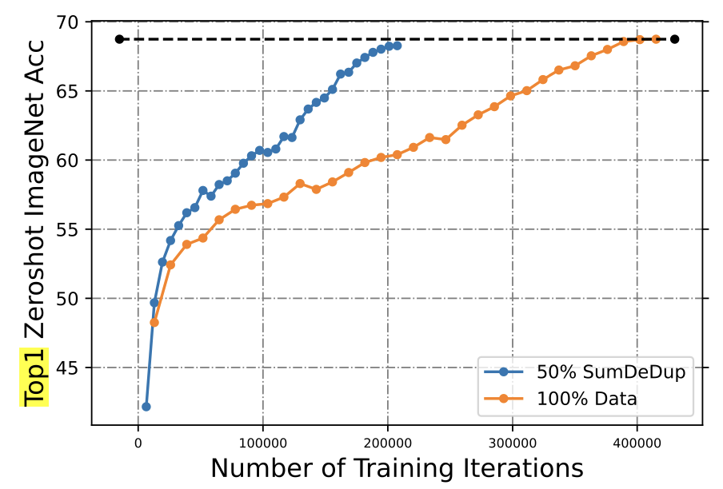
02 Data: Deduplication Challenges
Quantifying Memorization Across Neural Language Models, N. Carlini, D. Ippolito, M. Jagielski, K. Lee, F. Tramer, C. Zhang, ICLR 2023
Research shows that duplication leads to:
Memorization,
Lack of Generalizability,
Duplication can lead to copyright concerns if scientific papers are memorized
There are two types of Duplication
Textual – the text overlaps (partially?) with another text
Semantic – the “meaning” of text overlaps with another text
Some semantic overlap is good in training: learning distributions of synonymous words/phrases, but duplication can slowdown training significantly
SemDeDup: Data-efficient learning at web-scale through semantic deduplication, A. Abbas, K. Tirumala, D. Simig, S. Ganguli, A. S. Morcos, ICLR 2023
Slide Credit: Ian Foster
Slide source : Robert Underwood (ANL)

Slide 16
Accelerating Discovery: Required Model Capabilities
Scientific skills
Reasoning, math, literature understanding (for research assistant), integrity, safety
Multi-modal capability
Understanding text, images, time-series, tabular data, etc. Simulation/experiment/observation
Effective assistance (no hallucination!)
Trustworthy in the different tasks related to scientific activities
Relevant human and environment interaction modalities (communication skills)
Understanding command (semantic of it), interface with tools and devices
Degree of autonomy
From repeating learned workflows to developing the workflow.
Capable of hypothesis generation

Slide 17
Accelerating Discovery: Evaluation Methodology?
How to assess:
Scientific skills
Reasoning, math, literature understanding (for research assistant), integrity, safety
Multi-modal capability
Understanding text, images, time-series, tabular data, etc. Simulation/experiment/observation
Effective assistance (no hallucination!)
Trustworthy in the different tasks related to scientific activities
Relevant human and environment interaction modalities (communication skills)
Understanding command (semantic of it), interface with tools and devices
Degree of autonomy
From repeating learned workflows to developing the workflow.
Capable of hypothesis generation

Slide 18
04: Evaluation: Goals
Comprehensive evaluation infrastructure for AI foundation models for science: (Skills, Trust, Safety): F. Cappello (ANL), B. Li (U. Chicago), S. Madireddy (ANL)
Primary purposes:
Evaluate foundation models/Compare with models trained with 100M+ scientific papers + data
Compare Pre-training vs. fine-tuning with scientific papers + data
Compare model architectures, hyperparameters, extensions (RAG)
Standard benchmarks (Skills): EleutherAI Harness, HELM, SkillMix, FLASK (alignment)
Safety Benchmarks (Trustworthiness, Safety): DecodingTrust, TrustLLM, WMDP
Existing Domain Specific Benchmarks in Chemistry, Physics, Climate, Biology, etc.
Create the AuroraGPT Benchmark: AI4Science Bench

Slide 19
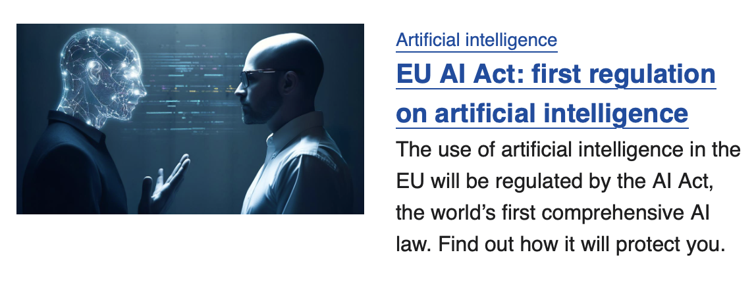
Evaluating Scientific Skill: Needed.
Evaluating Safety: Paramount!
A\ (Claude)September, 2023
OpenAI (ChatGPT) July 5, 2023

Slide 20
04: Evaluation: Establishing a Methodology
Foundation Models (FMs) seen as black boxes.
Evaluation should ultimately relate to how researchers will use LLMs
Capture interactions (how researchers uses AI assistants)
Assess knowledge/Skills
Scientific
Data
External
Software
(theorem provers, numerical libraries
Device interface.)
Assess Requests to external modules
Assess Response
FM/
LLM
Knowledge, Skills
Researchers
interactions
with the FM/LLM
Input
Outputs
Responses to
interaction

Slide 21
04: Evaluation Methodology: AuroraGPT Approach
LLMs/Foundation Models (FMs) seen as black boxes.
This is ultimately how researchers will use them
Other white/grey box approach may help: Checking the embeddings for semantic proximity)
We need to create a Benchmark to test general scientific knowledge and representing real use cases:
Benchmarks: sets of Q&A (MCQs, open responses)
Would typically require x1000s questions by scientific domain
General scientific knowledge: Q&A generated from experts and from litterature
Real use cases (1) : Lab style experiments: Experts using LLMs/FMs in real situation: solving an open problem, a recently solved problem (recording/analyzing all responses)
Real use cases (2): In the wild: Recording/analyzing x1000s scientific user interactions

Slide 22
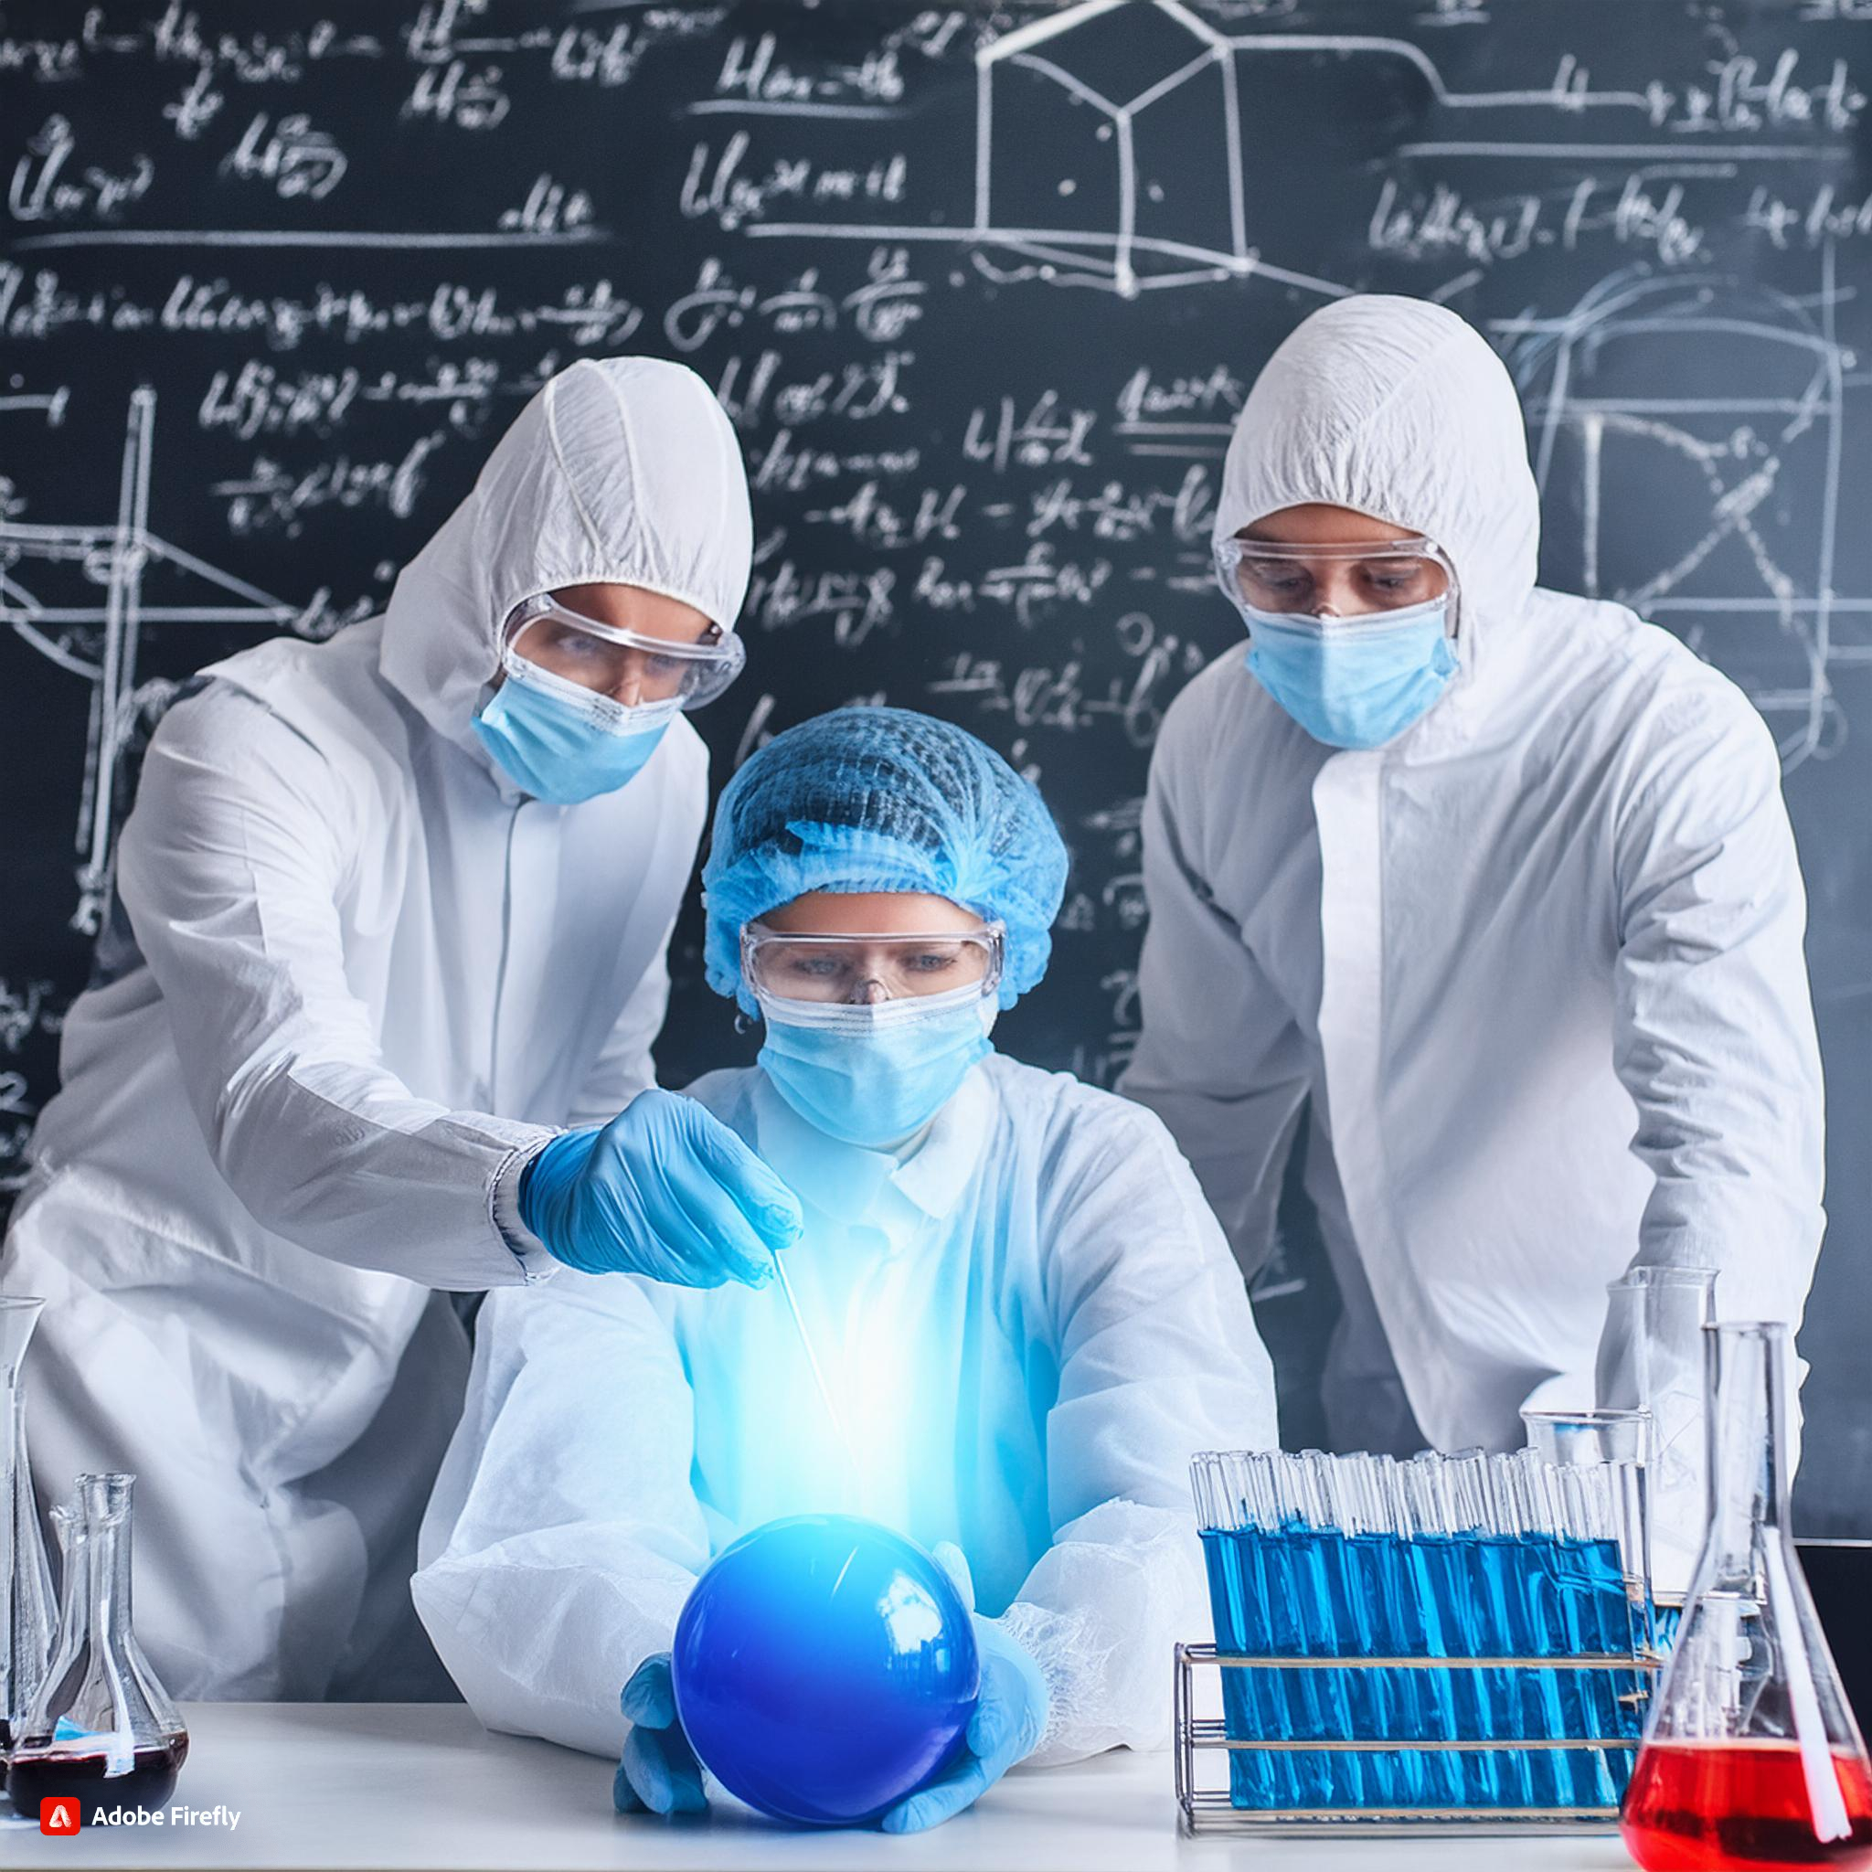
Conclusion
AI is becoming pervasive in industry, research and education
LLMs/foundation models have proven capabilities in language processing
There is an opportunity to use LLMs as research assistants
Gap analysis shows a significant mismatch between ideal and actual capabilities
AuroraGPT explores all aspects of the foundation model training/inference/evaluation for scientific activities.
Many challenges in parallel and distributed computing!
Two critical parts of AuroraGPT effort are
Multi-modal data collection/curation/preparation
Evaluation: Assess scientific skills and safety

Slide 23
Thanks!
Q&As

