Slide 1
On Training Foundation Models on Frontier
Sajal Dash
Analytics and AI Methods at Scale (AAIMS)
NCCS, ORNL
dashs@ornl.gov
Notes:
1

Slide 2
Outline
Distributed training of LLMs
Preparing a training software stack for Frontier
Finding best distributed training strategies
Training a Trillion parameter model on Frontier (for a few iterations)
Training “Sparsely Activated” models

Slide 3
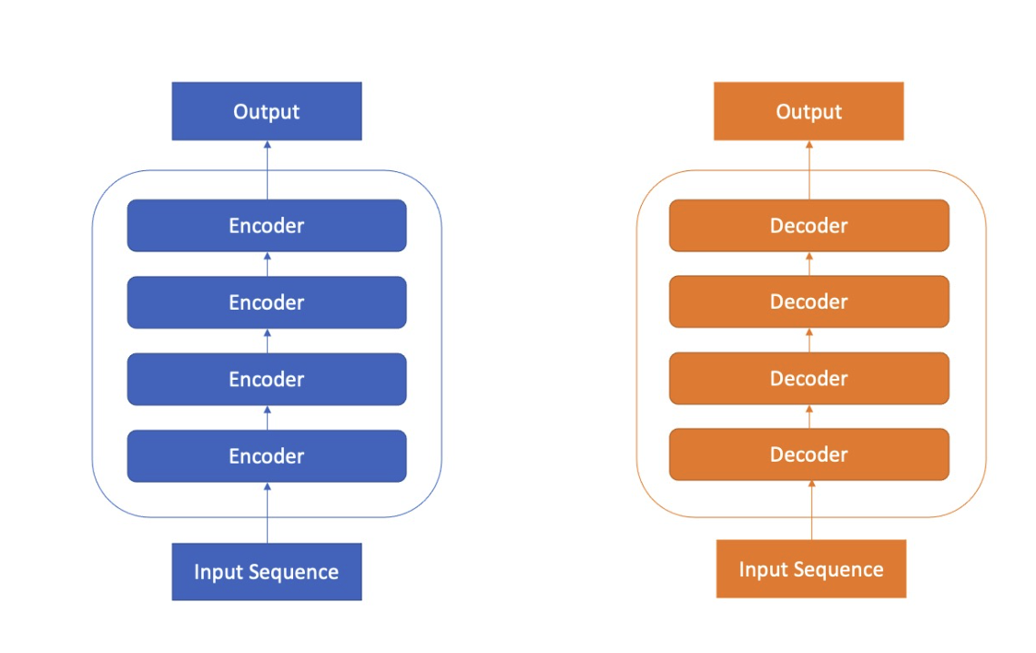
Transformer Model Architecture
BERT
GPT

Slide 4
Inside a Transformer Layer

Slide 5
Model Parallelism: Why and How
Models (or Memory needed for their training) are too big to fit in a single GPU
So, we need to break the model into pieces
What’s broken needs to be rebuilt from the pieces
It’s like Kintsugi, but with a more practical concern such as price of gold (comm. Latency)
Kintsugi

Slide 6
Tensor Parallelism (TP=4)
L11
L21
L31
L41
GPU1
L1
L2
L3
L4
L12
L22
L32
L42
L11
L21
L31
L41
GPU2
L12
L22
L32
L42
L13
L23
L33
L43
L13
L23
L33
L43
GPU3
L14
L24
L34
L44
L14
L24
L34
L44
GPU4

Slide 7
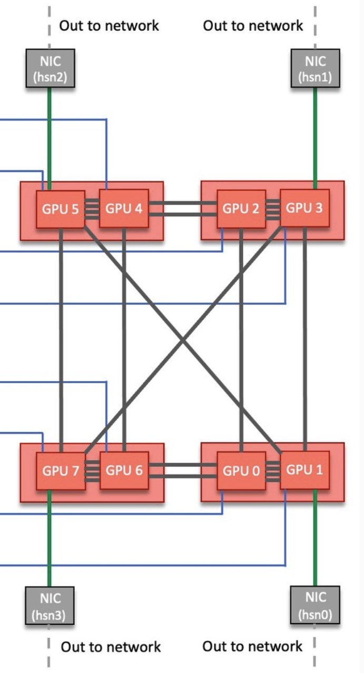
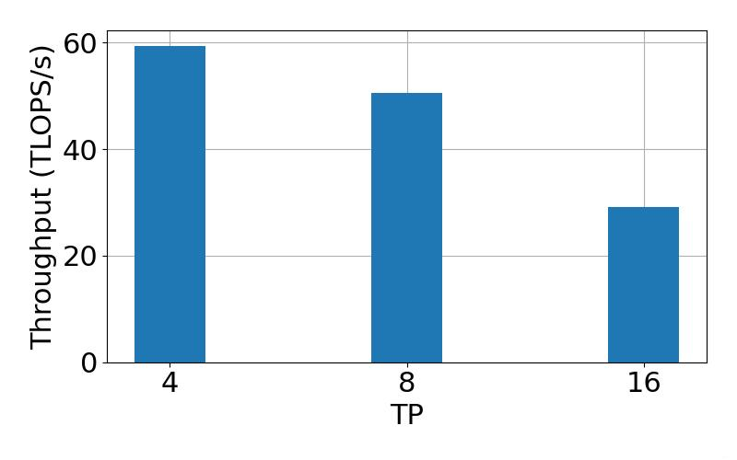
Lessons Learnt From Tensor Parallelism

Slide 8
Pipeline Parallelism (PP = 2)
L1
L2
L3
L4
GPU1
GPU2

Slide 9
Pipeline Parallelism (Gpipe)

Slide 10
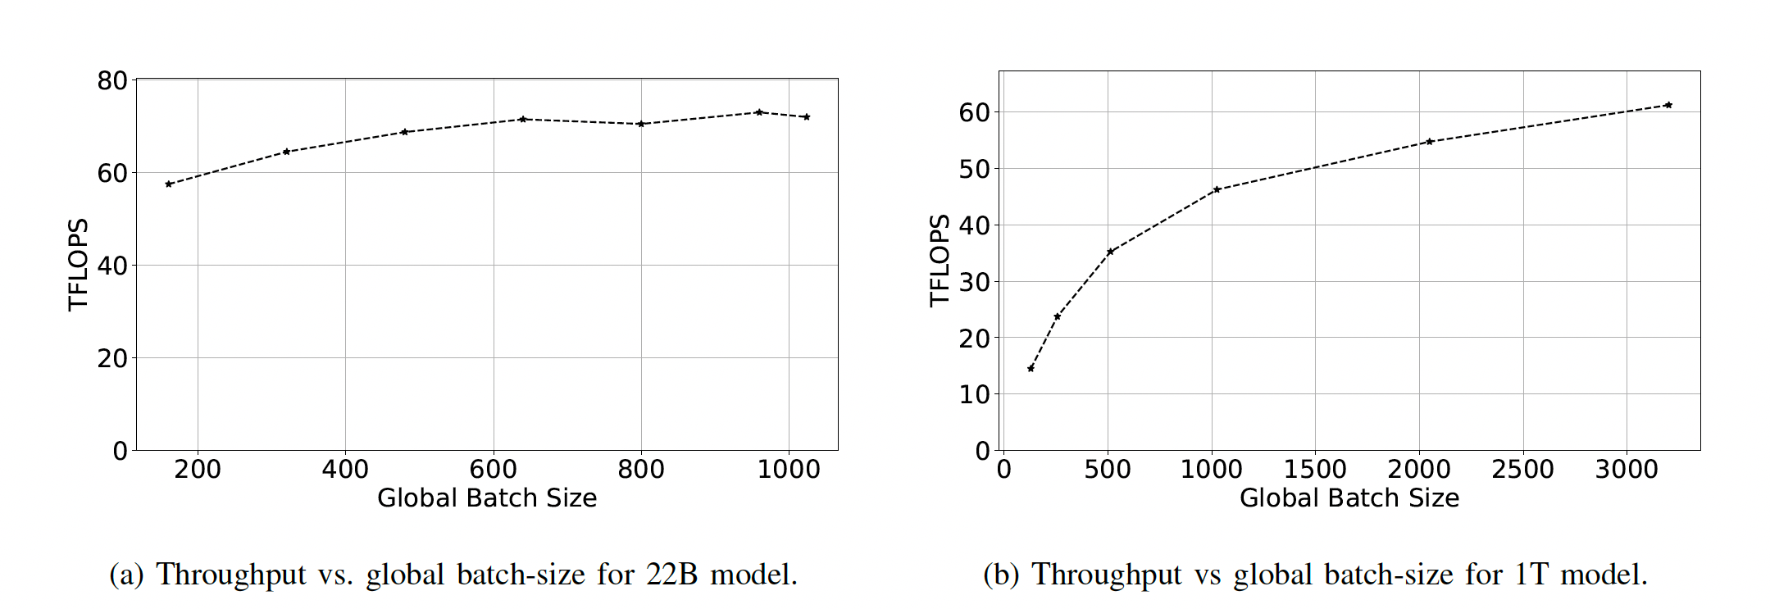
Pipeline Bubble vs #Microbatches
Increasing the #Microbatches will reduce the bubble
But that will result in large global batch size, hurting the convergence

Slide 11
3D Parallelism using Megatron-DeepSpeed
Megatron-DeepSpeed is a state-of-the-art training framework developed by Microsoft and NVIDIA
It supports 3D+ parallelism (Tensor, Pipeline, Data, Sharded Data)
We ported this Framework to Frontier through hipify and combining with ROCM specific packages
https://github.com/sajal-vt/Megatron-DeepSpeed-ORNL/tree/frontier-sd

Slide 12
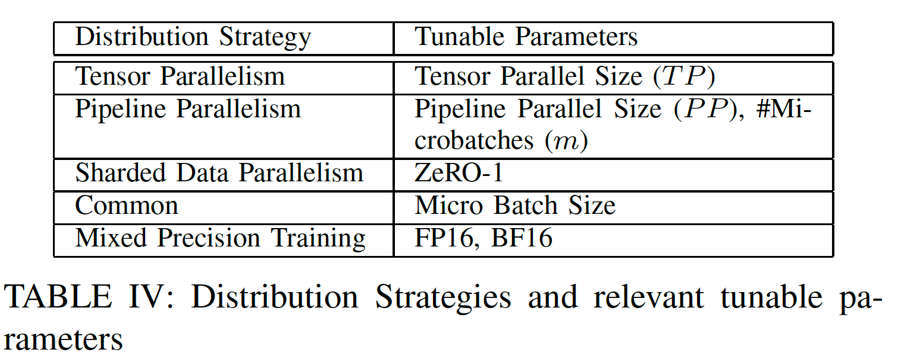
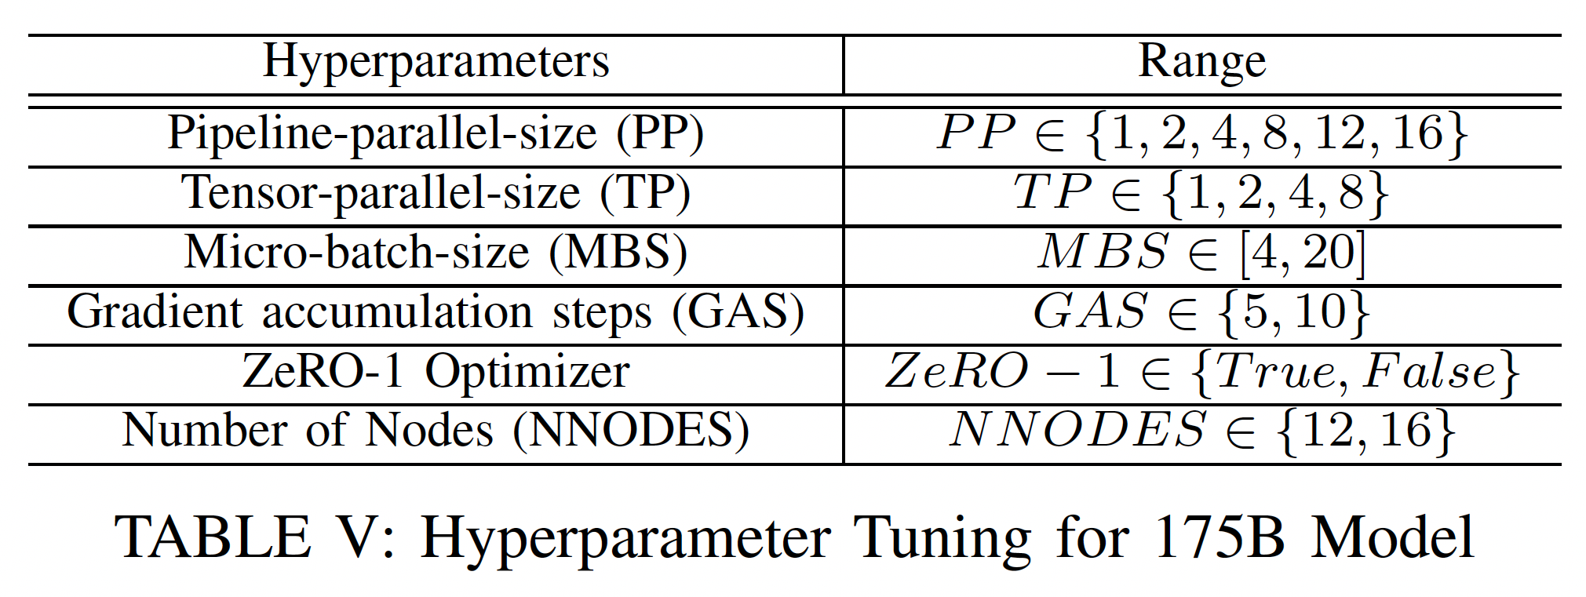
3D Parallelism
A Combination of Tensor, Pipeline, and Data Parallelism
Determine how many GPUs (world-size) you need to fit the model
Factorize world-size into TP (tensor parallel size) and PP (pipeline parallel size)

Slide 13
Hybrid (TP=4, PP=2)
L11
L21
L31
L41
GPU1
GPU5
L1
L2
L3
L4
L12
L22
L32
L42
L11
L21
L31
L41
GPU2
GPU6
L12
L22
L32
L42
L13
L23
L33
L43
L13
L23
L33
L43
GPU3
GPU7
L14
L24
L34
L44
L14
L24
L34
L44
GPU4
GPU8
Node 1
Node 2

Slide 14
Best practices with parallelism paradigms
Tensor Parallelism
Keep it within the node (TP < 8)
Pipeline Parallelism
Use large number of micro-batches (But that can increase the global batch-size)
Data Parallelism
Can’t use too much data parallelism. A large global batch size will make the model divergence.

Slide 15
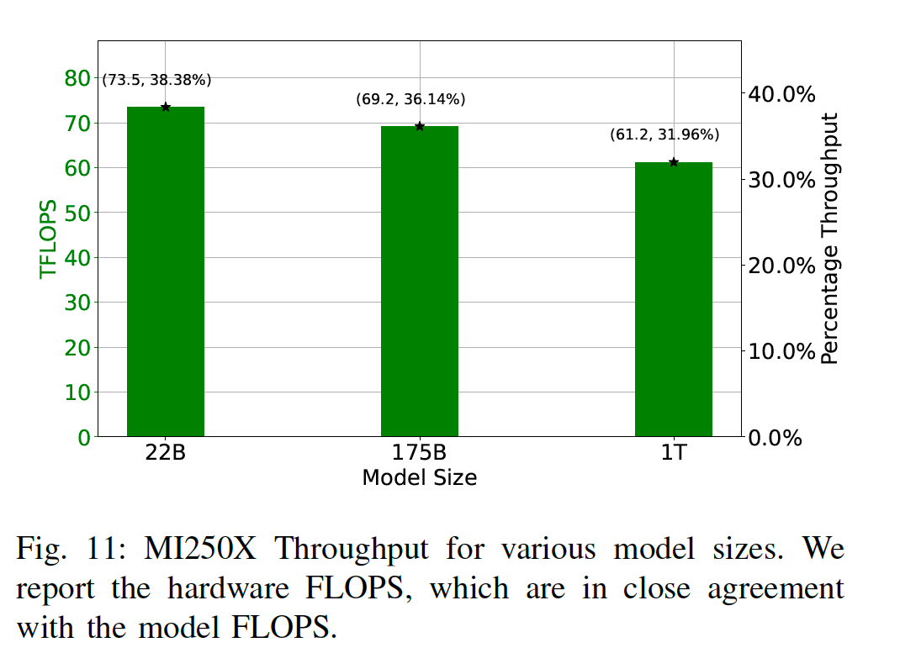
“Best” Strategy to Train 175B and 1T Models
Disclaimers:
We didn’t train any model till completion. We only trained for 10 iterations and less than 2 hours.
We don’t have any completely trained models

Slide 16
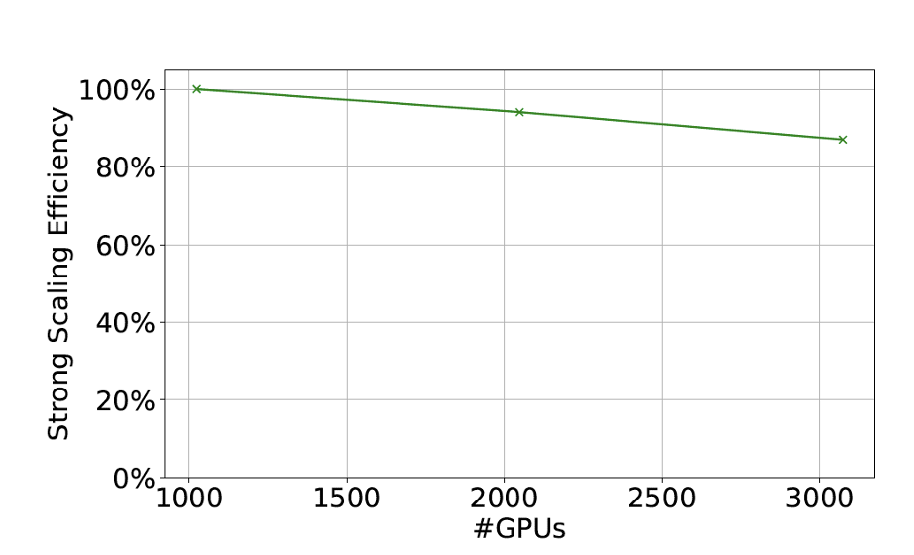
Scaling Performance
Weak Scaling for 1T Model
Strong Scaling for 1T Model

Slide 17
A Case for Sparsely Activated Model
Models with more parameters performs better
More parameters means more compute time
“Mixture of Experts” mechanism sparsely activates model parameters, thus limiting computational requirements to that of a single expert

Slide 18
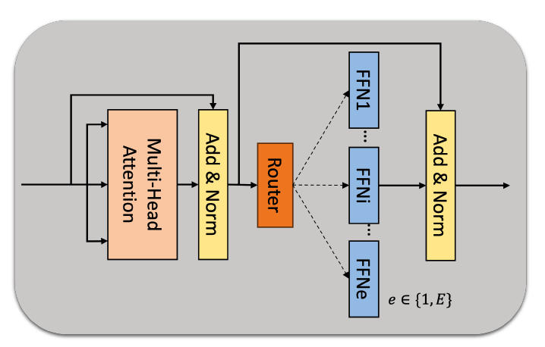
Design Space

Slide 19
Early observations on design space

Slide 20
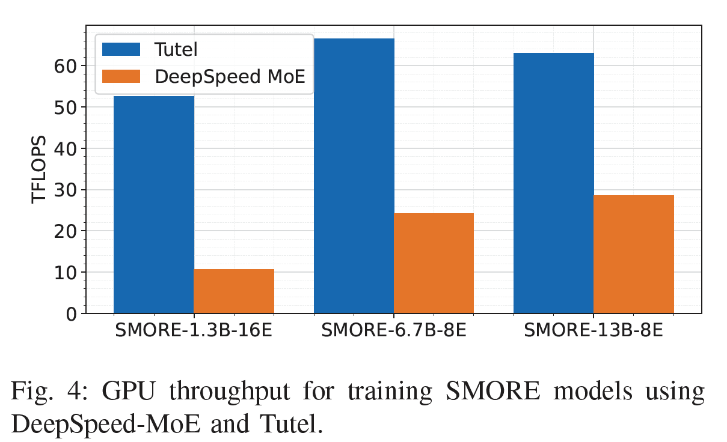
Exploring existing frameworks

Slide 21
Comparing parallelization strategies

Slide 22
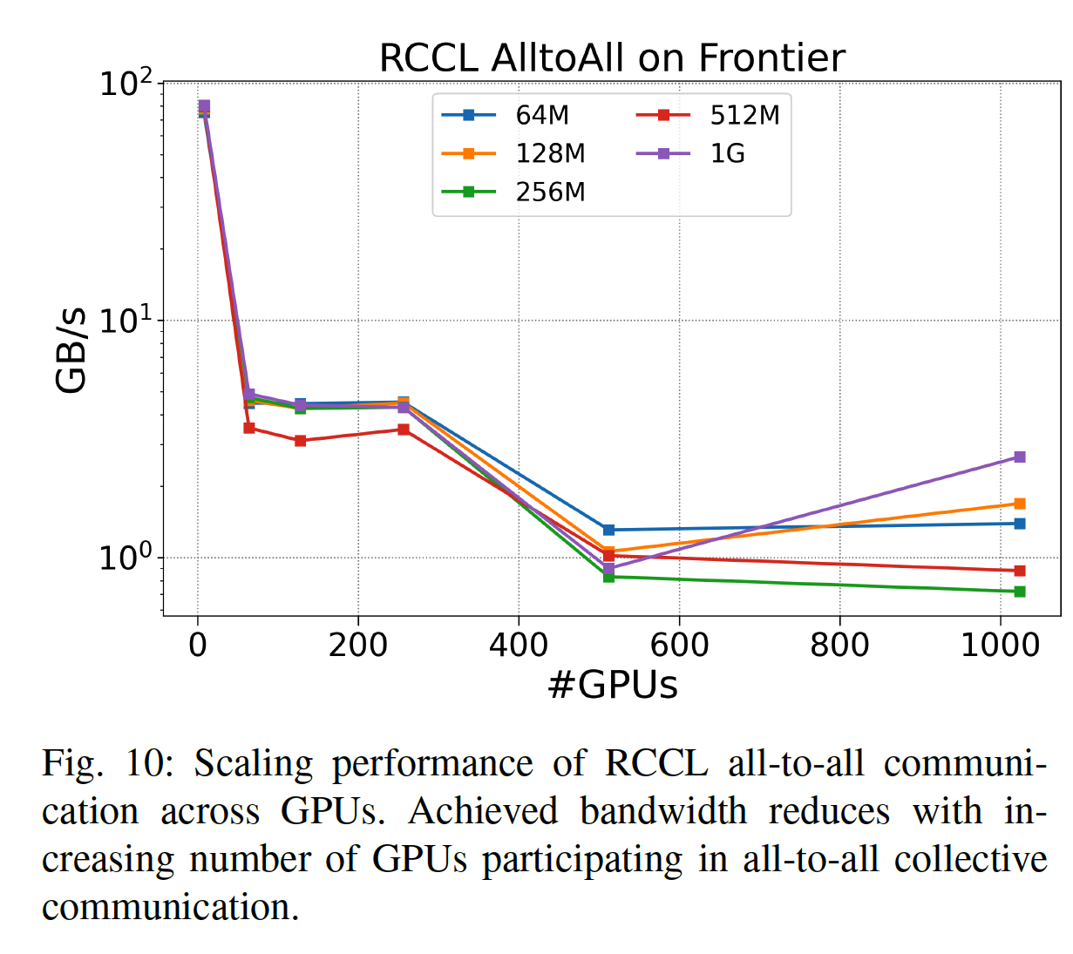
Identifying opportunities and bottlenecks

Slide 23
Training SMOREs

Slide 24
Our Foundation Models
Forge: A GPT-NeoX Based LLM of size 1.3B, 13B, and 22B parameters trained on scientific articles
ORBIT: A Vision Transformer trained on geospatial images from climate science with 100B parameter
SMOREs: Models under training with 100s of Billions of Parameters

