Slide 1
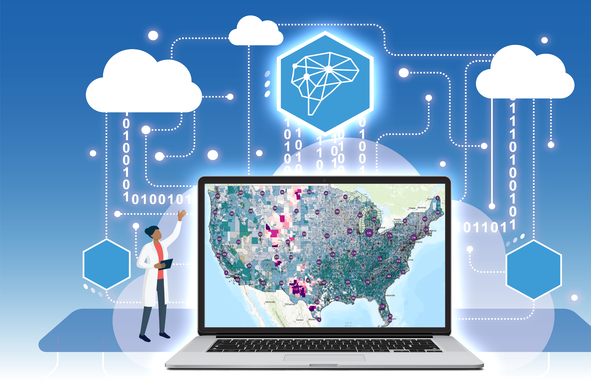



Data aggregation and integration for energy infrastructure modeling
Speaker: Kelly Rose,
Senior Fellow, Computational Sciences & Engineering, Research Innovation Center,
National Energy Technology Laboratory
…NETL’s GAIA Research Group
9/2024
https://edx.netl.doe.gov/sami

Slide 2
Disclaimer
This work was funded by the United States Department of Energy, National Energy Technology Laboratory, in part, through a site support contract. Neither the United States Government nor any agency thereof, nor any of their employees, nor the support contractor, nor any of their employees, makes any warranty, express or implied, or assumes any legal liability or responsibility for the accuracy, completeness, or usefulness of any information, apparatus, product, or process disclosed, or represents that its use would not infringe privately owned rights. Reference herein to any specific commercial product, process, or service by trade name, trademark, manufacturer, or otherwise does not necessarily constitute or imply its endorsement, recommendation, or favoring by the United States Government or any agency thereof. The views and opinions of authors expressed herein do not necessarily state or reflect those of the United States Government or any agency thereof.​

Slide 3
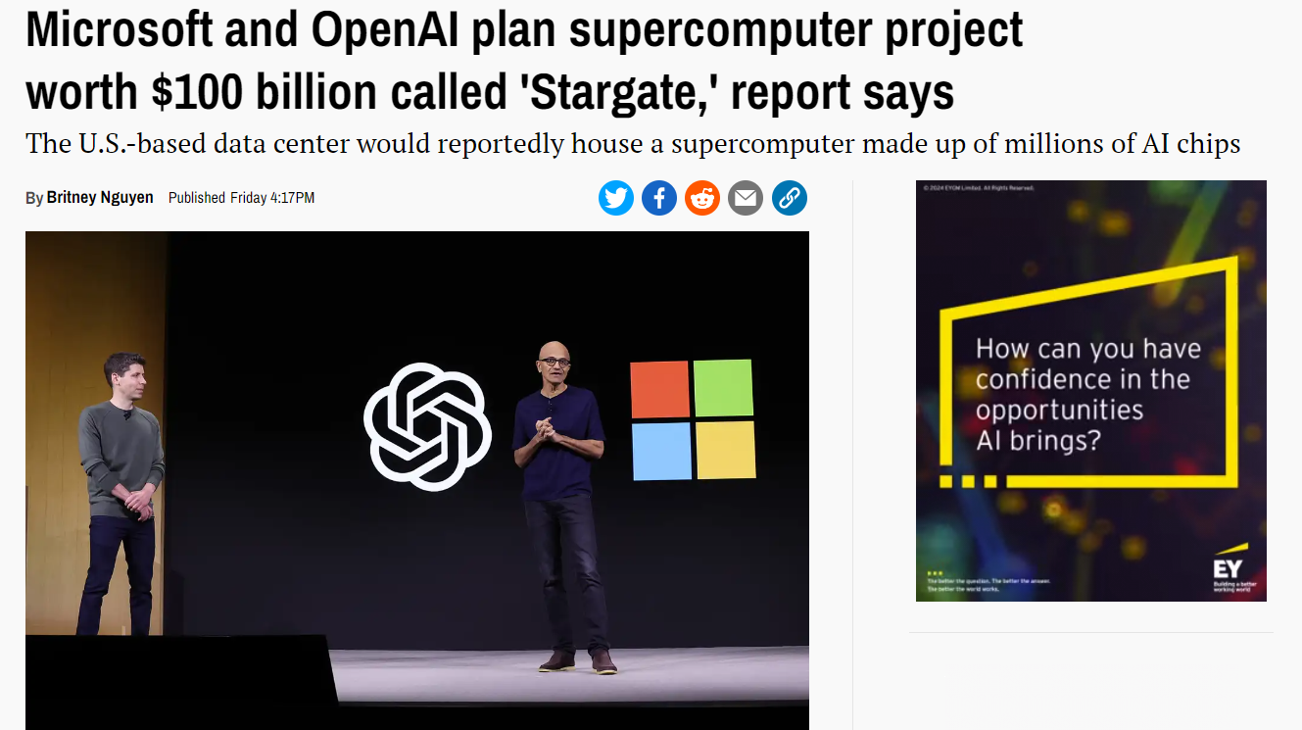

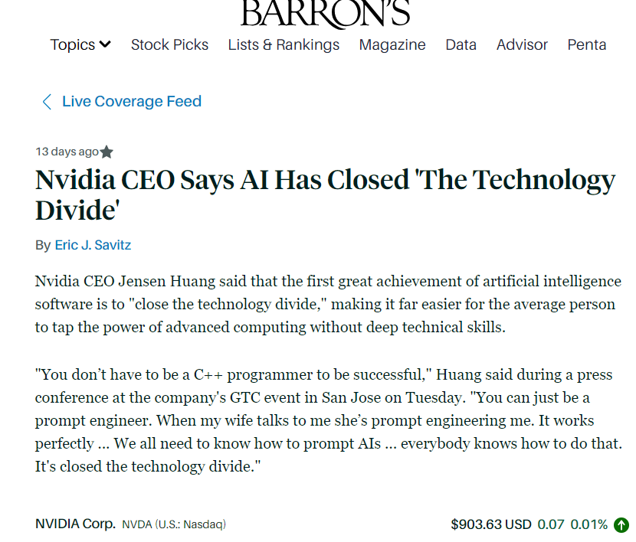
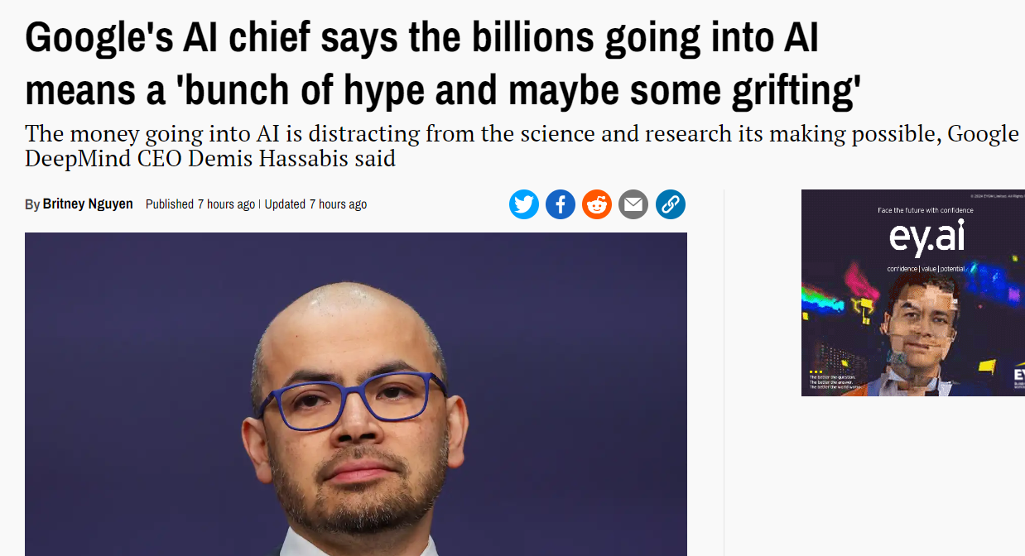
Digital Discovery is Accelerating… and yet…
AI is not magic…
It takes expertise to enact

Slide 4

… & complex systems require more
Data science in action for clean energy
Innovation to bridge the digital divide

Slide 5
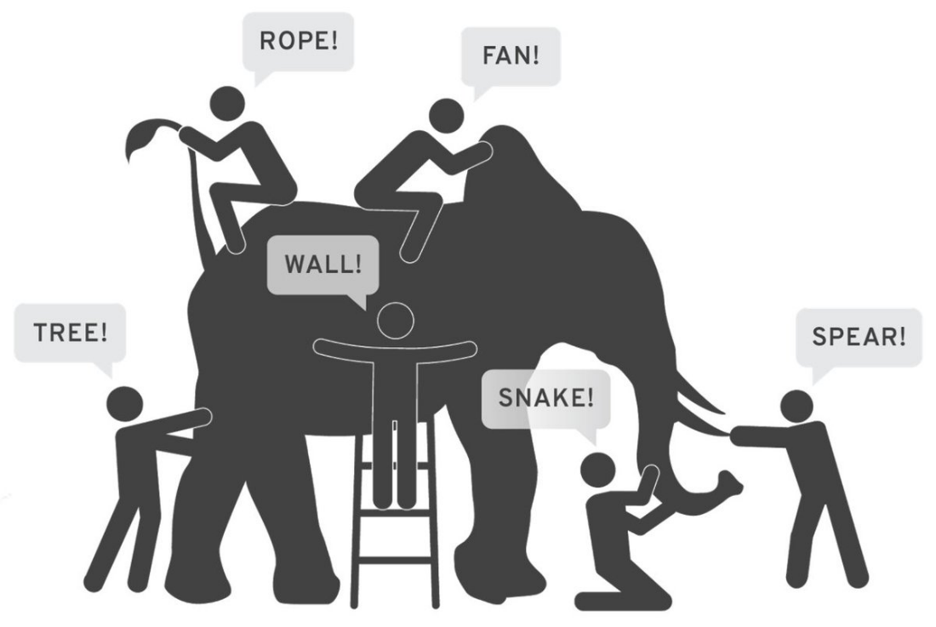
Using Data + AI & Science to Inform
Geosciences
Geostatistics
Geo-microbiology
Geology
Geochemistry
GIS
Geophysics
Geography
Geotechnical Engineering
Computer Science
Mathematics
Data discovery, processing, QA/QC, programming
Spatio-temporal statistics
AI/ML
Using data to enable science-based predictions to improve our understanding of the whole

Slide 6
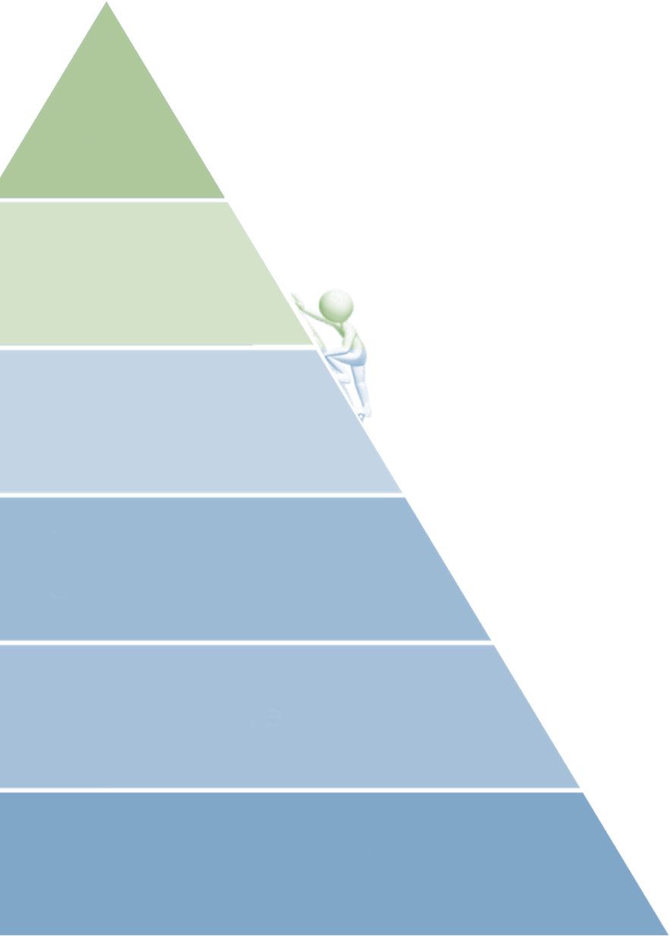
Data Resources are the Energy for Innovation
What are data?
“Essentially, any information that can be encoded into a format that a computer can read and manipulate can be considered data.” Gemini 2024
Data – data products are defined as a single product or collection of information categorized and displayed as datasets, publications, tools, applications, and software. Data can be downloadable files or hyperlinks to a reputable external resource. EDX
Inform
Analyze
& Optimize
Innovation to connect the digital divide
Integrate & Label
Explore & Transform
Bridging the gap to enable compute at all scales for all users
Move & Store
Discover & Collect
https://edx.netl.doe.gov/reference-shelf
Notes:
Did you know?
Historically, researchers spend the majority of their time preparing their data than actually the data to analyze and inform.
80% of their time is used to address the bottom half of the pyramid.
Only 20% of their time is spent to draw conclusions and inform.
Today, NETL’s Energy Data Exchange is inverting the data pyramid to accelerate innovation.

Slide 7
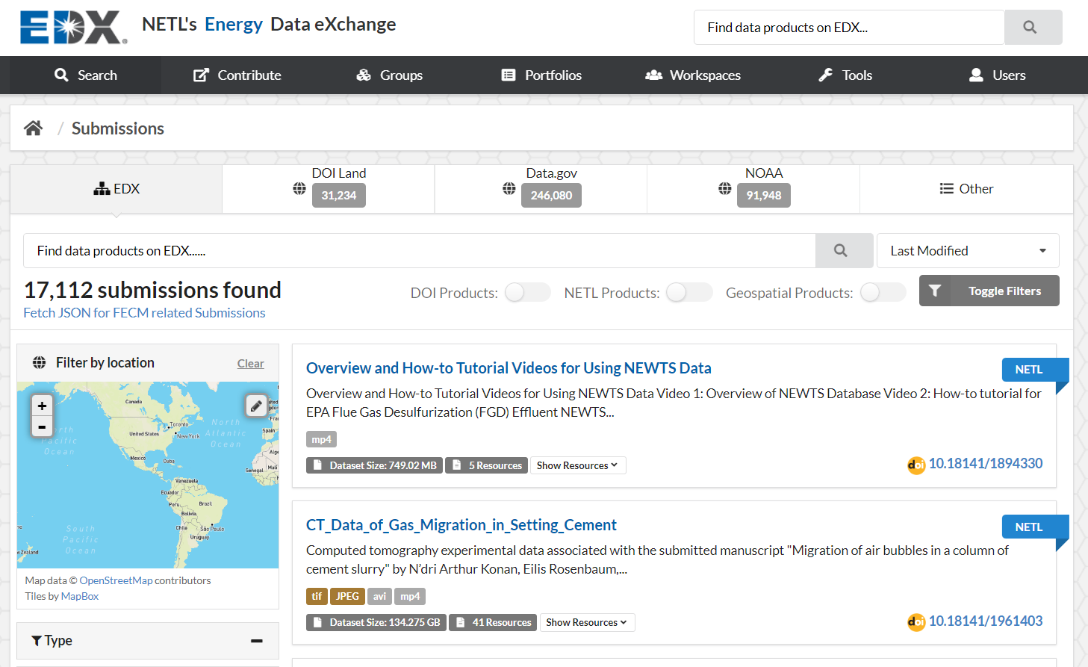

How has DOE/NETL addressed Clean Energy R&D data needs?
2021 U.S. DOE, Secretary of Energy’s Achievement Award winner
a web-hosted, virtual library and laboratory
that supports the DOE applied energy community
v.1 2012
12+ years
EDX++ v.4 2024
https://edx.netl.doe.gov/reference-shelf
Notes:
EDX provides public dissemination of data products including authoritative links out to externally hosted data products.
It promotes discoverability of published data products for use/re-use
It supports multi-organizational collaboration within secure workspaces
It facilitates data compute on-prem and in the cloud

Slide 8


AI to Accelerate use of individual data pieces, putting the puzzle together
Source: Gemini
Source: Gemini

Slide 9


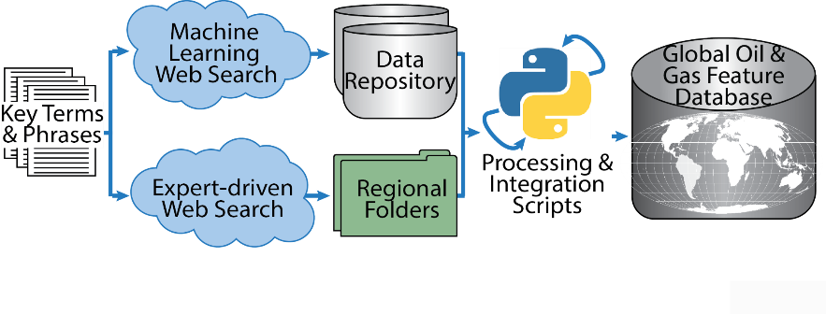
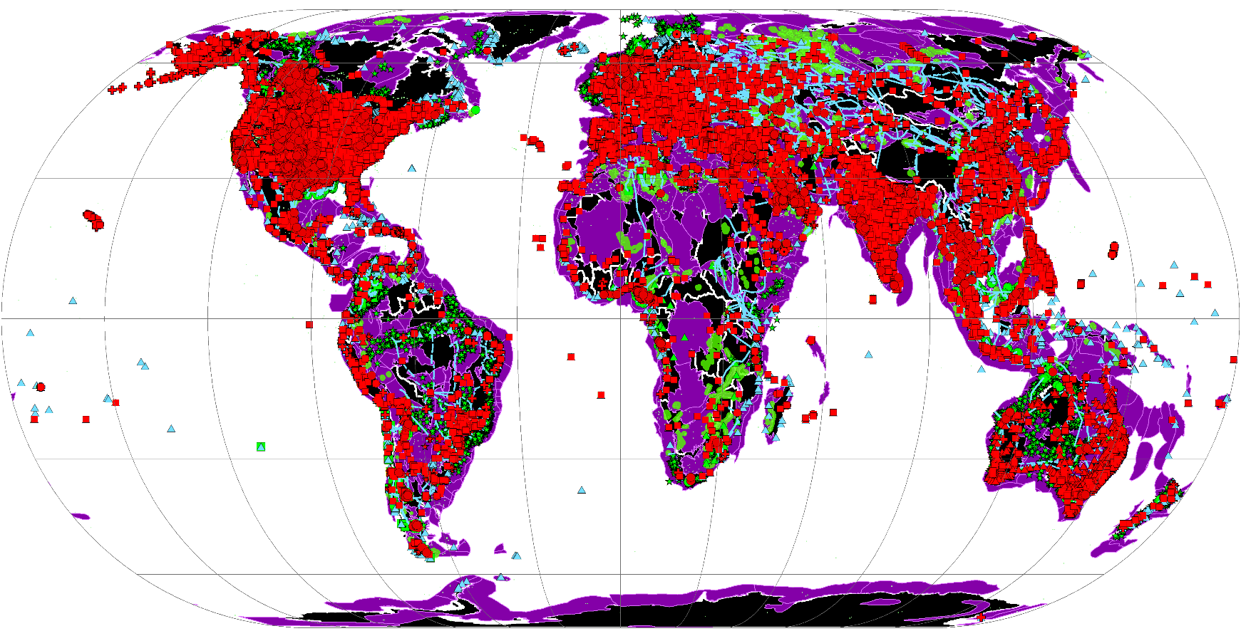

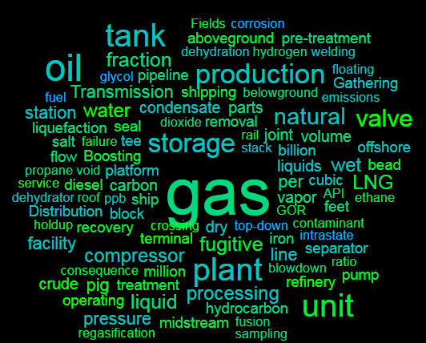
Developing a Global Oil & Gas Database
Inverting the 80% - Using BD/ML/NLP to generate data rapidly for R&D
  >1000 datasets
  >6 million features
  >1000 downloads
Database available at https://edx.netl.doe.gov/dataset/global-oil-gas-features-database
Notes:
Project overview, quickly identifying the overall goal of the project: develop a database of publicly available, global (excluding the U.S.) oil and gas infrastructure datasets. Brief mention of the two methods used to identify and collect these datasets, the search terms used to identify the datasets, and statistics on the overall data collected. Also include text on the ultimate drivers for creating this database ( to: improve awareness of open global oil and gas infrastructure data, identify information gaps, and identify advanced analyses leveraging this dataset to support reduction of methane emissions)

Slide 10
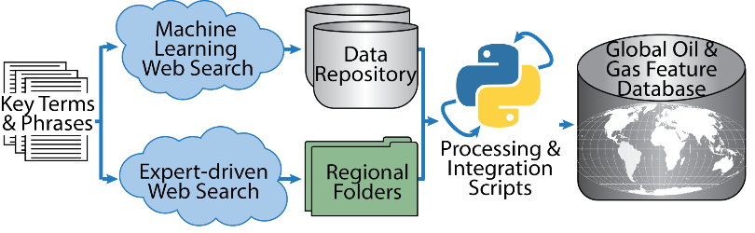
Approach & Features
Combined these approaches resulted in:
Acquisition of disparate data by country, region, & continent
Data Categories | Example Infrastructure Features Types
Transport | Ports, Railways, Pipelines
Facilities/ Installations | LNG, Power Plants, Processing Plants, Refineries, Stations, Storage, Terminals
Production/ Extraction | Oil and Gas Fields, Platforms, Well Pads, Underground Storage, Mines, and Wells
Geology | Sedimentary Basins
Dataset = Collection of data from a single source that represents real world objects
Feature Type = A collection of one kind of feature (e.g. wells)
Feature = a record for a single resource (i.e. – a well, a pipeline, a port, etc)

Slide 11
Custom Scripts
Python source scripts used to create, translate, and integrate the GOGI geodatabase.
Used to check and remove for duplicates
Conduct language translation to English
Project spatial data
Generate updated versions of the geodatabase
Data Integration

Slide 12

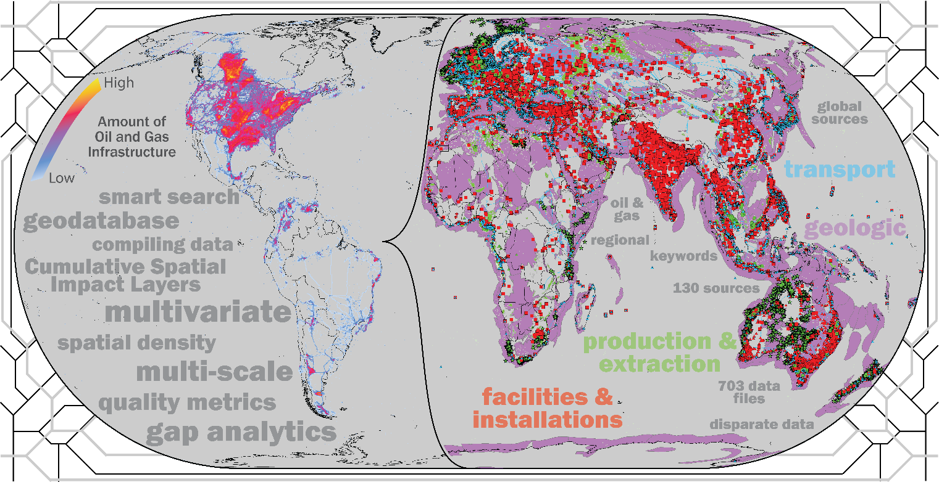

Data-Driven & AI-Informed
Energy Infrastructure Resources
Supporting Risk Assessments, Accelerating Carbon Management,
and Informing Reuse Potential
Global Oil and Gas Infrastructure (GOGI) Database, 2018
Built and assessed public global oil and gas infrastructure data to support emission mitigation
Two-pronged machine learning and subject matter expert approach
  1000+ datasets
  6+ million records
Products include publications (Rose et al 2018), database (Sabbatino et al 2018), and a Mapping Application
https://edx.netl.doe.gov/dataset/global-oil-gas-features-database
Notes:
https://arcgis.netl.doe.gov/portal/apps/experiencebuilder/experience/?id=fb1e4d1c775042b2a55ce3568e1036ac

Slide 13
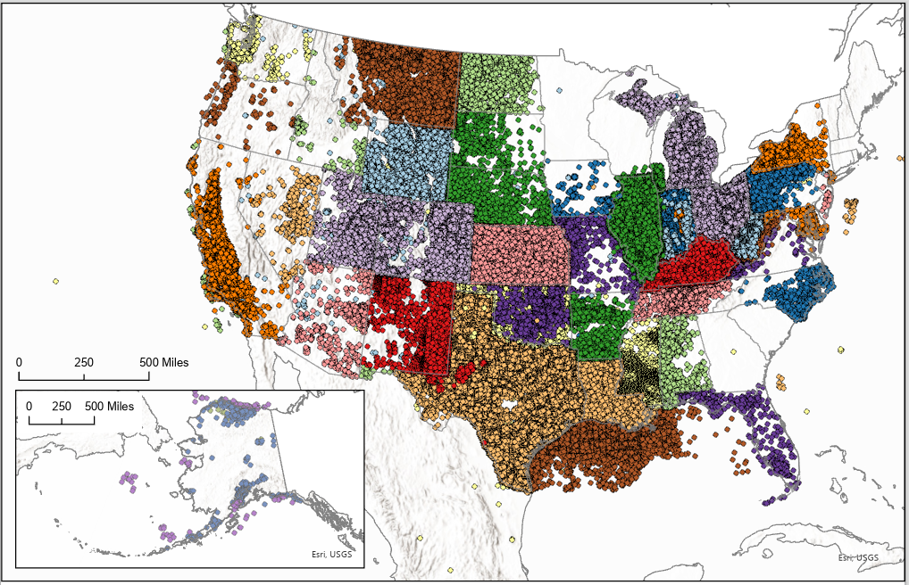
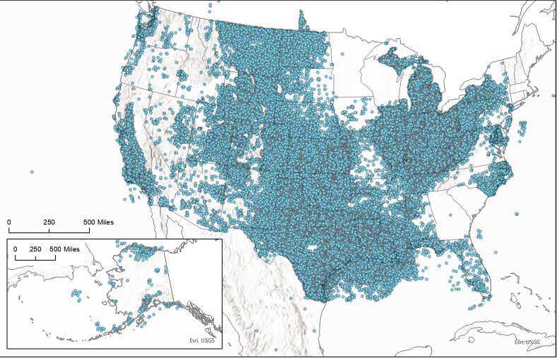
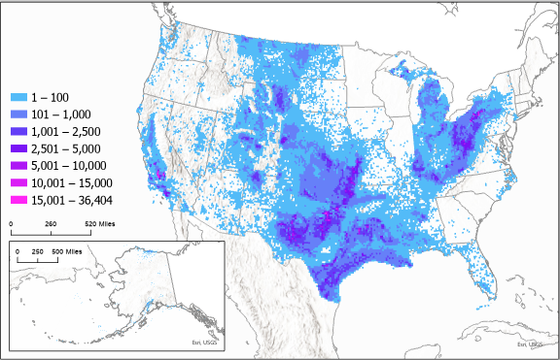
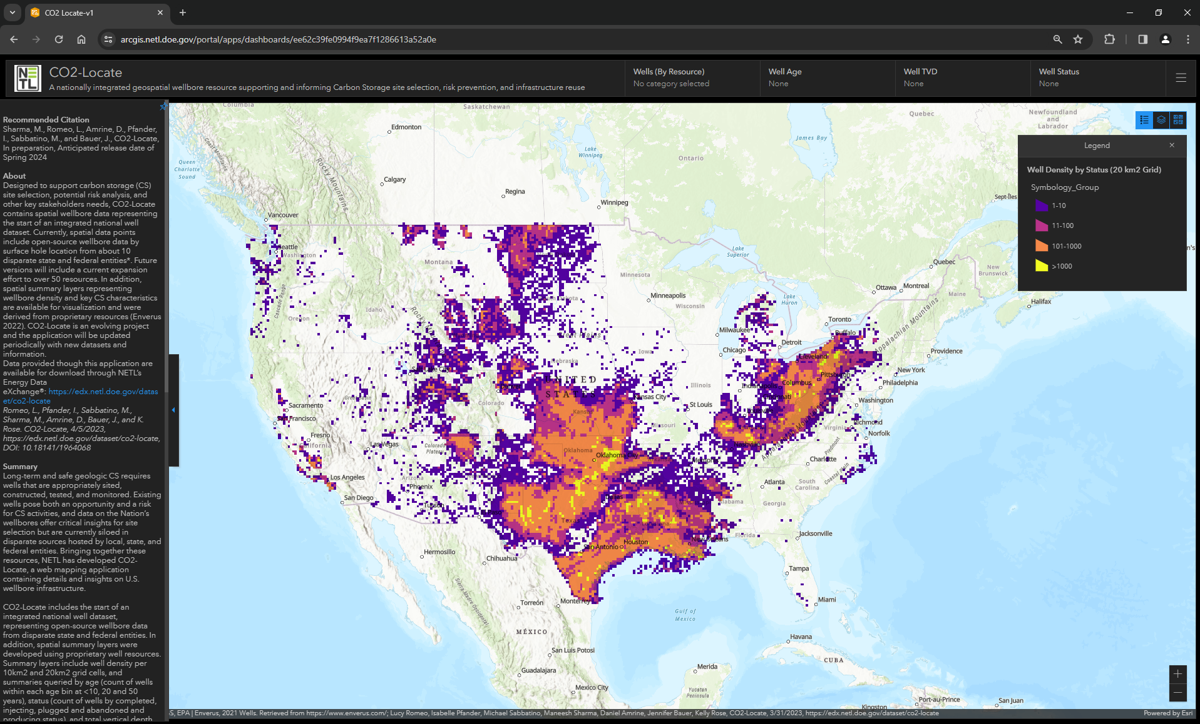

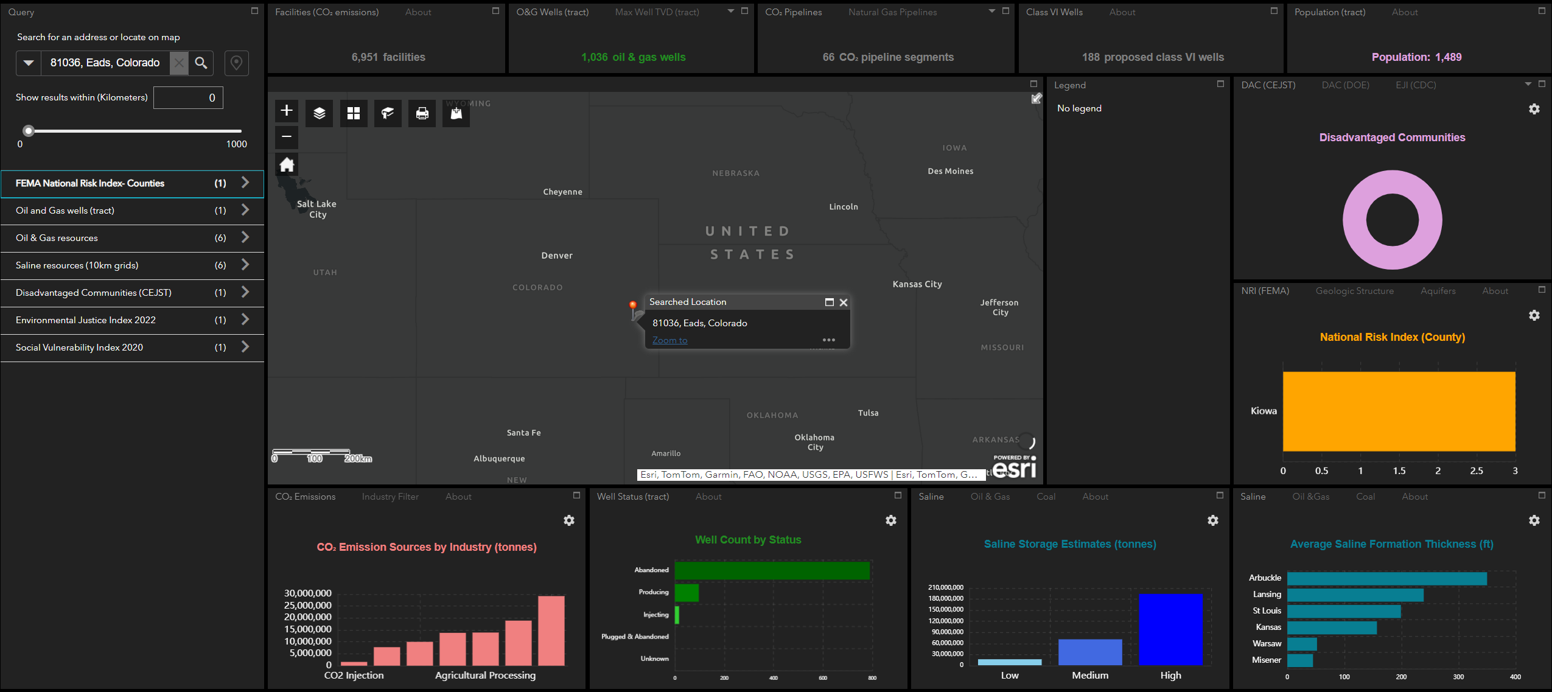

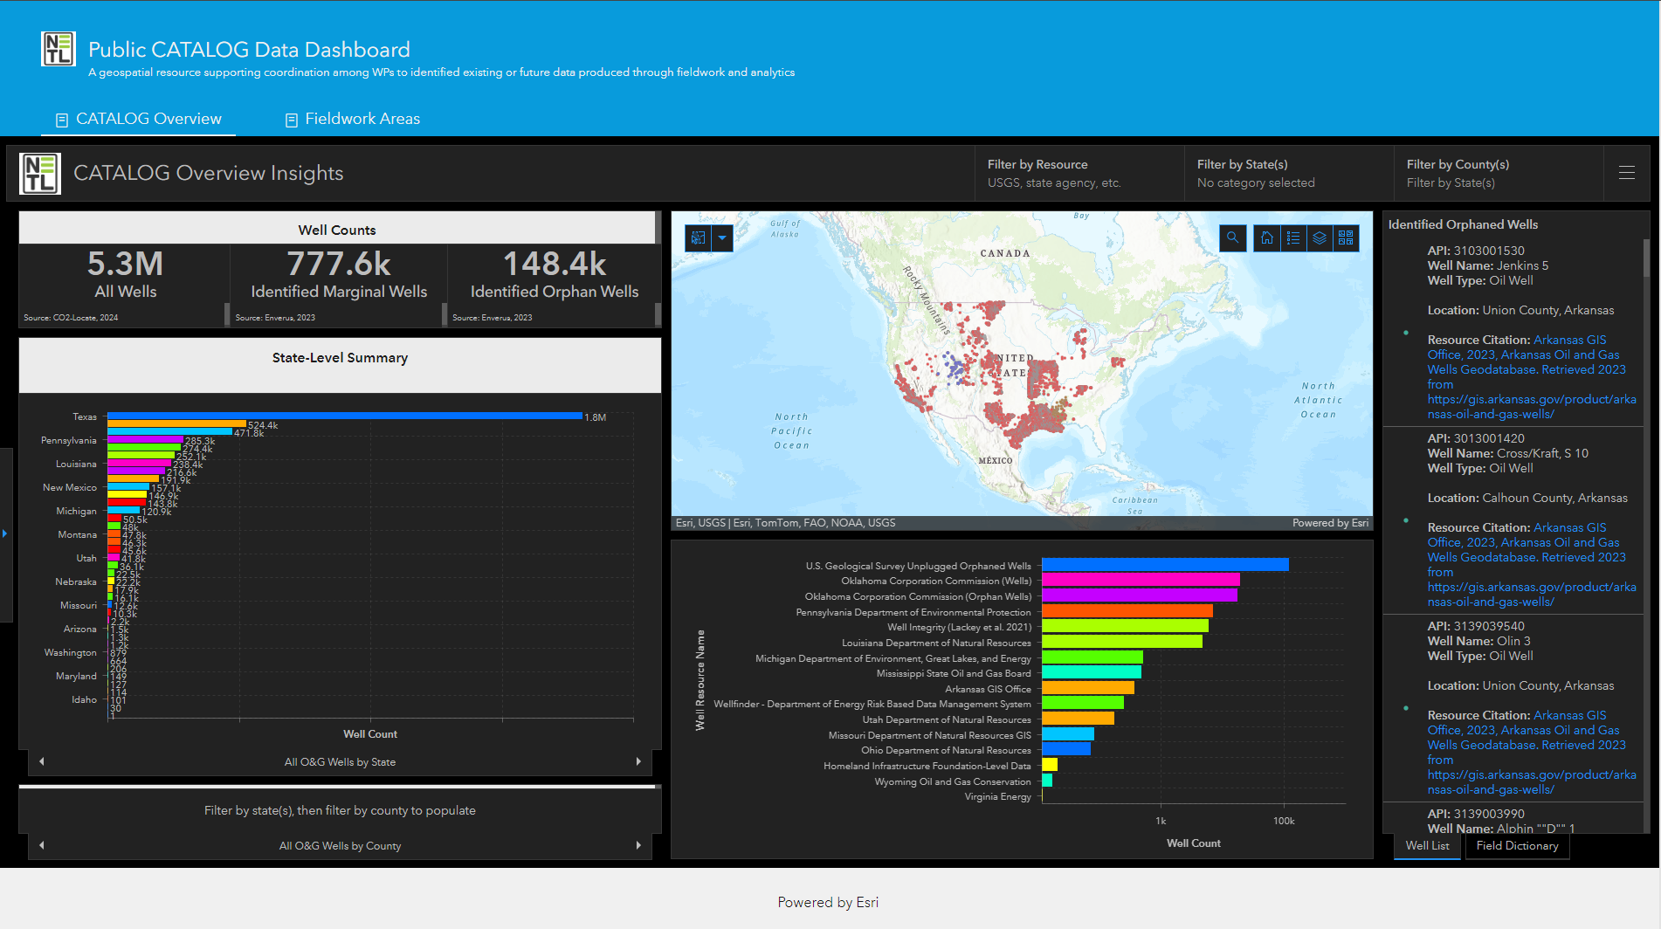


Building a Living National Well Resource
Integrated and standardized data across 60+ credible state, federal, and tribal well resources
A dynamic resource
Resulting CO₂-Locate containing in 17 million+ records, ~5 million unique wells
A resource supporting carbon transport and storage, methane mitigation, and environmental prudent planning
https://edx.netl.doe.gov/dataset/co2-locate
Notes:
https://arcgis.netl.doe.gov/portal/apps/experiencebuilder/experience/?data_id=dataSource_1-18ebf1c8018-layer-9%3A6&id=845a0643bbc64b0dba52be0016293f74&page=page_1

Slide 14
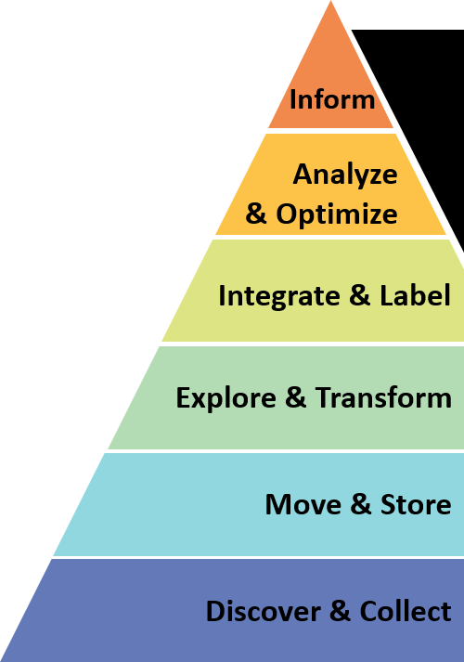




Materials Data Framework to Accelerate Alloy Design
Challenge:
Discovery
Deployment
Creating a data framework to address all levels of the Data Hierarchy
1
2
3
4
5
6
7
Development
Property Optimization
Systems
Design and Integration
Certification
Manufacturing
Traditional materials development takes 10-20 years (source: OSTP MGI White Paper, 2011)
Empirical lifetime prediction is unreliable and not transferable to new alloys
Solution: Use data analytics to reduce time and cost of alloy design and deployment
Accelerating the bottom using data science techniques
Project Goals:
Collect, store and transform materials data from new and heritage resources, and use machine learning to predict alloy behavior and to optimize properties

Slide 15




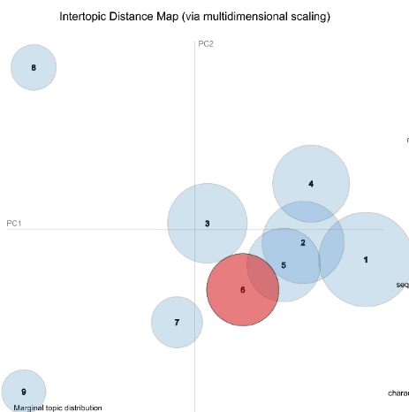

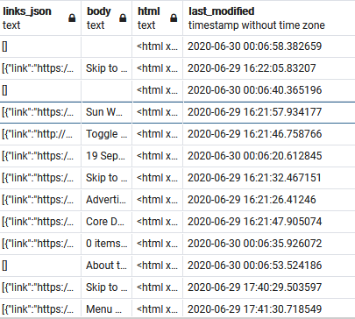

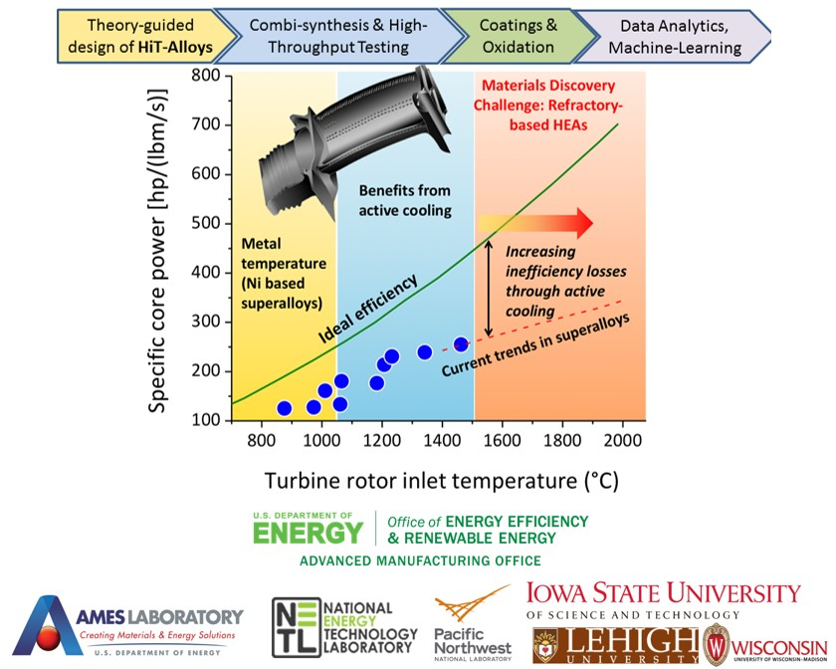
Smart Search – Example of Materials Data Search
SmartSearch is a deep learning, custom digital search algorithm
Generate a topic model to visualize & understand the information contained in the returned documents
Materials Database
Machine learning & natural language processing tools for efficient searching
45 seed documents
1.74 million URLs returned from online searches
269,992 parsed texts with relevance score + body text
30,364 parsed texts with relevance score > 0.4
keywords: refractory; high entropy alloy; HEA; multiple principal element alloy; MPEA; oxidation; microstructure; modulus; strength; molybdenum; high temperature
Smart Search parsing tools to determine relevance
Relevancy score: similarity of document to original corpus

Slide 16
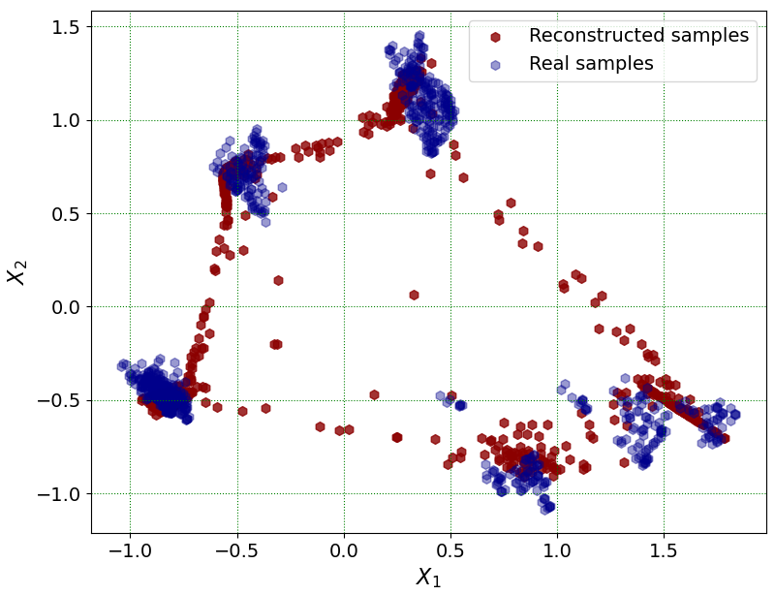
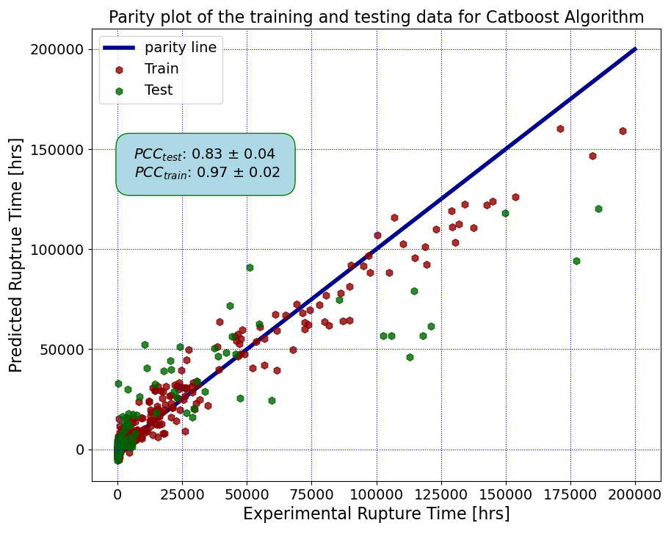
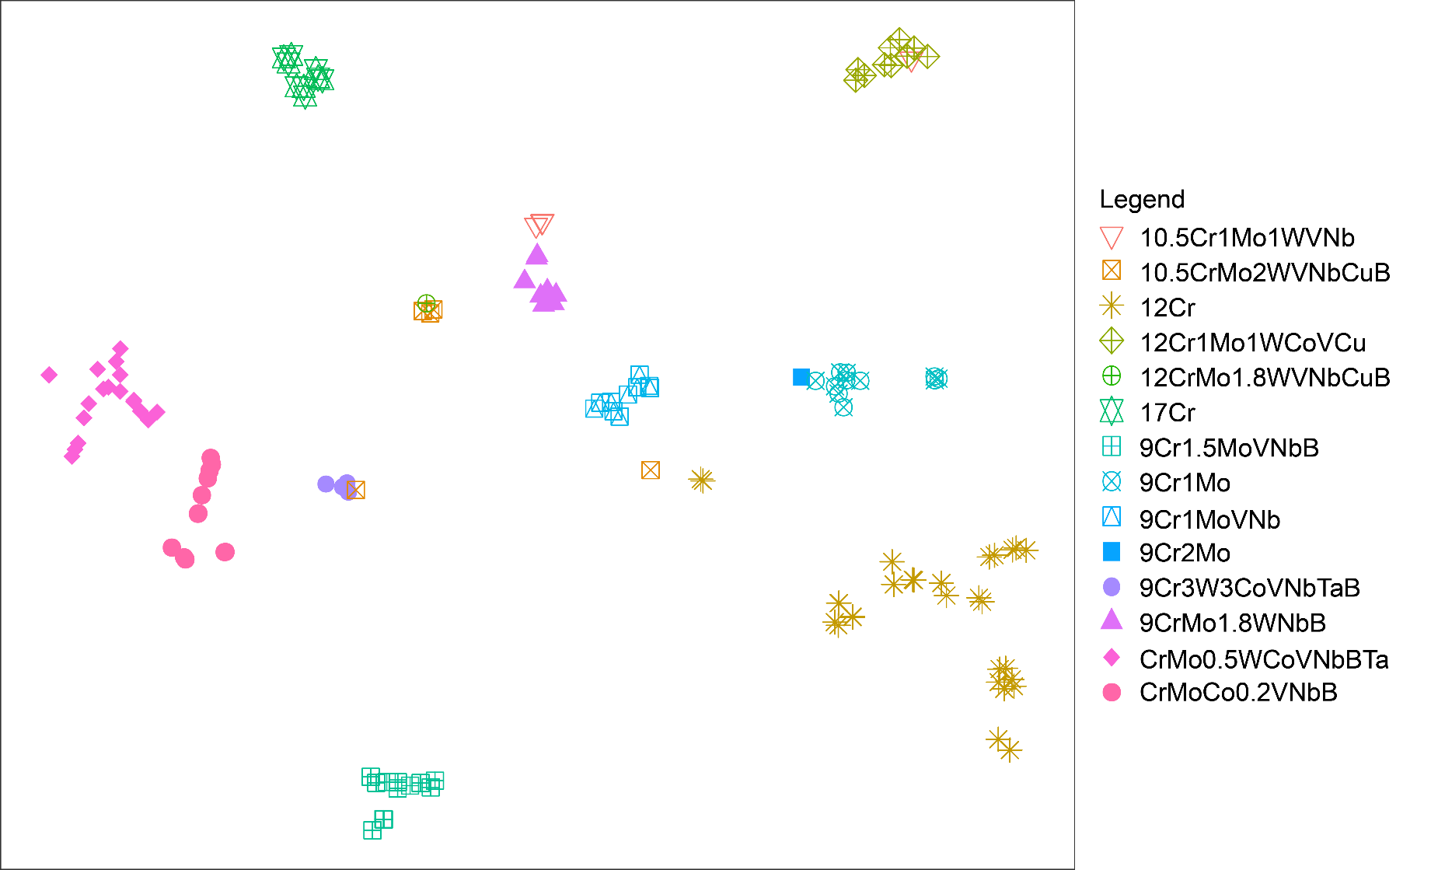
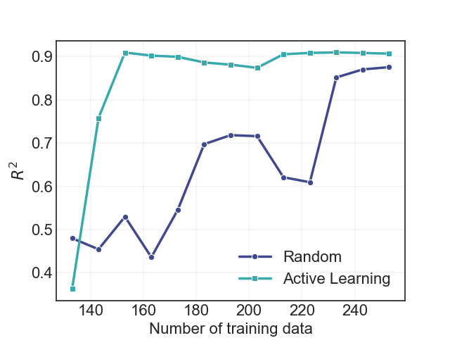
AI/ML in eXtremeMAT
Leveraging multiple techniques for a wide range of data types & formats
Clustering: assessing trends in materials data
Integrating domain knowledge into analysis
Assessing outliers to the dataset
ML regression + variational autoencoder: Modeling material properties: creep rupture life, yield strength
Suggesting new alloy compositions for optimal performance
Active Learning for efficient experimentation: reducing uncertainty in predictive models
Using gaussian process regression predictive model including understanding of uncertainty
Wenzlick, M., et al. J of Mat Eng and Perf, 2021. https://doi.org/10.1007/s11665-020-05340-5
Mamun, O., et al. Sci Rep 12, 2083 (2022). https://doi.org/10.1038/s41598-022-06051-8
Mamun, O., et al. npj Mat Deg, 2021. https://doi.org/10.1038/s41529-021-00166-5

Slide 17

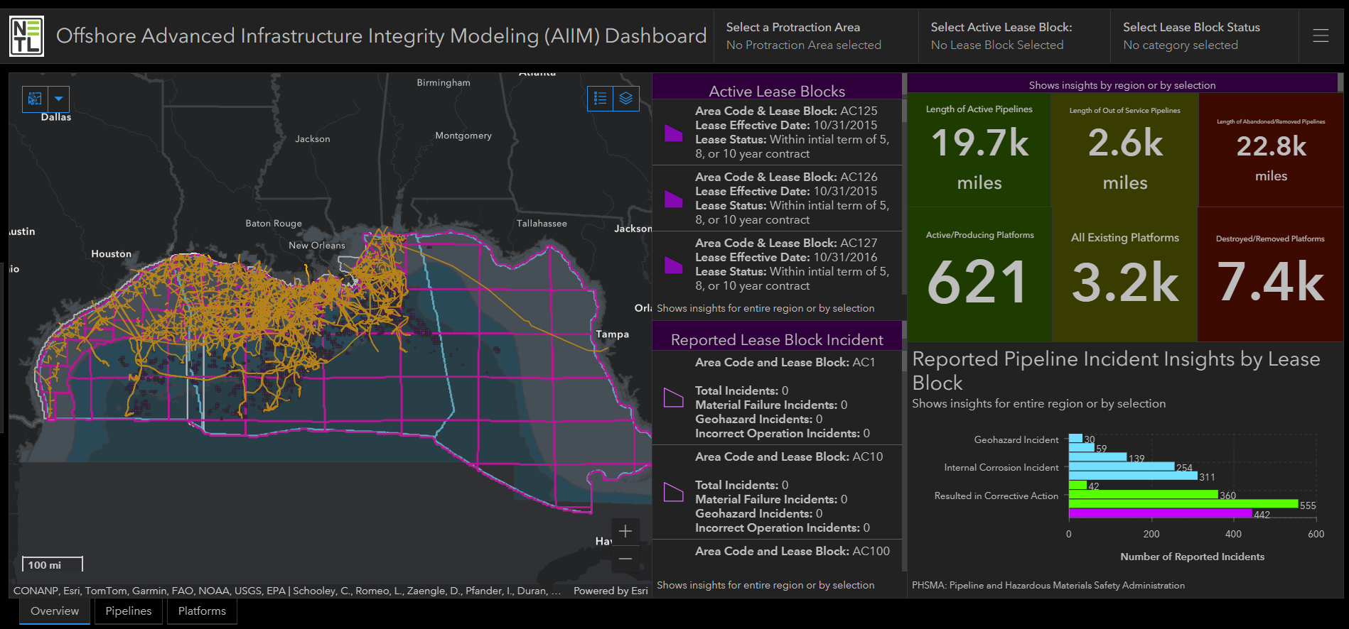
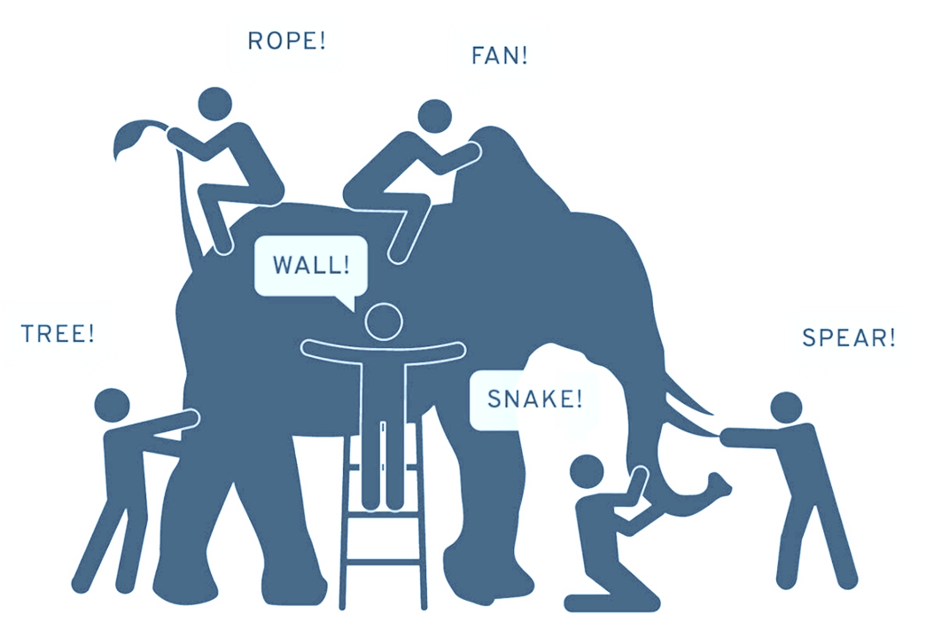

Enabling Smart Infrastructure Assessments
Advanced Infrastructure Integrity Modeling
1. Integrate data spanning natural-engineered system
2. Evaluate stressors with multiple machine learning models
3. Corroborated results by cross-validation with models, news, and regulatory reports
Using data representing the whole to inform local predictions
A validated and published approach turned application informing remediation needs, repurposing opportunities, and risk prevention
https://edx.netl.doe.gov/dataset/offshore-aiim-dashboard
Notes:
https://arcgis.netl.doe.gov/portal/apps/experiencebuilder/experience/?id=86a9ec068e504eaebb9f68ba4554f7cc

Slide 18
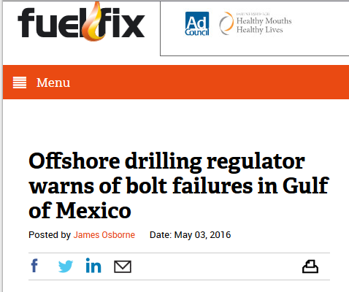


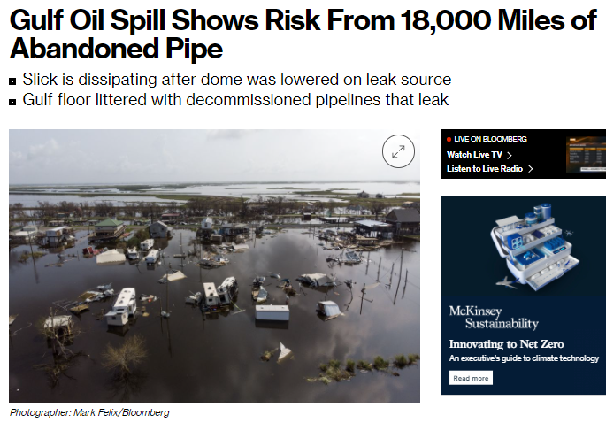
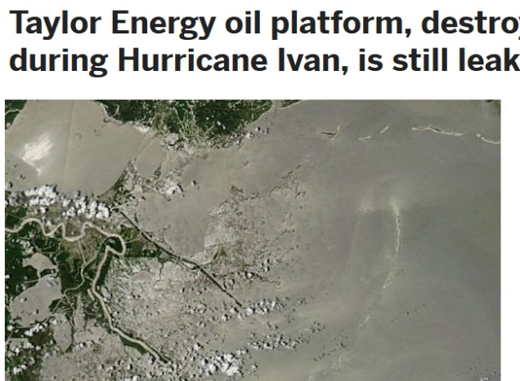

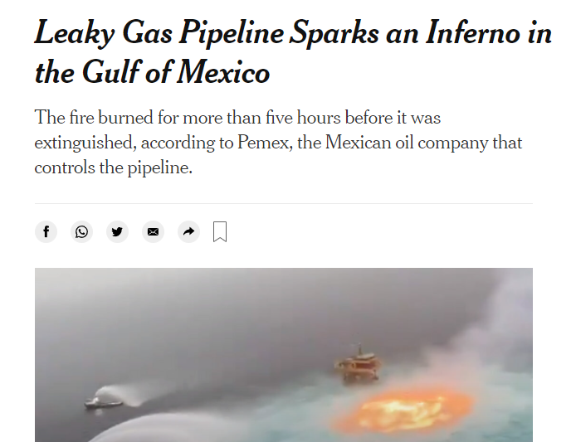
Energy Infrastructure: Potential Risks & Impacts
Solution:
Applied NETL big data, big data computing, and advanced modeling capabilities to evaluate existing energy infrastructure
Developed multiple machine learning (ML) models & spatio-temporal analytics to understand existing infrastructure integrity
Enable model-driven insights & visualization with AIIM (Advanced Infrastructure Integrity Modeling) published method-turned-tool
Natural hazards
Integrity risks
Values Delivered
Evaluates the current state of offshore infrastructure for reuse potential
Inform lifespan extension, remediation, and safe-use/reuse strategies
Support environmental & operational risk prevention
Environmental impacts

Slide 19


Approach:
Using the Whole to Inform Local Trends & Predictions
  11k+ platform records
  26k+ miles of pipelines
  55k+ well records
  51k+ environmental layers
  Geohazard layers
    Landslide prediction surface from NETL’s Ocean and Geohazard Analysis smart tool
  46GB+ biochemical data
  Spatio-temporal production data at the well, platform, and lease block level
  70+ years of platform incidents
  30+ years of pipeline incidents
  50.6GB of monthly ship trackline data
Data representing the natural-engineered offshore system for Gulf of Mexico

Slide 20
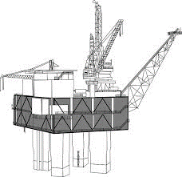
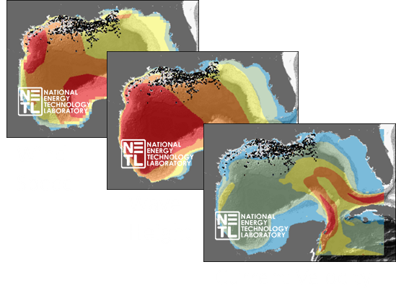
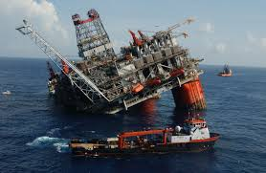

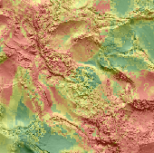
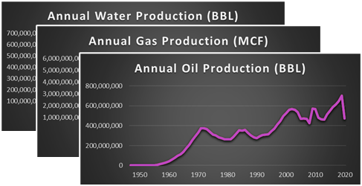


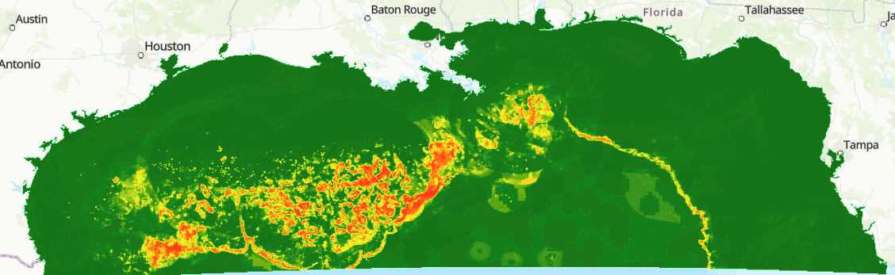
Analytical Approach
Advanced Infrastructure Integrity Model (AIIM)
Multiple Machine Learning (ML) and Advanced Modeling
Structural information
Machine Learning Models (Dyer et al. 2022)
Gradient Boosted Decision Trees (2 models)
Artificial Neural Network (2 models)
Bayesian Network
Advanced Analytics
Geographically Weighted Regression
  (Nelson et al. 2021)
Causality/Time Series Analytics
Why multiple models?
Evaluate strengths vs. weaknesses
Internal cross-validation
Incident reports
Metocean & Biochemical variables
AI/ML & Advanced Modeling
Production information
z
z
Geohazard data
Identified significant connections among biochemical variables and incidents
Corroborated results with news and reports
ML models capable of predicting removal age < 3 years
https://edx.netl.doe.gov/offshore

Slide 21
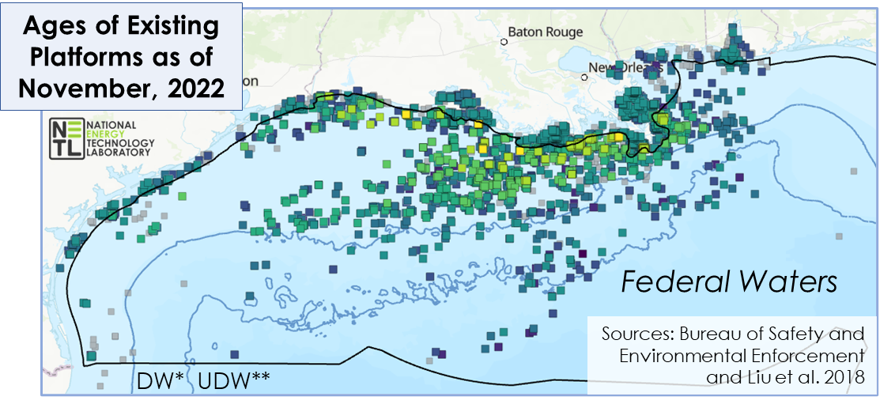
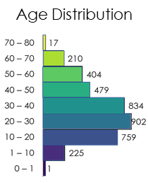
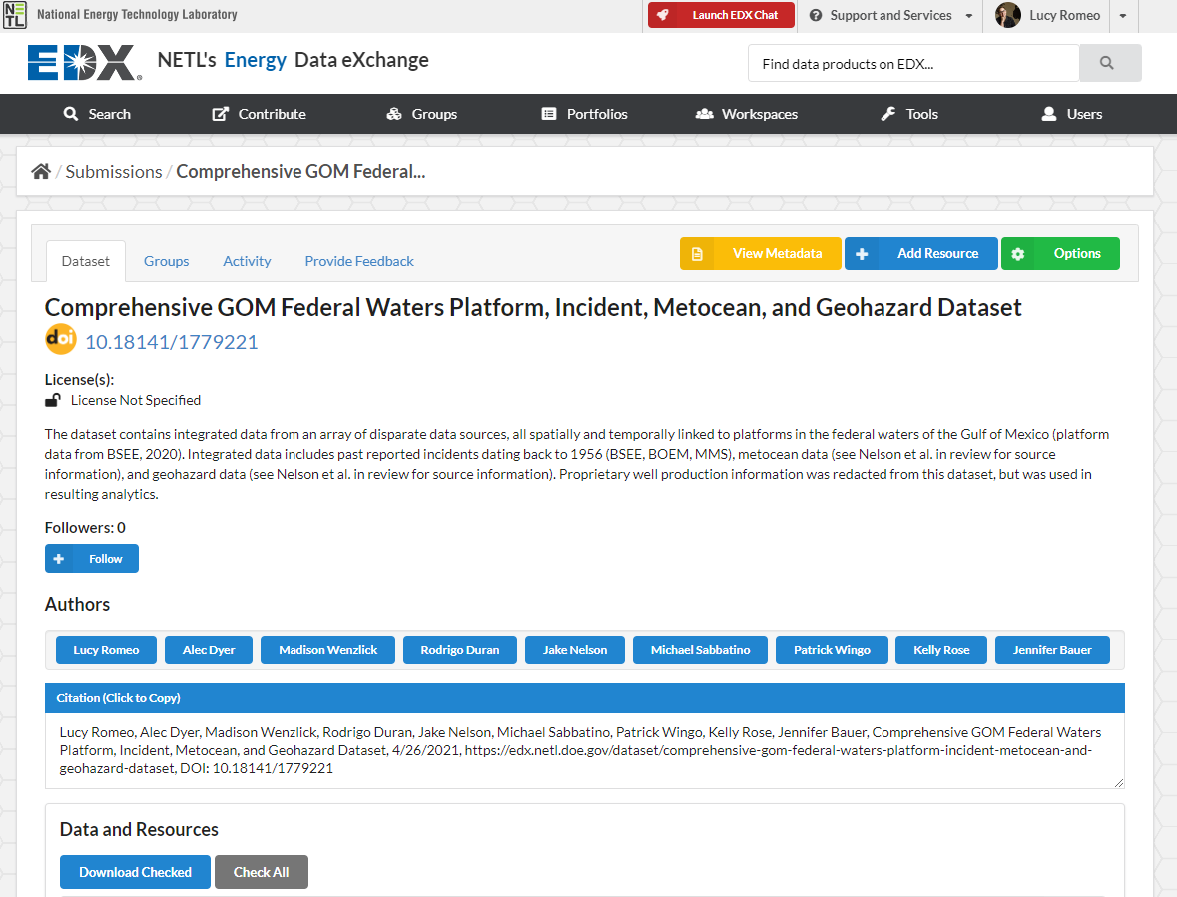
: Research Products & Insights
Evaluating Platform Infrastructure
  Integrated 70+ years of data
    11k+ structure records
    1,700+ features
    Updated incidents & metocean statistics
Updated ML models capable of predicting removal age within ~3 years
Key stressors included:
Model | Root Mean Square Error (RMSE)
ANN | 5.3 years
GBDT (XGBoost) | 3.4 years
GBDT (CatBoost) | 3.1 years
*Deepwater (1,000ft+)
**Ultra-deepwater (5,000ft+)
Comprehensive Platform Dataset on EDX
  Storm occurrences (wind gust, minimum central pressure)
  Corrosive factors (biochemical variables)
  Number of well slots
  Water depth
  Reported incidents
(Romeo, 2021)

Slide 22
Expanding Analytics on Reported Incidents
Examining Risk Cause and Effect
  What factors potentially catalyze cascading events?
Causes
Consequences
Structure type, age, location
Severity (e.g. cost, damage)
Preventative maintenance
Environmental impact
Reported Incident
Operations & activities
Fatalities or injuries
Past incidents
Fire
Explosion
Collision
Leak
Environment conditions
Monetary cost
Other external factors
Corrective actions
  Answer questions such as,
At what age are platforms most prone to incidents?
Where are infrastructure more vulnerable to incident?

Slide 23
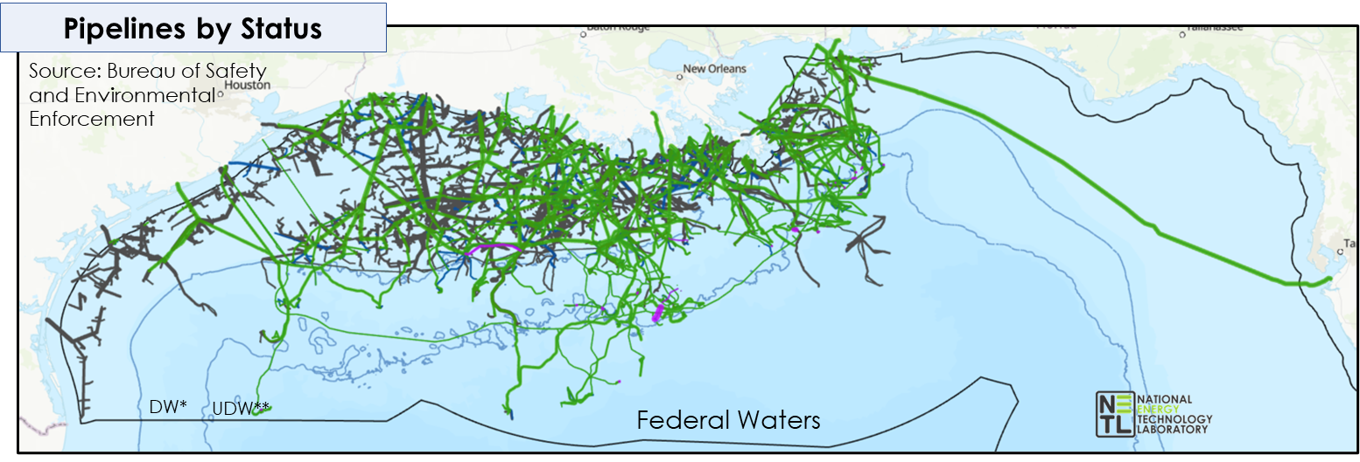
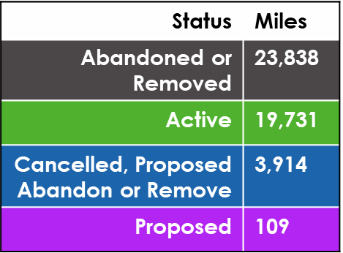
: Research Products & Insights
Evaluating Pipeline Infrastructure
Preliminary model runs capable of predicting abandonment age within ~3 years
Key stressors included:
Model | Root Mean Square Error (RMSE)
ANN | 3.3 years
GBDT (XGBoost) | 3.1 years
GBDT (CatBoost) | 0.7 years** 0.99 R²
  26k+ miles of pipelines
    100k+ locations (every 1km + end points)
    400+ features
Added seafloor metocean data (floor current, bottom pressure)
  Biochemical variables
  Installation date/proxy date
  Cathodic code
  Status code
  Facility operator
Database Publication
(Pfander et al. 2024)

Slide 24
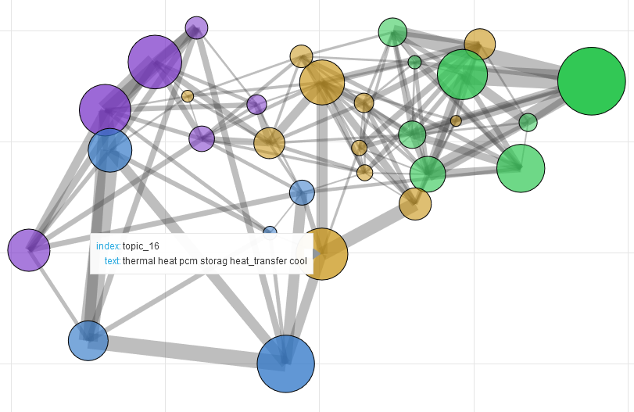
Data take aways
Context matters for complex problems
  Collect disparate datasets and contextual info
Incorporate data across various scales and formats
Not all data is equal, not all data are perfect…but AI with data science can put it to work
ML/BD solutions can help streamline and automate data collection, transformation, and utilization
Topic Connection Network
Notes:
Within EDX, we are building a virtual subsurface data framework
The VSS is a collection of datasets and contextual information that characterizes subsurface properties in a given region
It can incorporate data across various scales and formats, and span the S-SS interface
The VSS framework leverages NETL tools and capabilities to streamline data curation, storage, and processing
Thereby maximizing time and resources for users to spend with analytics and decision-making

Slide 25
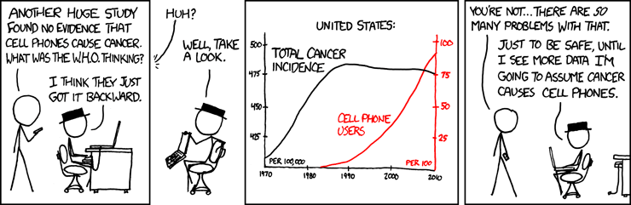
Other considerations
Correlation does not always equal causation
Multi-modeling approach can build trust
  Can help address data quality and quantity challenges
Uncertainty is critical
  Capture, reduce if possible, represent, utilize, quantify
Not all data are equal or valuable
  Lazer et al 2014, the parable of google flu: traps in big data analysis, Science
Notes:
insufficient information provided to effectively support advanced computational analyses and individual research and policy decisions utilizing these results

Slide 26
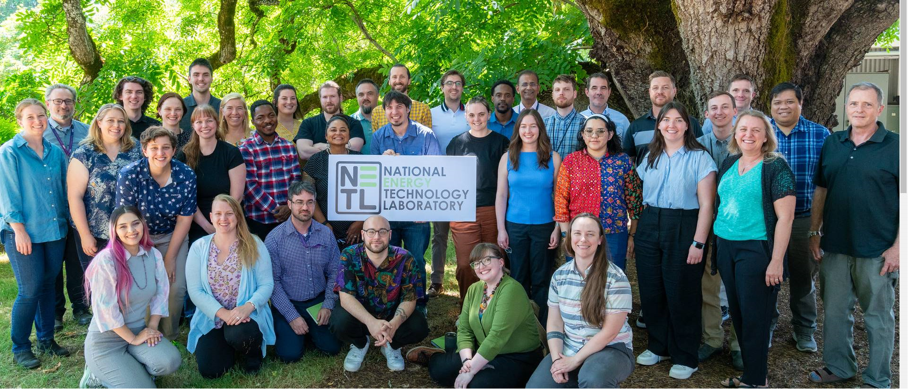

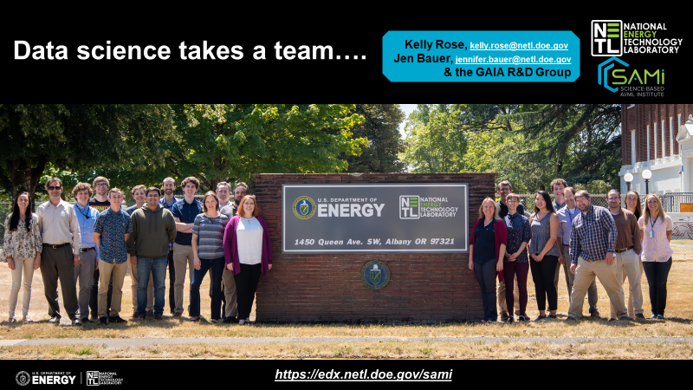
Data science takes a team….
…some of our AI wizards

Slide 27
Data aggregation and integration for energy infrastructure modeling
Speaker: Kelly Rose,
Senior Fellow, Computational Sciences & Engineering, Research Innovation Center,
National Energy Technology Laboratory
…NETL’s GAIA Research Group
9/2024

Slide 28
Key References pg 1
Bagdonas, D., Nye, C., Thomas, R., and Rose, K., 2019, Rare Earth Element Occurrence and Distribution in Powder River Basin Coal Core, Wyoming, Proceedings of the Thirty Sixth Annual 2019 International Pittsburgh Coal Conference, September 3 - 6, 2019, 13 pgs.
Bauer, J. et al. 2015. Variable Grid Method: an Intuitive Approach for Simultaneously Quantifying and Visualizing Spatial Data and Uncertainty. Transactions in GIS, 19, 377–397.
Creason, C.G., Justman, D., Rose, K., Montross, S., Bean, A., Mark-Moser, M., Wingo, P., Sabbatino, M., Thomas, R.B., 2023. A Geo-Data Science Method for Assessing Unconventional Rare-Earth Element Resources in Sedimentary Systems. Nat Resour Res. https://doi.org/10.1007/s11053-023-10163-x
Creason, C. G., Montross, S. N., Justman, D., Mark-Moser, M., Thomas, R., Bean, A., Rose, K. 2021. Towards A Geo-Data Science Method for Assessing Rare Earth Elements and Critical Mineral Occurrences in Coal and Other Sedimentary Systems; DOE/NETL-2021/2653 ; NETL Technical Report Series; U.S. Department of Energy, National Energy Technology Laboratory: Albany, OR, 2021; p 32. DOI: 10.2172/1809028
Dyer, A., Zaengle, D., Nelson, J.R., Duran, R., Wenzlick, M., Wingo, P., Bauer, J.R., Rose, K., and Romeo, L.. 2022. "Applied machine learning model comparison: Predicting offshore platform integrity with gradient boosting algorithms and neural networks." Marine Structures 83 : 103152.
Hoover, B., Wingo, P., Gao, M., Morkner, P., Sharma, M., Bauer, J., and Rose, K. Geospatial and Information Substitution and Anonymization Tool (GISA) Beta version 1.0. National Energy Technology Laboratory, 8/1/2023. www.edx.netl.doe.gov/dataset/geospatial-and-information-substitution-and-anonymization-tool-gisa , DOI: 10.18141/1992880
Justman, D., Creason, C.G., Gordon, A., Yesenchack, R., Mark-Moser, M., Rose, K., Montross, S., Wingo, P., Sabbatino, M. (2023). A Regional Geospatial Characterization of Rare-Earth Occurrence Potential within Unconventional Sedimentary Systems of the Central Appalachian Basin. Natural Resources Research. In preparation
Justman, D., Creason, C.G., Montross, S., Mark-Moser, M., Thomas, R.B., Bean, A., Rose, K. 2021. Supplementary data for Technical Report: Towards A Geo-Data Science Method for Assessing Rare-Earth Element Occurrences in Coal and Other Sedimentary Systems, 5/24/2021, https://edx.netl.doe.gov/dataset/supplementary-data-ree-sed-trs , DOI: 10.18141/1784272
Justman, D., Creason,. C.G., Rose, K., Bauer, J., 2020. A knowledge-data framework and geospatial fuzzy logic-based approach to model and predict structural complexity, Journal of Structural Geology, Volume 141, 2020, 104153, ISSN 0191-8141, https://doi.org/10.1016/j.jsg.2020.104153 .
Justman, D., Creason, C.G., Sabbatino, M., Rocco, N., DiGuilio, J., Rose, K., Thomas, R.B., REE and Coal Open Geodatabase, 2018, https://edx.netl.doe.gov/dataset/ree-and-coal-open-geodatabase , DOI: 10.18141/1475030STA
Mamun, O., et al. npj Mat Deg, 2021. https://doi.org/10.1038/s41529-021-00166-5
Morkner, P., Schooley, C., Shay, J., Pantaleone, S., Pfander, I., and Strazisar, B. “Carbon Storage Site Mapping Inquiry Tool (MapIT) Geodatabase v3”. May, 2024. https://edx.netl.doe.gov/dataset/mapit-database
Julia Mulhern, Jacob Shay, Neyda, Gabriel Creason, MacKenzie Mark-Moser, Araceli Lara, Kelly Rose, Carbon Storage Technical Viability Approach (CS TVA) Database, 6/11/2024, https://edx.netl.doe.gov/dataset/edx4ccs-carbon-storage-technical-viability-approach-database , DOI: 10.18141/1984655
Nelson, J.R., Romeo, L., and Duran, R. 2021. "Exploring the Spatial Variations of Stressors Impacting Platform Removal in the Northern Gulf of Mexico." Journal of Marine Science and Engineering 9, no. 11: 1223.
Nelson, J.R., Dyer, A., Romeo, L., Wenzlick, M., Zaengle, D., Duran, R., Sabbatino, M. 2021. Evaluating Offshore Infrastructure Integrity. No. DOE/NETL-2021/2643. National Energy Technology Laboratory (NETL), Pittsburgh, PA, Morgantown, WV, and Albany, OR (United States).

Slide 29
Key References cont.
Montross SN, Bagdonas D, Paronish T, Bean A, Gordon A, Creason CG, Thomas B, Phillips E, Britton J, Quillian S, Rose K. On a Unified Core Characterization Methodology to Support the Systematic Assessment of Rare Earth Elements and Critical Minerals Bearing Unconventional Carbon Ores and Sedimentary Strata. Minerals. 2022; 12(9):1159. https://doi.org/10.3390/min12091159
Patrick Wingo, Devin Justman, C. Gabriel Creason, MacKenzie Mark-Moser, Scott N. Montross, Kelly Rose, URC Assessment Method, 3/29/2023, https://edx.netl.doe.gov/dataset/urc-assessment-method , DOI: 10.18141/1963714
Pfander, I., Romeo, L., Duran, R., Dyer, A., Schooley, C., Wenzlick, M., Wingo, P., Zaengle, D., and Bauer, J. Extensive Pipeline Location Data Resource: Integrating Reported Incidents, Past Environmental Loadings, and Potential Geohazards for Integrity Evaluations in the U.S. Gulf of Mexico. Data in Brief. Available at https://doi.org/10.1016/j.dib.2024.110728
Rocha-Valadez, T.. , Hasan, A.R.. R., Mannan, S.. , and C.S.. S. Kabir.2014. "Assessing Wellbore Integrity in Sustained-Casing-Pressure Annulus." SPE Drill & Compl 29: 131–138. doi: https://doi.org/10.2118/169814-PA
Rose, K.; Bauer, J.; Baker, V.; Bean, A.; DiGiulio, J.; Jones, K.; Justman, D.; Miller, R. M.; Romeo, L.; Sabbatino, M.; Tong, A. Development of an Open Global Oil and Gas Infrastructure Inventory and Geodatabase; NETL-TRS-6-2018; NETL Technical Report Series; U.S. Department of Energy, National Energy Technology Laboratory: Albany, OR, 2018; p 594; DOI: 10.18141/1427573 https://edx.netl.doe.gov/dataset/development-of-an-open-global-oil-and-gas-infrastructure-inventory-and-geodatabase .
Rose, K., Bauer, J.R., and Mark-Moser, M., 2020, A systematic, science-driven approach for predicting subsurface properties, Interpretation, 8:1, 167-181 https://doi.org/10.1190/INT-2019-0019.1
Sabbatino, M., Romeo, L., Baker, V., Bauer, J., Barkhurst, A., Bean, A., DiGiulio, J., Jones, K., Jones, T.J., Justman, D., Miller III, R., Rose, K., and Tong., A., Global Oil & Gas Features Database, 2017-12-12, https://edx.netl.doe.gov/dataset/global-oil-gas-features-database , DOI: 10.18141/1427300
Schooley, C., Pantaleone, S., Shay, J., Strazisar, B., Bauer, J., Morkner, P., Carbon Storage Site Mapping Inquiry Tool, 06/28/2024, https://edx.netl.doe.gov/dataset/carbon-storage-site-mapping-inquiry-tool, DOI: 10.18141/2378020
Schooley, C., Lucy Romeo, Dakota Zaengle, Isabelle Pfander, Rodrigo Duran, Jennifer Bauer, Kelly Rose, (2024) Advanced Infrastructure Integrity Modeling Dashboard, https://edx .netl.doe.gov/dataset/offshore-aiim-dashboard
Wenzlick, M., et al. J of Mat Eng and Perf, 2021. https://doi.org/10.1007/s11665-020-05340-5
Wenzlick, M., Mamun, O., Devanathan, R., Rose, K., Hawk, J. Assessment of outliers in alloy datasets using unsupervised techniques. JOM, 2022. https://doi.org/10.1007/s11837-022-05204-4
Wingo, P., Justman, D., Creason, C.G., Jones, K., Bauer, J. Development of a Tool for Assessing Leakage Risk in Information-Poor Regions of the Subsurface using a Spatially Integrated Multivariate Probabilistic Assessment Approach. In review. Data in Brief
Rachel Yesenchak, Devin Justman, Sophia Bauer, Michael Sabbatino, C. Gabriel Creason, Andrew Gordon, Scott N. Montross, Kelly Rose, National Critical Minerals Data Dashboard, 3/21/2023, https://edx.netl.doe.gov/dataset/national-critical-minerals-data-dashboard
Rachel Yesenchak, Devin Justman, Sophia Bauer, C. Gabriel Creason, Andrew Gordon, Scott N. Montross, Michael Sabbatino, Kelly Rose, Unlocking the Potential of Unconventional Critical Mineral Resources Story Map, 10/21/2022, https://edx.netl.doe.gov/dataset/unlocking-the-potential-of-unconventional-critical-mineral-resources-story-map , DOI: 10.18141/1891489

Slide 30

Acknowledgment
  This work was funded by the United States Department of Energy, Office of Fossil Energy and Carbon Management via the Environmentally Prudent Stewardship (DOE FE 1022409), and the Bipartisan Infrastructure Act (BIL) EDX4CCS (DOE FE 1025007) funded FWPs.
  Neither the United States Government nor any agency thereof, nor any of their employees, nor the support contractor, nor any of their employees, makes any warranty, express or implied, or assumes any legal liability or responsibility for the accuracy, completeness, or usefulness of any information, apparatus, product, or process disclosed, or represents that its use would not infringe privately owned rights. Reference herein to any specific commercial product, process, or service by trade name, trademark, manufacturer, or otherwise does not necessarily constitute or imply its endorsement, recommendation, or favoring by the United States Government or any agency thereof. The views and opinions of authors expressed herein do not necessarily state or reflect those of the United States Government or any agency thereof.

