Slide 1
Synthetic Teammates: Challenges Developing and Validating Human Digital Twins to Optimize Human-AI Performance in Critical Missions
Svitlana Volkova, PhD
Chief of AI
Office of Science and Technology
Aptima, Inc.
New York Scientific Data Summit 2024: Addressing Data Challenges in Digital Twins
New York, NY September 16, 2024
Notes:
Strategic surprise
Proactive

Slide 2
Overview
Paradigm Shift in Human-AI Collaboration
HDTs represent a transformative approach to integrating AI into human teams
How? Compound AI system with LLMs, MFMs, agents, tools etc. to create high-fidelity HDTs
Key Components:
HDT development using models, agents and tools
Evaluation of HDT fidelity and HAT performance
Emotional-cognitive measures in HDTs
Causal investigations into factors affecting HDT and HAT performance
Operational Impact: Revolutionizing training, decision-making, and teamwork in high-stakes environments
Notes:
Develop and validate Human Digital Twins (HDTs) to enhance Human-AI Teams (HATs) in critical missions

Slide 3
Compound AI Systems¹ Models, Agents, Tools and AIP calls
Shared Mental Model
Episodic
memory
Declarative
memory
Semantic
memory
Experiences
Past Training
Knowledge base
RAG
Real-world
Simulations
Human
Initiates
HDT
Profile:
Personality
Competencies
...
…
interacts
interacts
HDT
AI Agents
Interventions
AI Agents
Small-scale real-world training (observational data)
Large-scale simulated training (interventional data)
Predictive tools: Anticipate
Causal tools: Explain
¹https://bair.berkeley.edu/blog/2024/02/18/compound-ai-systems/
Volkova et al., Compound AI Ecosystem: Agents and Tools to Improve Training and Learning. Interservice/Industry Training, Simulation and Education Conference2024 (To Appear).
Notes:
CAIS for training and learning or other operational DoD scenarios: search and rescue, command and control, intelligence analysts document search and knowledge retrieval, or pilot training

Slide 4
Operational Scenarios
Operational Scenario/Mission | Search & Rescue | Command & Control with UAV | Intelligence Document Search and Knowledge Retrieval | Pilot Competency and Skill Training
User/HDT | Human player | UAV Operator | Intelligence Analyst | Pilot
Past HAT Performance | Human-AI Bot communications and performance on the mission^{[1]} | Human-UAV communications and UAV behavior on the mission^{[2,3]} | Analyst interactions with AI tools for document search and retrieval of varied competencies^{[4]} | "Think-aloud" communications, interactions with red-force agents, flight performance
HAT Goals | Planning Coordination | Coordination Collaboration | Trust Cohesion | Pilot training performance Red force effectiveness
Scenario type | Cooperative | Cooperative | Levels of cooperation | Competitive
[1] Freeman, J., Huang, L., Wood, M., & Cauffman, S. J. (2022). Evaluating Artificial Social Intelligence in an Urban Search and Rescue Task Environment. In N. Gurney & G. Sukthankar (Eds.), Computational Theory of Mind for Human-Machine Teams (pp. 72–84).
[2] McNeese, N. J., Demir, M., Cooke, N. J., & Myers, C. (2018). Teaming With a Synthetic Teammate: Insights into Human-Autonomy Teaming. Human Factors, 60(2), 262-273. https://doi.org/10.1177/0018720817743223
[3] Gorman, J. C., Cooke, N. J., & Winner, J. L. (2006). Measuring team situation awareness in decentralized command and control environments. Ergonomics, 49(12-13), 1312–1325. https://doi.org/10.1080/00140130600612788
[4] Hidalgo, M., Rebensky, S., Nguyen, D., Cohen, M., Temple, L., & Fegley, B. (2023). Measurement and Manipulation in Human-Agent Teams: A Review. 14th International Conference on Applied Human Factors and Ergonomics (AHFE 2023).

Slide 5
Research Questions and Datasets
Research Questions
How do emotional-cognitive, objective and subjective measures explain HAT performance?
What are the key factors in creating high-fidelity HDTs that accurately represent human behavior in HATs?
How do different LLMs affect HDT fidelity and HAT performance in simulated high-stakes environments?
What role do empathy, emotions, and moral values play in shaping effective HDTs and human-AI collaboration?
DARPA ASIST Study 3 Data^{[1,2]}
Search and rescue mission
Medic, transporter and engineer roles
99 HAT constructs
Planning
Strategy Development
In-action Coordination
…
[1] Freeman, J., Huang, L., Wood, M., & Cauffman, S. J. (2022). Evaluating Artificial Social Intelligence in an Urban Search and Rescue Task Environment. In N. Gurney & G. Sukthankar (Eds.), Computational Theory of Mind for Human-Machine Teams (pp. 72–84).
[2] Lixiao Huang; Jared Freeman; Nancy Cooke; John “JCR” Colonna-Romano; Matt Wood; Verica Buchanan; Stephen Caufman, 2022, Artificial Social Intelligence for Successful Teams (ASIST) Study 3, ASU Library Research Data Repository, V3.

Slide 6
HAT Performance Measures: ASIST Scenario
Teaming Category | Construct | Measurement Options | Data Source
Emergent State | Trust | Validated Scale | Prompt Digital Twin
 |  | Behavioral (Compliance) | System Output
 |  | Open-Ended Response | Prompt Digital Twin
 | Utility | Validated Scale | Prompt Digital Twin
 |  | Open-Ended Response | Prompt Digital Twin
Processes | Synchronization | Subtask latency | System Output
 | Adaptation | Pre- vs Post- Perturbation Score Ratio | System Output
 | Coordination | Validated Scale | Prompt Digital Twin
 |  | Communication Entropy | Chat Log
 |  | Coordination Frequency | System Output
 | Communication | Validated Scale | Prompt Digital Twin
 |  | Communication Frequency | Chat Log
Outputs | Performance | Mission Score Composite | System Output
 |  | Number of Victims Saved | System Output
 |  | Mission Percentage Score | System Output
 | Error Rate | Number of Unsaved Victims | System Output
We rely on a set on objective and subjective measures to evaluate HAT performance using emergent states, processes and outputs
Emergent States – the feelings and thoughts team members have that form as they interact (a.k.a., teamwork)
Processes - the way teams engage tasks and move toward achieving team goals (a.k.a., taskwork)
Outputs - what precipitates from taskwork and teamwork (a.k.a., results)
Hidalgo et al. (2023) - AI Readable HAT Measures Framework

Slide 7
Emotional-Cognitive Measures of HDTs and HATs
Sentiment
Hugging Face Sentiment
https://huggingface.co/distilbert/distilbert-base-uncased-finetuned-sst-2-English
Emotions
Bert-base-uncased trained for emotions
https://huggingface.co/google-bert/bert-base-uncased
Empathy (Intent and Emotion)
EmpGPT-3
https://github.com/passing2961/EmpGPT-3
Toxicity
Detoxify
https://github.com/unitaryai/detoxify
Connotations, Perspectives, Attitudes
Lexicon-based analytics
https://hrashkin.github.io/connframe.html
Moral Values (Harm, Fairness, Purity, Authority, Ingroup)
Lexicon-based analytics
https://moralfoundations.org/wp-content/uploads/files/downloads/moral%20foundations%20dictionary.dic
Subjectivity
Lexicon-based analytics
https://hrashkin.github.io/factcheck.html

Slide 8
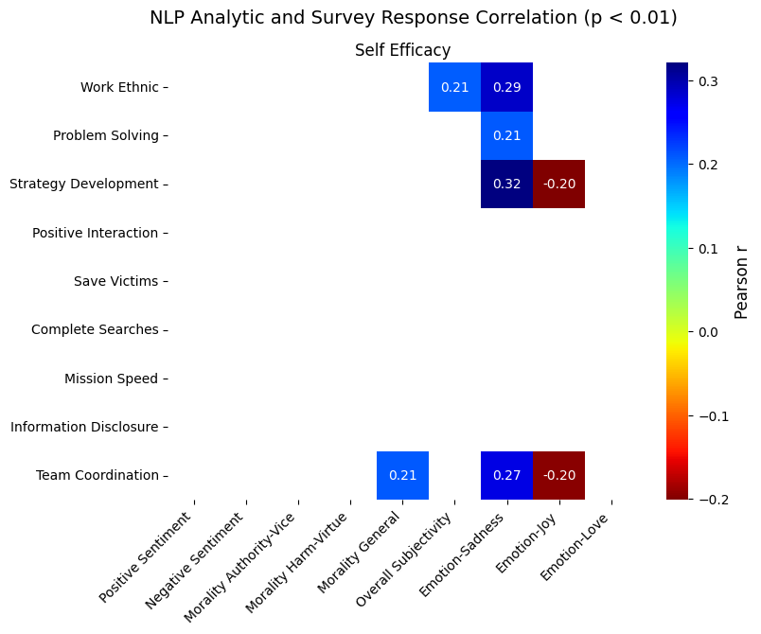
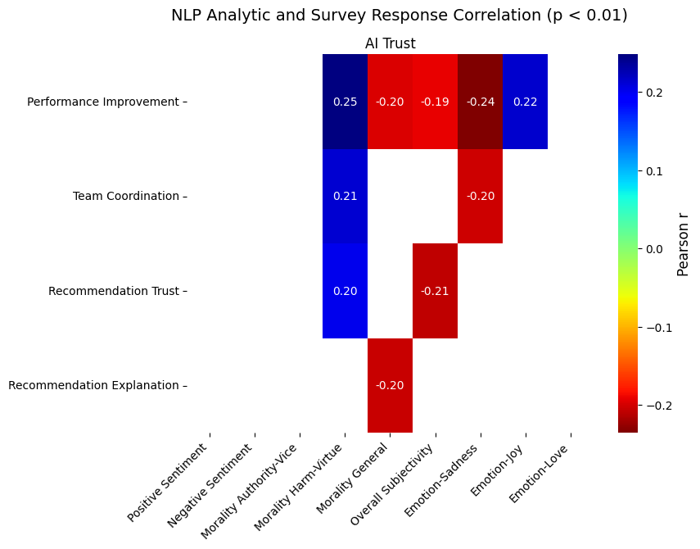
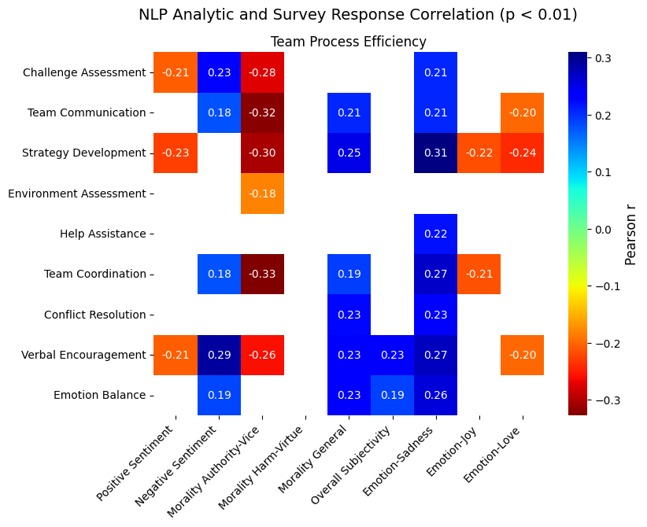
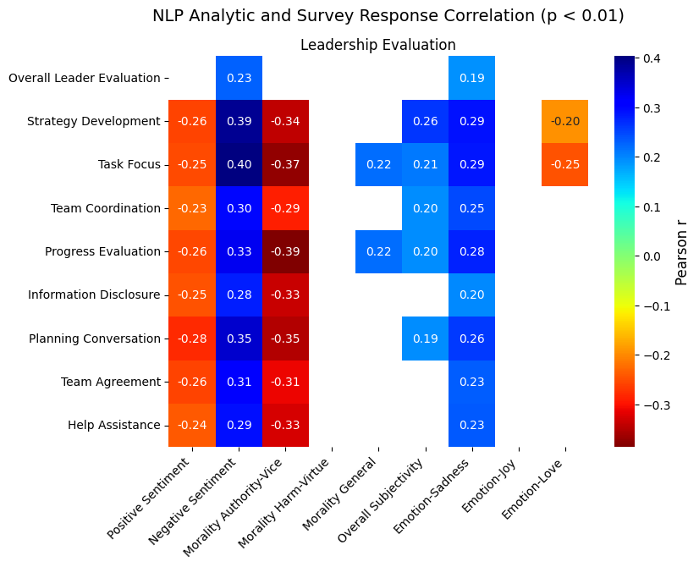
ASIST Ground Truth Data Analysis: Emotional-Cognitive vs. Subjective HAT Measures
Key Findings
Emotion sadness and morality positively correlates with HAT self efficacy
Subjectivity, emotion sadness, negative sentiment and morality positively corelates HAT leadership and team process measures
Morality, subjectivity and emotion sadness negatively correlates with AI Trust
Moral authority vice- and positive sentiment negatively corelates with team process measures

Slide 9
ASIST Ground Truth Data Analysis: Emotional-Cognitive vs. HAT Performance Measures
HAT Performance Measures
Emotional-Cognitive Measures | Self Efficacy | Leadership | Team Processes* | Trust
Sentiment positive | + | + | +
Sentiment negative | + | + | +
Subjectivity |  | + | + | +
Emotion sadness | + |  | + | +
Emotion joy | + |  | +
Morality general | + |  | + | +
Moral authority vice |  | + | +
Harm virtue |  |  |  | +
*Coordination, Communication, Synchronization, Adaptation

Slide 10
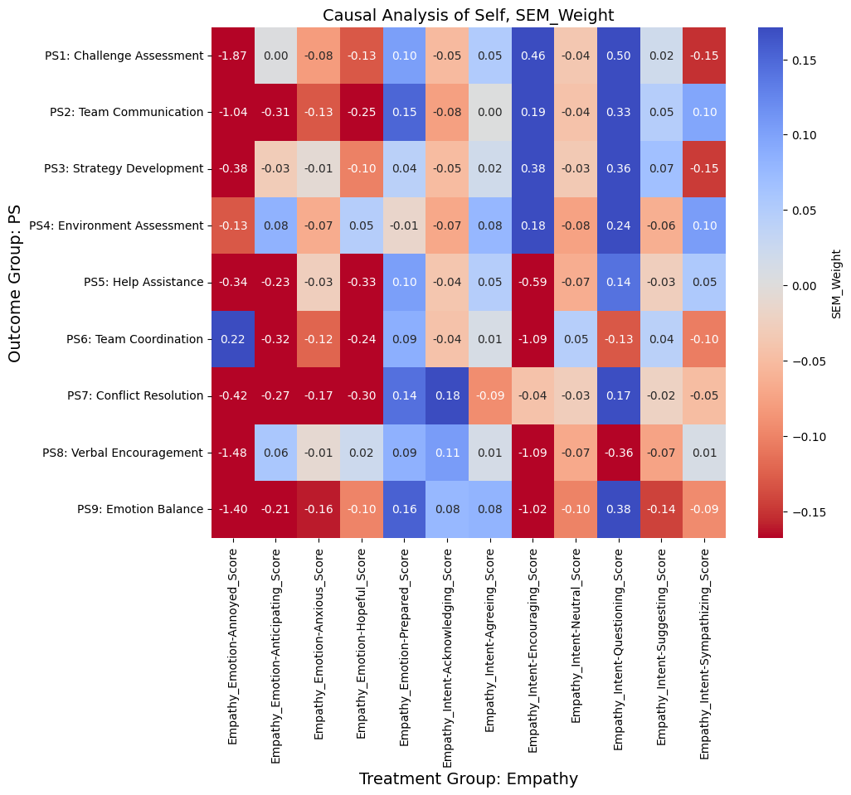
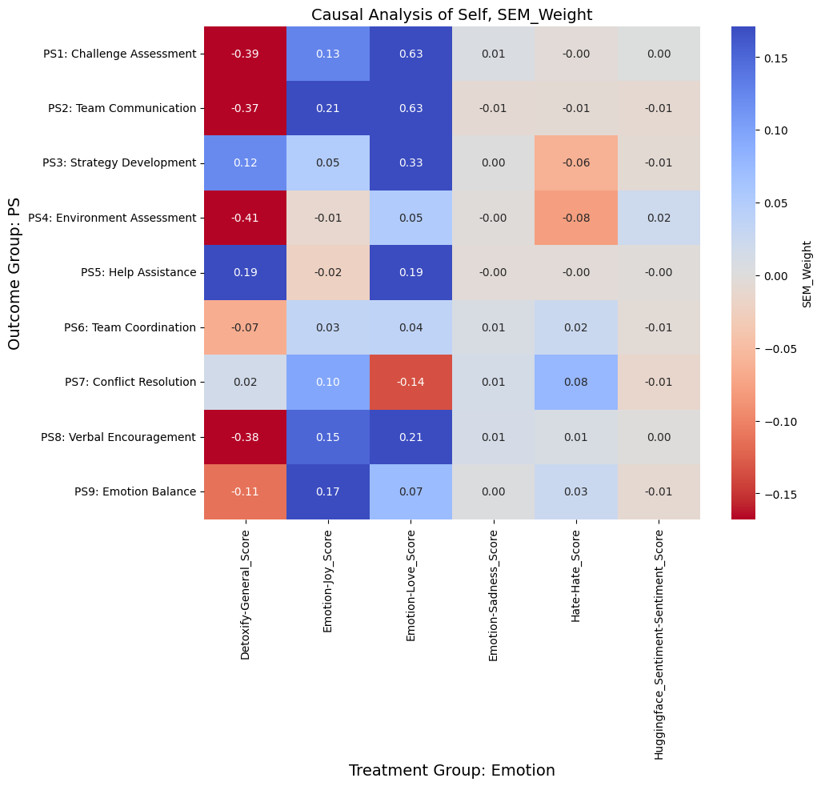
ASIST Ground Truth Data Causal Analysis: Emotional-Cognitive vs. HAT Performance Measures
Causal Structure Learning^{[1, 2]}
Estimate how signals extracted from ASIST communications (emotions, intent, sentiment) treatments, and outcomes (HAT performance measures) relate to each other NO-TEARS
Key Findings
Empathy intent encouraging and questioning has a positive effect on team coordination and strategy development, challenge and environment assessment
Joy and love emotions have strong positive effects on all HAT performance measures
Annoyed emotion has negative effect on all HAT performance measures
Toxicity has a strong negative effect on team communication and verbal encouragement
[1] Zheng, X., Aragam, B., Ravikumar, P., & Xing, E. P. (2018). DAGs with NO TEARS: Continuous optimization for structure learning. Advances in Neural Information Processing Systems, 31.
[2] Volkova, S., Arendt, D., Saldanha, E., Glenski, M., Ayton, E., Cottam, J., ... & Shrivaram, K. (2023). Explaining and predicting human behavior and social dynamics in simulated virtual worlds: reproducibility, generalizability, and robustness of causal discovery methods. Computational and Mathematical Organization Theory, 29(1), 220-241.

Slide 11
Ground Truth Data Analysis across Scenarios: Emotional-Cognitive vs. HAT Performance Measures
HAT Performance Measures
Emotional-Cognitive Measures | Team Coordination | Strategy Development | Team Communication | Team Conflict Resolution
Agreeing, encouraging, sympathizing, suggesting, questioning, anticipating*, acknowledging*
Emotion annoyed*
Toxicity
Emotions joy and love
Emotions sadness and hate
*Findings confirmed across two operational scenarios: search and rescue, command and control (ASIST, UAV)
Notes:
Annoyed emotion has negative effect on all HAT performance measures
Empathy intent encouraging and questioning has a positive effect on team coordination and strategy development, challenge and environment assessment
Toxicity has a strong negative effect on team communication and verbal encouragement, challenge and environment assessment
Joy and love emotions have strong positive effects on all HAT performance measure except conflict resolution
Annoyed emotion has negative effect on conflict resolution
Agreeing, encouraging, sympathizing, suggesting, questioning, acknowledging has a positive effect on team coordination but has a negative effect on strategy development
Joy and love emotion have positive effects on conflict resolution but negative effects on strategy development
Sadness emotion, hate, and sentiment have a positive effect on verbal encouragement but a negative effect on team communication

Slide 12
HDT Experimental Setup: ASIST Scenario
Goal 1. Evaluate how LLM types effects HDT fidelity and HAT performance
Open models:
Llama3.1 8B Q8
Gemma2 9B Q8
Phi3 14B Q6
Mistral 7B Q6
Closed models:
GPT4o mini (6 hours per 100 missions; much faster compared to other models)
Goal 2. Evaluate how prompt context effects HDT fidelity and HAT performance
Prompt 1: mission overview only
Prompt 2: 1 + mission examples
Prompt 3: 2 + outcomes + HAT measures (survey)
We generate 100+ utterances per mission, 20 missions per prompt type and evaluate HDT fidelity and HAT performance
Notes:
Comparing distributions over missions: Kolmogorov Smirnov
Agent fidelity (analytics; measure whether agents replicate human style conversations; NLP metrics...) vs. HAT performance (objective and subjective metrics)

Slide 13
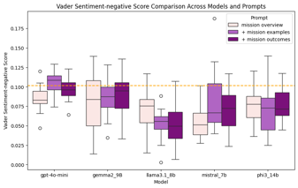
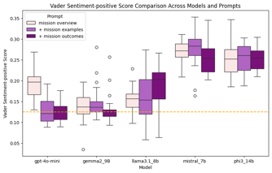
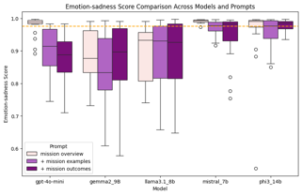
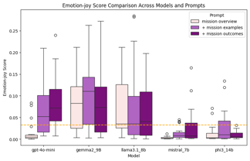
HDT Evaluation Results: Emotional-Cognitive Measures
Key Findings:
Expected effect of prompts using GPT4o mini
+ mission outcomes >> + mission examples >> mission overview
GPT4o mini and Gemma 2 are the closest to the ground truth when evaluating positive and negative sentiment of HDTs → HAT Leadership, Self Efficacy and Team Processes
Mistral and Phi 3 are the closest to the ground truth when evaluating joy and sadness emotions of HDTs → HAT Self Efficacy and Team Processes

Slide 14
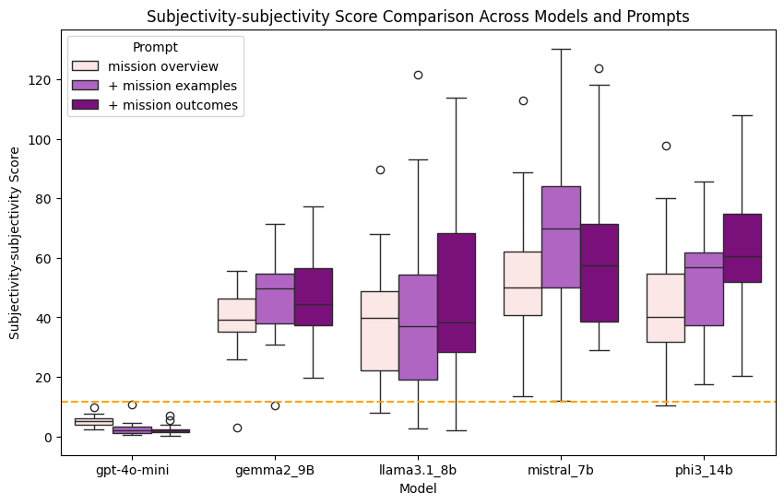
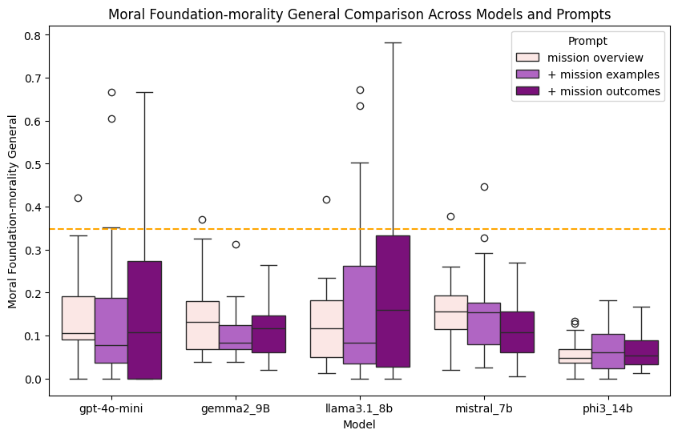
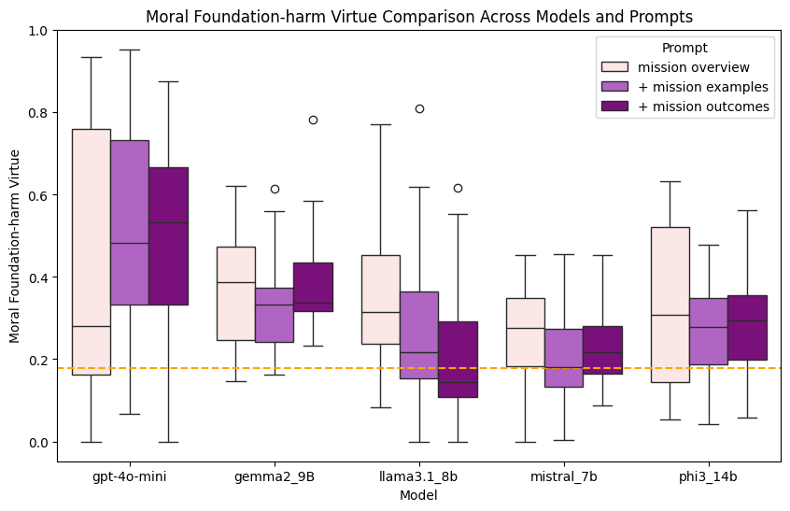
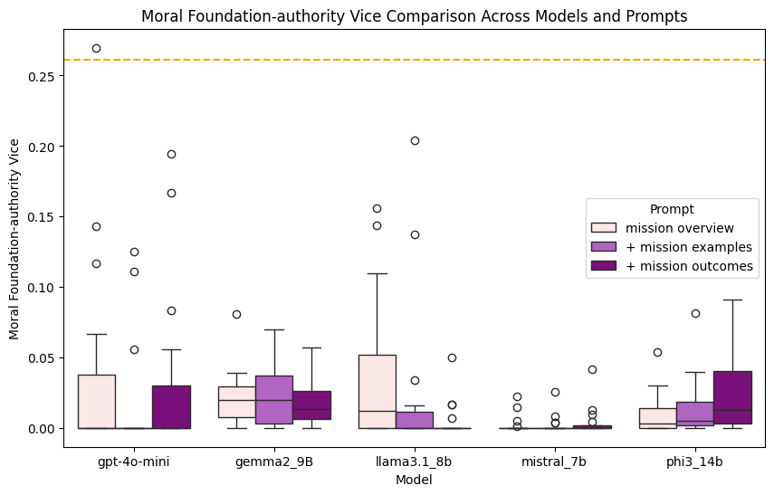
HDT Evaluation Results: Emotional-Cognitive Measures
Key Findings
Subjectivity and moral values are extremely difficult to simulate using HDTs, most models fail, but GPT4o mini demonstrates results most like the ground truth

Slide 15
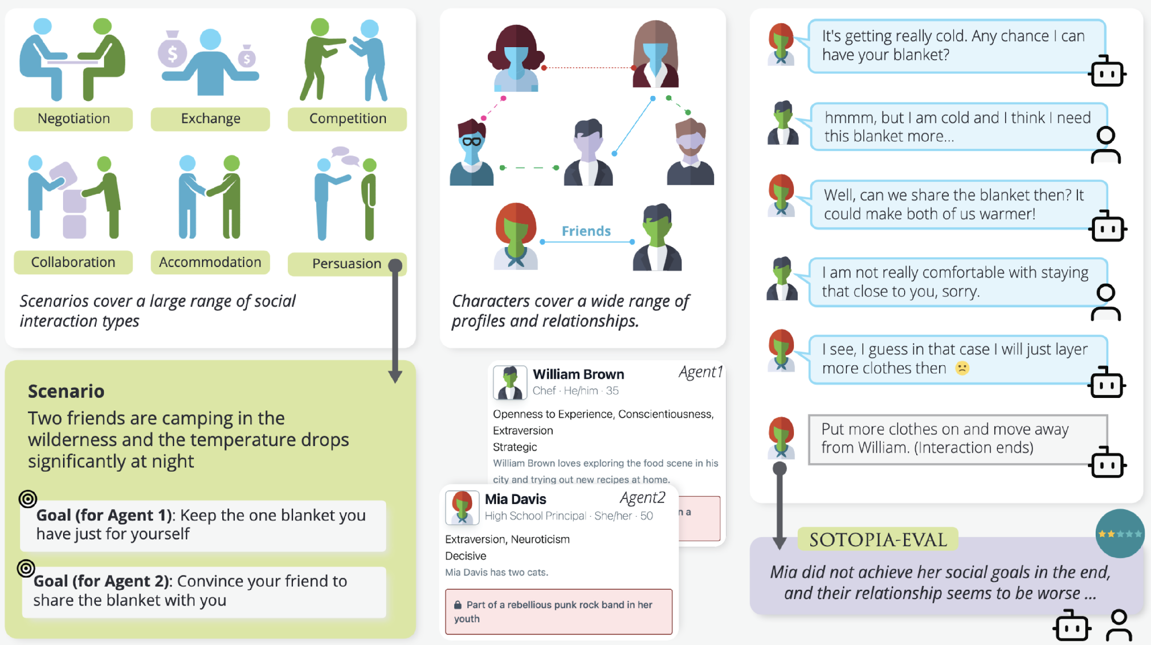
AgInteract: a simulation environment for Agents to Interact towards achieving goals
LLM-based agents that play roles (human digital twin, AI assistant)
Dr. Sap, CMU
Accommodates flexible range of scenarios, cooperative to mixed motive
Various interaction modalities (multi-party, human-AI)
AgInteract-Eval:
Team goal achievement &
Character fidelity
Scenarios incorporate public and secret goals for agents
AgInteract Eval
Enables causal investigations into team performance
LLM-based agents have rich character descriptions, personality, secrets, etc.

Slide 16
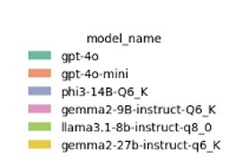
Socio-Behavioral Simulations: Bias Analysis
Gender
LLM biases when simulating human digital twins:
Gender: GPT4o Female vs. LLaMa3.1 Male​
Profession: All models are biased towards engineers ​
Location: All models are biased towards California​
Ethnicity: e.g., GPT4o Asian vs. LLaMa3.1 Caucasian​
Religion: GPT4o Agnostic vs. LLaMa3.1 Atheist​
Education: All models are biased: MS and BS degrees
Age: All models are biased: mid age generations
…
Age
Profession
Education

Slide 17
HAT Performance Causal Investigations into Socio-Behavioral Simulations
Emotional-cognitive measures effected include empathy intent and emotions, toxicity, sentiment, connotations, and moral values
Personality | Scenario | LLM
High neuroticism effects emotions sadness, love and hate and empathy intent agreeing and encouraging Medium agreeableness and high neuroticism exhibit lower empathy intent agreeing, encouraging High neuroticism exhibit lower morality and connotation High conscientiousness, low neuroticism, medium openness exhibit more positive sentiment | Accommodation and collaboration, competition and Persuasion scenarios similar Empathy Collaboration scenario exhibits Joy↑, Toxicity↑, Sadness Persuasion exhibits positive sentiment↓ | GPT 4, GPT3.5 exhibit largely positive empathy signatures Llama 2 exhibits higher empathy intent suggesting, and emotion anxious but lower empathy intent prepared, acknowledging, agreeing GPT 4 and GPT 3.5 Turbo exhibit higher positive sentiment but oppose for Llama 2 GPT 4 exhibits lower Emotion Joy and Love but oppose for Llama 2 and MPT

Slide 18
Key Takeaways
Socio-Cognitive and Affective Simulation Challenges:
Difficulty in accurately simulating subjectivity and moral values
Varying performance across LLMs in replicating emotions, empathy, and sentiment
LLM Biases in Simulating HDTs:
Gender, profession, location, ethnicity, religion, education, and age biases observed across different LLMs
Need for diverse and representative training data
Validation Hurdles:
Lack of ground truth for complex human behaviors and interactions
Need for robust evaluation frameworks across different scenarios
Performance Variability:
Significant differences in HDT fidelity and HAT performance across LLM types and prompt contexts

Slide 19
The Road Ahead: Key Considerations for HDTs and HATs
Complex Interplay of Technology and Human Factors
Success of HDTs and HATs hinges on balancing technological capabilities with nuanced understanding of human behavior
Data-Driven Insights into Human Behavior
HDTs and HATs provide unprecedented opportunities to study and model complex HAI interactions
Scalability and Adaptability Challenges
Creating HDTs that can perform effectively across diverse scenarios and team compositions is a significant challenge
Cross-Domain Applications and Knowledge Transfer
Insights gained from HDTs in one domain (e.g., DoD) can inform applications in others (e.g., healthcare)
Future of Work Potential
HDTs and HATs have the potential to augment human capabilities and redefine the boundaries of human-AI collaboration
Ethics and Societal Impact
Development of HDTs raises profound questions about privacy, identity, and the nature of human-AI interactions

Slide 20
Our Team
Dr. Daniel Nguyen
Associate Scientist
Laura Cassani
Deputy Division Director
Gabe Ganberg
Chief Architect
Bob McCormack
Division Director
Dr. Summer Rebensky
Senior Scientist
Peter Bautista
Capability Lead
Dr. Will Dupree
Data Scientist,
Causal Modeler
Spencer Lynch
Principal Software Engineer
Dr. Jeff Beaubien
Chief Behavioral Scientist,
IRB Chair
Ryan Kao
Data Scientist,
ML Engineer
Louis Penafiel
Data Scientist, Capability Lead
Myke Cohen
Industrial Engineer,
Cognitive Scientist
Collaboration with Carnegie Mellon University, College of William Mary, University of Notre Dame, and University of Illinois Urbana Champaign

Slide 21
Dr. Svitlana Volkova
https://www.linkedin.com/in/svitlanavolkova/
svolkova@aptima.com
This work is supported by the Defense Advanced Research Projects Agency (DARPA).
The views, opinions, and/or findings expressed are those of the author(s) and should not be interpreted as representing the official views or policies of the Department of Defense or the U.S. Government.
443.615.2577

