Slide 1

Operationalizing Biomedical Digital Twins compliant with the National Academies Report:
Issues regarding machine learning and data quality
Gary An, MD, FACS
Department of Surgery
University of Vermont
New York Scientific Data Summit 2024: Addressing Data Challenges in Digital Twins
New York City, NY, Sept 16, 2024

Slide 2
A talk in 3 parts
Part 1: The NASEM Definition and Biomedical Digital Twins (BDTs)
Part 2: Problems with data-centric BDTs…
Part 3: Fine, you want to make a data-centric BDT…Data quality approaches => Attribution of slides to Davera Gabriel from Evidentli, Inc, Presentation from 22nd International Conference on Complex Systems (ICCAI 2024, https://iccai.org/)

Slide 3
National Academies of Science, Engineering and Medicine Report
“DEFINITION OF A DIGITAL TWIN
…modified from a definition published by the American Institute of Aeronautics and Astronautics (AIAA Digital Engineering Integration Committee 2020):
A digital twin is a set of virtual information constructs that mimics the structure, context, and behavior of a natural, engineered, or social system (or system-of-systems), is dynamically updated with data from its physical twin, has a predictive capability, and informs decisions that realize value. The bidirectional interaction between the virtual and the physical is central to the digital twin. “

Slide 4
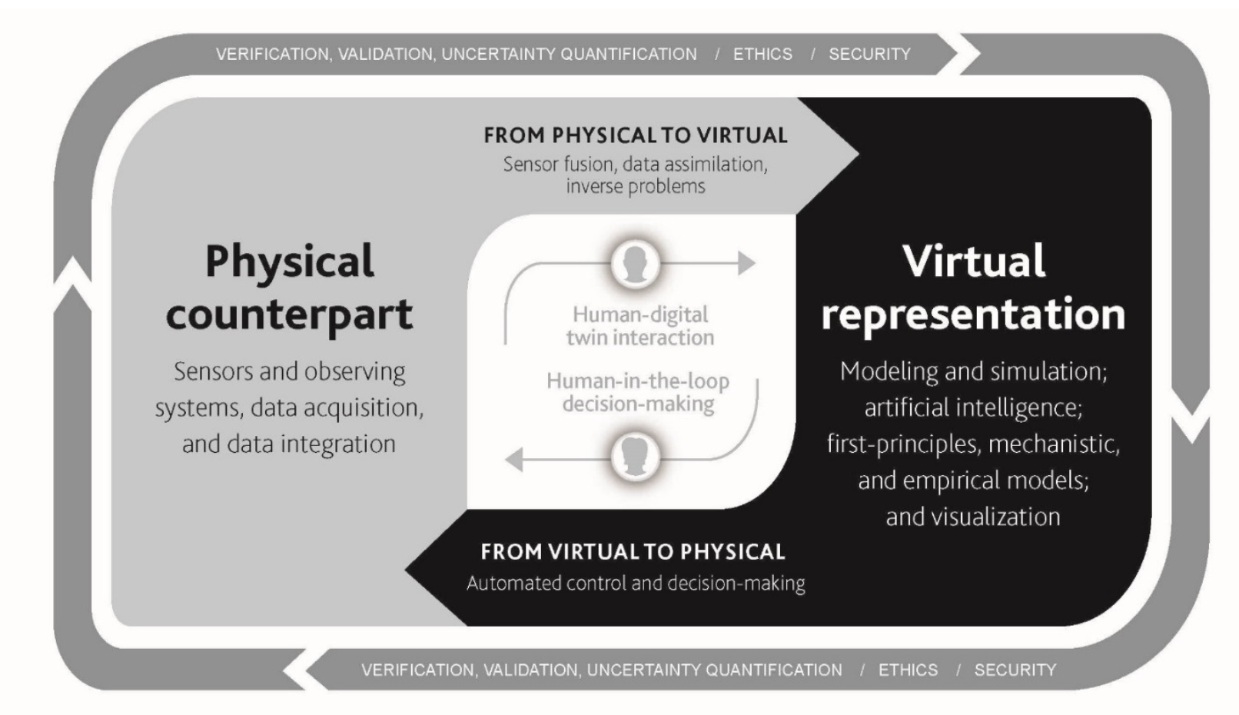
NASEM Elements of DT Ecosystem
The “DT Loop”
How does this map onto Biomedical Digital Twins (BDTs)?

Slide 5
Axioms of “True” Precision Medicine
Axiom 1: Patient A is not the same as Patient B (Personalization)
Axiom 2: Patient A at Time X is not the same as Patient A at Time Y (Precision)
Axiom 3: The goal of medicine is to treat, prognosis is not enough (Treatment).
Axiom 4: Precision medicine should find effective therapies for every patient and not only to identify groups of patients that respond to medicine (Inclusiveness)
An and Day, “Precision Systems Medicine: A Control Discovery Problem”
Systems Medicine: Integrative, Qualitative and Computational Approaches (2021).

Slide 6
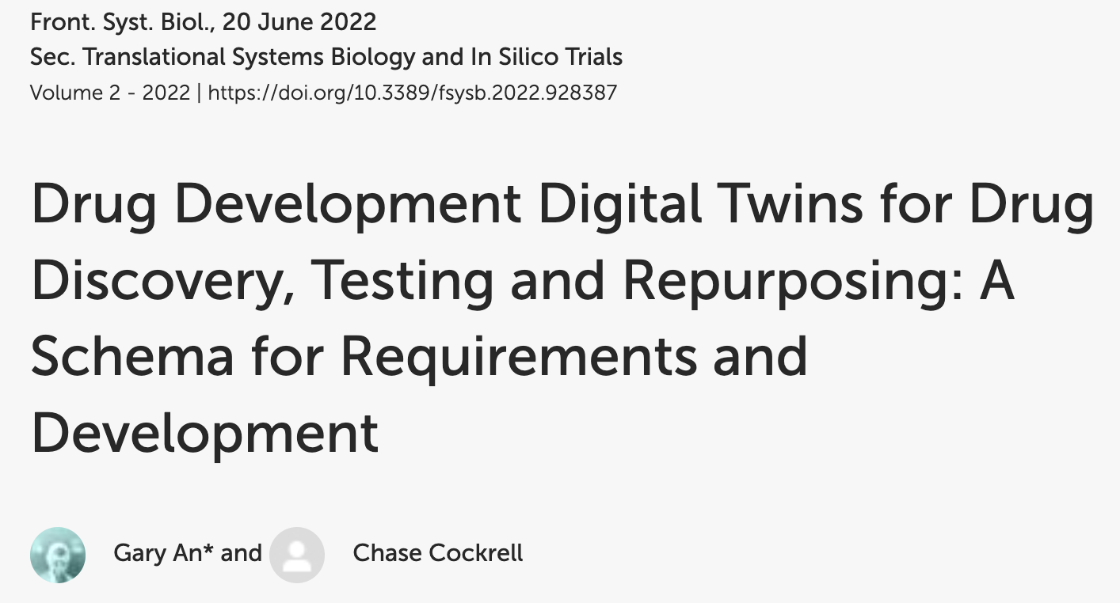
Using BDT for “True” Precision Medicine
A MDT of any individual means we are able to make a BDT of every individual (Axioms 1, 2, 4)
Therefore, BDTs need to encompass heterogeneity (Axiom 1 and 2)
Trajectories are implicit in BDT => mechanisms. (Axiom 3) And data-centric methods are strongly discouraged for linking time series (Wright and Davidson, 2020)
Epistemic uncertainty => BDTs that are “good enough” => Thus finding “good enough” must be overall goal (Axiom 4)

Slide 7
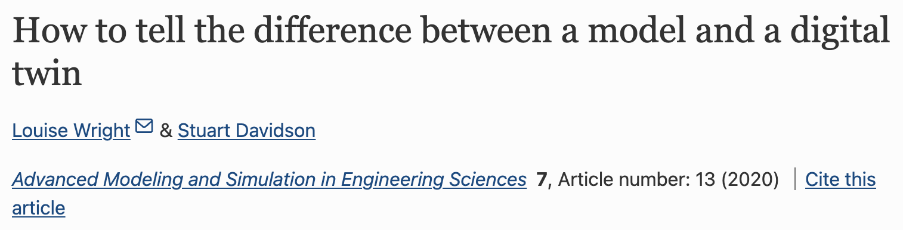
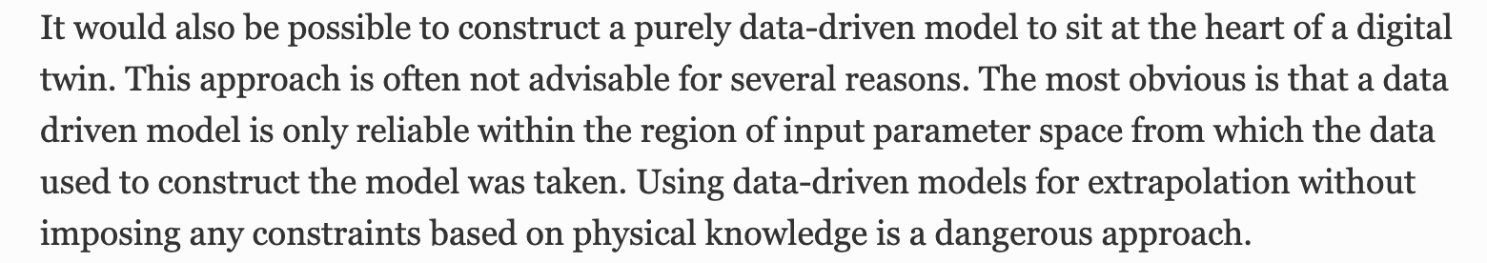
Issues with Data-centric BDTs
“
“
This is essentially the generalizability issue of modern ML/AI

Slide 8
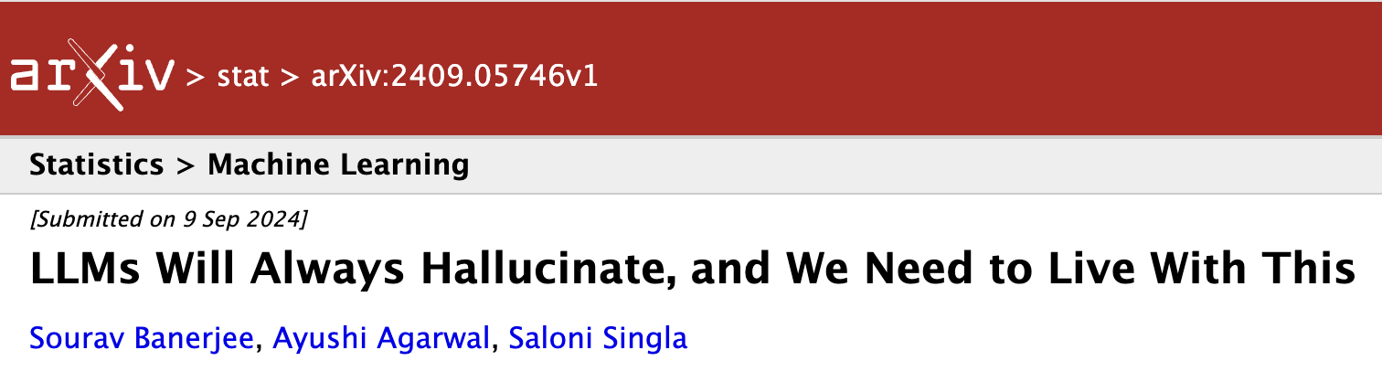
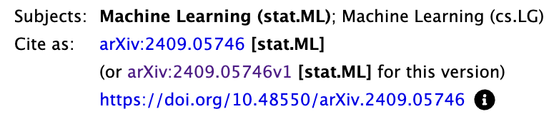
An example of fundamental ML/AI constraints:
LLM Hallucinations
TL:DR = Preprint presents formal proof of the limitations of LLMs => essential features intrinsic to modern ML/AI

Slide 9
ML/AI in Biomed: Pluses and Minuses
Pluses: Application areas drawn from other domains with robust development
  Image Analysis is the main one
  ML surrogates for systems with well-defined and known governing equations (e.g. molecular dynamics) => Computational Efficiency
Minuses: Relative data sparsity in biomed
  Biomed big data (thousands) = ML big data (millions+)
  Data breadth vs # of instances => Curse of Dimensionality
  General lack of time series data (system state trajectories)
Even before you get to data “quality”…

Slide 10
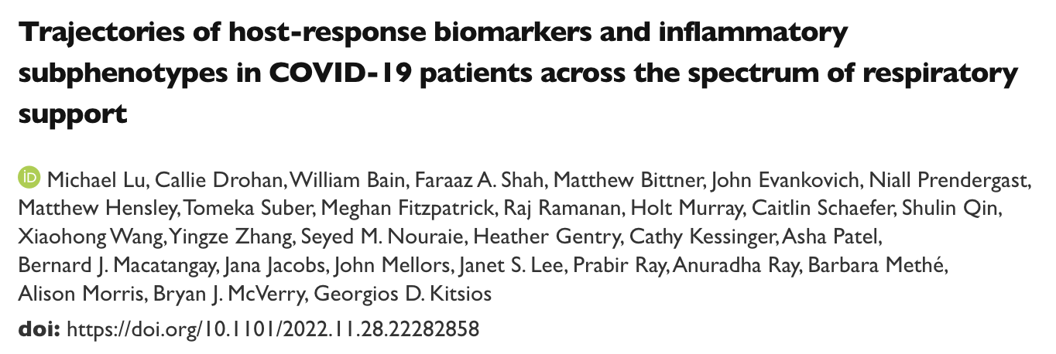
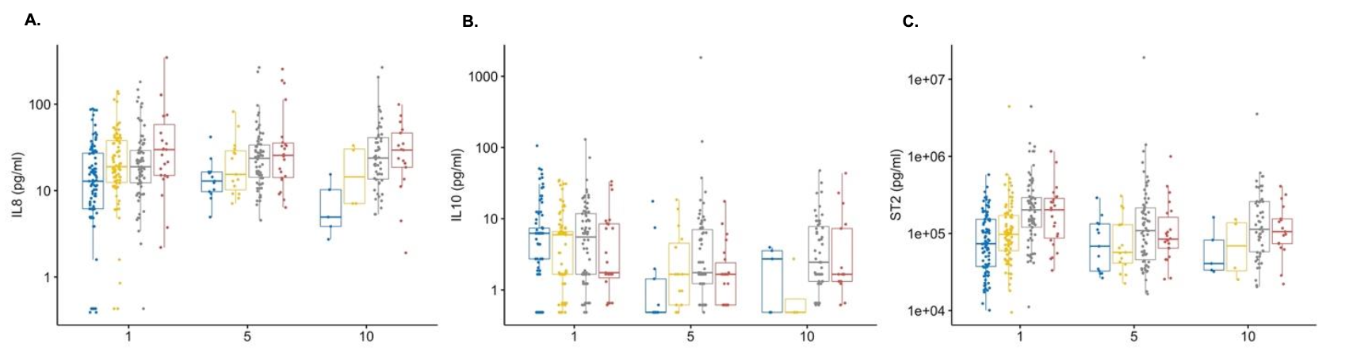
The Challenge of “Twinning”
Populations to Individuals

Slide 11
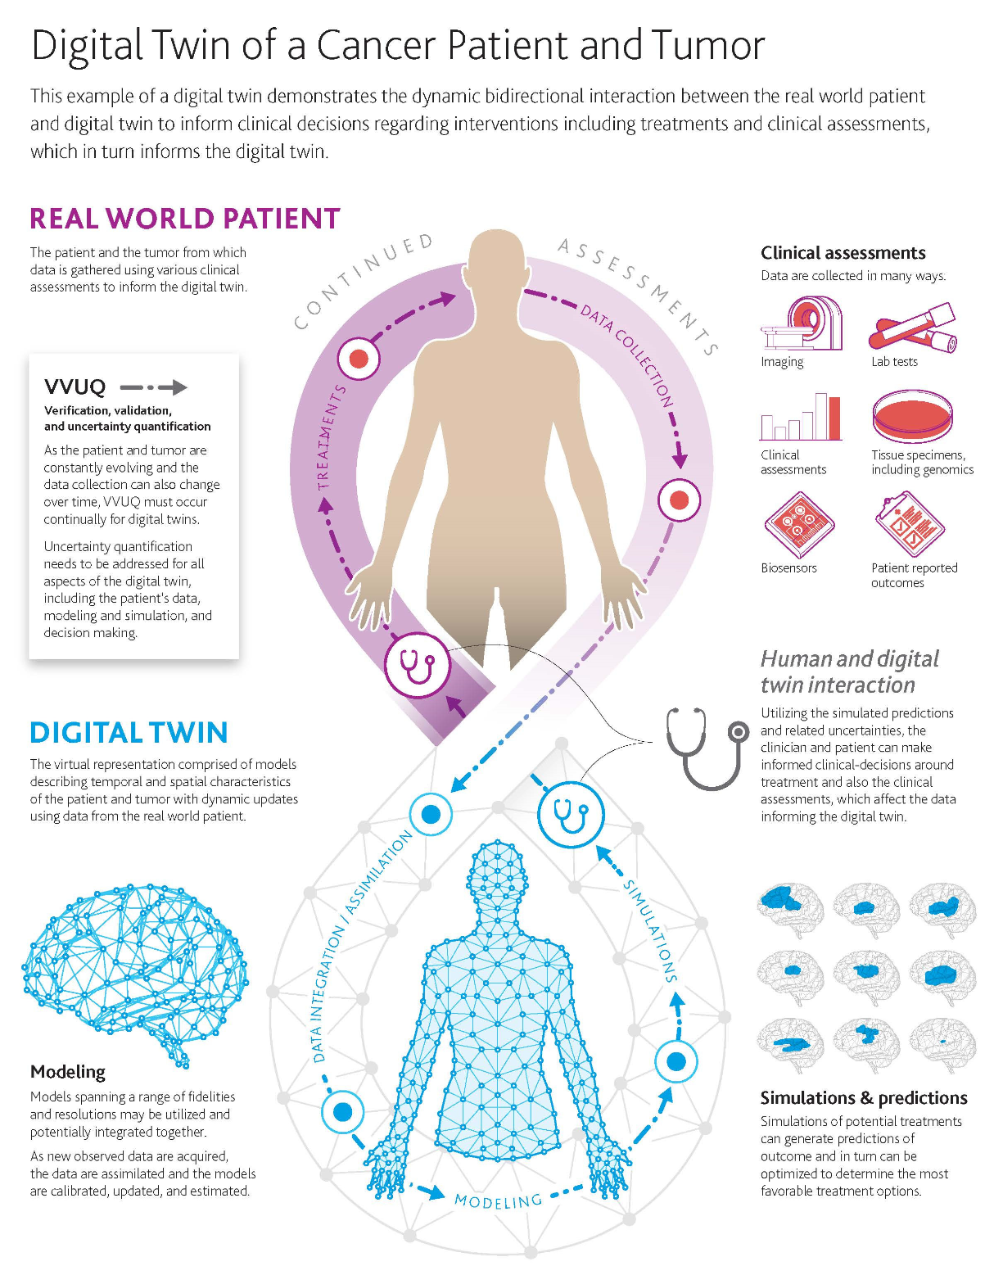
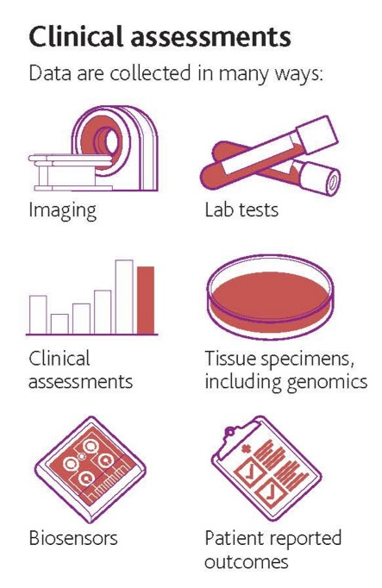
So you want a Data-centric BDT…
NASEM Report Example: A cancer pt BDT
Good use-case
Goal = Rx Optimization/Personalization
Data is “Flat” => all associations non-hierarchical
Here Data Quality is critical!

Slide 12
USA FDA RWD Quality Guidance
From Gabriel 2024 ICCAI
“...documented, well-annotated, and complete, which would allow FDA to replicate the study analysis using the same dataset and analytic approach.”
“Ensure that the RWD required by the protocol are accurate and consistent with the source records”
“ …completeness, consistency, and accuracy of data; the data should also be attributable, legible, contemporaneously recorded, and an original or a certified copy.”
Considerations for the Use of Real-World Data and Real-World Evidence to Support Regulatory Decision-Making for Drug and Biological Products Guidance for Industry (FDA-2021-D-1214)
August 2023

Slide 13
EMA (European Medical Association RWD / RWE Data Quality
From Gabriel 2024 ICCAI
“... adequately characterise the dataset and assess the quality of the RWD… and present it in the feasibility analysis”
At least 2 key dimensions of DQ in study protocol:
  Reliability: property of the data irrespective of their use in any specific study
  Relevance: evaluated in relation to specific study objectives and data needs
Multi-database studies: result heterogeneity must be addressed
Utilize the OHDSI DQ Framework
EMA: Reflection paper on use of real-world data in non-interventional studies to generate real-world evidence
Public Consultation closed 31Aug24

Slide 14

A Framework for Describing Data Quality
From Gabriel 2024 ICCAI
Contexts
Verification
Focuses on how data values match expectations with respect to metadata constraints, system assumptions, and local knowledge
Validation
Focuses on the alignment of data values with respect to relevant external benchmarks
Categories
Conformance
The compliance of the data with formatting, relational, or computational definitions
Completeness
The frequencies of data attributes present without reference to data values
Plausibility
Features that describe the believability or truthfulness of data values
Kahn et al., eGEMS 2016, doi: 10.13063/2327-9214.1244

Slide 15


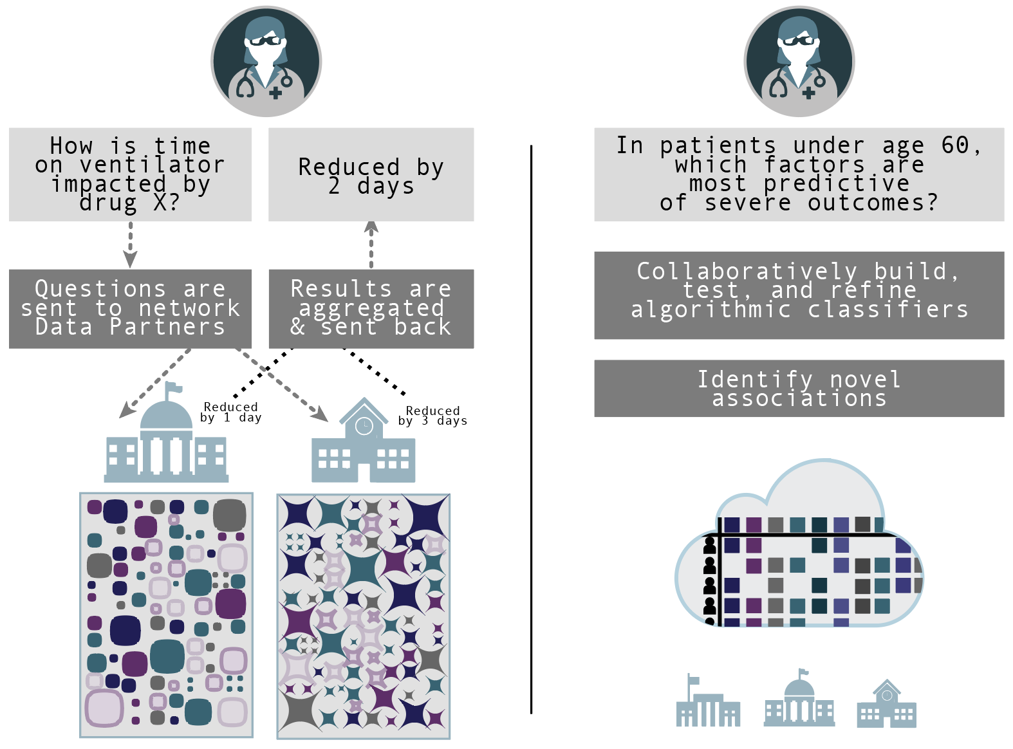
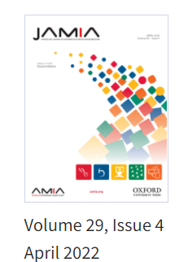


From Gabriel 2024 ICCAI
Federated
querying
Centralized analytics
Federated and centralized approaches are synergistic:
we need both!
Data resides locally
Data resides centrally in a secure enclave
N3C
cloud
PMID:34590684
https://bit.ly/3eMIO1j

Slide 16
Operationalizing the NASEM Report for BDTs: Challenges
No trustworthy generalizable mathematical description of the system (vs physical systems) => forced into data-centric
Most biomedical data is descriptive => forces virtual asset to be a collection of features vs mechanistically linked outputs => no formally expressible “truth” underpinning correlations
Statistical causality vs mechanistic causality => cannot evaluate anything novel (e.g. novel control/drugs)
Persistently data-sparse in terms of features => limits generative AI

Slide 17
Operationalizing the NASEM Report for BDTs: Proposed Approaches
Link back to Axioms of “True” Precision Medicine
Importance of fit-for-purpose => circumscribe/constrain components, define resolutions in BDT (level of representation in virtual asset, what is “real-time”)
Use mechanistic models for simulation (can be hybrid) with non-falsifiability/sufficiency as goal => (t)heories
Validation and UQ to account for perpetual epistemic incompleteness of virtual assets and perpetual data sparsity re physical twin (no ground truth) => Approach uses Maximal Entropy Principle (MEP) to avoid biases
Emphasis on control as the goal of the BDT => robust control arises from MEP approach => Examples:
  Critical Illness Digital Twin to cure sepsis: doi.org/10.48550/arXiv.2405.05301
  Wound Digital Twin to increase functional recovery of volumetric muscle loss: doi.org/10.1101/2024.06.04.595972

Slide 18
Finis
Support:
NIH Grant #: UO1EB025825
DoD Grant #: CDMRP- W81XWH-22-MBRP-CTRA
DARPA Grant #: HR00111950027

