Slide 1
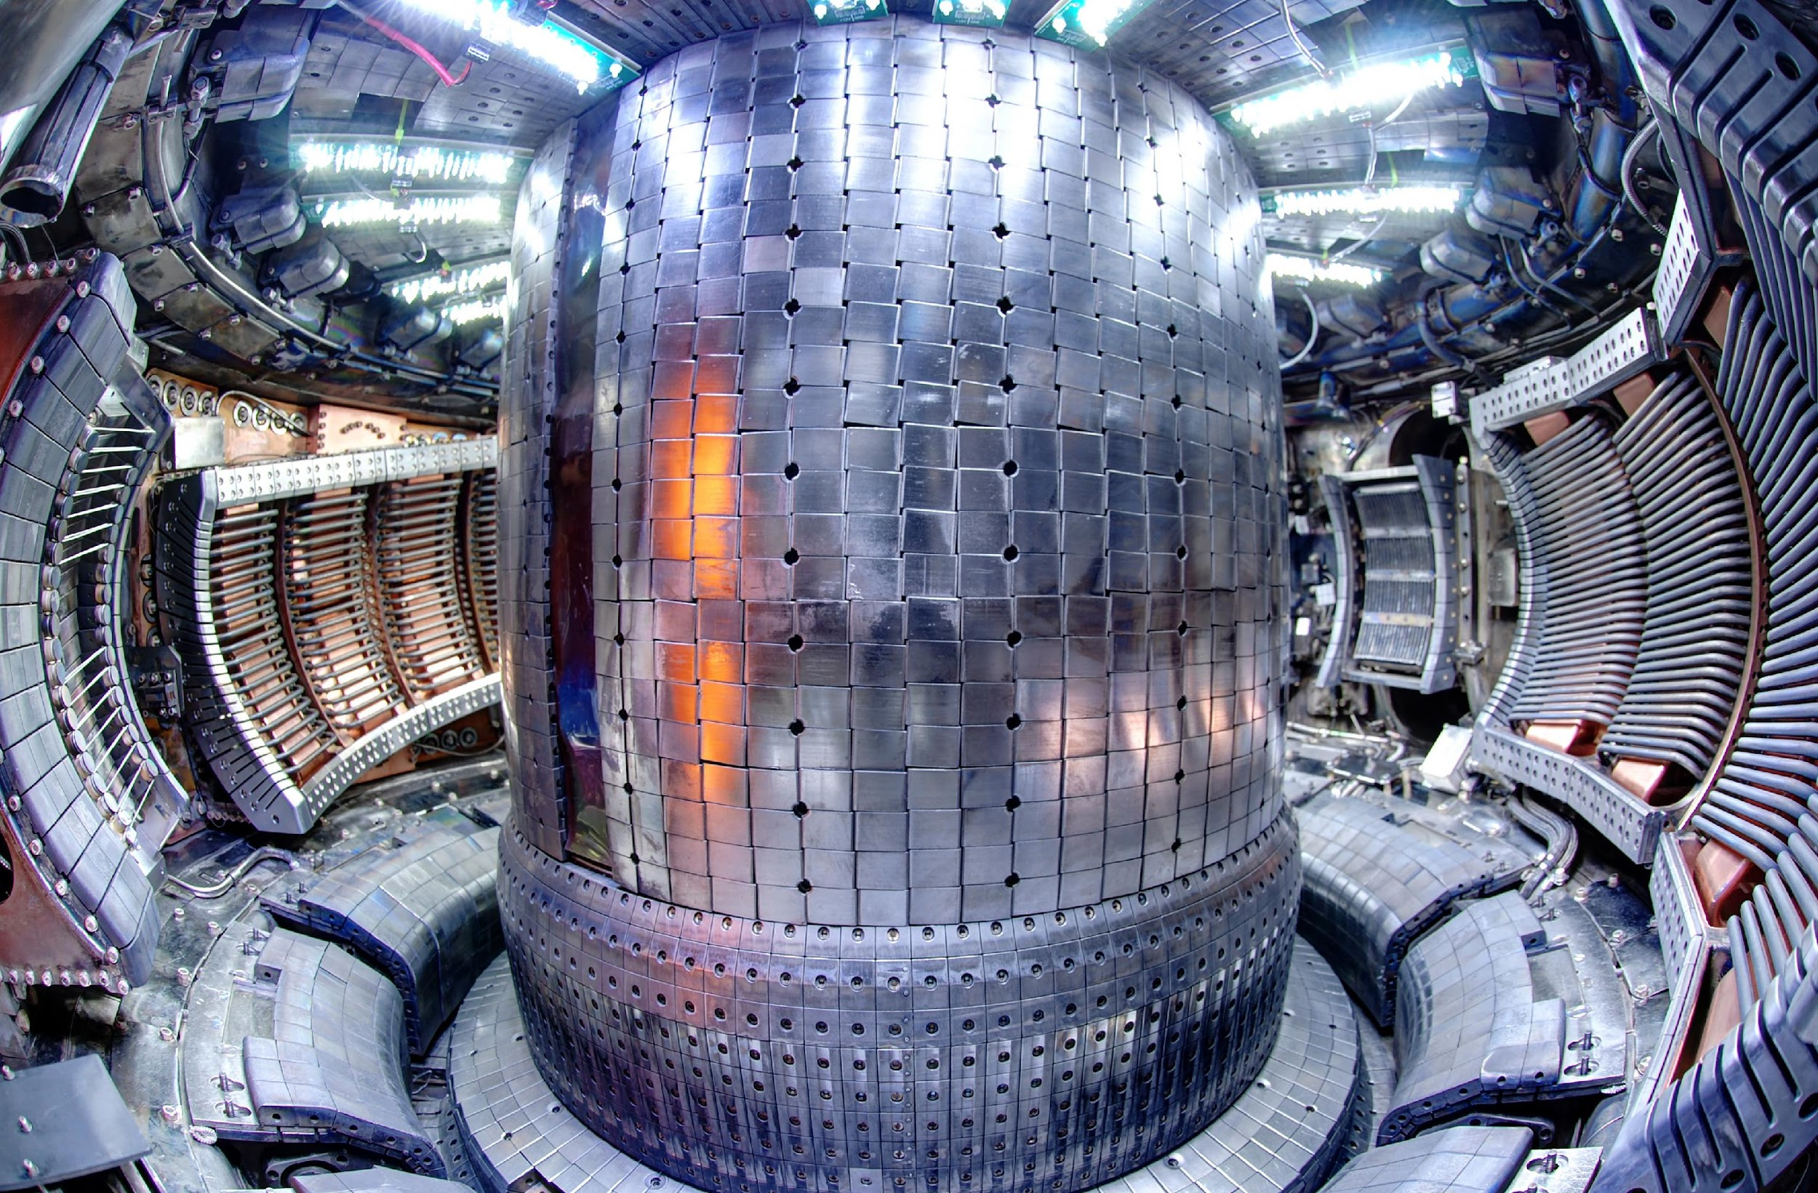

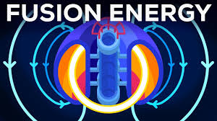
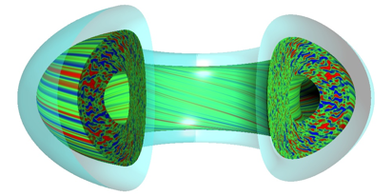

Fusion Energy Digital Twins - from Experiment to Power Plant
EXP
R. Michael Churchill (PPPL)
SIM
Fusion researcher
AI/ML

Slide 2

Viz by Jamison Daniel

Slide 3
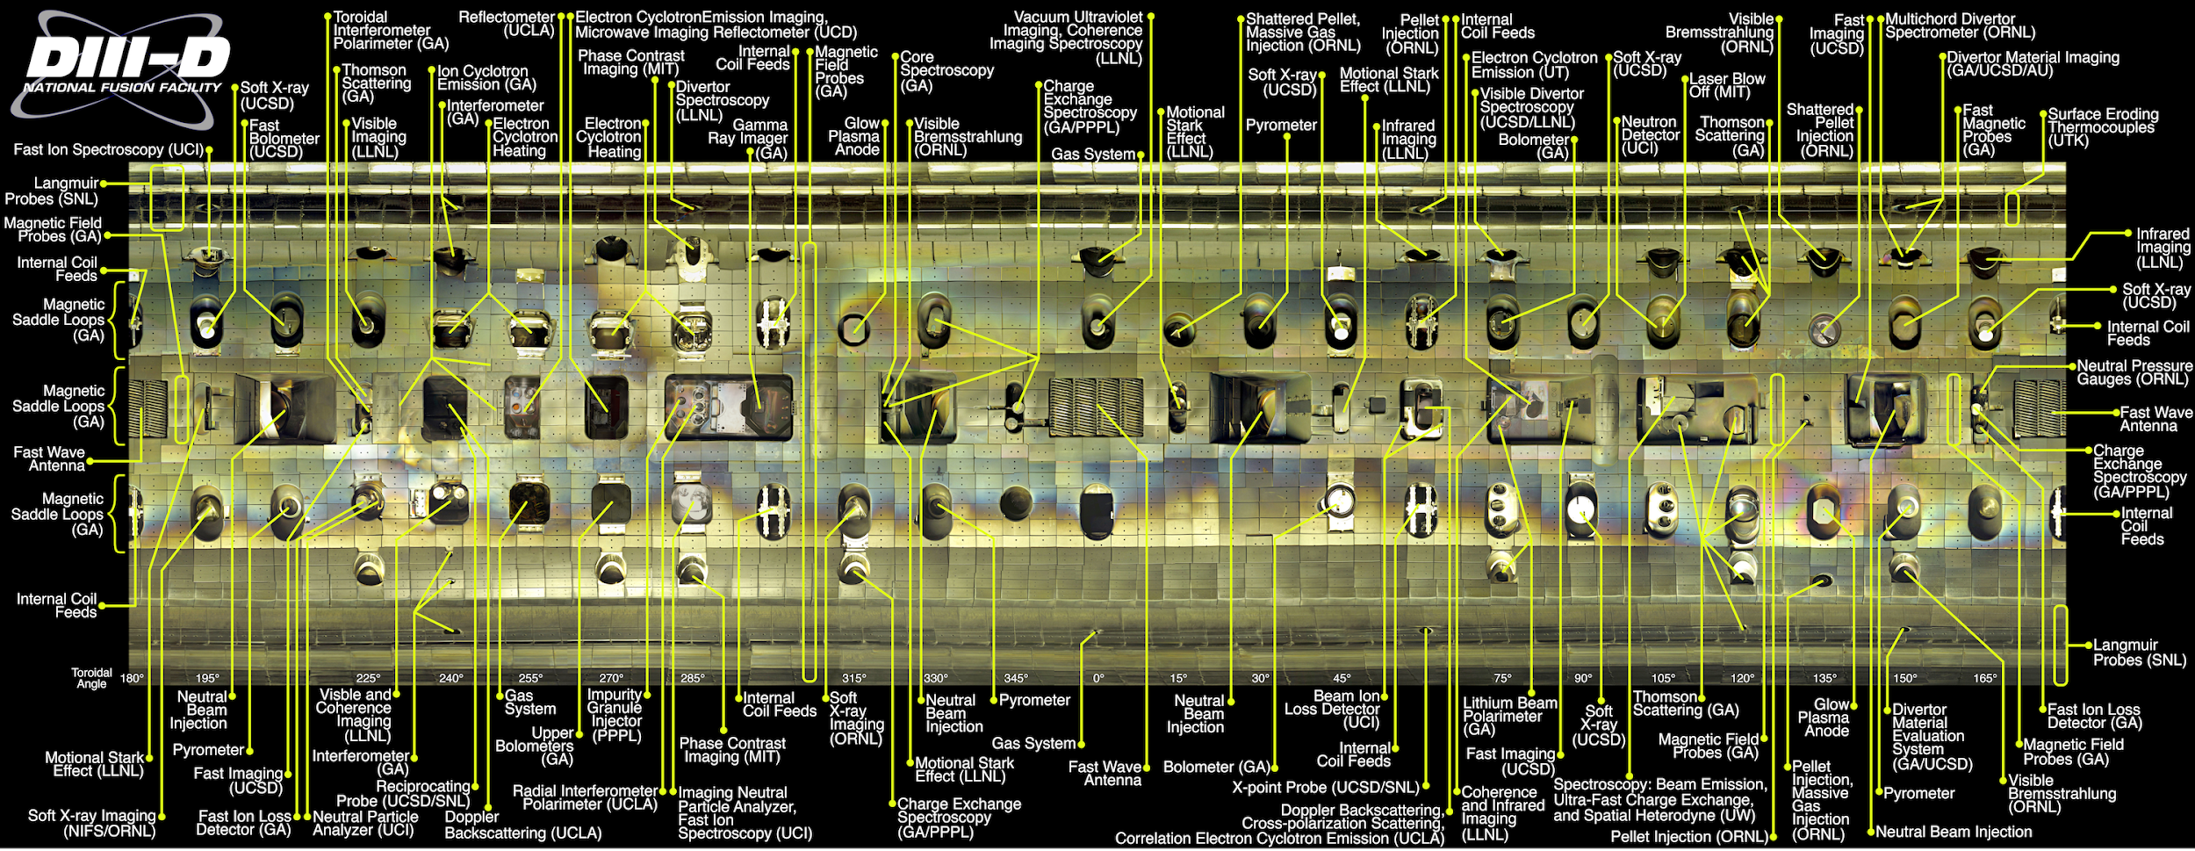

Slide 4
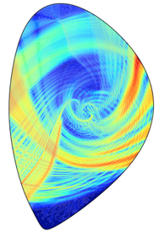
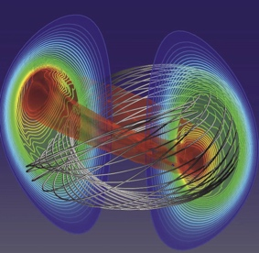
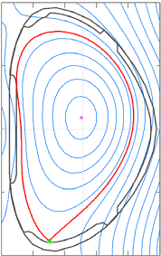
Fusion plasmas have a range of phenomena, manifest over multiple time and spatial scales
Understanding fusion plasmas requires extracting information from multiple diagnostics at these wide ranges of time and spatial scales
Full-wave solvers
MHD codes
Transport solvers
Gyrokinetic codes

Slide 5

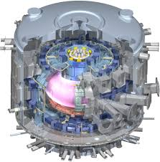
What a scientist needs
Natural to focus first on the algorithms (bottom up). But what does a scientist need (top down)?
  Holistic view of not only current workflow but also fundamental needs of scientists can point out opportunities
Insight
Algorithms, analysis, modeling/simulation
Analyzed data
Initial processed data
Raw data

Slide 6

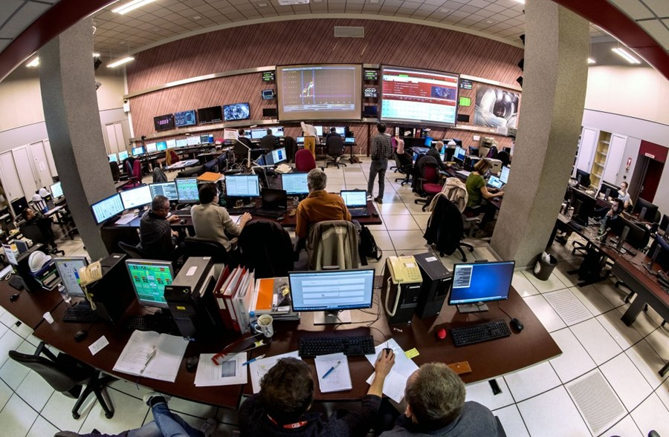
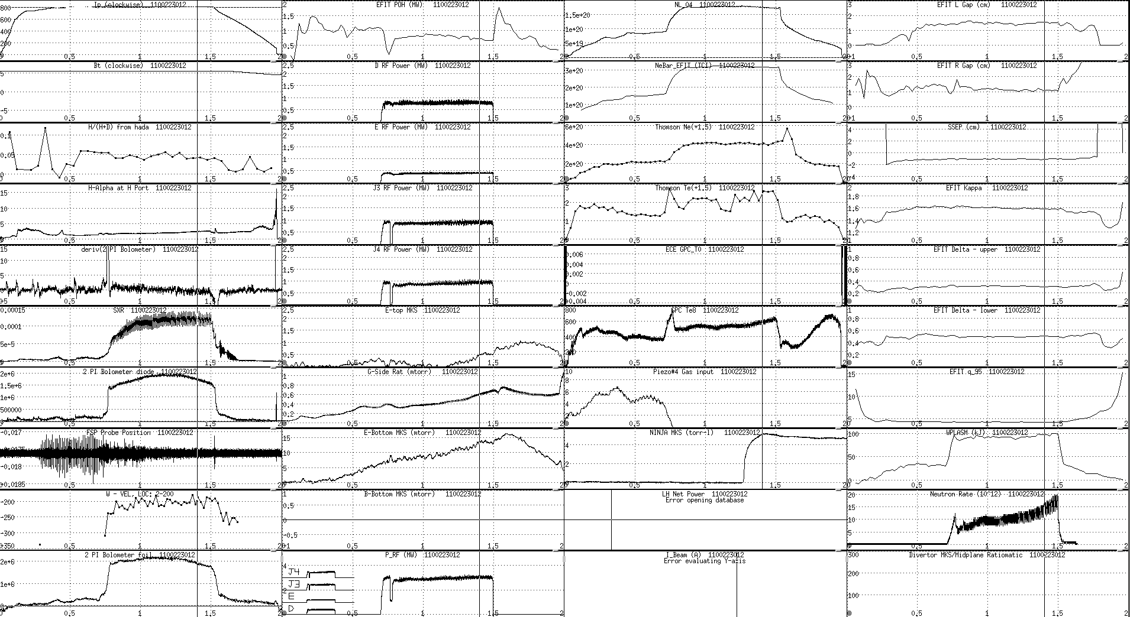
Fusion scientists need understandable analysis results quickly
Experimental “shot”
(~1oo’s seconds)
Simple automated analysis
(~ few minutes)
Decide and
set next shot
(~ few minutes)
Scientists interpret
(~10 minutes)

Slide 7
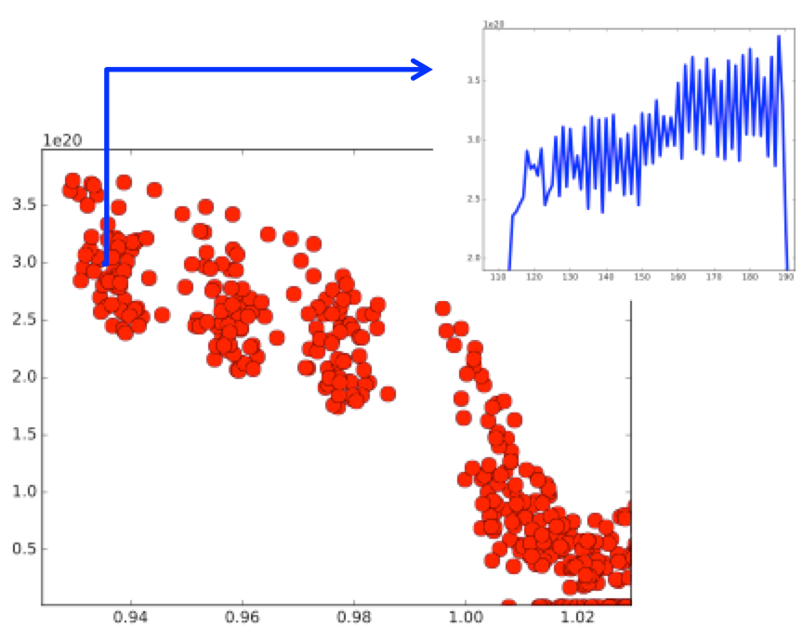
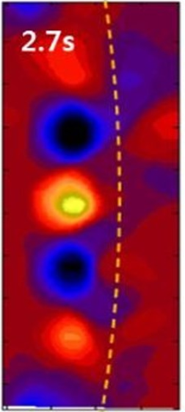
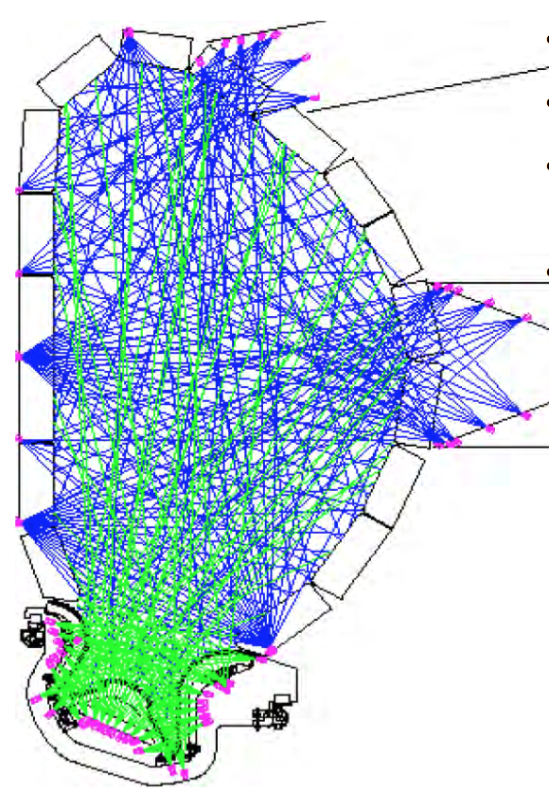
Fusion data from experiment (and simulation) possess all the big-V properties
Volume
Velocity
~1/2EB/year
Subsequent simulations can greatly enhance data volume
>50GB/s for up to 1000s, each shot
Hierarchy of analysis for near-real-time feedback
time
density
5 Vs of big ITER data
Wide variety data from thousands of sensors
Many-scale many-physics
All the expensive sensors are there because they produce valuable data
radius
Variety
Value
All the sensor have different quality: e.g., validity range, error, and noise
AI/DL/NN in high demand
Veracity

Slide 8
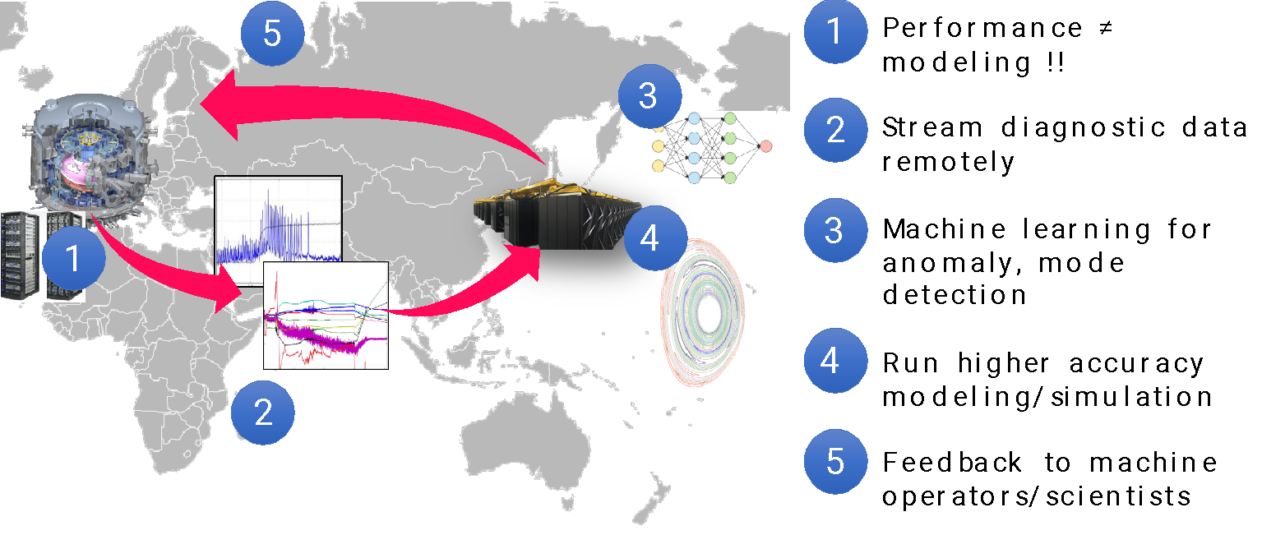
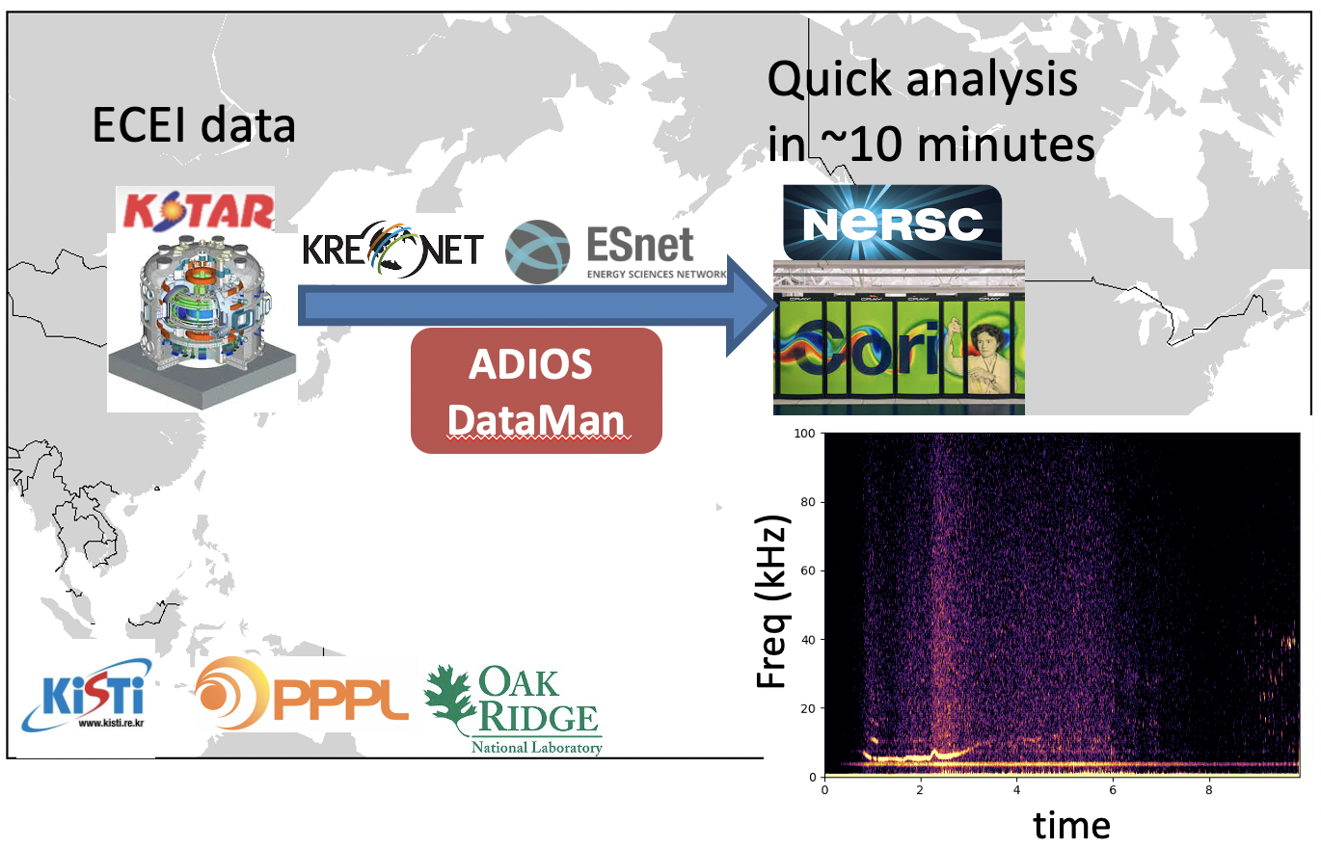
Integrated Research Initiative (IRI) i.e. SuperFacility workflows for fusion energy
Churchill, FST 2021
IRI leverages remote compute for science experiment data analysis and simulations
For fusion energy enables faster, better comparison of simulation and experiment on timescales meaningful to the scientist
Multiple levels of digital twins can be executed (high- to low-fidelity)
https://github.com/rkube/delta

Slide 9
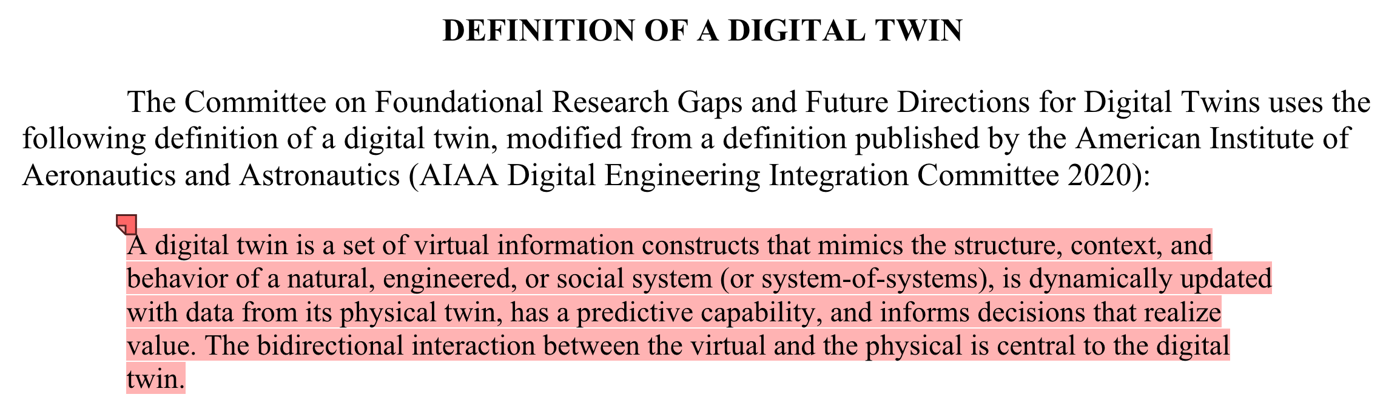

Slide 10
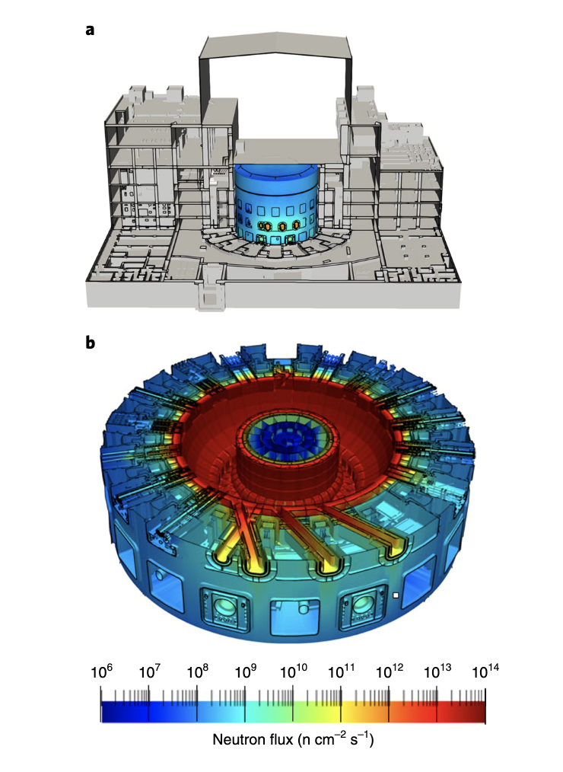
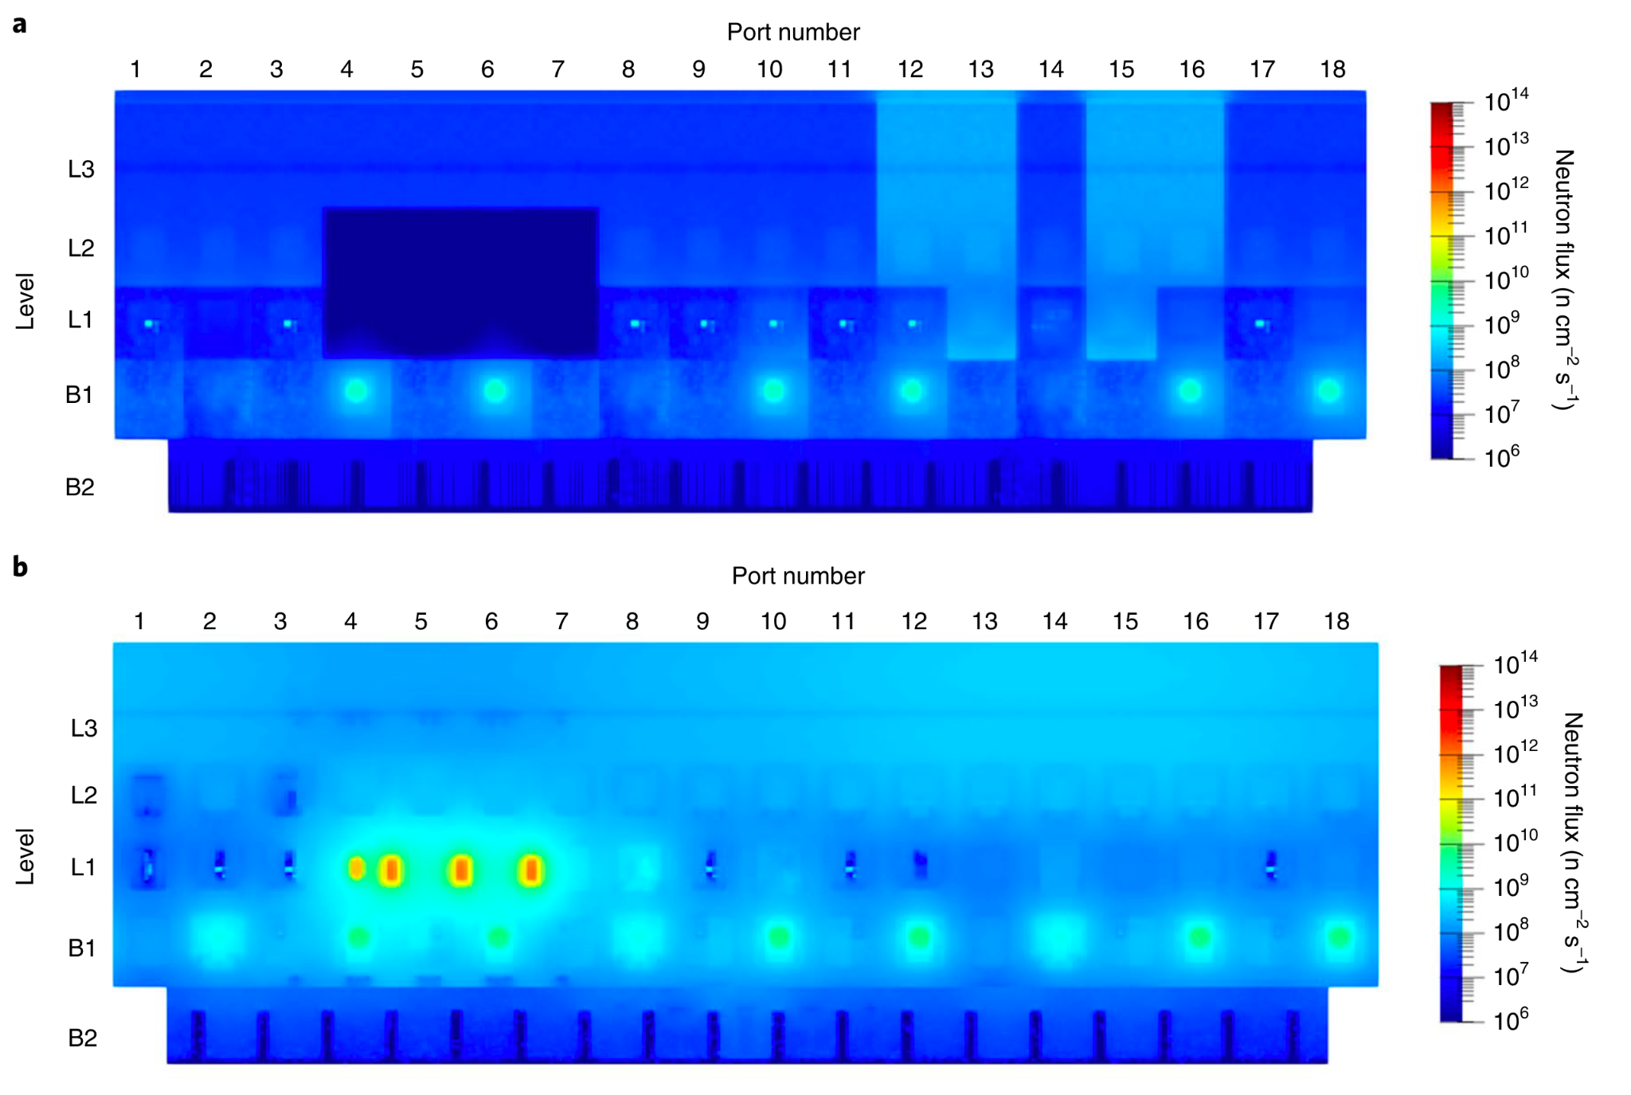
Why aim for high fidelity digital twins?
Example of ITER neutronics calculations
  Previously simplified wedge geometry used, mosaic to estimate total neutron transport
  Full geometry CAD-level neutronics simulation revealed significant difference, mainly due to port structure
Juarez

Slide 11
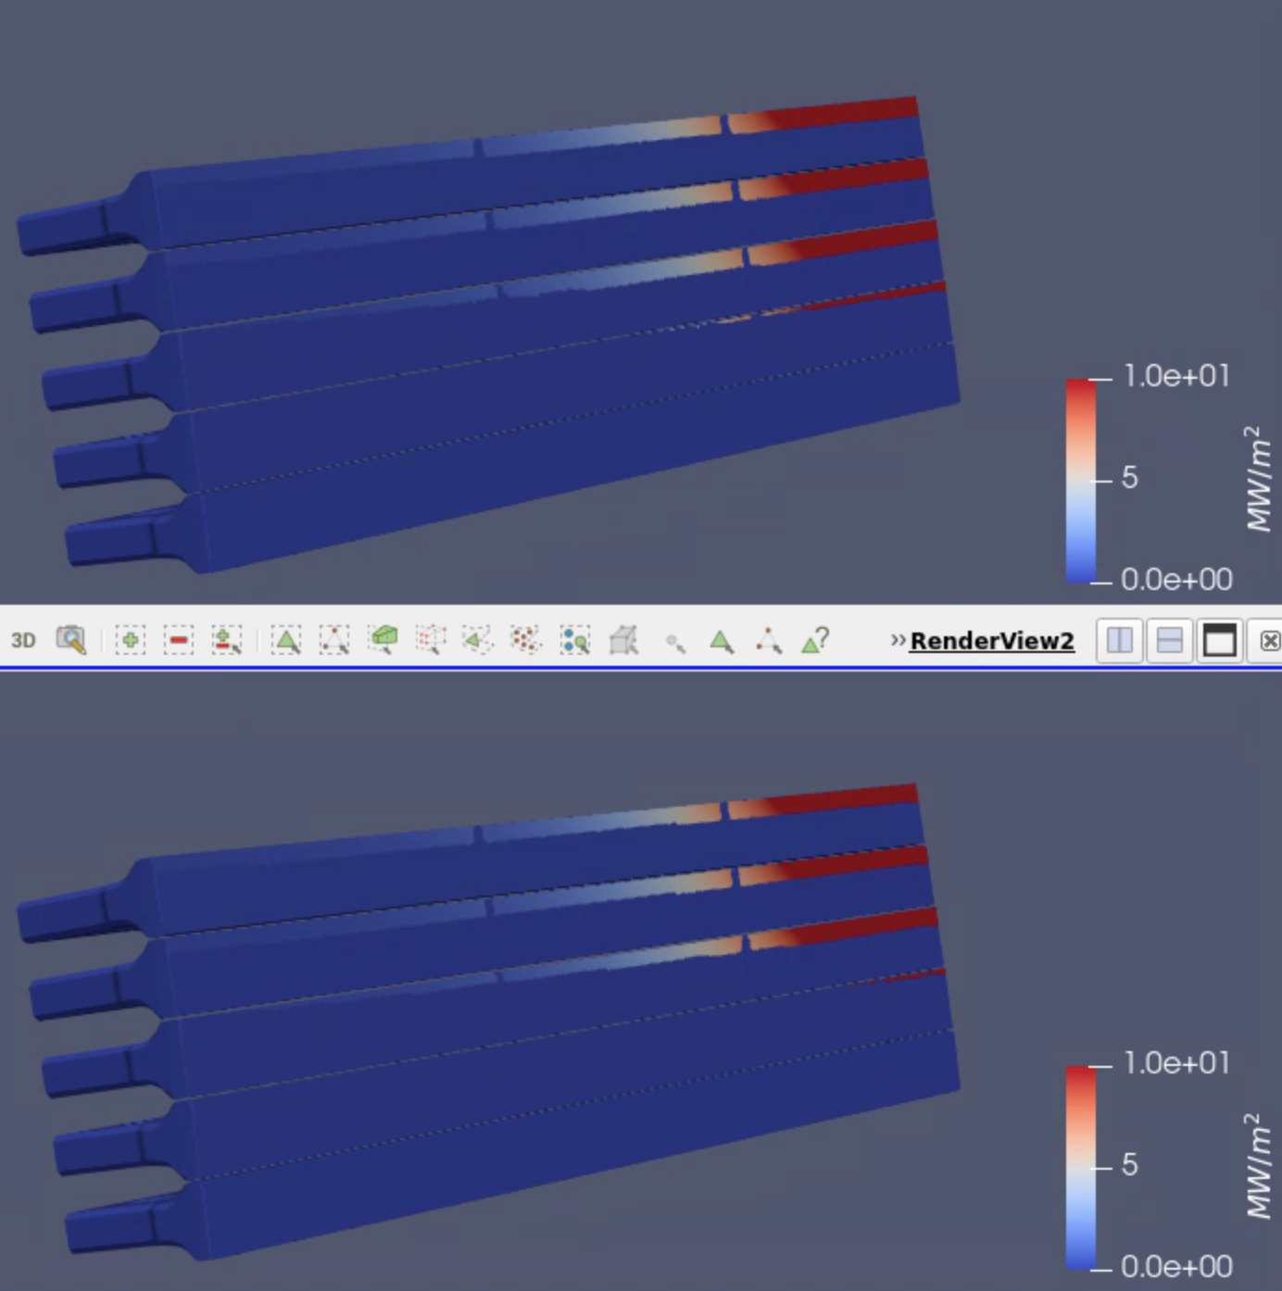
AI based digital twins for engineering operations
AI models for accelerating HEAT code (divertor heat flux modeling code), for fast comparison to experimental conditions
Based on low(er)-fidelity physics combined with accurate 3d CAD geometries
  Faster for generating training data, but needs to be modified by experiment data. Not clear if can adjust incorrect simulation with experiment sufficiently
Tension between low- and high-fidelity for creation of digital twin (can low-fidelity based be corrected?)
AI
Normal
D. Rivera 2024 to be submitted

Slide 12
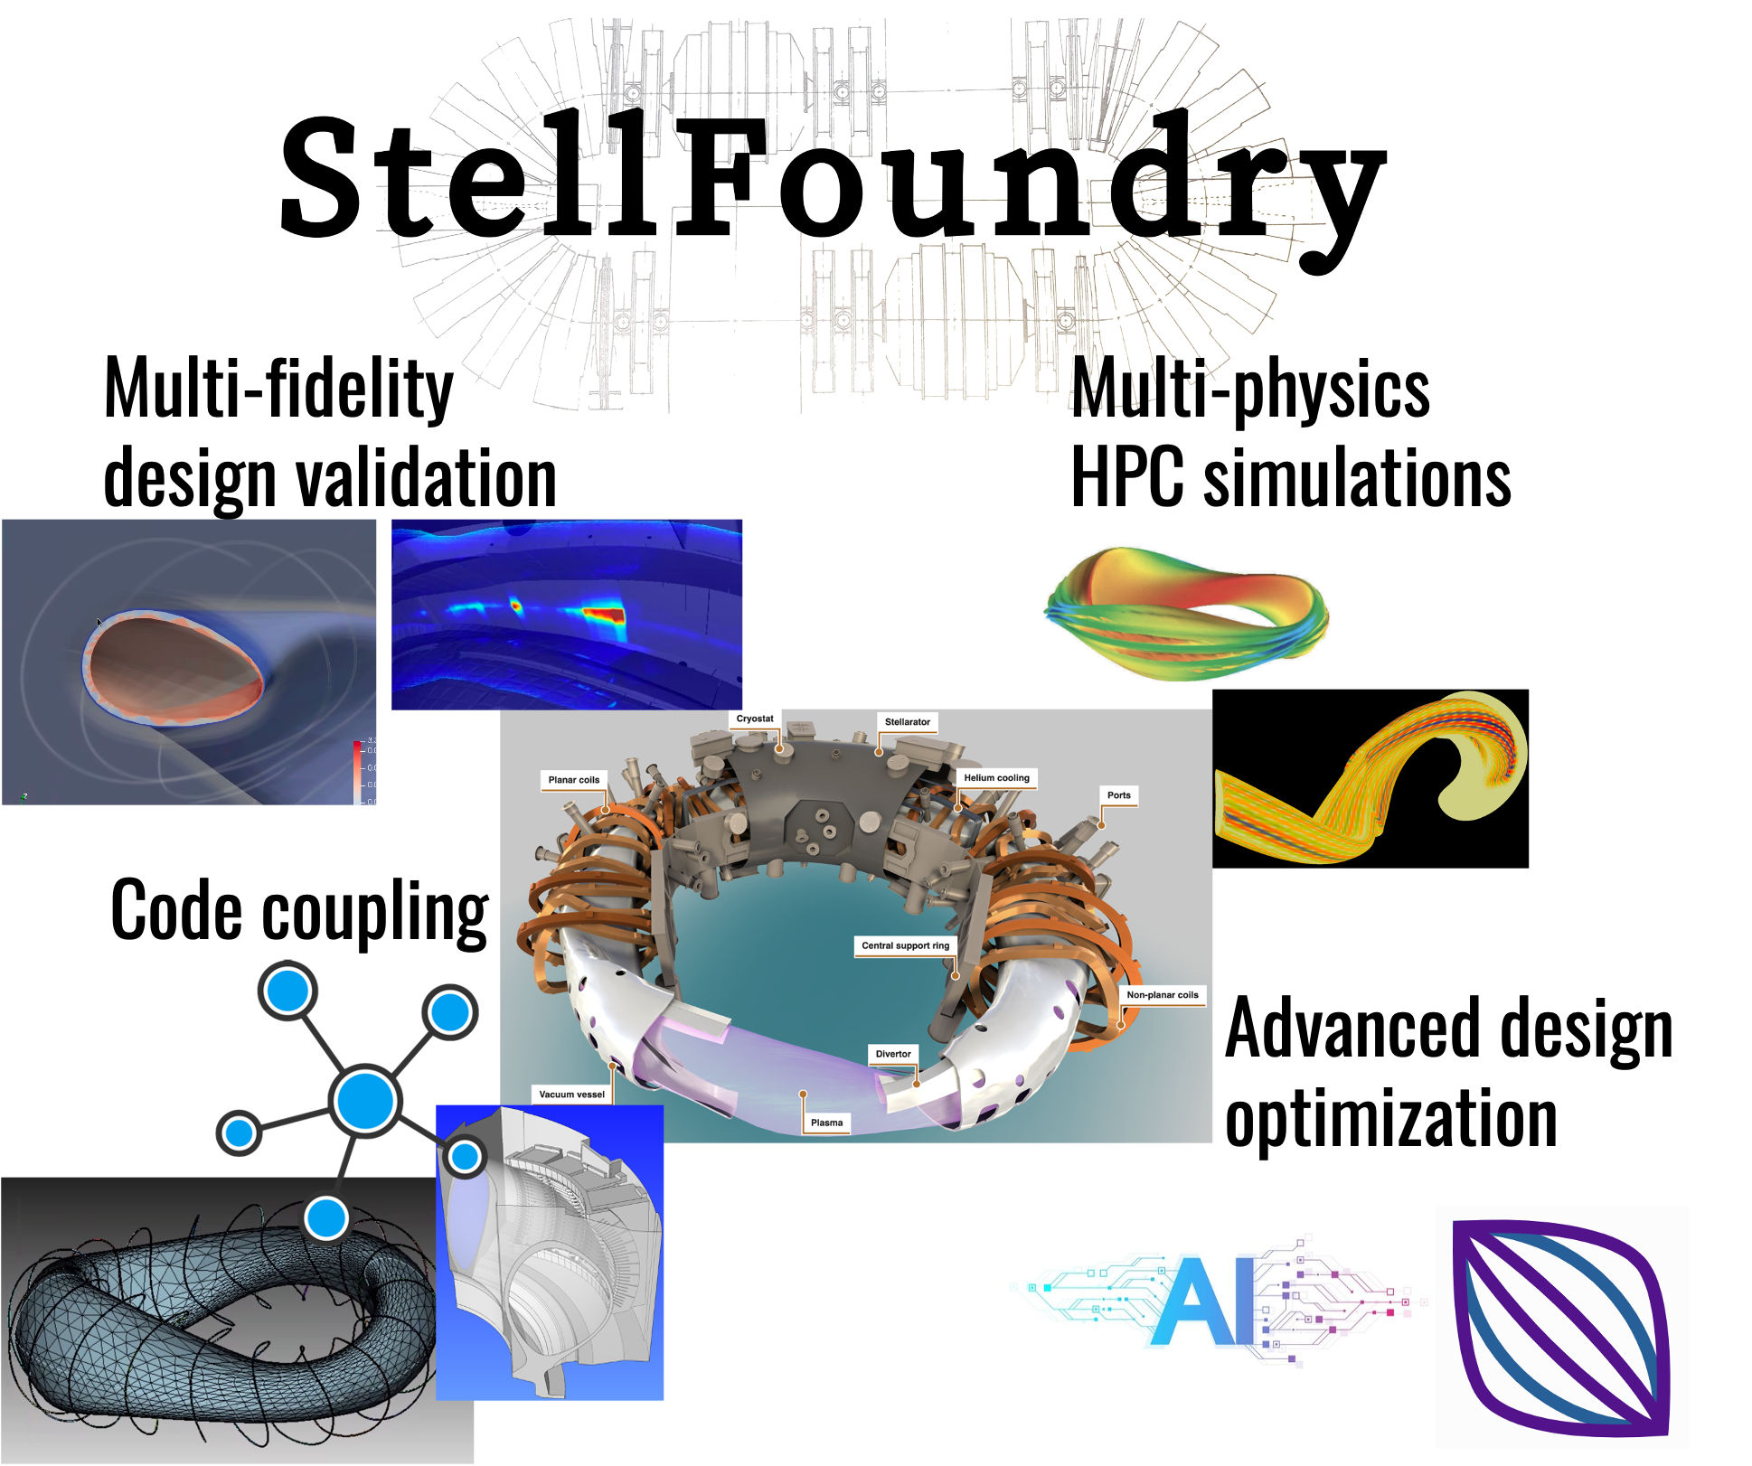
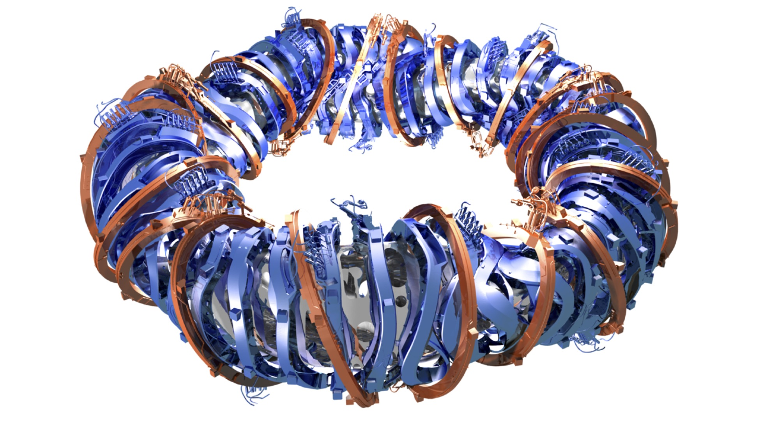
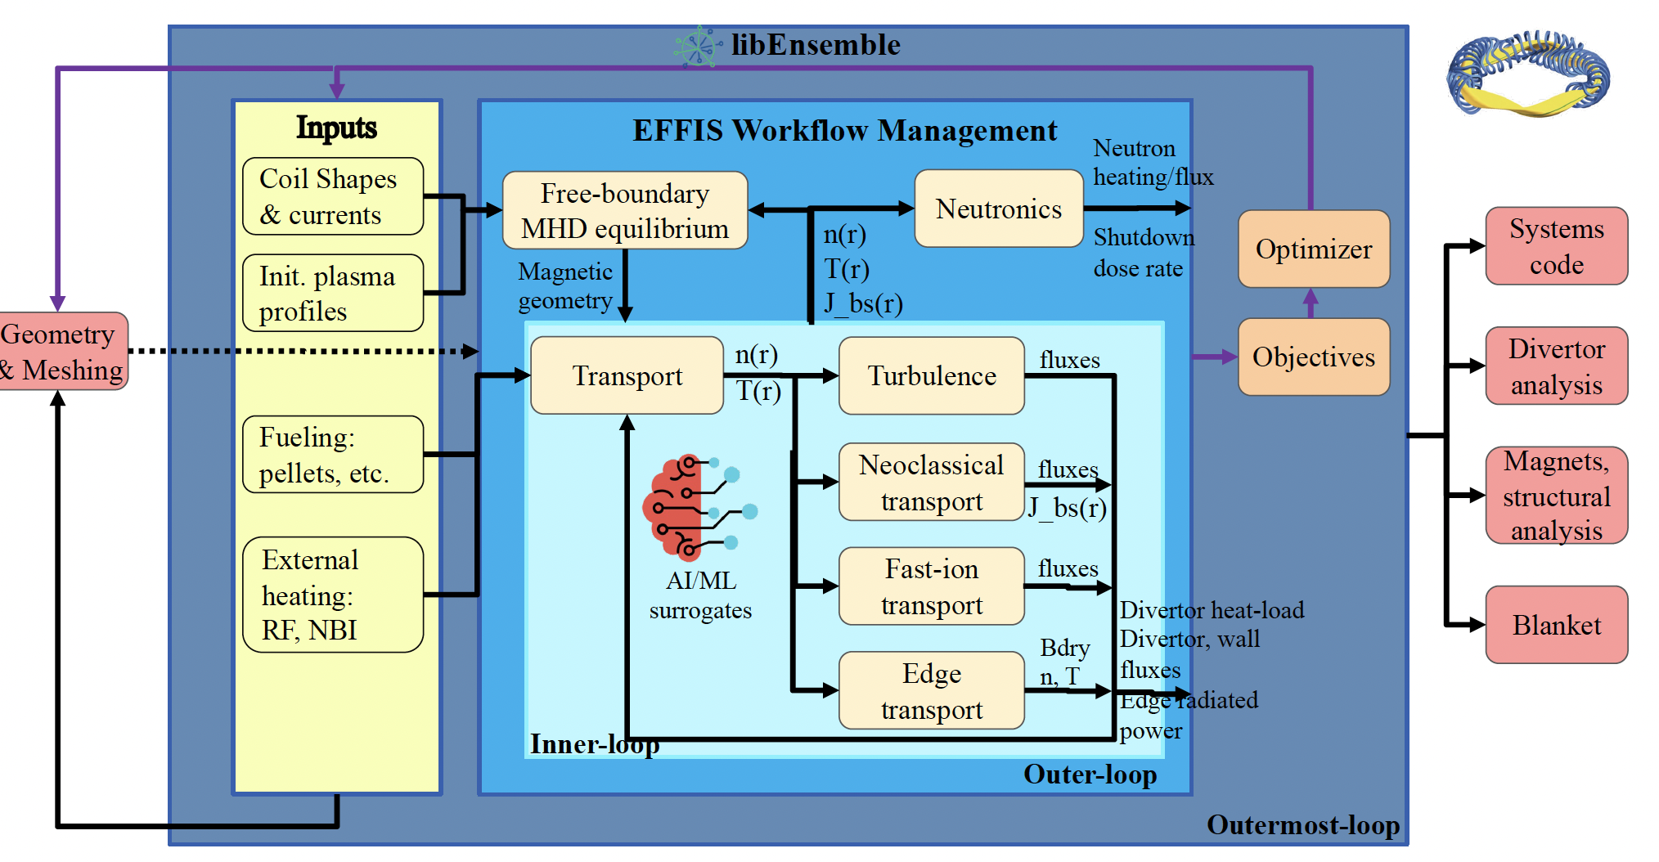
Coupling multiple fidelity codes for stellarator design optimization and verification
Design optimization traditionally makes use of simplified metrics for speed
  Direct optimization using high-fidelity simulation when needed can make more robust designs
Consistent plasma state from simulation by coupling multiple codes using EFFIS
  Leverage AI surrogates/differentiable simulations for design optimization
  High-fidelity simulation for design verification
SciDAC-5 project

Slide 13
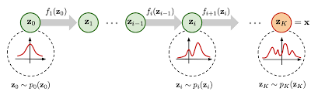
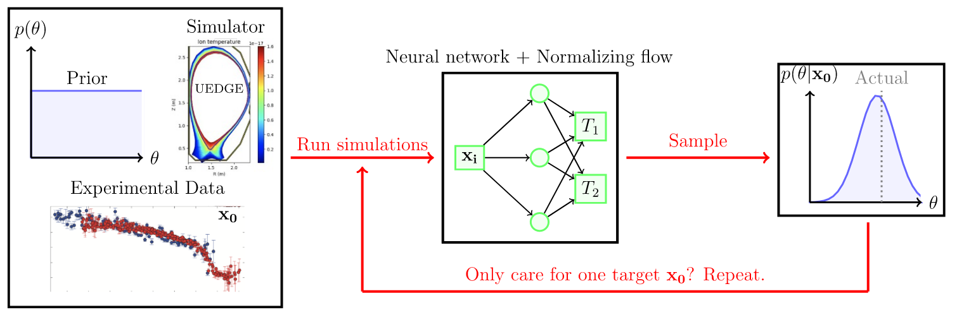
How to determine validity of simulation?
(and capacity of model to be corrected?)
Running multiple higher-fidelity simulation against experiment often unfeasible computationally (certainly on timescale of experiment)
Amortized training of simulation-based inference (sbi) AI neural density estimators can ensure fast comparison to high-fidelity simulation
  Naturally combines multiple diagnostics in a Bayesian manner
Run many simulations,
trained model used for
statistical inference on
experimental data
(compares to simulation)
Furia 2022 PPCF

Slide 14
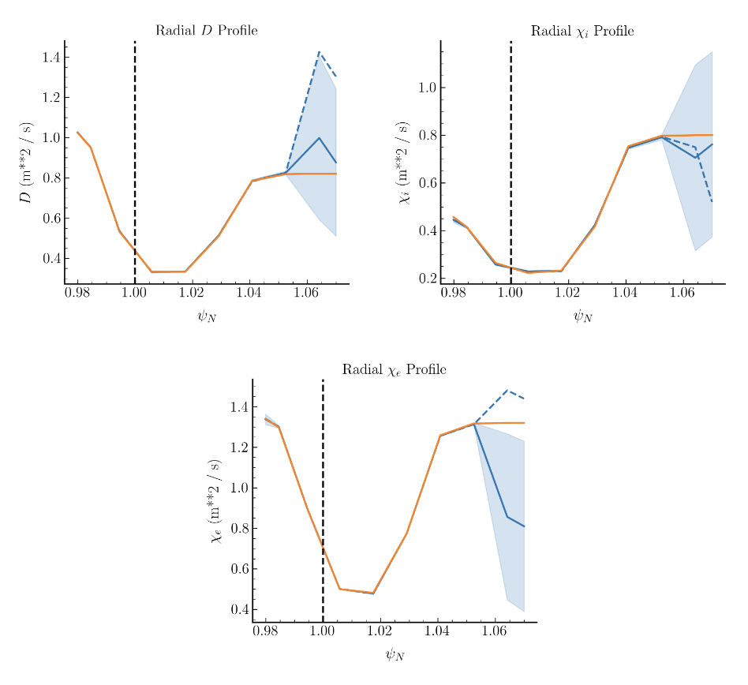
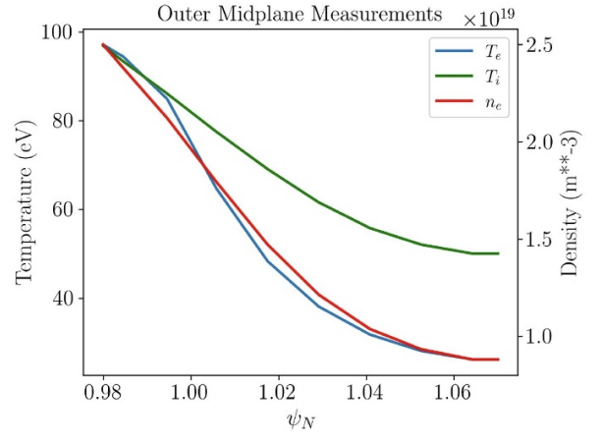
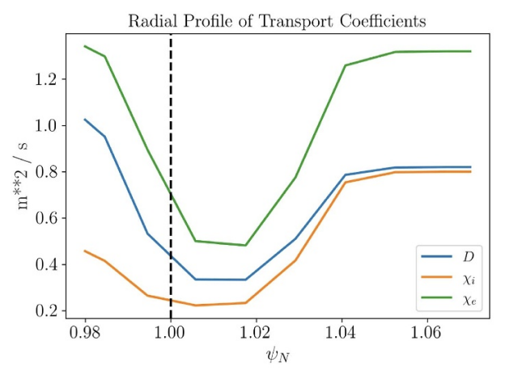
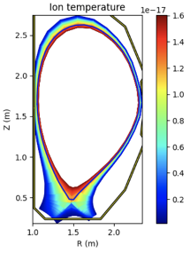
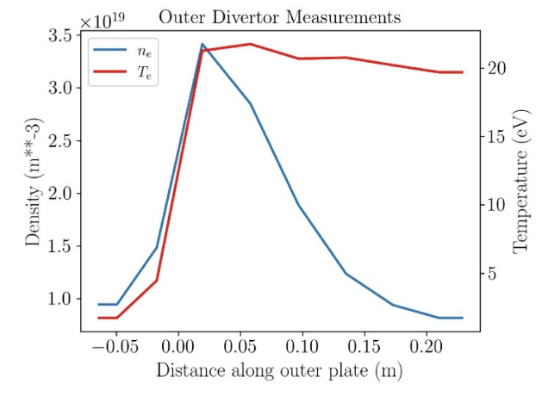
Simulation-based inference (SBI) using neural density estimators for fast inference from diagnostic data
SBI offline trains a normalizing flow based neural network with thousands of simulations. Trained model used to infer physics parameters from experiment observables
Basis for digital twin, interpreting experiment.
Algorithm for permanent model updates in progress.
Orange: Actual (θ₀)
Dashed: SNPE maximum-a-posteriori
Solid: SNPE expected value (95% C.I., 10^5 samples)
x₀
θ₀
Furia, PPCF, 2022
UEDGE
SBI NN
KEY INSIGHT: NN can enable fast simulation to experiment comparison

Slide 15
Conclusions
Fusion energy has a rich dataset of multimodal experiments and accompanying variety in simulation foundational to interpreting physical mechanisms
Digital twins show promise, but inclusion of higher-fidelity simulation may be necessary at least supplementally
Complex dataset geometries, modalities require underlying digital twin representations which can work in higher-dimensions (future work: diffusion models)

Slide 16
End Presentation

