Slide 1
Recent developments in uncertainty quantification and model validation for complex systems
Roger Ghanem, USC
New York Scientific Data Summit 2024: Addressing Data Challenges in Digital Twins
Brookhaven National Laboratory September 16–17, 2024

Slide 2
MOTIVATION
RESOLVED MODELS OF PHYSICAL PHENOMENA CANNOT BE EXECUTED IN REALTIME.
WE TYPICALLY INTRODUCE ERRORS TRYING TO RUN FASTER:
  MUST REALIZE THAT ERRORS ARE INTRODUCED
  IDENTIFY THE ERRORS
  ANALYZE THE ERRORS (math or heuristics)
  ASSESS CONSEQUENCES OF ERRORS

Slide 3
THRUST AREAS
STOCHASTIC MODELING
FASTMATH
AUTONOMY

Slide 4
EXAMPLE THAT RUNS ACROSS THRUSTS:
MODEL VALIDATION
VERIFICATION: Ascertain that we are solving the equations correctly.
TEST PREDICTIONS AGAINST EXACT SOLUTION OF EQUATIONS
VALIDATION: Ascertain that we are solving the correct equations.
TEST PREDICTIONS AGAINST DATA
More reasonably: Determine to what extent the data does not invalidate the model.

Slide 5
TRADITIONAL THINKING ABOUT VALIDATION
COMPARES MODEL PREDICTION TO EVIDENCE
USING UNCERTAINTY QUANTIFICATION TO PROVIDE A CLOUD OF PREDICTIONS THAT IS REASONABLE

Slide 6
TRADITIONAL THINKING ABOUT VALIDATION
COMPARES MODEL PREDICTION TO EVIDENCE
USING UNCERTAINTY QUANTIFICATION TO PROVIDE A CLOUD OF PREDICTIONS THAT IS REASONABLE
WE OFTEN DO NOT HAVE MODELS (COMPLETELY DATA DRIVEN)
OR
OPERATING CONDITIONS BETWEEN MODELS AND EVIDENCE ARE DIFFERENT AND CANNOT BE RECONCILED

Slide 7
TRADITIONAL THINKING ABOUT VALIDATION
COMPARES MODEL PREDICTION TO EVIDENCE
USING UNCERTAINTY QUANTIFICATION TO PROVIDE A CLOUD OF PREDICTIONS THAT IS REASONABLE
WE OFTEN DO NOT HAVE MODELS (COMPLETELY DATA DRIVEN)
OR
OPERATING CONDITIONS BETWEEN MODELS AND EVIDENCE ARE DIFFERENT AND CANNOT BE RECONCILED
WE SHOULD STILL BE ABLE TO VALIDATE A MODEL

Slide 8
APPROACH
INSIGHT FROM THE HUMAN BODY:
WE CAN RELATE BODY TEMPERATURE AND BLOOD PRESSURE TAKEN AT THE WRIST TO SPECIFIC AILMENTS.
NECESSARILY WITH SOME LEVEL OF UNCERTAINTY.
NO NEED TO HAVE A COMPLETE CHARACTERIZATION OF CELLS AND ORGANS – WHICH MAY BE EXPENSIVE AND NOT NECESSARILY RELATABLE TO THE AILMENT IN A CAUSAL FASHION.

Slide 9
APPROACH
DEPENDENCE BETWEEN FEATURES OF THE MODEL MAY BE SUFFICIENT INDICATION OF REALISM

Slide 10
APPROACH
DEPENDENCE BETWEEN FEATURES OF THE MODEL MAY BE SUFFICIENT INDICATION OF REALISM
WE MUST IDENTIFY WHICH FEATURES
WE MUST IDENTIFY THE REALISTIC SHAPE OF DEPENDENCE (NOT JUST CORRELATION !)
WE MUST IDENTIFY WHAT WE MEAN BY SUFFICIENT

Slide 11
EXAMPLES
SYNTHESIS

Slide 12
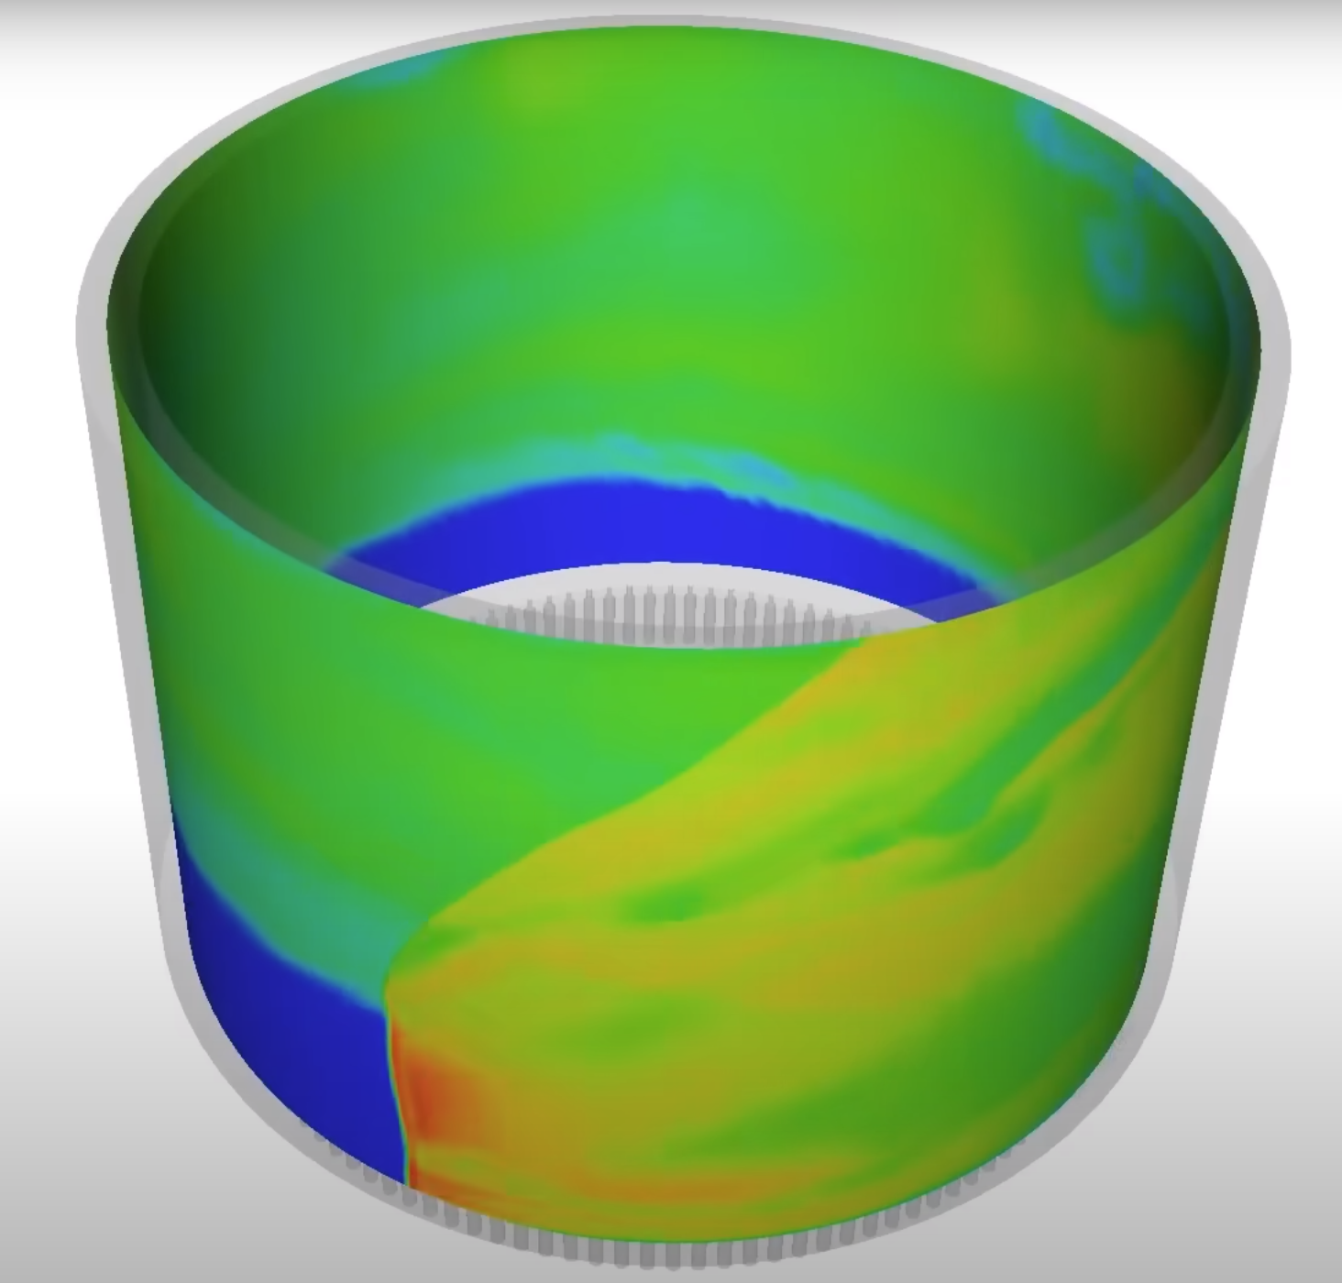
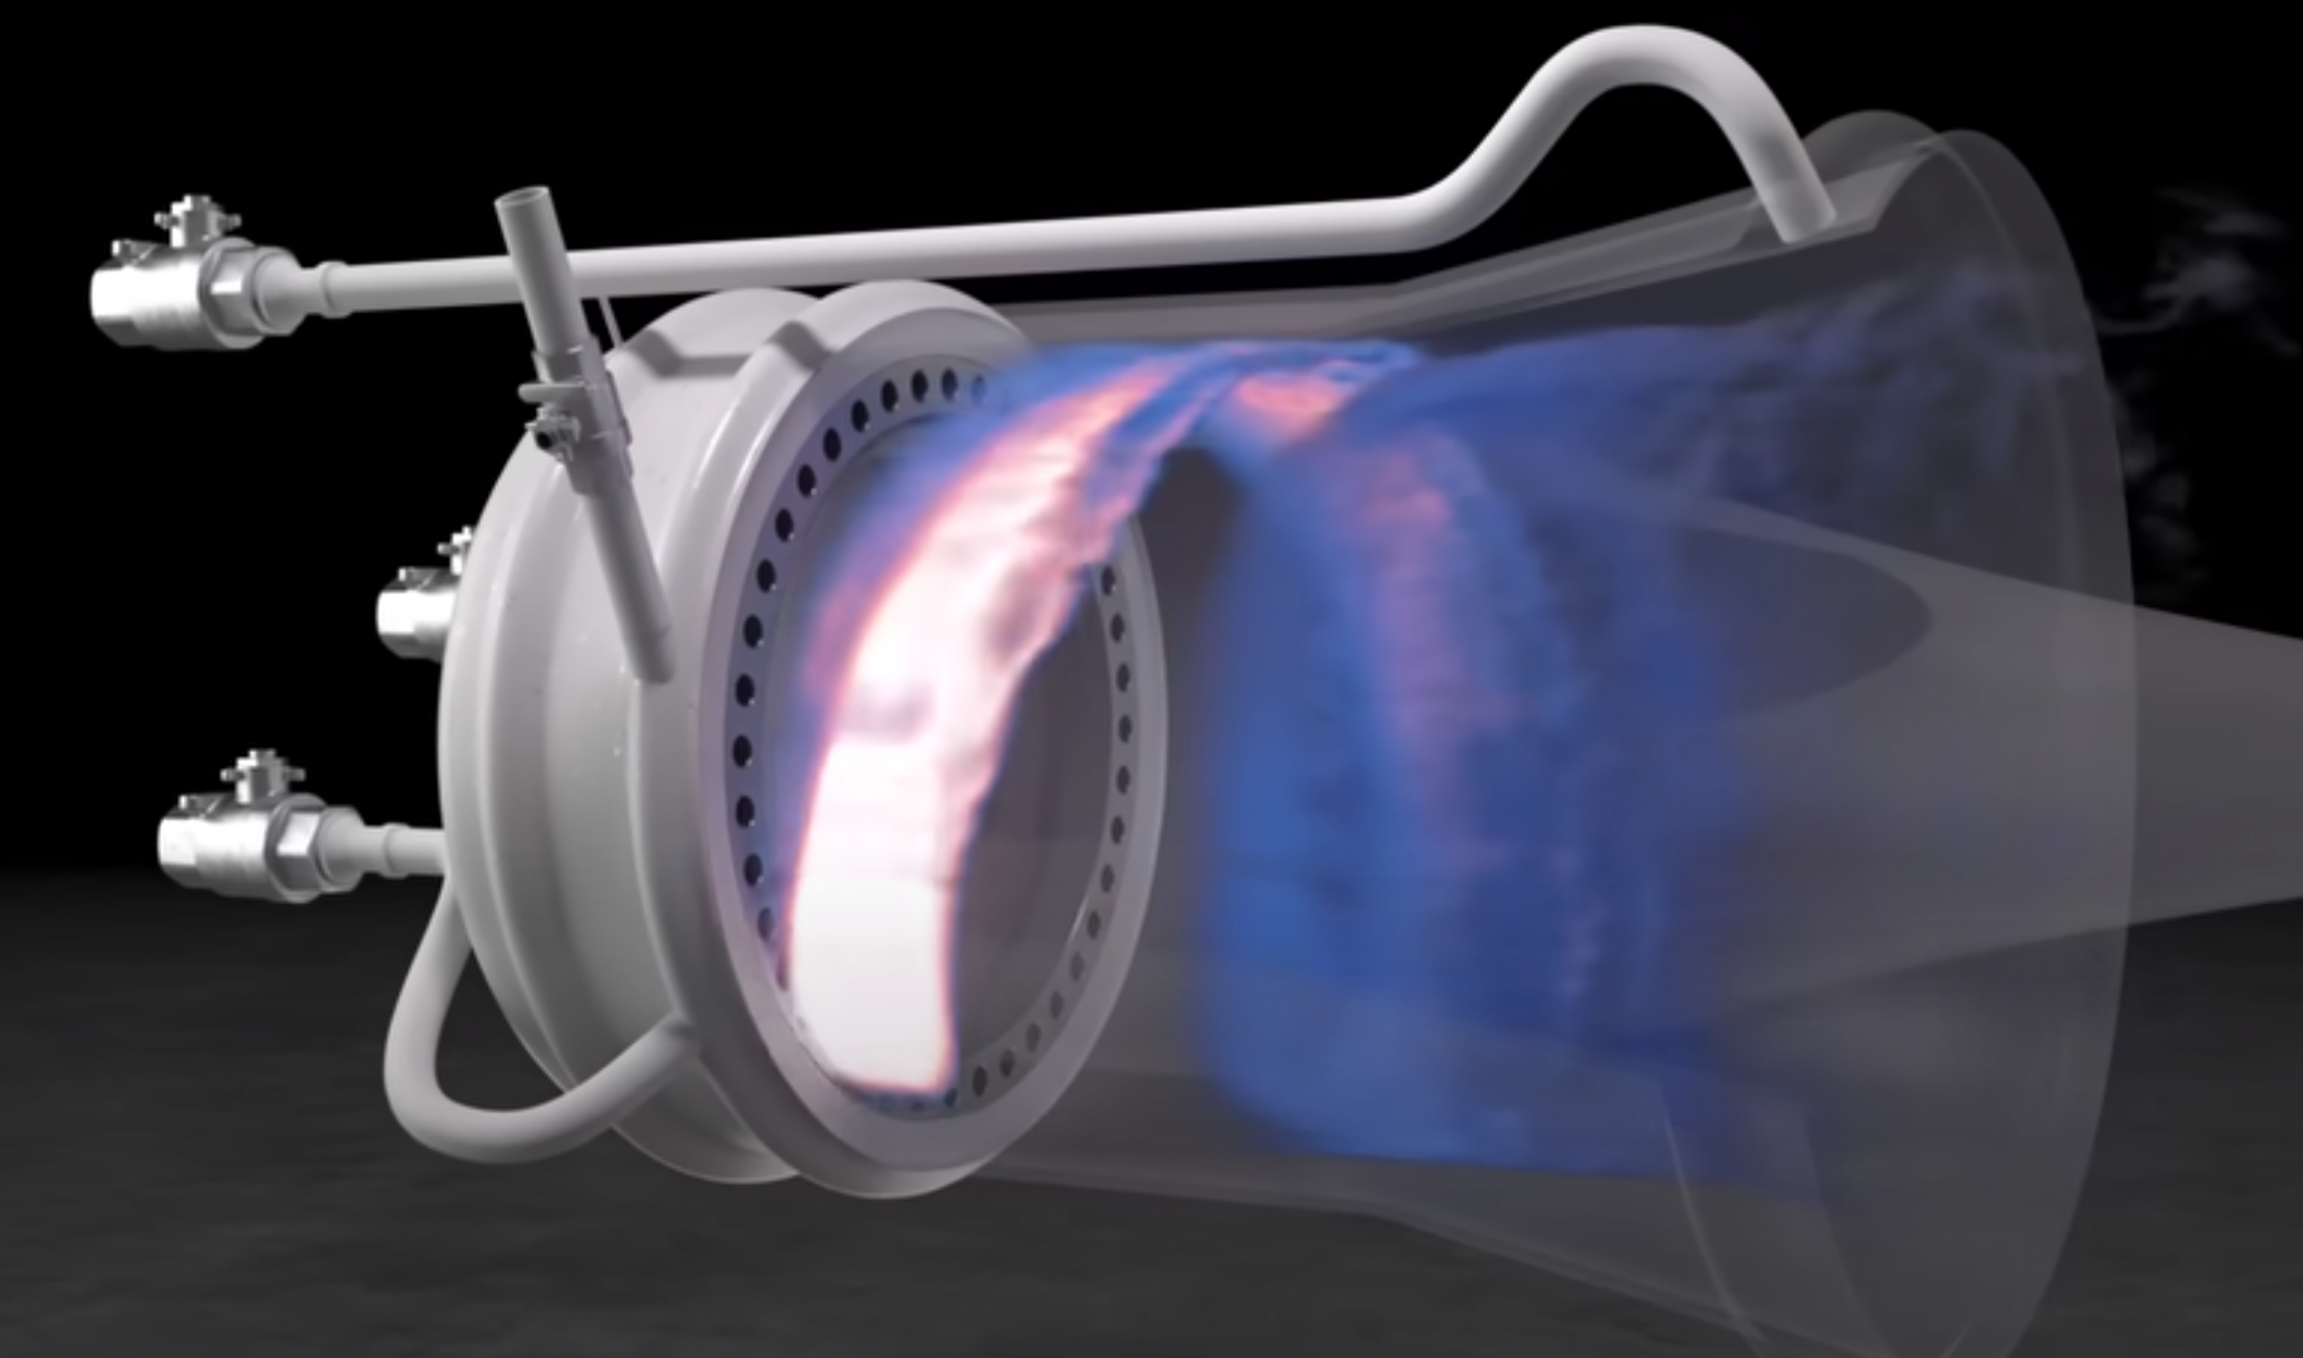
Rotary Detonation Engines (RDE)
Continuous thrust (propulsion)
Supersonic detonation wave and shock front
Thermodynamic efficiency 36.9% → 59.3%

Slide 13
Rotary detonation engines (RDE)
Given measurements on Boundary
Pressure,
Temperature
Density
Velocity

Slide 14

Rotary detonation engines (RDE)
Given measurements on Boundary
Infer state inside the tube
Pressure,
Temperature
Density
Velocity
p, t, rho, v, Q, w, and gradients
Space/time features

Slide 15



Training SET:
Explore sensitivity of each QoI to following features:
Distance between ”meta” droplets
Inclination to horizontal
H/O Composition of droplets
Size of droplets
USING A LOW-FIDELITY LES MODEL,
we generate 1000 samples.

Slide 16
RESULTS:
Representing the SENSOR data (Temperature data)
CHALLENGE: TEMPERATURE DATA IS POSITIVE
CONSTRAINED LEAST SQUARES PROMOTED POSITIVITY
NON-NEGATIVE MATRIX FACTORIZATION (NMF) ENSURED POSITIVITY

Slide 17
RESULTS:
Representing the FEATURE data:
AT A GIVEN INSTANT OF TIME
TEST FEATURE
RECONSTRUCTED
PARAMETERIZED
TEST FEATURE
PCE OF
RECONSTRUCTED
FEATURE
FEATURE
INFERRED FROM
SENSOR DATA

Slide 18
RESULTS:
Sensing a different experiment:

Slide 19
RESULTS:
Sensing a different experiment:

Slide 20
POLYNOMIAL CHAOS FRAMEWORK
EXERCISING THE FORWARD MODEL

Slide 21
POLYNOMIAL CHAOS FRAMEWORK

Slide 22
POLYNOMIAL CHAOS FRAMEWORK
ACCURATE MAPPINGS FROM SDOF TO Q1 and Q2 ARE CRITICAL FOR Q1 <-> Q2 TO BE USEFUL.
WE USED A HIGH ORDER PCE TO DESCRIBE THE MAPPING FROM SDOF TO Q1 and Q2.
EFFECTIVE INFERENCE HINGES ON SUITABLE PARAMETERIZATION OF SIGNAL AND FEATURES.

Slide 23
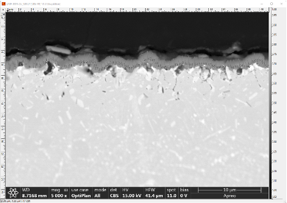
Oxidation in a hydrogen environment
Train on about 100 experimental specimens:
11 variables characterizing the morphology of oxidation:
Thickness, length, depth, area
of various key features

Slide 24
Oxidation in a hydrogen environment
Train on about 100 experimental specimens:
11 variables characterizing the morphology of oxidation:
Thickness, length, depth, area
of various key features
NO TRUSTED GOVERNING EQUATIONS

Slide 25
Oxidation in a hydrogen environment
During Operation
Observe some of the known variables
Infer other key variables

Slide 26
Oxidation in a hydrogen environment
During Operation
Observe some of the known variables
Infer other key variables
NO CLOSURE FOR THESE VARIABLES (missing information a.s.)
ONLY PROBABILISTIC INFERENCE IS REASONABLE

Slide 27
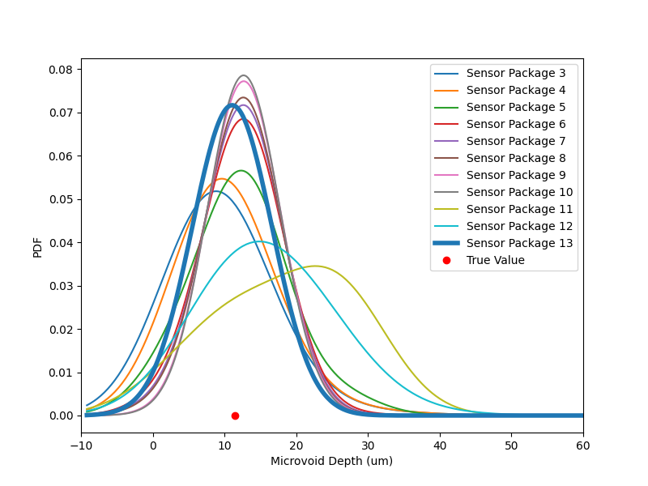
Oxidation in a hydrogen environment
PREDICTING MICROVOID DEPTH (FOR A TEST CASE) CONDITIONAL ON A VARIETY OF SENSING PACKAGES
A SENSOR PACKAGE IS A SET OF CONDITIONNING VARIABLES ( A SUBSET OF THE 11 FEATURES WE TRAINED ON)

Slide 28
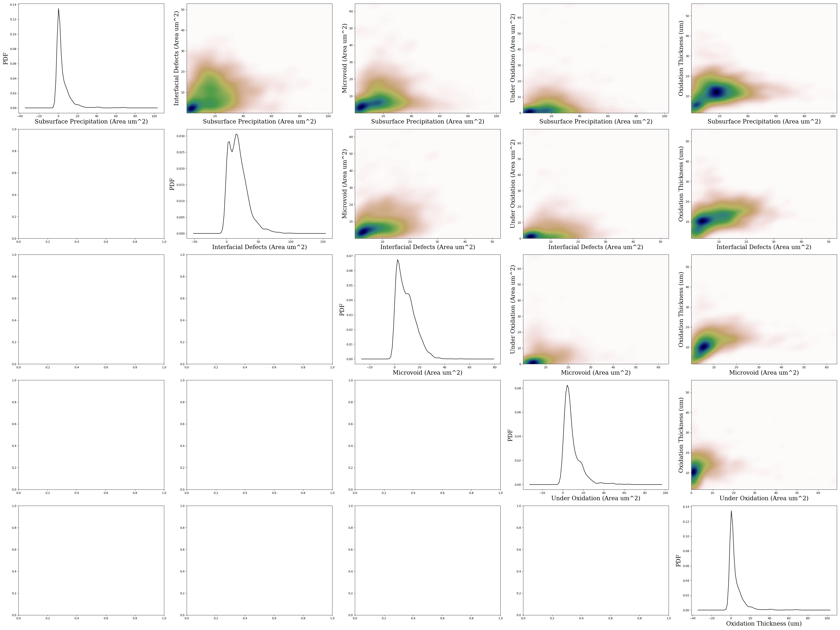
Oxidation in a hydrogen environment
STATISTICAL DEPENDENCE AMONG THE KEY 5 VARIABLES

Slide 29
PLOM FRAMEWORK: MODEL-FREE
DETECT AN INTRINSIC STRUCTURE IN DATA
  e.g. DIFFUSION COORDINATES
CONSTRUCT A PROBABILITY FLOW FROM (SMALL) TRAINING SET TOWARDS A COLLECTIVE MEASURE
CONSTRUCT AN ITO EQUATION WHOSE INVARIANT MEASURE IS THIS COLLECTIVE MEASURE
SOLVE A PROJECTED ITO EQUATION TO OBTAIN CONSTRAINED SAMPLES
NON-PARAMETRIC CONDITIONAL DENSITY ESTIMATION PROVIDES THE INFERENCE ENGINE

Slide 30
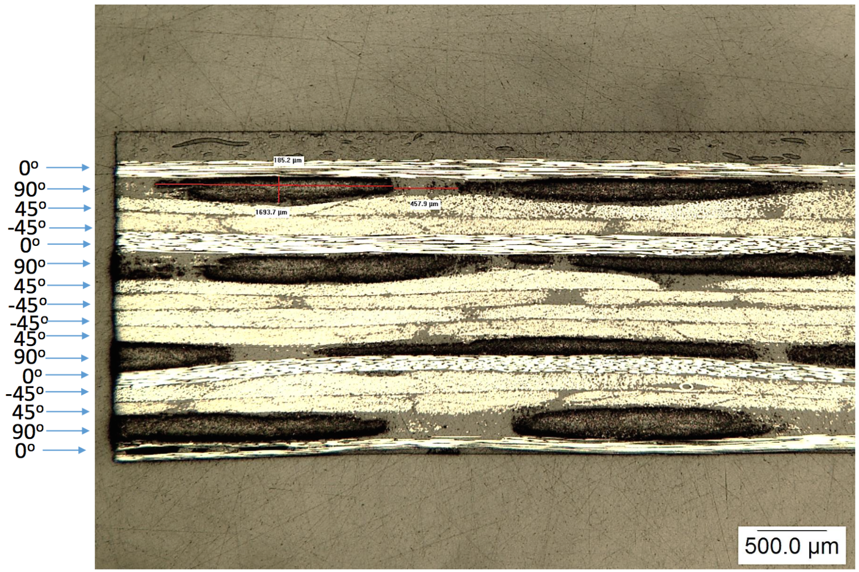
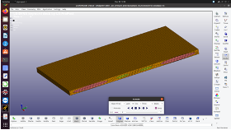
Hybrid Composites
Train on numerical samples of a hybrid composite lamina:
Observe:
Glass, carbon, resin properties
Effective Stress, strain relations
During Operation:
Given microscale properties
Infer stress-strain relations
or
Given stress-strain relations
Infer microscale properties

Slide 31
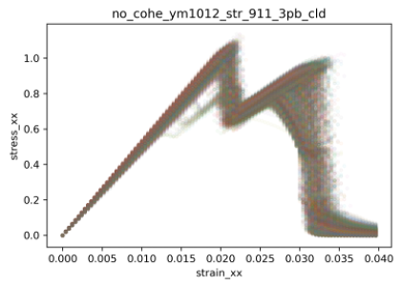
Hybrid Composites
Stress-strain curves from training data

Slide 32
Hybrid Composites
Inferred stress-strain relationships

Slide 33
REMOTE SENSING: PACE Data
TRAINING DATA: (1516 features)
149 Satellite images:
Instrument properties
Irradiance at 4 wavelengths and 90 view angles.
Wind speed
Surface pressure
Aerosol properties

Slide 34
REMOTE SENSING: PACE Data

Slide 35
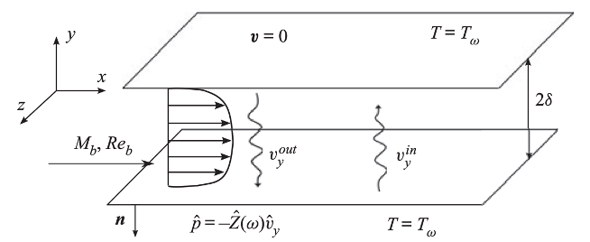
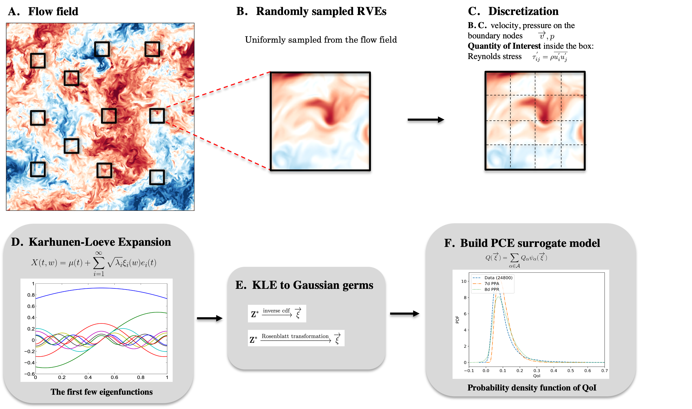
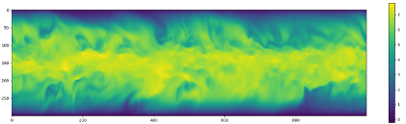
Turbulence
DATA SOURCE:
JOHNS HOPKINS TURBULENCE BOX
OBSERVE:
Velocity, pressure as spatial processes on the boundary of a 3D cube
INFER:
Subgrid stress over cube,
Q-Criterion, …

Slide 36
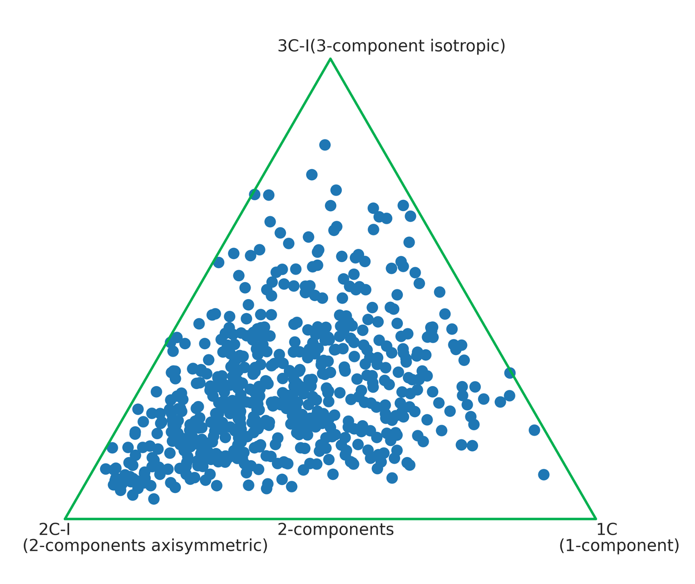
Turbulence
CONDITIONAL INFERENCE
PDF of subgrid stress tensor conditional on local spatial values of
velocity
Pressure
temperature

Slide 37
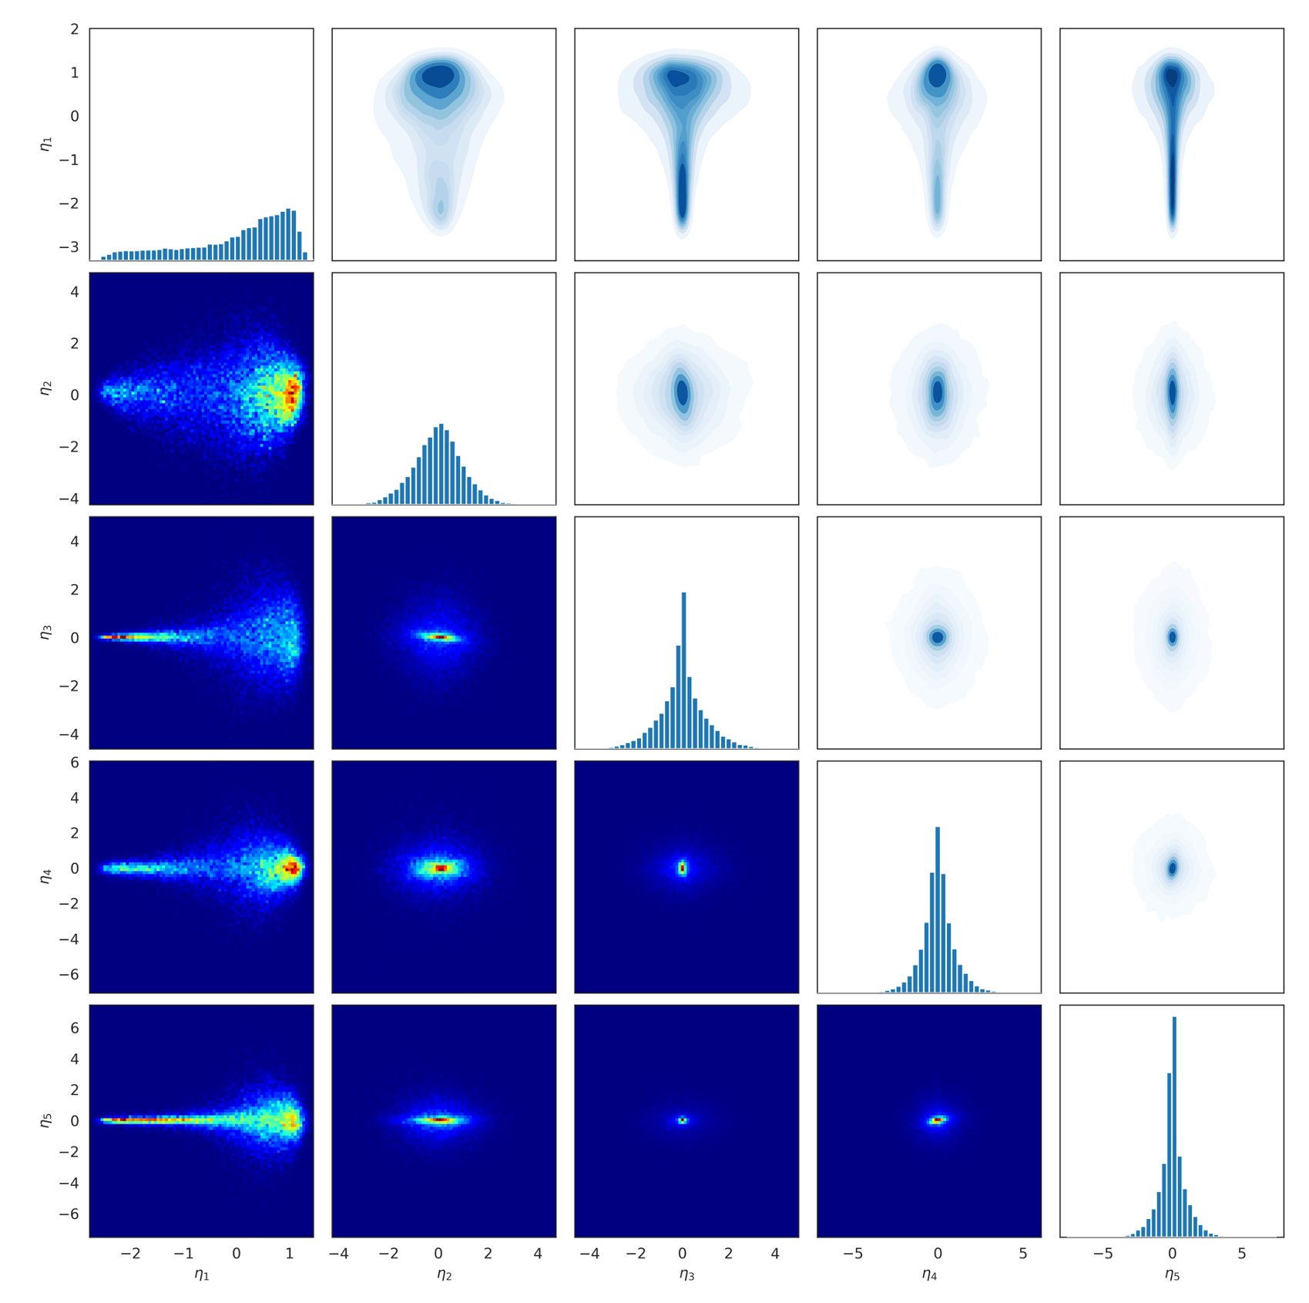
Turbulence
JOINT PDF OF SUBGRID STRESS COMPONENTS

Slide 38
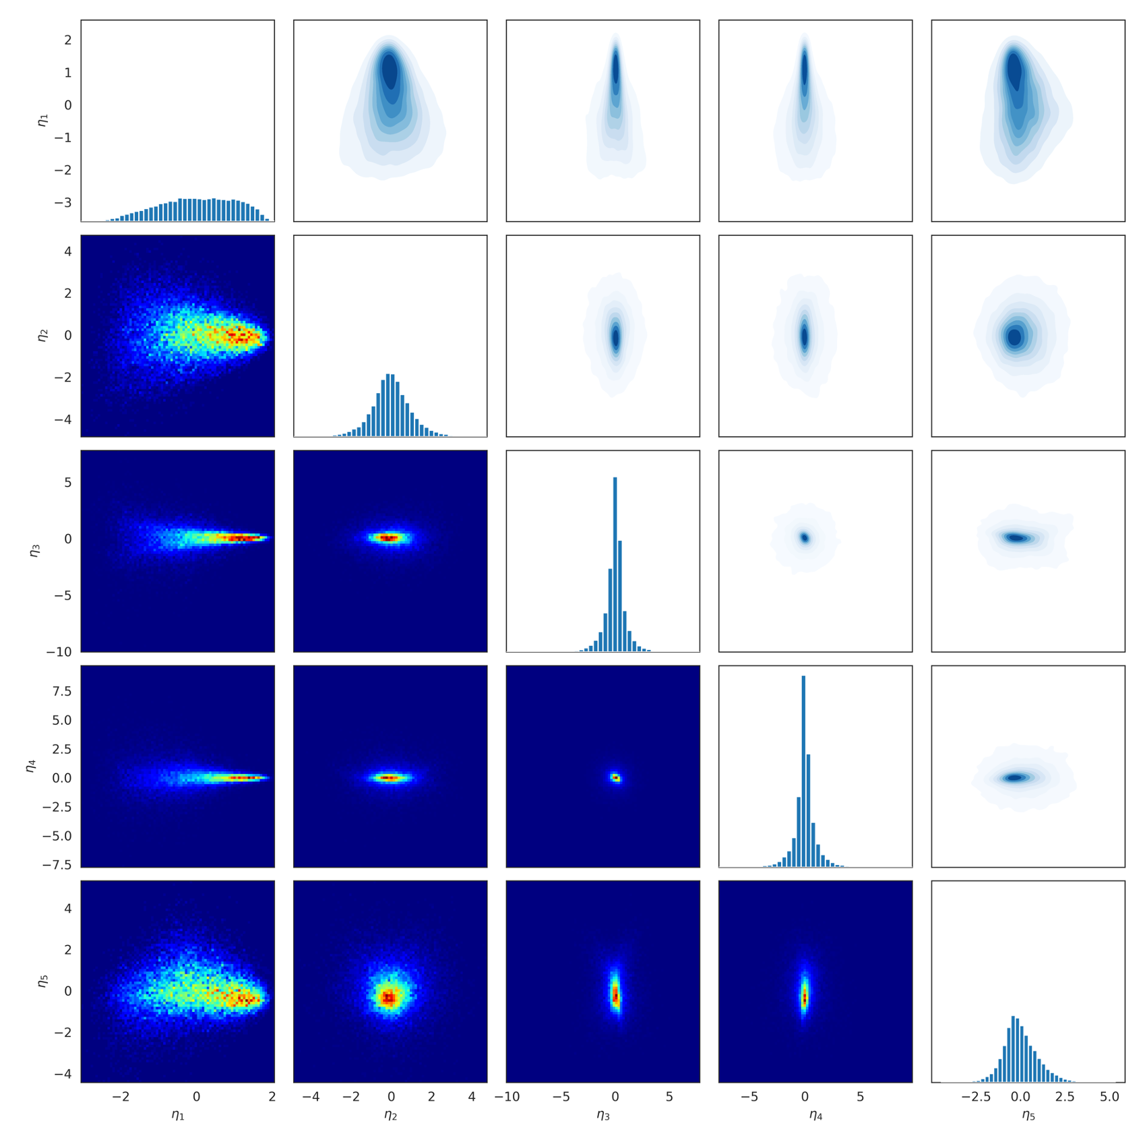
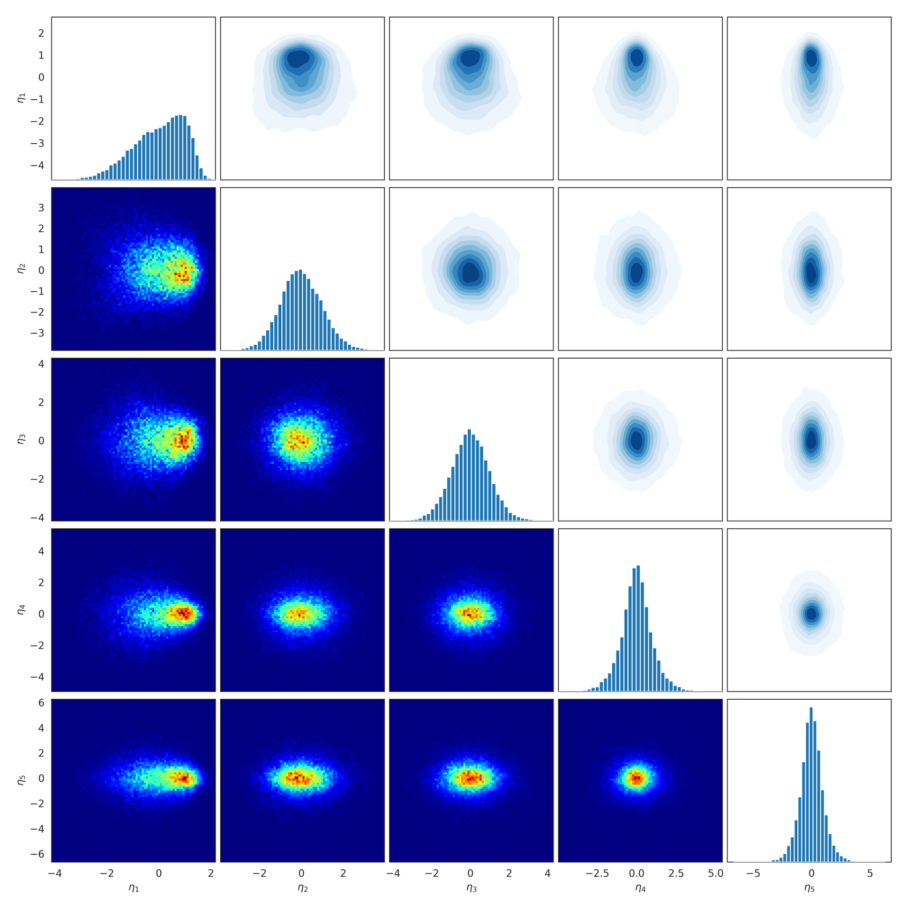
Turbulence
INCLUDING DISTANCE TO WALL AS A CONDITION
ELIMINATES BI-MODALITY AND
SHRINKS SUPPORT OF CONDITIONAL PDF

Slide 39
Turbulence
The specific relationship that our probe discovers informs it how close it is to a feature :
  Proximity to a wall
  Proximity to vortices
  Proximity to specific reacting chemicals

Slide 40
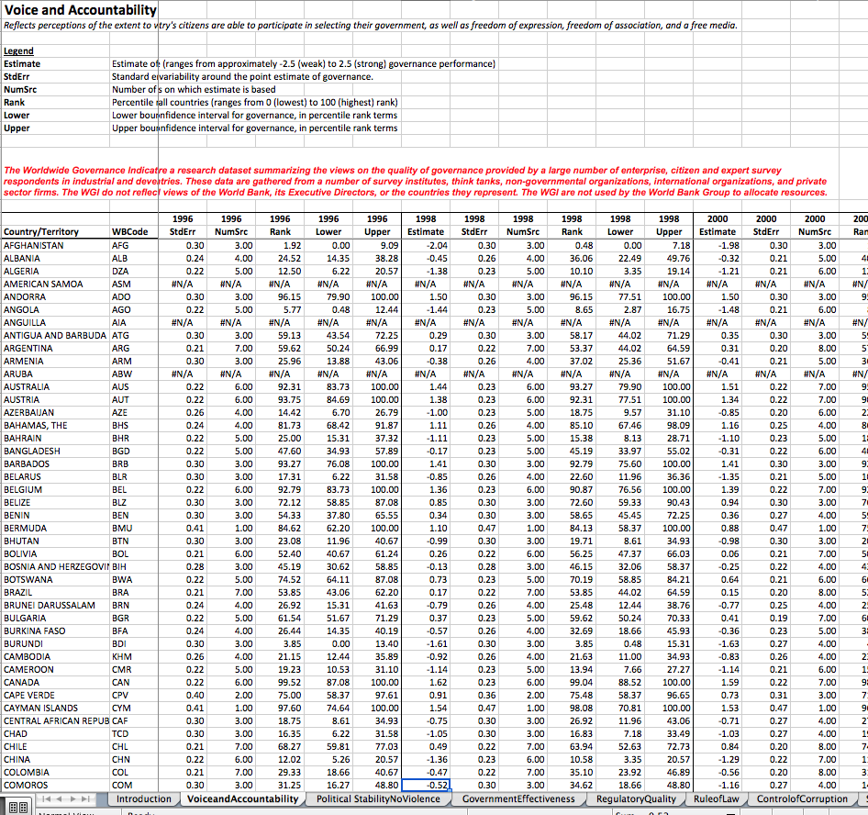
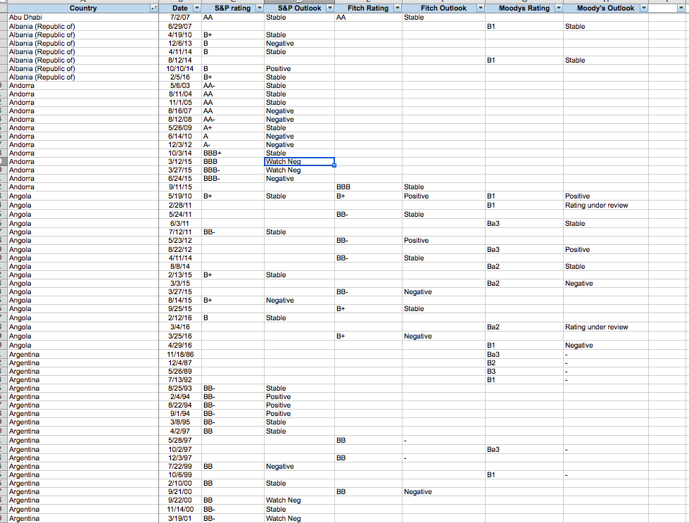
Sovereign ratings and GDP
Train on 50 years of data:
Batches of 5 consecutive years of data.
NO FIRST PRINCIPLES MODEL
GOVERNANCE INDICATORS
Voice and Accountability
Government Effectivness
Political Stability
Regulatory quality
Rule of law
Control of Corruption
GDP
S&P Ratings

Slide 41
Sovereign ratings and GDP
During Operation:
Observe 4 consecutive years of some variables
Predict 5th year of some other variables

Slide 42
Sovereign ratings and GDP
Figures below:
Observe the ratings and GPD in a four years sequence
Predict GPD and ratings in 5th year

Slide 43
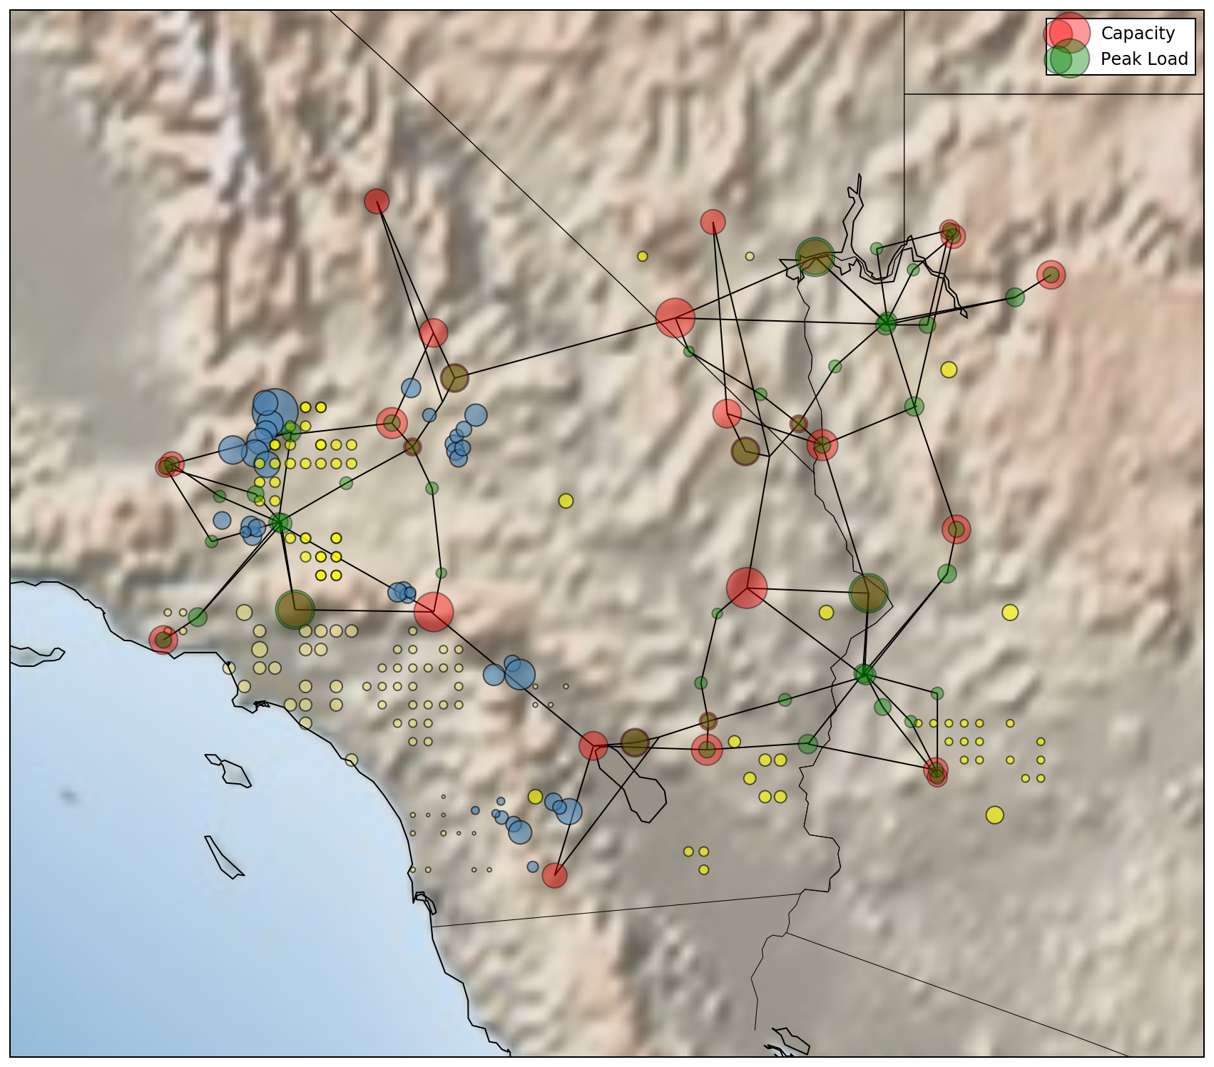
Extremes on Powergrid
Train on few years of data:
Daily Cost of operation
Hourly Generation at 326 generators
Hourly Demand at 118 buses
During Operation:
Anticipate shutdowns:
Anticipate operational topology associated with high cost

Slide 44
Extremes on Powergrid
High cost is associated with blackout.
PDF of generation at No.22 under various operating cost scenarios

Slide 45
SYNTHESIS
DATA ACQUISITION UNIT:
  CHOICE OF SENSORS
  CHOICE OF SAMPLE SIZE
DATA INTERPRETATION UNIT:
  PCE / PLOM / NN ETC…
AUTONOMY:
  CHOICE OF VARIABLES TO CONDITION ON
  DESIGN OF EXPERIMENT
  DESIGN OF SENSORS

Slide 46
SYNTHESIS
ANALYSIS METRICS:
  LEARNING POTENTIAL (WHETHER WE CAN LEARN ANYTHING)
  LEARNING CAPACITY (WITH UNLIMITED RESOURCES)
  CONSTRAINT VIOLATION/PENALTY
FRAMEWORK OF STATISTICAL LEARNING IS USED TO EVALUATE THESE METRICS
WE ARE PURSUING THE OPTIMAL DESIGN OF THESE KNOLWEDGE EXTRACTION PROBES

