Slide 1
Digital Twins for Science – Advanced Visualization @ (Exa) Scale
The 10th New York Scientific Data Summit 2024 | Hosted by Brookhaven National Laboratory
Barton Fiske, NVIDIA Senior Alliances Manager – HPC DevTools, Math Libs & Digital Twins

Slide 2
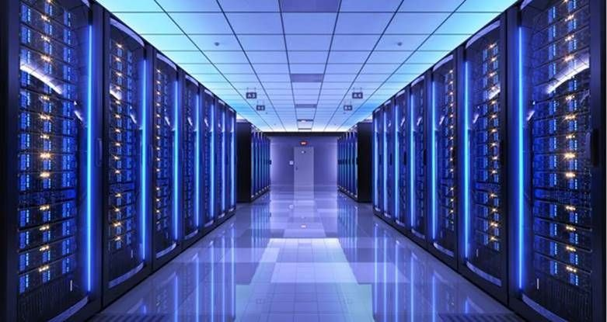
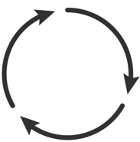
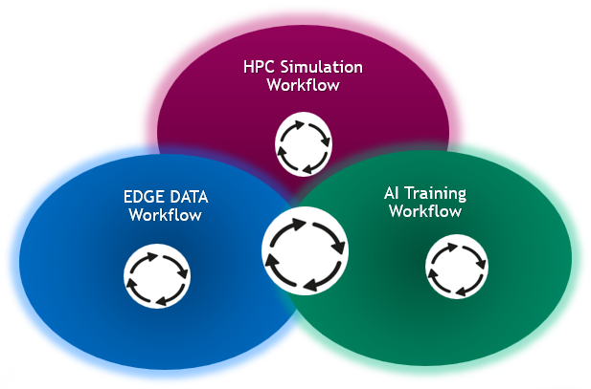
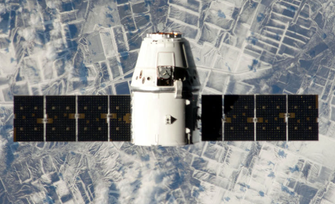
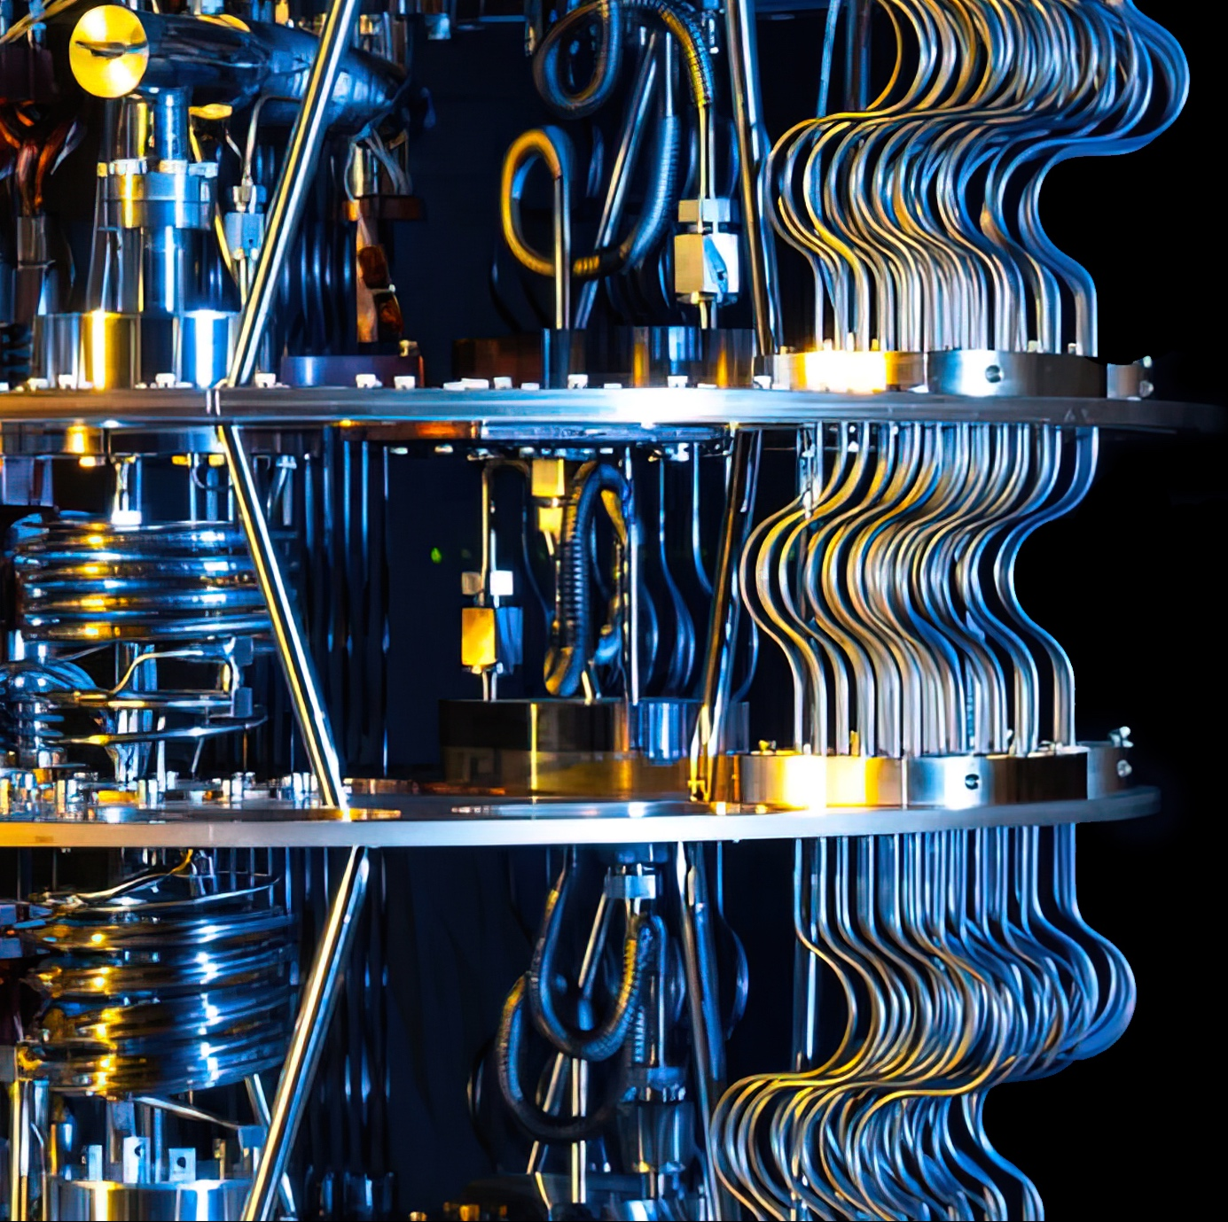
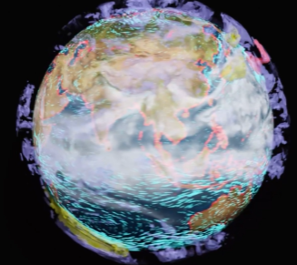
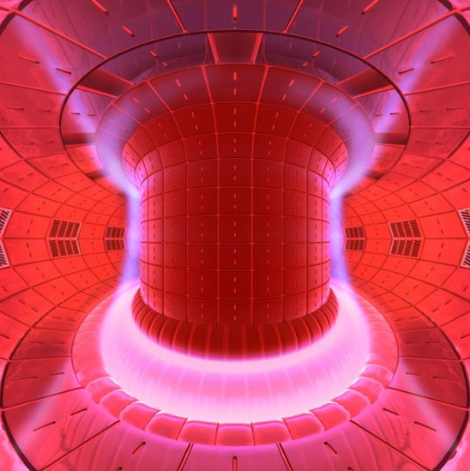
Composite Workflows Emerging Being Developed to Address the challenge of full-scale science models
Data Center
Cloud
Sensors and Experiment
Data and Operation
At the Edge
Quantum circuit
Simulation
Quantum
Computing
Digital Twin

Slide 3
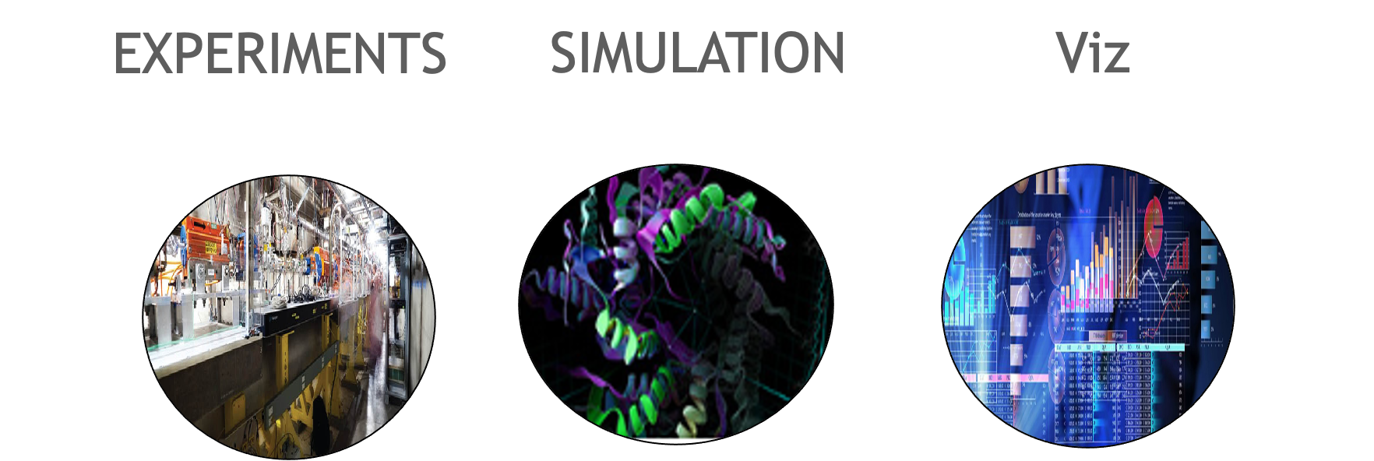
TRANSITION TO POST EXASCALE ERA
FEATURE | TERA THROUGH EXASCALE | POST EXASCALE
USAGE | BATCH & MOSTLY LOCAL TO A SITE | INTERACTIVE & DISTRIBUTED WITH MULTIPLE SITES
WORKLOAD | SINGLE SIMULATION/ENSEMBLE | WORKFLOW COMPRISED OF SIMULATION ENSEMBLES, AI TRAINING AND INFERENCE, LIVE DATA ANALYTICS
EXPERIMENTS | OFFLINE DATA ANALYSIS FOR EXPERIMENTS | MIX OF REAL-TIME ANALYSIS TIGHTLY COUPLED WITH OFFLINE
DIGITAL TWINS | IN-SITU VISUALIZATION – (OFFLINE) | INTERACTIVE VISUAL MODEL COUPLED WITH PHYSICAL ASSET
QUANTUM COMPUTING | SIMULATION | SIMULATION PREPARING FOR A HYBRID MODEL
PROGRAMMING MODELS | FORTRAN, C++, MPI, OPENMP | STANDARD PARALLELISM SUPPORT IN FORTRAN, C++ (STDPAR) MPI, OPENMP, OPENACC, PYTHON, JULIA, PYTORCH, TENSORFLOW, (RUST?)
SYSTEM CONFIGURATION | MONOLITHIC | MODULAR & COMPOSABLE
CLOUD | GRID | BURST CAPABILITIES, FASTER REFRESH CYCLE, ACCESS TO LATEST TECHNOLOGY AT SCALE, HPC FABRICS
Notes:
Rows describe areas of transition that overlap or relevant to areas that Digital Twins seek to serve or are drawn from.
Column 2 is the “Way it used to be” – Column 3 is “How it’s going to be”…

Slide 4
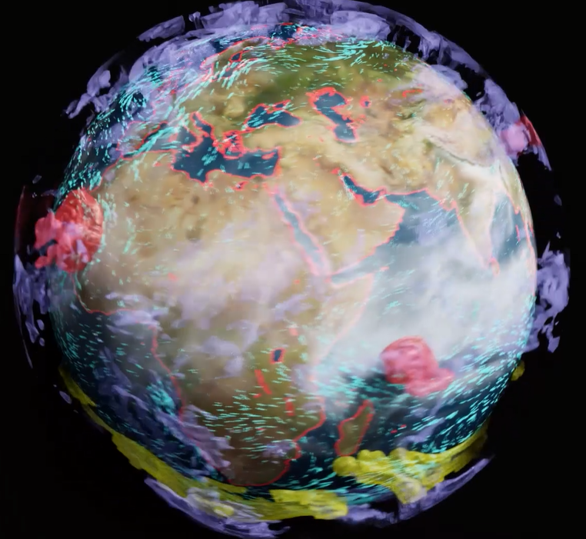
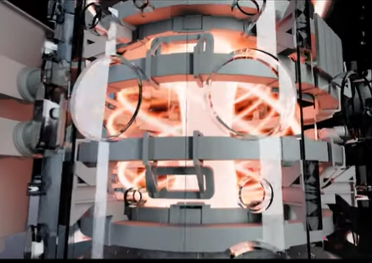
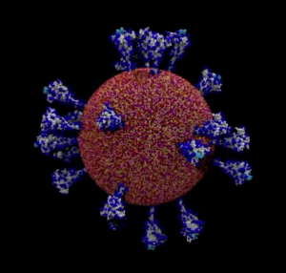
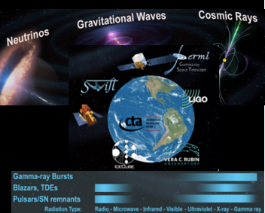
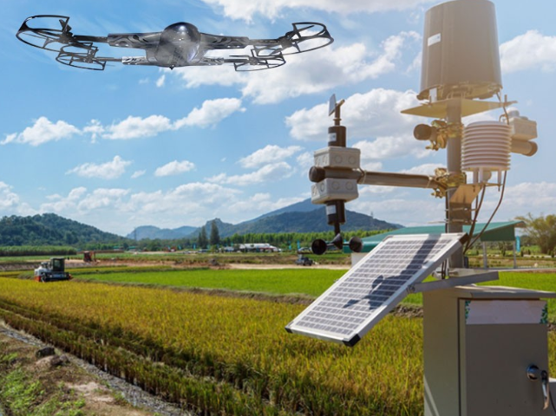
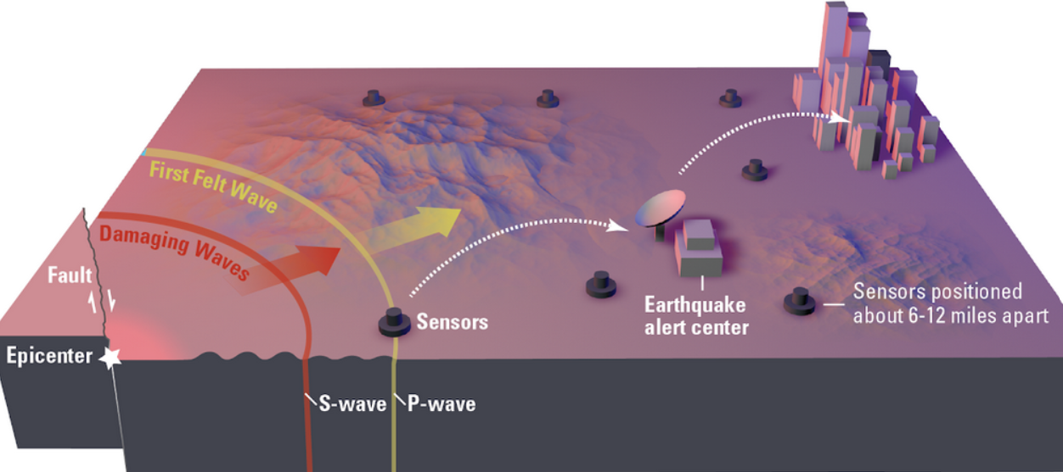
DIGITAL TWIN POC SCIENCE EXAMPLES
Collaborate with the Global Research Community to Pursue Science Discovery that Benefits Mankind
Genome Scale LLMs for Covid
Covid is Airborne
Earth 2
Destination Earth
Towards Real time Fusion Reactor Design
Generative AI to Predict Disruption
Kubota For Earth For Life
Real Time Multi-Messenger Astrophysics
Earthquake Model with Machine Learning
Multi-Messenger Neutrino Detection
Earthquake Early Warning SCEC
Notes:
Link to Kubota and Accenture Digital Twin project:
https://www.kubota.com/news/2022/20220830.html

Slide 5
DIGITAL TWIN OVERVIEW
Digital Twin
Physical System
Generic Definition
An interactive model with real world scope and scale
Scientific Twin
The model includes components with the accuracy and detail required for the model to support new science discovery and/or ingest live data to improve the operation of the physical system
Engineering Twin
The model includes components with the accuracy and detail required for the model to support optimizing the design and manufacturing process and monitor the physical system for the lifetime of a new or existing product.. Monitoring
Physical Asset that we would like to model
Early Examples
Data Center
Factory Operation
Fusion Reactor
Climate
Hazardous Weather
Drug Development Lab
Drive Sim
“Blueprint”
Describe what we want the Twin to do
High level outline of the model flow and how the digital assets will be combined
Identify the digital assets that will be needed

Slide 6
DIGITAL TWIN BLUEPRINT EXAMPLES
Define The GOAL
Describe what we want the Twin to do
Improve the control system for a new or existing Fusion reactor
Model the Climate and impact of approaches to limit carbon in the atmosphere
Provide hazardous weather response
Model biological disease detection and experimental treatments
Outline Model Flow
High level outline of the model flow and how the digital assets will be combined
As new parts are tested live or virtually the twin and PLM tools are synchronized
The twin gathers data from the recent experiments and provides updates to the prediction and recommender control systems
A full scale model of the earth and atmosphere that can show trade offs with carbon input as a variable; or the human heart or brain
A model that connects sensors gathering data on the weather and the earth that can evaluate risk and mitigation and provide update to response teams in real time
A model that integrates multi-modal brain imagery and brainwave data can guide and inform brain surgeons before, during and after surgery.
Define the Digital Assets Required
Fusion CAD tools (MOOSE), PLM tools, CAD Files …….
Connector for EPIC Control system, Surrogate models of core and edge plasma, disruption predictor models, recommender system model, CAD files ……
Legacy simulation with surrogates for key portions of the model…..
Connectors for sensor inputs and response teams, surrogate models backed up by legacy simulation, risk/reward trade off model……..

Slide 7
BUILDING A DIGITAL TWIN
Multiple Steps, Different Entry Points
CONNECT TO THE REAL WORLD
Connection and real time streaming of data inputs from physical twin via sensor models
FULL FIDELITY VISUALIZATION
Aggregation of 3D datasets, materials, lighting, visualizing in real time
OMNIVERSE
CUSTOM 3D TOOLS
Workflow dependent, building own custom tools to connect, enhance, or expand workflows.
BRING IN AUTONOMOUS SYSTEMS
Connection and operation of multiple autonomous, robotic systems for optimization, management, and oversight
PHYSICS SIMULATION
Addition of physics simulation through microservices
Notes:
Not all digital twins are built in the same way.
Depending on the competencies, expertise of a partner or customer – they may enter at any point in the cycle.
We’ve broken down the creation of a digital twin into 4 high level areas:
Full Fidelity Visualization – where customers are aggregating 3D datasets in full-fidelity, adding materials, and lighting and visualizing in real time. This requires a platform to harness open standards, like USD, and multi-GPU scalable compute resources in order to enable the user to visualize these massive scenes in real time.
Physics Simulation – next, simulations of physical systems are added via real time sensor inputs, or real time simulations, through microservices.
Sensor Inputs – the connection of the physical twin to the digital twin is imperative for a true digital twin simulation – constantly streaming new information from the physical twin requires connection of industrial automation, IoT sensors.
Autonomous Systems – a true digital twin encompasses multiple autonomous robotic systems operating in the same space time – helping optimize and operate the virtual twin, and transfer learnings to the physical twin.

Slide 8
DIGITAL TWIN: ACTIONABLE RESULTS IN ACTIONABLE TIME at Physical scale
Digital Twin
Typically comprised of multiple Simulations, AI Models and Live Data
Physical System
sec, days, years
m, km, light years
Typical Simulation n
AI Model n
Typical Simulation 2
AI Model 1
Live Data Source
Typical Simulation 1
ns, ms
nm, mm

Slide 9
KEEPING THE TWIN IN SYNC WITH REALITY
Physical System
Digital Twin
Source of
Truth

Slide 10
DIGITAL TWIN AT REALISTIC COMPLEXITY
Physical System
Digital Twin
Data Harvesting
Physics-based
Models
(AI)
Surrogate
Source of
Truth
…
…
Physics-based
Models
(AI)
Surrogate
Sensor
Human in
the Loop
Virtual Actor

Slide 11
OMNIVERSE: PLATFORM FOR BUILDING DIGITAL TWINS
Physical System
Digital Twin
Data Harvesting
Physics-based
Models
(AI)
Surrogate
…
…
Physics-based
Models
(AI)
Surrogate
Sensor
Human in
the Loop
Virtual Actor

Slide 12
NVIDIA OMNIVERSE for Scientific Computing
COLLABORATION ENGINE FOR BUILDING A DIGITAL TWIN
CAD Model
AI-Surrogate 1
OMNIVERSE
Physics-based Sim
AI-Surrogate 2
Nucleus
Physical Sensor
Virtual Sensor/Actor
Human in
the Loop
Notes:
DATA HOMOGENIZATION VIA USD​
Allows multiple software tools to talk to each other as well as live sync workflow​
Universal asset exchange – can house assets of any filetype​
Enables collaboration on large, ultra-complex scenes and passes only the change deltas​
Because only deltas are exchanged, extremely fast creation/replication is enabled​
No more hour-long or overnight uploading/downloading of entire scene files – everything is real-time and live​
Enables a single source of truth and eliminates messy, redundant file copies​

Slide 13
NVIDIA OMNIVERSE for Scientific Computing
NVIDIA
ISV
Customer
COLLABORATION ENGINE FOR BUILDING A DIGITAL TWIN
CAD Model
AI-Surrogate 1
OMNIVERSE
CAD Importer
Model
Modulus
Model Training
CAD Tools
Physics-based Sim
AI-Surrogate 2
Nucleus
HPC SDK
Custom
Connector
PyTorch
Model Training
Physical Sensor
Virtual Sensor/Actor
Human in
the Loop
Data Operators
Sensor SDKs
IsaacSim, DriveSim, ...
HoloScan
Kit, USD Composer, Connector SDKs
Notes:
DATA HOMOGENIZATION VIA USD​
Allows multiple software tools to talk to each other as well as live sync workflow​
Universal asset exchange – can house assets of any filetype​
Enables collaboration on large, ultra-complex scenes and passes only the change deltas​
Because only deltas are exchanged, extremely fast creation/replication is enabled​
No more hour-long or overnight uploading/downloading of entire scene files – everything is real-time and live​
Enables a single source of truth and eliminates messy, redundant file copies​

Slide 14
OMNIVERSE NUCLEUS
Asset Database and Collaboration Engine
Allows multiple software tools to talk to each other as well as live sync workflow
Universal asset exchange – can house assets of any filetype
Enables collaboration on large, ultra-complex scenes and passes only the change deltas
Because only deltas are exchanged, extremely fast creation/replication is enabled
No more hour-long or overnight uploading/downloading of entire scene files – everything is real-time and live
Enables a single source of truth and eliminates messy, redundant file copies
CLIENT APPLICATION 1
*Only changes are transmitted
CLIENT APPLICATION 2
Scene Graph
Plugin
Plugin
Scene Graph
USD Library
USD Library
Omniverse Connect
Omniverse Nucleus
Omniverse Connect
Persistent
Store

Slide 15
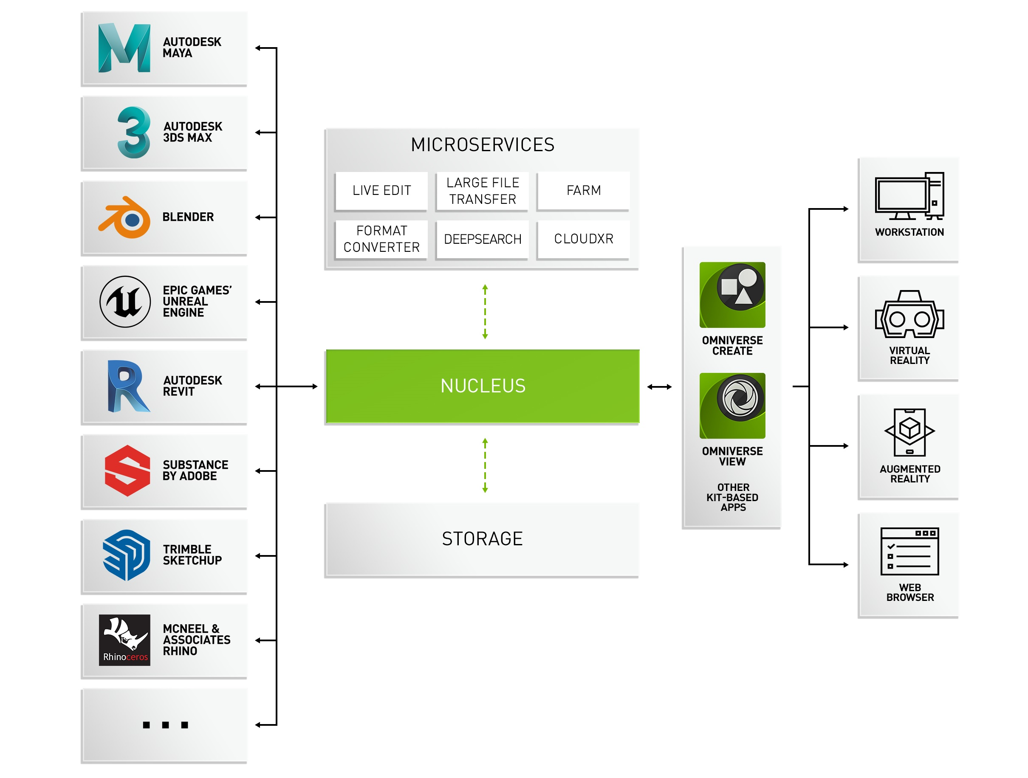
NVIDIA OMNIVERSE Platform
Notes:
Let’s take a closer look. Here is another, more technical schematic view of the Omniverse platform.
On the left, connectors provide 3D data coming from external applications or live input from sensors into Nucleus, where it gets stored or referenced.
Microservices that are loaded into the platform operate on the data, like converting or translating into a suitable representation, annotating and augmenting with meta data, searching and categorizing, manipulating and transforming using AI algorithms, editing, extending, and multiplying, and finally visualizing and rendering.
Developers and software vendors can build complete Omniverse Apps. They combine relevant components, services and UI into a final application that is designed for specific users and dedicated workflows. We develop and provide key Apps for Omniverse, like Create and View, which cover primary 3D workflows for creation and reviewing, and allow anyone to get started quickly and easily.
Omniverse can be used with any output device, on a conventional workstation, or used remotely and streamed to web browser, or displayed in VR using a headset or AR display.
--

Slide 16
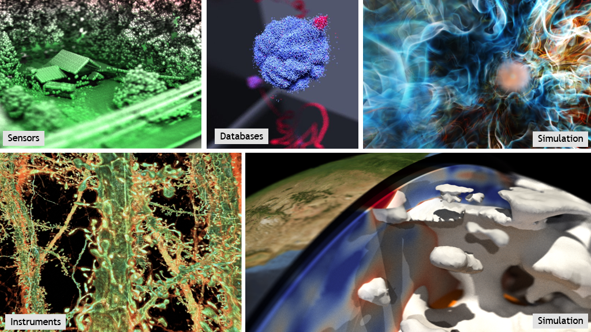

Slide 17
Meeting the Challenge
SIMULATION
GEANT4
QCD
VASP
LAMMPS
MICROSCOPES
HPC SDK
HPC*AI
JAX
PINN
LIGHT SOURCES
Fleet Command
SuperPOD
Base Command
EXPERIMENTS/SENSORS
HGX
GPU
CPU DPU
NVLINK
DGX
Modulus
Holoscan
BERT
TELESCOPES
OVX
EGX
RAPIDS
JETSON
AGX
PARTICLE
ACCELERATORS
GNN
Magnum I/O
QODA
LLM
Omniverse
CuQuantum
QUANTUM
SIMULATION
DIGITAL TWINS
QUANTUM COMPUTING
VIRTUAL DESIGN
AND CONTROL

Slide 18
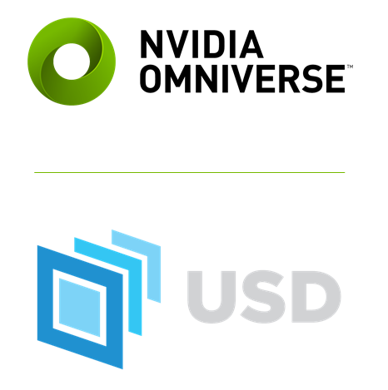
DATA HOMOGENIZATION VIA USD
Universal SCENE DESCRIPTION
The “HTML” of 3D Virtual Worlds
Developed by Pixar
Foundation for NVIDIA Omniverse
Open-sourced API and file framework for complex scene graphs
Easily extensible, simplifies interchange of assets between industry software
Introduces novel concept of layering
Enables simultaneous collaboration for large teams in different department working on the same scene
Originated in M&E, now becoming a standard across industries including AEC, Manufacturing, Product Design, Robotics

Slide 19
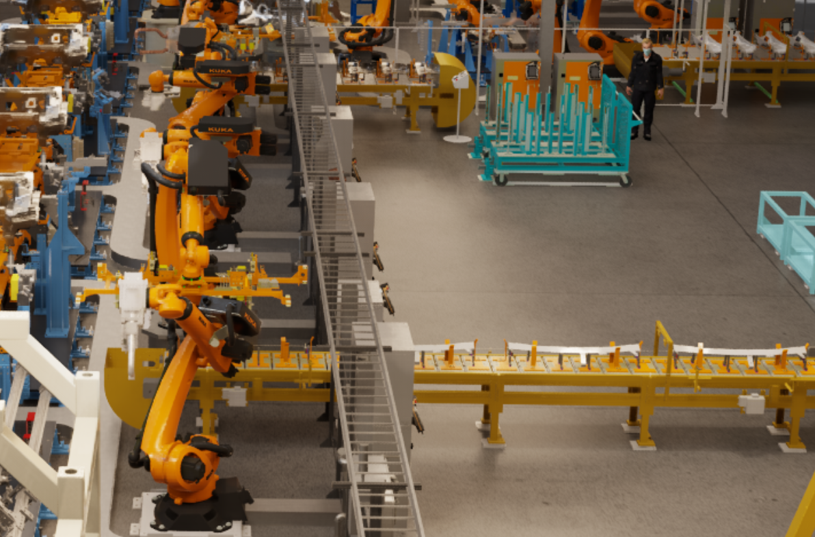
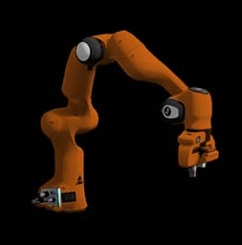
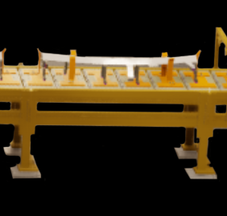
UNIVERSAL SCENE DESCRIPTION IS THE STANDARD FOR VIRTUAL WORLDS
Unlocking Disconnected 3D Pipelines
Composed World
Layer Stack
Layer Stack
Robot
Assembly Line
SENSOR DATA
MECHANICAL DATA
ELECTRICAL INFO
ELECTRICAL INFO
PHYSICS
PHYSICS
LIGHTING
LIGHTING
SHADING
SHADING
GEOMETRY
GEOMETRY
Ground Truth, Full Design Fidelity Asset Ingestion
Interoperability Between 3rd Party 3D Ecosystems
Non-Destructive, Collaborative 3D Workflows
Accelerate Time To Production
Notes:
Let’s take closer look at USD, the open and extensible language of 3D worlds. It was originally invented for media and entertainment needs
as a way to simplify content creation pipelines and the interchange of assets between different software tools that their distributed teams would work across.
USD is far more than a static file format. It’s a 3D composition engine with APIs for composing, editing, querying, rendering, collaborating, and simulating virtual worlds.
And USD is unique - with its the ability to work in non-destructive, layered workflows. The framework is highly extensible, providing the ability to build custom schemas for specific workloads or new industries.
Today, it’s becoming widely adopted across all visual industries, including architecture and engineering, manufacturing, product design, and robotics.
NVIDIA Omniverse is a USD native platform, a toolkit for building metaverse applications, and a compute engine to run virtual worlds and simulations.
--

Slide 20
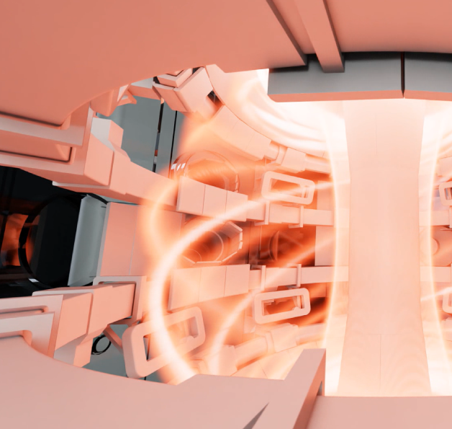
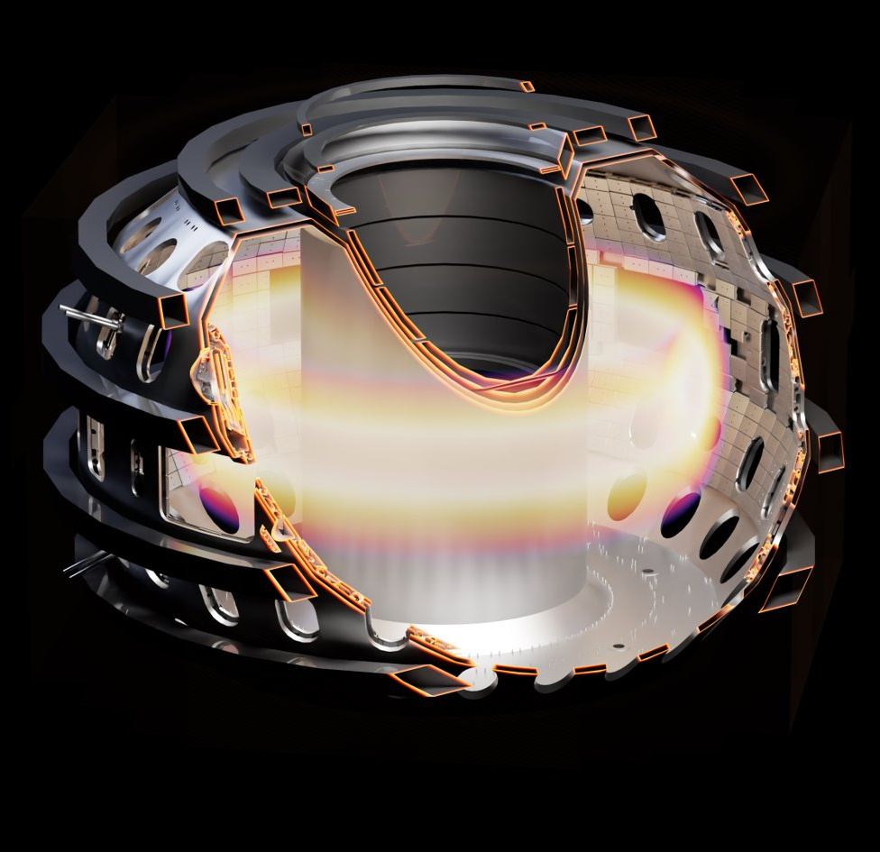
Scientific Visualization
Visualize and explore live scientific data
Advanced Scene Composition, Lighting, Rendering
USD-enabled, custom coloring and shading
Physically-accurate materials, and real time ray and path traced rendering
Emissive volumes
Connect with external simulation engines via ParaView Connector, File Import, Python, ...
Notes:
A quick look at famous Omniverse Apps we’ve build ourselves and provide within Omniverse.
Create is an application that accelerates advanced scene composition and allows users to interactively assemble, light, simulate, and render scenes in USD in real-time.
Users can work in a live, synchronous or asynchronous environment, whatever is preferred. You can combine separate design files and data from different industry tools into a single project and iterate freely and infinitely.
Create offers advanced layout tools to build virtual worlds with ease.
It includes the RTX Renderer, which is a fully GPU-accelerated renderer that outputs stunning, photoreal scenes at the speed of light. It supports multiple GPUs, so you can scale your simulation to almost any speed. Decorated with NVIDIA vMaterials based on a physical material model MDL it can produce renderings that are realistic, interactive, and true to reality.
For high-speed playback and authoring, Create also includes real-time ray tracing powered by RTX. For the ultimate lighting simulation, it also exposes the RTX Accurate renderer based on NVIDIA Iray technology.
The recommended GPU is of RTX class for best performance. Other GPUs are supported as well at lower speed, including data center GPUs A100 or H100.
--

Slide 21
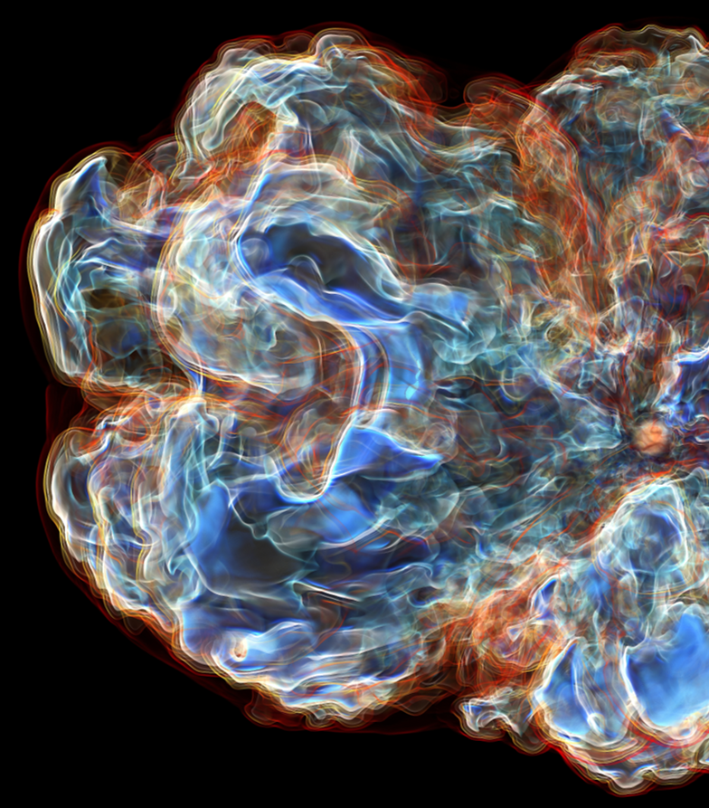
NVIDIA INDEX in Omniverse
Enabling Scientific Workflows and Interactive Volume Visualization in Omniverse
IndeX Scientific Renderer Viewport
Interactive 3D Volumes and 2D Slices
OpenVDB and RAW Volumes Import
ParaView Connector Volume Data
Colormaps Presets and Editing
Runs on any modern CUDA GPU
IndeX Native Scalability
What’s Next
Composite Rendering PBR + SciVis
Omniverse Scalability and Cloud
Omniverse App Streaming Support
Custom Shading and Programmability

Slide 22
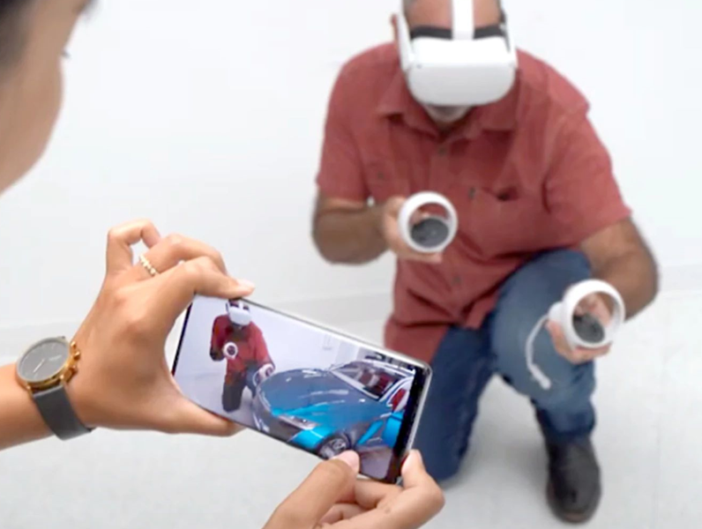
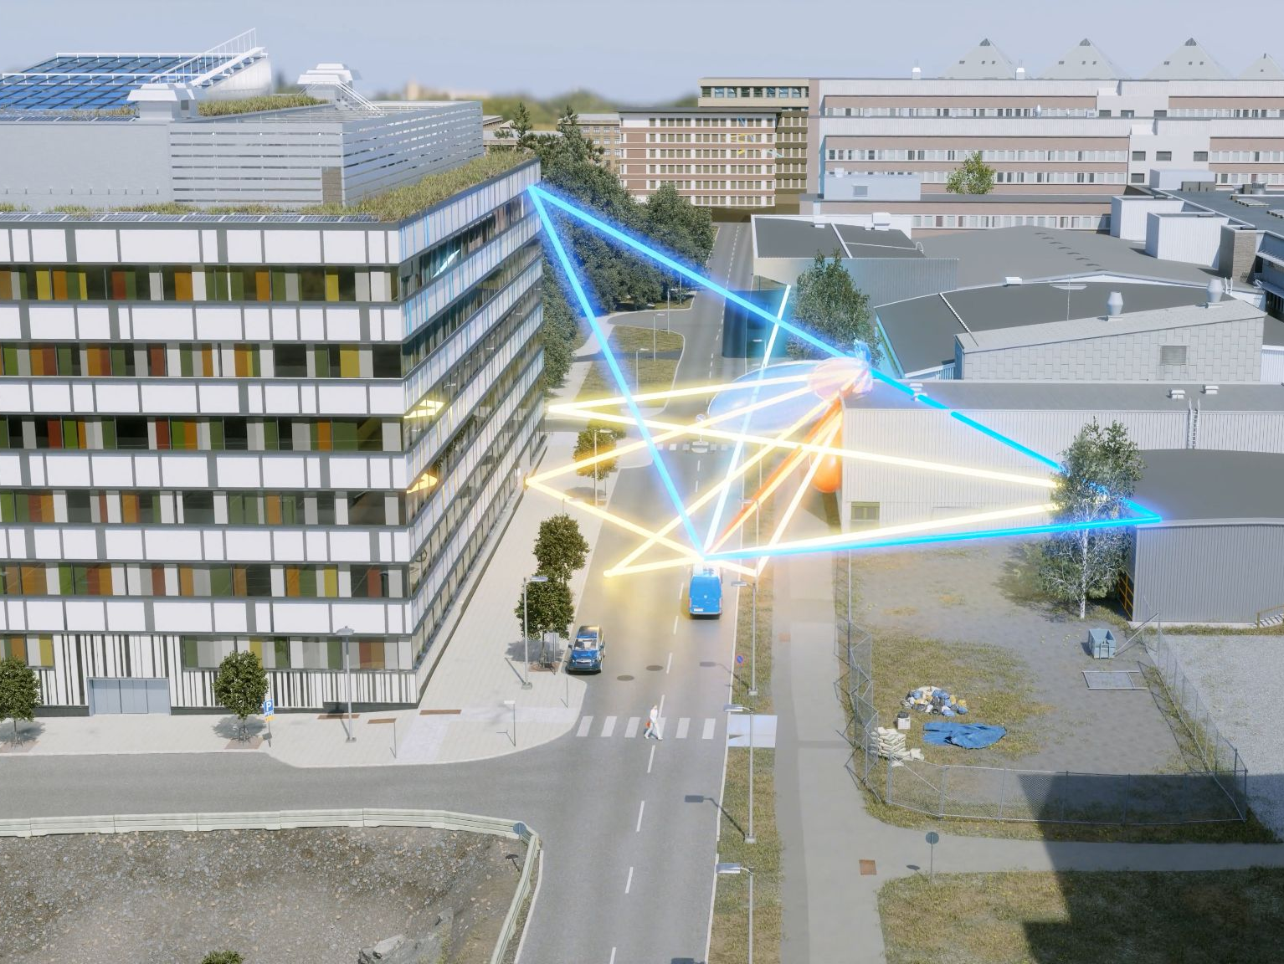
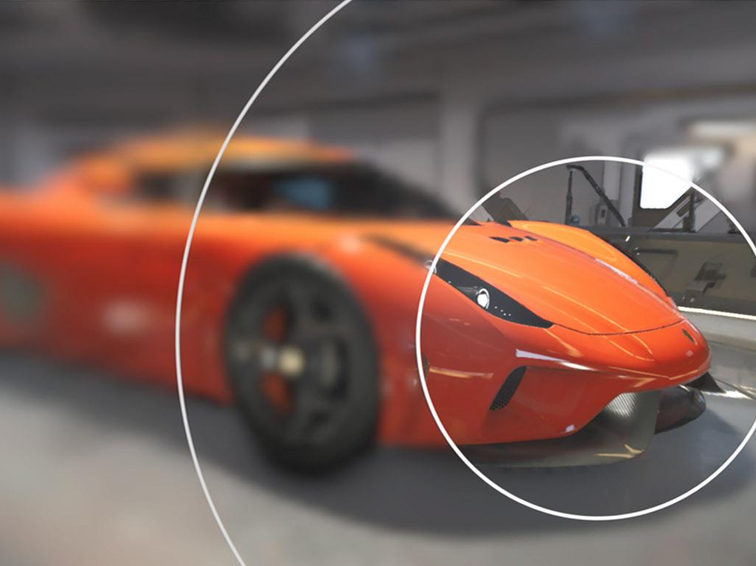
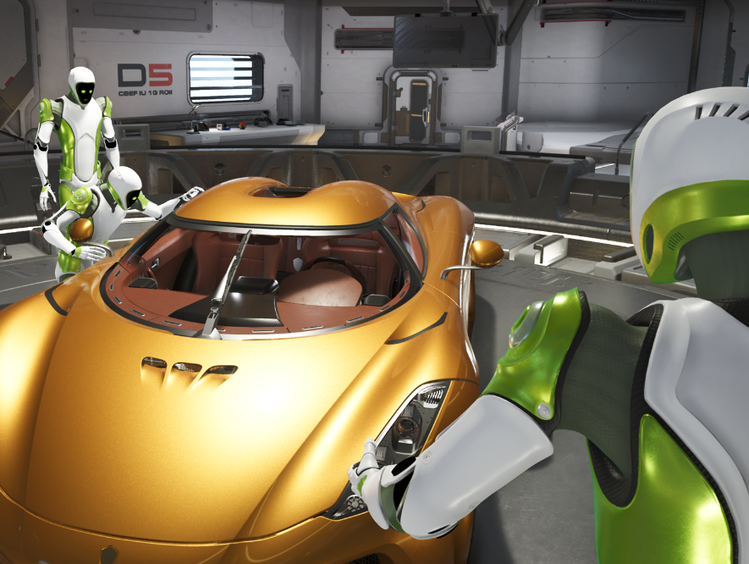
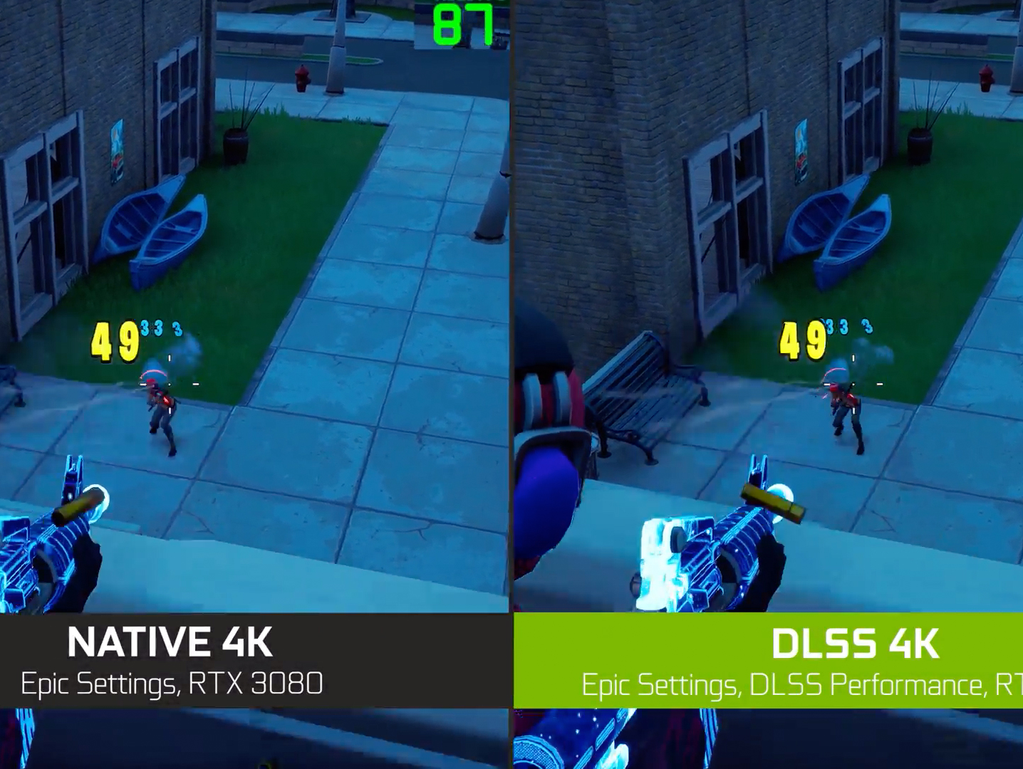
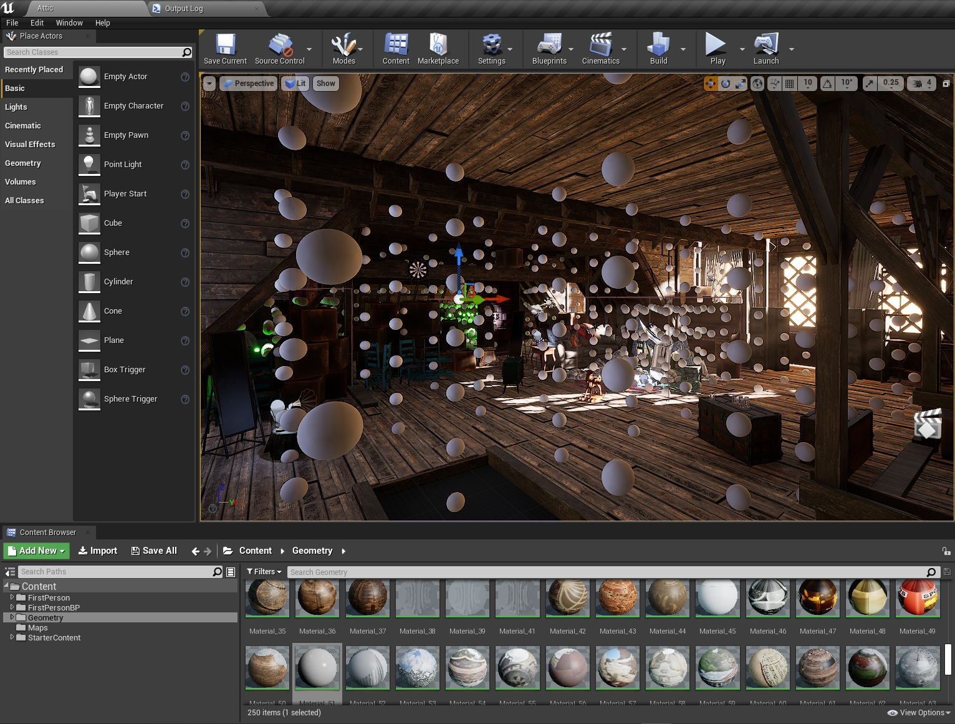
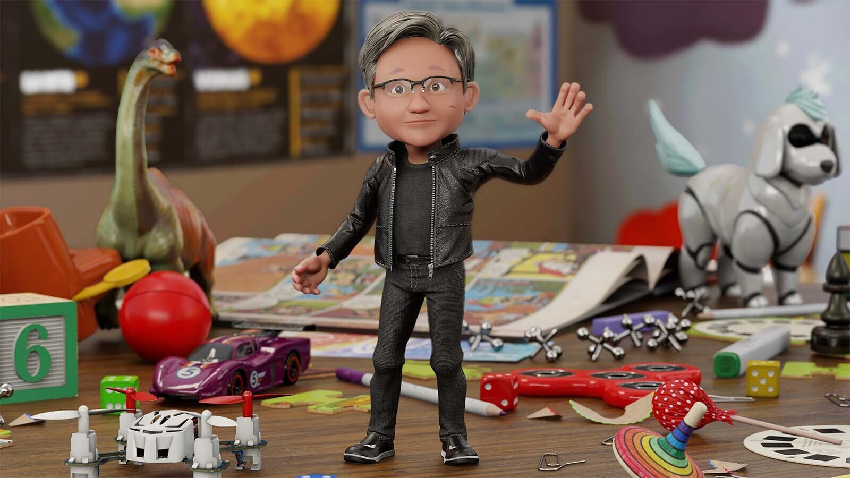
NVIDIA’s XR SOLUTIONS
Groundbreaking AR and VR solutions for professionals, gamers, and developers.
CloudXR
Omniverse
VRWorks
VR Capture & Replay
Stream XR content from anywhere
The world’s first real time, fully ray traced VR
Improve VR performance & visual quality
Easily capture and replay VR content
DLSS
RTXGI
Riva
Truly immersive graphics without sacrificing performance
Add realism to a virtual scene with global illumination
Add conversational AI to XR

Slide 23
DLSS SDK
Deep Learning Super Sampling
WHAT IT DOES
NVIDIA DLSS is a deep learning neural network that boosts frame rates and generates beautiful, sharp images for your games and applications. It gives you the performance headroom to maximize ray tracing settings and increase output resolution. DLSS is powered by dedicated AI processors on RTX GPUs called Tensor Cores.
BENEFITS
Uncompromised Quality with Higher Performance
AI Models that Continuously Improve
Provides Headroom for Ray Tracing and High-Fidelity XR/AR Content
PERFORMANCE
From 0.79 ms to 2.18 ms at 2160p depending on GPU
From 0.28 ms to 0.61ms at 1080p depending on GPU
REQUIREMENTS
RTX GPU and minimum driver of 471.11
DirectX11+ or Vulkan
Windows and Linux
Rendering Engine that meets the requirements
Example of DLSS in action in Theia Interactive
AVAILABILITY
DLSSv2.4 available today on Devzone and GitHub.
Learn More: developer.nvidia.com/dlss
Learn More: developer.nvidia.com/image-scaling
Notes:
DLSS Combines
Feature Enhancement
Anti-Aliasing
Upscaling

Slide 24
RTX Global Illumination
Overview
WHAT IT DOES
RTX Global Illumination SDK provides scalable solutions to compute multi-bounce indirect lighting without bake times, light leaks, or expensive per-frame costs.
BENEFITS
Speeds up iteration time with no light baking and instant in editor updates
Highly scalable cross platform solution works on any DXR GPU
Supports emissive light sources and area lights
No additional denoising required
PERFORMANCE
Under 3ms render time on RTX3070 or higher
REQUIREMENTS
DirectX® Raytracing 1.0 API, or higher
Vulkan 1.2, or higher (RTXGI SDK)
Any DXR Capable GPU
Unreal Engine 4.27
VR requires DX12 and deferred renderer
RTXGI in the UE4 RTX Showcase
AVAILABILITY
RTXGI plugin available for UE 4.27 via the Unreal Engine marketplace.. You can also download the RTXGI SDK now or utilize the NVIDIA Branch of Unreal Engine.
Learn More: developer.nvidia.com/rtxgi

Slide 25
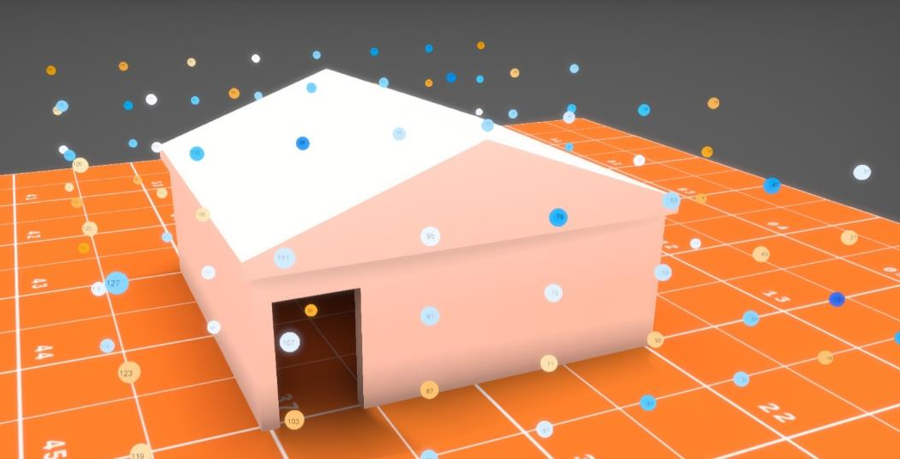
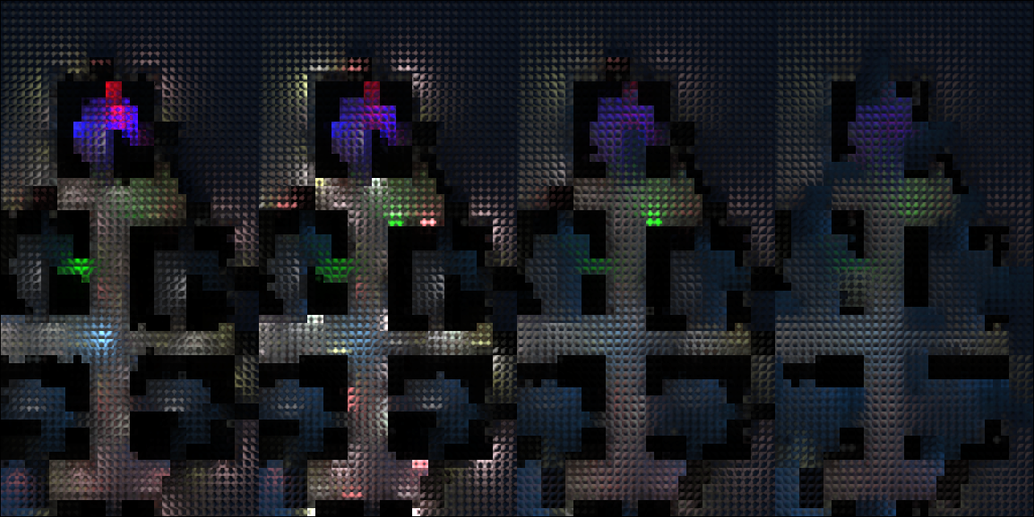
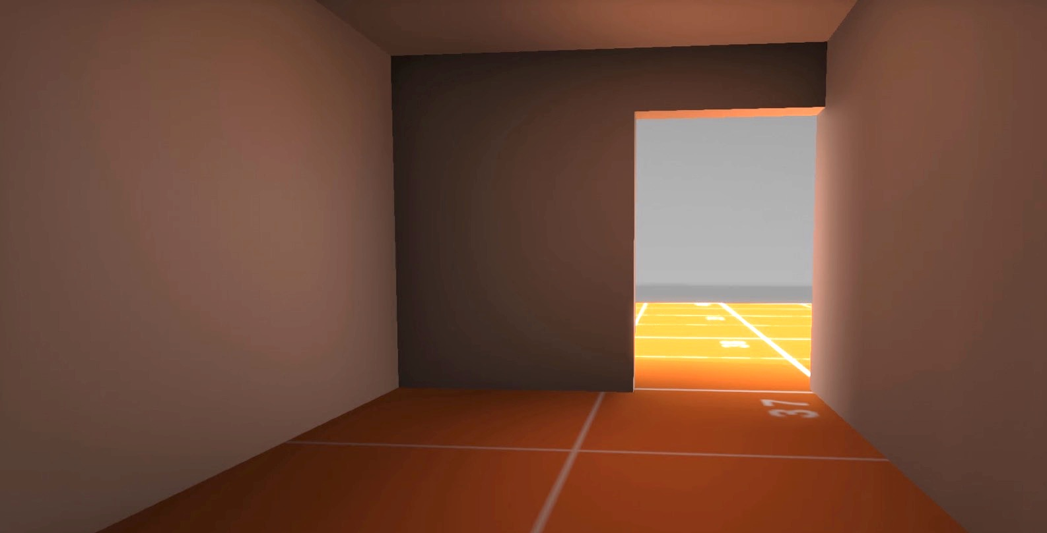
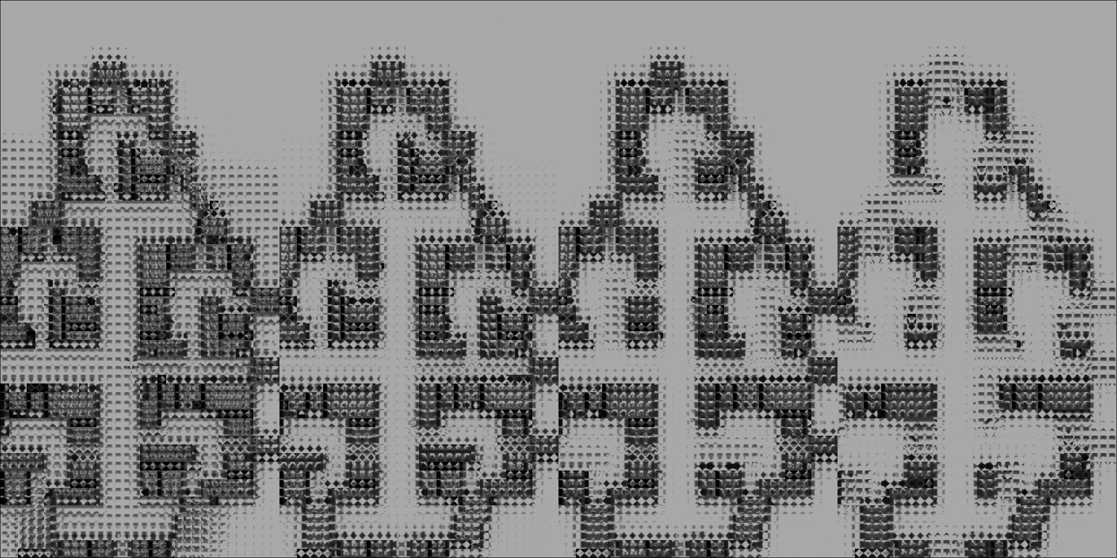
RTX Global Illumination
RTXGI Rendering Process
How It Works
Scene Authoring
Trace & Shade
Update Probes
Render Indirect Light
Irradiance
Distance to Geometry
Place volumes of probes
in the 3D world
Trace rays from active probes and shade
Use previous probe data
for infinite bounce GI
Blend ray traced
results into probes
Store irradiance and distance to geometry
Compute indirect lighting and visibility from the probes
Independent of screen resolution and frame rate
Offline
Runtime

Slide 26
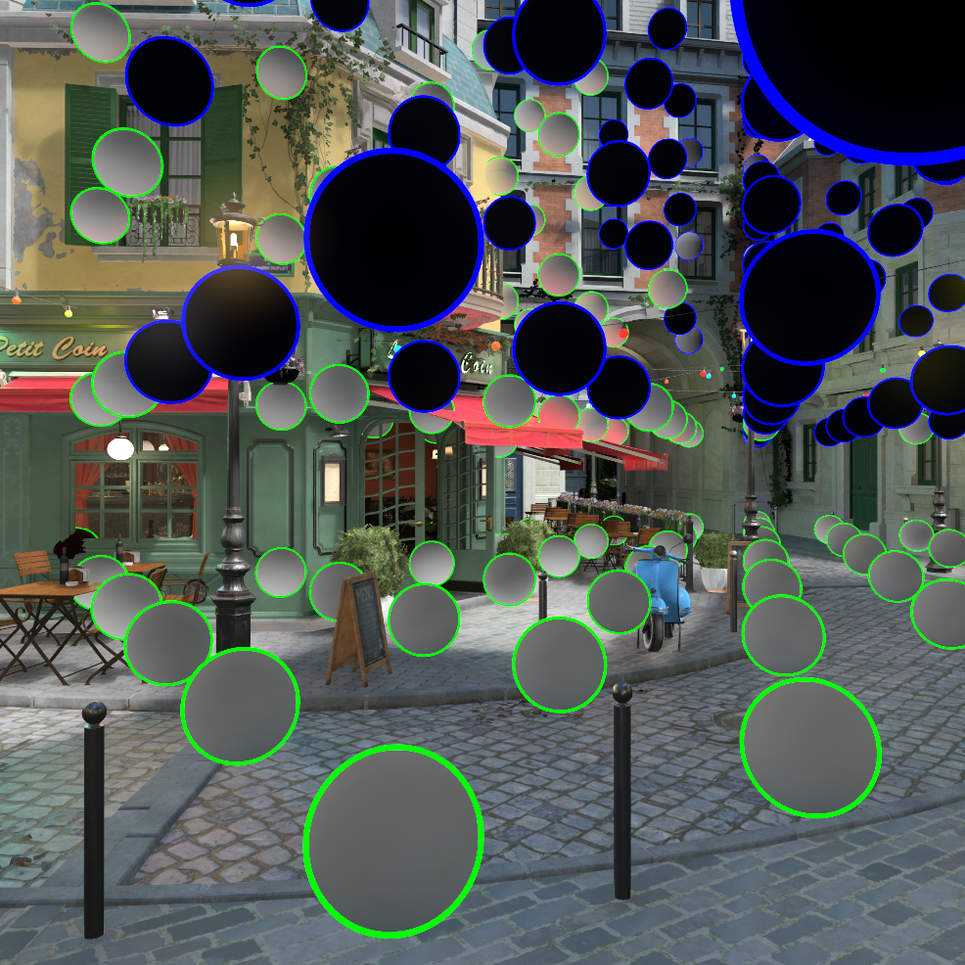
RTXGI Benefits For VR/XR
Flexible authoring for artists/designers:
Control placement, size, and density of volumes
High performance real time solution that scales based on probe counts and not on resolution or frame rate
Advanced features to optimize performance:
Probe Classification
Probe Relocation
Infinite Scrolling Volumes
Runtime Static Volumes (store pre-computed lighting in probes)

Slide 27
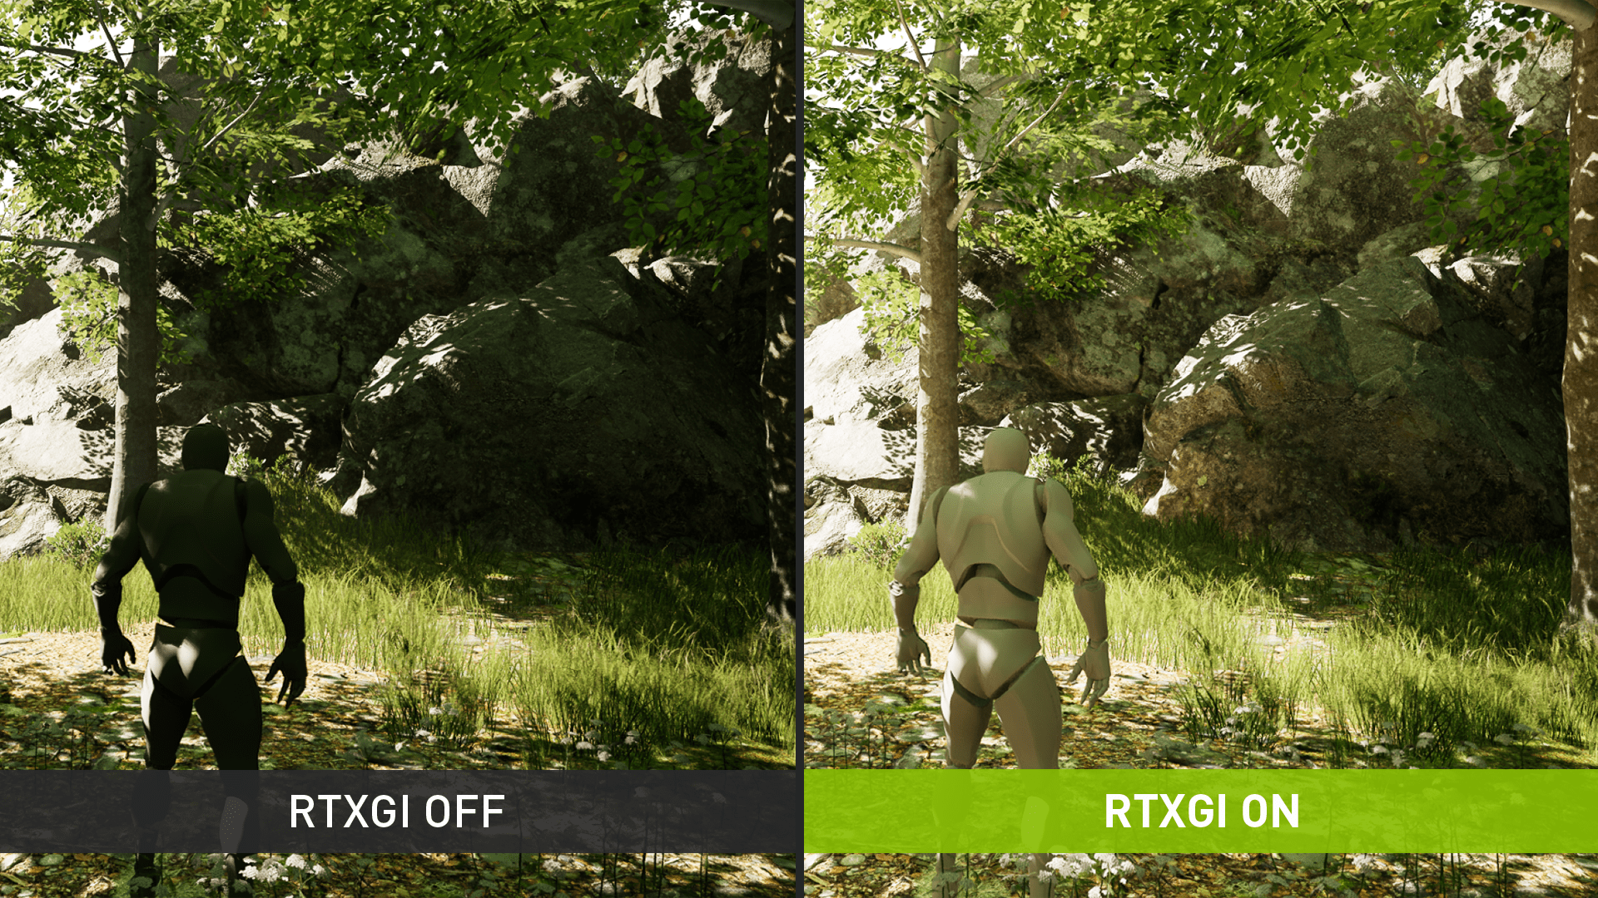
RTXGI Examples
Visual Comparison

Slide 28
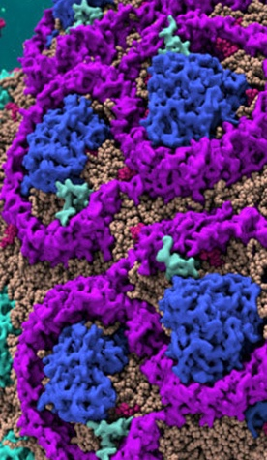
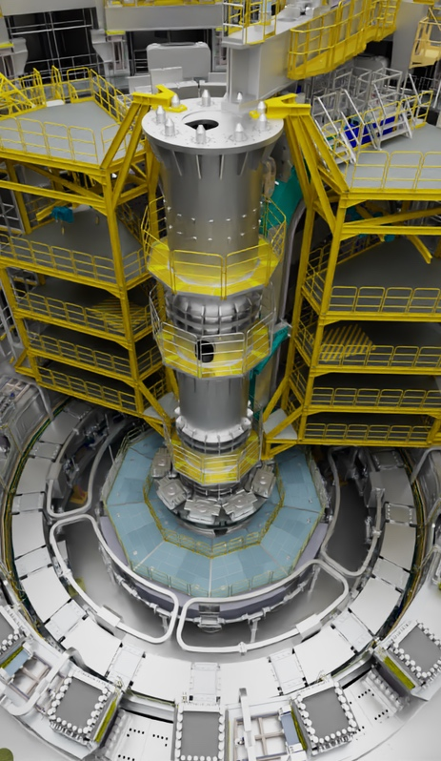
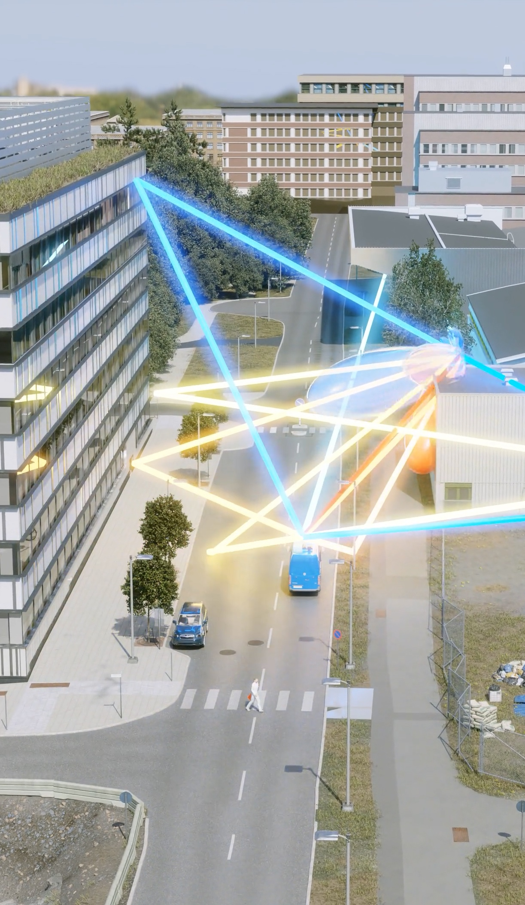
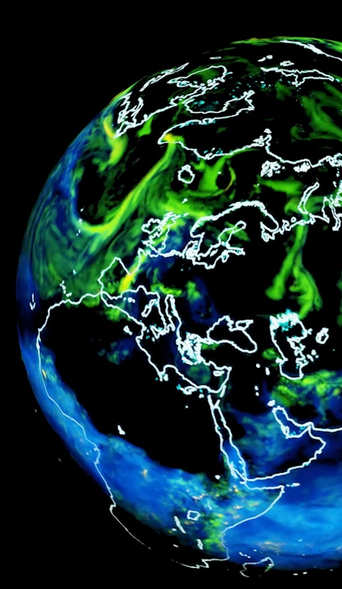
DIGITAL TWINS WILL EXIST AT EVERY SCALE
MOLECULAR
EXPERIMENT
CITY
PLANETARY
Notes:
Convergence of GPU Accelerated systems, data center scale simulations, and AI is powering a new class of digital twin.
On every scale - digital twin simulations enable researchers, engineers, and scientists to:
time travel to the past
Time travel to the future
explore an infinite number of possible futures.
Molecular - digital twins of human cells help researchers predict how a cell will react to new drugs in development, accelerating discovery of more effective treatments.
Plant - digital twins of industrial assets introduce new level of industrial automation, optimization, and innovation
(Image: UK Atomic Energy Authority is building a digital twin of their fusion power plants)
City - digital twins make cities safer, more efficient, giving policymakers more acute insight to test effects of urban planning projects
(Image: Ericsson is building a digital twin of Stockholm to better optimize 5G microcell and tower deployment decisions)
Planetary – NVIDIA and collaborators including LBNL, U Michigan, Rice, Purdue, Caltech built a digital twin of our planet will enable researchers and decision makers to gain acute understanding of Earth’s climate, and rapidly explore what-if scenarios
(Image: NVIDIA Earth-2, digital twin of Earth to accelerate climate research)

Slide 29
DIGITAL TWINS BRING NEW TECHNOLOGICAL DEMANDS
DATA CENTER GPU COMPUTE
GPU ACCELERATED, PRECISION TIMED SYSTEMS
EDGE-TO-CLOUD ACCELERATION
SPECIALIZED INFRASTRUCTURE
Scalable Simulation
Hyperscalability, Precision Networking
Notes:
Convergence of GPU Accelerated systems, data center scale simulations, and AI is powering a new class of digital twin.
On every scale - digital twin simulations enable researchers, engineers, and scientists to:
time travel to the past
Time travel to the future
explore an infinite number of possible futures.
Molecular - digital twins of human cells help researchers predict how a cell will react to new drugs in development, accelerating discovery of more effective treatments.
Plant - digital twins of industrial assets introduce new level of industrial automation, optimization, and innovation
(Image: UK Atomic Energy Authority is building a digital twin of their fusion power plants)
City - digital twins make cities safer, more efficient, giving policymakers more acute insight to test effects of urban planning projects
(Image: Ericsson is building a digital twin of Stockholm to better optimize 5G microcell and tower deployment decisions)
Planetary – NVIDIA and collaborators including LBNL, U Michigan, Rice, Purdue, Caltech built a digital twin of our planet will enable researchers and decision makers to gain acute understanding of Earth’s climate, and rapidly explore what-if scenarios
(Image: NVIDIA Earth-2, digital twin of Earth to accelerate climate research)

Slide 30
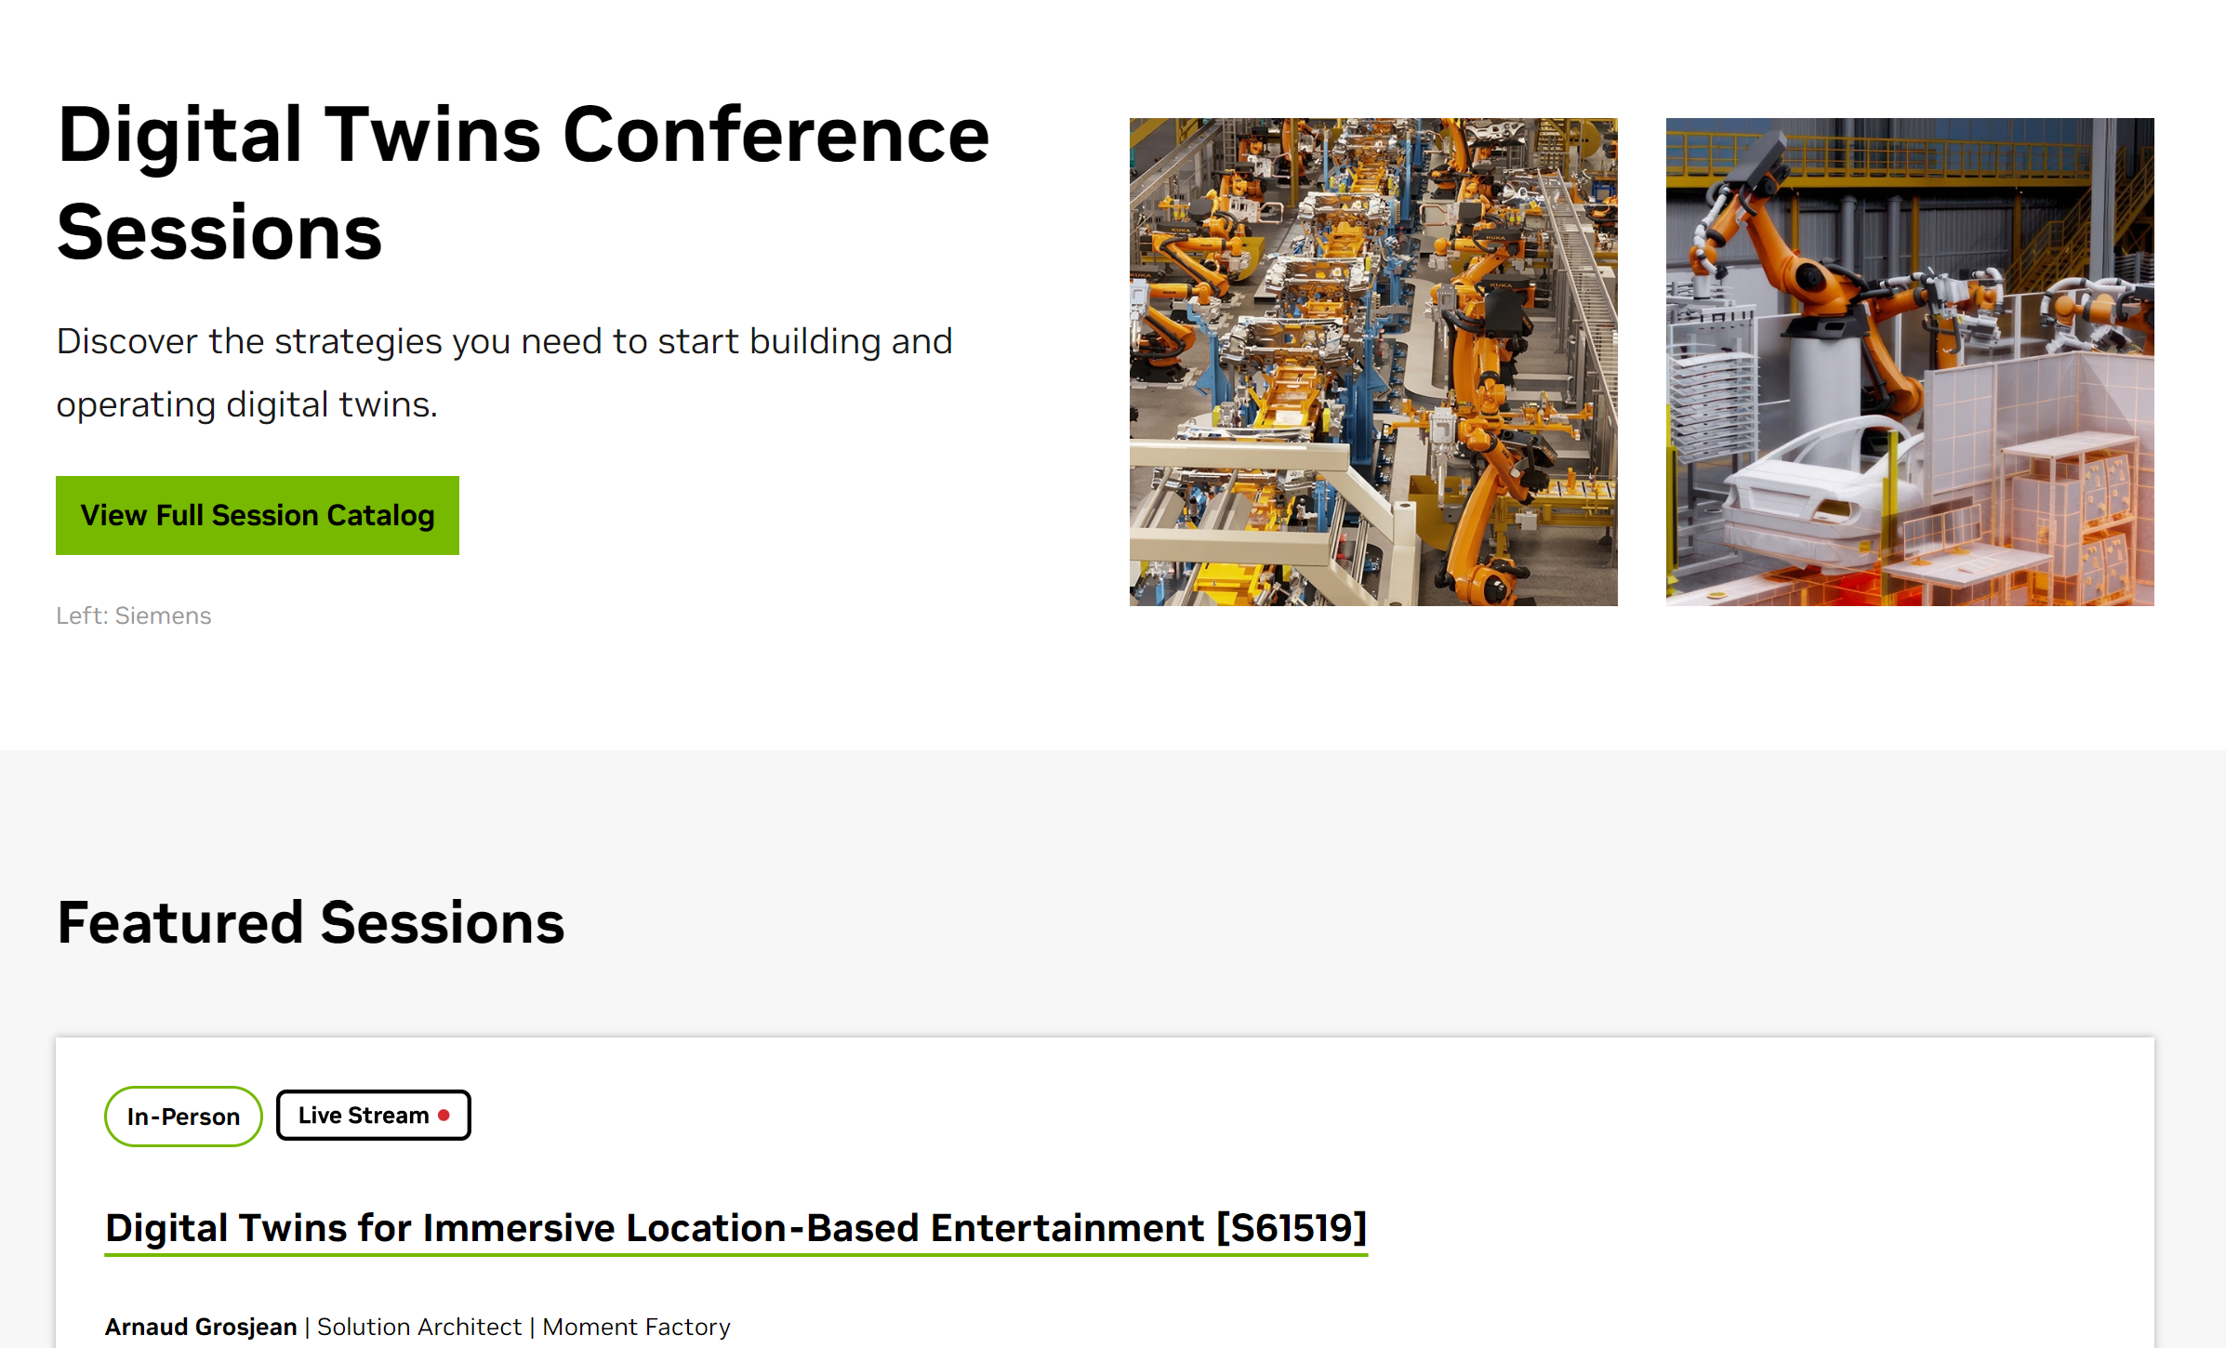
Digital Twins
Sessions from NVIDIA GPU Techology Conference (GTC) 2024
https://www.nvidia.com/gtc/sessions/digital-twins/

Slide 31
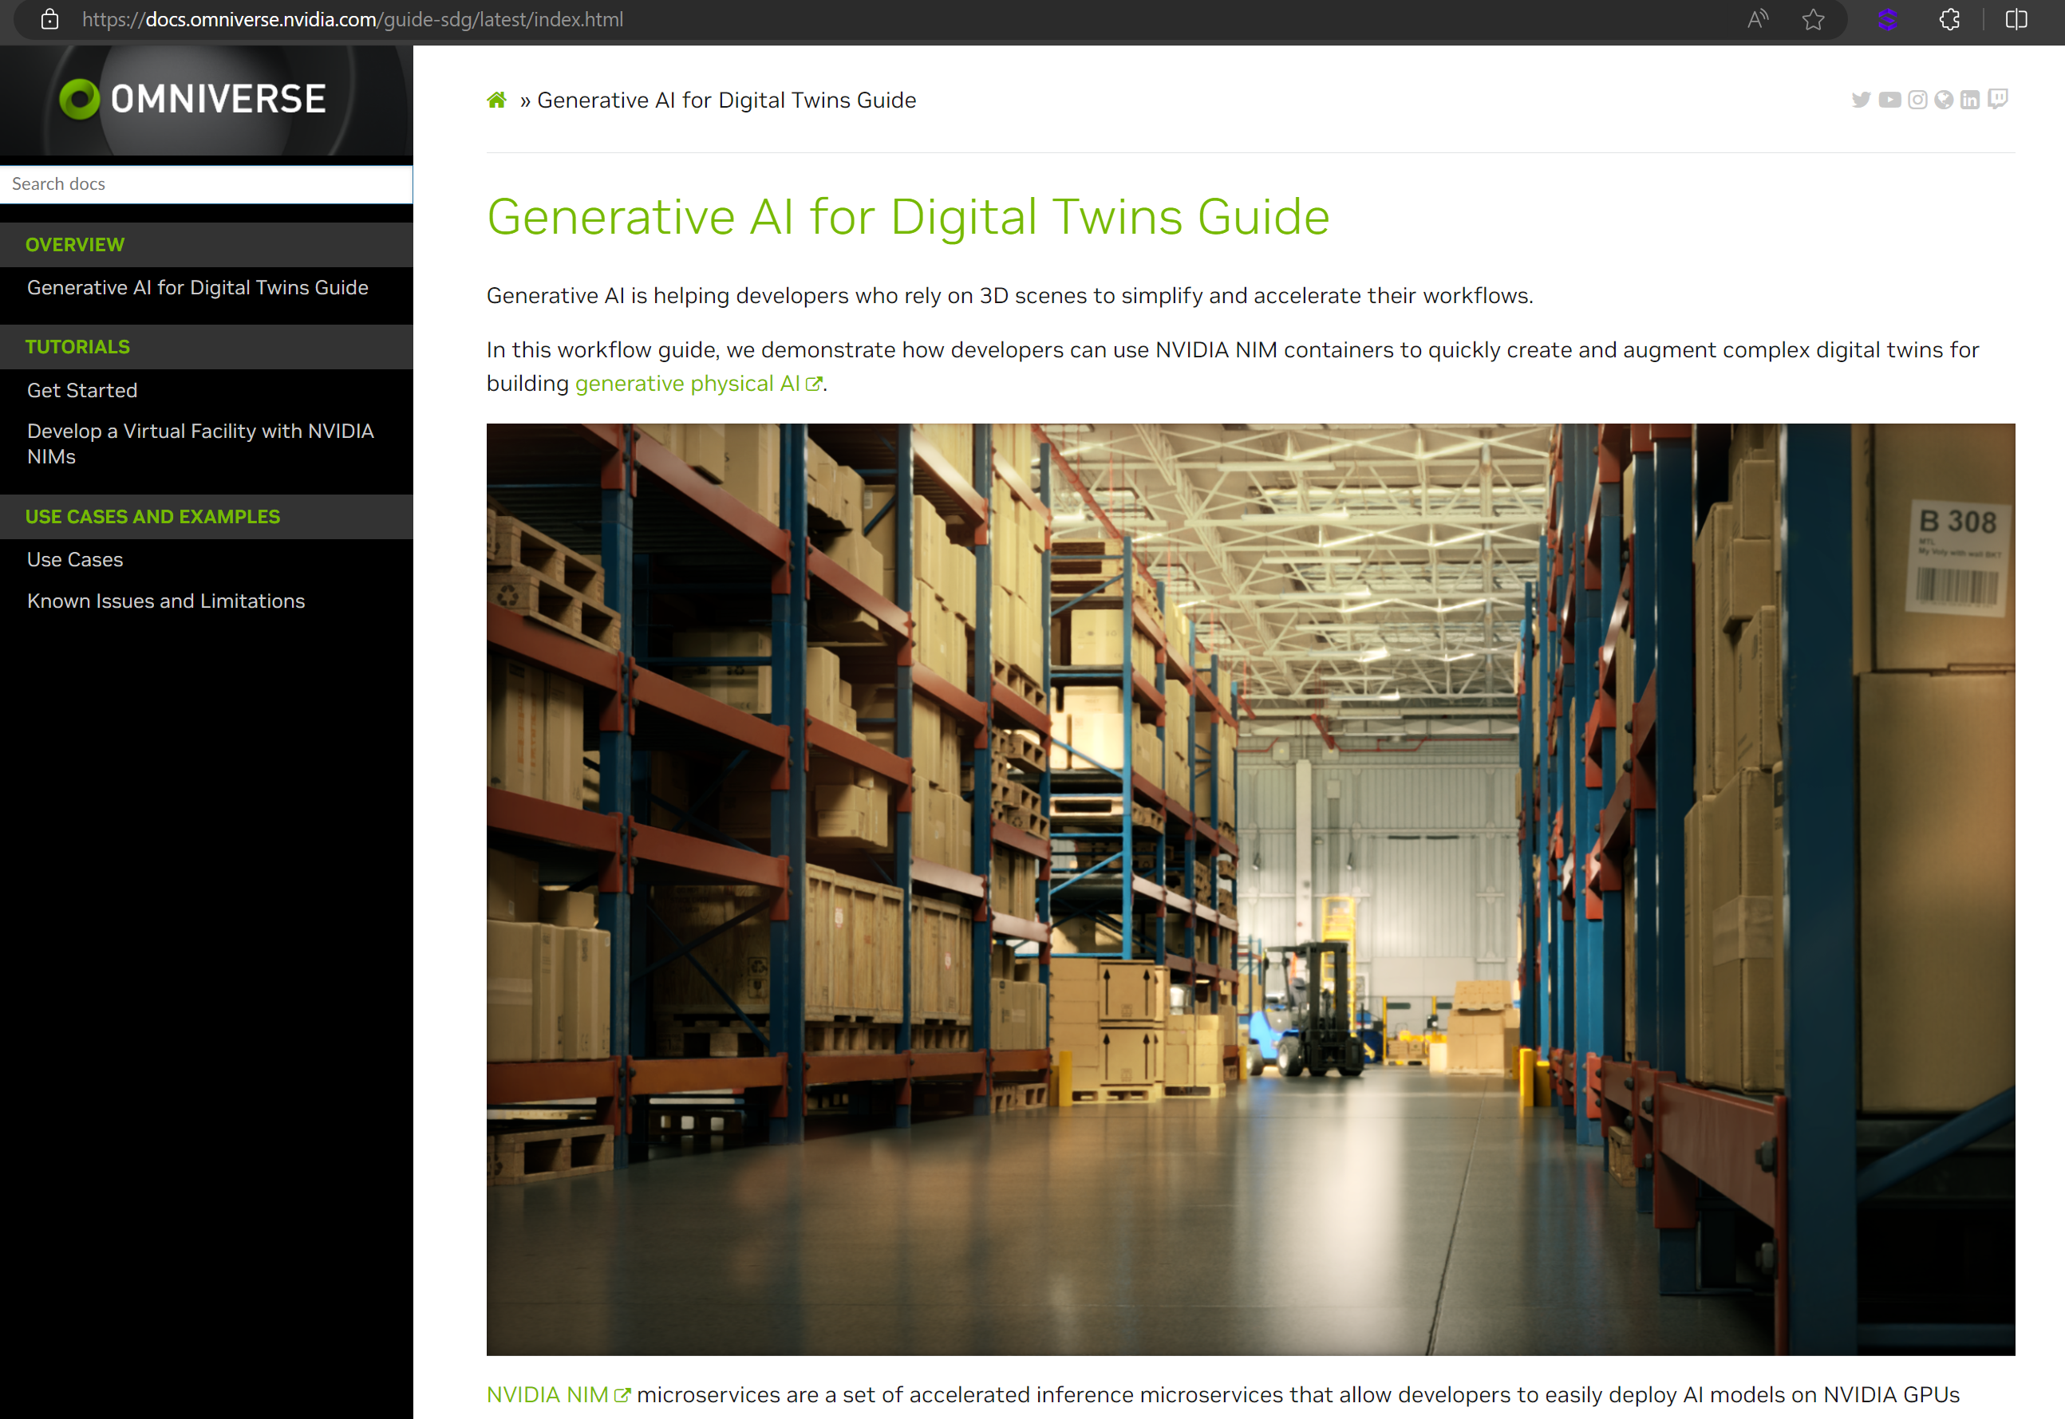
Digital Twins with NIMS
Omniverse Generative AI for Digital Twins Guide

Slide 32
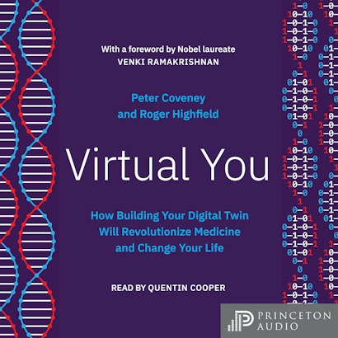
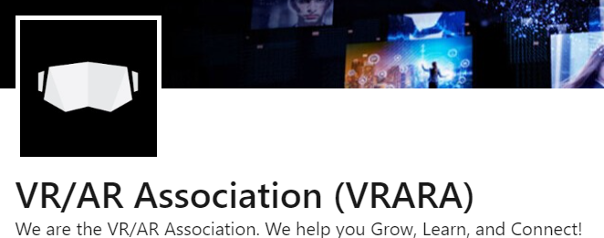
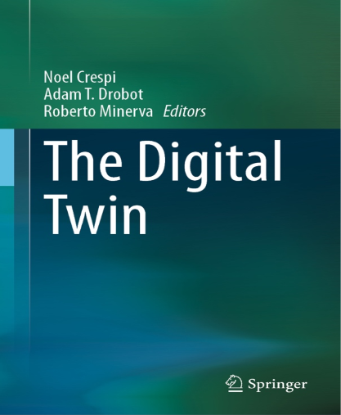
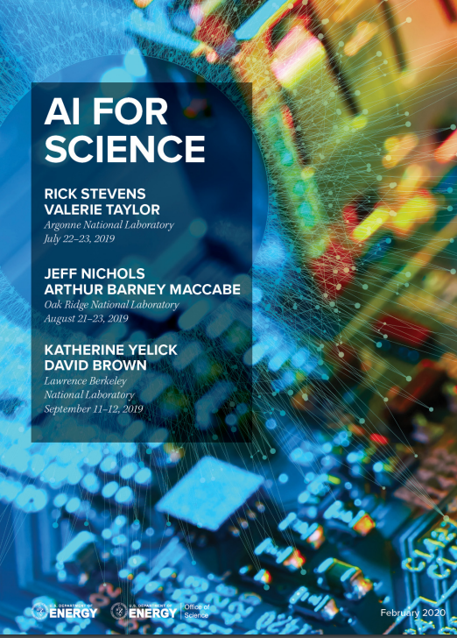
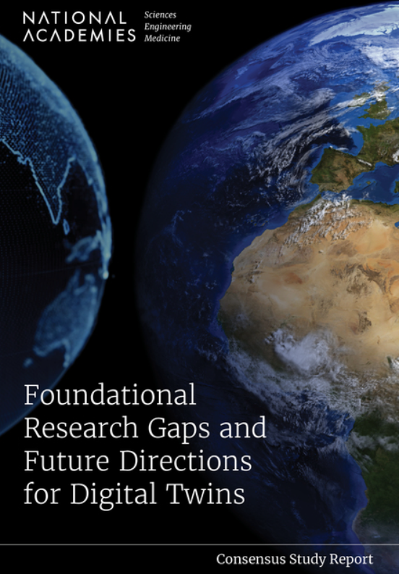
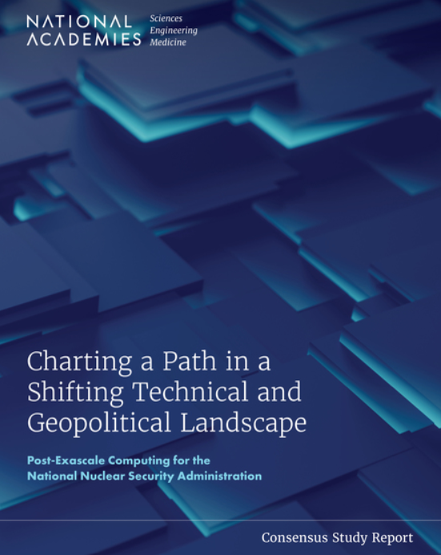
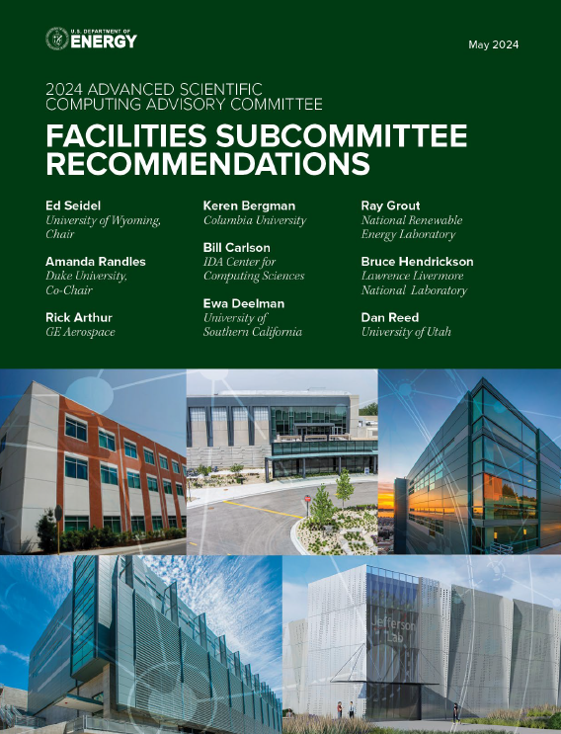
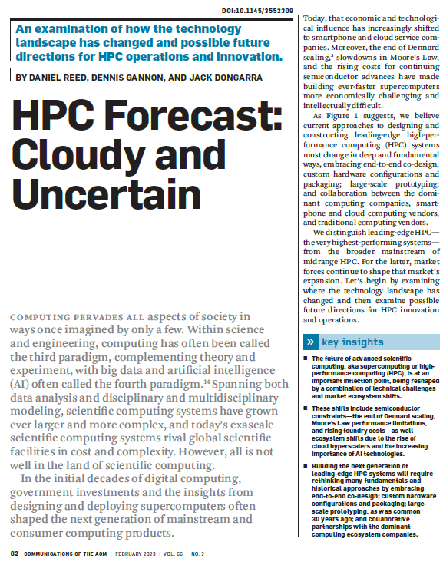
Digital Twins
Other Resources To Check Out
Virtual You
- Peter Coveney & Roger Highfield
LinkedIn:VRARA
The Digital Twin
-Noel Crespi, Adam T. Drobot, Robert Minerva – EditorsPeter Coveney

Slide 33
Digital Twins
Upcoming SC24 Fulll Day Workshop!
SuperComputing 2024 – The 2nd Digital Twins Workshop for High Performance Computing

Slide 34
Call to Action: Build Your Own Digital Twin !
Necessity is the Mother of Invention

Slide 35
Build Your Own Digital Twin
Work in Progress

Slide 36
Call to Action: Build Your Own Digital Twin !
Goal: Monitor Water, Gas, Electric Usage & Fire Suppression Status

Slide 37
Thank you!
Q&A

