Slide 1
Safety, Security and Privacy in the Age of Generative AI
Carlos Soto
September 17, 2024

Slide 2
Outline
AI and Digital Twins
Themes affecting Safety, Security & Privacy in Generative AI
Scalability challenges
Data security and privacy
Reliability and trustworthiness
AI ecosystems
Adversarial risks
Key research areas and additional challenges

Slide 3
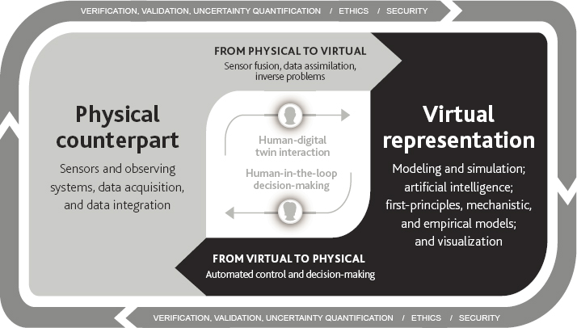
AI and Digital Twins
Roles of AI in Digital Twins
Forward models (e.g., simulation surrogates, direct data-driven models) or components of them
Data analysis, control and decision support
Orchestrators (e.g., LLM OS)
For virtual modules, or entire physical + virtual loop
AI may also be used to build or inform DT components
Physical
sensors,
actuators, etc.
Data analysis
Virtual
Control, Decision support

Slide 4
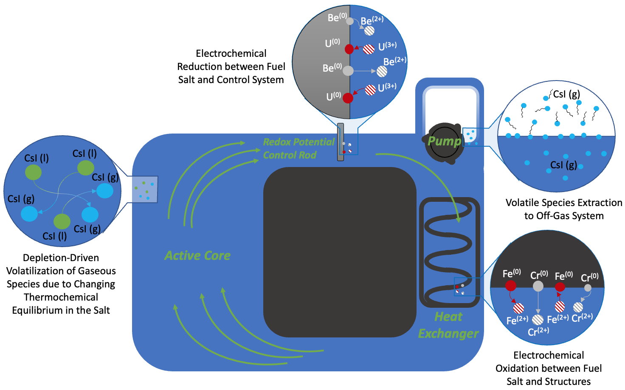
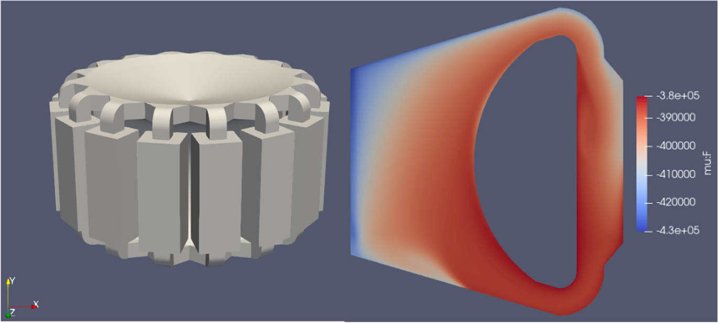
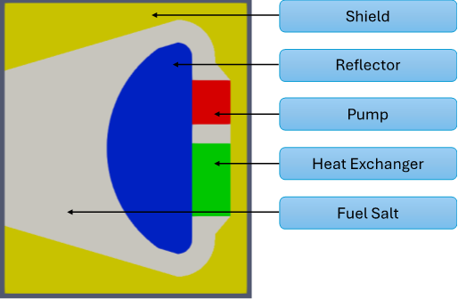
An AI-driven Digital Twin Example
Molten Salt Reactors (MSRs) are advanced nuclear reactors with unique security, safeguards challenges
Digital Twin of MSR core and diversion scenarios modeled via multi-physics
Isotopic composition evolution (in-core and off-gas)
Emission gamma spectra (in-core and off-gas)
Delayed neutron precursors
AI module predicts risk of diversion
Predict diversion strategies and rates
Tracked chemical species, geometry and representation of molten salt fast reactor (INL & BNL, 2024)

Slide 5
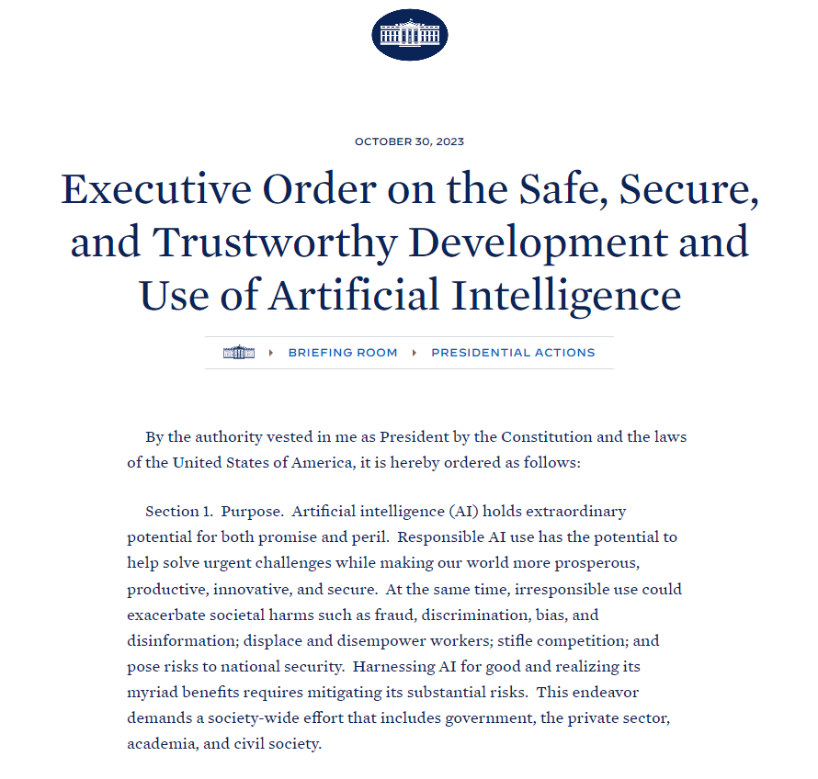
AI for Science & Security
Safety, Security and Trustworthiness are necessary for effective AI use in sciences and security
AI outcomes and products
Correctness, verifiability, repeatability, uncertainty quantification, explainability
AI data and applications
User & data privacy, security
Action and autonomy validation
AI infrastructure
HPC, networking, streaming data, edge computing

Slide 6
Generative AI, the new normal
Frozen, general models
Limited fine-tuning
Prompt engineering
In-Context Learning
Few-shot learning
Chain-of-thought, Tree-of-thought, etc.
External resources
Retrieval-augmented generation (RAG)
Tool use (APIs, interpreters, etc.)

Slide 7
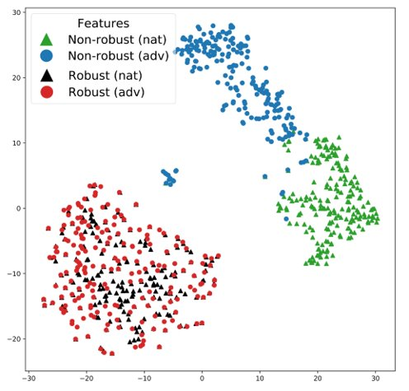
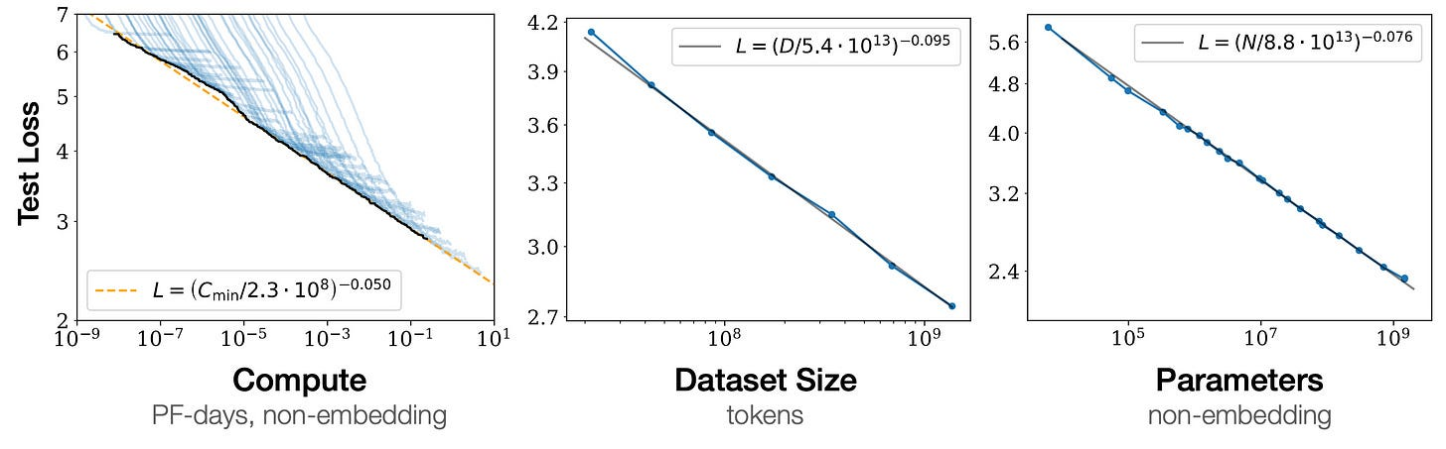
Scaling Safety in AI
Privacy-preserving AI
e.g., differential privacy
Encrypted ML
e.g., fully homomorphic encryption
Uncertainty quantification
e.g., Bayesian inference
Adversarial attacks resilience
e.g., robust training strategies
Explainability/interpretability
e.g., feature inspection
Left: Bayesian inference for uncertainty quantification (Sanket Jantre, BNL 2023)
Right: Robust AI training to counter adversarial attacks (Hong Wang, BNL 2024)
LLM performance scaling relative to compute, data, parameters (OpenAI, 2020)

Slide 8
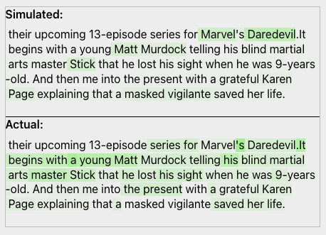
Scaling Safety in Generative AI
Using LLMs to interpret and predict neuron activations
OpenAI, 2023
Identifying and manipulating features with sparse autoencoders (SAEs)
Anthropic, 2024
Opportunity for scientific foundation models to use such approaches
e.g., infer physical laws, explain proposed action in a digital twin
Language models can explain neurons in language models (OpenAI, 2023)
Mapping the Mind of a Large Language Model (Anthropic, 2024)

Slide 9
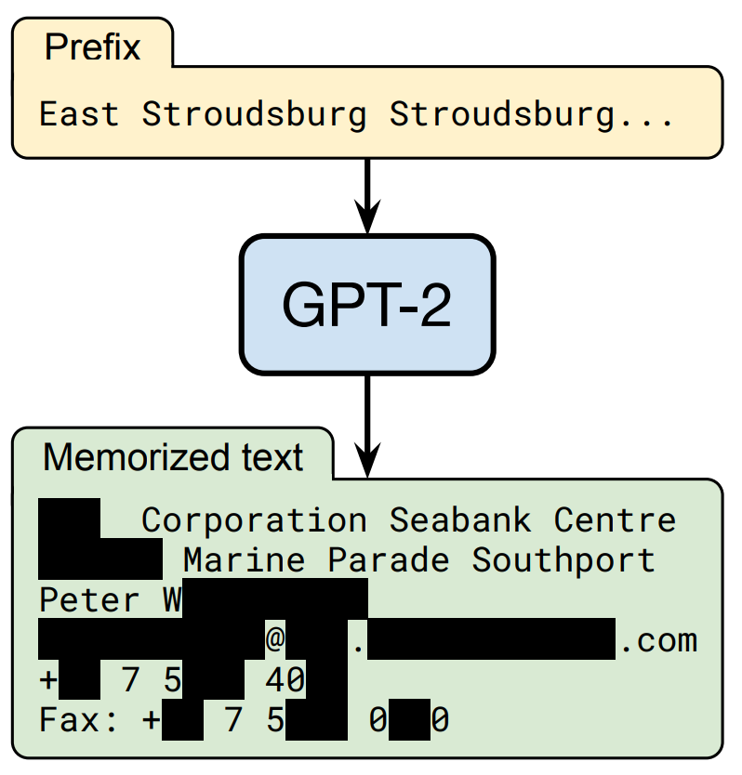
Data Risks for Generative AI
Data Security and Privacy in multiple places
Pre-training data
User and operator context (i.e., user and system prompts)
External resources (e.g., RAG)
Data tainting & ingest
Did your private/secure data get into a training set?
Data poisoning
Has someone tampered with your data?
Data leakage
Can someone get private/secure data out of your trained model?
Extracting training data from deployed model
(Carlini 2021)

Slide 10
Data Risks and Infrastructure
In-context learning & RAG
Your prompt and datasets are part of learned context for AI responses
Data risks imply infrastructure security challenges too
Trust AI platform host? Network? Contractors? Data processing staff?
Model choices
On-prem vs cloud?
Commercial vs open?
Frozen or tuned?

Slide 11
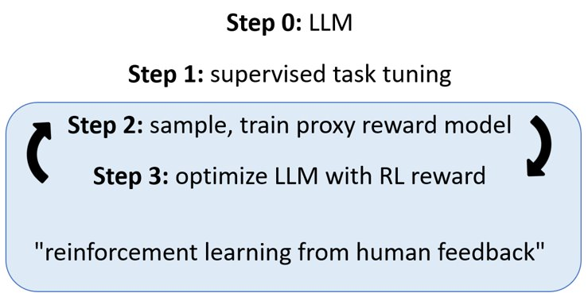
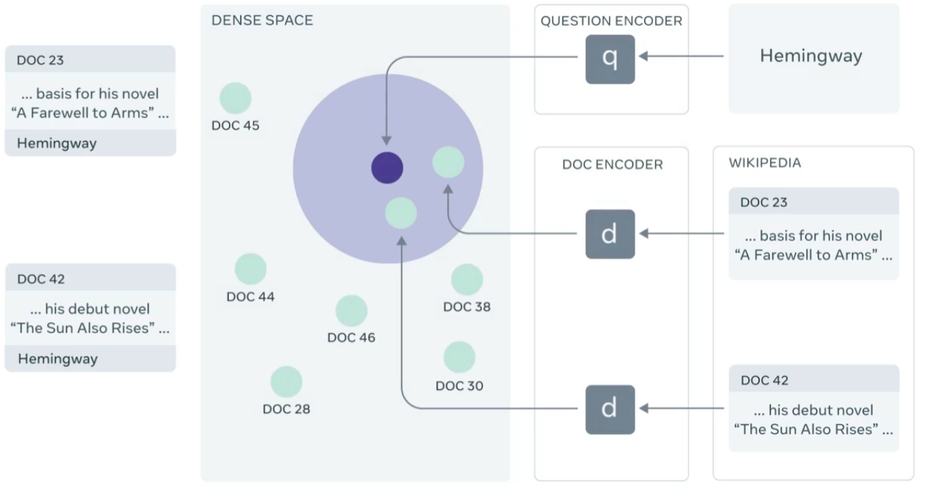
Reliability of Generative AI
Biases and alignment issues
May be mitigated by indirect human feedback, e.g., RLHF (Reinforcement Learning from Human Feedback)
Hallucinations and Verification
Due to imperfect memorization & reasoning
May be mitigated by special prompting (e.g., Chain-of-Thought), and leveraging external resources (e.g., RAG)
Open challenges
Alignment with scientific priorities (e.g., evidence-based), reproducibility and verifiability (e.g., real references), RAG for private/secure data
RLHF is used to align LLM output with human reviewer expectations
RAG can map queries and knowledge resources to common embedding space, LLM retrieves relevant context to inject in prompt or response (Lewis 2020)

Slide 12
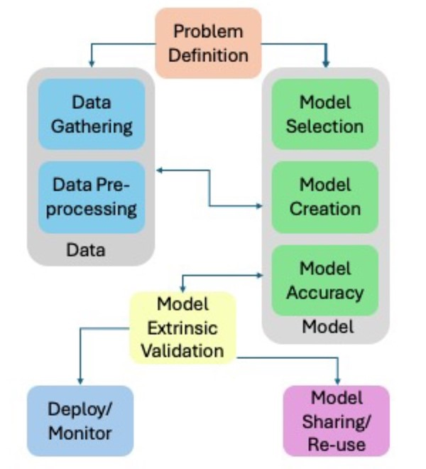
Safety, Security & Privacy in AI Ecosystems
AI models exist as part of interconnected ecosystems (DTs), with own lifecycles
Data, reliability, scaling challenges are compounded by every resource AI touches
Risks persist during continuous integration, deployment
AI in Digital Twins
Forward models, data analysis, and control
suited to purpose-built ML models, or tuned foundation models
Decision support and DT orchestration may be opportunities for generative AI
e.g., orchestration as AI tool-use
Require utmost safety considerations, oversight
The AI Lifecycle
(Castro 2023)

Slide 13
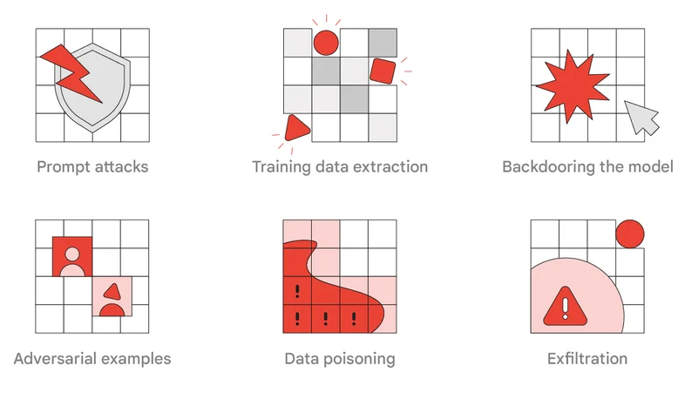
Adversarial Risks of Generative AI
AI risk assessment has become own area of research
Benchmarking, red teaming, evaluation frameworks, defenses
Misuse mitigations (esp. commercial)
Guardrails (input and output), jailbreak detection
Analytical and generative AI pose dual use risks, lowering information barriers for adversaries
True for both specialized (e.g., drug design candidates) and general (e.g., LLMs) models
Adversarial Attacks on AI models and systems (Google, 2023)

Slide 14
Key Research Areas & Challenges
Safety, Security & Privacy in AI for Digital Twins
UQ, Verifiability, Robustness | Fundamental to scientific results validity, general methods do not suffice
XAI, Reliability | Essential to domain science acceptance and actionability
PPAI, Encryption | Needed for sensitive data, impacted by performance and scale
Additional Challenge Areas
MLOps, AIOps | Widely underestimated, needed for deployability and reuse
Federated Learning | Moving data is impractical, need distributed/edge data and compute
Multimodality | Central to scientific AI initiatives, huge scientific opportunity
Hardware | Novel architectures and codesign, efficiency, DT instrumentation
Scalability | Critical to AI and DT objectives, complicates all of above
csoto@bnl.gov

