Slide 1
Digital Twins in Large Scale Scientific Instruments: Improving Particle Accelerator Performance and Operation
Weijian (Lucy) Lin
Collider Accelerator Department, BNL
New York Scientific Data Summit 2024
September 17, 2024

Slide 2
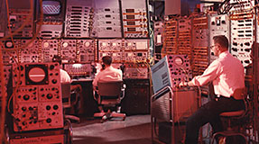
Motivation
Particle accelerator – kilometer-scale machine with thousands of coupled components to generate and preserve beam with very precisely defined qualities (e.g., energy, emittance, luminosity etc.)
Traditionally maintained with many hours of manual tuning, taking time away from data collection
Constantly varying complex system – no constant set of routine, needs real-time adjustments

Slide 3
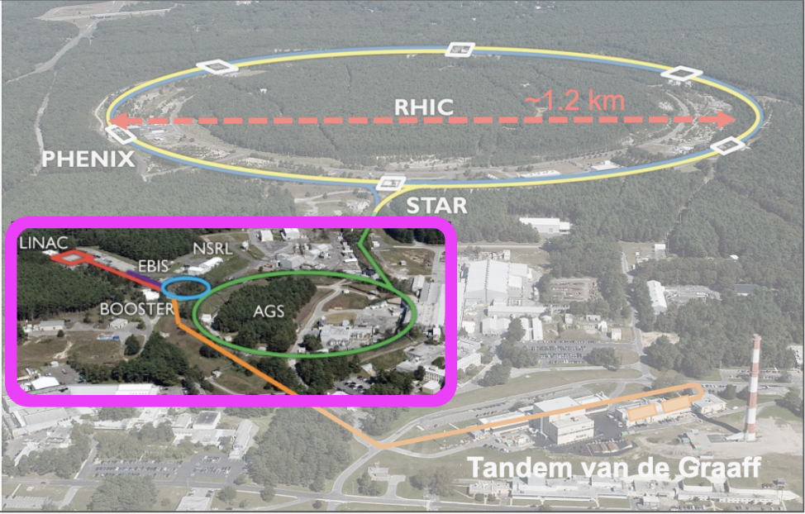
Motivation
Alternating Gradient Synchrotron (AGS) and its Booster serve as part of the injector compound for RHIC and future EIC
 | Max Energy [GeV] | Pol. At Max Energy [%]
Source+Linac | 1.1 | 82-84
Booster | 2.5 | ~80-84
AGS | 23.8 | 67-70
RHIC | 255 | 55-60
Loss in polarization along the chain
Digital Twin can be used to optimize beam luminosity, quality, and polarization in RHIC and EIC
Difficulty in improving beam quality:
polarimeter measurement is slow and has big error bars
tuning is an empirical process, due to the lack of accurate models for the machines

Slide 4
Digital twin at CBETA
Multi-turn energy recovery linac (ERL) developed by BNL and Cornell
Had success in building digital-twins for CBETA: combine physics simulation model with EPICS control system
CBETA-V: measure beam trajectories and compare to the digital twin in real time on control-system screens

Slide 5
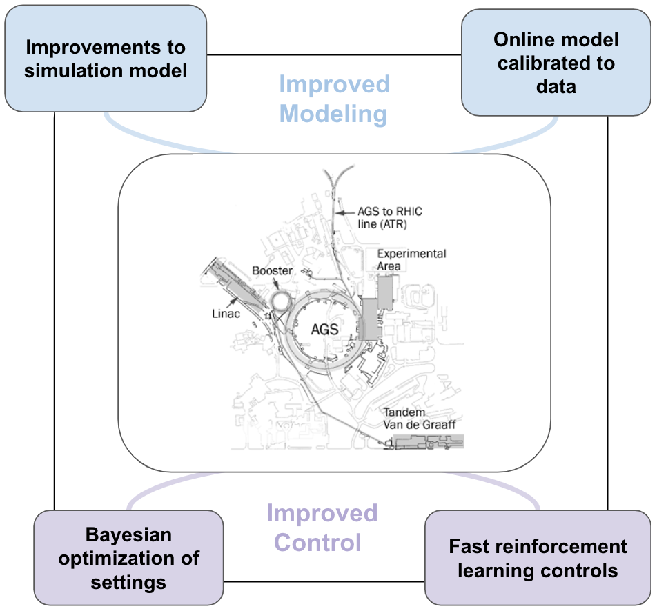
Improve Accelerator Operations with DT
Figure-of-merits (FOM) for machine learning (ML) algorithms (“experimental outputs”): beam position, beam size, emittance, beam intensity, polarization
real measurements can be expensive
Improved modeling $→$ Digital Twin
Digital twin can be used for:
fast real-time predictions for operators
error detection and correction
offline development of optimization and tuning routines

Slide 6
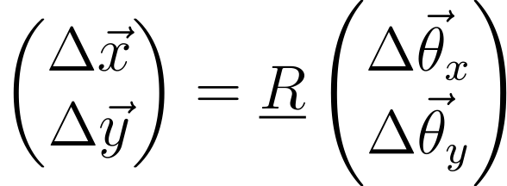
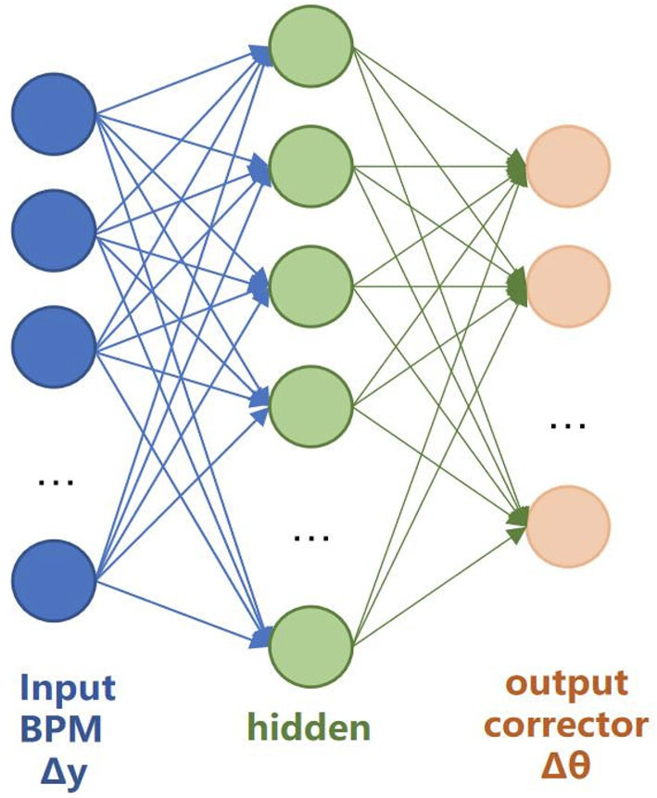
Automatic orbit correction
Traditional orbit correction
obtain mapping $\underline{R}$ (orbit response matrix) from corrector settings $\vec{θ}$ to orbit measurements $\vec{y}$
inverse mapping to get corrector settings $∆\vec{θ}$ needed to cancel orbit deviations $∆\vec{y}$
Problem: time-assuming measurement, system drift over time
Orbit correction with DT
train neural network models for fast correction routine, no need for matrix inversion
update with new data and stay accurate

Slide 7
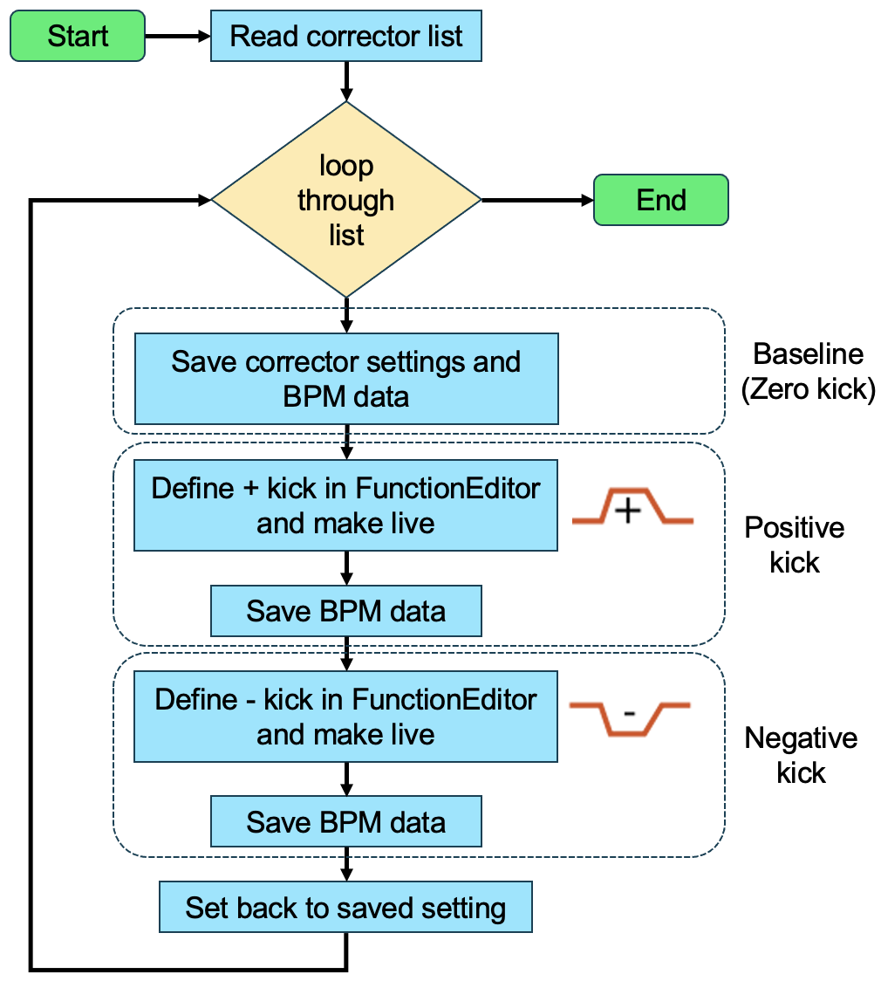
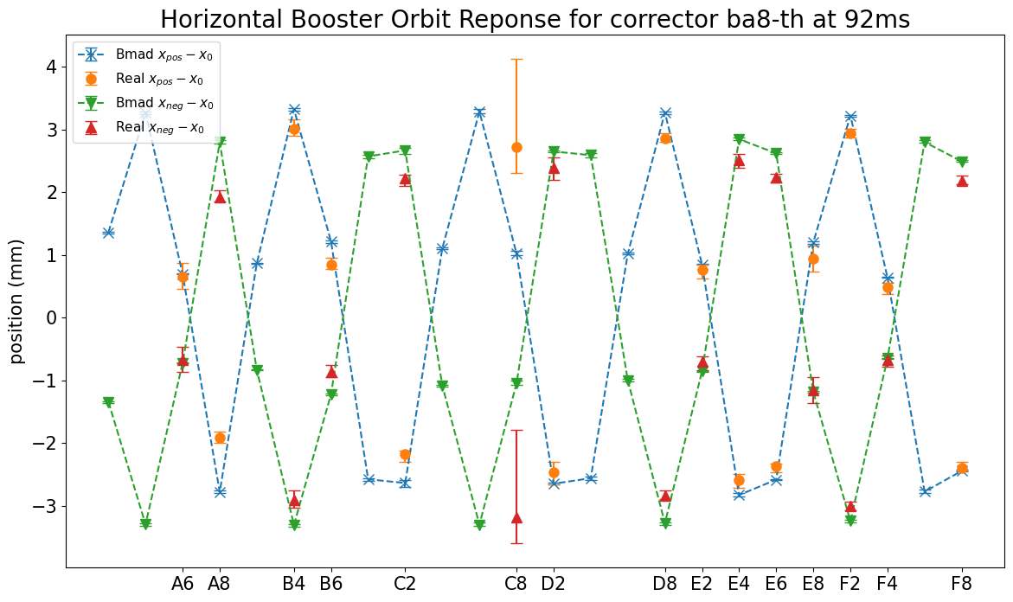
Orbit response in AGS Booster
Script development with Collider Accelerator Department (CAD) Controls Group to measure orbit data
Good agreements between data and model are reached, despite some faulty monitors (i.e., C8)
Good candidate for incorporating digital twin into the control system

Slide 8
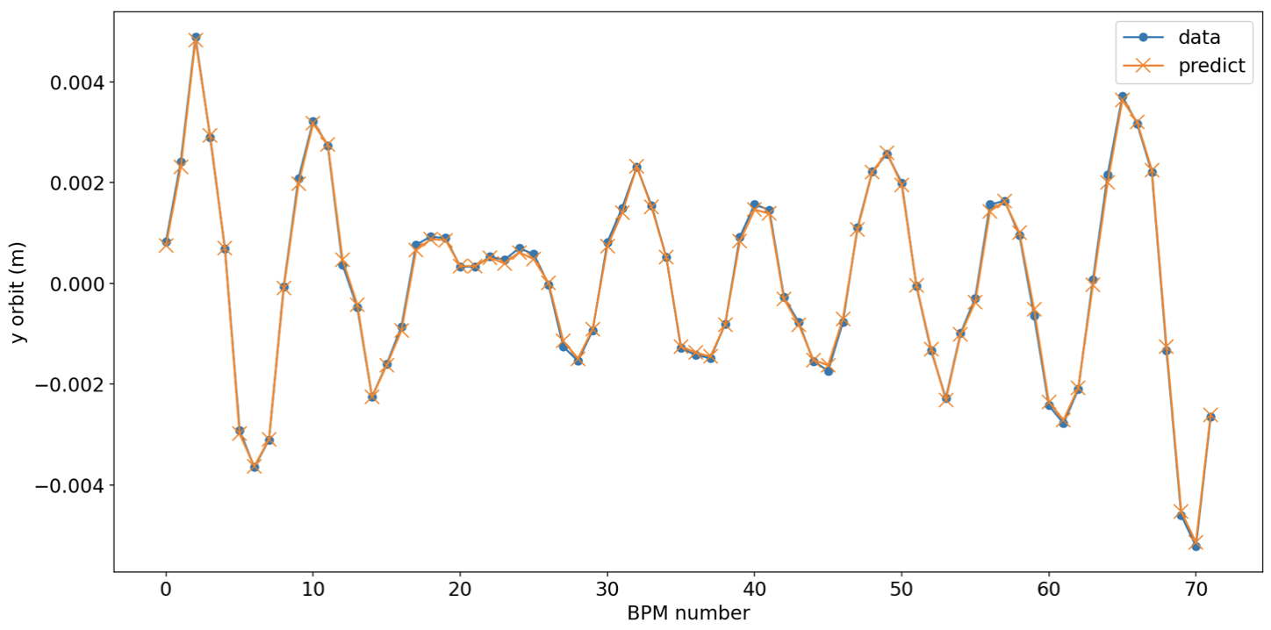
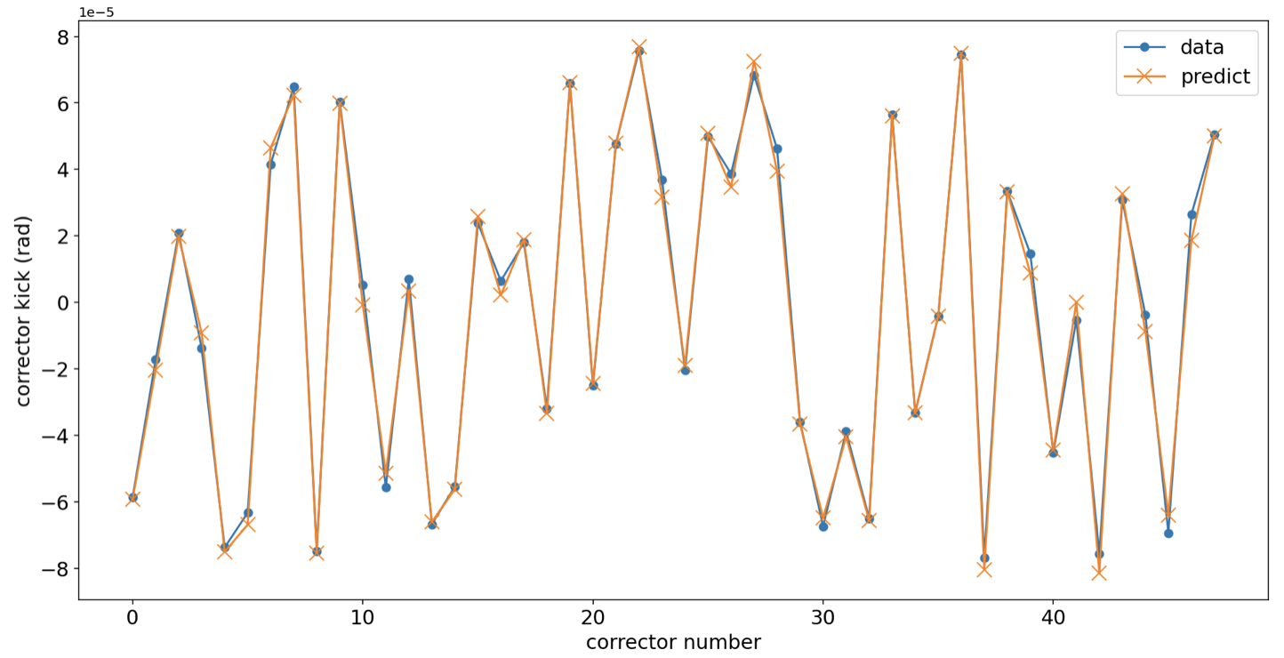
AGS orbit response NN model
Simulation model can be used to train neural network model for the orbit response matrix
48 vertical corrector kick $↔$ 72 y orbit measured at beam position monitors
Trained models accuracy > 99%
NN models can be trained for fast orbit correction routine given accurate digital twin model
ORM NN
Inverse ORM NN

Slide 9
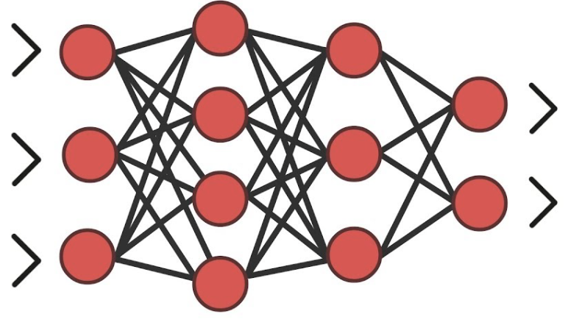
Error detection with orbit response
Actual machine with errors (e.g. quadrupole gradient errors, corrector calibration errors, etc.) produce different orbit response ${\underline{R}}_{ measured}$ from model/reference machine ${\underline{R}}_{ model}$
Considering all possible sources of errors as a vector $\vec{ν}$, digital twin can be used to build response error model ${\underline{J}}_{ model}$. Any $\vec{ν}$ can be reconstructed given known $∆\vec{R}$ and ${\underline{J}}_{ model}$

Slide 10
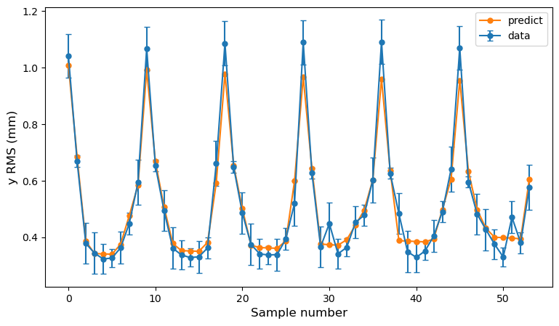
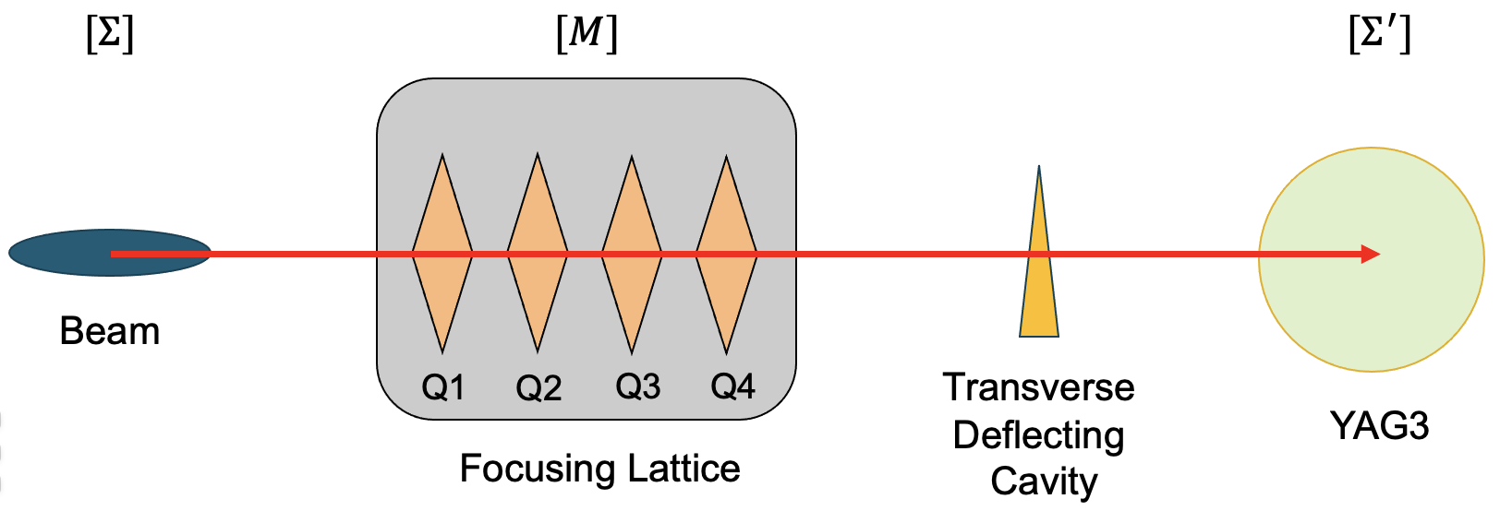
Virtual Diagnostics
Many diagnostic measurements (i.e., quadrupole scan, polarimeter measurement) are very time consuming and disrupt normal accelerator operations
Example: Coherent electron Cooling experiment at RHIC scans >100 quadrupole settings, and takes > 1 hour for an entire scan routine
Digital twin can replace real measurements with faster virtual measurements, without taking away valuable operation time
Digital twin can also provide virtual diagnostic information at locations where monitors cannot be placed in real machine

Slide 11
Offline optimization routine development
Digital twin can be used to test and develop optimization algorithms without the need to take away beam time or the risk of sabotaging beam quality
Example: Bayesian optimization algorithm for optimizing AGS Booster injection was first tested on a model of beam intensity response with regards to corrector settings. Subsequent real machine tests achieved satisfactory results.

Slide 12
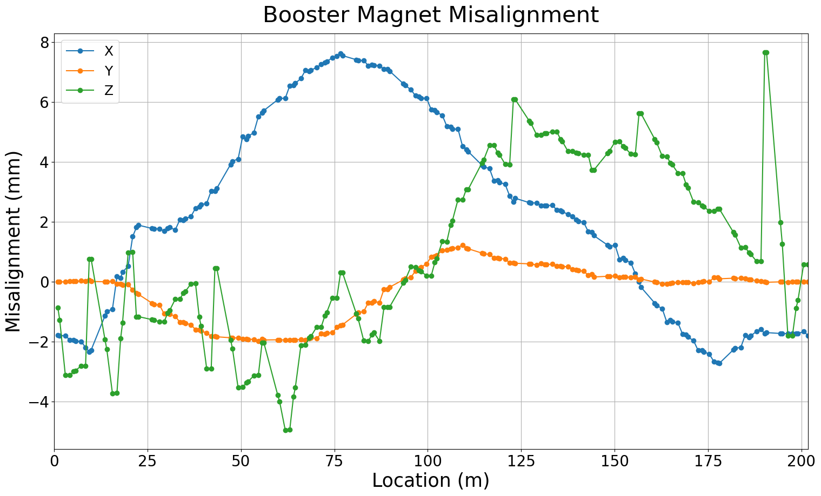
Challenge for accelerator digital twins
Physics simulation models have been / are being developed at BNL
Injection and extraction processes are more difficult to model $→$ require geometry and physical coordinates of transfer line elements
Model calibrations are necessary to match with real machine
Require large amount of measured data within limited operation time
Measurements can be taken at different frequencies $→$ time synchronization is difficult
Disagreement between model and measurements would require further error source investigation

Slide 13
Summary
Particle accelerators are large scale machines with very complicated tuning and maintenance needs
Majority of particle accelerators still rely on empirical tuning by human operators
Digital twins can be hugely beneficial for improving accelerator performance and operations by providing:
Foundation to develop tuning and correction routines which can involve other machine learning techniques (e.g., neural network, Bayesian optimization etc.)
Fast real-time virtual diagnostics for operators to make quick and efficient adjustments
Building digital twins for particle accelerators requires more carefully planned beam studies and script development

Slide 14
Thank you! Questions?

