Slide 1
Open Source Digital Twin:
Development & Deployment in India
2024 New York Scientific Data Summit: Addressing Data Challenges in Digital Twins (NYSDS) September 16-17, 2024
01

Slide 2
About Myself
President, Open Health Systems Laboratory
Special Volunteer, Radiation Research Program, National Cancer Institute and later worked with caBIG (Cancer Bioinformatics and information Technology)
My background is application of computer science to socio-economic development
Senior Advisor, Life Sciences, Internet2 (University Corporation for Advanced Internet Development)
Senior Advisor, World Bank Information Services Group
Senior Vice President and Chief Knowledge Officer, CTIS Inc.—NCI Cancer Therapy Evaluation Program (CTEP)
Senior Advisor, Booz•Allen & Hamilton
Executive Director, National Association of Software and Services Companies (NASSCOM)
NSF Visiting Scholar, Educational Object Economy, Apple Advanced Technology Group
Director and Head of Knowledge Engineering, Center for Development of instructional Technology (Cendit)
02

Slide 3
03

Slide 4
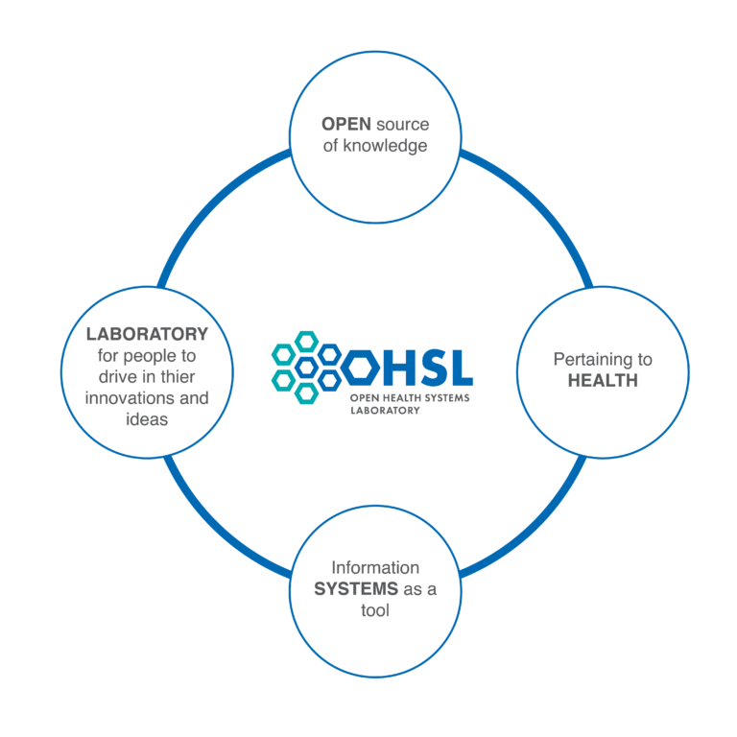
OHSL searches and finds researchers worldwide, determine their interests and capabilities
Brings them together into a community of interest
Through a process of dialogue help develop their scientific proposition and create a community of practice
Proposal development
International Team Science Consortium to undertake the research
04

Slide 5
Digital Twin: Doctors Show the Way
Better Physician
Better Patient Outcome
Like Ubiquitous Stethoscope
Augmenting capability to predict the effect of a new therapy
Not about Technology
Experimental Treatment
N+1 In silico Clinical Trial

Slide 6
What is a digital twin?
Bring together computer science and medicine to develop digital twins
A virtual model of a person—a virtual patient/avatar
May be used to predict the effect of a new therapy
To run a simulation—a clinical trial—without harming a human
May be used for personalized medicine, preclinical drug development, treatment simulation/clinical trial
Precision and predictive cancer care
Anna Marie Lopez, Jefferson Cancer Institute

Slide 7
Not interested in AI
only interested in
how technology can make me
a better doctor and get
better outcomes for my patients.
Professor Haresh KP, All India Institute of Medical Sciences (AIIMS)
07

Slide 8
We have been working with Dr. Haresh at All India Institute for Medical Sciences (AIIMS) for several years on how information technology can help with translational research leading to precision medicine.
C3.ai and Microsoft Research approached OHSL to work on a proof-of-concept using C3.ai technology and Azure within NIH Science and Technology Research Infrastructure for Discovery, Experimentation, and Sustainability (STRIDES) Initiative.
AIIMS selected as a site (a) rich medical records; (b) regulation in India permitting true translational research—bench-to-bedside; and (c) close knit team of biomedical and bioinformatics researchers.
08

Slide 9
One Stop Solution for Guiding Neuro-oncology Management
Patient and Treatment Details database
Proactive intelligent Database
Evidence based Treatment guidance
Results from Literature with a particular treatment path
Results from ones own similar patient cohorts
Real time Statistical analysis for publications
Drop out detection and corrective measures
Patient selection for trials/thesis enrollment
09

Slide 10
OHSL Precision Medicine Patient Digital Twin Project: Use case
A smart and lively Electronic records for Neurooncology
Able to collect all relevant information randomly (Demographic, clinical, radiology, pathology, genomic, PRO, treatment details) and present back in a temporal sequence
Repository of all available images like Clinical photos, radiology images, pathology photomicrographs, Genomic data etc.
10

Slide 11
SMARTER: INFUSING LIFE TO THE NEUROONCOLOGY DATA
Readily Analyzable with predefined queries at click of button
Intelligent to give suggestions for investigations and treatment
Automatic staging module
Blending of Standard Guidelines to the database
Linked to literature and or protocols that ready reference is possible
Auto summary display & Faster and easy navigation to the right page for saving time
11

Slide 12
Most Important: Real Time Guidance from our own Patient Cohort
The database should look into the whole patient encounters in realtime
The results for similar patients in the database need to be provided when an index patient is encountered
It should provide guidance for treatment based on the results from our local cases
Each patient entering into the database is going to guide a future patient if the characteristics match
Digital twin or Digital family?
12

Slide 13
Key Lessons Learnt
Need Open Source Digital Twin Software Platform
Multiomics
No Design Manual for Human—Whole Person Research
No one size fits all—need to combine different models
Incremental process aspiring to Virtual You
Open Science: Collaborative and cooperative process across research institutes
Goal is Better Patient Outcome, Technology is a Tool
Learn from application in other industries
13

Slide 14
Next Steps
Expanding to other cancers and other locations—across the world—building international team science consortium
Ever Widening, Never Ascending Circles
Strong Public Private Partnerships (PPP)
Whole Person Research
14

Slide 15
Setting up a Centre for Digital Health in partnership with the University of Leicester at Apollo University and further as part of its collaboration with OHSL to develop and deploy open source digital twins
Discussing with Peter Coveney, University College, London, for his participation
Working with Ana Maria Lopez, Jefferson Cancer Institute, to use digital twins for integrative medicine and whole person research
Exploring with Eric Stahlberg, FNLCR, on using its longitudinal big data and data analysis to develop digital twins and pseudopatient data sets
Evaluating Trust Axis proposed by Intel and OHSL which provides data, analytic tools and compute as shared interoperable intercloud global research platform focused on LMICs
16

Slide 16
Digital Twin Development and Deployment Laboratory @ Centers for Digital Health
In consultation with
Peter Coveney, University College, London
Eric Stahlberg, Virtual Human Global Alliance
Ravi Mahajan, Apollo Research Academy
Chittoor, India
Apollo University partnership with University of Leicester
Sharjah, UAE
University of Sharjah
Technology Innovation Institute, Abu Dhabi

Slide 17
Other Initiatives
Sangam Digital Twin Initiative of the government of India with more than 150 proposals to implement digital twins in several sectors
ATOM co-development and hackathons as part of Virtual Human Global Alliance framework by C-DAC (Centre for Development of Advanced Computing)
iDEX-INDUS-X for cooperation on double use technology
US DoD indicated its interest in dual use digital twins technology
Industry-Academia collaboration for India-United States startups
OHSL attended the 3rd INDUS-X Summit at Stanford on September 9th
OHSL Technology Innovation Laboratory @ Amity University
32 Workstations Connected to NVIDIA Cloud
147+ computer and biology students
4 OHSL Mentors working with Amity Faculty
Digital Twin covered in computer science syllabus in collaboration with OHSL and Digital Twin Consortium (DTC)
17

Slide 18
Growing Community of Practice
All India Institute of Medical Sciences Delhi
Apollo Research Academy
Sidney Kimmel Cancer Center, Thomas Jefferson University
Apollo AyurVAID
Virtual Human Global Alliance
Nishith Desai Associates
Digital Twins Consortium
Amity University
Indraprastha Institute of Information Technology
Indian Institute of Technology Delhi

Slide 19
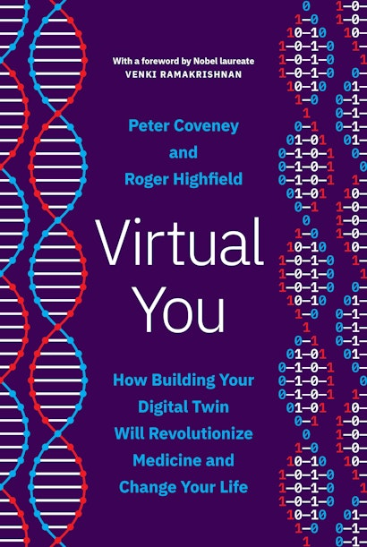
Jeremy Balian (TileDB)
Jeff Buchsbaum, NCI
Ken Buetow, ASU
Peter Coveney, UCL
June Deng, Yale
Haresh KP, AIIMS
Tina Hernandez-Boussard, Stanford
Simran Joshi, Yale/OHSL
Ana Maria Lopez, Jefferson
Andy Norris, Microsoft Research
Koninika Ray, OHSL
Nicholas Siebenlist, C3.ai
Allison Thomas Rodriguez, Microsoft Research
Khushi Sharma,TUS Ireland/OHSL
Eric Stahlberg, FNLCR
Anvi Sud, Yale
Shreya Tewari, IIT Bombay/OHSL Nick Weber, NIH STRIDES
Mariano Vazquez, ELEM Biotech
Jane Yu, Microsoft Research

Slide 20
Thank You
Anil Srivastava
anil.srivastava@ohsl.us
+1.240.463.3686
20

