Slide 1
Advancing Digital Twin Innovation Dan Isaacs: CTO September 2024

Slide 2
Mission
Digital Twin Consortium drives the adoption, use, interoperability and development of digital twin technology. It propels the innovation of digital twin technology through consistent approaches and open-source development. It is committed to accelerating the market and guiding outcomes for users.
Vision
The goal of the consortium is to be The Authority in Digital Twin as it relates to policy, security, interoperability and overall development of digital twins. The consortium will define the ecosystem, standards requirements, architectures, open-source code, identify gaps, and publish statements and opinions. This will be done in partnership between
industry, academia and government in a collaborative open environment.

Slide 3
Steering Committee Members
XL Industry Members
Researchers | Technology Providers | Academia | Government | Digital Twin Users
200+ Members and Growing
3

Slide 4
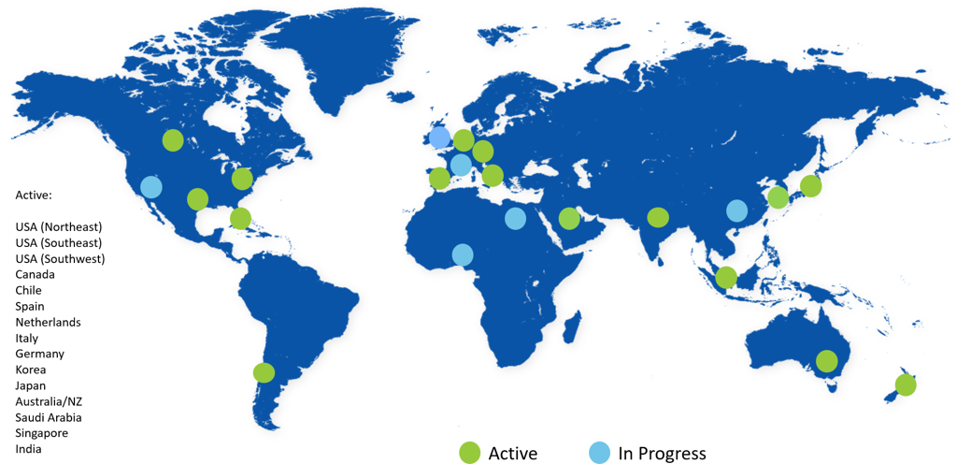
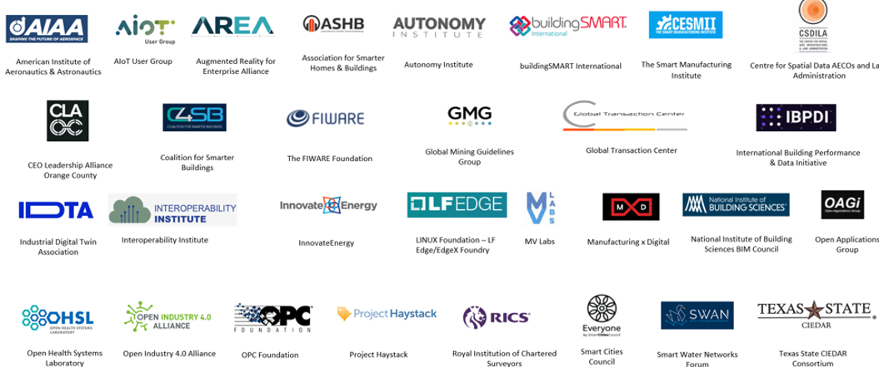
International Regional Branch Organizers
Industry-wide Liaison Network
Notes:
Accelerate transformative business outcomes
Develop and utilize best practices innovation, and thought leadership.
Showcase digital twin value through real-world applications
Provide expert guidance from lessons learned across the digital twin lifecycle

Slide 5
2024
Sustainability
Pharma & Regulatory
Working Group
Growth
2022
Fintech
Fintech
AI Joint
Consortia
Academia & Research​
Healthcare &
Life Sciences
Academia & Research​
Healthcare &
Life Sciences
2020
Natural
Resources
Smart Ag,
Food &
Beverage
Mobility & Transportation
Smart Ag,
Food &
Beverage
Mobility & Transportation
Terminology, Taxonomy & Technology
Capabilities
&
Technology
Capabilities
&
Technology
Telecomm
Telecomm
Aerospace & Defense
Aerospace & Defense
Natural
Resources
Aerospace & Defense
Natural
Resources
Aerospace
&
Defense
Natural
Resources
Manufacturing
Manufacturing
Infrastructure
Manufacturing
AECO
AECO
Manufacturing
AECO
AECO
AECO
© 2024 Digital Twin Consortium. All rights reserved. ​

Slide 6
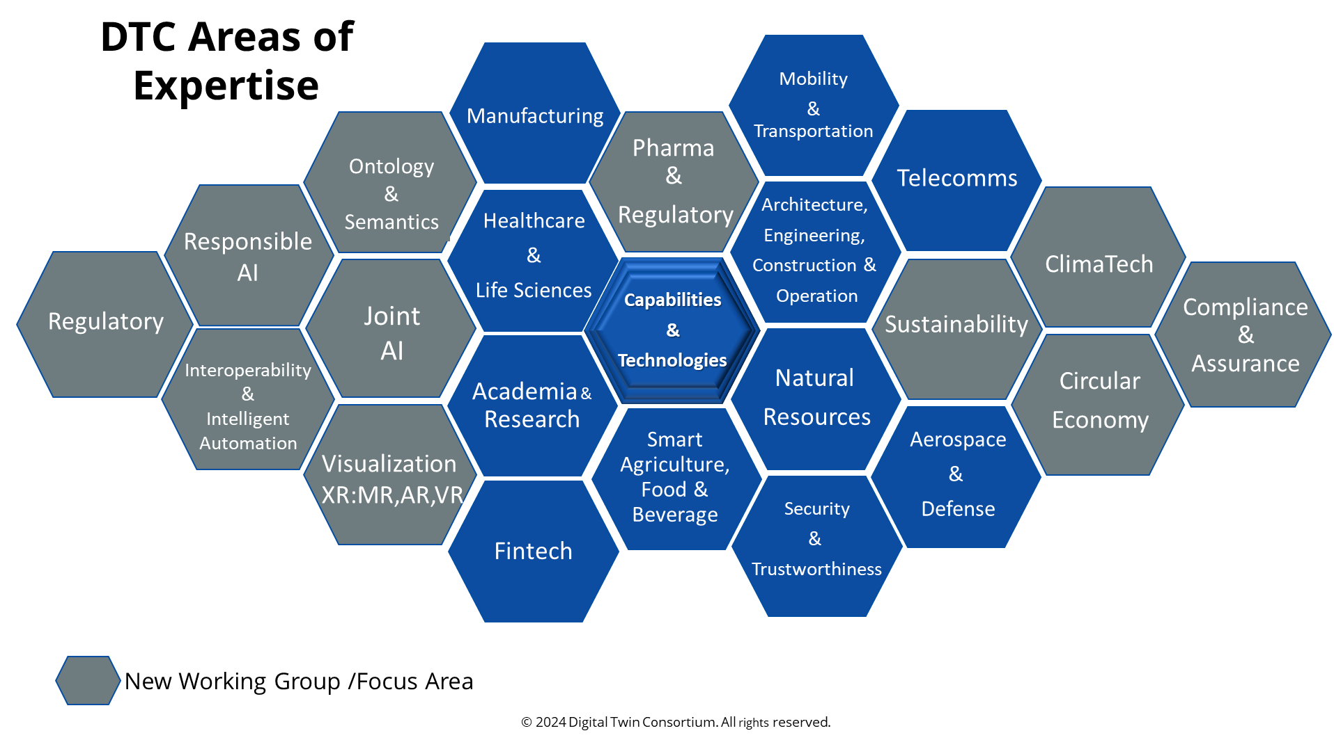

Slide 7
Capabilities & Technologies Subgroups Creating the Foundation for the Digital Twins
Focus
Helps to create and identify the horizontal foundational elements and fundamental building blocks for digital twins
Contributes to standard requirements, open source and cross-functional use cases
Identifies and develops composable frameworks through corresponding subgroups that focus on business maturity models, system reference architectures, simulation & modeling, security & trust and spatial & visual data.
Develop use cases and case studies that align and are consistent with the composable framework for the Technology Showcase and promote the Technology Spotlight, focusing on DTC member innovation and thought leadership.
Modeling & Simulation
Open Source, Standards req.
Patterns &
Platform Stacks
Full Stack Connectivity
Business Maturity
Modeling
Capabilities
&
Technologies WG
Terminology & Vocabulary
Composability Framework
Security
& Trustworthiness
Spatial & Visual Data
© 2024 Digital Twin Consortium. All rights reserved. ​

Slide 8
Advancing Digital Twin Innovation
Increasing industry adoption of Digital Twins from cloud to on-premise
Accelerating over a wide range of use cases
Spanning from informant to performant
Including the emergence of AI-infused digital twins
Expanding the Digital Twin Consortium scope to encompass
Advanced Digital Engineering - methodologies and leading practices (MBSE, MBD,…)
Digital Thread Lifecycle - from origination to decommissioning
Infusion of AI - driving Digital Twin evolution and adoption
© 2024 Digital Twin Consortium. All rights reserved. ​

Slide 9
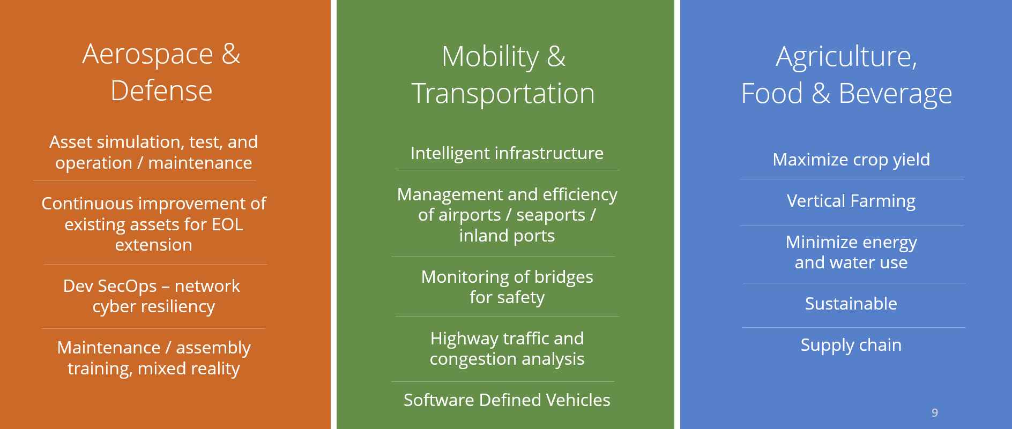
Use Cases in Progress
Healthcare &
Life Sciences
AECO
Natural Resources
Grid design and upgrade
Resilient and secure
Disaster prediction and emergency service delivery
Renewables: Wind, Solar, Hydro...
Alternative Energy
Mining,
Asset track & trace,
How systems are developed, designed and deployed
Personalization for precision medicine
Disease detection and analysis, treatment
Notes:
Dan

Slide 10
Use Cases in Progress
Healthcare &
Life Sciences
AECO
Natural Resources
Grid design and upgrade
Resilient and secure
Disaster prediction and emergency service delivery
Renewables: Wind, Solar, Hydro...
Alternative Energy
Mining,
Asset track & trace,
How systems are developed, designed and deployed
Personalization for precision medicine
Disease detection and analysis, treatment
Notes:
Dan

Slide 11
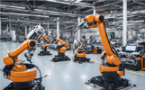
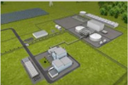
End Users – Catalyst for new Use Cases
Academia and Research
Research Institutes
Smart Cities
Smart Buildings
Aerospace & Defense
Artificial Intelligence
Open Source Developers
Financials
Healthcare
Data Centers
Manufacturing
Robotic Automation
Supply Chain
Transportation
Maritime
Airports
Oil & Gas
Renewables
Modular Nuclear Energy
Pharma
Precision Agriculture
Regulatory and Compliance
Emergency Management
Telecomm

Slide 12
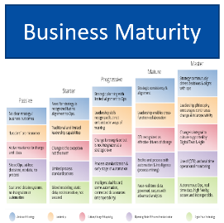
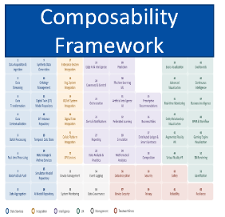
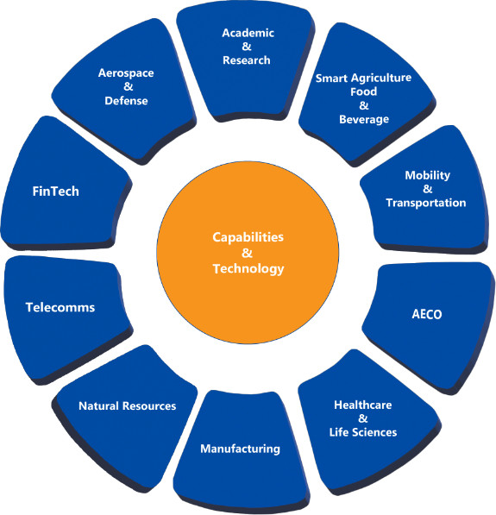
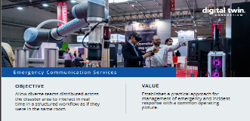
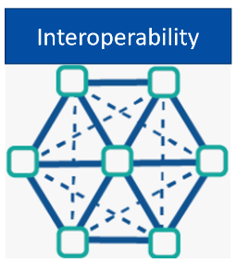
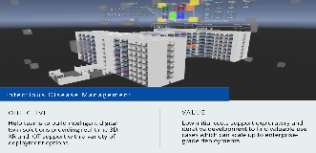
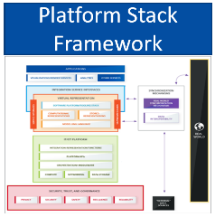
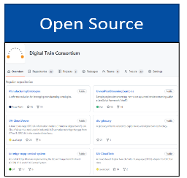
Structure
Frameworks
Showcase
ROC Windfarms - XMPro
Ecol Café End-to-End Enterprise Digitalization I4.0
5G Secure Network - Intuitus
Battery System Development – Dassault Systemes
Flood Management – University of Melbourne
Tracking Injuries in Hospitals – Axomem
Long-haul COVID Management – Dell
Financial Transactions – Intuitus
Smart Airports and AR – EventSystems, others
Intelligent Transport – Autonomy Institute
Member Driven
Highly Collaborative
Results Oriented
Demonstrative
Global Regional Branch Organizers
Industry-wide Liaisons

Slide 13
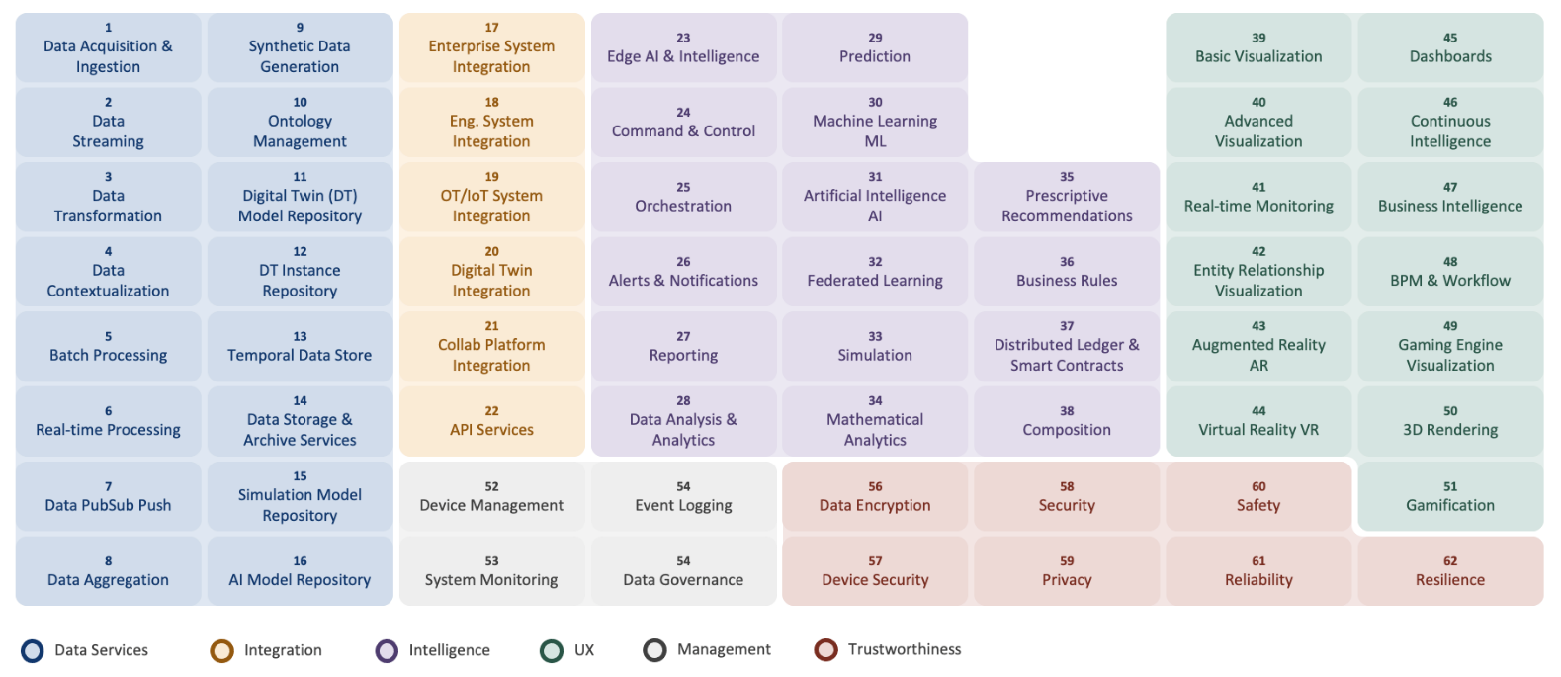
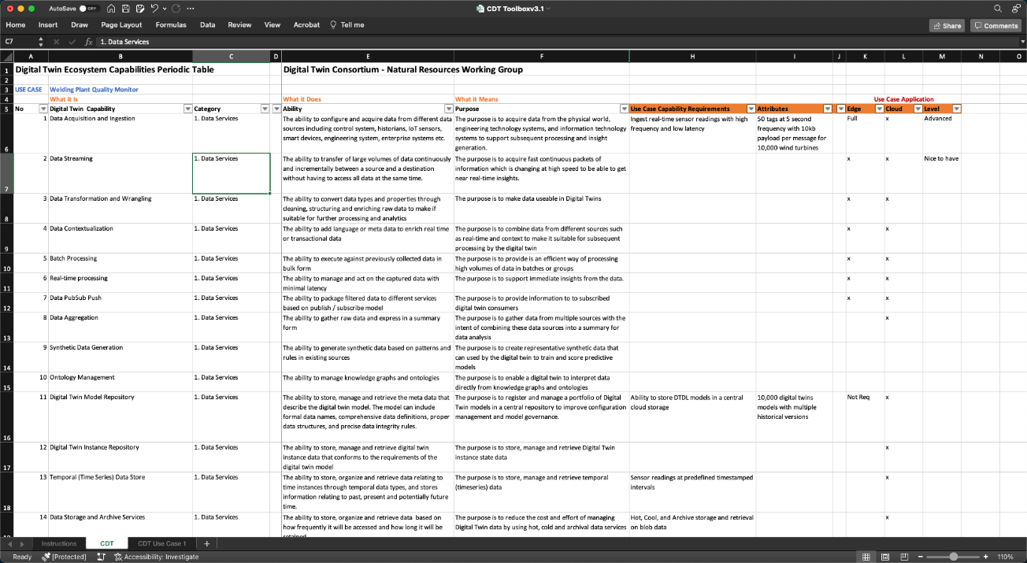
Digital Twin Composable Framework
Capabilities Periodic Table
Excel Toolkit
User Guide
DOWNLOAD THE MATERIALS
https://www.digitaltwinconsortium.org/initiatives/capabilities-periodic-table/ or https://bit.ly/dtc-dtct

Slide 14
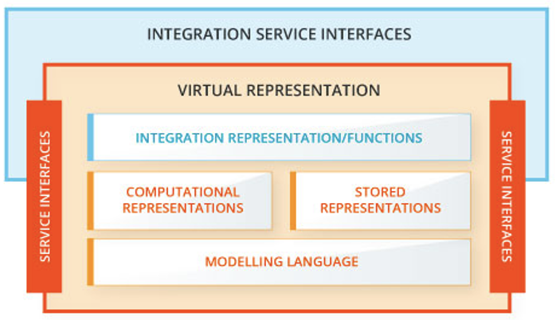
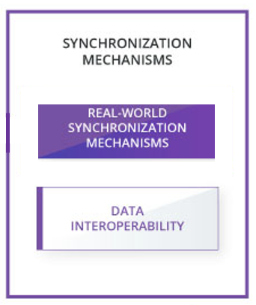
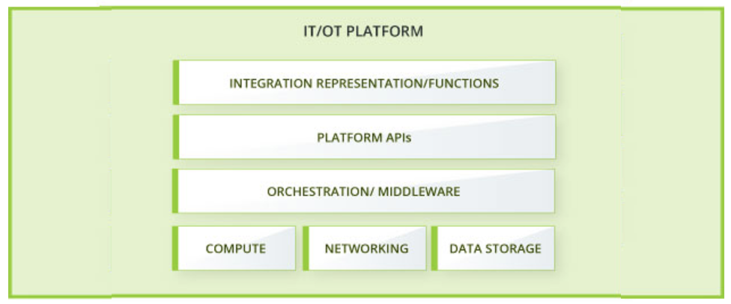
Platform Stack Architectural Framework
DIGITAL TWIN SYSTEM
Representative framework outlining essential constituent layers and component levels that comprise a digital twin system
Establishes foundational structure for real-world data integration, virtual representation and synchronization mechanisms / interfaces between physical and virtual entities

Slide 15
From Work Product to Use Case Workflow
© 2024 Digital Twin Consortium. All rights reserved. ​

Slide 16
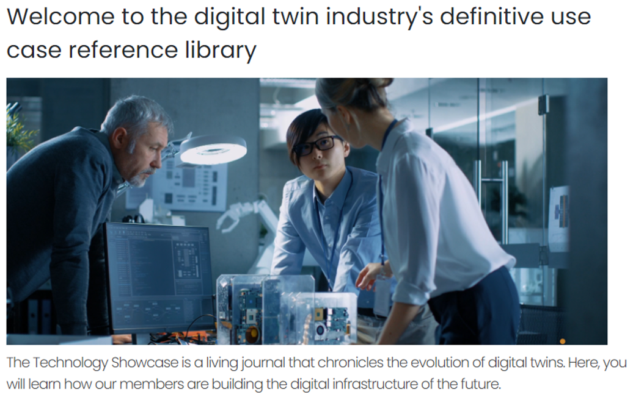
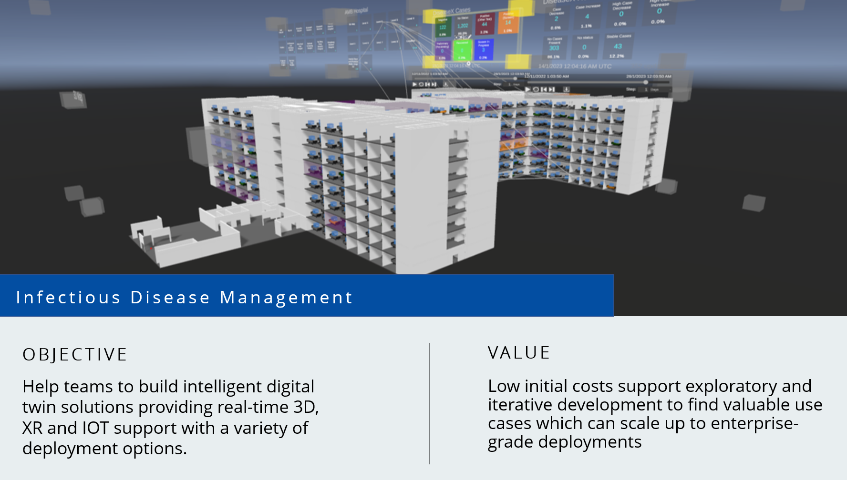
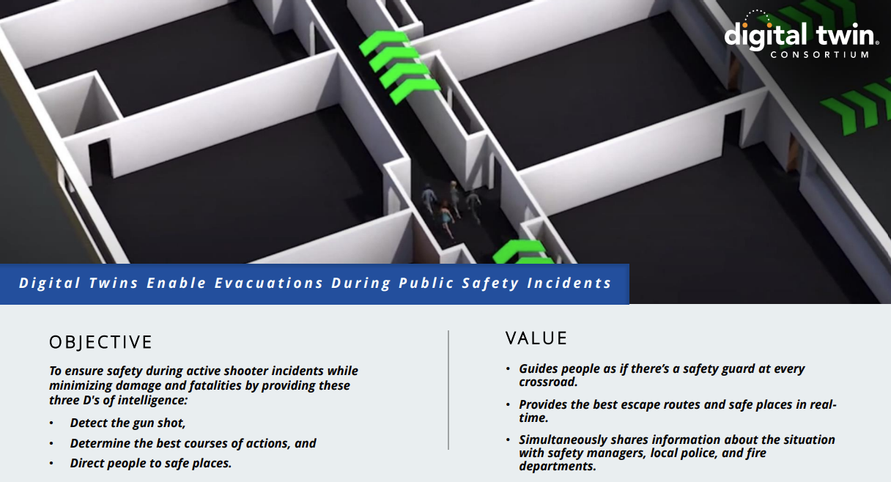
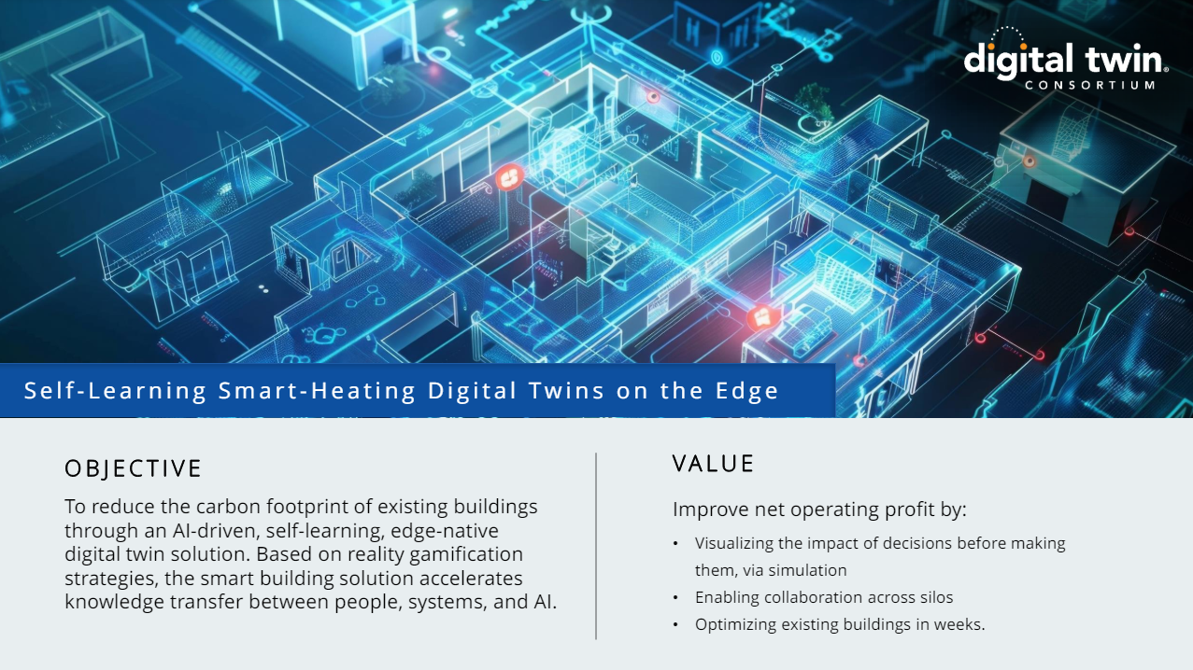
Technology Showcase Reference Library
Digital Twins for Public Safety
Wind Farms Remote Operations Center (ROC)
Scope 3 Carbon Emissions Reporting
Infectious Disease Management
Emergency Communication Services
Buildings as Batteries
Manufacturing Quality Control Via Remote Operator
16
© 2024 Digital Twin Consortium. All rights reserved. ​

Slide 17
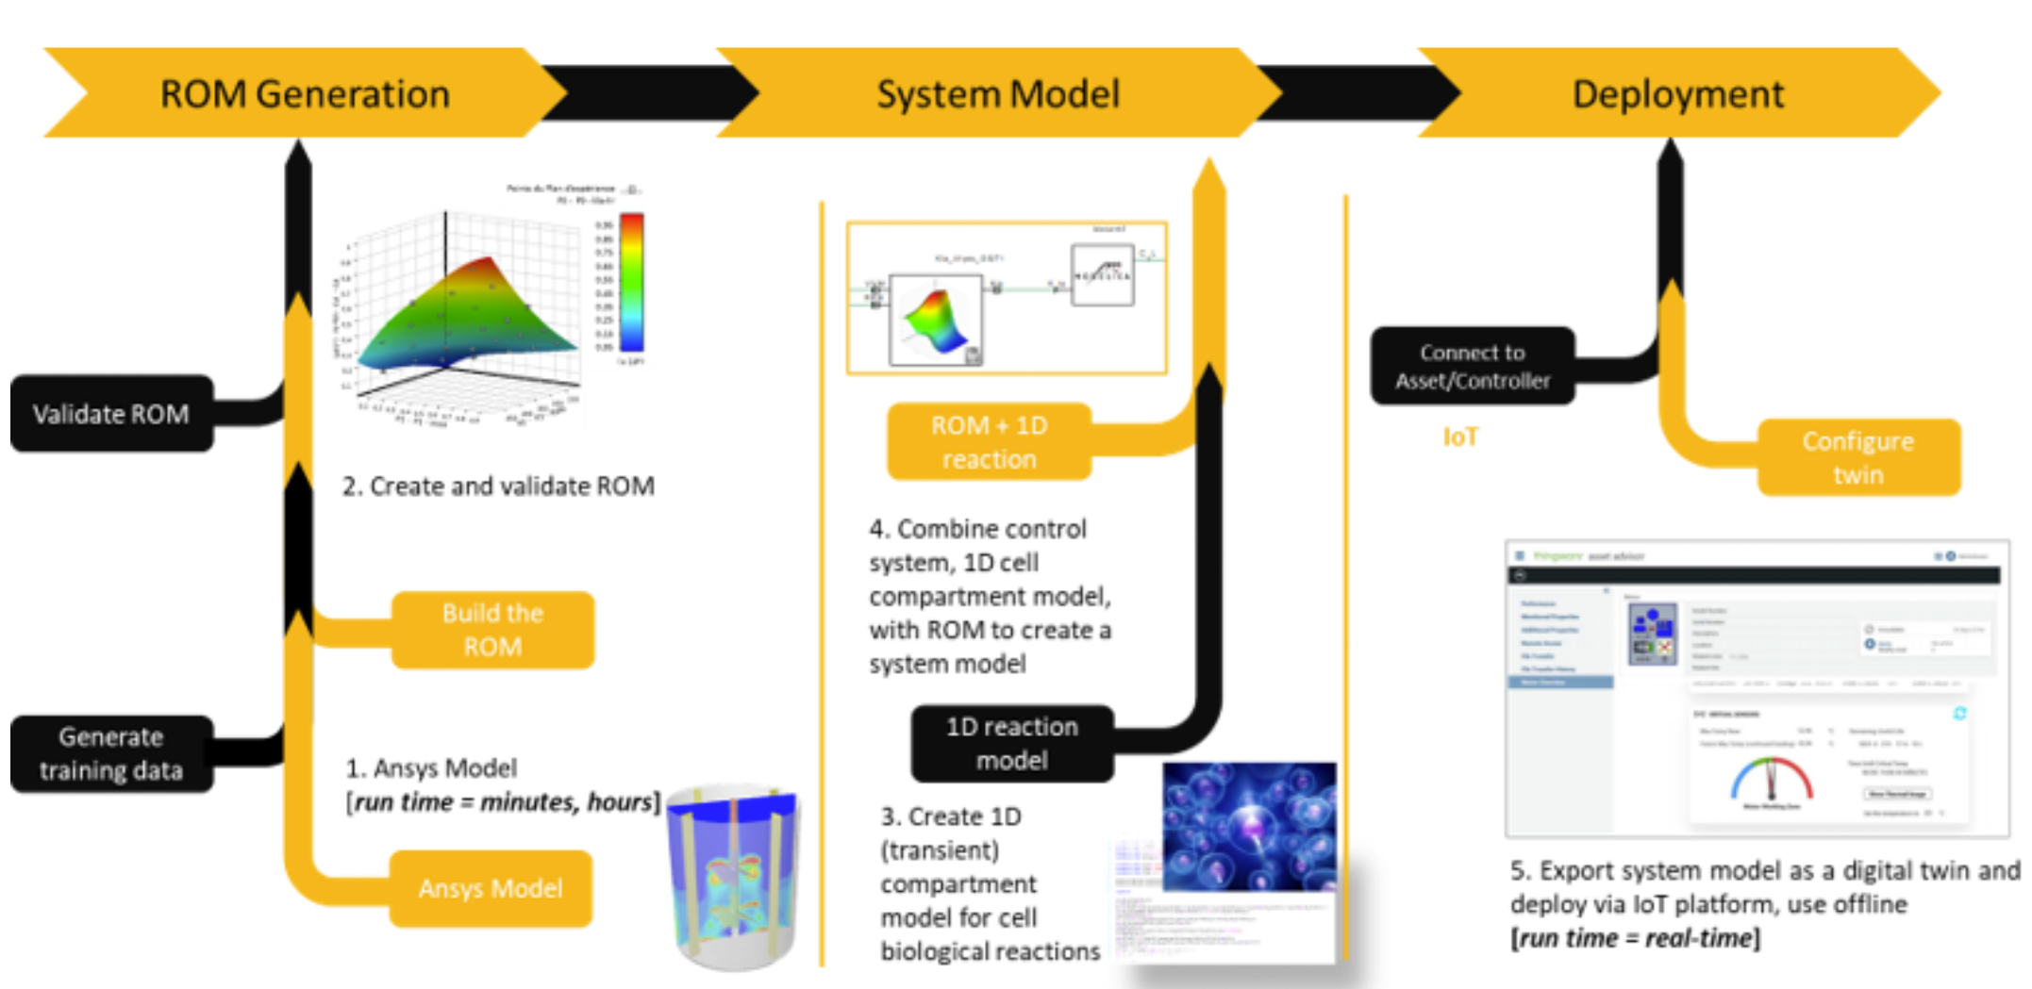
Hybrid Digital Twins for Biopharmaceutical Manufacturing

Slide 18
Digital Twin Evolution
Traditional (DT)
Passive
Offline
Goal Given
Predictive
Intelligent (IDT)
Active
Online
Goal Seeking
Anticipatory
Multi-Agent GenAI (MAGS)
Interactive
Autonomous
Reasoning
Decision-Making
DATA
DATA FLOW
GENERATIVE
Adopted from: Grieves, Michael. (2022). Intelligent digital twins and the development and management of complex systems. Digital Twin. 2. 8. 10.12688/digitaltwin.17574.1.
18
© 2024 Digital Twin Consortium. All rights reserved. ​

Slide 19
Decision-making is Changing
Environment EI
Supply Chain EI
Governance
External Intelligence
Decision Intelligence
Internal Intelligence
Business Rules & AI IP
Process & IoT EI
Human Capital
Distributed Intelligence System – DIS
Informant
Performant
Decision Support
Decision Augmentation
Decision Automation
DT
DT
DT
Dashboards
Business Intelligence
Condition Monitoring
AI Augmented Information
Prescriptive Recommendations & FRS
Closed-loop Feedback & Learning
Business Process Automation
Distributed Intelligence System
Algorithmic Business with DIS
EI: Event Intelligence FRS: Front Running Simulation

Slide 20
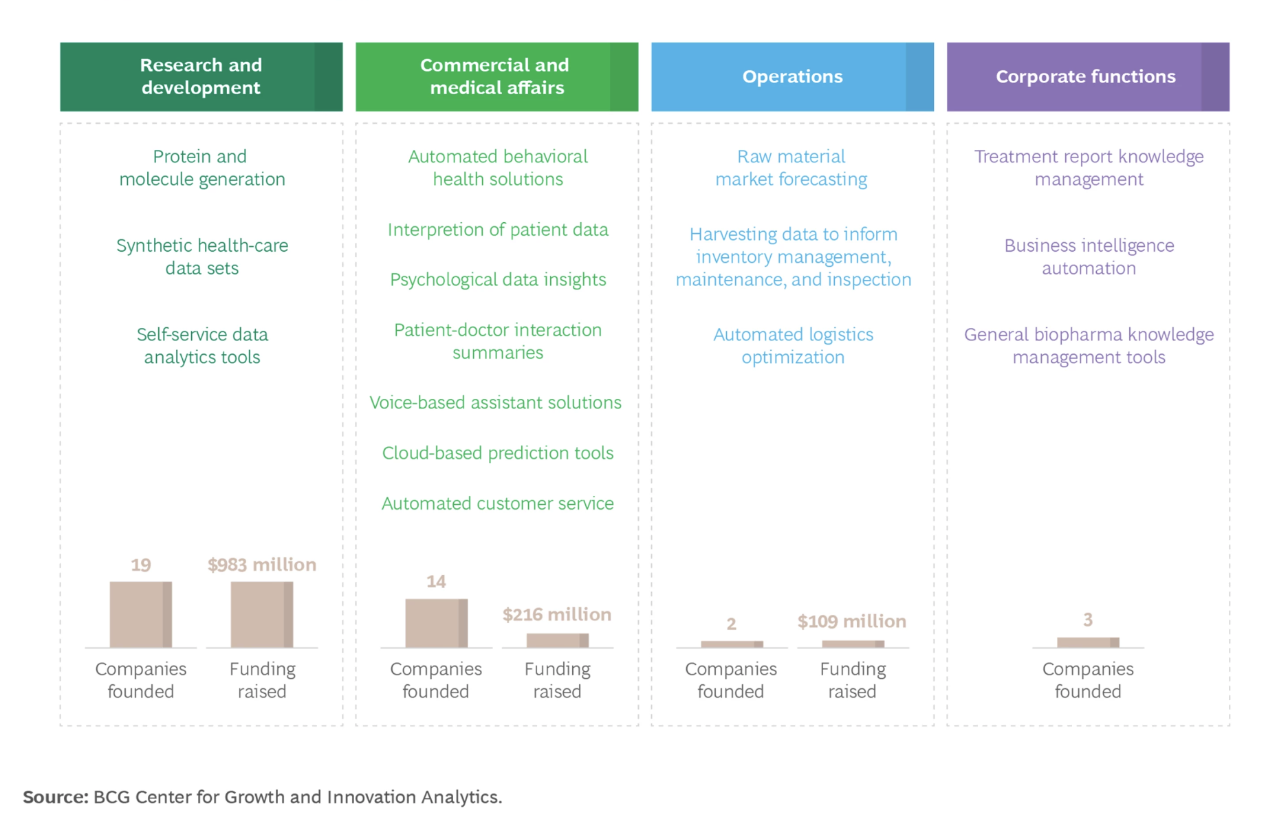
Funding for Gen AI Started Across the Entire Value Chain
Gen AI market health: CAGR of 85%, from ~ $1 billion to $22 billion by end of 2027*
*Three Steps to Value with Generative AI in Pharma | BCG Jan, 2024
“Gen AI is a Strategic Imperative”

Slide 21
APEX As-a-Service Solutions for Artificial Intelligence | Dell USA
¹(footnote 1)Enterprise Strategy Group research report, "Beyond the GenAI Hype: Real-world Investments, Use Cases, and Concerns.” [ ↑ ] –https://research.esg-global.com/reportaction/515201644/Marketing
²(footnote 2)Enterprise Strategy Group research report, “Navigating the Evolving AI Infrastructure Landscape.” [ ↑ ] –https://research.esg-global.com/reportaction/515201675/Marketing
³(footnote 3)Based on Dell analysis, August 2023. Dell Technologies offers solutions to support AI workloads across 12 product and service categories [ ↑ ]
Notes:
Research Findings GenAI Adoption Is Nascent But Will Gain Extensive Traction in the Next Year
Planned Generative AI Use Cases Will Impact Nearly Every Corner of Organizations
GenAI Stakeholders Emerge Across All Organizational Departments
GenAI Shows Strong Opportunity for Third-party Vendors and Service Providers, But the Market Will Not Be Their Exclusive Territory
GenAI Integration Will Spark Sales, But to What Extent?
To Assess GenAI, Organizations Will Turn to…GenAI

Slide 22
© 2024 Digital Twin Consortium. All rights reserved. ​

Slide 23
MAGS Examples
© 2024 Digital Twin Consortium. All rights reserved. ​

Slide 24
Source: Sev1Tech Public Presentation – DTC Member Meeting 2024

Slide 25
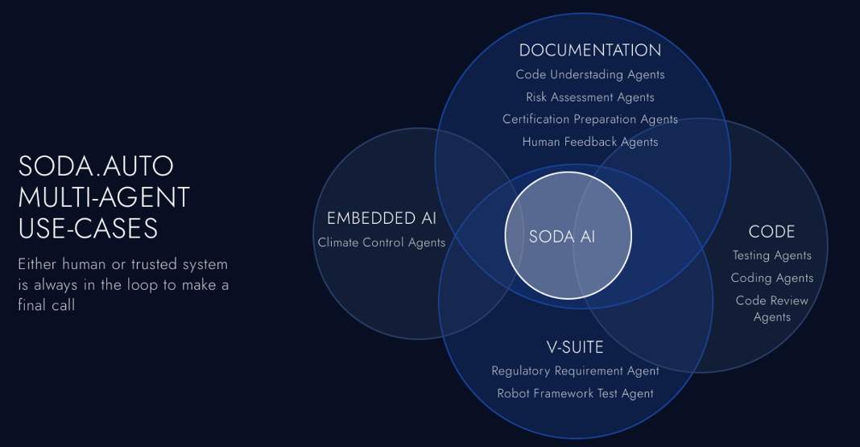
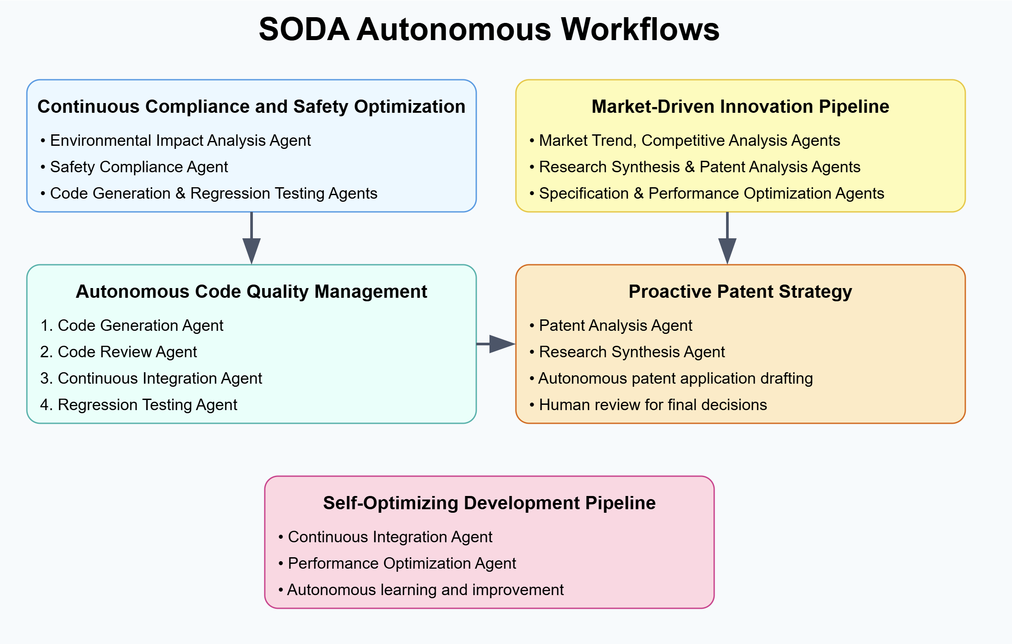
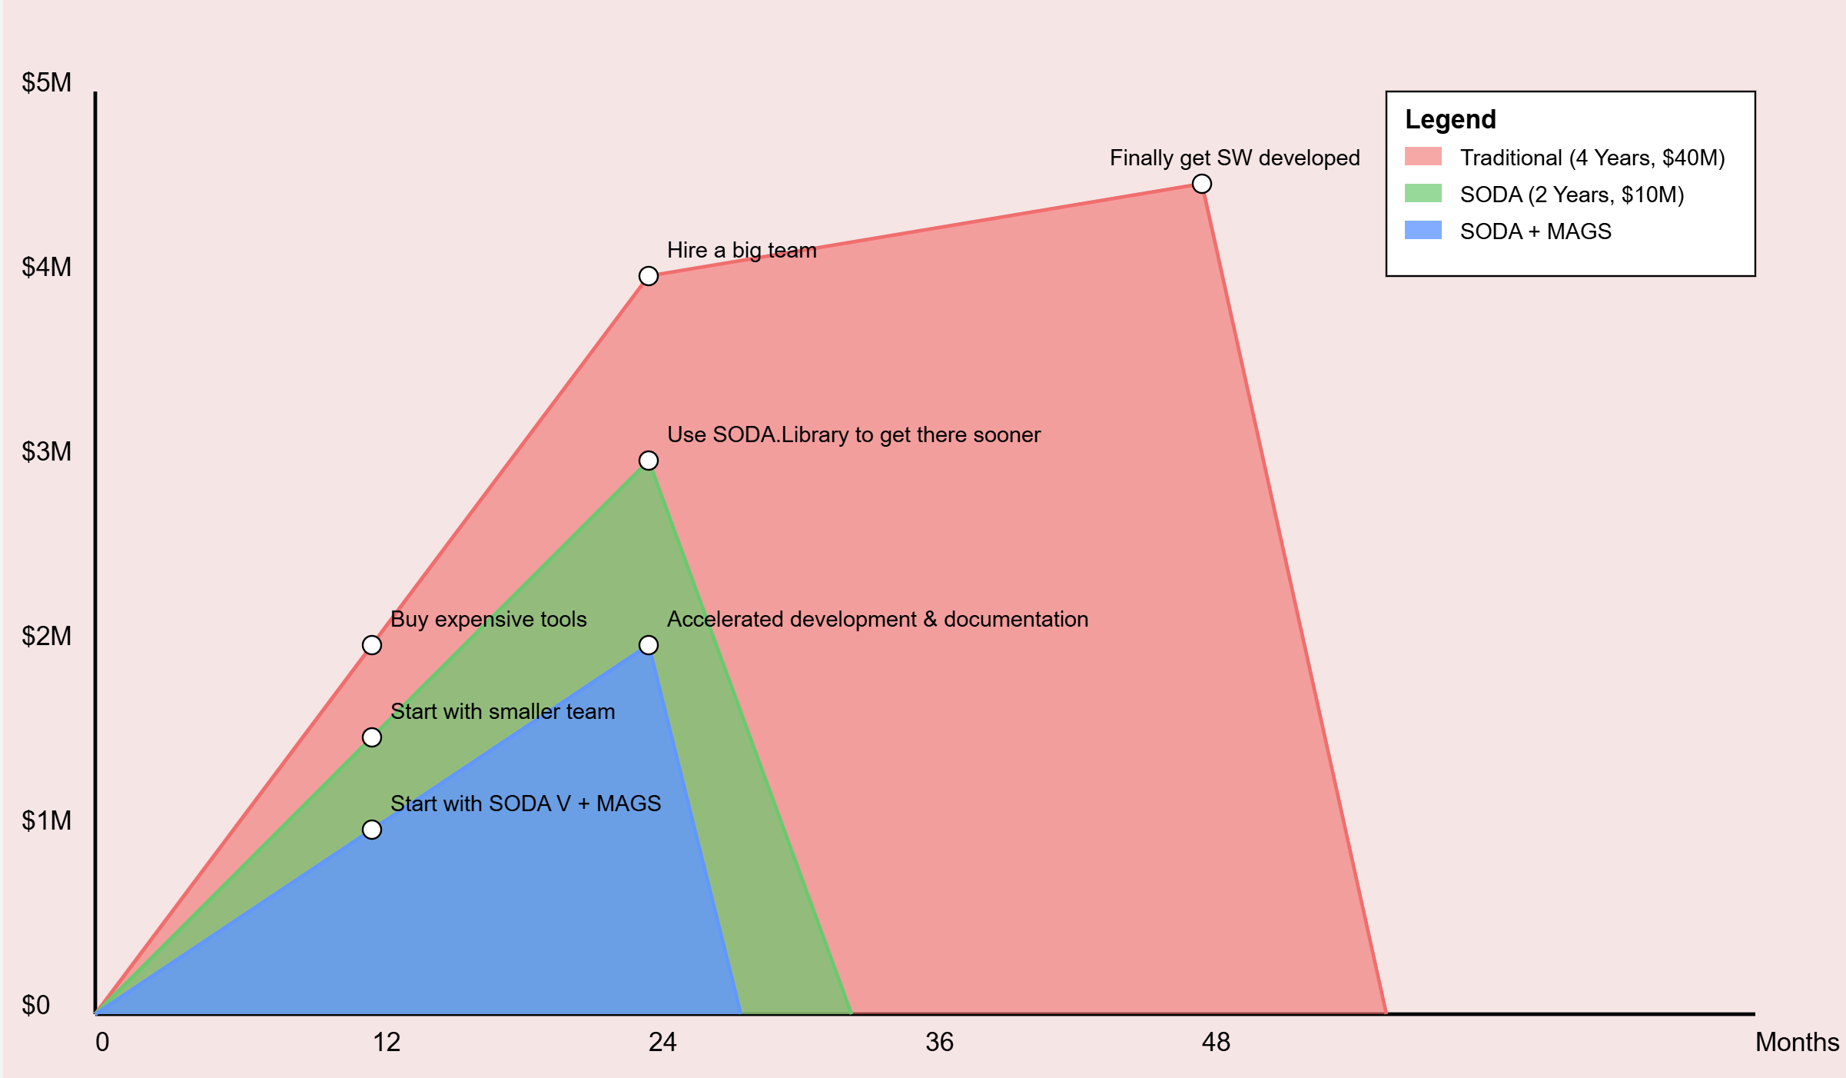
SODA: Software Defined Automotive
“ MAGS seamlessly integrates with Digital Twin technology and Software Defined Vehicle (SDV) approach, creating a dynamic, intelligent ecosystem for automotive innovation that spans from concept to certification and aftersales.”
Source: https://soda.auto/blog/soda-multi-agent-systems-mags-implementation

Slide 26
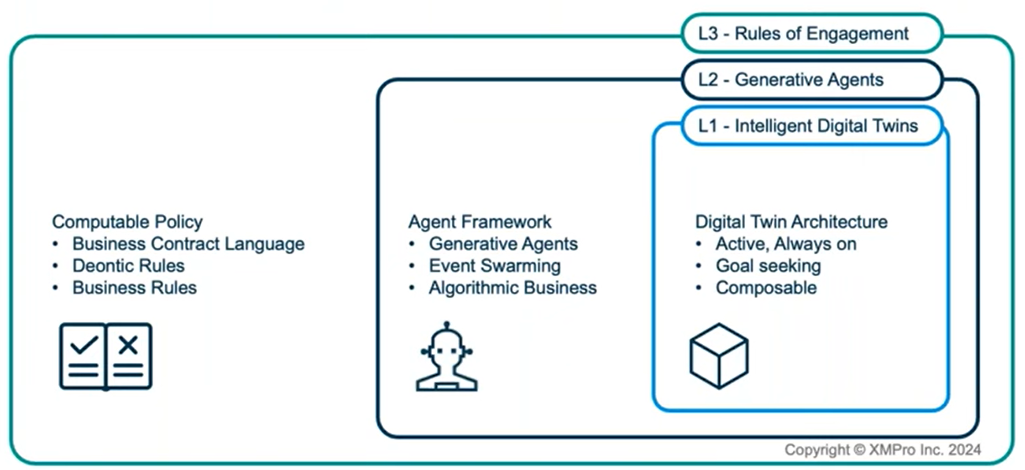
XMPro With GenAI is Impacting Industry In 2024
Source: Generative AI - XMPRO

Slide 27
Advancing Digital Twin Innovation
Increasing industry adoption of Digital Twins from cloud to on-premise
Accelerating over a wide range of use cases
Spanning from informant to performant
Including the emergence of AI-infused digital twins
Expanding the Digital Twin Consortium scope to encompass
Advanced Digital Engineering - methodologies and leading practices (MBSE, MBD,…)
Digital Thread Lifecycle - from origination to decommissioning
Infusion of AI - driving Digital Twin evolution and adoption
© 2024 Digital Twin Consortium. All rights reserved. ​

Slide 28
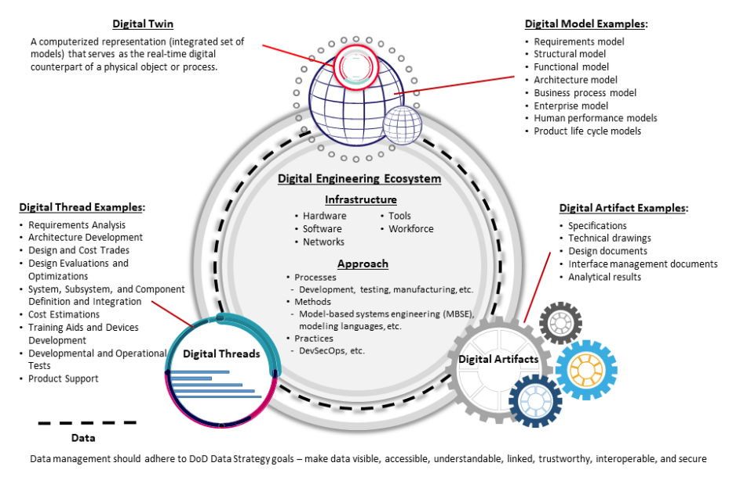
Digital Twin Consortium Scope Expansion
Source: DoDI 5000.97, "Digital Engineering," December 21, 2023 (whs.mil)

Slide 29
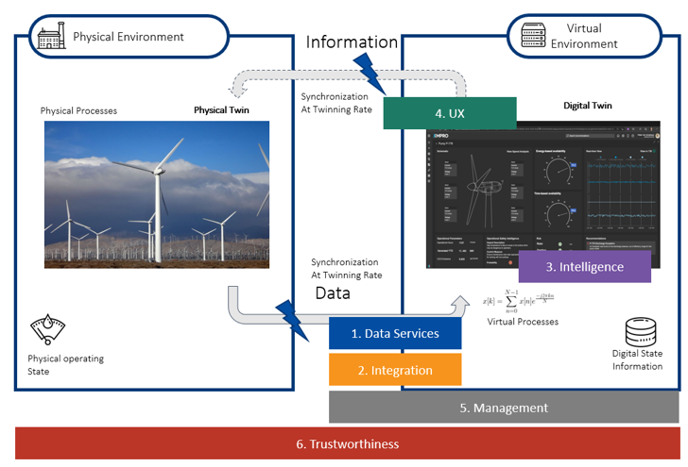
Digital Twin
Definition
A digital twin is an integrated
data-driven virtual representation
of real-world entities and processes, with synchronized interaction
at a specified frequency and fidelity.
© 2024 Digital Twin Consortium. All rights reserved. ​
Notes:
Dan
Before getting further into the presentation , since there are many different interpretations of what a Digital Twin is,
to make sure everyone has the same understanding
as, I want to share the Digital Twin Consortium’s published definition of a digital twin.
As shown, the foundational elements in the digital twin definition, as defined by the consortium,
showing the virtual representation, (shown in the dashboard to the right),
of the physical environment, (the windfarm pictured in the left)
and or process with a synchronization mechanism to transfer the data at a given frequency,
the twinning rate, to ensure the requisite fidelity between both the physical and the virtual environments is maintained.
For reference of interest in further details, our glossary, also released to our open source, provides more details and a framework
around the terminology, taxonomy used by our consortium members.

Slide 30
Updated Definitions
Digital Twin Definition
Digital Thread Definition
A digital twin is an integrated data-driven virtual representation of real-world entities and processes, with synchronized interaction at a specified frequency and fidelity.
A digital thread is a bidirectional, dependable and trustworthy interconnected information system that links multiple dimensions, including structure, behaviour, space, time, and lifecycle stages.

Slide 31
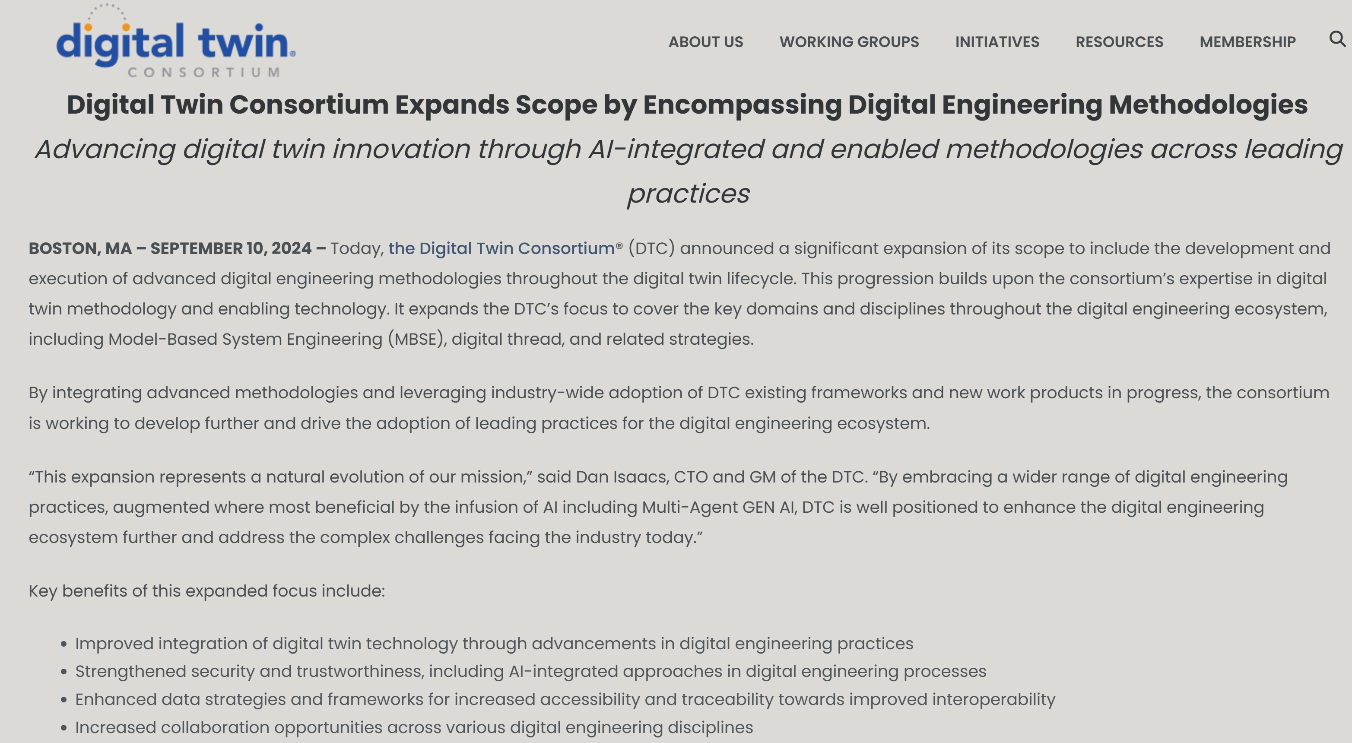

Slide 33
AI Joint Consortia Working Group
Digital Thread
Interoperability & Automation
Standardization & Semantics
Extended Reality XR:AR-MR-VR
Digital Thread
Digital Thread
Standards Development
Augmented Reality
NEW CROSS-CONSORTIA
AI JOINT WORKING GROUP
Responsible AI
Digital Thread

Slide 34
AI Joint Working Group Focus
Standardization &
Semantics
Interoperability &
Intelligent Automation
Extended Reality
(AR/MR/VR)
Responsible AI/Ethics
& Data Provenance
FOCUS AREAS

Slide 35
Advancing Innovation and Business Outcomes
Innovation
Collaboration
Leadership
Growth
Thought Leadership
Non-traditional approaches to problem solving using Unconventional thought process
Force Multiplier
Engage with industry leaders, innovators, researchers, and others to develop and implement advanced technology
Establish Authority
Bring Expertise and Knowledge to forefront Drive Industry Transformation
New Revenue Sources
Ability to recognize and rapidly execute on market opportunities
www.digitaltwinconsortium.org

Slide 36
Thank You!

Slide 37
Digital Twin Definition
A digital twin is an integrated data-driven virtual representation of real-world entities and processes, with synchronized interaction at a specified frequency and fidelity.
Digital Twins are motivated by outcomes, driven by use cases, powered by integration, built on data, enhanced by physics, guided by domain knowledge, and implemented in dependable and trustworthy IT/OT/ET systems.
Digital Twin Systems transform business by accelerating and automating holistic understanding, continuous improvement, decision-making, and interventions through effective action.
Digital Twin Systems are built on integrated and synchronized IT/OT/ET systems, use real-time and historical data to represent the past and present, and simulate predicted futures
Digital Twin Prototypes use data to model and simulate predicted futures before being integrated into IT/OT/ET Systems and before synchronization with the real-world entity or process

Slide 38
Digital Thread Definition
A digital thread is a bidirectional, dependable and trustworthy interconnected information system that links multiple dimensions, including structure, behaviour, space, time, and lifecycle stages.
It facilitates secure and resilient data and model management and governance, ensuring trustworthiness in data exchange and interoperability.
By integrating different types of data and providing ontologies, the digital thread fosters a seamless flow of information throughout the lifecycles of a digital twin.
Through its reciprocal interaction, the digital thread enhances visibility and transparency, enabling organizations to make informed decisions and optimize operations.
Digital twin systems may comprise of multiple digital threads working together to ensure comprehensive linkage across isolated data, repositories, and systems, enabling safe and secure closed-loop communication across products, people, processes, and places.

Slide 39
Digital Twin Value across the Pharma Value Chain (simplified)*
Phase | Value Provided by Digital Twins | Relevant KPIs
Discovery | - Predictive Modeling: Simulating molecular interactions for drug behavior prediction. - Chemical Space Exploration: Efficient exploration of chemical compounds. - Lead Optimization: Rapid assessment of drug candidates. | - Hit Rate: Percentage potential leads that become successful drug candidates. - Time to Candidate Selection: Time taken from screening to lead identification
Manufacturing | - Process Optimization: Improving manufacturing efficiency. - Quality Assurance: Real-time monitoring for consistency - Predictive Maintenance: Early detection of equipment issues. | - Overall Equipment Effectiveness (OEE): Equipment performance. - Batch Yield: Percentage of successful batches produced. - Downtime: Time equipment is not operational.
Delivery | - Personalized Medicine: Tailoring treatments based on patient data. - Supply Chain Visibility: Tracking drug movement. - Safety Assurance: Ensuring authentic medicines reach patients. | - Patient Adherence: Patient compliance with prescribed medications. - Inventory Turnover: How quickly inventory is used or replaced. - Order Fulfillment Time: Time from order placement to delivery.
Regulation | - Compliance Management: Facilitating regulations adherence - Traceability: Accurate record-keeping. - Risk Mitigation: Early detection of deviations. | - Regulatory Compliance Score: Adherence assessment to regulations. - Audit Findings: #non-compliance issues found during audits. - Risk Exposure: Identification of potential risks.
*Source: Internal Research + Bing CoPilot

Slide 40
Gen AI Value across the Pharma Value Chain (simplified)*
Phase | Value Provided by Generative AI
Discovery | - Novel Drug Candidates: Gen AI accelerates the identification of potential drug candidates. - Molecular Design: Efficiently explores chemical space for new compounds. - Predictive Insights: Rapid assessment of drug behavior and efficacy.
Manufacturing | - Process Optimization: Gen AI optimizes manufacturing processes, reducing costs and waste. - Quality Enhancement: Real-time monitoring ensures consistent product quality. - Predictive Maintenance: Early detection of equipment issues, minimizing downtime.
Delivery | - Personalized Medicine: Gen AI tailors treatments based on individual patient data. - Supply Chain Efficiency: Improved logistics and inventory management. - Safety Assurance: Ensures authentic medicines reach patients.
Regulation | - Compliance Automation: Gen AI facilitates adherence to regulatory requirements. - Traceability and Audit Trails: Accurate record-keeping for inspections. - Risk Mitigation: Early detection of deviations from standards.
*Source: Internal Research + Bing CoPilot

