Slide 1
Voice-Enabled Beamlines at NSLS-II
Shray Mathur, Esther Tsai, Kevin Yager

Slide 2
Goal
Make user operation easier and more efficient at the beamline using AI agents.
High-level speech commands
Beamline executable code
Move sample x to absolute 15 mm and use quick align.
sam.xabs(15)
sam.quick_align()

Slide 3
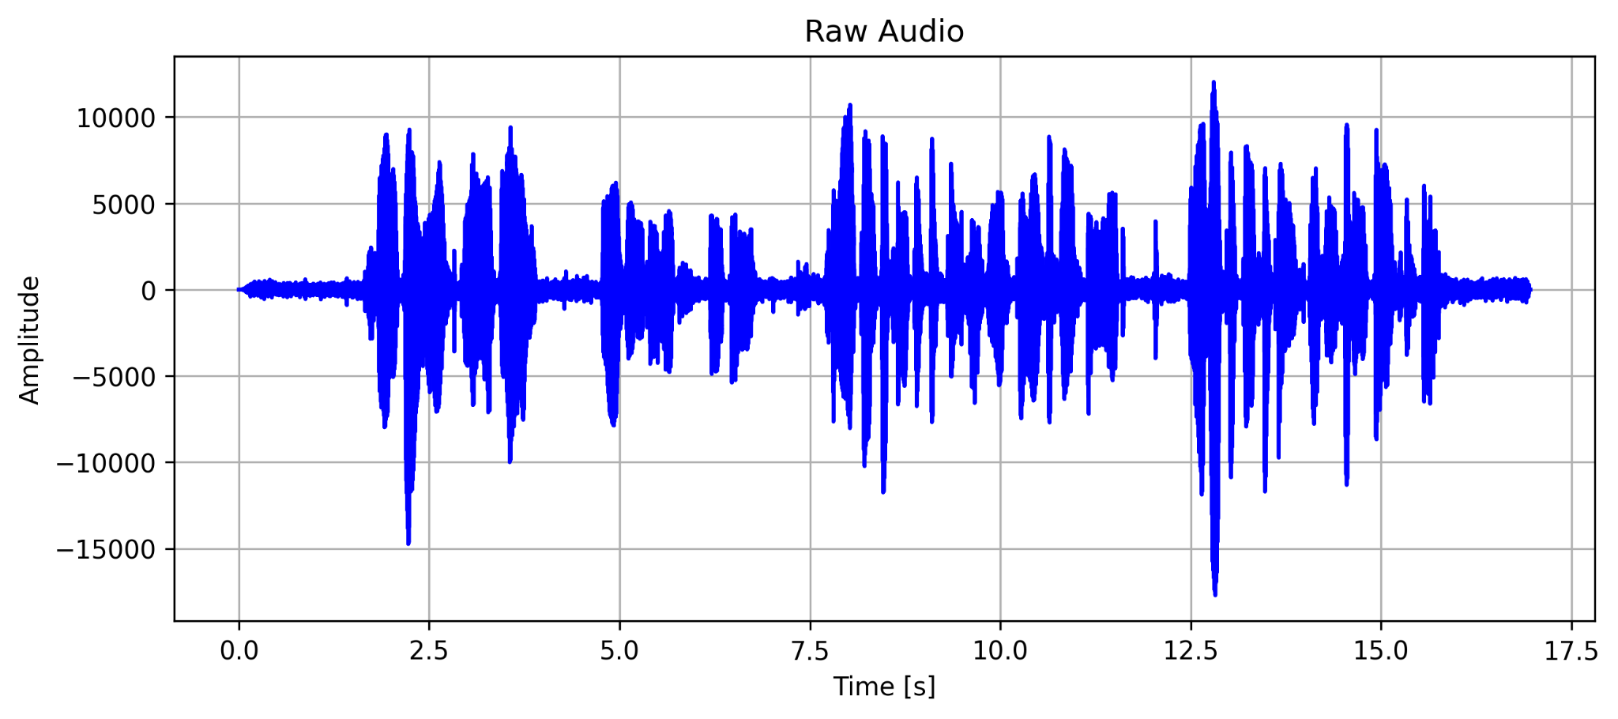
Challenges
Out of the box pretrained Speech-to-Text (STT) models not familiar with beamline specific terminology (SAXS, WAXS, GISAXS, GIWAXS, etc) or commands.
This process uses feedback from in-situ sacks wax measurements
❌
Pre-trained STT

Slide 4
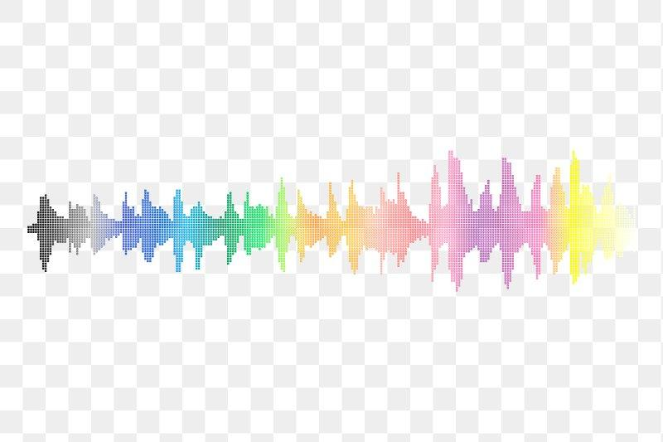
Solution: Fine-tuning
Further Challenges
Data Requirements: Require high-quality audio-text pairs to learn effectively
Data Availability: Where do we find reliable beamline-specific audio-text pairs?
Solution: Utilize Text-to-Speech (TTS) models to generate synthetic audio from beamline proposal documents

Slide 5
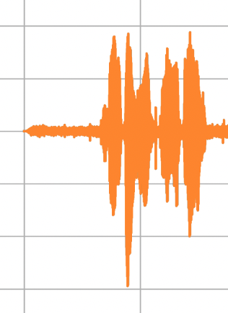
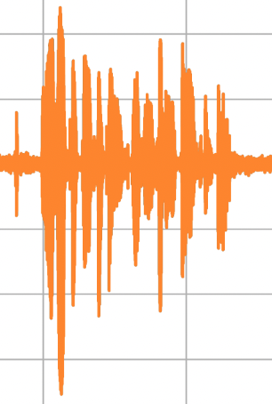
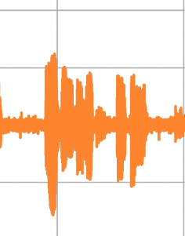
Fine-tuning pipeline: TTS + LoRA
Proposal Documents
Chunk
TTS model
TTS
Synthetic Audio - Text Pairs
LoRA FT
Fine-tuned STT
LoRA
Pre-trained STT

Slide 6
Fine-tuned Model
This process uses feedback from in-situ sacks wax measurements
❌
Pre-trained STT
This process uses feedback from in-situ SAXS/WAXS measurements
✅
Fine-tuned STT

Slide 7
Key Takeaways
Fine-tuning pipeline is:
Simple
Effective
Scalable
Requires about 8-10 mins of audio-text pairs to teach STT model a new word
Work part of a larger project - Exocortex!
Yager, Kevin G. "Towards a Science Exocortex." Digital Discovery (2024).

