Slide 1
Menopause: It’s about FemHealth, not just FemTech
Michael N. Liebman, PhD
Sasha Rieders, MSc
IPQ Analytics, LLC (Kennett Square, PA)
in collaboration with 23Strands (Sydney, Australia)

Slide 2
IPQ’s Women’s Health Program (Development and Disease)
newborn
Conception
-natural
Pre Term
Birth
Full Term
Birth
Infant
Toddler
child
adolescent
adult
28 days
23 mos
11 years
18 years
IVF
Hypertensive Disorders of Pregnancy
Developmental Issues
Breast Cancer
Pre-eclampsia
Postpartum Conditions
Multiple Sclerosis
Infant/
Maternal
Morbidity/Mortality
Premature Birth
Normal/
abnormal
Development
Rare Diseases
Peri-menopause/
Menopause
Bronchopulmonary
Dysplasia
Cardiovascular Disease
Infectious Diseases
Underserved Populations

Slide 3
Perimenopause is a Process, Not a Symptom
Hot Flashes
Female 1
Female 3
50
Frequent urination
Headaches
Female 2
Headaches
10
Margaret Hamburg, FDA, "clinicians have long
observed that patients with similar symptoms
may have different illnesses”
Paving the Way for Personalized Medicine 2013
time

Slide 4
Female Developmental Landmarks
Gene Expression
Protein Expression
Processes and Pathways
Cumulative
Development
Post-Menopausal
Disease Risk
Lactation
-Breast Cancer
-Cardiovascular
Disease
-Osteoporosis
-…..
Fetal
Development
Conception
Menarche
Child-bearing
Menopause
Peri-menopause
1 Ridge stage Less than 5mm embryo
2 Milk hill stage More than 5.5-mm embryo
3 Mammary disc stage Around 10–11mm embryo
4 lobule type stage 11.0–25.0-mm embryo
5 Cone stage 25–30-mm embryo
6 Budding stage 30–68-mm embryo
7 Indentation stage 68-mm to 10 cm
8 Branching stage 10 cm fetus
9 Canalization stage 20 and 32 weeks of gestation
10 End-vesicle stage, in which the end vesicles are
composed of a monolayer of epithelium and contain
colostrums Newborn
Gestational Age
Weight gain
HDP’s
Gestational Diabetes
Delivery Method
Breast Feeding
Pregnancy Intervals
Symptoms
-which ones
-in what order
-co-occurrence
-treatment
Exampla:
Breast
Development
Notes:
In particular, it is well established that the breast undergoes developmental changes throughout a patient’s lifetime, starting with at least 10 separate stages in the fetus and ongoing through the post-menopausal period. Several critical physiological stages are noted in the timeline shown in this slide because of their potential significance in understanding the changes in risk of breast cancer. To understand the details at the molecular level of what is happening at each stage of development and to also be able to understand that it is the molecular level processes that interact with the risk factors, e.g. smoking, alcohol, it is necessary to examine additional literature to identify, initially, the physiological processes that are changing through development, then the underlying biological pathways that are enabling/supporting those changes, and subsequently the changes in protein expression and gene expression levels which may be the direct targets responsible for the breast cancer risk from such factors. So this means that the epidemiological analysis of the previous slide and identification of developmental stages and associated risk factors can be interpreted as interacting with molecular, e.g. proteins, genes and pathways, which are active at those stages and thus provide some insight into developing better diagnostics, therapeutics, patient management, stratification of disease, etc

Slide 5
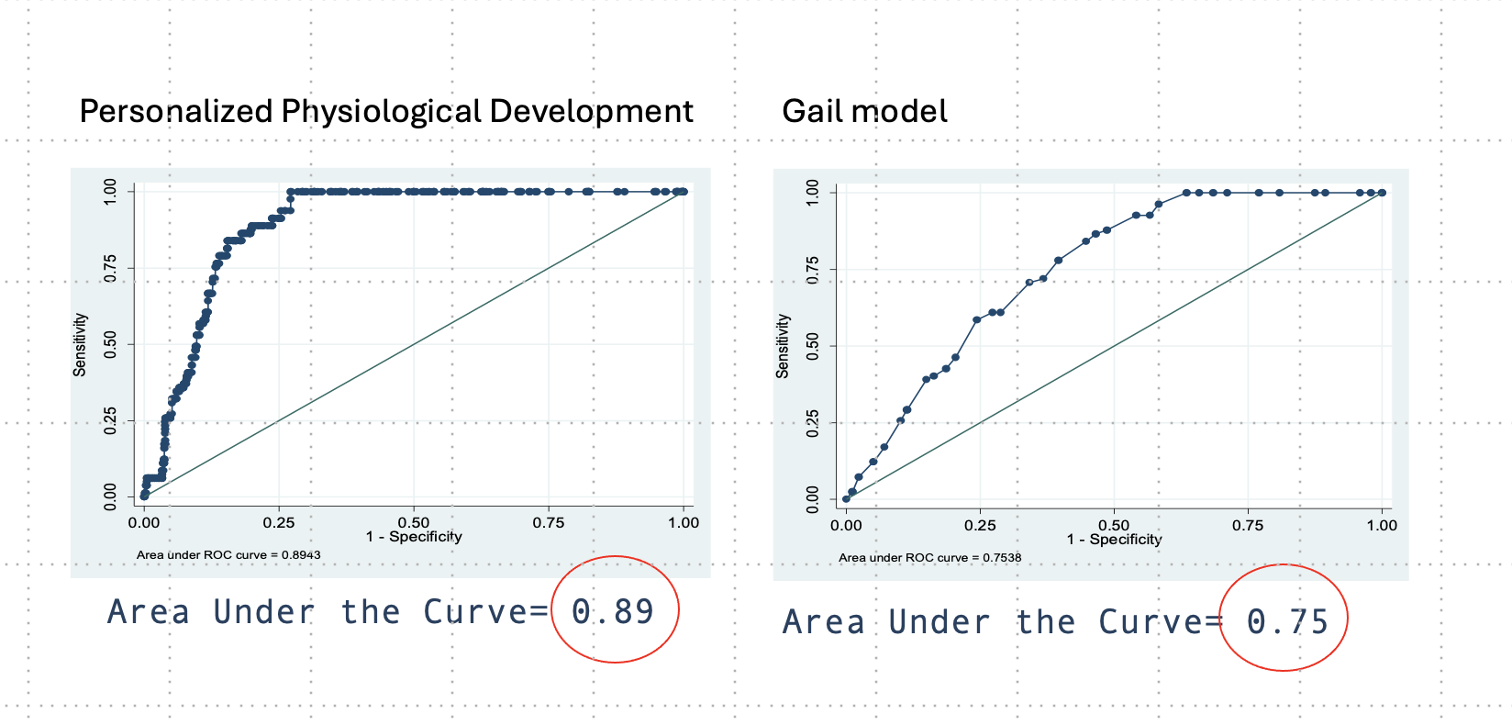

Slide 6
Figure 2
TODAY
Stratification:
Disease,
Development
Pathway
Simulation
Digital
Twin
Digital
Monitoring
Menopause
Survey
Risk
Modeling
UNDER
DEVELOPMENT
UNDER
DEVELOPMENT

Slide 7
