Slide 1

Biomimetic Digital Twins and Multiomics: Applications to Rheumatoid Arthritis to Understand the Molecular Mechanisms of Disease
NYSDS
09-17-2024
William G. Kearns

Slide 2

NAS - 2022 Opportunities and Challenges for Digital Twins in Biomedical Research.
DOI: https://doi.org/10.17226/26922
NAS published a 164-page report: “Foundational Research Gaps and Future Directions for Digital Twins” (December 15, 2023)
National Academies of Sciences, Engineering, and Medicine. 2023. Foundational Research Gaps and Future Directions for Digital Twins. Washington, DC: The National Academies Press. https://doi.org/10.17226/26894

Slide 3
Digital Twin (DT) Technologies
Biomimetic DT Ecosystems
Mechanistic DT Methods
Model agents or independent components of a problem domain that may interact
Output real-world evidence of previously unseen interactions
Biomimetic design supports interactions between models of diverse domains and scales enabling discovery & learning
Model defined systems or subsystems
Simulate or predict the behavior of the model in diverse scenarios
Mechanistic design limits the learning from interactions between models of diverse domains and scales

Slide 4
Technical Advance Using Multiomics and Biomimetic Digital Twins - Endometriosis
Kearns WG, Stamoulis G, Glick J, Baisch L, Benner A, Brough D, Du L, Wilson B, Kearns L, Ng N, Seshan M, Anchan R.
The Application of Knowledge Engineering via the Use of a Biomimetic Digital Twin Ecosystem, Phenotype-Driven Variant Analysis, and Exome Sequencing to Understand the Molecular Mechanisms of Disease.
Key Result – The identification of a potential biomarker in Muc20
Biomimetic methodology enabled the use of small and diverse data
J Mol Diagn. 2024 Jul;26(7):543-551. doi: 10.1016/j.jmoldx.2024.03.004. Epub 2024 Mar 29.PMID: 38556123

Slide 5





5

Slide 6
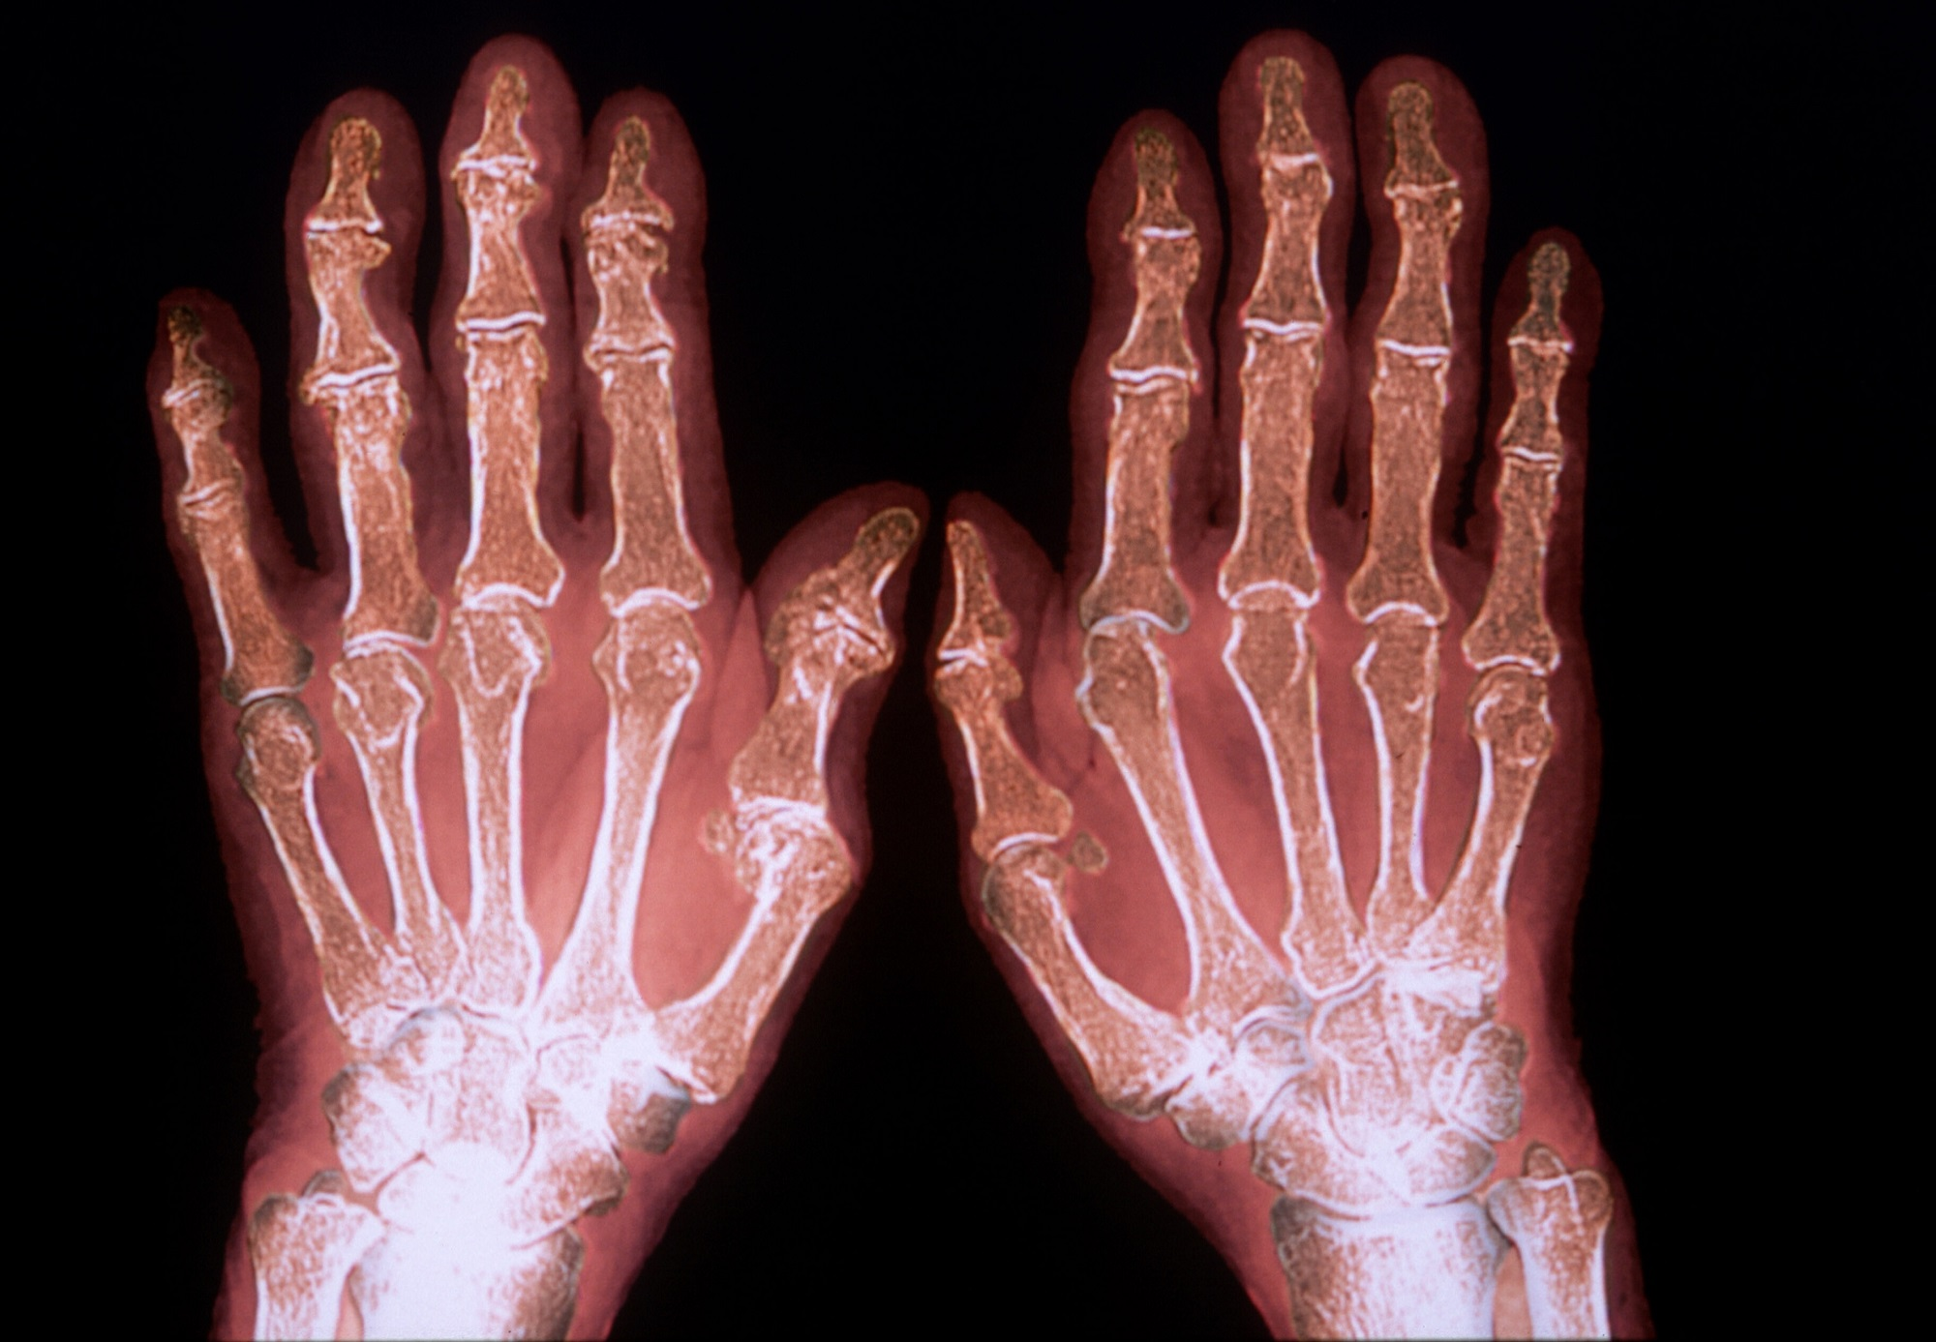
Rheumatoid Arthritis

Slide 8
Rheumatoid Arthritis Study
Published papers identified 6786 gene inter-relationships potentially associated with this disorder
Genotype – phenotype correlations – potentially associated with the disease
All proteins classified as missense or frameshift mutations.
  6 gene DNA variants classified as VUSs
    4 have a direct relationship to the pathophysiology of the disorder
    2 have an indirect relationship
Submitted to J Molecular Diagnostics
  Under revised peer review

Slide 9
Genes Directly Related to the Pathophysiology of Rheumatoid Arthritis
HIF1A - The hypoxia-inducible factor-1α (HIF-1α) gene is over expressed in rheumatoid arthritis and may play a role in the disease's pathogenesis
HLA-DOA -Is a non-classical HLA gene that belongs to the HLA class II alpha chain paralogues. It forms a heterodimer with HLA-DOB and appears to contribute to a risk of rheumatoid arthritis.
PTGER3 - The protein encoded by the PTGER3 gene is a member of the G-protein coupled receptor family. This protein is one of four receptors identified for prostaglandin E2 (PGE2). In inflamed joints of rheumatoid arthritis, PGE (2) is highly expressed, and IL-10 and IL-6 are also abundant. PGE (2) is a well-known activator of the cAMP signaling pathway, and there is functional crosstalk between cAMP signaling and the Jak-STAT signaling pathway.
HIPK3 - HIPK3 encodes a homeodomain interacting protein kinase 3. This enables protein serine/threonine kinase activity. It is involved in mRNA transcription, cell proliferation, inflammation, negative regulation of the apoptotic process, and protein phosphorylation. Over expression of HIPK3 protein in immune cells is associated with rheumatoid arthritis.

Slide 10
Genes Indirectly Related to the Pathophysiology of Rheumatoid Arthritis
TGFBR3 - This locus encodes the transforming growth factor (TGF)-beta type III receptor. TGFBR3 is indirectly related to the development of rheumatoid arthritis by interacting with pathways including TNF. This gene encodes a multifunctional proinflammatory cytokine that belongs to the tumor necrosis factor (TNF) superfamily.
HIF1A-AS3 – The HIF1A gene encodes the alpha subunit of transcription factor hypoxia-inducible factor-1 (HIF-1). HIF-1 functions as a master regulator of cellular and systemic homeostatic response to hypoxia. Tissue hypoxia are major characteristics of rheumatoid arthritis.

Slide 11
Conclusions
We incorporated biomimetic digital twins with our multiomics platform to potentially clarify the pathogenesis of complex disorders. We accomplished this by identifying hidden relationships as either directly or indirectly related to the development of the disease studied.
Our results suggest that by using biomimetic digital twins and a comprehensive multiomics platform, that we can potentially begin the process of reclassifying variants of unknown clinical significance (VUS).
The reclassification of VUSs would play a critical role in complex diagnostics and drug development.
We can potentially reduce the time and cost of drug development

Slide 12


New Collaborations
The Study of Rare Diseases Genomics Institute
All of Us

