Slide 1
Agriculture Digital Twin Production of Renewable BioEnergy Crops
Presented by Nathaniel Bradley, CEO Datavault Inc. (NASDAQ: WISA)

Slide 2
PhytoIntel Platform with High Performance Computing (HPC)
Nearing quantum speeds of processing with superior memory management and photorealistic 3D display capabilities the virtual plant digital twin is a tool that will improve and optimize outputs for feed, fuel and industrial crops.
Higher renewable energy outputs, greater health for people & animals are also achievable upon successful creation of agricultural grade digital twins of plant species. Their counter part the clinical grade digital twins of people are both required for the creation of valuable insilico research methods.
Project thesis; PhytoIntel Platform by Datavault patented software along with the HPC environment at BNL including AI & High Performance Computing (HPC) from CSI will;
A. Create Digital Twins designed to Improve & Optimize Chemical & Energy Crop Outputs
1. Bioethanol – Corn, Hemp…
2. Biodiesel – Oil Rape Seed, Canola…
4. Industrial Chemicals
5. Fibers
B. Digital Twins Improve Crops for Human Consumptions
1. Optimization of Input & Output Traits
A) One pathway for synthetic metabolite to increase Fatty Acid or Aromatic Amino
Acid of Tryptophan could have incredible compound economic affect.
2. Optimization of Nutritional Value and Output Traits

Slide 3
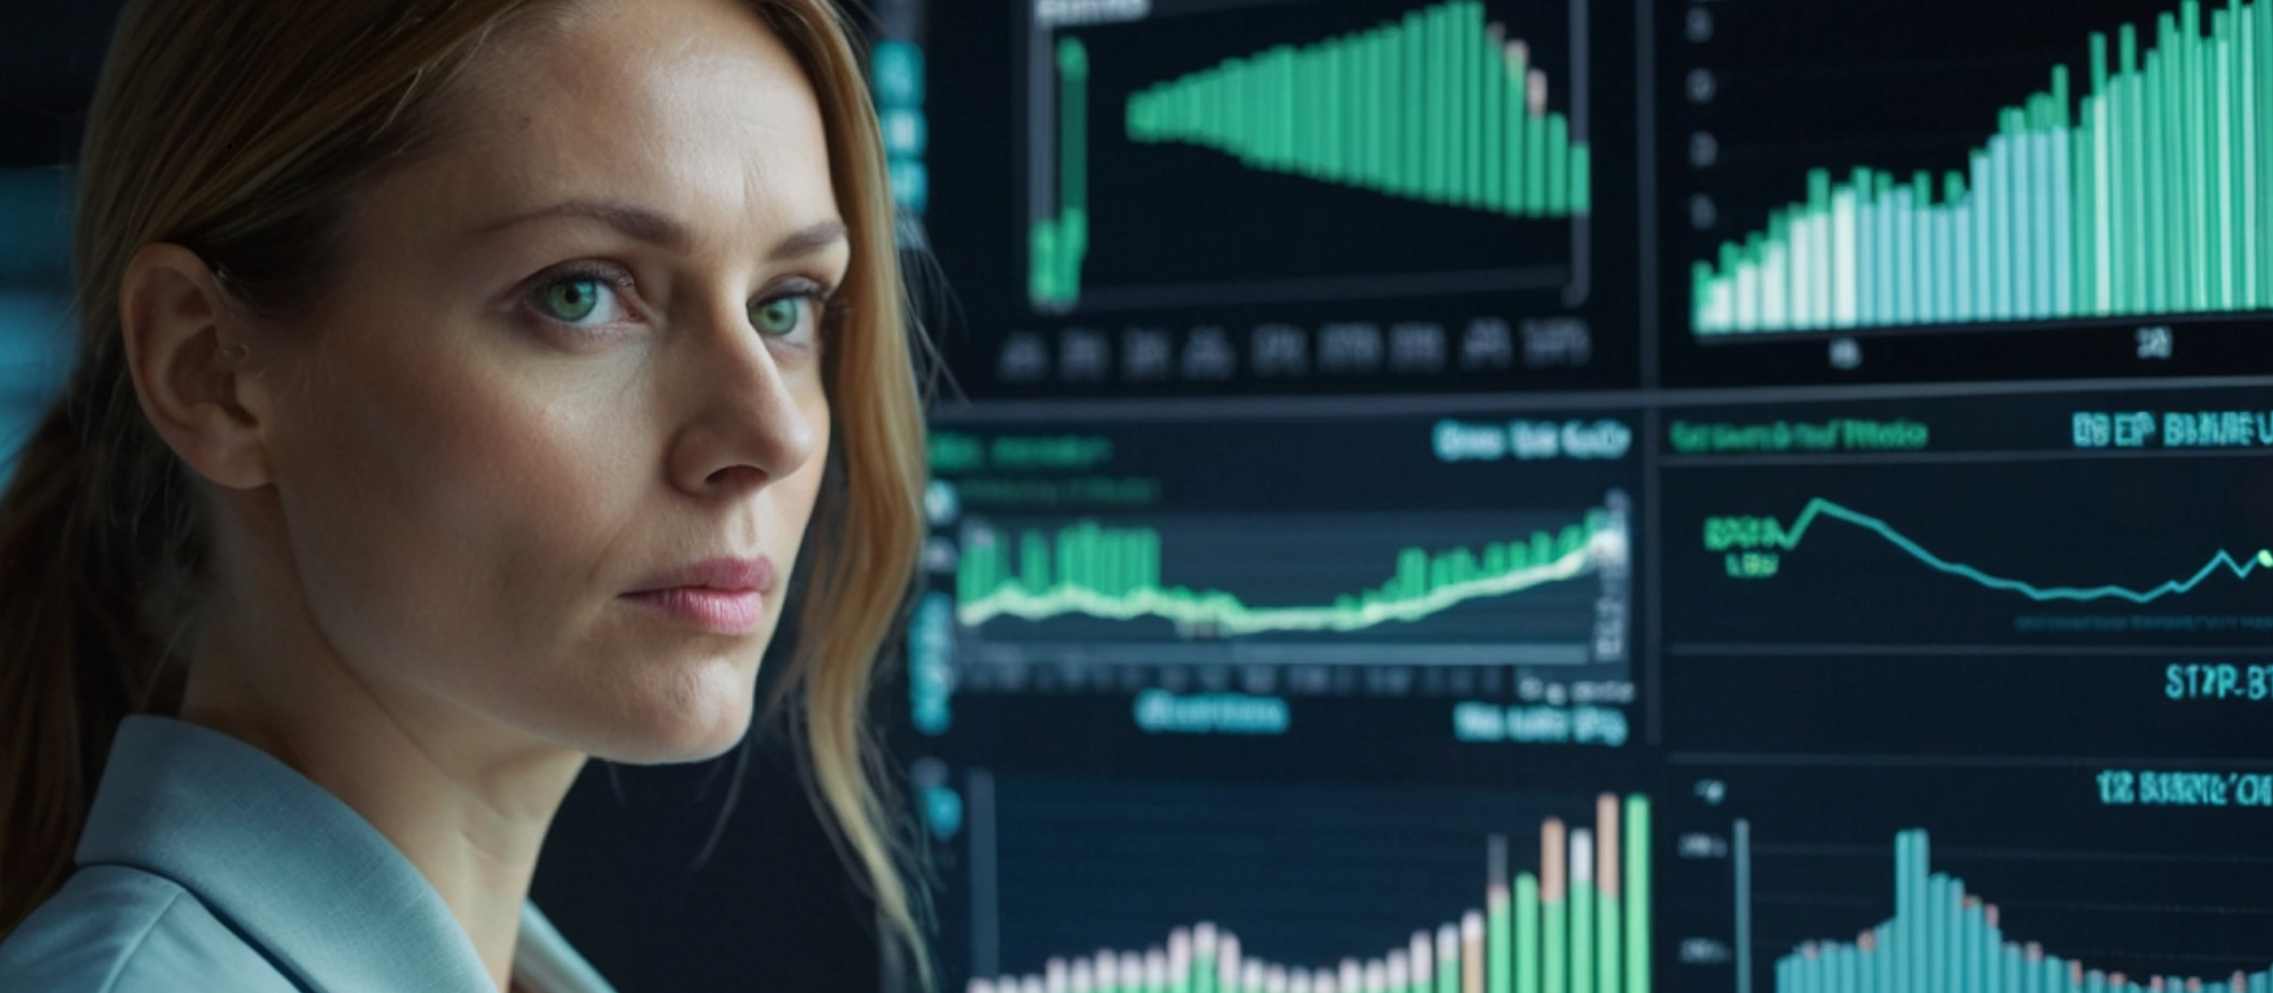
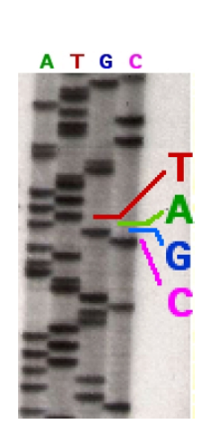
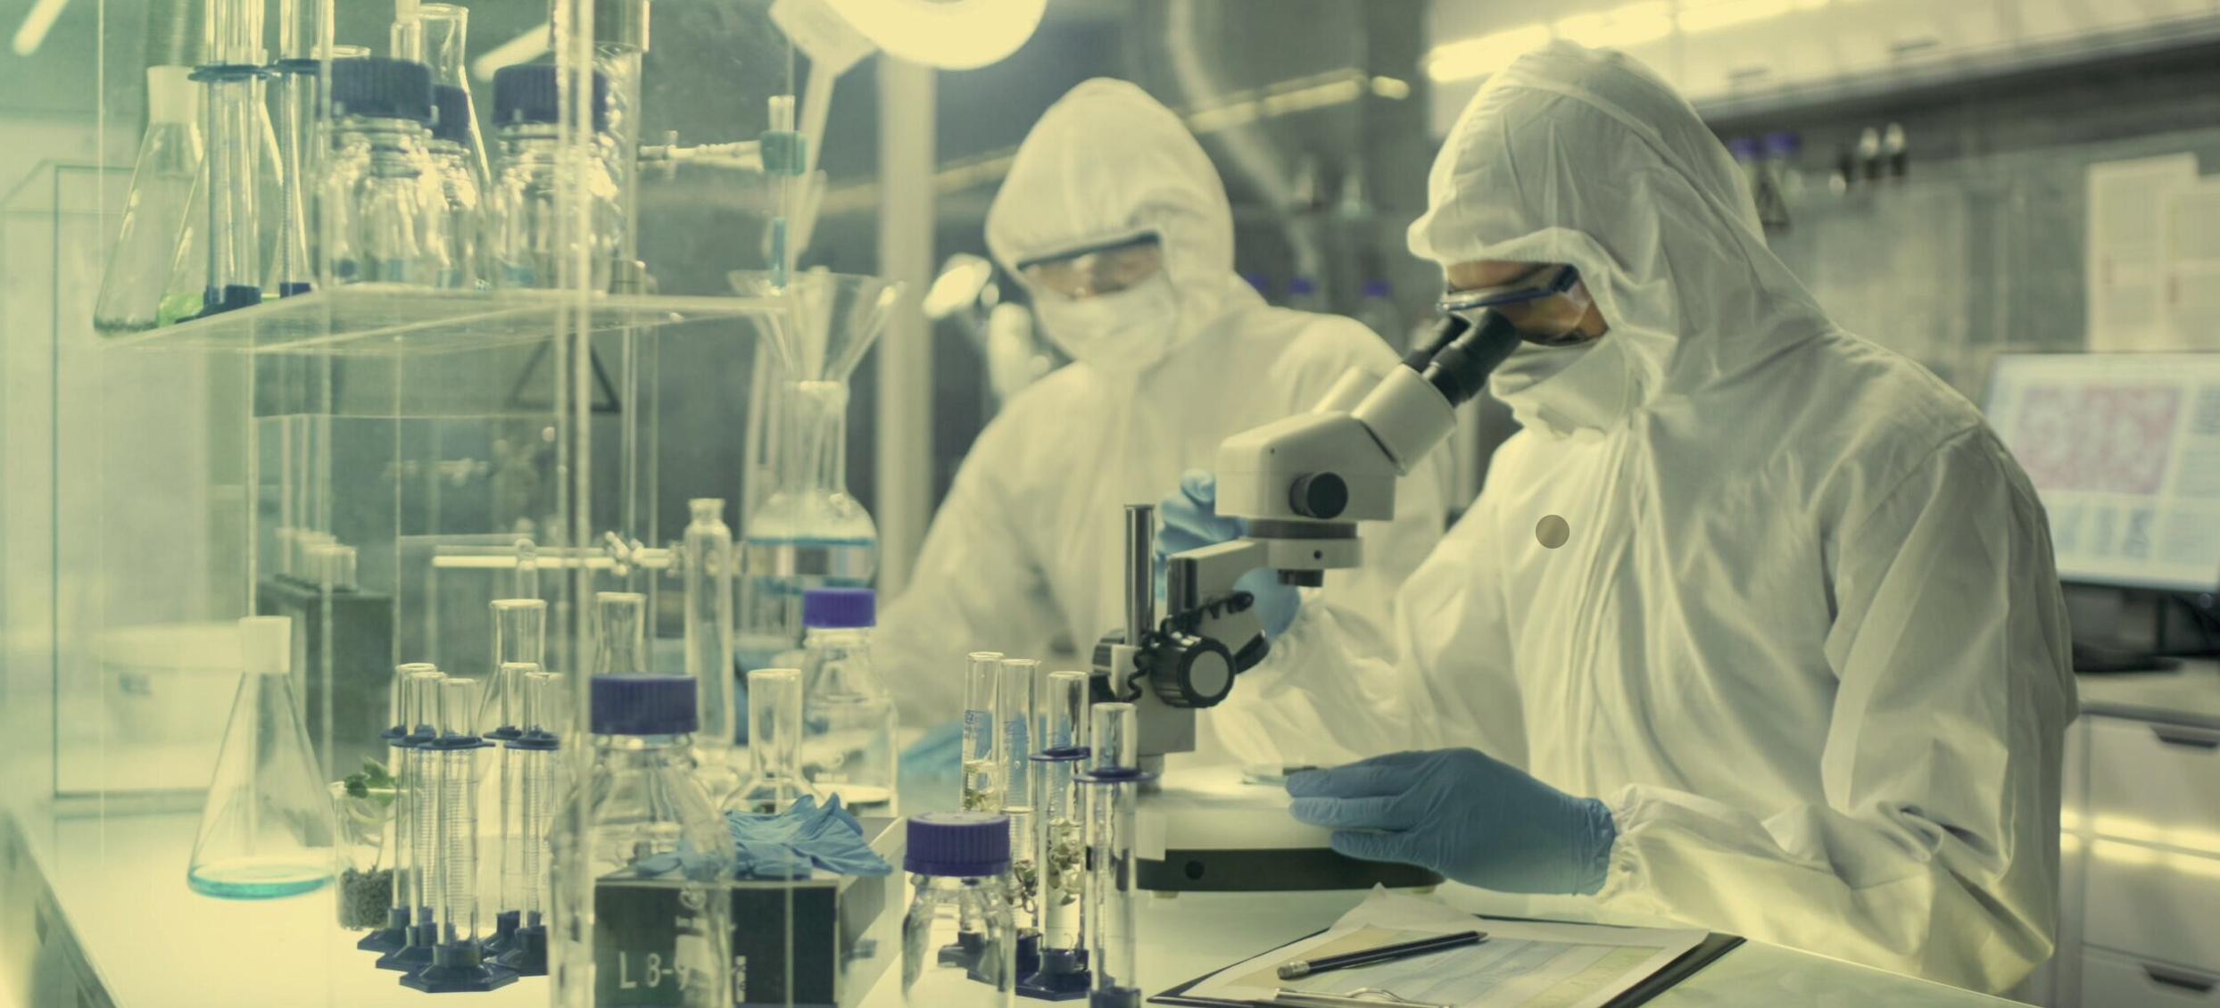
The Second Life Science Revolution: Industrialization to Virtualization
1980’s: Laboratory Groups
Single Gene Research 2-5 Years per Gene
COMPLEXITY UP BY A FACTOR OF 5,000,000,000 TIMES
2000’s: Industrialization
50-100 Genes per Week
2020’s Virtualization
Whole Genomes per Month
10^3
5*(10^3)^4
5 Billion
Complexity of possible interactions 1980’s | 2000’s 2020’s

Slide 4
1980’s Single Gene
~10y Per Lead - Few leads for development

Slide 5
2000’s INDUSTRIAL SCIENCE ERA
1 Lead per month
~5 years to screen one genome
painfully slow this era was first mass scale data collectors and were networked with resources and the best bioinformatics and IT softwares, Internet, Intranet and shared content were available with varied levels of access

Slide 6
2020’s Virtualization
All leads for entire Genome ~2-3 Months
High potential candidates for development
Complex development combinations

Slide 7
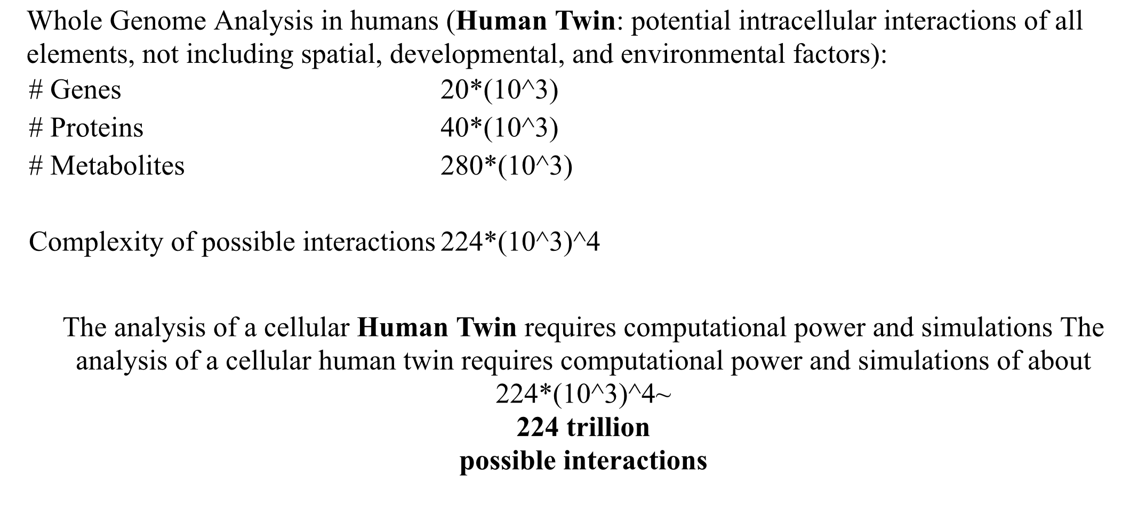
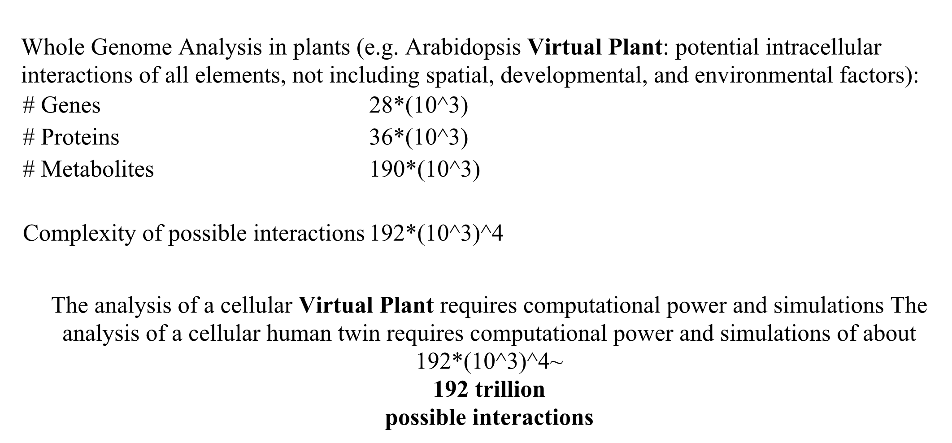
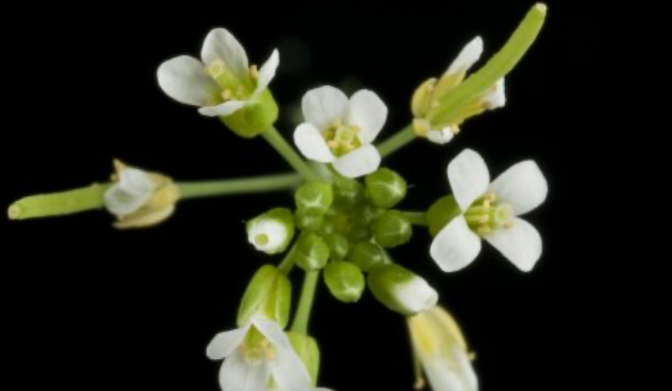
Comparison of Human vs Plant omics
Possible Interactions
224
Trillion
VS.
192
Trillion

Slide 8
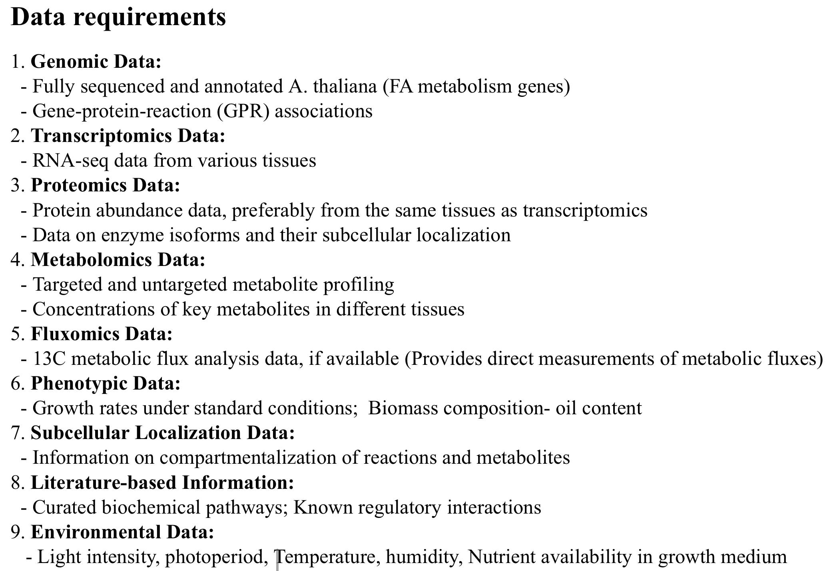
Trust is a key component and can be enhanced through responsible AI, Crypto Anchors and Blockchain Credentialing
Datavault, DataValue and Information Data Exchange

Slide 9
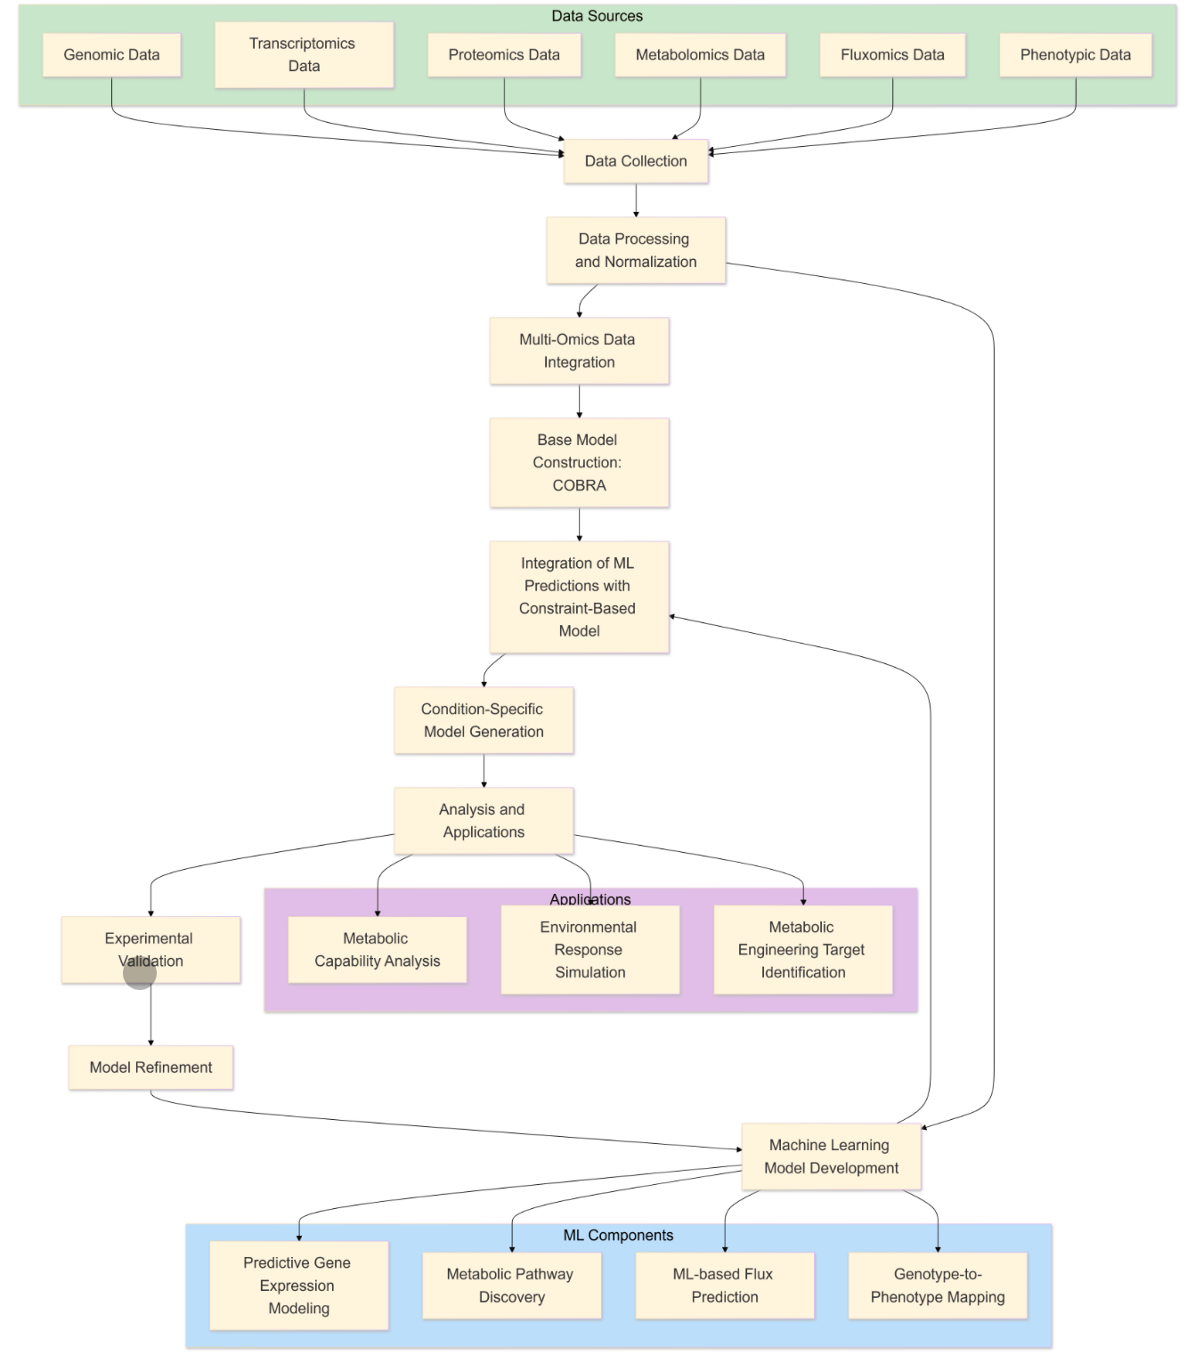
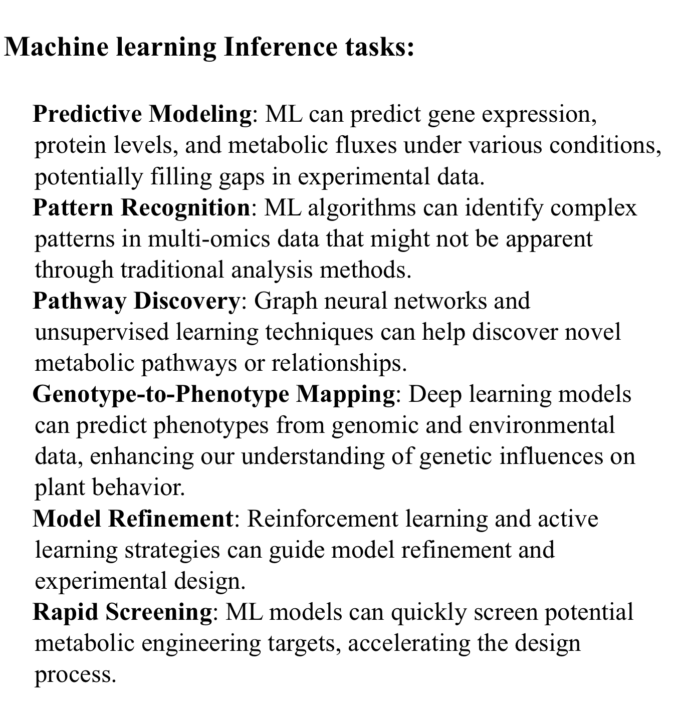
TYPES OF DATA SCHEMAS FOR VIRTUAL PLANT. INFERENCE TASKS FOR HPC ENABLED ENVIRONMENT.

Slide 10
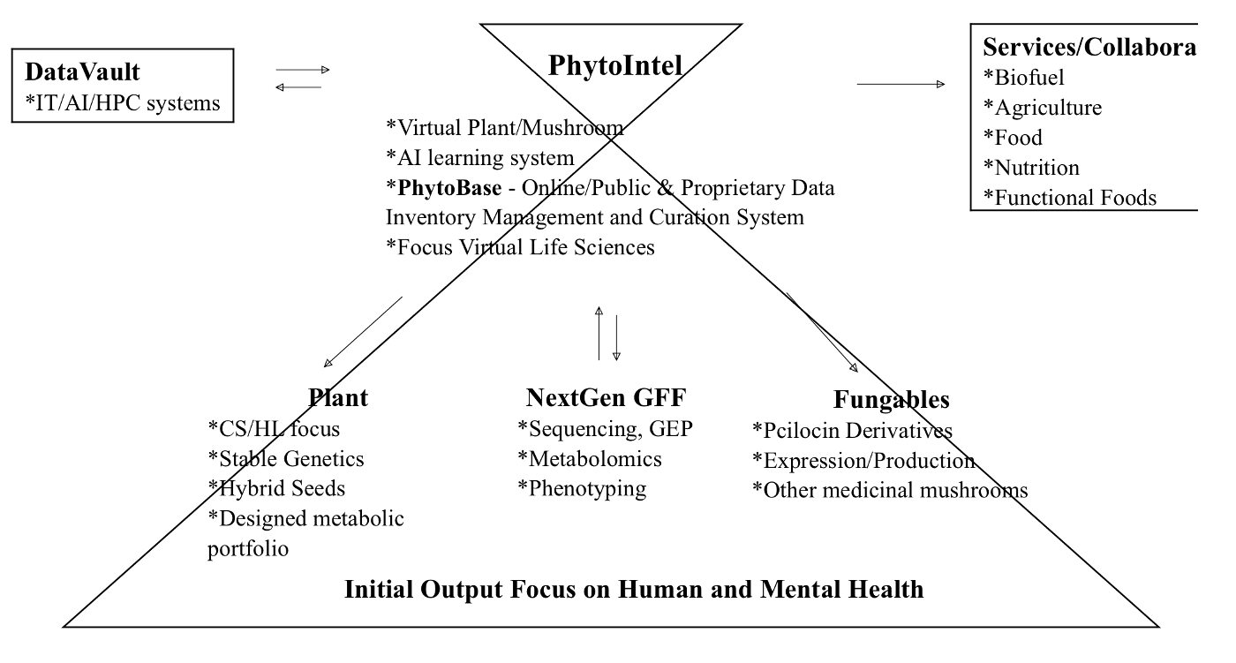
DATA SCHEMA & DATA REFINERY
FOR VIRTUAL PLANT DIGITAL TWIN
PhytoIntel – Outline

Slide 11
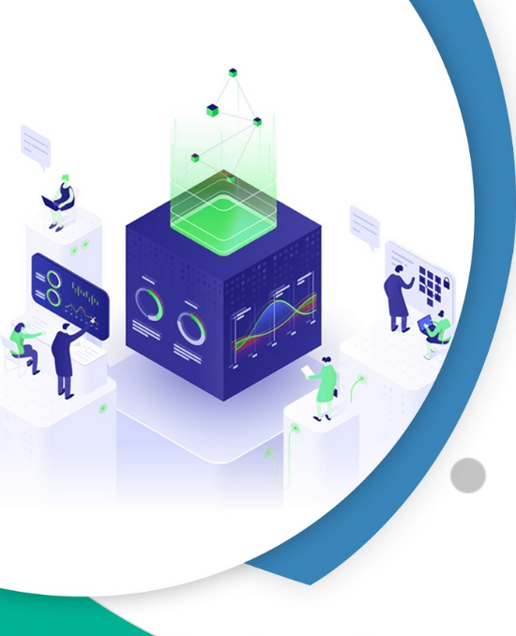
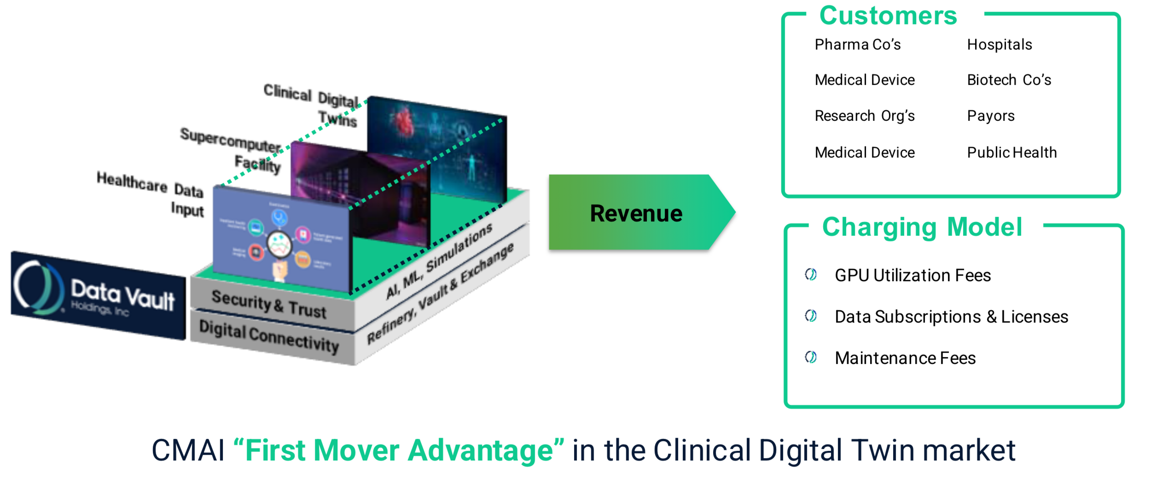
72 PATENTS
& PATENTS PENDING

Slide 12
Current R&D Process 15 to 20 Years to Product

Slide 13
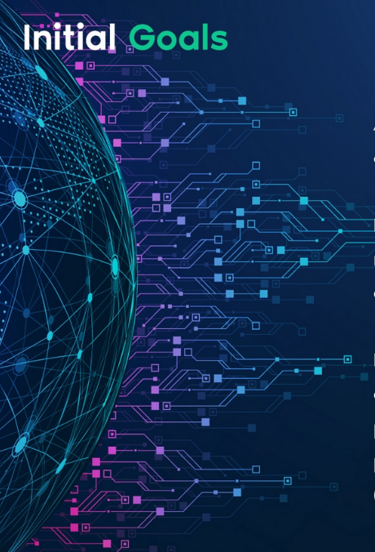
PHASE 1 HPC – Virtualization of Hit Identification delivered via PhytoIntel Platform with Datavault, Sumerian Crypto Anchors and High Performance Computation (HPC)

Slide 14
PHASE 2; Year 3-4 Virtualization of Research

Slide 15
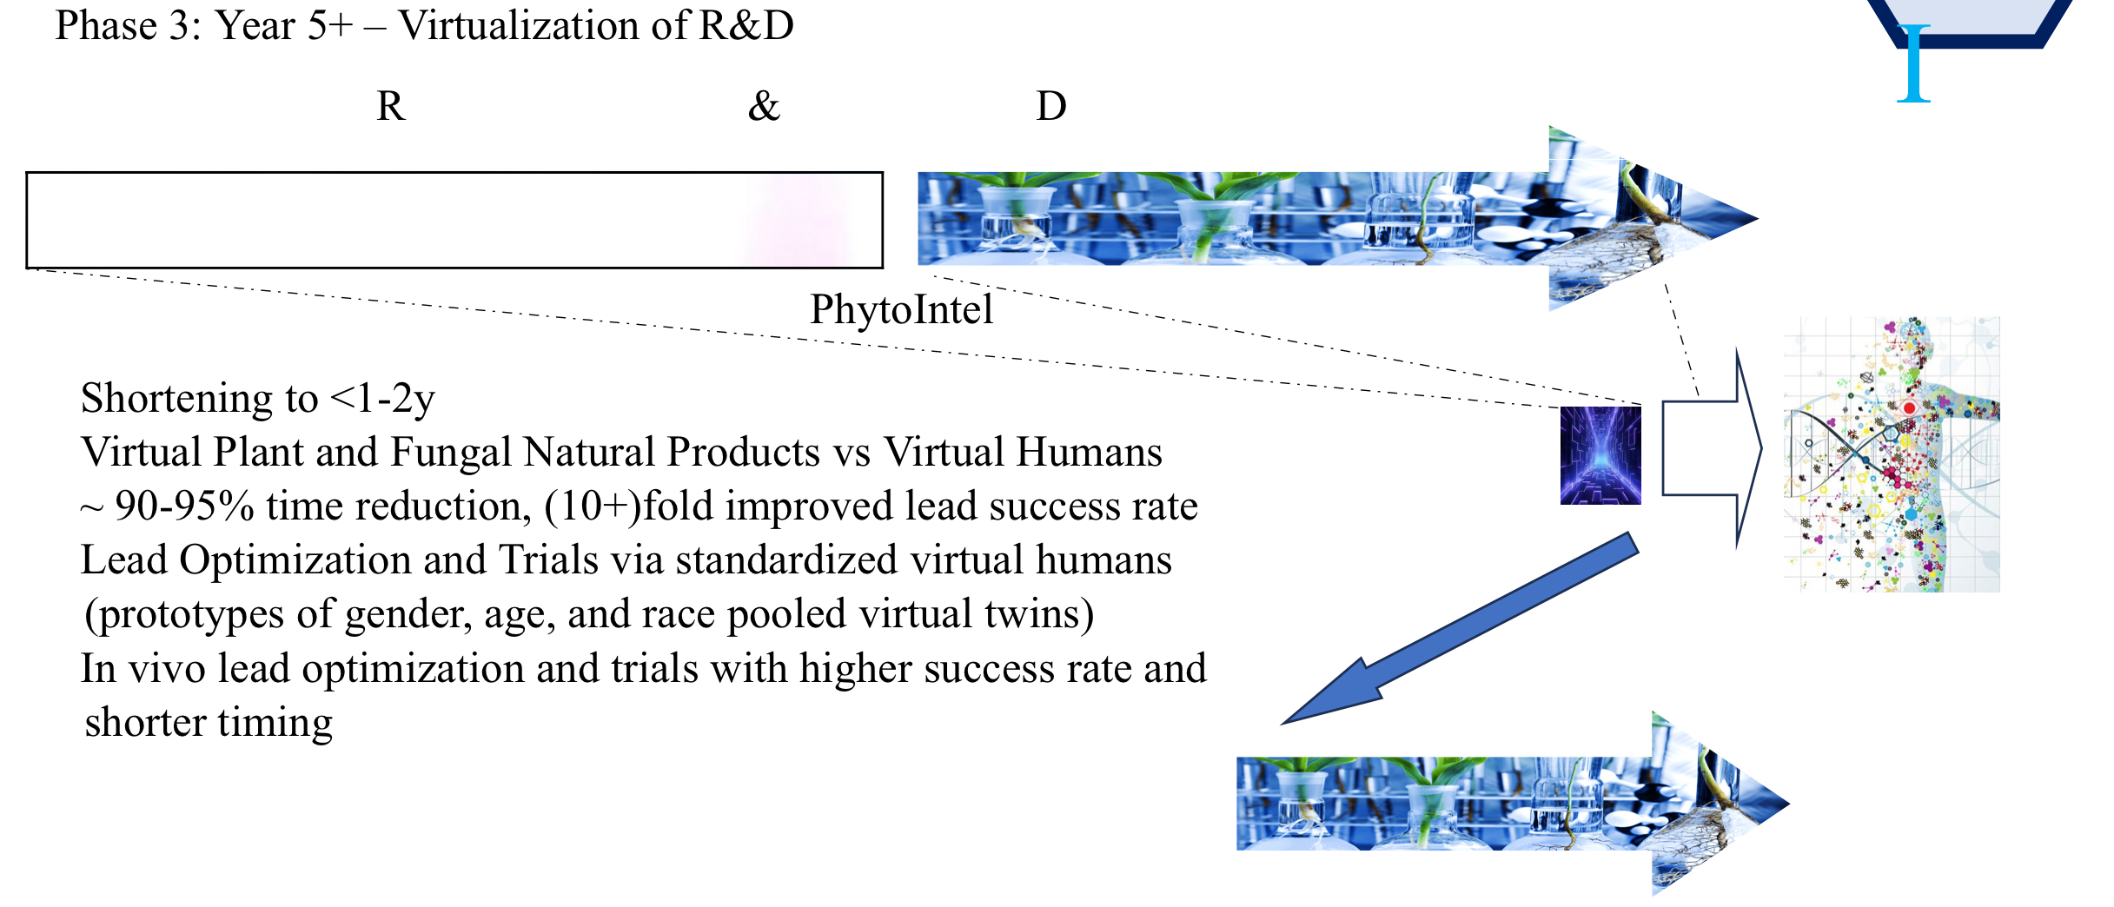
Phase 3 ~ 5 Years PhytoIntel, HPC & Datavault
Research 100% PhytoIntel Virtualization - Development involves trials with clinical grade human Digital Twins

Slide 16
Advantages and Disadvantages of Virtual Plant Digital Twins in HPC
+ We are trying to optimize the plant itself to use minimal resources to reach maximum results in renewable fuels
+ Genetic modification is NOT the goal of human digital twins but in plants it can be
+ Plants can be killed, cloned and transgenic
+ ML/AI with sufficient memory can be fed known gene squencing data and can learn to display and develop.
- Real World results require inputs such as sunlight, nutrients, and water that all have limitations, regionality, costs and growth cycles that take time to completely asses in the Real World.
- Those same inputs make completely independent data sets final calculations even more complex as to the variables and optimizations opportunities that exist for digital twins.
- The Genome vs Genome comparison of plants vs humans is nearly equivalent in complexity interactions, organisms and environmental, input variation make for even more complex algorhythmes in any give plant experiment.

Slide 17
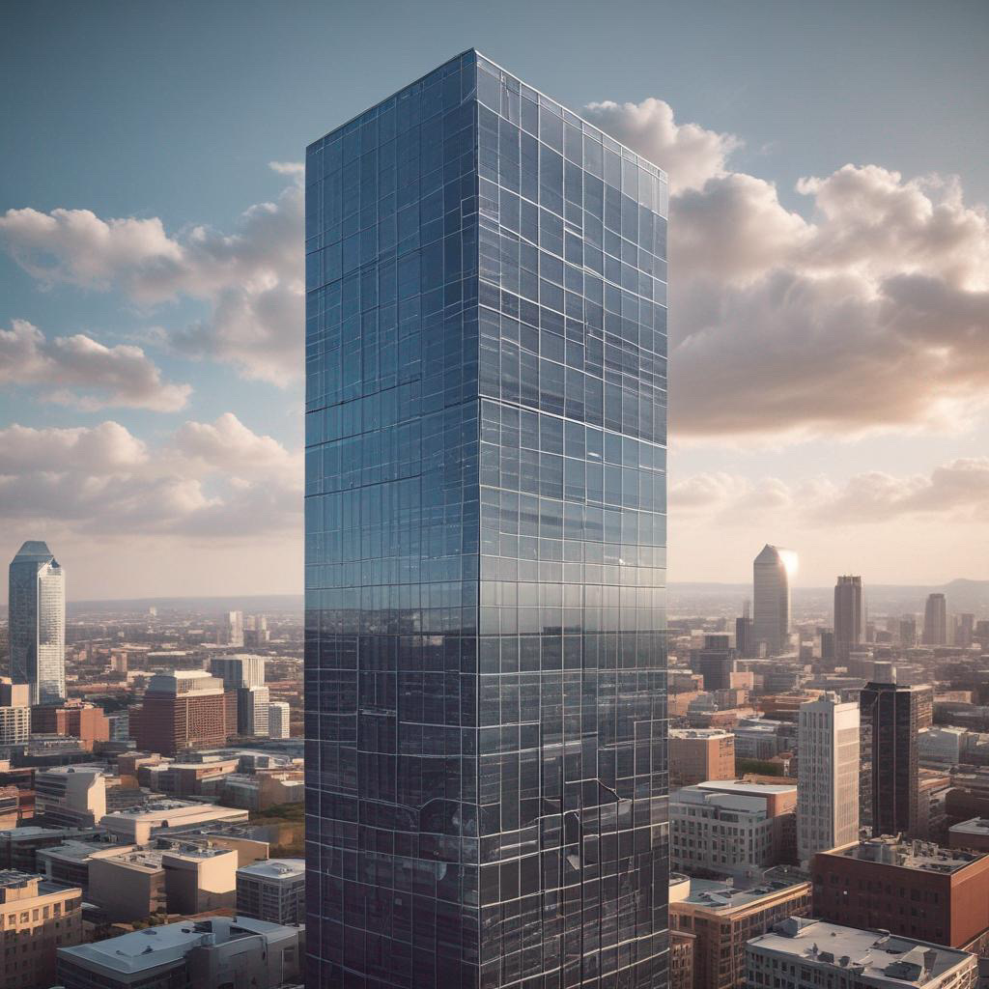
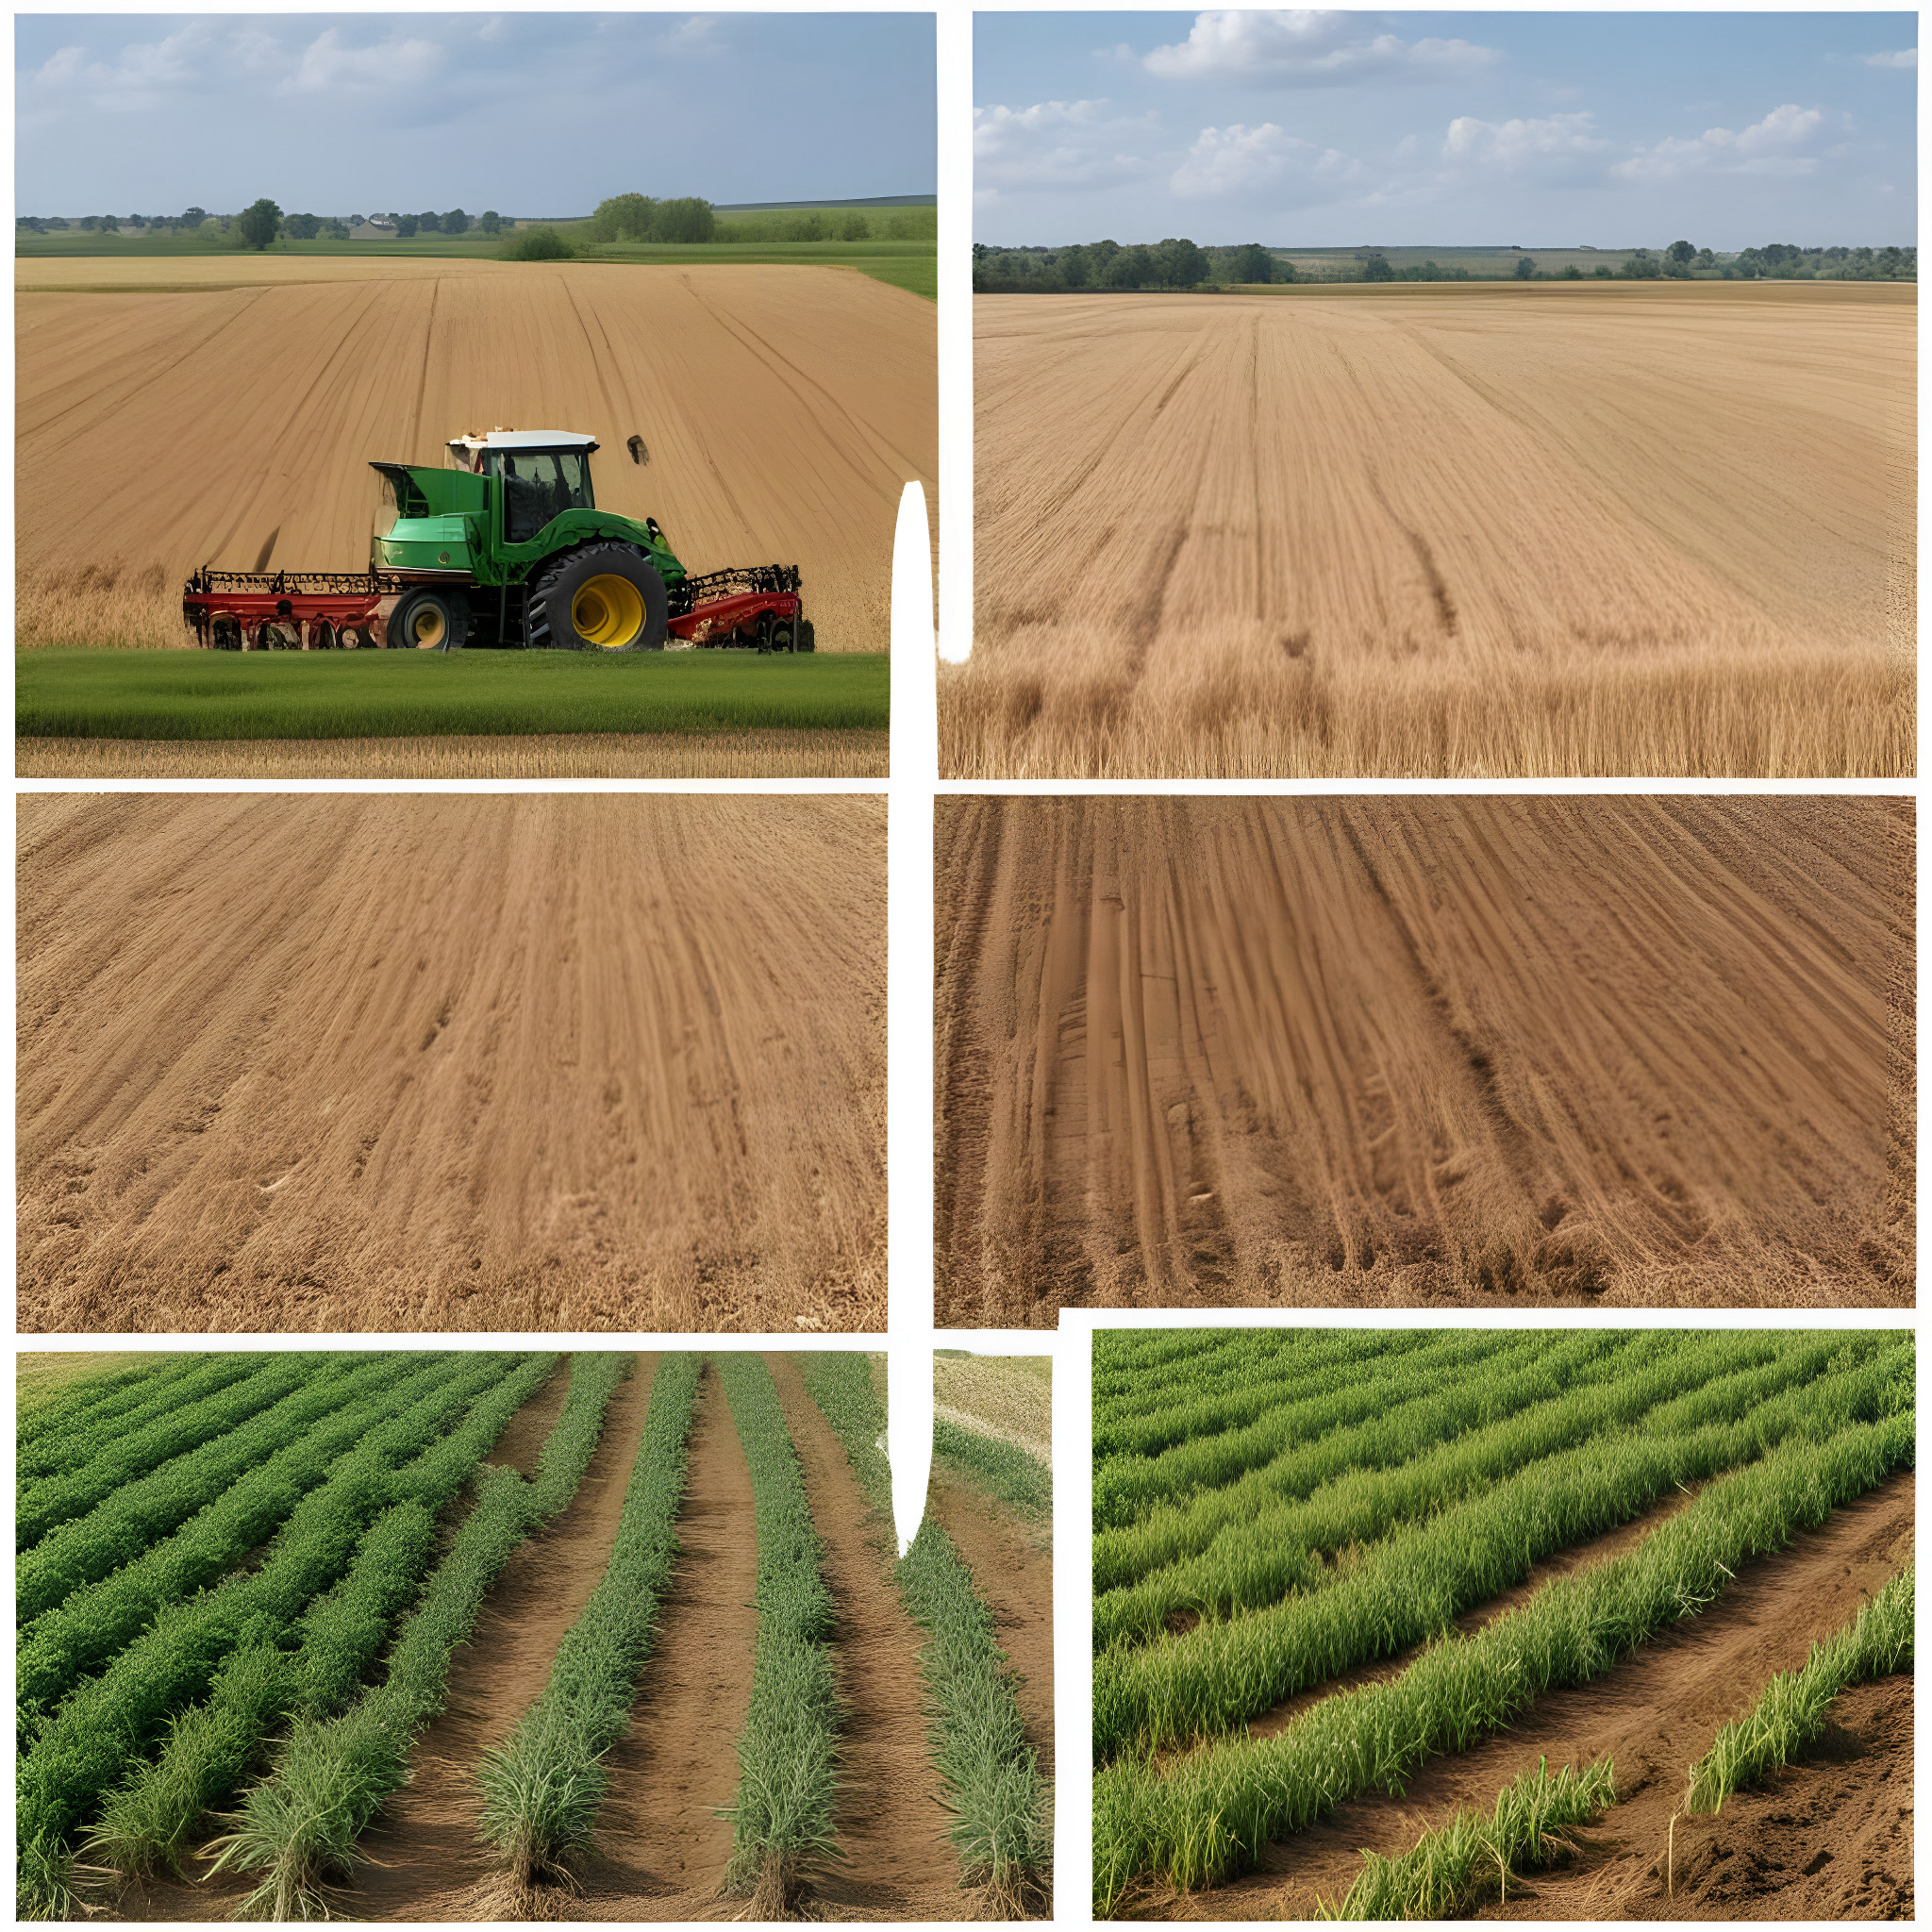
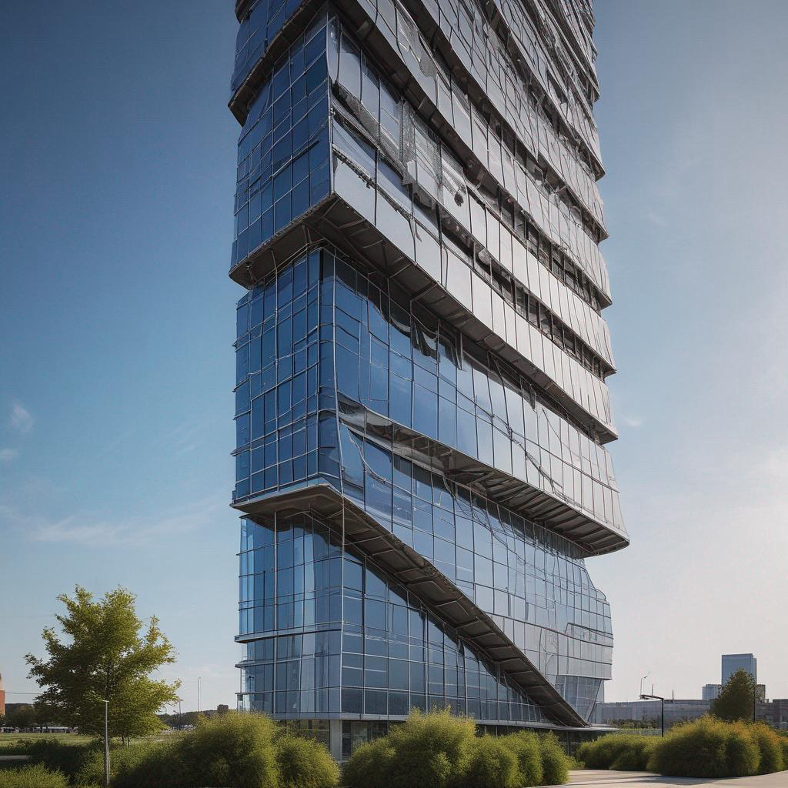
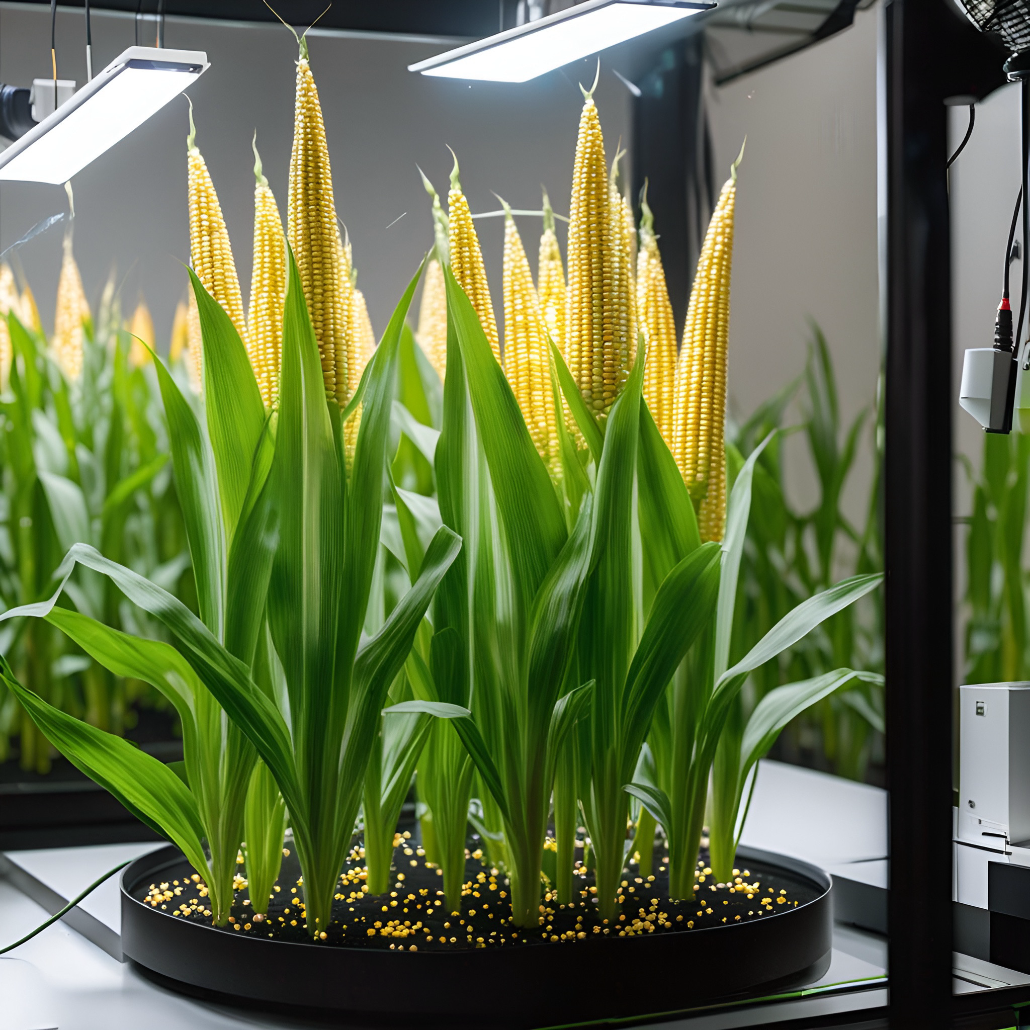
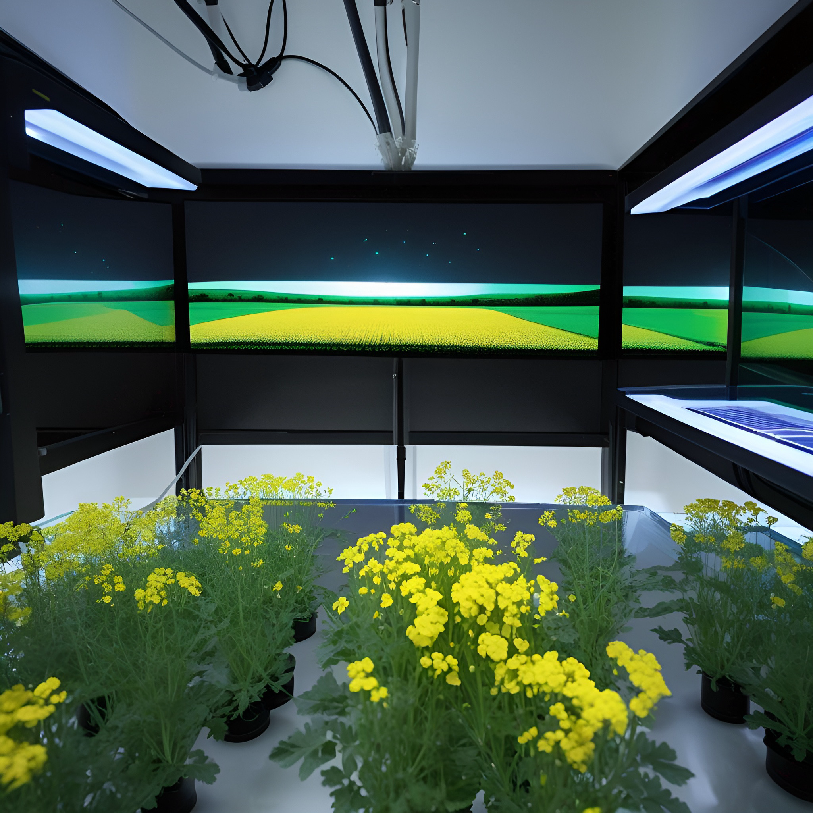
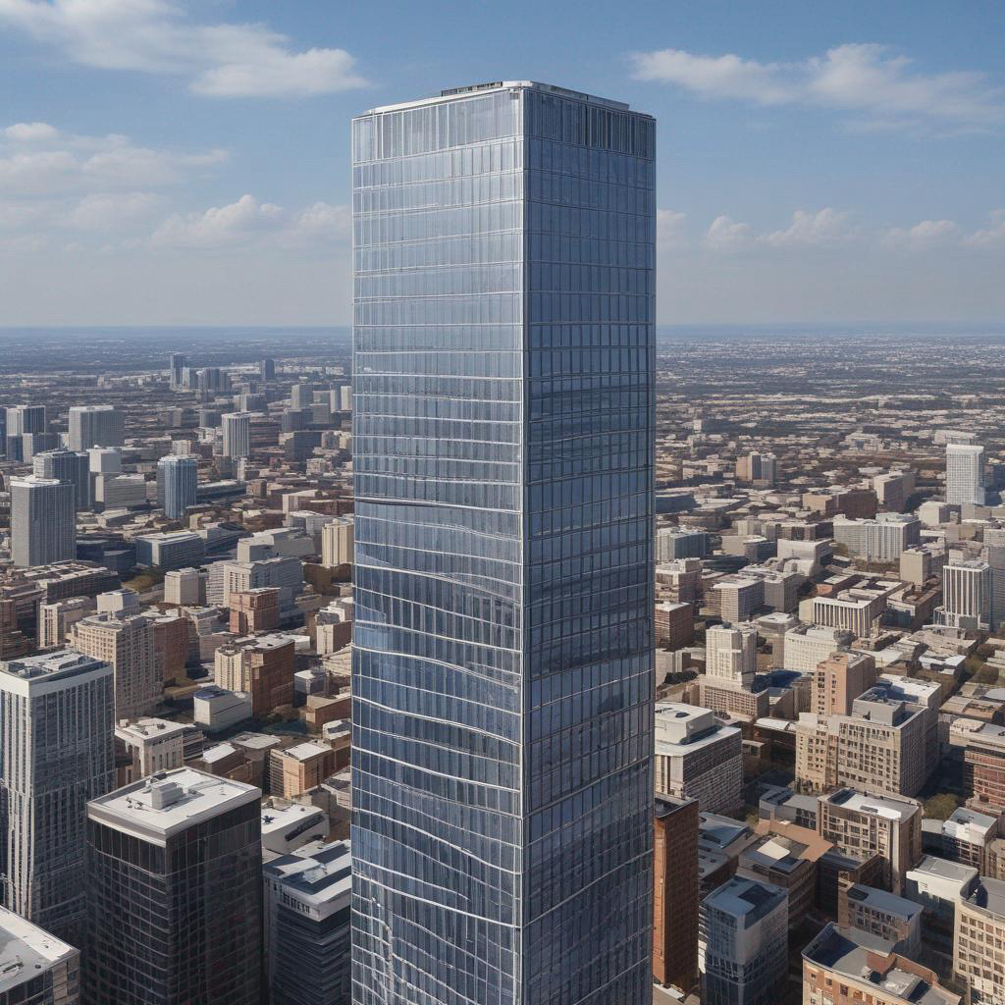
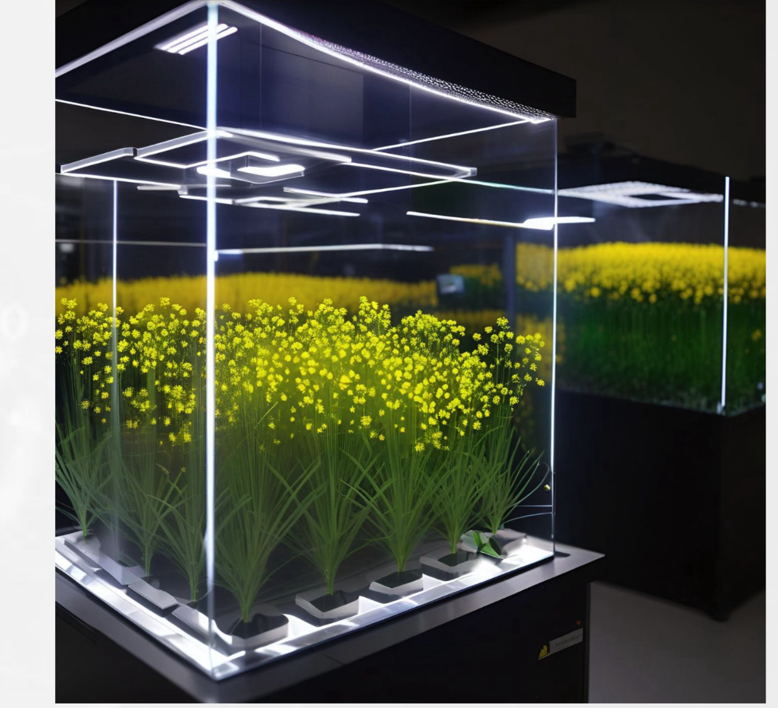
WHAT THE FUTURE HOLDS FOR DIGITAL TWINS?
Parallel Datavault work in Commercial Real Estate, City Planning and; AI & High Performance Computing (HPC) will;
A. Improve land usage – Feed Crops vs Fuel Crops vs Industrial Crops
1. Photovoltaic – Solar Panels
2. Agrivoltaic - Bio Energy Crops with Renewable Solar Strategies
3. Alignment of Financial Incentives
1. DataScore
2. DataValue
B. Improve Usage and Yield of Commercial Properties
1. Photovoltaic Industrial Solar Projects
2. Renewal Energy Crop Research Facilities – High Value Crops
3. Wharehouse & Outdoor Spaces – Agrivoltaic Strategies
4. Agrivoltaic & Photovoltaic Hybrid Facilities
C. Monitor IoT and Sensory Network, All Real Estate Systems
1. Actionable Intelligence (HVAC, POWER, ELEVATORS…)
2. Data Monetization - Datavault’s Information Data Exchange
3. Capture Manage and Utilize Carbon Credits
ps

Slide 18
We have found that there is a direct correlation between our Datavault platform and the work being done on human Digital Twins and with the establishment HPC, ML/AI Data Center that is dedicated to Digital Twins and the PhytoIntel Platform that could aid in addressing issues of obesity and malnutrition.
Our PhytoIntel Platform on HPC has value for humans and animals as it helps solve for the Food v Feed v Industrial crop debate. Nutrition and more specifically malnutrition issues afflict people and animals on a global basis.
Conclusions Virtual Plants for Agriculture Production of High Yield Renewable Energy Crops
We will use the PhytoIntel Platform with HPC environment and Datavault’s patented software to find the best plants for;
Plant based fibers for the creation of high yield – Bioethanol
Plant based oils for the creation of high yield - Biodiesel
Humans, livestock, domestic & service animals and our food supply can all see improvements through the successful use of the PhytoIntel Platform on HPC and Digital Twins of plants.
HPC AI/ML and PhytoIntel can be used to support a curated scientific data set the serves bioinformatics that have been created by scientists with approved credentials. anchored, and immutable whenever possible.
The provenance, ownership rights, copyright of the data providers, proven acceptance scientific standards, and curated data perfect Digital Twins.
Optimizing the use of available lands. Creating new farmlands within residential, commercial, and municipal building structures can be farmed through automated robotics and with high quality scientific jobs for both the scientific research community and biotech research required could be crowd sourced as the platform becomes populated.
Output crops that can be set up under a number of emerging Agrivoltaics and Photovoltaics strategies and land usage can also be optimized.

Slide 19
Except for Geothermal energy all energy comes from the Sun
Hydro - Sun evaporates the water which creates clouds… melts the snow, or runs down stream.
Wind – Warmer air moves cooler air
Fossil Fuels – Stored energy of the Sun generated over 10s and 10s of millions of years – Fixated Carbon in coal, oil, is burned, despite all it’s known qualities, industrial products and chemicals it provides.
Humans have evolved in the climate that was stable until the Industrial Revolutions in the 1800s
We slowly began to change the the environment and the acceleration of which is well documented and evident in our seas, our lands, air and even the food we eat.
Oil and coal is precious, we know it yet we burn it up into our atmosphere changing the equilibrium for the environment that until now provided continual human evolution.
Fossil bound Co2 burned and released into atmosphere has caused atmospheric changes that threaten the equilibrium and current status, stability of ecological systems.
Sustainable/Renewable Plant Based Energy can be optimized through HPC and ML/AI empowered PhytoIntel Platform and Digital Twins.
Conclusions II Virtual Plants for Agriculture Production of High Yield Renewable Energy Crops
Digital Twins of Farming Lands & Commercial, Municipal Real Estate
1 Photovoltaic Optimization
2. Agrivoltaic Optimization
3. Hybrid Optimization
a) Temp, humidity, light cycle & quality, water supply and nutrients can be administrated through robotic means.

Slide 20
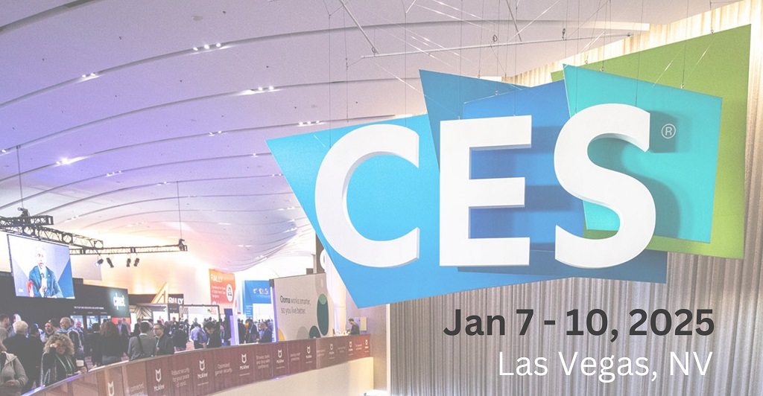
Special thanks our partners below as well as Dr. Jorn Gorlach and Dr. Keith Davis.
Illustrations by Keith Tomcyzk, Sonia Choi, and Kriti Chopra – Video & Audio Production by Brett Allen Bradley
Join us in Las Vegas for CES 2025
Thank you NYSDS!
Visit us @ www.datavaultsite.com

