Slide 1

ePIC Collaboration News
J. Lajoie, S. Dalla Torre
July 12, 2024

Slide 2
Hey John, start the recording….

Slide 3
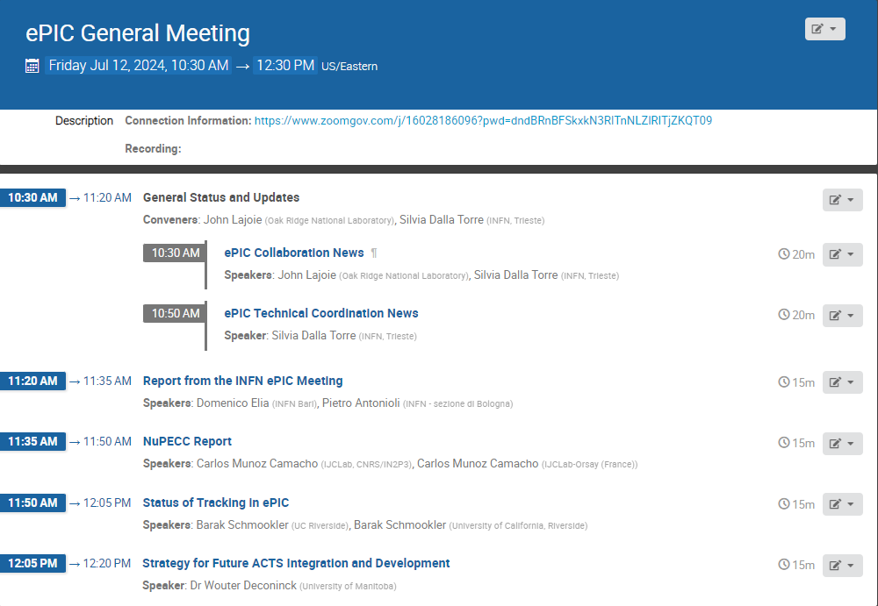
Today’s
Agenda

Slide 4
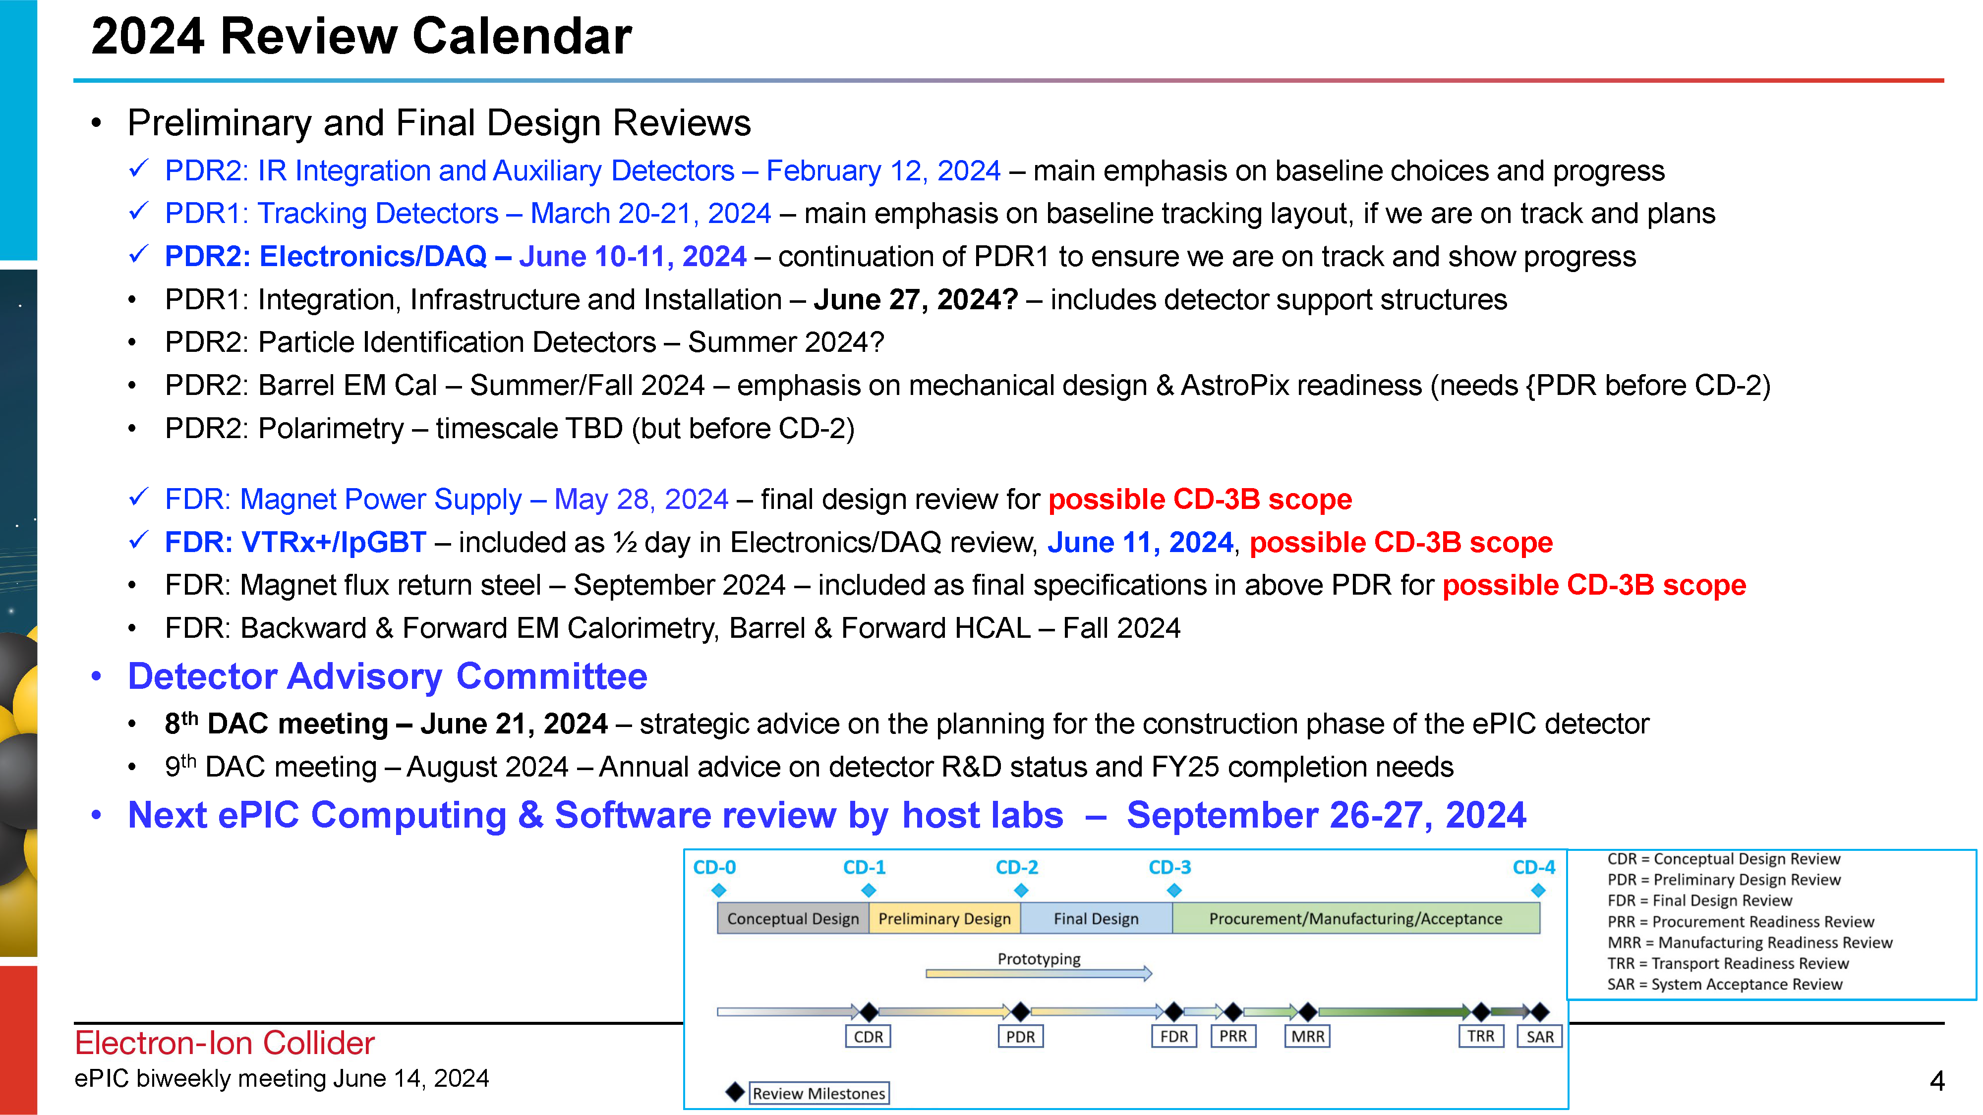
When we last left our heroes…
Since our last GM on June 14th…..
July 15, 2024

Slide 5
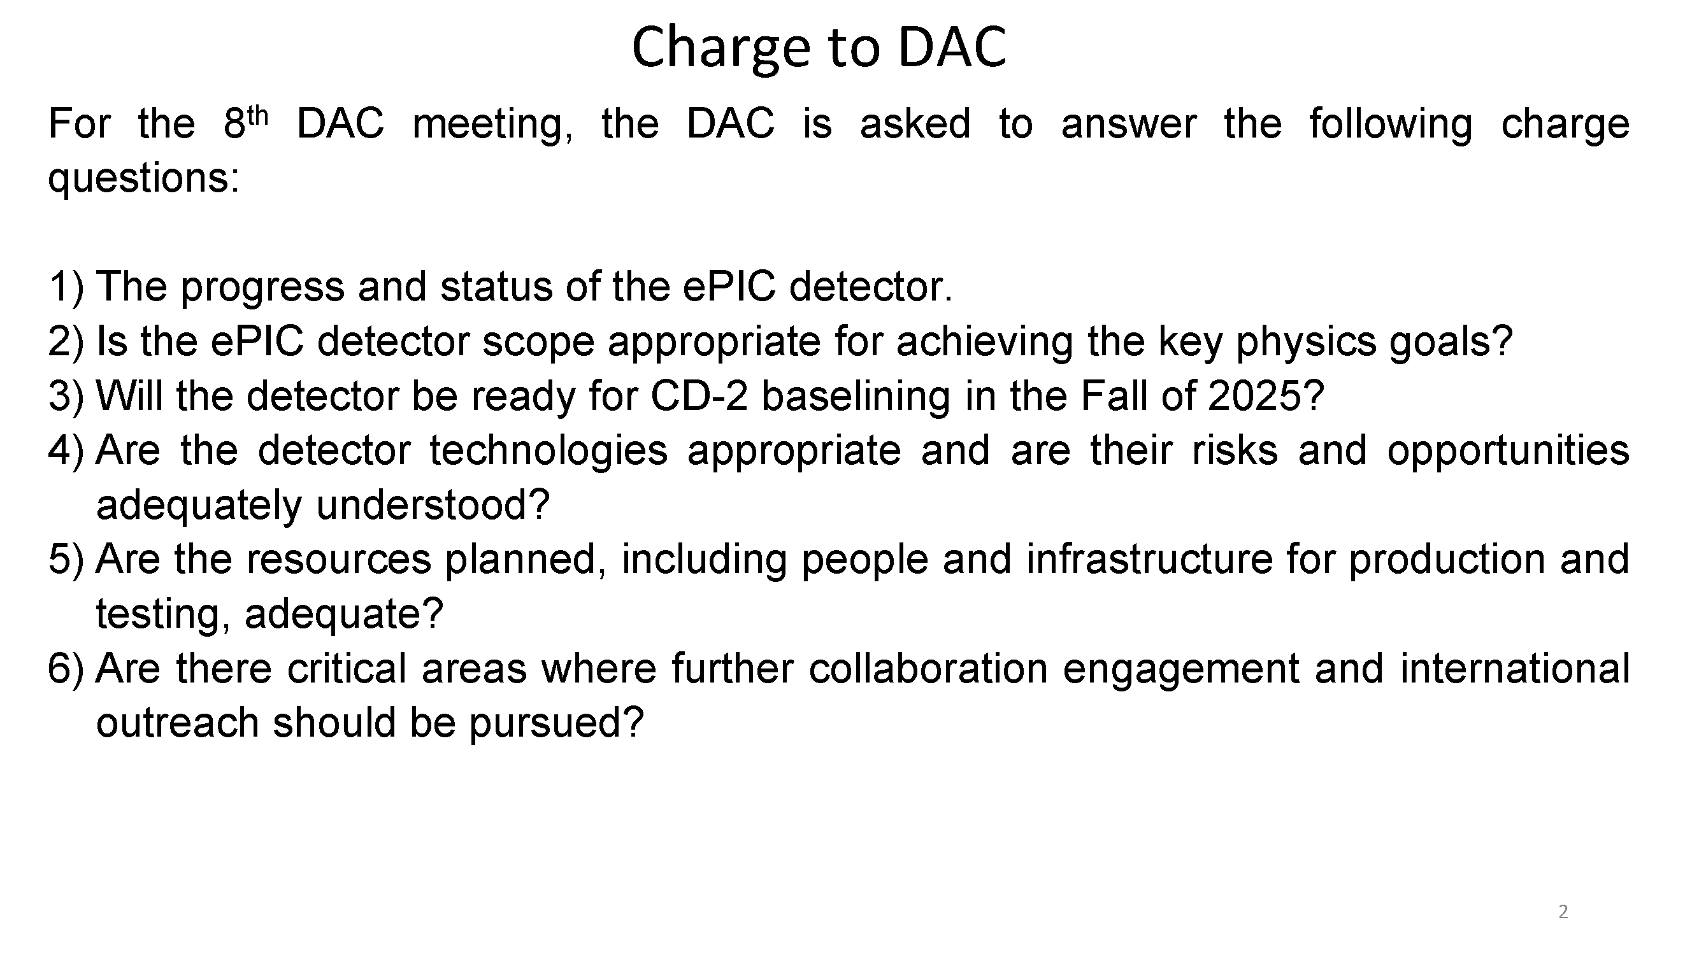
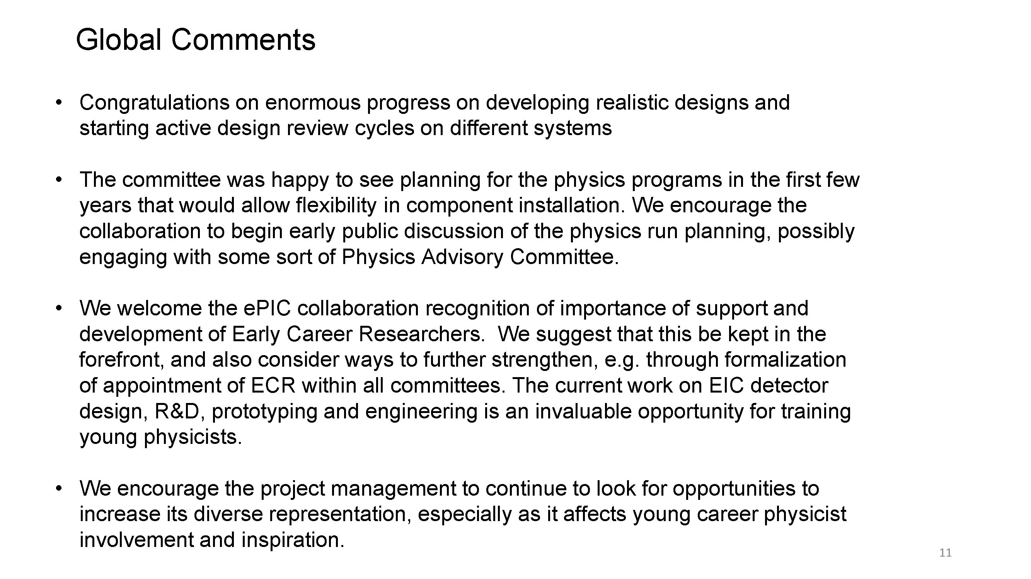
Comments from the DAC Review
Many positive and constructive comments from the DAC.
The DAC fully appreciates the challenges ahead of ePIC and the EIC Project.
Encouraged attention to integration, installation and commissioning.

Slide 6
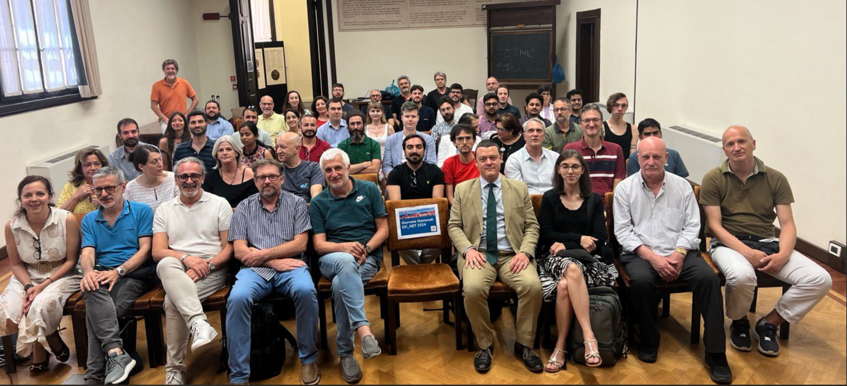
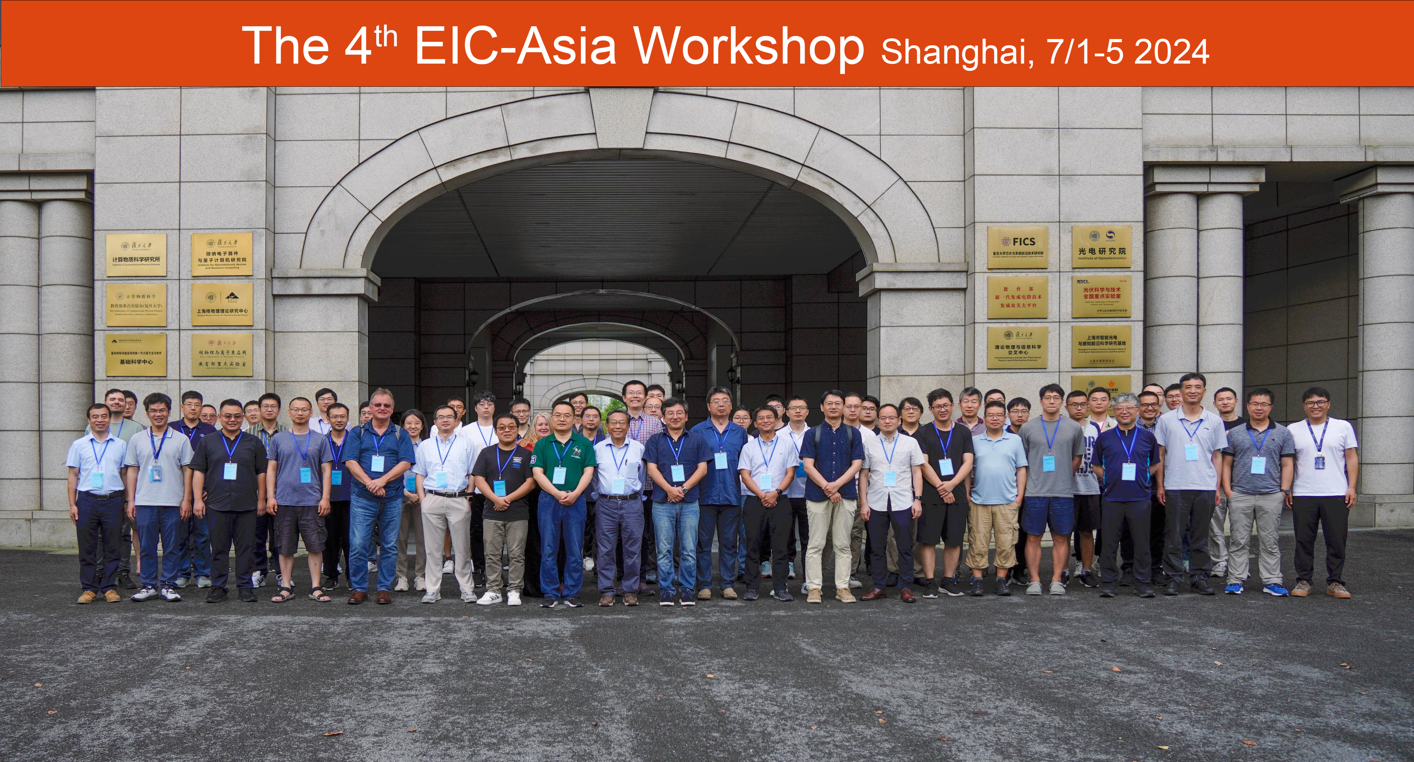
Recent ePIC Meetings
INFN ePIC Meeting:
  June 27th-28th
  Report later this meeting
4th EIC-Asia Workshop:
  July 1st-5th
  Report at a future General Meeting

Slide 7

It’s Almost Here!!!
Lehigh University
Bethlehem, PA
July 22-27
Jointly organized with the EICUG
ePIC Meeting
July 24-27th
Registration is OPEN!
https://indico.bnl.gov/event/20727/

Slide 8
EICUG/ePIC Collaboration Meeting Logistics
Please register ASAP if you plan to come in person, final numbers go to catering Monday July 15th!
  Everyone who registers should get a google form to fill out, please do so or there won’t be enough coffee: Form
If you want a airport shuttle ride, please contact Jasleen Sandu (jks323@lehigh.edu)
If you have dietary restrictions and haven’t filled in the form, you can do so at: Form
There are still some rooms left in the on-campus housing ($55 per day!) - please contact Rosi Reed (rosijreed@lehigh.edu)
Social dinner is funded for all early career scientists!

Slide 9
EICUG/ePIC Collaboration Meeting Statistics
200 Indico Registrants!! 157 have filled in the google form
Early Career Day – 43 registrants
Online – 39 registrants (10 EC)
# Early Career – Postdoc - 47
# Early Career – Student - 19

Slide 10
EICUG/ePIC Collaboration Meeting Statistics
Only 3 people are attending just the EICUG/Early Career day and not the ePIC Meeting

Slide 11
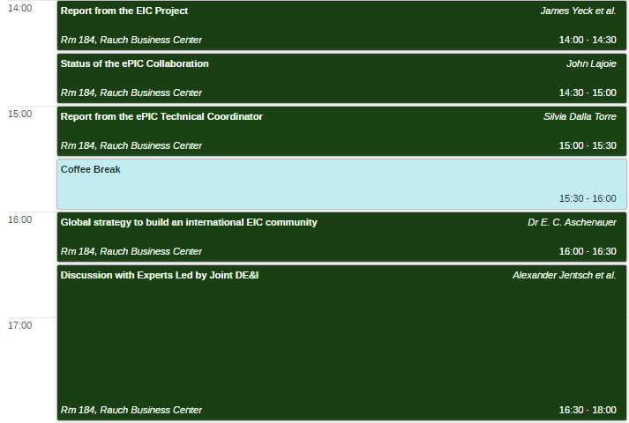
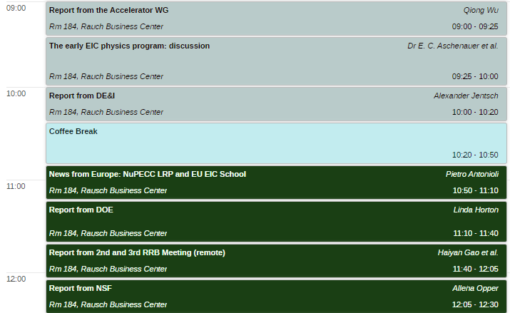
Very Important Joint Session Wed. July 27th
The beginnings of a discussion on what the early EIC physics program might look like – important machine constraints!
This is YOUR opportunity to be part of the discussion!
An equally important conversation on growing the EIC community!

Slide 12
Joint ePIC and EICUG DEI Session
The ePIC and EICUG DEI committees are hosting a joint workshop from 4:00pm to 5:30pm on Wednesday, July 24th as part of the joint ePIC and EICUG meeting. The agenda will consist of the two components:
Two presentations + discussion:
  Former Dean of the College of Arts and Sciences and current STEM professor at Lehigh University, Anne Meltzer. She will lead a discussion on DEI issues faced in STEM,
  Deputy Vice President for Equity and Community and Associate Provost for Academic Diversity, Henry Odi. He will lead a discussion on DEI initiative employed in academia, and discuss how they have been used to improve the diversity of the university.
A discussion on challenges faced by international collaborators involved in EIC.
Please complete the anonymous form to help facilitate the discussion:
https://forms.gle/QDzQLPSi9JXkuwLZ9
Or email the DEI committee
Megan Connors (Chair): mconnors@gsu.edu

Slide 13
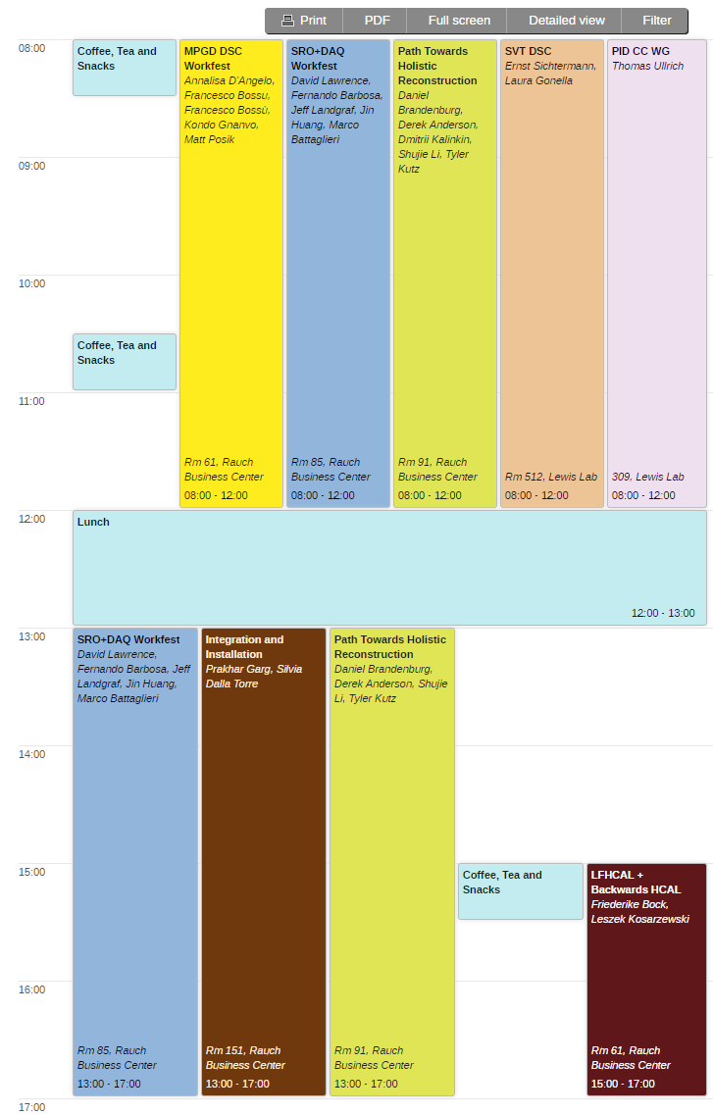
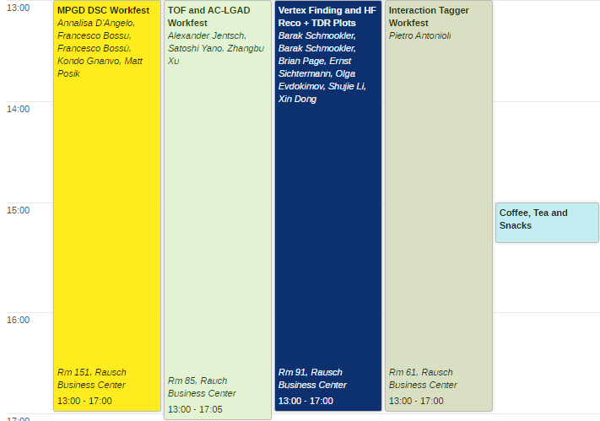
Workfests!
Friday, July 26th
Thursday, July 25th

Slide 14
Workfest/Parallel Session Organizers
MPGD DSC:
  K. Gnanvo, F. Bossu, A. D’Angelo, M. Posik
TOF and AC-LGAD:
  Zhangbu Xu, Satoshi Yano and Alex Jentsch
SRO + DAQ
  Jeff, Marco, David, Fernando, Jin
Integration and Installation:
  TC Office (Prakhar Garg)
Electron ID & Reconstruction +
Path Towards Holistic Reco.
  Daniel Brandenburg, Tyler Kutz, Derek Anderson, Dmitry Kalinkin, Shujie Li, Umberto Tamponi
Vertex Finding and HF Reco.+ TDR Plots for Vertex and Reco.
  Xin Dong, Olga Evdokimov, Brian Page, S. Li, B. Schmookler, E. Sichtermann
SVT DSC:
  E. Sichtermann
PID CC WG:
  Thomas Ullrich, Umberto Tamponi
LFHCAL + Backwards HCAL/Hackathon
  F. Bock, L. Kosarzewski

Slide 15


TDR/Publication Timeline
Just as the January Collaboration Meeting defined the goals for 2024, the July Collaboration Meeting at Lehigh is an opportunity to take stock of the progress we have made and make plans for the remainder of the year and the Jan 2025 CD-3B review.
process design phase
structuring the
effort
draft ePIC pre-TDR
ePIC pre-TDR (CD-2)
writing
(TDR/notes)
Preparing papers for
publication
Mid Jan.24
Mid Mar.24
End Oct. 24
Late 2024
Early 2025
Silvia’s talk today – many thanks to Doug Higinbotham, Anil Panta, and Rolf!
Putting the tools in place:
Overleaf/Github for TDR
Zenodo.org selected as document database solution
Discussed in June 14th GM

Slide 16
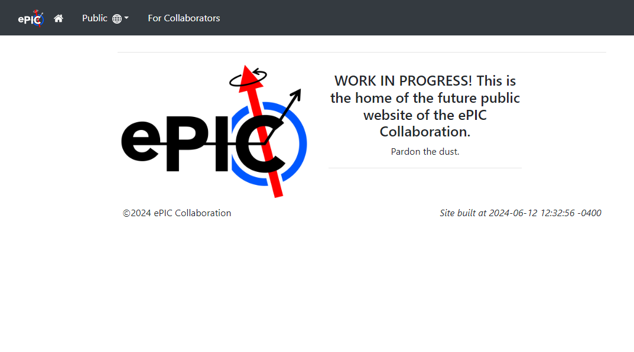
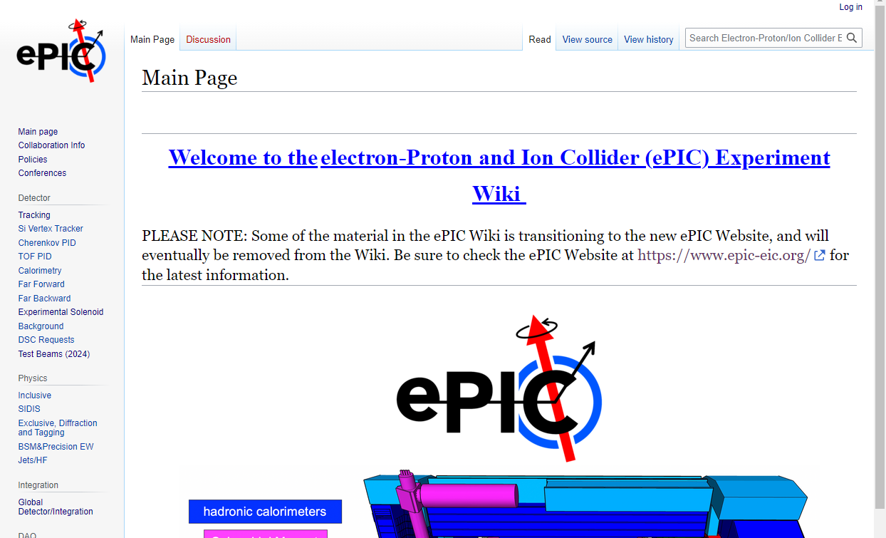
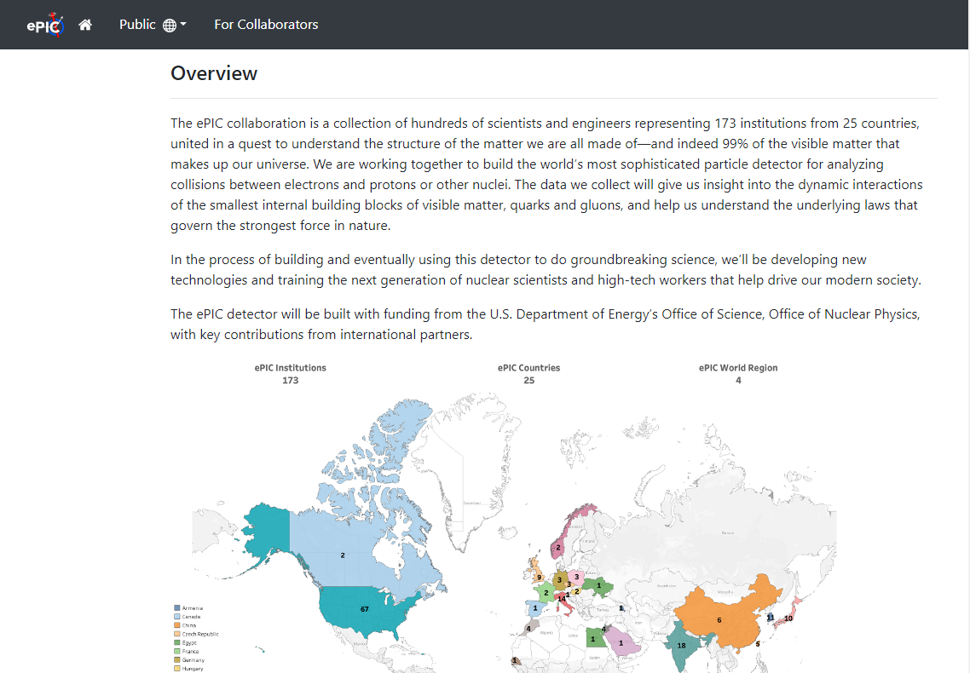
ePIC Website Progress
https://www.epic-eic.org/
Contact Maxim Potekhin potekhin@bnl.gov and
Thomas Ullrich thomas.ullrich@bnl.gov if you would like to help get the ePIC website up and running!

Slide 17
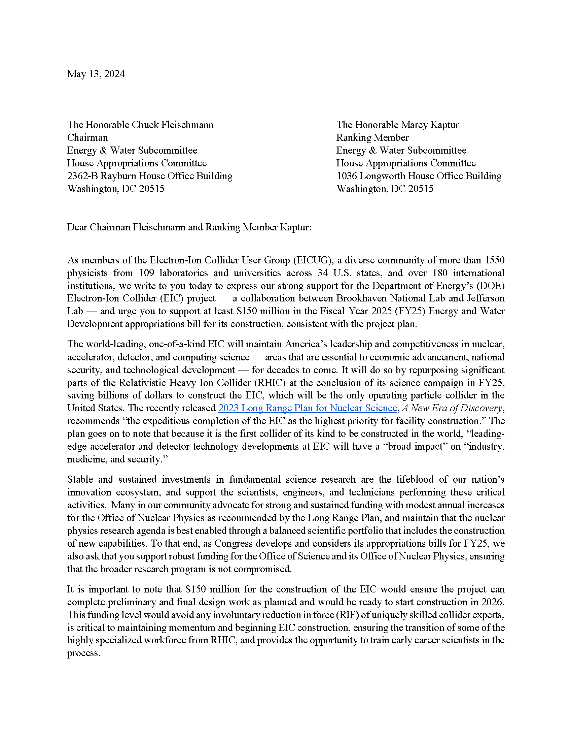
EIC Advocacy Letter
Advocacy letter to Energy and Water Committee leadership.
Organized by EICUG
Sent to EICUG non-.gov/.org email list
Letter available here
Consider expressing your support by signing the letter
https://forms.gle/rxEXdNiogx6pSYnT8

Slide 18

Summary
Making progress on draft pre-TDR development timeline
Getting stoked for the July Collaboration Meeting!
Sign the EICUG advocacy letter
See you at the Joint EICUG/ePIC
meeting at Lehigh July 22-27th

Slide 19


Slide 20
ePIC Resources
Public Website - https://www.bnl.gov/eic/epic.php
Mailing Lists – https://lists.bnl.gov/mailman/listinfo
Indico Agenda - https://indico.bnl.gov/category/402/
  ePIC Software and Computing: https://indico.bnl.gov/category/435/
Wiki - https://wiki.bnl.gov/EPIC
ePIC Software Training:
  Landing Page: https://eic.github.io/documentation/landingpage.html
  Tutorials: https://eic.github.io/documentation/tutorials.html
Mattermost: https://chat.epic-eic.org
ePIC Zenodo Community: https://zenodo.org/communities/epic

Slide 21


EICUG Membership
The EICUG is a vital organization to promote the interests of the EIC community!
  Without the EICUG we would never have gotten far enough to form ePIC!
Please register your institution!
Check with your EICUG IB representative to get registered as a member
https://www.eicug.org/content/join.html

Slide 22


Upcoming Notable Events…
DIS 2024 in Grenoble, France April 8-12th , 2024
  https://lpsc-indico.in2p3.fr/event/3268/
ePIC Software and Computing meeting
@ CERN April 22nd-26th
  https://indico.cern.ch/event/1343984/
EIC RRB Meeting – May 6-7th in Italy
MC4EIC @ Durham University June 5-7th
  https://conference.ippp.dur.ac.uk/event/1292/
JLab Users Meeting, June 8-12th
  https://www.jlab.org/conference/2024-jluo
4th EIC-Asia Workshop in Shanghai July 1-5, 2024
  https://indico.cern.ch/event/1361239/
Joint EICUG/ePIC Collaboration Meeting
@ Lehigh University July 22nd-28th
  https://indico.bnl.gov/event/20727/

Slide 23
EICUG/ePIC Collaboration Meeting Statistics
The demographics between those attending in-person and online with respect to the early career participants is similar

