Slide 1
Modular Rich Detector Simulation
Cherenkov Ring Radius obtained from Circular Hough Transform
Cheuk-Ping Wong
Georgia State University
2016-09-12

Slide 2
Outline
Obtain Cherenkov Ring Radius from simulation results using Circular Hough Transform.
Monte Carlo result
  Infinite pixel size
  Finite pixel size (6x6mm²)
Simulation result

Slide 3
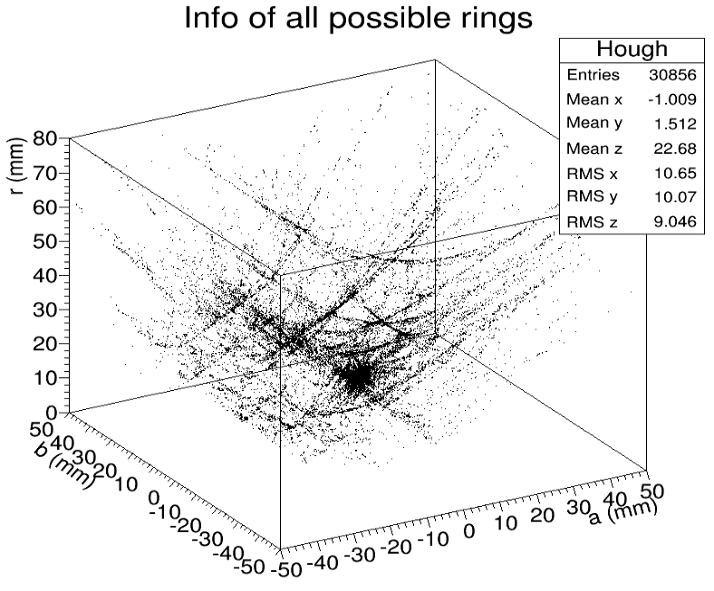
Ring Finder Algorithm Update
When filling 3D (a,b,r) histogram
Center position(a,b) cut:
  If (|a|>3mm or |b|>3mm) skip;
Not considered
✘
✘

Slide 4
Monte Carlo

Slide 5
Monte Carlo
10,000 events
Infinite pixel size / finite pixel size (6x6mm²)
In each events
  Number of hits
    Total number of Hit= N_{signal}+N_{noise} <15
  Ring radius
    Radius = Gaussian distribution function
    Mean of radius=20mm
    Sigma of radius=0.1mm

Slide 6
Event by Event Display (infinite pixel)
low noise
Signal
noise
strong noise

Slide 7
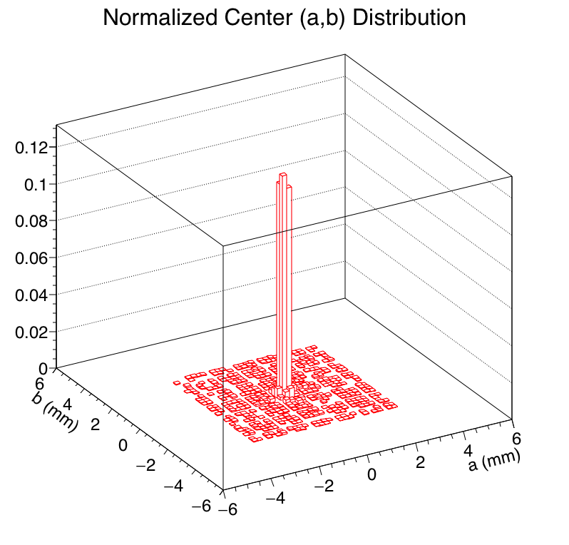
Radius (in each event) Distribution (infinite pixel)
20.0±0.129 mm

Slide 8
Event by Event Display (finite pixel)
Fitted rings are generally smaller than the actual rings
low noise
● Signal
○ noise
loud noise
Fitted rings are close to the actual rings, even with loud noise

Slide 9
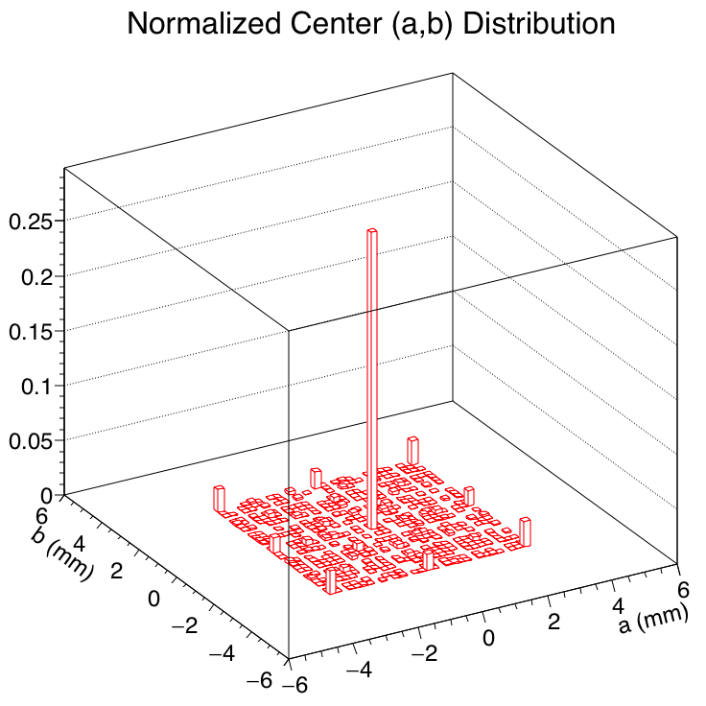
Radius (in each event) Distribution (finite pixel)
r=15.4±0.12 mm
Sensor 2
Sensor 1
r
3.54mm
Sensor 3
Sensor 4
measured value of radius
=r+3.54
=18.94mm
Smaller than the actual value (20mm).
difference due to pixel size

Slide 10
Simulation Result

Slide 11
Simulation Setup
Beam
  120GeV proton
  1,000 events
  Launched perpendicularly toward center of the detector
  Beam diameter 1cm
Detector
  Aerogel gel: 3.3cm thick, n=1.03
  Fresnel lens: f=3 inches
  Sensor plane : at Fresnel lens focal plane, 1mm gap between glass windows (or 5mm between sensors)

Slide 12
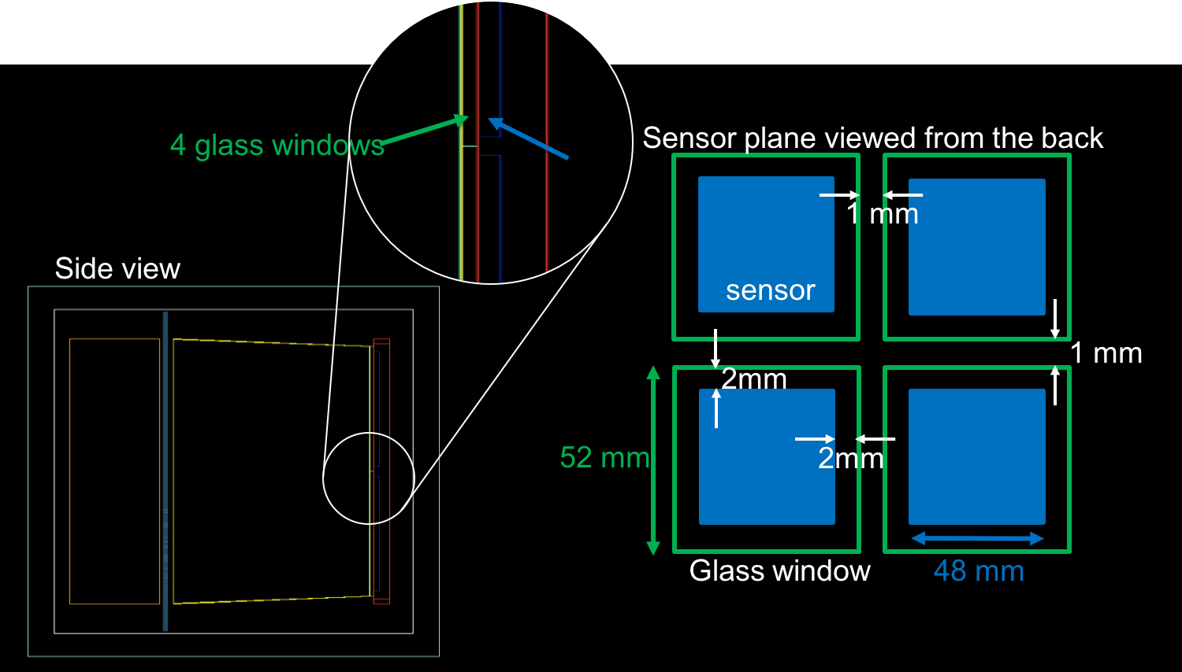
Detector Setup
Sensor plane

Slide 13
Event by Event Display
low background
strong background

Slide 14
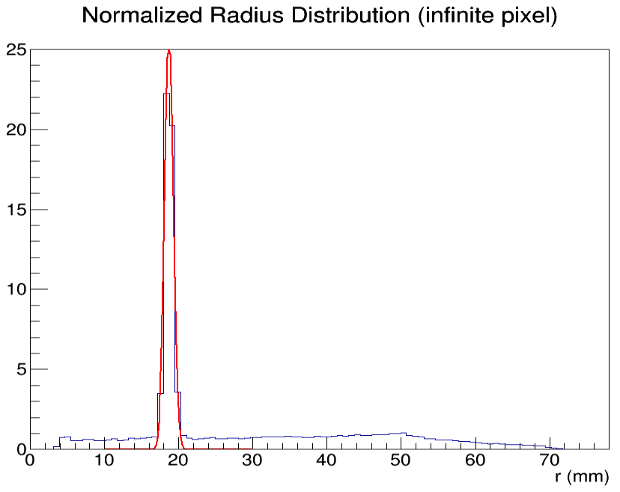
Radius (in each event) Distribution
r≈15.4±0.15 mm
r
3.54mm
r≈18.7±0.60 mm
Actual measured value of radius
=r+3.54
=18.94mm
Radius of each photon hit from simulation result.
No Q.E. applied

Slide 15
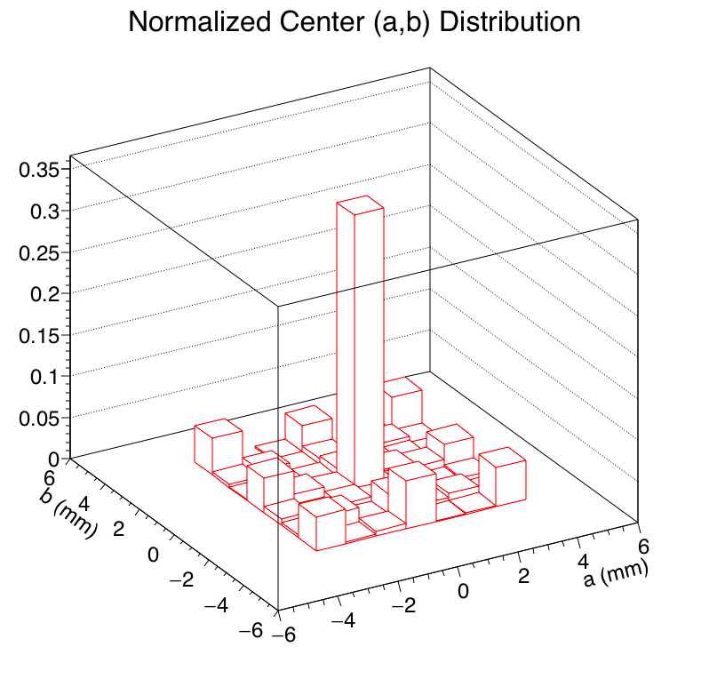
Center Position (in each event) Distribution

Slide 16
Summary
Ring Finder Algorithm has be tested using Monte Carlo method
Ring Finder Algorithm is implemented in simulation analyses

Slide 17
Back Up

Slide 18
Ring Finder Analysis Procedure
Accumulated Data

Slide 19
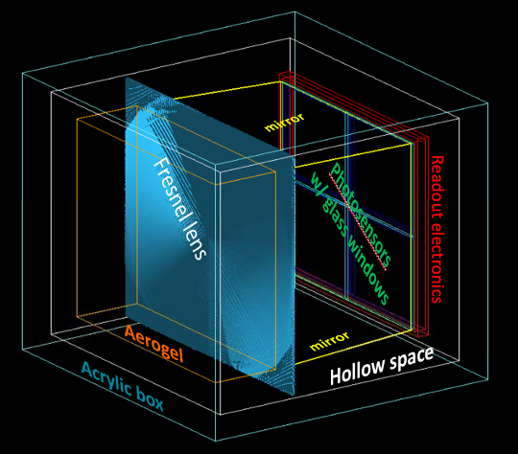
Detector Setup

Slide 20
Detector Setup
Sensor plane

