Slide 1
ProtoDUNE News
Wenqiang Gu

Slide 2
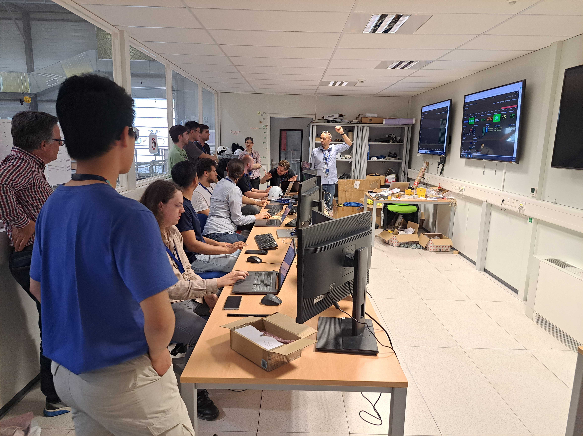
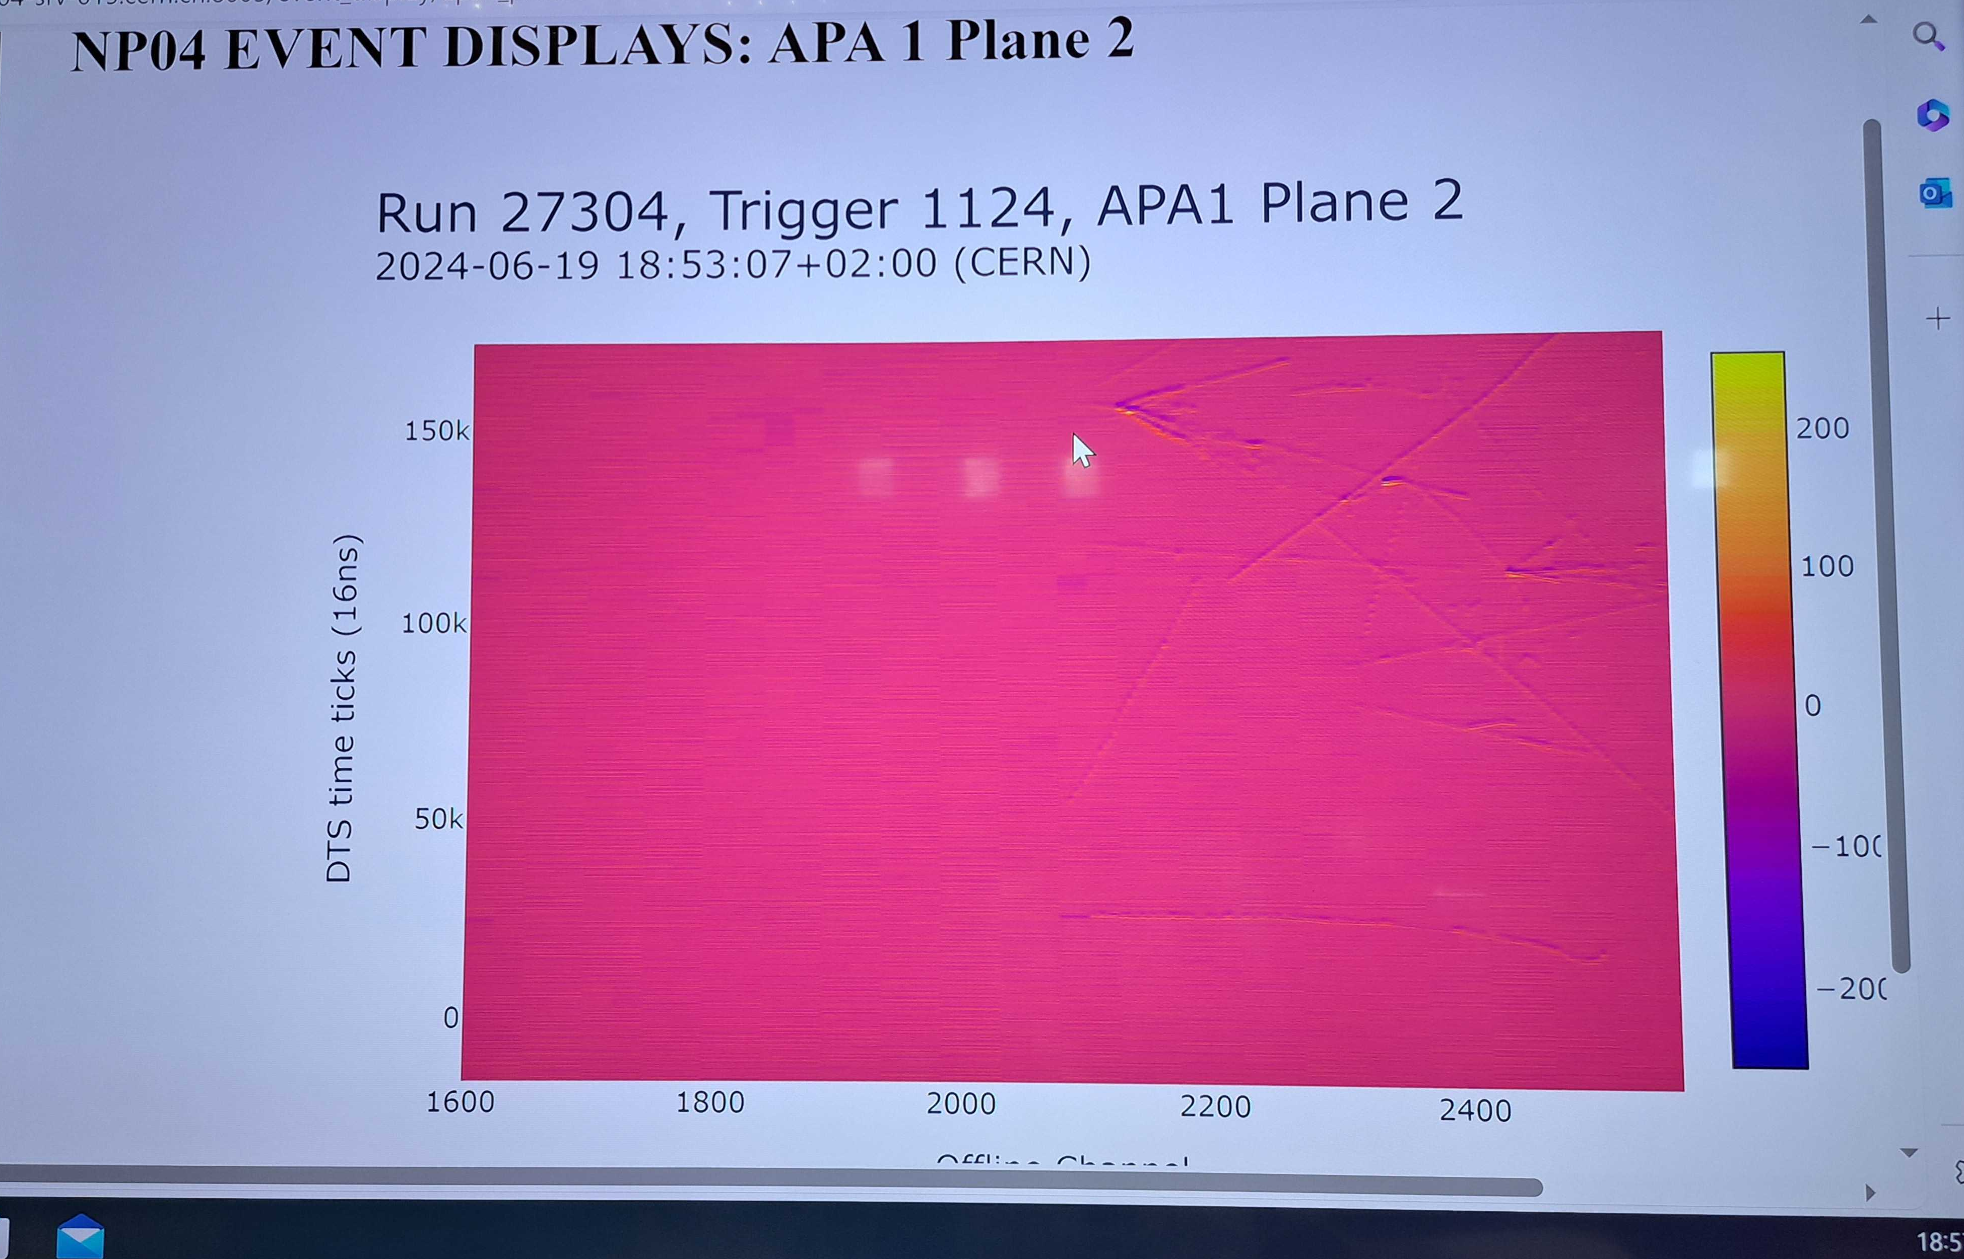
ProtoDUNE HD
We have been collecting 7 GeV/c beam data since June 19th 6PM CERN local time
  ~ 24Hz beam triggers + 1Hz random trigger
Keep wire bias voltage at nominal except first APA’s collection wires
  Baseline was re-adjusted in V & W, new pulser data was taken
  Weak signal remains in the W view

Slide 3
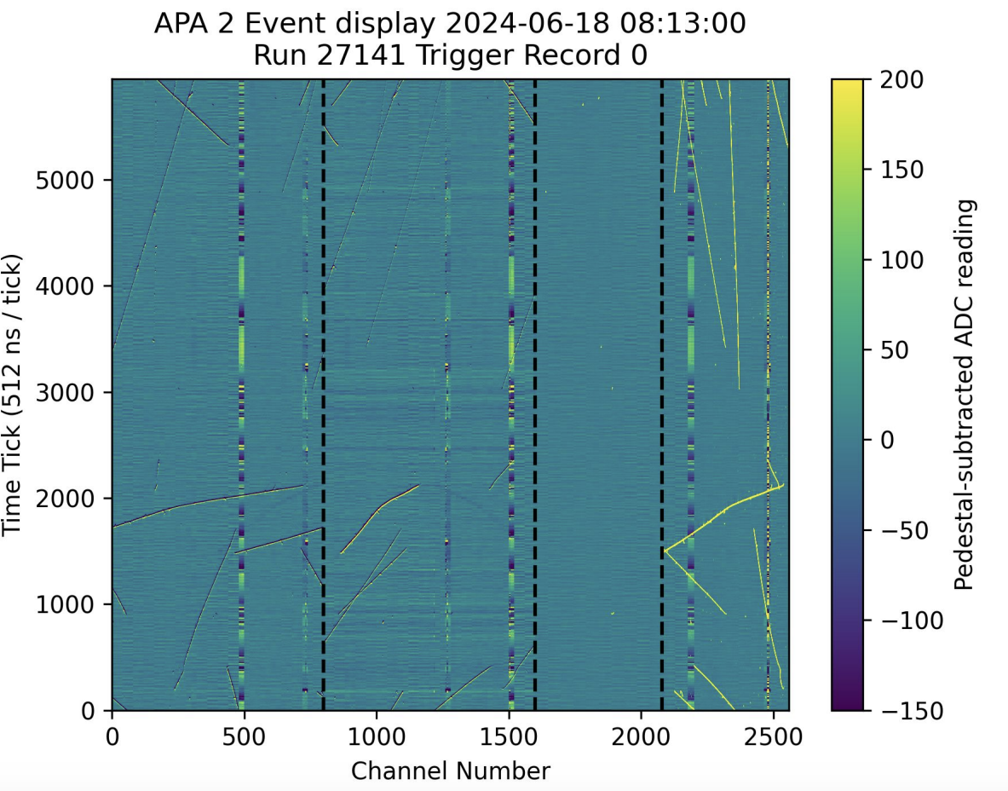
APA2 Short?
Some noise issue observed in APA2 one all three planes before the beam run
Need to check for recent beam runs
Roger Huang
Check with Chao’s tool

Slide 4
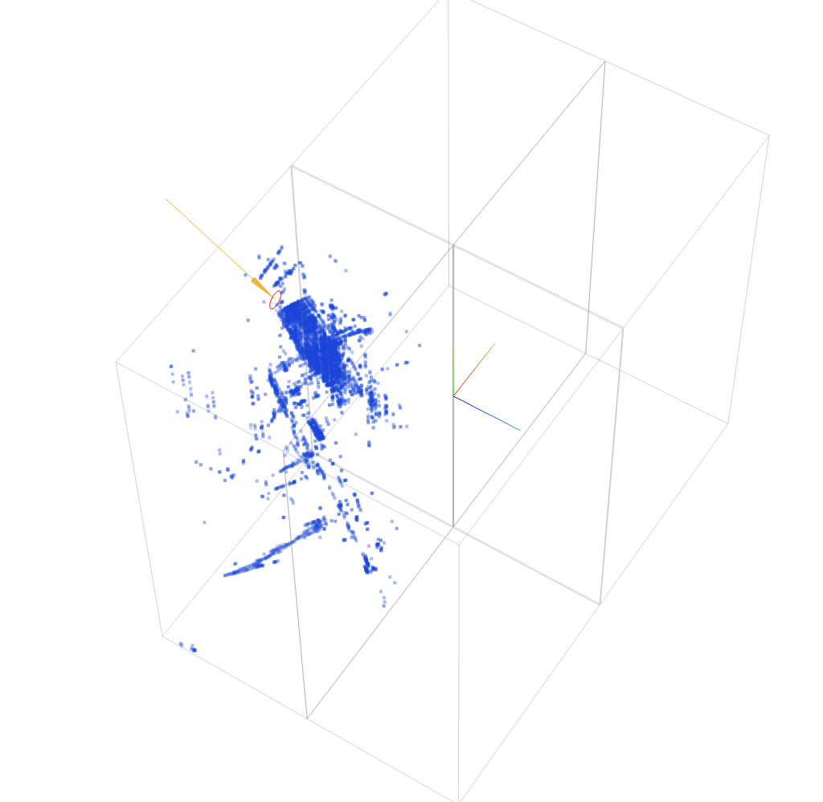
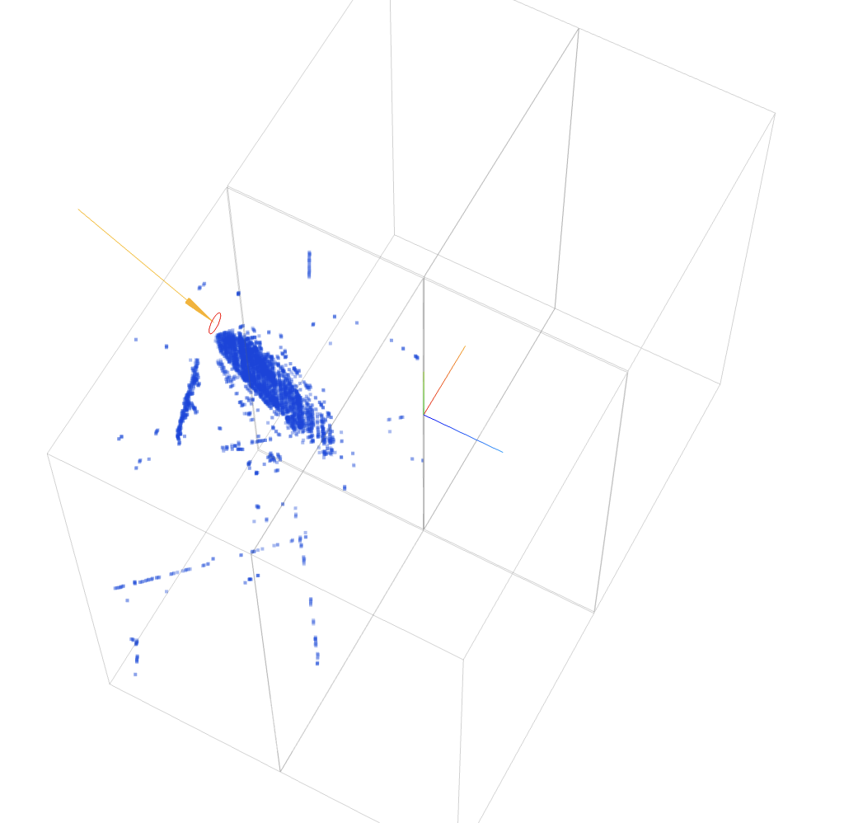
First beam interaction in ProtoDUNE HD
https://www.phy.bnl.gov/twister/bee/set/bf72f8c3-664c-4140-90f7-3cc79089296f/event/0/
https://www.phy.bnl.gov/twister/bee/set/1771469d-7ccb-4ed8-a9ed-28486bff6e80/event/0/
27304 - 424
27304 - 844
Need more deghosting?
Beam window matching: speed, anode offset, pre-trigger window

Slide 5
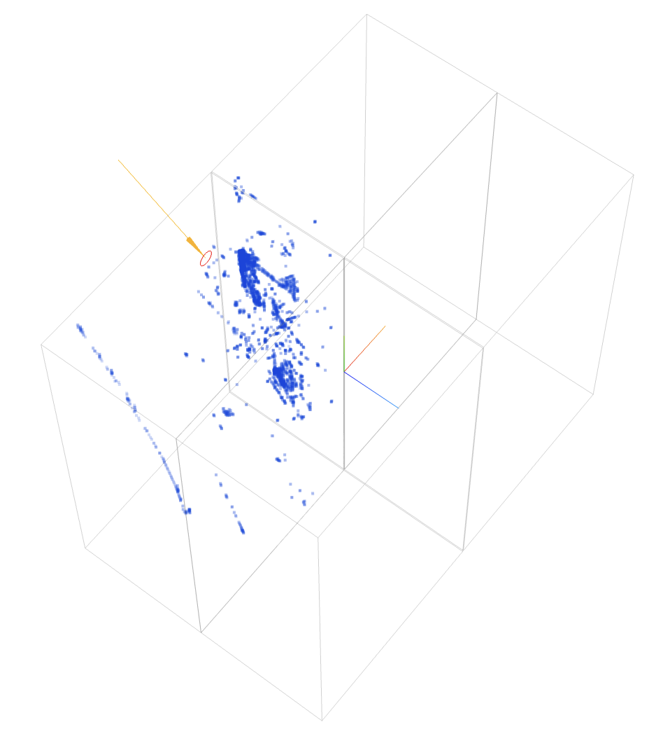
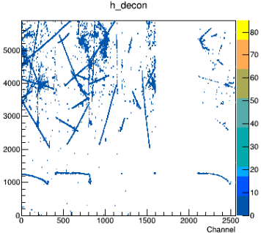
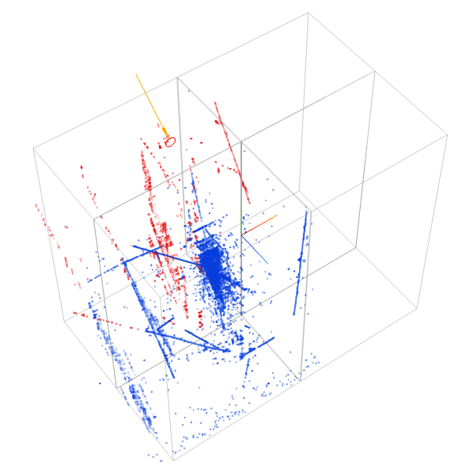
https://www.phy.bnl.gov/twister/bee/set/2826ae01-ad7a-4352-b1f7-05ab4219eb9f/event/0/
https://www.phy.bnl.gov/twister/bee/set/96e92308-9430-48fe-b14f-545a57f7a0da/event/0/
27304-1124
27307 - 2694
Pion
& halo pion charge exchange?
First pion interaction observed in adjacent APA
Why gap happens between two clear tracks?

