Slide 1
Prototype stave design and tooling review - outcome

Slide 2
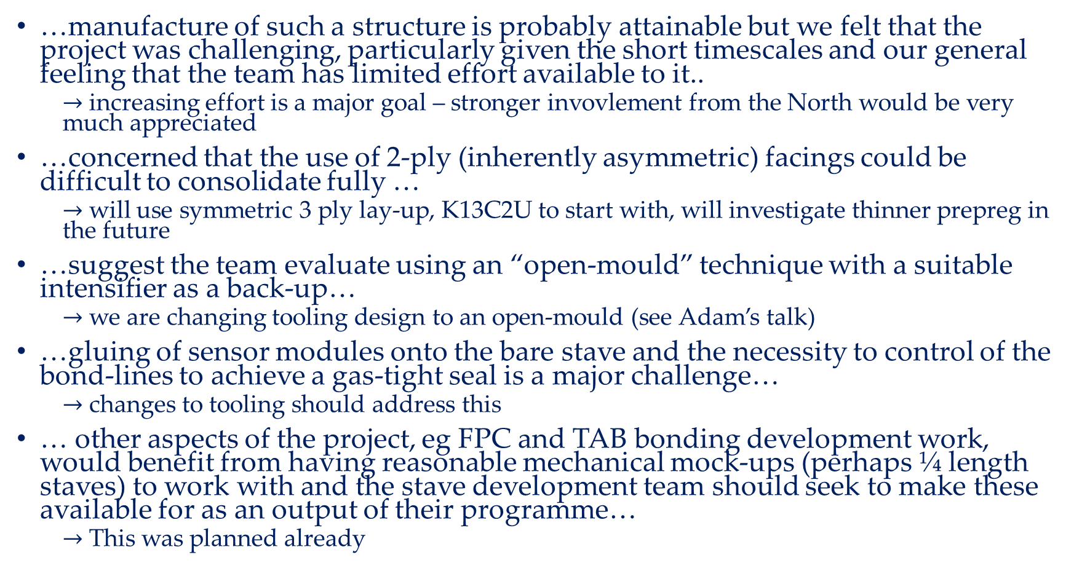
Key observations and reaction
…manufacture of such a structure is probably attainable but we felt that the project was challenging, particularly given the short timescales and our general feeling that the team has limited effort available to it..
$→$ increasing effort is a major goal – stronger invovlement from the North would be very much appreciated
…concerned that the use of 2-ply (inherently asymmetric) facings could be difficult to consolidate fully …
$→$ will use symmetric 3 ply lay-up, K13C2U to start with, will investigate thinner prepreg in the future
…suggest the team evaluate using an “open-mould” technique with a suitable intensifier as a back-up…
$→$ we are changing tooling design to an open-mould (see Adam’s talk)
…gluing of sensor modules onto the bare stave and the necessity to control of the bond-lines to achieve a gas-tight seal is a major challenge…
$→$ changes to tooling should address this
… other aspects of the project, eg FPC and TAB bonding development work, would benefit from having reasonable mechanical mock-ups (perhaps ¼ length staves) to work with and the stave development team should seek to make these available for as an output of their programme…
$→$ This was planned already

