Slide 1
OB Stave Structure & Tooling
Component Prototyping and Design changes
Adam Huddart Stephanie Yang Georg Viehhauser

Slide 2
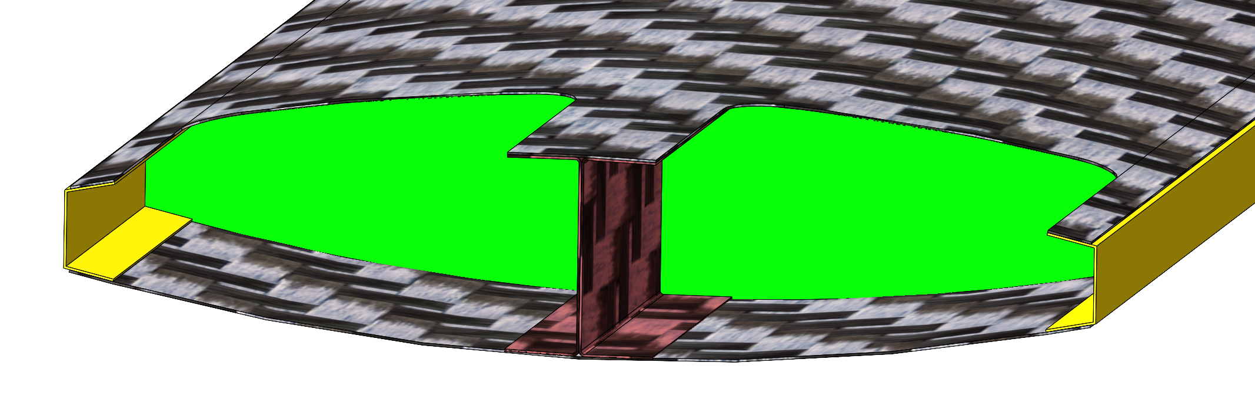
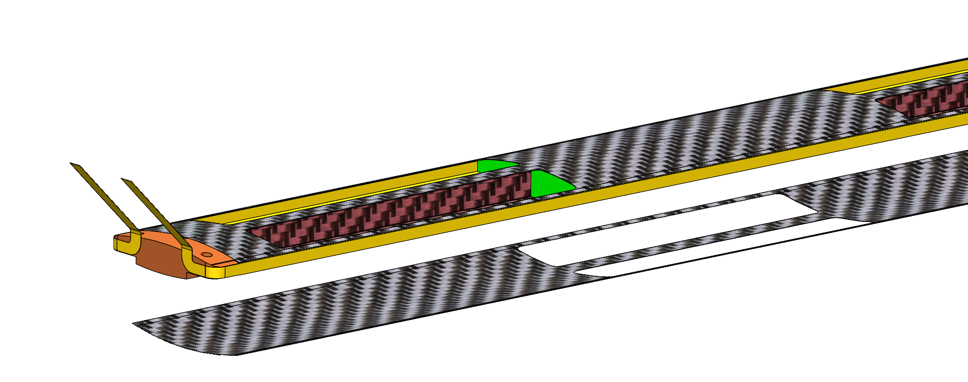
New Baseline Stave Structure
RVC foam replaced with structural FPC/carbon skin
Top/Bottom Carbon fibre skin now has material under all sections of the module adhesive area
  Removes height difference around outer edge which causing height disparities/potential sealing issues
K9 Foam extends to edge of the stave → Full coverage of LEC
Material Addition

Slide 3
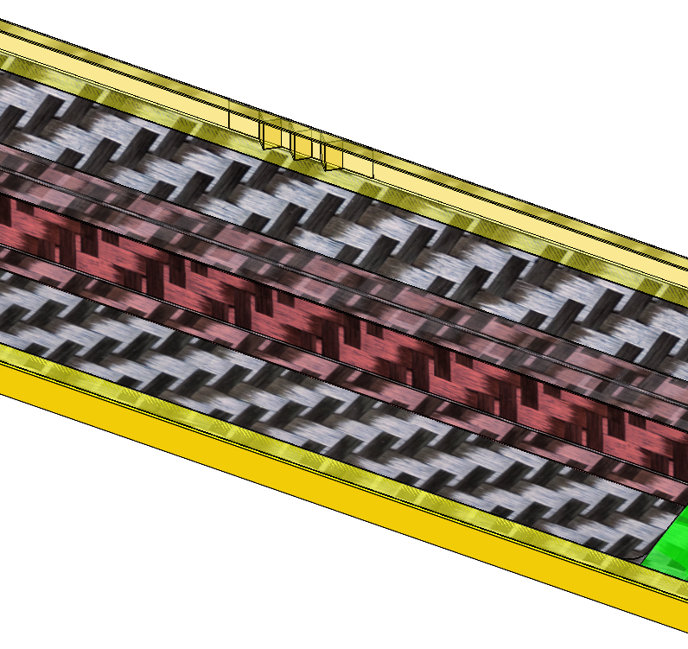
FPC Stiffening
Prototyping/buckling analysis will tell us is if FPC alone is stiff enough to avoid bucking (3.25 mm vertical height at edge)
We can add corrugated stiffeners after curing (before module installation), to increase stiffness if required.

Slide 4
Tooling
Preform Carbon Fibre I Beam
Kapton (FPC) Thermal Pre-forming
Stave Structure Assembly Tooling

Slide 5
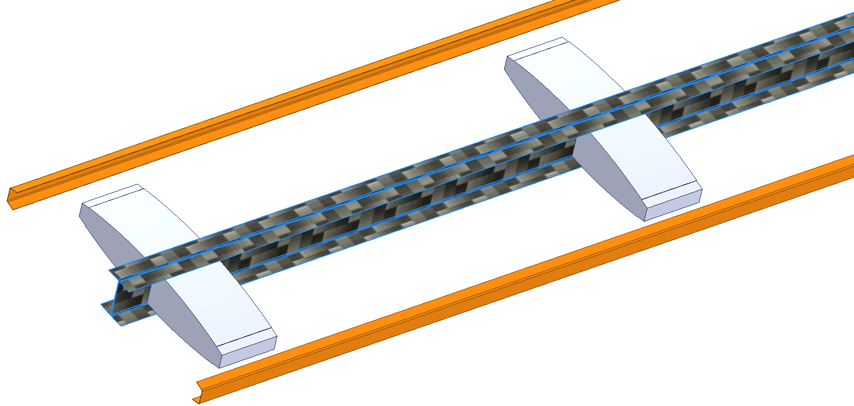
Stave Component Prototypes
Carbon fibre I beam
Kapton channel
K9 foam (will be machined next week

Slide 6
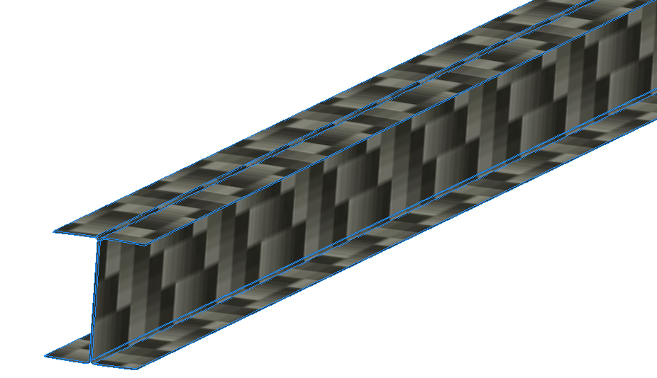
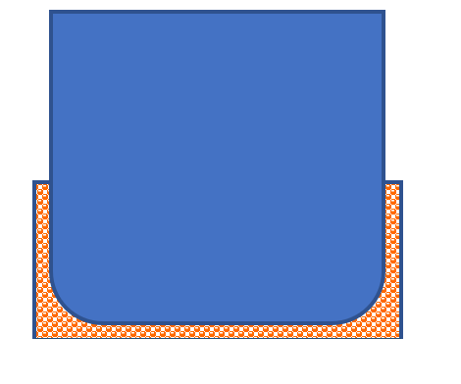
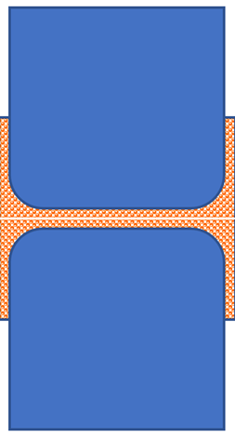
Carbon Fibre I-Beam
Vacuum bag the assembly
Cure in Autoclave

Slide 7
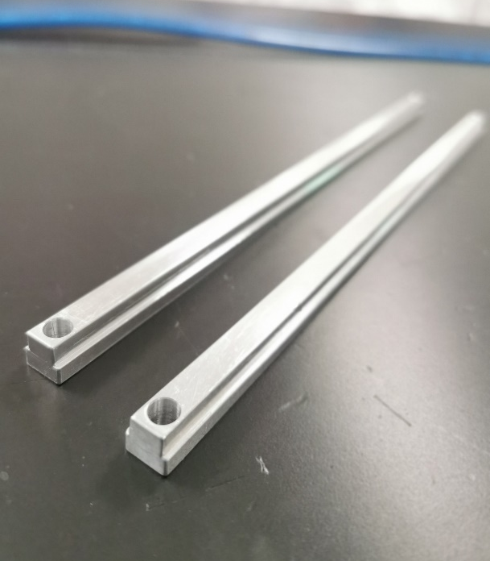
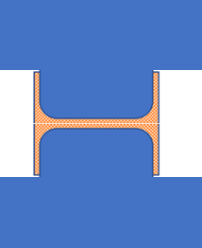
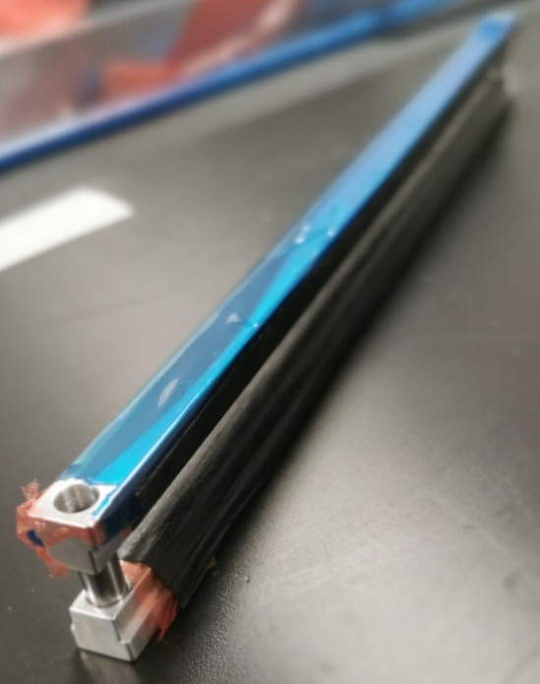
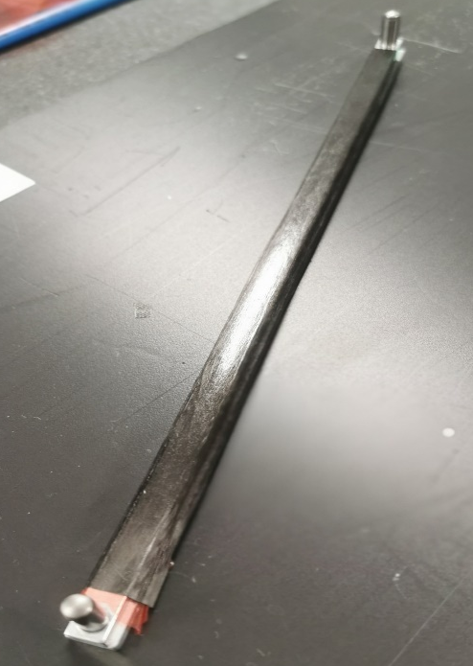
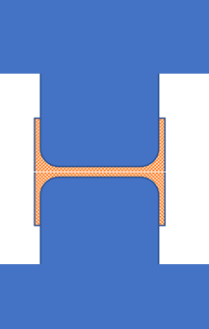
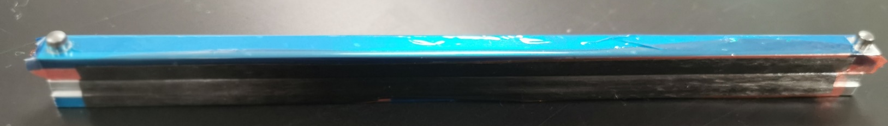
Carbon fibre I beam -1st attempt
2 layers of K13C2U (0/90)
Configuration#1
Configuration#2
Two configurations have been tried:
Configuration#1: the tooling gives the nominal size, the 2 layers of prepreg applied to the mould and the excessive material are trimmed off before assembly for vacuum bag.
Configuration#2: the tooling gives oversized flange area, the prepreg applied to the mould and no trimming before vacuum bag but trimming after the cure.

Slide 8
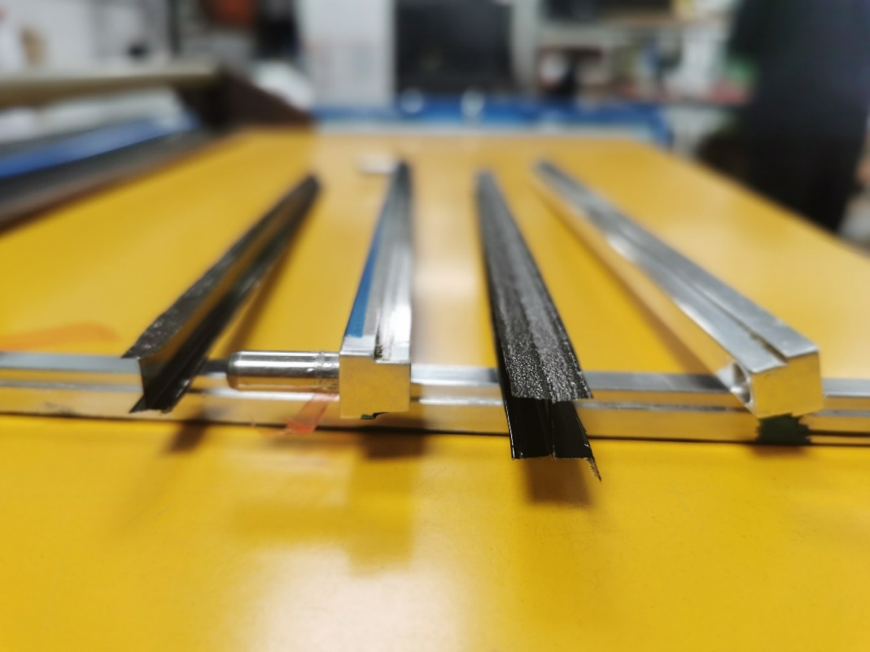
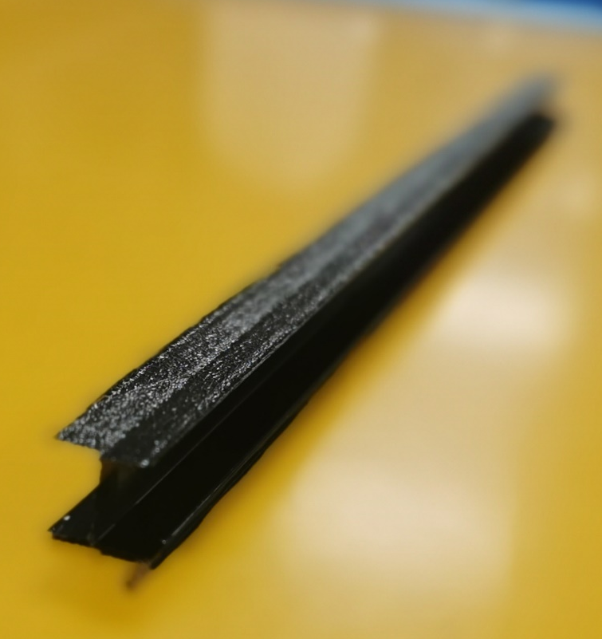
Carbon fibre I beam -1st attempt
I-beam flanges trimmed
I-beam flanges untrimmed
The central beam thickness is 0.15mm (4 layers of CF),
After the cure, we found that the trimming is harder:
Partly because the existing tooling has no feature showing the cutting line;
The cured CF I beam flanges are thin and crispy, tricky to trim without damage it.
Trimming the prepreg is straightforward and we shall do that for our next iteration.

Slide 9
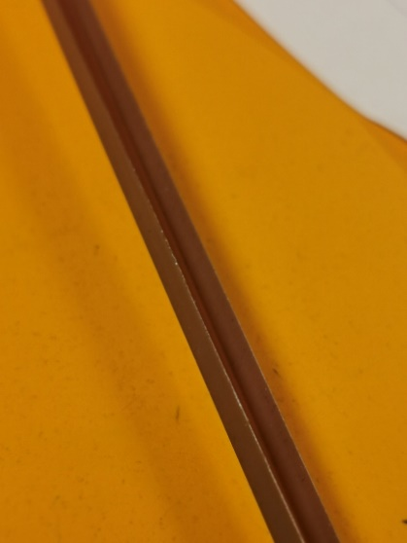
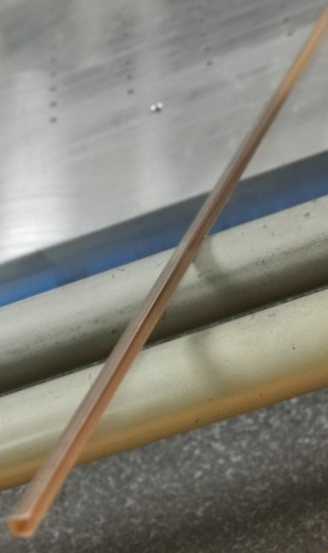
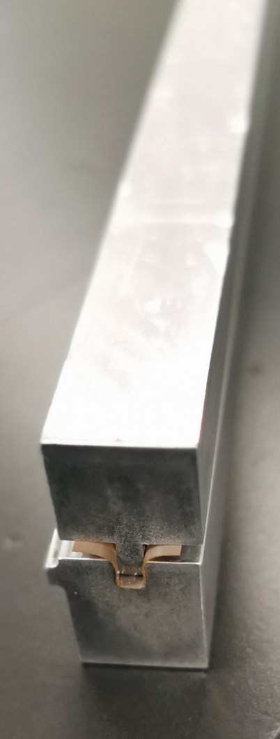
Kapton Folded FPC forming-1st attempt
Use a piece of 100 microns thick Kapton and form it to a “U” shape.
Process:
  Pre heat Kapton in the oven (~150ºC) for 15 minutes, then use forming die to shape it;
  leave the assembly in the oven at ~150ºC for ~30mins.
  Then Autoclave for 3 hours.
  Trim to size before disassembling it from the tooling
The formed Kapton U channel looks good and feels stiff.
Note: We will need a different mould design which defines the location of the fold, as this will be the FPC, trace locations need to be controlled.
cutting line
2mm
3mm

Slide 10
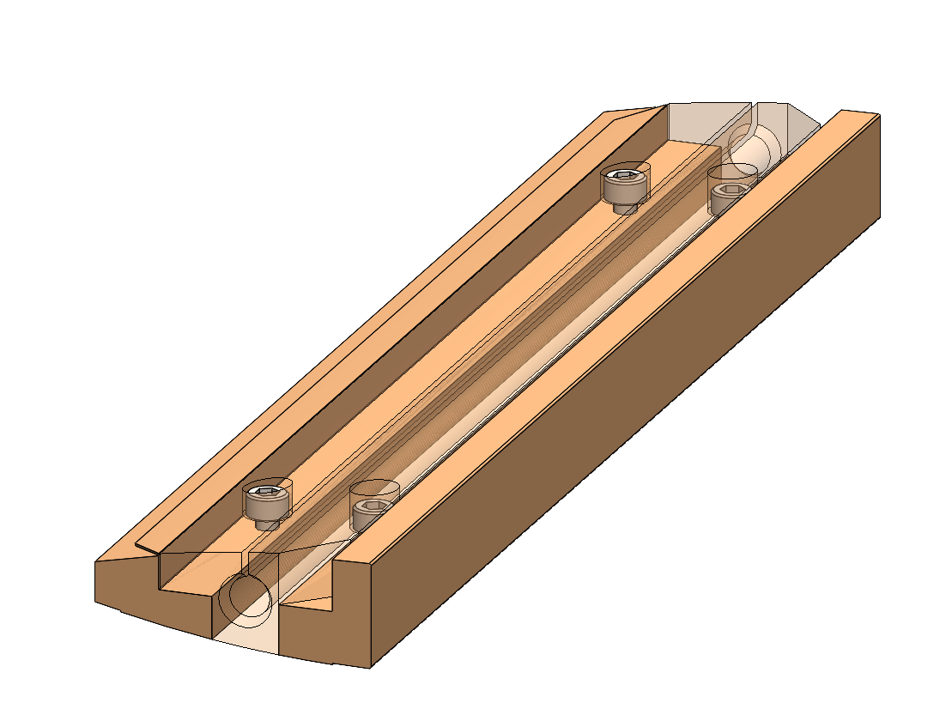
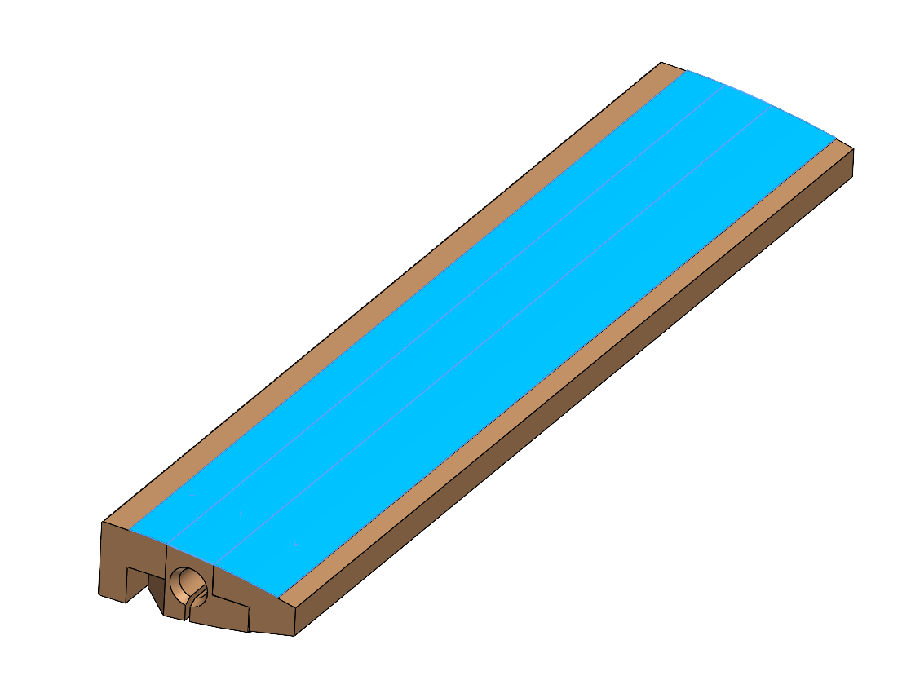
Review Comments
Review panel expressed concern that it may be difficult to achieve good/uniform consolidation of carbon fibre skins using press, should consider feasibility of autoclave cure.
Currently tooling is being redesigned for aluminium internal supports and vacuum bagging.

Slide 11
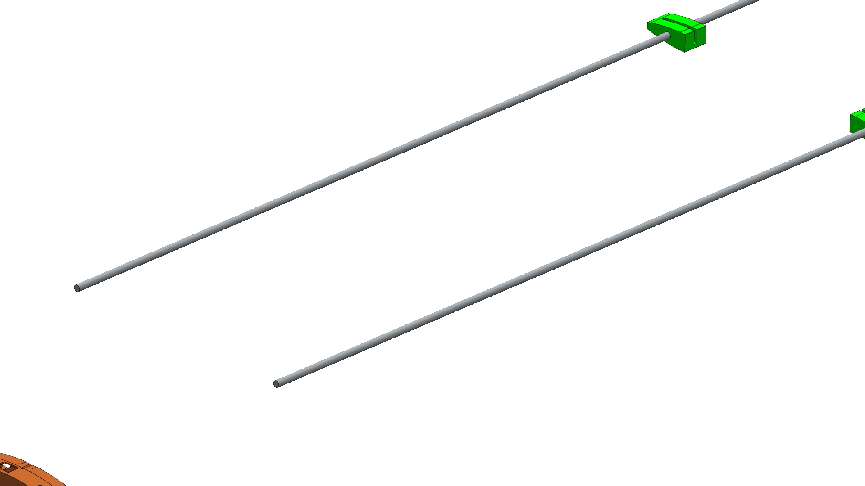
Internal Structure Assembly
Note: 3 mm dowel through stave core is just one option, similar results could be achieved by aligning tooling segments onto a base plate with dowels

Slide 12
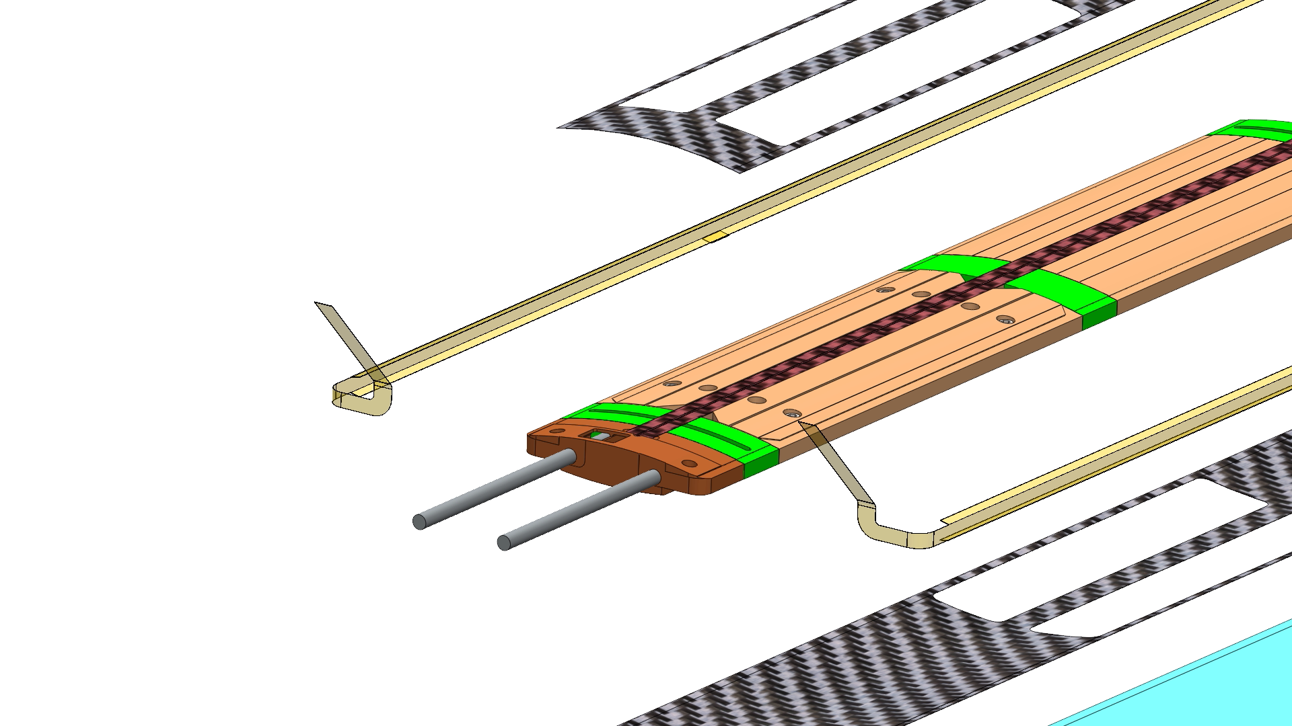
Carbon Skins/Intensifier
Internal tooling give near stepless surface on top and bottom of the stave.
Silicone intensifier added on both sides
We may need a curved support structure to hold layers during alignment

Slide 13
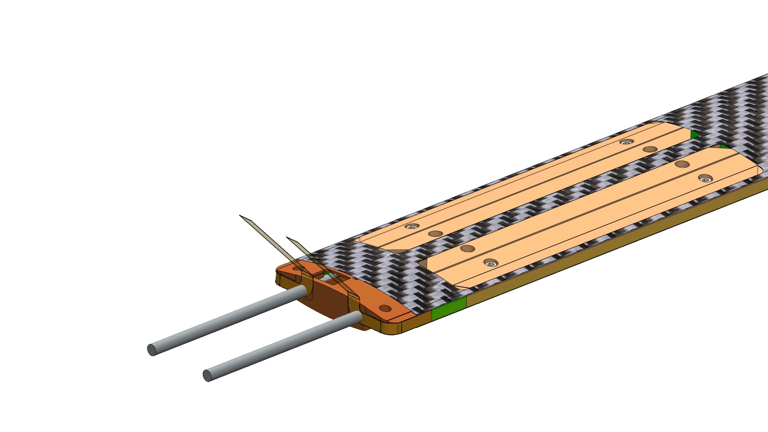
Tooling Removal

Slide 14
If rods down stave length are not feasible these can be replaced for dowel from underside.
  To achieve this we will need holes in carbon fibre skin to allow these dowels to pass through 4 of 8 module location (these can be patched after assembly).

Slide 15
End

Slide 16
Additional Slides

Slide 17
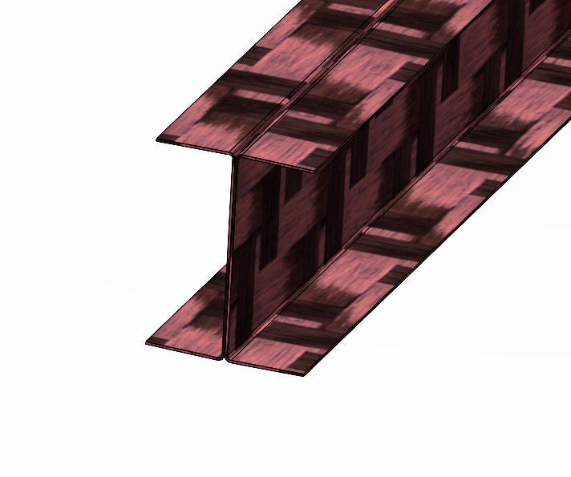
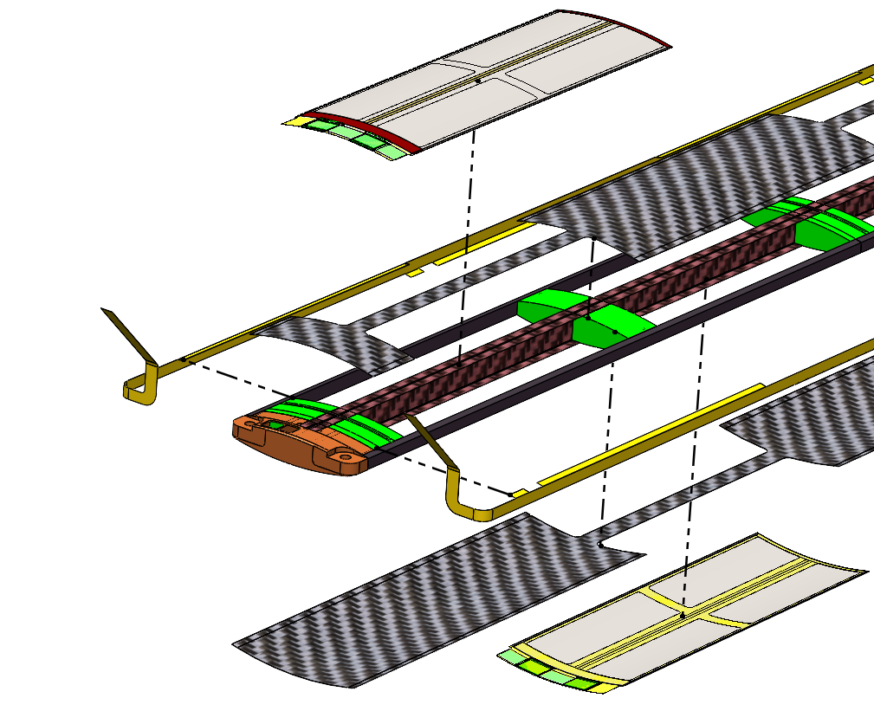
Stave Structure
Combination of carbon foams and carbon fibre prepreg laminates
  Central carbon fibre I-beam divides left and right air channels (shown in red)
  2 Densities of carbon foam (high porosity → allow airflow)
    K9 used as a heatsink, in contact with the high power regions (ASIC & LEC) to aid heat dissipation
    3% RVC foam longerons for structural support
  0.1mm thick 2 ply carbon fibre skins on top and bottom of the structure
  FPCs run along the longerons (shown in yellow)
Notes:
The stave structure is primarily build from carbon foam and carbon fibre laminates.
Main spine of the stave is a carbon fibre I beam build from 2 x 0.1mm thick U channel laminates, this runs uninterrupted down the lengths of the stave, giving rigidity and dividing the air volume of the stave into a left and right channel.
We use 2 types of carbon foam, K9 which you may be familiar with from ATLAS, is a higher density foam which gives better heat transfer properties and 3% RVC which offers lower flow resistance and is lighter weight. Importantly in both vases high porosity of the foams allow air to pass through them.
We use K9 foam for the cross braces which sit under the high power density regions of the stave (so the Left End Cap and the Ancillary ASIC)
3% RVC foam is used for the longerons which run along the edge of the stave structure, used to support the FPC, and outer edge of the sensor module.
A carbon fibre laminate skin runs accroos the top and bottom of the stave, combined with the EIC;LAS this forms the boundary for the internal flow channel.

Slide 18
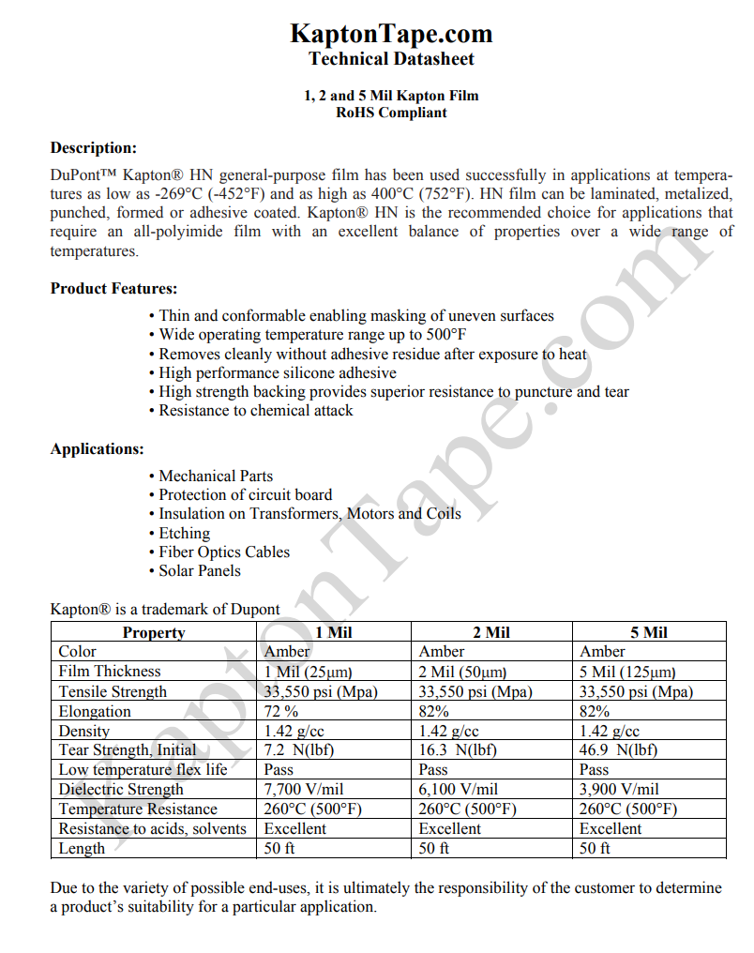
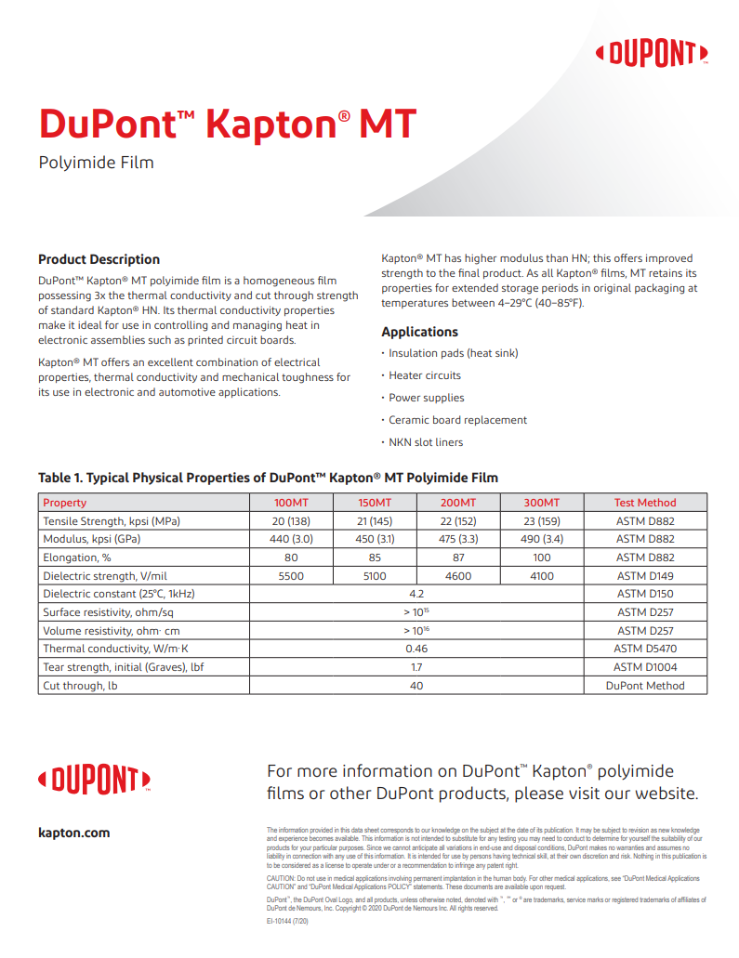
https://www.kaptontape.com/PDF/Kapton_Films_Datasheet.pdf

