Slide 1



Test plans at RAL
Todd Huffman – Oxford
Rebecca (Becca) Augier - Durham

Slide 2
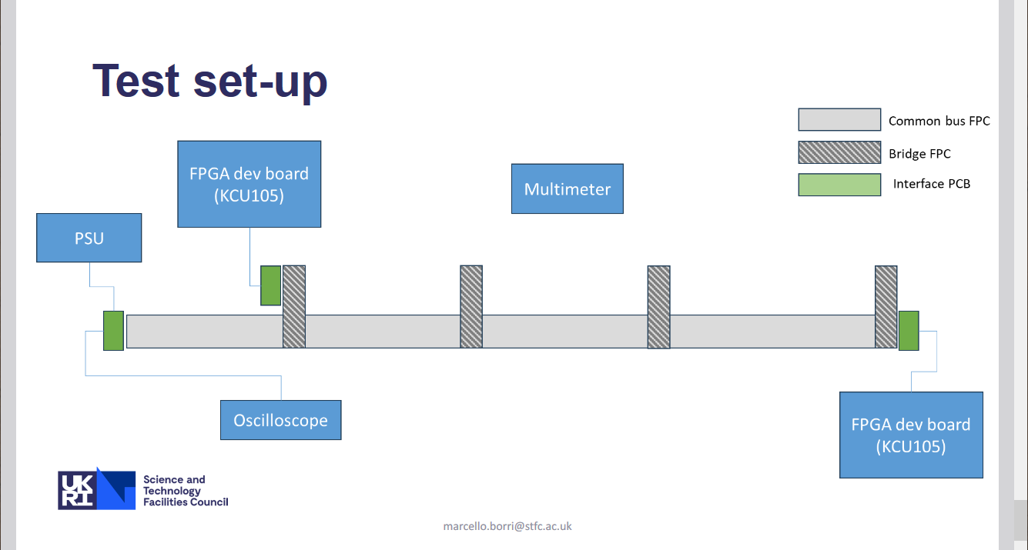
From Face-2-face meeting at B’ham

Slide 3
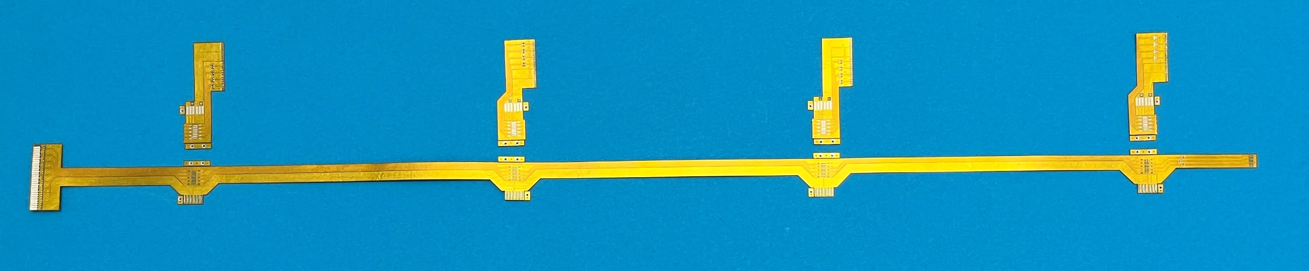
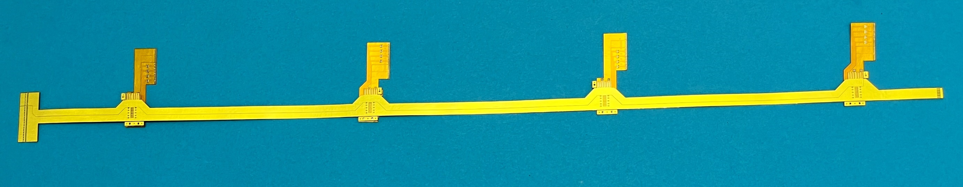

Set of assembled technological FPCs
Set of multilayered FPCs (M-FPC+ B-FPCs) for ePIC SVT multilayered multicomponent FPC
B-FPC-A (pos.1)
B-FPC-B (pos.2)
B-FPC-A (pos.3)
B-FPC-B (pos.4)
M-FPC
Aligned (but not assembled) components of multilayered multicomponent ePIC SVT FPC
viatcheslav.borshchov@cern.ch, ihor.tymchuk@cern.ch

Slide 4
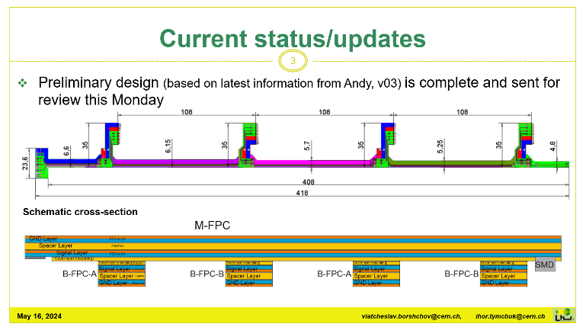
Current cable design. (in mm)

Slide 5
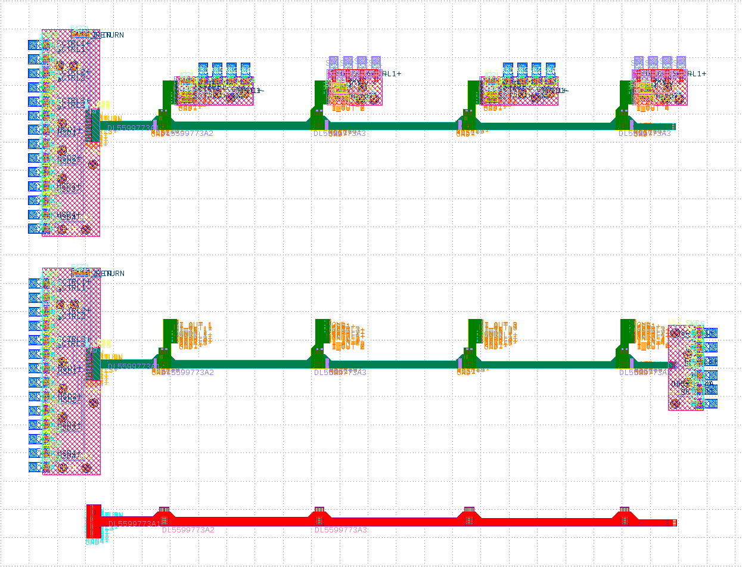
Cable and interface boards

Slide 6
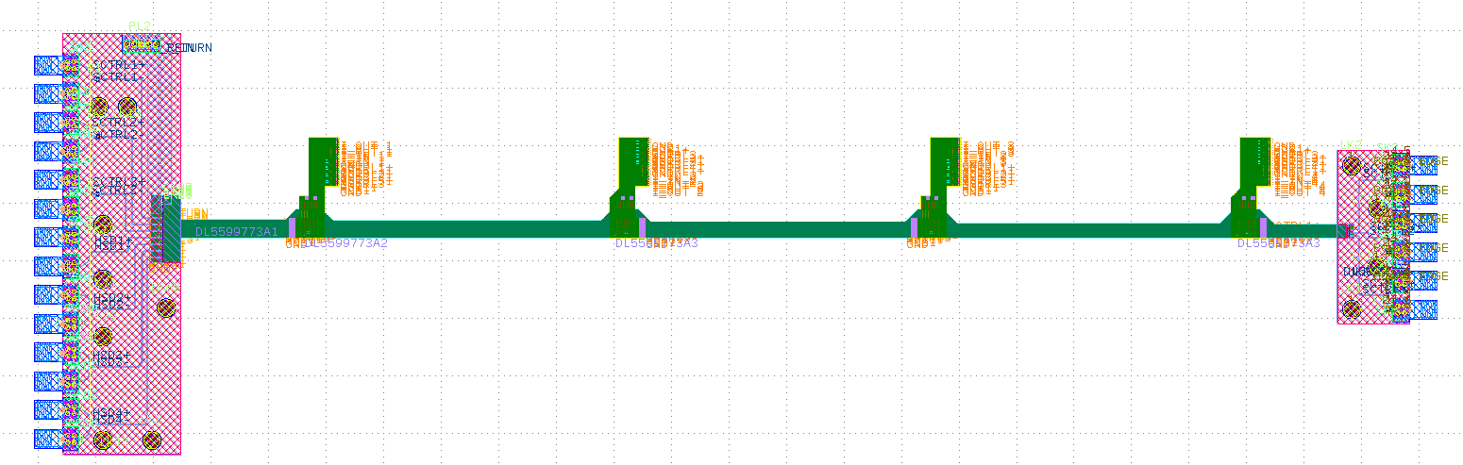
Current status
Cable and Bridges expected 2 weeks
Interface boards ordered (expedited) 4 weeks?

Slide 7
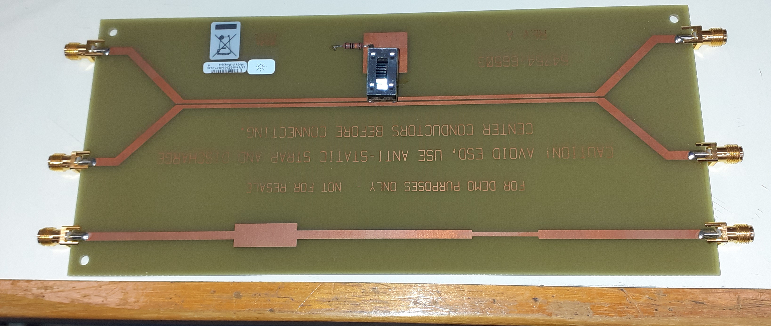
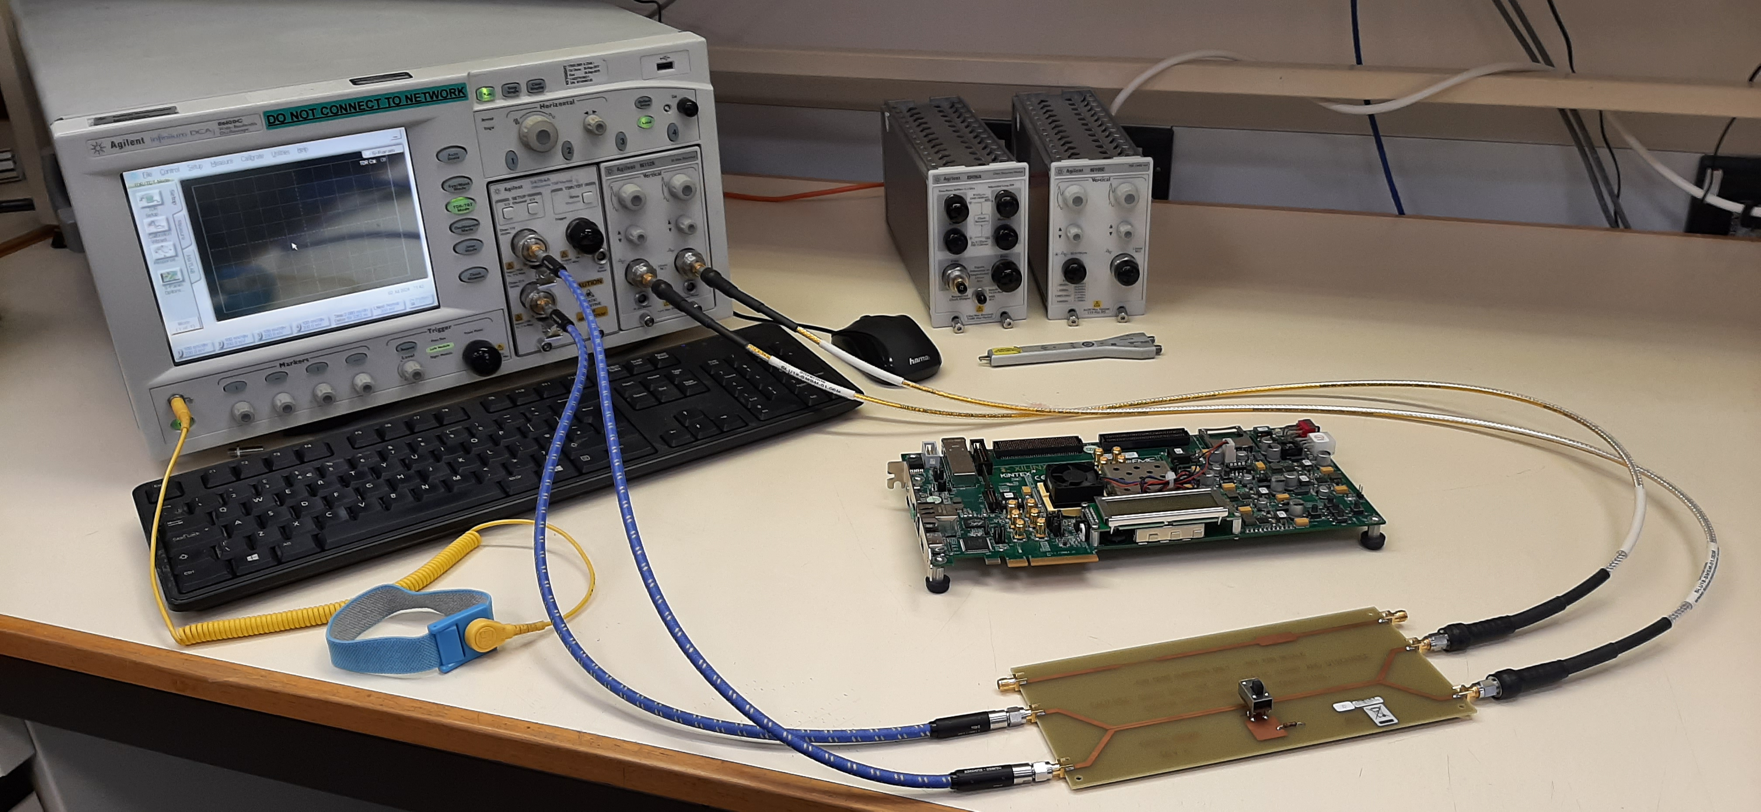
UNIQ+ summer student @Oxford Equipment @RAL
54754A TDR
86112A 20 GHz (12.4 GHz)
Test board: Use to set up tests
Also have a Kintex 7 board to generate Psuedorandom bit streams

Slide 8
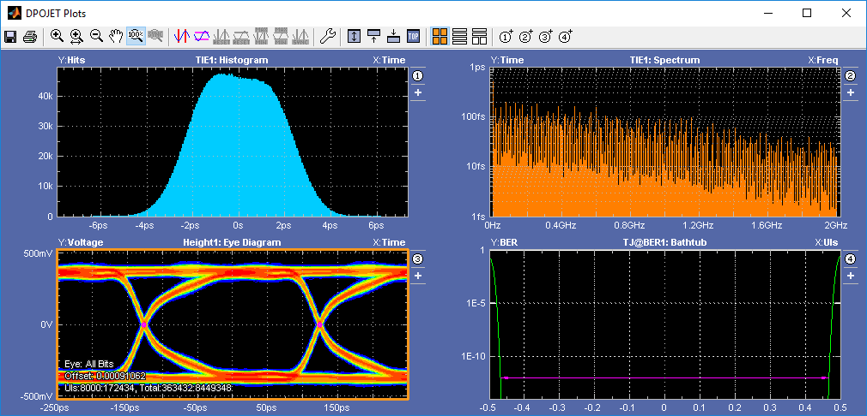
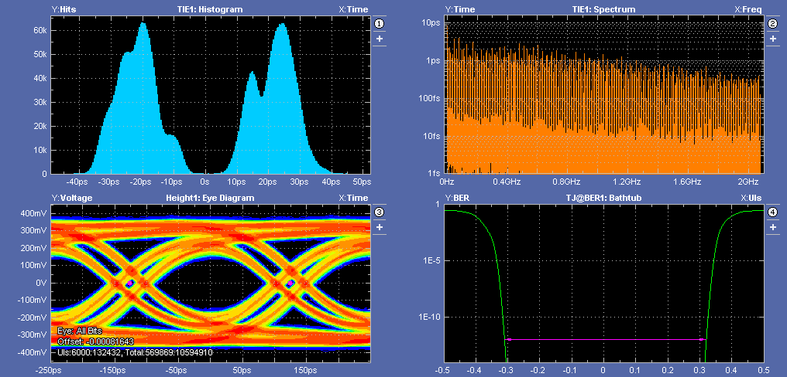
Hoping to do something similar with FPC
KCU105 direct to ’scope (72 inch cables)
KCU105 to DUT to ’scope (72 inch cables)
Pictures From William Helsby – Daresbury lab.
Eye diagrams, bathtub plots – other suggestions?

