Slide 1
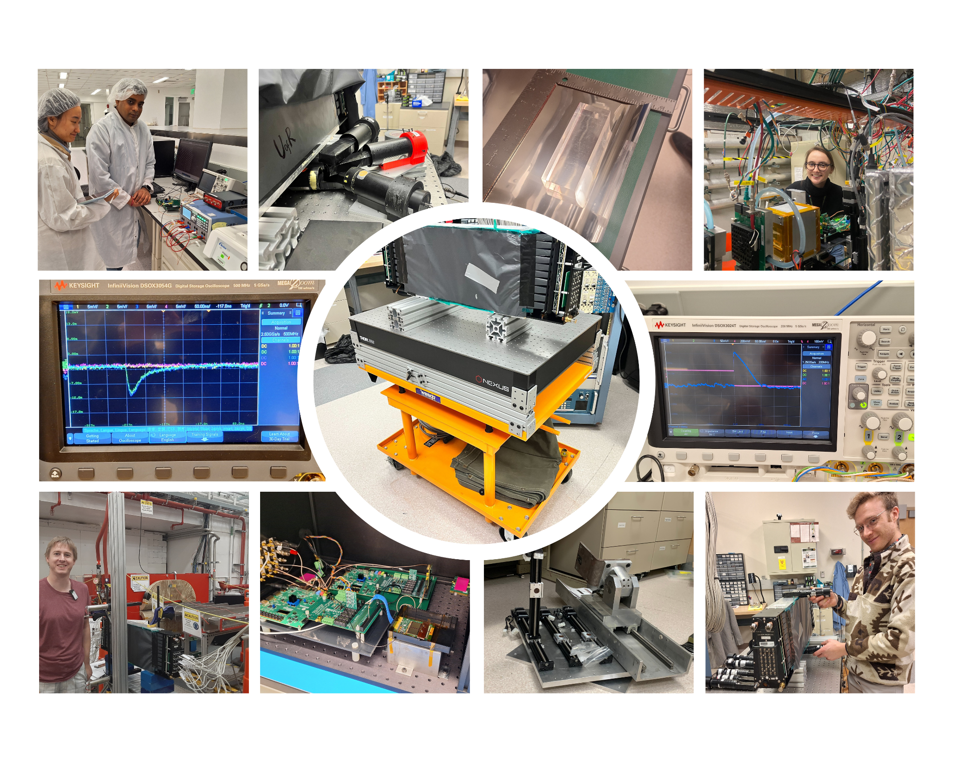

Barrel Imaging
Calorimeter
Homework
eRD115
Detector Advisory Meeting
28-29 August 2024
08/29/2024

Slide 2
DAC 10/10/2023 Recommendation 1
From Project R&D Review
Comment: Characterization of the high energy side and determination of the detector’s linearity in response for the electrons is very relevant for this detector. The dynamic range of the GlueX apparatus has been changed from few GeV up to 50 GeV (for the electrons) and it is not immediately evident that the selected SiPM pixel size (50 um as used in GlueX) will not suffer non-linearity at the highest energy points.
Recommendation: The test beam should be used for testing the readout section with SiPMs of different pixel size to be sure that linearity is proven before starting the SiPM LLP. Test of different sensors is already foreseen in Milestone N.9 and our request can be accommodated in this framework.
Our response: We discussed this topic in detail during the SiPM Final Design Review in September 2023. The exact performance requirements for the barrel region are:
Good photon energy reconstruction between 0.1-10 GeV
Electron ID between 1-50 GeV
Sufficient dynamic range to see the MIP for calibration purposes
Our FY24 test beam data demonstrated perfect linearity up to 10 GeV with the 50 µm S12 series SiPM (same as used in GlueX), meeting requirement (1). Given this, requirement (2) is inherently met, as electron-pion separation at energies above 10 GeV is straightforward in the barrel region due to minimal pion flux at these energies.
Using SiPMs with a smaller pixel size would substantially reduce photon detection efficiency (PDE), conflicting with requirement (3). Lower PDE would make it challenging, if not impossible, to separate MIP signals from noise, especially after expected levels of radiation damage.
Additional supporting information can be found on slides 3-5.

Slide 3
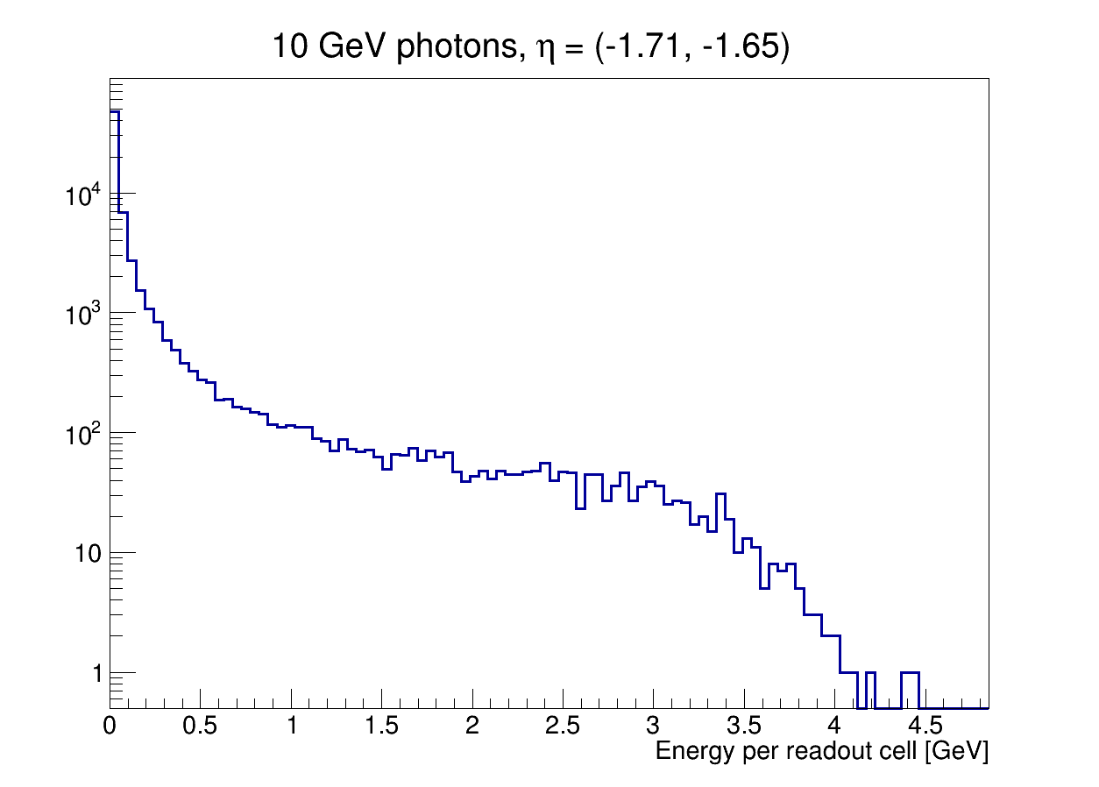
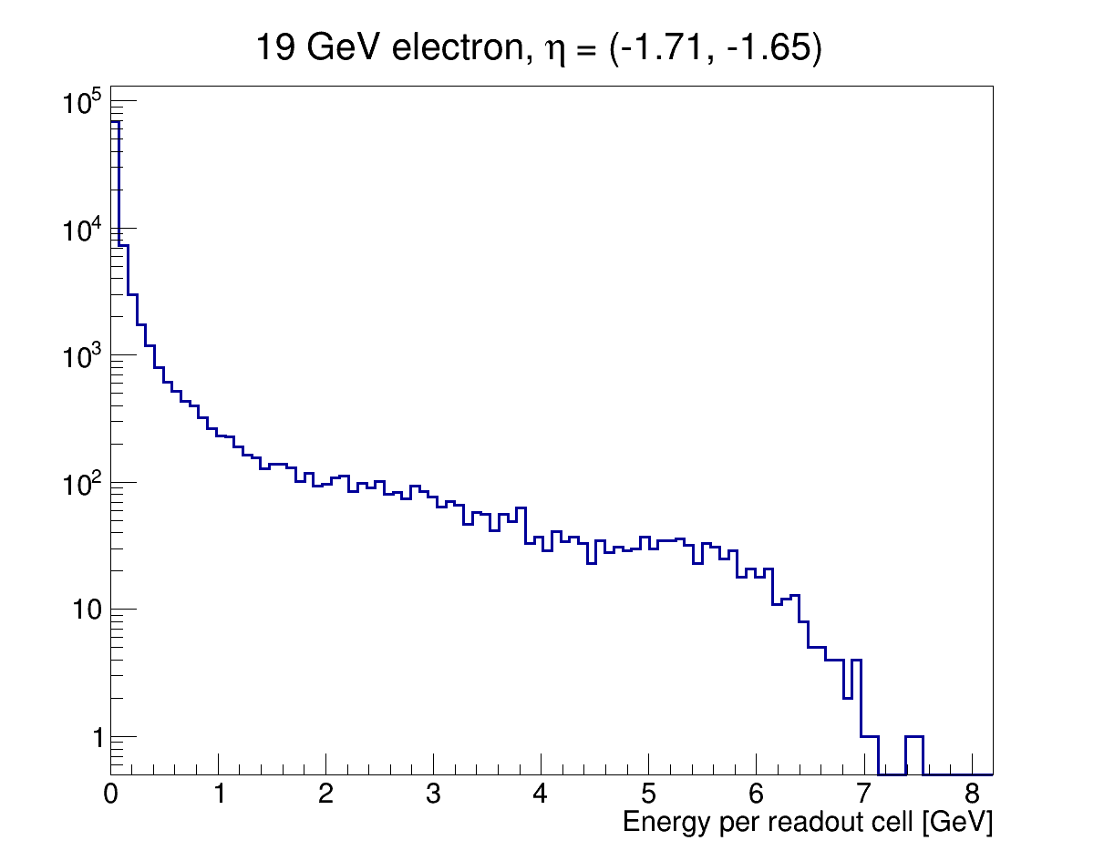
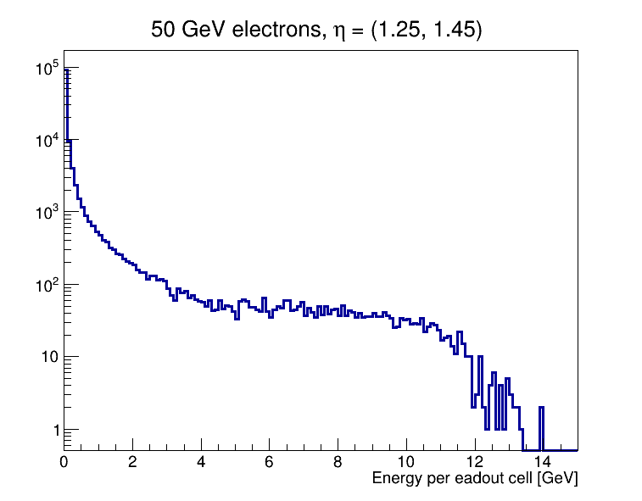
BIC Detector Requirements
Driving SiPM Pixel Size and Required Total Number of Pixels
As defined in the EIC Detector Requirements Database: https://eic.jlab.org/Requirements/
Energy measurement ranges in BECal:
Shall provide photon measurements up to 10 GeV (F-DET-ECAL-BAR.2) and down to 100 MeV (F-DET-ECAL.9)
Shall provide electron ID up to 50 GeV and down to 1 GeV and below (F-DET-ECAL-BAR.1)
  Electron energy measurement needed for e/π separation only (straightforward at high energies)
Reasonable performance for MIPs needed for calibration and for muon ID
Largest energy deposit occurs for particles at large η (steep angle) where the pathlength in a cell is maximal and the attenuation is minimal.
Energy deposit per BIC readout cell
ePIC GEANT4 simulation
10 GeV photons at η ~ -1.7
ePIC GEANT4 simulation
19 GeV electrons at η ~ -1.7
ePIC GEANT4 simulation
50 GeV electrons at η ~ 1.4
extreme case
4.3 GeV
7.1 GeV
13.5 GeV

Slide 4
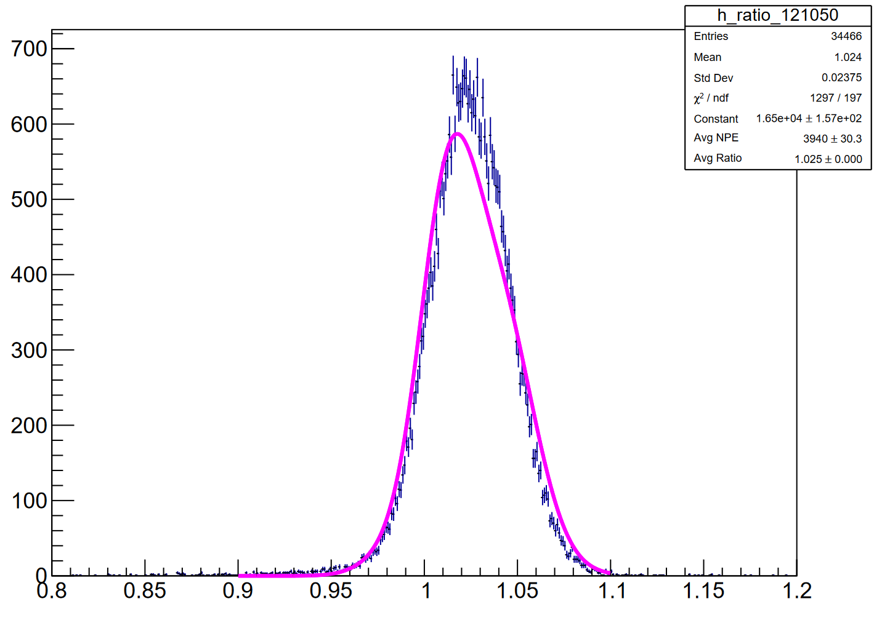
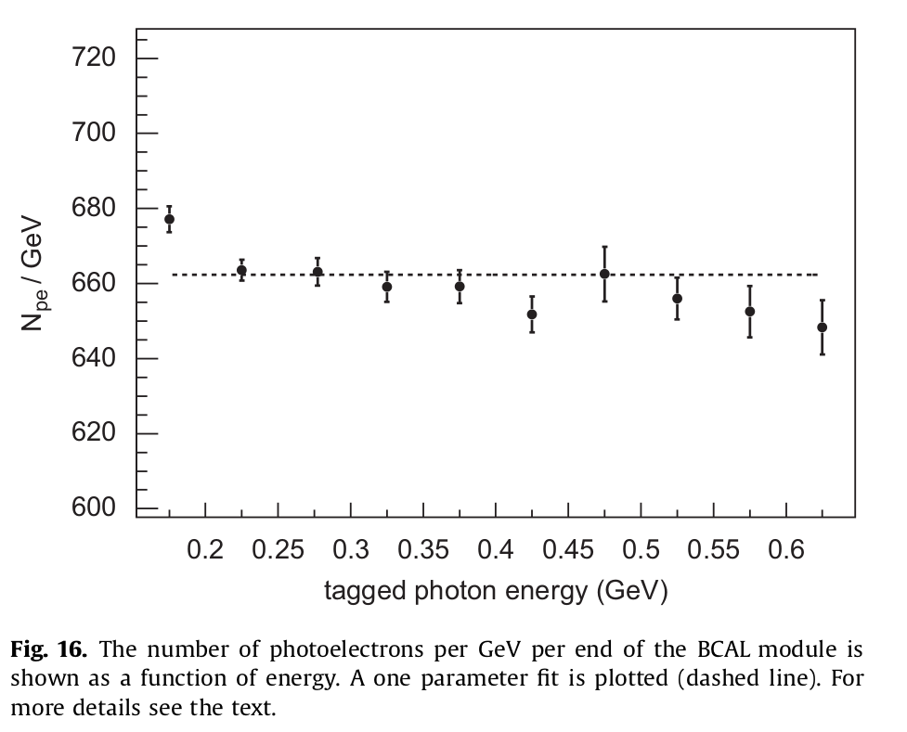
Expected photoelectron statistics
2023 Hall D, Baby BCal, 3.9 GeV e⁺
From our 2023 Hall D tests using GlueX SiPMs and double-clad Kuraray fibers: 1000 phe/GeV per side for showers at the center of the Baby BCAL prototype
Corrected for attenuation: 1077 phe/GeV per side
We can scale these results for the BIC:
x 1.5 factor improvement in SiPM photon detection efficiency
x 1.16 factor to account for better optical coupling (simulated)
x 0.69 reduction accounting for single-clad Kuraray fibers (measured)
This gives ~ 1239 phe/GeV per side (fully corrected for attenuation)
10 GeV ɣ at η ~ -1.7: 5560 phe → 9.8 % max SiPM occupancy
19 GeV e⁻ at η ~ -1.7: 9181 phe → 16.1 % max SiPM occupancy
50 GeV e⁻ at η ~ 1.4 (most extreme case): 17456 phe → 30.1% max SiPM occupancy
1000 phe/GeV
per side
not corrected
for 29 cm
atten.
2008 Hall B beam test, photons
660 phe/GeV
per side
not corrected
for 195 cm atten.
Well below the region where large nonlinearities in the SiPM response are expected in almost all cases.
Small non-linear effects possible for some ultra-high energy electrons, which is acceptable (e-π separation straightforward).

Slide 5
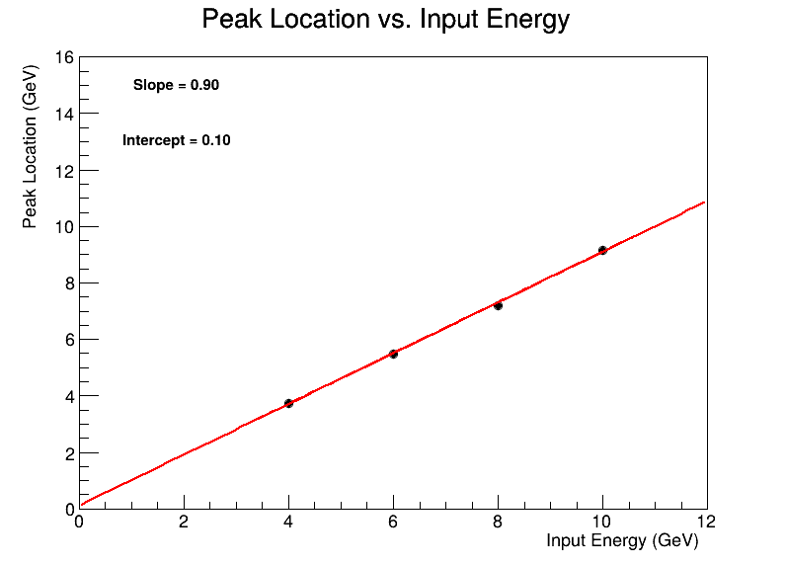
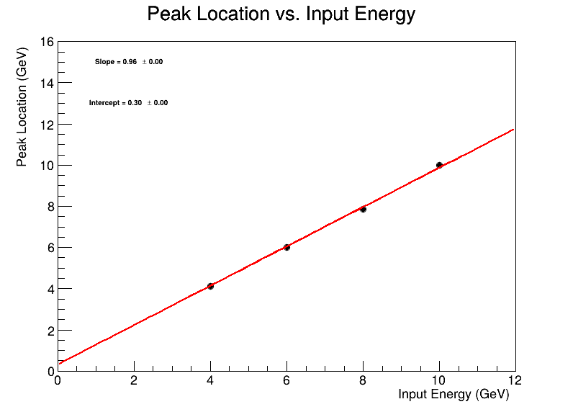
Linearity of response - R&D FY24
As defined in the EIC Detector Requirements Database: https://eic.jlab.org/Requirements/ Barrel ECal should measure gamma energy up to 10 GeV/c and only identify electrons up to 50 GeV/c as the main energy measurement for electrons will come from the tracker.
Therefore, in the R&D Program in FY24, we have tested the linearity of response up to 10 GeV with with 50×50μm² pixels SiPMs (Hammamatsu S12045(X), GlueX SiPM), in addition to the evaluations we have made on the previous slides.
Obtained calibration constants from MIP calibration with muons have been applied to all energy samples (4, 6, 8, 10 GeV), and the dependence of calibrated energy to true beam energy is linear
The calibration has been also refined using electron energy information (for all beam energy points together, not(!) point-by-point for each energy separately), and energy response is also linear
MIP calibration
MIP + electron
calibration
Preliminary
electrons
FTBF, 2024
Preliminary
electrons
FTBF, 2024

Slide 6
DAC 10/10/2023 Recommendation 2
From Project R&D Review
Recommendation:
In case it is needed, we recommend the prioritization of the efforts related testing the e/pion response with respect to more advanced integration efforts (mechanics, DAQ, triggering) since many of those can be carried out, independently from the FNAL test beam, also with cosmic ray data acquired at a later time at a parallel stage of development.
Our response:
Given the severe reductions in available beam time we decided to focus on setting up our DAQ system for the Baby BCAL aiming to collect analysis-quality data with the π/e beam while simultaneously working on the integration of AstroPix layers and Baby BCAL (See results on slides 11-20 from original presentation)
More details on the FTBF situation:
  Delays in the start of the beam at the Fermilab Test Beam Facility in FY24 caused by ESH paperwork: our team received only one week (6 days, 76 hours) of beam test out of the planned 4-6 weeks + funds to ANL available end of March 2024 only
  Due to a heat wave in the Chicago area we were provided only 30.5 hours of beam (~ 30% of the nominal 1-week allocation)

