Slide 1
dRICH
We encourage the dRICH group to follow the recommendations from the July 2023 PID review.
Most of the comments and final recommendation from the 2023 PID review regarded the temperature treatments of the dRICH sensors (and impact on quartz window and gas radiator) and were in line with the dRICH development plan presented at that time. The annealing protocol optimization is being studied in conjunction with the dRICH front-end development and PDU design (one example of study is presented on slide 17*). The prototype has been complemented with temperature and humidity sensors: induced gradients in the detector box volume (slide 11*) and on the radiator gas volume (slide 15*) have been measured with different windows and cooling air flow to provide inputs for the thermal modelling. The influence on neighbouring systems will be minimised as part of the detector box effort (point 6 below). The study in realistic conditions will be finalized with the real-scale prototype.
The SiPM studies for the Long Lead Procurement should be finalized as soon as possible. The procurement
should be carried out with a close relationship with the manufacturer to monitor fabrication progress and quality.
As realized in accordance with the EIC Project and manufacturer, the dRICH sensors are peculiar and do not need to be necessarily mated with the large production for ePIC calorimeters. We are in contact with Hamamatsu to evaluate possible further optimization (e.g. UV enhanced type, slide 17*). The plan it to start the production in 2026, and we checked there is no real concern about the lead time at this stage. Three QA stations are being realized in Italy (INFN-BO, INFN-SA-CS-CT and INFN-TS, slide 9*) to support the SiPM quality standards during production and before assembling.
* Slide number refers to the dRICH report given at the DAC Meeting on August 28
EIC Project R&D - DAC Meeting - 28th August 2024
1
Notes:
Aggiungere distribuzioni in numero fotoni ?

Slide 2
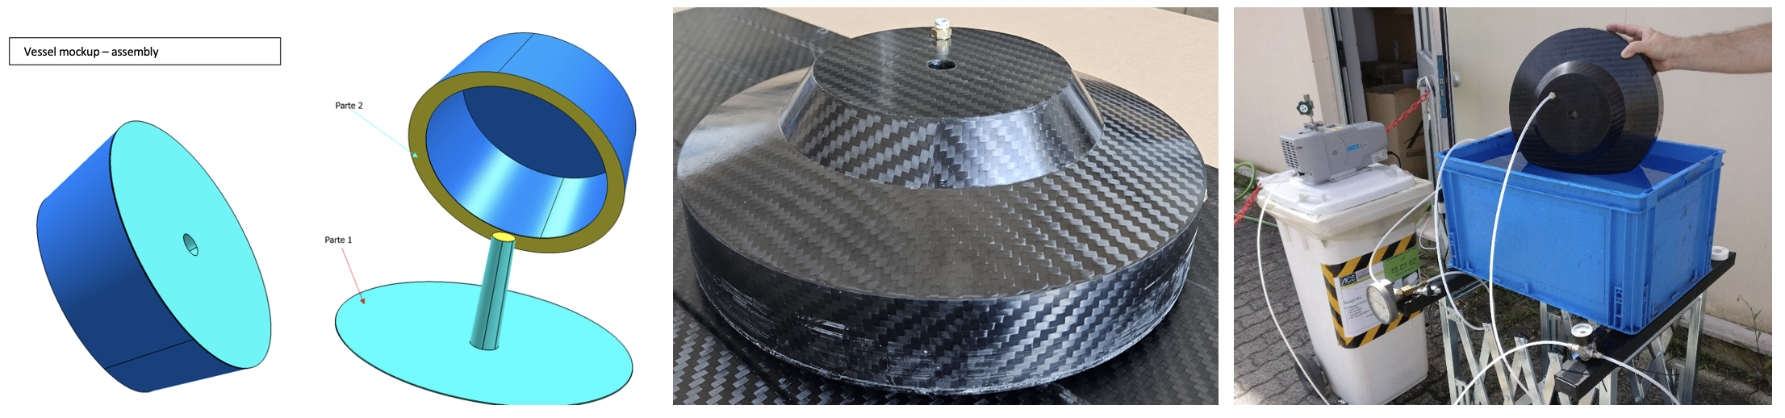
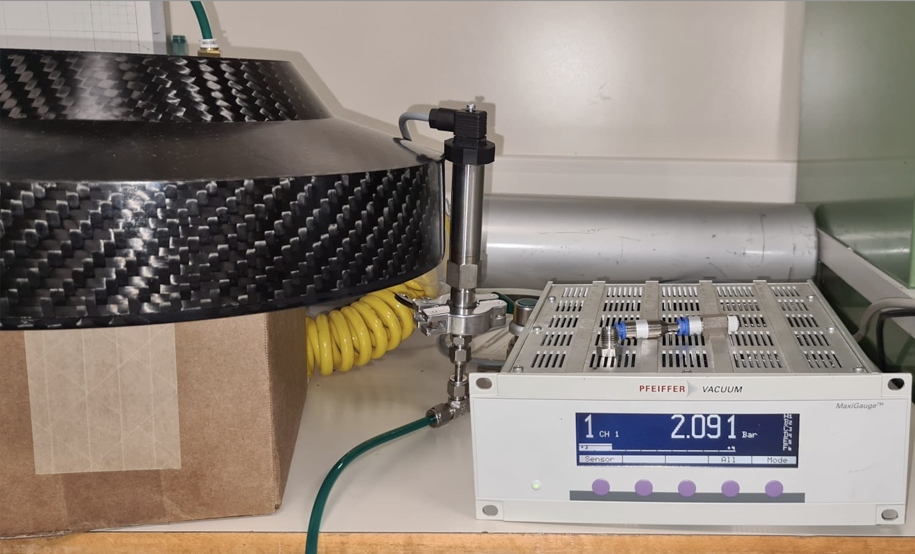
dRICH
It is important to understand the aerogel quality issues and give feedback to this manufacturer in order to
allow time for the production of aerogel which meets the requirements of the detector.
The quality issue has been solved by an optimization of the refractive index n (slide 6*). In accordance with the manufacturer, we now target n=1.026 and move to the tile dimension optimization (slide 7*). The target is to reach BELLE-II standard (18 cm side) in 2024 and, possibly, CLAS12 standard (20 cm side) in 2025 to minimize edge effects.
We recommend that a detailed design of the gas box and circulation system be given high priority.
The design of the gas box is proceeding in parallel with the one of the real-scale prototype, being the latter the basic building block to be replicated for the final detector (slide 21-23*). The foreseen carbon-fiber composite material has been already validated with a mock-up that probed no gas leak up to +1 bar (presented at the DAC in 2023), see figure below.
* Slide number refers to the dRICH report given at the DAC Meeting on August 28
EIC Project R&D - DAC Meeting - 28th August 2024
2
Notes:
Aggiungere distribuzioni in numero fotoni ?

Slide 3
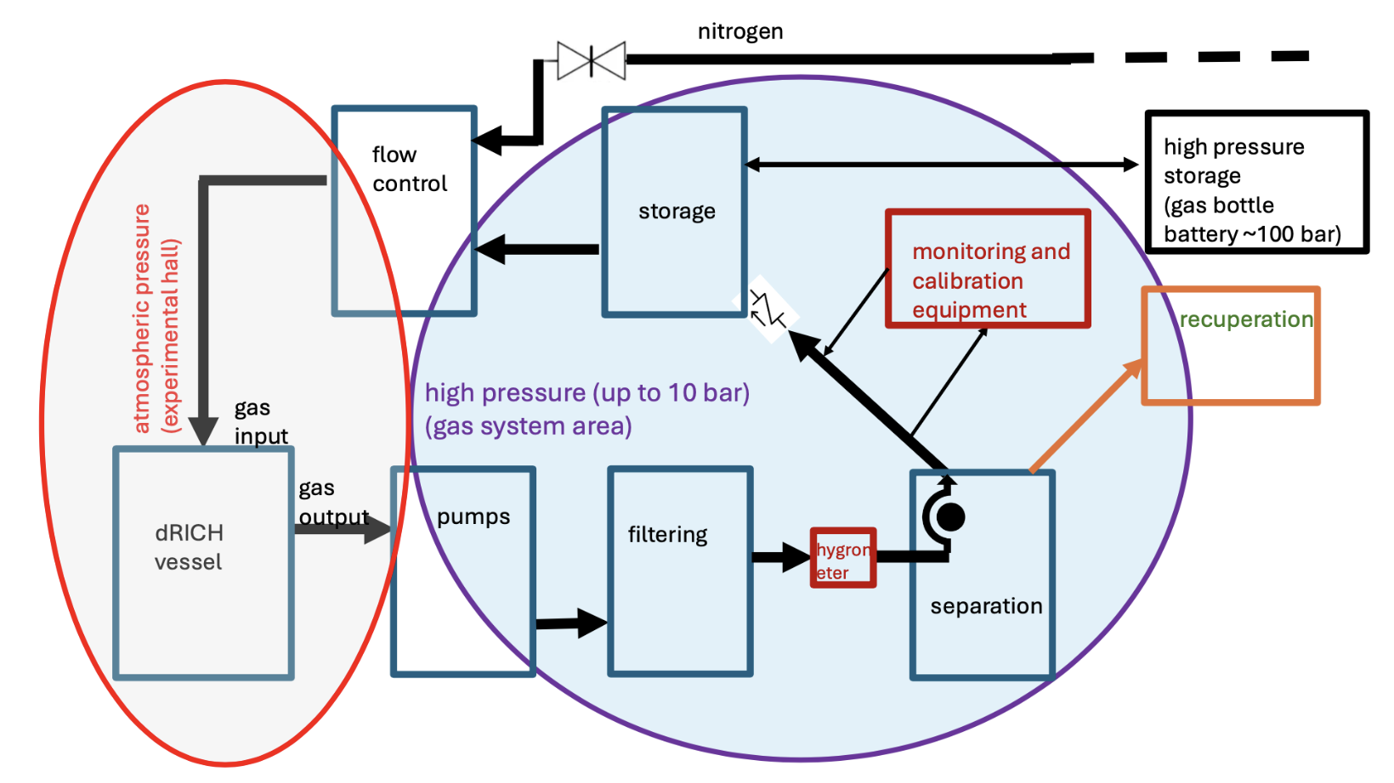
dRICH
We recommend that a detailed design of the gas box and circulation system be given high priority.
(continued) The INFN-TS group has taken the responsibility to design the gas circulation and monitoring system (within a proposed PED activity), building from their experience with the COMPASS/AMBER gas RICH system. (It is assumed that the final executive drawings and infrastructure realization of the circulation system is eventually done by the EIC Project engineering team to conform to US safety regulations). The INFN-TS group works in close connection with CERN experts and is taking into account the last CERN standards for minimum gas leakage and environmental impact (slide 28*). A conceptual sketch of the gas recirculating system is depicted in the following figure.
EIC Project R&D - DAC Meeting - 28th August 2024
3
Notes:
Aggiungere distribuzioni in numero fotoni ?

Slide 4
dRICH
To address concerns with multiple track PID, we recommend the implementation in the simulation of the
expected backgrounds from the accelerator and study performance in the presence of overlapping tracks.
This task is ongoing. We implemented in ePIC simulations a model for the SiPM dark count background: an example of worse-case scenario study was presented at the ePIC R&D Day in March ’24 and is reported in the figure below (at nominal refractive index n=1.02). We also implemented the measured optimized aerogel parameters in order to get a proper signal over background ratio. At the same time, we initiated a study of the accelerator background as part of the dRICH event tagging effort to reduce the DAQ data rate (slide 27*). Preliminary results have been discussed at the ePIC Meeting in Lehigh (summer ‘24).
* Slide number refers to the dRICH report given at the DAC Meeting on August 28
EIC Project R&D - DAC Meeting - 28th August 2024
4
Notes:
Aggiungere distribuzioni in numero fotoni ?

Slide 5
dRICH
We recommend the development of a detailed design of the mechanical support of the photon detectors,
as the arrangement seems complex.
A prototype of the detector box has been realized (slide 11*). It already introduces many aspects of the final design: PDU assembling and mounting, integrated sensor cooling and distribution, electronics cooling, optical window, temperature and humidity monitor and control. The box has been used to study the working conditions in laboratory tests and during the beam tests. With the completion of the successful 2024 beam-test dedicated to the ePIC driven detector, INFN is taking the responsibility of the detector box design and is organizing the workforce to this end. Three new technologists are joining the project: one expert of mechanics (INFN-FE) and two experts of cooling and thermal modelling (INFN-TO). The detector box effort will run in parallel with the planned PDU optimization (within a proposed PED activity) and will eventually complement the real-scale prototype.
We support the development and testing of the full-scale prototype.
This is one of eRD102 current priorities (slide 21-22*), as it can provide a benchmark for all the technical aspects of the project and support further component optimization and engineering in a realistic configuration.
The parameters of the annealing of the SiPMs should be studied to ensure they don’t affect neighbouring systems.
The optimization of the annealing protocol is ongoing. An example of study of the effective temperature limit, indicating no need to go above 150 C has been presented (slide 17*). The impact on the dRICH electronics is studied as part of the PDU development (slide 16* and 20*). The impact on neighbouring systems is part of the detector box effort (point 6 above).
* Slide number refers to the dRICH report given at the DAC Meeting on August 28
EIC Project R&D - DAC Meeting - 28th August 2024
5
Notes:
Aggiungere distribuzioni in numero fotoni ?

