Slide 1
eRD109 (ASICs/Electronics) EIC Project R&D – DAC Meeting
Fernando Barbosa (TJNAF)
L3 CAM WBS 6.10.08
Chief Electrical Engineer
EIC Project R&D – DAC Meeting
August 28 - 29, 2024

Slide 2
Outline
Readout Channels
eRD109 – R&D Initiatives
FY24 eRD109 Proposals - Progress Summary:
A – Calorimeters, SiPM - Discrete/COTS/ASIC
B – Calorimeters, SiPM – HGCROCv3, CALOROC
C – dRICH, SiPM – ALCOR
D - AC-LGAD – EICROC, FCFD, Barrel Low-Mass Service Hybrid, High-Precision Clock Distribution
E – MPGD - SALSA
FY24 eRD109 Milestones
FY25 Proposals & Costs
Timeline
Summary
Charge Questions:
FY24 - Status, Progress, Milestones
FY25 – Proposals
Plans Towards Completion

Slide 3
Streaming Readout - Channels – Scale & Technology
Detector System |  | Channels | SensorTechnology | Redout Technology
Si Tracking
 | 3 vertex layers | 7 m^2 | MAPS | lpGBT, VTRX+
 | 2 sagitta layers | 368 pixels | MAPS | lpGBT, VTRX+
 | 5 backward disks | 5,200 MAPS sensors | MAPS | lpGBT, VTRX+
 | 5 forward disks |  | MAPS | lpGBT, VTRX+
MPGD Tracking
 | Barrel, e & H Endcaps | 202 k | uRWELL, MicroMegas | SALSA
Forward Calorimeters
 | LFHCAL | 63,280 | SiPM | CALOROC
 | HCAL Insert | 8 k | SiPM | CALOROC
 | pECAL W/SciFi | 16,000 | SiPM | Discrete
Barrel Calorimeters
 | HCAL | 7,680 | SiPM | CALOROC
 | ECAL SciFi/Pb | 5,760 | SiPM | CALOROC
 | ECAL Imaging Si ASTROPIX | 500 M pixels | Astropix
Backward Calorimeters
 | nHCAL | 3,256 | SiPM | CALOROC
 | ECAL (PWO) | 2,852 | SiPM | Discrete
Far Forward
 | B0: 3 Crystal Calorimeter | 135 | SiPM/APD | Discrete
 | B0: 4 AC-LGAD layers | 688,128 | AC-LGAD Pixel | EICROC
 | 2 Roman Pots (RP) | 524,288 | AC-LGAD Pixel | EICROC
 | 2 Off Momentum (OMD) | 294,912 | AC-LGAD Pixel | EICROC
 | ZDC: Crystal Calorimeter | 900 | SiPM/APD | Discrete
 | ZDC: HCAL | 9,216 | SiPM | CALOROC
Far Backward
 | Low Q Tagger 1 | 33,030,144 | Timepix4
 | Low Q Tagger 2 | 33,030,144 | Timepix4
 | Low Q Tagger 1+2 Cal | 420 (2x210) | SiPM | CALOROC
 | 2 Lumi PS Calorimeter | 3,360 (2x1680) | SiPM | Discrete
 | 2 Lumi PS Tracker | 128,000 (2x64,000) | AC-LGAD Strip | FCFD/EICROCx
 | Lumi Direct Photon Calorimeter | 100 | SiPM | Flash250
PID-TOF
 | Barrel bTOF | 2,359,296 | AC-LGAD Strip | FCFD/EICROCx
 | Hadron Endcap fTOF | 3,719,168 | AC-LGAD Pixel | EICROC
PID-Cherenkov
 | dRICH | 317,952 | SiPM | ALCOR, VTRX+
 | pfRICH | 69,632 | HRPPD | FCFD/EICROCx
 | hpDIRC | 73,728 | MCP-PMT or HRPPD | FCFD/EICROCx
eRD109
eRD109 Initiatives:
Discrete COTS – SiPM, 14-bit
CALOROC – SiPM, 10-bit
ALCOR – SiPM, 1 pe
EICROC – AC-LGAD, pixel
FCFD – AC-LGAD, strip
SALSA - MPGD
eRD109
eRD109
eRD109
FCFD/EICROCx variant

Slide 4
eRD109 – ASIC & Electronics R&D Initiatives
Charge 1
FY23 Proposals submitted in October 2022
Contract awards took longer than expected.
eRD109 DAC Review – August 2022
FY24 Proposals submitted in July 2023
Contract awards took longer than expected.
Continuation of previous work.
eRD109 DAC Review – August 2023
FY25 Proposals submitted in July 2024
Continuation of previous work and final year for eRD109.
ASIC & Electronics:
Discrete COTS – Calorimeters, SiPMs, 12-14 bit
CALOROC/H2GCROCv3 – Calorimeters, SiPMs, 10 bit
EICROC - AC-LGAD, pixel
FCFD – AC-LGAD, strip
ALCOR – dRICH, SiPM, 1 p.e.
SALSA – MPGD.

Slide 5
FY24 eRD109 proposals
Charge 1, 3
 | File | Authors | Sub-Detector | Sensor Type | Readout Solution
A | eRD109_FY24_waveform_readout_prototype_Gerard | G. Visser (IU), et al. | Calorimeter | SiPM | Discrete, COTS
B | eRD109ProposalFY24_Norbert | N. Novitzky (ORNL), F. Dulucq (IN2P3/IJCL), et al. | Calorimeter | SiPM | ASIC (H2GCROCv3, CALOROC)
C | eRD109-application_ALCOR_INFN_TO_BO_Michela | M. Chiosso (INFN), et al. | dRICH | SiPM | ASIC (ALCOR)
D | eRD109-FY24-20230710_Zhenyu | Z. Ye (UIC), et al. | Central, Far-Forward | AC-LGAD, SiPM | ASIC (EICROC, FCFD, CALOROC)
E | eRD109_2024_SALSA_proposal_vfinal2_Damien | D. Neyret (CEA), et al. | Micromegas, GEM, MicroRWell | MPGD | ASIC (SALSA)
Continuation in PED
Continuation in PED
FY25 OPC
Continuation in PED
FY25 OPC
Contract Awards – these took longer than expected.
 | Detector/Technology | Discrete/ASIC | Group | Awarded
A | Calorimeter/SiPM | Discrete | IUCF | January 2024
B | Calorimeter/SiPM | CALOROC/H2GCROCv3 | Omega/IJCL/ORNL | April/July 2024
C | dRICH/SiPM | ALCOR | INFN | February 2024
D | AC-LGAD | EICROC | Omega/IN2P3/IJCL | August 2024
 |  | FCFD | FNAL | March 2024
 |  | Barrel L-M Serv. Hybrid | ORNL | April 2024
 |  | High Prec. Clock Dist. | BNL/RICE/LBNL | April 2024
E | MPGD/µRWell | SALSA | CEA | April 2024
 |  |  | USP | June 2024
In consideration of limited OPC funds and aggregation by detector technology application.

Slide 6
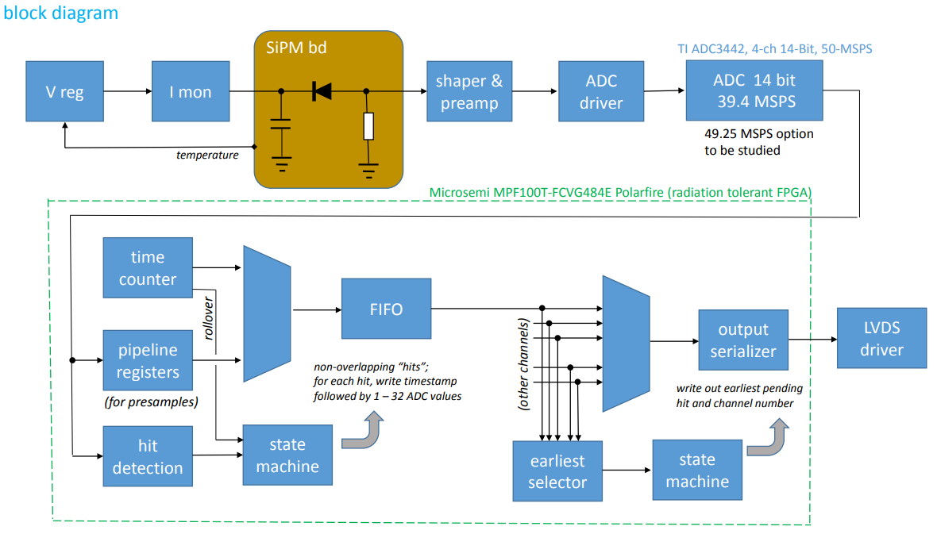
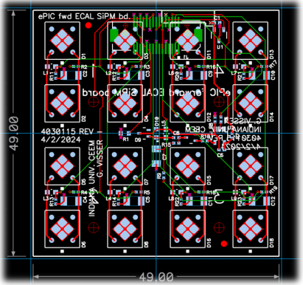
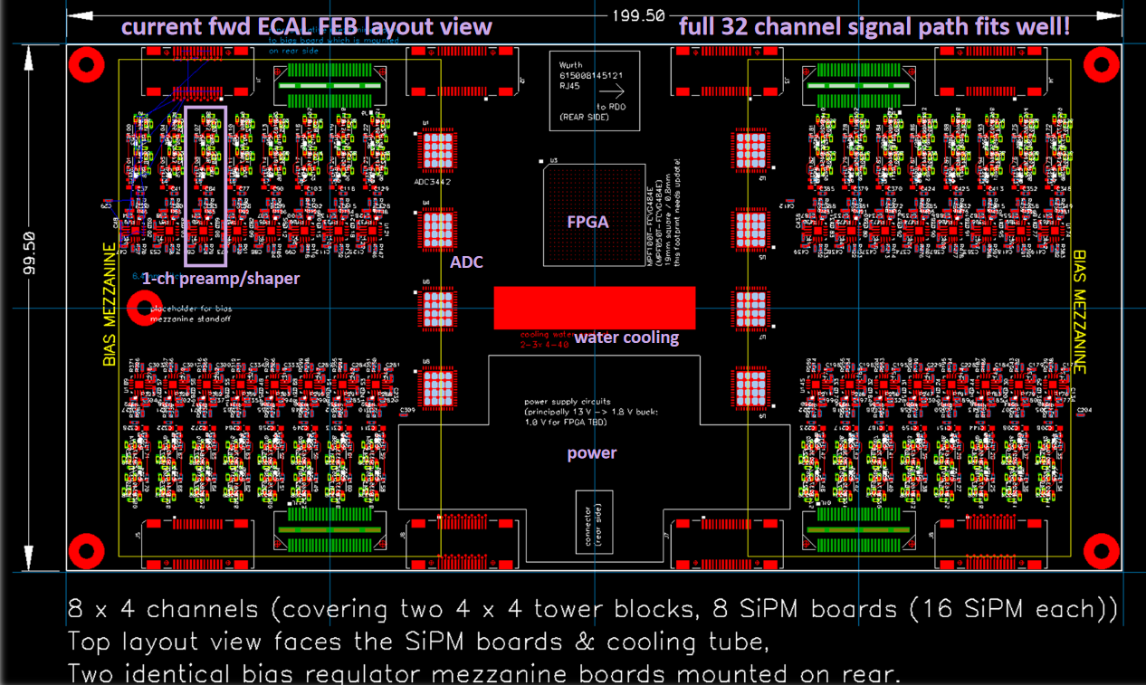
FY24 Progress Proposal A – Calorimeters, SiPMs – Discrete/COTS/ASIC (IU)
Adapter PCBs
Charge 1
FEB PCBs
Adapter PCB (Fwd ECAL)
FEB PCBs
32 ch Waveform Digitizer
12/14-bit TI ADC3422
Microsemi MPF100T-FCVG484E Polarfire (radiation hard FPGA)
CERN DC/DC converter bPOL12V/bPOL48V or LTC3601
Cabling (CAT6), Power (DC-DC), Cooling (liquid), Packaging (rack).
Progress Summary:
Devices selected
COTS DC/DC converters radiation tested in May 2024.
Shaping (80 ns peaking time), 12 mW/ch PA
PCB design practically complete, Adapter PCB prototype under tests.
Design, Fab: FY23 –FY24
Tests + Beam: FY24 – FY25
Engineering Article: FY26
Production: FY27

Slide 7
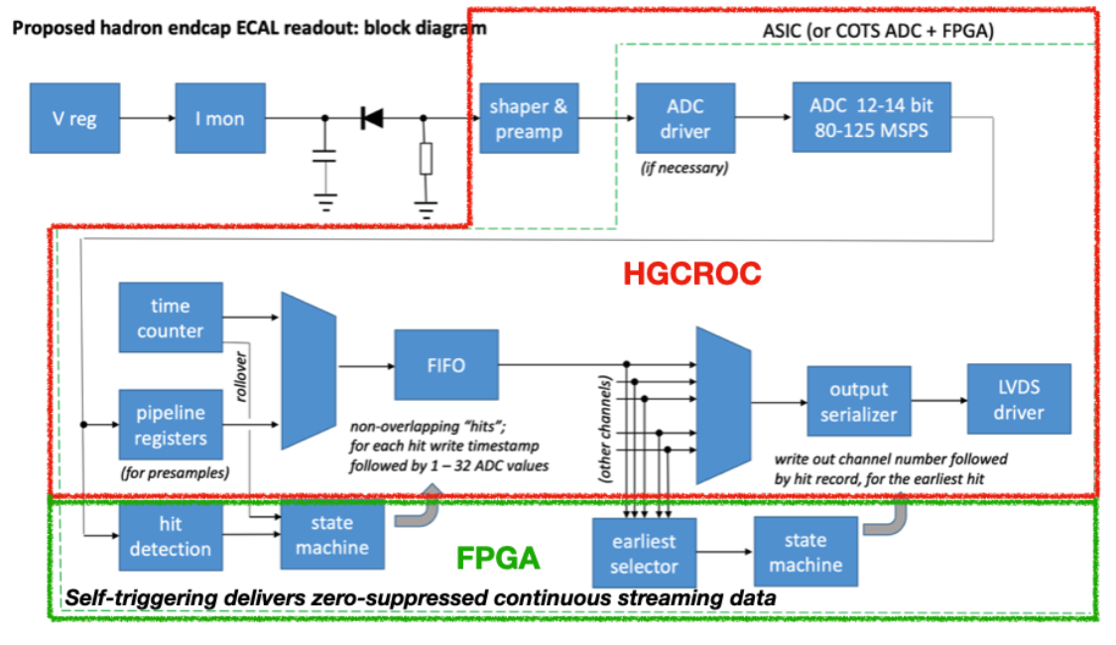
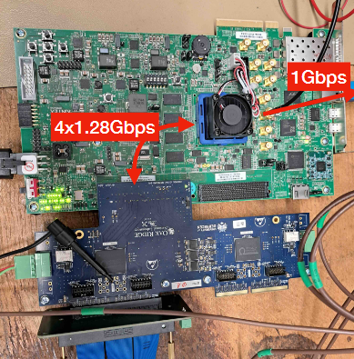
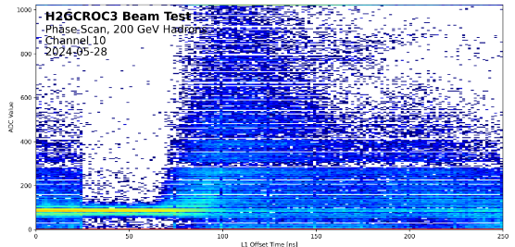
FY24 Progress – cont. Proposal B – Calorimeters, SiPMs – H2GCROCv3 (ORNL)
Charge 1
Develop a readout solution for the calorimeters with SiPMs by:
Employing existing H2GCROCv3 ASIC
Developing PCBs for full readout chain
Developing cabling infrastructure
Input to CALOROC design.
Adapter PCBs
FEB PCBs
Beam Tests, Waveforms
RDO PCBs
H2GCROCv3
Progress Summary:
H2GCROCv3 PCBs (6) from OMEGA with KCU105 FPGA eval kit – Beam tests validating streaming readout operation algorithms.
I2C and DAQ GUI interfaces done.
Cabling studies for interconnects from FEBs to RDOs are progressing (SAMTEC connectors).
Design and production of SiPM summing PCBs for full characterization with multiple sensors under way.

Slide 8
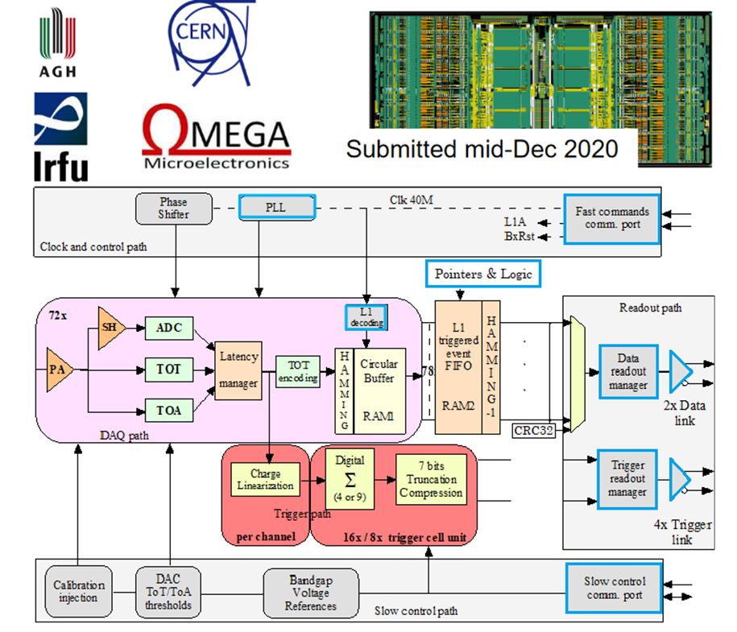
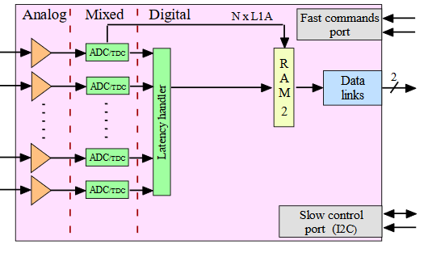
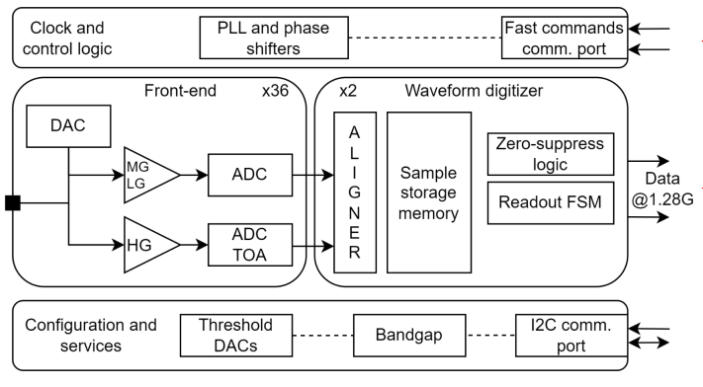
FY24 Progress – cont. Calorimeters, SiPMs – CALOROC (OMEGA/IN2P3/IJCL)
Charge 1
CALOROV1A
H2GCROCv3
No Change
Modify trig, mem, CLK dist.
1D, 64 ch.
130 nm CMOS
Charge (ADC+TOT) + Time (TOA)
Cdin: 500 pF-10 nF
Dynamic Range: up to 12 nC
Timing: <500 ps (1 MIP)
ADC: 10b; TOT: 15b
39.4 MHz operation from BX 98.5 MHz
Links: 1260.8 Mbps @ 39.4 MHz, multiple
Power: 10 mW/ch
Radiation tolerant.
Progress Summary:
CALOROC1A and 1B – different FE (TOT or switched gain), same backend.
FE fully characterized (ADC/TOT and TOA).
Backend designed and under simulation:
Streaming Readout logic
Memory
Clock pre-scaling & distribution.
Design Backend: FY23 - FY24
CALOROC1A/B: FY24 – FY25
CALOROC2: FY25 – FY26
CALOROC3: FY27 Production

Slide 9
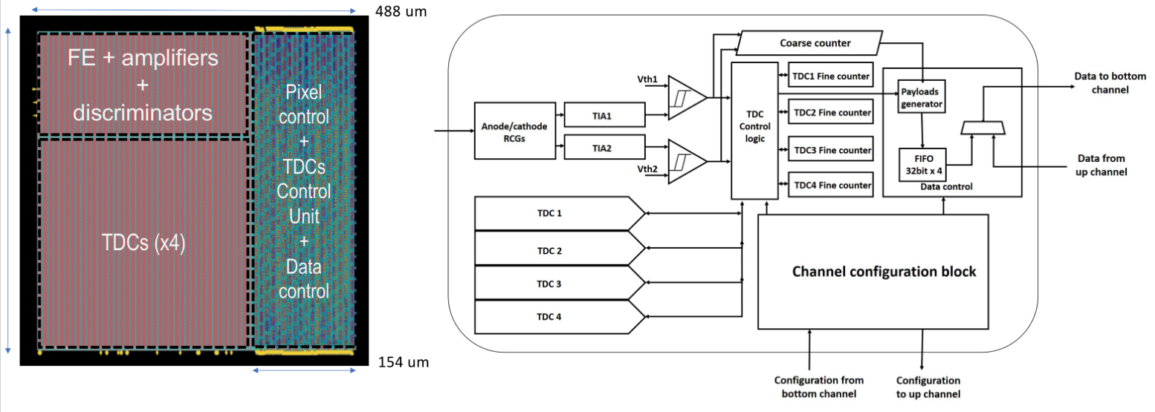
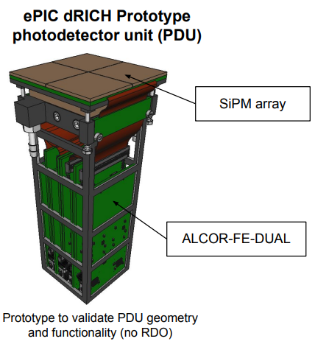
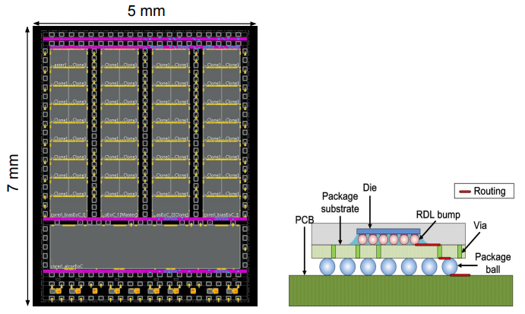
FY24 Progress – cont. Proposal C – dRICH – SiPMs – ALCOR (INFN)
Charge 1
Originally developed by INFN for DARKSIDE.
Progress Summary:
ALCOR v2: 32-pixel, TDC logic fix, improved gain, internal pulse generator supports both signal polarities, bias improved for reduced noise.
ALCOR v2.1 delivered in Jan 2024 and currently in beam tests.
Two 32 ch ALCOR on PCB (FE-DUAL) for PDU tests.
2D 8x8 pixel readout
110 nm CMOS
Dual polarity, RCG Amplification, conditioning, inhibit , digitization.
Modes of operation: single-photon tagging or time and charge.
Triggerless and triggered operation; Digital Shutter; Timing: <100 ps
25 ps TDCs, TOA+TOT
5 MHz input
4 or 8x 640 Mbps LVDS links.
SPI Configuration.
Power: 12 mW/Ch
Radiation tolerant.
ALCOR v2.1 (32 pixel): FY24
ALCOR v3: FY24 – FY26
ALCOR: FY26 – FY27 Production

Slide 10
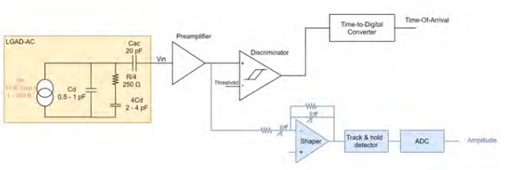
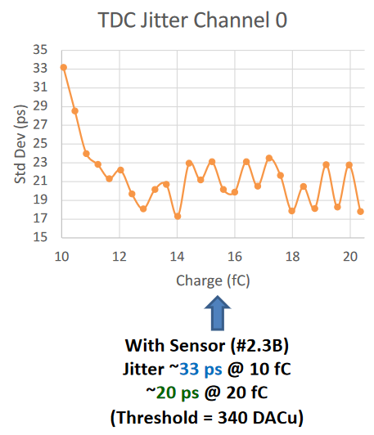
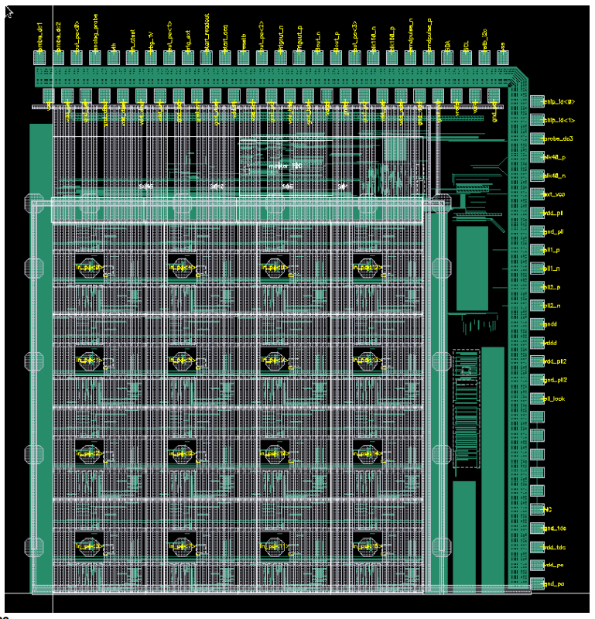
FY24 Progress – Cont. Proposal D - AC-LGAD pixel – EICROC (OMEGA/IN2P3/IJCLab/CEA-IRFU/AGH)
Charge 1
One pixel – EICROC0
2D, 32x32 pixel readout
130 nm CMOS
Preamp, Discriminator, TOA, ADC, TDC
Cdin: 1-5 pF; Dynamic Range: 1-50 fC
Timing: 30 ps; ADC: 8b; TDC: 10b
39.4 MHz operation from BX 98.5 MHz
Links: 1260.8 Mbps @ 39.4 MHz, multiple
Power: <2 mW/ch
Packaging: Bump+Wire bonds
Radiation tolerant.
Sensor
Plus backend as CALOROC
Progress Summary:
EICROC0 (4x4) full characterization almost complete.
Preamps, TDCs, ADCs meet EIC requirements.
Noise coupling to ADCs fixed (FPGA Firmware).
EICROC0A – intermediate iteration for low power designed.
EICROC1 – 8x32 design started.
Wire
EICROC0 (4x4): FY23 – FY24
EICROC0A (4x4): FY24 – FY25
EICROC1 (8x32): FY25
EICROC2 (32x32): FY27 – FY28 Production
Wire
Bump
4x4 500 um pixels

Slide 11
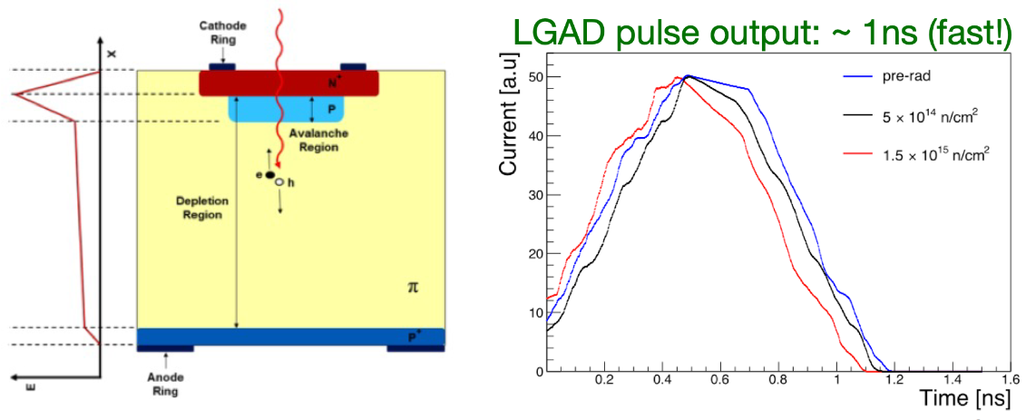
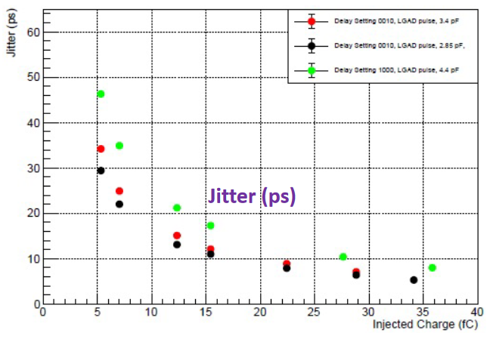
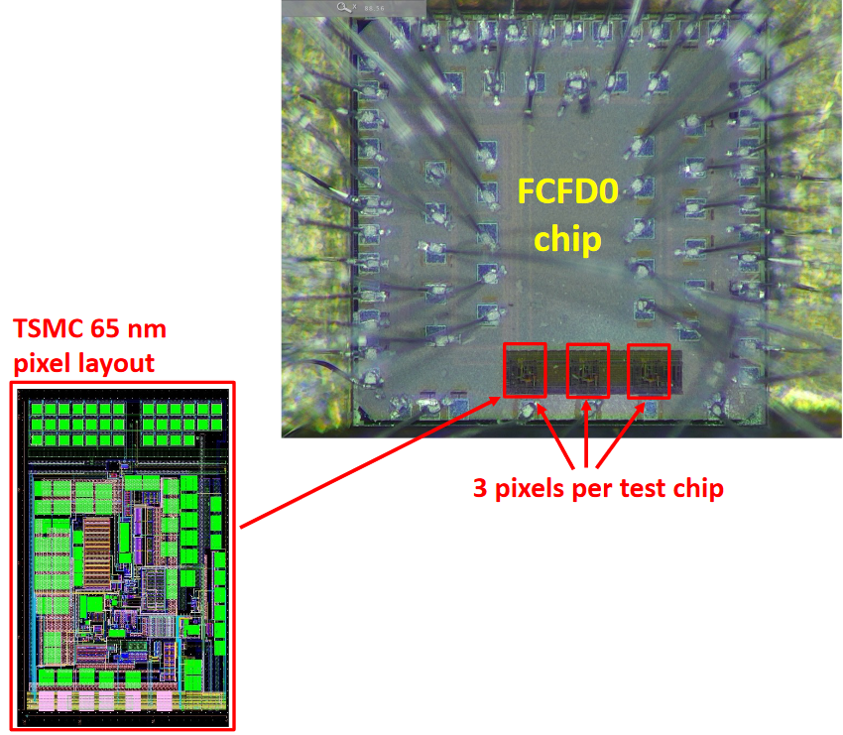
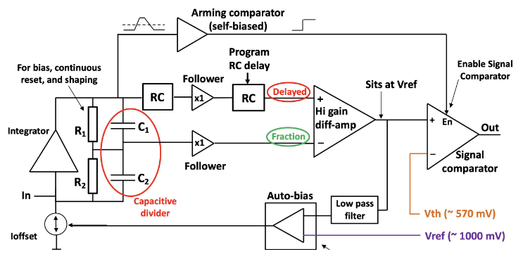
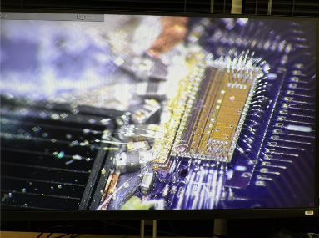
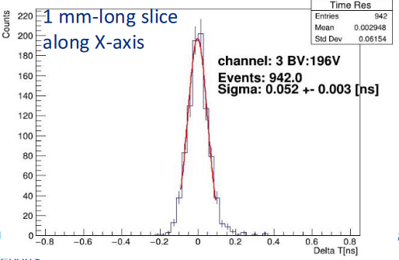
FY24 Progress – Cont. Proposal D - AC-LGAD strip – FCFD (FNAL)
Charge 1
Progress Summary:
FCFDv1 – 6 channel received Jan 2024.
Tested at FNAL in May & June 2024, AC & DC-LGAD (1 mm):
DC-LGAD @ 50 ps; AC-LGAD @ 52 ps
AC-LGAD should get ~35 ps with improved comparator.
128 ch strip readout
65 nm CMOS
Constant Fraction Discriminator
Plus TDC, ADC, interfaces
Cdin: <15 pF
Dynamic Range: 5-40 fC
Timing: 10-30 ps
Links: ~Gbps, multiple
Radiation tolerant.
FCFDv1 (6 ch): FY23 – FY24
FCFDv2: FY25 – FY26
FCFDv3: FY27 Production

Slide 12
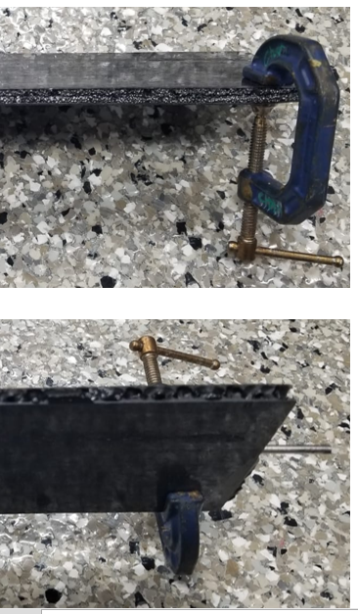
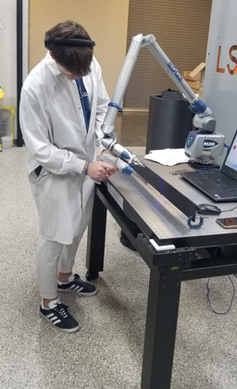
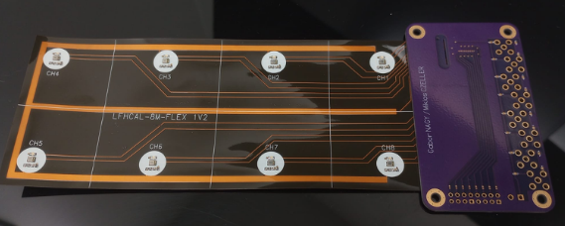
FY24 Progress – Cont. Proposal D - AC-LGAD – Barrel Low-Mass Hybrid (ORNL)
Charge 1
Flex with LV, HV, Temperature sensors
2-layer and multi-layer Kapton with different stack-ups
With peel-off Kapton to protect ENIG pads
Flex-PCB
Barrel TOF Carbon Fiber Test Structures
Progress Summary:
Pre-prototypes fabricated and successfully co-cured onto the TOF prototype staves at Purdue.
Full characterization under way.
Materials and equipment procured for flip-chip assembly (~$2M from ORNL).
Started making test assemblies with Flex-PCB pre-prototypes.

Slide 13
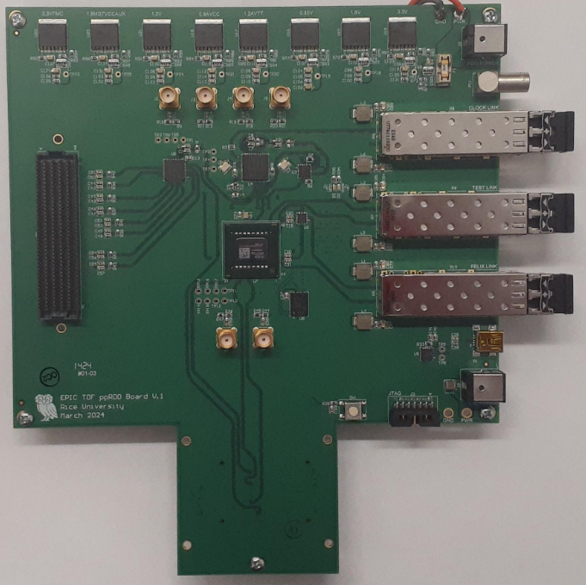
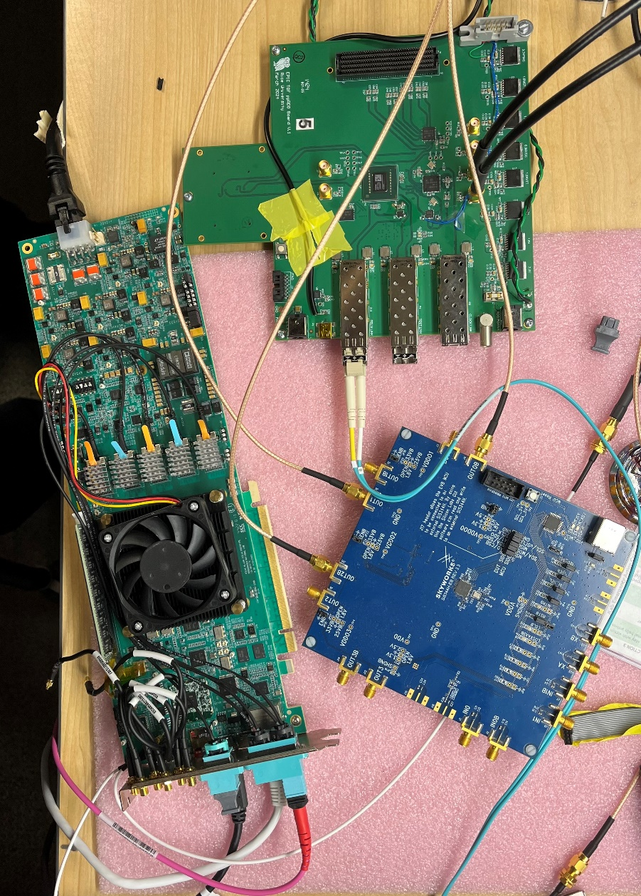
FY24 Progress – Cont. Proposal D - AC-LGAD – High Precision Clock Distribution (BNL/LBNL/RICE)
Charge 1
ppRDO – pre-prototype Readout Board:
Generalized to allow readout from various ASICs – FMC connector
Xilinx Artix+ FPGA (low cost, CERN TCLink compatible
Clock Jitter cleaner – 5 ps
Clock recovery on Rx of SFP or direct clock on dedicated fiber
Establish procedures to readout ePIC’s ASICs prototype PCBs
Develop common streaming readout scheme with DAQ’s protocols
Platform for radiation tests (SEU measurement and handling)
ppRDO
(ADCLK944)
Progress Summary:
Produced and tested 6 PCBs.
Jitter measured at 3 ps (Ref clock – FLX182 Tx serializer – ppRDO)
In Progress:
General firmware
Readout of CMS ETROC ASIC, as a test
DAQ readout firmware
Planning tests with VTRX+ transceiver.
FLX182
Si5344H
(ref Clock)

Slide 14
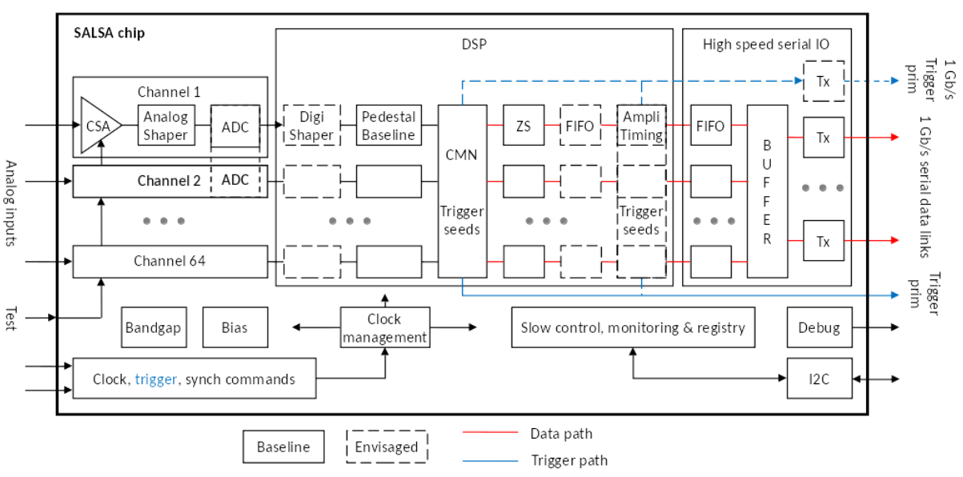
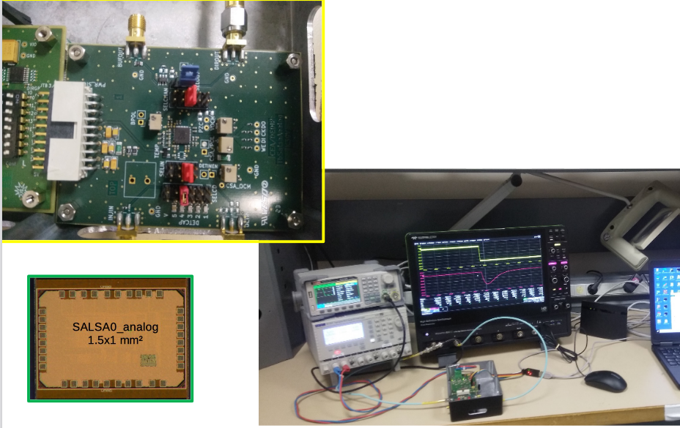
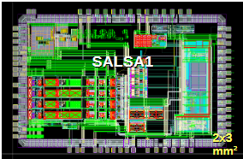
FY24 Progress – Cont. Proposal E - MPGD – SALSA (CEA-Saclay, U. Sao Paulo)
Progress Summary:
SALSA0_analog and SALSA0_digital blocks fully characterized.
PLL block + services prototyped under PRISME. Evaluation in progress and radiation tests soon.
SALSA1 (full frontend and ADC chain) submitted for production in April 2024.
SALSA2 (32 ch fully featured with DSP) design in progress for submission in March 2025.
64 Ch
65 nm CMOS
Peaking time: 50 – 500 ns;
Inputs: Cdin<200 pF; Dual polarity; Q: 3 – 250 fC
ADC: 12 bits, 5 – 50 MSPS.
Extensive data processing capabilities
I2C configuration.
Triggerless and triggered operation;
Several 1 Gbps links.
Power: 15 mW/Ch
Radiation tolerant.
SALSA0 (IP blocks): FY23
SALSA1: FY23 – FY24
SALSA2: FY23 – FY25
SALSA3: FY25 – FY26
SALSA: FY27 – FY28 Production

Slide 15
FY24 eRD109 Milestones
Charge 1, 3
Proposal A: Discrete COTS
 | Milestone | Estimated Date | Status
1 | Power, bias, preamp | November 2023 | @ 95%, October 2024
2 | PCB design and fabrication | February 2024 | November 2024
3 | Firmware development | February 2024 | November 2024
4 | Start of bench tests | December 2023 | February 2024
5 | ASIC evaluation | January 2024 | CALOROC, June 2025
6 | Beamtest support and precision measurements | May 2024 | May 2024 - March 2025
7 | Revision of firmware and (potentially) of PCB’s | August 2024 | May 2025
*Power distribution validation: bPOL12V, bPOL48V, LTC3626.
Proposal B: CALOROC/H2GCROCv3
 | Milestone | Estimated Date | Status
1 | Results from beam tests with LFHCAL prototype | October 2023 | August 2024
2 | Start of mid-level tests of the H2GCROC with SiPM | October 2023 | April 2024
3 | Mid-level design of on-detector prototype boards | October 2023 | April 2024
4 | Start of design of off-detector prototype boards | April 2024 | April 2024
5 | FPGA phase 1 firmware completion | December 2023 | May 2024
1 | Start of Interface Design (CALOROC/EICROC) | October 2023 | July 2024
H2GCROCv3
CALOROC

Slide 16
FY24 eRD109 Milestones – cont.
Charge 1, 3
Proposal C: dRICH ALCOR, RDO
 | Milestone | Estimated Date | Status
1 | Irradiation tests on ALCOR V2 and SEU evaluation | July 2024 | August 2024
2 | ALCOR v3 at 75% completion | September 2024 | August 2024
3 | RDO board for dRICH complete | September 2024 | October 2024
Proposal D: AC-LGAD
 | Milestone | Estimated Date | Status
1 | EICROC0 noise coupling studies | November 2023 | July 2024
2 | Characterization of EICROC0 with 4x4 AC-LGAD | February 2024 | December 2024
3 | EICROC0_v1/EICROC0A design | December 2023 | December 2024
4 | EICROC0_v1/EICROC0A fabrication complete | March 2024 | June 2025
5 | EICROC0_v1 tests complete | September 2024 | December 2025
6 | EICROC1 design and submission to fab | June 2024 | December 2024
7 | EICROC 1 fabrication complete |  | June 2025
1 | FCFDv2 specifications complete | December 2023 | October 2024
2 | FCFDv1 final performance characterization | June 2024 | August 2024
3 | FCFDv2 Design of mixed-signal multi-channel | September 2024 | November 2024
4 | FCFDv2 fabrication submission | September 2024 | December 2024
EICROC
FCFD

Slide 17
FY24 eRD109 Milestones – cont.
Charge 1, 3
Proposal D: AC-LGAD Cont.
 | Milestone | Estimated Date | Status
1 | Flex PCB design, fabrication and characterization start | April 2024 | April 2024
2 | Flex PCB design, fabrication and characterization completion | July 2024 | September 2024
3 | Low cost sensor-ASIC hybridization | August 2024 | September 2024
1 | Procurement of one ppRDO prototype | May 2024 | May 2024
2 | Firmware Installation on ppRDO | June 2024 | August 2024
3 | Characterization and Measurements of Clocks and Signals | September 2024 | August 2024
4 | Collaboration with Developers to understand the interface between EICROCx and the Xilinx dev kit | September 2024 | September 2024
1 | Understand the interfaces between the Artix FPGA evaluation kit and ETROC2, and finalize the plan to use evaluation kit to communicate with ETROC2 | February 2024 | April 2024
2 | Obtain ETROC2 test board, Artix FPGA evaluation kit, extension board and cables needed to connect FPGA Kit and ETROC2 test board | March 2024 | May 2024
3 | Complete 50% of the initial version firmware to communicate with ETROC2 using FPGA evaluation kit | April 2024 | May 2024
4 | Compete the initial version of the firmware to communicate with ETROC2 using FPGA evaluation kit | May 2024 | July 2024
5 | Finalize the firmware to communicate with ETROC2 using FPGA evaluation kit | June 2024 | September 2024
Barrel Low-Mass Service Hybrid
BNL
High Precision Clock Distribution
LBNL

Slide 18
FY24 eRD109 Milestones – cont.
Charge 1, 3
Proposal D: AC-LGAD Cont.
 | Milestone | Estimated Date | Status
1 | Schematics 50% complete; major parts established | March 2024 | April 2024
2 | Order major parts | March 2024 | April 2024
3 | Schematics 100% complete (with internal review) | June 2024 | May 2024
4 | Order all parts | June 2024 | May 2024
5 | PCB layout complete (with internal review) | August 2024 | June 2024
6 | Board assembly complete. 5 pieces delivered | September 2024 | July 2024
7 | Basic electrical & power Q&A. FPGA loads a simple example FW from PROM and blinks LEDs | September 2024 | August 2024
High Precision Clock Distribution - ppRDO
RICE
Proposal E: SALSA
 | Milestone | Estimated Date | Status
1 | SALSA1 design complete and submission | January 2024 | April 2024
2 | SALSA1 evaluation and SALSA2 specifications | July 2024 | December 2024
3 | SALSA2 submission | March 2025 | June 2025
4 | SALSA2 tests | September 2025 | November 2025

Slide 19
FY25 eRD109 Proposals & Costs
Charge 2, 3
Budget requests for each of the two (2) proposals:
 | File | Authors | FY25 ($k) | Notes
C | eRD109_ALCOR & eRD109-2025_dRICH RDO | F. Cossio, D. Falchieri (INFN), et al. | 60 | Note 1
E | eRD109_2025_SALSA_proposal | D. Neyret (CEA), M. Bregant (USP), et al. | 368 | Note 2
Note 1: INFN-BO $20 k; INFN-TO $40 k.
Note 2: CEA/IRFU $300 k; USP $68 k.
Total FY25 eRD109 Funds = $428
 | FY23 ($k) | FY24 ($k) | FY25 ($k)
eRD109 Funding Requests | 567.7 | 817.4 | 428
Work under proposals C and E will complete development of the dRICH readout (ALCOR, RDO) and the MPGDs (SALSA) from OPC funds.
Remaining work on Discrete, H2GCROCv3/CALOROC and EICROC/FCFD/Low-Mass Hybrid/High Precision Clock Distribution will be finalized within the project, i.e. PED funds.

Slide 20
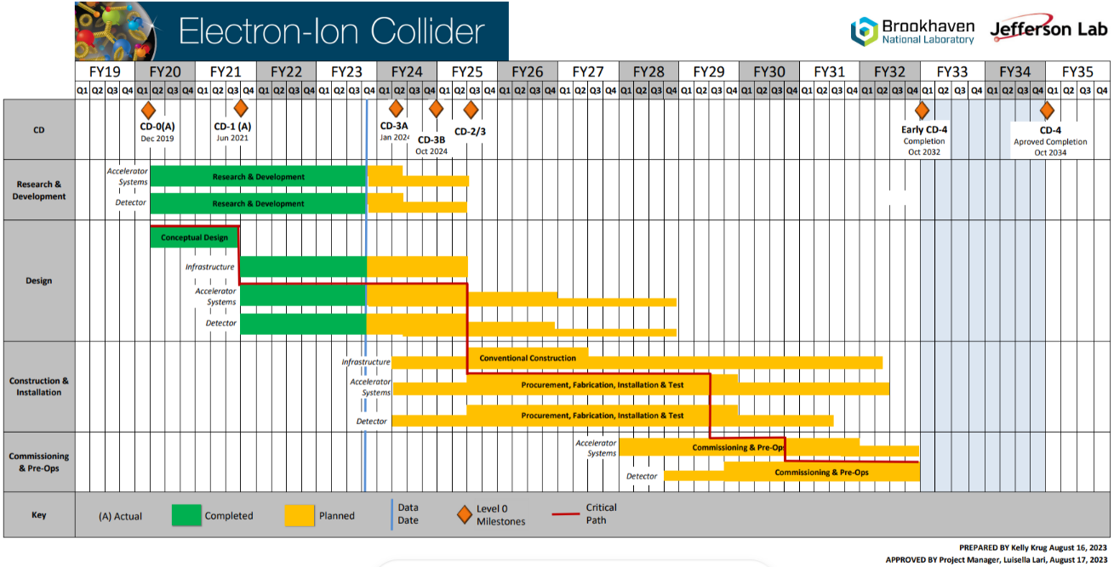
Timeline - Project
Charge 3
Construction and Installation includes procurements and deliveries and are initiated at different times of this phase.
A few R&D activities for FY25 (OPC)
ASIC Production in FY26 – FY28
R&D
Engineering & Design
Design until 9/2028 (PED)
Construction
4/2025 to 4/2031
Bulk of Construction & Installation phase for Electronics: April 2025 – October 2029.
Installation of some items may be extended to April 2031.

Slide 21
Summary
There were delays in awarding FY23 and FY24 eRD109 contracts, ~6 months relative to the start of the FY and the same is to be expected for the FY25 proposals. It is noted that there were also delays due to technical aspects, which have been or are being resolved.
However, we have made good progress and we continue refining detector requirements, interfaces and services towards final implementations.
The two FY25 eRD109 proposals are distinct, cover and inform packing form-factors and integration into the various sub-detectors. These also address technical risk factors for the realization of the EIC and its physics reach and finalize the readout needs for the dRICH and MPGD sub-detectors.
Continuation of the other initiatives under FY24 eRD109 will proceed to completion under project engineering and design efforts (PED).
Consideration for funding of these proposals is essential to ensure timely developments in agreement with the EIC project schedules.

Slide 22
Backup Material

Slide 23
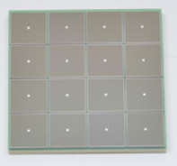
Streaming Readout Chain – P6 Partitions
Global Timing Unit (GTU)
-Interfaces to Collider, Run Control & DAM
-Config & Control
-Clock & Timing
Sub-Detector P6s
Electronics P6
WBS 6.10.08
DAQ P6
WBS 6.10.09
On Detector
SMT BGA
Name
Design
Function
Attributes
Sensor
Detector Specific
-Multi-Channel Sensor
-MAPS
-AC-LGAD
-MPGD
-MCP-PMT
-SiPM
-LAPPD
Adapter
Detector Specific
-HV/Bias Distribution
-HV divider
-Interconnect Routing
-Sensor Specific
-Passive
Front End Board
(FEB)
Detector Specific
-Amplification
-Shaping
-Digitization
-Zero Suppression
-Bias Control & Monitoring
-ASIC/ADC
-Discrete
-Serial Link
Readout Board
(RDO)
Few Variants
-Communication
-Aggregation
-Formatting
-Data Readout
-Config & Control
-Clock & Timing
-FPGA
-Fiber Link
Data Aggregation Module (DAM)
Common
-Computing Interface
-Aggregation
-Software Trigger
-Config & Control
-Clock & Timing
-Large FPGA
-PCIe
-Ethernet
Computing
Common
-Data Buffering and Sinking
-Calibration Support
-QA/Scalers
-Collider Feedback
-Event ID/Building
-Software Trigger
-Monitoring
-COTS
-Ethernet

Slide 24
Scope of the Effort - Production
Approximate quantities and costs.
Costs include mask sets, fabrication and packaging, wrt quantities needed.
 | #Ch | #Ch/Unit | #ASICs/Wafer | #Wafers | Node (nm) | Packaging | Cost/ch ($)
Discrete/COTS | 24 k | 32 | NA | 740 Digitizers | COTS | NA | 91*
CALOROC | 97 k | 64 | 480 | 5 | 130 | BGA | 3.2
EICROC | 5.2 M | 1,024 | 160 | 42 | 130 | Wafer Bump | 0.1
FCFD | 2.6 M | 128 | 180 | 149 | 65 | Wire Bond | 0.5
ALCOR | 318 k | 64 | 800 | 8 | 110 | BGA | 0.9
SALSA | 202 k | 64 | 500 | 9 | 65 | BGA | 4.1
* Includes FE
Production
65 nm: $750 k masks + $3.5 k per wafer
110 nm: $190 k masks + $4 k per wafer
130 nm: $250 k masks + $4 k per wafer
Packaging BGA: $3-$7.5 per chip.
ASIC Costs Total: ~$3.3 M
Masks: ~$2.2 M; Chips: ~$1.1 M

Slide 25
Timeline cont. - Development
Example of development (not to scale)
Construction
FY23 through FY26
ASIC Development (eRD109)
FY26 – FY28 – 1 Year
ASIC Fab Production & Testing
6 Months
ASIC Testing
Eng. Article Development
Eng. Article Tests
Installation
<1 Year
PCB Production
<1 Year
First Production ASICs
Production Tests
<3 Months
Integration Tests
<3 Months
R&D
System Tests
Design

Slide 26
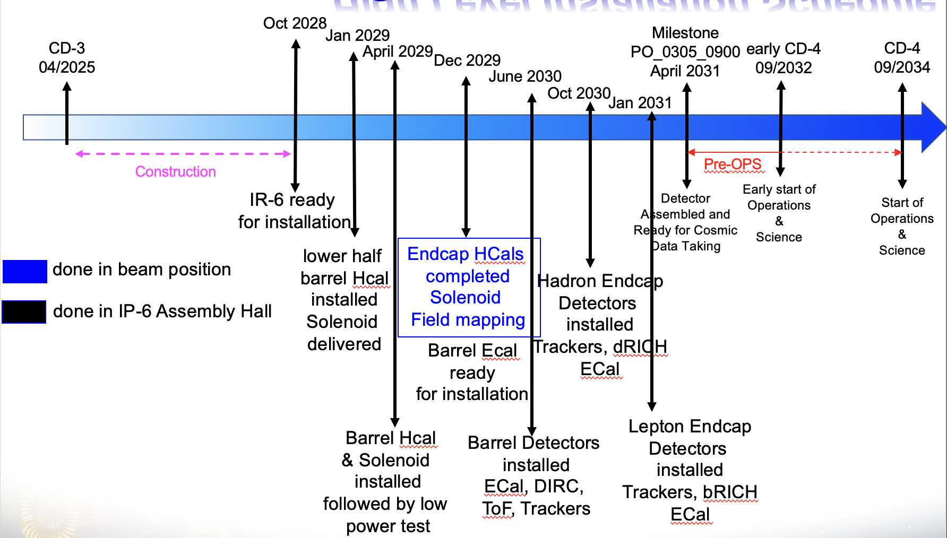
Timeline cont. - Installation
WBS6.10.02 | eRD109 | R&D Milestones | FEB QC Complete
Calorimeters | Discrete, CALOROC | 30 September 2025 | Mar 2028 – Jan 2030
AC-LGAD | EICROC, FCFD | 30 September 2025 | Nov 2027 – Jan 2029
dRICH | ALCOR | 2 January 2026 | Nov 2028
MPGD | SALSA | 31 March 2026 | Sep 2028 – Jun 2029
HRPPD/MCPMT | FCFD/EICROCx | 23 December 2026 | Sep 2028 – Jan 2029
Installation
Jan 2029 – Jan 2031
WBS 6.10.02 – Electronics for detectors R&D.
eRD109 – Readout R&D.
R&D Milestones – ASICs ready for production.
ASIC Production FY25 – FY28.
FEB QA/QC Complete – Ready for integration.
FY23 – FY26
FY26 – FY28
R&D (eRD109)
ASIC Production
11/2027 – 1/2030
FY26 – FY29
Readout Production & QC
QC Complete

