Slide 1
Streaming Readout WG Meeting – 7/9/24
dRICH data reduction
Introduction
Ideas regarding dRICH data reduction (Alessandro Lonardo)

Slide 2
Summary of Channel Counts and Data Flow
dRICH: 30 DAM boards
dRICH eventually needs significant data reduction inside DAQ
Initial noise in dRICH is ~12Gb/s. Radiation damage will increase this x100 over approximately 4 years.
Annealing should keep the noise at / under this x100 increase for lifetime of detector.
As DAQ, I typically ignore this, but there is also the difficulty of analyzing the data when noise dominates signal by factors > 100.
Summary of Data Flow
Detector
FEB
Copper
RDO
Fiber
DAM
PCI/Eth
Readout Computer
Eth
100% Occupancy | 27.5-1760 Pb/sec
Aggregate | 109 Gb/sec
Collision Signal | 62 Gb/sec
Synchrotron Rad | Under design
Electron Beam | 4.5 Gb/sec
Hadron Beam | 1.0 Gb/sec
Noise | 41 Gb/sec
Aggregate | 1.8 Tb/sec
Noise | 1.4 Tb /sec
Signal from Physics + Background | 400 Gb / sec
Aggregate | 1.8 Tb/sec
Per RDO (Avg) | 0.6 Gb/sec

Slide 3
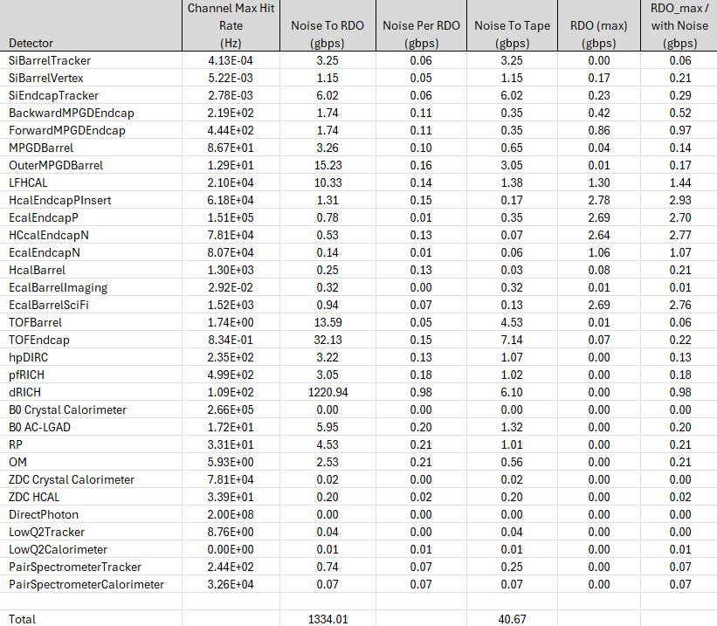
Data Bottlenecks
Evaluated Data Bottlenecks by tiling detector regions with RDO/ASIC combos
For some detectors, bandwidth difficulties arise from high rates in small regions of the detector
For dRICH, the noise will dominate, so rates are relatively uniform. The highest rates are expected to have a safety factor of x5 or so.
The noise is dependent upon radiation in the dRICH, so there might be some spacial distribution, but the quoted values are the highest rates expected.
The DAM boards (for the dRICH) are also a potential bottleneck. There are a maximum of 48 RDO / DAM, so the estimate is about 48 Gb/s maximum rate to the DAM boards. Expecting DAM output to be about 100Gb/s, (only a x2 safety factor, so DAM board reduction is valuable)

Slide 4
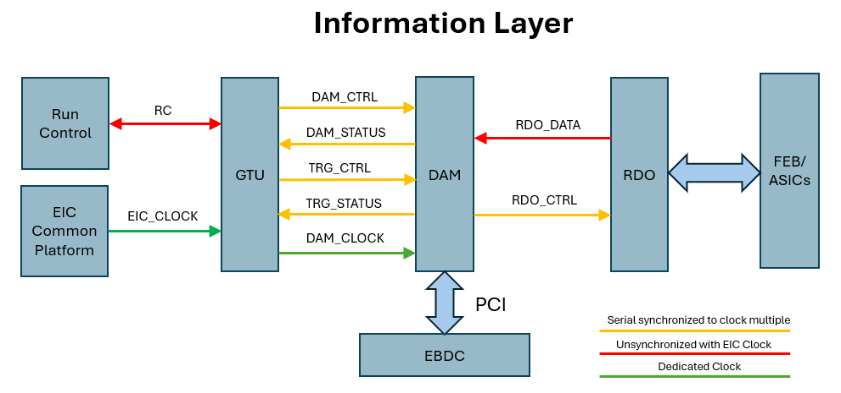
Protocol Document
https://indico.bnl.gov/event/23989/
ePIC DAQ WIKI -> Talks and Slide Library -> DAQ Directory Link -> proposed_DAQ_PROTOCOL_v0.1.pdf
DAM_CTRL = 64 bits. Same information copied to all(subset?) DAM. Forwarded to RDO_CTRL
DAM_STATUS ~ 20(64) bits DAM information copied back to GTU.
TRG_CTRL = 160 bits Send trigger commands (to selected DAM boards: e.g. dRICH, low Q taggers)
TRG_STATUS = 160 bits Return summary information (from selected DAM boards: e.g. dRICH, Calorimeters)
RDO_CTRL = 64 biits Clock + RDO commands
RDO_DATA ~ 10gb/s ASIC DATA + SC data + headers
96 x
100 Gb ethernet switched network
108 x
Echelon 0 Nodes
~100 Gb/s target
(Assume 400Gb/ethernet x 2)

