Slide 1
Towards higher gains for improved timing& spatial resolution
Old BNL gain layer
DC-LGAD
new BNL gain layer
AC-LGAD
DC-LGAD
Higher gains by a deeper implant
(we can implant deeper)

Slide 2
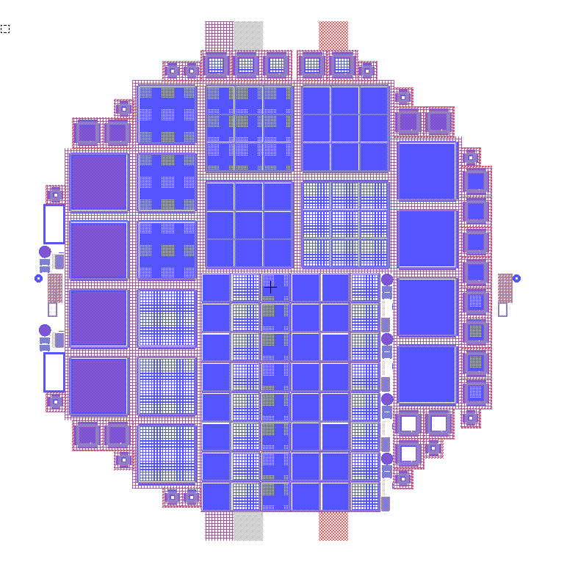
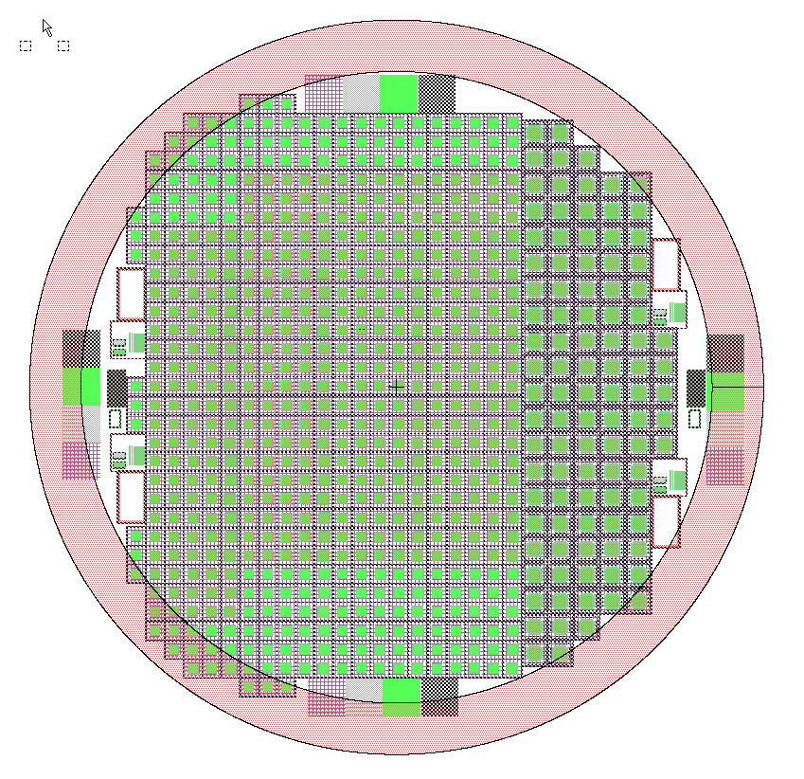
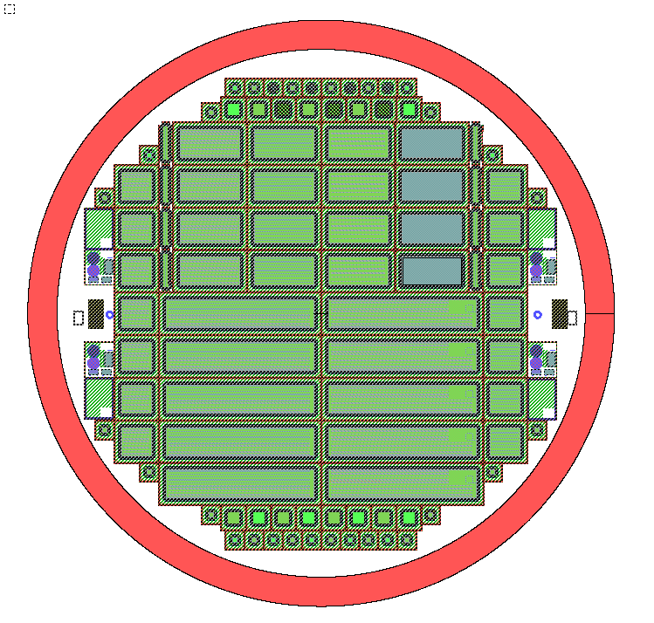
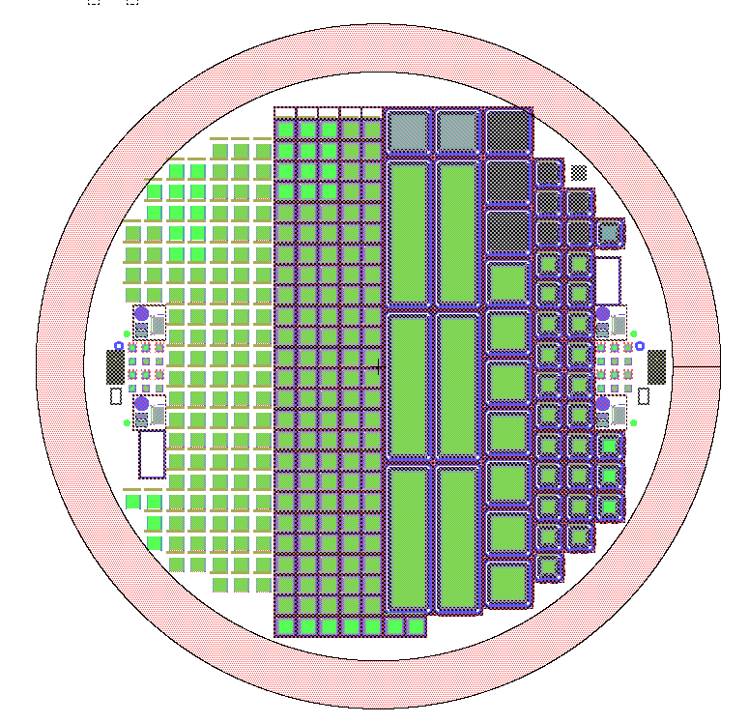
Several AC-LGAD/LGAD productions for R&D towards LGADs/ACLGADs
(Another production possible later this year)
1MeV gain layer as standard gain implantation energy
Option to go deeper with some wafers

