Slide 1
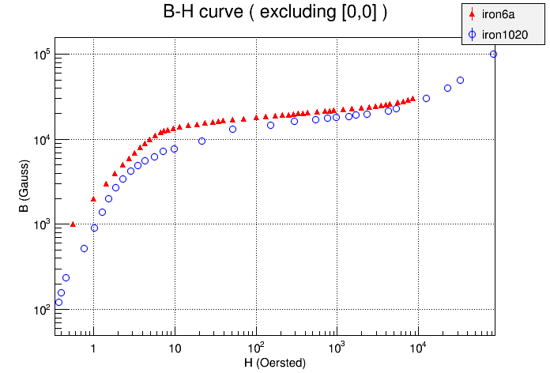
Differences in magnetic field with different steels
I have used Wuzheng’s model of sPHENIX which has used a file iron6a.bh, something that Wuzheng has used in g-2 for 1006 steel (with his smoothing)
J. Haggerty pointed me to http://www.fieldp.com/magneticproperties.html#Steel1020 and I have to do H = B/μ_{R} (CGS) to make the B-H curve (and dropped the 1st non-zero point as its H is bigger than the 2nd H that “Opera” doesn’t like).

Slide 2
Opera
I have used Opera 18.0 in fido of ITD (which would disappear at the end of . Nov. 2016) to run Wuzheng’s 3D model: “sphenix_m1q_dz=0_24-coils.oppre”
For the run using Steel 1020, I started before 4 pm last Friday (Sept. 23) and it finished after 2 am on Sat. (Sept. 24) ⇒ 10 hours.
It has taken into account everything that exists in the model ( ~< |700 cm| ).
Mostly, to consider the field inside TPC, I’ve typically plotted:
r<80 cm and |z| < 100 cm.

Slide 3
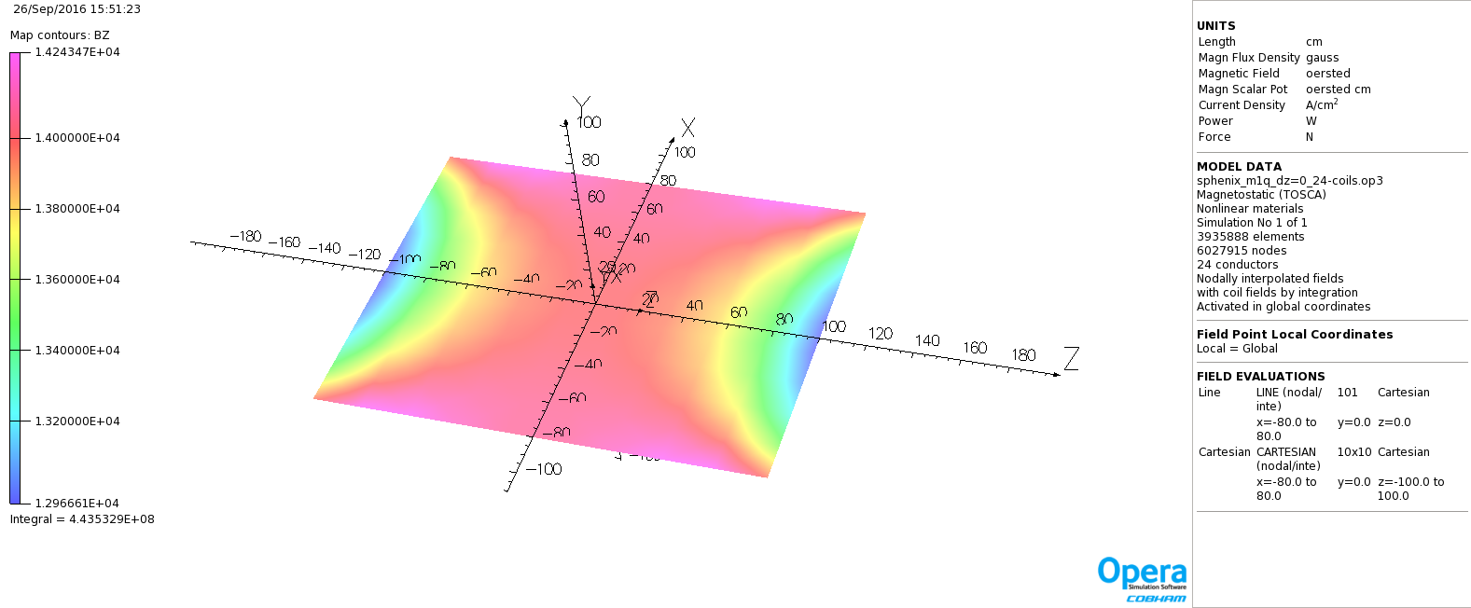
B_{z} (magnetic field) in y=0 plane
(Gauss)
(x/y/z coordinates in cm)
~Steel 1006

Slide 4
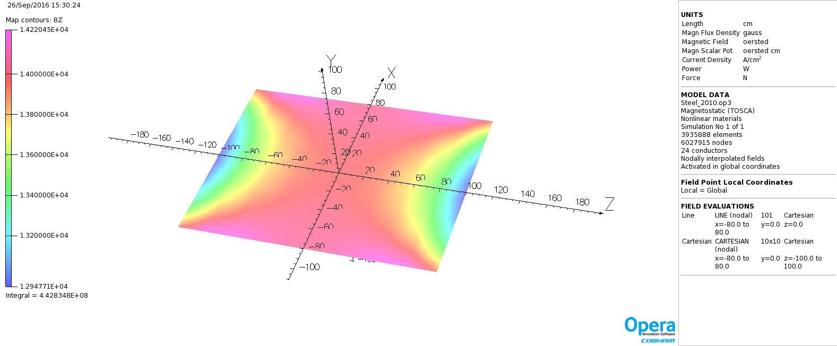
B_{z} (magnetic field) in y=0 plane
(Gauss)
(x/y/z coordinates in cm)
~Steel 1020

Slide 5
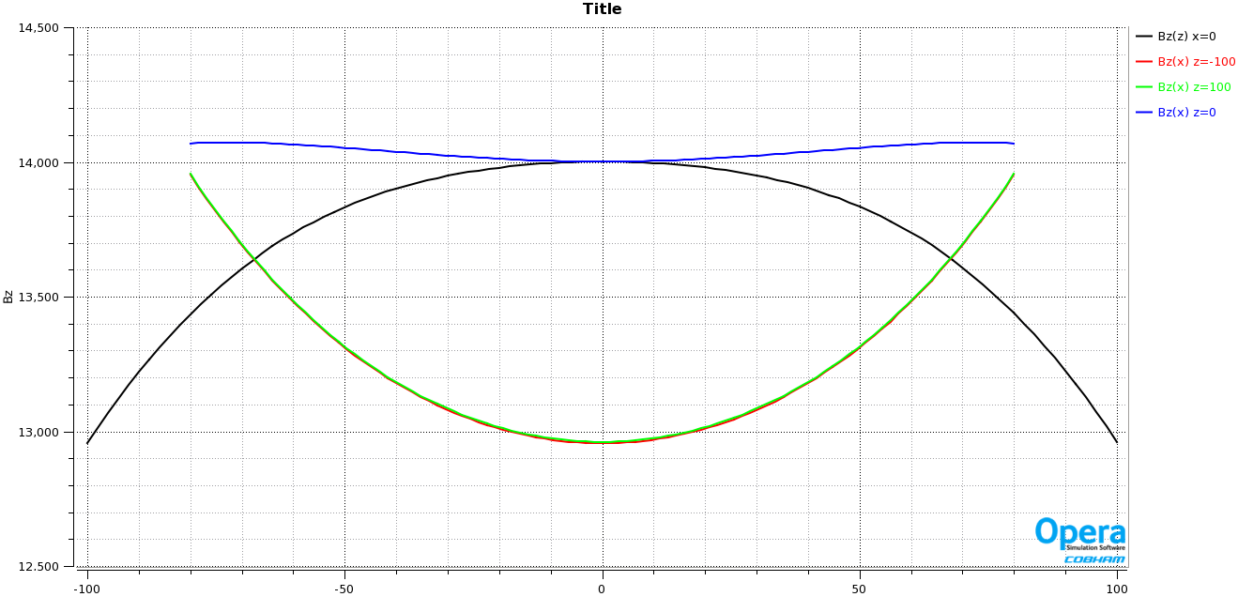
B_{z} (magnetic field) wrt X anz Z (beam-axis)
B_{z}(0,0,0) = 14001 G
(Gauss)
(cm)
~Steel 1006

Slide 6
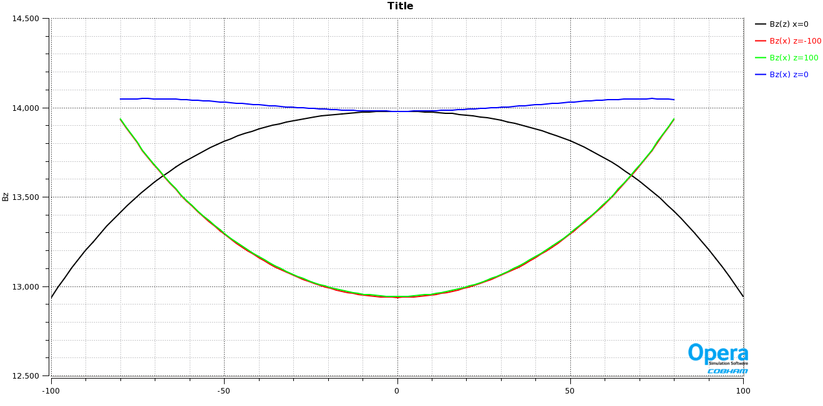
B_{z} (magnetic field) wrt X anz Z (beam-axis)
B_{z}(0,0,0) = 13979 G
(Gauss)
(cm)
~Steel 1020

Slide 7
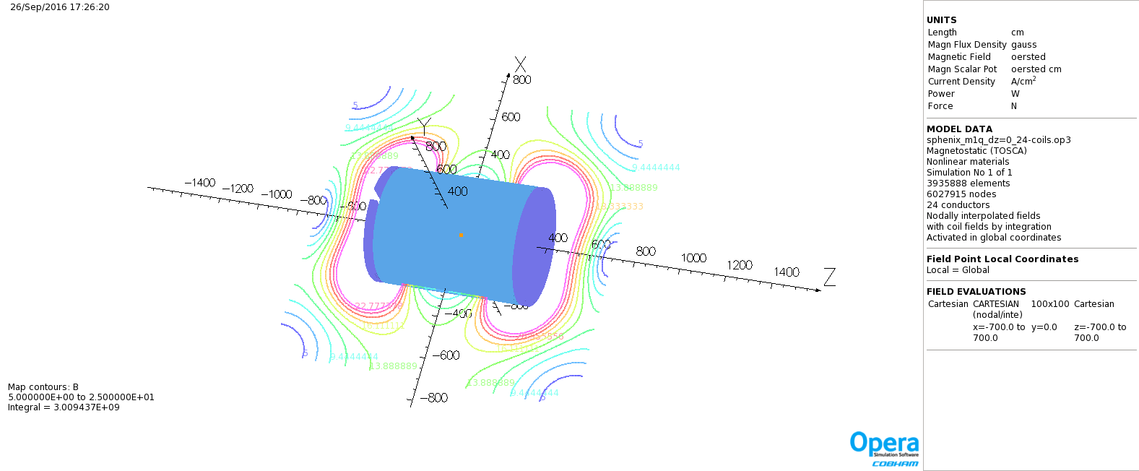
Contour of B (from 5 G to 50 G)
(x/y/z coordinates in cm)
~Steel 1006

Slide 8
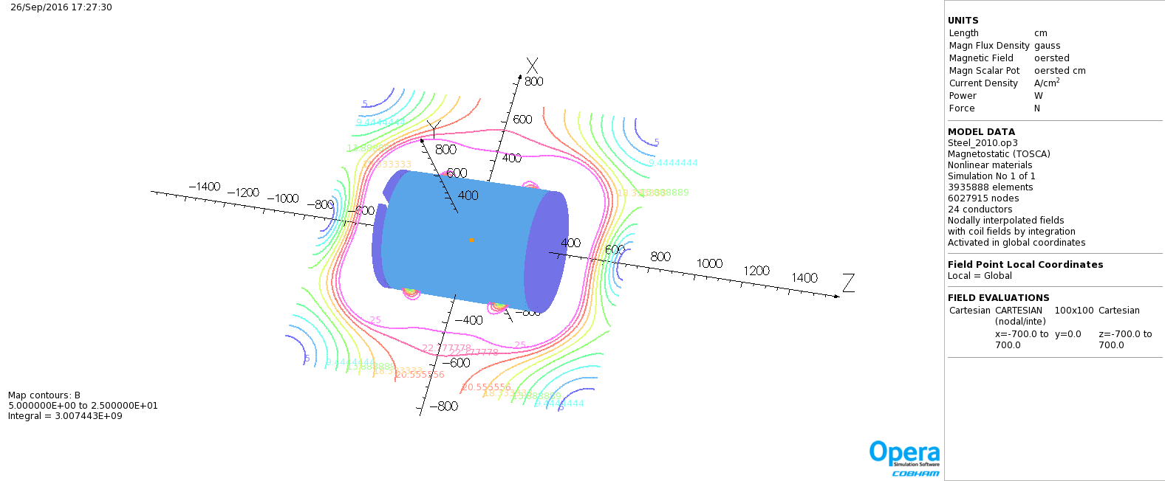
Contour of B (from 5 G to 50 G)
(x/y/z coordinates in cm)
~Steel 1020

Slide 9
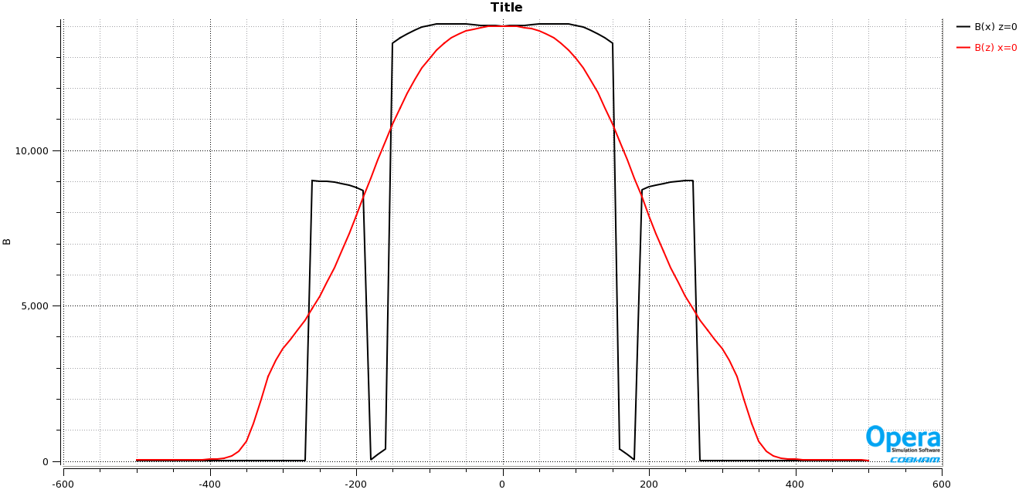
B (to larger extent in x and z)
(Gauss)
(cm)
~Steel 1006

Slide 10
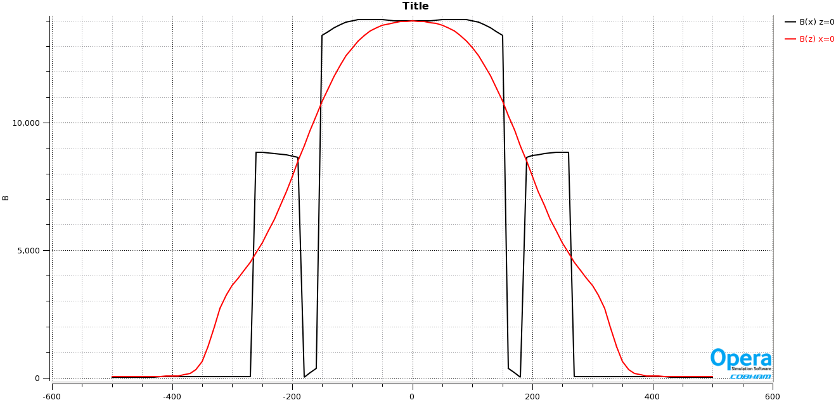
B (to larger extent in x and z)
(Gauss)
(cm)
~Steel 1020

