Slide 1
Mirror coating and testing midsummer update
Chandra Chatterjee, Ross Corliss, Bill Li, Preet Mann, Kong Tu, Jin Feng Zhuang
July 11, 2024

Slide 2
Conclusions first
What we have achieved:
We have performed 14 mirror coating tests. Our small mirror samples’ reflectivity can meet the requirement: ~ 90% reflectivity between 300-600 nm
Coating is uniform within 1-2% (our current uncertainty).
We have quantified the absolute thickness of our coating deposition, with a narrow range of thickness to focus in the near future to fine tune.

Slide 3
Our coating recipes for a few recent studies.
Evaporation Number | Coating Recipe (QCM) | Procedural Changes
7 | Cr: 5.19 KAng Al: 12.03 KAng | Decrease in total deposition amount from previous coatings 70 KAng → 17 KAng
10 | Cr: 4.66 KAng Al: 22.24 KAng | Thicker Aluminum Test
11 | Cr: 5.08 KAng Al:12.36 KAng | Consistency Check Attempted Repeat of #7
12 | Cr: 5.17 KAng Al:12.27 KAng | Waviness Test + Rotation Decrease 60 RPM → 30 RPM
13A | Cr: 0.11 KAng Al: 0.93 KAng | Very thin coating test
13B | Cr: 1.13 KAng Al: 2.578 KAng | Account for QCM to Substrate deposition ratio [rough estimate of distance discrepancy]
14 | Cr: 2.14 KAng Al: 7.34 KAng | COMPASS + NA62 Ratio based upon profilometer results

Slide 4
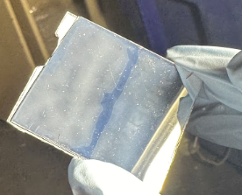
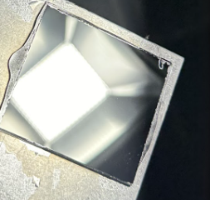
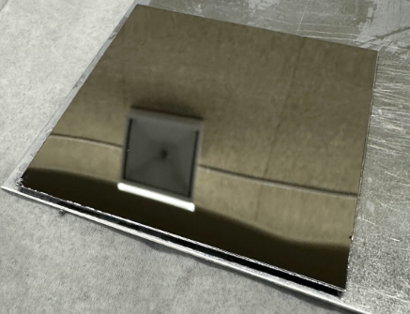
Samples Over Time:
The following images show coatings 5, 7, 12, and 13. Issues such as haziness are no longer present in recent coatings but some aspects such as waviness have appeared and need to be resolved.
SBU 5
SBU 13 AB [Lexan Back + Front]
SBU 13A
SBU 7
Purdue 13B
Purdue 13A
SBU 12
SBU 12
Purdue 12

Slide 5
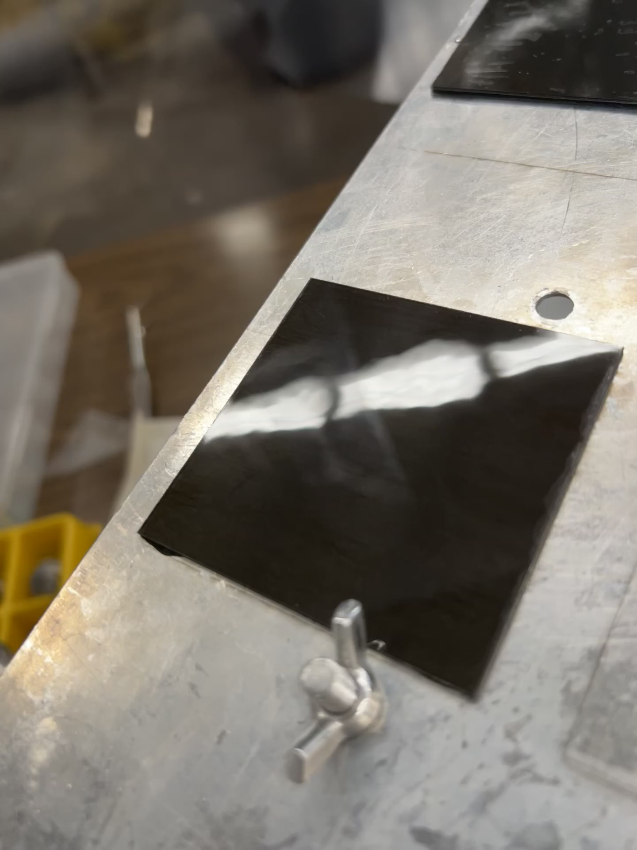
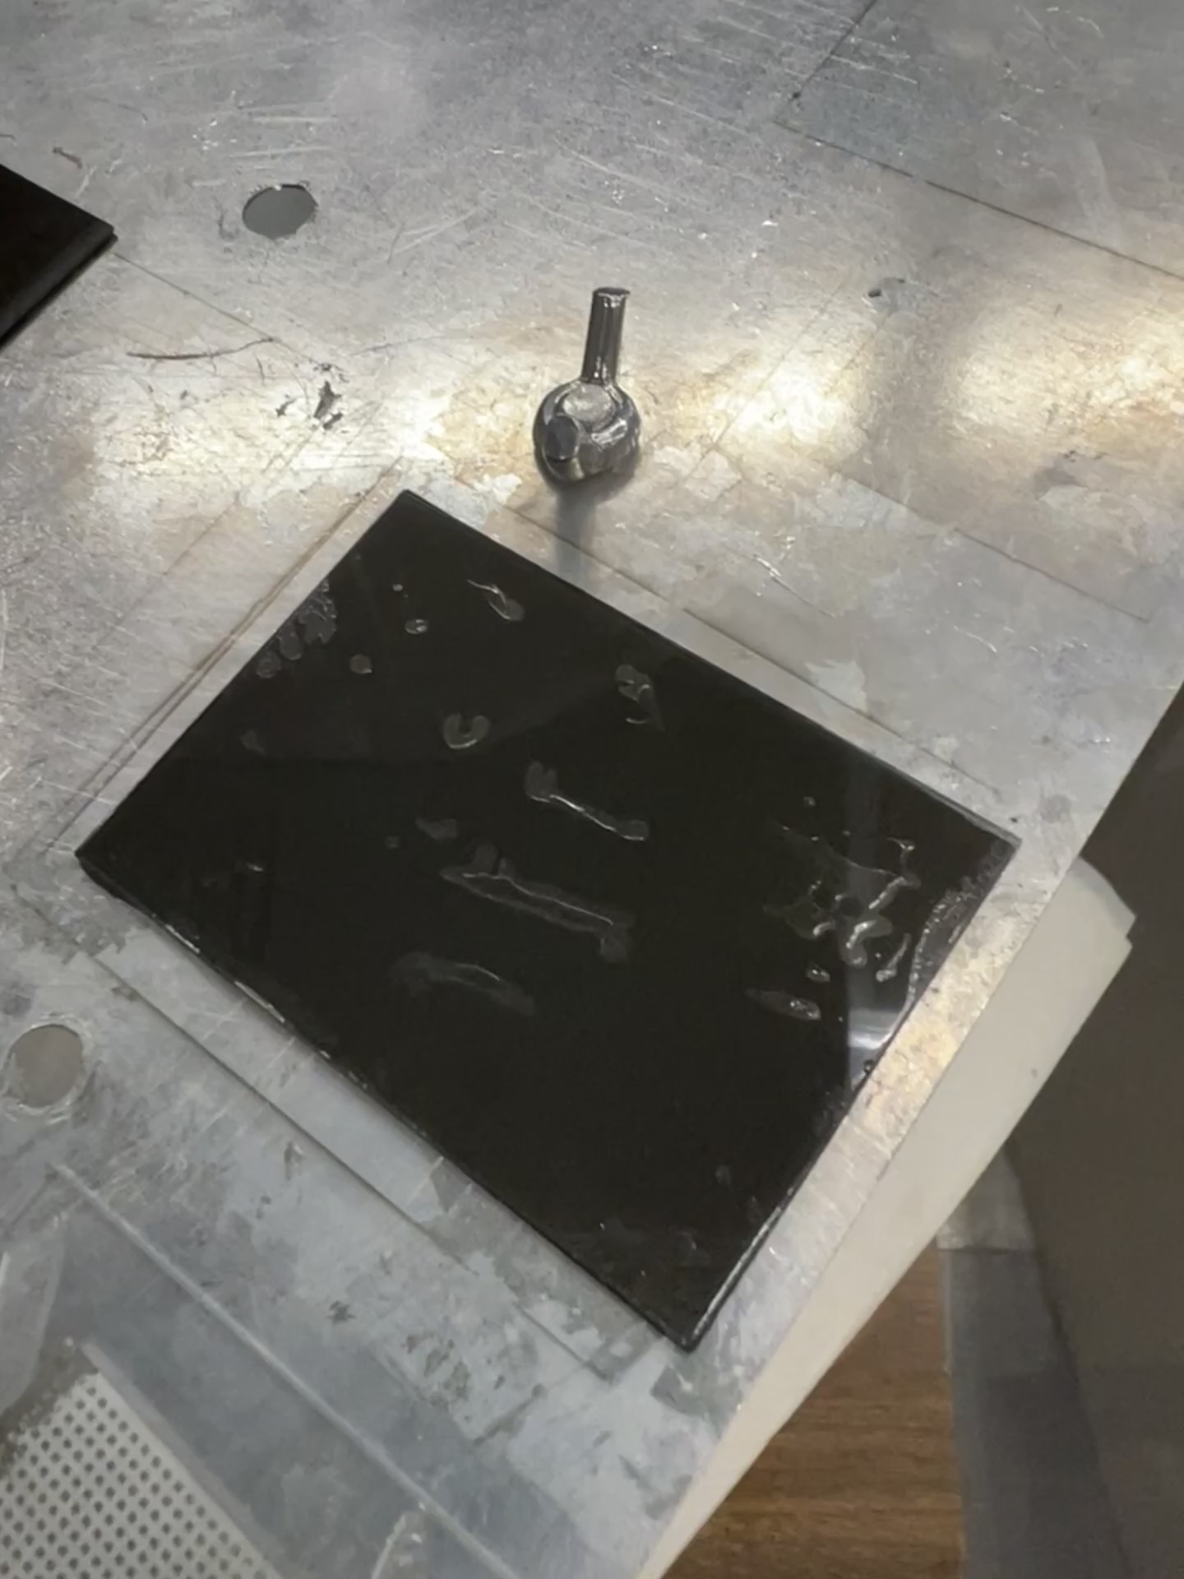
Waviness comes from substrates, not coating.
Both are before coating. (screenshots of a video, which shows better)
The conclusion:
Co-bonding technique is the key to get rid of/create waviness for the substrates.
Purdue sample 7x7 cm (link)
SBU sample (link)
Epoxy was used for co-bonding and no heavy weights applied (Epoxy 3M DP 190), which is why the there are some bubbles.

Slide 6
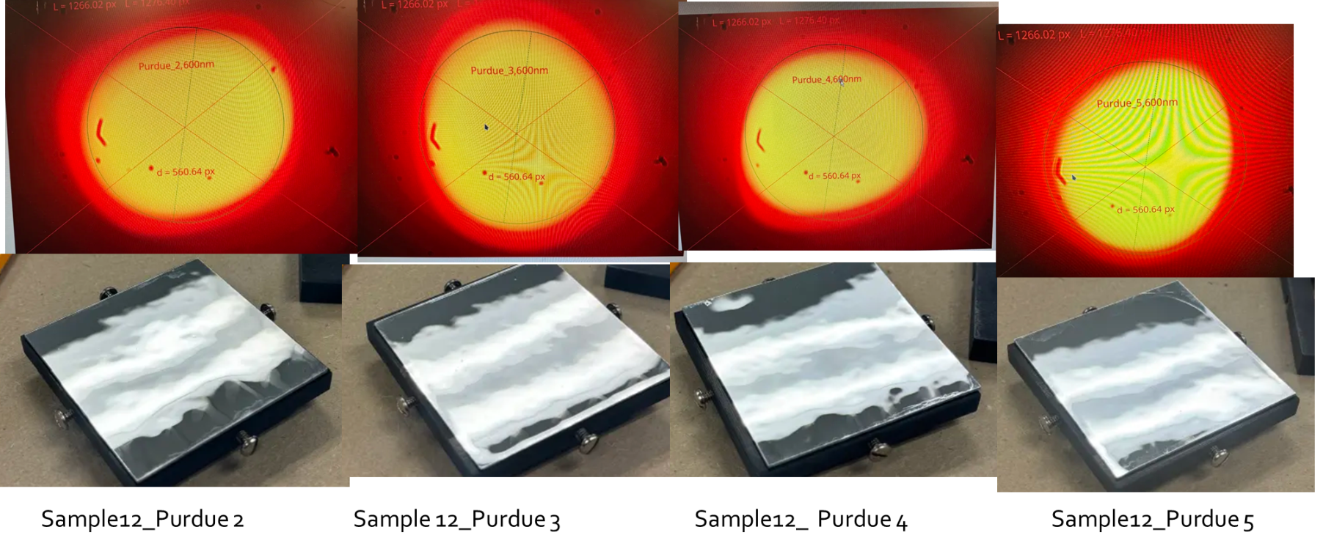
Mirror surfaces show waviness from substrate.
These are Purdue samples

Slide 7
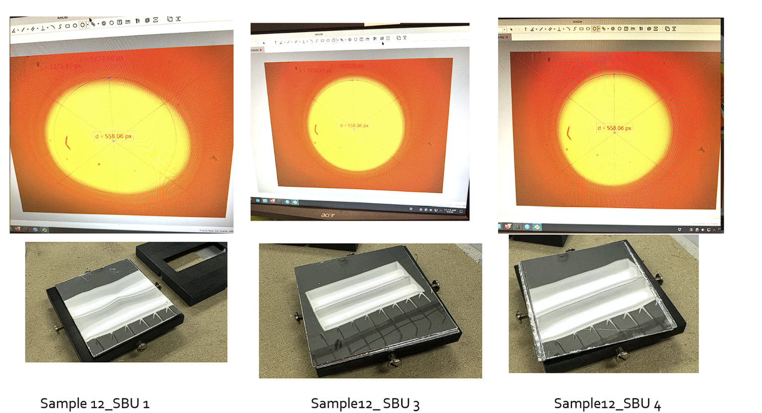
These are SBU samples made very quickly

Slide 8
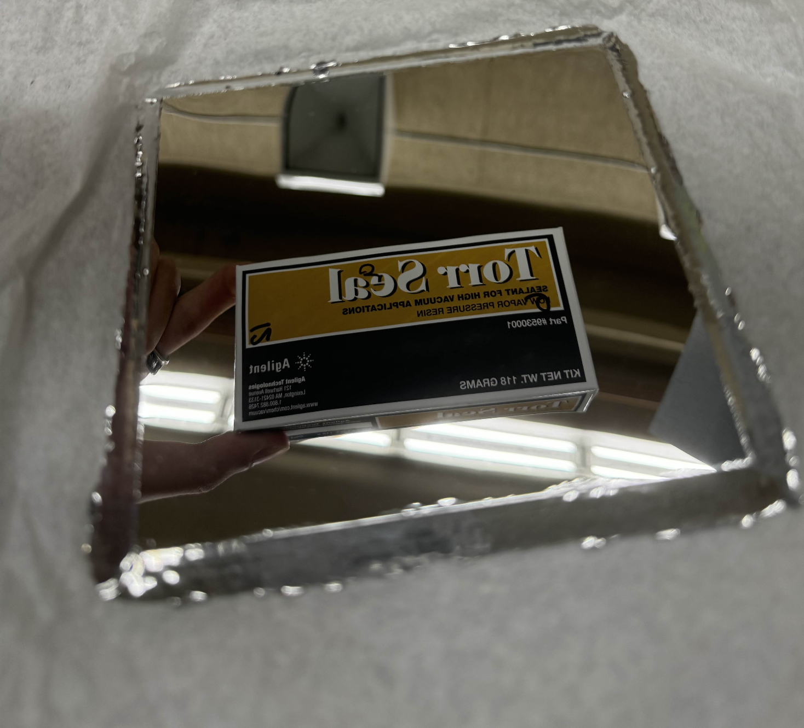
The very first test sample from Purdue
(Evaporation #9)
Never tested due to its size (larger than 7x7 cm).
Cut into pieces on 7/09 to be characterized
However, the important takeaway is that it doesn’t show much waviness in comparison to recent substrates.

Slide 9
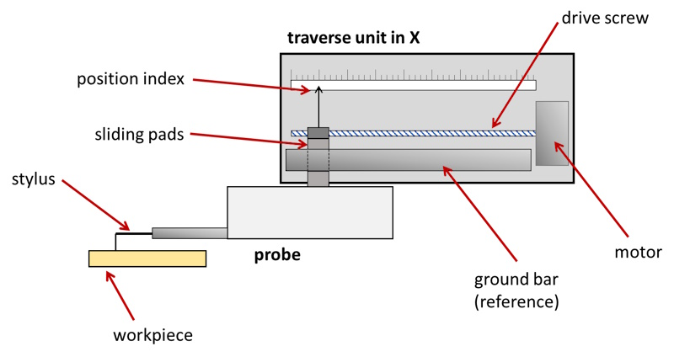
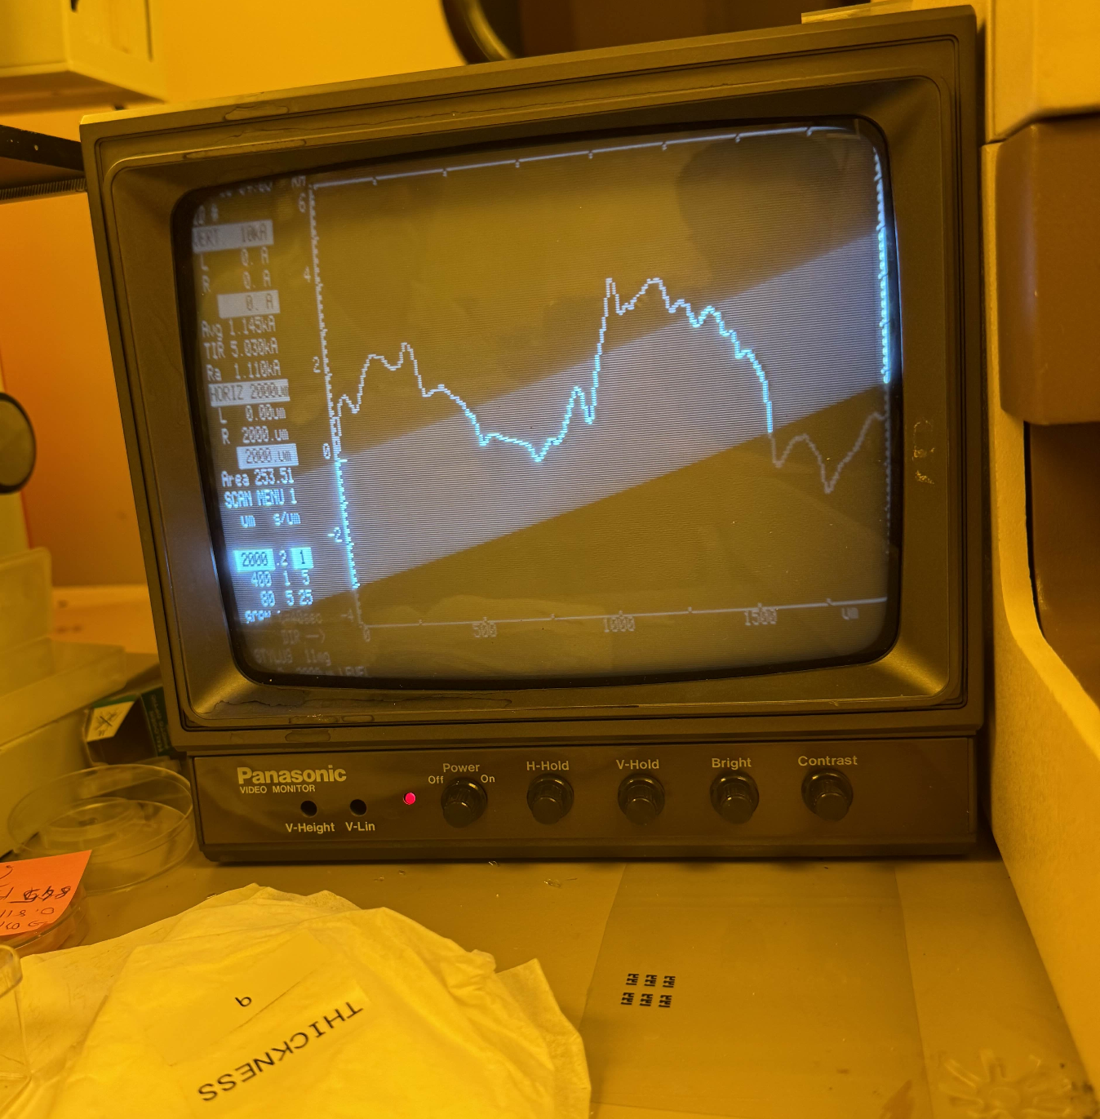
True Deposition Values:
The stylus-profilometer provides true thickness values on the surface of a coated substrate. It scrapes across the surface while recording the position. This reading is then compared with the Quartz Crystal Monitor (QCM) measurement to determine a ratio between QCM readings and true deposition.
Coating #9 was tested via this profiliometer, with a QCM reading of 28.3 KAng and a true reading of ~ 350 nm (8.085 times less deposition).
During calibration

Slide 10
Reflectivity Measurements

Slide 11
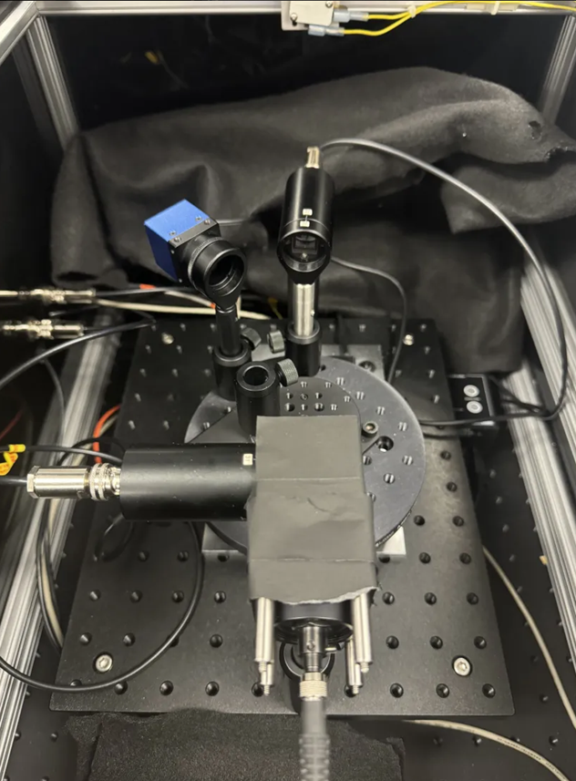
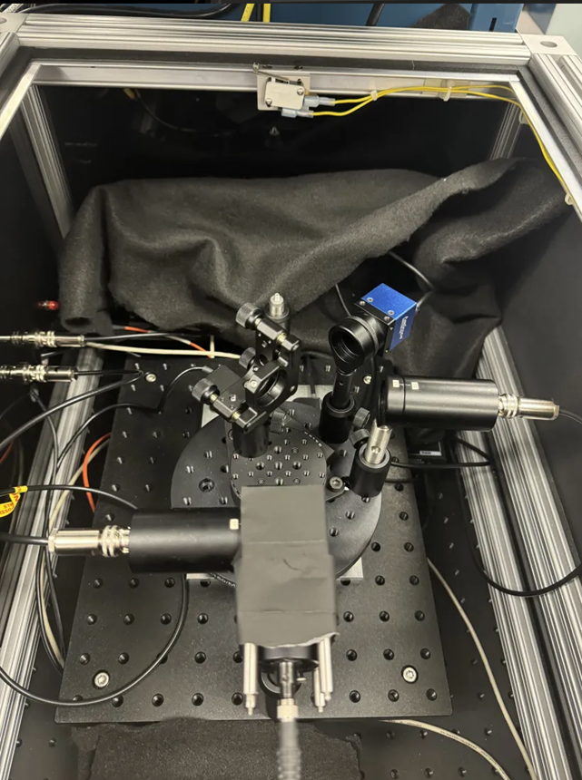
Method of Calculation
Direct Measure(Sensor 2)
Reflected Measure (Sensor 2)
Comparing Direct and Reflected Measurement
Holder

Slide 12
Normalization
Beam splitter
Sensor (2)
Remain constant
Normalization (Sensor 1)

Slide 13
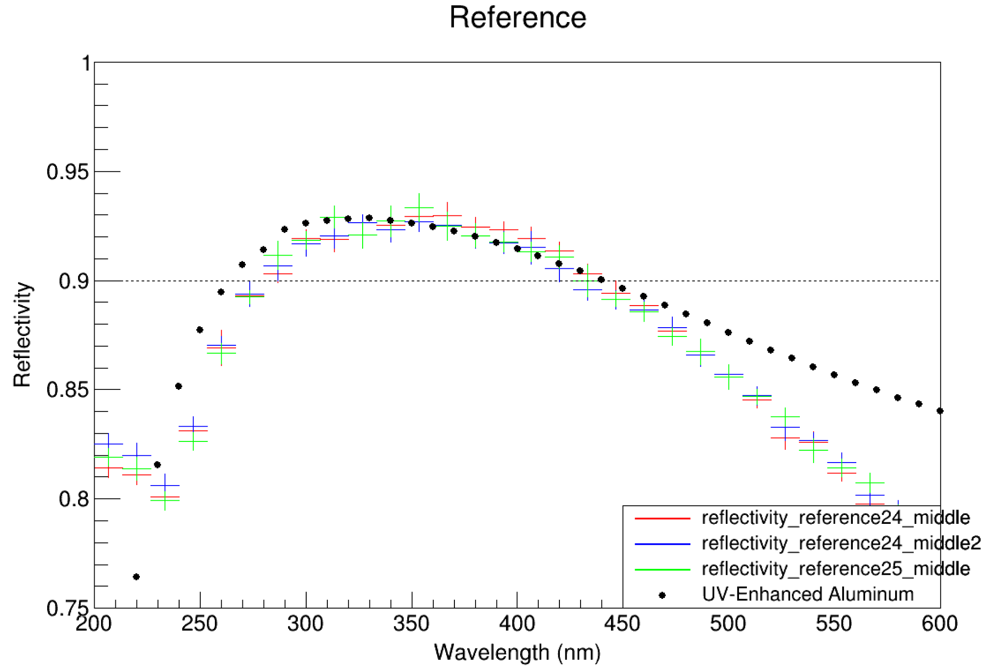
Reference result
Testing the validity of our setup involves comparing the reference mirror and data provided by ThorLabs against our own measurements at BNL.
Our peaks appear to have shifted slightly to the right, with uncertainties emerging after 450 nm and around 200 nm.
To ensure our setup remains consistent, we take reference measurements between each test. While these measurements might not precisely reflect the actual reflectivity of the mirror, they ensure consistency across samples.

Slide 14
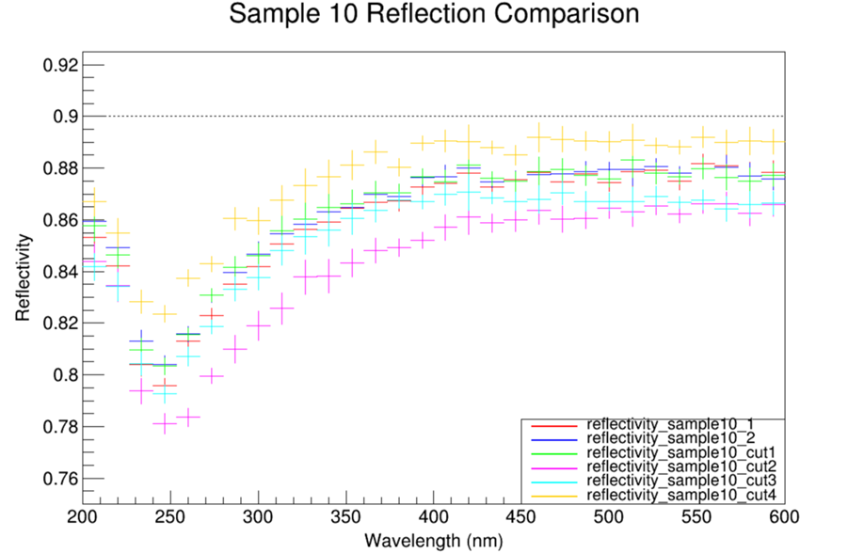
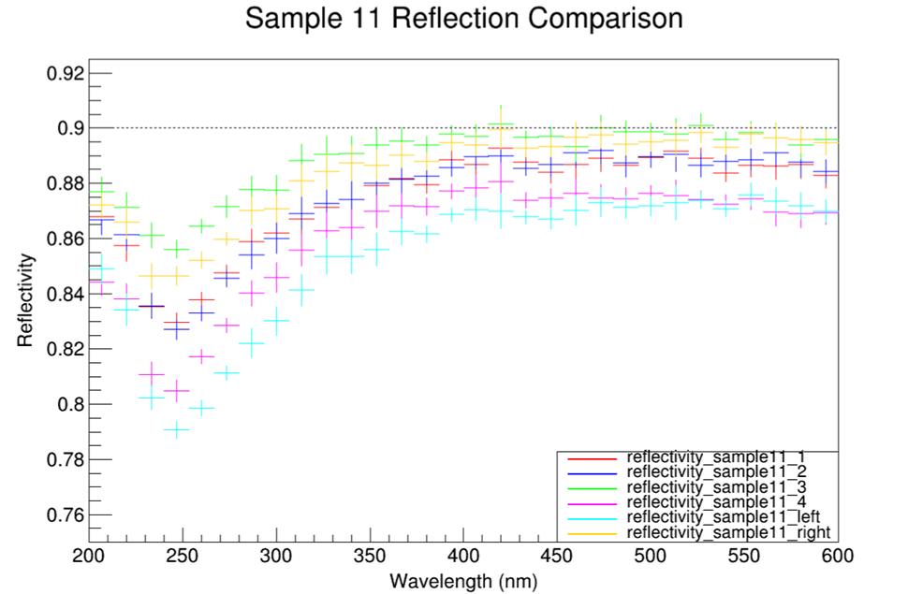
Previous Results
Previous test results show a wide range in the difference between the best and worst samples, with a 4% variation within the sample set.
We are also investigating whether the placement of the mirrors in the coating chamber affects their reflectivity.

Slide 15
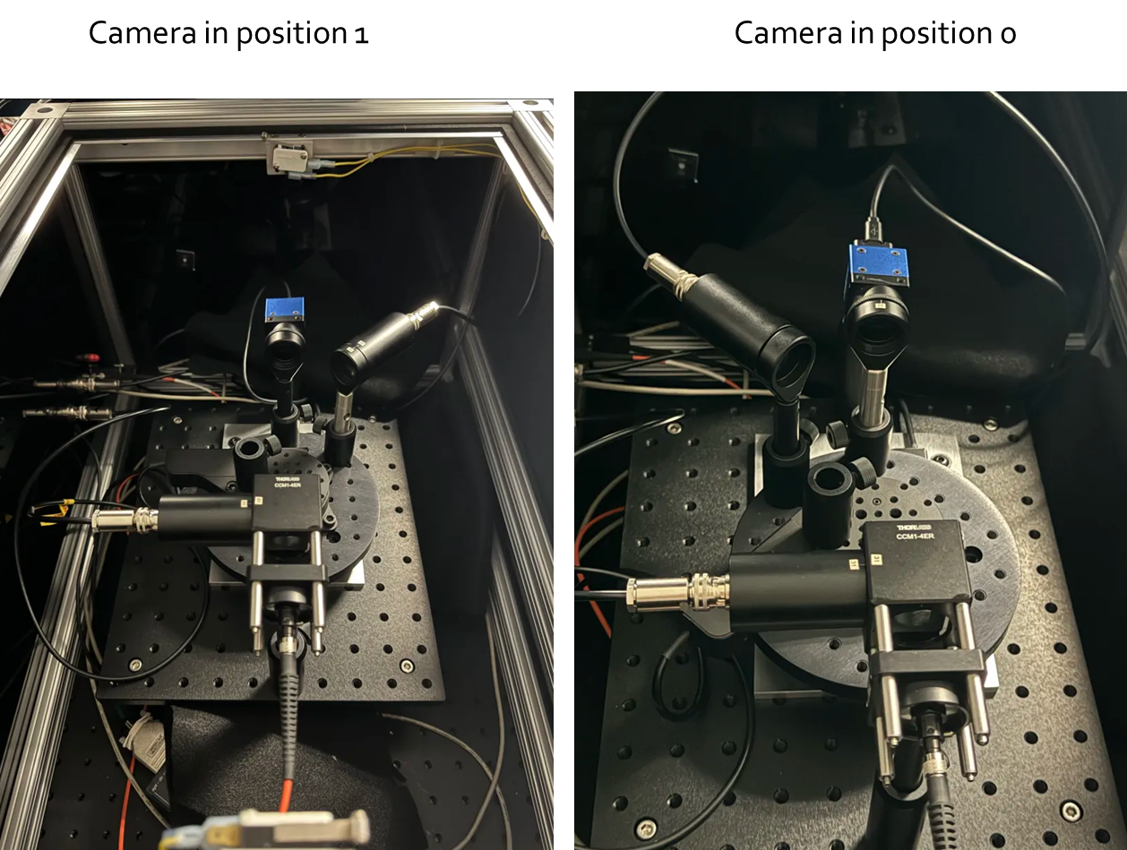
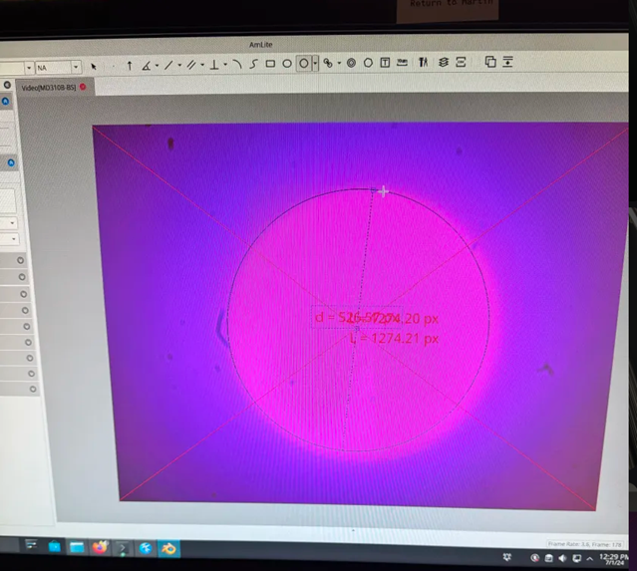
Calibration redone.
Screw in holder
Cross-reference the camera to ensure the beam spot is consistently positioned in the same place.

Slide 16
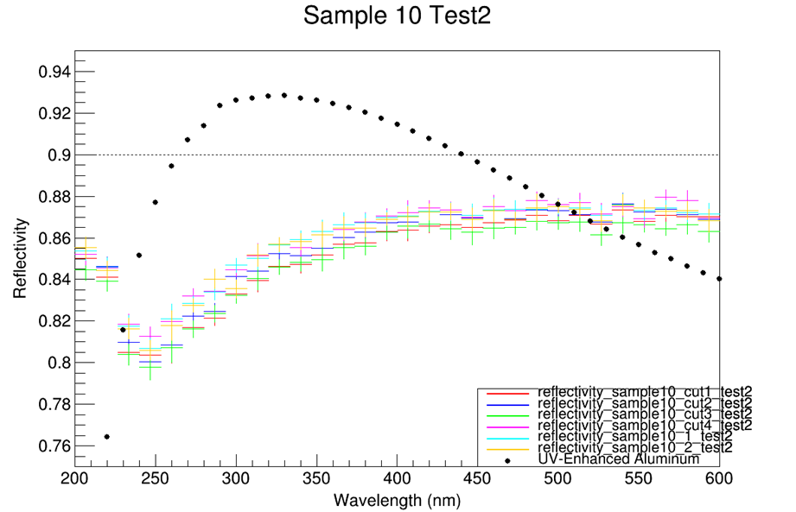
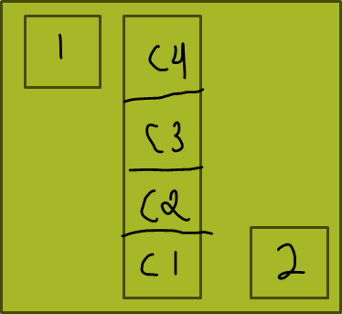
Sample 10
4% spread in the first test.
After recalibration, drops to 2%
Almost even coating across all 6 pieces.

Slide 17
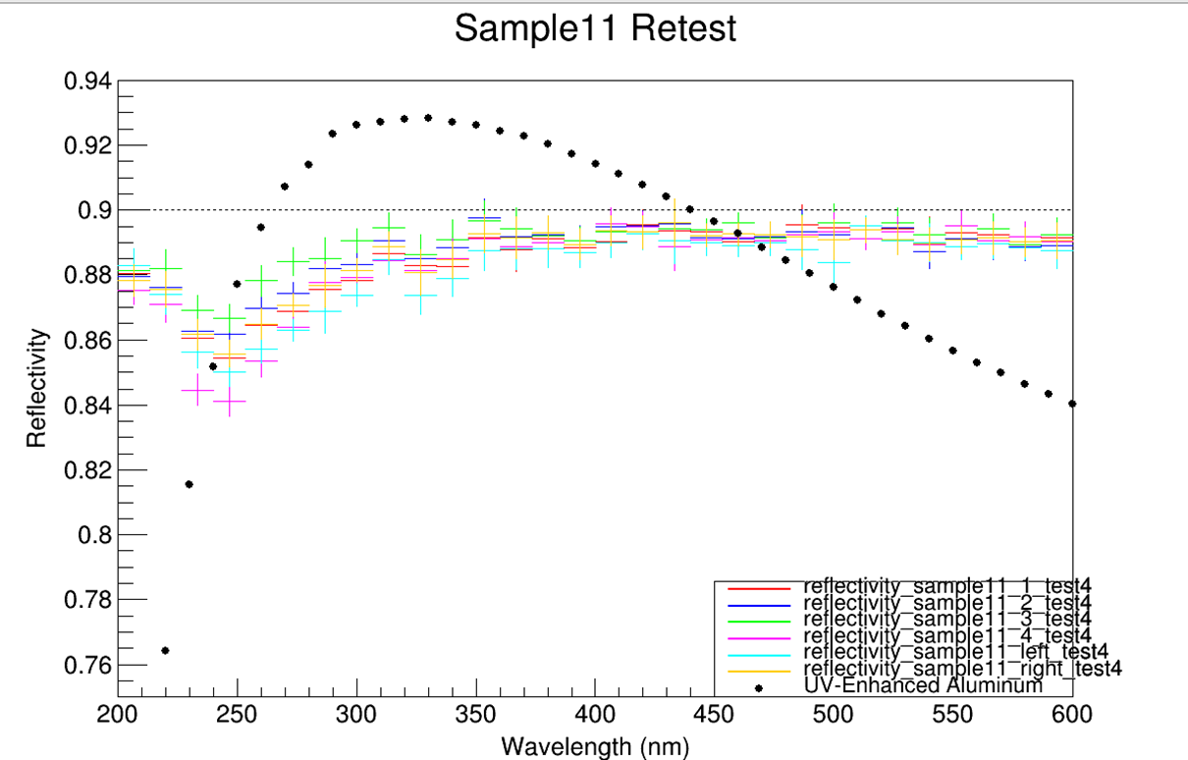
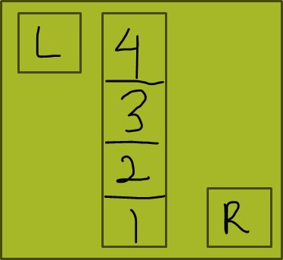
Sample 11
After recalibration, drops to 2%
Almost even coating across all 6 piece

Slide 18
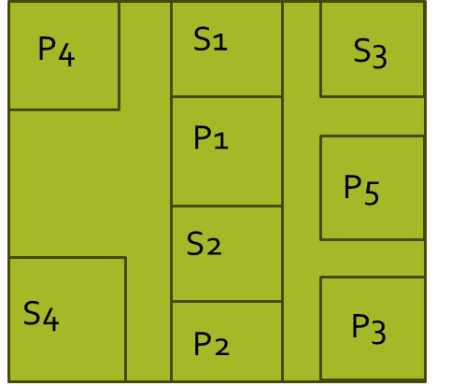
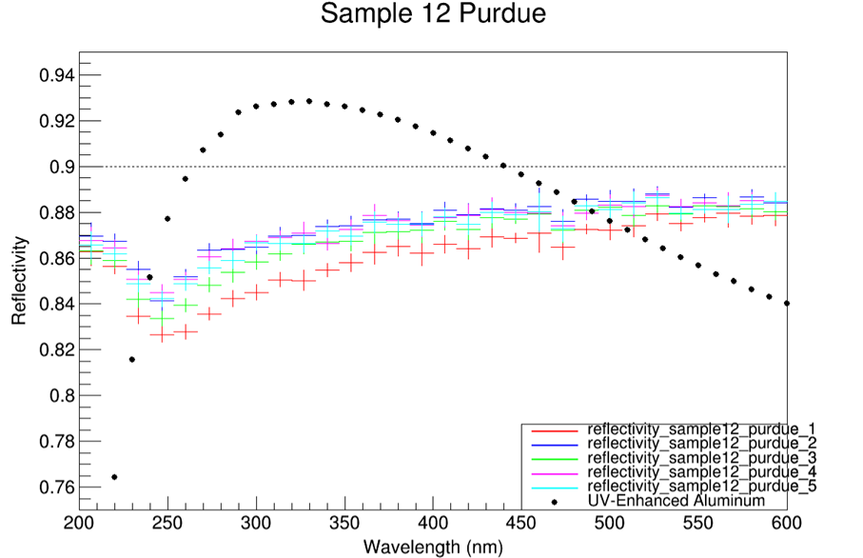
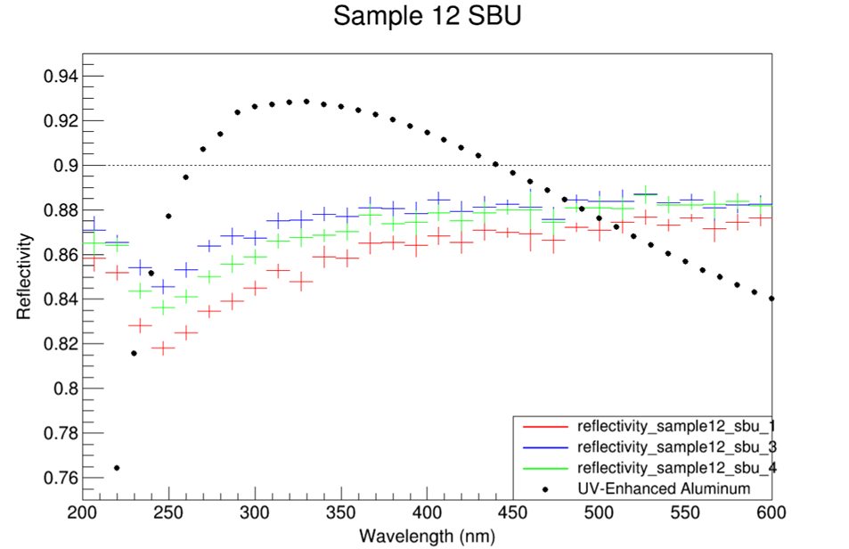
Sample 12
Same observed 2% variation. Results are better than Sample 10, but worst than Sample 11.

Slide 19
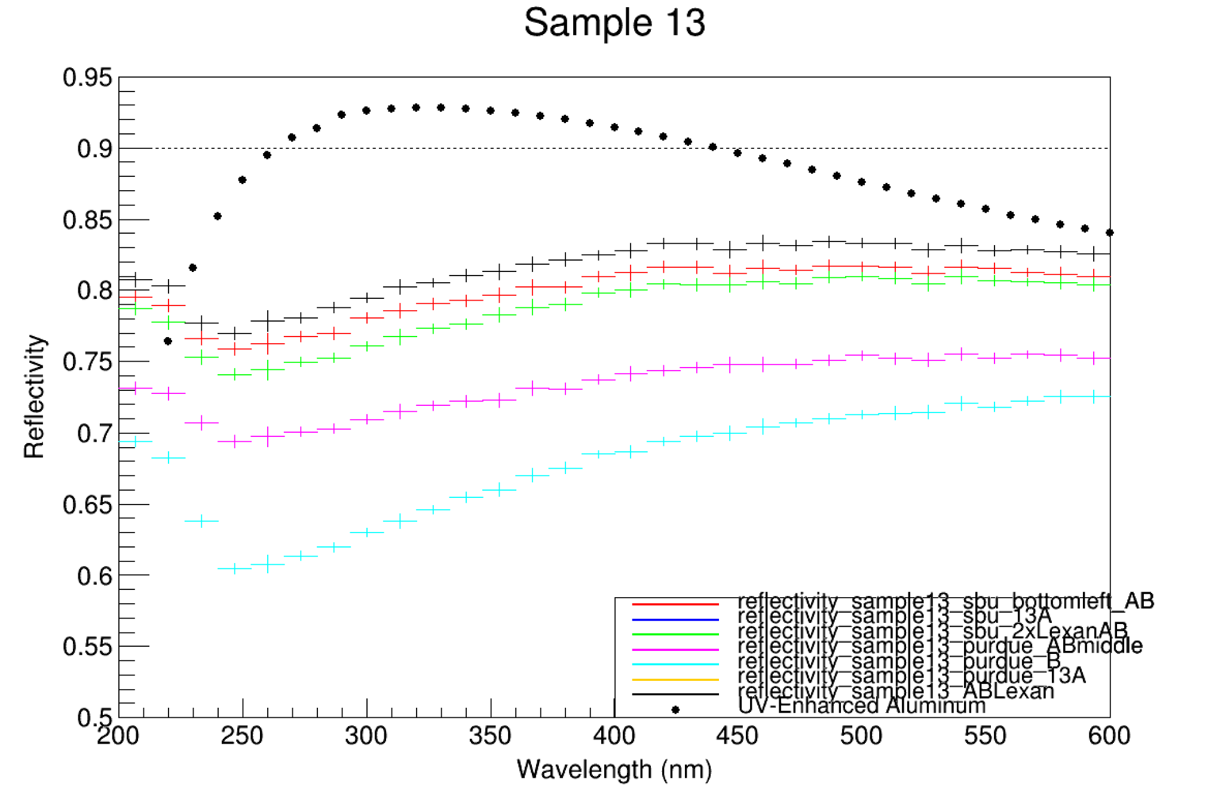
Sample 13
We have used vastly different coatings and materials for each sample to pinpoint the boundaries and understand the effects of changing the formula. This approach helps us determine what to expect with each variation.

Slide 20
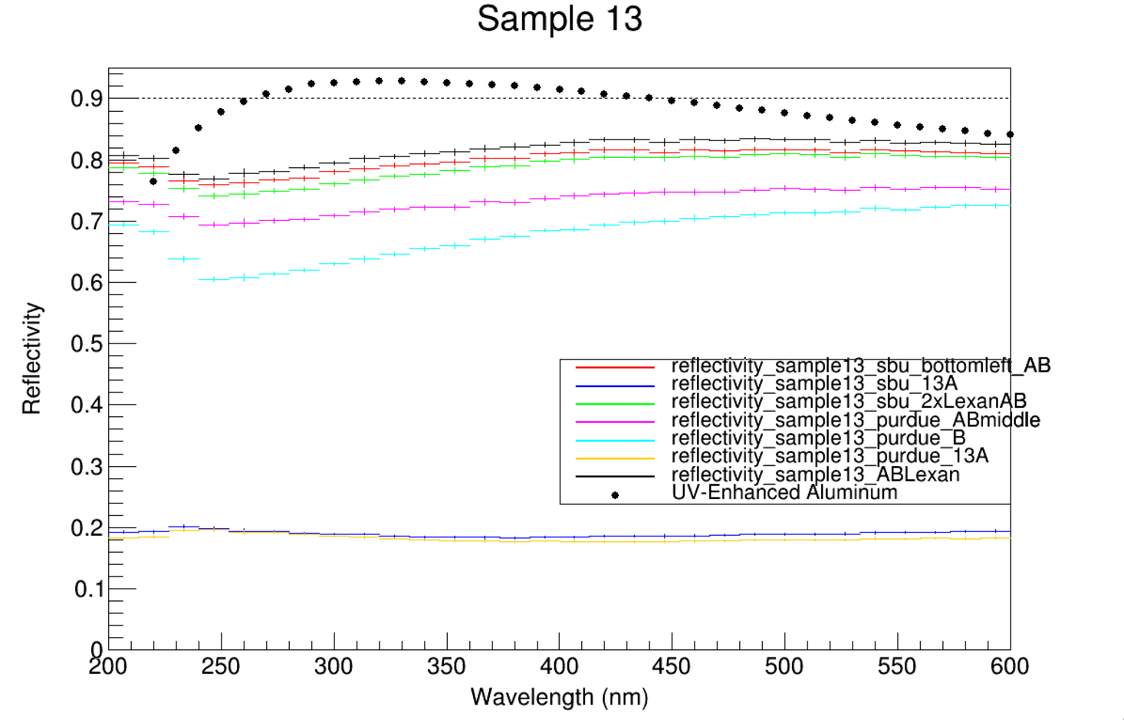
13A

Slide 21
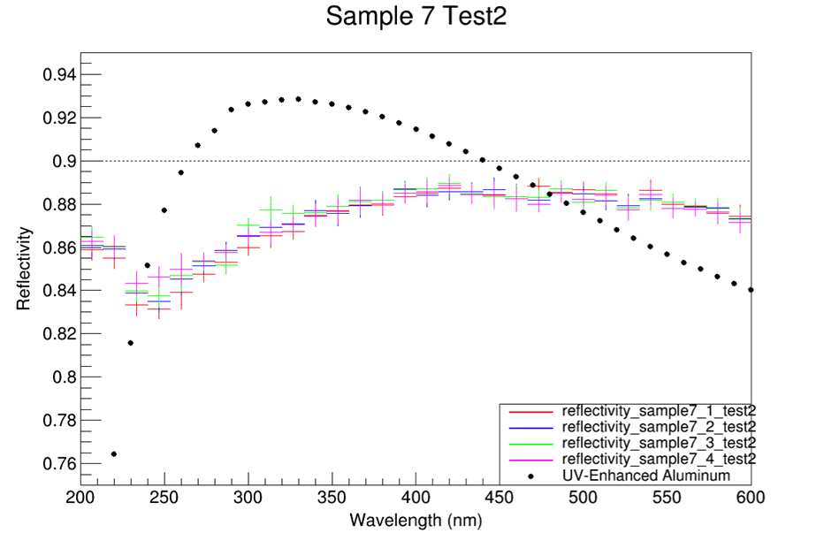
Sample 7 Retested
One of our best earlier coatings, while not having the highest reflectivity, is very compact.
Newly tested results show an overall reflectivity of around 0.88 with a 1% uncertainty.
Could be a sign of degrading over time (compare to #11)?

Slide 22
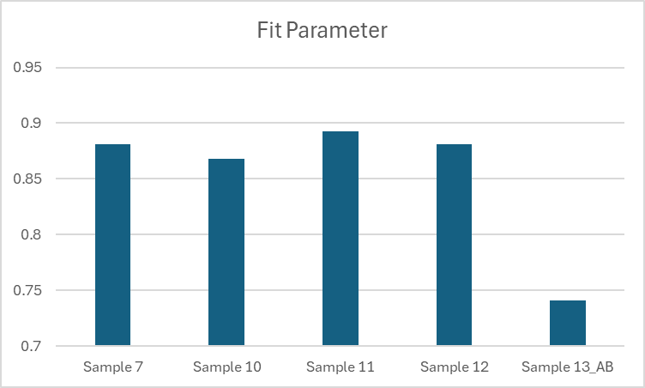
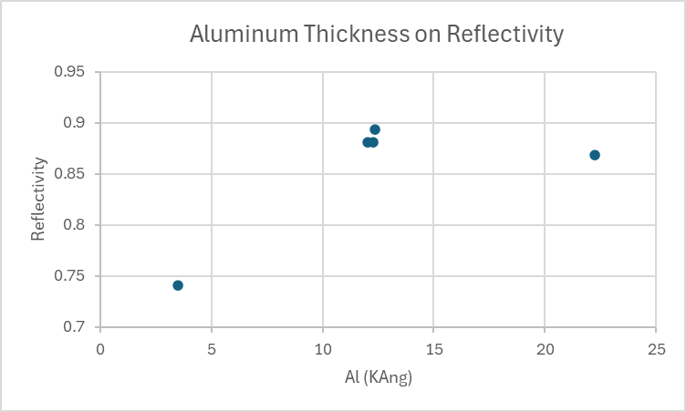
Understanding the reflectivity in terms of coating and other parameters.
Average reflectivity (300-600 nm)
Sample Name | Average reflectivity (300-600 nm) | Al (KAng)
Sample 7 | 0.880914 | 12.03
Sample 10 | 0.868409 | 22.24
Sample 11 | 0.89305 | 12.36
Sample 12_Purdue | 0.880803 | 12.27
Sample 12_SBU | 0.88098 | 12.27
Sample 13_Purdue_AB | 0.74114 | 3.51

Slide 23
What’s next for reflectivity testing?
Replace the cable with a smaller diameter one and rerun the reference test to check for matching results.
Improve the code to enable analysis of angular dependence from the same sample.
Aim to reduce the statistical uncertainty. To achieve this, consider increasing the number of data points from the current five.
Study systematic uncertainties of the reflectivity test.
Large scale mirror testing stand design @ BNL

Slide 24
Near term plans of mirror coating and equipment upgrades

Slide 25
Upcoming Coating Tests:
SiO2 coating to prevent oxidation and preserve reflective coating
Variation of rotation speed, ranging from no rotation to faster than 60 RPM rotation (suspect the difference between coating #11 vs 12)
Fine tuning of coating recipe, e.g., either increasing Aluminum and decreasing Chromium.
Consistency test (same coating, multiple times; see the consistency of our operation and procedure)
Complete Thickness Analysis (Preet now is learning the technique)
Usage of newly purchased Aluminum pellets.
More carbon-fiber is required for samples. (Thank you Sushrut and Andy!)

Slide 26
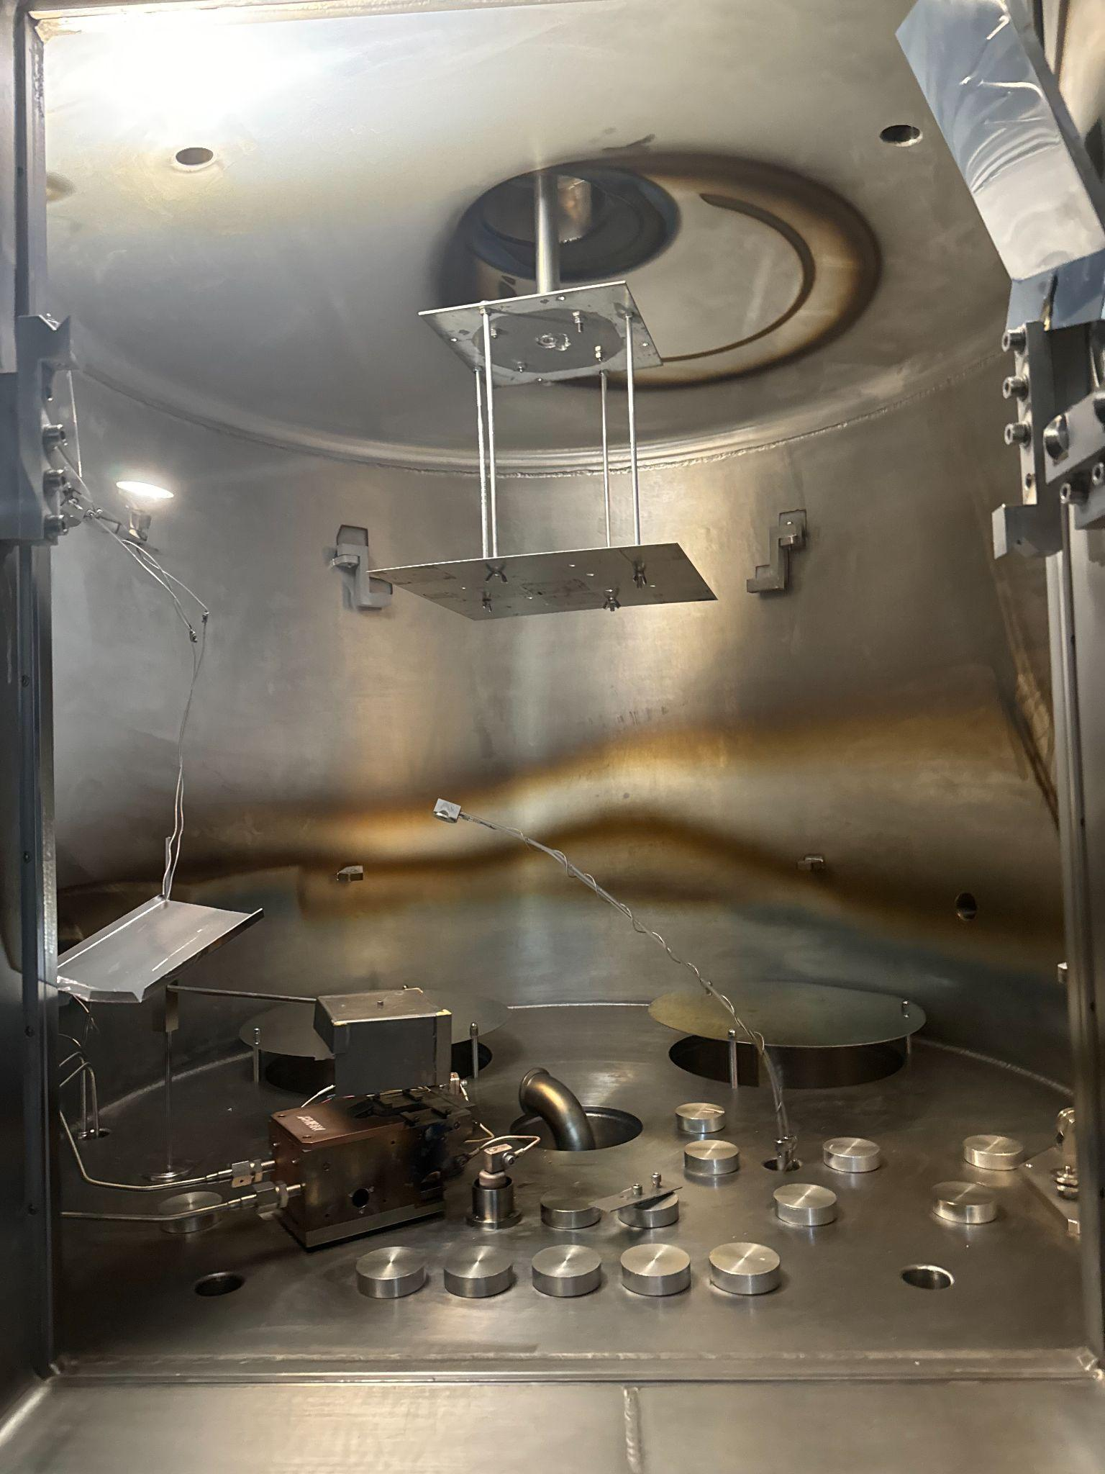
Upcoming Chamber Update:
CAD Model of Ion Source Mount (completed earlier this week, see later slides.)
Large Scale Mirror Mount and coating test (in progress at SBU machine shop)
Need to remeasure the absolute deposition thickness and the monitoring system, given the distance to the e-gun will be increased.
Achieve the same reflectivity for small mirror sample.
Large mirror coating.
Ion Source Mount and test in the chamber.

Slide 27
Ion Source Stand
Restrictions:
15 lbs Ion Source must be supported
Area restriction within chamber, cannot exceed 10 inches in length and 15 inches in height
Allow space for proper wires and cables to be fed through the chamber floor
Adjustable height of the ion source
Ion gas envelope must adequately cover the substrate at the top of the chamber [angle]

Slide 28
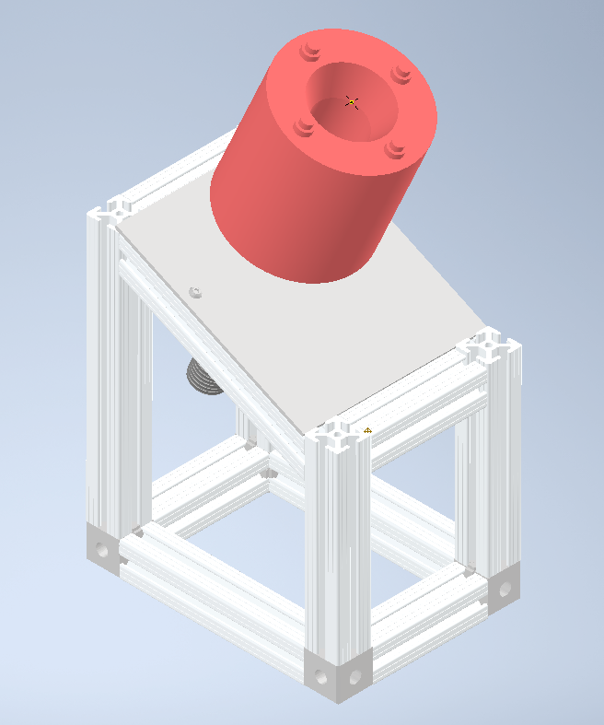
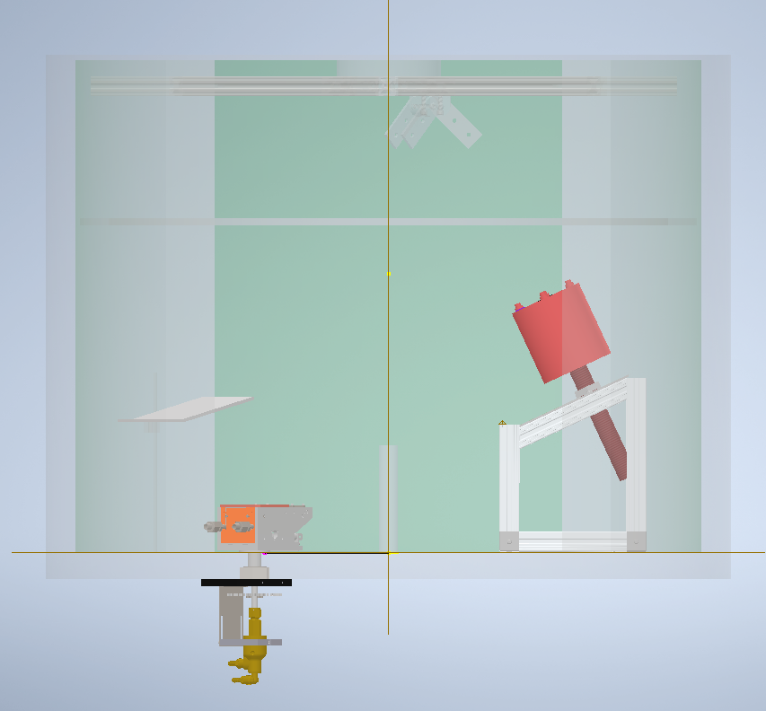

Slide 29
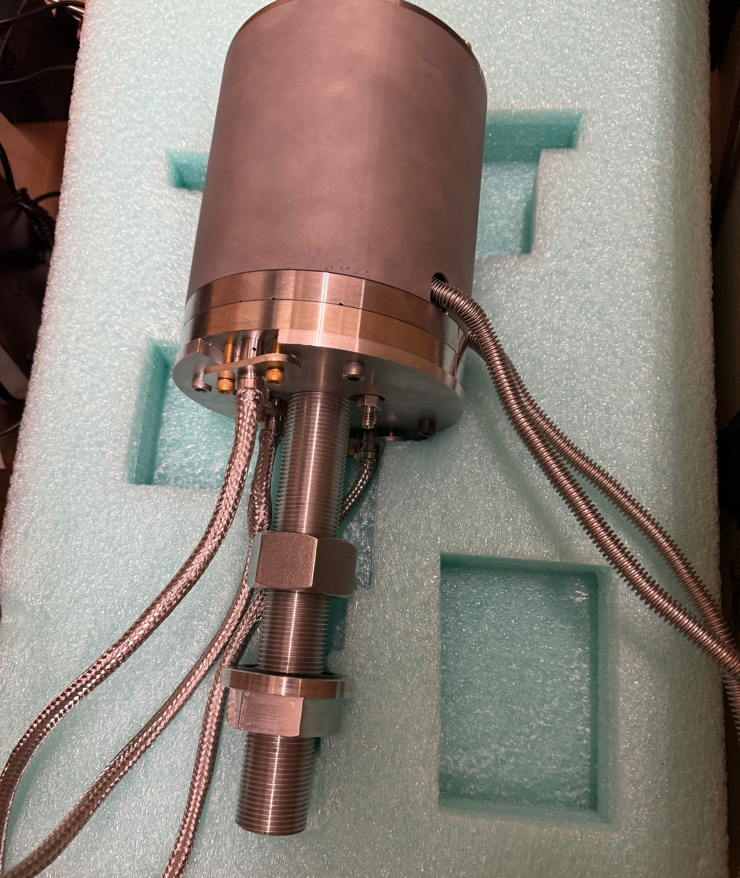
Current Ion Source Plan:
Machinists will cut 80-20 to the determined angle and length, and build the ion source stand for us. Time unknown now, pending the machine shop’s availability.
Ion Source will be mounted in chamber upon completion - within 1 week.
Additional parts i.e. filaments, Conflat feedthrough, will be ordered in the meantime
Ion Source wiring and set-up will be followed.
Timeline is heavily driven by machine shop availability and lead time of the orders.

Slide 30
Summary
The mirror efforts have been going very well and good progresses have been made.
Reflectivity of small mirror samples are ~ 90% between 300 and 600 nm.
For coating, we are entering the next phase - fine tuning the coating recipe and equipment upgrades.
Important tasks ahead of us:
Substrate preparation to make surface more smooth (w. Purdue)
Large conical sample coating.
Ion gun installation.
Dielectric coating as a protective layer.
* Vacuum improvement with cryo pump. (* separate funding has been applied.)

Slide 31
Backup

Slide 33
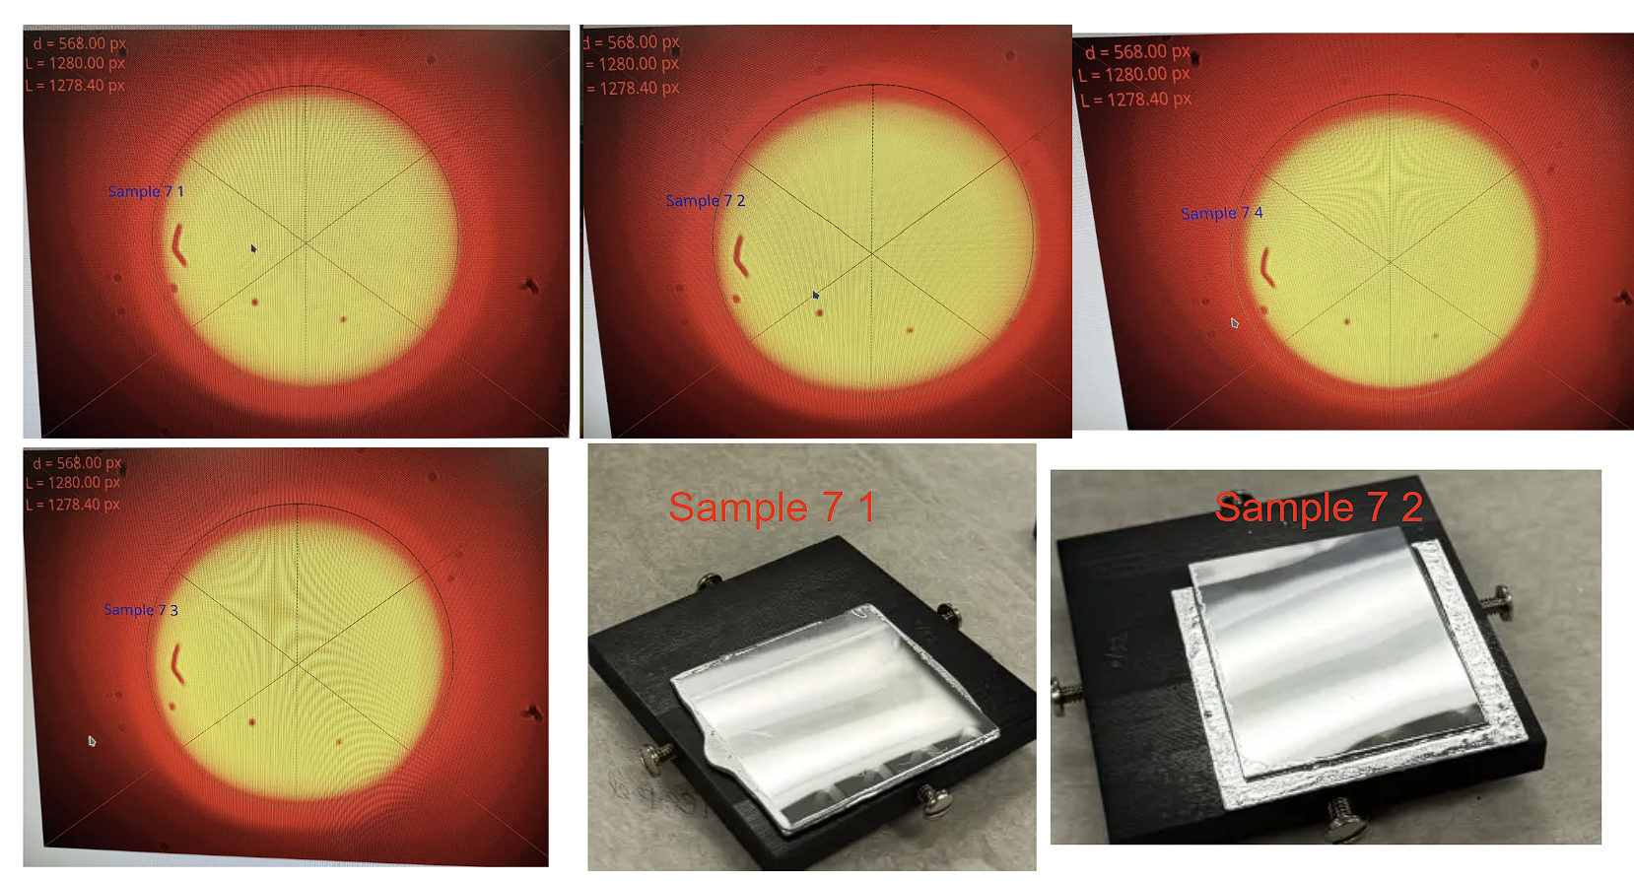
Sample7
Almost Perfect Circle

Slide 34
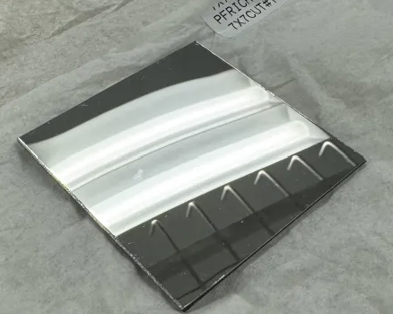
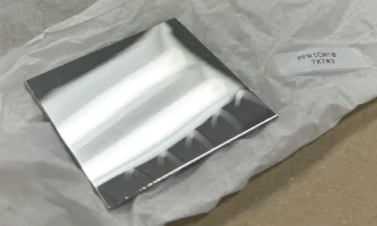
Sample 10 pic
Sample10_Cut1
Sample10_2

Slide 35
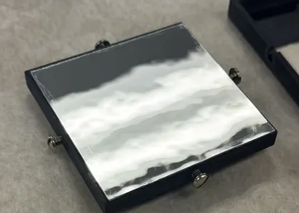
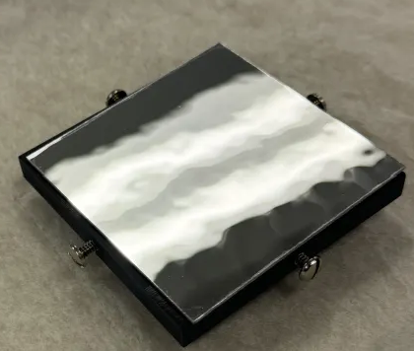
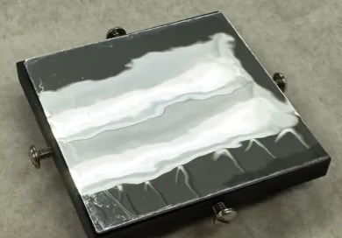
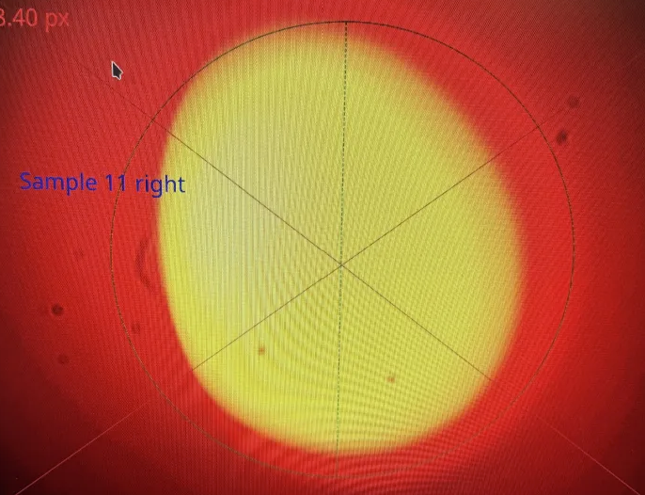
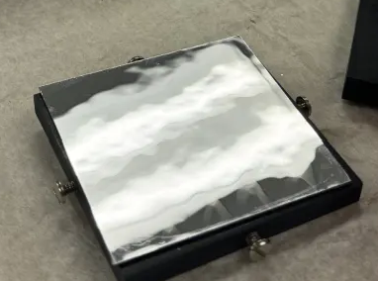
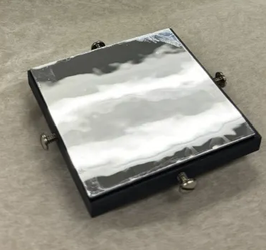
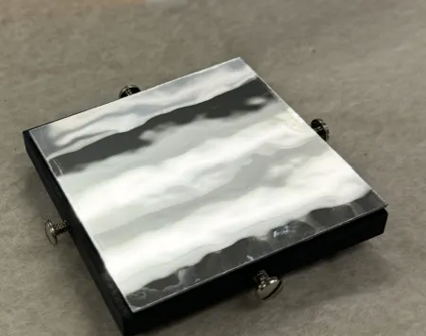
Sample 11 pic
Sample11_1 Sample 11_2 Sample11_3
Sample11_4 Sample11_Left Sample11_Right

Slide 36
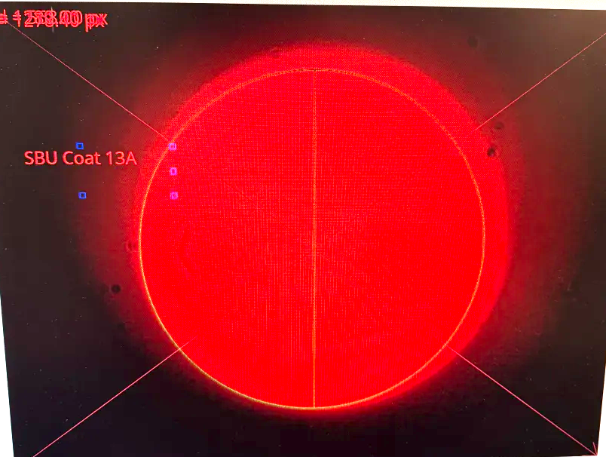
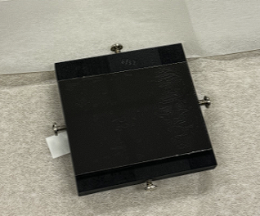
Sample 13
SBU_Coat 13A
Reflectivity:20%

Slide 37
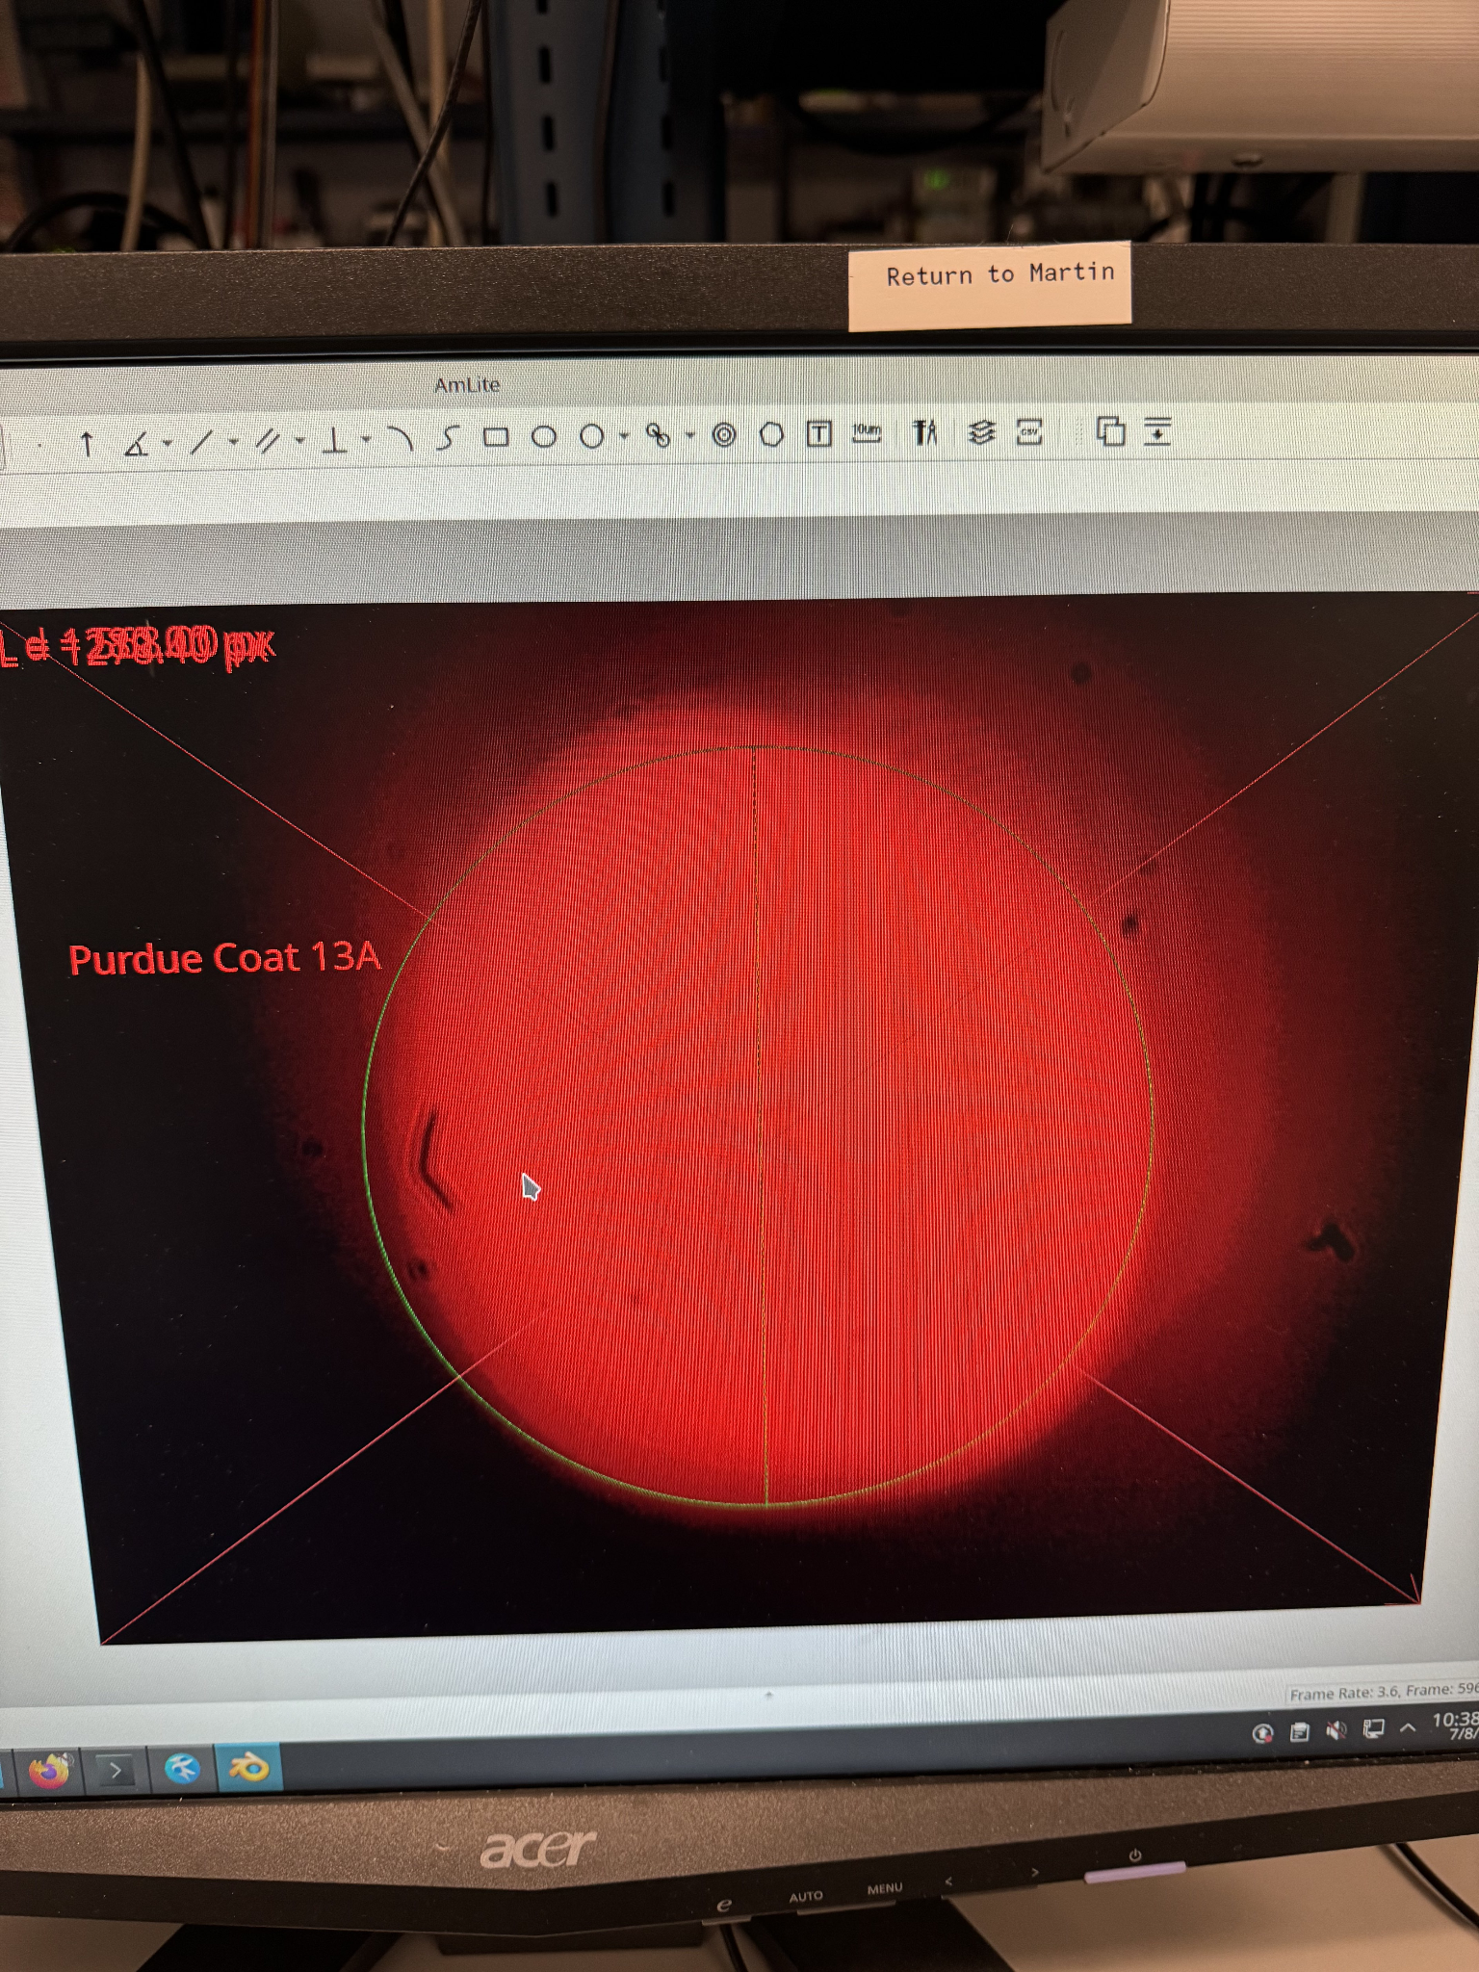
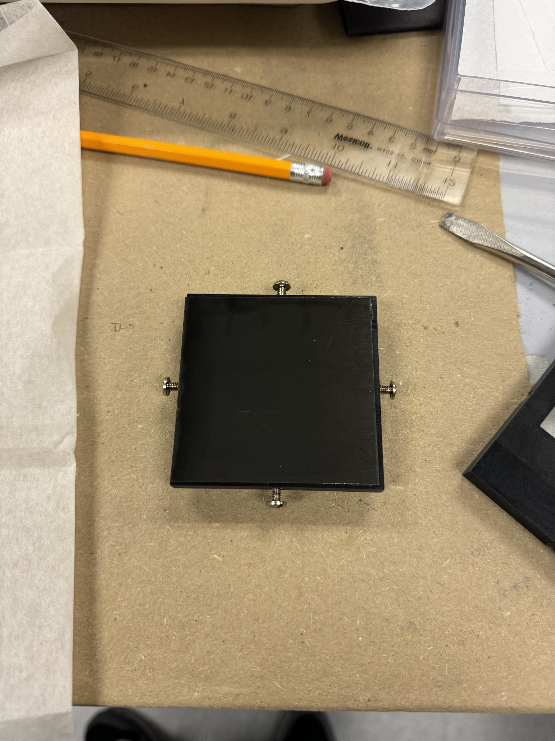
Purdue_Coat 13A
Reflectivity:20%

Slide 38
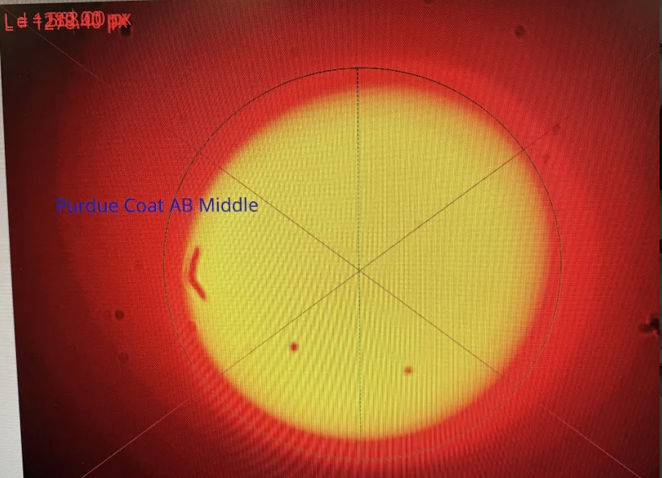
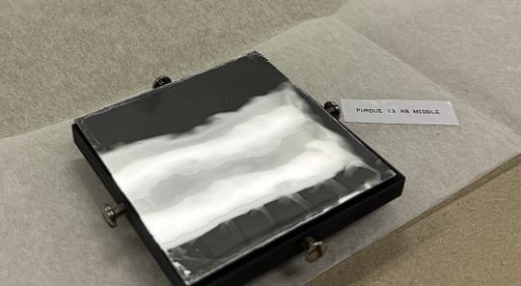
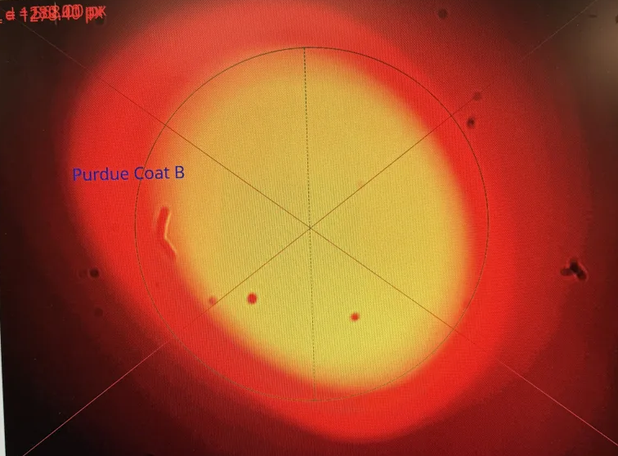
Purdue13_ABmiddle
Reflectivity:73%
Purdue13_B
Reflectivity:65%

Slide 39
13AB_Lexan Reflectivity:81%

Slide 40
SBU_2xLexanAB
Reflectivity:78%

Slide 42
Sample Name | Average reflectivity
Sample13_purdue_13A | 0.179841
Sample13_sbu_13A | 0.187919
Sample13_Purdue_B | 0.690125
Sample13_Purdue_ABmiddle | 0.741140
Sample13_sbu_2xLexan | 0.796937
Sample13_sbu_bottomleft_AB | 0.807813
Sample13_ABLexan | 0.823800

