Slide 1
Offline Data Quality Monitoring
Xuyang Ning, Wenqiang Gu
07/11

Slide 2
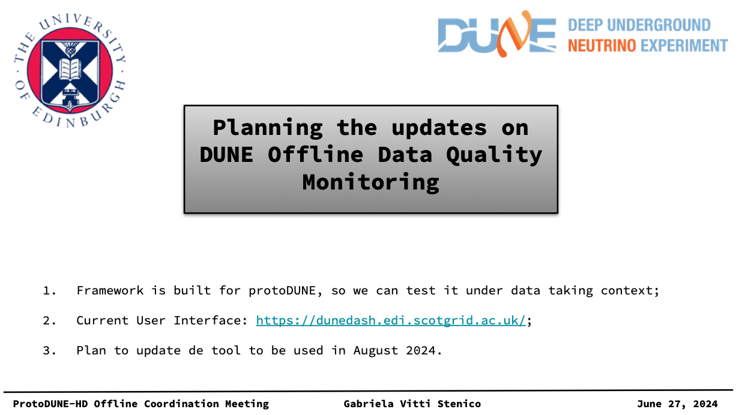
protoDUNE offline Data Quality Monitoring
Team:
Gabriela Vitti Stenico
Robert Currie
Wenlong Yuan
Xuyang Ning

Slide 3
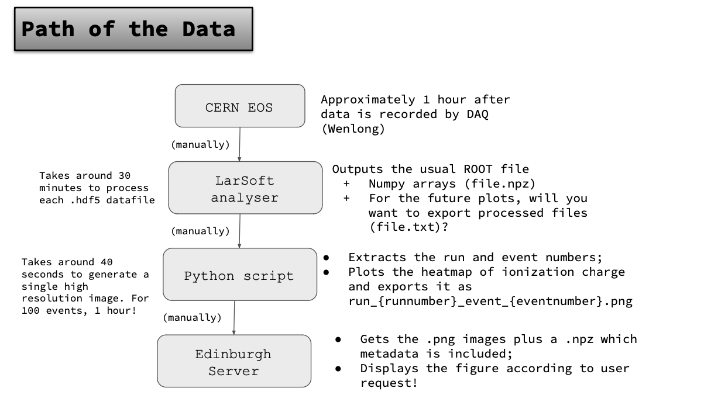
From Gabriela

Slide 4
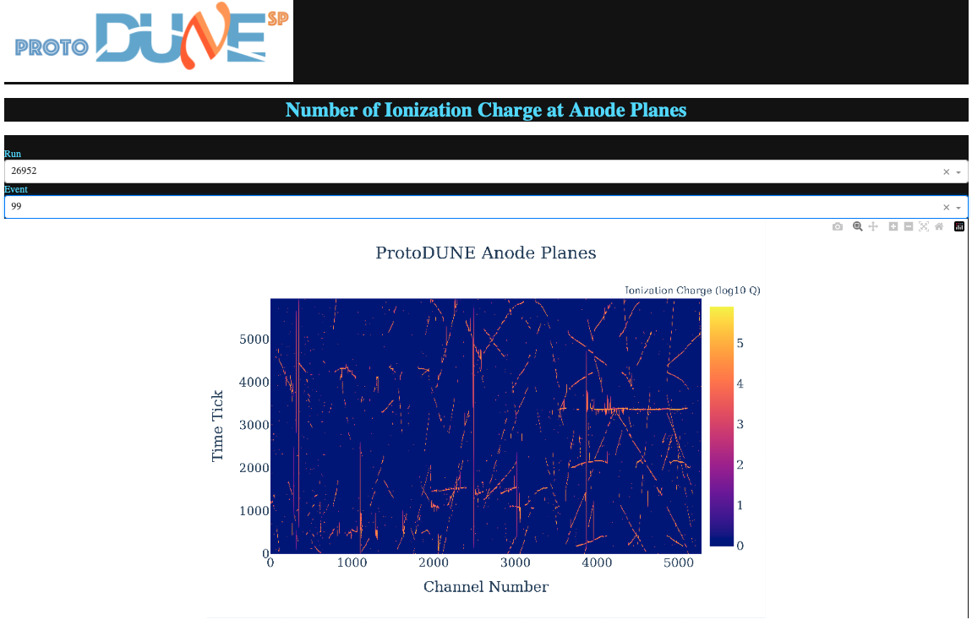
From Gabriela

Slide 5
Improve
Outputs Art rootfile
Gallery root script
Add some plots
For us, I run it on dunegpvm
Notes:
This is the current process of their framework. Here is the raw data in CERN. The datafiles are in .hdf5 format. Then they manually put all datafile in the process of larsoft. This is where they generate all the data of plots they want to see to monitor the quality of the data. Next the data is extracted by a python script and generate all the plots, and store it at some place. They also develop an interface on a website for users to easily see the result.
For now they only have the plot for the waveform. And each step is doing manually. And the whole process consume lots of time. So there is still lots of things need to be done.
For me, now with all the configuration file, python script they provide. And with help of Wenqiang, I can now, first get the numpy file for the waveform, and then draw the plot with python script. And then,

Slide 6
Demo
Plots available now:
Baseline
Waveform; before&after noise filter
RMS; before&after noise filter
Spectra vs frequency; before&after noise filter
Channel-to-channel correlation; before&after noise filter
On your local terminal:
ssh -N -f -L localhost:8050:localhost:8050 <username>@dunegpvm11.fnal.gov
http://127.0.0.1:8050/

Slide 7
Next
More plots:
Hit finding information
Summary plots of different runs
…
Improve the interface.
Move to Django
…
Reduce running time.
Setup automatic process

