Slide 1
ProtoDUNE News
Wenqiang Gu

Slide 2
Recent progress
Restarted beam run now, overnight 7GeV run nice and stable
This week’s activities:
PDS: noise investigation, if coincident with TPC activities
High pressure Cherenkov: not enough light reaching PMTs, will replace it with another Cherenkov from the East Area
CE gain: unexpected undershoot at 14mV/fC (see next slide), confirmed by Roger with pulser run. Issue not obvious with 7.8mV/fC, will keep this gain for the coming data taking. “Should be only 2% change in noise”
Beam run plan: operate at 1GeV/c, changing polarity every two days

Slide 3
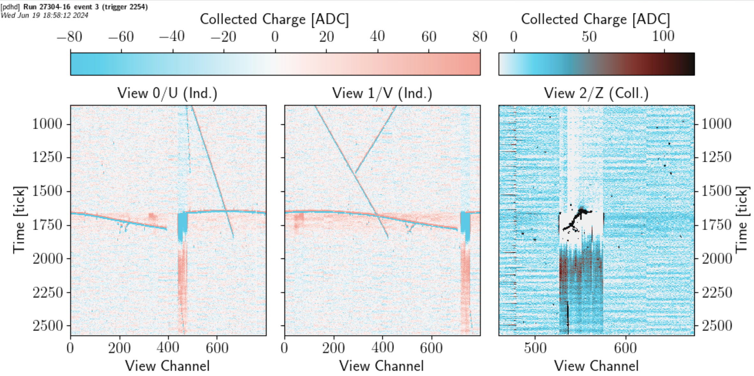
Unexpected undershoot
Plan to run at 7.8mV/fC
Stakeholders:
Noise filter (Xuyang et. al)
CE calibration (Karla)
Signal processing (e.g., threshold for ROI)
Simulation
Stakeholders: noise filter (Xuyang et al.),

Slide 4
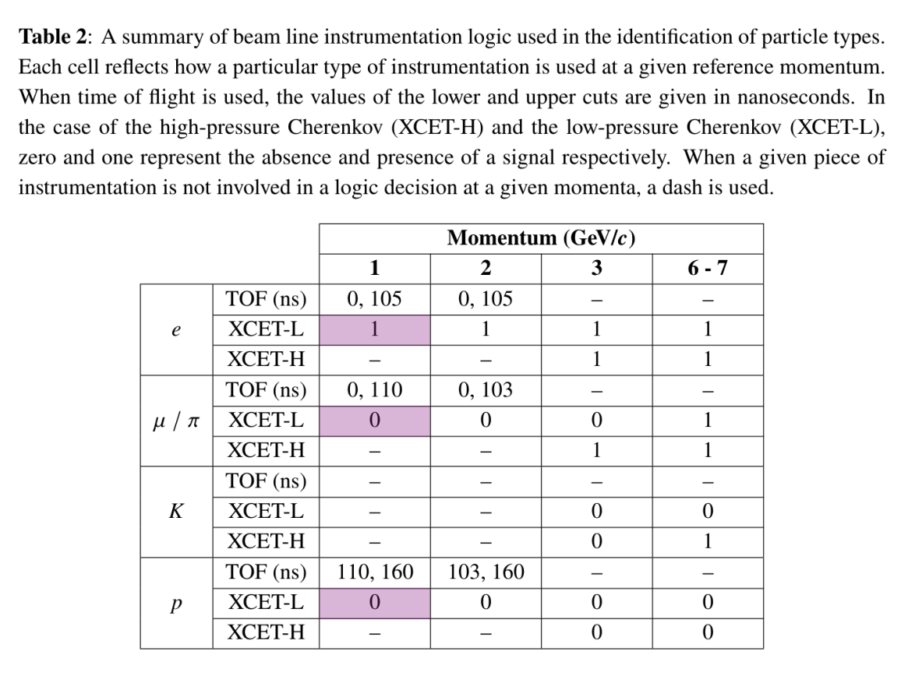
The Cherenkovs
Only low-pressure Cherenkov is currently working
It’s okay for +/-1GeV/c pion data
Only 1GeV/c electron is vetoed by low-pressure Cherenkov
1GeV/c proton is vetoed using TOF

Slide 5
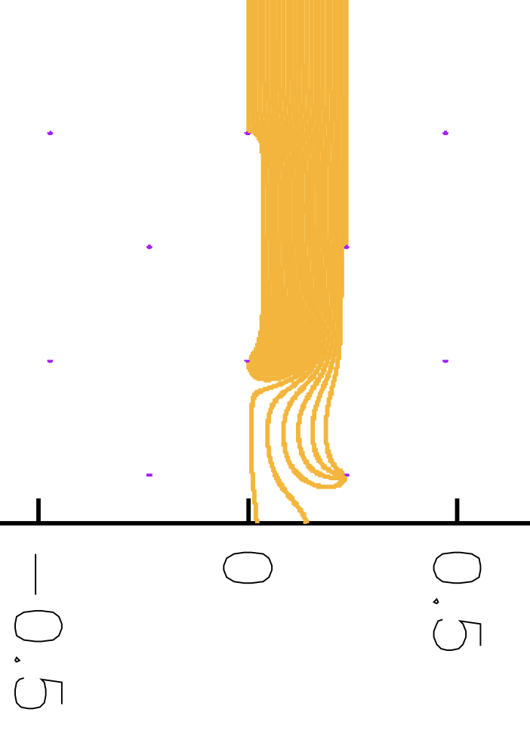
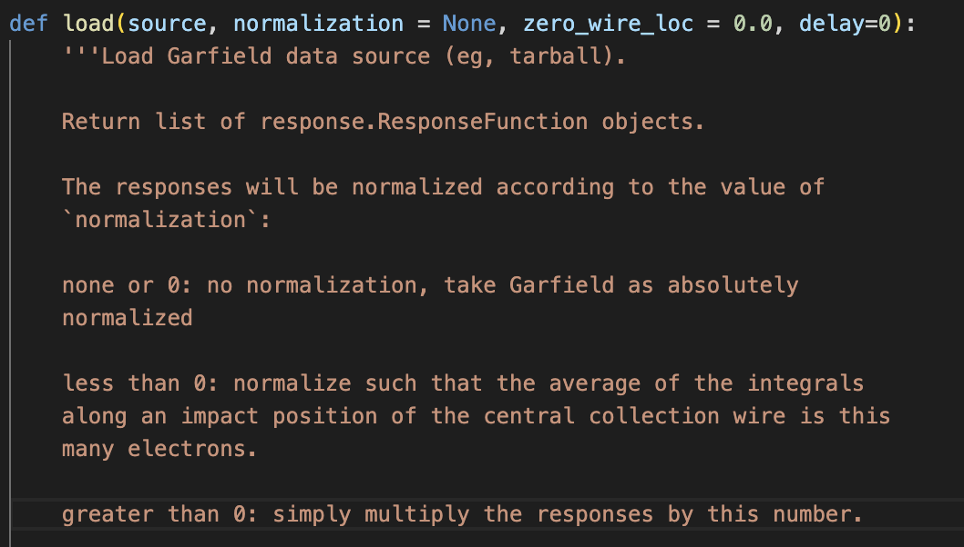
Progress on APA1’s field response (FR)
Yichen
For the v1, a standard 6-electron-path simulation is converted to the wirecell FR format
To-dos:
Use a fine-grained 26-path simulation from Yichen
How to take care of the charge normalization? PDSP normalized to 1 electron on a W wire, now we just take the value from GARFIELD for PDHD

Slide 6
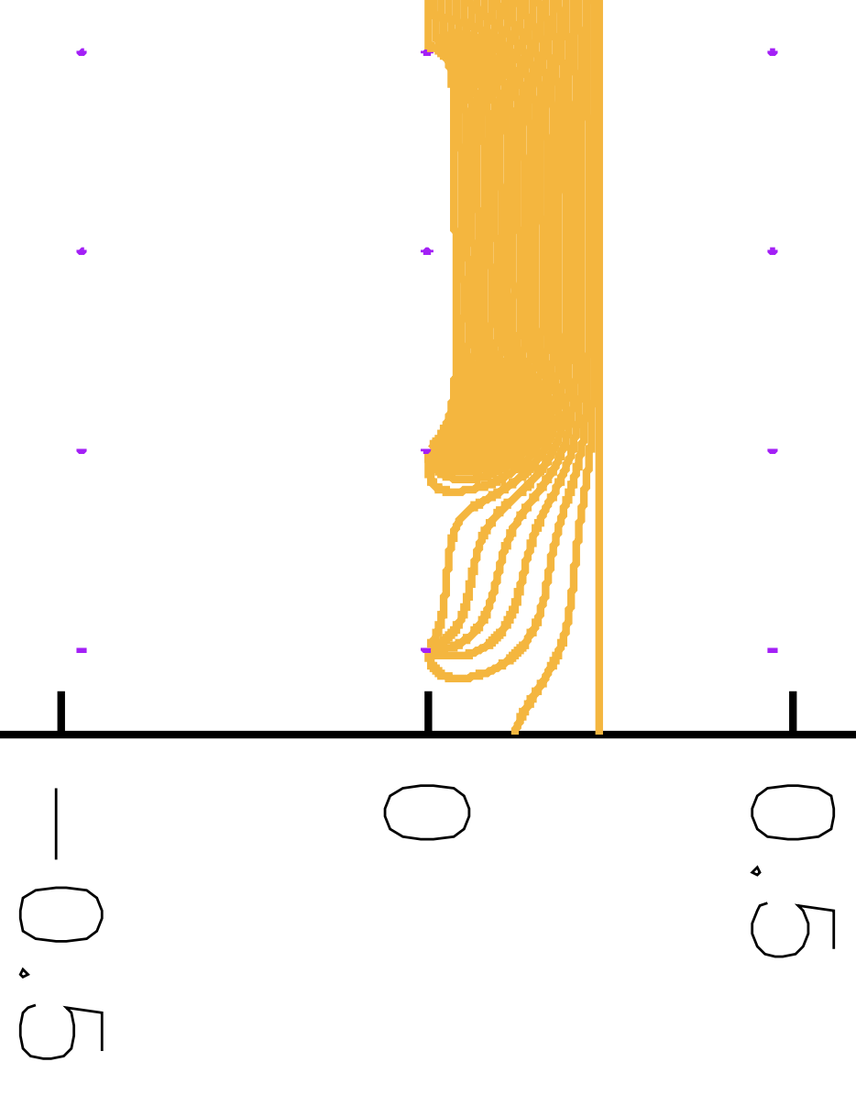
G
U
V
W
Total electrons | Grid collected | U | V | W | Others
26 | 0 | 0 | 19 | 5 | 2
Total electrons | Grid collected | U | V | W | Others
26 | 0 | 1 | 19 | 4 | 2

Slide 7
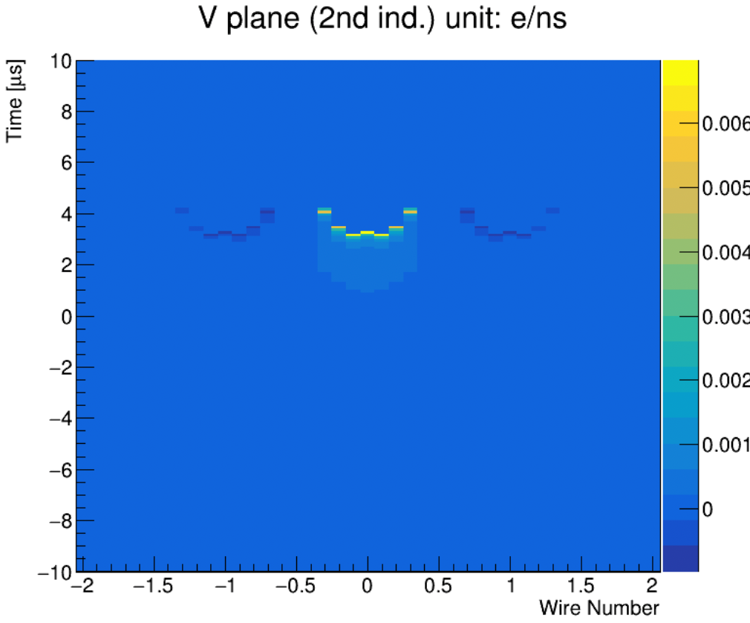
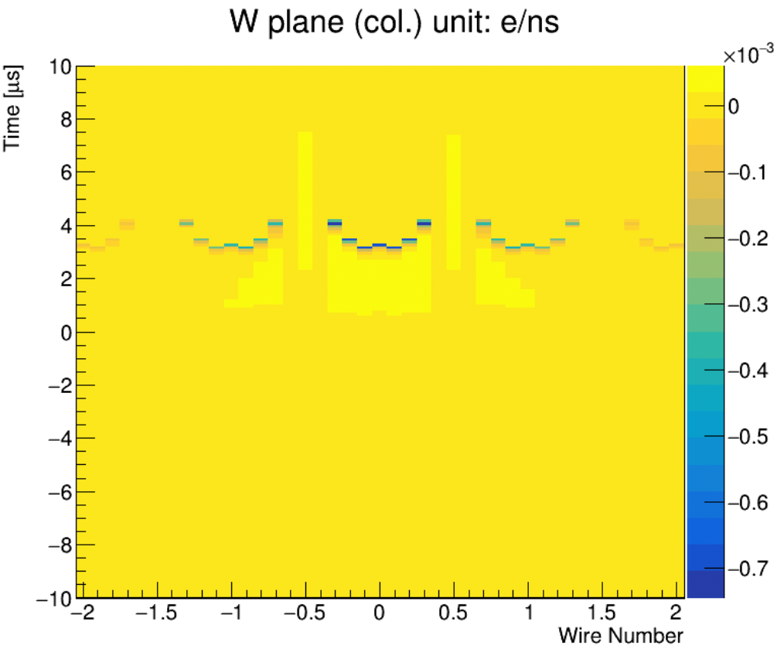
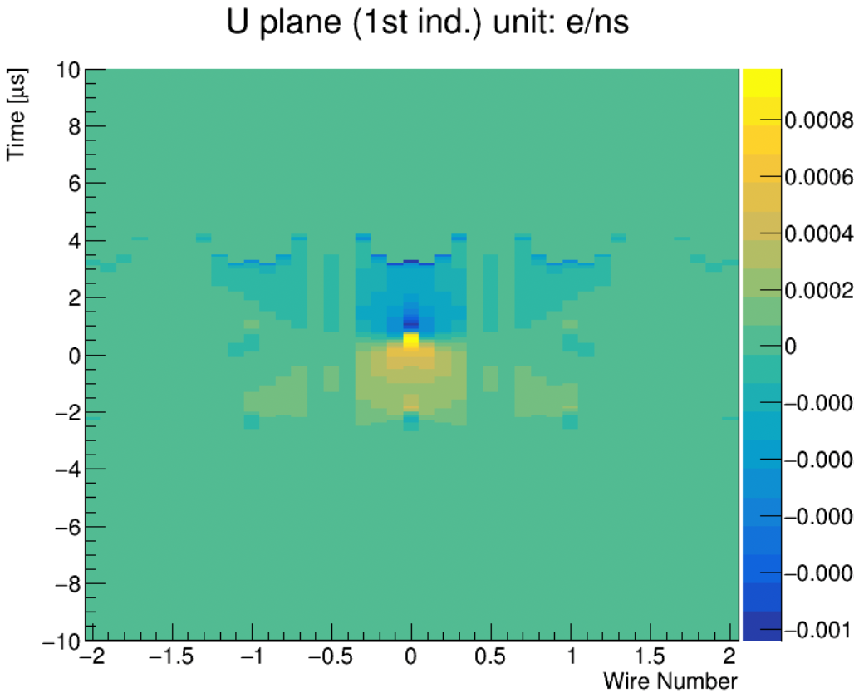
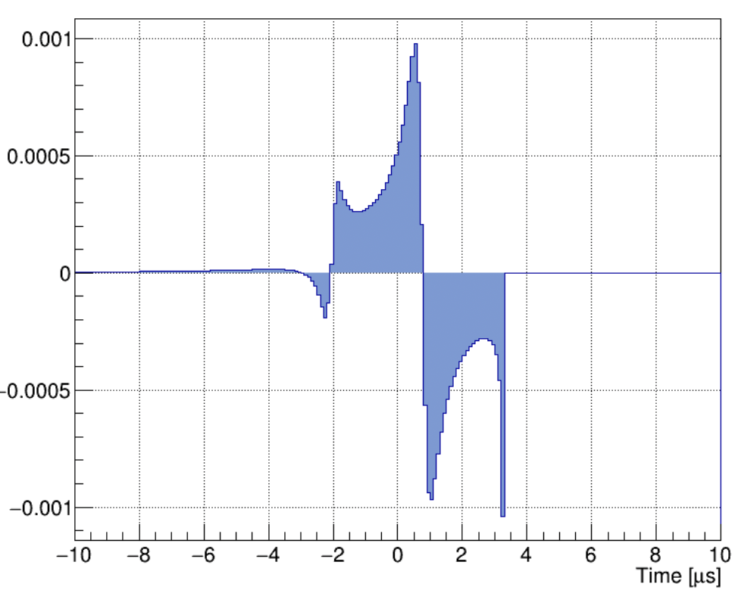
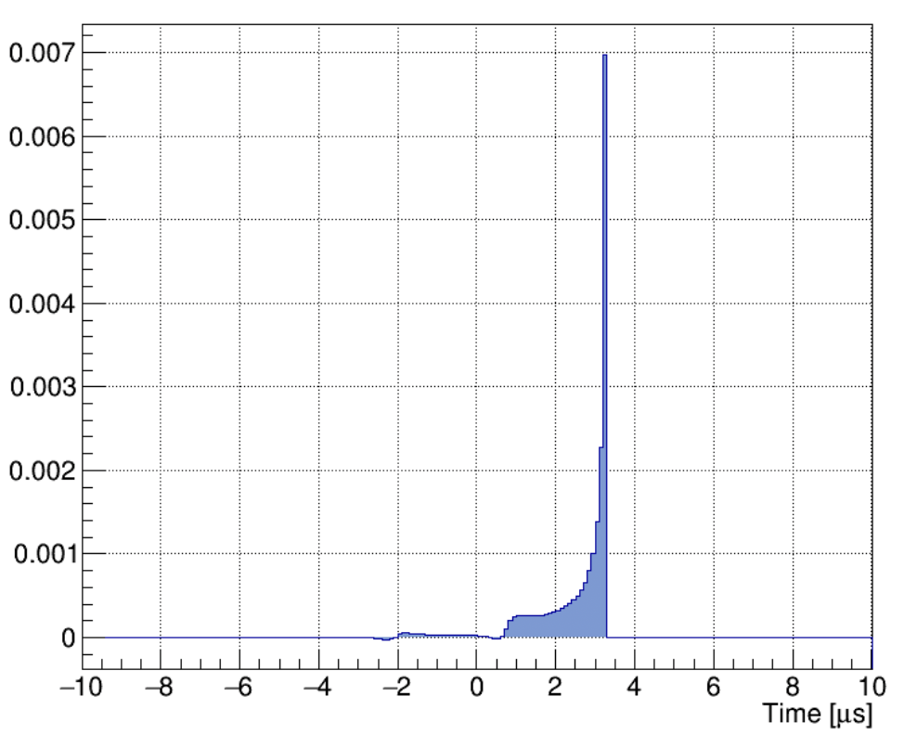
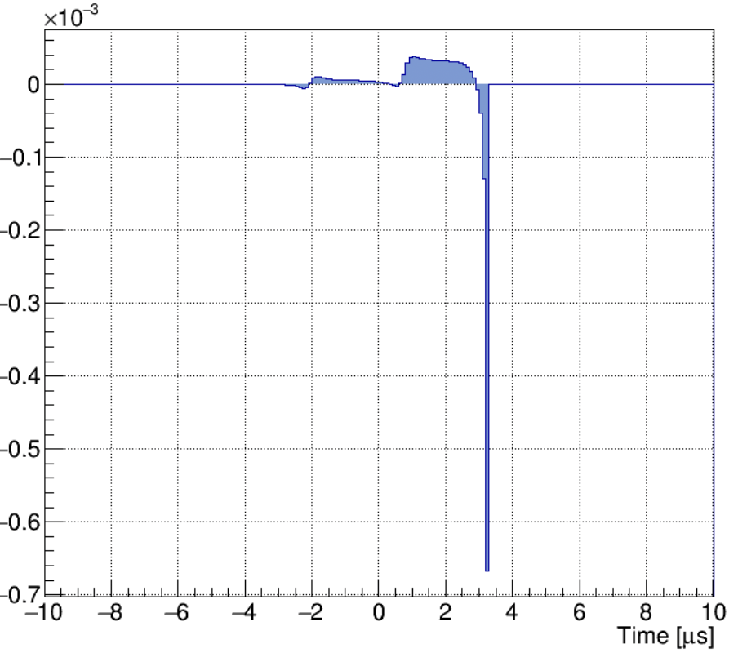
2D field response: PDHD APA1
central electron path
central electron path
central electron path
Mostly induction in W now

Slide 8
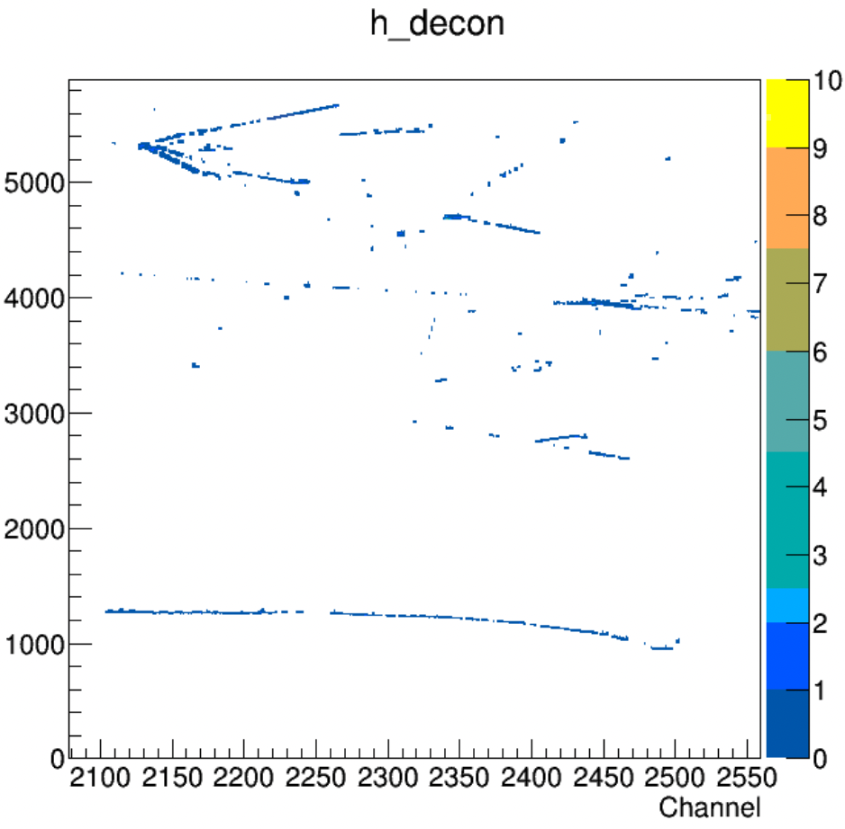
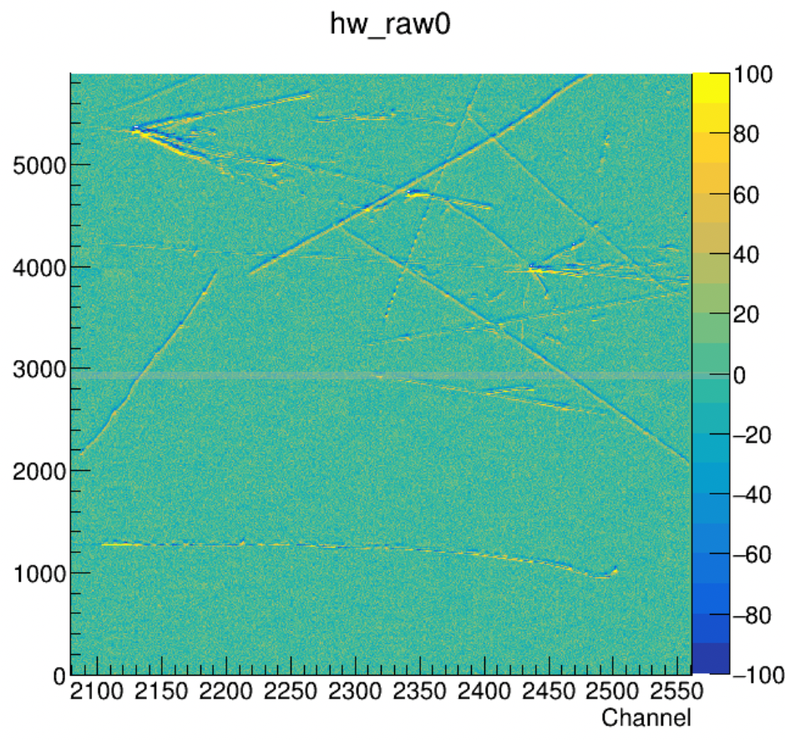
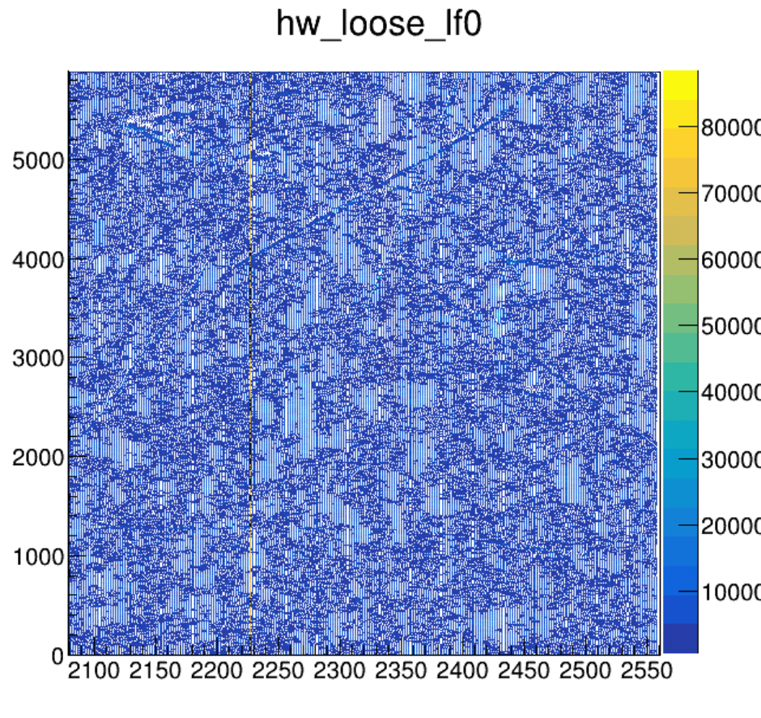
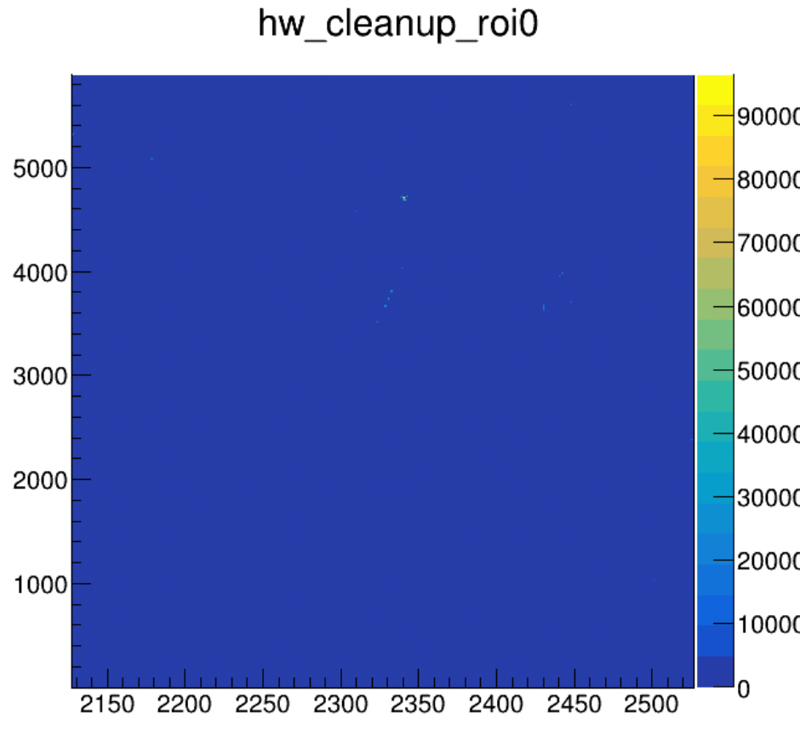
Signal processing frames
original sigproc with wrong field response
Noisy deconvolution?
Field response issue?
Barely see ROIs in the signal processing with the new v1 FR
See tracks in the initial deconvolution (“loose_lf”)
Maybe noisy, is S/N ratio good enough? Check with simulation
Problems in the ROI finding? see next slide

Slide 9
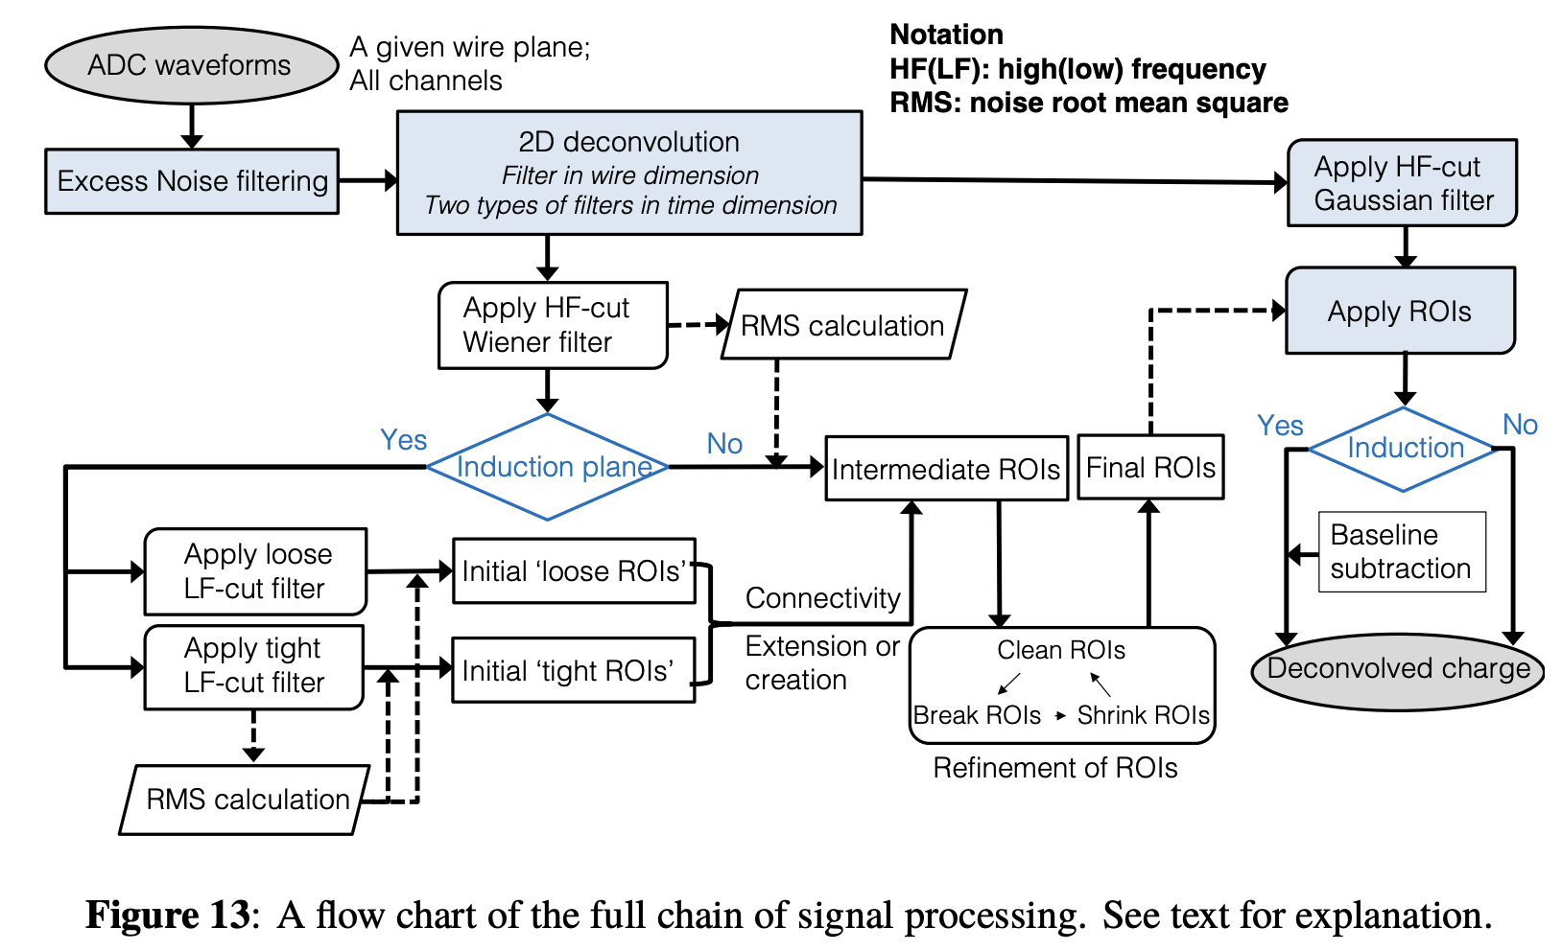
Use the induction-specific workflow for W
X

