Slide 1
Polarized Protons at BNL and some Run 24 results
V. Schoefer
8/21/24
Machine Learning Collaboration Workshop, BNL, Aug 2024

Slide 2
Overview
Facility overview
Digressions about
ML work to date
Challenges for digital twin
Recent operations

Slide 3
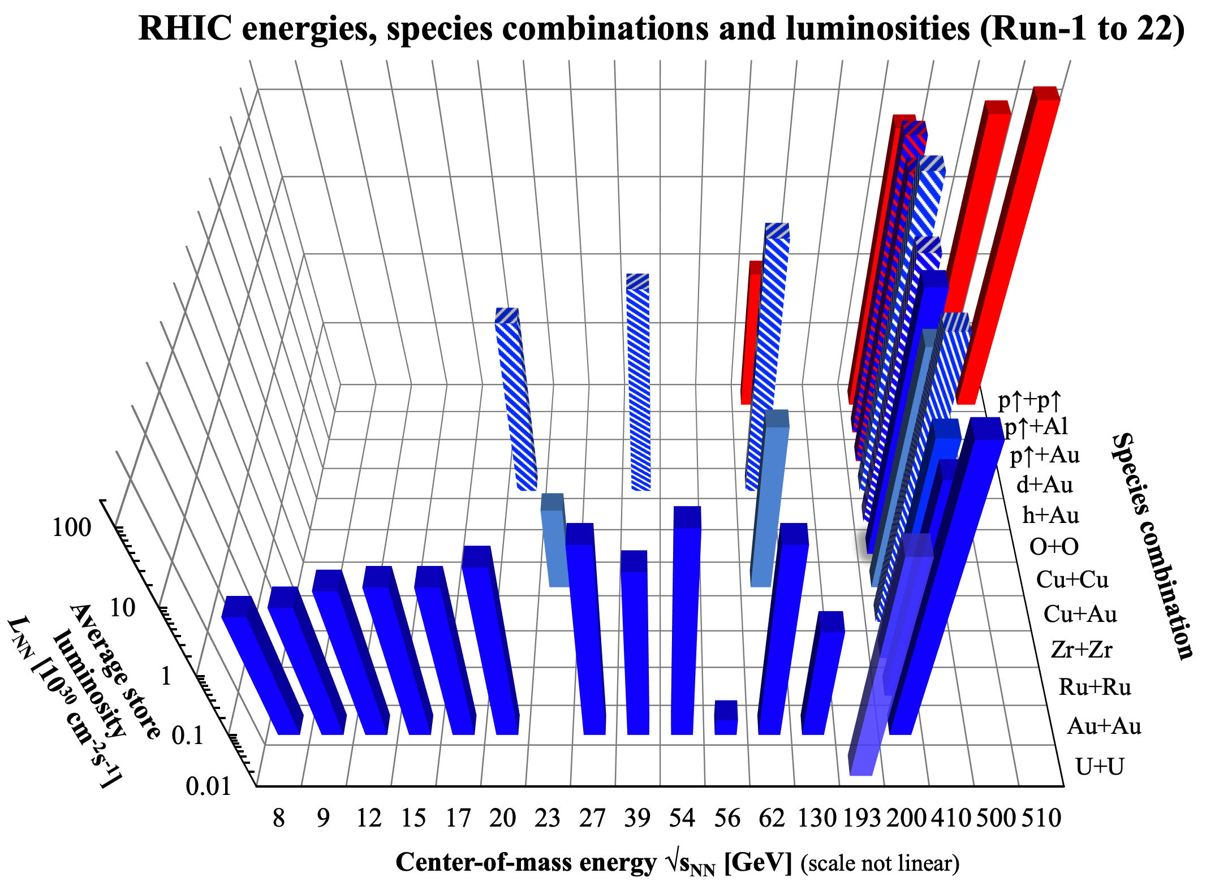
RHIC Physics Program
To date: 12 different species combinations in collision
Polarized p-p and p-ion collider operation
Energy scan of Au-Au collisions from 100 GeV/N (max) down to sub-injection energies as low as 3.85 GeV/N
Polarized beam operation
Beam energy scan at low energies

Slide 4
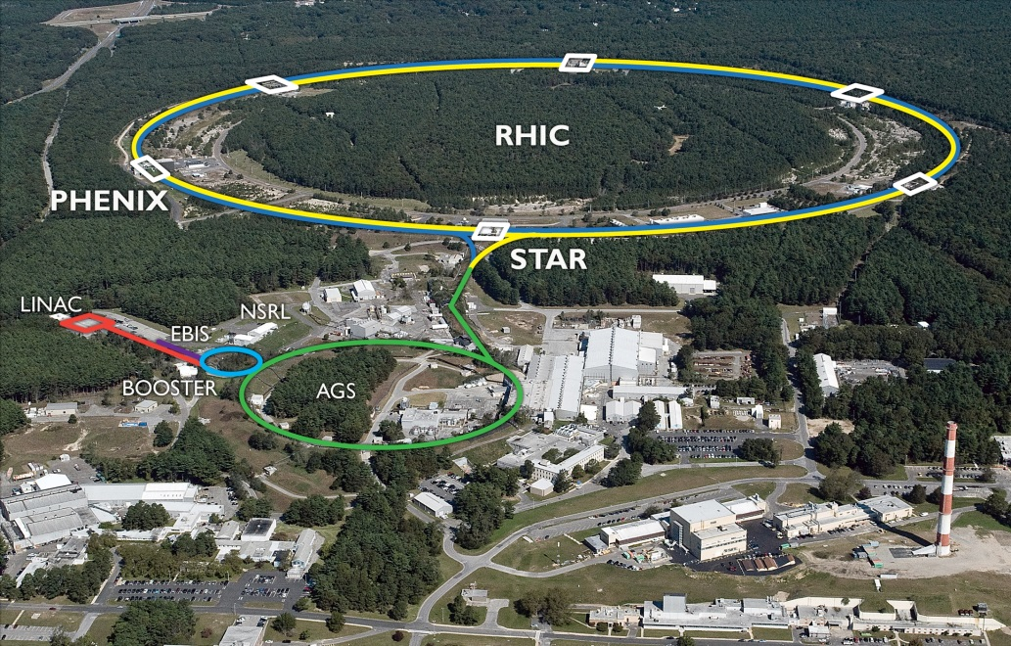
RHIC Accelerator Complex
Accelerator Rings
 | Circumference [m]
Booster | 201
AGS | 807
RHIC | 3833
~1.2 km
Typical Top Energies [Total, GeV/N]
 | Au | Pol. Protons
Linac (H⁻) | -- | 1.1
Booster | 1 | 2.3
AGS | 10 | 23.8
RHIC | 100 | 255
Tandem van de Graaff
Heavy Ions | Protons
E-beam Ion Source (EBIS) | OPPIS (polarized)
Tandem Van de Graaf | High-intensity H⁻ (unpolarized)
4

Slide 5
Collider performance
Luminosity: instantaneous rate of collisions, related to the beam density, depends on
Intensity : number of particles in a bunch
Emittance: a measure of the beam volume
We’re also concerned with:
Polarization: degree to which the (quantum mechanical) spin of all the particle in the beam are aligned along some direction, usual vertical
In general, the beam starts highly polarized, then motion in the accelerator fields scrambles them (depolarizing resonance). You can either
Manipulate the fields to avoid or cancel resonance
Make the beam size (emittance) small, which weakens the resonance effects

Slide 6
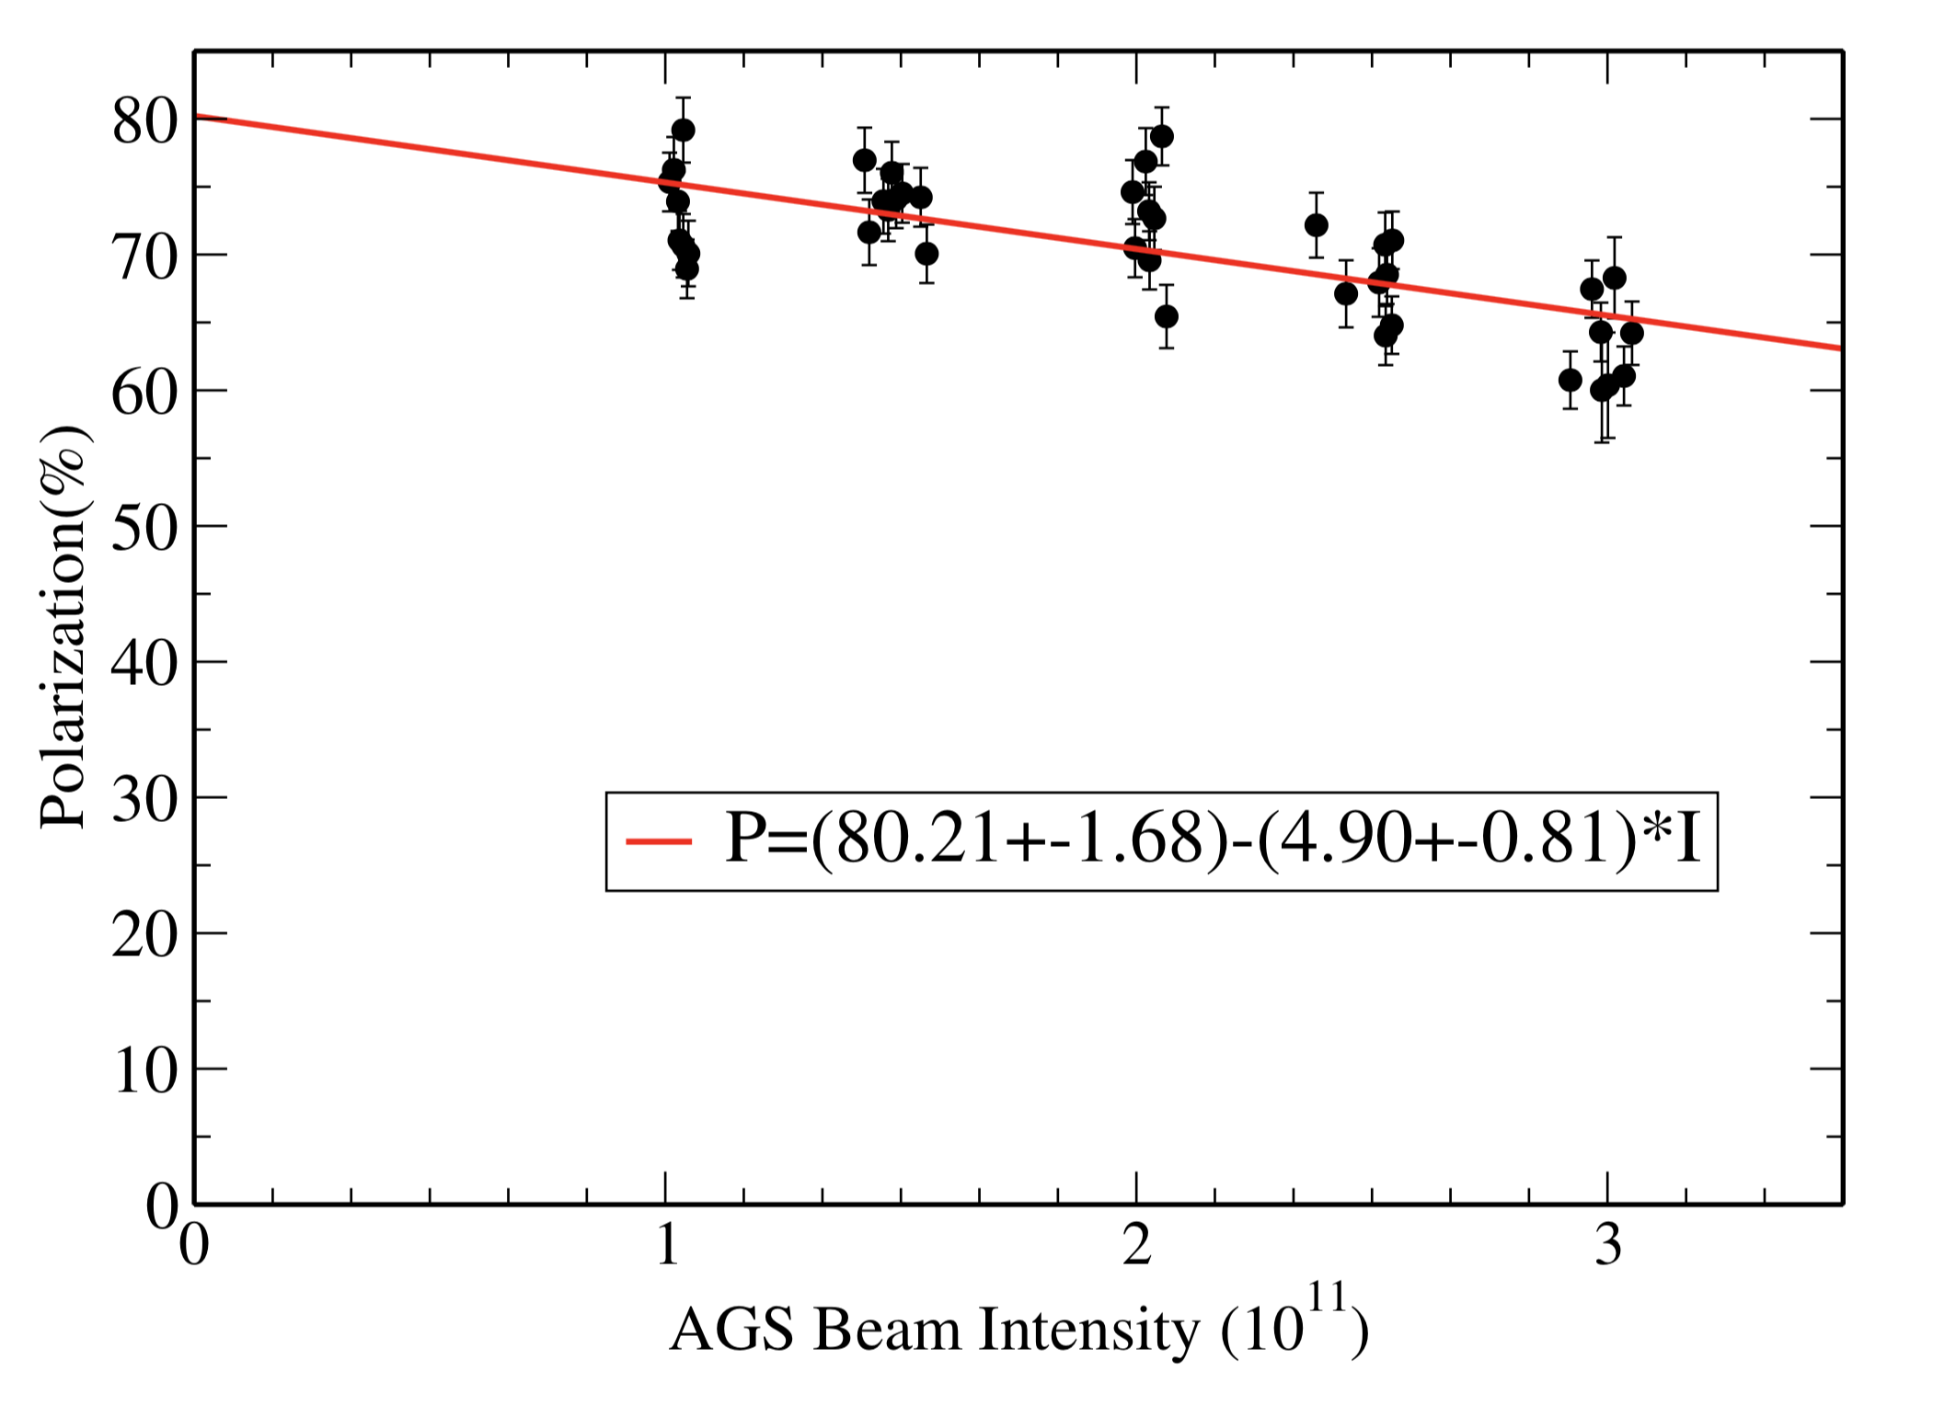
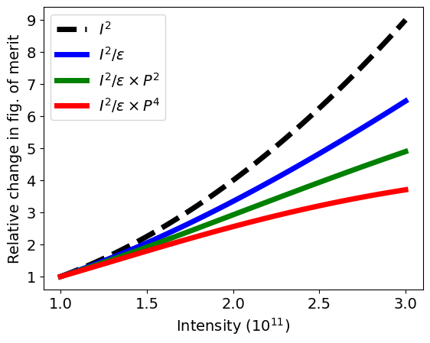
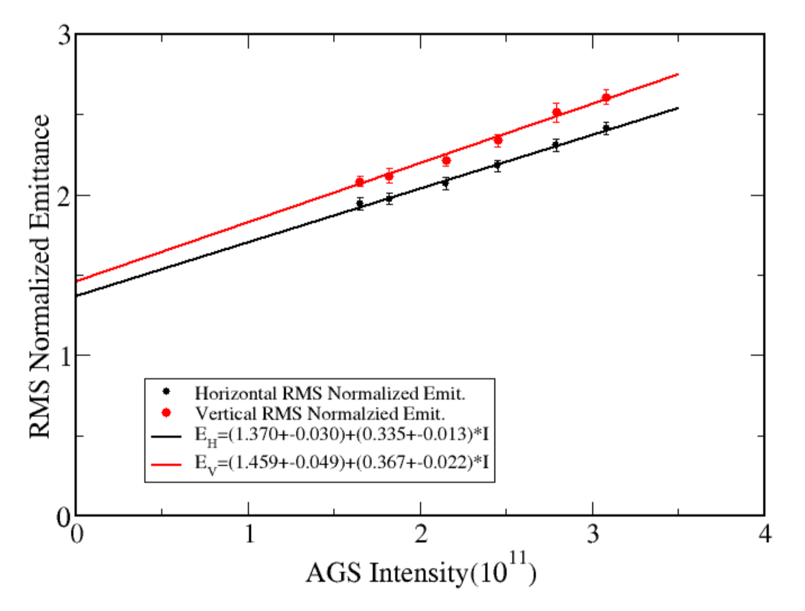
Polarized collider performance
AGS extraction
Collider luminosity, $ℒ$
Pol vs Intensity
$$ℒ∝\frac{N^{2}}{ε}$$
N = intensity/ bunch
$ε$ = tran. emittance
Polarized beam collider FOM
Polarized collider figure of merit (for polarization P):
$$ℒ P^{2}$$
$$ℒ P^{4}$$
transverse spin
FOM =
longitudinal spin
Emittance vs Intensity
Since both emittance and polarization degrade with intensity figure of merit decreases rapidly
FOM dependence on intensity closer to linear in N than quadratic.
Impact of intensity increase on FOM given emittance and polarization dependence at AGS extraction

Slide 7
RHIC Polarized Beam Complex
 | Max Energy [GeV] | Pol. At Max Energy [%] | Polarimeter
Source+Linac | 1.1 | 82-84
Booster | 2.5 | ~80-84
AGS | 23.8 | 67-70 | p-Carbon
RHIC | 255 | 55-60 | Jet, full store avg*
2 Siberian Snakes/ring
Spin flipper
Absolute Polarimeter (H jet)
RHIC pC Polarimeters
PHENIX
* Includes both ramp loss and store decay
STAR
Spin Rotators
(longitudinal polarization)
Spin Rotators
(longitudinal polarization)
LINAC
BOOSTER
Pol. H⁻ Source
Helical Partial
Siberian Snake
 | Relative Ramp Polarization Loss (Run 17, full run avg)
AGS | 17 %
RHIC | 8 %
200 MeV Polarimeter
AGS
AGS Polarimeter
Strong AGS Snake

Slide 8
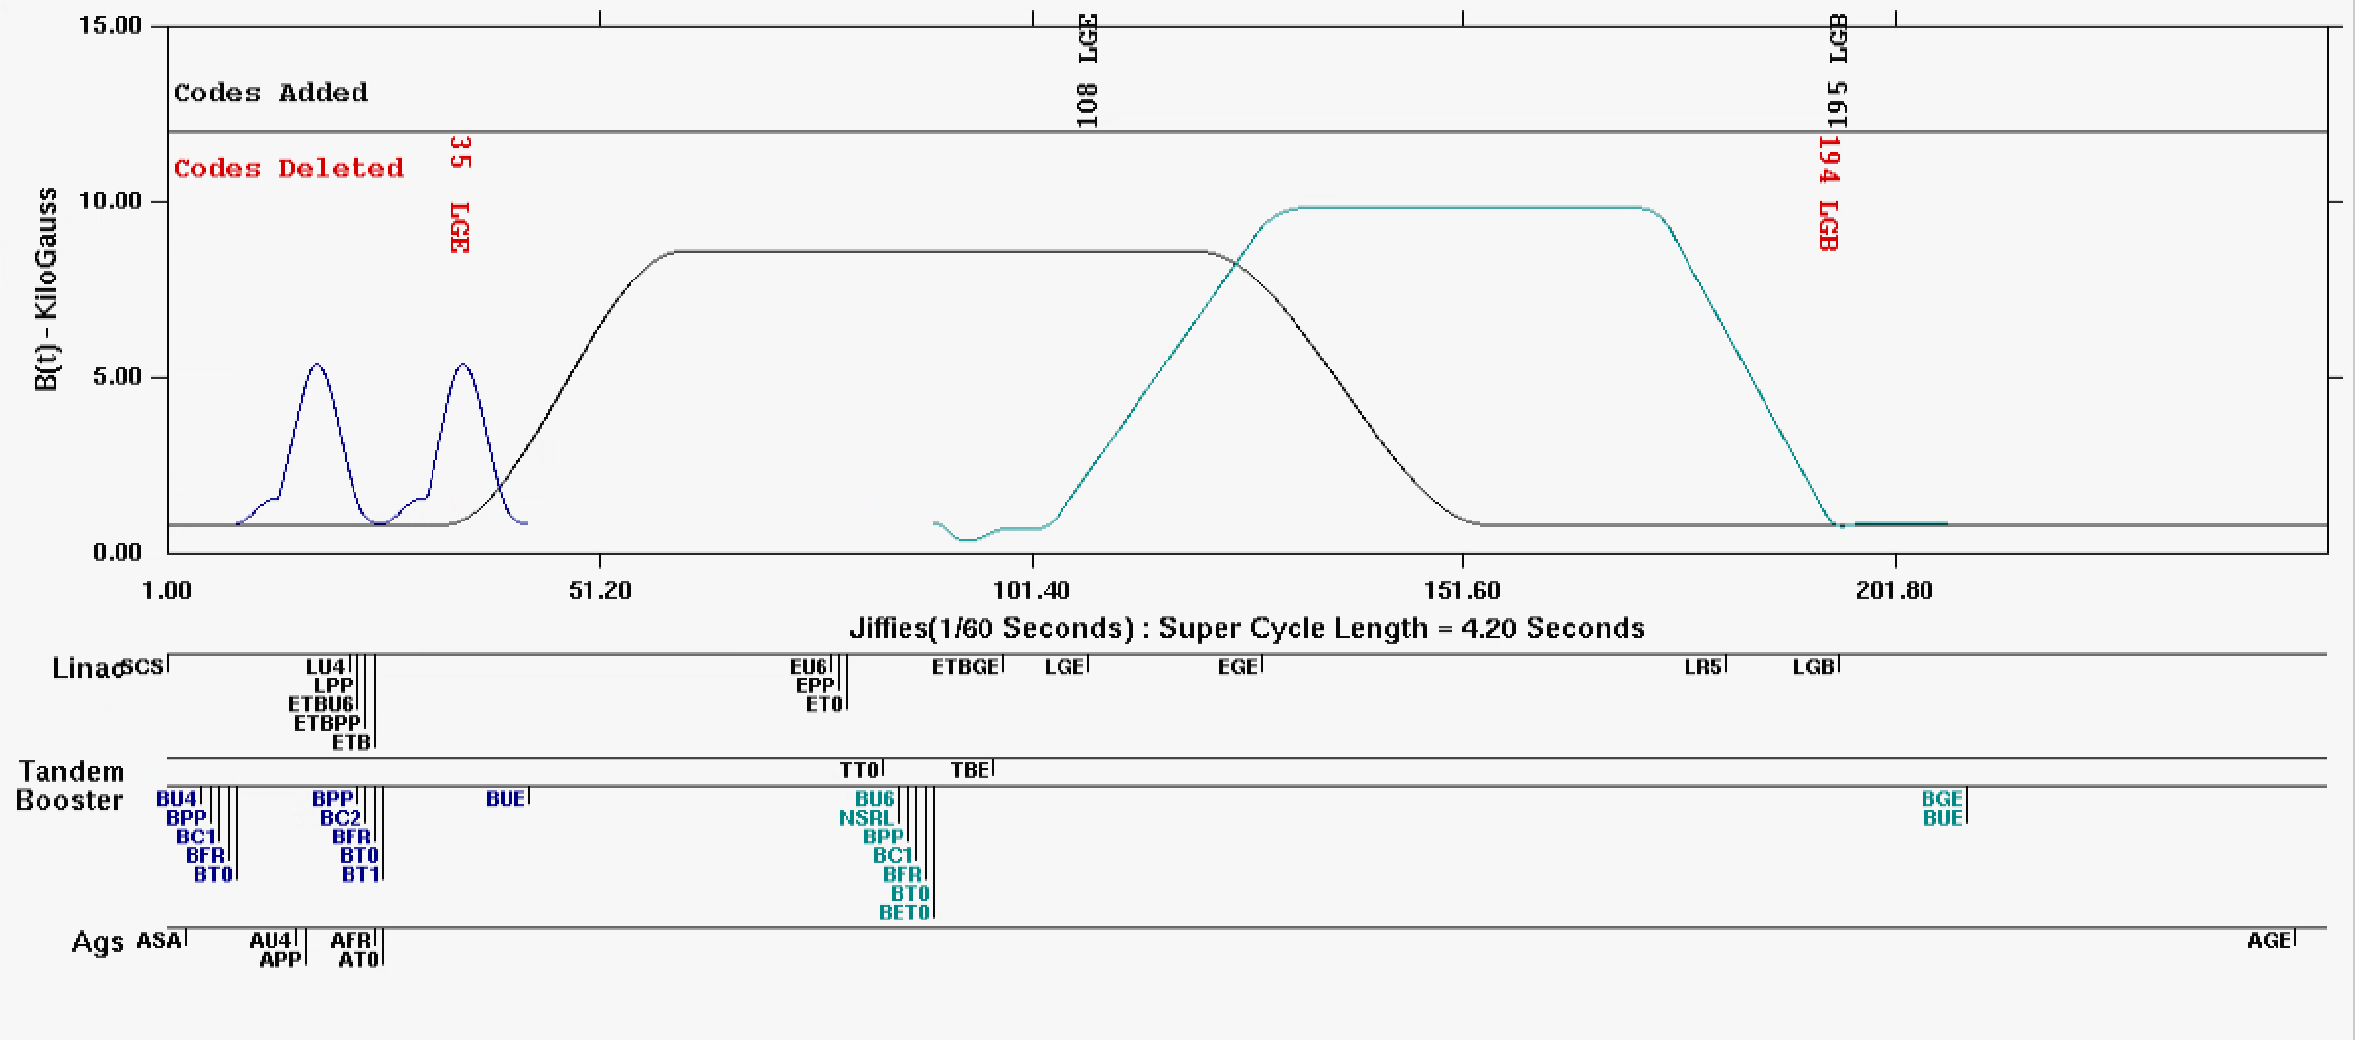
RHIC Injector Cycle: The supercycle
The “supercycle” is the collection of all the injectors cycles (sources, Booster, AGS)
Typically 4-6 seconds long
Single pulse of Linac protons becomes a single bunch at AGS extraction
Each RHIC ring (blue and yellow) takes 111 bunches for a fill
Fill setup take 1-2 hours
A RHIC proton store lasts ~8-9 hours
RHIC per bunch intensity 2.5-3x10¹¹
Booster main magnet cycles
AGS main magnet
Booster NSRL cycle
hysteresis

Slide 9
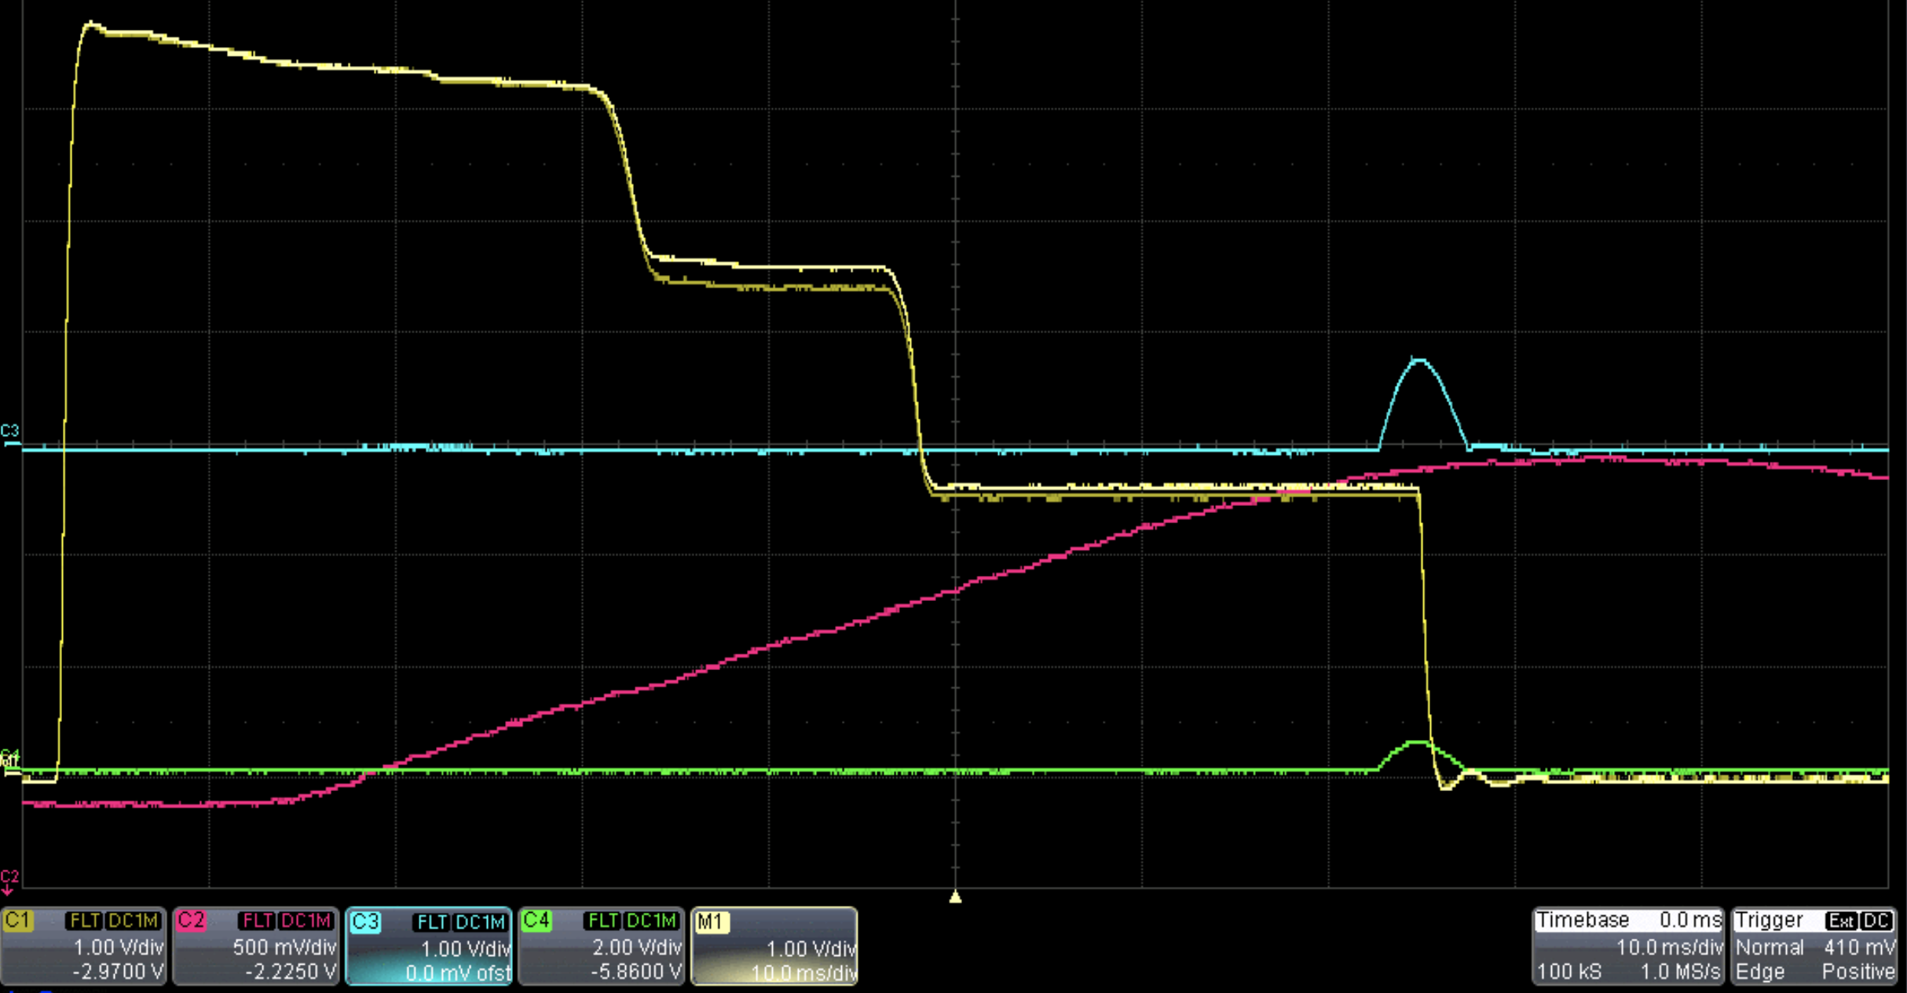
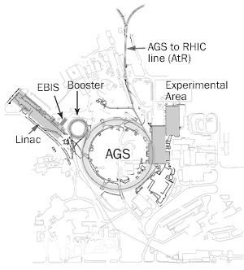
Booster injection
Booster cycle
Booster injection/early acceleration process sets maximum beam brightness for rest of acceperation though RHIC
Linac pulse of 300 us, H⁻ beam ~6-9x10¹¹ protons
Multi-turn, f_{rev} ~ 1 us
Strip injected through a carbon foil
Beam steered off foil after pulse finished
Coasting beam adiabatically captured by RF and accelerated
Intentional horizontal and vertical scraping reduce emittance (and intensity) to RHIC requirements ~2.5x10¹¹ protons
Intensity
Hor scrape
Ver scrape
injection
Capture
Extraction
Main Magnet

Slide 10
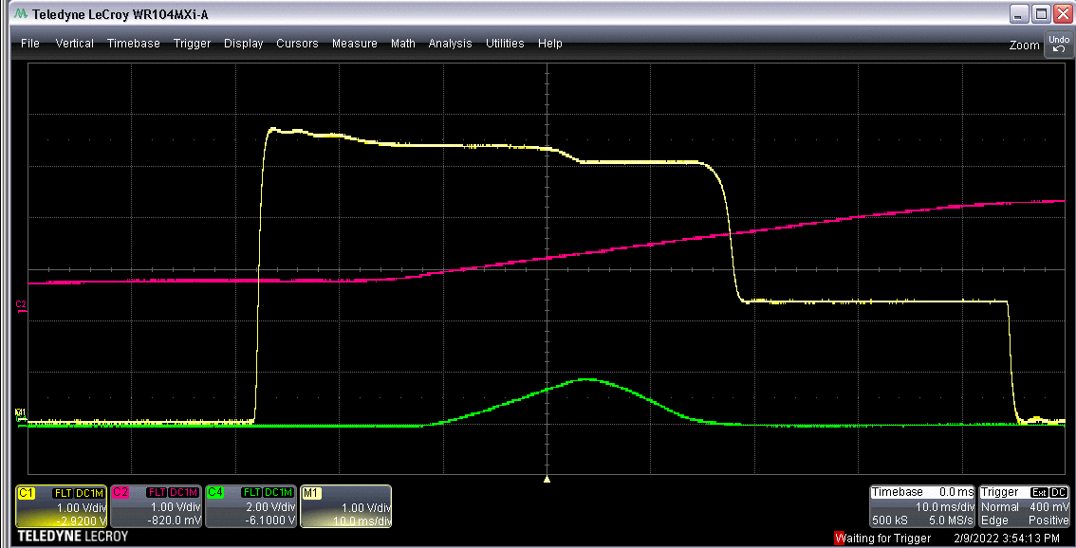
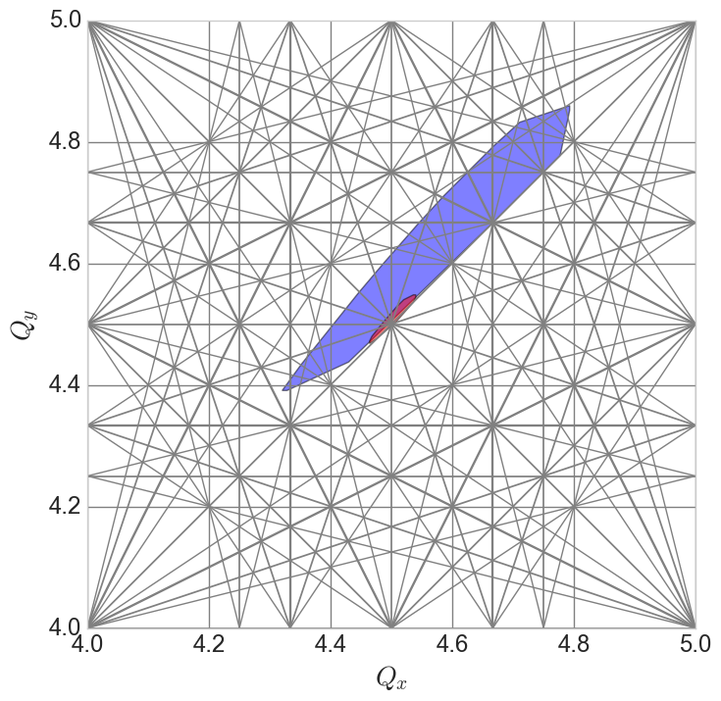
Booster injection
Intensity
Main mag
Booster injection/early acceleration process sets maximum beam brightness for rest of acceleration though RHIC
Many ”knobs”
Linac to Booster trajectory/optics matching
Optimization of time on foil (Linac pulse length vs height)
Linac RF phases affect capture and acceleration efficiencies
Booster RF capture rate affects longitudinal emittance (and transverse, via space charge)
Booster orbit and optics affect foil scattering, matching and intensity transmission.
Betatron ‘stop band’ correctors for intensity, emittance preservation.
Difficult instrumentation
WCM, BPMs don’t work until after capture
No transverse profile monitor in Booster
Scraping efficiency as proxy
Measurable in the extraction line via multiwire
Difficult model
Linac to Booster longitudinal effects
Space charge
Stripping foil
See Lucy’s talk for progress on this front.
Injection
V scrape
Extraction
Capture
H scrape
Space charge tune spreads
Capture/Early acc
Injection

Slide 11
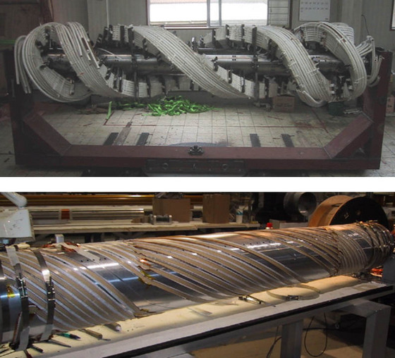
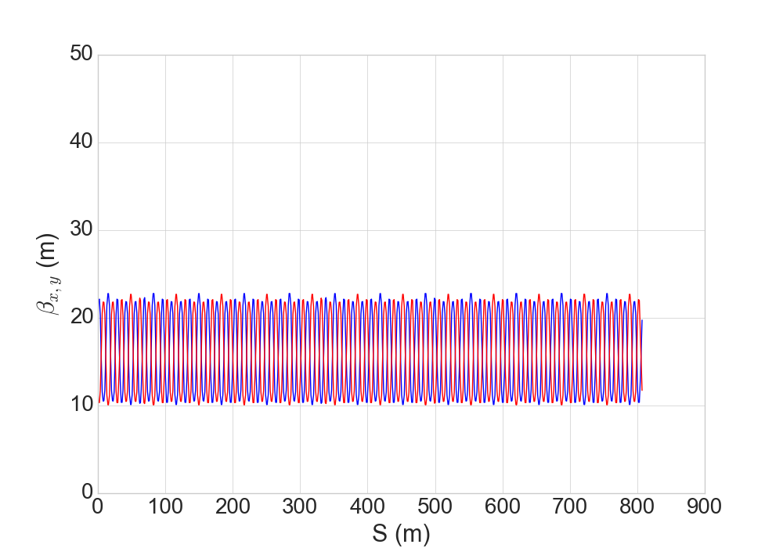
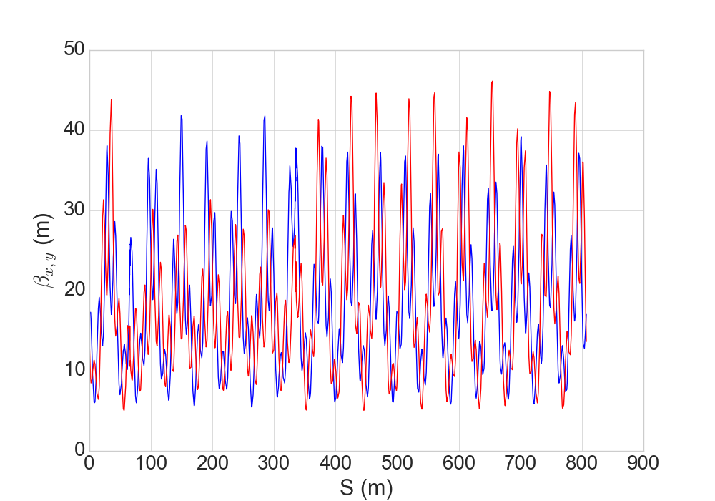
AGS, Polarization and Snakes
AGS Warm snake
Proton energy range 2.5 GeV -> 23 GeV
Polarization preserved using
helical dipole snakes
+ horizontal tune jump
Resonance correction in development (would replace tune jump)
AGS Cold snake
Requires “near integer” tune
Orbit, optics unusually sensitive to errors
Helical dipoles are complicated magnets
Large optical effects at low energy
Many related magnetic elements for compensation orbit/optics
The complex fields and lattice + high tune requirements are a challenge to modeling (Eiad’s talk)
AGS Optics (low energy)
No snakes
Snakes +compensation

Slide 12
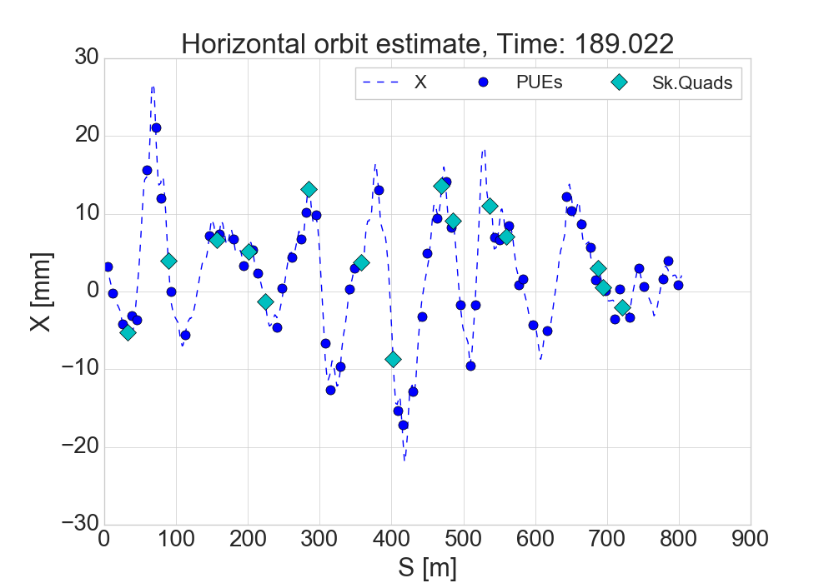
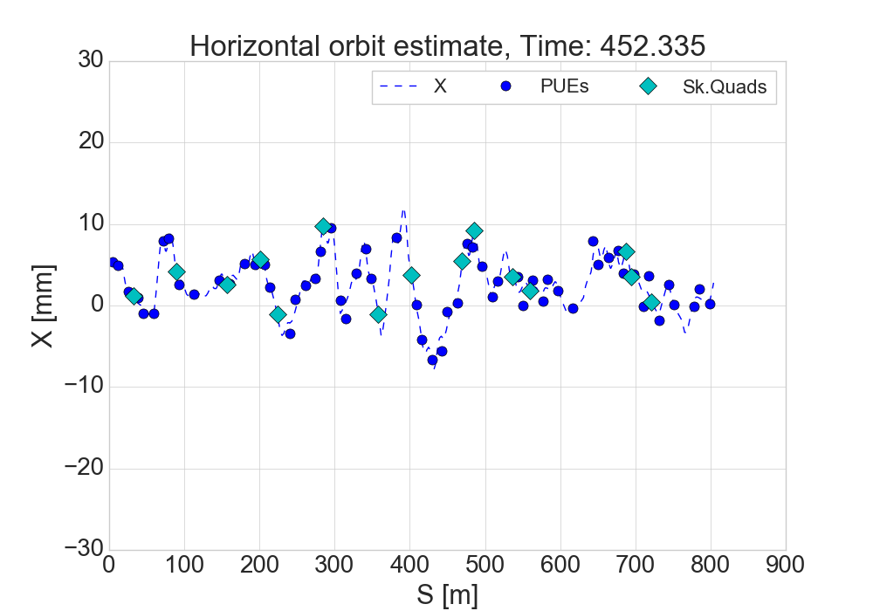
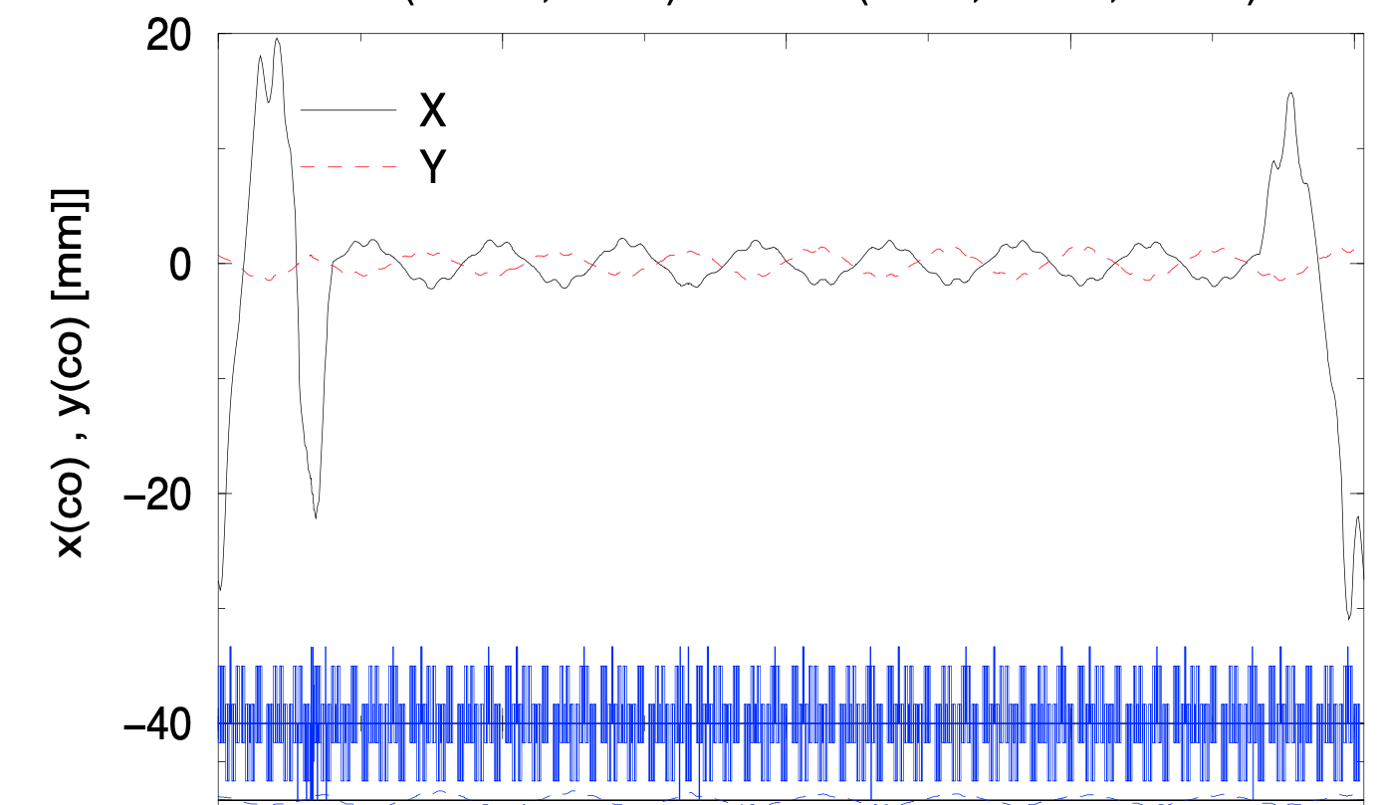
AGS Orbit
Measured orbits
Challenge underlying all experimental efforts, optics assessments, machine learning efforts
Large, difficult to address horizontal orbit
Makes even modeling difficult
Necessary excursions for:
Snake trajectory
Injection/extraction
Remainder driven by misalignments
Control is currently distributed to different devices, controlled separately
No definition of target orbit
No automated corrections (one minor exception)
Coordinated orbit control that includes snakes, backleg windings, orbit steerers and a target seems like a pre-requisite for digitial twin (and for reliable normal operation, actually…)
First resonance (lowest rigidity)
Representative of post-transition orbits
Original design orbit for injection with snakes
from Tsoupas, “Acceleration of polarized protons in AGS”

Slide 13
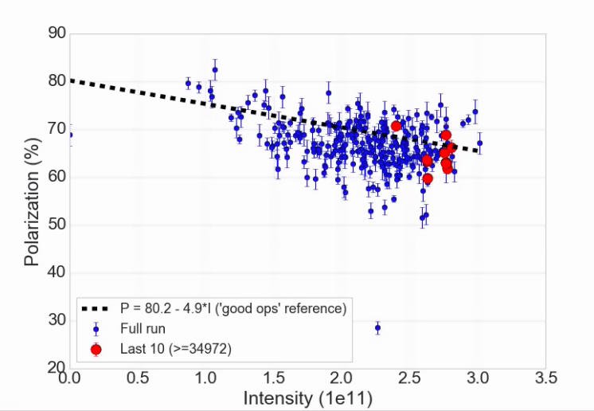
AGS Performance
AGS Polarization vs intensity for RHIC fills (Run 24)
Highest AGS performance is difficult to achieve and maintain
Value in just holding a known optimum
A combination of maintaining emittances and direct polarization interventions
Known good performance line
(Not a fit)
Good performance achievable, but hard to keep

Slide 14
ML efforts in the injectors
Injection and transfer (Lucy Lin’s talk)
Booster injection with Bayesian optimization
Natural extension of Booster injection work to AGS injection
Merge optimization (Yuan Gao’s talk)
Accelerating low intensity bunches and merging later avoids intensity dependent problems
High energy merging is a delicate process, ML finding/maintaining an optimum is useful
Energy measurement (NO talk)
Polarization interventions usually rely on precise measurement of energy as a function of time in ramp
Multiple methods cross-calibrated
Inverse problem / data assimilation to determine unknown parameters
Skew quad spin resonance correction optimization (NO talk)
New system being commissioned
Many variables, weak signal, expensive measurement (5-10 min)

Slide 15
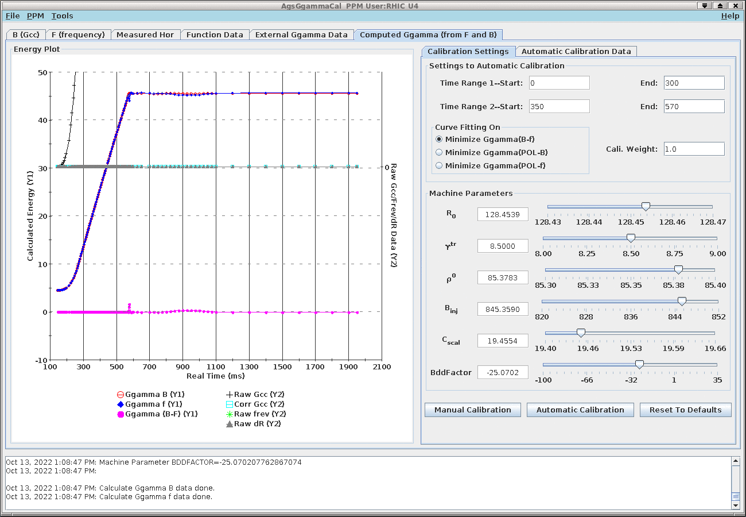
Measuring Energy (Ɣ)
Calibration of the Ggamma meter consists of measuring Gg(B) and Gg(f) at the same times in the cycle and fitting parameters until they agree to sufficient precision
Dedicated calibration ~2 weeks
Essentially an inverse problem with data assimilation, good candidate for uncertainty quantification (how well can we determine these parameters, which is responsible for most variation?
From RF frequency
From field
In RED:
Measured quantities
f = RF frequency
dR = radial shift from ’zero’
B_{clock} = Field reported by Gauss clock
AgsGgammaCal application
In BLUE:
Machine parameters (not known to sufficient precision)
Ɣ_{tr} = transition gamma
R0 = true central radius of AGS
ρ₀ = avg bend radius of AGS main magnet
C_{scal} = Gauss clock calibration (gauss/tick)
B_{inj} = Dipole field at injection
Bdfactor = [NOT IN FORMULA] Gauss measurement sensitive to dB/dt (B-dot), not well understood

Slide 16
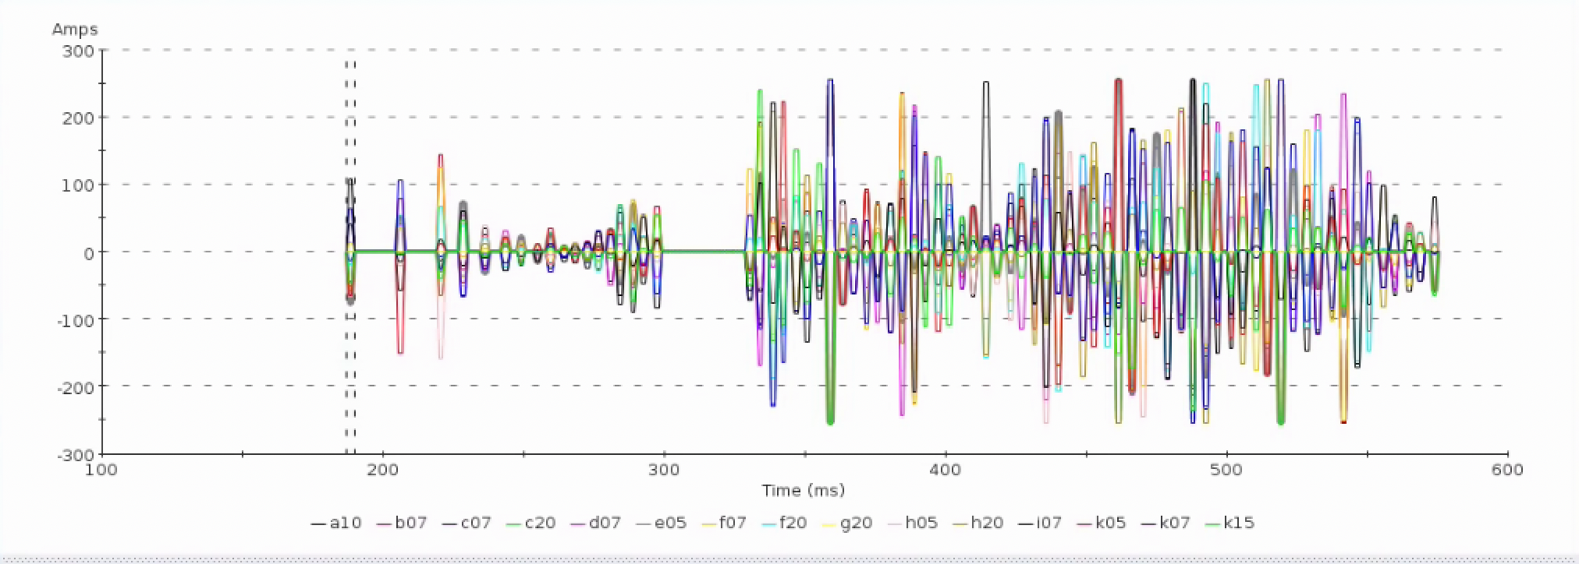
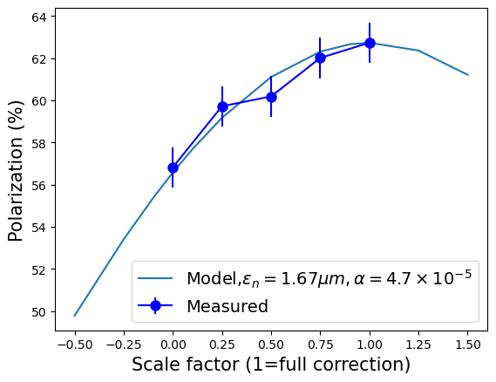
AGS Spin Resonance Correction Skew Quadrupoles
A set of 15 pulsed skew quadrupoles, each with an individual power supply
Designed to excite coupling resonance to compensate the 82 depolarizing resonances associated with horizontal betatron motion in the AGS partial snakes
15 knobs, 82 different resonances
Expected effect is 10-15% gain in polarization
A +/-2% measurement takes 5-10 minutes
Run 24: Observation of polarization gain factor (+10%) during acceleration (similar to existing tune jump), with ~half the pulses enabled)
Further improvements (enabling more pulses, +5-10% gain):
Addressing model inaccuracies at low energy
Iteration on orbit centering
Possible optimizations based on ML methods
No solid plan for how to approach this
Skew quad current pulses
Skew quad current pulses
Correction amplitude scan
Partial correction
Zero correction

Slide 17
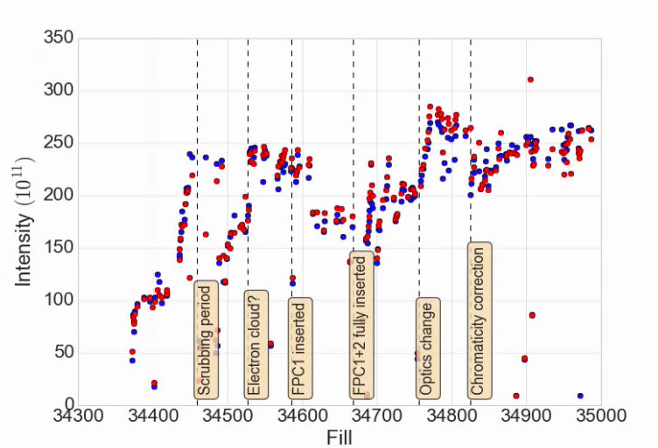
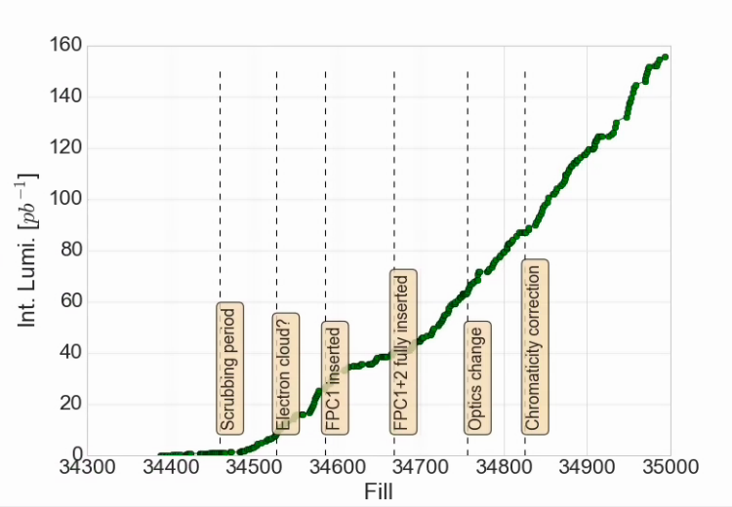
RHIC Run 24
RHC Injected Intensity
Planned
14 weeks of p^ physics, 100 GeV
6 weeks of Au, 100 GeV
Currently finishing week 13
Extended +3 weeks of p^
3 weeks of Au
Nominal switchover date is 9/16
Operations
Commissioning of brand new sPHENIX detector
Superconducting solenoid
New time projection chamber
Collision crossing angle
Luminosity ramp-up delays (and restarts)
Emittance blowup from 56 MHz SC cavity
Transfer function/optical error
STAR Integrated Lumi

Slide 18
Prospects for remainder of Run 24
Six remaining weeks
3 wks colliding polarized protons
3 wks setting up and colliding Au
Protons still available in the injectors
What do we want to do?
Booster/AGS injection
Dedicated model validations?
Tests of optimization with different (optimized?) knobs?
How to determine optimal set of knobs?
Skew quads
Demonstrate an optimized configuration. Maybe in time to extract to RHIC
Measure 1-2 more single resonance flattop responses
Bunch merging?
AGS/snake model validations
Vertical dispersion predictions/measurements
Other?

