Slide 1
Experimental examples of Bayesian Optimization at BNL
Lucy Lin
Machine Learning Collaboration Meeting
August 21-22, 2024

Slide 2
Bayesian Optimization
A powerful tool for finding the extrema of objective functions that are expensive to evaluate
Bayes’ theorem: probability of event based on previous knowledge of conditions
Tune hyperparameters of $f$ to maximize likelihood of getting data $D_{1:t}$

Slide 3
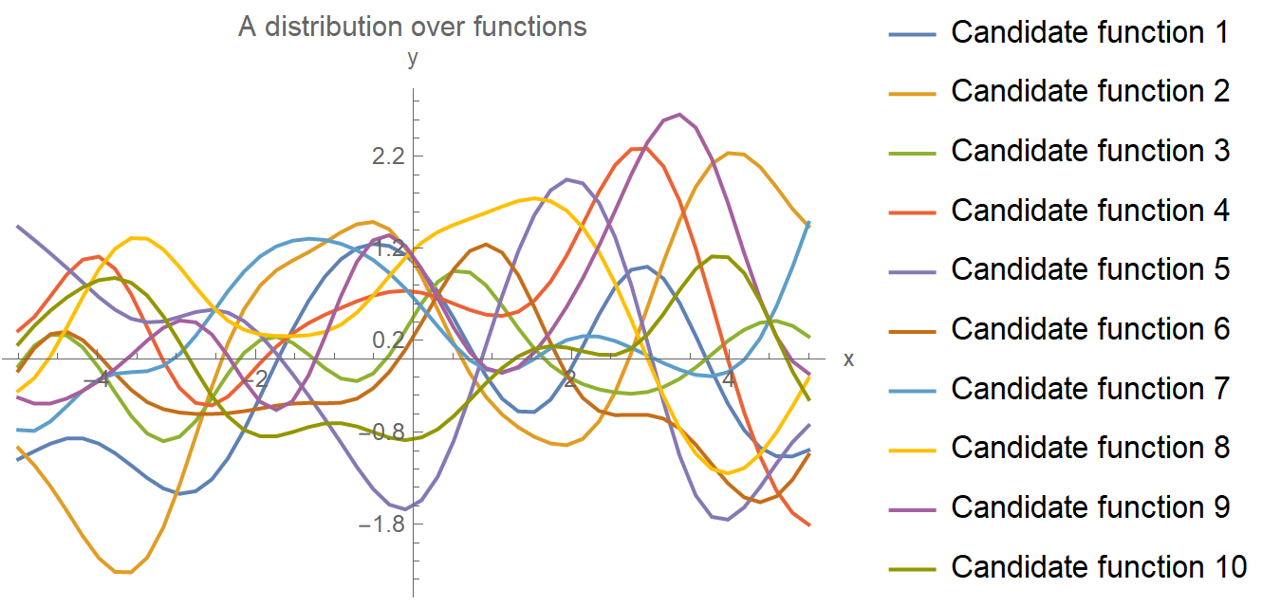
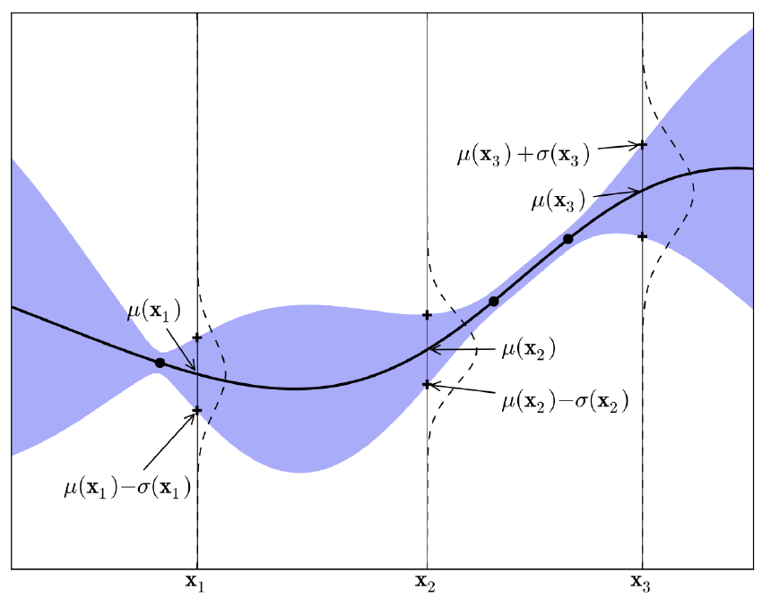
Gaussian Process
A probability distribution over possible functions that fit a set of points
GP model consists of mean function $m$ + covariance function $k$
The probability distribution of the model output is given by a normal distribution
$$f\left(\vec{x}\right) \sim 𝒢𝒫\left(m\left(\vec{x}\right),k\left(\vec{x},\vec{x}\right)\right)$$
$$P\left(y | f\left(\vec{x}\right)\right)=𝒩(μ\left(\vec{x}\right),σ^{2}\left(\vec{x}\right))$$

Slide 4
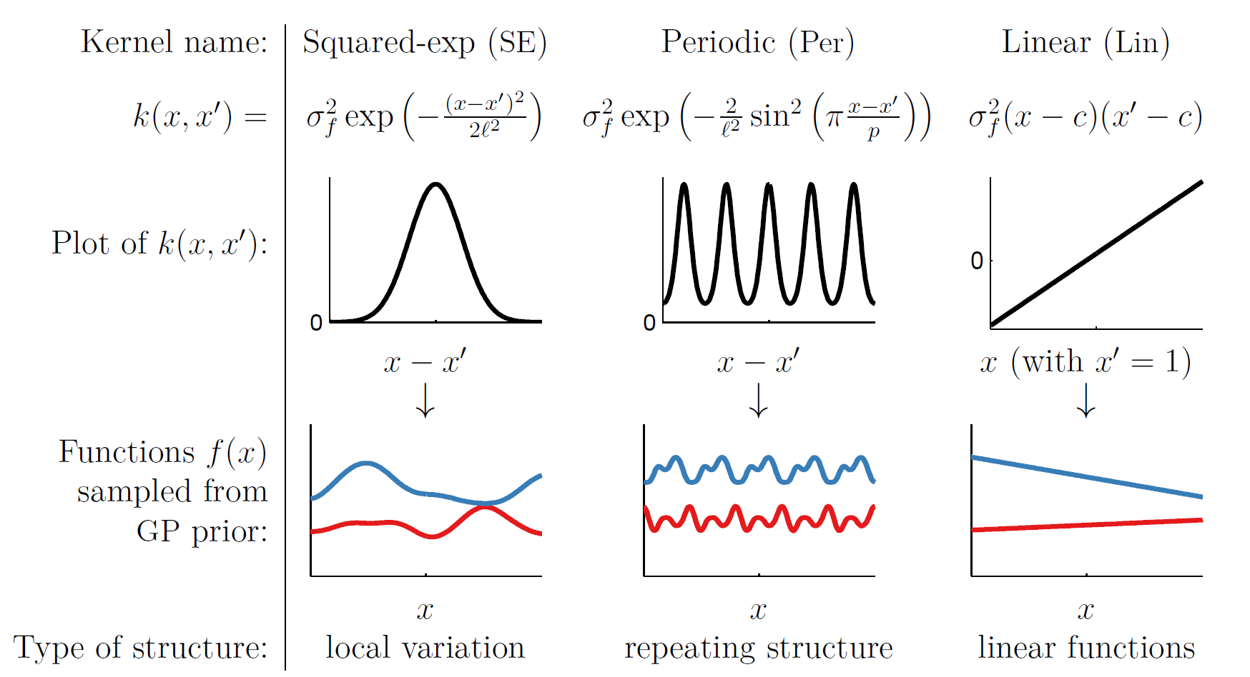
Kernel Function
Kernel: covariance function $k(x_{i},x_{j})$ describes how the objective varies (e.g. smoothness) in terms of the changes in the input space
Kernel function is chosen based on prior knowledge of the objective function
$$k\left(x_{i}, x_{j} \right)=𝔼\left[\left(f\left(x_{i}\right)−m(x_{i})\right)\left(f\left(x_{j}\right)−m(x_{j})\right)\right]$$

Slide 5
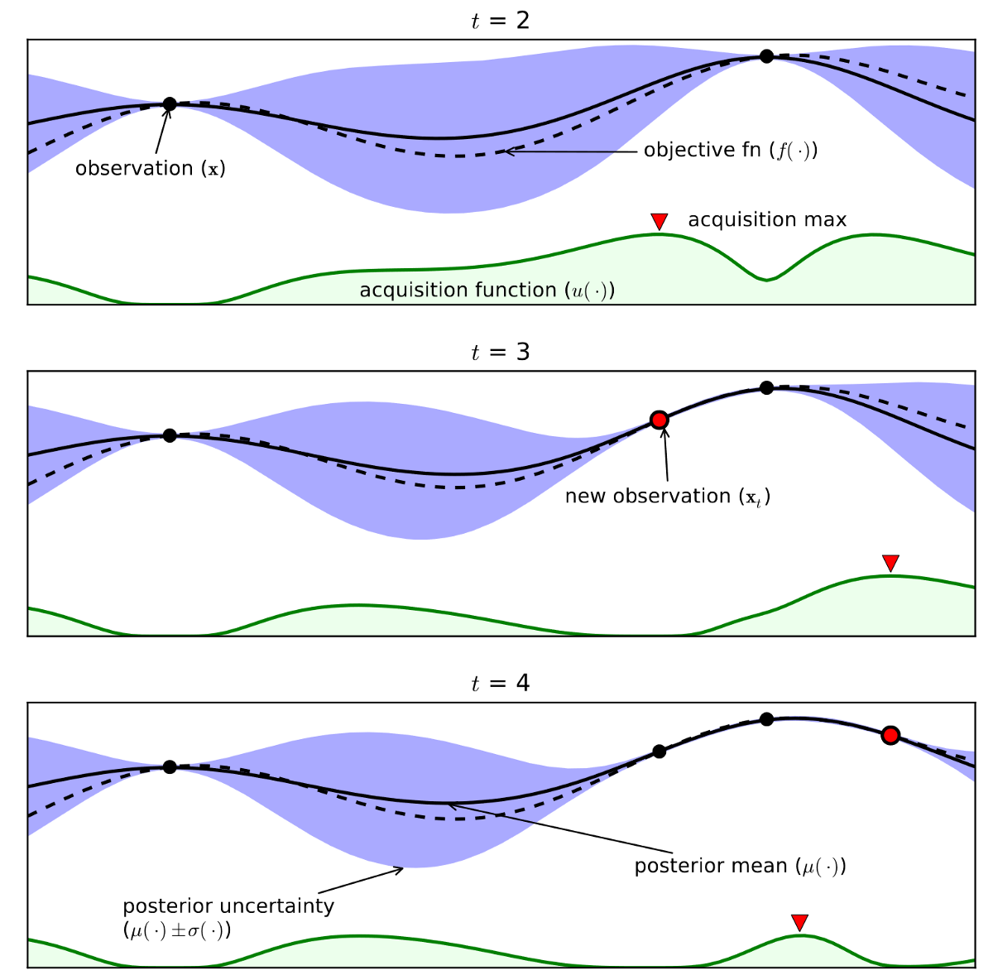
Acquisition Function
Guide how input space should be explored during optimization
Combine predicted mean and variance from Gaussian Process model
Probability Improvement (PI)
Expected Improvement (EI)
Upper Confidence Bound (UCB)
$$UCB\left(x\right)=μ\left(x\right)+κσ(x)$$

Slide 6
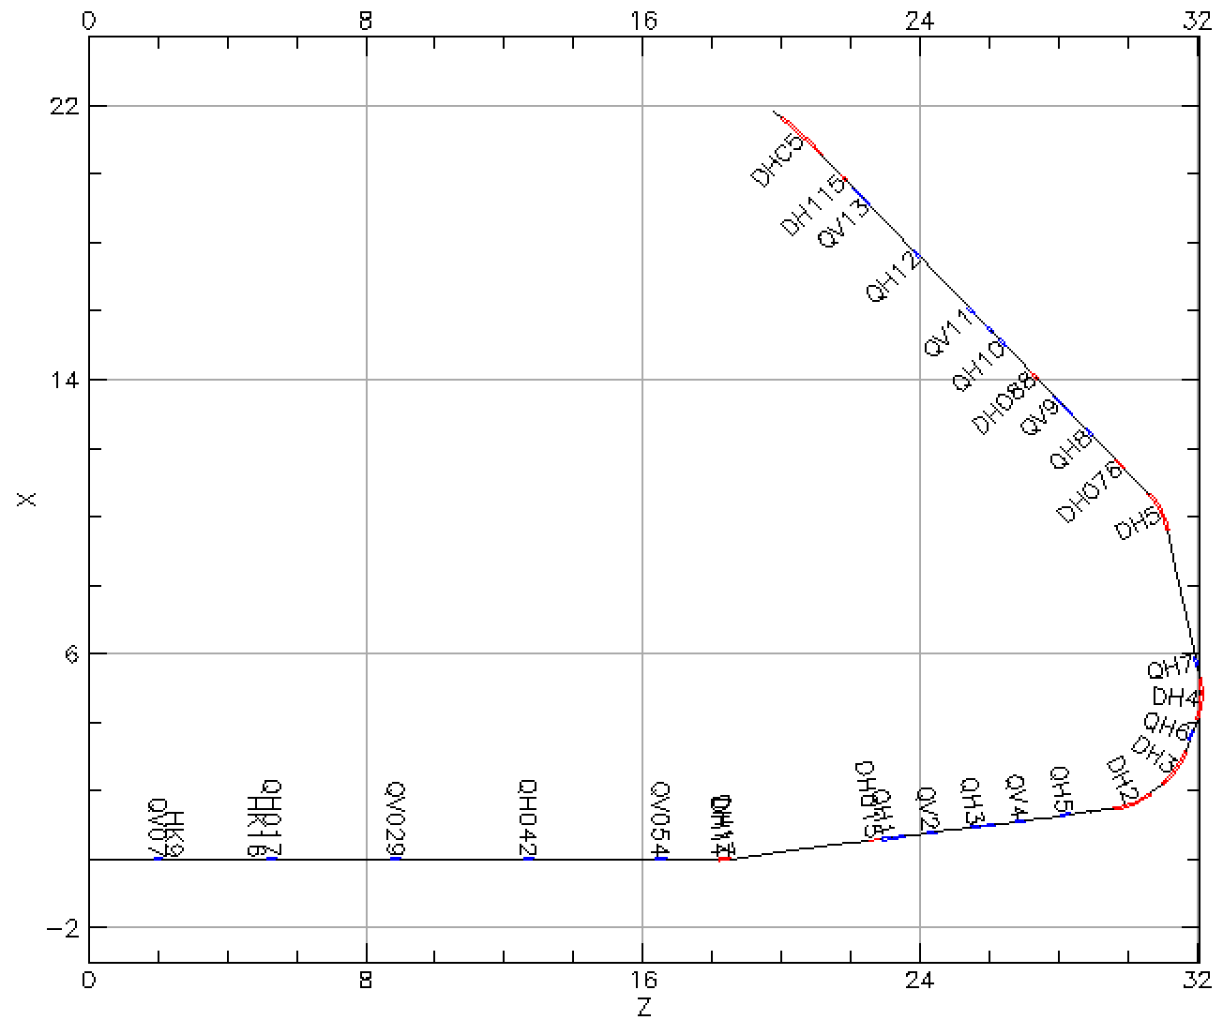
Booter injection
scrape
Booster injection process sets maximum beam brightness for rest of acceleration through RHIC
Known emittance effect on polarization loss
Intentional horizontal and vertical scraping reduce emittance to RHIC requirements
Goal: minimize emittance / maximize beam intensity after scraping
Controls: Linac to Booster (LtB) transfer line optics
Method: Bayesian optimization
To Booster
$126°$
bend
From Linac

Slide 7
ML package for BO: Xopt
Flexible framework for optimization of arbitrary problems using python
Independent of problem type (simulation or experiment)
Independent of optimization algorithm & easy to incorporate custom algorithms
Easy to use text interface
https://github.com/ChristopherMayes/Xopt

Slide 8
Xopt structure
Note: this process can also be done asynchronously

Slide 9
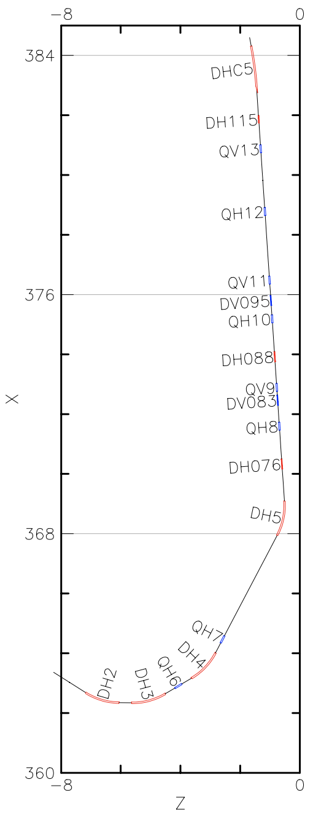
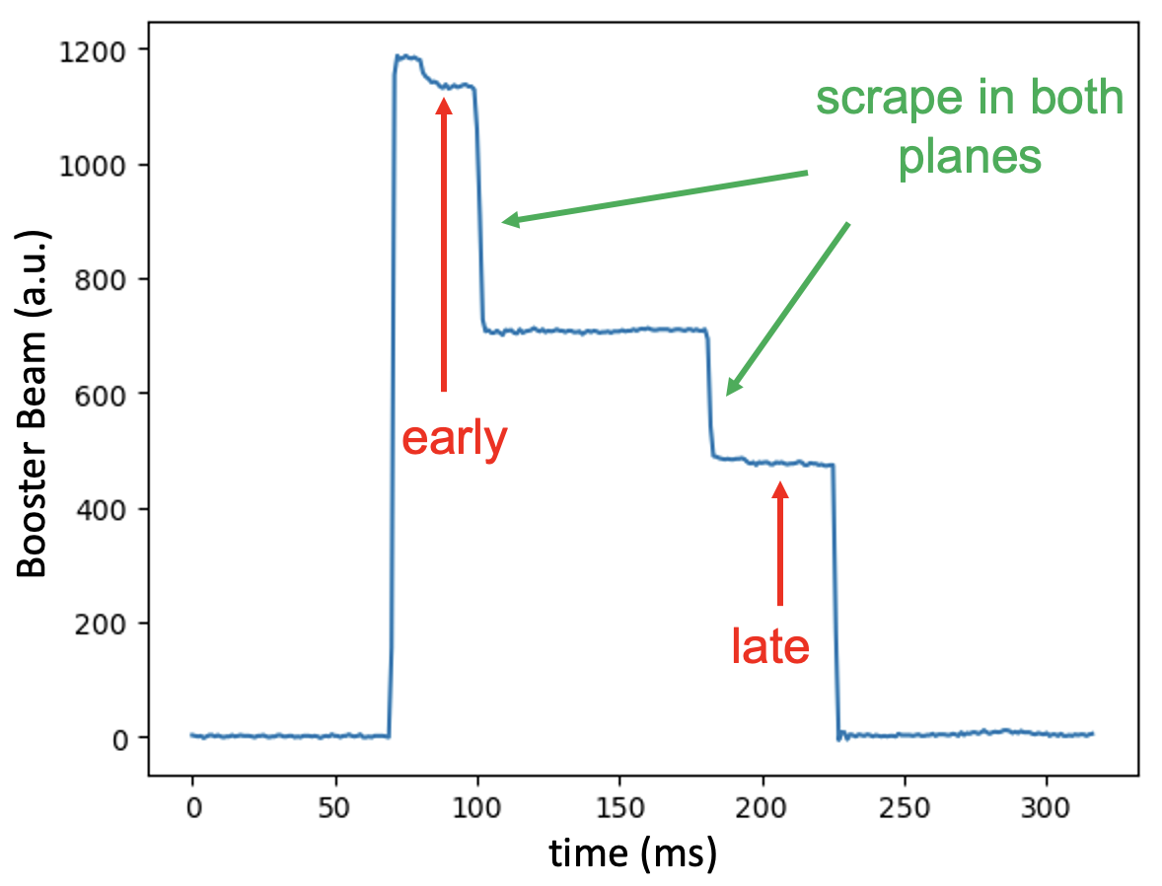
LtB controls and measurement
Booster
13 quadrupoles and 16 correctors between Linac and Booster
Common practice to improve Booster injection efficiency: tune last few correctors at the end of the LtB line
Criteria to check injection efficiency: Booster early and late intensity

Slide 10
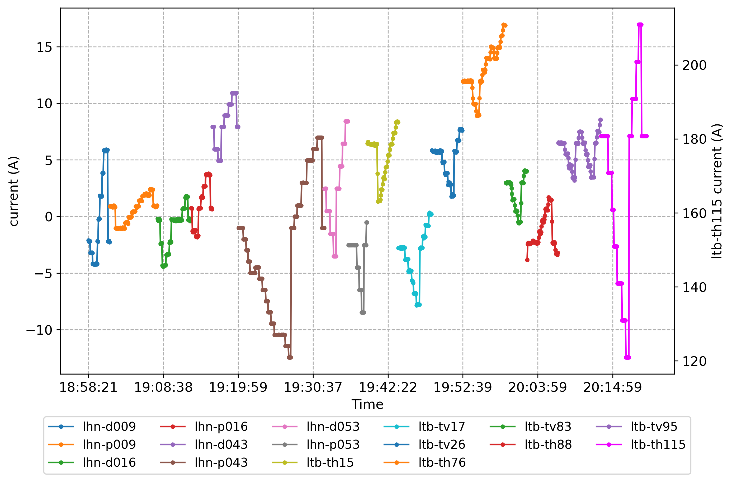
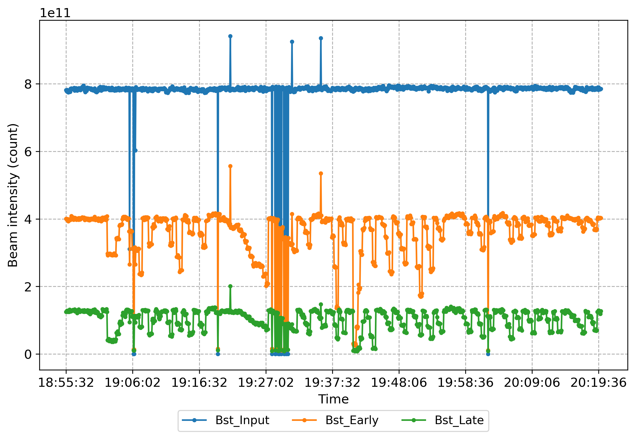
LtB corrector scan
All 16 correctors were scanned on Jan 25, 6:55pm – 8:20pm, on PPM user 4 until Booster late intensity dropped by 50%

Slide 11
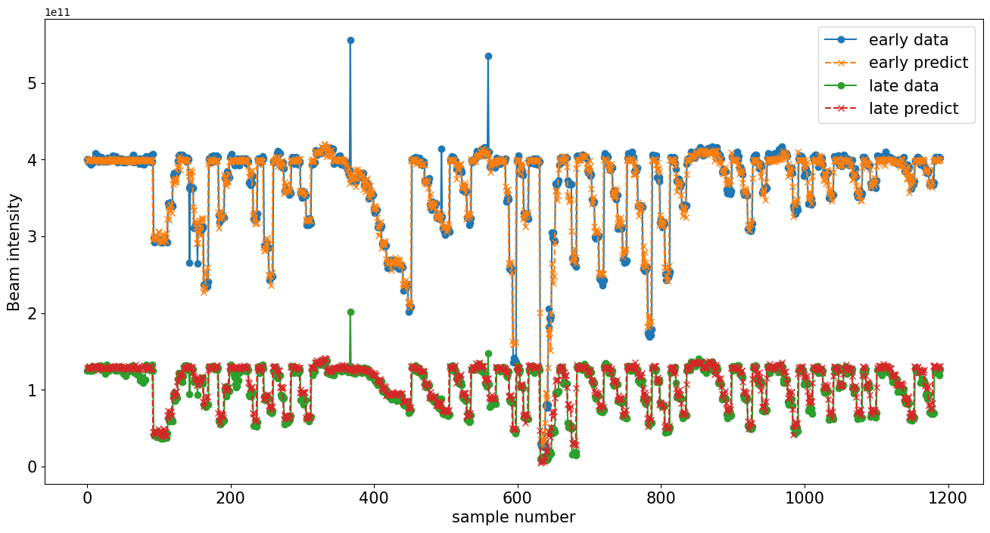
NN model for LtB scan
15 correctors (lhn-d009 is excluded due to insensitivity) $→$ 2 intensities (Bstr_Early, Bstr_Late)
2 hidden layers: ReLU + Tanh
Training data 75% (893 points), testing data 25% (297 points), $R^{2}$ score = 0.85

Slide 12
Test on LtB scan NN model
Controls: Power supply currents of three correctors (two horizontal, one vertical) at the end of the LtB line
Booster late beam intensity (after scraping, before extraction to the AGS)
BO algorithm developed using Xopt, using 242 LtB scan data points as training data
Algorithm converged within 50 samples

Slide 13
Test Xopt on real machine
Controls: Power supply currents of correctors and quadrupoles at the end of the LtB
Goal: maximize Booster late beam intensity (after scraping, before extraction to the AGS)
Objective function: send PS current to selected magnets, wait 5 seconds (each Booster cycle/injection pulse lasts ~ 4 seconds), read and return Booster intensity measurement
BO algorithm developed using Xopt, with added features such as interpolated optimization and trust region BO (tuRBO)
https://christophermayes.github.io/Xopt/examples/single_objective_bayes_opt/turbo_tutorial/

Slide 14
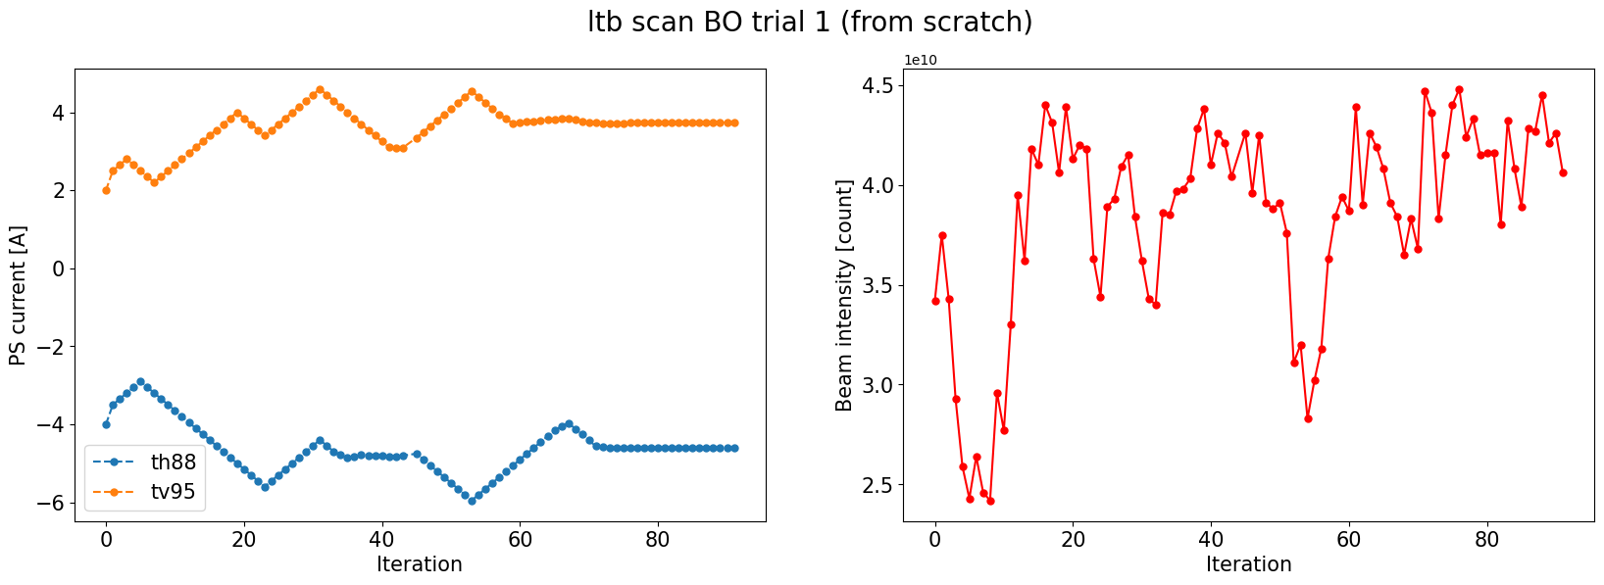
Case 1: 2 correctors
Operator: Petra Adams
Feb 26, PPM user 4, 7pm – 9pm
Controls: Power supply currents of two correctors (one horizontal, one vertical) at the end of the LtB line
Algorithm converged within 100 samples (15-20 minutes)

Slide 15
Case 2: 4 correctors
Operator: Petra Adams
Feb 27, PPM user 4, 7pm – 9pm
Controls: Power supply currents of four correctors (two horizontal, two vertical) at the end of the LtB line
Algorithm converged within 120 samples (20-25 minutes)

Slide 16
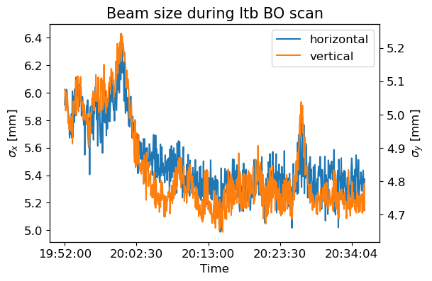
Case 3: 2 correctors + 2 quadrupoles
Operator: Petra Adams
Mar 4, PPM user 3, 7pm – 9pm
Controls: Power supply currents of two correctors and two quadrupoles at the end of the LtB line
Beam size decrease in both planes in the BtA line in correspondence with intensity increase

Slide 17
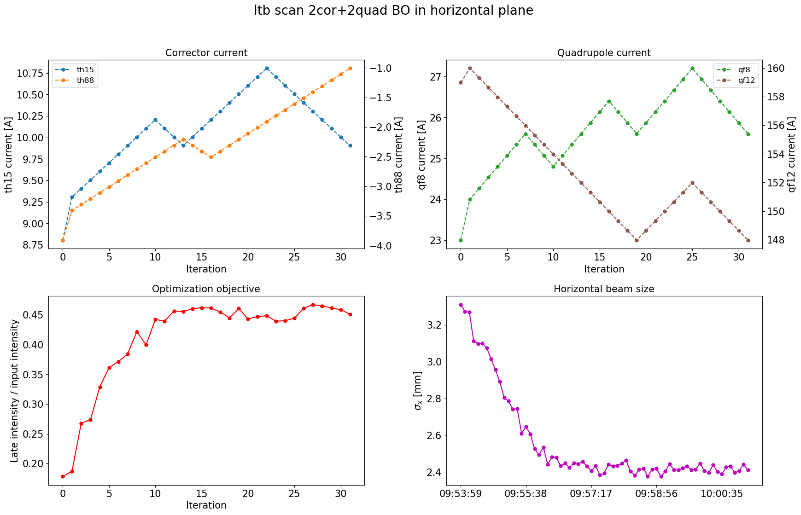
Case 4: horizontal only
Operator: Vincent Schoefer
Mar 13, PPM user 4, 9:30am – 10am
Controls: Currents of two horizontal correctors and two horizontal quads
Maximize Booster late intensity / input intensity (to reduce noise)
Initial beam was sabotaged by changing magnets in the middle of LtB line
Multiple solutions for optimization: objective value converges but input values don’t

Slide 18
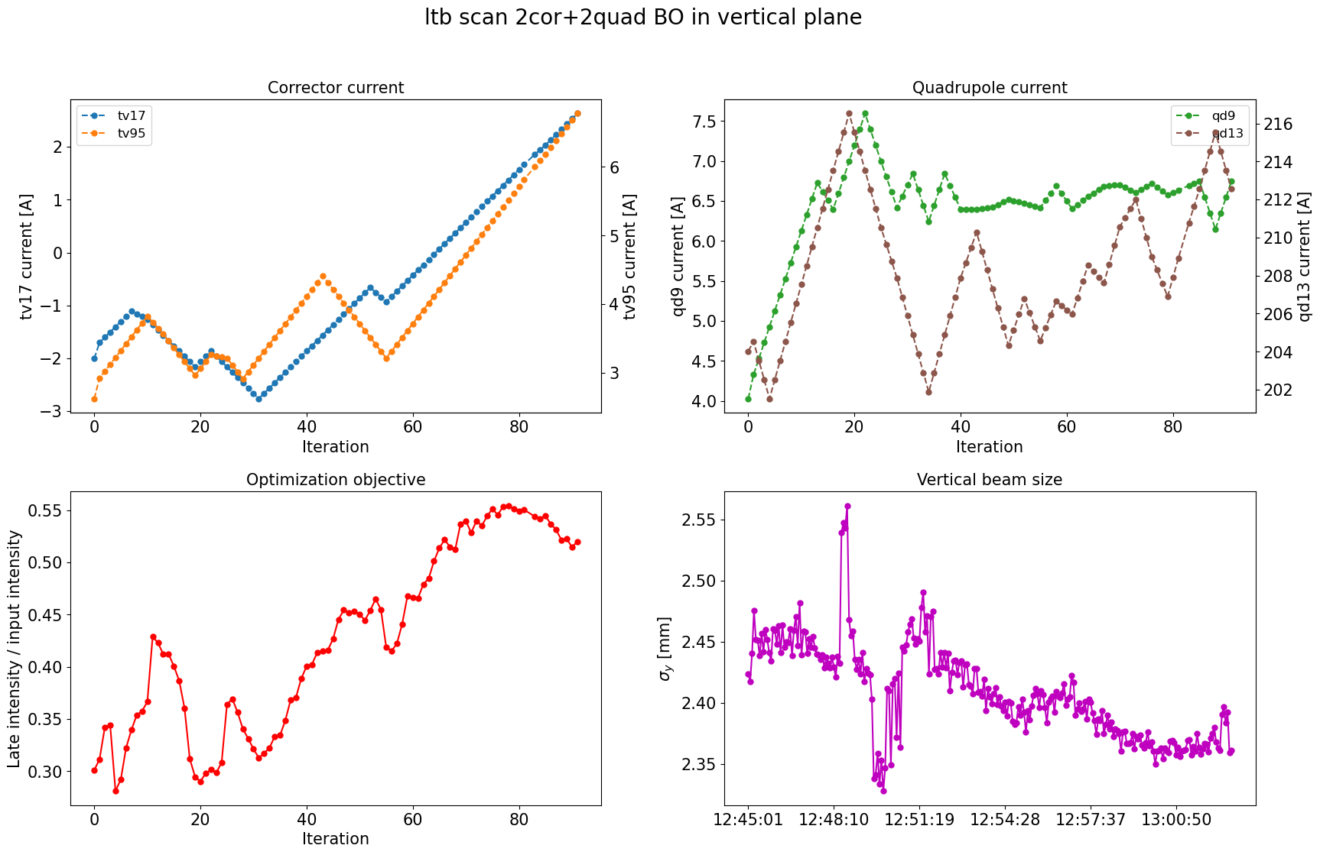
Case 5: vertical only
Operator: Vincent Schoefer
Mar 14, PPM user 4, 12:30pm – 1pm
Controls: Power supply currents of two vertical correctors and two vertical quads
Maximize Booster late intensity / input intensity (to reduce noise)
Initial beam was sabotaged by changing magnets in the middle of LtB line
Same problem with multiple solutions

Slide 19
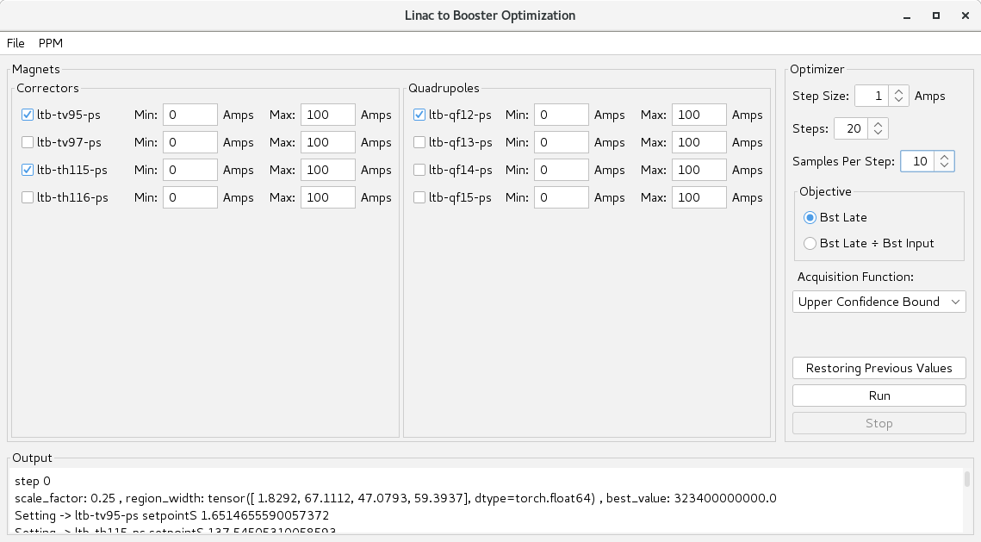
LtB BO: next step
In the process of creating operational interface for running BO in the control room
More input options can be considered: Linac Tank 9 phase etc.
Averaging option for objective to reduce noise/obtain error bars
Allow user to set BO hyperparameter choices: Step size, Acquisition function, GP kernel & prior function etc.

Slide 20
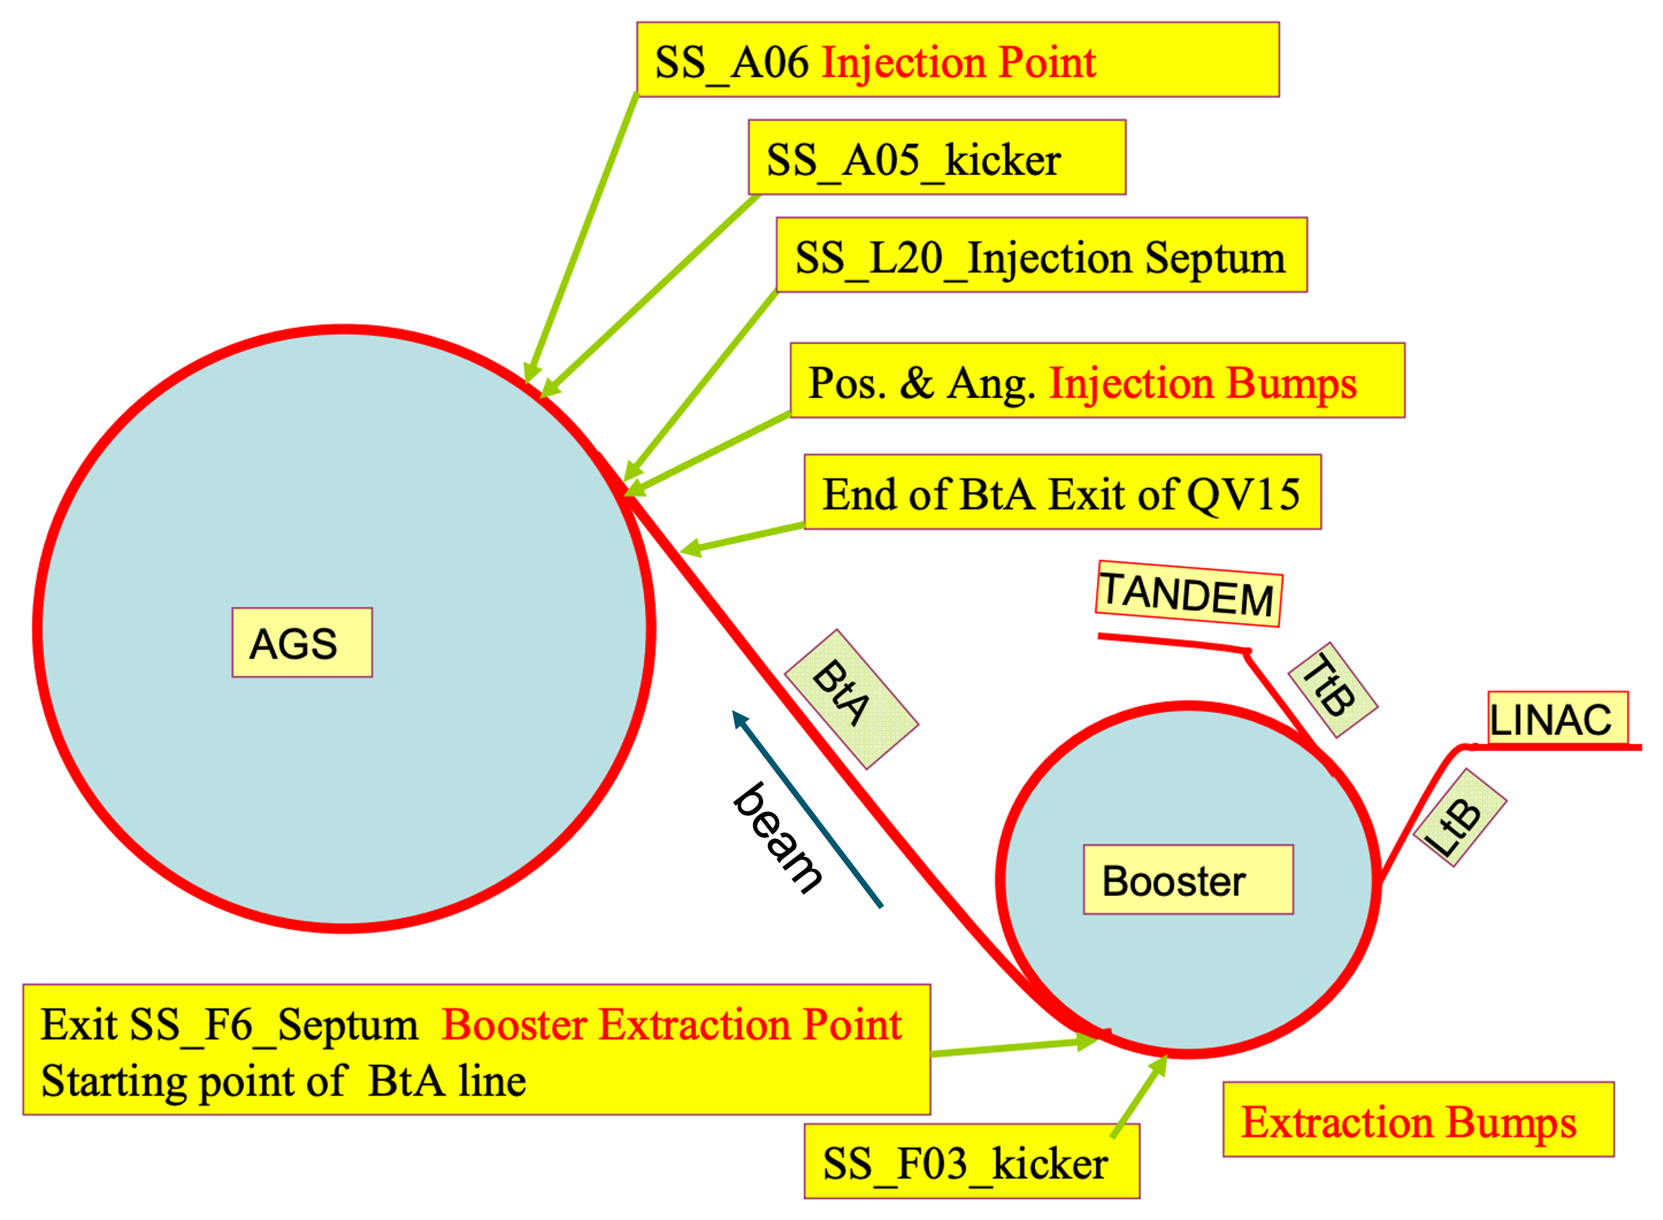
Booster to AGS transfer line
Extraction septum at F6 in Booster, injection septum at L20 in AGS, no scraping
15 quadrupoles, 2 major bends (15$°$ DH2 & 3), 3 small bends (2$°$ DH1, 1$°$ DH4, 8$°$ DH5)
Multi-wires MW006, MW060, MW125, MW166

Slide 21
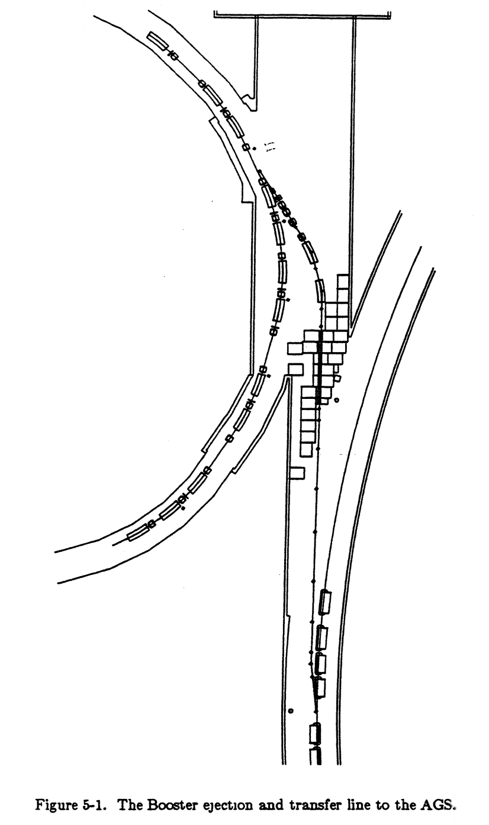
BtA controls and measurement
5* (horizontal) bends
2 (horizontal) correctors
4 (vertical) correctors
7 (focusing) quads
8 (defocusing) quads
Objective (beam intensity ratio): ags_Early / bst_Late (no scraping in BtA injection, optimal value should be ~1)
*only 4 power supplies
Booster
AGS

Slide 22
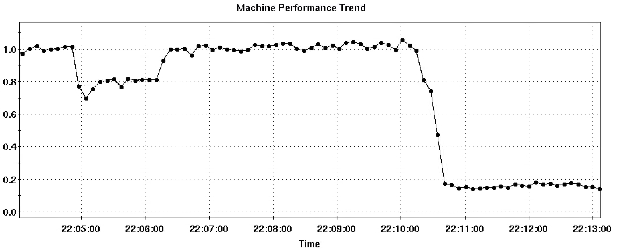
First attempt (07/08 inconclusive)
Horizontal steering + focusing
(…, correctorH, quadD, quadF, correctorH, quadD, quadF, bend, correctorV, quadD]
Used for optimization
Turned ON
Detune #1
Reset
Detune #2:
BtA vacuum valve closed

Slide 23
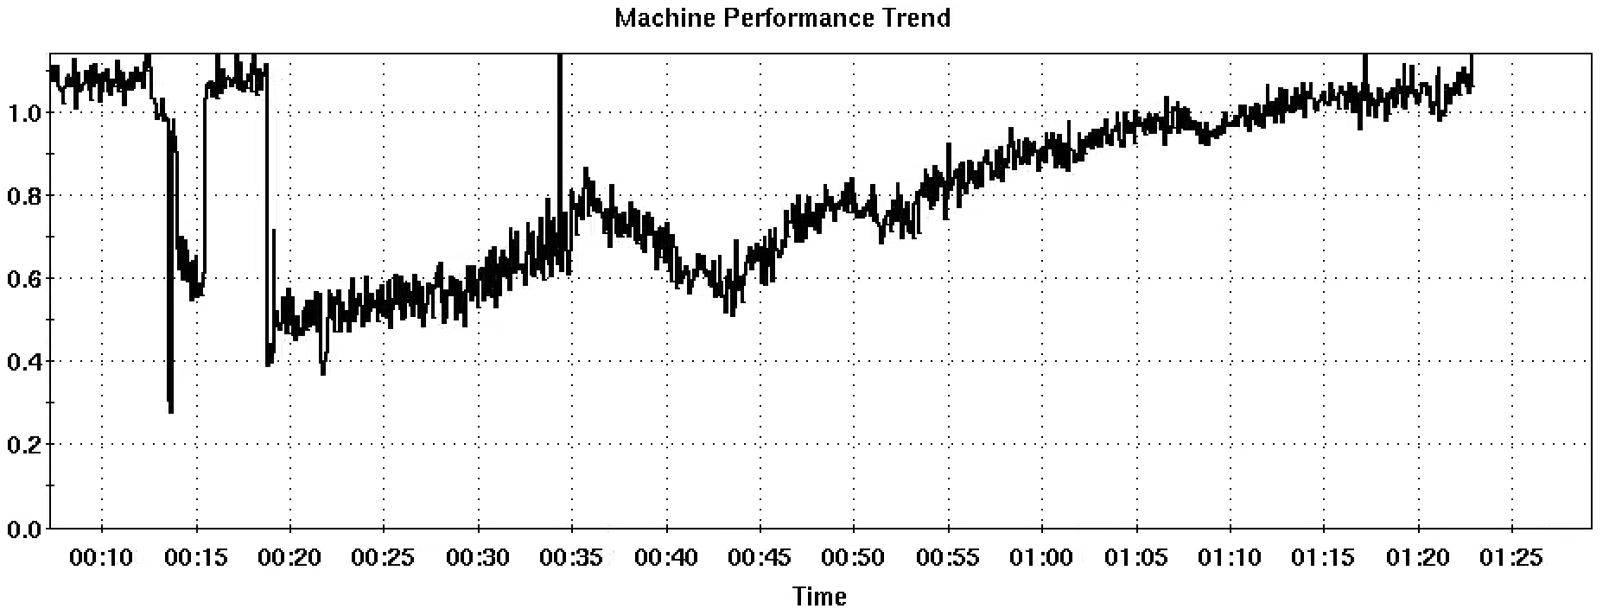
Second attempt (07/09 successful)
Horizontal + vertical steering
(…, correctorV, quads, correctorH, quads, correctorH, quads, bend, correctorV, quad]
Used for optimization
Turned ON
Detune #1
Bayesian Optimization

Slide 24
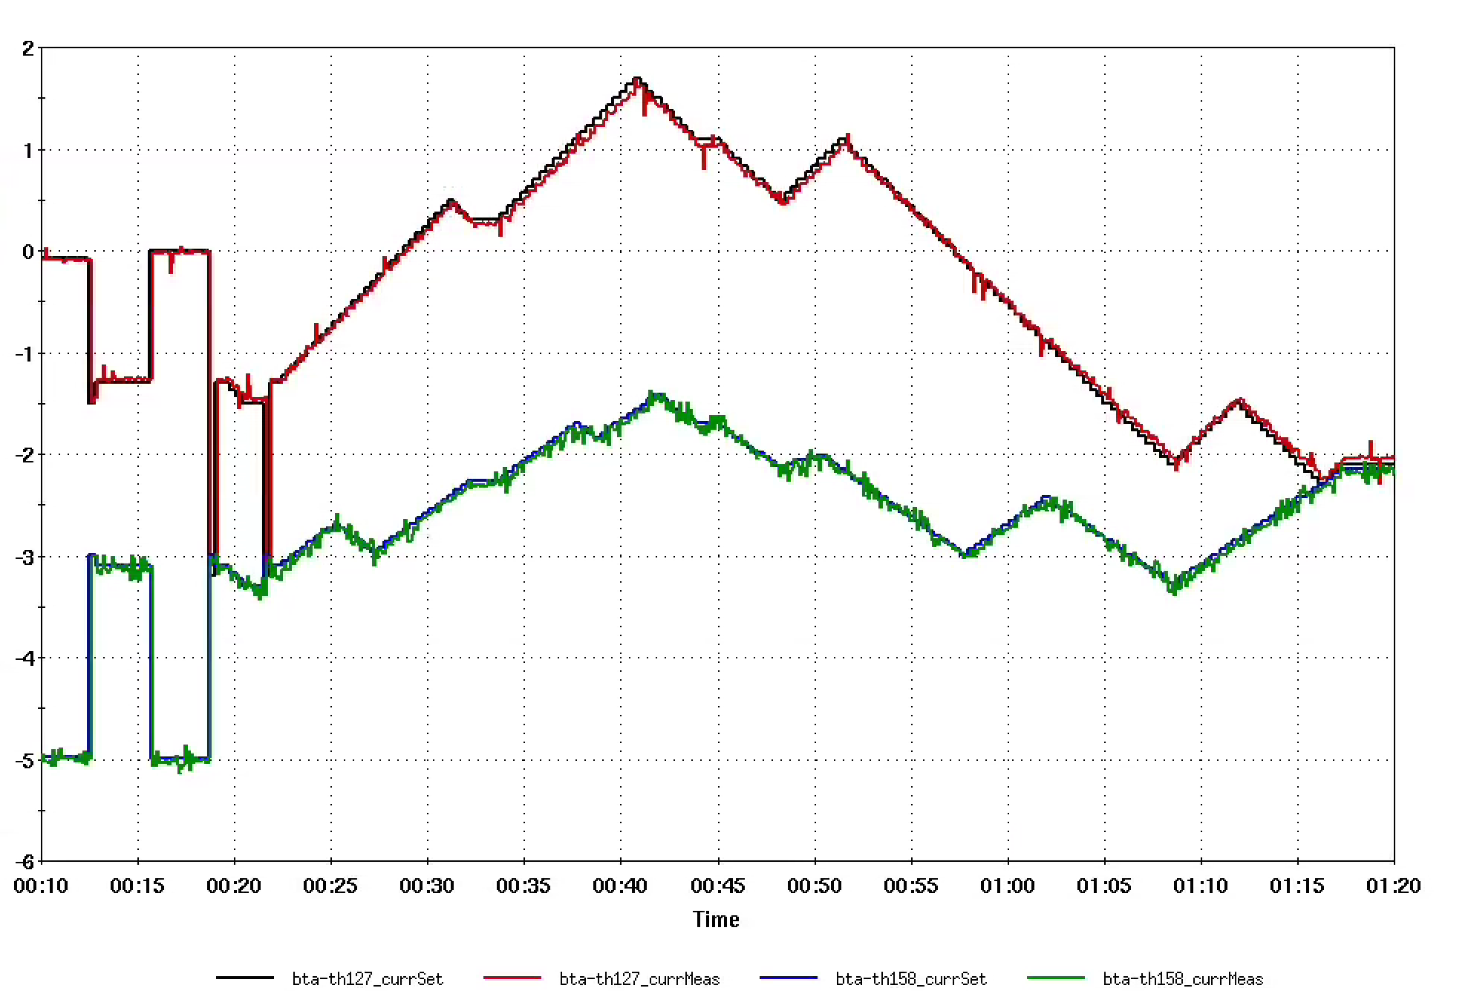
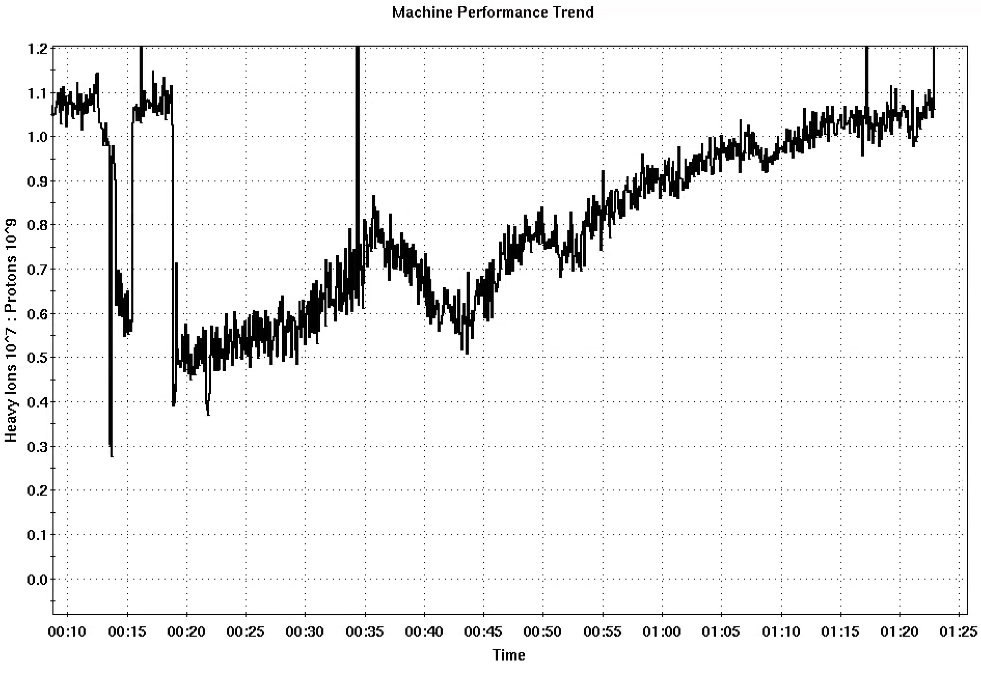
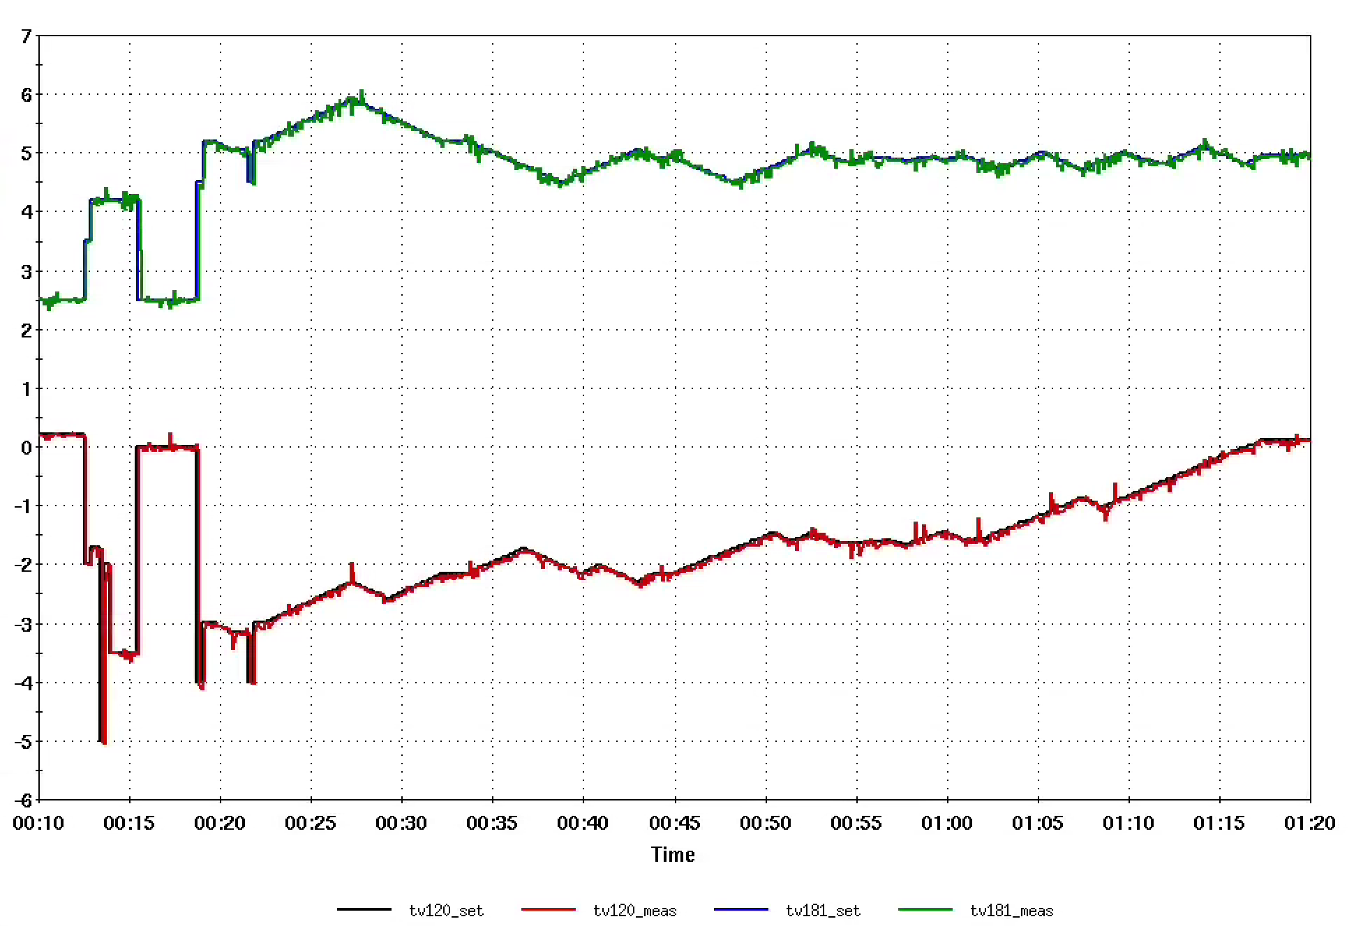
07/09 BtA BO results
Horizontal correctors
Convergence speed can be better (~1 hour for 4 inputs), could be due to small step sizes
Algorithm finds different solution from previous optimal settings
Objective ratio bigger than 1: calibration error
Vertical correctors

Slide 25
BtA BO: next step
Currently, the optimization is ignoring the following measurements:
Turn-by-turn orbit coherence (AGS F18 BPM)
Emittance/beam size (AGS eIPM)
Polarization (AGS pCNI polarimeter)
The first two could be included by using multi-objective Bayesian optimization (MOBO), or by defining a custom a reward function. Before this, it is important to write some data preparation and data pipelining scripts for proper handling of all the ADO data + timing.

Slide 26
Summary
Bayesian optimization algorithm has been demonstrated to work well to improve and maintain Booster injection efficiency in both planes under different system settings (PPM users)
If controls include upstream and downstream LtB magnets, changes made in the middle can be compensated to bring Booster beam intensity back up
Decrease in beam size in the BtA is observed in both planes in correspondence with intensity increase, which signals decrease in emittance
Preliminary results show the algorithm also works for AGS injection, further studies are needed to improve performance
Software development is underway to incorporate the algorithm into the control system

