Slide 1


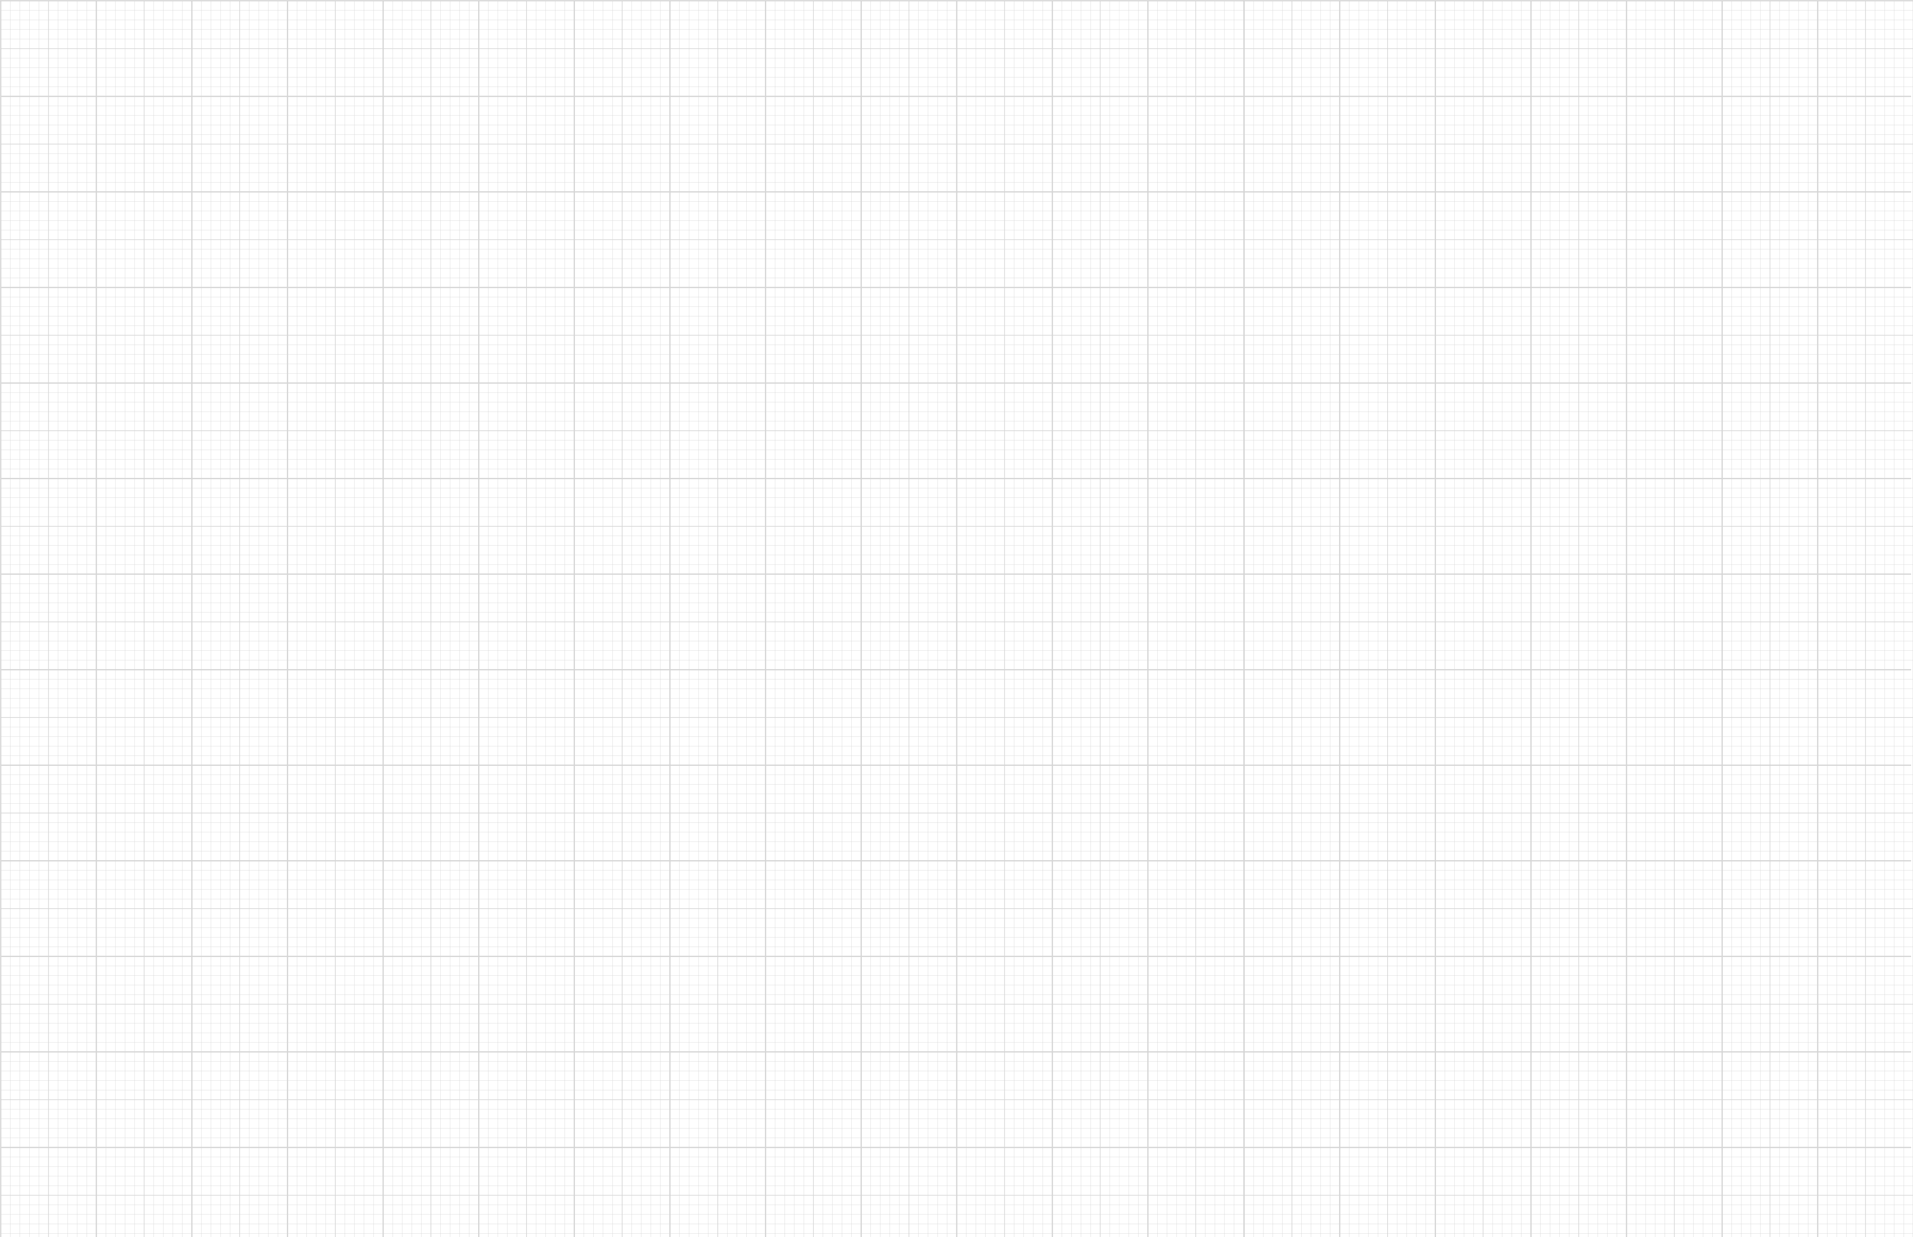
Basis of Bayesian Optimization – Theory and Application
Yinan Wang, Ph.D.
Assistant Professor, Department of Industrial and Systems Engineering
Rensselaer Polytechnic Institute
Collaboration Meeting on Aug. 21 @ BNL

Slide 2
Gaussian Process: Intuitive Example
Sampled posterior functions
Posterior samples with means and confidence interval
Sampled prior functions
Sampled posterior functions with means
Point predictions and confidence interval

Slide 3
Gaussian Process: Formulation
Observation
Noise-free function
Training observations
Gaussian noise

Slide 4
Gaussian Process: Formulation
Observation
Noise-free function
Training observations
Gaussian noise
Weights
Basis function
Approximation of noise-free function
$=φ{\left(x\right)}^{⊤}E\left[w^{⊤}w\right]φ\left(x^{′}\right)−{φ{\left(x\right)}^{⊤}\left(E\left[w\right]\right)}^{2}$ $φ\left(x^{′}\right)$

Slide 5

Gaussian Process: Kernel Function
Observation
Noise-free function
Training observations
Gaussian noise
Weights
Basis function
$$m(x)$$
Radial Basis Function

Slide 6
Gaussian Process: Kernel Function
Observation
Noise-free function
Training observations
Gaussian noise
Weights
Basis function
$$m(x)$$
RBF Kernel

Slide 7
Gaussian Process: Posterior and Inference
Observation
Noise-free function
Training observations
Gaussian noise
By taking the logarithm of the Gaussian density function:
The kernel hyperparameters $θ$ can be learned by maximizing the log marginal likelihood

Slide 8
Gaussian Process: Posterior and Inference
Observation
Noise-free function
Training observations
Gaussian noise
Estimated
The inference on new input is conducted using conditional distribution
Joint distribution
Point prediction is a linear combination

Slide 9
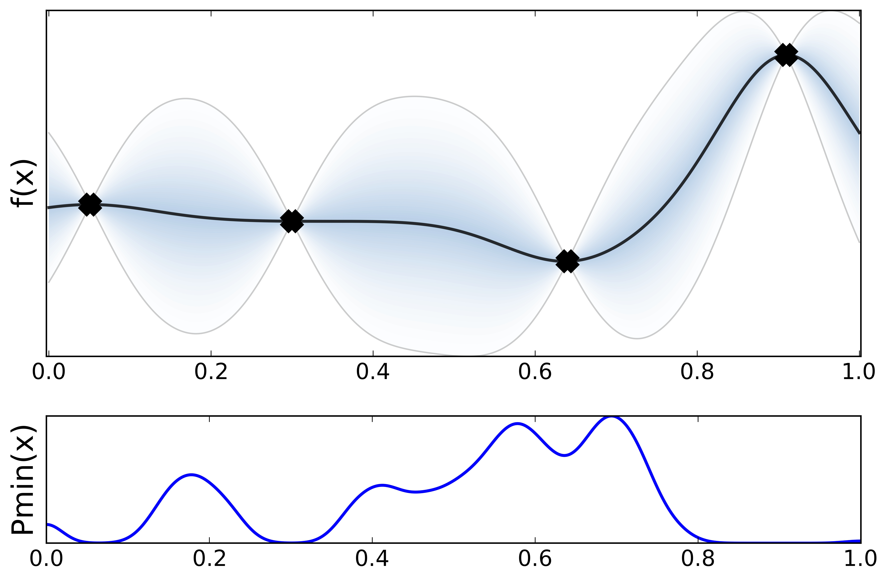
Intuitive Example of Bayesian Optimization
Data Visualization
Surrogate model
Acquisition function
Note: With an appropriately defined surrogate model and an acquisition function, we can efficiently evaluate the point that will highly likely lead to the optimized output.

Slide 10
General Formulation
Data Visualization
Note: With an appropriately defined surrogate model and an acquisition function, we can efficiently evaluate the point that will highly likely lead to the optimized output.

Slide 11
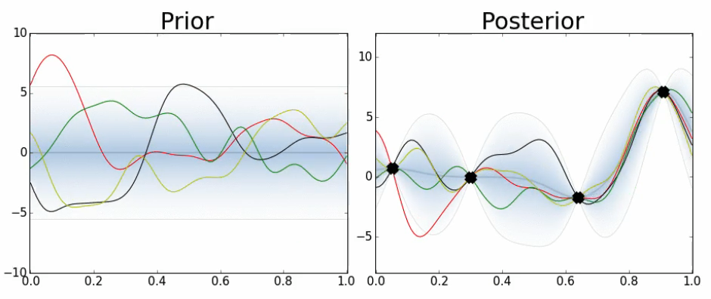
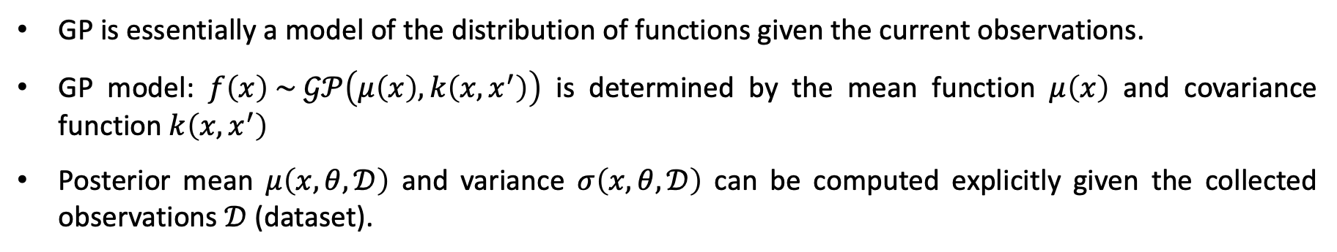
Surrogate Model: Gaussian Process (GP)
GP is essentially a model of the distribution of functions given the current observations.
GP model: $f\left(x\right) \sim 𝒢𝒫\left(μ\left(x\right),k\left(x,x^{′}\right)\right)$ is determined by the mean function $μ\left(x\right)$ and covariance function $k\left(x,x^{′}\right)$
Posterior mean $μ\left(x, θ,𝒟\right)$ and variance $σ\left(x, θ,𝒟\right)$ can be computed explicitly given the collected observations $𝒟$ (dataset).

Slide 12
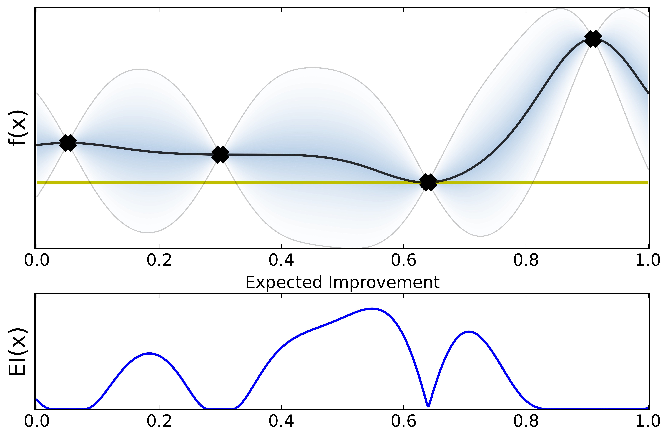
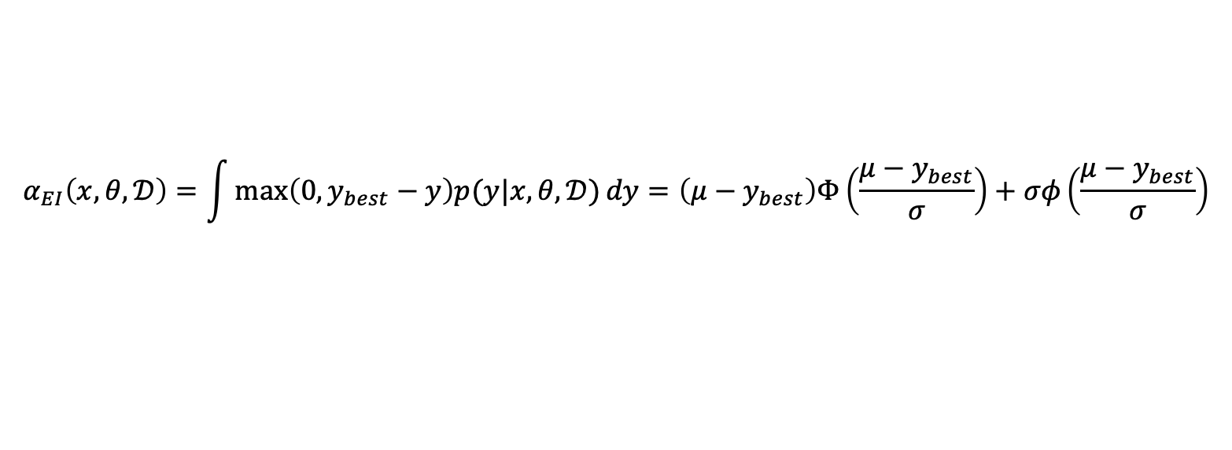
Acquisition Function: Expected Improvement (EI)
$$α_{EI}\left(x,θ, 𝒟\right)=\int{\max\left(0,y_{best}−y\right)p(y|x,θ,𝒟)}dy=\left(μ−y_{best}\right)Φ\left(\frac{μ−y_{best}}{σ}\right)+σφ\left(\frac{μ−y_{best}}{σ}\right)$$
Exploitation
Exploration
Note: The trade-off between exploitation and exploration can be adjusted by introducing a hyper-parameter in $(μ−y_{best}−η)$. A larger value of $η$ will encourage exploration.

Slide 13
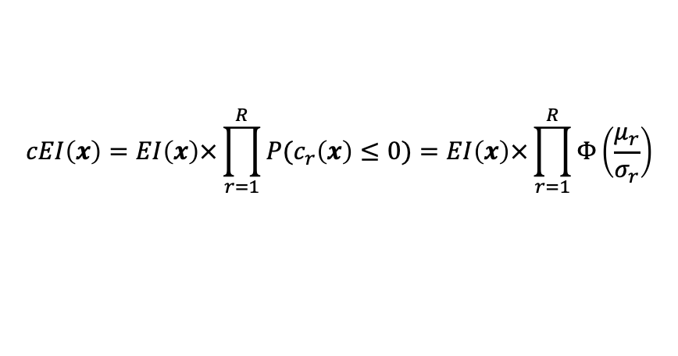
Constrained Expected Improvement (cEI)
Optimization with linear constraints
Objective and constraints as GPs
$$cEI\left(x\right)=EI\left(x\right)×\prod_{r=1}^{R}{P(c_{r}\left(x\right)≤0)}=EI\left(x\right)×\prod_{r=1}^{R}{Φ\left(\frac{μ_{r}}{σ_{r}}\right)}$$
Integrate the feasibility through the CDF
Penalized
Note: The idea of cEI can naturally benefit to the physics-constrained optimization.

Slide 14
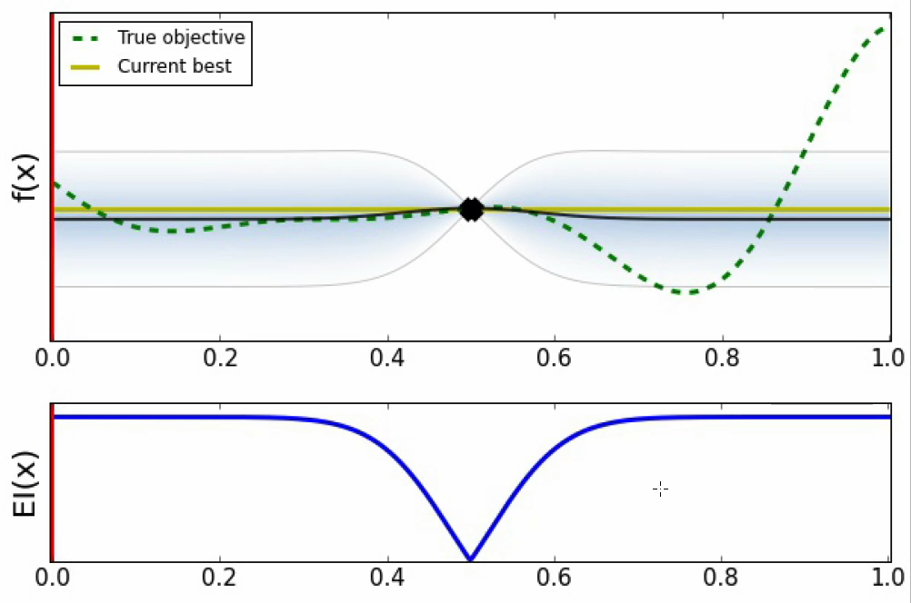
Demonstration of BO

Slide 15
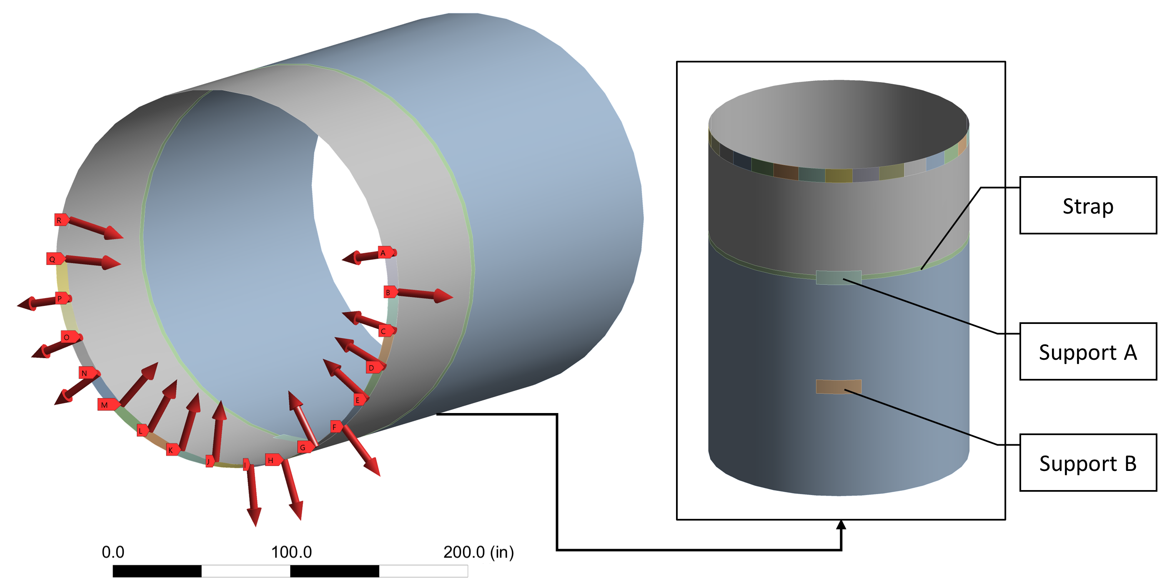
Case Study: Physics-Constrained Bayesian Optimization
Initial deviation
Displacement matrix
Adjusted deviation
Note: The objective is to place a set of actuators in all feasible locations to minimize the total variations under the constraints of feasible ranges of forces and a maximum number of actuators.
Wang, Y., & Yue, X. (2024). Multimodal Deep Learning for Manufacturing Systems: Recent Progress and Future Trends. Multimodal and Tensor Data Analytics for Industrial Systems Improvement, 221-252.

Slide 16
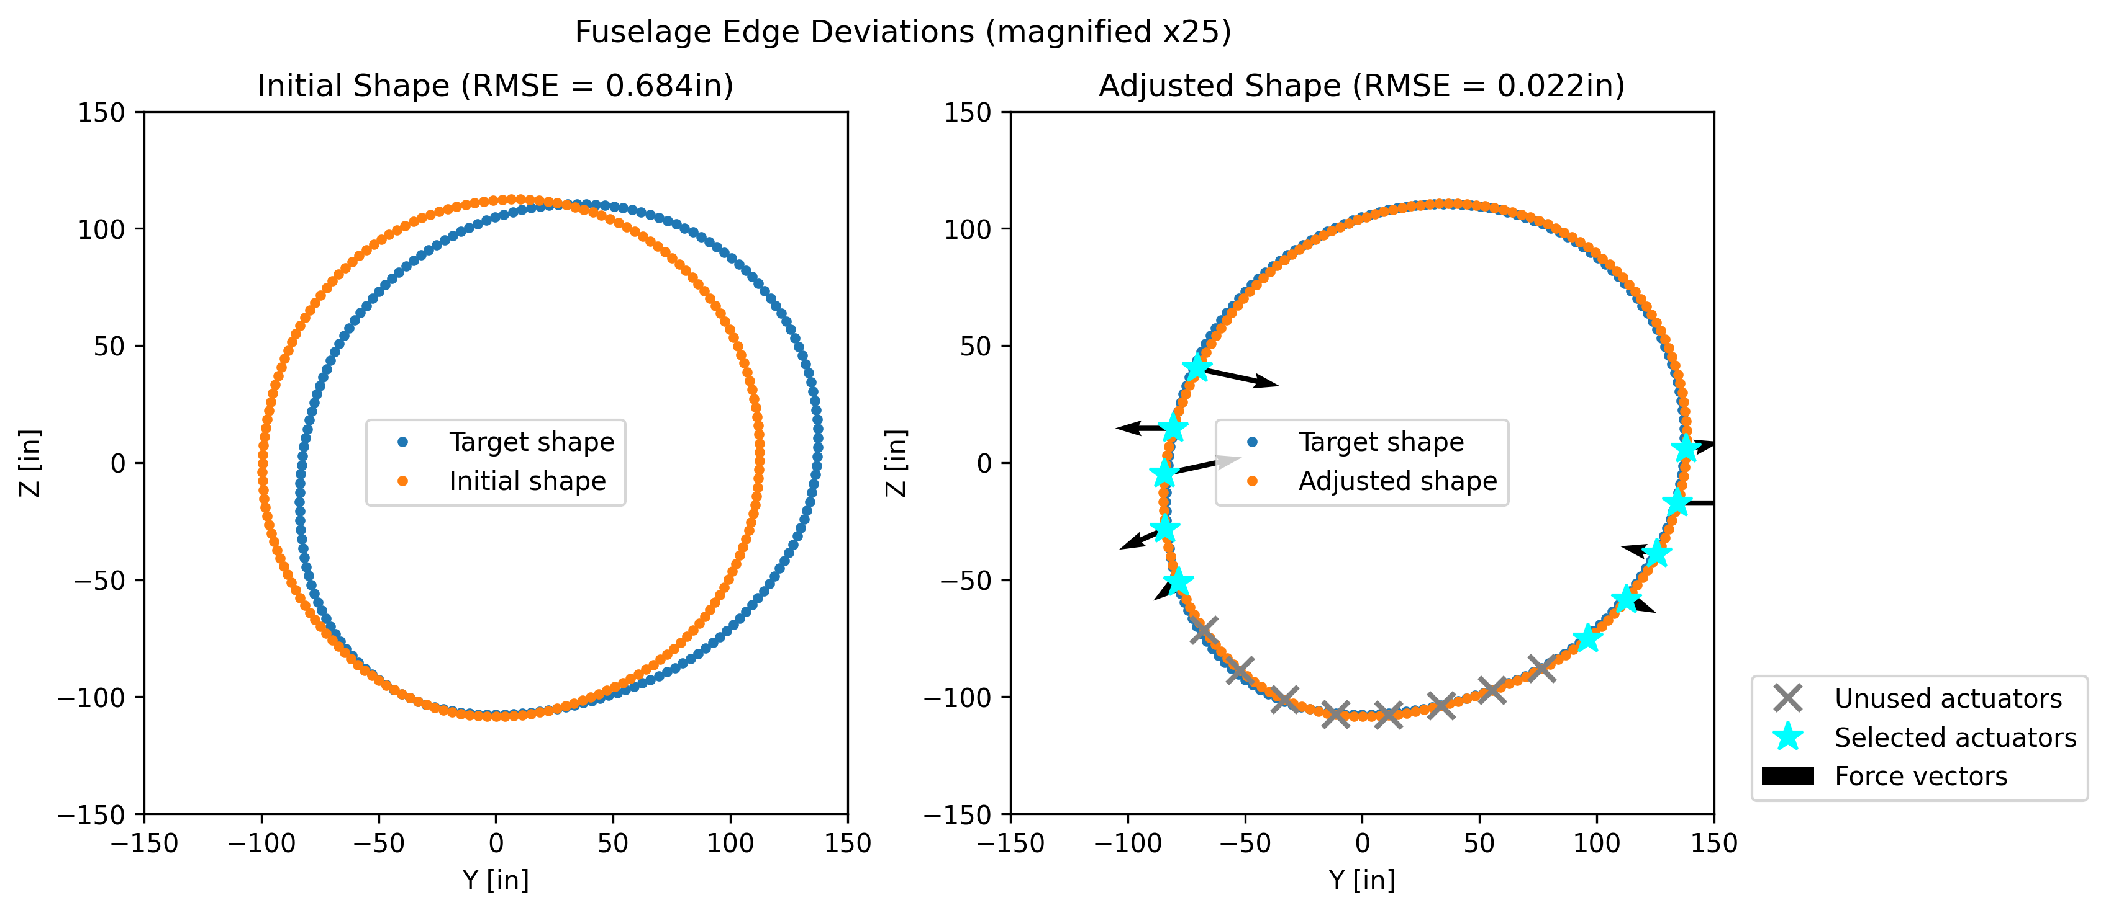
Case Study: Results
Performance comparison between physics-constrained BO and other optimization method
Note: MGP-CBO achieves smaller shape deviation using fewer actuators and smaller forces.
Wang, Y., & Yue, X. (2024). Multimodal Deep Learning for Manufacturing Systems: Recent Progress and Future Trends. Multimodal and Tensor Data Analytics for Industrial Systems Improvement, 221-252.

Slide 17
Alternative Method: Physics-informed Reinforcement Learning
The action is the vector of forces at the candidate locations.
Each single element is a continuous variable, which is sampled from a distribution.
The Neural Network is exploited to approximate the mean and variance of this distribution.
The constraints on the force are applied by bounding the output from the Neural Network (ReLU)
Wang, Y., et al. (2024). Reinforcement Learning for Fuselage Shape Control during Aircraft Assembly. IISE Transactions (minor revision).

Slide 18
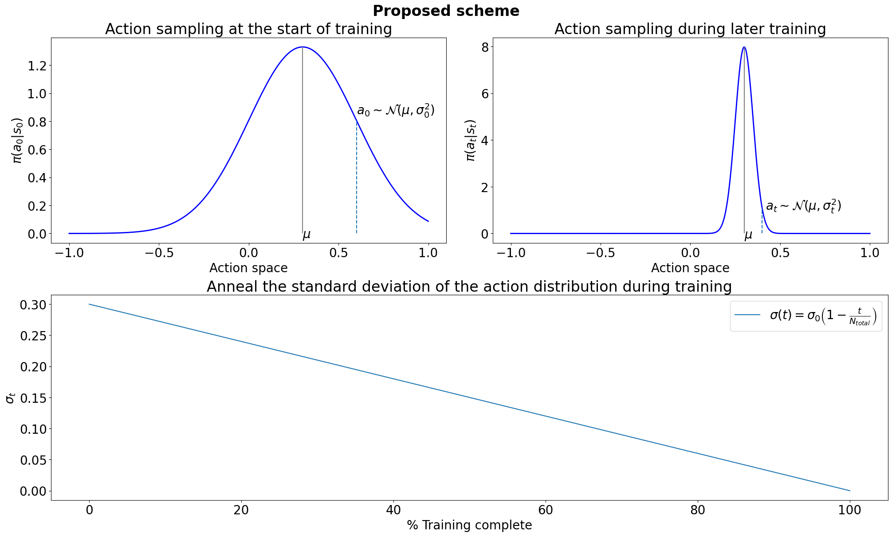
Annealing the Variance of Action Distribution
Note: Variance annealing enables exploration at early training stages and focuses more on exploitation later.

Slide 19
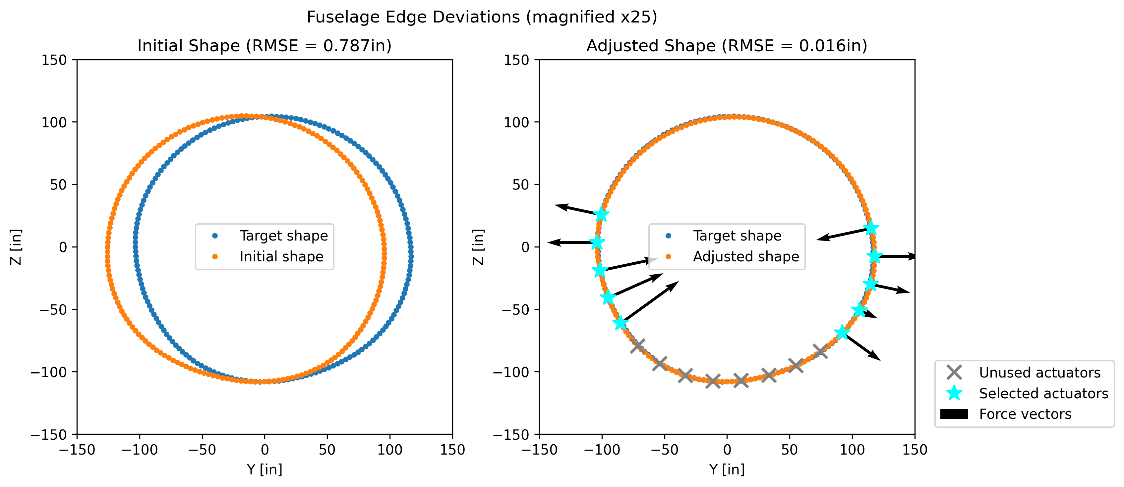
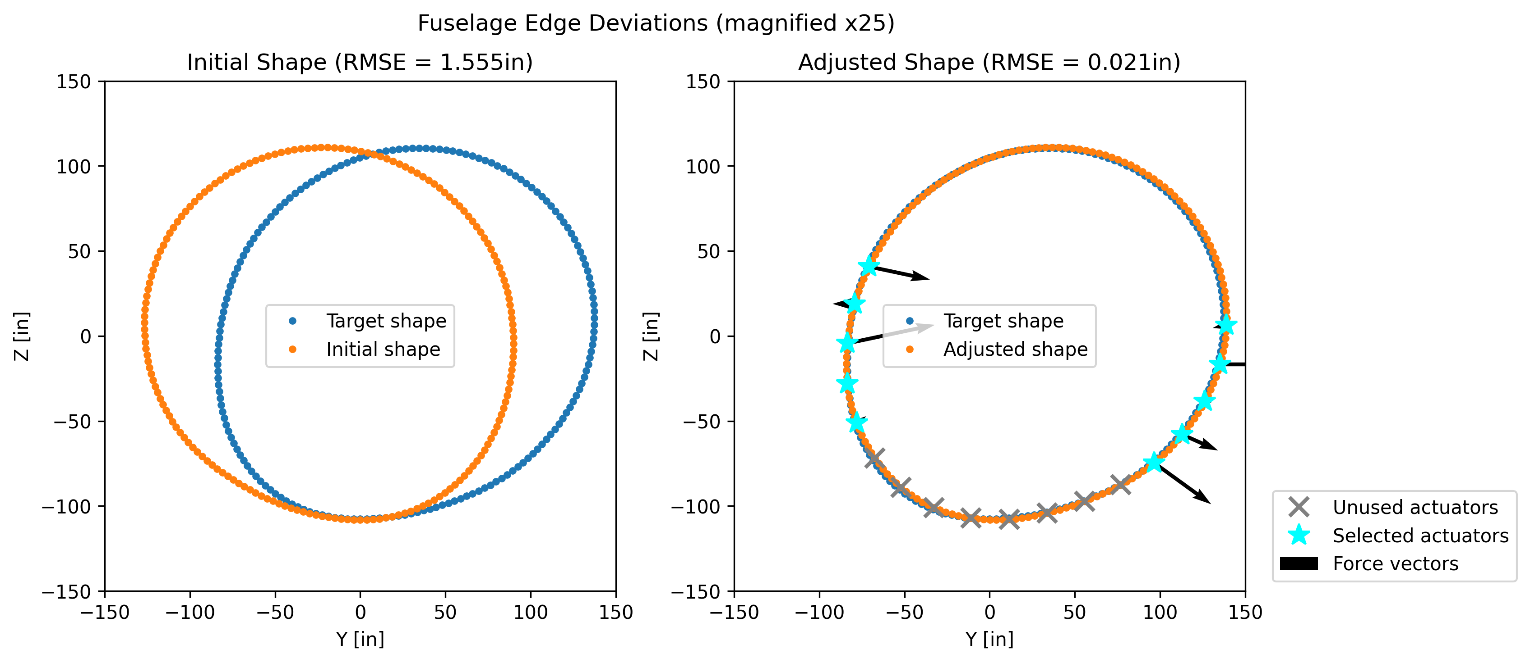
Results Visualization

Slide 20
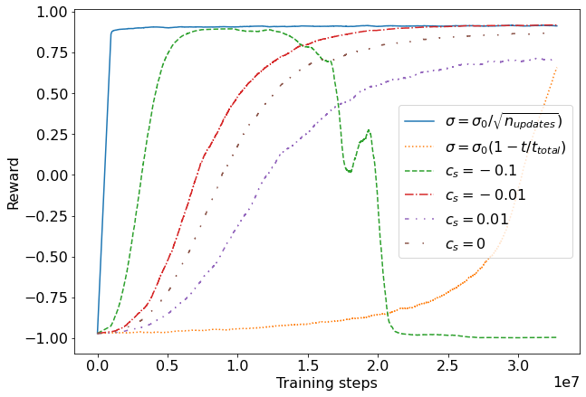
Results Visualization
Note: Variance annealing apparently speeds up the convergence of RL training.

Slide 21
Summary
Bayesian optimization is a sequential optimization framework with the interaction between the surrogate model and the acquisition function.
Bayesian optimization is known for sample efficiency and guaranteed performance. However, its typical issue is the lack of scalability and memorylessness properties.
Reinforcement learning is an end-to-end optimization framework to train the intelligent agent through interaction with the environment.
Reinforcement learning is criticized for sample demanding and slow convergence. However, it can deal with giant search space and can be easily transferred to unseen scenarios without further training.

Slide 22
Thank you!
Q & A
Yinan Wang (wangy88@rpi.edu)

