Slide 1
Jefferson Lab Data Science Optimization Toolkit
Reinforcement Learning Toolkit for Controls and Optimization
Presented by: Armen Kasparian
Coauthors: Kishan Rajput, Malachi Schram
armenk@jlab.org
Authored by Jefferson Science Associates (JSA) operating the Thomas Jefferson National Accelerator Facility for the U.S. Department of Energy under Contract No. DE-AC05-06OR23177. Part of this work was supported by the DOE Office of Science, United States under Grant No. DE-SC0009915 (Office of Basic Energy Sciences, Scientific User Facilities program).Part of this research is also supported by Office of Advanced Scientific Computing Research under Award Number DE-SC0021321. This research used resources at the Spallation Neutron Source, a DOE Office of Science User Facility at Oak Ridge National Laboratory operated by UT Battelle LLC under contract number DE-AC05-00OR22725.
Notes:
BES, NP, ASCR

Slide 2
Outline
Reinforcement Learning (RL) Basics
Agents (Off Policy) / Environments (API)
Scientific Optimization and Controls Toolkit (SOCT)
Development Advantages
Composability of codebase
Reproducibility of runs
Live Visualizations and Monitoring
Hands on example w/ Live Demo
Walk through custom environment
DDPG/TD3 agent comparison
Train both algorithms on benchmark environment
Current Developments
Multi-Objective Reinforcement Learning
SNS BPM Minimization

Slide 3
Reinforcement Learning Basics
Learning from interaction with an environment to achieve/maximize a long-term goal related to the state
Agent
Learns to make decisions and take actions to achieve a specific goal or maximize a reward signal
Environment
Represents the world or system in which the agent operates and learns
Encompasses everything external to the agent that the agent interacts with, observes, and receives feedback from
Reinforcement Learning Example – KDNuggets
Notes:
Give examples on RL environments

Slide 4
Reinforcement Learning Loop
Agent learns a Policy from Experiences
Buffer
Train $(s_{t, }a_{t},r_{t},s_{t+1})$
Store $(s_{t, }a_{t},r_{t},s_{t+1})$
Agent
State $(s_{t})$
Reward $(r_{t})$
Action $(a_{t})$
State $(s_{t+1})$
Environment
Notes:
Talk about chess

Slide 5
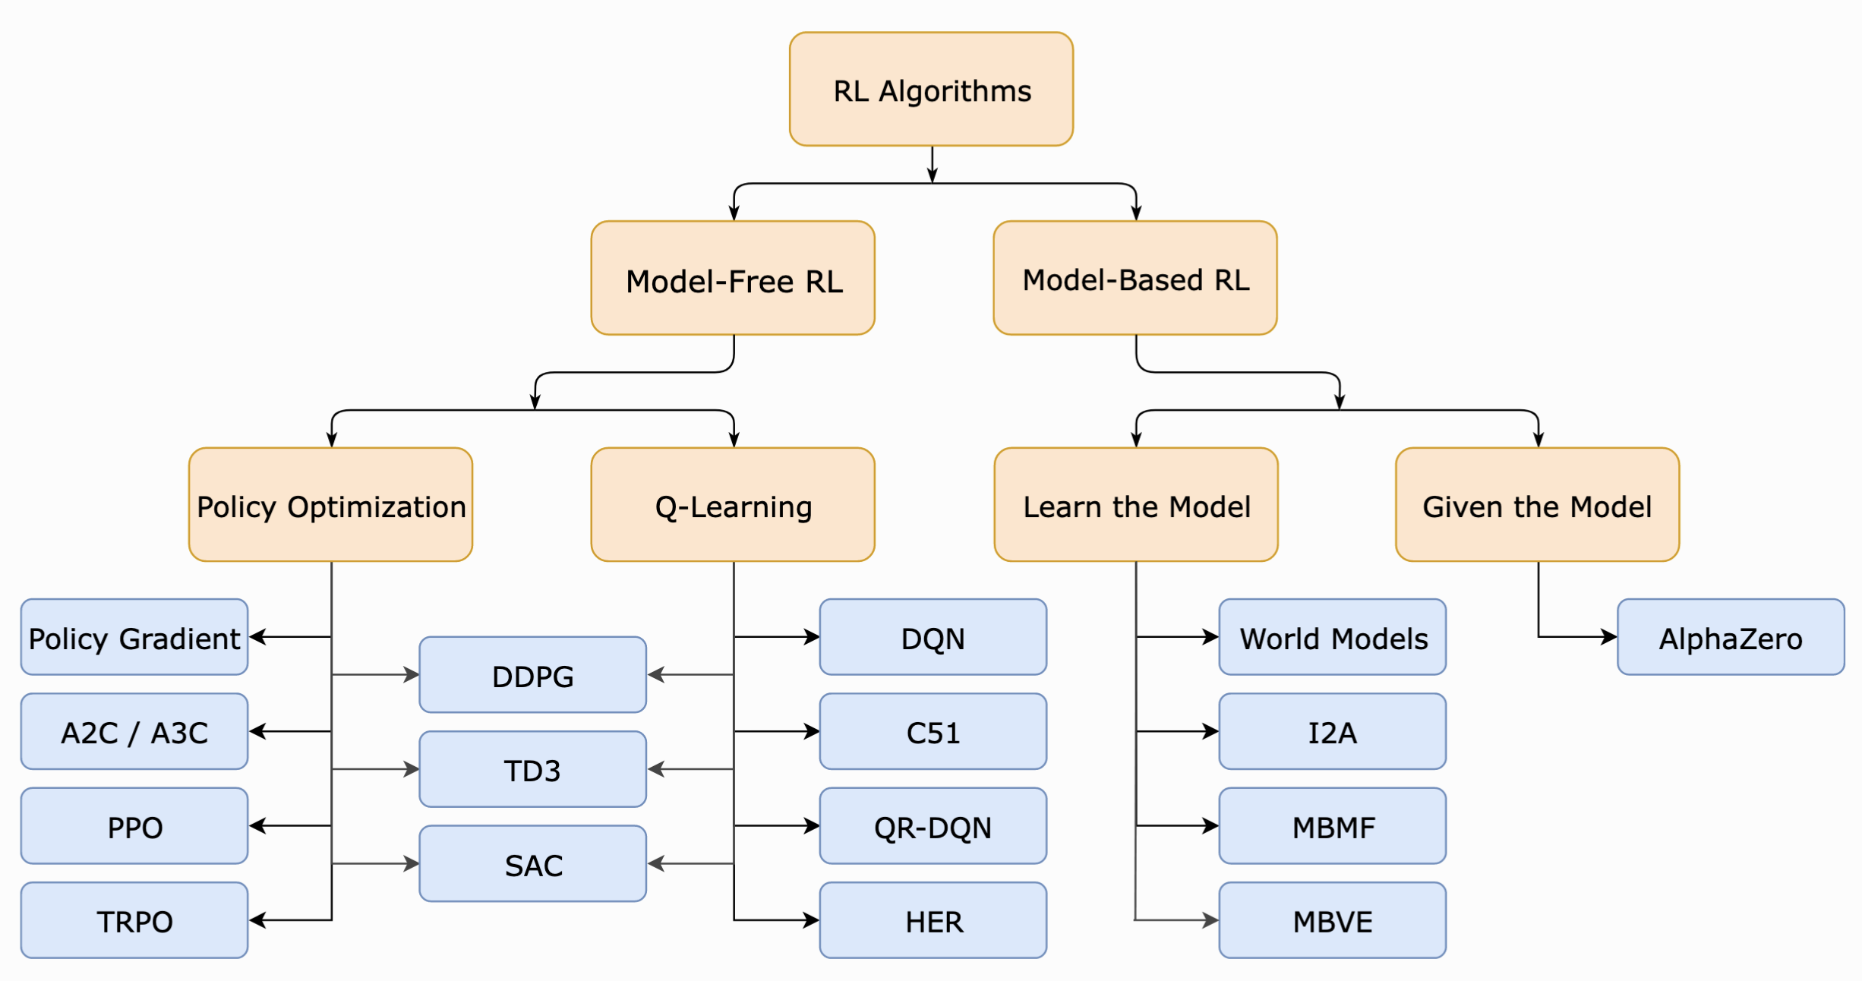
Agents
Agents are implementations of RL algorithms
Agents are selected based off the needs of the problem and the environment
Accuracy of modelled environment
Sample efficiency
Continuous (Policy based) or Discrete (Value based) action spaces
Problem complexity
Two main approaches
Model-Based RL: The agent can predict the reward for some action before actually performing it thereby planning what it should do.
Model-Free RL: The agent needs to carry out the action to see what happens and learn from it.
https://spinningup.openai.com/en/latest/spinningup/rl_intro2.html#citations-below
Notes:
TALK ABOUT CUSTOM ALGORITHMS

Slide 6
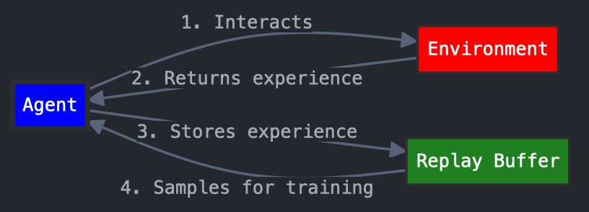
Off Policy RL Agents
Agent learns from stored past experiences
Takes in state of system and produces an action (actor model)
Key component: Replay Buffer
Data structure that stores transitions (state, action, reward, next state) from past experiences
Learn from a diverse set of experiences, including those generated by older versions of the policy (agent)
Notes:
Use of the Buffer:
Data collection: The agent interacts with the environment, storing new experiences in the buffer.
Sampling: During training, random batches of transitions are sampled from the buffer.
Learning: The agent updates its policy/value function using these sampled experiences, often via gradient descent.

Slide 7
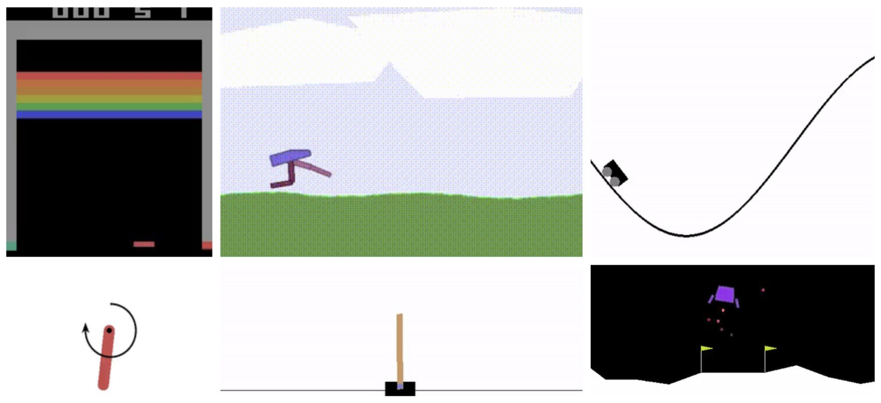
Environments
Environments are the setting the agent exists in
Can be continuous or discrete
Environments include the follow:
State Space: Representation of what the agent can see
Action Space: Valid actions that the agent can take
Reward: Representation of the quality of the next state the agents actions drove the system to
Built using the Gymnasium API
Standardized environments allows for plug and play use of many agents
Differential environments in development
Repository of custom complex system environments
Notes:
Tease paces!

Slide 8
Basic Functions of the Gymnasium Env API
OpenAI Gym standards
https://github.com/openai/gym/blob/master/gym/core.py
Env base class
class Env(Generic[ObsType, ActType]):
def __init__()
def step(self, action: ActType) -> Tuple[new_state, reward, done, info]:
def reset(self, *) -> Tuple[state, info]:
def render(self) -> Optional[Union[RenderFrame, List[RenderFrame]]]:
def close(self) [Necessary cleanup]

Slide 9
Scientific Optimization Control Toolkit (SOCT)
https://github.com/JeffersonLab/SciOptControlToolkit
Composable
Easy to add new agents and environments
Registration mechanism
Allows for easy development and use of new components
Standard OpenAI Gymnasium API
Utilize industry standard Gymnasium environment specification
Visualizations
Tensorboard integration allows for live monitoring of training
Reproducible
Models and configurations are saved and stored for inference/retraining
Easily pull in previous runs for continued research

Slide 10
Advantages in Developing with SOCT
Faster development cycle for scientists
Developed algorithms
Industry standards RL algorithms implemented out of box
Consistent API
Developed environments will work with other toolkits and algorithms
Customizable workflow allows for tailored modules
Support for customizations for specific environments and applications
Developing Techniques for Accelerators
Custom agents
Explainable Constraints for RL
Multi-Objective Reinforcement Learning (MORL)
More in development with accelerator partners
Notes:
Not always needed but incase your application is more complicated we are happy to provide support
Unique factor that other packages cannot provide

Slide 11
SOCT Framework
Multiple Implemented Agents
DQN
DDPG
TD3
SAC
Multiple Buffer Implementations
Prioritized Experience Replay
Random Experience Replay
Custom Environments
complex environments of accelerators
Continuous Driver
Spawn Agent
Spawn Environment
Training Loop
Action
Policy
Environment
State
Reward

Slide 12
Composability with Python Registry
Agents
Neural Networks
Buffers
Follows OpenAI Gymnasium Standards
SAC
MLP
ER
Environment
- Number of state variables
- Number of action variables
- Optimization problem; Reward (Loss) function
DDPG
CNN
PER-v0
TD3
LSTM
PER-v1
Python registry allows to register python classes within a directory and assign unique ids
A default initialization can be provided (optional)
Allows to build objects from registered modules without changing code (imports)

Slide 13
Reproducibility
Validation of results
All utilized configuration files saved in results of run
Initialized models files as well as iteratively improved model files saved
Iterative Improvement
Facilitates building upon previous work
Accelerating scientific progress
All results are labelled and tagged with identifying information to enable categorical history of tests
Example Folder Name
index0_agent_KerasTD3-v0_buf_cfg_bsize_cfg_env_Pendulum-v1_hash28f7901_results_20240820-090924
Agent Name
Buffer Info
Env Name
Git Hash
Timestamp

Slide 14
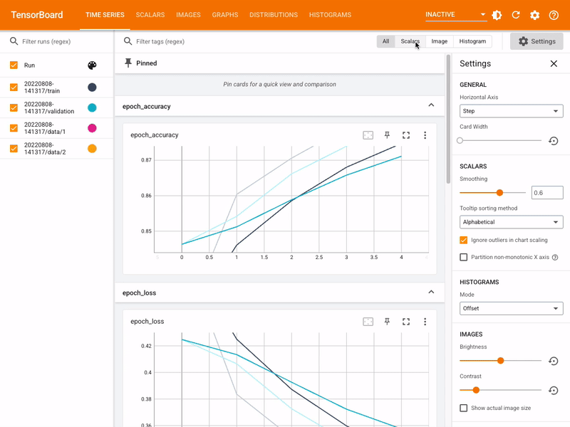
Live Visualization and Monitoring
TensorBoard provides the visualization and tooling needed for machine learning experimentation
Tracks and visualizes key metrics (e.g. loss, accuracy)
Visualizes model architecture and components
Monitors parameter distributions over time
Track custom variables

Slide 15
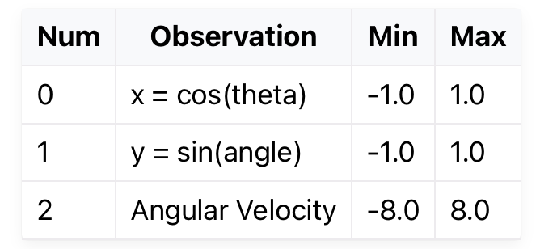
Gymnasium Environments Explained for Live Demo
Pendulum
Pendulum attached at one end to a fixed point, and the other end being free
Goal: apply torque on the free end to swing it into an upright position

Slide 16
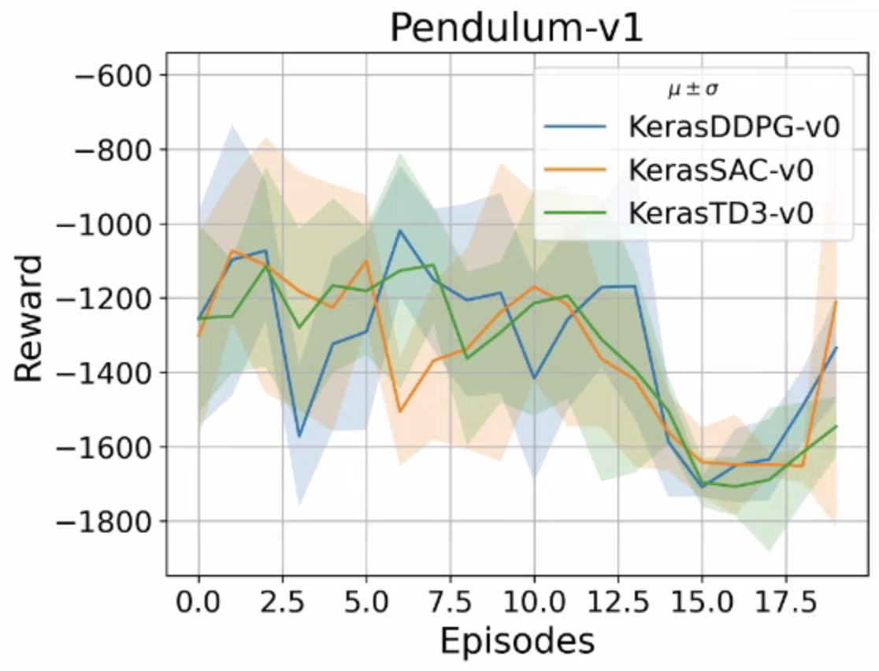
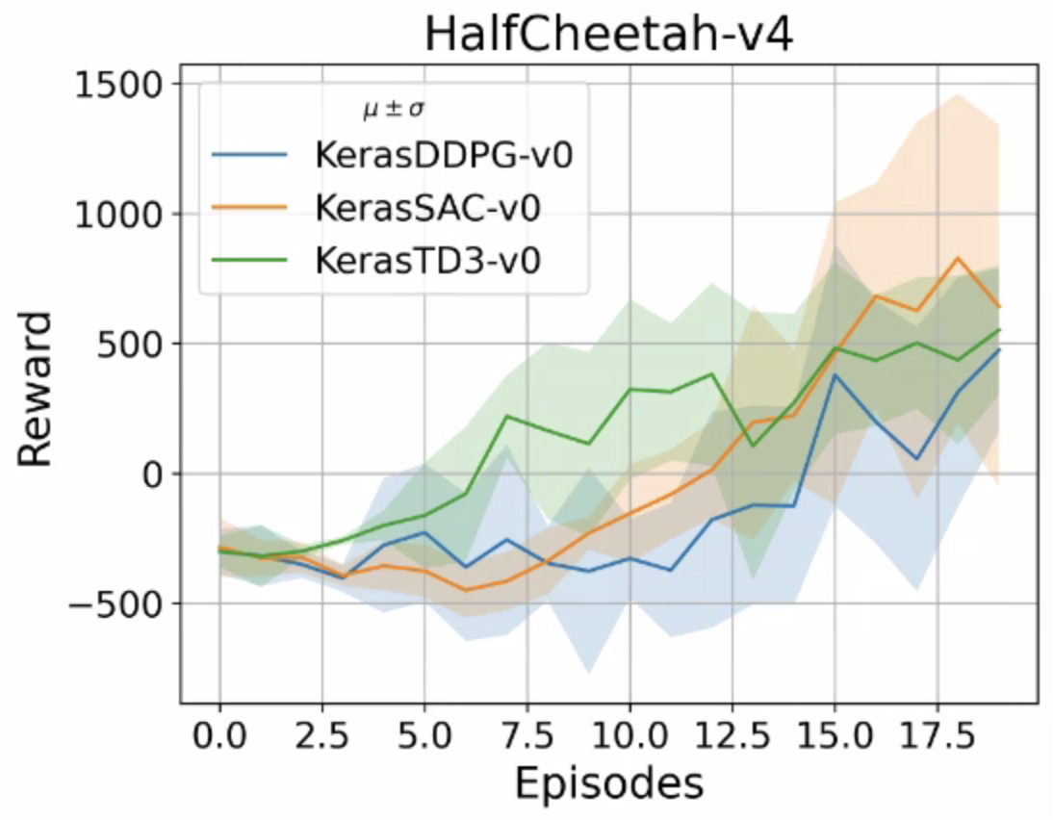
Command Line Example
python -O run_continuous.py --agent KerasTD3-v0 --env Pendulum-v1 --nepisodes 100
All selections are registered in registry
Agent Selection
Selected via CLI argument
KerasDDPG-v0
KerasTD3-v0
KerasSAC-v0
Environment Selection
Selected via CLI argument
Pendulum-v1
HalfCheetah-v4
<Your Custom Env>

Slide 17
Live Demo

Slide 18
Current Developments

Slide 19
Current Developments: Multi-Objective Reinforcement Learning
We also are developing a multi-objective reinforcement learning agent
Optimized the CEBAF virtual environment with 8 gradients

Slide 20
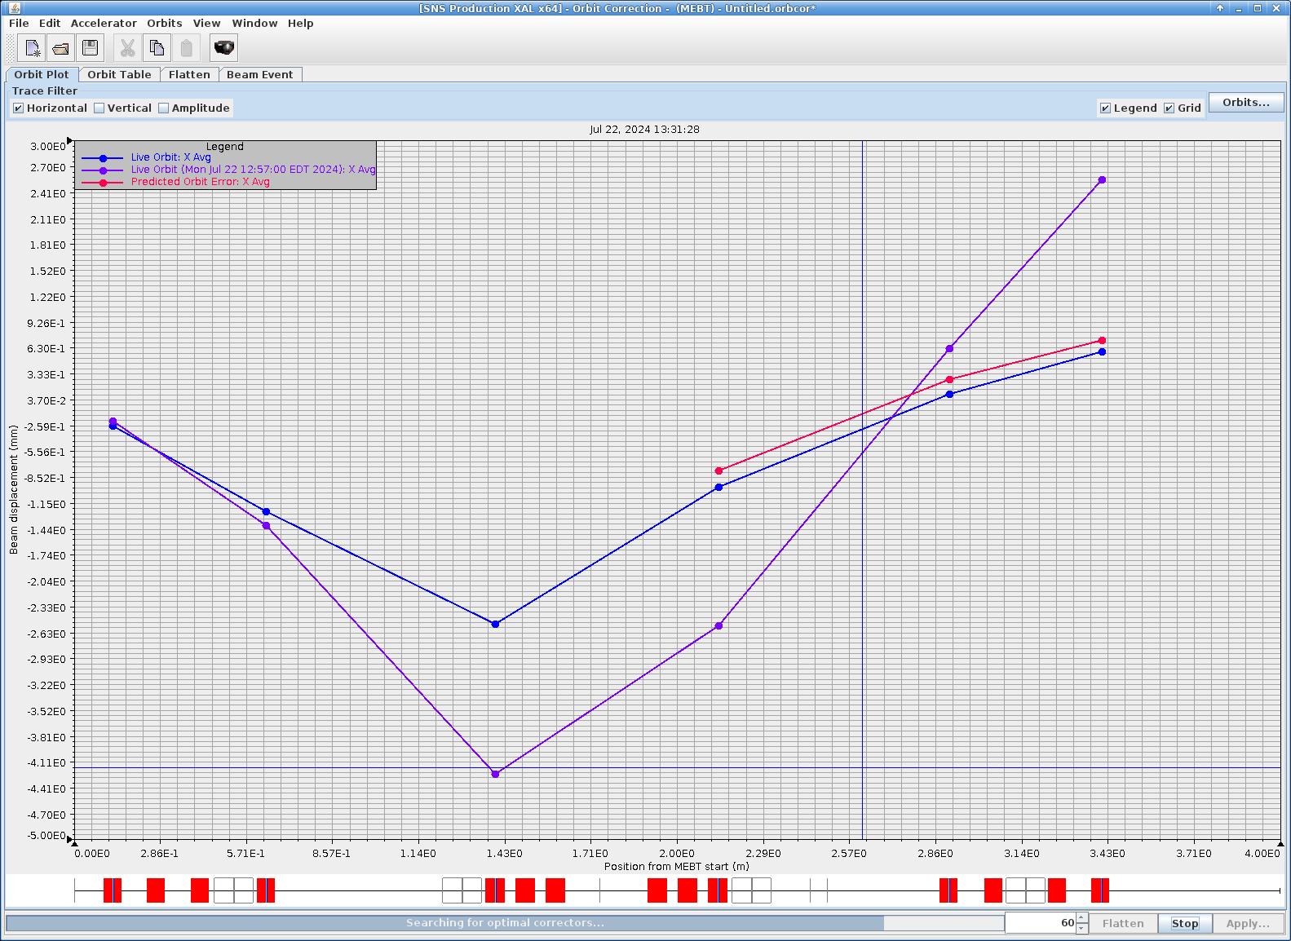
Current Developments: SNS Collaboration
We are moving the effort to real SNS accelerator
Trained reinforcement learning Twin Delayed DDPG (TD3) algorithm on VIRAC
Used trained model for inference on SNS accelerator
Existing Ideal
Solution
Preliminary
RL TD3 Solution
Initial Conditions

Slide 21
Repository of Open Accelerator Environments
Working on collection of environment shared across communities
Build a resource to test algorithms and work on solutions practical for multiple complex environments
Current collaborators include Oak Ridge National Lab, SLAC, DESY, Fermi Lab, Jefferson Lab
We'd love to add BNL's environment!
Open invitation to build something as a community!
Notes:
place to develop environments
Please please please please please join
Trying to build something broader than this
More people involved the more environments and the better we can make the algorithms

Slide 22
Resources
Scientific Optimization Controls Toolkit
Gymnasium Environment Documentation
Relevant Papers
An Introduction to Deep Reinforcement Learning
Continuous Control with Deep Reinforcement Learning
TD3: Addressing Function Approximation Error in Actor-Critic Methods
Prioritized Experience Replay

Slide 23
Acknowledgements
Thank you to BNL for hosting this collaboration

Slide 24
Backup Slides

Slide 25
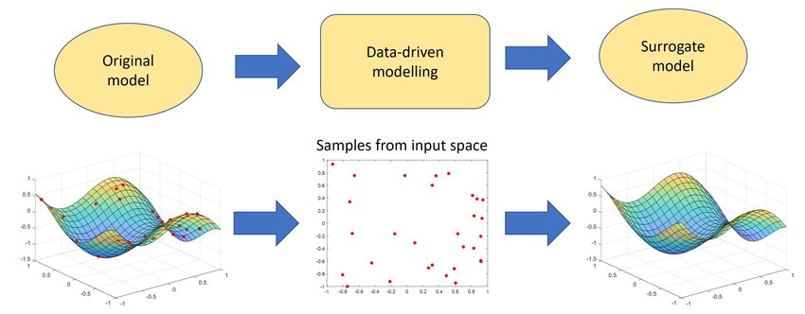
Offline Surrogate Environments
When previously logged data is all that is available, a surrogate model can be developed*
Surrogate model
Data driven approach
Utilizing the previously saved data create a model that given the state and action of the environment returns the most likely next response of environment
Built into a custom gymnasium environment
Drop in solution for SOCT framework
Surrogate modelling for the forecast of Seveso-type atmospheric pollutant dispersion - Scientific Figure on ResearchGate. Available from: https://www.researchgate.net/figure/The-principle-of-surrogate-modelling_fig1_360665374 [accessed 13 Aug 2024]
Notes:
Talk more offline

