Slide 1
Bmad-Julia and Machine Learning
David Sagan
Cornell ERL / EIC group
Advisor: Georg Hoffstaetter de Torquat
August 22, 2024

Slide 2
What is ?
Bmad-Julia is a new, open-source project to develop, in the Julia language, an ecosystem of programs and modular packages (software libraries) providing the tools and methods commonly needed for accelerator simulations including machine learning.
✔ Full features of present Bmad and significantly more.
✔ Instantly can use Julia's rich ecosystem of optimizers, symplectic integrators, machine learning toolkits, plotting packages, etc with zero minimal effort.
✔ Fully-differentiable for advanced optimization methods and machine learning.
✔ GPU-parallelized tracking capability.
✔ Highly modular structure for easy extension / plug-and-play.

Slide 3



The motivation for Bmad-Julia comes from the history of all the wasted time and effort that has been spent developing accelerator simulation programs that are no longer or seldom used:
TRACE-3D
ALIGN
BETA
COMFORT
DESIGN
DIMAD
GUINEA-PIG
HARMON
LEGO
LIAR
Etc. Etc...
MAGIC
MARYLIE
PATRICIA
PETROS
RACETRACK
SYNCH
TRACY
TRANSPORT
TURTLE
UAL
How many man-years of effort went into these programs?

Slide 4
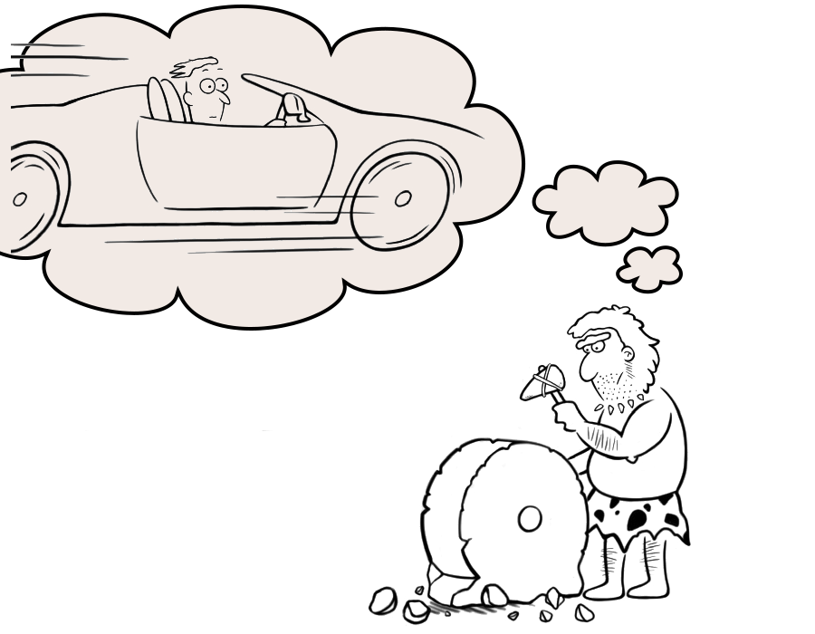
Developing simulation programs takes time!
Reinventing the Wheel can be costly!
Accelerator
Physicist
Actual Simulation
Program

Slide 5

The disorganized state of accelerator physics simulation development has been recognized by the Latest High-Energy Physics community Snowmass white paper:
The development of beam and accelerator physics codes has often been largely uncoordinated. This comes at a great cost, is not desirable and may not be tenable. Due to developers retiring or moving on to other projects, numerous simulation programs have been completely abandoned or are seldom used. This has resulted in a collection of codes that are not interoperable, use different I/O formats and quite often duplicate some physics functionalities using the exact same underlying algorithms.

Slide 6
Snowmass White Paper Recommendation:
Organize the beam and accelerator modeling tools and community through the development of (a) ecosystems of codes, libraries and frameworks that are interoperable via open community data standards, (b) …
Bmad-Julia aims to be part of this ecosystem

Slide 7
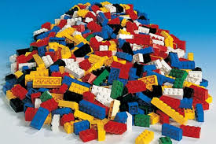
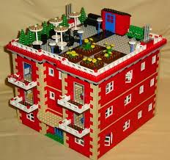
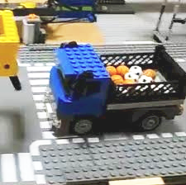
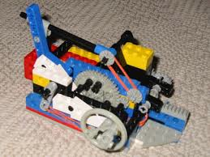
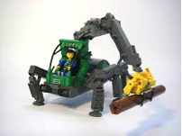
Bmad-Julia will be a Collection of Programs and Toolkits (Libraries)
Toolkit
Dynamic Aperture Program
Advantages of a toolkit:
Cuts down on the time needed to develop programs.
Cuts down on programming errors (via module reuse).
Provides a simple mechanism for lattice function calculations from within control system programs.
Standardizes sharing of lattice information between programs.
Increased safety: Modular code provides a firewall. For example, a buggy module introduced into the toolkit will not affect programs that do not use it.
Lattice Design Program
Control System Programs
IBS Simulation Programs
Etc.

Slide 8
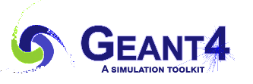
Impact
Bmad-Julia has the potential to have a huge impact on accelerator simulation efforts
  Saving countless hours of development time, and
  Resulting in better simulation code.
The potential of Bmad-Julia is similar to that of Geant4. The versatility of the Geant4 toolkit for the simulation of particle passage through matter has resulted in Geant4 having a large impact not only in the field of particle physics, but in other domains as well — including nuclear physics, astrophysics and space science, biomedical physics, and archaeology. Geant4’s main reference has achieved more than 16,000 citations in the Web of Science, making it the most cited publication in particle and field physics, nuclear physics, and other fields.

Slide 9
Relationship to the Current “Fortran” Bmad
The development of Bmad-Julia is inspired by the experience (both good and bad) with developing the current Bmad as well as experience with other simulation programs.
Bmad-Julia Is NOT:
  × A rewrite of current Bmad in a different programming language. No Fortran code will be in Bmad-Julia.
  × A Julia interface to the current Bmad. Lattice translation between the two will exist though.
  × A replacement for the current Bmad. While in the far-far future Bmad-Julia may supersede any number of programs (Bmad, MAD, Elegant, etc.), maintenance and development of the current Bmad will continue as usual.

Slide 10

Why ?
Short answer: Julia “walks like Python and runs like C” – that is, It is easy to use and is fast.
31 pages
“In view of this study, the HEP community will definitively benefit from a large scale adoption of the Julia programming language for its software development.”

Slide 11
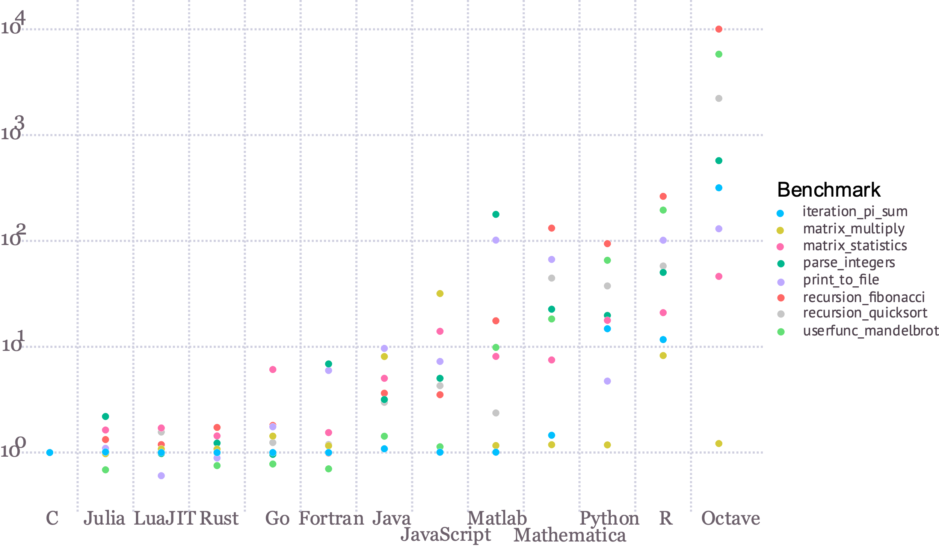
is fast

Slide 12
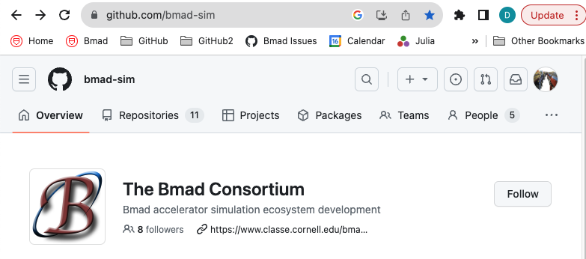
Bmad-Julia is hosted on GitHub by the Bmad Consortium:

Slide 13
Packages in Development
AcceleratorLattice.jl - Package for accelerator lattice construction and manipulation. Main developer: David Sagan.
GTPSA.jl - Generalised Truncated Power Series Algebra. Main devaloper: Matt Signorelli.
NonlinearNormalForm.jl - Nonlinear normal form analysis using differential algebra maps including spin. Main developer: Matt Signorelli.
AtomicAndPhysicalConstants.jl - Library of atomic and subatomic particle properties and other physical constants. Main developer: Alex Coxe.
BeamTracking.jl – Particle tracking. Main developer: Dan Abell.
MapAnalysis.jl - Routines for analyzing Taylor maps. Main developer: Matt Signorelli

Slide 14
Versatility
Julia’s entire ecosystem of optimizers, symplectic integrators, plotting packages, etc. at one’s fingertips with minimal effort
E.g. suppose you have some tracking function, and you want to find the closed orbit:
We can use any optimizer, written by the experts, immediately. E.g. Optim:
Or NLSolve, etc.
function track(ring, z0)
...
return zf # Final phase space position
end
using Optim
optimize(z->norm(z-track(ring, z)), [0,0,0,0,0,0])
using NLsolve
nlsolve(z->norm(z-track(ring, z)), [0,0,0,0,0,0])

Slide 15
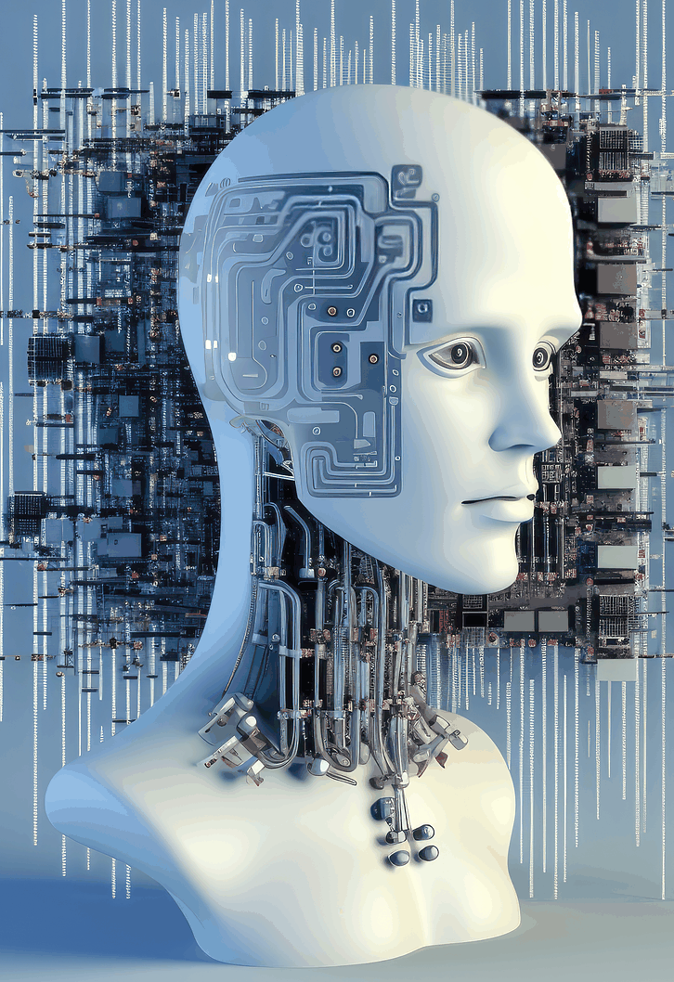
Bmad-Julia and Machine Learning
While the Bmad-Julia will be developed for accelerator simulations in general, the first applications of Bmad-Julia will be in the area of machine learning.
Bmad-Julia will provide a maximally-differentiable simulation and lattice design environment. This enables machine learning techniques (e.g. backwards differentiation to train ML models) to be employed naturally, as well as any optimization techniques utilizing automatic differentiation for lattice design purposes.
Computation speed is critical for ML/AI applications as well as for other accelerator-based simulations. Hence there will be a heavy focus on developing GPU compatible code along with multi-threading capabilities.
Julia's entire ecosystem of optimizers and machine learning packages are at one's fingertips in Bmad-Julia.

Slide 16
Conclusions
Bmad-Julia is a new, open-source project to develop, in the Julia language, a set of programs and modular packages providing the fundamental tools and methods commonly needed for accelerator simulations.
By avoiding the necessity of "reinventing the wheel", simulation programs can be developed in less time and with fewer bugs than developing from scratch.
The Bmad-Julia project will develop accelerator simulation programs for various simulation tasks. Initial program development will focus on Machine Learning and Artificial Intelligence applications. However, Bmad-Julia will be applicable to accelerator simulations in general.
Timeframe: Goal is to be able to do basic tracking and ML in 2025.
Bmad-Julia is an open collaboration of the entire accelerator community. Anyone interested is welcome to join.

Slide 17
Acknowledgements
Development of Bmad-Julia is currently in full-gear, and would not be this far along without the help of many people
Dan Abell
Alex Coxe
Oleksii Beznozov
Scott Berg
Etienne Forest
Chris Mayes
Ryan Roussel
Auralee Edelen
Laurent Deniau
Lixing Li
Juan-Pablo Gonzalez
Gavin Hunsche
Matt Signorelli
Georg Hoffstaetter

Slide 18
Thank You

Slide 19
Extra

Slide 20
Bmad-Julia: The Future of Machine Learning Focused Accelerator Modeling
Project Objectives:
  Using the experience gained with Bmad, create simulation packages using the Julia Language that has Machine Learning (ML) / Artificial Intelligence (AI) capabilities built in from the ground up.
  While the initial applications will be ML / AI, the code can be used for accelerator simulations in general.
  The project will engage the entire accelerator community to promote sustainability and portability of the software. Currently there is participation of people from Cornell, BNL, RadiaSoft, SLAC, ANL, Berkeley Lab, JLab.
  This gives the Bmad-Julia project the potential to revolutionize accelerator simulation program development just as Geant4 has revolutionized the simulation of particle-matter interactions.
Due to Bmad's wide adoption and breadth of capabilities, for the foreseeable future, Bmad-Julia will not be a replacement for Bmad and both will coexist side by side.
Project Status: Started in 2023, DOE funding has been applied for, and open source packages are in development for
  Lattice instantiation and manipulation.
  Truncated Power Series Algebra (Taylor maps).
  Normal form analysis including spin.
  Atomic and physical constants.
And much more to do...

