Slide 1
Step towards Digital Twin
Lucy Lin
Machine Learning Collaboration Meeting
August 21-22, 2024

Slide 2
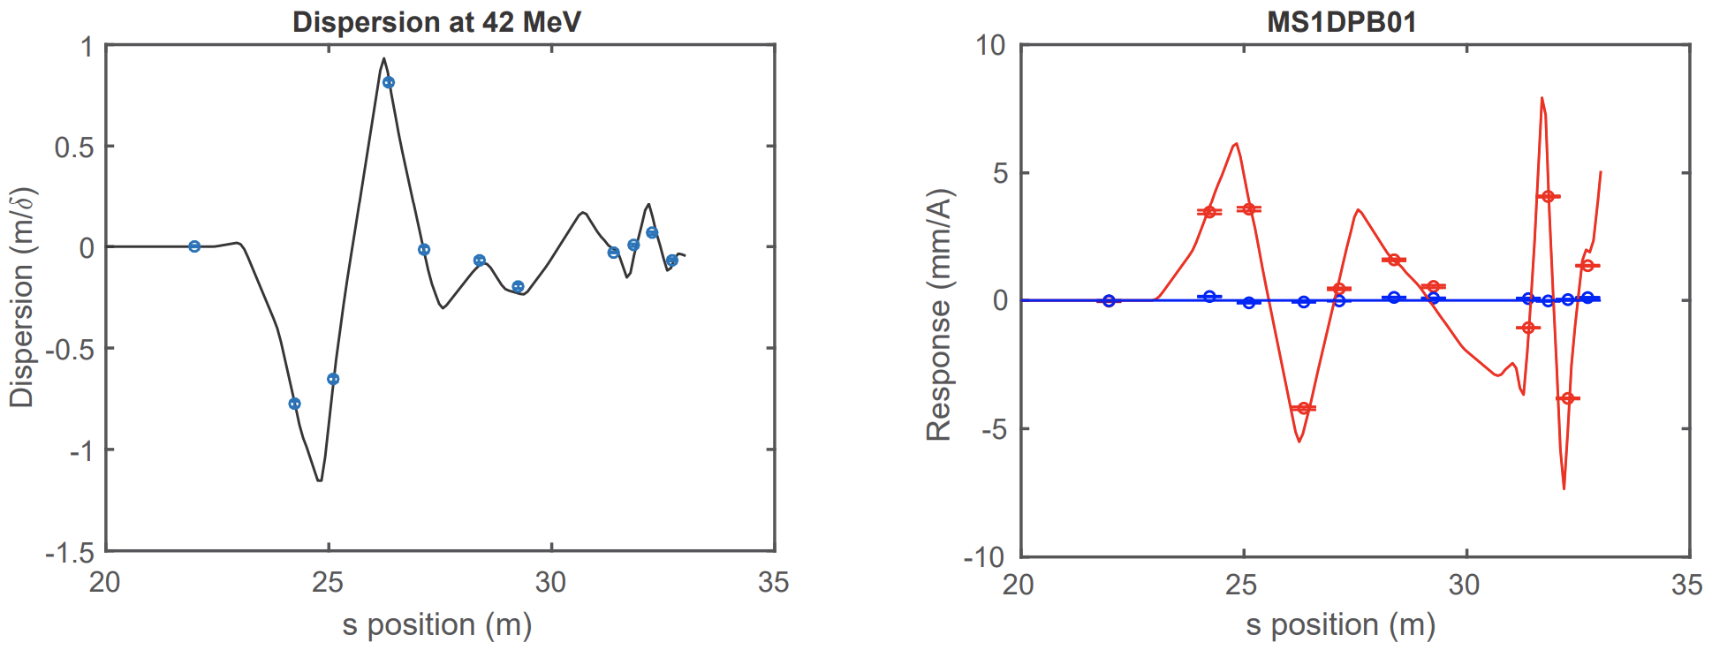
Motivation: Digital twin at CBETA
Had success in building digital-twins for CBETA: combine custom version of Bmad/Tao with EPICS
CBETA-V: measure beam trajectories and compare to the digital twin in real time on control-system screens
Neural network can be trained to predict orbit response using Bmad simulation data
NN model can predict beam behavior due to both linear (correctors) and non-linear (cavity) relationships

Slide 3
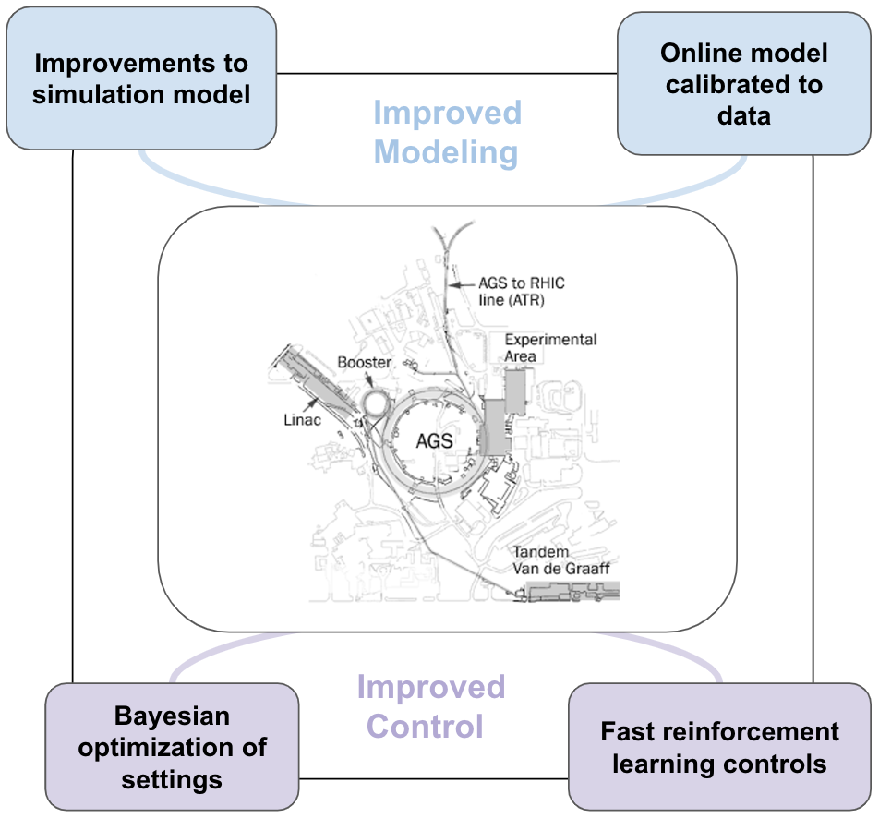
Improve Accelerator Operations with DT
Figure-of-merits (FOM) for machine learning (ML) algorithms (“experimental outputs”): beam position, beam size, emittance, beam intensity, polarization
real measurements can be expensive
Improved modeling $→$ Digital Twin
Digital twin can be used for:
offline development of optimization and tuning routines
fast real-time predictions for operators
error detection and correction

Slide 4
Orbit Response modeling

Slide 5
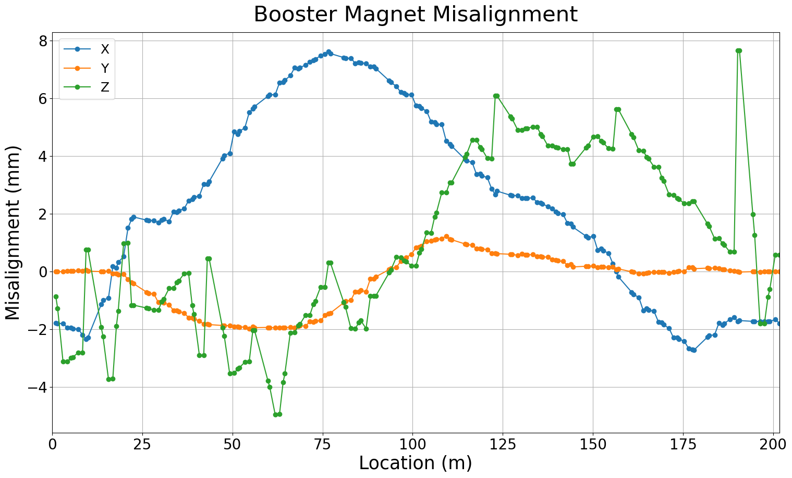
Booster magnet misalignment
Magnet location in real machine from 2015 survey data
Misalignment data for quadrupoles and dipoles
Trouble with making physics simulation with misalignment agree with real base orbit data

Slide 6
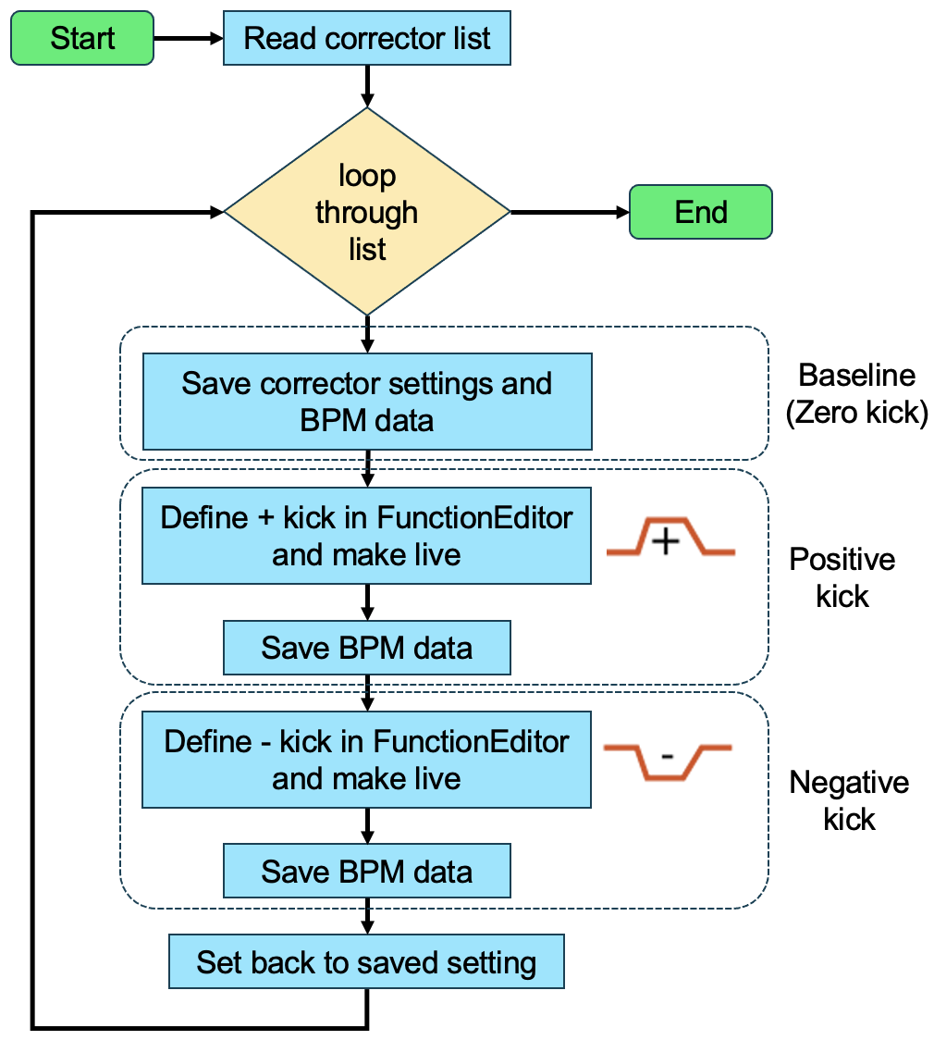
CAD script to get real orbit responses
Script development with Collider Accelerator Department (CAD) Controls Group
Can be easily adapted to any accelerator at BNL
Script sets three corrector settings: positive, zero, negative; and save corresponding orbits
All magnet settings (including dipoles and quadrupoles etc.) are saved for model construction and calibration for digital-twin

Slide 7
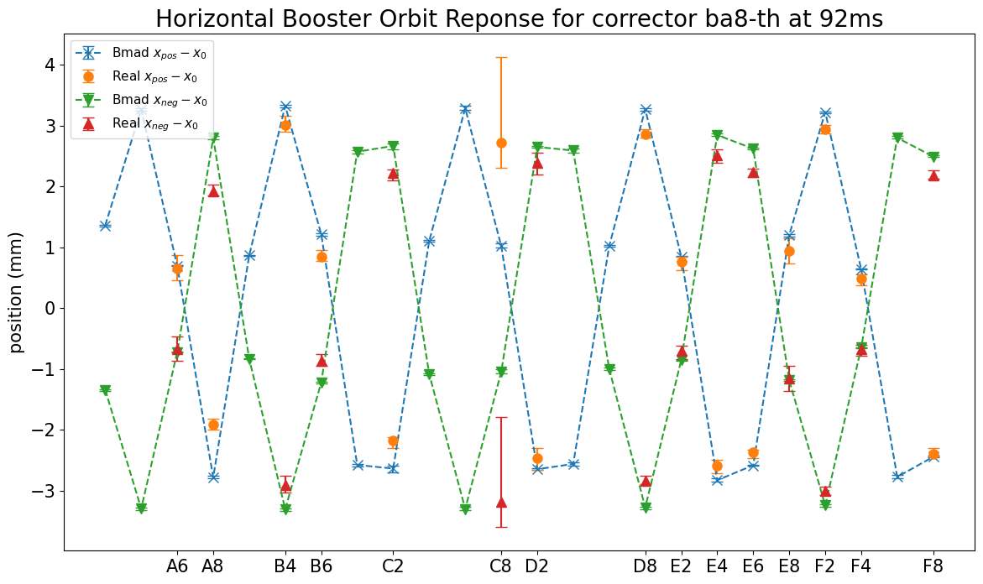
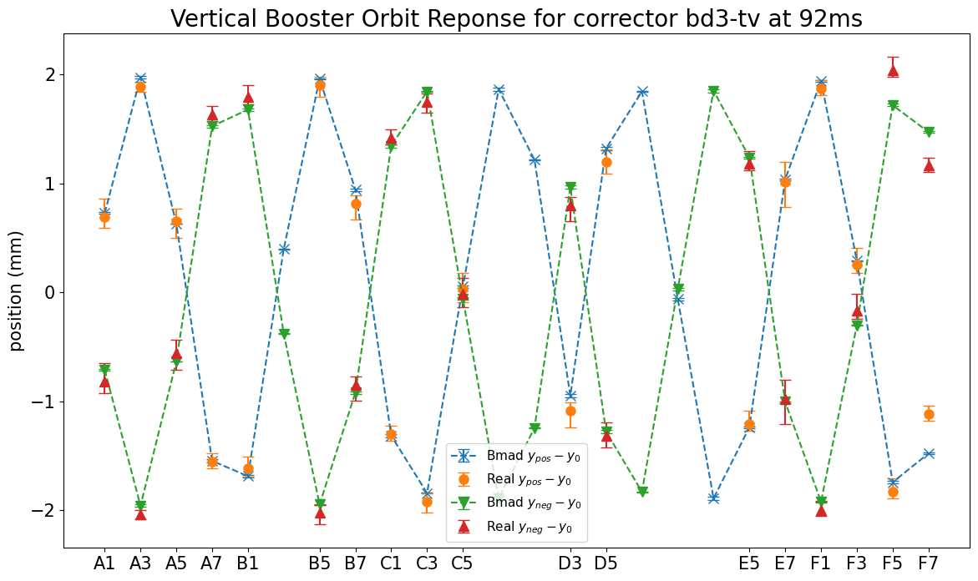
Orbit response data in AGS Booster
Orbit response data can be used to find and quantify unknown parameters (e.g., power supply scaling factors, magnet misalignment etc.) in real accelerators
Good agreements between AGS Booster data and Bmad model are reached, despite some faulty BPMs (i.e., PUEHC8)
Small discrepancies (within 1 mm) beyond error bars is being investigated
This can be the first step to incorporate digital twin into the control system

Slide 8
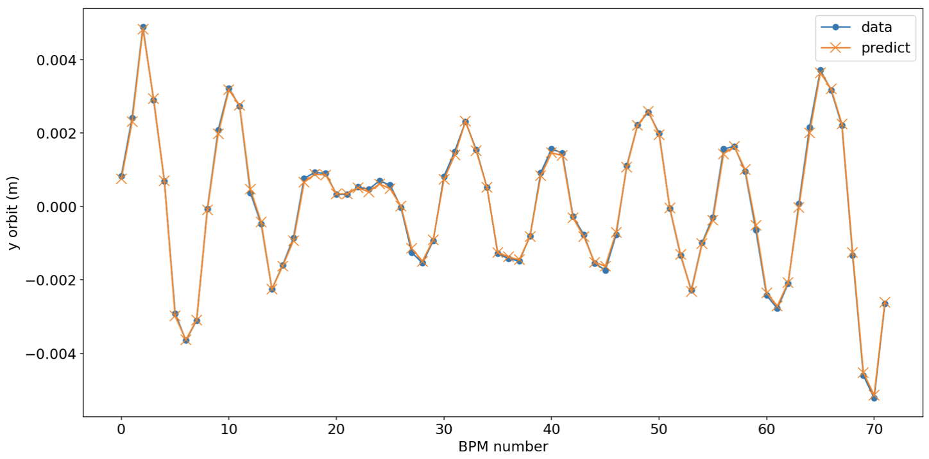
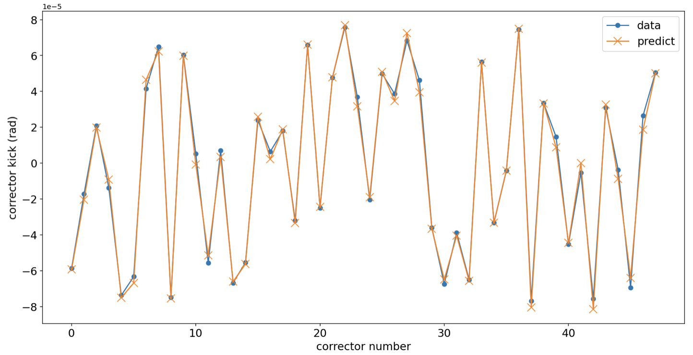
AGS ORM NN model
AGS physics simulation model constructed in Bmad, translated from MAD-X
48 vertical corrector kick $↔$ 72 y orbit measured at BPM
Trained models accuracy > 99%
ORM studies in the real AGS ring would be beneficial for model calibration
ORM NN
Inverse ORM NN

Slide 9
First step towards virtual machine (for ORM)
CAD development
Save all system settings in a format for loading into Bmad
Save necessary outputs for comparison, some need extra data processing and calculation with raw data (e.g., difference orbit)
Bmad development
Include necessary calibrations for satisfactory model accuracy
Define all necessary variables and data for fast model modification and data retrieval
General development
Align naming conventions for ADOs and Bmad variables/data

Slide 10
Use ORM to identify machine errors
Actual machine with errors (e.g. quadrupole gradient errors, corrector calibration errors, etc.) produce different ${\underline{R}}_{ measured}$ from model/reference machine ${\underline{R}}_{ model}$
Considering all possible sources of errors as a vector $\vec{ν}$, build response error model ${\underline{J}}_{ model}$. Reconstruct any $\vec{ν}$ given known $∆\vec{R}$ and ${\underline{J}}_{ model}$
Next step after we have satisfactory models incorporated into control system

Slide 11
Beam line modeling

Slide 12
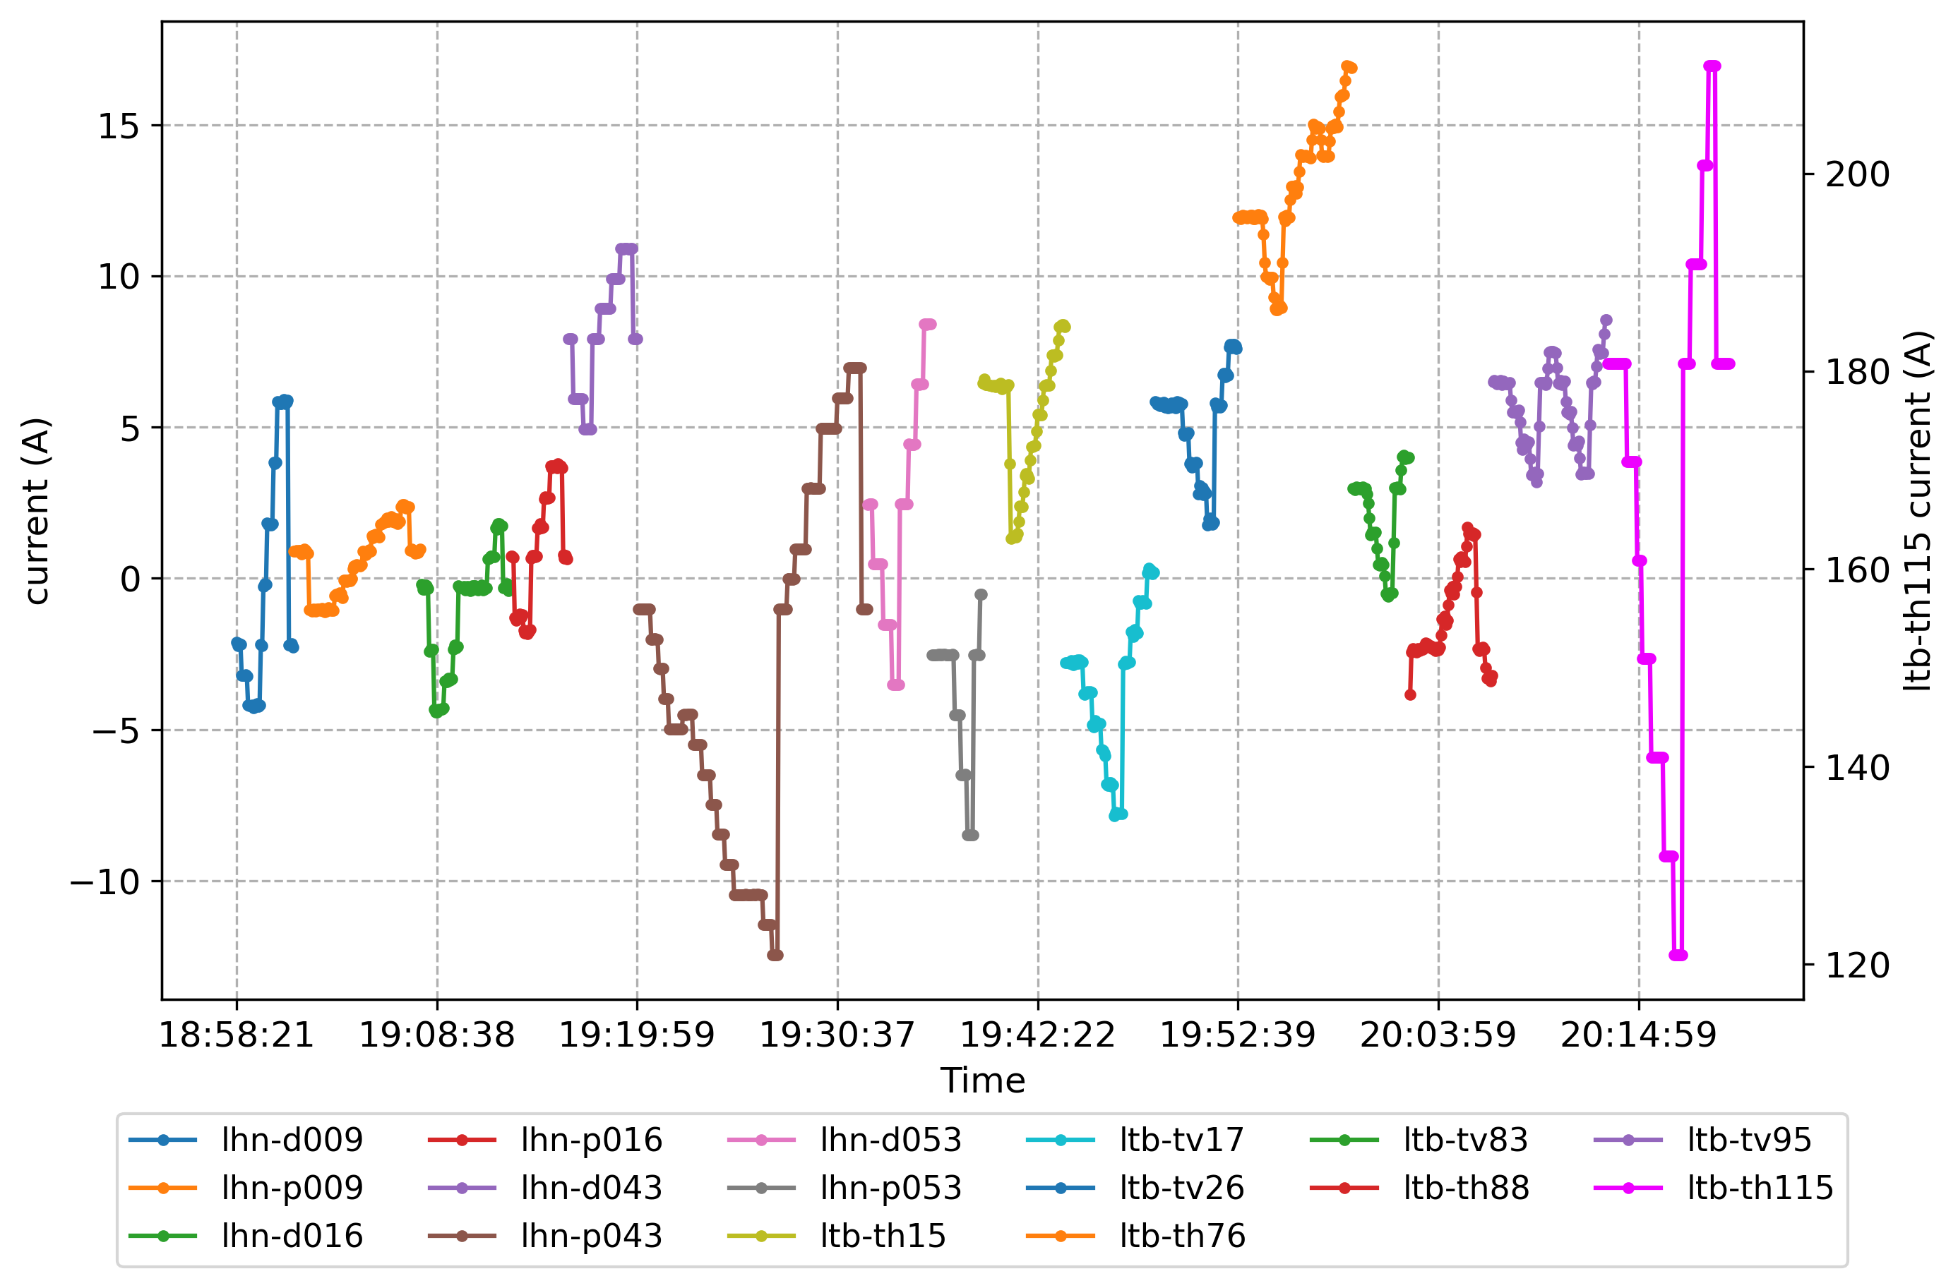
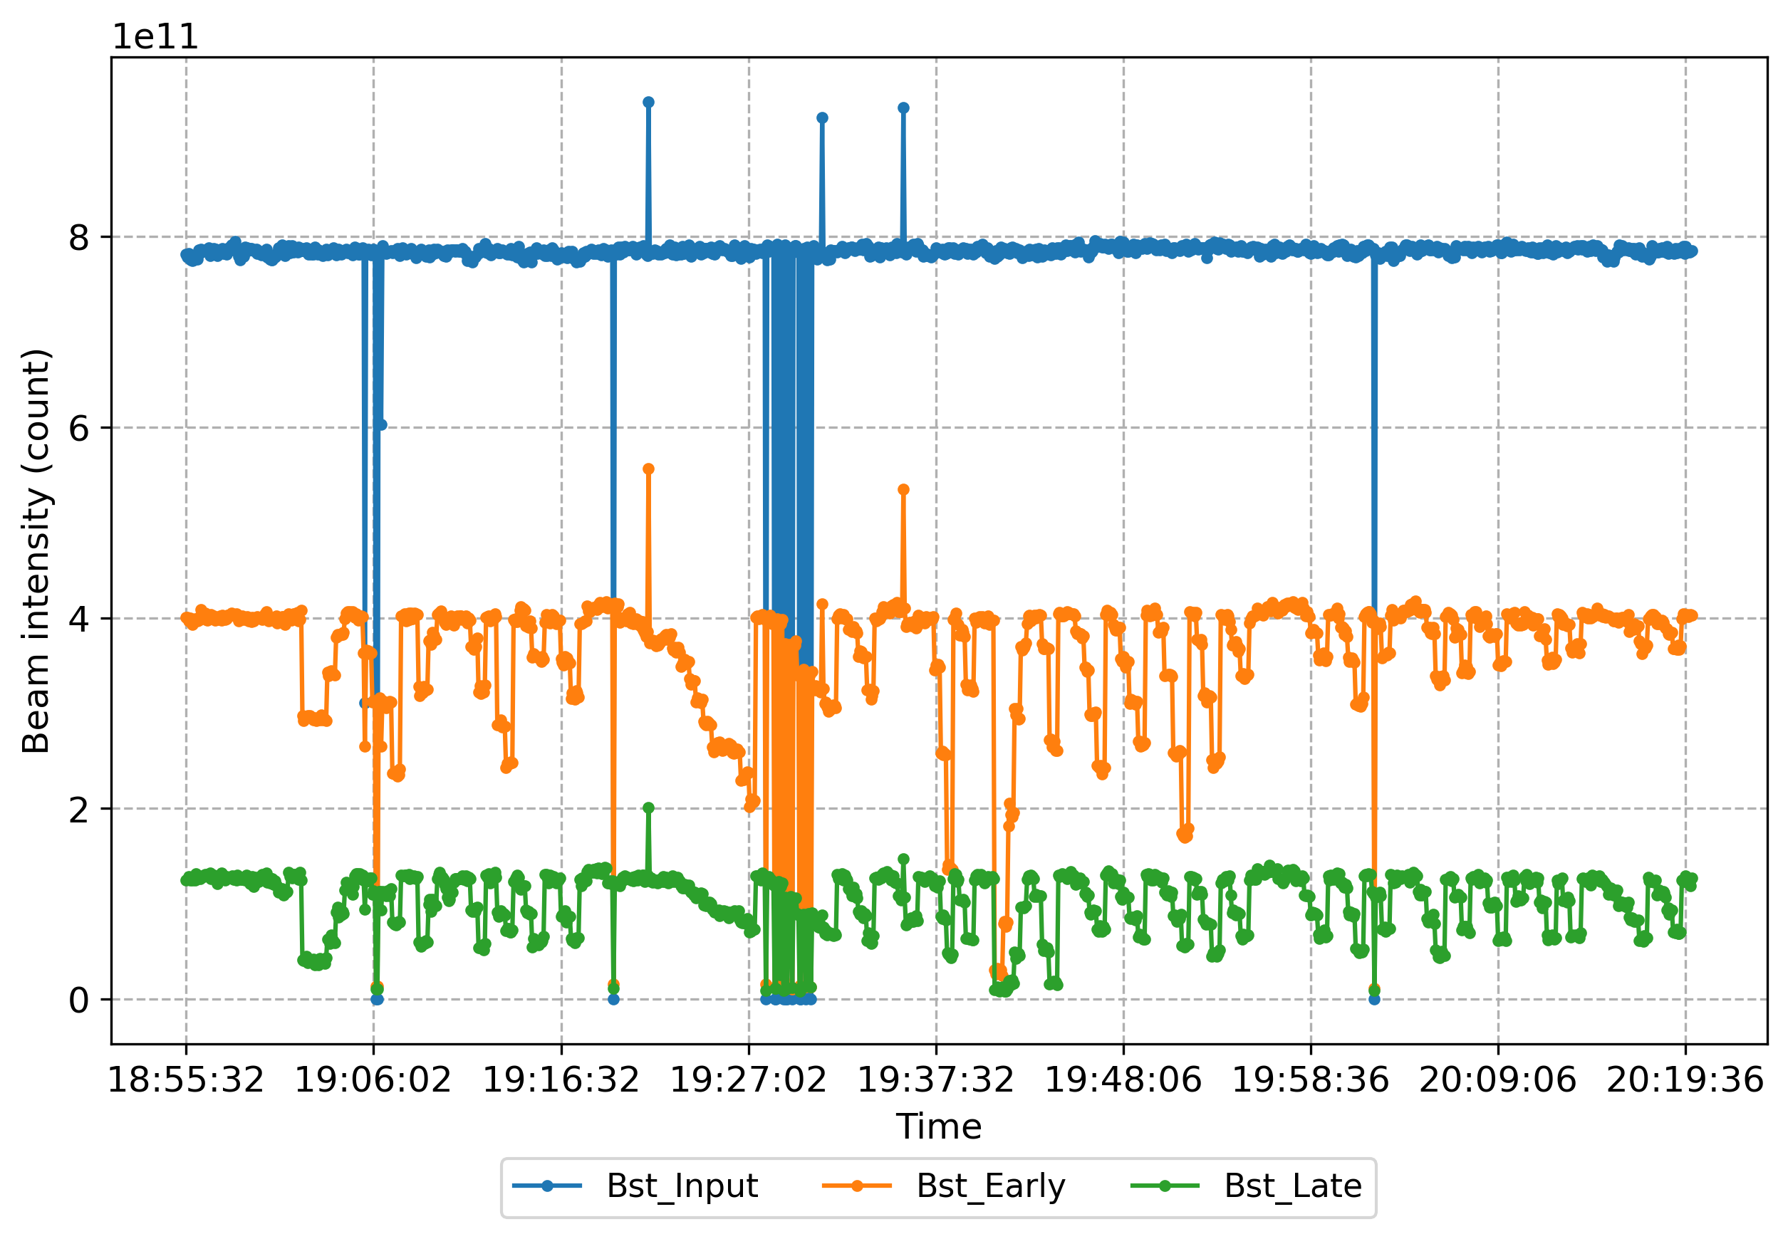
LtB corrector scan
All 16 correctors were scanned on Jan 25, 2024, 6:55pm – 8:20pm, on Pulse-to-Pulse Modulation (PPM) user 4 until Booster late intensity dropped by 50%

Slide 13
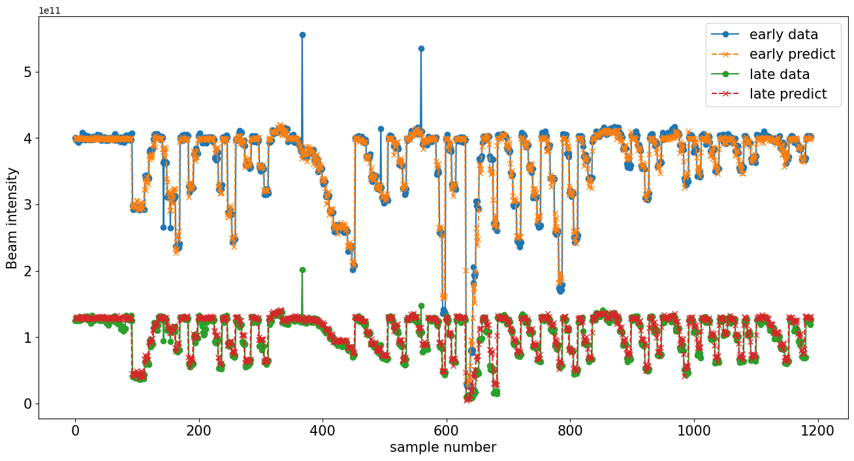
NN model for LtB scan
15 correctors (lhn-d009 is excluded due to insensitivity) $→$ 2 intensities (Bstr_Early, Bstr_Late)
Option to use surrogate models in digital twin for processes without good physics models?

Slide 14
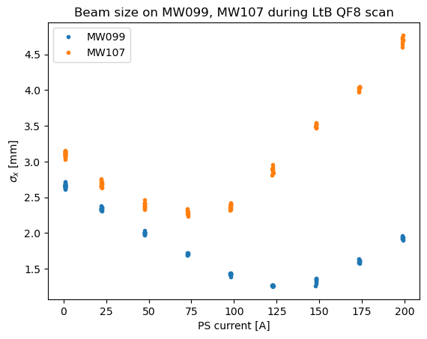
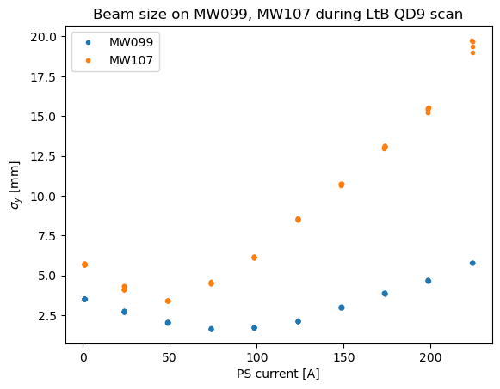
LtB Quadscan: coupling from Linac
Known transverse coupling for H- beam from Linac
Difficult to measure via Quadscan: multi-wires only measure x and y separately

Slide 15
Booster skew quad: coupling investigation
Coupled transfer matrix of skew quads will allow coupling term of initial beam to be measured on the multi-wire x and y profiles during quad scan
Proposed study: Booster injection at C5 $→$ travel through part of Booster ring with skew quads on $→$ Booster extraction at F6 $→$ measure beam profiles at BtA multi-wires
Skew quads located upstream of QV1, QH2, QV7, QH8 in each super-period, 24 in total
12 can be used for coupling study between injection and extraction
QSSTR1: QSA1, QSA7, QSC1, QSC7, QSE1, QSE7
QSSTR2: QSA2, QSA8, QSC2, QSC8, QSE2, QSE8
QSSTR3: QSB1, QSB7, QSD1, QSD7, QSF1, QSF7
QSSTR4: QSB2, QSB8, QSD2, QSD8, QSF2, QSF8

Slide 16
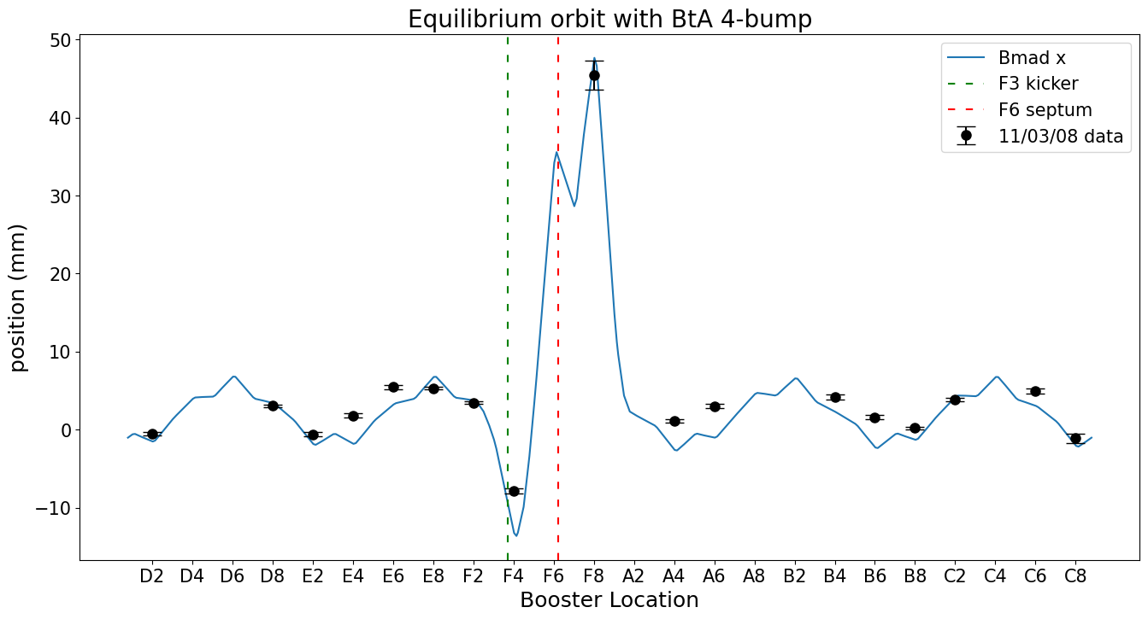
Booster extraction modeling
Orbit distortion (bump) for extraction with back leg windings on four Booster main dipoles (F2, F4, F7, A1)
Not perfect agreement with measured data from 2008, need further investigation, can collect newer data for calibration

Slide 17
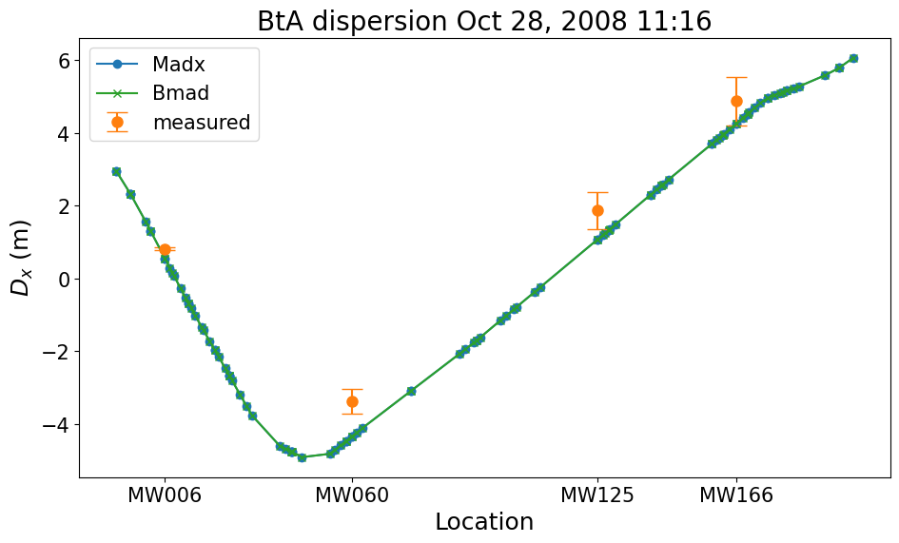
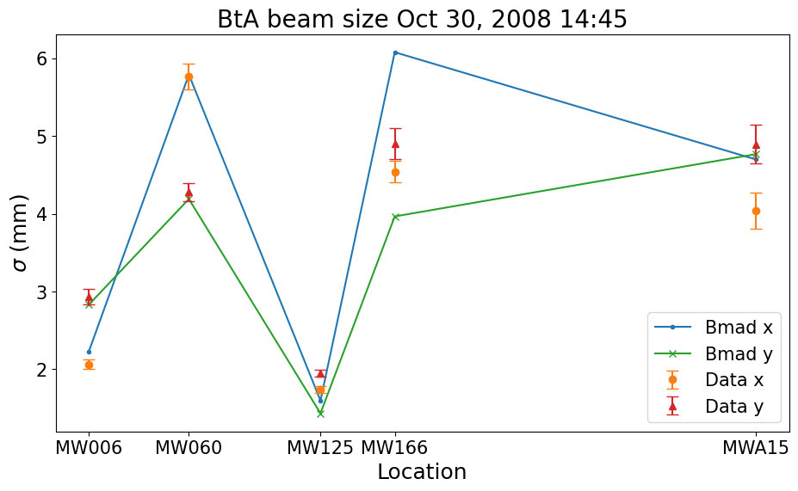
BtA modeling
Bmad tracking obtains same Twiss parameters as original MAD-X model, horizontal dispersion matches measurements
Beam size values from bunch tracking show agreements for upstream multi-wire measurements, disagreement downstream needs further investigation

Slide 18
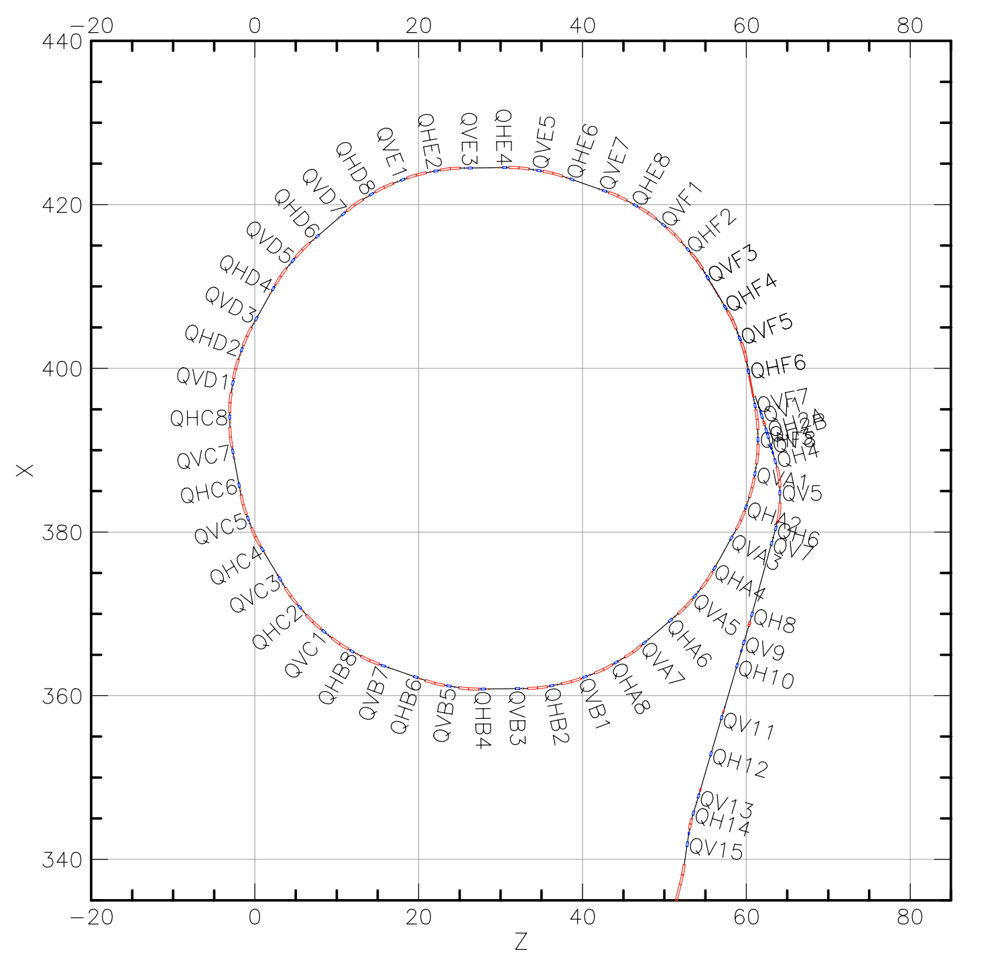
Transfer Line Structure in Bmad
Lattice can be divided into branches connected with forks to simulate connection to a transfer line
Require documented coordinates for elements to construct correct geometry
Beam parameters from the end of one branch is automatically inherited by the start of downstream branch $→$ continuous tracking
BtA universe with three branches
1st branch: Booster ring with extraction bumps
2nd branch: Extraction line from F2 to F6 septum with F3 kicker on
3rd branch: BtA transfer line

Slide 19
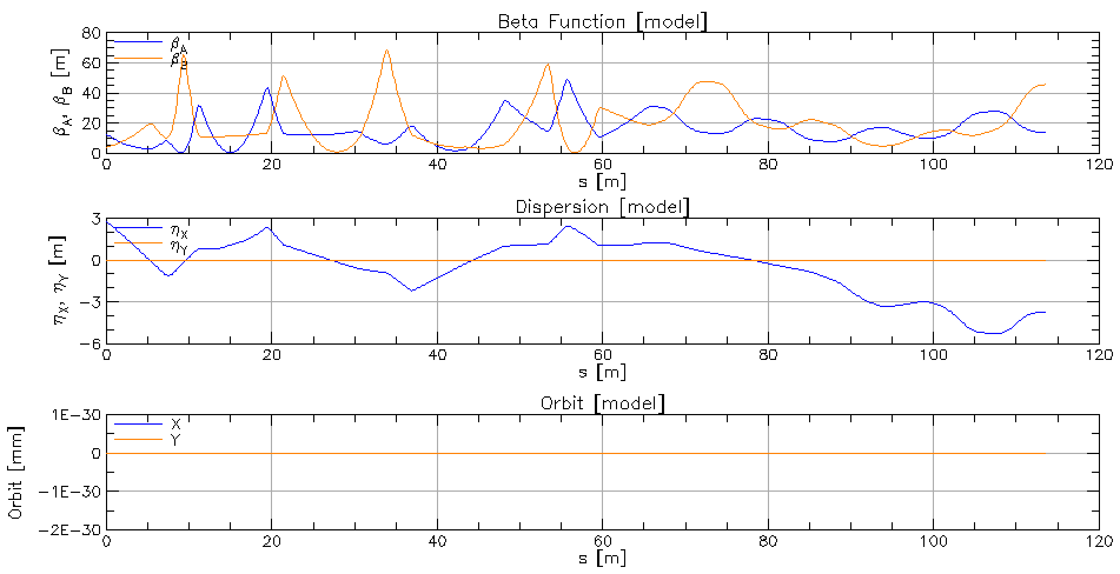
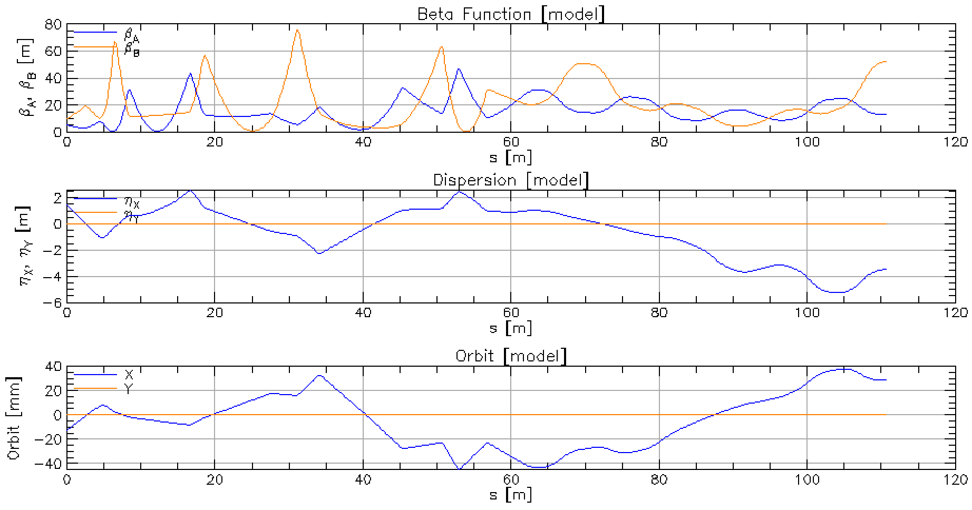
BtA branch modeling
Just BtA (longer due to inclusion of F6)
Beta and Dispersion matches well with original BtA line
Forked BtA
Orbit needs calibration using measured data

Slide 20
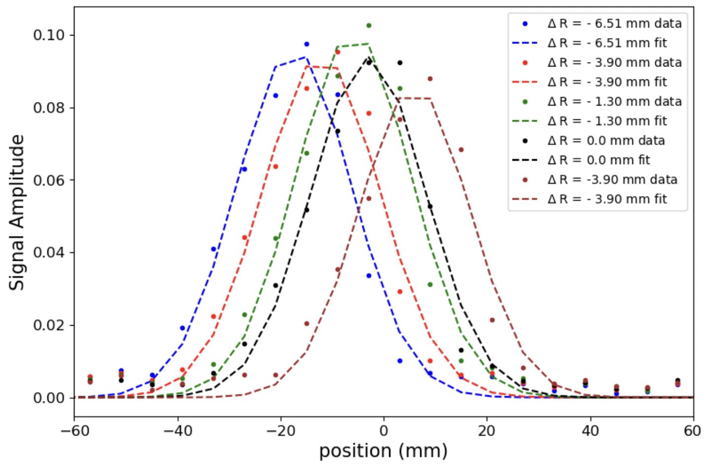
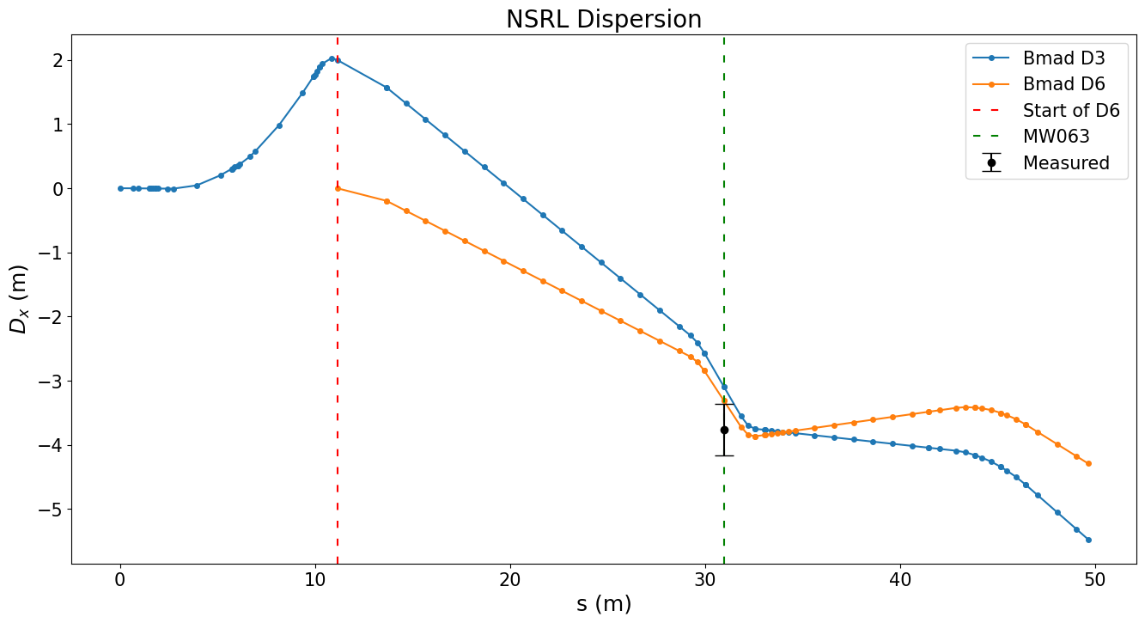
NSRL Dispersion modeling
Horizontal dispersion measurement:
beam momentum $p$ changed by changing beam radius $R$ in the Booster
observe change in beam center $x$
Two models (starting at D3 or D6 septum) were constructed, further calibration is needed, MW063 is not a good reference location
$$D_{x}=\frac{∆x}{∆p/p_{0}}=\frac{∆x}{γ_{tr}^{2} ∆R/R_{0}}$$
Method | Dx (m)
D3 model | $$−3.10$$
D6 model | $$−3.31$$
Measurement | $$−3.76±0.40$$

Slide 21
AGS Polarization

Slide 22
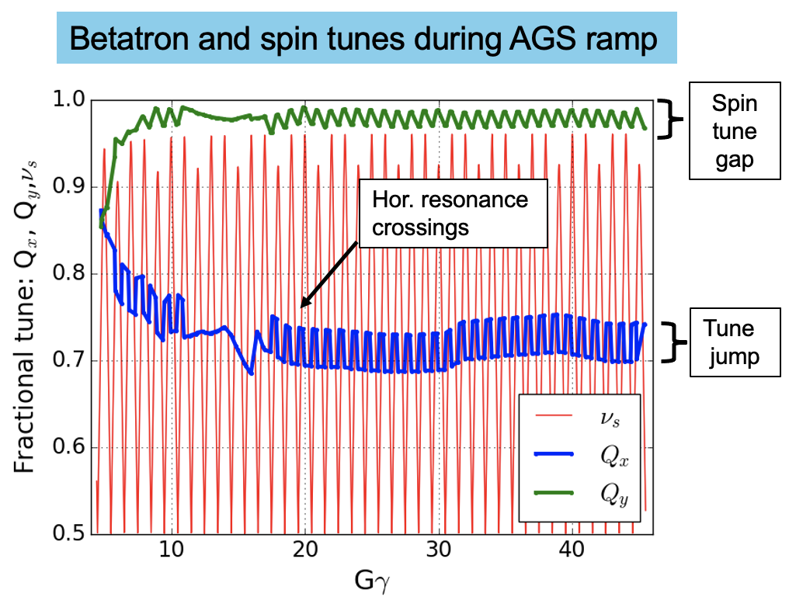
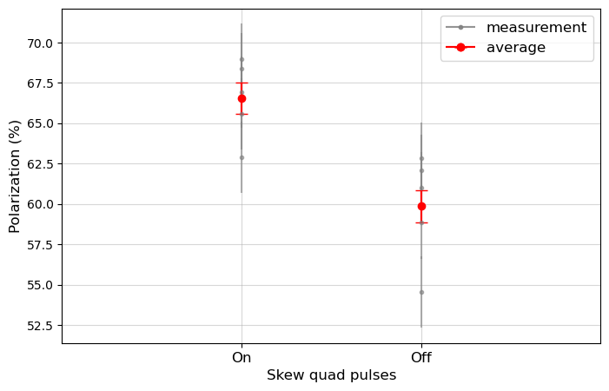
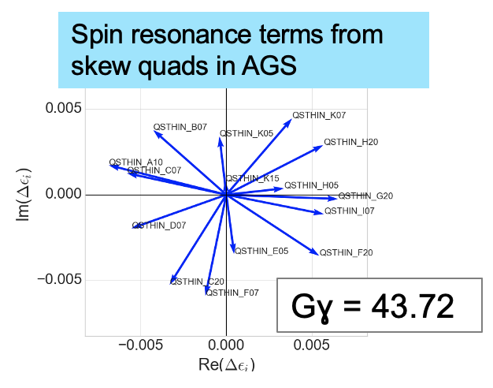
AGS skew quads
Partial snakes in the AGS helps avoiding vertical resonances
Goal: compensate 82 horizontal resonances with 15 pulsed skew quadrupoles
Satisfactory results for above-transition resonances

Slide 23
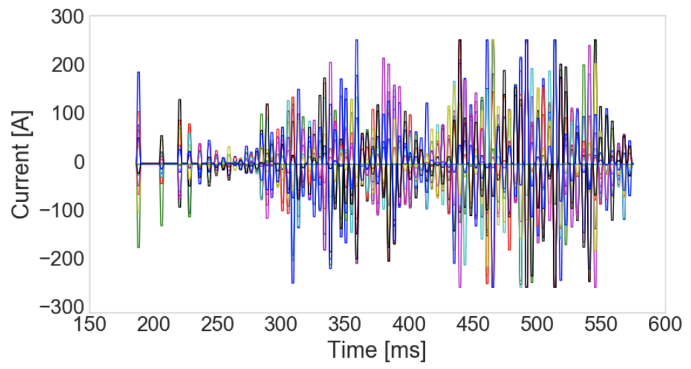
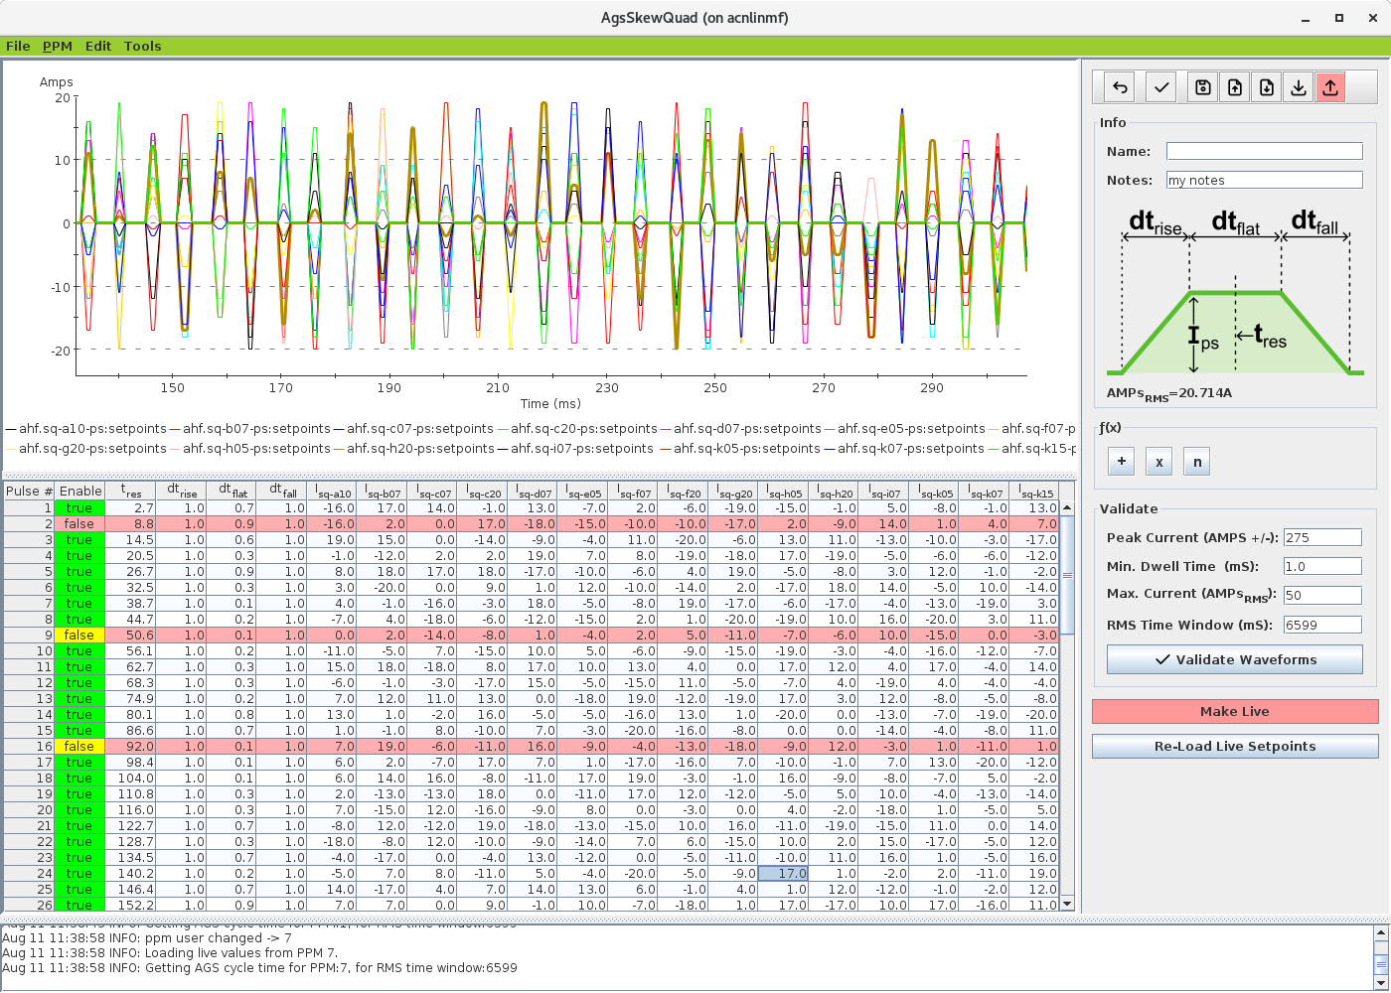
ML for AGS skew quads tuning
Complicated current functions needed to correct all resonances $→$ large table in control application
Impossible for quick and easy manual tuning $→$ ML algorithm can be trained to generate control table when tuning is needed
Control Table

Slide 24
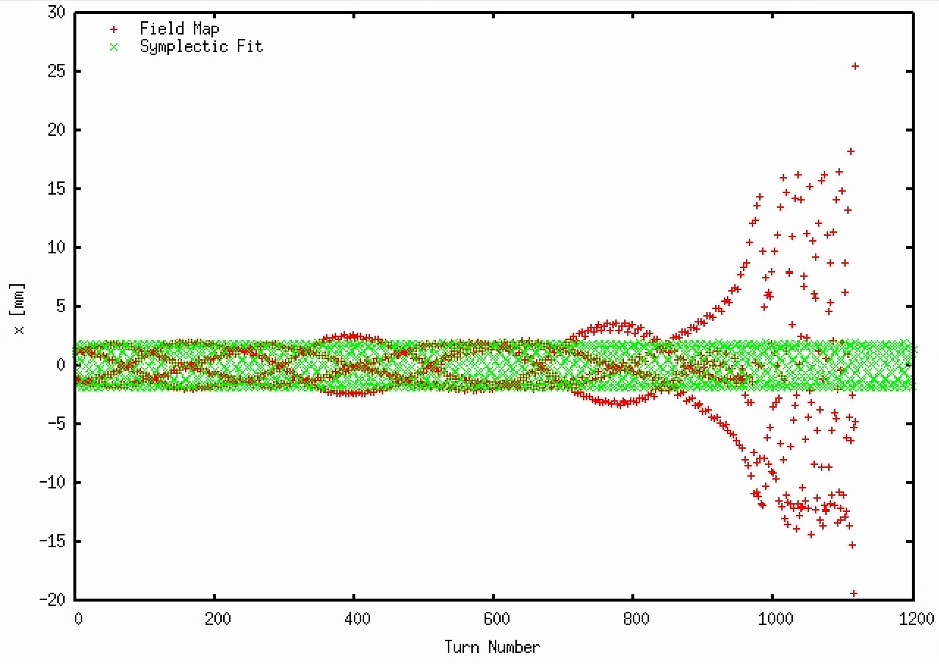
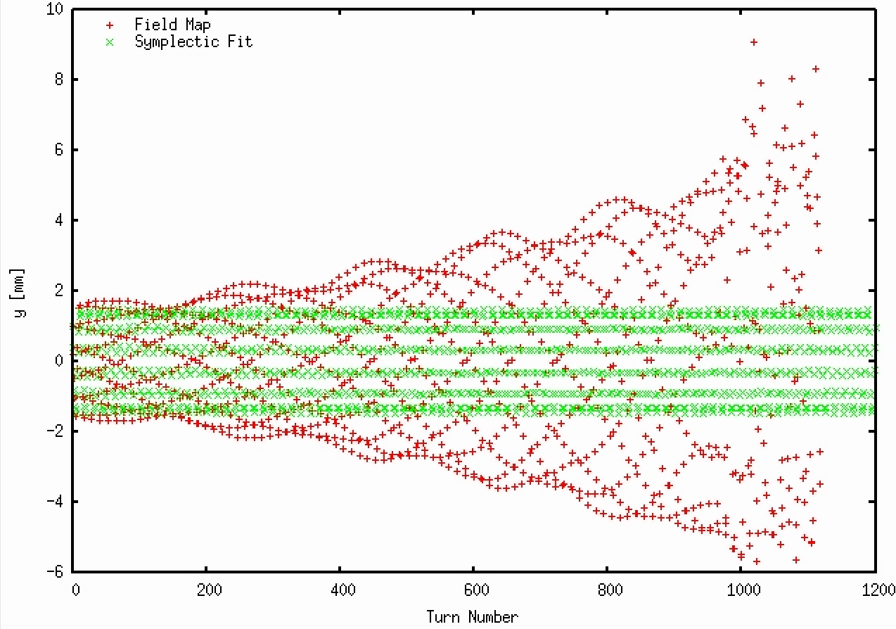
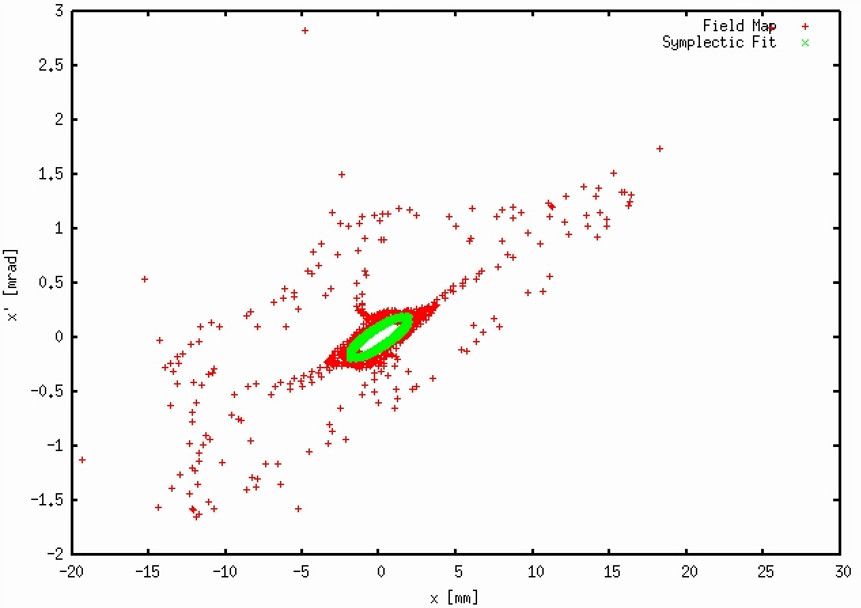
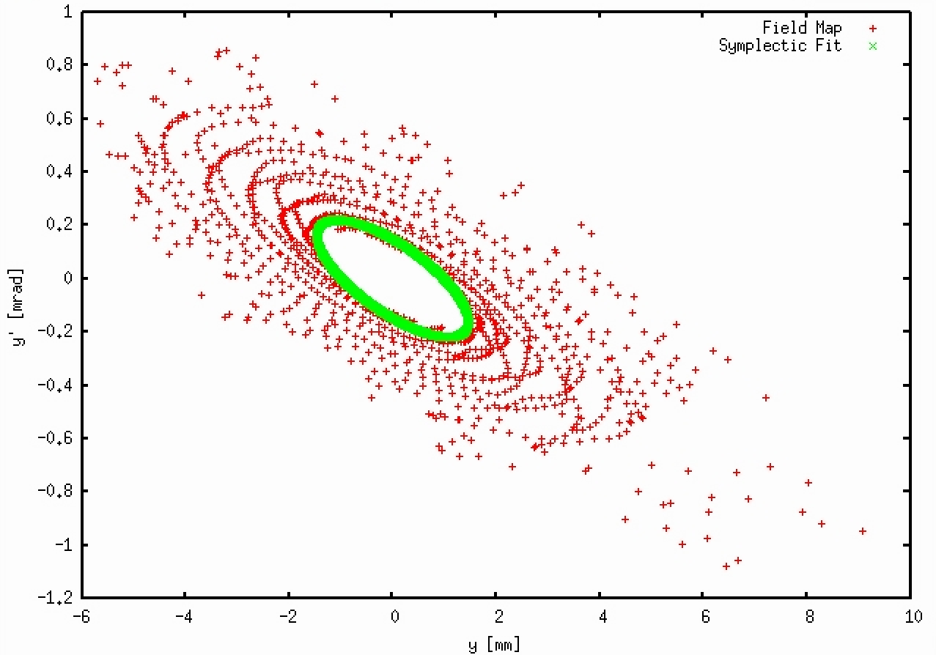
AGS Siberian Snakes modeling
Horizontal
Vertical
AGS Siberian snake field maps violates symplecticity, especially at AGS injection energy
Symplectic tracking (green) is stable for over 10,000 turns

Slide 25
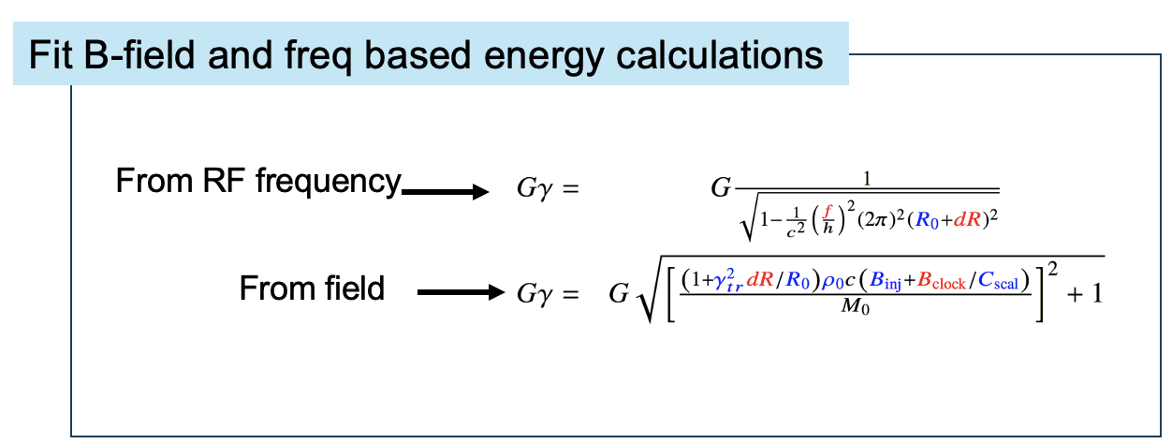
ML for AGS polarization
Polarization measurement is expensive (5-10 minutes)
Improve G-gamma meter: energy measurements from field and frequency needs calibration for ‘unknown’ parameters (e.g., Gauss clock calibration, real radius of AGS)
ML model can be built to account for these parameters, and slow drifts over time
Digital-twin: surrogate model for polarization vs. all relevant parameters can be trained
ML algorithm can suggest maximally informative changes, instead of traditional scans with fixed steps

Slide 26
Next steps towards AGS digital twin
Reproduce ‘bare AGS’ orbit & optics (without snakes):
Dispersion measurements via RF
Beta measurements via correctors
Orbit-Response Matrix measurements via correctors
Empirical snake compensation:
Repeat all (1.)
ORM measurements via BLW
Alignment measurements via skew quads
Alignment measurements via thin quads
Alignment measurements via (correctors + tune quads)
High-fidelity symplectic snake models

Slide 27
Summary
Physics simulation models in Bmad have been developed for Linac to Booster (LtB) line, Booster ring, Booster to AGS (BtA) line, and the AGS ring. However, further calibrations are needed.
Have preliminary success in achieving rough agreement between model and real machine in the Booster and BtA.
Injection and extraction processes need special attention: 1) transverse coupling from Linac affects Booster injection; 2) there is no good model for AGS injection, making AGS skew quad studies challenging.
More script development and beam studies necessary for digital twin development.
Interface development for simpler things like Booster orbit response could be beneficial first step.

