Slide 1
Status of bunch-merge simulations and experiments using reinforcement learning
Presenter: Yuan Gao
Collider-Accelerator Department (C-AD), BNL
Machine Learning Collaboration Meeting
Aug 21–22, 2024

Slide 2
Outlines
Introduction
Simulation Results
Machine Results
Future Work

Slide 3
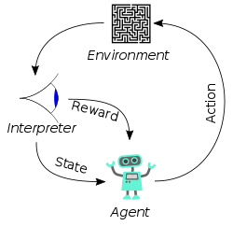
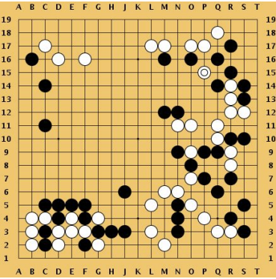
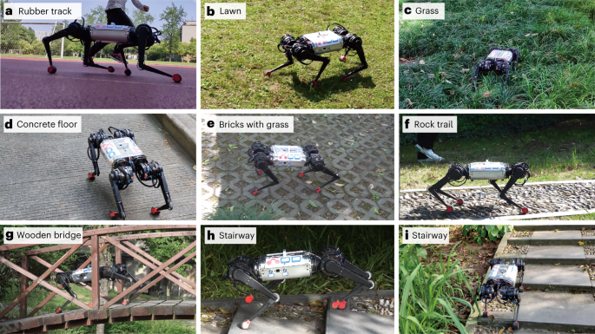
Reinforcement Learning
Problems involving an agent interacting with an environment, which provides numeric rewards
Goal: Learn how to take actions in order to maximize reward
Markov property: Current state completely characterizes the state of the world
Atari Games
Go
Robot Locomotion

Slide 4
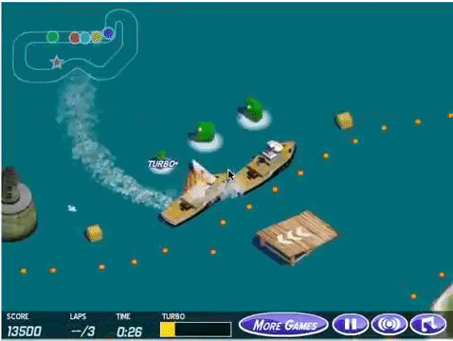
Designing a good reward function can be hard
Recall that the reward function is the only incentive for the agent to learn;
Designing a reward function is sometimes straightforward, but can get hard:
Complicate objectives;
Sparse or delayed rewards;
Several ways to improve the reward function:
Learning from demonstrations:
Learn the policy directly (imitation learning)
Learn the reward function first, then learn the policy (IRL)
Incorporate human feedback (in an interactive manner);
Curriculum learning;
Transfer learning;
Reward shaping:
Incorporate domain knowledge;
Potential-based reward shaping, can slow down learning if not design well;
Reward design can go wrong

Slide 5
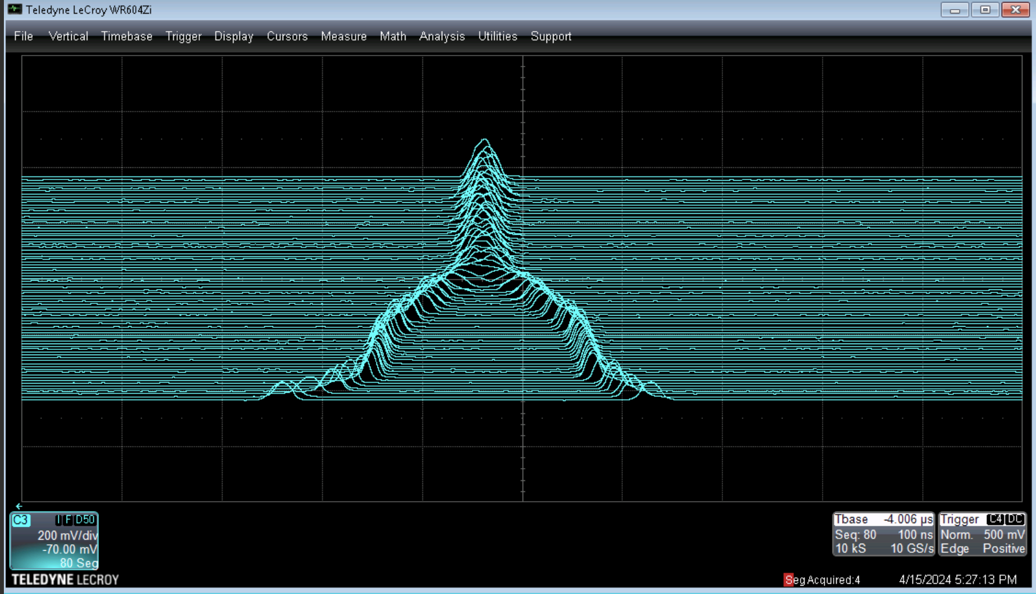
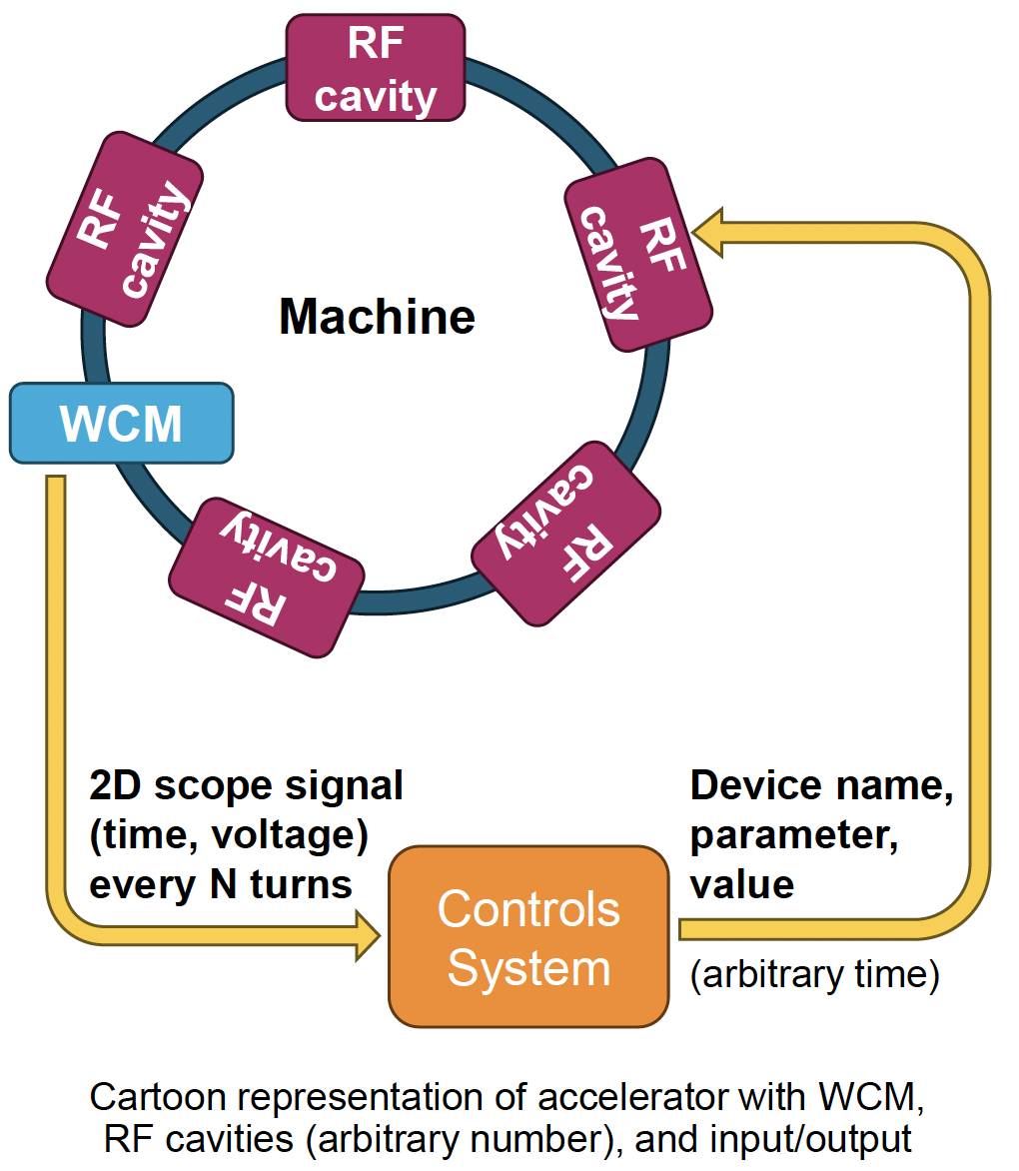
AGS Bunch Merging
Real mountain range data showing 2-to-1 bunch merge in AGS
Wall current monitor (WCM) generates voltage vs time signal. Each separated in time by N turns (N accelerator periods)
Before transferring to AGS, beam bunch is split into 2 longitudinally to reduce the space charge effect
-> reduce emittance -> improve polarization
Bunches are later merged before AGS extraction;
Requires expert tuning of many parameters:
Prone to drift over time;
Time consuming;
Controls: RF voltages, phases
Goal: Obtain a “good” merged bunch profile:
Emittance preservation:
No particle lost;
Gaussian shape;
No “baby” bunches;
Stable final bunch profile:
Not shifting left to right;
Not bouncing up and down;
Merged in the center;

Slide 6
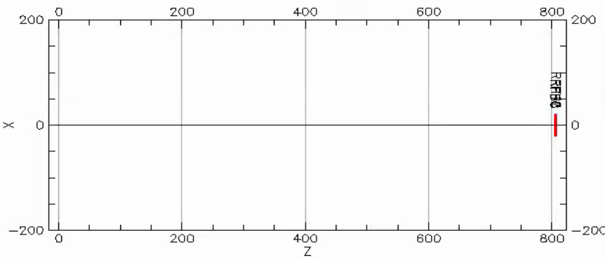
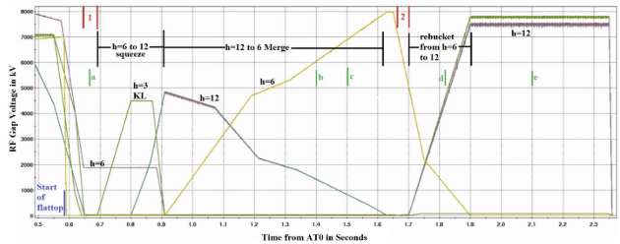
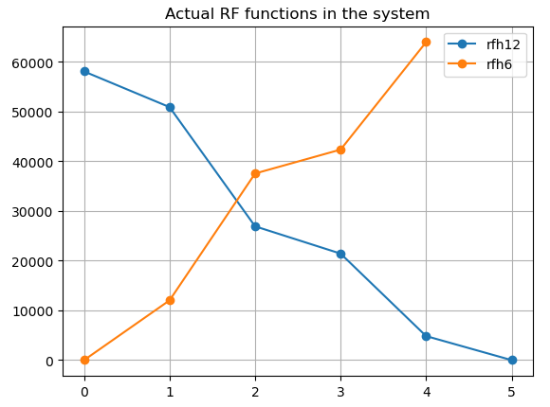
A Bmad Simulator
Simulator built in Bmad:
Only model RF cavities;
Merge parameters taken from the actual system and run22 data;
RF voltages (6 for rfh12, 5 for rfh 6) -> (final emittance, 2 bunch’s final positions, bunch length, bunch length variations);
Slow: 200 particles, with 50-core parallelization, 50 sec / point;
Julia simulator (in development), 300 particles, 10 sec / point;

Slide 7
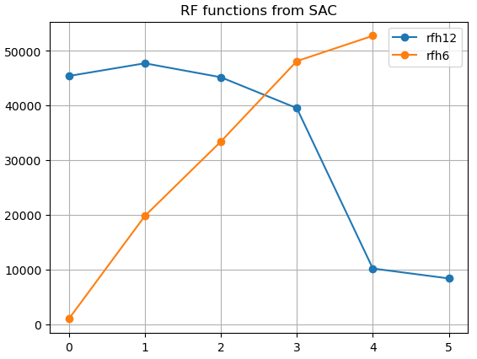
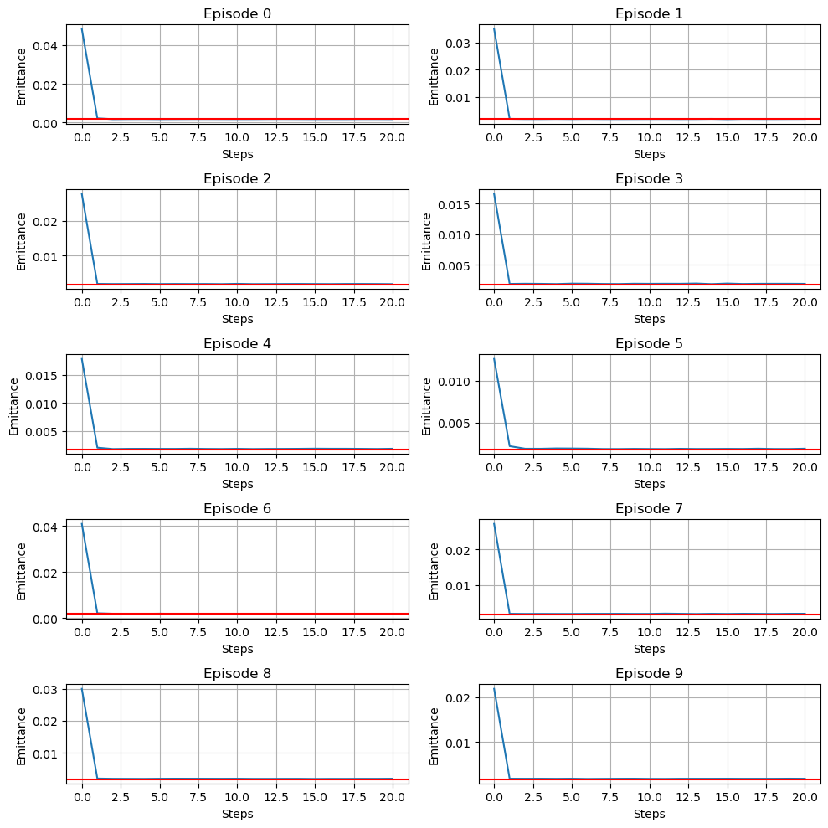
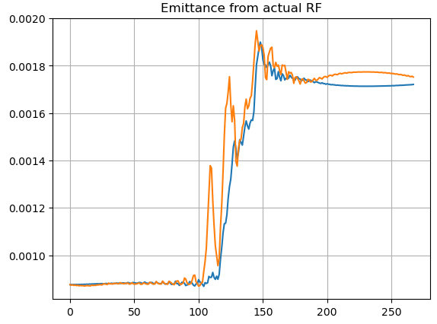
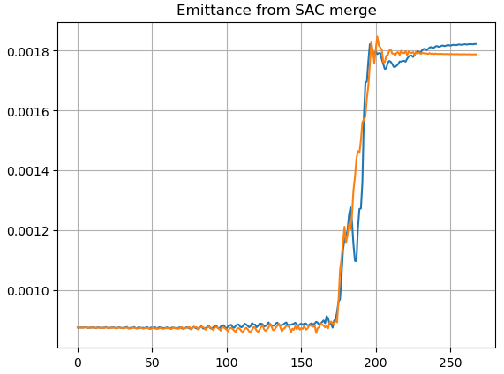
Simulation Results
Target functions
Agent learned functions
Fast tuning on the test episodes
Soft-Actor Critic agent: 10,000 initial samples + 4,000 training steps;
Can learn the RF functions reasonably well; 3% emittance growth;
To improve:
Agent only considers minimizing emittance growth;
Not considering stabilizing final bunch profiles;

Slide 8
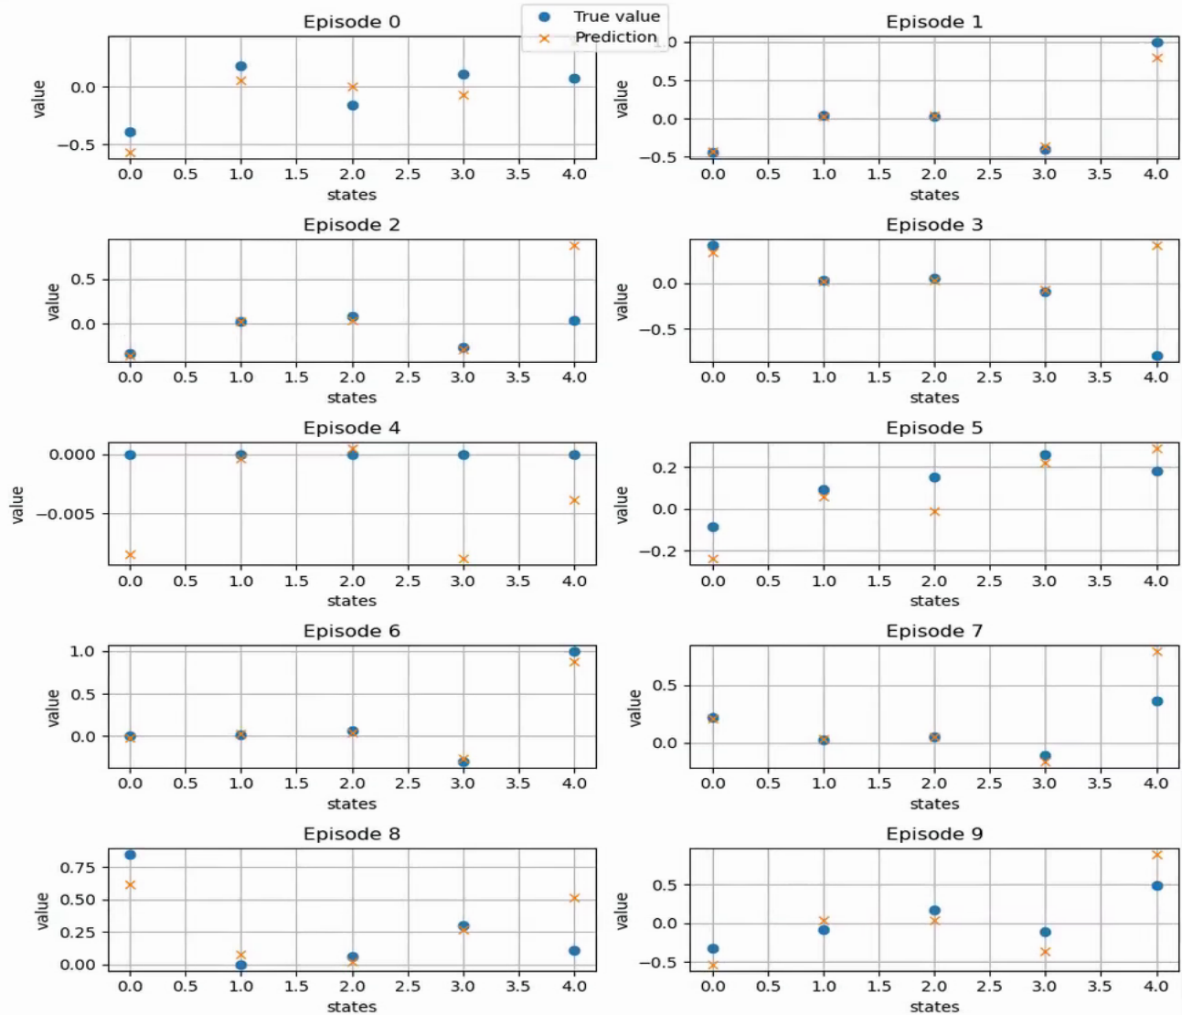
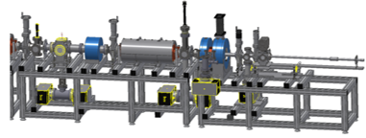
Workflow with a Surrogate Model
Agent required information are missing from the actual system;
Actual data are still related;
Retrain would take a long time;
Use simulation data to build a surrogate model;
Bridge between real-world and simulation;
Need to be accurate;
Cover large enough parameter space;
Accelerator system
RF settings
WCM signals
Saved
RL Agent
Surrogate
Required inputs

Slide 9
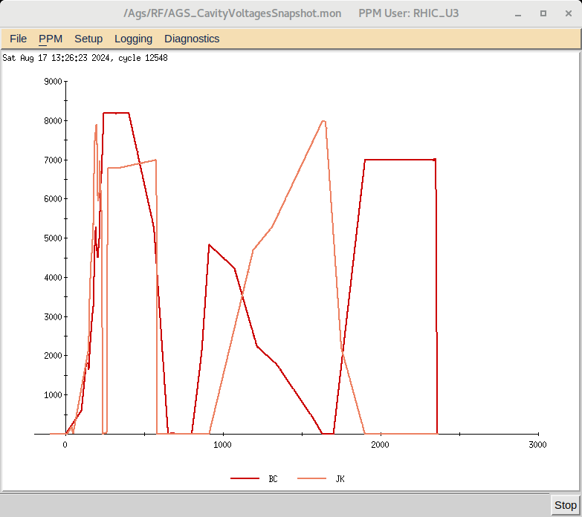
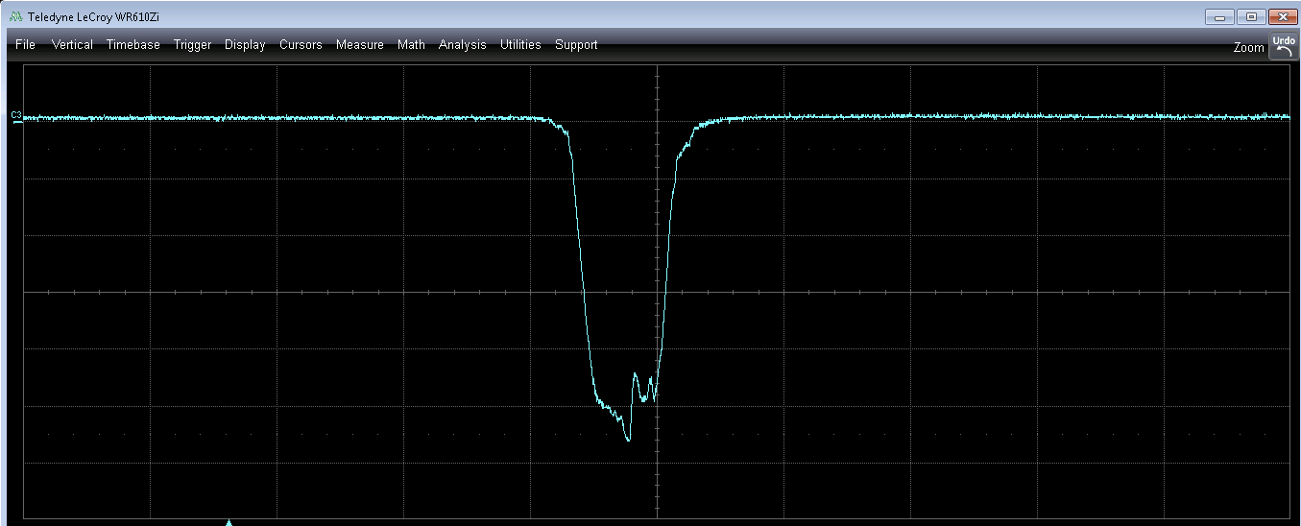
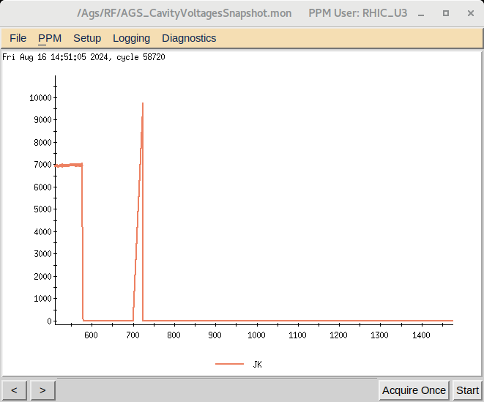
Machine Setup
Bunch merge uses cavity harmonic number 6 and 12:
Merge period ~ 900-1650 ms;
Three cavities in harmonic 12 (B, BC, C), two in harmonic 6 (JK, K);
This test only tunes BC and JK; Should also try all cavities in one harmonic group;
The JK cavity went beyond voltage limit in the first step:
Measurement unit: Volt, Setting unit: kV;
The program sent Volt values to kV settings;

Slide 10
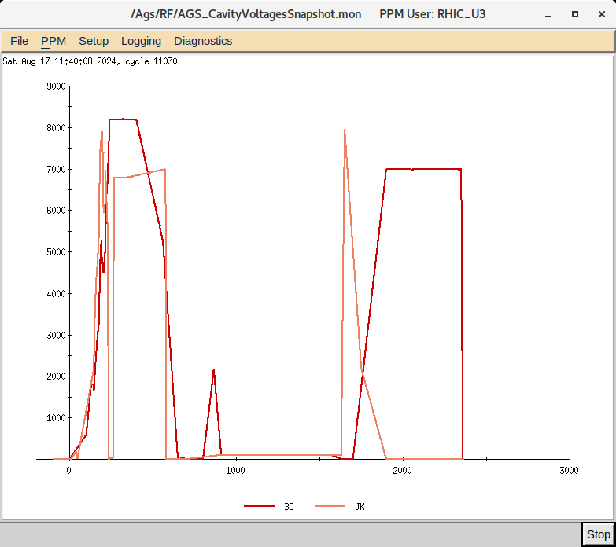
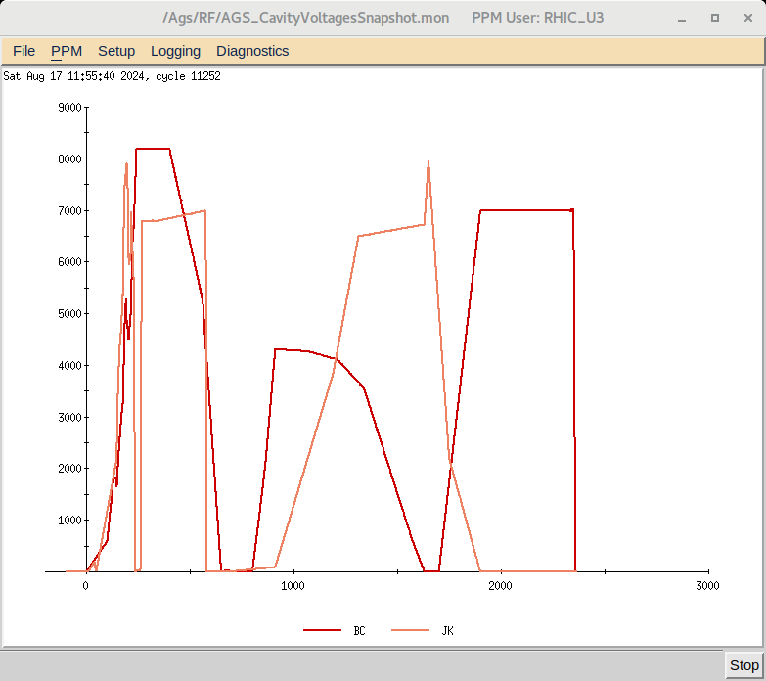
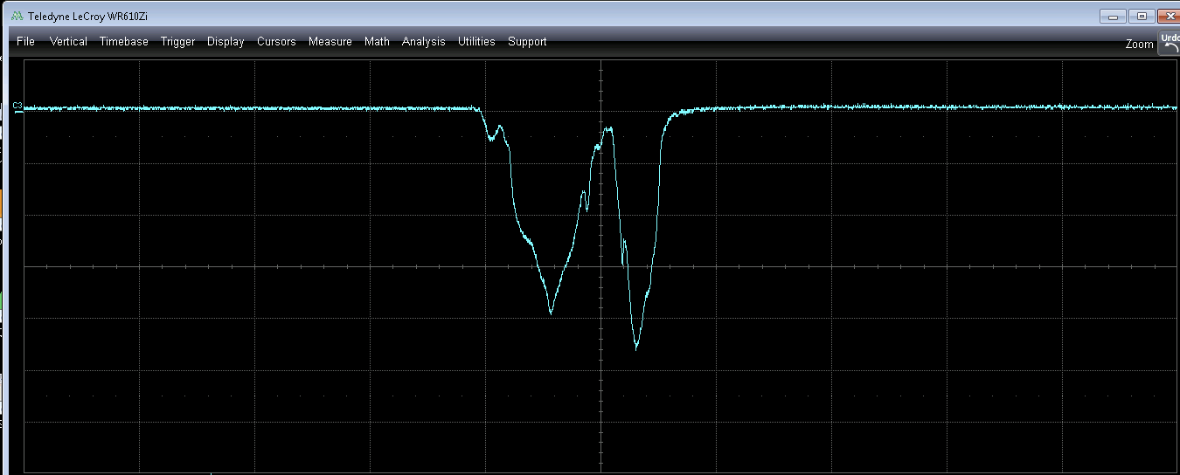
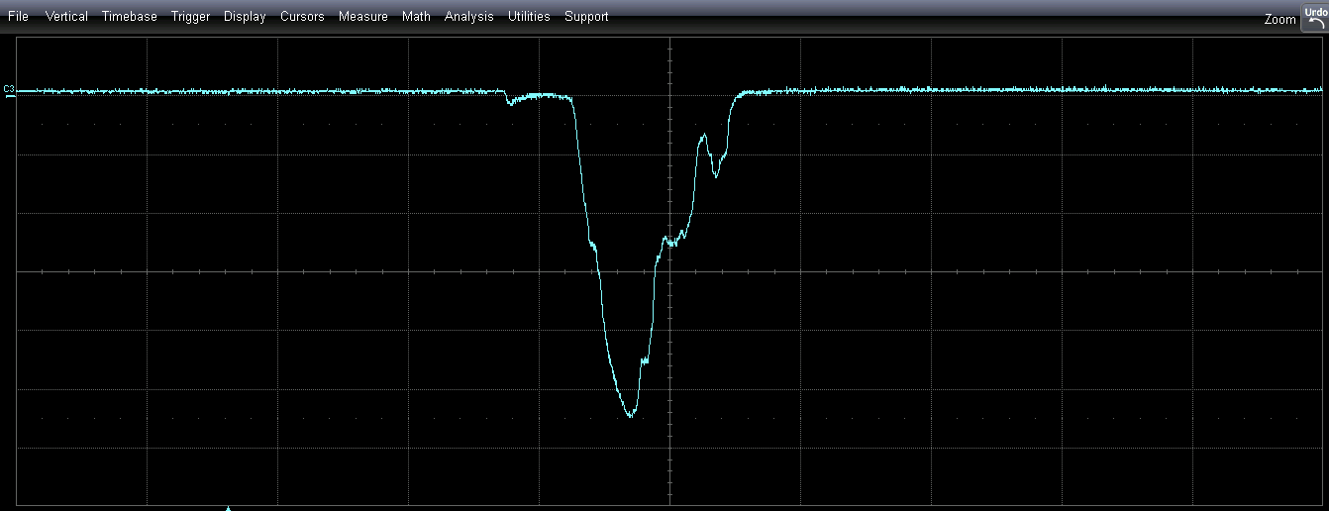
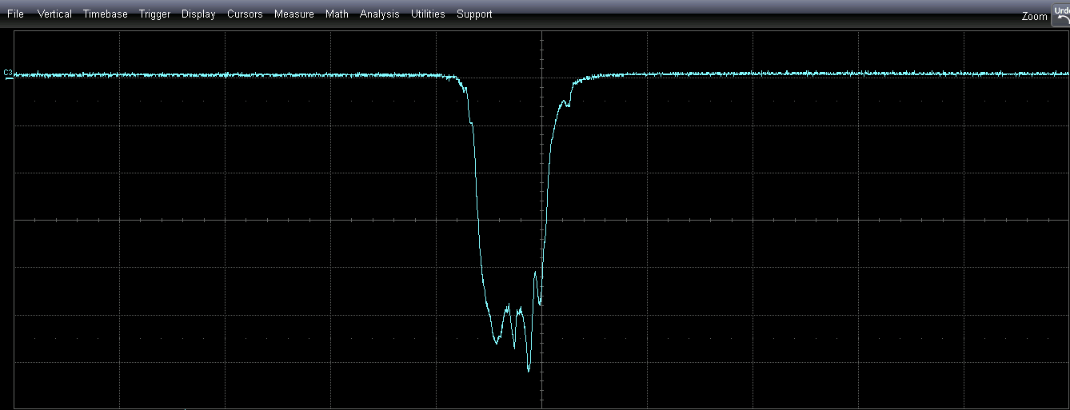
RL Tuning – 1st test
Initial settings are 0.1 kV
5th step
Original
Merged Bunch Profile – last trace
RL agent observes the RF voltages, and uses the knowledge from the simulation to make the next move;
Recover the general shape of the RF functions, but had difficulty recovering the edge value;

Slide 11
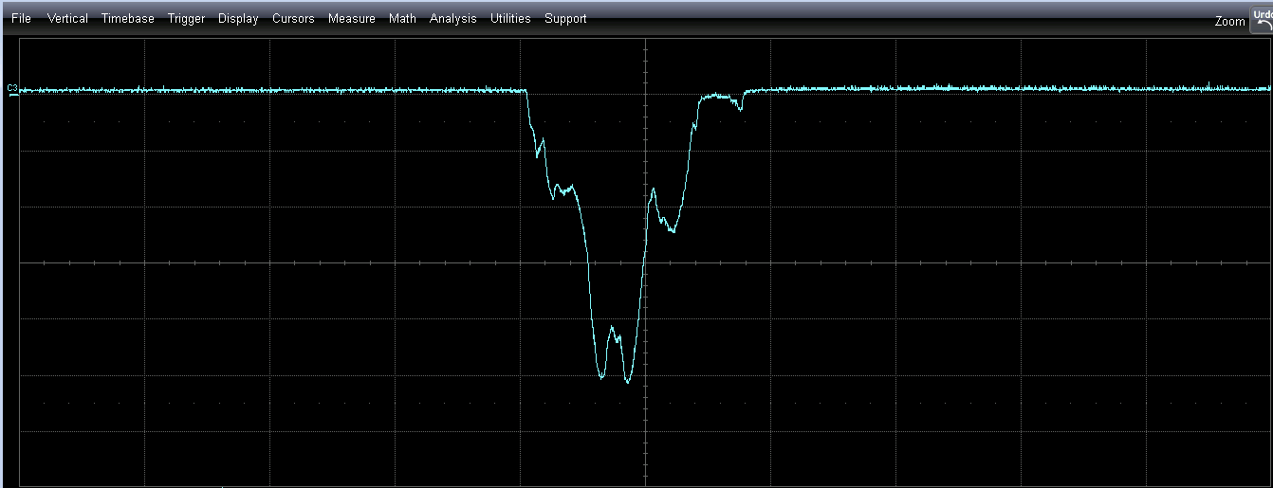
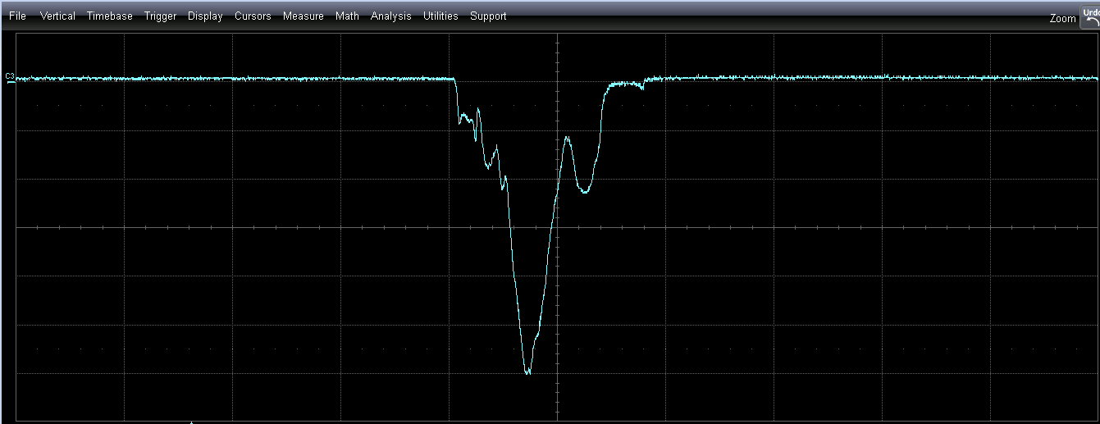
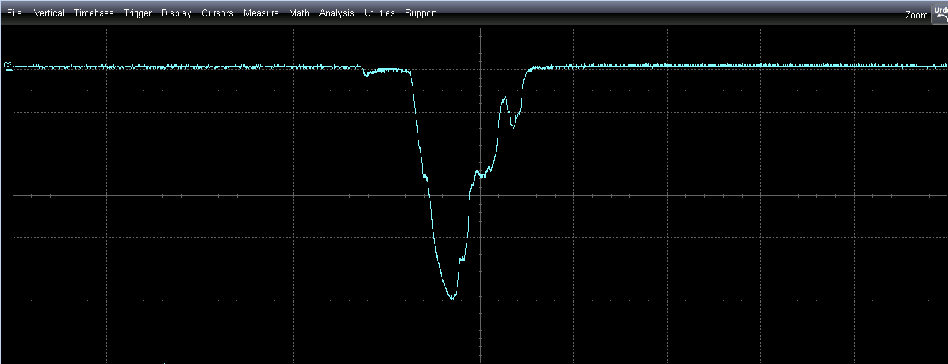
RL Tuning – 1st test
Initial
Initial
1st step
3rd step
5th step
5th step

Slide 12
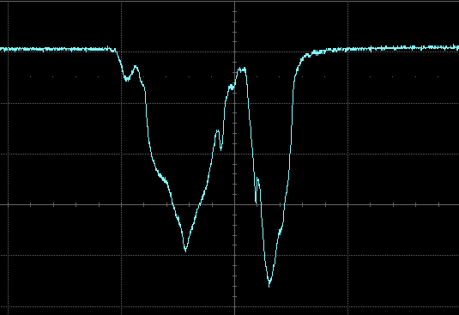
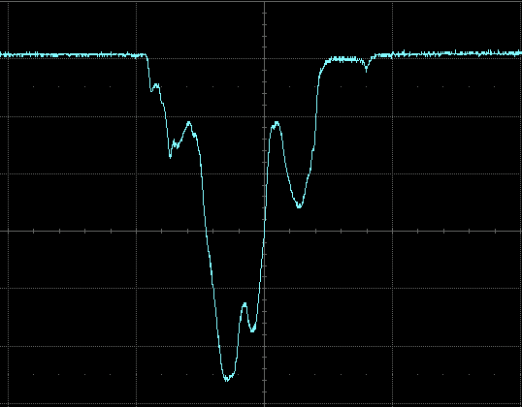
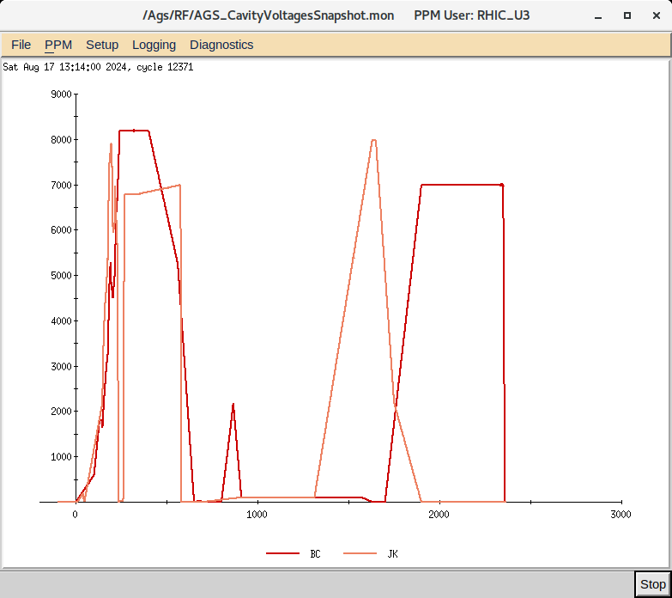
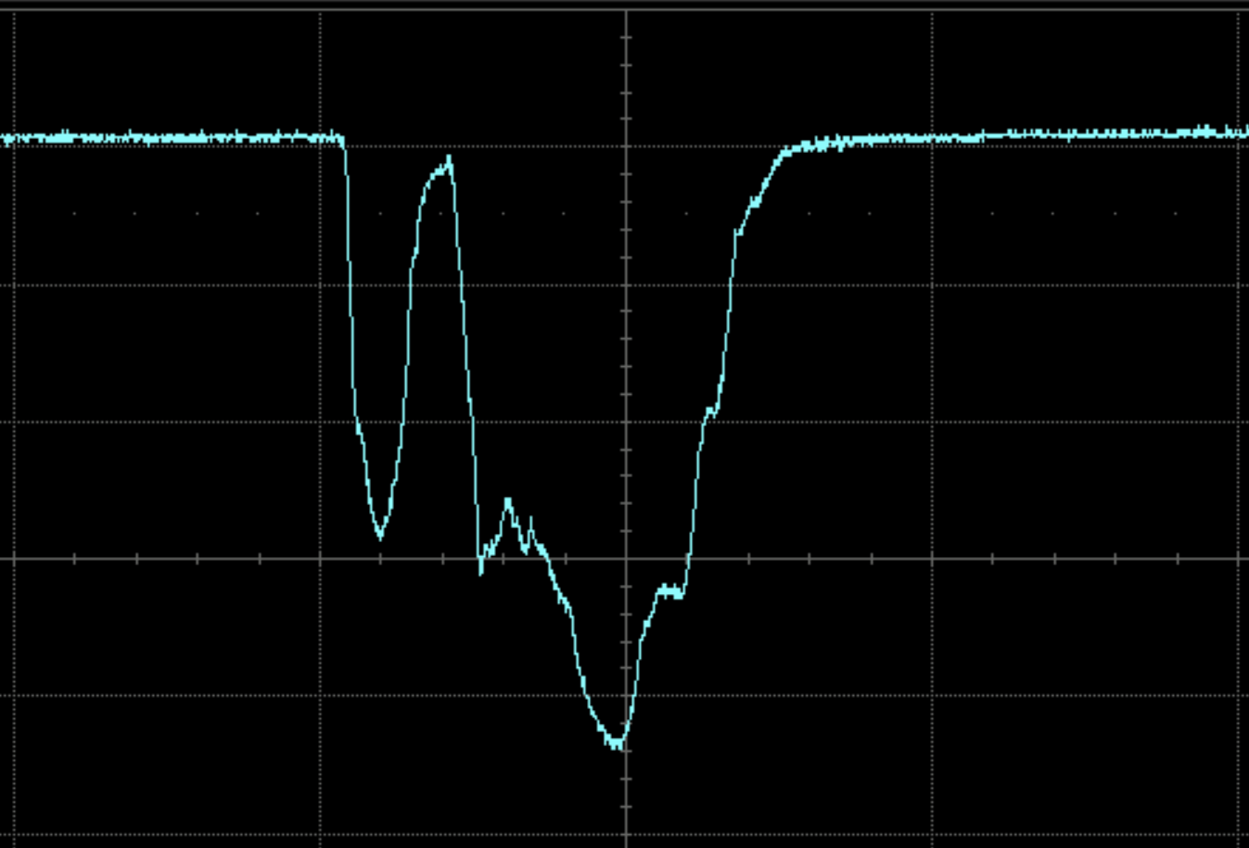
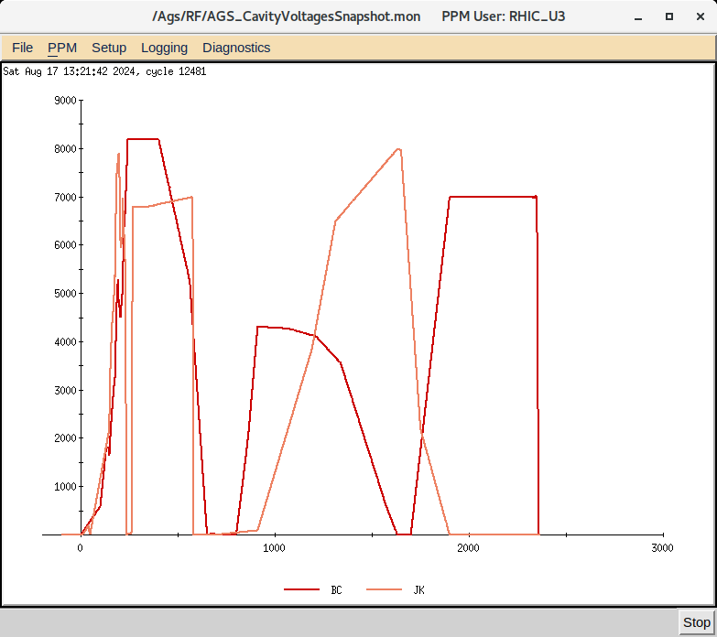
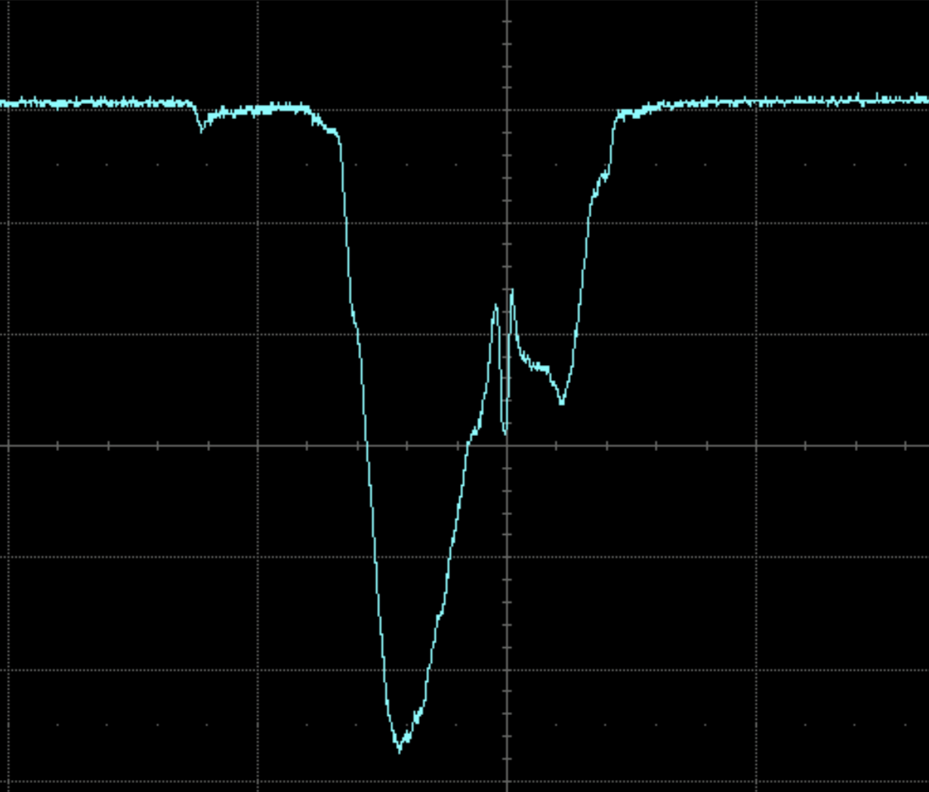
RL Tuning – 2nd test
Change the initial condition to fix the edge value
Initial
5th step
1st test
2nd test

Slide 13
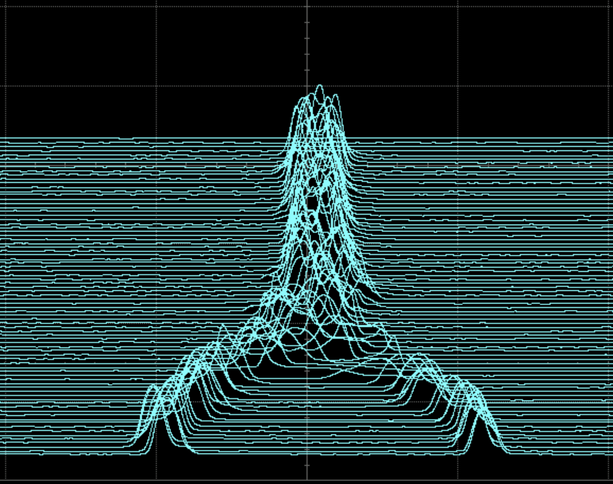
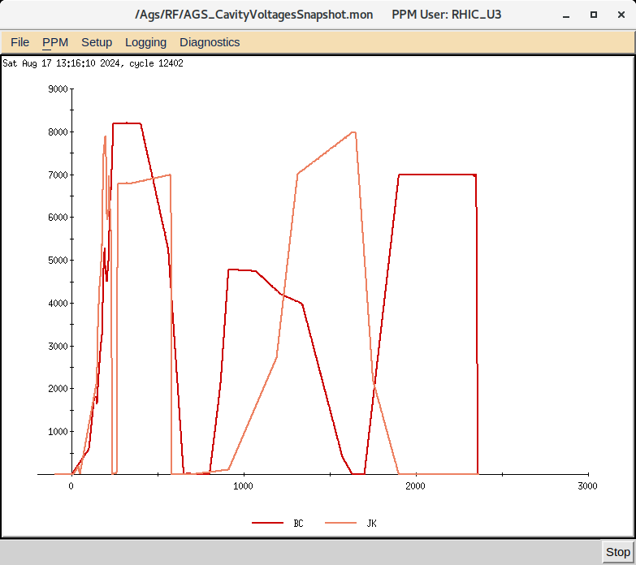
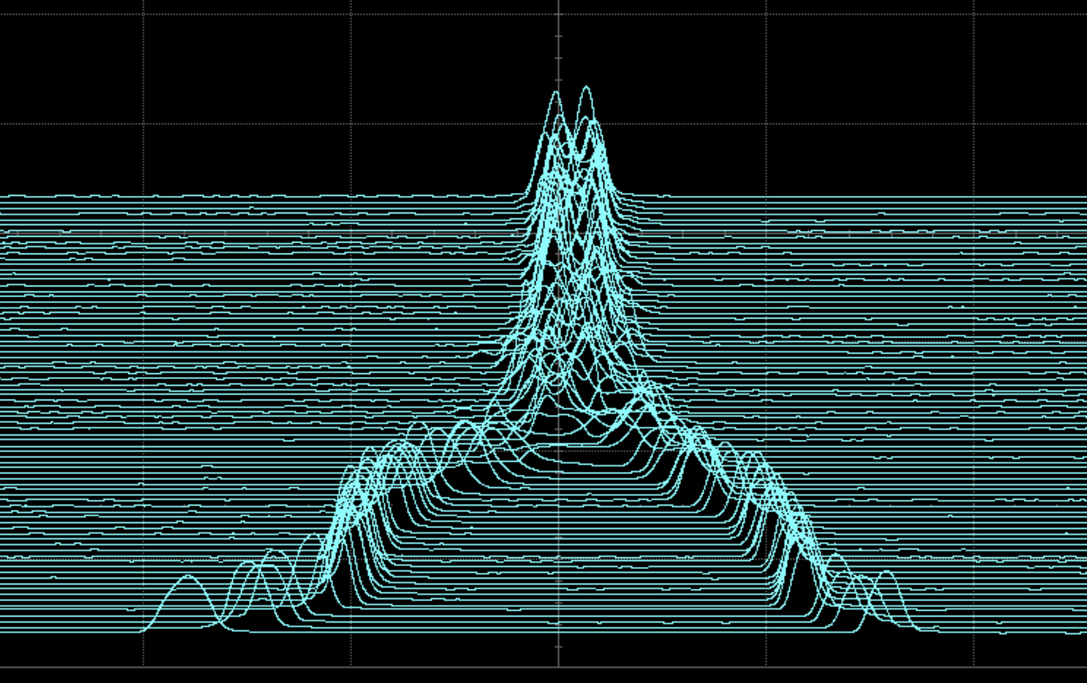
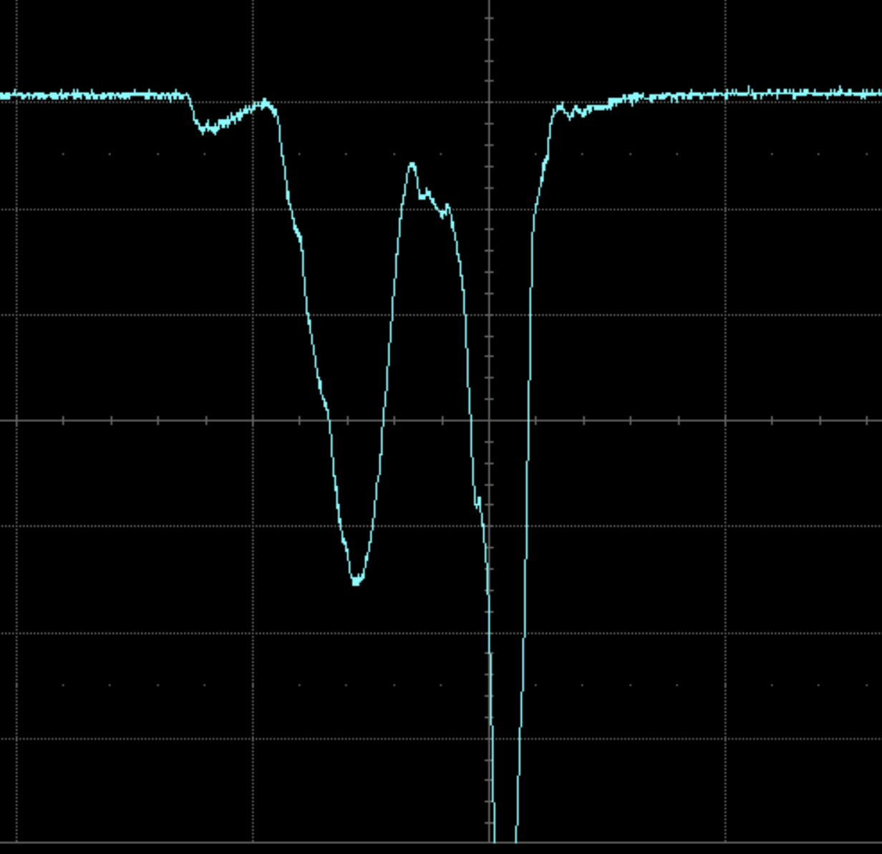
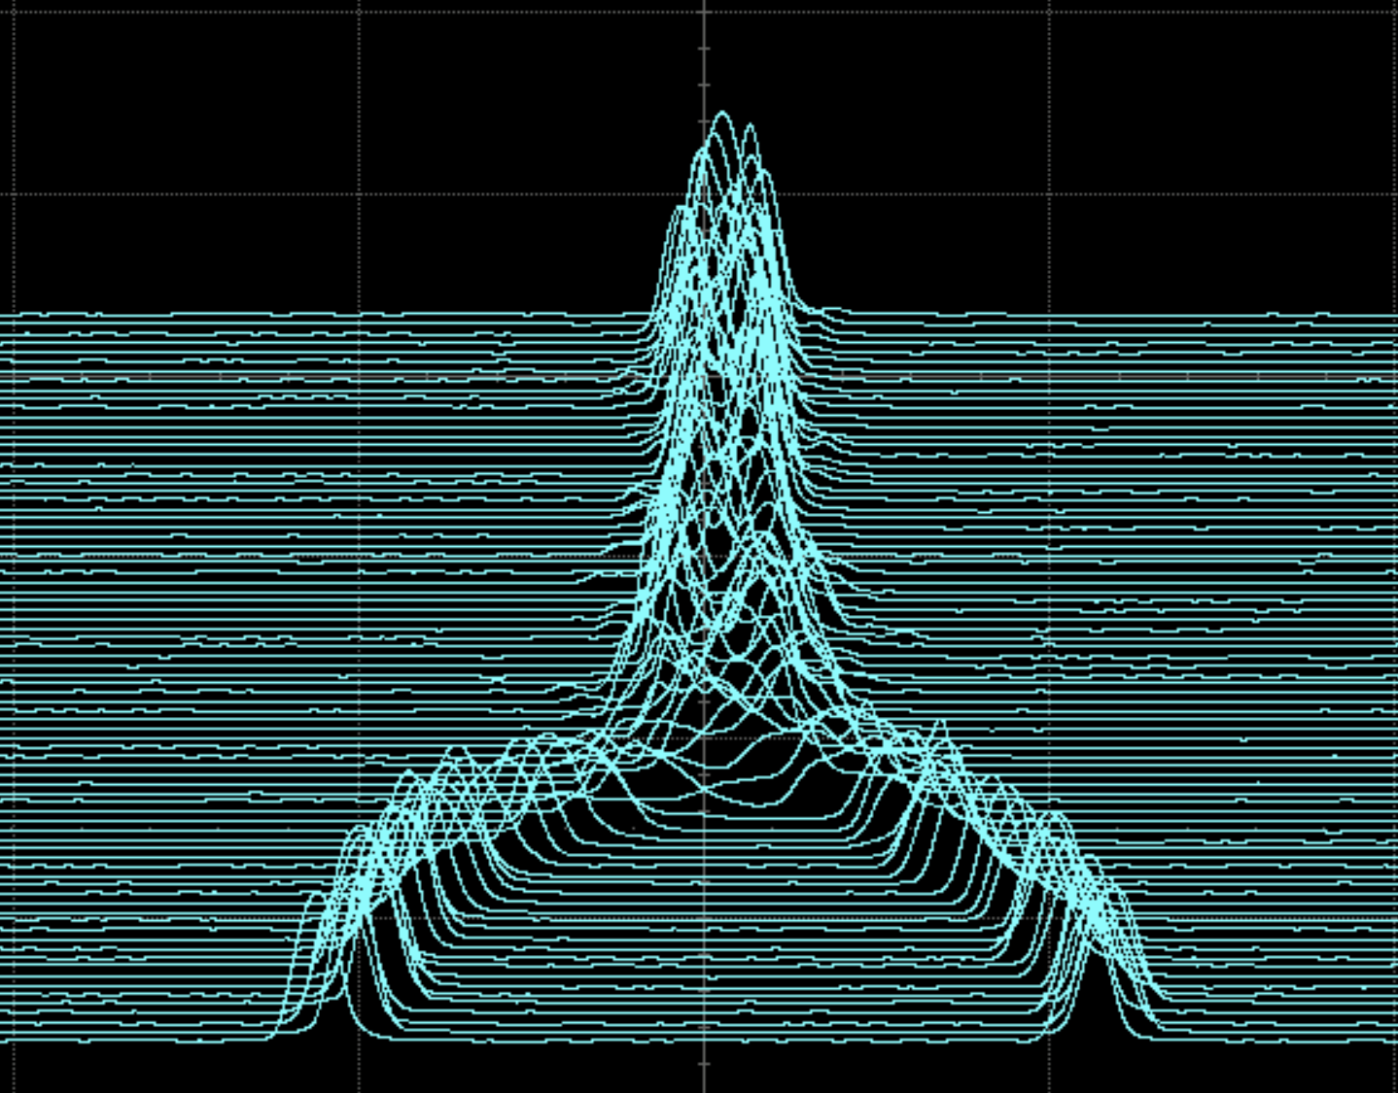
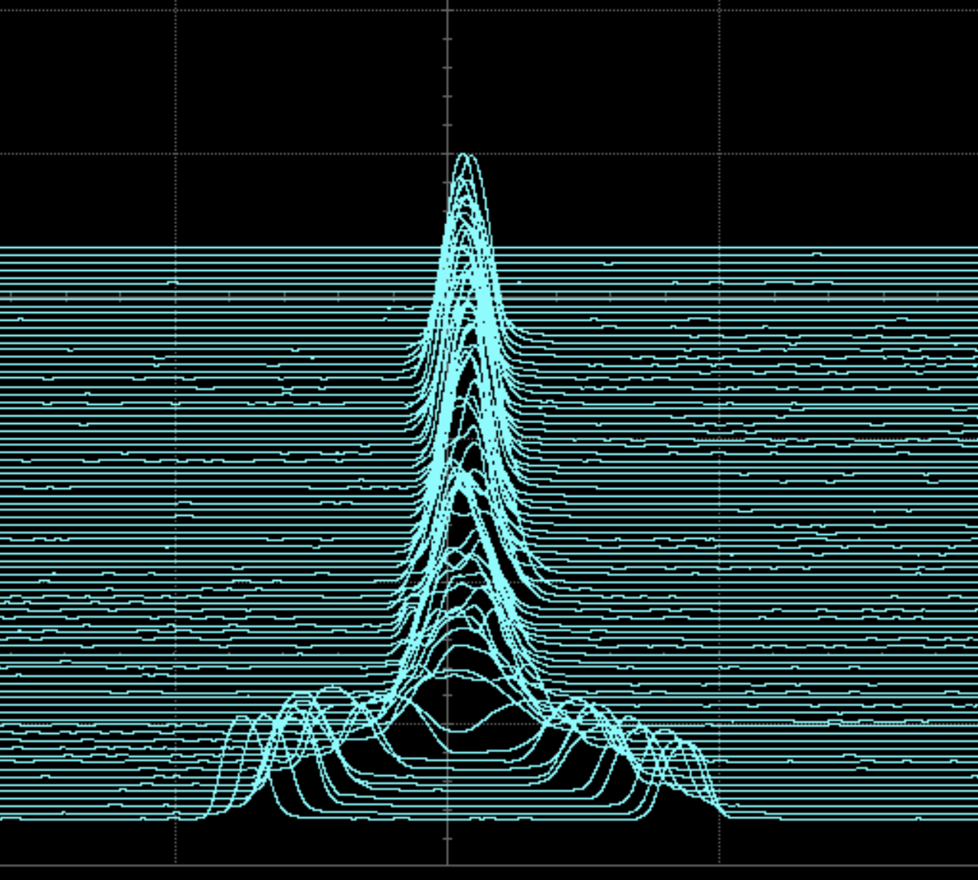
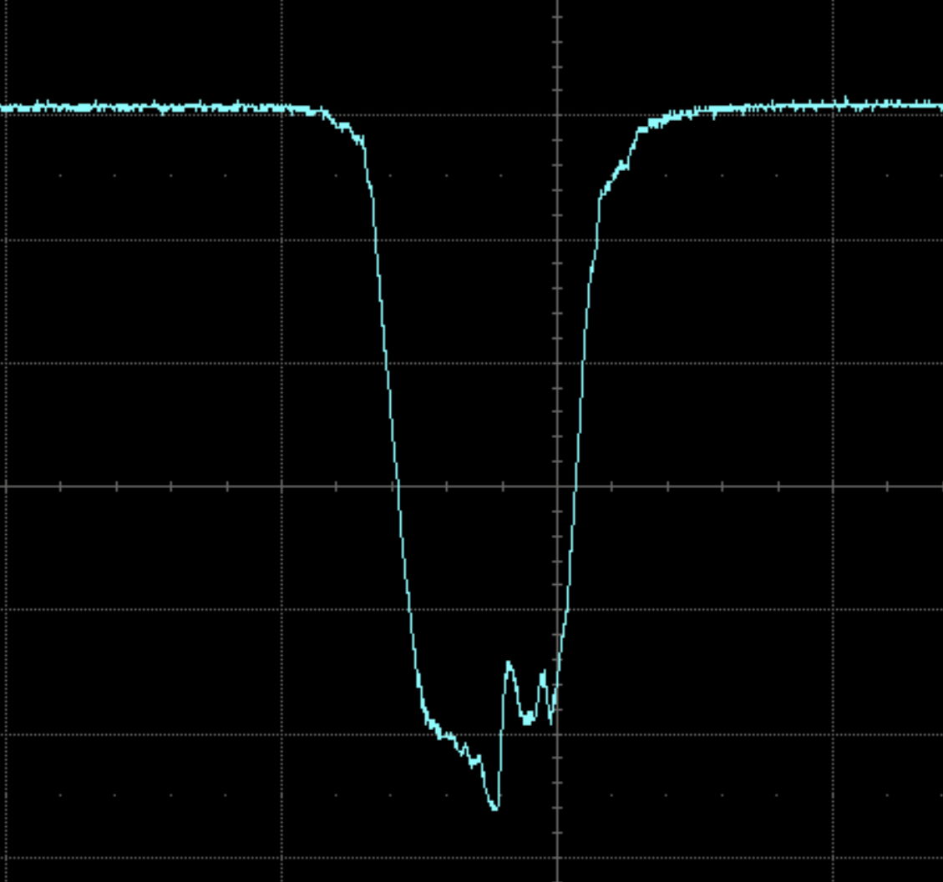
RL Tuning – 2nd test
RF voltages
Bunch traces
Last trace
Initial
1st step
5th step
Original

Slide 14
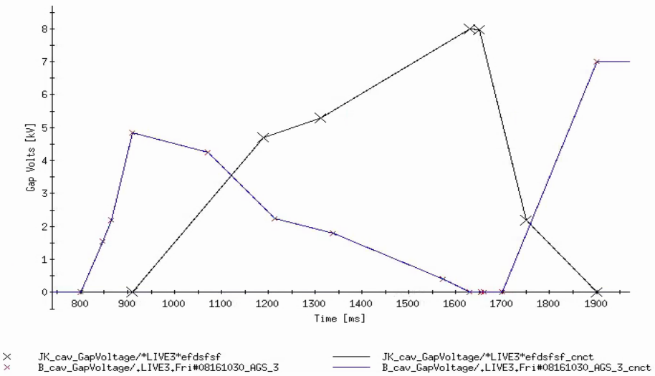
Final Workflow
RF settings:
Voltage and Phase
Accelerator system
RL Agent
Process & Feedback
WCM signals
Save to archive
Pipeline to process the mountain range plots to get the following information:
Final emittance;
Final bunch position;
Center oscillations;
Bunch length and its variations;

Slide 15
System Side Preparations
We can now do a basic demonstration code to acquire input signals from wall current monitors (offloading oscilloscope data) and show results in a Jupyter notebook.
We have a Zynq Ultrascale FPGA evaluation board and an FMC expansion card to digitize the WCM signals:
12-bit conversion at 1,000 Megasamples per second, with an analog range of +=2.5V
Next steps after this is completed:
Evaluating multiple commercially available digitizer products for performance comparison to FPGA-based system;
Work on buffer memory implementation (to store multiple turns);
Work on the hardware configurations to match the actual system specifications;
Work on auto-save the waveforms;

Slide 16
Future Work
Stabilize bunch profile
WCM information
Integrate phase into optimization

Slide 17
Pros & Cons of RL Approaches
Advantages:
It can better handle giant search space:
AlphaGo essentially has search space of all permutations in the Go Game;
Accelerator control tasks may involve a large number of control points;
Learning can be swiftly transferred or adapted to novel scenarios:
What RL learned is stored by the model weights in the Neural Networks; transfer learning
Online decision-making:
After training, RL can be applied in an online manner;
Limitations:
Training requires lots of data, usually need a high-fidelity simulator;
Not easy to make it work;
Problem should be frameable as an MDP (or partial):
All decisions are based on the current state of the world;

Slide 18
Acknowledgement
Kevin Brown, Michael Costanzo, Andrew Houston, John Morris, Vincent Schoefer, Freddy Severino, Shruti Tajne, Rachel Terheide, Keith Zeno
Jonathan Unger, Eiad Hamwi, Georg Hoffstaetter, Daria Kuzovkova, Lucy Lin, David Sagan, Matthew Signorelli
Yinan Wang
Auralee Edelen
Armen Kasparian, Kishan Rajput, Malachi Schram

Slide 19
Thank you for your attention!

